Slide 1



Temperature and Humidity Monitor for CMS Tracker FEH Electronics Testing
Peter Carney

Slide 2

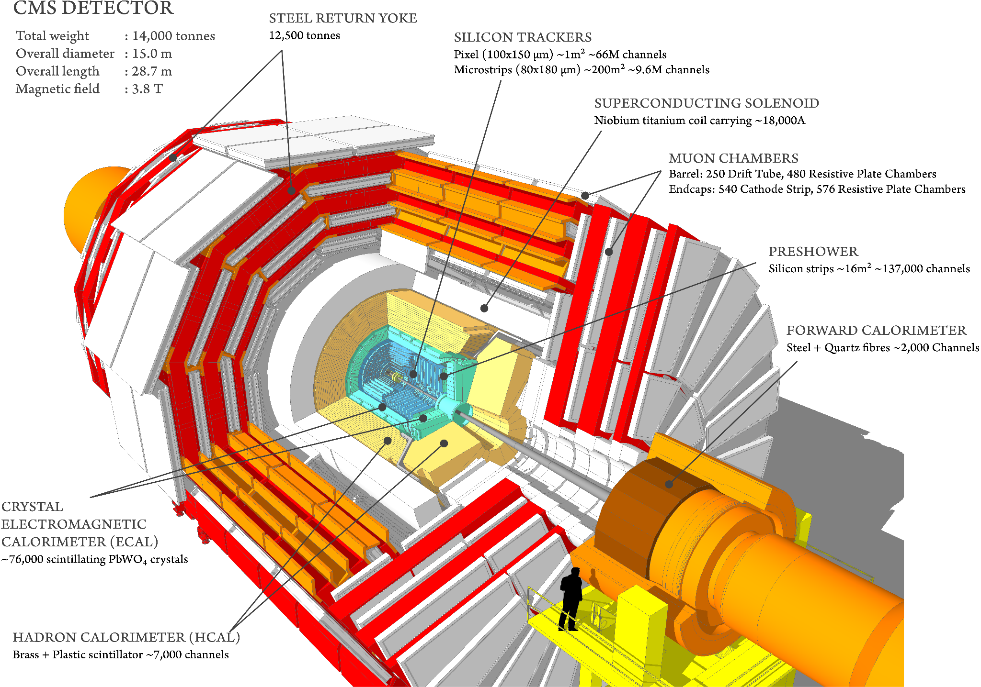
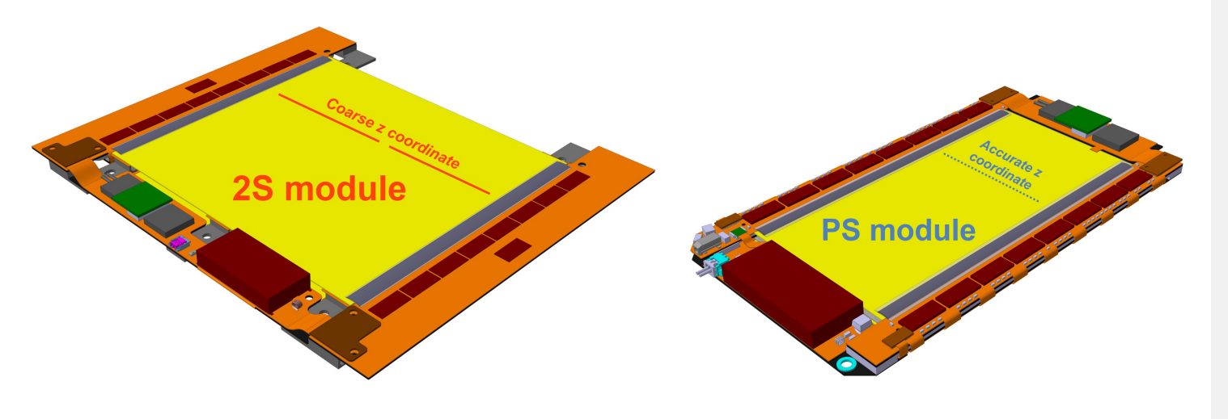
CMS Tracker System
Front End Hybrid Electronics
Used to gather and deliver
binary data from silicon sensor
Phase-2 upgrade desires less bulk electronics
3

Slide 3
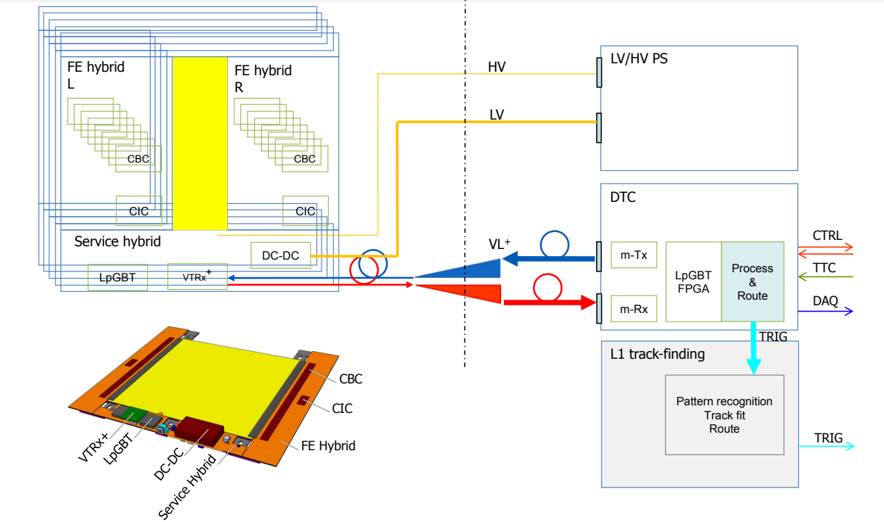
Testing of the FEH Electronics
Tests of the FEH Electronics functionality will be done at - 40° C and at room temperature
Temperature / dew point monitor needed to conduct testing.
3

Slide 4
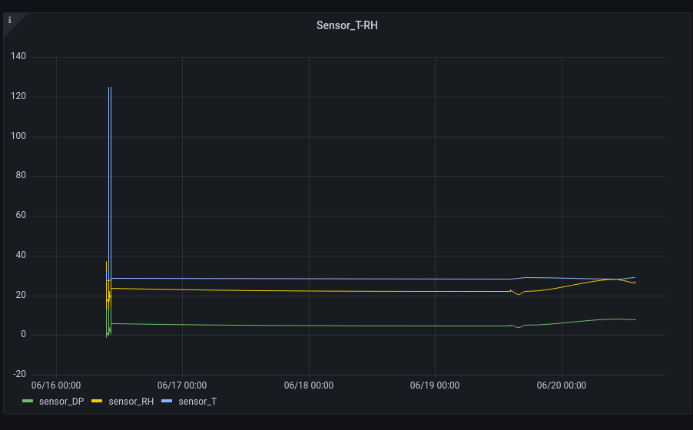
Creating Temperature Monitor
Temperature in C
Time
3

Slide 5
Accomplished
Next Steps
Configured AlmaLinux9 on my Laptop
Got InfluxDB and Grafana Working
Meet with collaborators to see how we proceed with system testing
Familiarize myself with GUI
Implement monitoring system into testing site
Write script to give automatic signals/warnings depending on temperature.
3

