Slide 1
4Top studies and BDT Optimization 6/22/2023
Lynn Rong

Slide 2
Agenda
1. Optimized BDT for default BDT setup
Introduction of 4Top
Introduction of Boosted Decision Trees (BDT)
BDT optimization results
Introduction of CMS paper and motivation
CMS replication results
4-top Next Leading Order studies results
2. Reproduced CMS results of BDT
3. 4-top Next leading order studies reproduction results

Slide 3
Why are we studying 4 top
Introduction and Motivation
Introduction of 4Top
Introduction of Boosted Decision Trees (BDT)
BDT optimization results
Introduction of CMS paper and motivation
CMS replication results
4-top Next Leading Order studies results

Slide 4
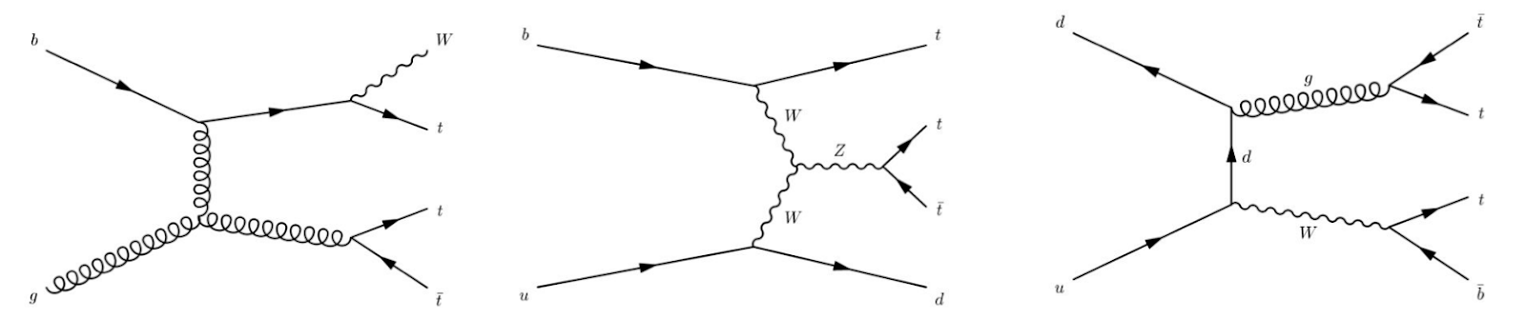
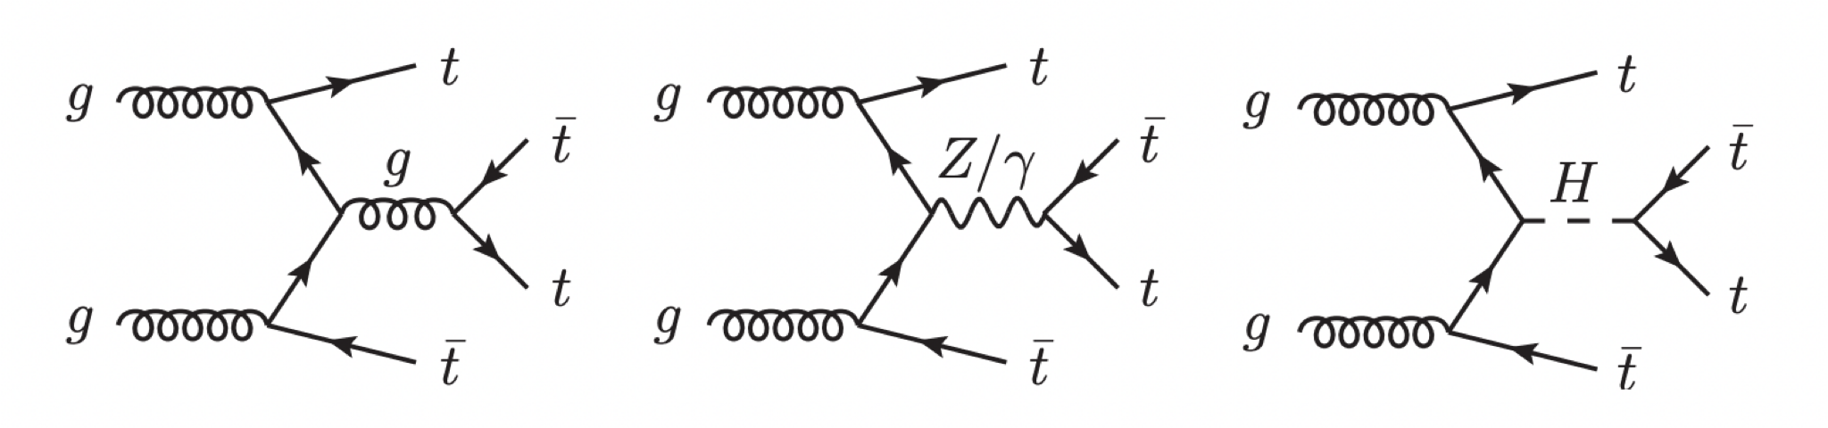
3/4-top process was predicted by Standard Model
3top
4 top generation is a rare process predicted by the Standard Model
It has been observed by ATLAS
However, it is hard to separate 4top from 3top because 4t and 3t have very similar kinematics
4top

Slide 5
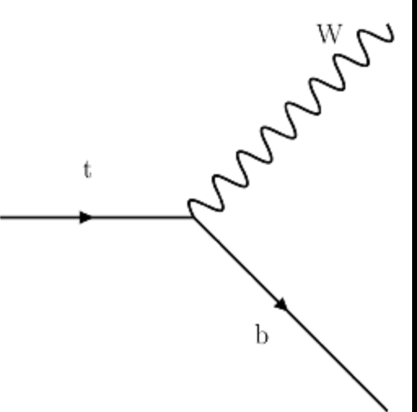
4top and 3top differences
Top quark decays into W and b:
Almost the same final states!
t
t
t
t
W
b
W
b
W
b
W
b
t
t
t
W
W
b
W
b
W
b
W
t
t
t
q
W
b
W
b
W
b
W
q’

Slide 6
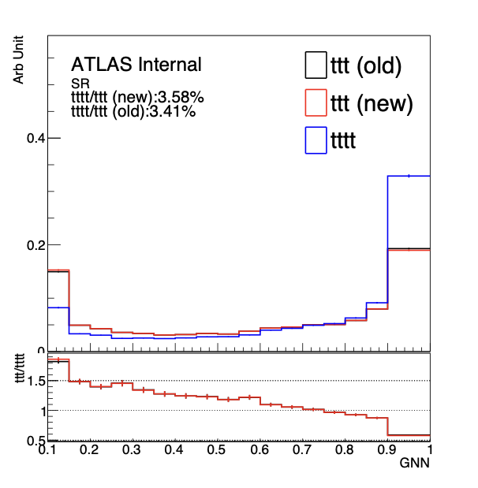
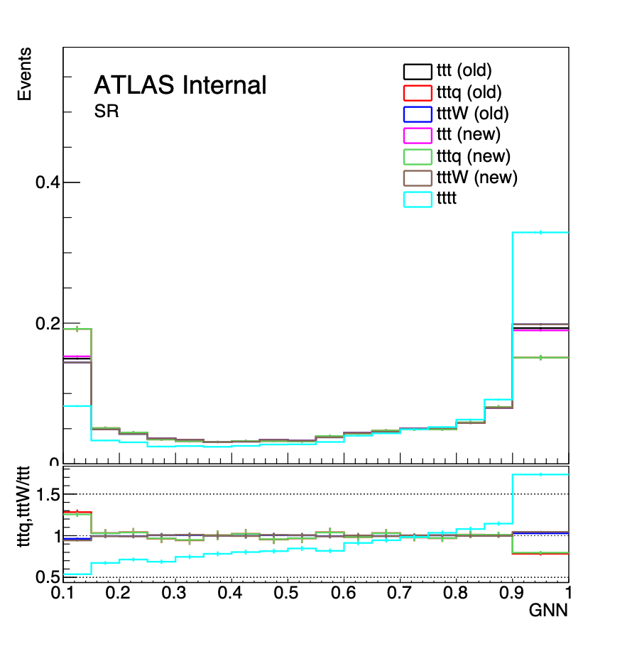
Motivation for 3-top Next Leading Order studies:
3-top process divided into ttt+q (including ttt+b) and ttt+W.
3-top and 4-top is very similar -> hard to separate 3-top and 4-top even with the GNN distributions

Slide 7
Boosted Decision Trees Introduction
Introduction and Motivation
Introduction of 4Top
Introduction of Boosted Decision Trees (BDT)
Recap
BDT optimization results
Introduction of CMS paper and motivation
CMS replication results
4-top Next Leading Order studies results

Slide 8
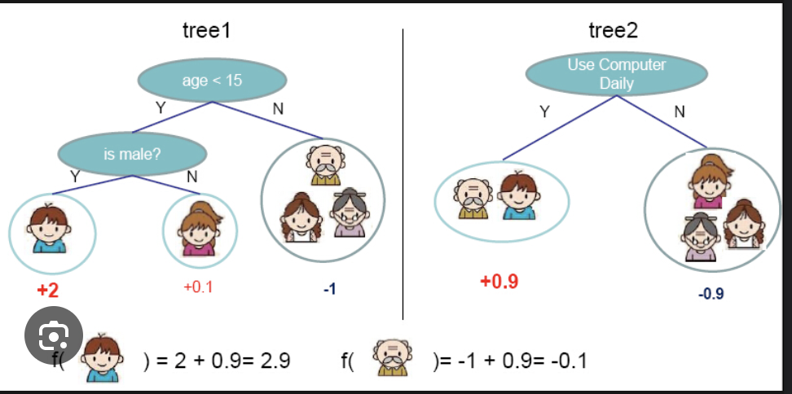
What are Boosted Decision Trees?
Boosted Decision Trees are a common Machine Learning technique in Particle Physics that separates signal from Background
Data is recursively split based on their individual features
An ensemble of decision trees are used, hence the boosting.
https://xgboost.readthedocs.io/en/stable/tutorials/model.html

Slide 9
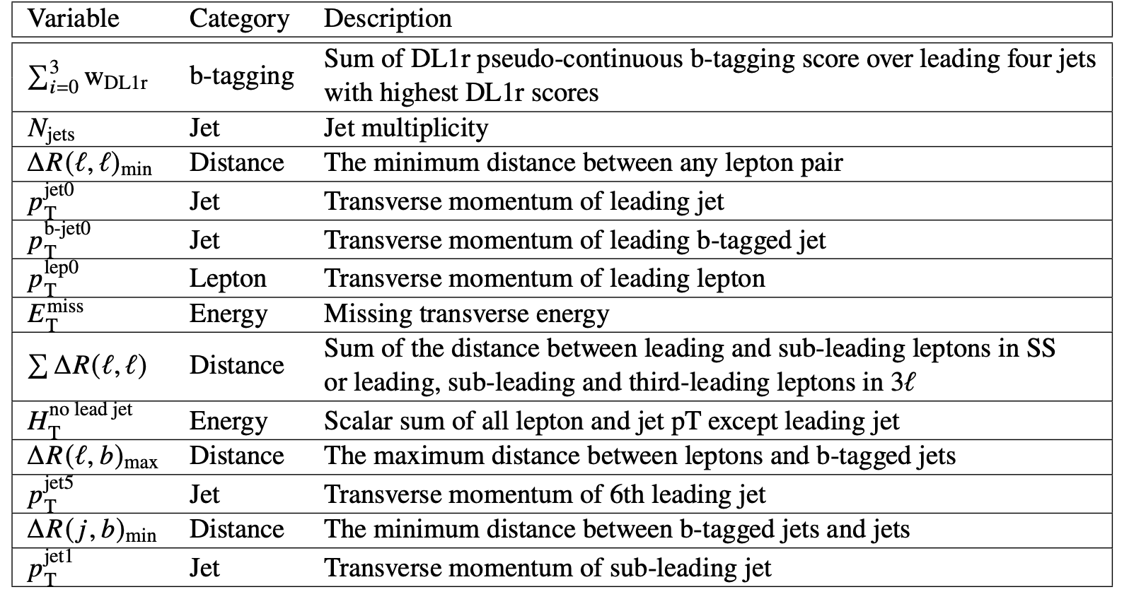
Example of BDT
*NOT TRUE DATA
Training:
How many Njets does particle have?
2
Feed in 2 sets of Monte-Carlo simulations: “Even” events and “Odd” events
What’s the Scalar sum of Energy?
Even
>500GeV
ttX background
3
Odd
Testing:
<500GeV
What am I?
3 jets
> 500 GeV
I think you’re ttX background

Slide 10
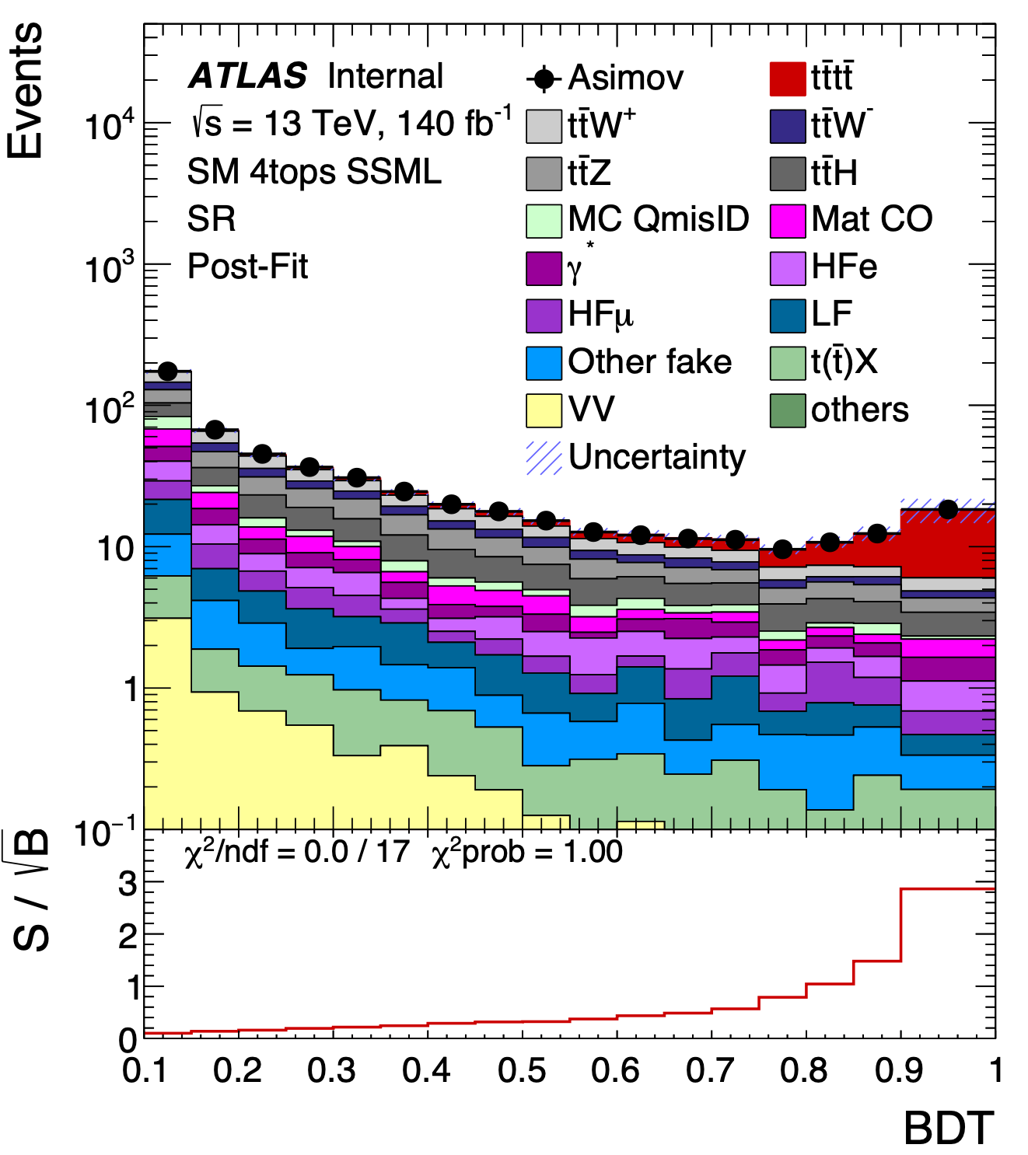
Motivation
Using BDT, we are able to distinguish tttt production from its remaining background
A BDT was used in the 4top observation paper (Release 21) as cross check method
We would like to reproduce the BDT results and validate the BDT in the current ongoing ATLAS SM/BSM 4top analyses (Release 22)
R&D: check with setup using in CMS 4-top paper (link) which split SS and 3L/4L as separate channels with loose selections than ATLAS

Slide 11
BDT Optimization
Ongoing work and results
Introduction of 4Top
Introduction of Boosted Decision Trees (BDT)
BDT optimization results
Introduction of CMS paper and motivation
CMS replication results
4-top Next Leading Order studies results

Slide 12
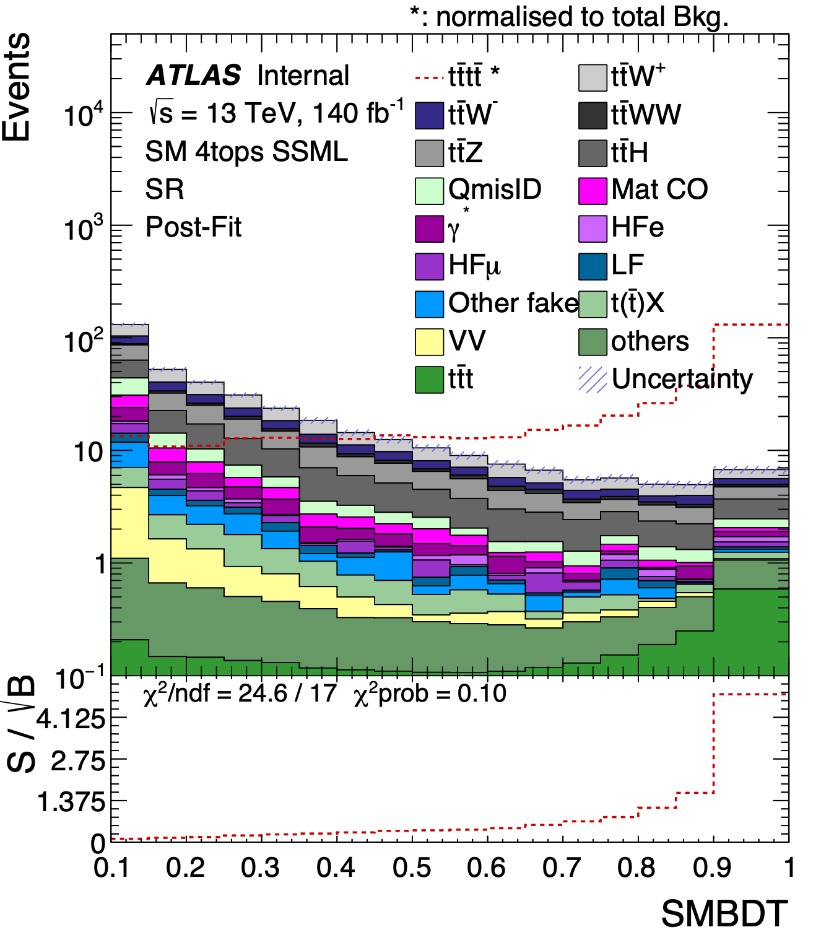
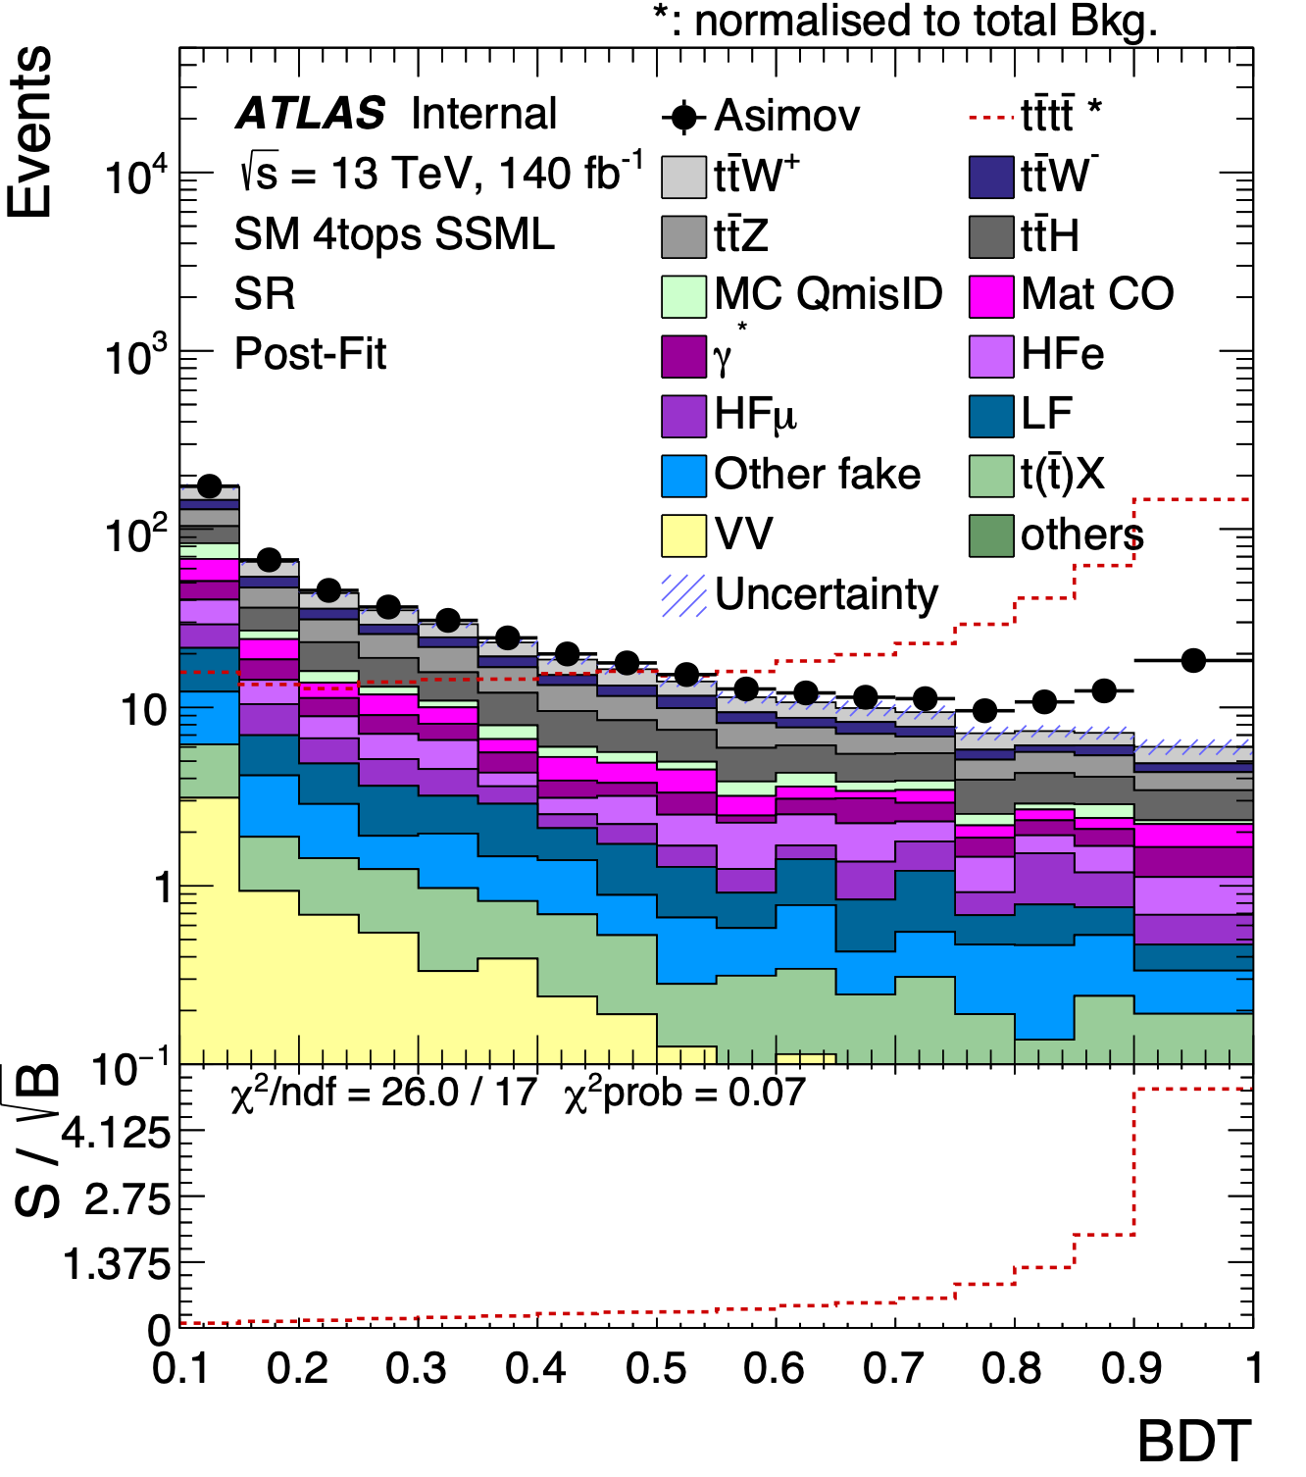
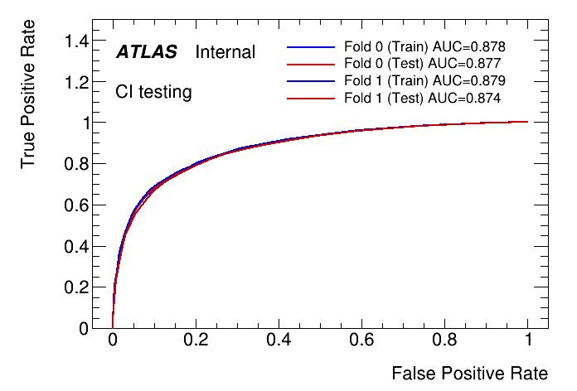
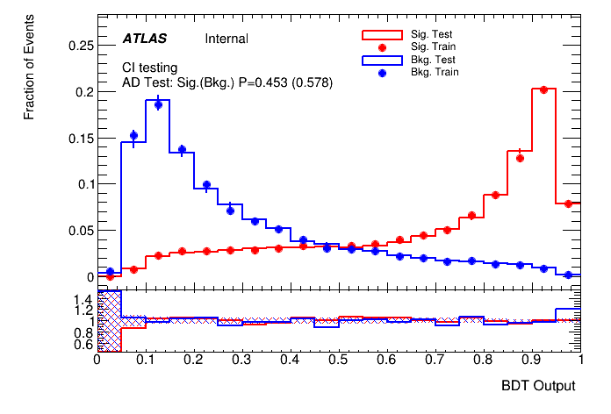
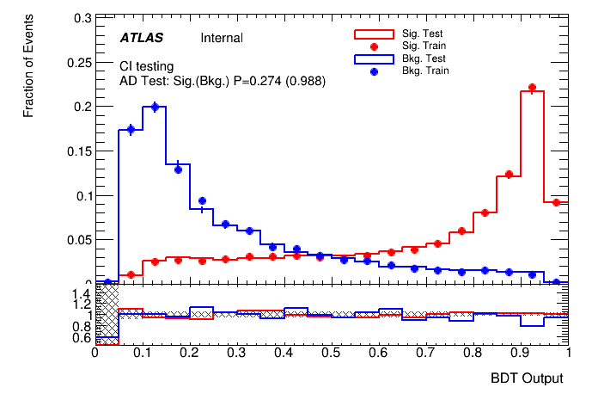
From Last Presentation
R21
Sig: 4.15
R22
Sig: 4.02 σ
We used Binary BDT to separate tttt signal from background in R22 to reproduce similar results as R21
Performed migration from R21 to R22, with optimized max_depth and learning rate
We used XGBoost to reproduce the previous R21 setup instead of SKLearn results used as temporary checks shown last time

Slide 13
Tunable Parameters for XGBoost
Eta (learning rate)
nTree (the number of trees)
Max Depth(the max number of branches of trees)
Subsample (% of sample we use to train) to prevent overtraining
Colsample(% of features used for training) to prevent overtraining

Slide 14
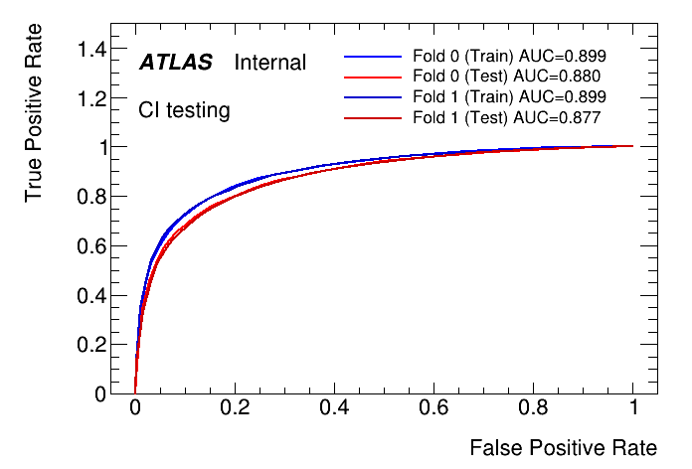
ROC curve
The higher the AUC the better training
If Training AUC > Testing, the model might be overtrained, hence
the better matched training and testing are, the better the training.

Slide 15
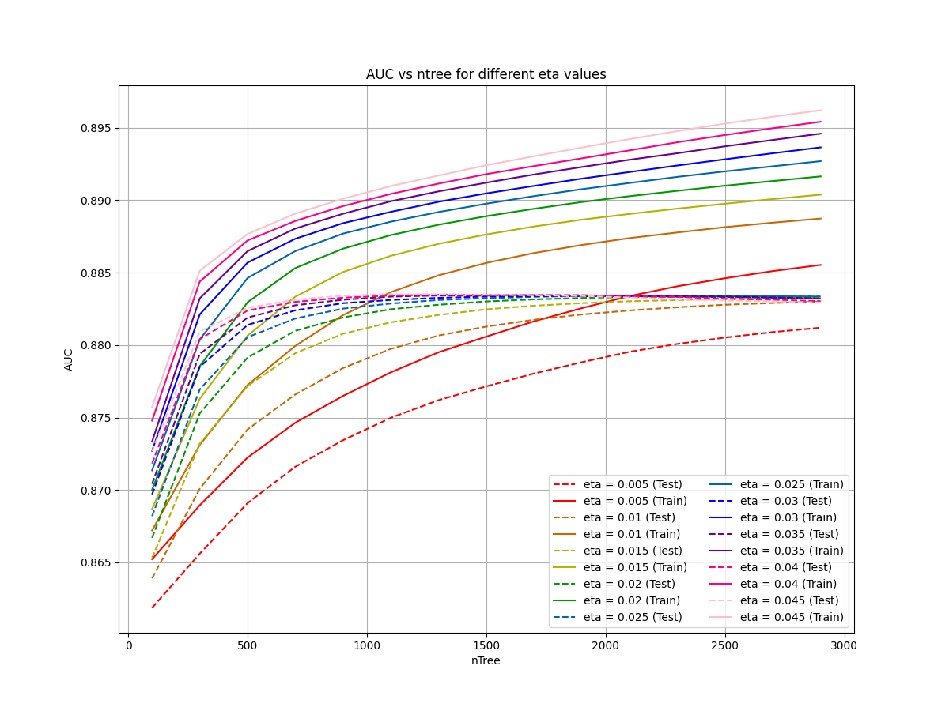
Optimizing Eta and nTree
Fix Max_Depth, SubSample and ColSample
Scan Eta and nTree

Slide 16
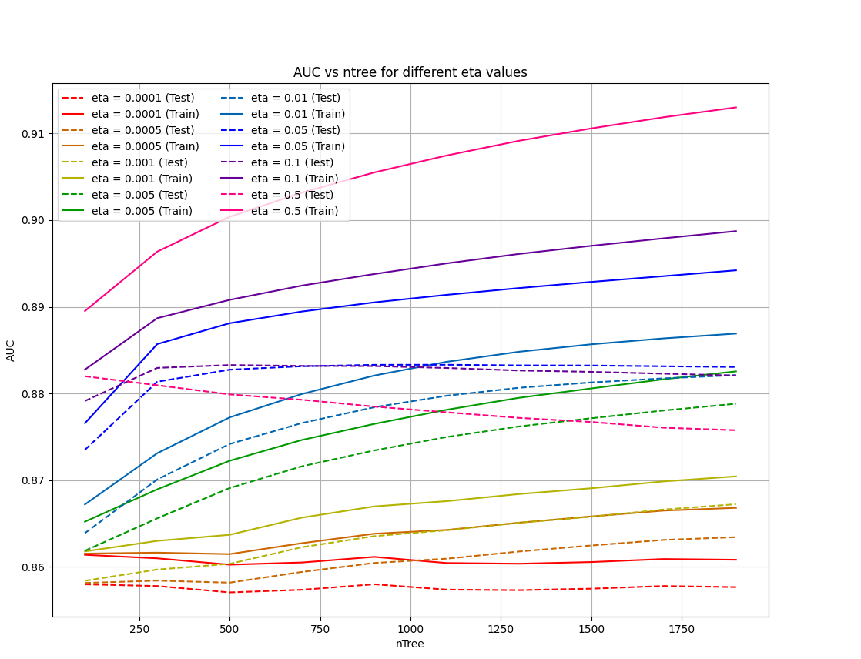
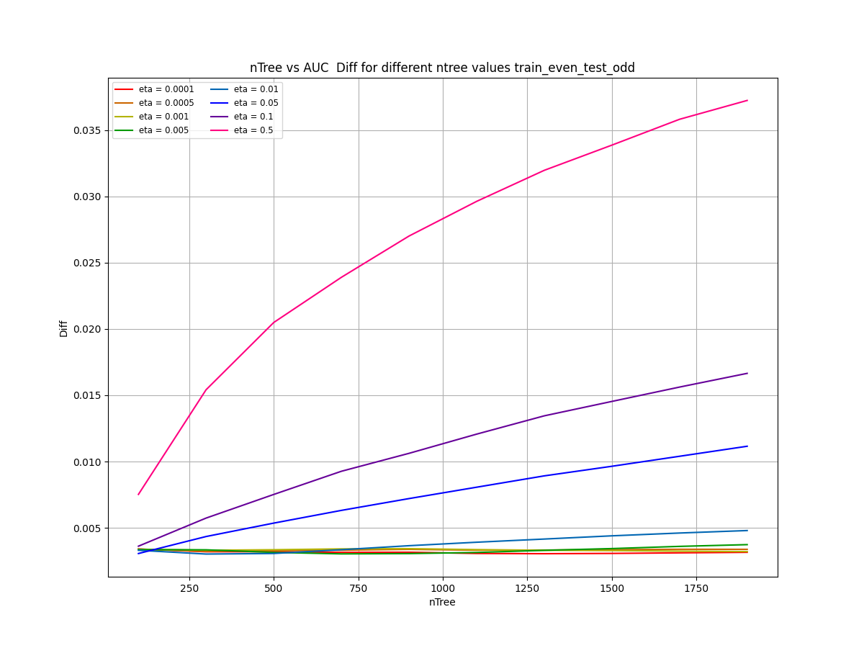
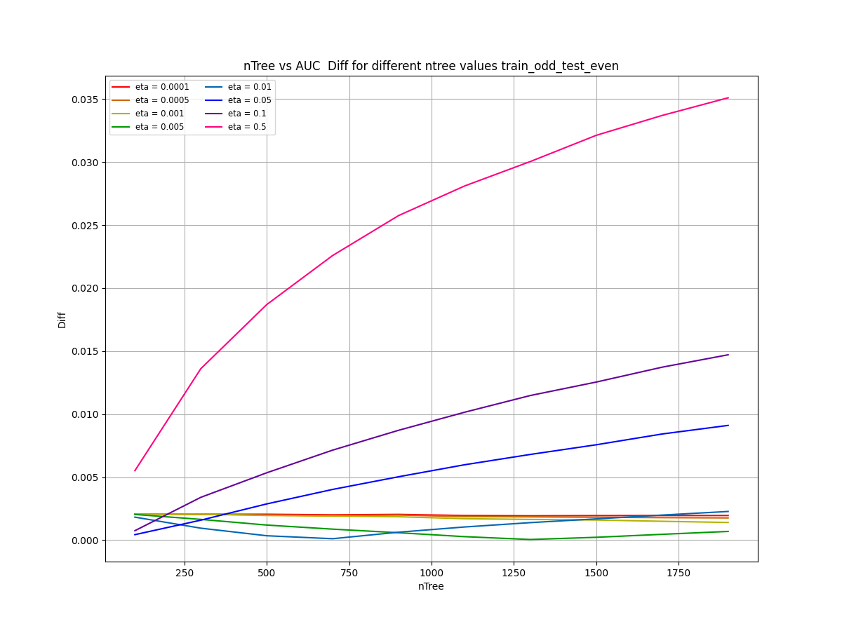
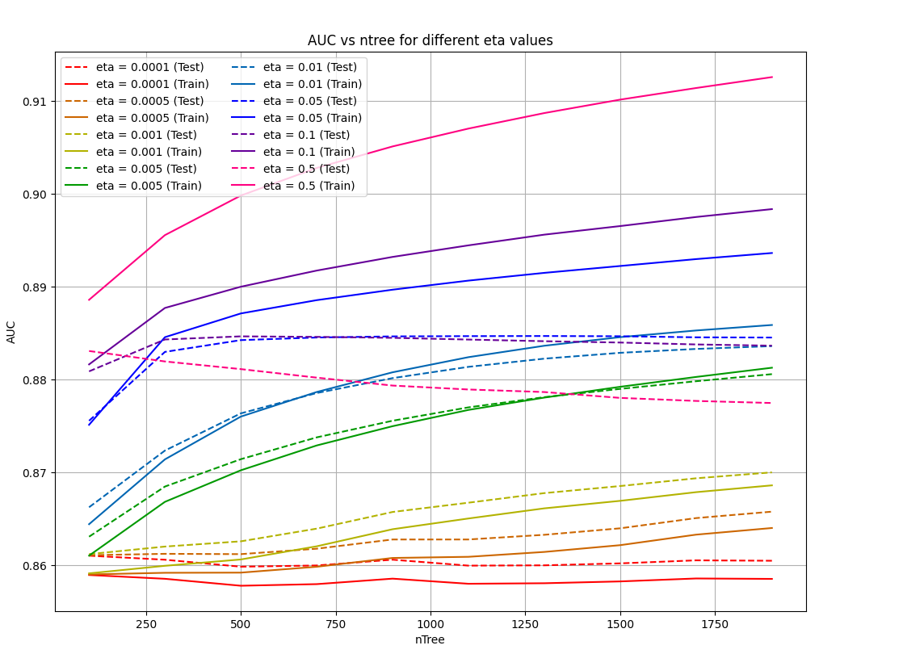
AUC vs NTree for Eta between 0.0001 and 0.5
Plotting |Difference| between Train and Test
Plotting both Train and Test
We compared nTree vs AUC for Eta between 0.0001 and 0.5 to find the parameter such that
  It has high testing AUC
  Curve for train and test matches
For eta > 0.05, the difference is too big
For eta < 0.005, the AUC is too small
So we did another scan from eta = 0.005 to 0.05
Train Even Test Odd
Train Odd Test Even

Slide 17
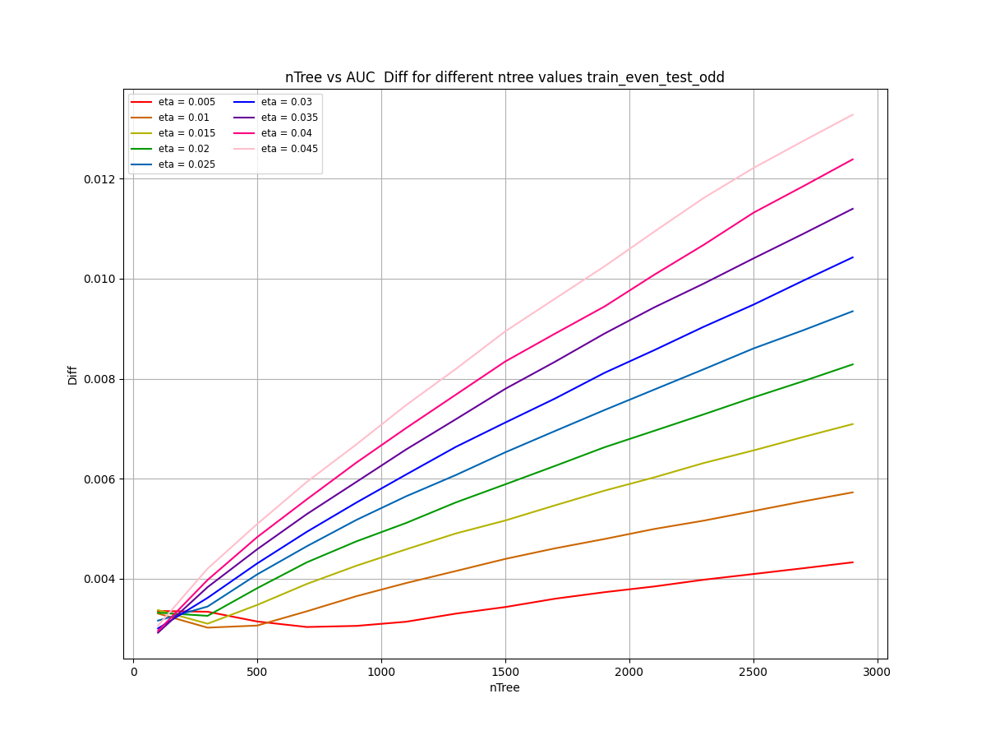
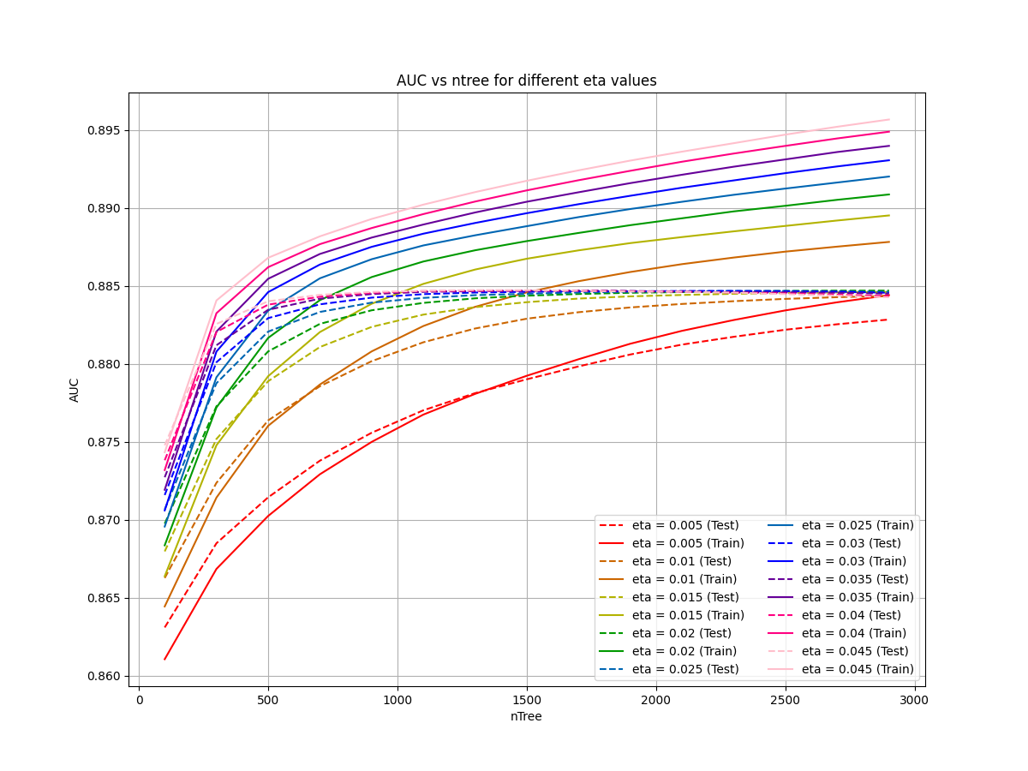
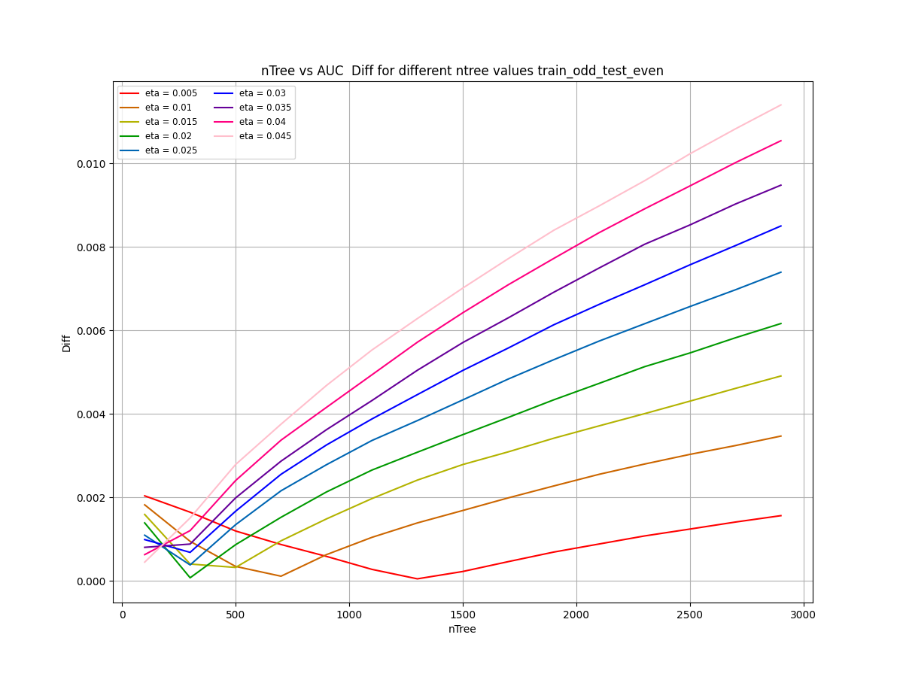

AUC vs NTree for Eta between 0.005 and 0.05
Plotting |Difference| between Train and Test
Plotting both Train and Test
From this, we see that AUC plateaus at around 0.884
The smaller the eta, the less overtrained the graphs are, however, AUC would be smaller
Performed a cut with Diff < 0.005, AUCTest > 0.880, and picked the optimal nTree and Eta.
Train Even Test Odd
Train Odd Test Even

Slide 18
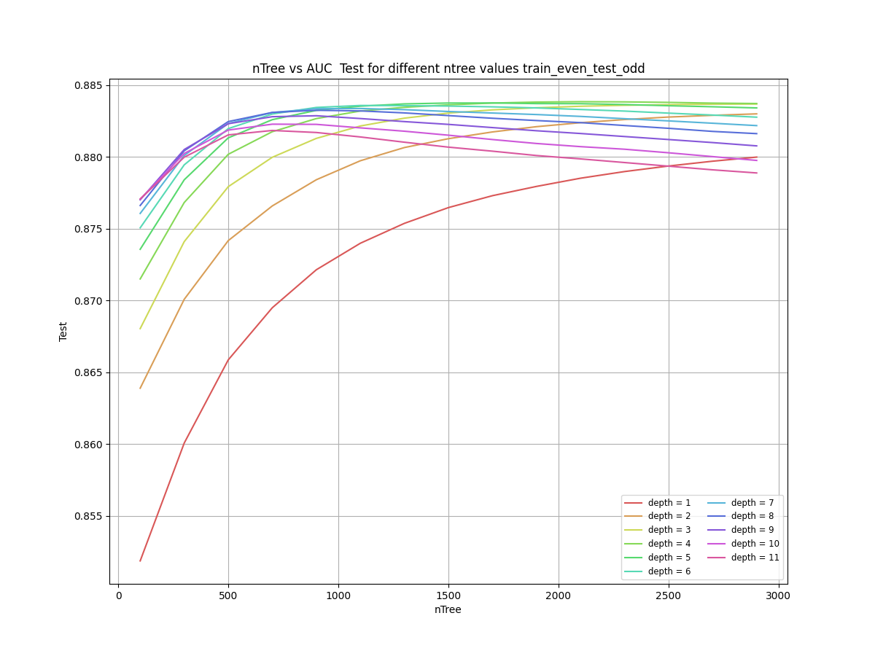
Optimizing Max_Depth
Fix Eta = 0.01
Fix SubSample and ColSample
Scan MaxDepth and nTree

Slide 19
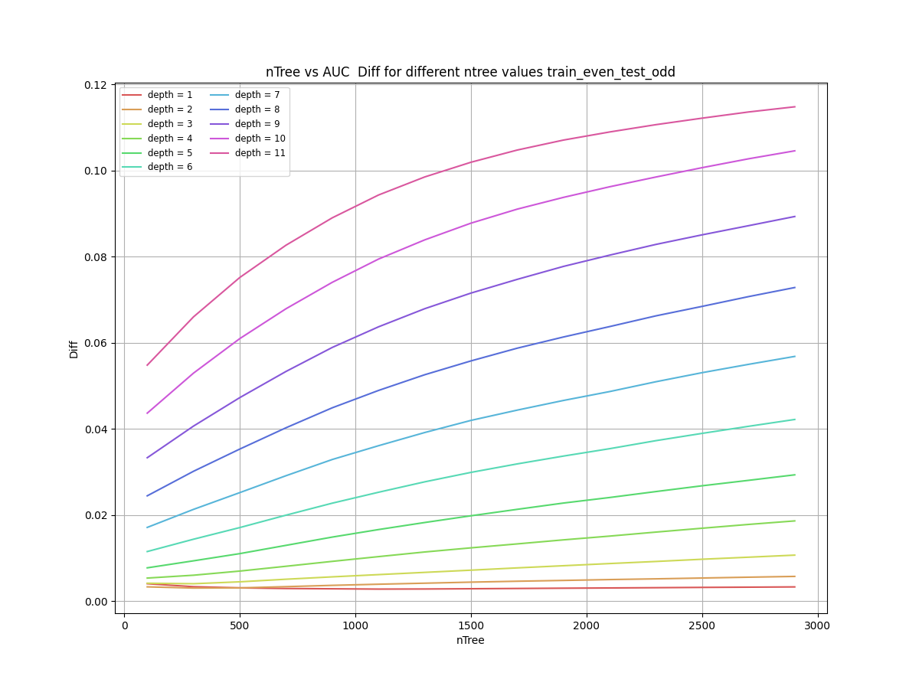
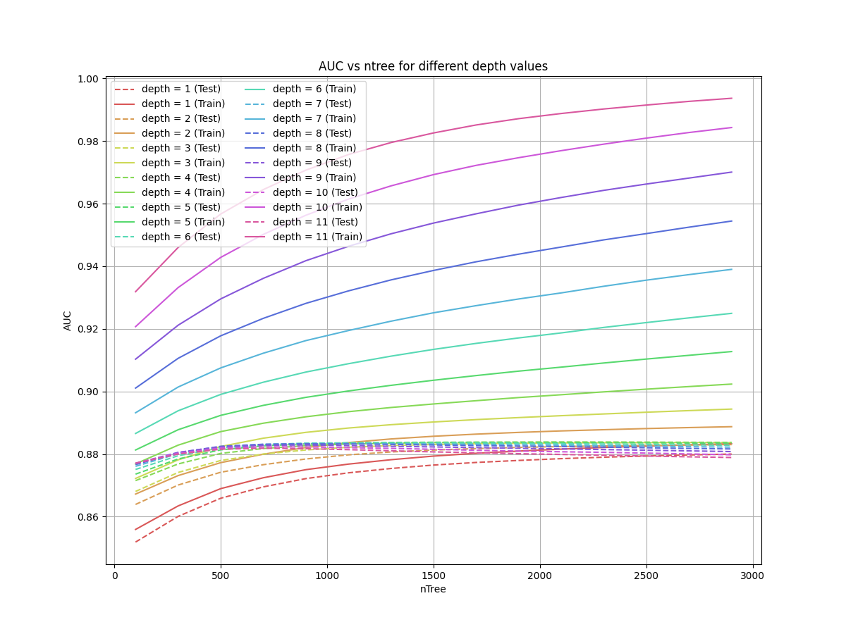
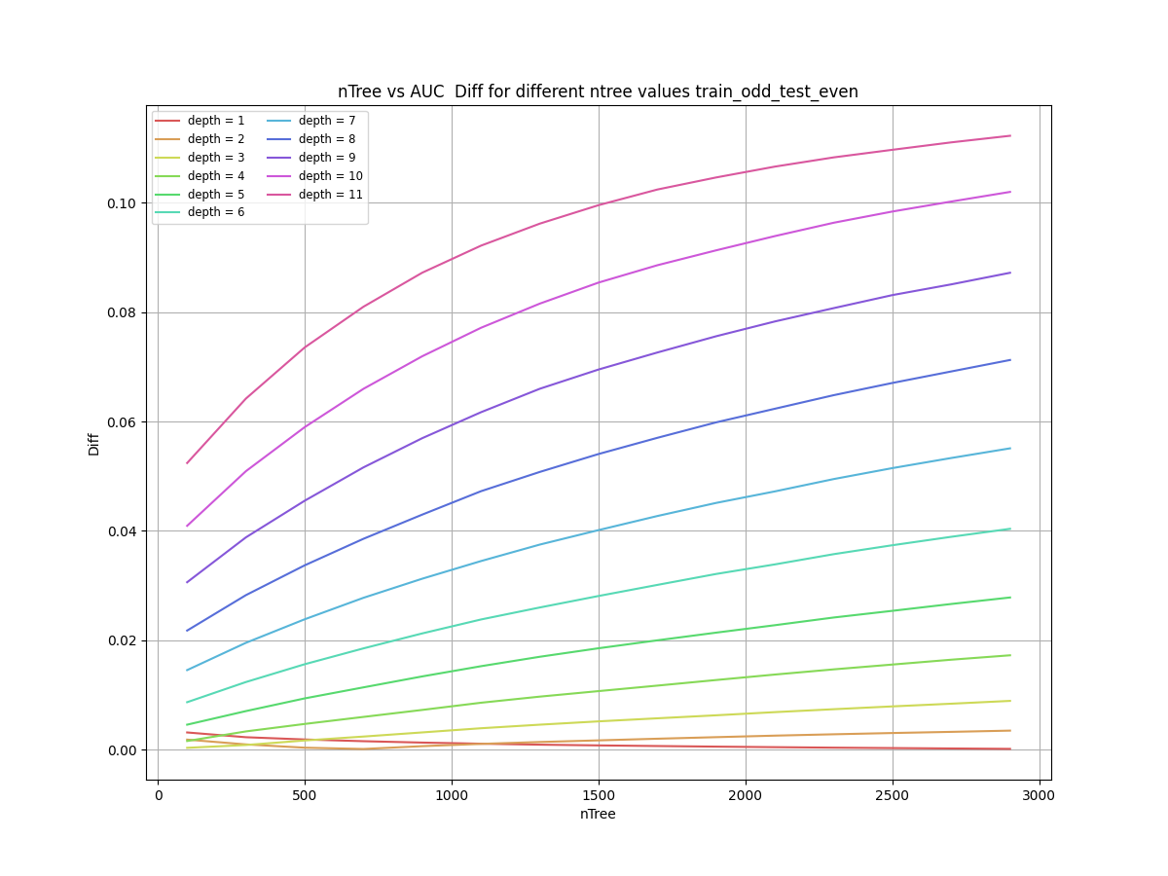
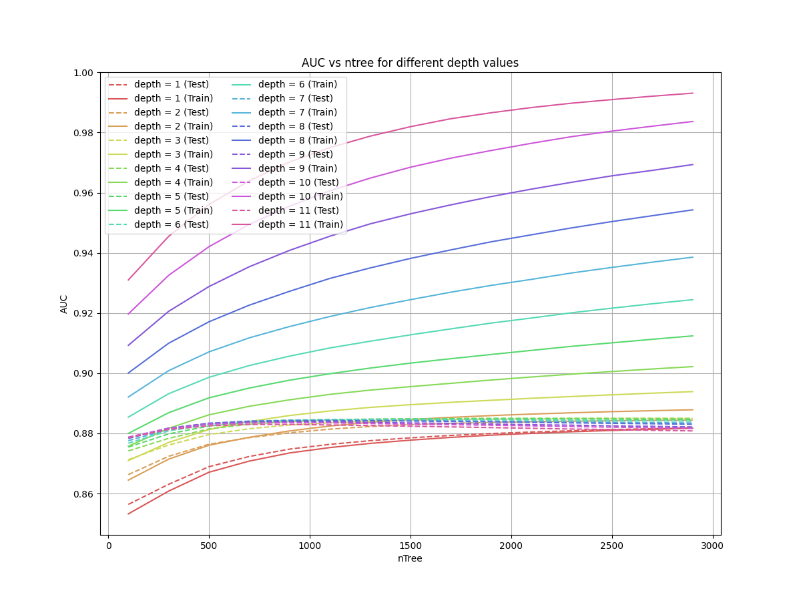
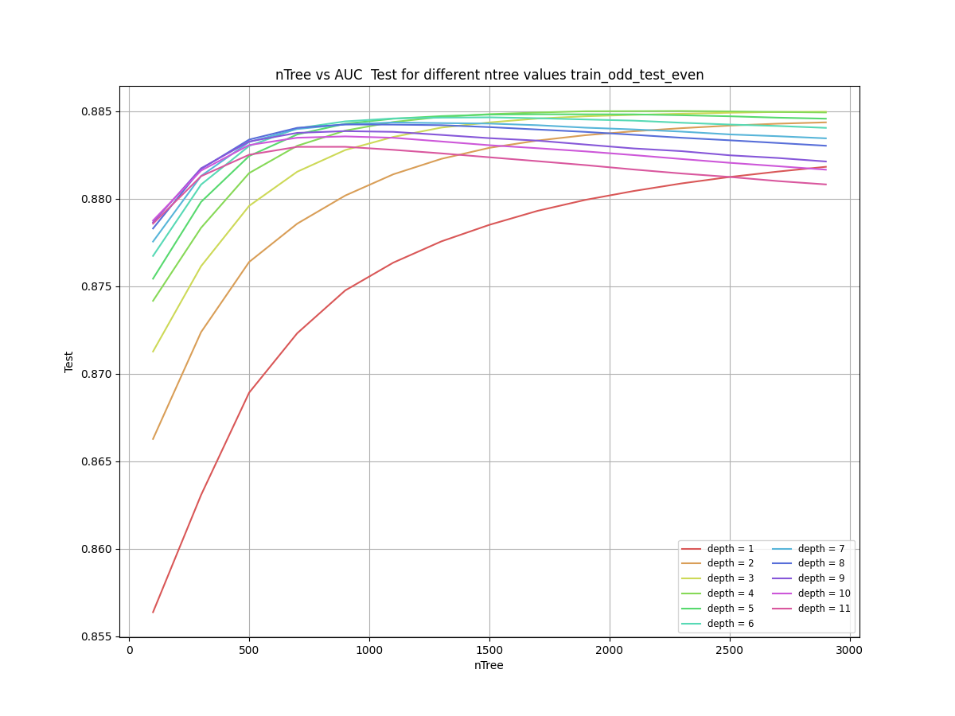
AUC vs nTree for Maxdepth between 0 and 12
Plotting |AUC Difference| between Train and Test
Plotting both Train and Test
Fixed Eta = 0.01
Performed a cut with Diff < 0.005, AUCTest > 0.880, and picked the optimal Max Depth.:
  nTree = 2000
  Max Depth = 2
Plotting Test AUC
Train Even Test Odd
Train Odd Test Even

Slide 20
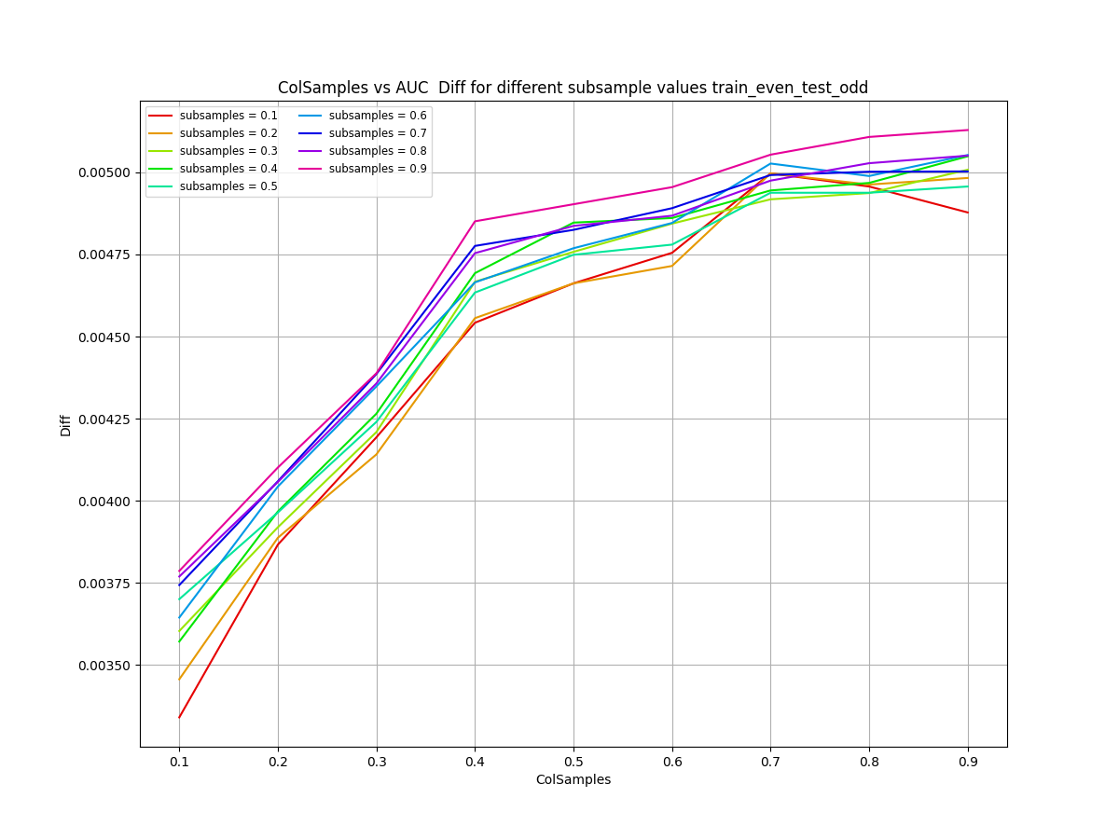
Optimizing Subsample and Colsample
Fix Eta = 0.01
nTree = 2000
MaxDepth = 2
Scan Subsample and Colsample

Slide 21
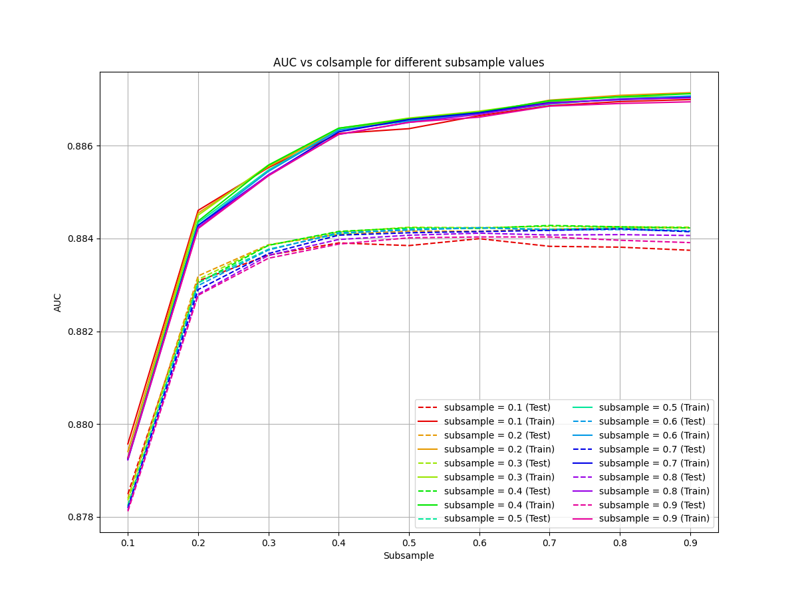
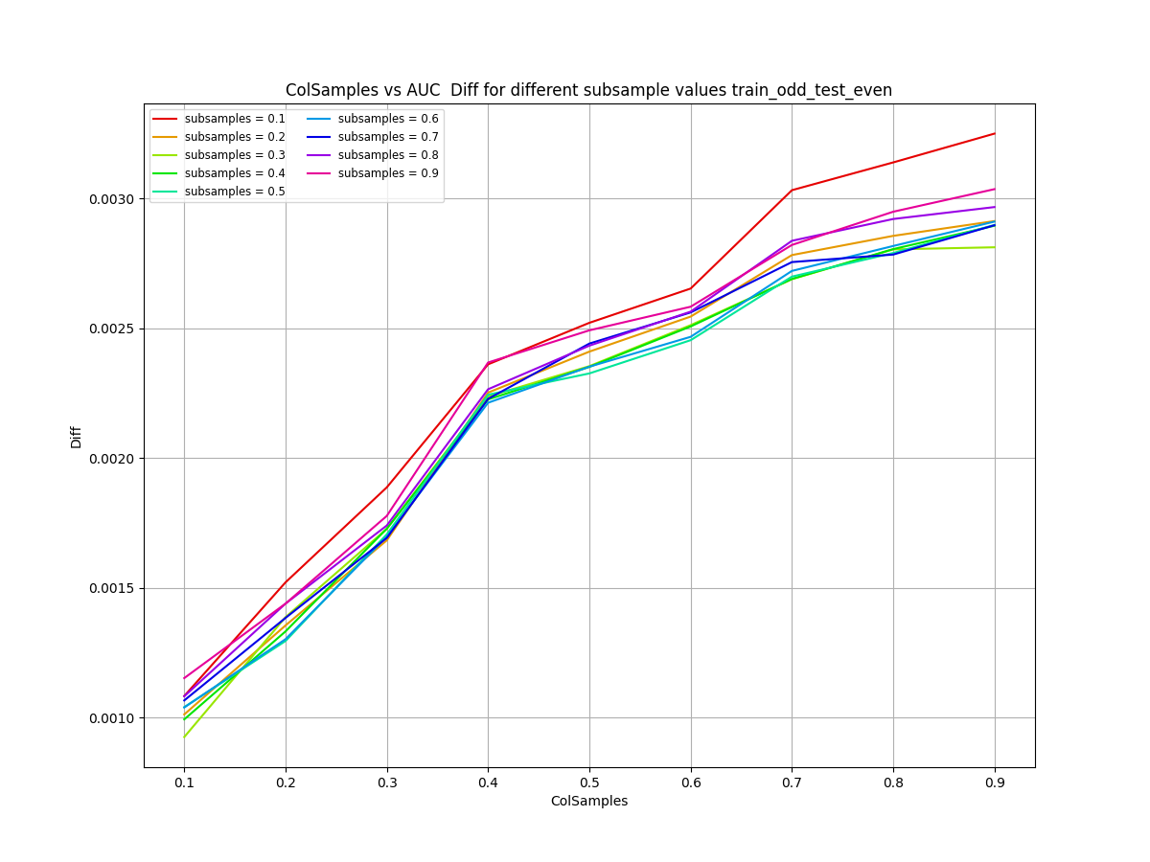
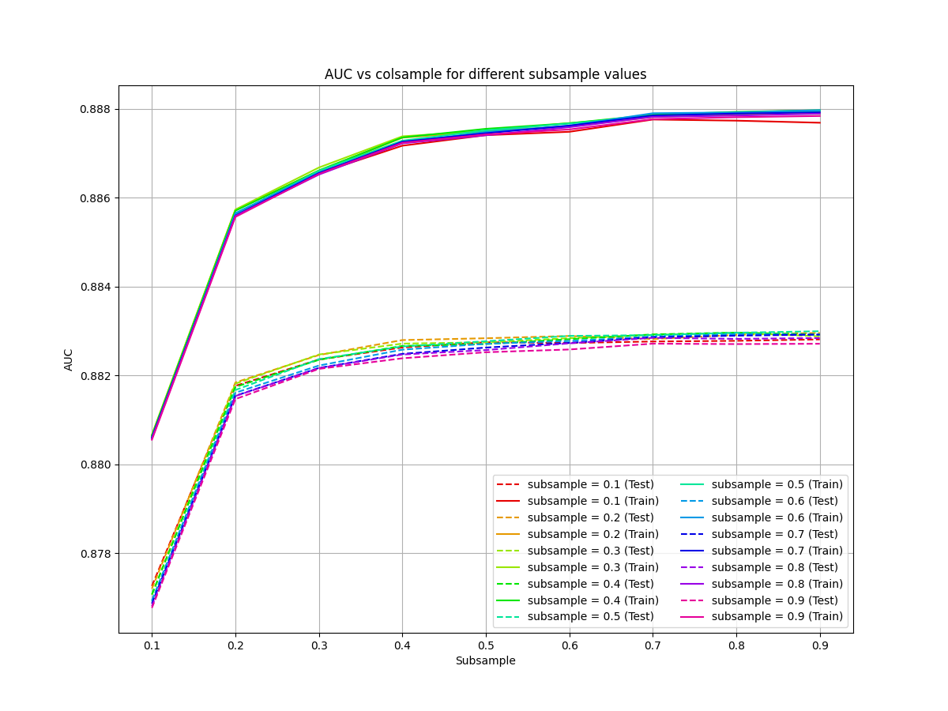
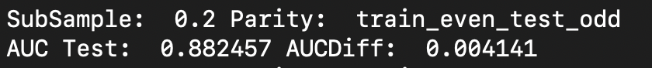

AUC vs Colsample for Subsample
Plotting |Difference| between Train and Test
Plotting both Train and Test
ColSample is optimal when = 3
Performed cut of AUC>0.882 and Diff < 0.0042
I picked subsample = 0.2 although 0.1 is also good
Train Even Test Odd
Train Odd Test Even

Slide 22
Reproduce results with optimized parameters
Fix Eta = 0.01
nTree = 2000
MaxDepth = 2
ColSamples = 0.3
SubSamples = 0.2

Slide 23
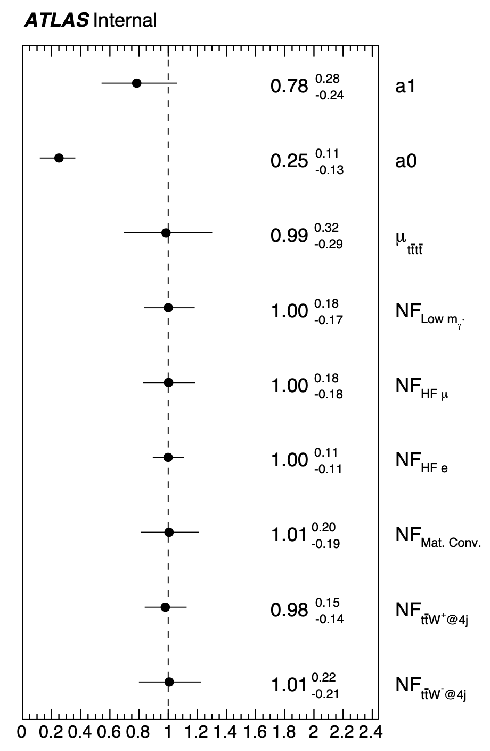
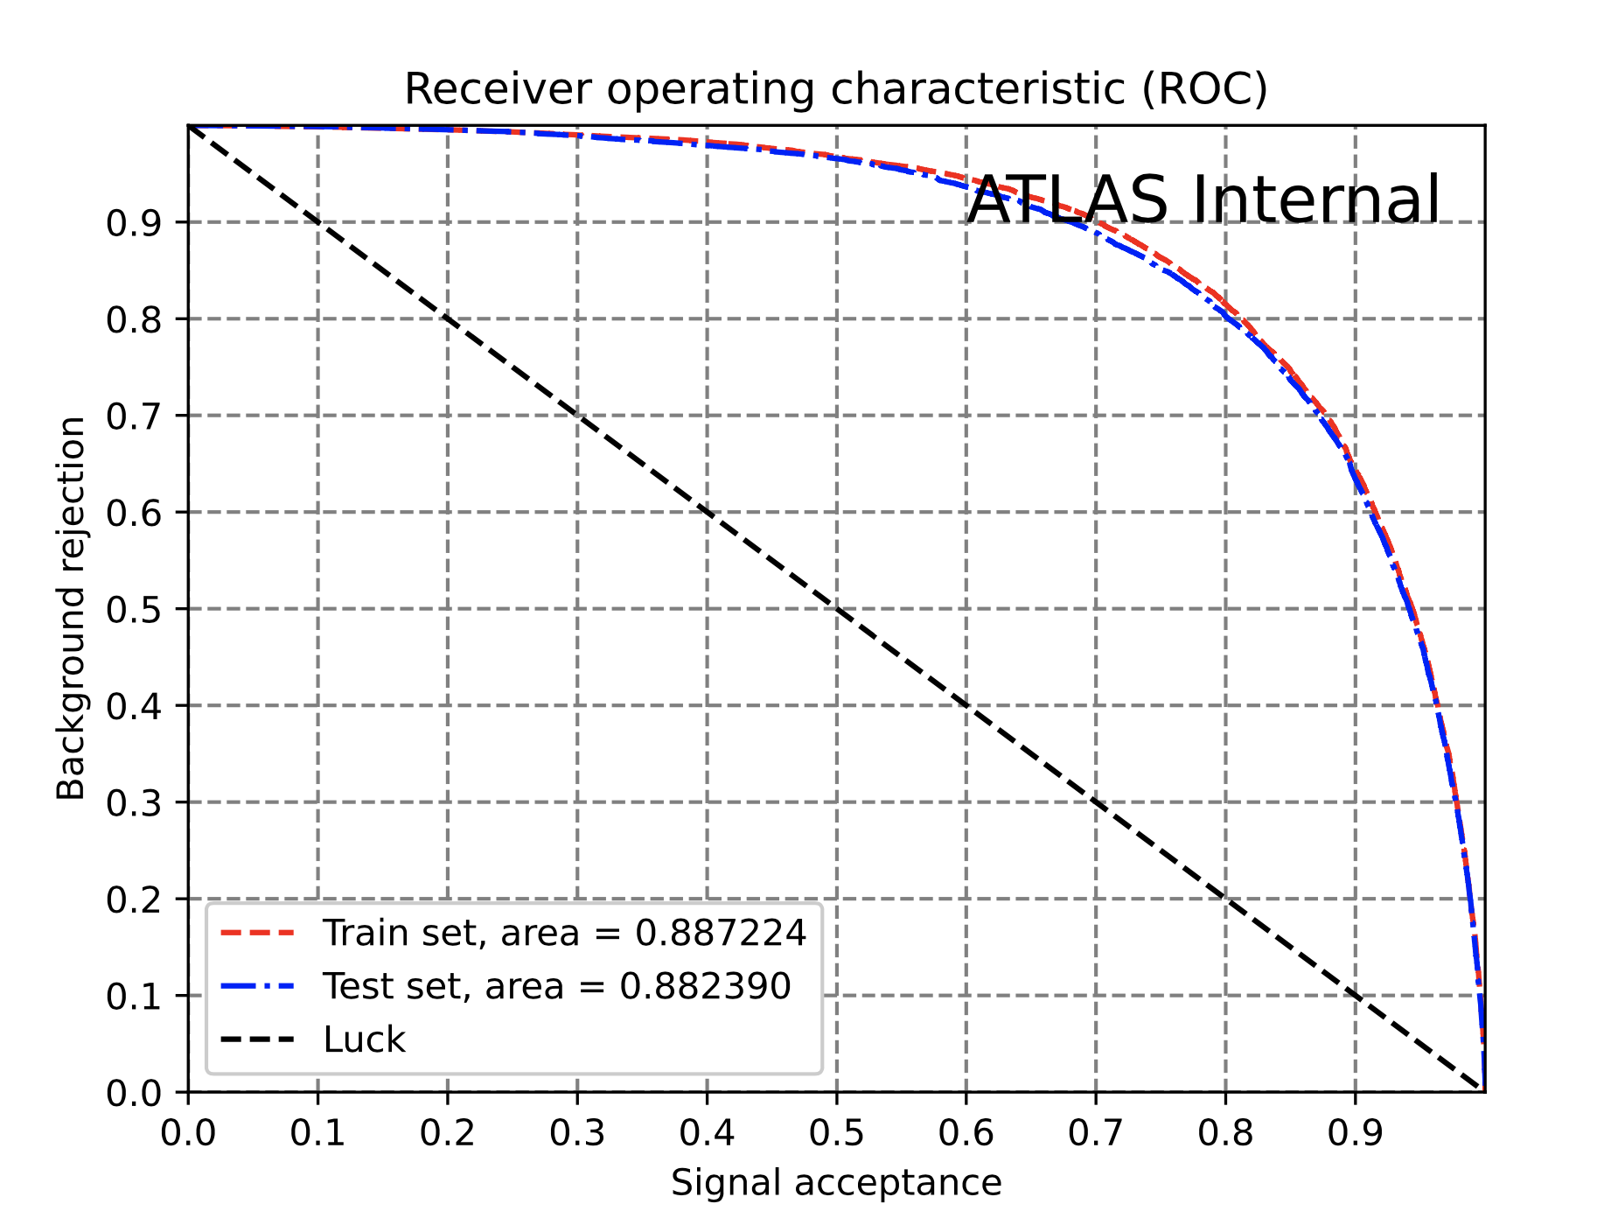
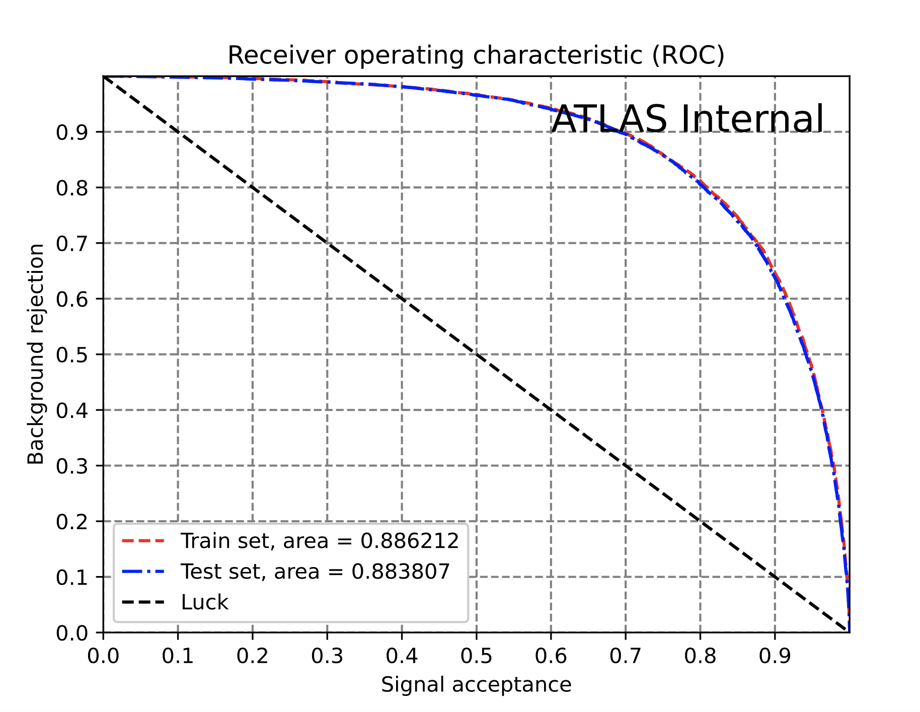
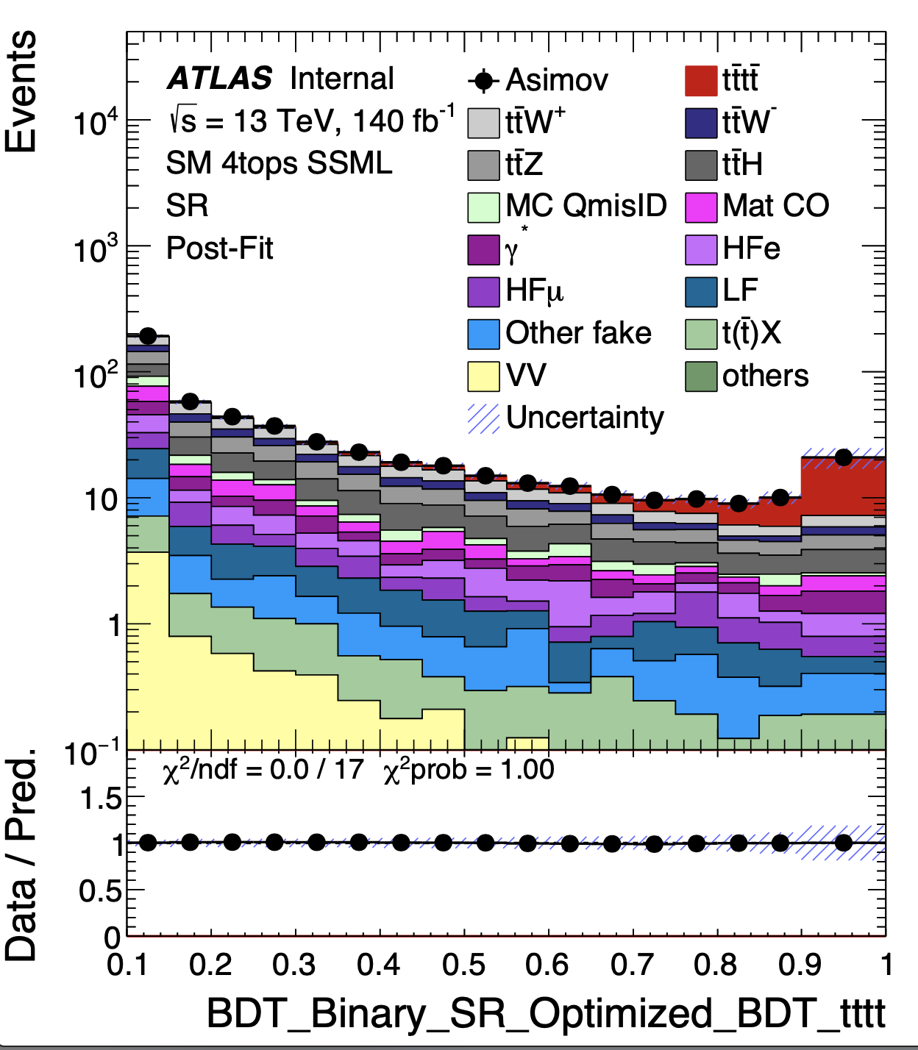
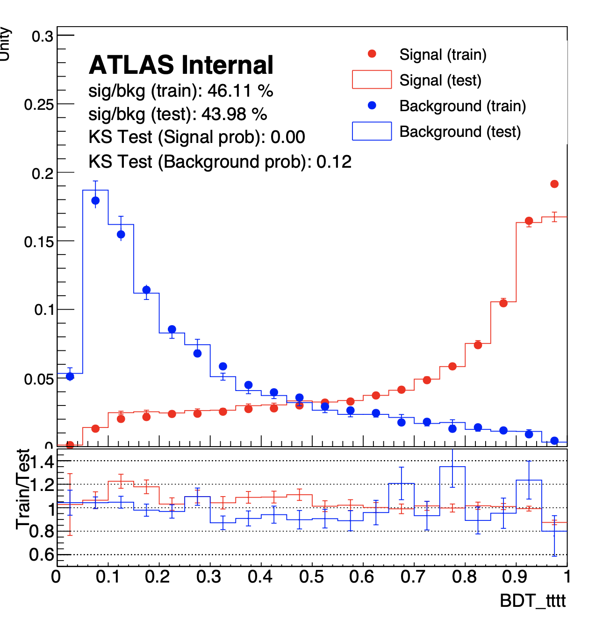
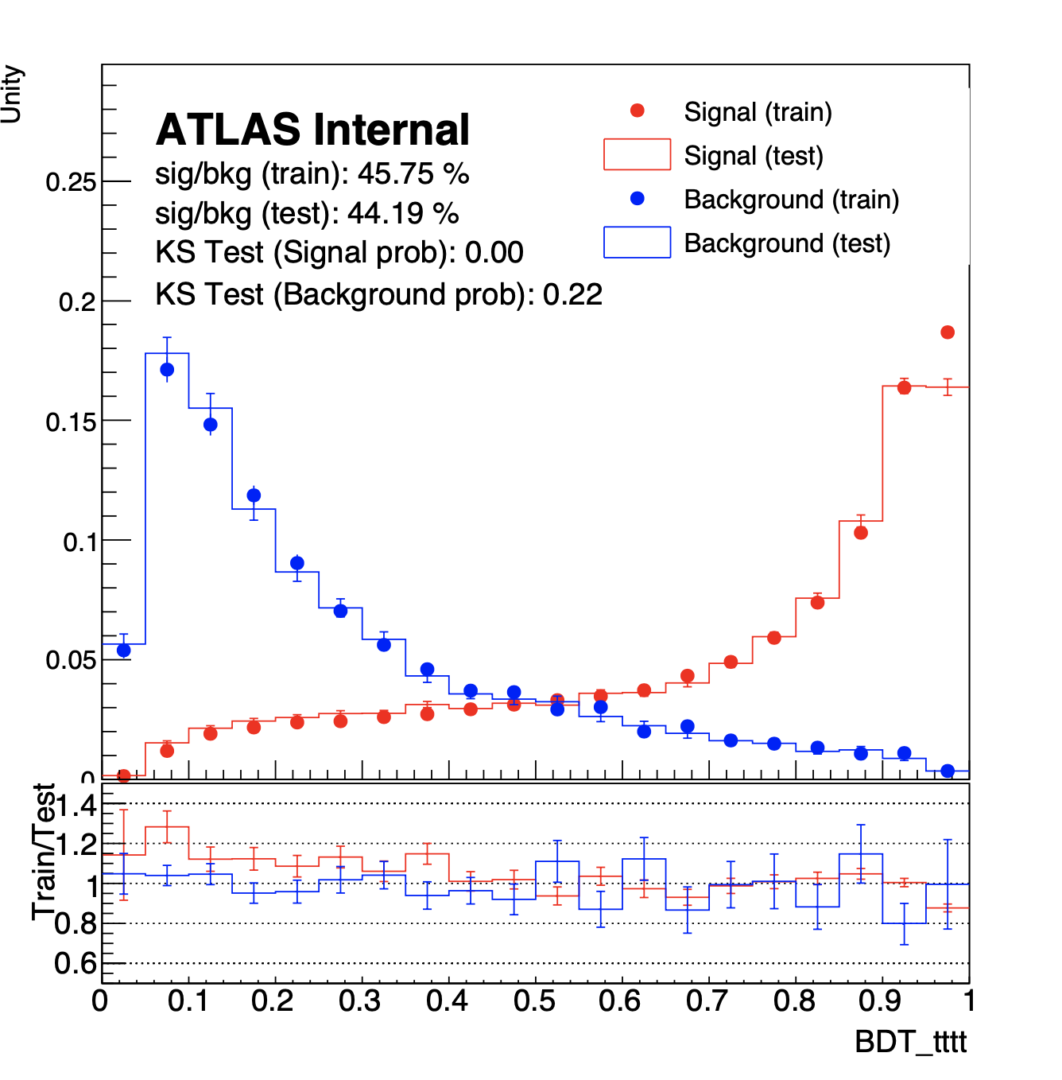

Performance with Optimal Values
nTree = 2000
Max Depth = 2
Eta = 0.01
ColSample = 0.3
Subsample = 0.2
Fit results
Sig: 3.96 σ
ROC signal region tttt (train even test odd)
ROC signal region tttt (train odd test even)
Separation Signal Region (train even test odd)
Separation Signal Region (train odd test even)

Slide 24
Comparison between results
SKLearn
XGBoost
Performance got slightly worse but still very similar
Ongoing tests to weigh ttW background more to gain better separation against ttW
Sig: 4.02 σ
Sig: 3.96 σ
Used MVA-trainer
New Train with XGboost, Doesn’t have ttW background weights

Slide 25
Reproducing CMS results with BDT
Introduction and Motivation
Introduction of 4Top
Introduction of Boosted Decision Trees (BDT)
BDT optimization results
Introduction of CMS paper and motivation
CMS replication results
4-top Next Leading Order studies results

Slide 26
Why do we want to recreate CMS 4-top publication?
Original Setup:
≥6j & ≥2b
HT>500GeV
Both 2 and 3 Lepton Channels
Original Setup:
Tighter selection
Binary classification with 2LSS+3L inclusively
CMS Setup:
Looser Selection:
  More training stats (signal/background), but try to recover signal purity with MVA and get better sensitivities
Multiclass classification with 2LSS/3L separately
Potential benefit:
  2LSS/3L kinematics might be different, 3L can be cleaner for 4top
  Multiclass might allow us to have better background estimated in close-to-SR region

Slide 27
BDT Setup
↙️Default
Binary: Only separates tttt with all other background
Binary
Multiclass: separates tttt, ttX(where X an be anything else) and other background separately
Signal Region
Multiclass
Binary
Same Sign 2-Lepton
Signal Region used in ATLAS 4top paper
≥6j & ≥2b
HT>500GeV
Same Sign 2-Lepton in CMS paper:
≥6j & ≥2b or ≥4j&≥3b
HT>280GeV
3-Lepton in CMS paper:
≥3J & ≥2b
HT>200GeV
=0Z candidate
*for 3 lepton we don’t have QmisID
Multiclass
Binary
3 Leptons
Multiclass

Slide 28
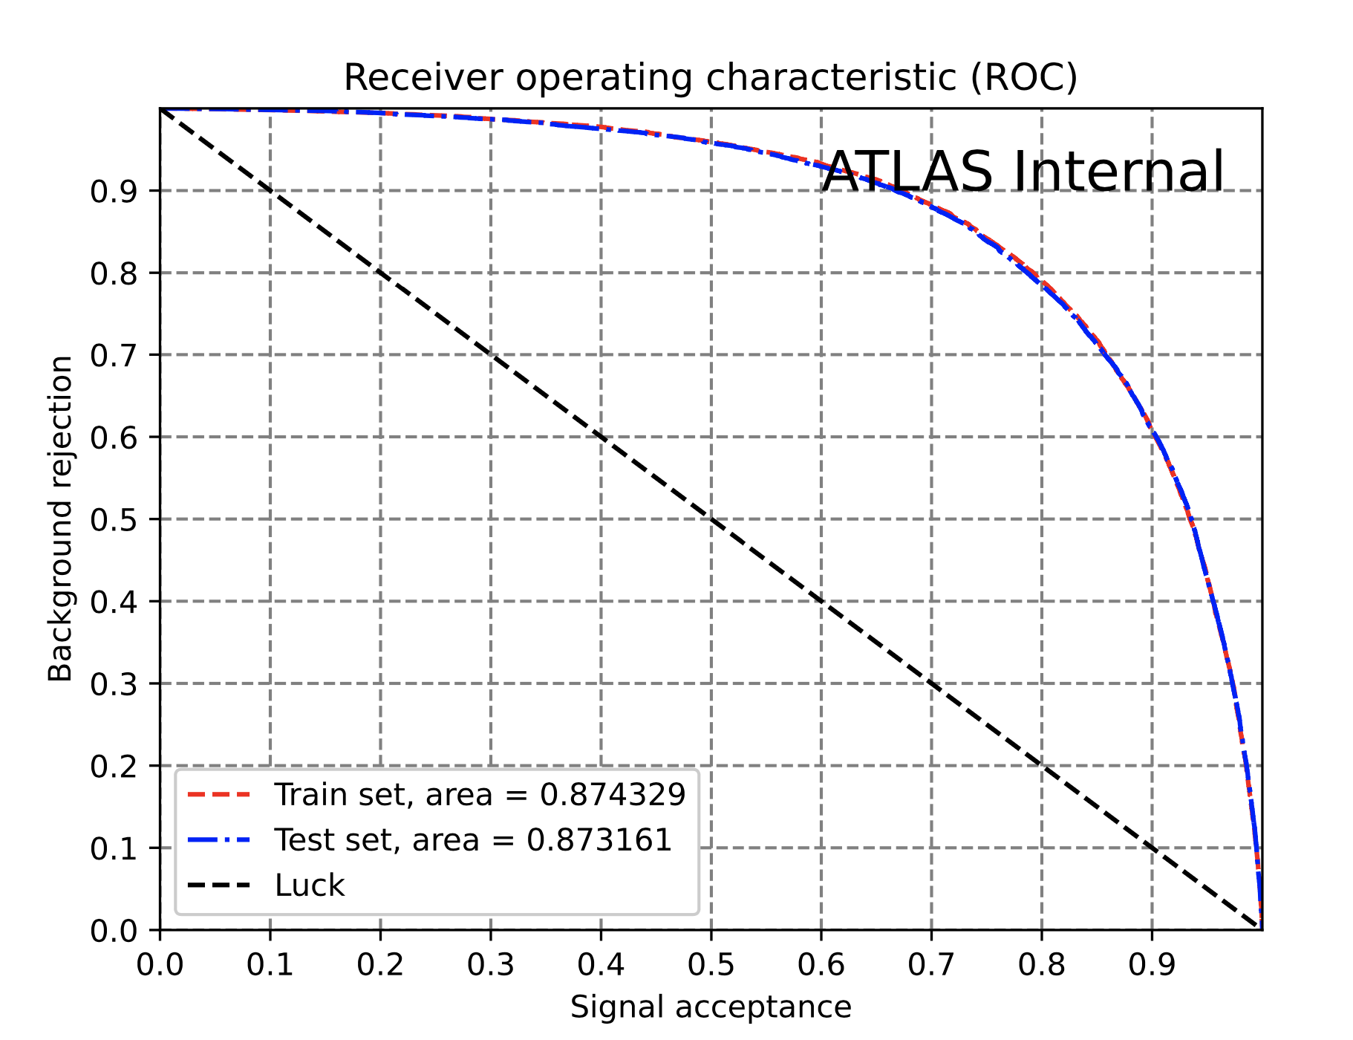
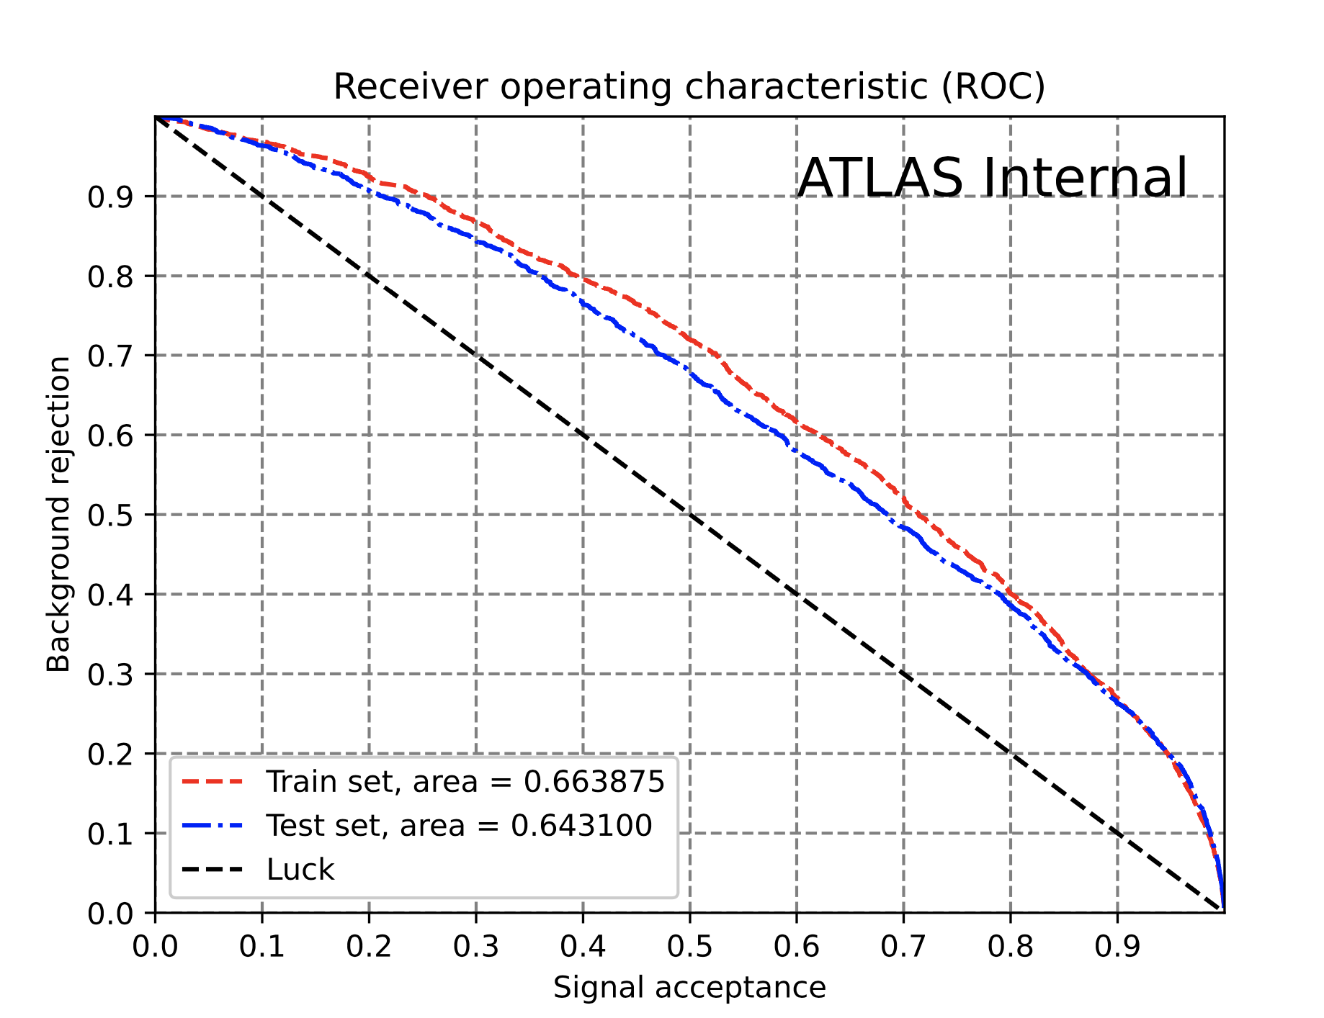
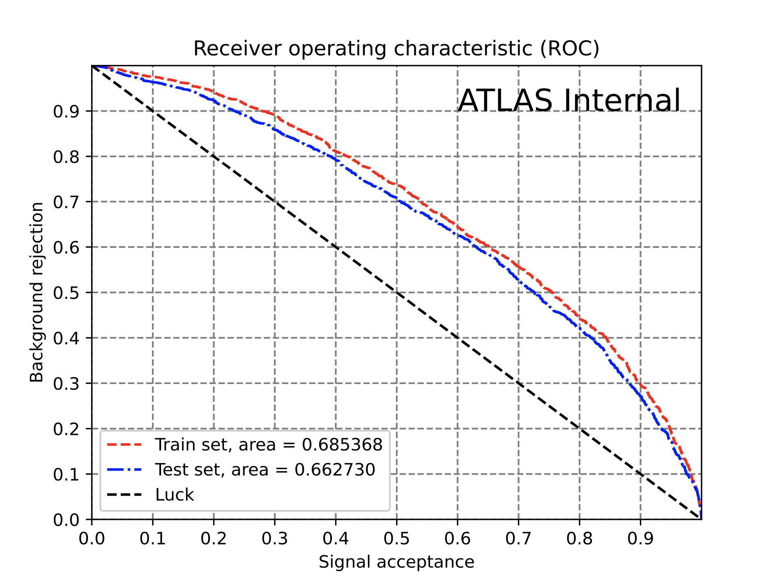


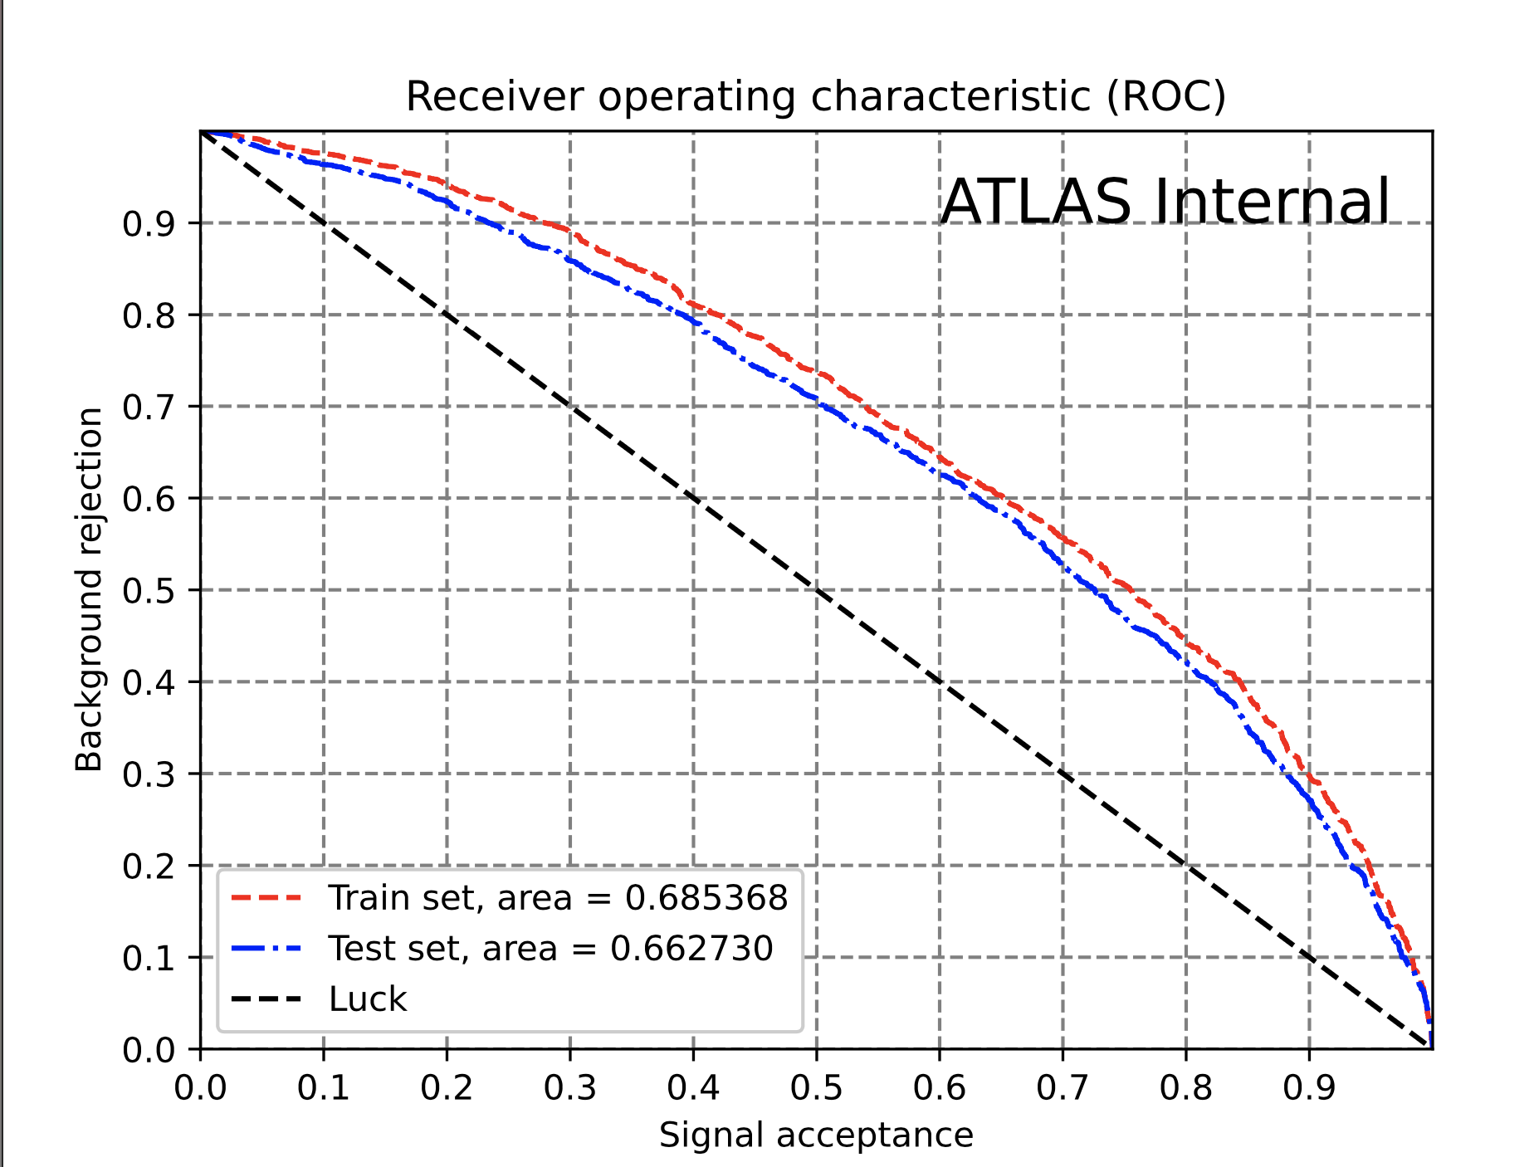
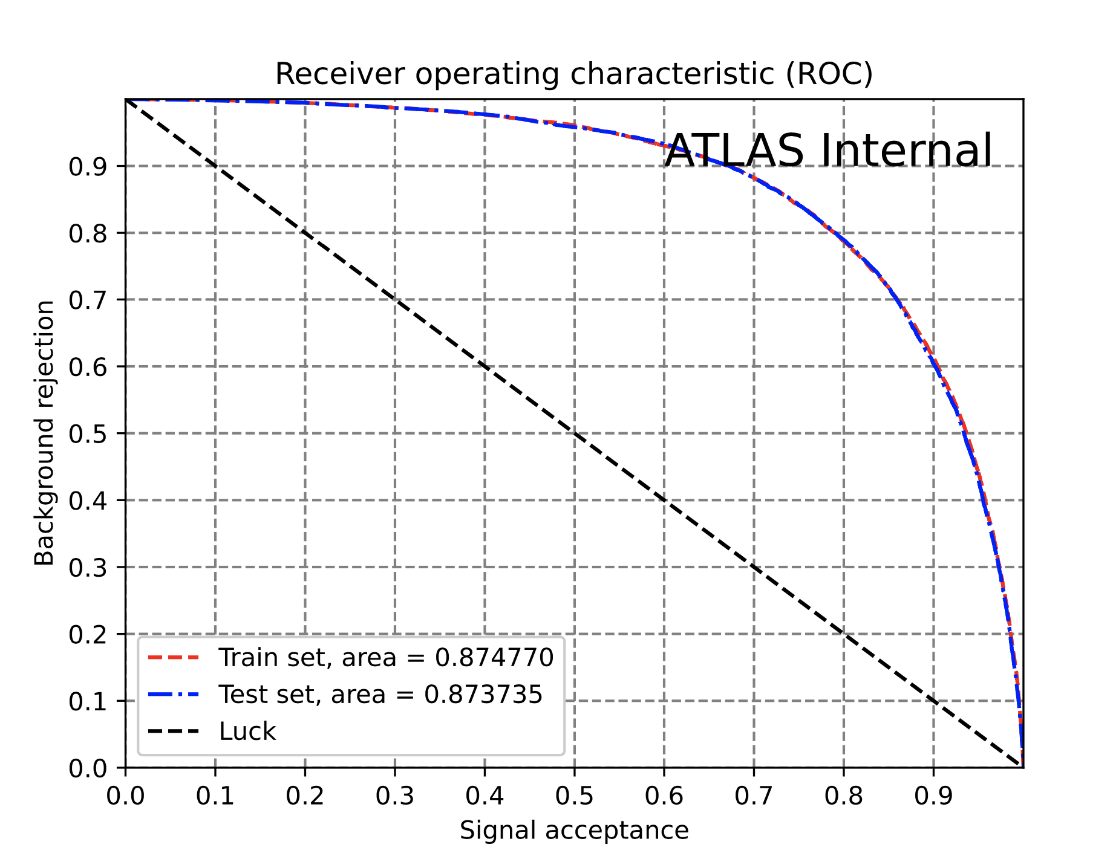
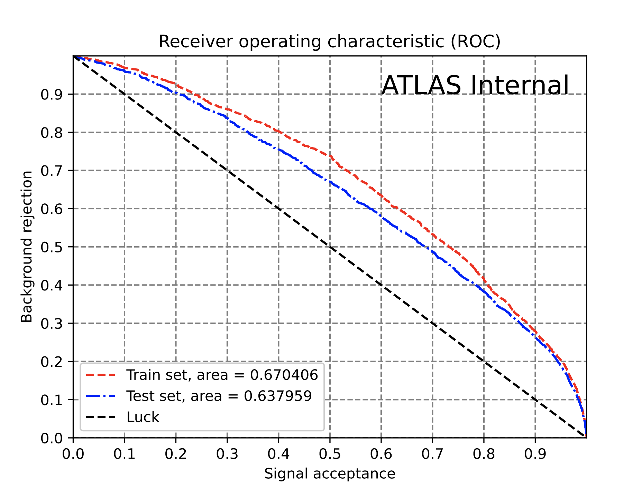
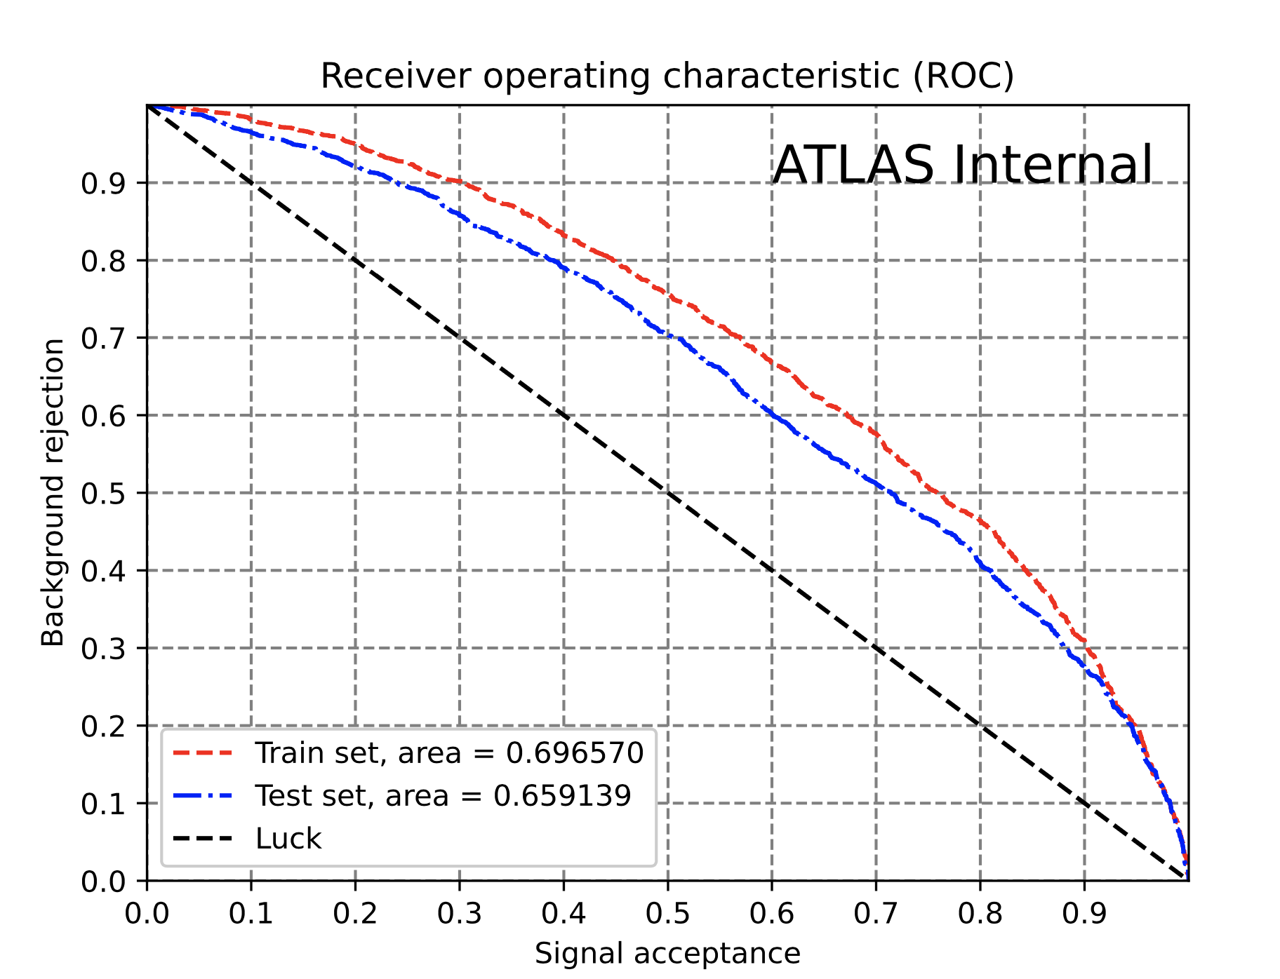
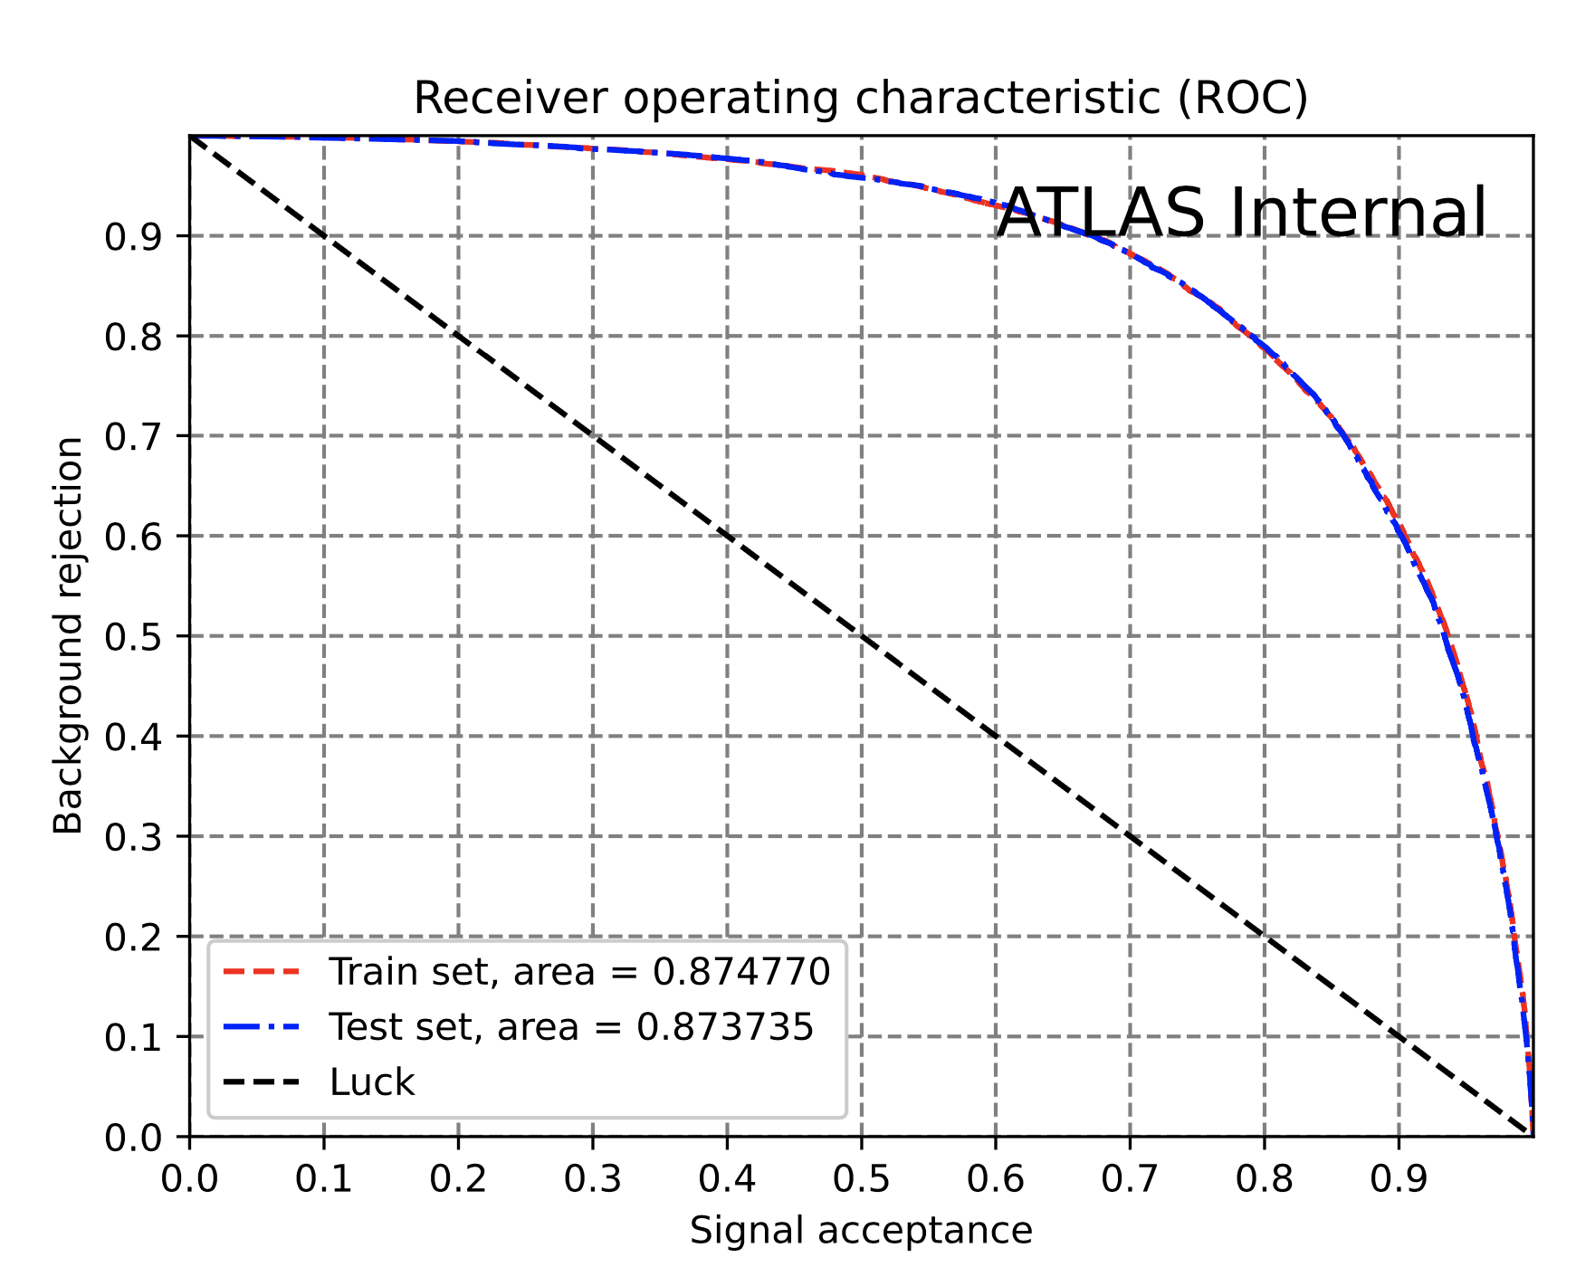
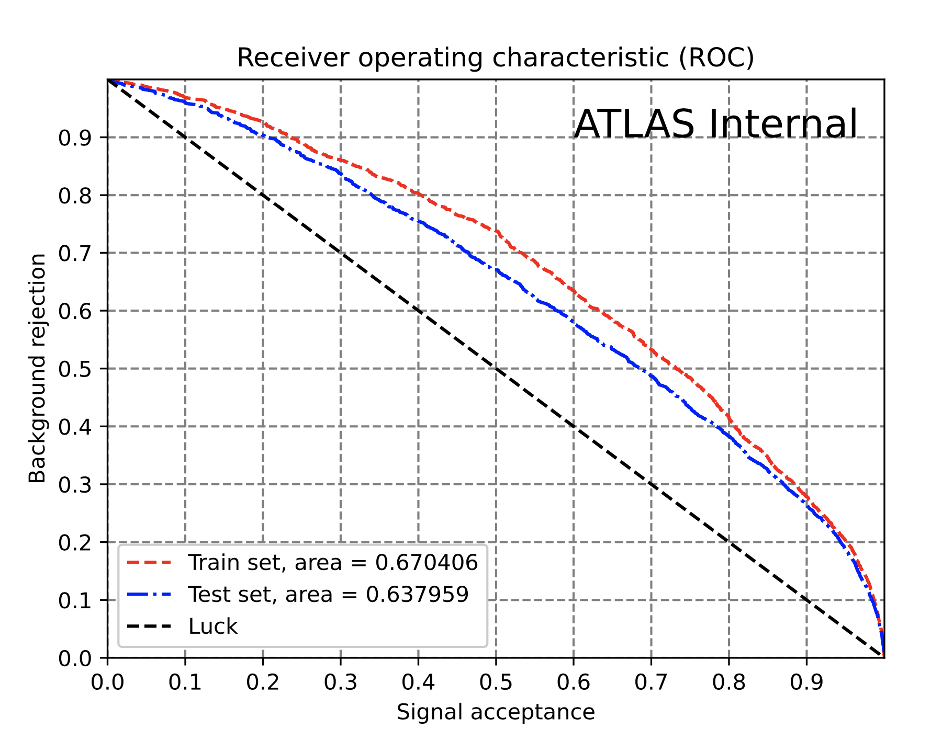
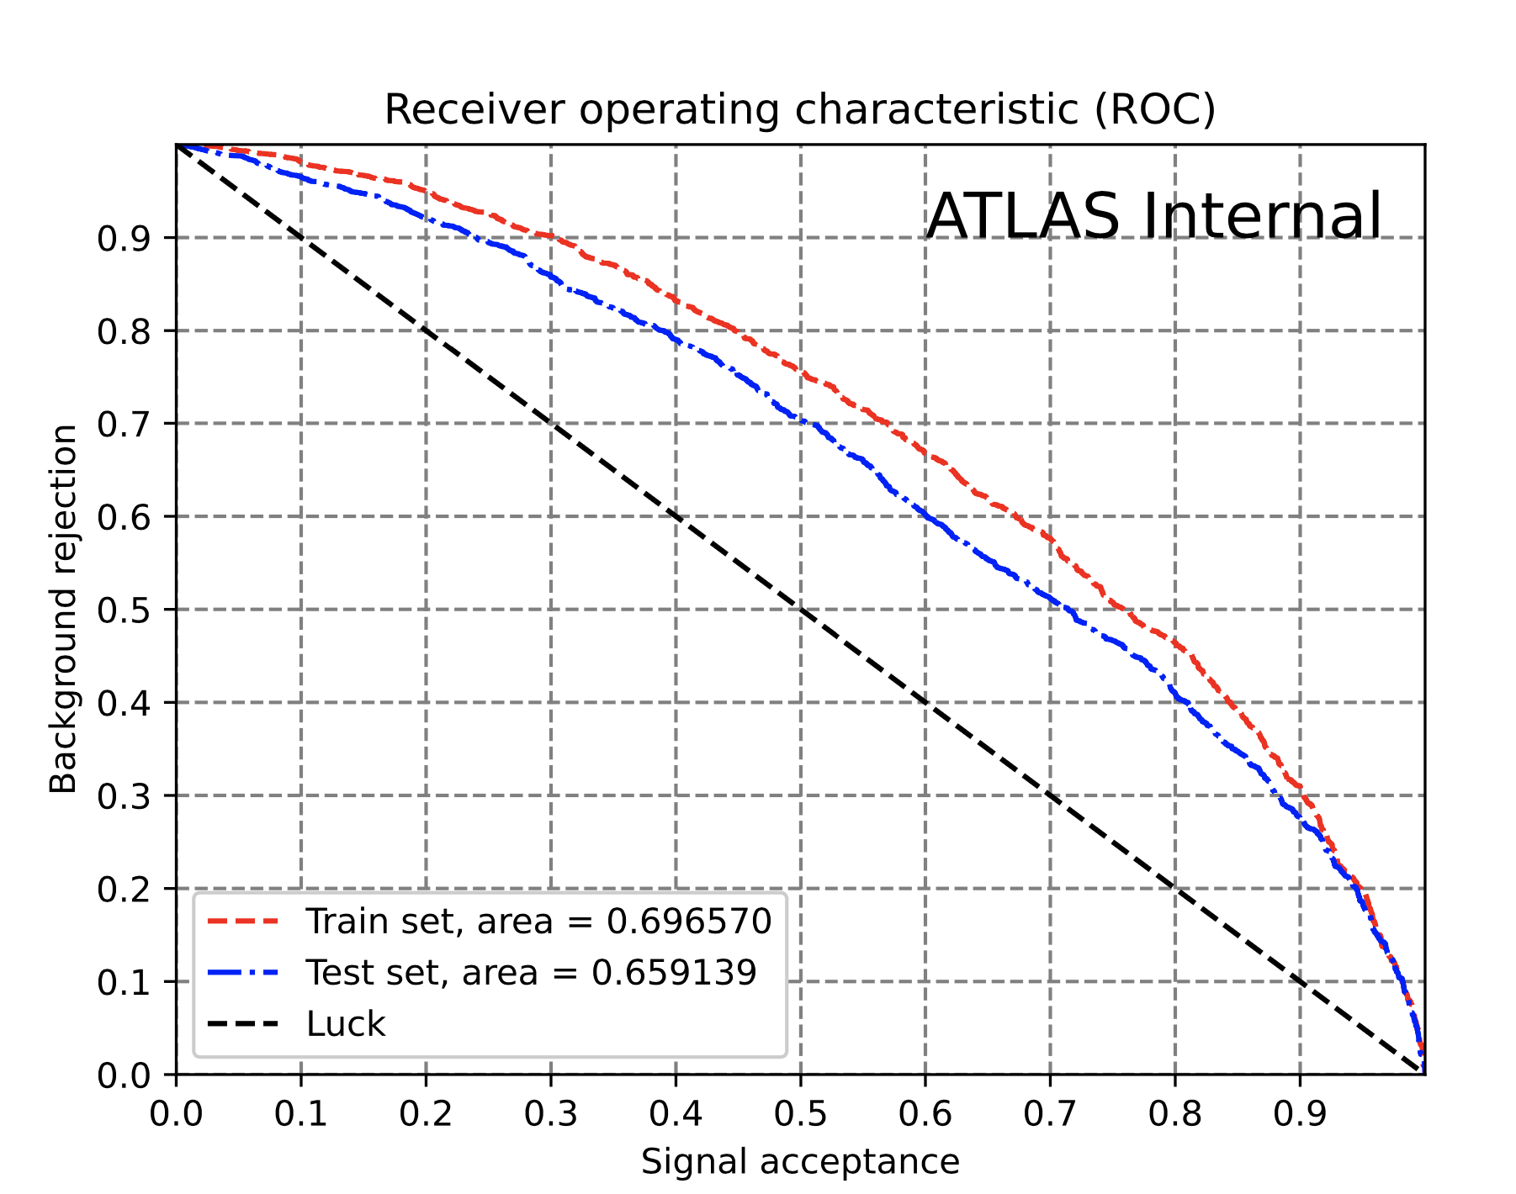
Signal Region - Multiclass - ROC
Preliminary checks with multiclass with SR used in the binary classification
ROC signal region tttt (train even test odd)
ROC signal region ttX
(train even test odd)
ROC signal region other (train even test odd)
ROC train region tttt
(train even test odd)
ROC train region ttx
(train even test odd)
ROC train region other
(train even test odd)
ROC signal region tttt (train odd test even)
ROC signal region ttX (train odd test even)
ROC signal region other (train odd test even)
ROC train region tttt
(train odd test even)
ROC train region ttx
(train odd test even)
ROC train region other
(train odd test even)

Slide 29
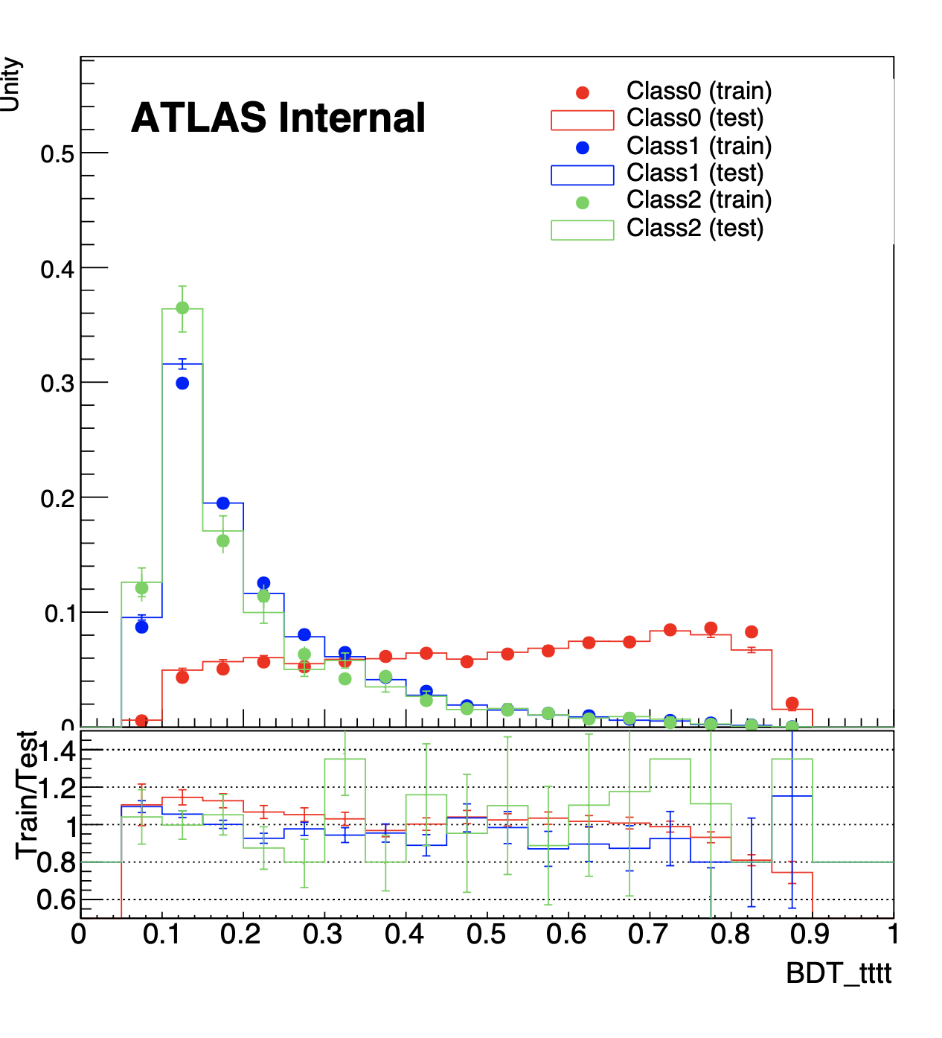









Signal Region- Multiclass - Train (train even test odd)
Signal region tttt
Signal region ttX
Signal region Other
Train region tttt
Train region ttX
Train region Other
Preliminary checks with multiclass with SR used in the binary classification
Class 0 = tttt
Class 1 = ttX
Class 2 = Other

Slide 30
BDT Setup
Same Sign 2 Lepton
3 Lepton
Signal Region
⬇️
With additional kinematics selection to make SR with signal enriched

Slide 31

CMS paper setup
link
Same Sign 2 Lepton:
( ≥ 6j & ≥ 2b ) or (≥4j & ≥3b)
HT > 280GeV
Cr-2l-45j2b: Enriched in ttW production
Cr-3l-23j1b Constrain ttW production and nonprompt lepton background
Signal Region 3 Lepton:
≥ 3j & ≥ 2b
HT >200GeV
no |m(ll) - mz| <15GeV
Cr-3l-45j2b: Constrain non-prompt lepton backgrounds
Cr-3l-23j1b Constrain ttZ production
4L we don’t have yet ;(

Slide 32
Difference between Binary and Multiclass
BDT for ttX
>=6j, >=2b
>=6j
Control Region: Background | Signal Region: tttt
ttX-enriched to control background | 2nd purest region for 4top
Other-enriched to control background | Purest region for 4top: tttt-like
Number of jets
<6j
1b
2b
BDT for 4top
Number of Bottom quarks

Slide 33
Reproducing CMS results with BDT
Results
Introduction of 4Top
Introduction of Boosted Decision Trees (BDT)
BDT optimization results
Introduction of CMS paper and motivation
CMS replication results
4-top Next Leading Order studies results

Slide 34
Reminder: ROC curve
The higher the AUC the better training
If Training AUC > Testing, the model might be overtrained, hence
the better matched training and testing are, the better the training.

Slide 35








CMS same sign 2-lepton - Binary - ROC
ROC signal region tttt (train even test odd)
ROC signal region tttt (train odd test even)
ROC train region tttt (train even test odd)
ROC train region tttt (train odd test even)
Binary: Separates tttt with background
Same Sign 2-Lepton:
≥6j & ≥2b or ≥4j&≥3b
HT>280GeV
Signal Region
(train even test odd)
Signal Region
(train odd test even)
Train Region
(train even test odd)
Train Region
(train odd test even)

Slide 36












CMS same sign 2-ltoepn - Multiclass - ROC
Multiclass: separates tttt, ttX and other background separately
Same Sign 2-Lepton:
≥6j & ≥2b or ≥4j&≥3b
HT>280GeV
ROC signal region tttt (train even test odd)
ROC signal region ttX
(train even test odd)
ROC signal region other (train even test odd)
ROC train region tttt
(train even test odd)
ROC train region ttx
(train even test odd)
ROC train region other
(train even test odd)
ROC signal region tttt (train odd test even)
ROC signal region ttX (train odd test even)
ROC signal region other (train odd test even)
ROC train region tttt
(train odd test even)
ROC train region ttx
(train odd test even)
ROC train region other
(train odd test even)

Slide 37












CMS same sign 2 Lepton- Multiclass - Train (train even test odd)
Signal region tttt
Signal region ttX
Signal region Other
Train region tttt
Train region ttX
Train region Other
Class 0 = tttt
Class 1 = ttX
Class 2 = Other

Slide 38












CMS 3-lepton - Multiclass - ROC
Multiclass: separates tttt, ttX and other background separately
3Lepton:
≥3J & ≥2b
HT>200GeV
=0Z candidate
ROC signal region tttt (train even test odd)
ROC signal region ttX
(train even test odd)
ROC signal region other (train even test odd)
ROC train region tttt
(train even test odd)
ROC train region ttx
(train even test odd)
ROC train region other
(train even test odd)
ROC signal region tttt (train odd test even)
ROC signal region ttX (train odd test even)
ROC signal region other (train odd test even)
ROC train region tttt
(train odd test even)
ROC train region ttx
(train odd test even)
ROC train region other
(train odd test even)

Slide 39












CMS same sign 3 Lepton- Multiclass - Train (train even test odd)
Signal region tttt
Signal region ttX
Signal region Other
train region tttt
train region ttX
train region Other
Class 0 = tttt
Class 1 = ttX
Class 2 = Other

Slide 40
Next steps
R&D with CMS setups to see if we can gain sensitivities with splitting 2LSS and 3L
We are debugging the 3-top issue and we would soon be able to produce the results inside ATLAS

Slide 41
Photos

Slide 42









Slide 43
Backup (and part 7)

Slide 44
3-top NLO cross sections produced (MG inside Atlas)
 | tttjp | tttjm | tttj | tttwm | tttwp | tttW
NLO (reproduced theorist results) | 0.2022±2.6e-03 fb | 0.4442± 1.9e-03 fb | 0.6464 fb | 0.5185± 1.5e-03 fb | 0.5212 ± 1.6e-03 fb | 1.04 fb
NLO (theorist) |  |  | 0.646 fb |  |  | 1.02 fb
LO (reproduced theorist results) | 0.1132± 2.1e-04 fb | 0.2485 ±4.5e-04 fb | 0.3617 fb | 0.2919 ± 6.1e-03 fb | 0.2923±6.1e-04 fb | 0.5842 fb
LO (theorist) |  |  | 0.363 fb |  |  | 0.576 fb

Slide 45




The tttjp sample produced inside ATLAS (10k events)
Particle level with inclusive selection
nBjets
njets
HT_jets
For B jets, it peaks at 3 as expected since top decays into W+b.
We expect to have >4 jets since each t decays into W+b, and tttj has an extra jet, so there’s at least 4 jets
HT
The scalar sum of transverse momentum of the jets and leptons
The scalar sum of transverse momentum of the jets

Slide 46



The tttjp sample produced inside ATLAS (10k events)
25⬇️(u+b)
d
u
s
c
b
g
d
u
s
c
b
g
15⬇️(d+b)
Type of q or gluon (Leading) (only produce ttt+1quark)
Type of q or gluon (Next Leading) ( produce ttt+2quark/gluon)
45⬇️(c+b)
Parton level with inclusive selection
What 2 quarks are produced

Slide 47
Reproduce but with Weighted ttW Background

Slide 48
Weighted tttW background
ttW as one class:
1a
2a
3a
ttW as 3 classes,
≤6jets 7jets ≥8jets:
1a 5a 5a
1a 5a 10a

Slide 49
Weighted tttW background
Weights/AUC | Train Even, Test odd | Train Odd, Test Even
Original | Test = 0.882255 Difference = 0.004906 | AUC test set = 0.883749 AUC difference = 0.002418
1a | Test = 0.882408 Difference = 0.003628 | AUC test set = 0.883513 AUC difference = 0.002312
2a | Test = 0.884807 Difference = 0.002050 | AUC test set = 0.884498 AUC difference = 0.002585
1a, 5a, 5a (≤6j:7j:≥8j) | Test = 0.868500 Difference = 0.003895 | AUC test set = 0.869582 AUC difference = 0.001787
1a, 5a, 10a (≤6j:7j:≥8j) | Test = 0.859127 Difference = 0.003651 | AUC test set = 0.859127 AUC difference = 0.003651

Slide 50
python share/create_opt_BDT.py --input "config/hyper_opt_new/BDT_binary_SR_depthscan.yaml" --output "hyper-opt-BinSR-Depth"
Difference < 0.5%, AUCTest > 88%

