Slide 1
Progress Report:
On the overall Functionality of New Small Wheel (NSW) of the ATLAS detector.
Harriet Shi
University of Michigan

Slide 2
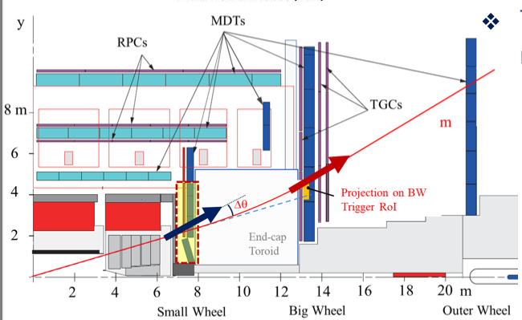
First of all, about SW:
Muon Tracking.
Where did Muon hit? High-resolution muon momentum measurement depends on the presence of the measured point at the Small Wheel level.
Trigger.
but how do you know the hits are muons? “An analysis of 2012 demonstrates that’s approximately 90% of muon triggers in end-caps are fake.” (NSW Design Report, pp6)
The NSW (installed 2021) is a set of precision tracking and trigger detectors able to work at high rates with excellent real-time spatial and time resolution.

Slide 3
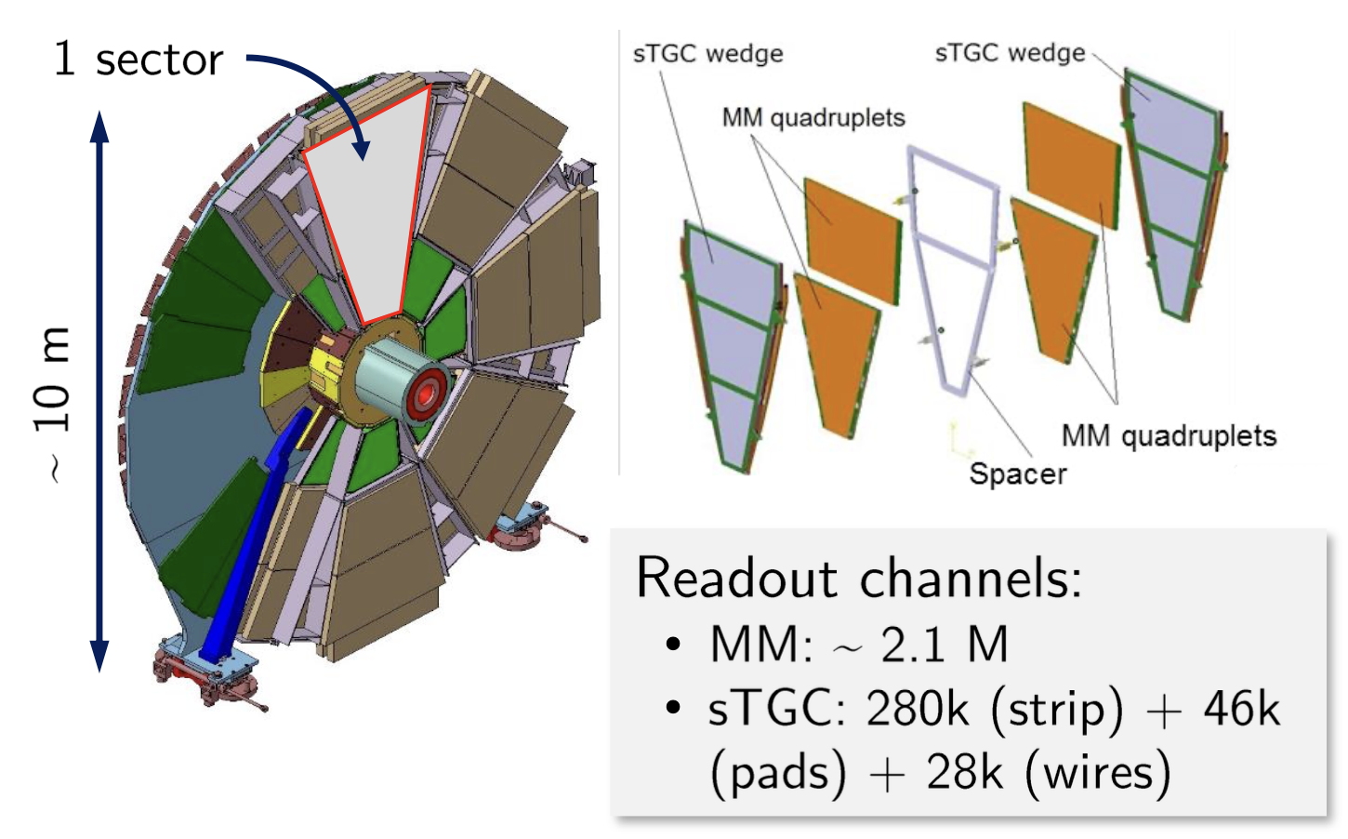
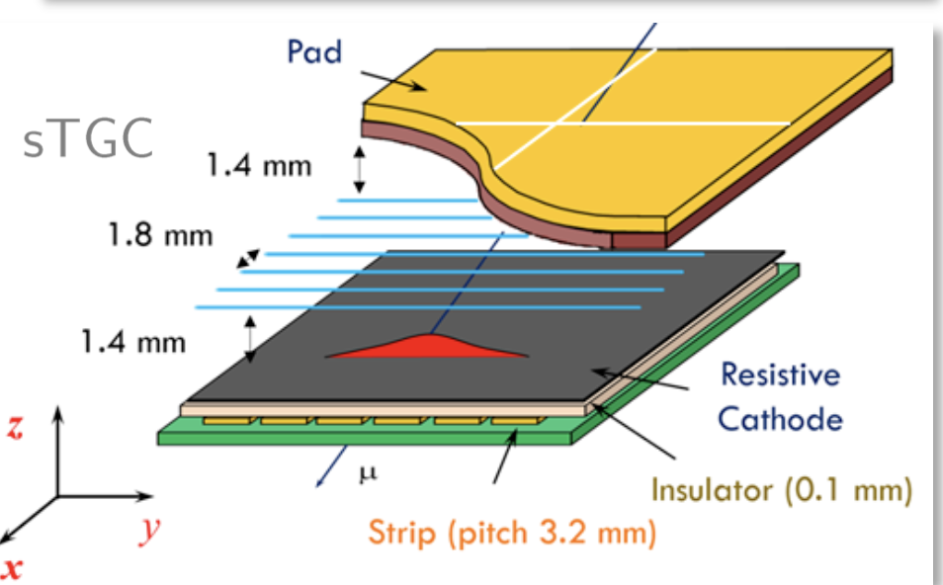
But how?
About Trigger:
New algorithm to confirm muon track from interaction point, which filtered out some fake trigger.
More layers.
Also for detector technology:
MM (Micromesh Gaseous Structure Detector ~ 21M readout channels)
sTGC ( Small-strip Gap Chamber: 280k strip + 46k pads + 28k wires)

Slide 4
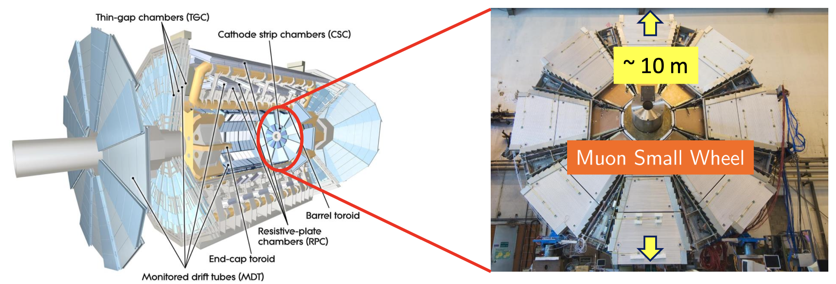
The goal of Summer:
Develop a program that can report the general functionality of NSW in any given run.

Slide 5
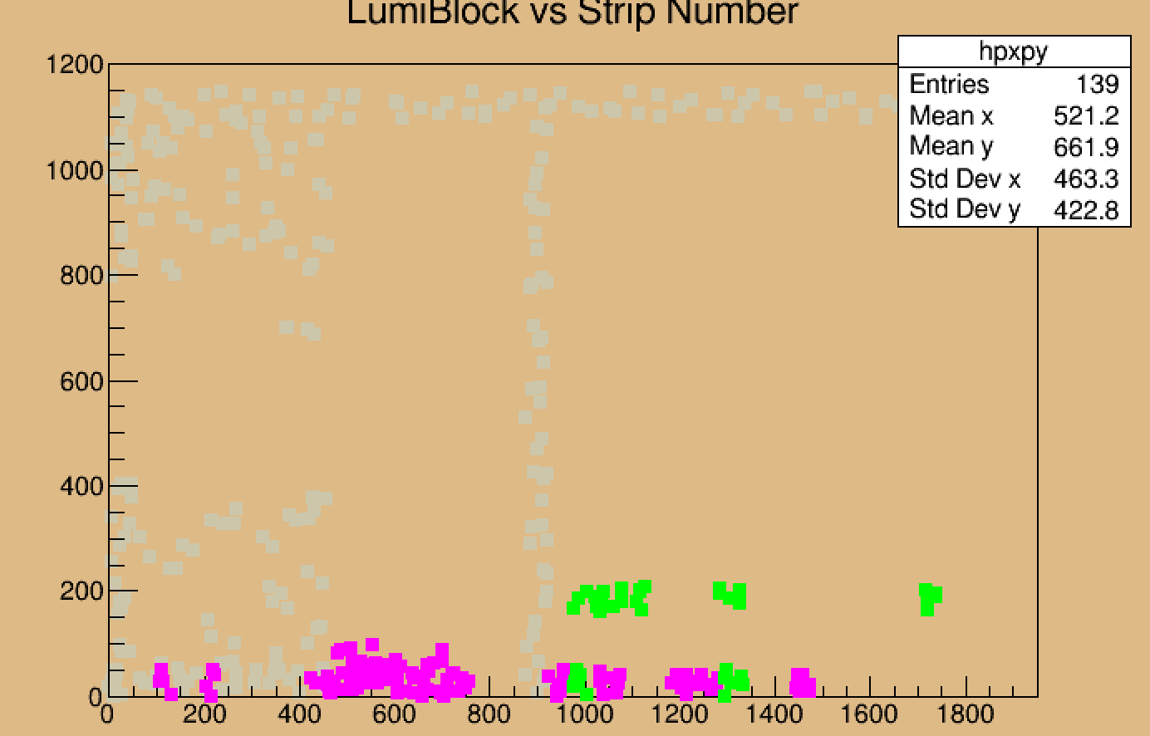
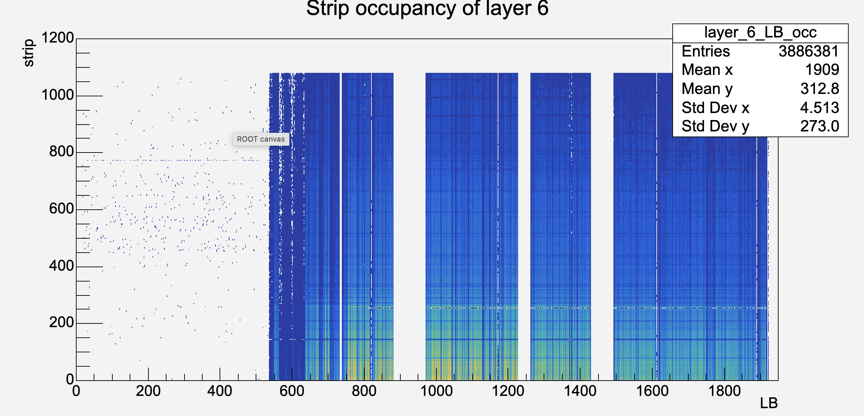
Previous effort (week 1-2):
“Just look at the hit rate, and see if there is a big gradient, because that would be physically impossible, mark those points. “

Slide 6
But this is obviously not rigorous.
What if there is a global inefficiency? That has nothing to do with gradient of a certain area
What do you mean by the gradient being too big? What is the threshold? Do you have studies regarding the hit rate? (*** Next Stage***)
3. Efficiency is not the only problem of this detector, what is worse is that some front and end boards are dead, or HV problems, causing it not to take data at ALL. (Today, work from week3-4

Slide 7
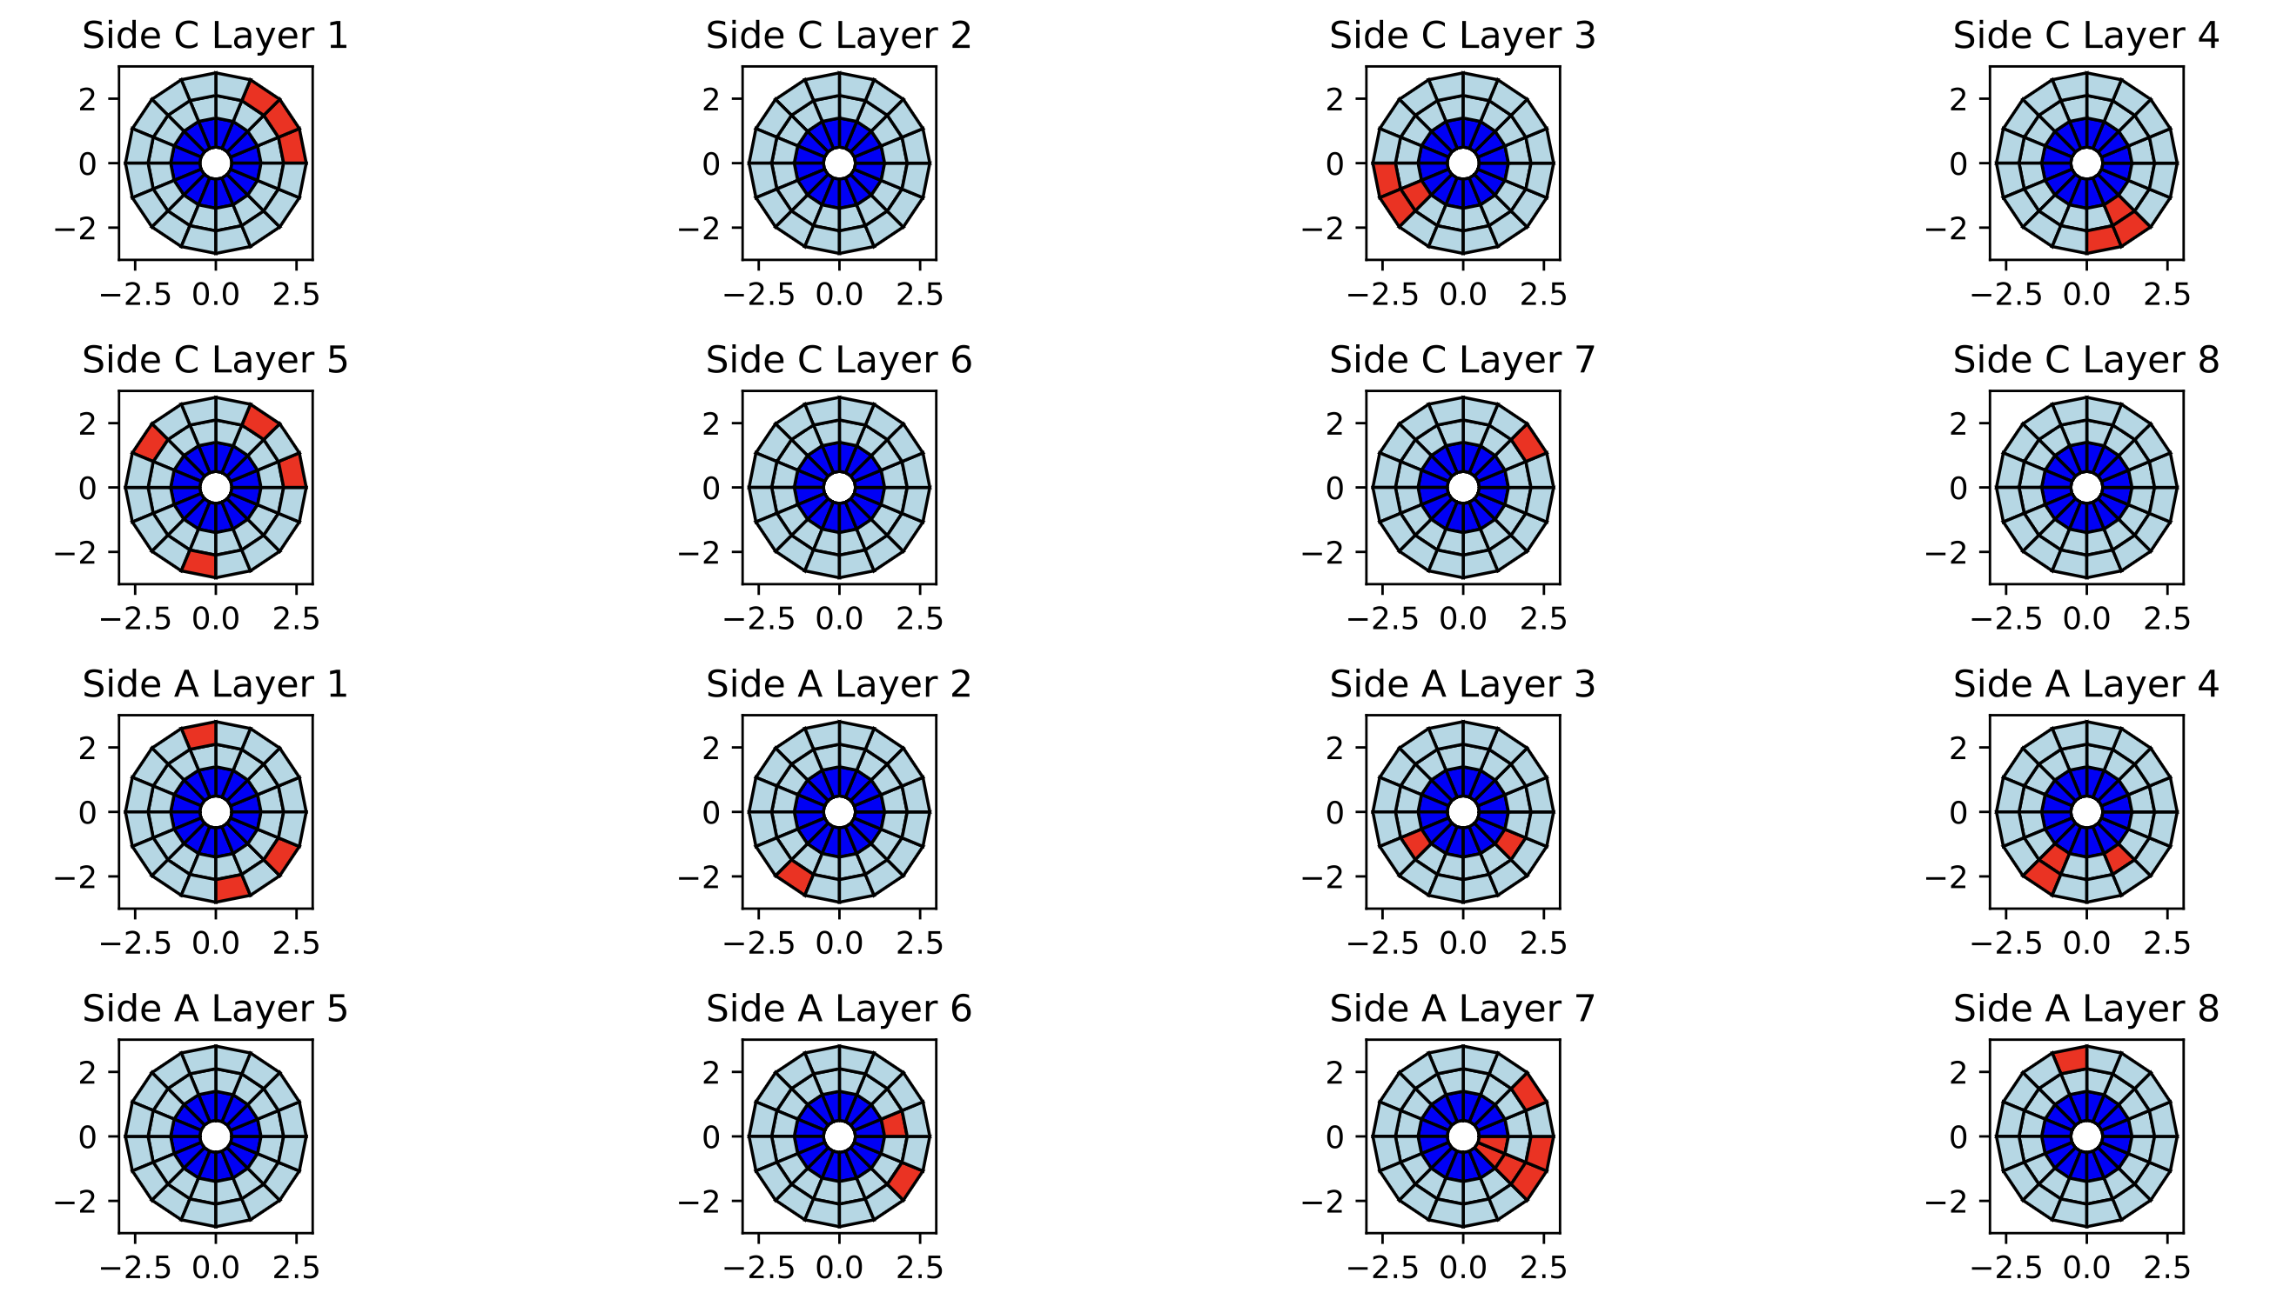
Step one: the obvious problem, some front and end board (which controls the quadruplets on sectors), are dead or disabled during the run.
Pic.1: Run 452573

Slide 8
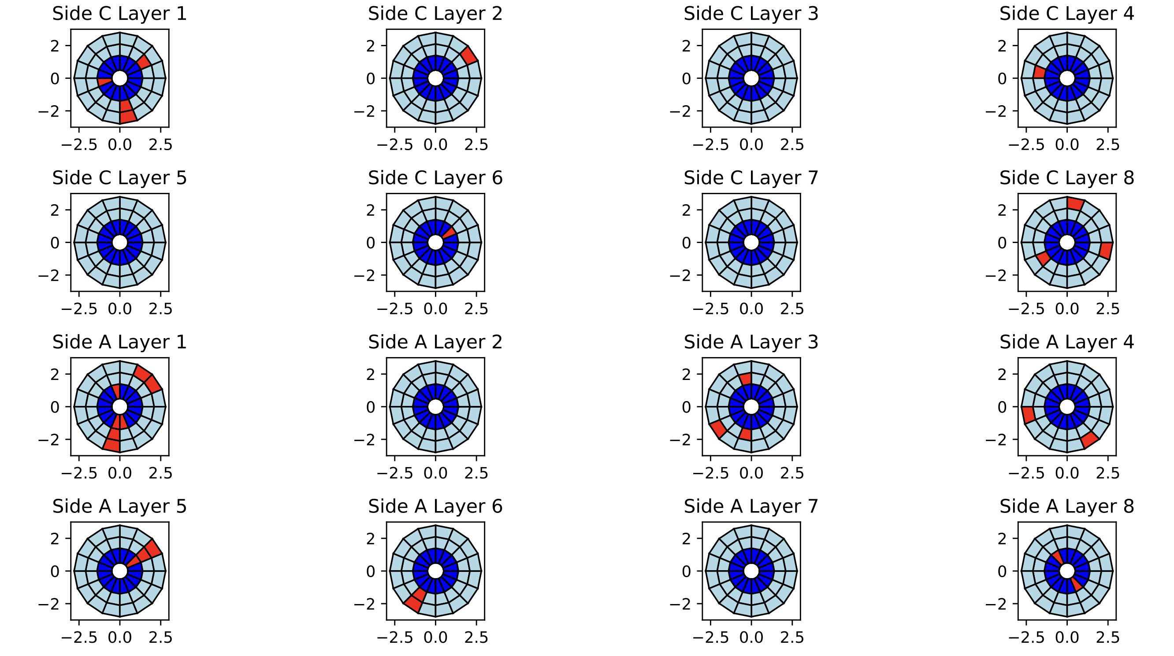
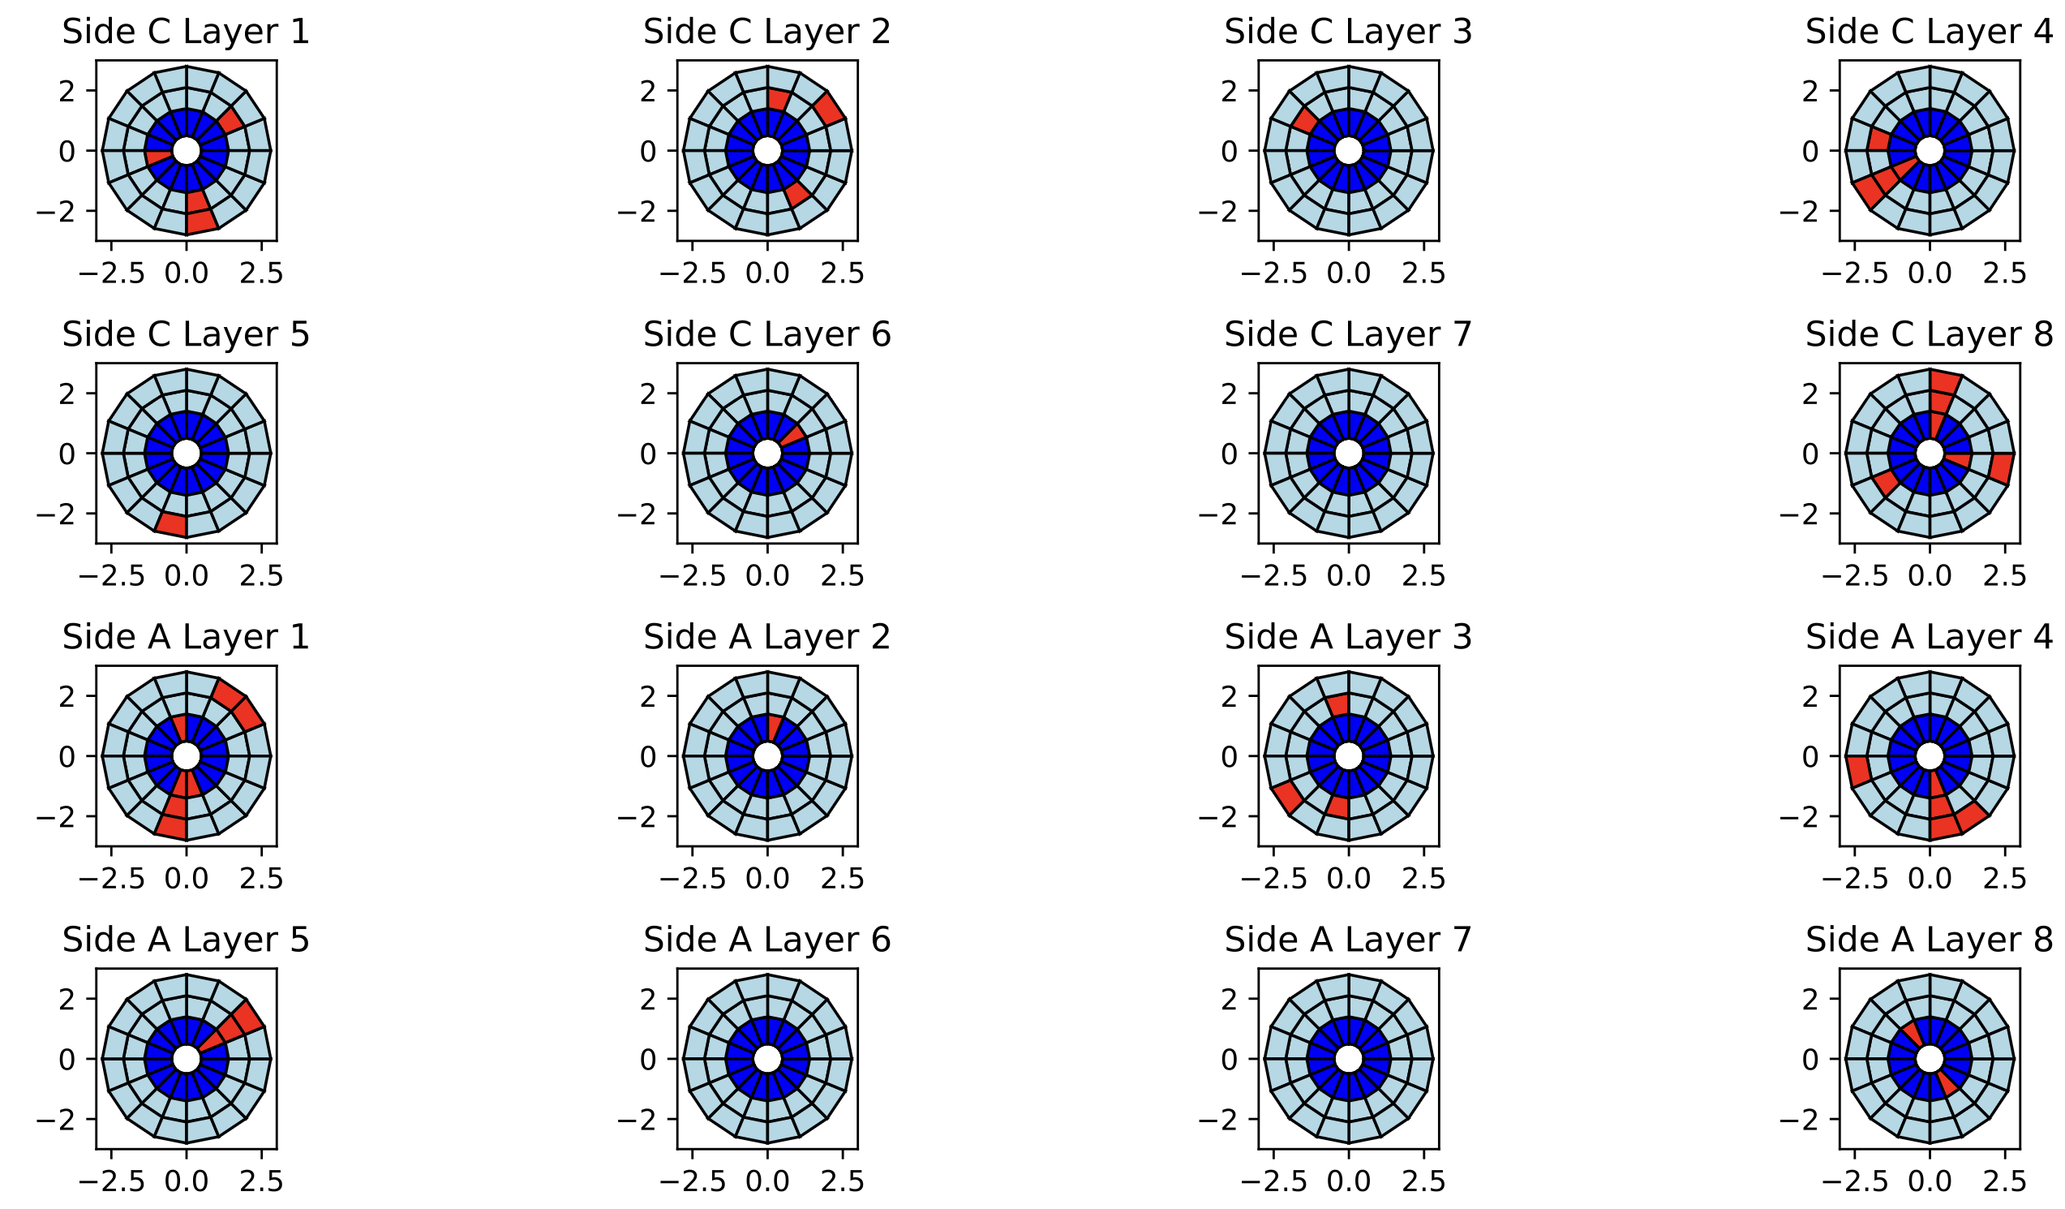
About HV problems:
For monitoring purposes and to detect discharge, we need HV..
Observation: if both strips and pads are not reading any data, then it means HV dead.
Another observation: if you leave the HV problems on without fixing it, those regions will expand.
Run earlier
Run later

Slide 9
Detected 36 FEB completely down, also 5% of region has HV problems – for runs in May.

Slide 10
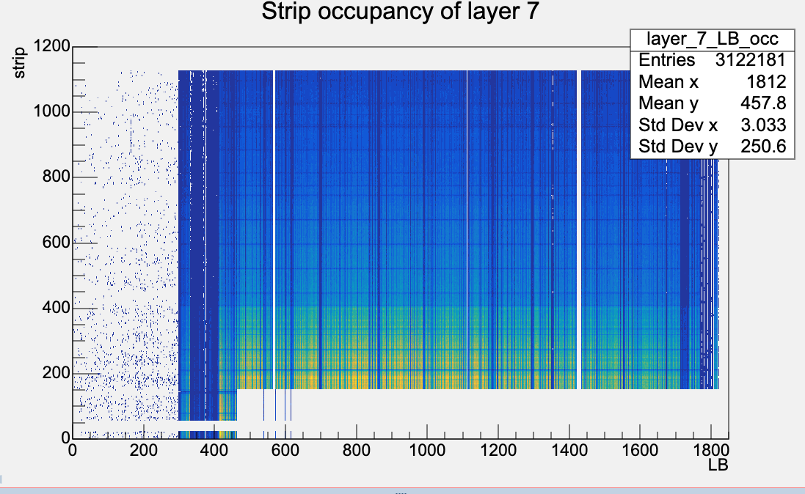
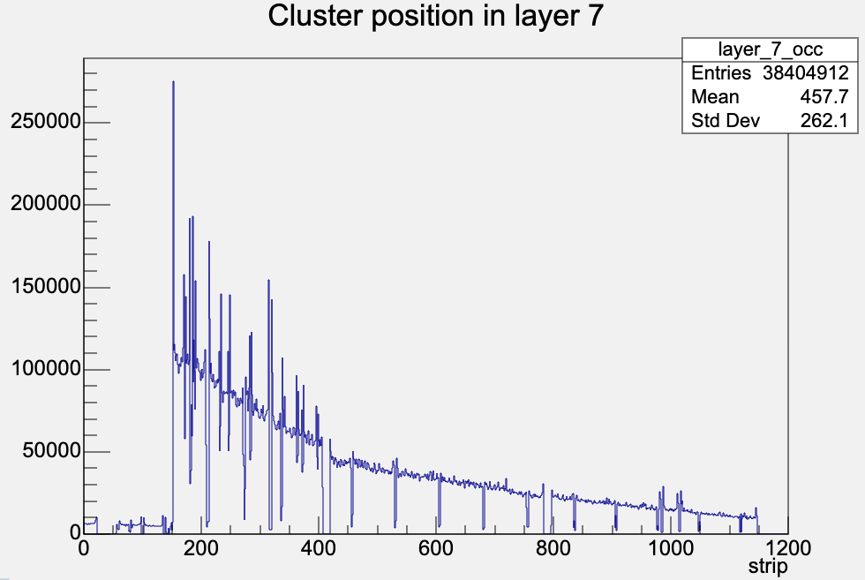
But they are not the only thing that can happen…
Run 453816

Slide 11
Things that are not noticeable by just looking --
Did not get enough (or expected number of hits) in a certain region. Study the expected hit rate – what does this relate to?

