Slide 1


Dark Photon Combination
Evan Rootness
22 June 2023

Slide 2
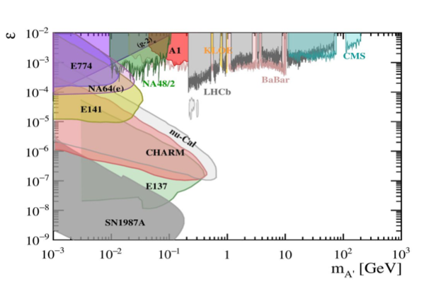
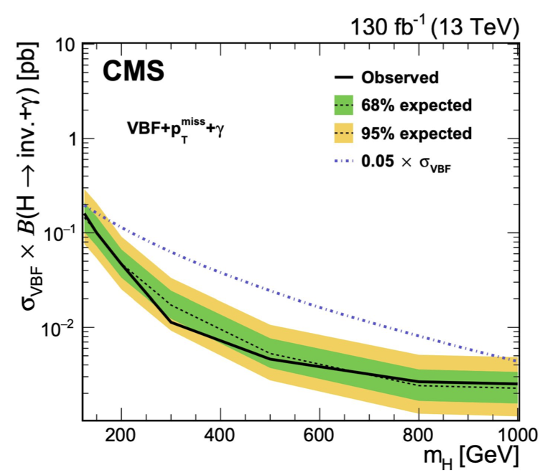
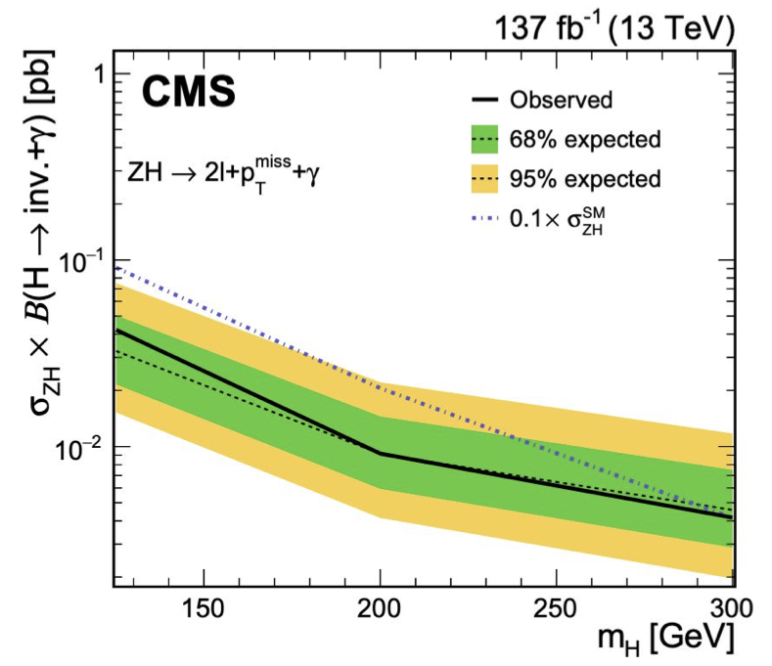
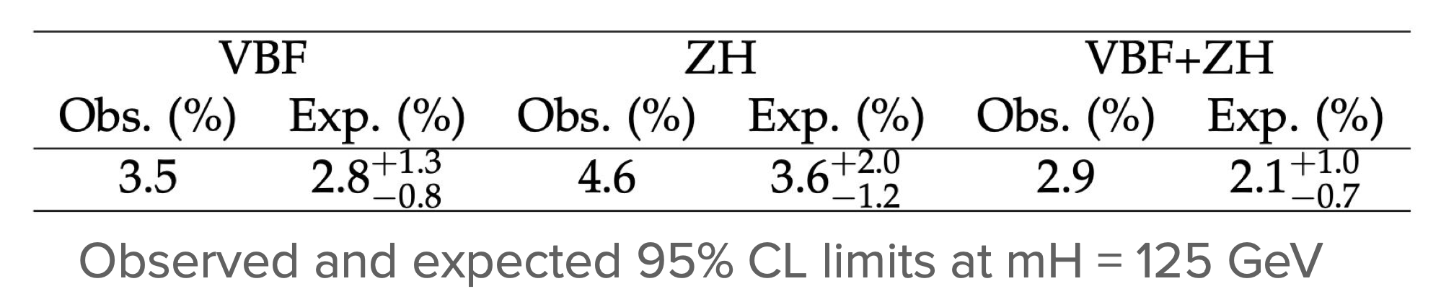
Introduction
The Dark Photon: A hypothetical particle connected to dark matter
Multiple dark photon analyses at CERN (ATLAS, CMS, NA64, LHCb, etc.)
CMS completed a combination analysis on two production modes (VBF + ZH)
Limits on the massive dark photon from di-lepton searches

Slide 3
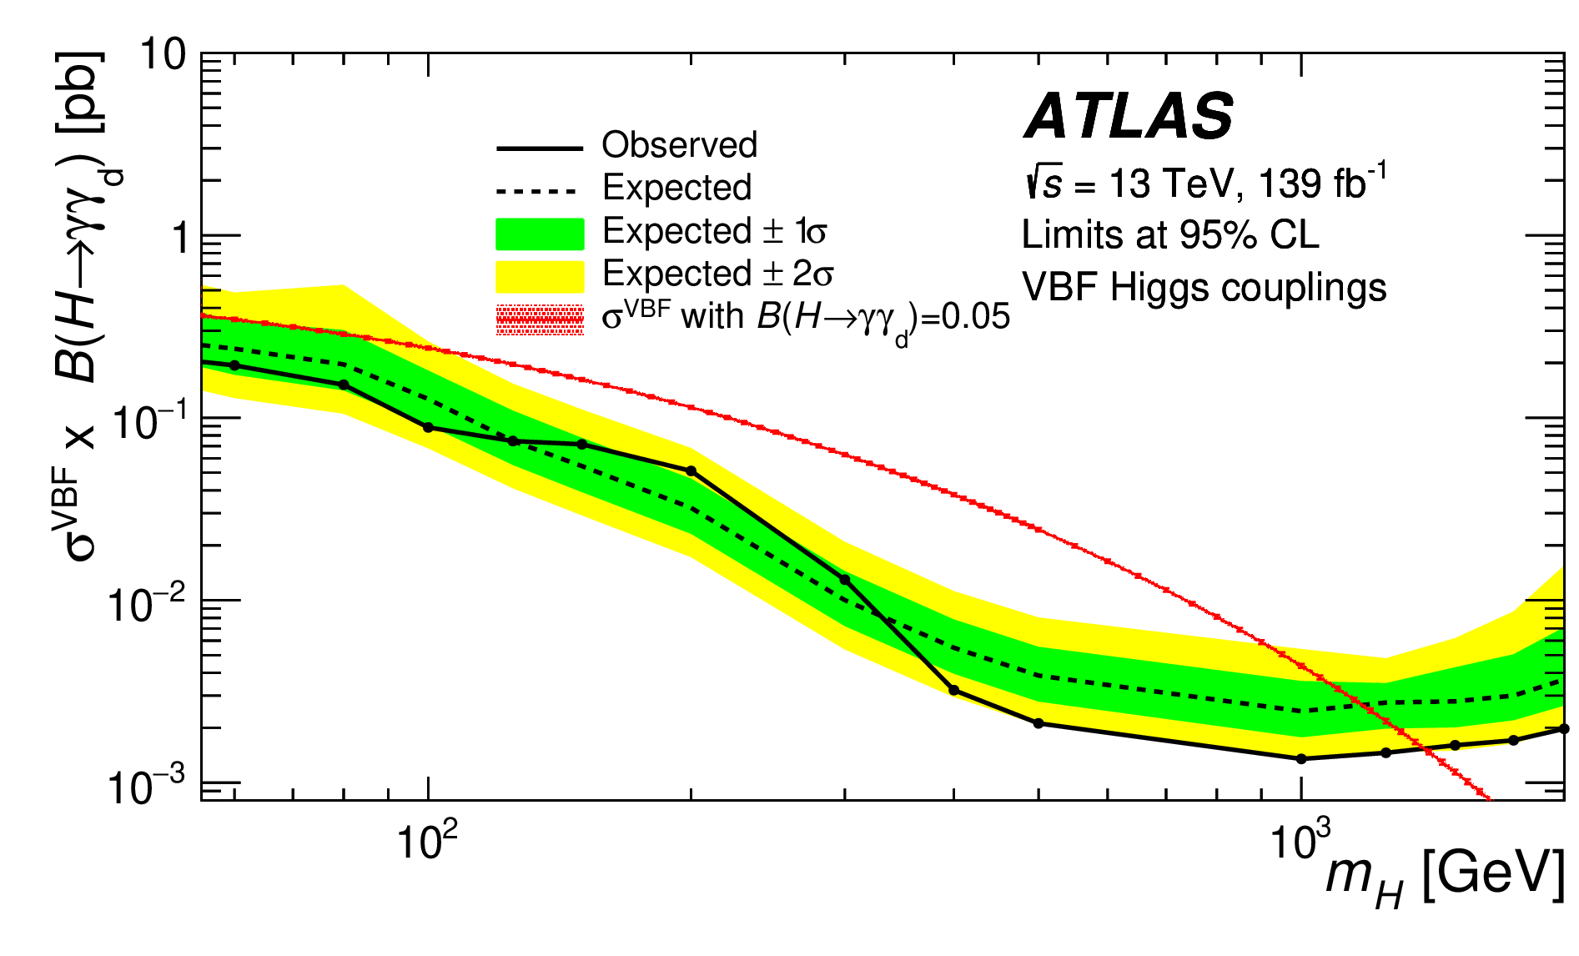
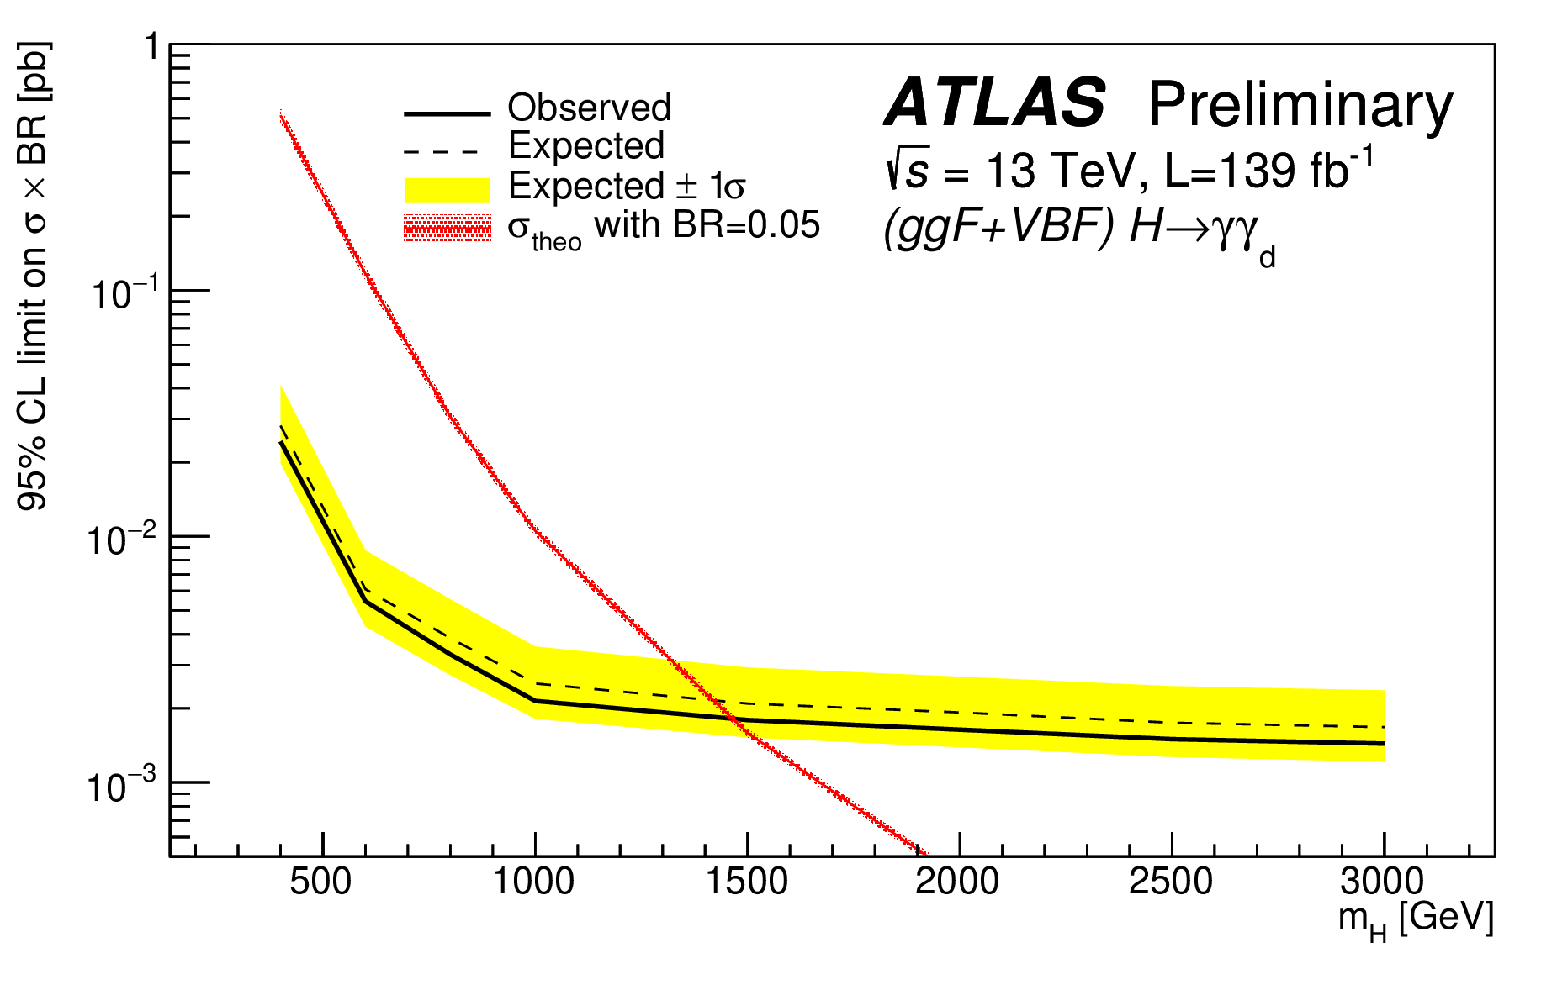
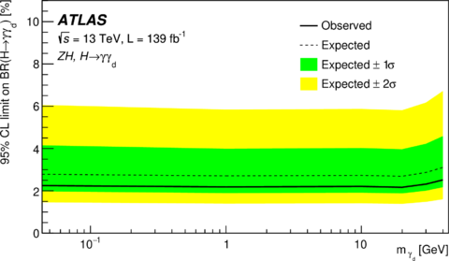
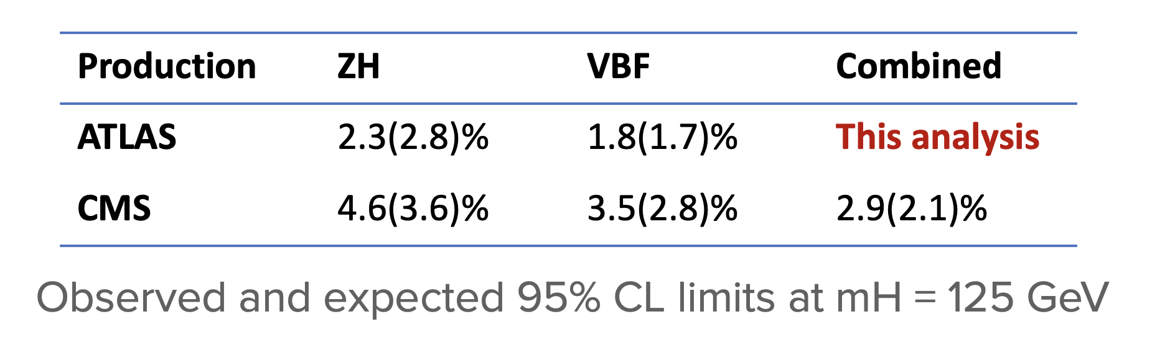
Dark Photons at ATLAS
  ATLAS individual analyses already complete
  Better constraints on decay rate sensitivity than CMS
My project: Work with the ATLAS dark photon combination group to combine the results from different Higgs production modes of the dark photon
  Deriving VBF channel results
  Building systematic correlation scheme
Individual results from ZH, ggF, and VBF

Slide 4
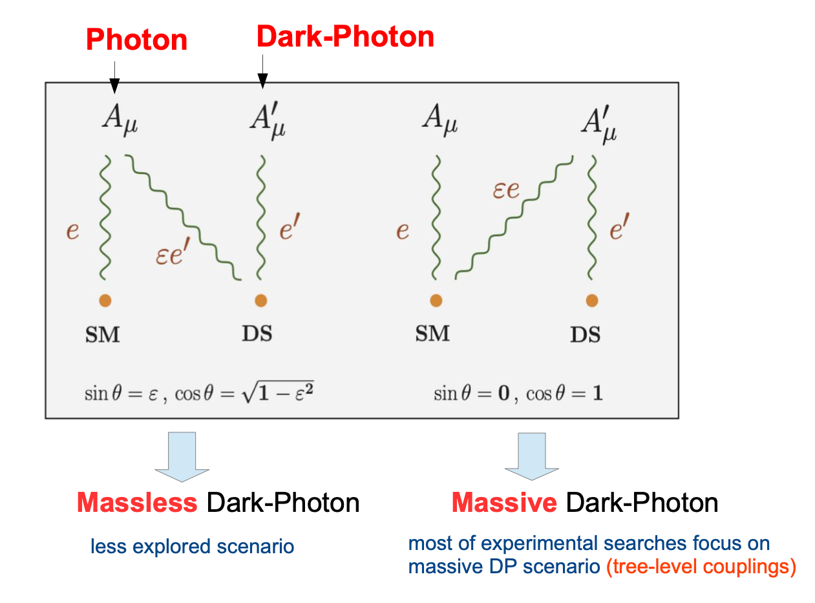
Theoretical Motivation
Dark sector (DS), which feebly interacts with the SM could explain dark matter
Dark photons may interact with both SM and DS
The massless dark photon has been investigated less than the massive dark photon
Two scenarios: either the photon or dark photon can interact with both the SM and DS.

Slide 5
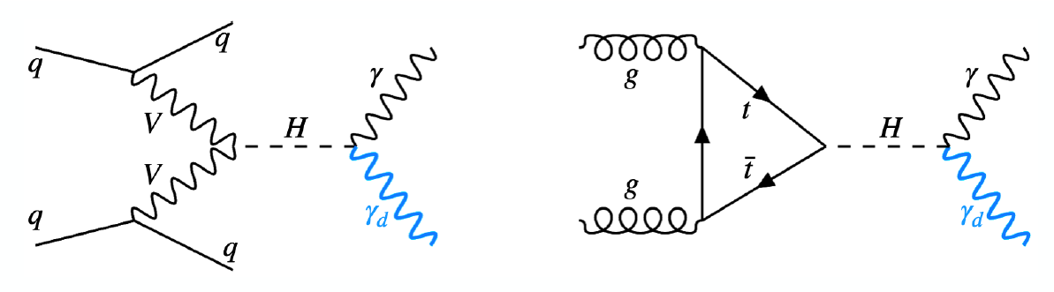
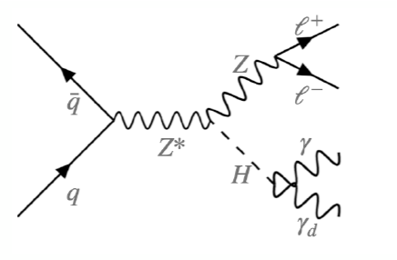
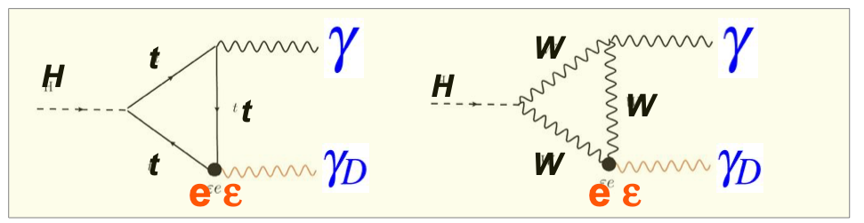
Theoretical Motivation
3 main NP production modes (VBF, ggF, ZH)
Virtual particles (top/W loops) decay to a photon and dark photon
ggF
ZH
VBF

Slide 6
Systematic Impacts Study
Derived the nuisance parameters impacts (background) for different production modes and different masses
ZH: 0 GeV 𝛾_{d} mass
ZH: 1 GeV 𝛾_{d} mass
ZH: 40 GeV 𝛾_{d} mass

Slide 7
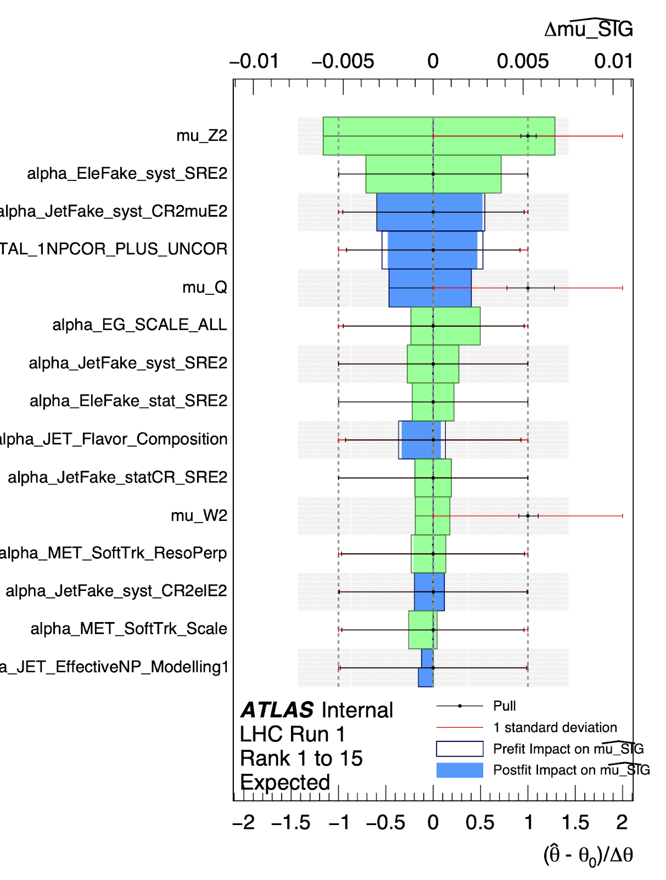
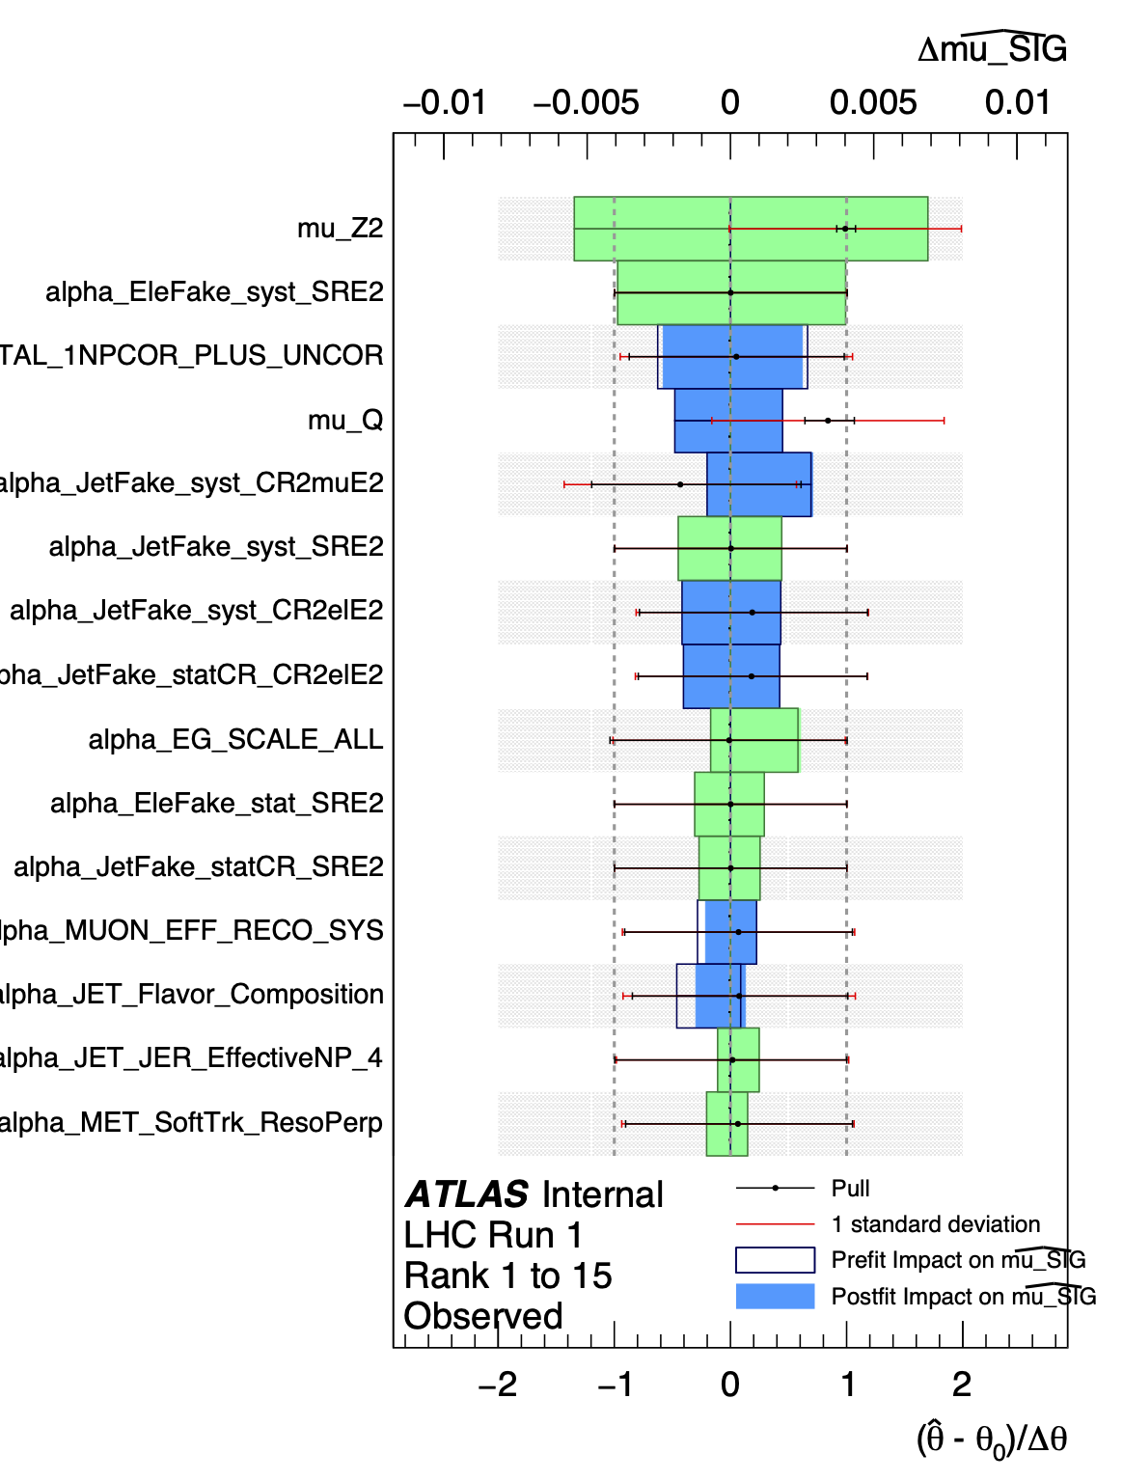
Systematic Impacts Study
ggF: 400 GeV Higgs mass
Both ZH and ggF expected results are very similar to observed
Pulls
Confirmed no NPs had pull issues or were over-constrained
Therefore, NPs can be directly correlated and there is no special concern to be taken when building the correlation scheme
Added my study’s results to the group’s supporting notes
Expected
Observed

Slide 8
Working On…
Deriving VBF channel results
Will be able to repeat systematic impact study for VBF
More impact plots soon!

Slide 9
Summary and To-do
Summary
Derived systematic impacts of ZH and ggF from expected and observed workspaces
Identified leading-impact systematics. Need to properly correlate those from common CP tools
All systematics have healthy pulls/no over-constraining
To-do
Use RECAST to derive VBF input likelihood models
Using results from systematics as references to build the correlation scheme

Slide 10





Pictures

Slide 11
Thanks!

