Slide 1



Tier-1 in GridPP7
Alastair Dewhurst
Notes:
The abstract pattern can be removed or repositioned if required. Be careful to ‘Send to Back’ so that it does not obscure any important information.

Slide 2
GridPP Confluence
Before I start the Tier-1 talk….
Yesterday I convinced the PMB to trial using confluence for GridPP.
  I have purchased 100 licenses for https://gridpp.atlassian.net
Everyone attending the conference should in the next day or so receive an invite from Atlassian to join.
  This is not Spam / Phishing.
  I hope this covers at least one person from all sites and I will provide documentation on how you can invite others who might not be present.
I will arrange a technical meeting to follow up but feel free to experiment.
  You don’t have to use it.
  I will be using it to share capacity planning, hardware and procurement information, which I know others find useful.

Slide 3
GridPP6
GridPP6 has been extremely stressful eventful!
We have completely replaced our tape instance.
  New Tape Robot and all hardware.
  Migration from Castor to Antares.
We have built an entirely new network.
  Upgraded LHCOPN link from 30Gb/s to 200Gb/s
  Joined LHCONE
There was a pandemic!
  We successfully adapted to WFH.
There were supply chain problems.
  We successfully procured hardware using large amounts of opportunistic capital.
We had some long running operational problems (e.g. Vector Reads).

Slide 4
GridPP7 Plan
I don’t have any major projects/changes planned.
  We still need to make many improvements, but I expect they will be smaller incremental changes.
  I hope there will be fewer major global events!
Agenda:
  Future trends
    Storage: HDD vs SSD
    Compute: x86 vs ARM vs GPU
  SC25
  Service Plans

Slide 5
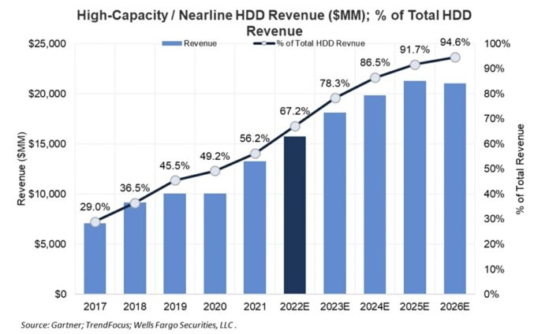
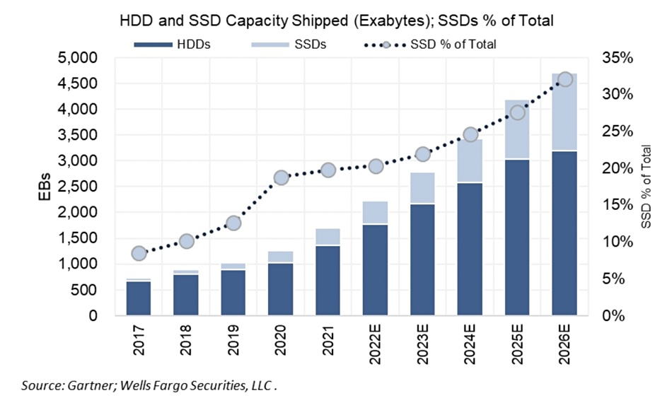
Future Trends: Storage
If/When will SSD beat HDD for cost / TB?
Gartner predicts by 2026
  High-capacity drives will become the vast majority (95%) of HDD sales.
  Worldwide SSD sales will make up 32% of capacity.
Today enterprise SSD costs are still 4 – 6 times more per TB than HDD.
  SSD are more reliable, use less power and have a smaller machine room footprint.
https://blocksandfiles.com/2022/05/16/monday-gartner-hdd-ssd-numberfest/

Slide 6
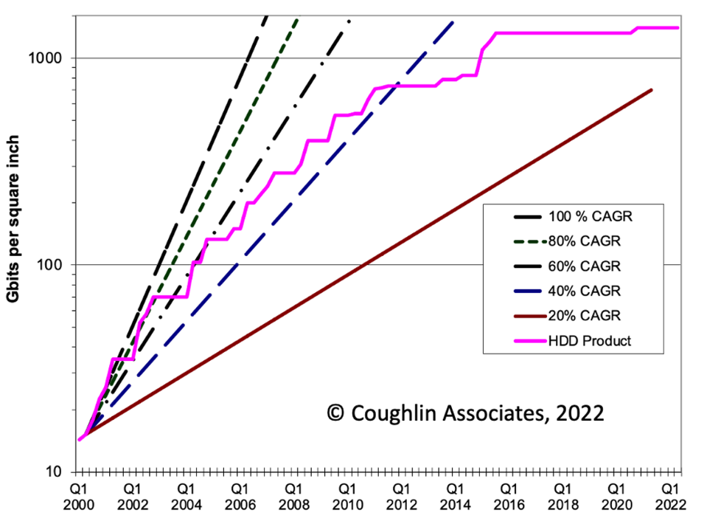
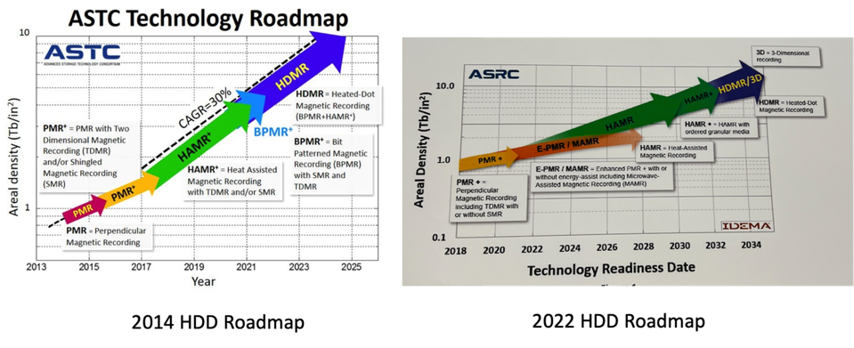
Capacity Growth
HDD capacity growth has been slowing.
This year the Tier-1 will be offered 22TB (maybe 24TB drives).
At the recent Flash Memory Summit Micron, Kioxia and Solidigm all debuted 30TB production SSDs.
Samsung showed off a 256TB NVME
https://www.forbes.com/sites/tomcoughlin/2022/09/18/we-need-a-boost-in-hdd-areal-density/?sh=3a32f6195f63

Slide 7
Tier-1 Storage Plans
HDD
SSD
Tape
I expect to have production SSD endpoints by the end of GridPP7.
Focusing Swift-HEP work on QoS specifically towards SSD.
As HDD become more archival why not just use Tape?

Slide 8
Future Trends: Compute
Industry is adopting a broader range of hardware to solve today’s computing problems.
  LHC software evolves slowly but is beginning to be able to take advantage of this.
The Tier-1 has purchased an Ampere Altra Max test server for delivery in September.
  I plan to order up to 5000 cores this year.
The Tier-1 has access to GPUs in STFC Cloud which it can add to batch farm if necessary.
  GPU innovation was a significant part of GridPP7 bid and overlaps with ATLAS Swift-HEP work.
With Operating Systems potentially diverging, I expect compute to become much more heterogenous.

Slide 9
What is SC2025?
STFC Scientific Computing Department is growing.
  All science needs computing to support it.
  Number of people is expected to double between 2020 – 2025.
Major restructuring is necessary to manage this.
  Also, its an opportunity to do things better.
Note to SCD people: The following slides are not an update on anything you haven’t heard. Some slides may even be slightly out of date. This is to explain things to the wider collaboration.
Most Tier-1 staff are currently in Systems Division split between 3 (of the 4 groups) groups:
  Data Services Group
  Distributed Computing Infrastructure Group
  Research Infrastructure Group

Slide 10
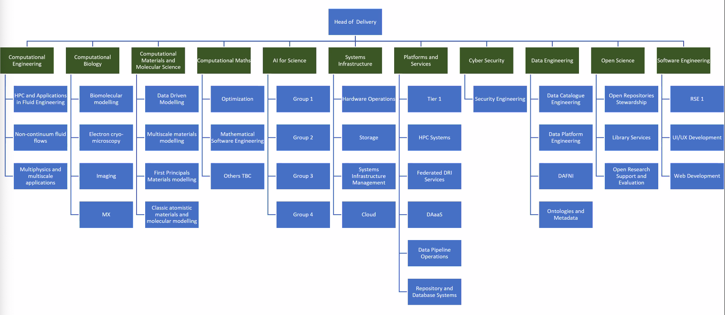
SC2025
This is an early draft of the structure.
Systems division will mostly become

Slide 11
GridPP project
GridPP Tier-1 Project
Federal DRI Services
Antares
Tier-1 Group
Network
Hardware Operations
Ceph
Tier-1 Liaison
Hardware expertise
Monitoring

Slide 12
Tier-1 Group
I anticipate I will be matched to the Tier-1 Group leads role!
I would like to move to a more Dev / Ops structure.
  Maximise development time available for exploiting new opportunities.
The LHC Liaisons belong to PPD, however the LSST Liaison will sit in the Tier-1 Group.
Operations
High Throughput Compute
Liaison
Tier-1 Manager
Data Transfer and Access

Slide 13
Antares
Antares is a new service in GridPP6, so I don’t expect major changes in GridPP7.
Goals for GridPP7:
  Migrate away from Oracle to PostgreSQL.
  Upgrade to EOS (and XRootD) 5.
  Introduce a new generation of Tape drives/media.
On August 23rd IBM announced the release of the new TS1170 drives and associated media.
  This has 50TB capacity (and increase from 20TB from TS1160).
  This was delayed by ~6 months due to last minute technical problems.
The Tape market is relatively small and while there are demonstrations of very high capacity tapes, newer generations are taking an increasing time to get to market.

Slide 14
Echo and XRootD
During GridPP6 we have separated the management of the Ceph backend and the XRootD frontends.
We have invested heavily in building our XRootD expertise.
  This has been a great success in fixing problems and for GridPP7 we want to be developing new features.
  I am trying to arrange next years XRootD workshop to be at Cosener’s in September 2024.
We will also need to test, optimize and deploy XRootD gateways utilizing 100Gb/s links.
The Ceph backend needs several major software upgrades and we may look into multiple Ceph instances using XRootD redirection to continue to appear as single service.

Slide 15
Batch Farm
HTCondor and ARC CEs continue to perform very well for the Tier-1.
  The utilization of the resources very impressive when compared to other science areas.
The most frequent operational problem is with VOs not always receiving their desired fairshare.
  This problem will become more complex as we add different architectures.
I feel that the amount of security patching / bug fixing is increasing.
  Once again is likely to increase further if we have more OS and different hardware.

Slide 16
Services
The Tier-1 / RAL will continue to provide a range of additional service during GridPP7
  These receive a mix of funding from GridPP and other sources.
CVMFS Stratum 0/1
FTS
  During GridPP6 LHC VOs consolidated FTS usage at CERN
Rucio
APEL
GOCDB

Slide 17
And finally…
You may have heard James Walder is leaving as the ATLAS Liaison.
  He will be working for UK SRC.
  A replacement ATLAS Liaison role is being advertised: https://www.careersportal.co.uk/UKRI-careers/jobs/research-software-engineer-atlas-tier-1-liaison-3498
A very similar worded role but for LSST should be advertised imminently.
There will also be plenty of roles being advertised as part of SC2025 which will be on our jobs board: https://careersportal.co.uk/UKRI-careers/jobs/search/1247917
SCD has a very flexible policy on remote working for many roles.

Slide 18



Notes:
The abstract pattern can be removed or repositioned if required. Be careful to ‘Send to Back’ so that it does not obscure any important information.

