Slide 1




GridPP Security
David Crooks
david.crooks@stfc.ac.uk
GridPP 50, August 2023, Ambleside
Notes:
The abstract pattern can be removed or repositioned if required. Be careful to ‘Send to Back’ so that it does not obscure any important information.

Slide 2
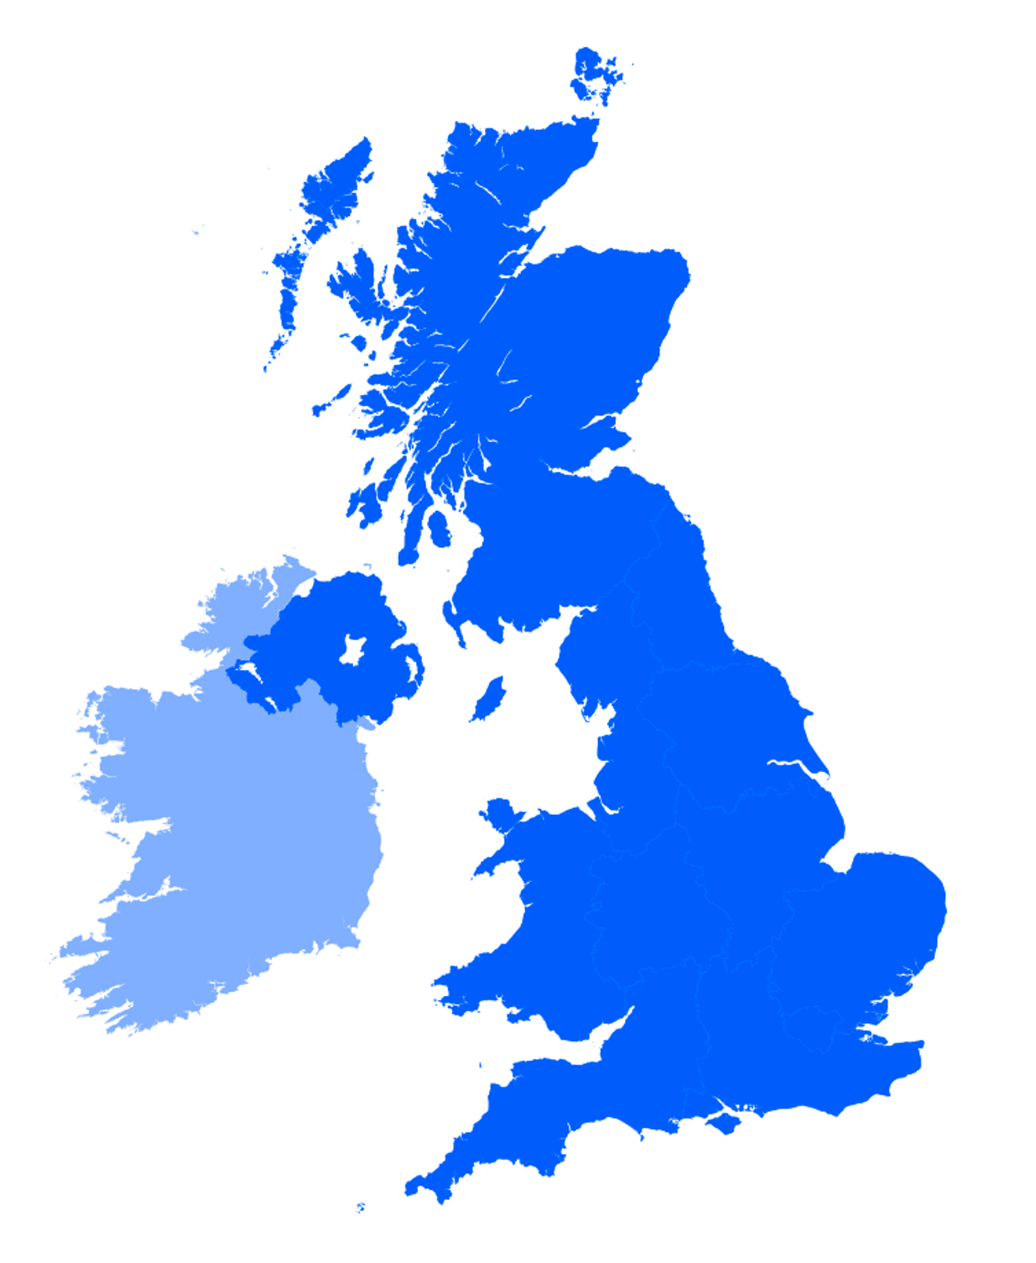
Framework approach
Keen to use a common approach of describing elements of cybersecurity development
Broadly maps (by design) to Cyber Assessment Framework/NIST Cybersecurity/etc.
  Risk Management/Identify
  Protection/Prevention
  Detection
  Recovery and Response
Help structured development across these areas
GridPP 50, August 2023, Ambleside
Notes:
Replace this guidance text with your own bullet pointed content.
For further guidance please see https://www.bdadyslexia.org.uk/advice/employers/creating-a-dyslexia-friendly-workplace/dyslexia-friendly-style-guide

Slide 3
GridPP/IRIS
GridPP 50, August 2023, Ambleside
Notes:
Replace this guidance text with your own bullet pointed content.
For further guidance please see https://www.bdadyslexia.org.uk/advice/employers/creating-a-dyslexia-friendly-workplace/dyslexia-friendly-style-guide

Slide 4

PROTECTION/PREVENTION
Software vulnerabilities
22 Vulnerabilities reported since GridPP49
14 advisories sent
  4 Critical Risk
  6 High Risk
  1 Moderate
  3 Alert
New SVG advisory template
  Shorter and easier to read
  Plan to start using as of 4th September
https://advisories.egi.eu
GridPP 50, August 2023, Ambleside
Notes:
Replace this guidance text with your own bullet pointed content.
For further guidance please see https://www.bdadyslexia.org.uk/advice/employers/creating-a-dyslexia-friendly-workplace/dyslexia-friendly-style-guide

Slide 5
PROTECTION/PREVENTION
Trust and Identity
Matt Doidge chairing revived Token Trust and Traceability WG
  First scope-setting meeting in the books, next one planned for early September
  Bringing together experts from token workflow development, operations and operational security
  There is much to do in relation to use of tokens and updated policies/trust etc, so this is very encouraging
Broader environment
  WISE is working on updating AARC PDK policy templates
  The first in-person WISE Community meeting post-pandemic will happen in October as part of the NSF Cybersecurity Summit
GridPP 50, August 2023, Ambleside
Notes:
Replace this guidance text with your own bullet pointed content.
For further guidance please see https://www.bdadyslexia.org.uk/advice/employers/creating-a-dyslexia-friendly-workplace/dyslexia-friendly-style-guide

Slide 6
PROTECTION/PREVENTION
IRIS/GridPP Security Team update
RESPONSE & RECOVERY
Matt has joined EGI CSIRT Incident Response Team
  Making really valuable contribution
Onboarding new security officer member from Cambridge very soon
IRIS Security Confluence space now in place
  Migration of existing materials into one area
GridPP 50, August 2023, Ambleside
Notes:
Replace this guidance text with your own bullet pointed content.
For further guidance please see https://www.bdadyslexia.org.uk/advice/employers/creating-a-dyslexia-friendly-workplace/dyslexia-friendly-style-guide

Slide 7
PROTECTION/PREVENTION
Training
RESPONSE & RECOVERY
Security thematic CERN School of Computing confirmed as taking place 8-14 October in Split
  Successful applicants being informed
  Some changes to the tutor line-up
    Tom Dack joining as the AAI lecturer
  Final tweaks being made to the school timetable
Key parts, particularly of hands-on exercises, planned to be brought back to the UK
GridPP 50, August 2023, Ambleside
Notes:
Replace this guidance text with your own bullet pointed content.
For further guidance please see https://www.bdadyslexia.org.uk/advice/employers/creating-a-dyslexia-friendly-workplace/dyslexia-friendly-style-guide

Slide 8
RESPONSE & RECOVERY
EGI CSIRT SSC Update
Extended reporting period hopefully coming to an end soon
  Extensive final report detailing the many moving parts
  Executive summary giving high level picture of the exercise (in preparation)
Some immediate red team lessons learned
  Reporting period too long
  Need to build into next exercise
Note Katy’s contribution to making the exercise successful
Talk at the Internet2 Technical Exchange in Minneapolis in September
  Should be available afterwards
GridPP 50, August 2023, Ambleside
Notes:
Replace this guidance text with your own bullet pointed content.
For further guidance please see https://www.bdadyslexia.org.uk/advice/employers/creating-a-dyslexia-friendly-workplace/dyslexia-friendly-style-guide

Slide 9
PROTECTION/PREVENTION
DETECTION
Site Security Survey
RESPONSE & RECOVERY
More on this in Matt’s talk on Friday
Extremely useful feedback across the board
  Thank you to everyone that responded!
Useful in making plans for the next year
  At the site, security team and project/infrastructure level
GridPP 50, August 2023, Ambleside
Notes:
Replace this guidance text with your own bullet pointed content.
For further guidance please see https://www.bdadyslexia.org.uk/advice/employers/creating-a-dyslexia-friendly-workplace/dyslexia-friendly-style-guide

Slide 10
DRI Cybersecurity
GridPP 50, August 2023, Ambleside
Notes:
Replace this guidance text with your own bullet pointed content.
For further guidance please see https://www.bdadyslexia.org.uk/advice/employers/creating-a-dyslexia-friendly-workplace/dyslexia-friendly-style-guide

Slide 11
DRI Cybersecurity update
Initial DRI Cybersecurity Workshop kick-off hosted by Jisc in London in July
At this meeting, representation (directly or by proxy) from
  Jisc
  STFC (UKRI)
  DRI Committee (cross-council oversight group)
  Research Infrastructures: SKA(O)/WLCG/GridPP/IRIS
  Trusted Research Environments
GridPP 50, August 2023, Ambleside
Notes:
Replace this guidance text with your own bullet pointed content.
For further guidance please see https://www.bdadyslexia.org.uk/advice/employers/creating-a-dyslexia-friendly-workplace/dyslexia-friendly-style-guide

Slide 12
DRAFT
DRI Cybersecurity pillars
Development of cybersecurity capabilities as a DRI community
  Threat intelligence is a core element alongside incident response
Development of cybersecurity culture across our constituent organisations
Establishment of strong links with our (inter)national cybersecurity partners
Development and maintenance of core skills within DRI community
  General outreach (users)
  Infrastructure (shared and agreed best practice for operations across)
  Specialist skills (cybersecurity professionals)
GridPP 50, August 2023, Ambleside
Notes:
Replace this guidance text with your own bullet pointed content.
For further guidance please see https://www.bdadyslexia.org.uk/advice/employers/creating-a-dyslexia-friendly-workplace/dyslexia-friendly-style-guide

Slide 13
DRAFT
DRI Cybersecurity core activities: strategy
Risk management + threat landscape intelligence
Cultural changes (outreach, best practice)
Policy
  Standards (external and internal)
  Best practice
  Compliance needs
  Elements required for federated context
    Ensuring that local and federated requirements mesh
GridPP 50, August 2023, Ambleside
Notes:
Replace this guidance text with your own bullet pointed content.
For further guidance please see https://www.bdadyslexia.org.uk/advice/employers/creating-a-dyslexia-friendly-workplace/dyslexia-friendly-style-guide

Slide 14
DRAFT
DRI Cybersecurity core activities: operations
Threat intelligence (real time monitoring, analysis and actionable delivery)
Supply chain management
  What does this mean at the DRI level
Active Monitoring
  Proactive (intelligence)
  Reactive (supporting response)
Cyber incident response
  What coordination work is needed at DRI level
Direct liaison with Identity Management activities
GridPP 50, August 2023, Ambleside
Notes:
Replace this guidance text with your own bullet pointed content.
For further guidance please see https://www.bdadyslexia.org.uk/advice/employers/creating-a-dyslexia-friendly-workplace/dyslexia-friendly-style-guide

Slide 15
DRI Cybersecurity next steps
Planning for early adopter funding this FY now very urgent
  Currently my highest priority
Next DRI Cybersecurity Workshop planned for later in the year
  Focused on these pillars and core activities
  James Acris from SCD Operational Security team working on coordination for this event
  Once workshop outline is in place, that will be time to promote to organisational cybersecurity leadership to encourage attendance
GridPP 50, August 2023, Ambleside
Notes:
Replace this guidance text with your own bullet pointed content.
For further guidance please see https://www.bdadyslexia.org.uk/advice/employers/creating-a-dyslexia-friendly-workplace/dyslexia-friendly-style-guide

Slide 16
SOC Working Group
GridPP 50, August 2023, Ambleside
Notes:
Replace this guidance text with your own bullet pointed content.
For further guidance please see https://www.bdadyslexia.org.uk/advice/employers/creating-a-dyslexia-friendly-workplace/dyslexia-friendly-style-guide

Slide 17
SOC Hackathon
Very successful 4.5 days in Cosener’s
  3.5 days of technical work
17 people in person representing
    GridPP (Durham)
    Jisc
    US ATLAS (Michigan + Chicago)
    Fermilab
    CERN
    STFC
    Politehnica University of Bucharest
Included others online including STFC and Bristol
GridPP 50, August 2023, Ambleside
Notes:
Replace this guidance text with your own bullet pointed content.
For further guidance please see https://www.bdadyslexia.org.uk/advice/employers/creating-a-dyslexia-friendly-workplace/dyslexia-friendly-style-guide

Slide 18
SOC Hackathon outcomes
Focus on documentation and revitalising the group
  Enabling sustained development
Renewed focus on documentation area
  Expect this to iterate quickly
  Lots to do so value any cycles people would like to contribute!
CERN Koji build system now being used to build Zeek network monitor for RHEL9
New Jisc CTI GitHub area with containerised MISP deployment method
  Automatically builds new image for Dockerhub when new MISP version released
GridPP 50, August 2023, Ambleside
Notes:
Replace this guidance text with your own bullet pointed content.
For further guidance please see https://www.bdadyslexia.org.uk/advice/employers/creating-a-dyslexia-friendly-workplace/dyslexia-friendly-style-guide

Slide 19
DRAFT
SOC Reference Design v2 [1]
New draft SOC Reference Design v2
  Increased focus on abstracting out technical elements of SOC design alongside suggesting tools and topologies
Use to illustrate different SOC models scaling from instances with almost no resource to sustained full-scale SOC development
    Lightweight
    Essential
    Maturing
GridPP 50, August 2023, Ambleside
Notes:
Replace this guidance text with your own bullet pointed content.
For further guidance please see https://www.bdadyslexia.org.uk/advice/employers/creating-a-dyslexia-friendly-workplace/dyslexia-friendly-style-guide

Slide 20
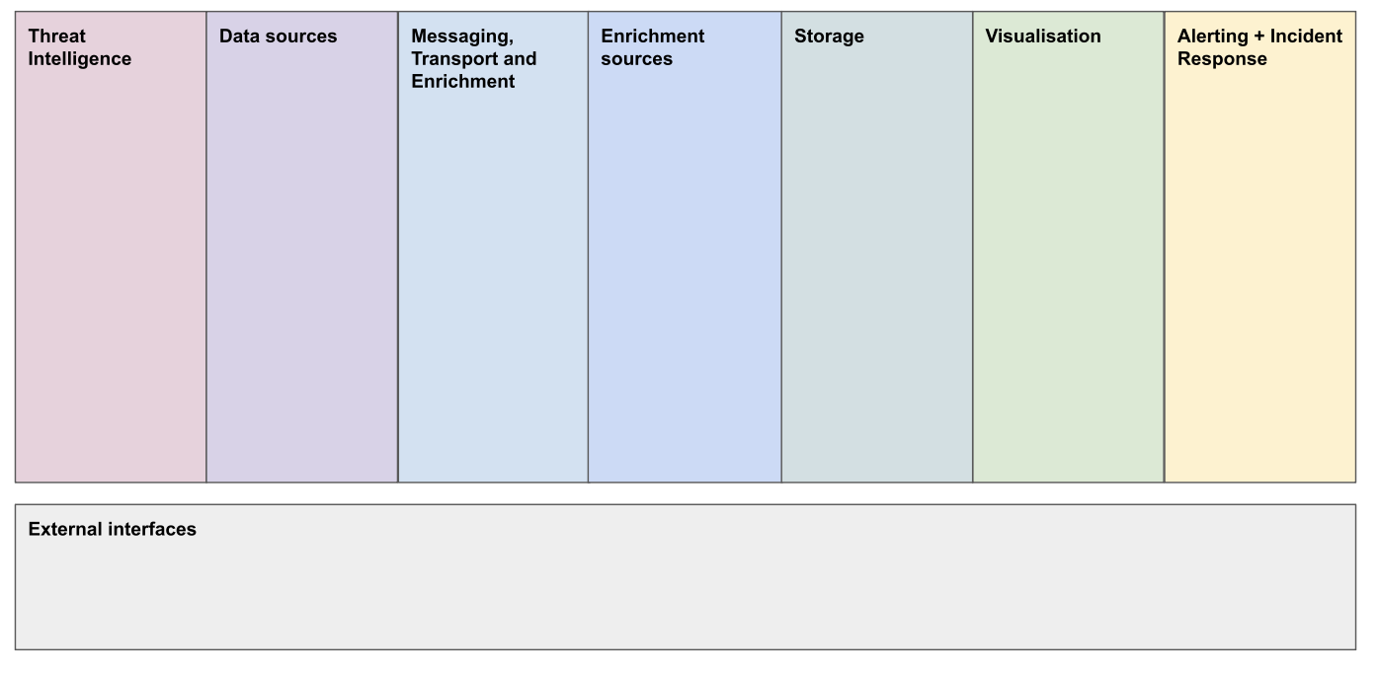
DRAFT
SOC Reference Design v2 [2]
GridPP 50, August 2023, Ambleside
Notes:
Replace this guidance text with your own bullet pointed content.
For further guidance please see https://www.bdadyslexia.org.uk/advice/employers/creating-a-dyslexia-friendly-workplace/dyslexia-friendly-style-guide

Slide 21
Looking forward
GridPP 50, August 2023, Ambleside
Notes:
Replace this guidance text with your own bullet pointed content.
For further guidance please see https://www.bdadyslexia.org.uk/advice/employers/creating-a-dyslexia-friendly-workplace/dyslexia-friendly-style-guide

Slide 22
Moving into the future
How do we best support
  GridPP at a project/infrastructure level?
  GridPP sites with constrained resources?
  larger GridPP sites?
GridPP 50, August 2023, Ambleside
Notes:
Replace this guidance text with your own bullet pointed content.
For further guidance please see https://www.bdadyslexia.org.uk/advice/employers/creating-a-dyslexia-friendly-workplace/dyslexia-friendly-style-guide

Slide 23


Conclusion
Landscape and high priority of cybersecurity remain the same
Full-scale DRI Cybersecurity workshop planned for later this year with priority early-adopter planning
Need structured development across cybersecurity elements
Focus on planning towards next 12 months
Photo by FLY:D on Unsplash
GridPP 50, August 2023, Ambleside
Notes:
Replace this guidance text with your own bullet pointed content.
For further guidance please see https://www.bdadyslexia.org.uk/advice/employers/creating-a-dyslexia-friendly-workplace/dyslexia-friendly-style-guide

Slide 24



Notes:
The abstract pattern can be removed or repositioned if required. Be careful to ‘Send to Back’ so that it does not obscure any important information.

Slide 25
Backup Slides
GridPP 50, August 2023, Ambleside
Notes:
Replace this guidance text with your own bullet pointed content.
For further guidance please see https://www.bdadyslexia.org.uk/advice/employers/creating-a-dyslexia-friendly-workplace/dyslexia-friendly-style-guide

Slide 26
TLP shorthand summary
TLP: RED | Do not share without additional consent beyond immediate meeting or discussion
TLP: AMBER | Share only as needed with security personnel following sharing rules
TLP: GREEN | Can be shared in community, do not share publicly
TLP: CLEAR | No sharing restrictions
GridPP 50, August 2023, Ambleside
Notes:
Replace this guidance text with your own bullet pointed content.
For further guidance please see https://www.bdadyslexia.org.uk/advice/employers/creating-a-dyslexia-friendly-workplace/dyslexia-friendly-style-guide

