Slide 1
Insights from the 2023 GridPP Site Security Survey
IRIS Security Team
GridPP50
1st September 2023

Slide 2
Context, Thanks, a little disclaimer
The aim of the survey was to give us a starting point and initial direction for future efforts on the cybersecurity front.
  A combination of finding out the "State of the Union" & getting site's thoughts on what they need.
  Will allow us to form plans for sites, as a whole and individually.
Thanks to everyone for taking time filling in the survey.
We're happy to report there were no big red flags, no reasons to panic.
Digesting these results is still a work in progress.
There will be no naming and shaming (and there's no shame to name), and we intend to keep results anonymous.

Slide 3
20 Questions.
Site Name
Your Name
E-mail
How is Security Managed at your site? (tick)
Expand if you ticked Other above
Describe how responsibilities are divided.
What Primary Security Controls to you have at your site?
Please expand with details.
Describe your process for reviewing vulnerabilities, including frequency.
Do you have an incident response plan?
What is your incident response plan based on? Please give details.
When was your incident reponse plan last reviewed?
If you plan to deploy additional security controls and/or monitoring please give details.
Are you aware of any institutional or organisational plans which will impact your security?
In your view are there any opportunities for the improvement of security at your site?
Do you have any comments related to security concerning your site or institution?
Are there any security issues you'd like to discuss in the wider community?
What would you like from the GridPP Security Team?
Is there anything we can do to improve this survey.
Anything not already covered?
Basic Info
Management
Controls and Response
Future Look
Community and Sec Team
Survey feedback

Slide 4
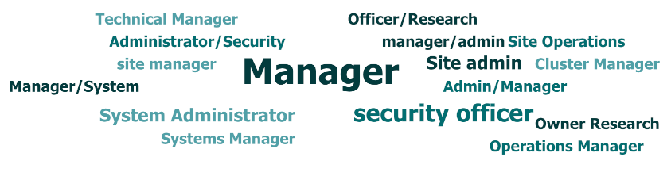
The Basics all looked good.
What is your name? What is your site? What is your quest...
Nothing exciting here – but that's a good thing.

Slide 5
Current Security Management
All but one site mentioned an Institute Sec Team they worked alongside with.
  Good to see.
  Relationships seem encouragingly cordial.
  Conversely only one site mentioned an intermediate "departmental" team.
Theme of everyone stretched thin.
Institute Teams tended to provide services such as external vulnerability scanning.

Slide 6
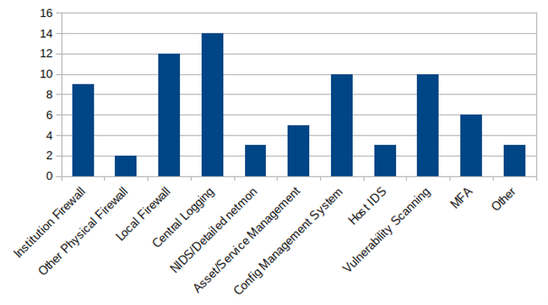
Current Security Controls

Slide 7
The take home from that chart?
Everyone has the basics covered (some kind of firewall + some kind of central logging).
Wide take up of best practices.
Some form of vulnerability scanning is available to many.
MFA on the rise, with some sites wondering how to incorporate it into ssh.
But most importantly, no cause for alarm.

Slide 8
Incident Response Plan
Most sites had an incident response plan
  For a lot this was just straight to the EGI SEC01
A few sites who replied No said "we'd just use SEC01", so only 2 "true negatives".
One mention of NIST, one of a standalone institute plan.
Not many sites regularly reviewed their incident response plan.
Outcome:
EGI SEC01 is our "official" incident response plan (template), and has been for a while. But this message seems to have faded over time.
  So we need to re-spread the message.

Slide 9
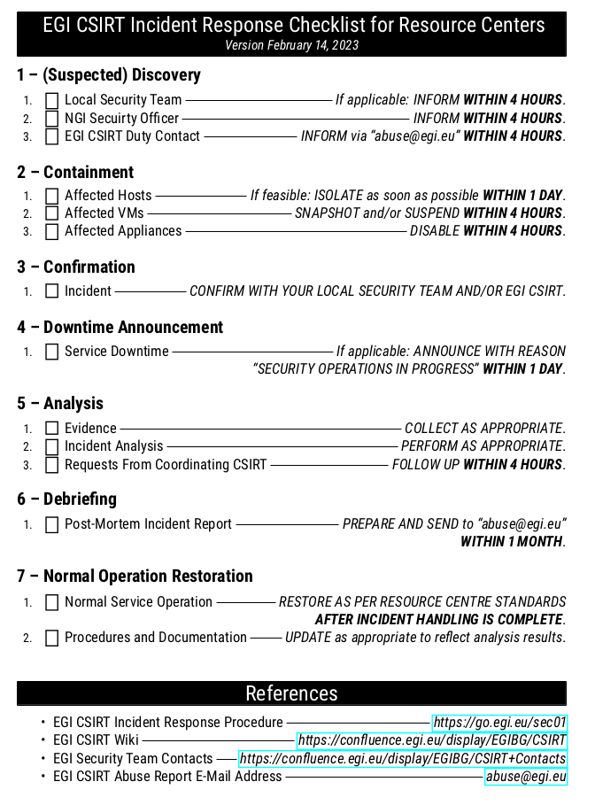
SEC01 - A Reminder
https://go.egi.eu/sec01
The checklist needs to be supplemented with your own list of local contacts.
All this information should also be available in a hardcopy format accessible to all team members.
  "In case of emergency"
All steps should be done alongside any department or institute ("local") requirements or guidance.
  "as appropriate"

Slide 10
Vulnerability Awareness and Handling
Many sites lean on the EGI SVG announcements for vulnerability awareness.
  Use of auto-updates on a number of sites to preempt issues.
    Not everyone can easily switch auto-update on though.
Regular scans using a varied suite of tools have become widespread
  Usually by the Insitute team, occasionally by a contracted third party.
  Spread in the frequency – from monthly to biannually.
Is there some way the UK Team can help in this area?
  For example, a UK pakiti instance with a scope for services beyond just the Worker Nodes.

Slide 11
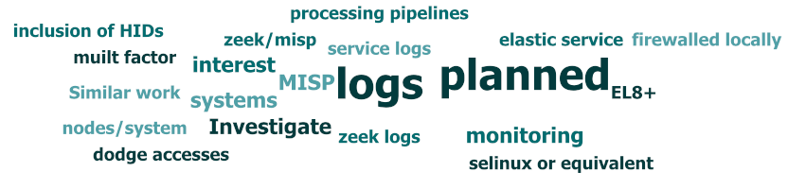
Tools being used
Pattern of "Homogeneity at the Core" of Security Ops
  Firewalld/iptables, rsyslog.
  Loki is increasing in use. One mention of FluentD.
Sense that a lot of sites are still keeping SELinux switched off, but would like to change this.
Tool "variance increases at the edges" – especially with external services (scanning, IDS)
  Scanning tools mentioned include Nessus, Rapid7, Greenbone, Appcheck, Cisco Secure Endpoint.
  Network Monitoring via LibreNMS, Shodan
    At this point I'm just listing keywords to throw into a search engine.

Slide 12
Site's Future Plans (and concerns)
A few sites had no plans.
Person power was often cited as a concern
  Sometimes a reason for no further plans.
  Extra security controls were often viewed as to not provide benefits comparable to the costs.
MFA integration has the potential to be something sites will have to engage in.
Only one mention of Cyber Security Essential certification.
A sense of foreboding that some possible future, possibly misinformed, security clampdown could come from "on high".

Slide 13
What sites would like from the Sec Team
Documentation – from simple guidance, how-tos to full white-papers.
Training – following on from the above
  A common theme was mentioning how the recent SSC showed holes in site's knowledge base, especially with tracing a job's life cycle.
Some responses were positive, with no suggestions of anything extra they'd like from the security team.
  Reassuring, but we agree there's room for improvement.
Need to balance expectations with what can be delivered.

Slide 14
The survey wasn't perfect
The platform had it's drawbacks – but it used what we had to hand.
  Not being able to "save and go back" was a pain for sites.
    Also a pain for us – we couldn't "ask for clarification".
In hindsight we were a little too broad in scope with many of the questions
  Useful feedback to that affect.
  Broadness is a natural side effect of this being a first survey.
  Future efforts will be more targeted
    Will be easier for us to digest too.
    A possible example would be a "Training Requirement" questionnaire.

Slide 15
Actions
Direct Follow Ups with sites.
Incident Response Plan
  SEC01 is our official incident response plan, need to raise awareness of this.
  Sites need to know their own contact points/local procedures too.
Best Practice Documentation
  Currently Linda has been cleaning up our existing wiki entries.
  Where to put our docs in the future?
    Determine the scope for the documentation.
  EGI IRTF have been having their own documentation drive.
    Coordinate efforts in this area.
    Need to advertise these once they're finished.
Training
  Job Tracing/Forensics
  Best Practice
  Need to survey (…) if there are any other training topics that sites would like to be covered.
  This will go to form an evolving syllabus.
    Training and Documentation feeding back into each other.

Slide 16

Thoughts?
Anything you'd like to add now?

