Slide 1


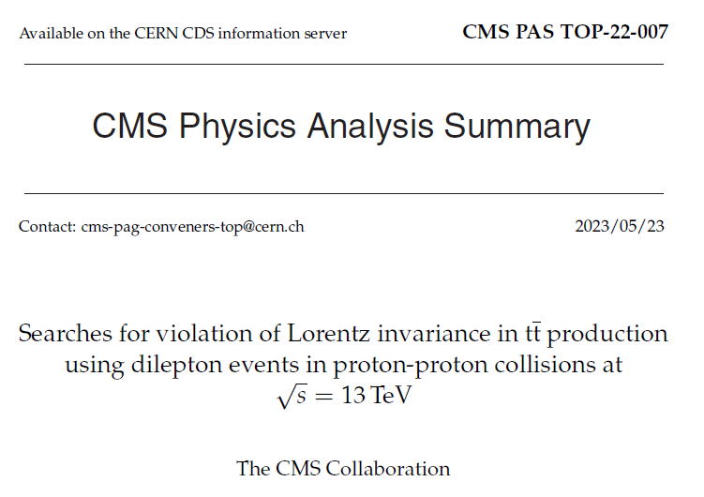
Arshin Khaje Borj Sefidi
June 2023

Slide 2
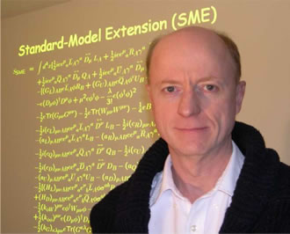
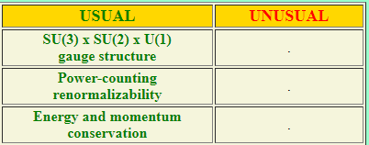
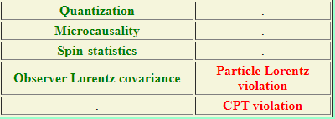
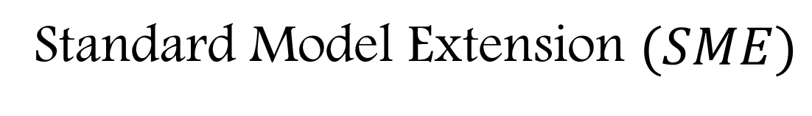
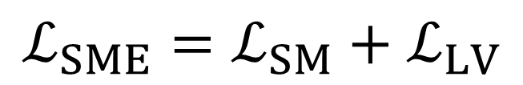
Standard Model Extension $(SME)$
$$ℒ_{SME}=ℒ_{SM}+ℒ_{LV}$$
https://lorentz.sitehost.iu.edu/kostelecky/faq.html

Slide 3

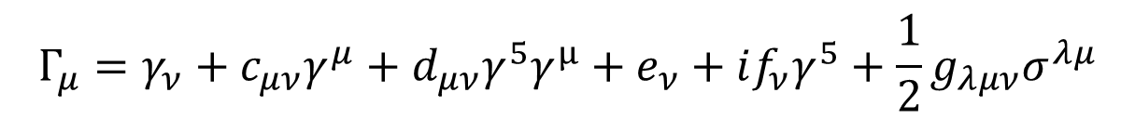

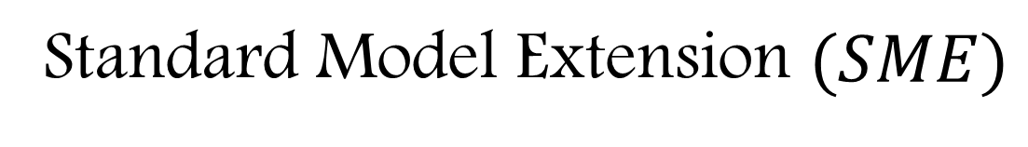
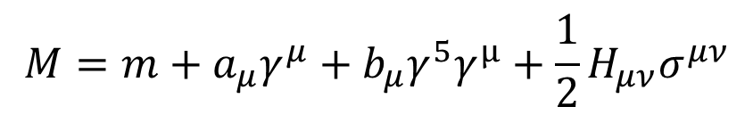
Standard Model Extension $(SME)$
$$ℒ=\overline{ψ}\left(iΓ_{ν}∂^{ν}−M\right)ψ$$
$$Γ_{μ}=γ_{ν}+c_{μν}γ^{μ}+d_{μν}γ^{5}γ^{μ}+e_{ν}+if_{ν}γ^{5}+\frac{1}{2}g_{λμν}σ^{λμ}$$
$$M=m+a_{μ}γ^{μ}+b_{μ}γ^{5}γ^{μ}+\frac{1}{2}H_{μν}σ^{μν}$$
Colladay, D. and Kostelecký, V. A., “CPT violation and the standard model,” Physical Review D, vol. 55, no. 11, pp. 6760, 1997.

Slide 4
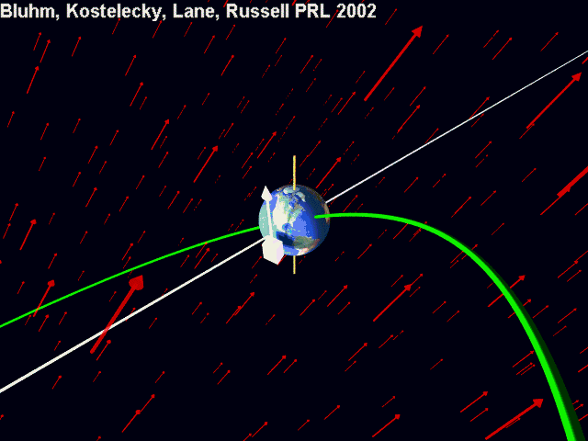
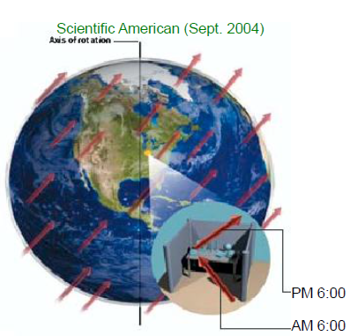
Bluhm, Kostelecky, Lane, Rassel 2002

Slide 5
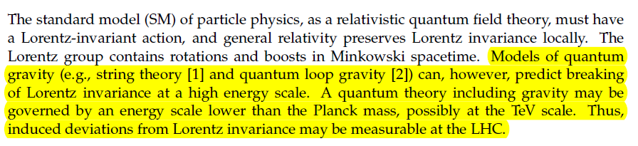
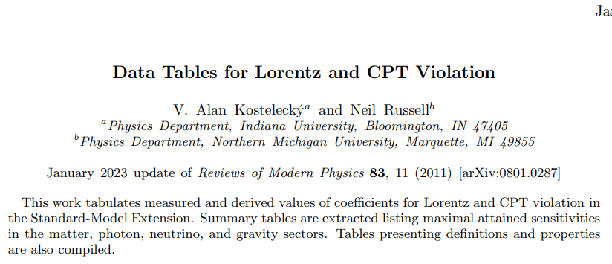
Motivation

Slide 6
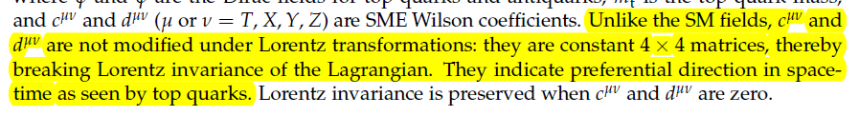


Slide 7
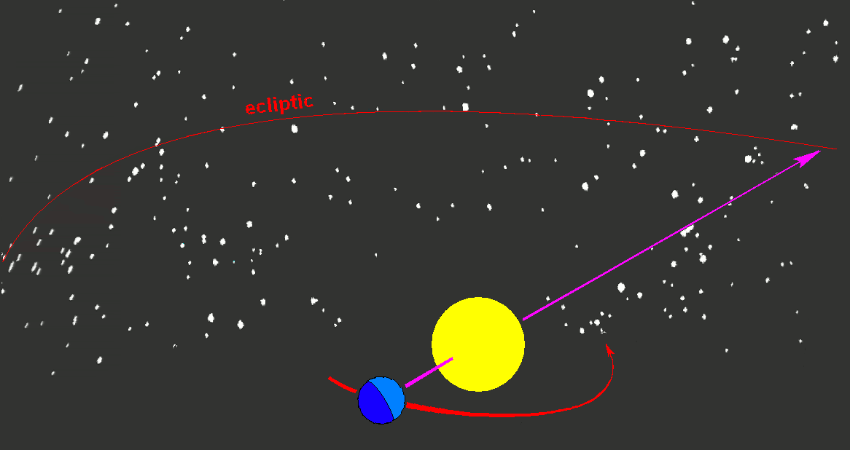
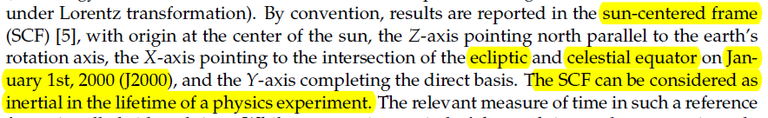
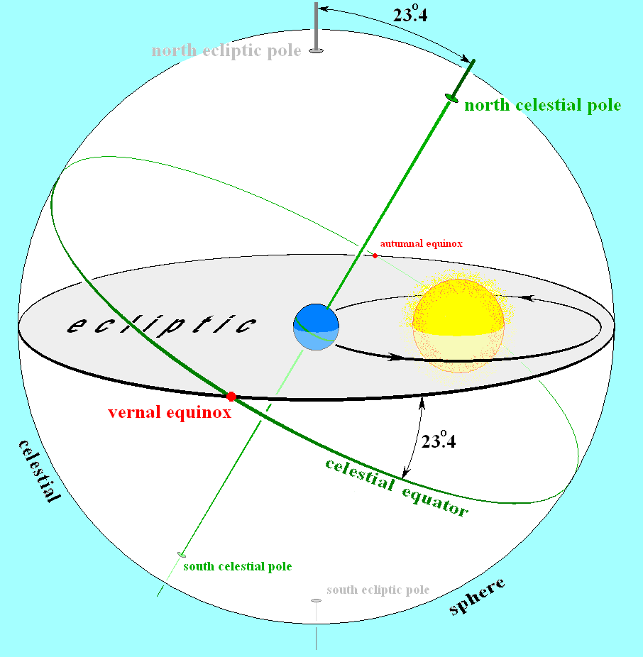
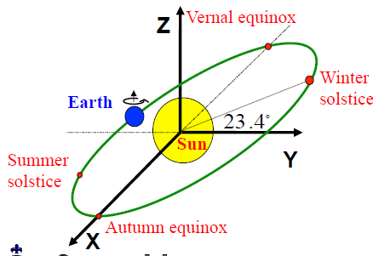
Sun-Centered Frame (SCF)
Wikipedia

Slide 8
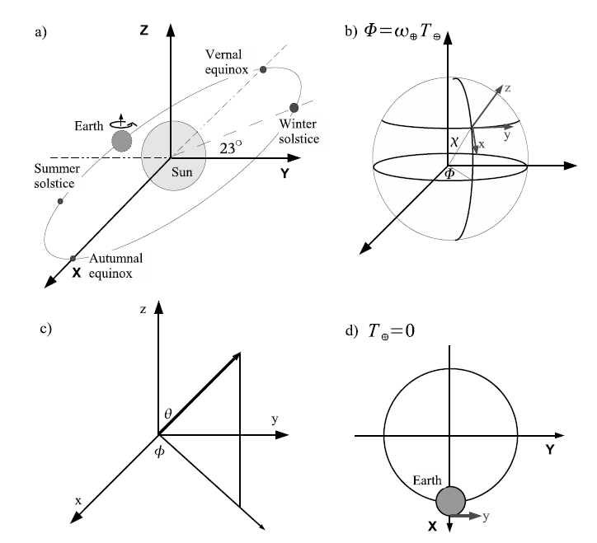
Sun-Centered Frame (SCF)
Katori, T., “Tests of Lorentz and CPT violation with MiniBooNE neutrino oscillation excesses,” Modern Physics Letters A, vol. 27, no. 25, 2012.

Slide 9
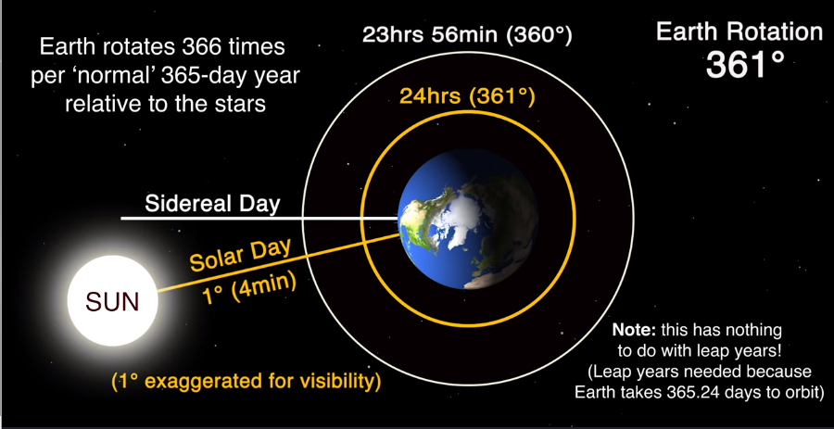
Sidereal time and solar time
Wikipedia

Slide 10



Signal and background
Main background
Single top
tW
background
$$t\overline{t}+X$$
$$t\overline{t}W+t\overline{t}Z$$
Diboson
WW,WZ,ZZ
W/Z+jets

Slide 11
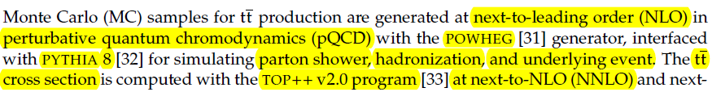
Simulation samples

Slide 12
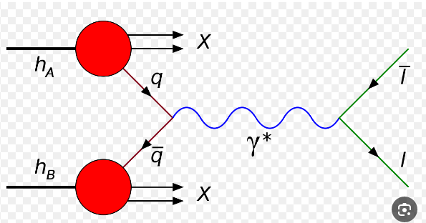
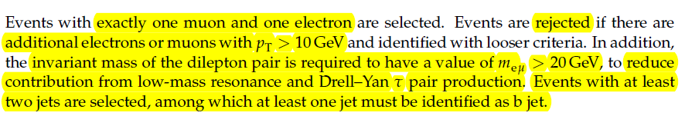
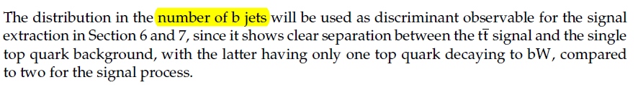
Event selection

Slide 13
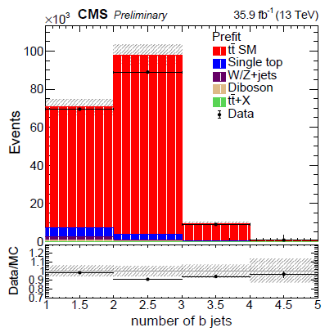
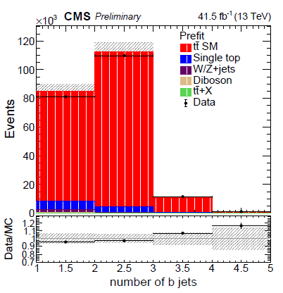


Slide 14
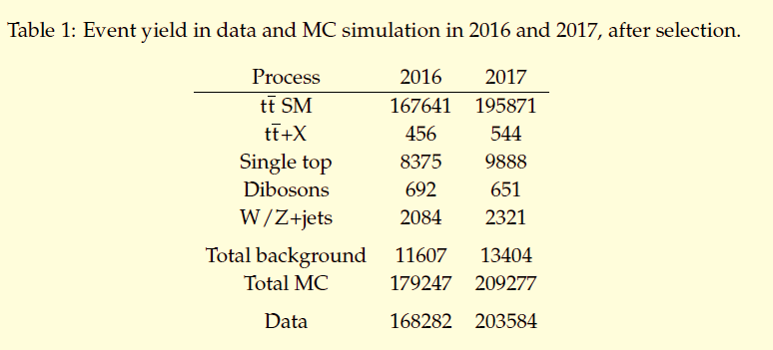

Slide 15
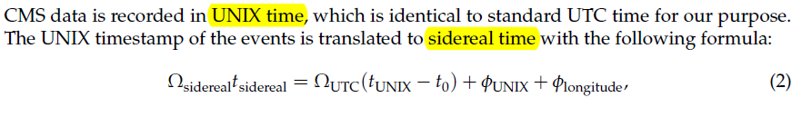
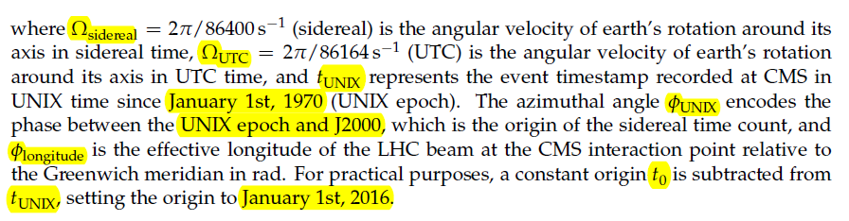
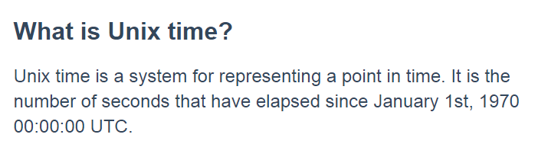
UNIX time and sidereal time

Slide 16
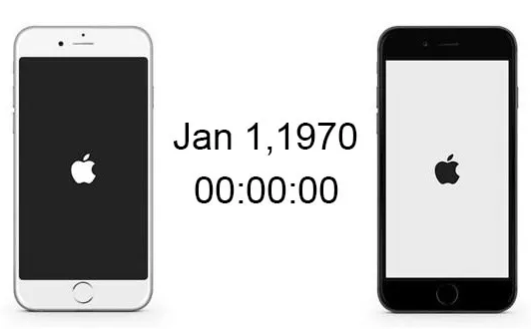
iPhone hates 1 January 1970

Slide 17
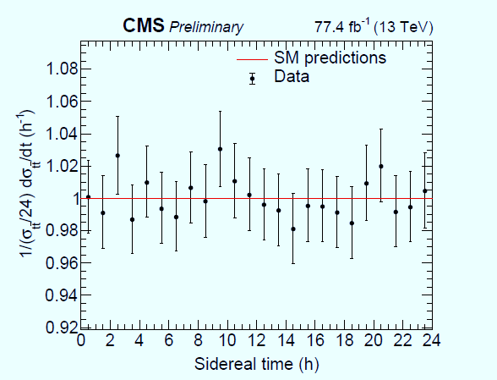
Measurement of the tt normalized differential cross section with sidereal time

Slide 18
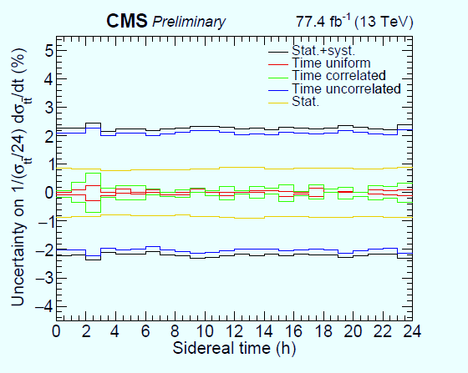
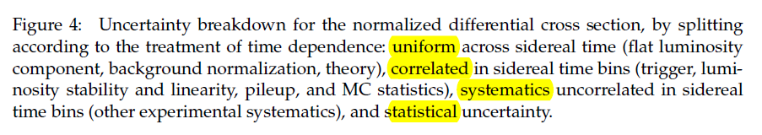

Slide 19
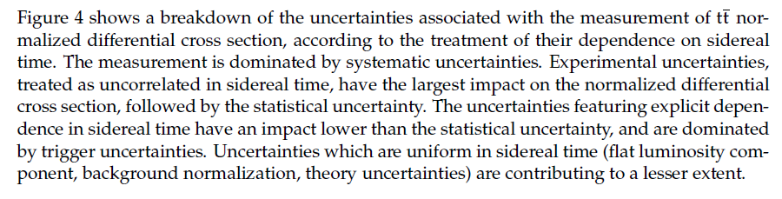

Slide 20




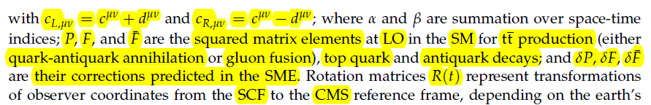
Testing Lorentz invariance with the SME

Slide 21
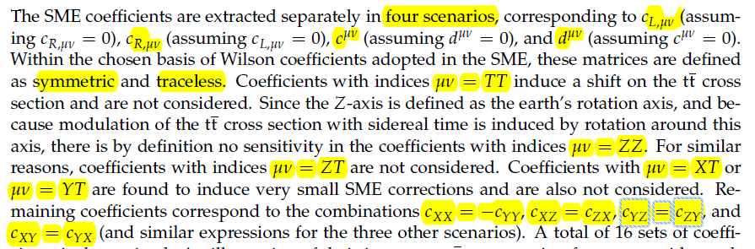
Testing Lorentz invariance with the SME

Slide 22
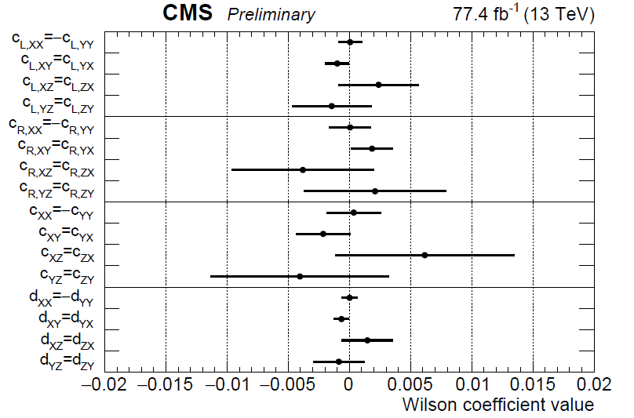
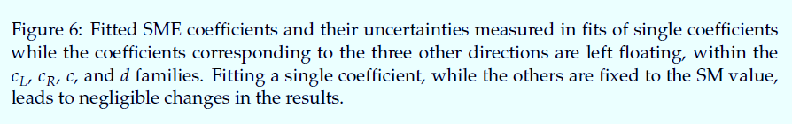

Slide 23
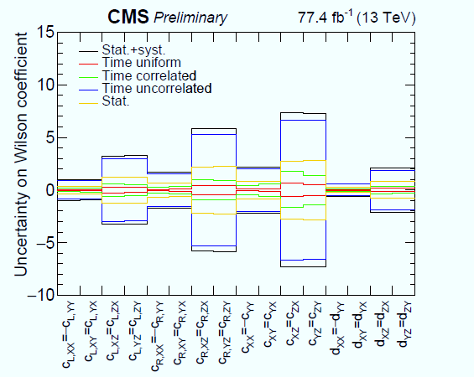
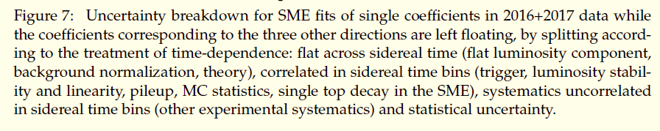

Slide 24
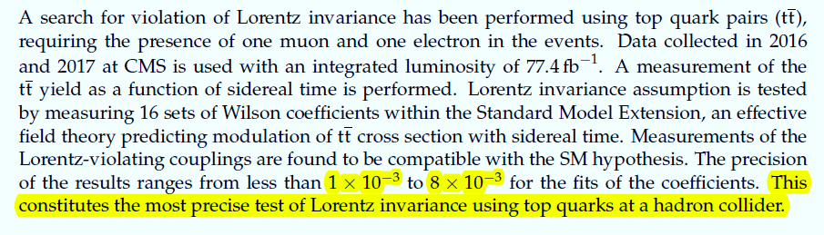
Summary

Slide 25


Thank you
Physics and agriculture

