Slide 1
600 A circuits resistance measurements
Edward Nowak
Wrap-up of hardware commissioning 2011
8th of Mars 2001

Slide 2
Procedure test
MP3 Procedure - LHC-MPP-HCP-0003 ver. 3.0 #EDMS 874716
PCS: SPLICES VERIFICATION (±I_PCS)
This test is to verify the low-current integrity of the splices.
PNO.A3: BIPOLAR CYCLE
This test is to verify the correct functionality of magnet and Current Leads at nominal current level as well as the high-current integrity of the splices.
NOTA BENE:
This test must be analysed by MP3 with the PCS Analysis Tool in the PM
Event Analyser, to automatically transfer data to MTF
Notes:
Elqa can make also non standard test- type test in the tunnel

Slide 3
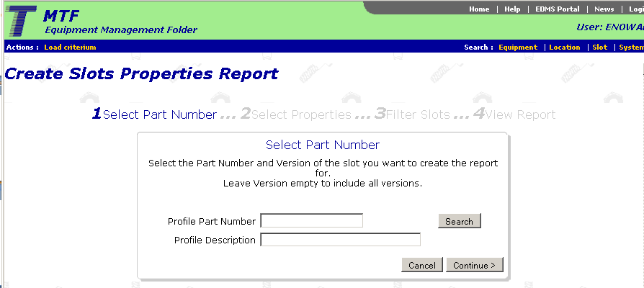
MTF
RC03 - Superconducting 600 A Without EE Circuit
RC06 - Superconducting 600 A With EE Circuit
RC17 - Superconducting 600 A Without EE With Crowbar Circuit
Notes:
Easy last data but previous on request to EDMS

Slide 4
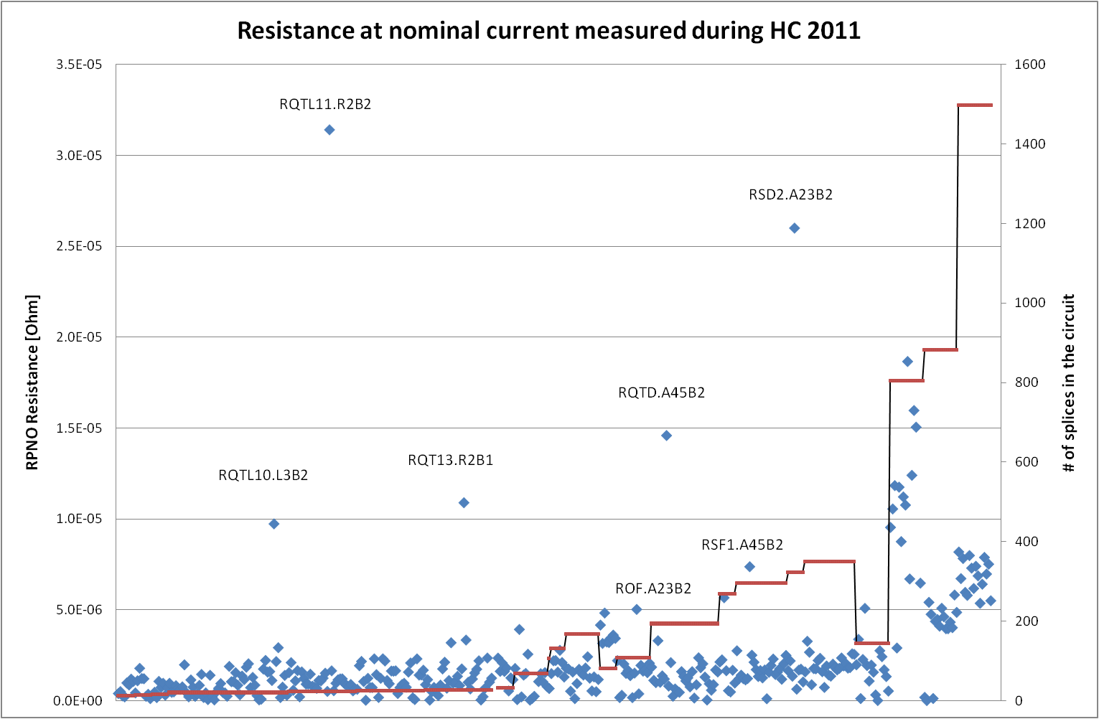
HC 2011

Slide 5
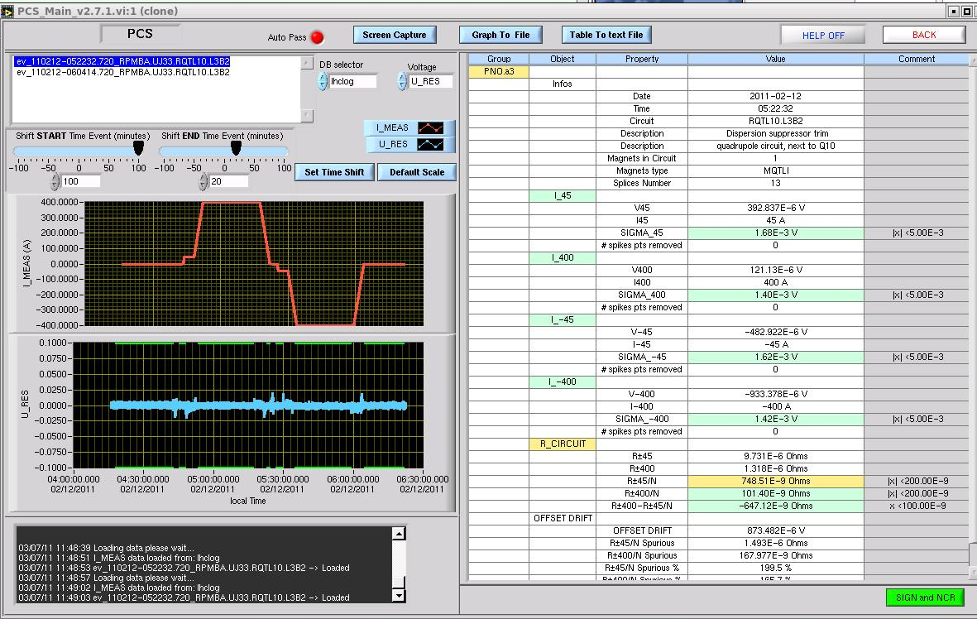
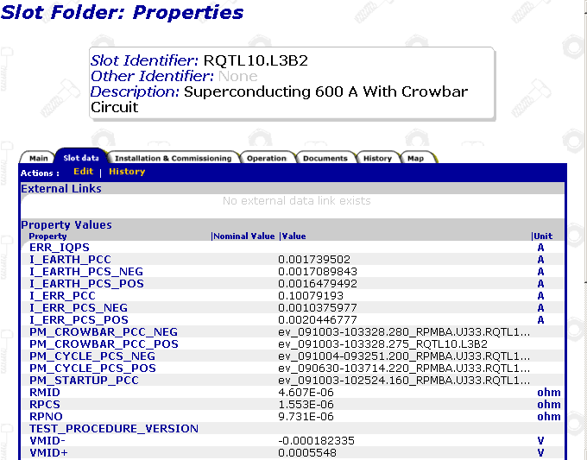
Fake data in the MTF
RPNO
9.731E-06
Ohm
R±45
9.731E-06
Ohm
?
Should be : RPNO = R± = 1.318E-06 Ohm

Slide 6
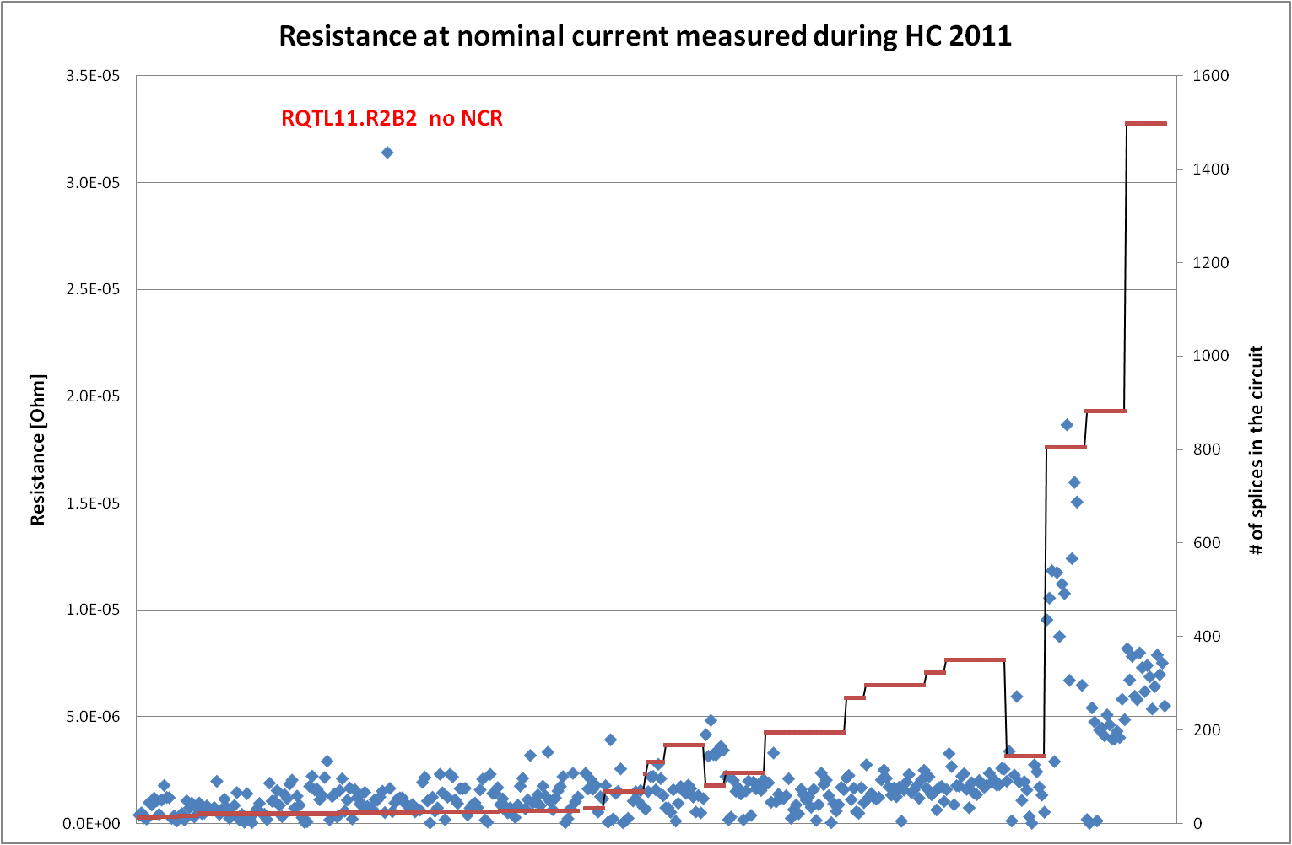
HC 2011

Slide 7
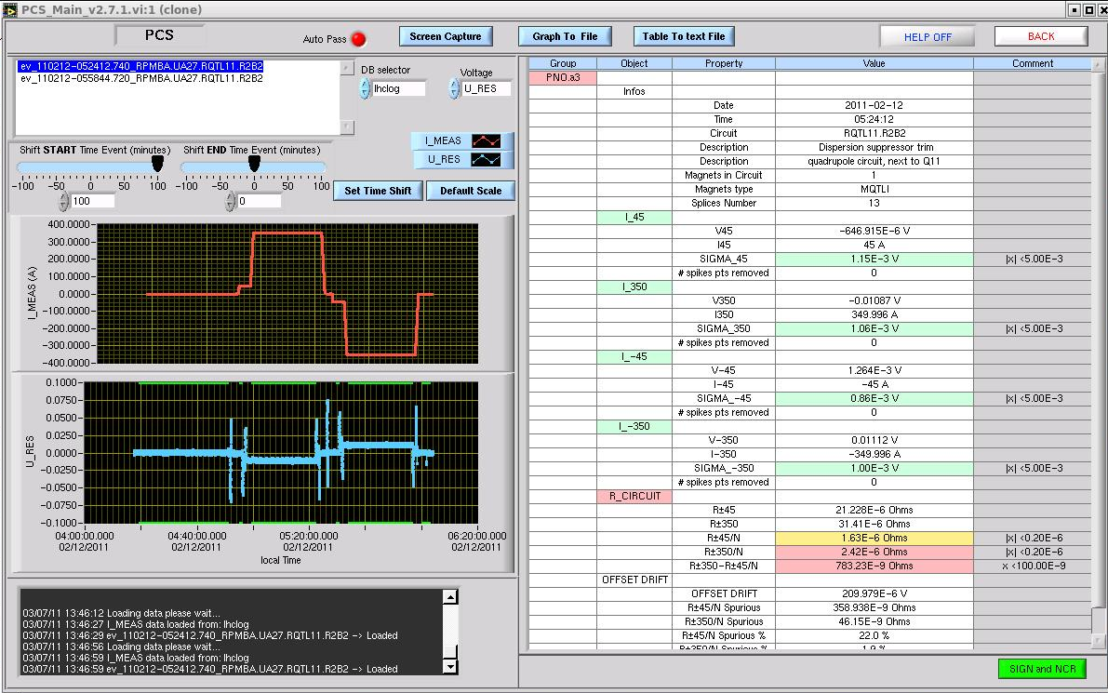
RQTL11.R2B2
R±45 21.228E-06 Ohm < R±350 31.41E-06 Ohm
Test passed ☹

Slide 8
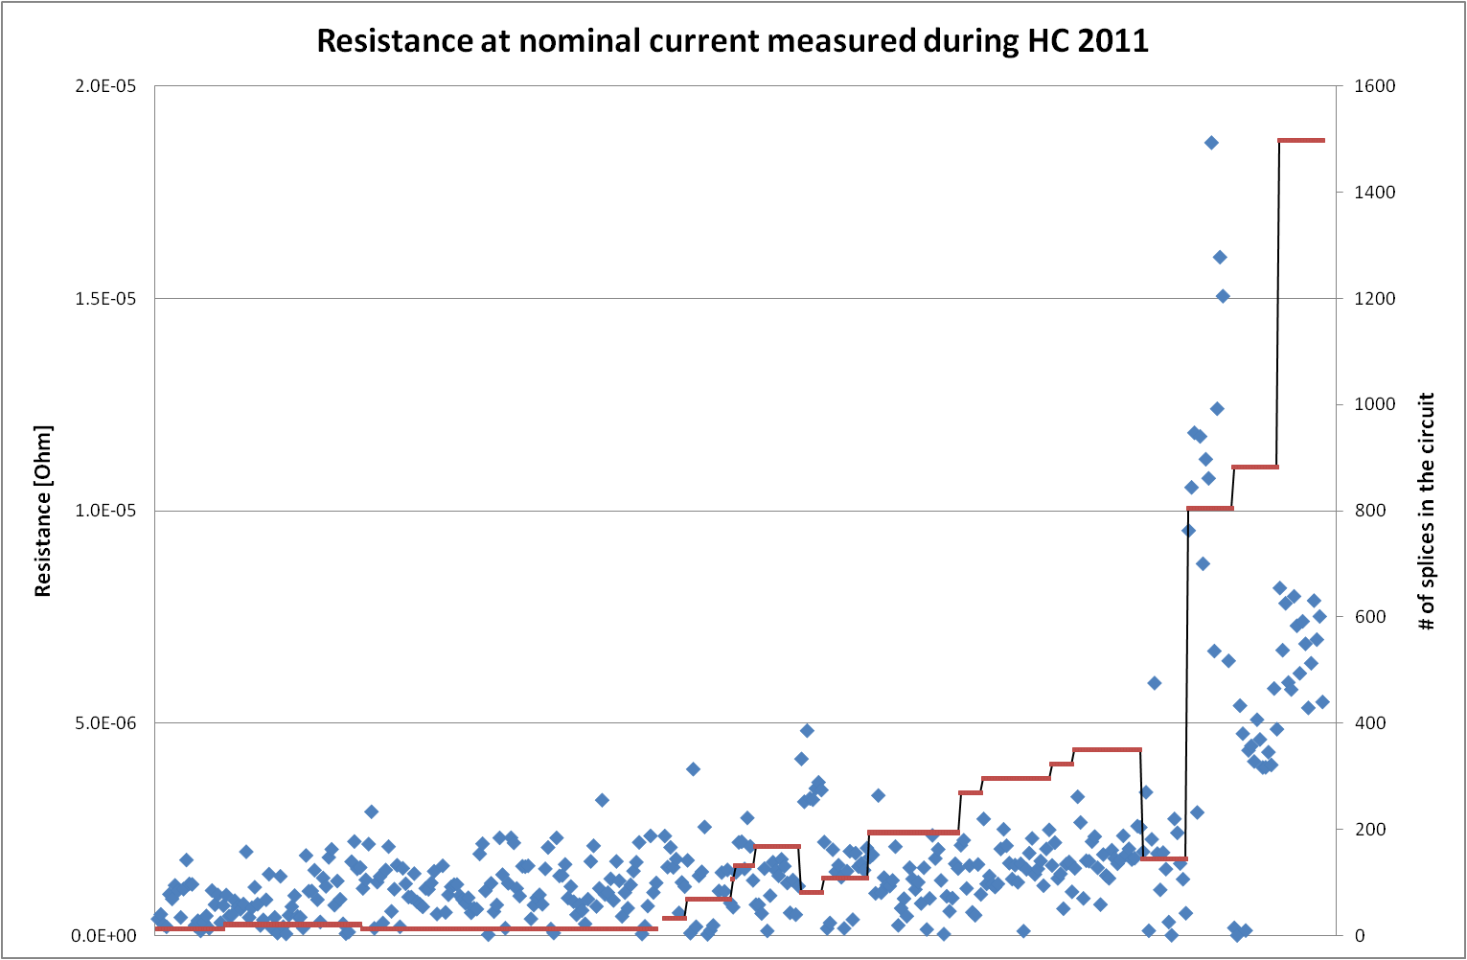
Without RQTL11.R2B2
RQTL11.R2B2
out of range
RCO
RQ6

Slide 9
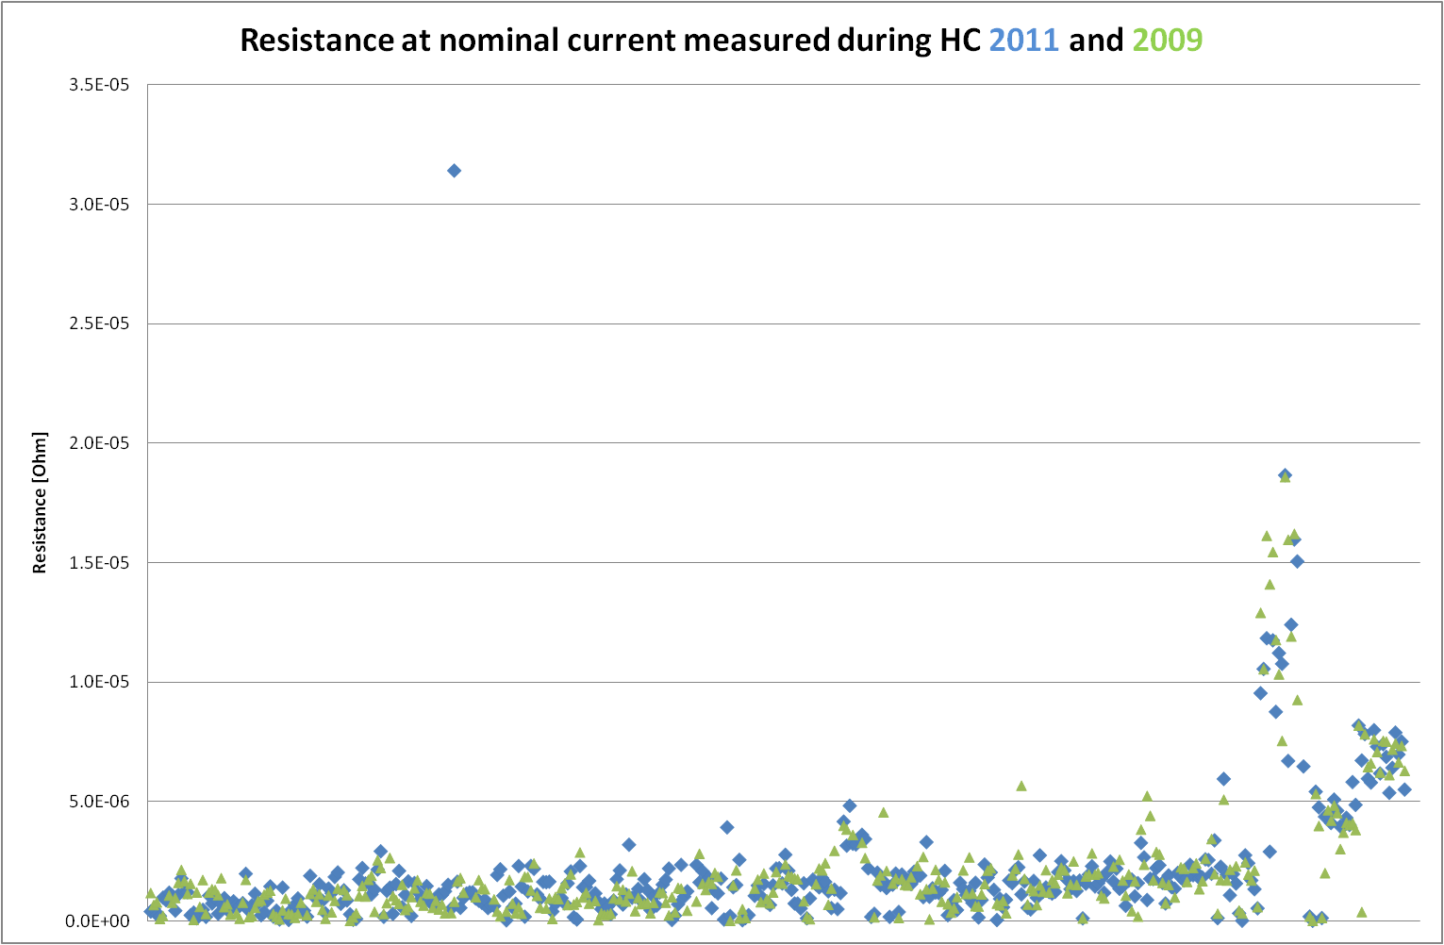
HC 2011 and 2009

Slide 10
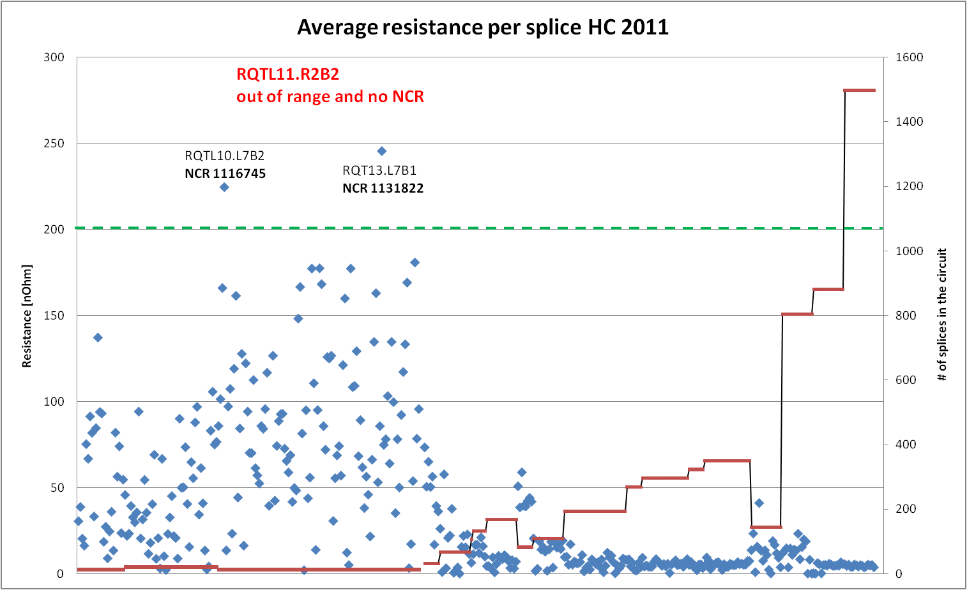
Resistance per splice

Slide 11
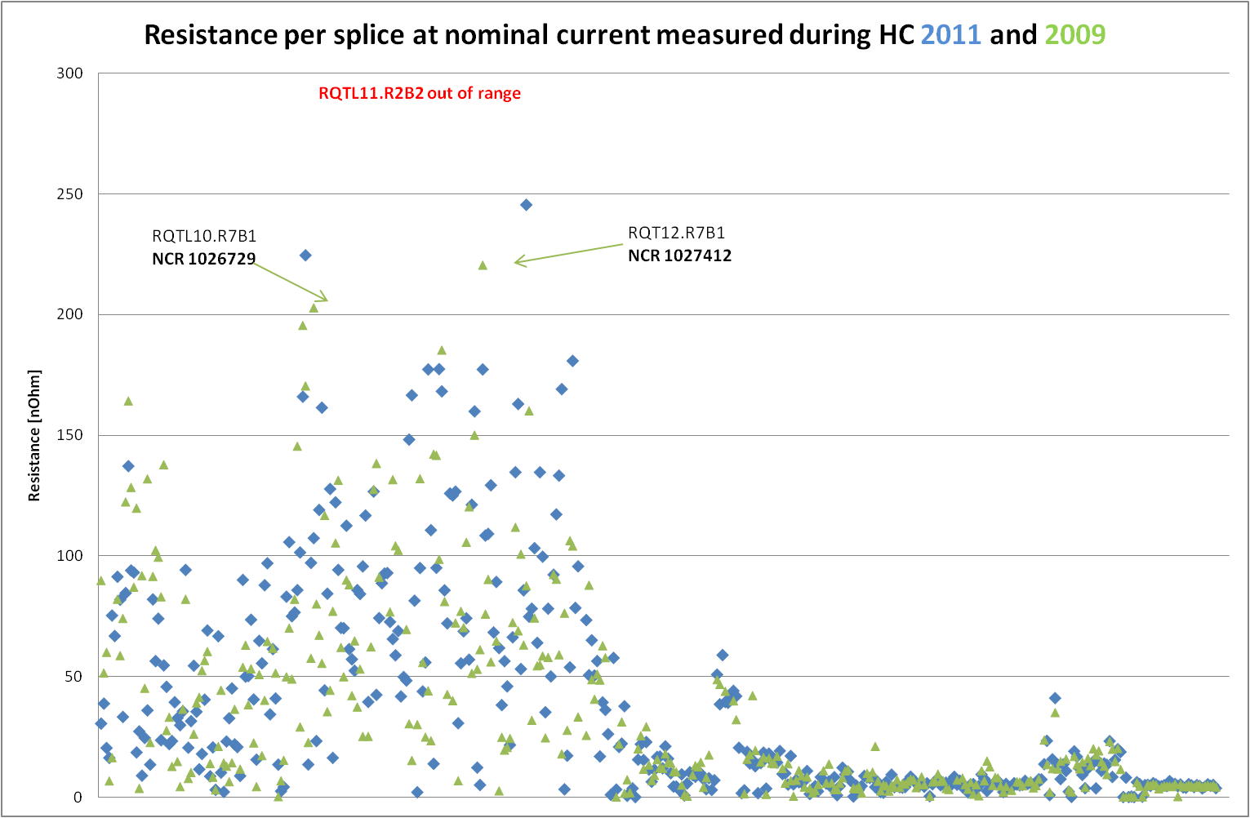
HC 2011 and 2009

Slide 12
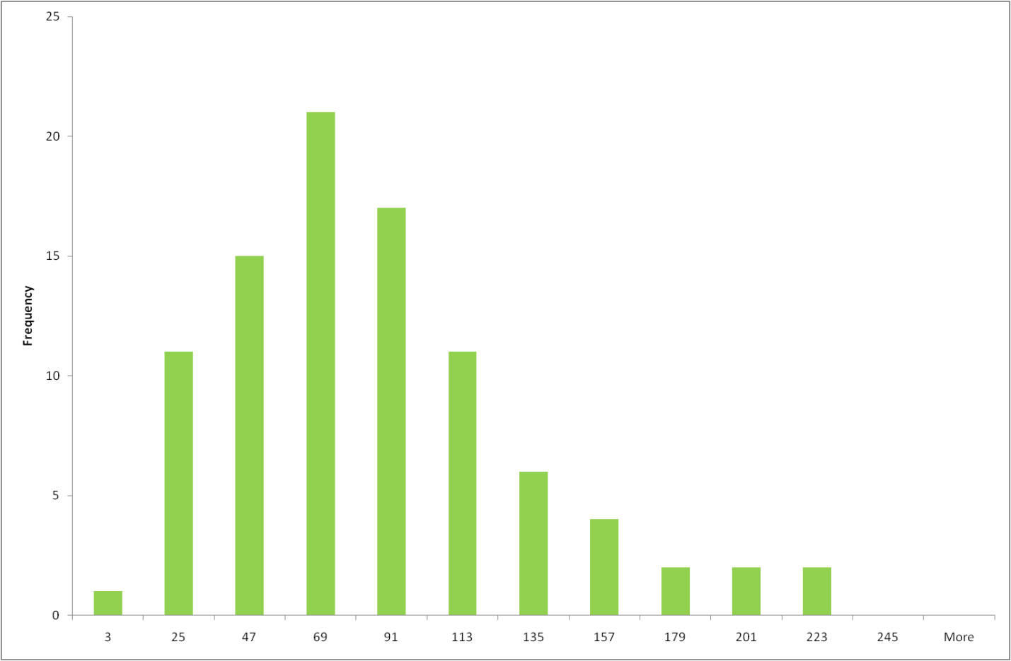
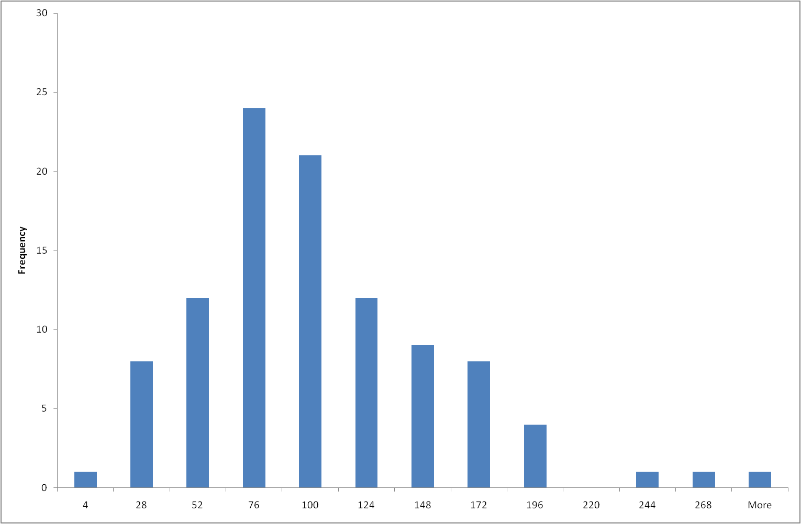
Histogram of resistance/splice in MQT%
HC 2009
HC 2011

Slide 13
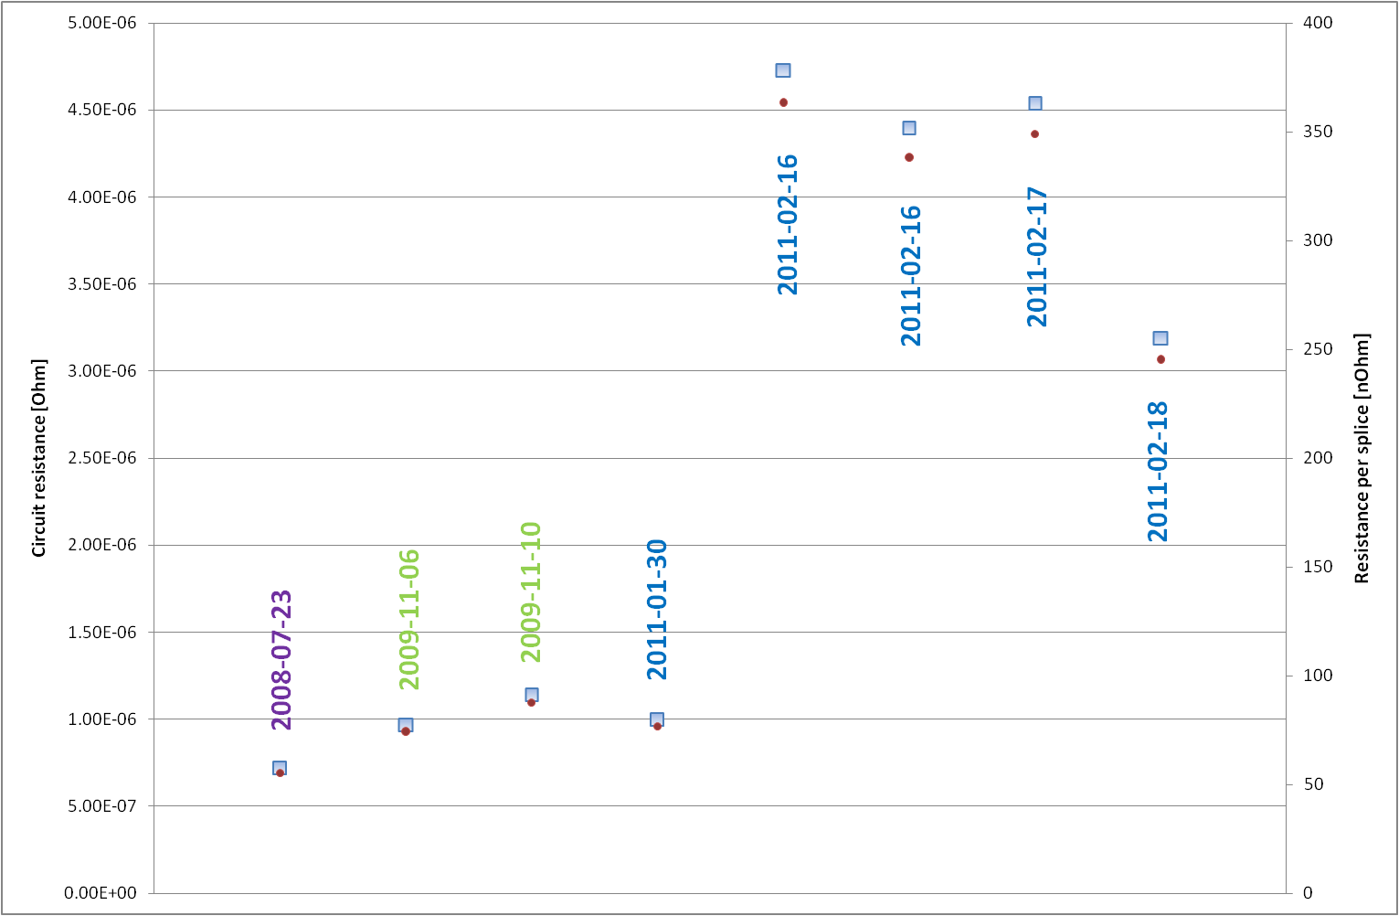
RQT13.L7B1 - history

Slide 14
Conclusions
Transfer data from PCS application to MTF
  Operator mistake
  Application bug (PCS or MTF)
Re-measure a resistance of RQTL11.R2B2 circuit
Do we really know how many and what kind of splices is in measured 600A circuit?
Does PCS application take proper number of splices?

Slide 15
600 A circuits resistance measurements
THANK YOU
Edward Nowak
Wrap-up of hardware commissioning 2011
8th of Mars 2001

Slide 16
