Slide 1
Electrical measurements and diagnostics
XMAS 2010/2011 shutdown

Slide 2
Outline
RQT13.L7B1 – circuit too resistive
  PNO.a3 strange results – exceeding the thresholds
  Circuit configuration
  Measurement details
  Current cycle
  Results
  Conclusions and ‘TO DO’ list
Resistance measurements in corrector circuits: type test on RCS.A45B1
  Type test configuration
  Acquisition system details
  Linear fit
  Results summary
  Conclusions
Upcoming tests – Quench propagation measurement

Slide 3
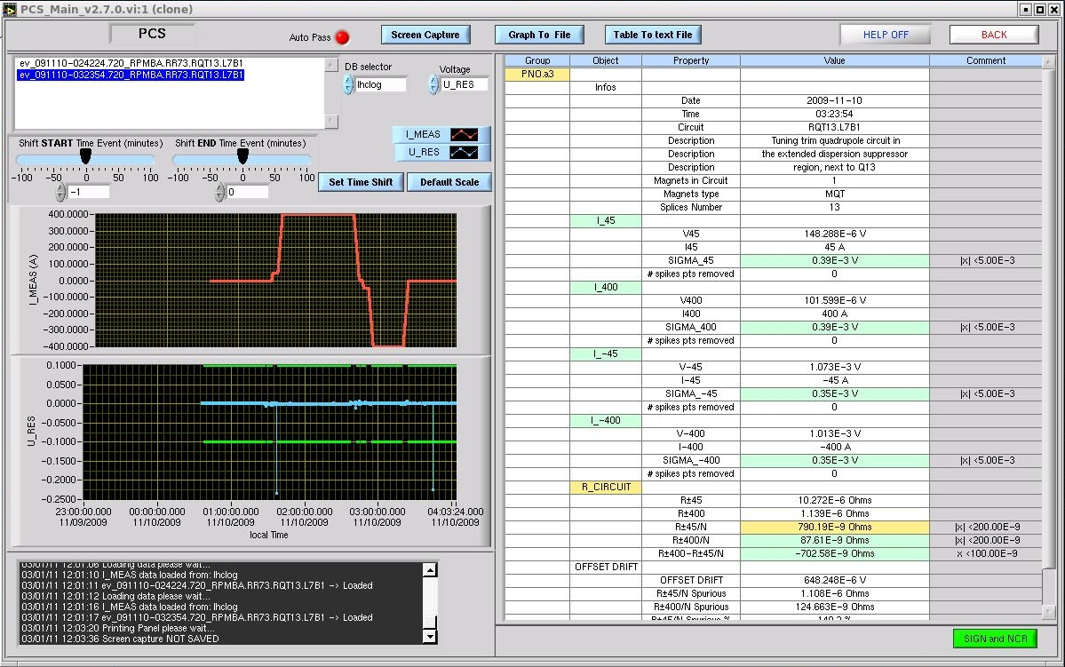
Hardware commisioning tests
PNO.a3 Bipolar Cycle 600A I_PNO
(PNO.A3: BIPOLAR CYCLE This test is to verify the correct functionality of magnet and Current Leads at nominal current level as well as the high-current integrity of the splices)

Slide 4
RQT13.L7B1 resistance checks
HCC 2008
  2008-07-23 16:22:45 RPNO 0.718E-06 ohm
HCC 2009
  2009-11-06 17:58:48 RPNO 0.967E-06 ohm
  2009-11-10 01:27:06 RPNO 1.139E-06 ohm
HCC 2011
  2011-01-30 14:30:26 RPNO 0.999E-06 ohm
  2011-02-16 17:43:46 RPNO 4.725E-06 ohm
  2011-02-16 20:24:21 RPNO 4.398E-06 ohm
  2011-02-17 02:04:09 RPNO 4.536E-06 ohm
  2011-02-18 18:31:47 RPNO 3.191E-06 ohm

Slide 5
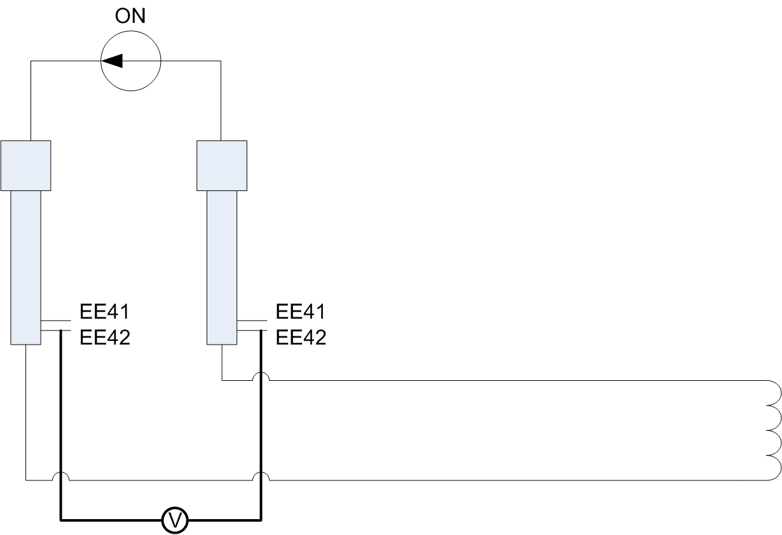
RQT13.L7B1 set-up

Slide 6
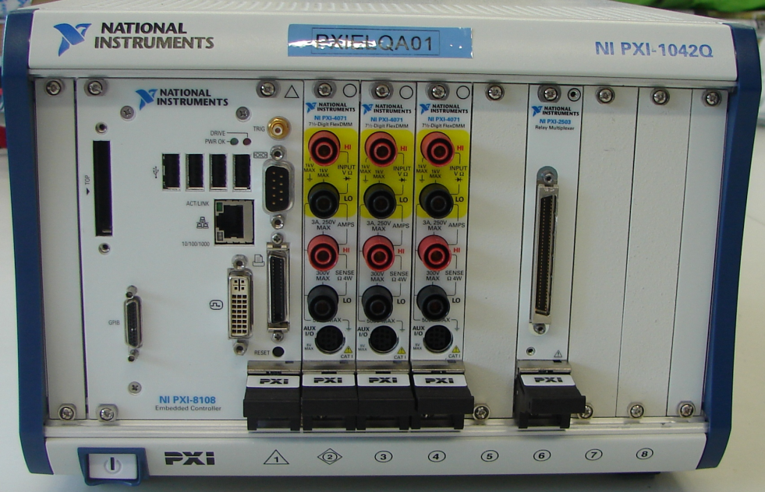
RQT13.L7B1 set-up

Slide 7
Measurement details
The purpose of this measurement was to use an independent voltmeter with a high resolution to get a precise value of resistance of the cold part of the circuit.
The measurement was done in parallel on both pairs of cold V-taps:
  EE41 lead 1 – EE41 lead 2
  EE42 lead 1 – EE42 lead 2
The aperture time of the DVM (we used a PXI device) was set to 1 PLC (power line cycle) in order to filter 50Hz noise.
Given a fairly high noise (only when powering) we have acquired data for at least 2-3 minutes at each current plateau.
We have acquired several plateaus in order to be able to apply a reasonable linear fit: 100 A, 200 A, 300 A, 400 A, 200 A, -100 A, -200 A,
-300 A, -400 A, -200 A.

Slide 8
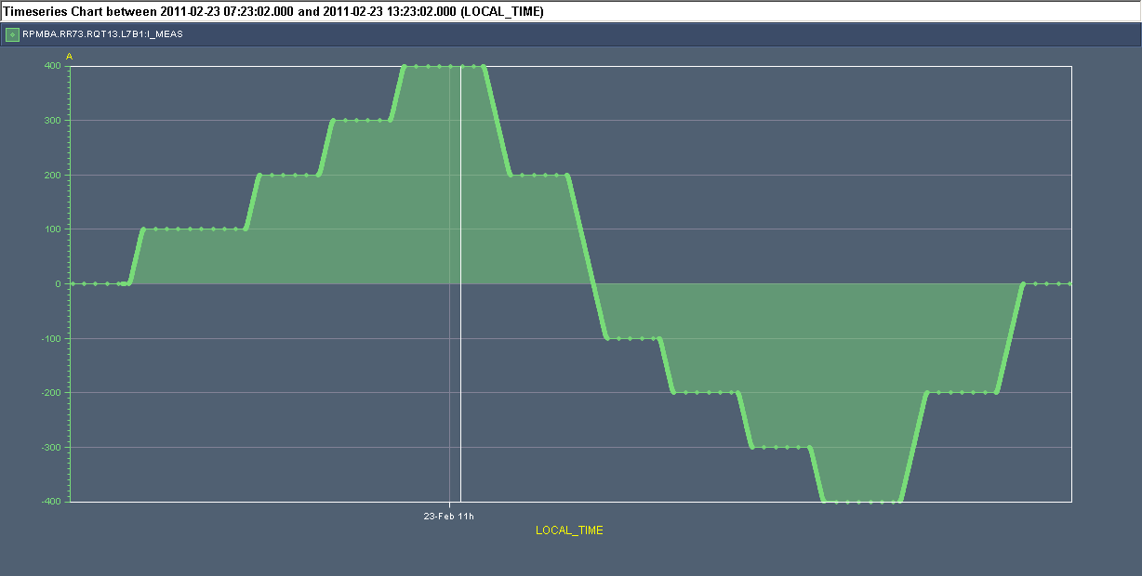
RQT13.L7B1

Slide 9
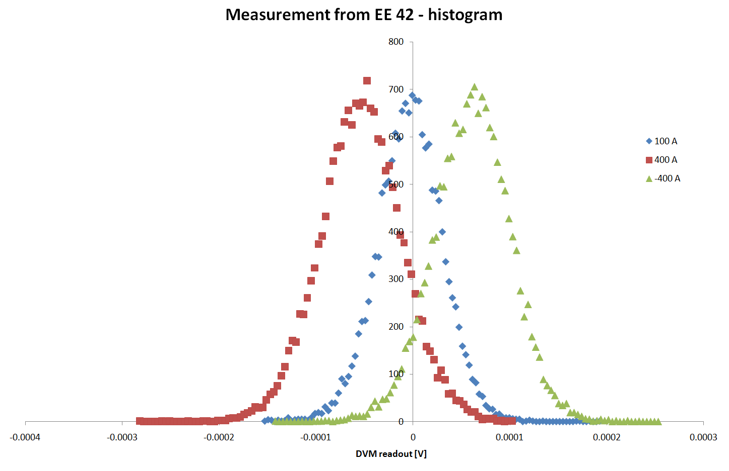
RQT13.L7B1 - histogram

Slide 10
RQT13.L7B1 results
Between V-taps EE41
  R = 136 nΩ
Between V-taps EE42
  R = 134 nΩ
Precision estimated from the linear fit is about 0.5 nΩ
Resistance per splice is 4.4 nΩ
Voltage readout at each current plateau has a Gaussian distribution
Time spent on the measurement was certainly long enough to precisely calculate the circuit resistance

Slide 11
RQT13.L7B1 - conclusions
RQT13.L7B1 – is a healthy circuit
There are 31 splices in this circuit (in the PCS application the value is 13)
Precision achieved with the PXI system is good
The circuit resistance is much lower than what was measured during the powering tests, probably because it is much below the resolution of DVMs used for this purpose (but not meant for it by design)
  Resolution of U_diff=5mV
  Low resolution is ‘hidden’ in a compensated U_res signal
  With the noise of 100-200 µV the long averaging time doesn’t help (no dither)
We can’t compare this value to the other circuits as this is the only one we have measured

Slide 12
Total number of splices per circuit
Sector | DFB | Circuit | Type | Splices
67 | DFBAL.5R6 | RQS.R6B2 | MQS | 65
 | DFBAL.5R6 | RQT12.R6B1 | MQT | 23
 | DFBAL.5R6 | RQT12.R6B2 | MQT | 23
 | DFBAL.5R6 | RQT13.R6B1 | MQT | 25
 | DFBAL.5R6 | RQT13.R6B2 | MQT | 25
 | DFBAL.5R6 | RQTD.A67B1 | MQT | 189
 | DFBAL.5R6 | RQTD.A67B2 | MQT | 191
 | DFBAL.5R6 | RQTF.A67B1 | MQT | 191
 | DFBAL.5R6 | RQTF.A67B2 | MQT | 189
 | DFBAL.5R6 | RQTL11.R6B1 | MQTLI | 21
 | DFBAL.5R6 | RQTL11.R6B2 | MQTLI | 21
 | DFBAM.7L7 | RQS.A67B1 | MQS | 131
 | DFBAM.7L7 | RQS.L7B2 | MQS | 71
 | DFBAM.7L7 | RQT12.L7B1 | MQT | 29
 | DFBAM.7L7 | RQT12.L7B2 | MQT | 29
 | DFBAM.7L7 | RQT13.L7B1 | MQT | 31
 | DFBAM.7L7 | RQT13.L7B2 | MQT | 31
 | DFBAM.7L7 | RQTL10.L7B1 | MQTLI | 25
 | DFBAM.7L7 | RQTL10.L7B2 | MQTLI | 25
 | DFBAM.7L7 | RQTL11.L7B1 | MQTLI | 27
 | DFBAM.7L7 | RQTL11.L7B2 | MQTLI | 27
 | DFBAM.7L7 | RQTL7.L7B1 | MQTLI | 19
 | DFBAM.7L7 | RQTL7.L7B2 | MQTLI | 19
 | DFBAM.7L7 | RQTL8.L7B1 | MQTLI | 21
 | DFBAM.7L7 | RQTL8.L7B2 | MQTLI | 21
 | DFBAM.7L7 | RQTL9.L7B1 | MQTLI | 35
 | DFBAM.7L7 | RQTL9.L7B2 | MQTLI | 35
 | DFBMH.7L7 | RQ6.L7B1 | MQTLH | 77
 | DFBMH.7L7 | RQ6.L7B2 | MQTLH | 77

Slide 13
TO DO list
Count splices in each circuit, include types of splices:
  Soft soldered joints current lead – bus-bar,
  Interconnection splices (done in the tunnel)
  Internal coil splices (done on the surface by the contractor)
Should we measure more circuits to get an idea about the mean value and the spread of the resistance values we have in the tunnel?
Should we measure all the circuits before the long shut-down???

Slide 14
Resistance measurements in corrector circuits: RCS.A45B1
Type test

Slide 15
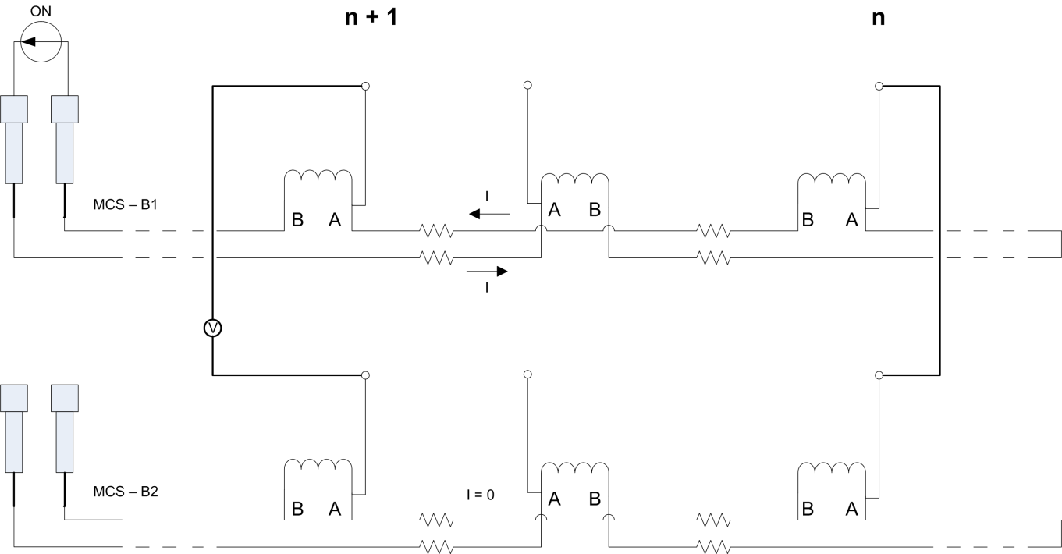
RCS.A45B1
  Details described in the EDMS document: LHC-MPP-HCP-96-0-10
The usage of the other circuit as an “extension cable” helped to limit the measurement
noise and simplified the cabling used.

Slide 16
Acquisition
Keithley 2750 was used
The DVM was set to a manual range 0.1 V as the signal – even when ramping the current (1.5 A/s) – never exceeded 2 mV
Aperture of 5 NPLC (Number of Power Line Cycles) – 100 ms –was used in order to filter out the 50 Hz (and multiples) noise
The DVM was set in a “burst” mode so that samples cover the full period of acquisition and there is no “dead time” in between them. Each recorded 100 s means 1000 samples acquired

Slide 17
Linear fit
Linear fits were calculated and coefficient errors were estimated for each segment.
Slope typically was about 30 nΩ with an error of 0.2 -0.6 nΩ depending on a number
of points and location.

Slide 18
Summary of the measurements
Segment | Measured points | Coil internal splices | Inter-connection splices | Number of splices | Segment resistance [Ω] | Error [Ω] | DVM/setup offset [V] | Error [V]
A8R4-A9R4 | 7000 | 7 | 3 | 10 | 2.94E-08 | 2.0E-10 | 2.34E-06 | 1.7E-08
A9R4-A10R4 | 6000 | 7 | 3 | 10 | 2.78E-08 | 2.0E-10 | 1.76E-06 | 2.2E-08
A10R4-A11R4 | 4000 | 7 | 3 | 10 | 2.99E-08 | 2.0E-10 | -1.30E-06 | 2.2E-08
A11R4-A12R4 | 3000 | 7 | 4 | 11 | 3.47E-08 | 2.4E-10 | 3.69E-06 | 2.5E-08
A12R4-C12R4 | 5000 | 7 | 2 | 9 | 2.04E-08 | 1.7E-10 | 4.91E-06 | 1.9E-08
C12R4-B13R4 | 7000 | 7 | 3 | 10 | 2.34E-08 | 1.7E-10 | 3.15E-06 | 1.7E-08
B13R4-A14R4 | 5000 | 7 | 3 | 10 | 2.63E-08 | 6.4E-10 | -4.39E-06 | 6.4E-08
A14R4-C14R4 | 5000 | 7 | 2 | 9 | 2.34E-08 | 1.7E-10 | 3.15E-06 | 1.7E-08
Each bus-bar segment was measured together with one coil as there is just one V-tap per magnet. It introduced some additional noise as well as additional resistance of 7 internal splices. Three configurations were met:
  2 interconnections (2 segments),
  3 interconnections (5 segments),
  4 interconnections (1 segment).

Slide 19
Interconnection splices resistance
From the collected data it could be deduced that the interconnection splice’s resistance is by average about 6 nΩ. In that case for the 7 internal joints remain 9 nΩ. It would mean that the average value of the internal splice is 1.3 nΩ.

Slide 20
Conclusions
It was confirmed that with the presented method it is possible to measure the corrector’s splice’s resistance with a good precision.
It would be interesting to measure more segments in order to understand better the resistances present in the machine.
  Getting a better population of measurements should allow to precisely estimate average values of interconnection and internal joints.
  Long return lines of MCO and MCD circuits that contain only the interconnection splices should be measured as well.
Similar measurement could be very interesting for the line N.
The main disadvantage of this measurement is its impact on the time schedule of the machine commissioning.
HV qualification of MB circuit after the spools measurement is required(?). Similarly in case of the Line N measurements MQD and MQF circuits HV test would be most likely needed.

Slide 21
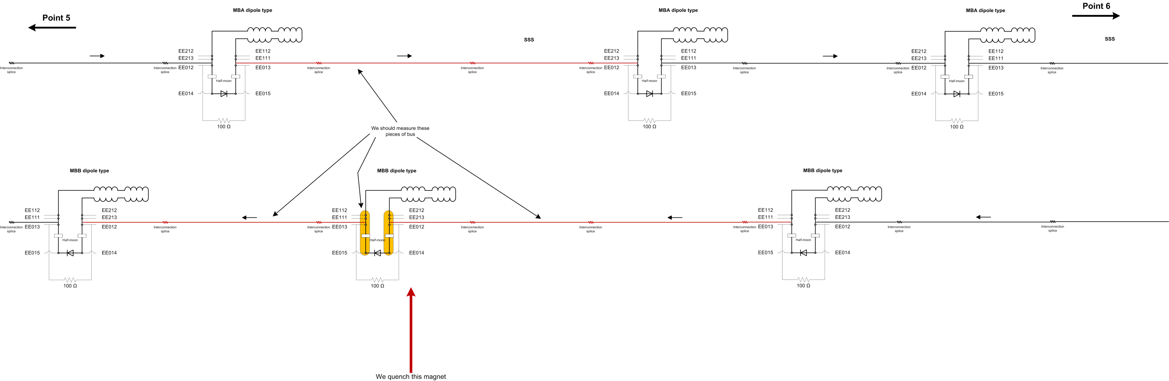
For the future…
Quench propagation measurement should spot some light on:
  Time from the magnet quench to the interconnection quench – does it really happen?
  Half-moon connector resistances

Slide 22
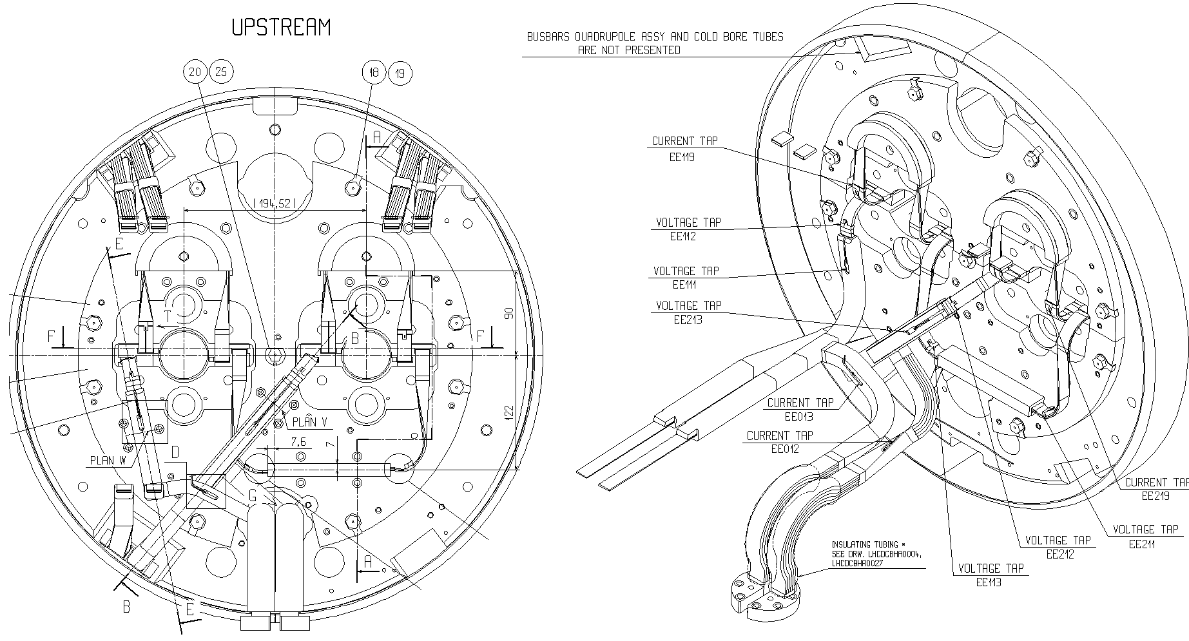
MBB magnet

Slide 23
Quench propagation test
The test will be done in sector 5-6
There will be 3 magnets instrumented with high precision volt-meters
2 magnets will be quenched
Magnets will be quenched at 2 or 3 different currents:
  2 kA
  4 kA
  6 kA
The technical specification will come soon and will contain all the details

Slide 24
Quench propagation test
The test is prepared together by
Mike Koratzinos,
Arjan Verweij,
Mateusz Bednarek
There will be a similar test in SM18 with a magnet equipped with thermometers and V-taps in the interconnection and half-moons region.

Slide 25
Thank you!
Any questions?

