Slide 1

Energy Shifts from Beam-Beam Interaction
(update)
D. Shatilov
Acknowledgments: A. Blondel
21th FCC-FS EPOL group meeting
13 Jul 2023

Slide 2
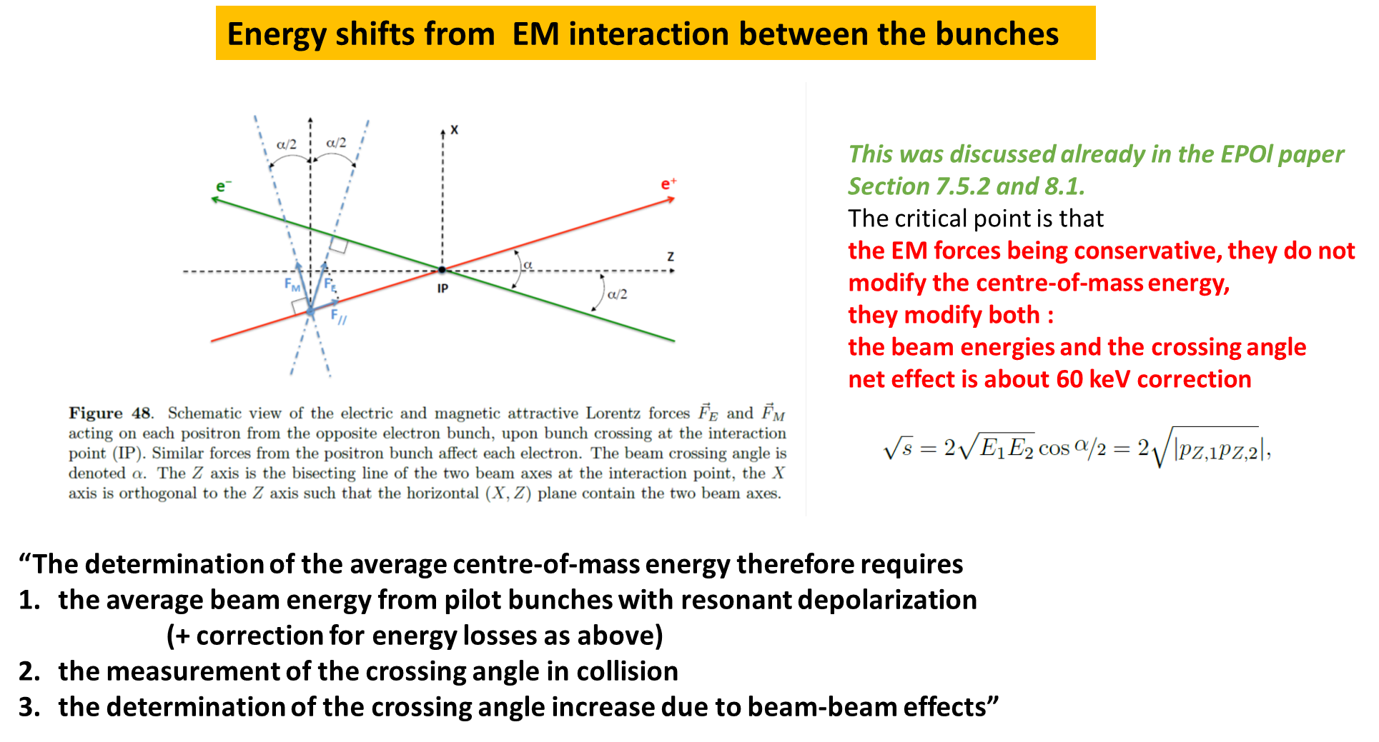
Preamble
The main effect is related to the collision with the crossing angle, and so far we have considered only this aspect.
But there are other factors that shift the beam energy during interaction at the IP. This is what we are going to discuss here.
To exclude the contribution of the crossing angle, we will further consider the head-on collision.
A. Blondel, FCC Week 2023
D. Shatilov 21th FCC-FS EPOL group meeting, 13 Jul 2023 2

Slide 3
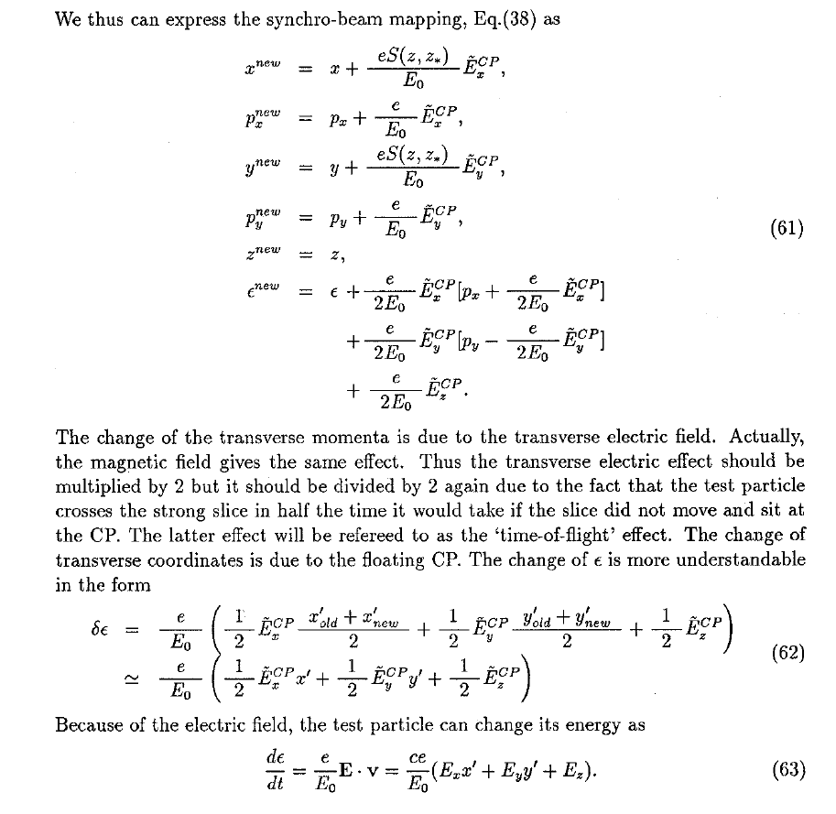
6D Symplectic Beam-Beam Interaction
Horizontal crossing angle
K. Hirata, H. Moshammer, F. Ruggiero
SLAC-PUB-10055, KEK Preprint 92-117
E_{z}
main E_{z} contribution
Can be several times larger than Δδ_{z}
Correlations between and are not small, so and it depends on the azimuth.
D. Shatilov 21th FCC-FS EPOL group meeting, 13 Jul 2023 3

Slide 4
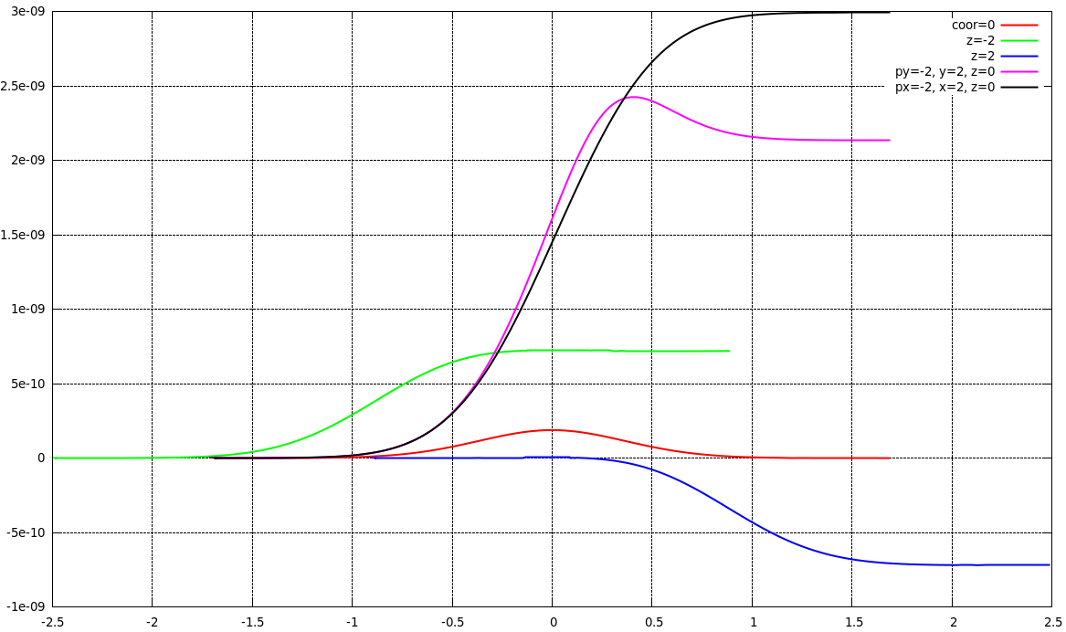
Energy Change vs. Particle Coordinates
δ_{E}
Head-on collision,
Other parameters except N_{p} are the same as for FCC-ee at Z.
Particle coordinates “just before IP”: all are zero except for the specified values (in sigmas) in the signatures.
The change in energy during a single passage through the IP is shown in the graph for different initial coordinates.
For the average “collision energy” shift, we need to run a long-term simulation that yields an equilibrium distribution.
Azimuth (mm)
D. Shatilov 21th FCC-FS EPOL group meeting, 13 Jul 2023 4

Slide 5
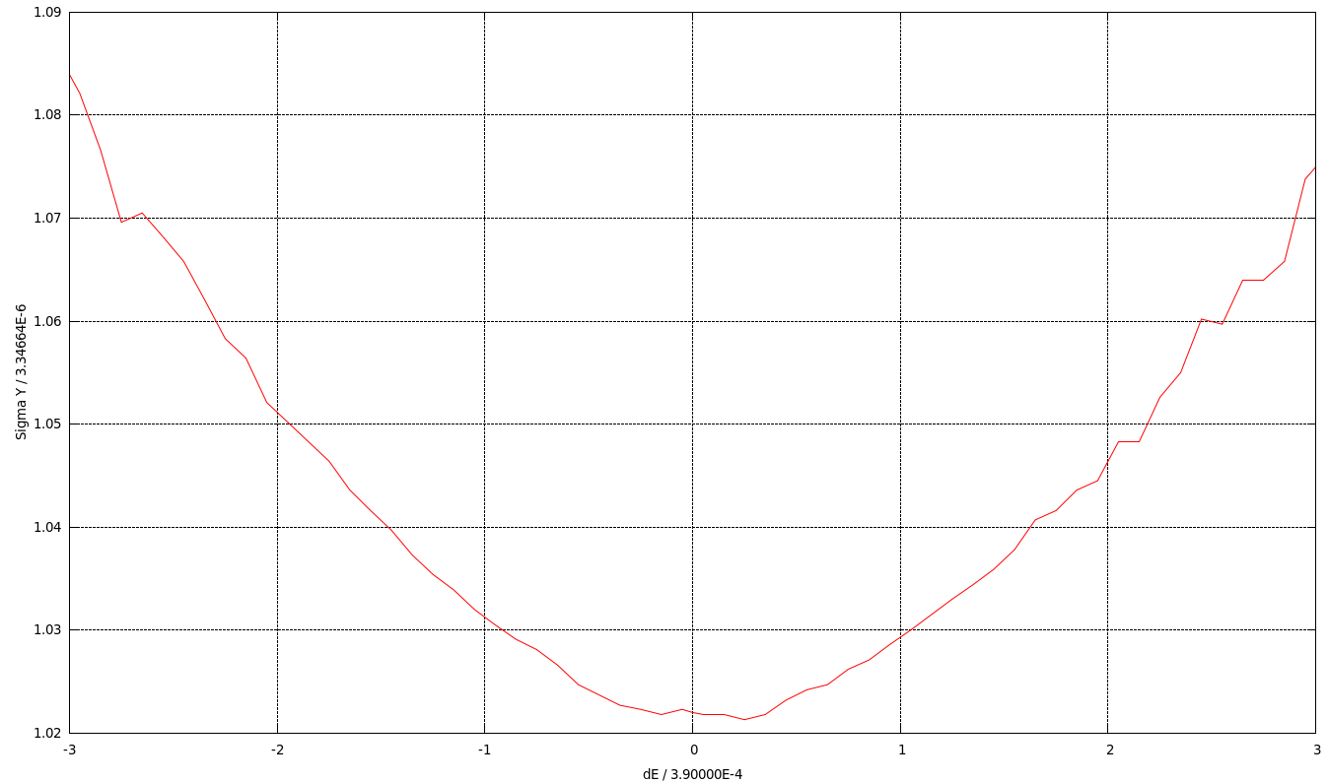
Energy Shift for the Luminosity
Collisions with every slice of the opposite bunch. E_{C} and δ_{C} are the particle’s energy and luminosity of such elementary collision.
A self-consistent equilibrium distribution was obtained in beam-beam simulations, but ξ_{y} was reduced to 0.02 to avoid blowup in head-on collision. Surprisingly, δ_{L} ∼ 3⋅10⁻⁷ was obtained. This result can be explained by the correlation between δ_{E} and σ_{y}.
Particles with positive δ_{E} interact with a higher density of the opposite bunch, and hence produce more luminosity.
The correlation between δ_{E} and σ_{y} depends on many parameters: synchrotron tune, betatron tunes, lattice imperfections, etc.
In a realistic nonlinear lattice with errors, misalignments and corrections, such correlation appears even without beam-beam interaction.
It will be difficult (perhaps impossible) to control this effect. The next step is to make a realistic estimate with account of beam-beam interaction, nonlinear lattice and imperfections.
D. Shatilov 21th FCC-FS EPOL group meeting, 13 Jul 2023 5

Slide 6
Summary
The change in energy due to the electric field of the oncoming bunch was estimated, which turned out to be negligible (if we do not consider the crossing angle).
The “collision energy” shift due to the correlation between δ_{E} and σ_{y} is not small (about 10⁻⁷ ÷ 10⁻⁶) and quite unpredictable.
The correlation can be caused by beam-beam interaction and lattice nonlinearities. To evaluate this effect, further modeling is required, taking into account imperfections, misalignments, etc.
D. Shatilov 21th FCC-FS EPOL group meeting, 13 Jul 2023 6

