Slide 1

Summer Student induction

Slide 2
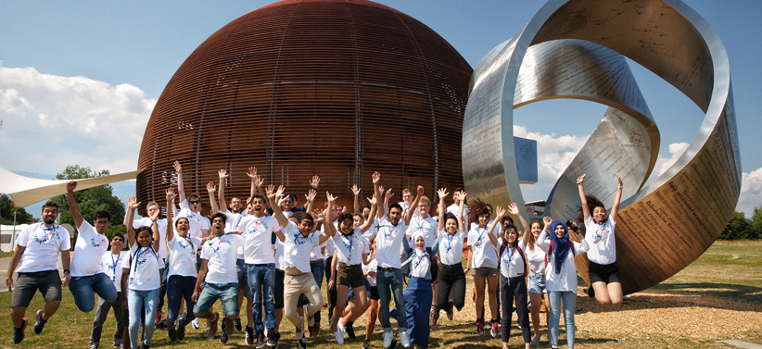

Your CERN openlab Summer Student Experience
Congratulations, you were selected from 1,880 applications!
9 weeks contract
Work on a project together with your CERN supervisor
  Project report
  Initial draft after 4 weeks (table of content, main sections)
  Final draft to your supervisor a week before leaving
A 5-minute ‘lightning talk’ to describe your project and its outcome in August
Visits to CERN experiments and installations
A series of lectures about IT, computing and data management applied to HEP and other scientific domains
Possibility to attend Workshops
The CERN openlab summer student webfest!

Slide 3
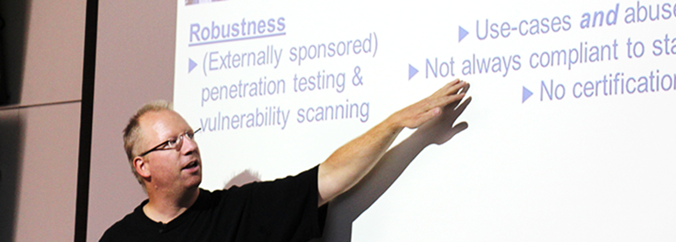
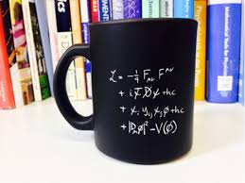

CERN openlab lecture programme
Bring your own coffee…
CERN openlab summer student lecture and training programme can be found here:
Lecture programme · Indico (cern.ch)
Lectures start at 14:00 in general, but please always check the programme!
As CERN openlab summer students you are required to attend the lectures ☺
The openlab lectures start on July 4th!

Slide 4
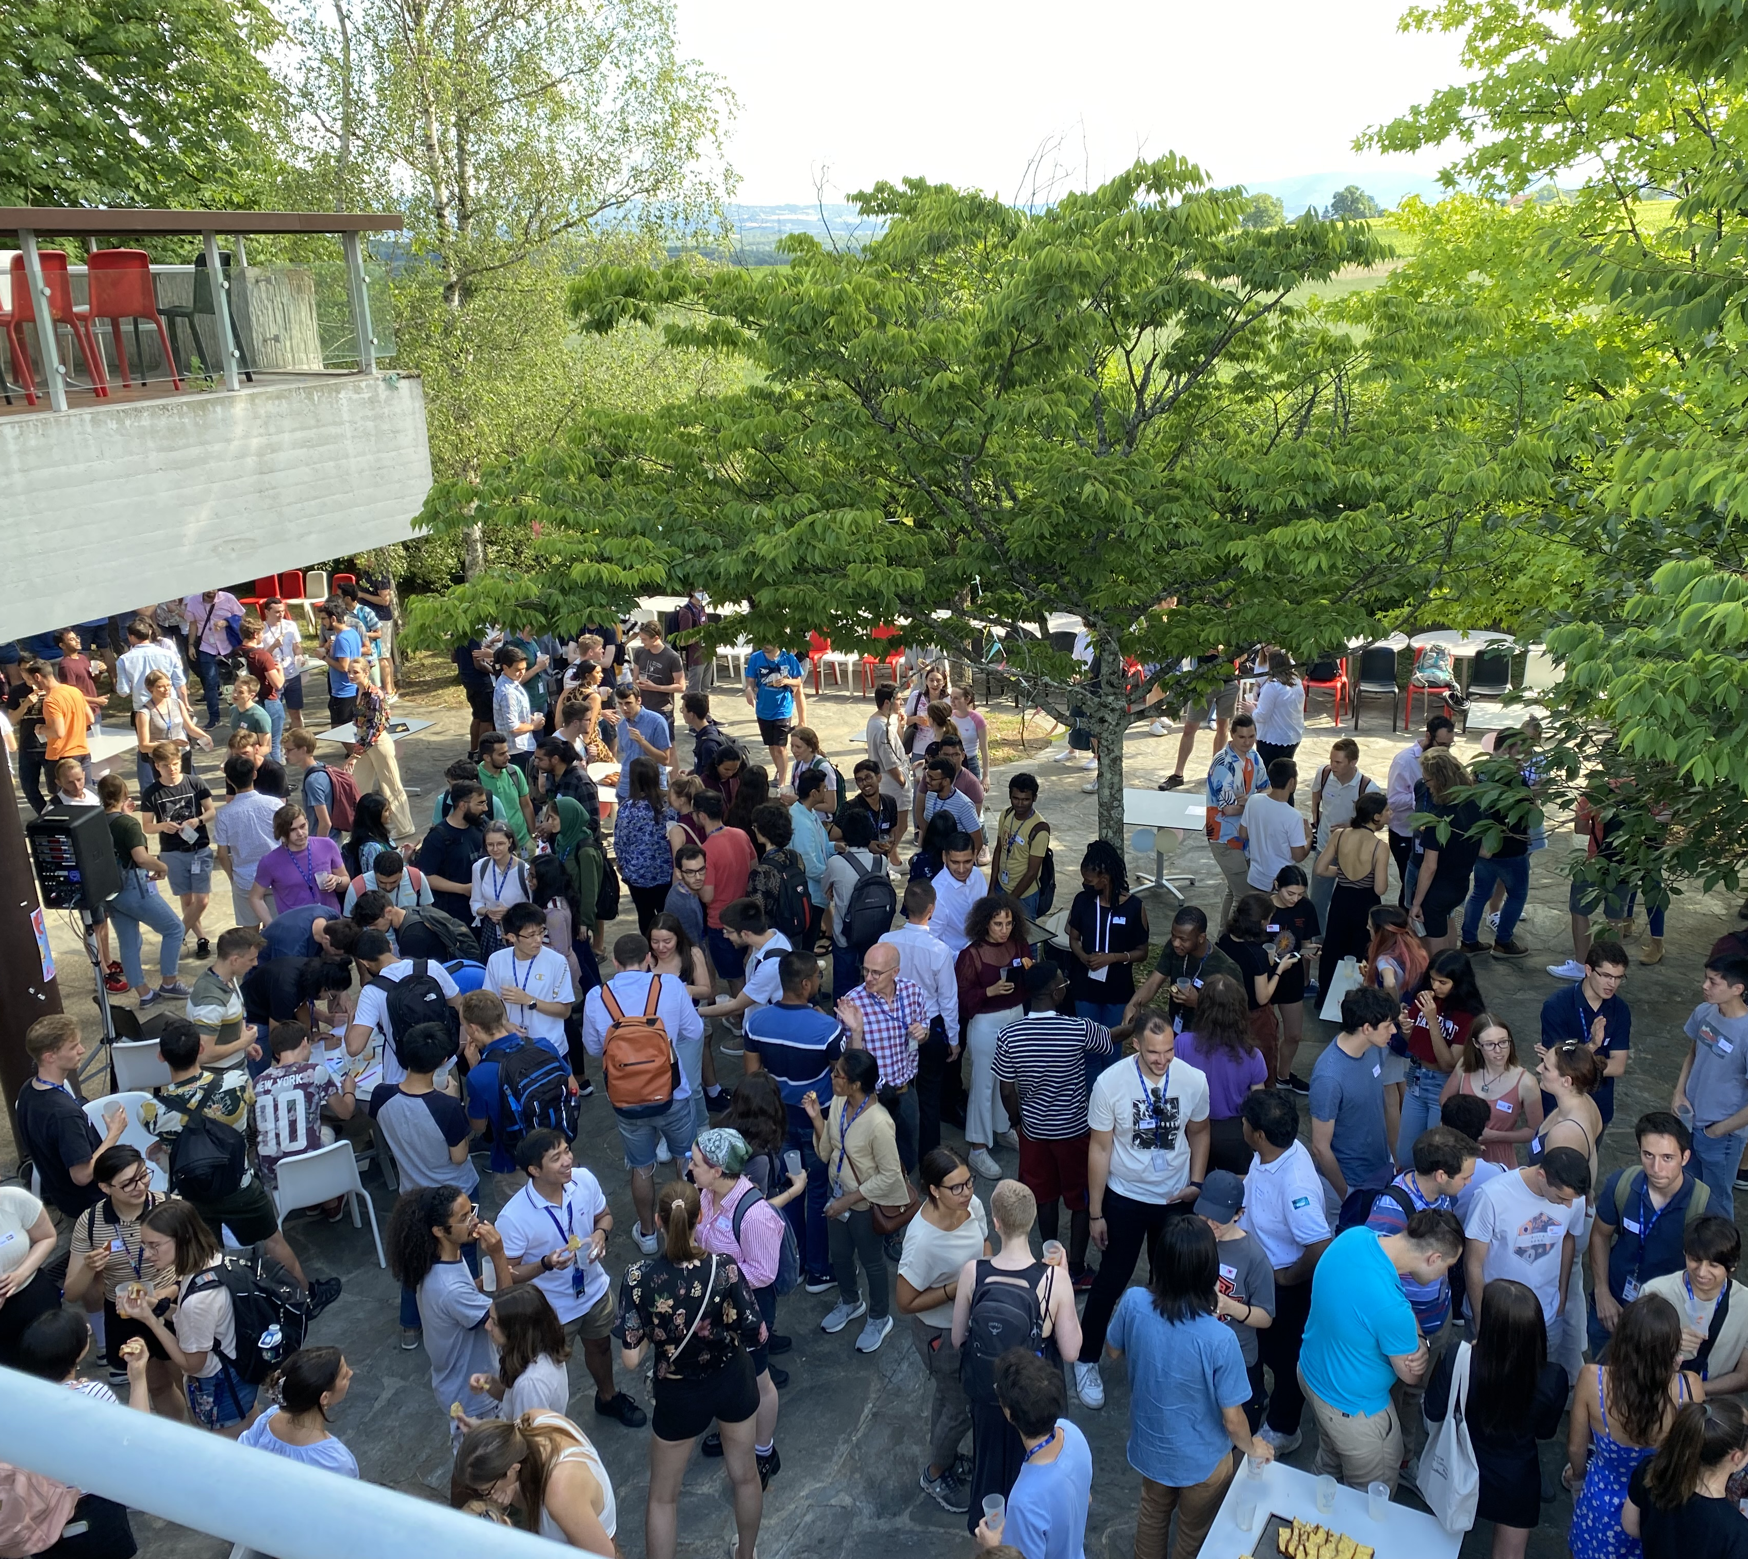
Physics Lecture Programme Schedule (Main auditorium):
The MS/NMS lecture programme ”aims at providing a pedagogical introduction to all the areas of the CERN research Mission”.
The full programme can be found here:
Lectures 2023 | summerstudent.web.cern.ch
You are welcome to attend as many lectures as you feel that you can manage. Please discuss with your supervisor.
The MS/NMS programme is also setting up workshops that might be of interest to you Workshops | summerstudent.web.cern.ch

Slide 5
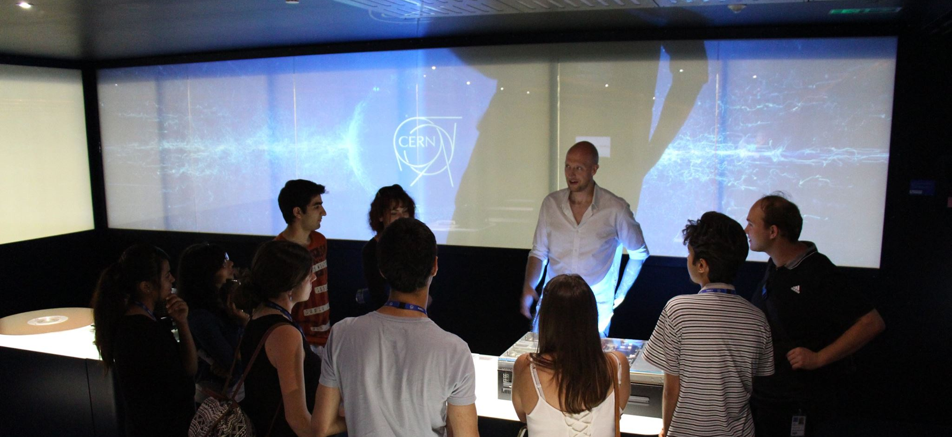
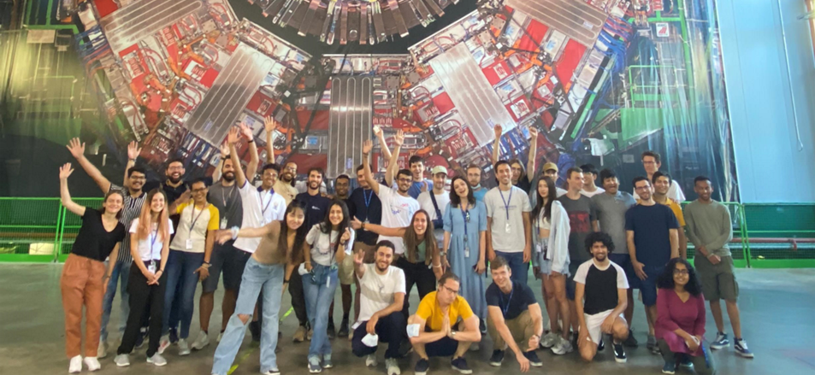
Events, excursions
Welcome drink for all summer students 4th of July at 17 h in R2
Treasure hunt in Geneva, date TBC
CERN visits to experiments and installations
Webfest
Final Lightning talk session
Openlab summer student BBQ on July 24th
…and anything else you can think of!

Slide 6

Webfest 2023
Running Friday 21 July – Sunday 23 July
Held in-person, building 40
This year’s theme is education, science, research
CERN's cutting-edge technologies in other spheres
We encourage all openlab summer students to take part in the Webfest – to share their skills, experience and collaborate with others.

Slide 7
Your contract conditions
Associated member of personnel
You are subject to all relevant legislation of CERN: Staff Rules and Regulations, Code of Conduct, Operational Circulars, Security rules…
Respecting the Organizations working hours (40h/week) 8.30-17.30
Behaving in a appropriate manner when being on the CERN site, handling property of CERN or when exposing in public your link to CERN (e.g. via social media)

Slide 8
Your contract conditions
Working
Hours
8 hours/day - ~08:30 – 17:30 -1 hour lunch break
Subsistence
90 92 CHF/day – tax free (every day from your 1st Monday – last Friday).
Health insurance
You are insured by UNIQA (already deducted from your subsistence)
Last salary+ travel lump sum will be paid according to schedule in the letter that comes with the pre-paid card
40 hour week
No paid overtime or shift work
See CHIS website: CHIS: CERN Health Insurance Scheme
No annual leave (holidays)
Pre paid cards for your subsistence
In case you have to see a doctor, try one in France first.
Reimbursements are made once the bill has been paid and the form for reimbursement filled out and sent to UNIQA.
Emerencies: Hopital de La Tour in Meyrin.
SUMs are NOT encouraged to telework (but yes, exceptions are made)

Slide 9

Prepaid Card
By Swiss bankers – distribution here today! Valid for six months
Fees:
Card fee: 0 CHF, paid by CERN
No fees charged for payments (shops & online)
No currency exchange fees, normal “exchange rate”
Cash withdrawal fee: CHF 5.- wherever you are
Online bank app:
  To see transactions & sold
  To transfer money to your home bank account (if you wish to)
Questions?
  Summer.Students.financialinfo@cern.ch
Did you know!?
  There is a 10 % reduction for meals at lunch time at the Novae restaurants, applicable to students under 25 years. Reduction cards available in your secretariat.

Slide 10

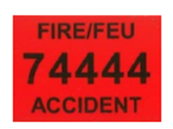
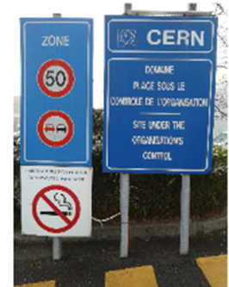



Safety at CERN
Each person … shall actively contribute to the implementation of the CERN Safety Policy through:
Exemplary conduct
Compliance with CERN Safety Rules
Actively seeking information to minimize risks
Avoiding dangerous situations for her/himself
Exercising the responsibilities given to her/him safely
Presentation on CERN security on July 4th

Slide 11
Bike to work
You can loan a bike at CERN for free! (Mobility Center, next to Entrance A)
How?
Map Meyrin-Hotel by Bike:
Online bike security training
Fill in the electronic bike form
Enjoy biking to work
Pick up your bike, locker, helmet and fluorescent vest
Deposit 100CHF
(in cash)
Wait for the email
Careful:
Always wear your helmet and fluorescent vest
Pay attention: at the roundabout in Saint-Genis, you do not have priority!

Slide 12
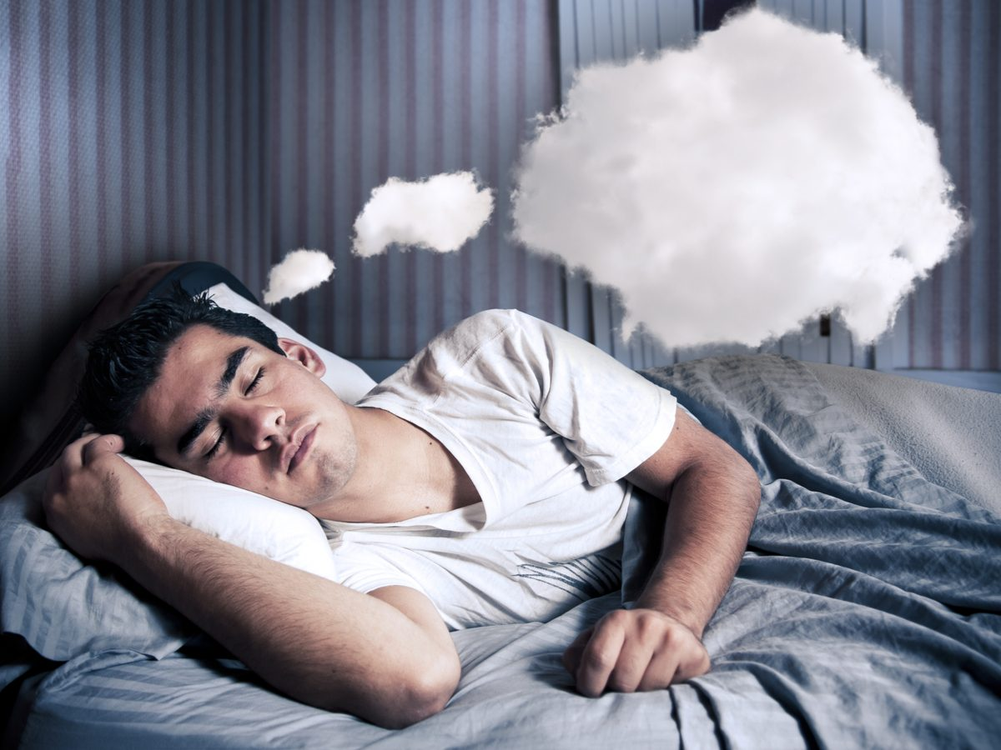

Hotel and cleaning
Séjours & Affaires Saint Genis
The facilities:
Green area
Fitness room
Balcony in each apartment
Parking (also for bikes)
Washing machine (5€/machine)…
Noise:
Remember that you aren’t alone in the hostel
Buy ear plugs!
Cleaning:
For your own comfort and to avoid any conflict, keep your apartment clean during your stay
Vacuum cleaner and other cleaning equipment available at the reception
Cleaning plan usually helps ☺
You will pay a cleaning fee at the end of your stay, this will be added to your last hotel invoice. (around 10 Euros/person)
Notes:
Cleaning fee:
45 EUR / Apartment
36 EUR / Studio

Slide 13





Other useful information
Want to organize a BBQ? Book your space at: https://indico.cern.ch/rooms/book

Slide 14
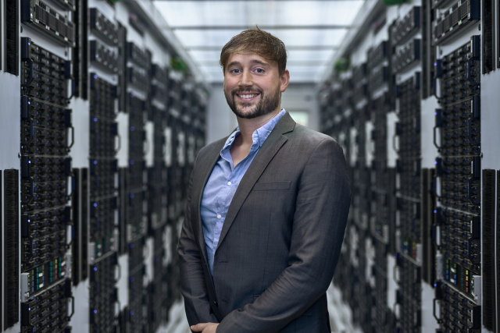
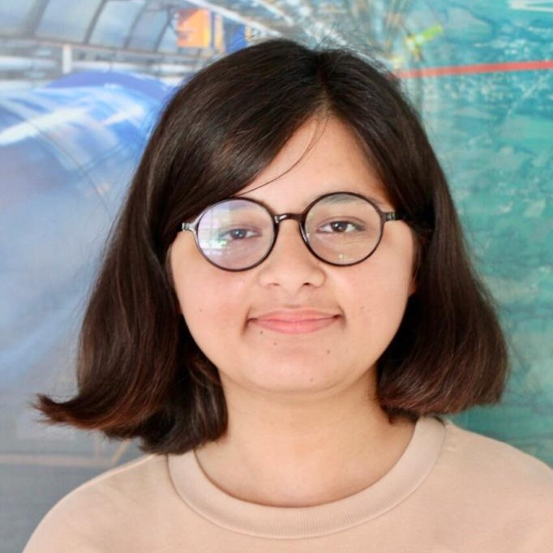
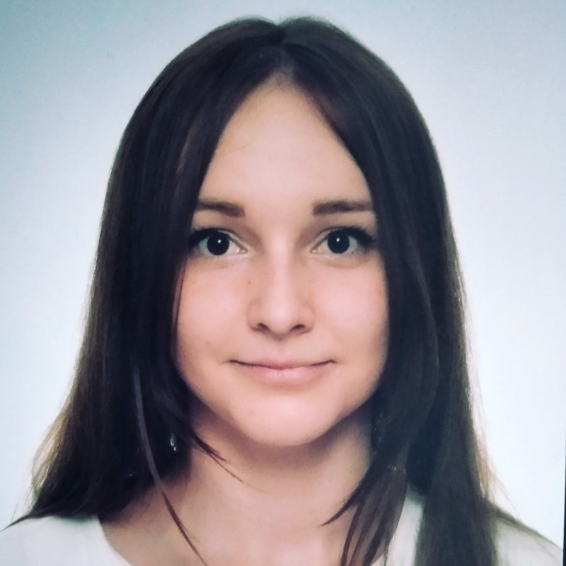
Communications
Contact the communications office
We encourage you to communicate about your work publically.
We can provide you with guidance, facts/figures, and other info.
Andrew Purcell
Communications officer
If you are contacted by the media, let us know.
It is important, however, that you please contact us first!
It is vital that you respect confidentiality agreements.
Be sure to remember the CERN Code of Conduct: http://cern.ch/go/CbD8.
Laraib Khan Marina Banjac
Junior communications officers

Slide 15

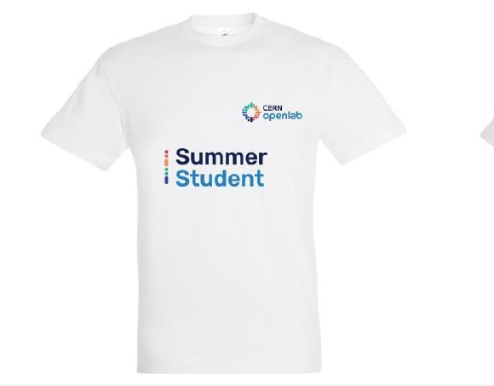
Communications
For you today
Group photo
A group photo will be taken on Monday 17th July, 11:30
Don’t forget: add this to your calendar.
Meet in front of the Globe
Remember to wear your T-shirts!
Don’t forget to pick up your t-shirt…

Slide 16
QUESTIONS?

