Slide 1


FLUKA studies for the FCC-ee MDI
Alessandro Frasca, Kevin André, Manuela Boscolo, Helmut Burkhardt, Daniele Calzolari, Andrea Ciarma, Barbara Humann, Anton Lechner, Giuseppe Lerner
FCC week 2024, 12 June 2024
alessandro.frasca@cern.ch

Slide 2
Introduction
FCC week 2024 | FLUKA studies for the FCC-ee MDI, Alessandro Frasca
In the FCC-ee interaction regions machine equipment exposed to several radiation sources
FLUKA studies to estimate the relevant quantities (power deposition, radiation levels) and contribute to equipment design
Outline
FLUKA model of FCC-ee experimental insertion
  geometry
  sources
overview of tunnel radiation levels (beamstrahlung+synchrotron radiation+radiative Bhabha)
impact of radiative Bhabha on FFQs
  total power absorbed (to be evacuated by cryogenic system)
  peak energy deposition in SC coils (quench risk and cumulative damage to insulator)
Previous talks
FCC week 2023, London (Jun 5 – 9, 2023)
FCC-ee MDI & IR mockup workshop, Frascati (Nov 16 – 17, 2023)
7th FCC Physics workshop, Annecy (Jan 29 – Feb 2, 2024)
FCC-ee MDI meeting #52, CERN (Mar 11, 2024)
6th FCC-ee Radiation and Shielding Meeting, CERN (Apr 24, 2024)

Slide 3
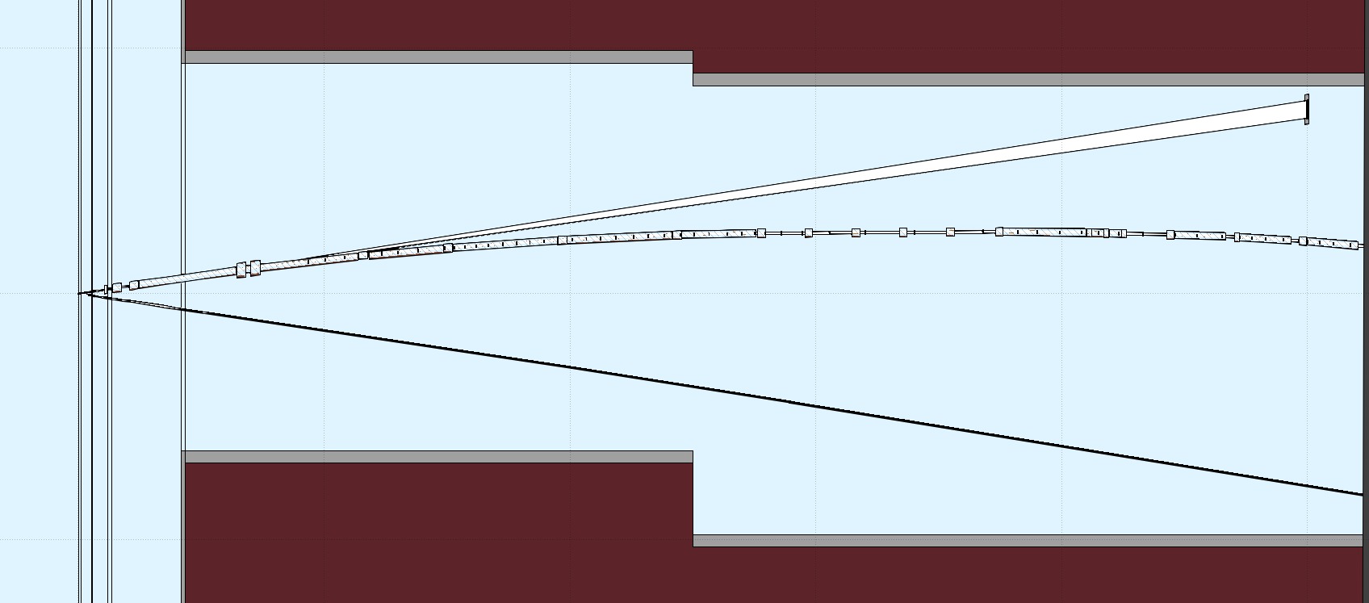
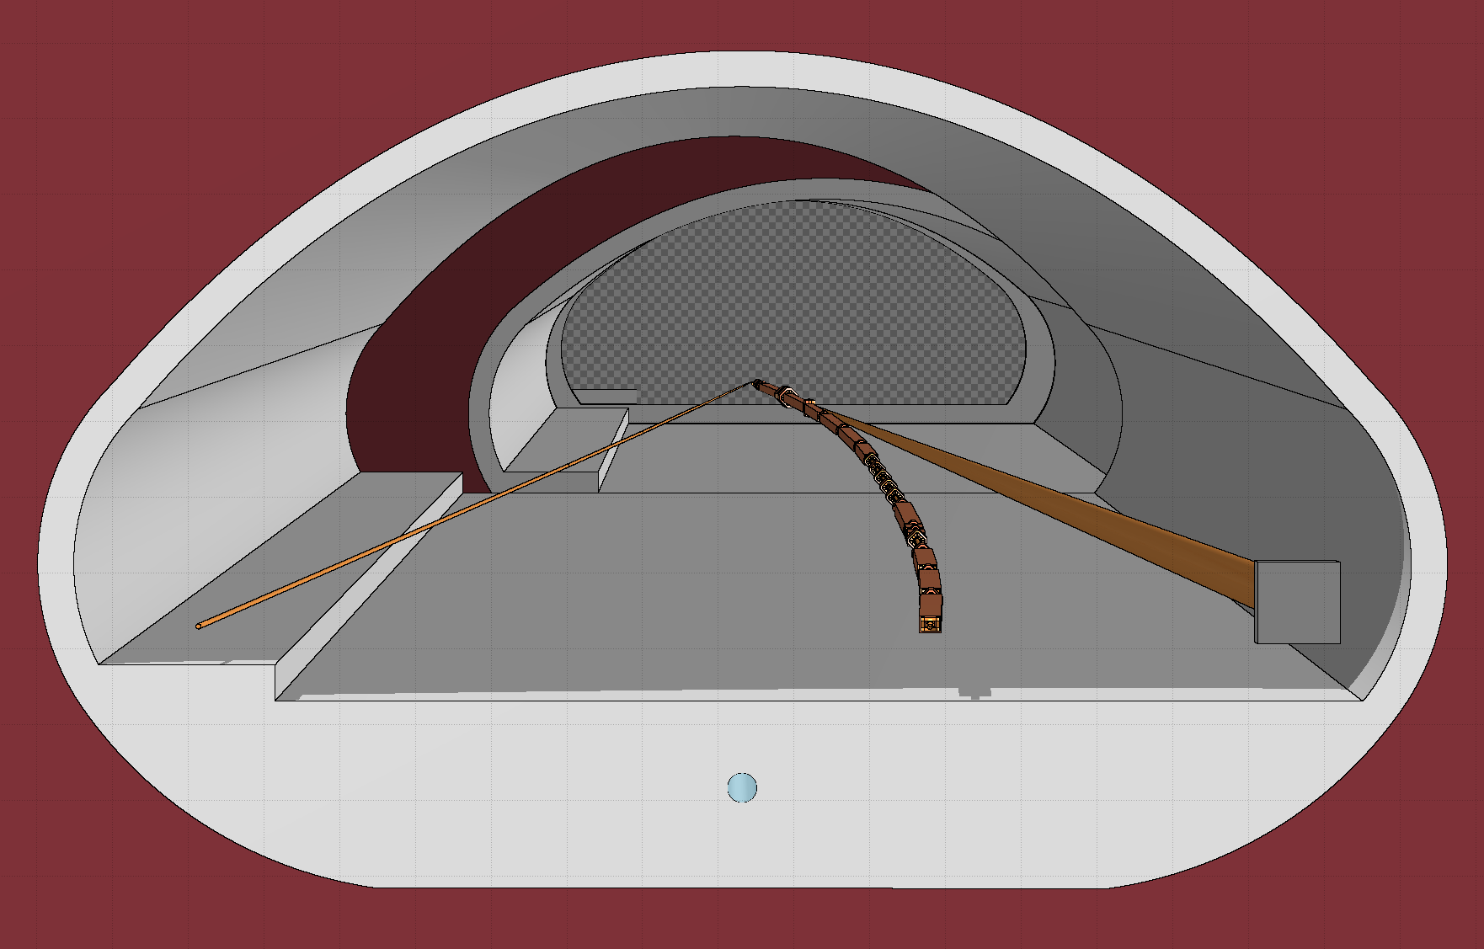
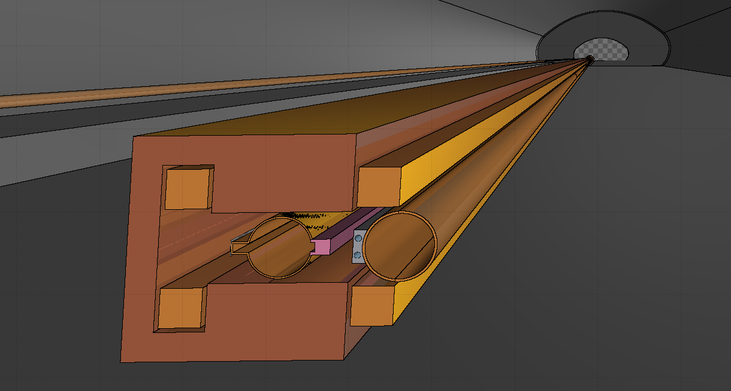
FLUKA geometry of the FCC-ee IR (right of IP)
FCC week 2024 | FLUKA studies for the FCC-ee MDI, Alessandro Frasca
IP
☆
beamstrahlung extraction line
BS
IP
☆
outgoing beamline
e⁻
∢
e⁻
BS
e⁺
dump
e⁺
520 m
Optics lattice v22
concrete tunnel surrounded by soil
copper beam pipe (35mm radius)
CuCrZr SR absorbers (no additional shielding)
dipoles and quadrupoles (including magnetic fields)
conical copper extraction line
beamstrahlung dump and shielding`
☆ IP
e⁻
BS
photons

Slide 4
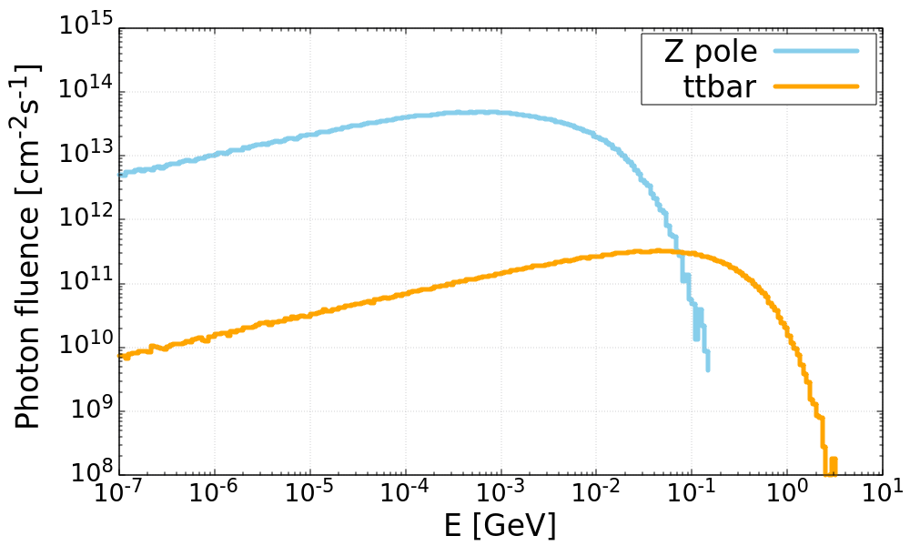
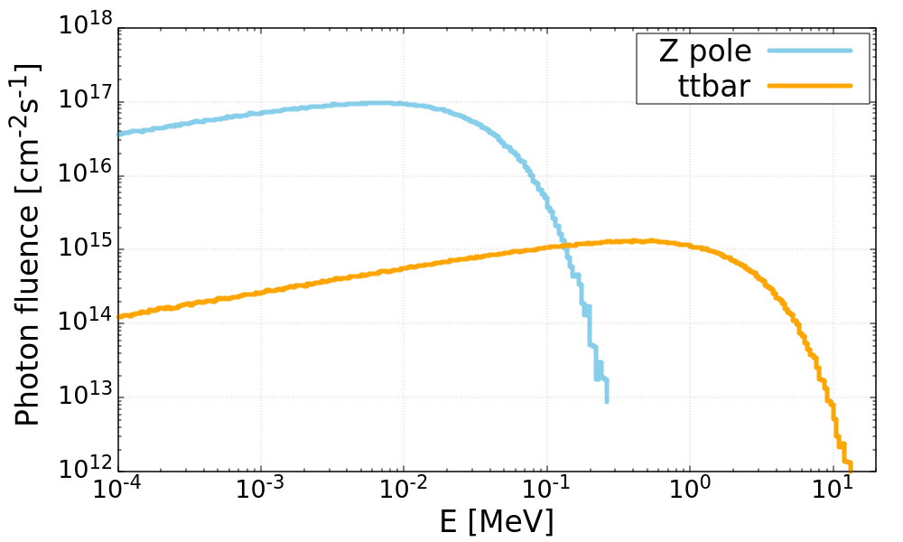
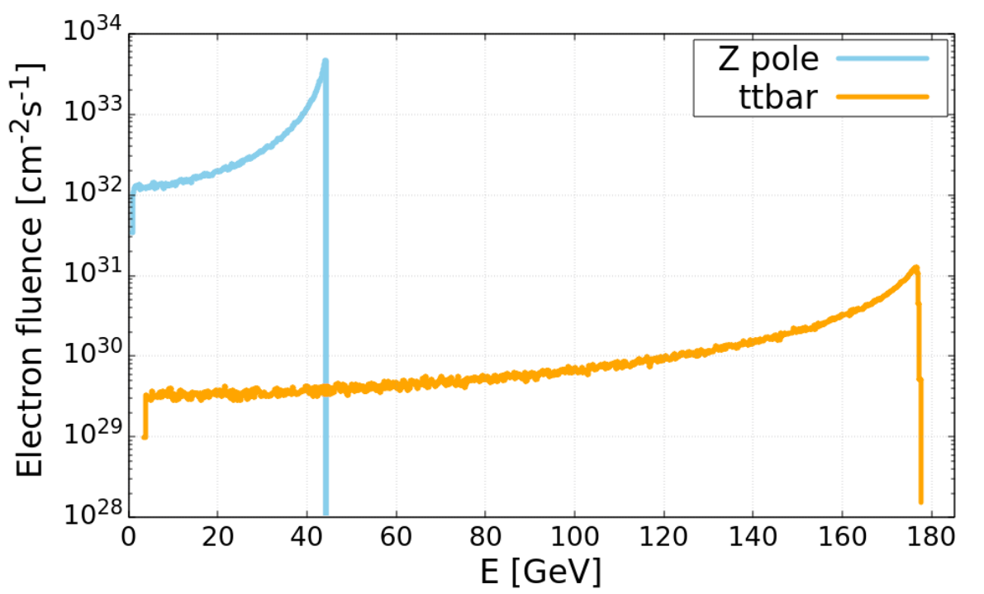
Sources
FCC week 2024 | FLUKA studies for the FCC-ee MDI, Alessandro Frasca
Beamstrahlung photons
photons emitted in the EM field of the counter-rotating bunch at the IP
intense photon flux (nominally 370kW @Z-pole, 77kW @ttbar)
  dedicated dump (see talk by M. Calviani)
sampled from distributions generated with GUINEA-PIG++ by A. Ciarma
Synchrotron radiation
photons emitted by beam particles when bent by the magnets
SR from the beam incoming to the IP neglected (1kW in 500m)
SR from the outgoing beam much more intense (164kW in 500m)
generated run-time by FLUKA when transporting beam particles along the magnets
Radiative Bhabha electrons
electrons scattered in radiative Bhabha at the IP and radiating one or more photons (up to 100% of their energy)
off-momentum electrons outgoing from the IP with significant angle
  lost downstream
sampled from distributions generated with BBREM and GUINEA-PIG++ by A. Ciarma
BG1 dipoles

Slide 5
Overview of tunnel radiation levels
FCC week 2024 | FLUKA studies for the FCC-ee MDI, Alessandro Frasca

Slide 6
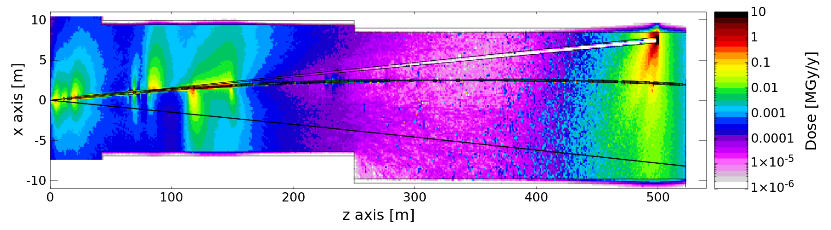
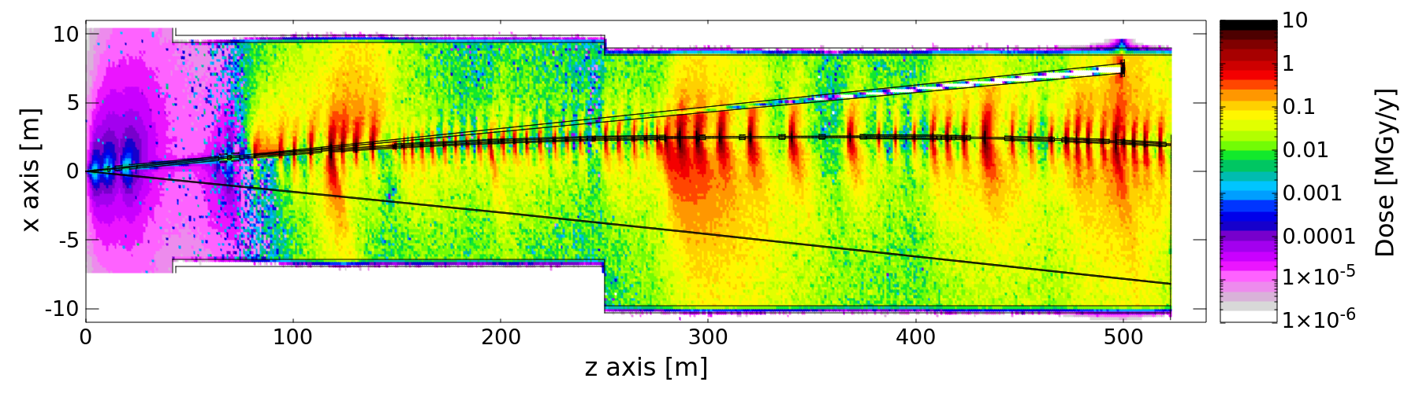
FCC week 2024 | FLUKA studies for the FCC-ee MDI, Alessandro Frasca
Annual TID in the tunnel from BS, SR, and RBB
BS photons
top view, beamline height (±20 cm)
Z pole
RBB electrons
SR photons
ttbar

Slide 7
Impact of radiative Bhabha on FFQs
FCC week 2024 | FLUKA studies for the FCC-ee MDI, Alessandro Frasca

Slide 8
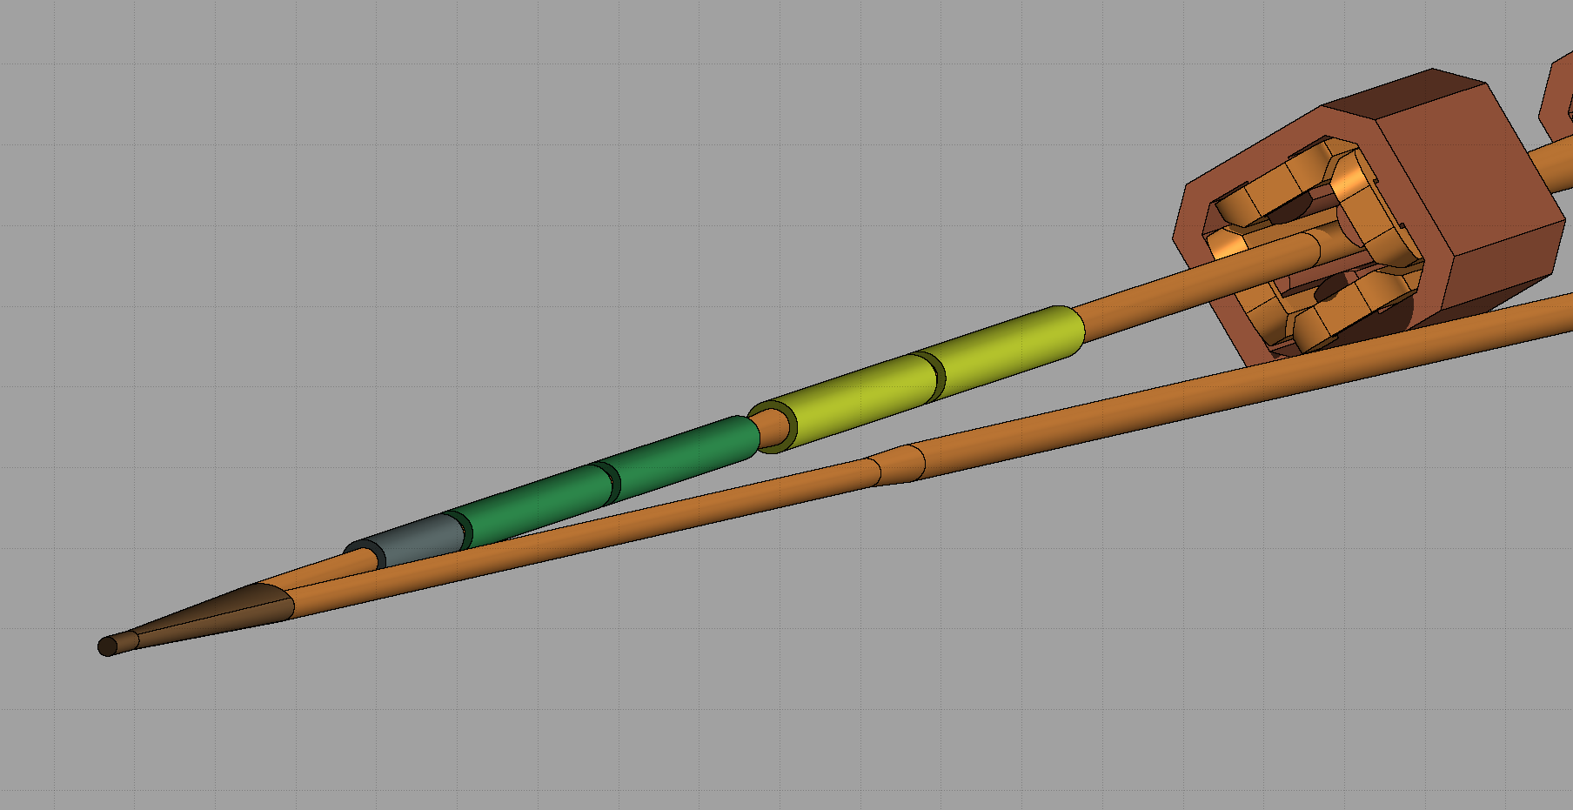


FLUKA model of final focus
FCC week 2024 | FLUKA studies for the FCC-ee MDI, Alessandro Frasca
Geometry:
dummy model of central chamber
dummy model of FFQs on the outgoing beamline (1-cm thick in equivalent material)
FFQ equivalent material:
density = 3.367gcm⁻³
volume fractions
  Al 0.6540582
  NbTi 0.0619107
  Cu 0.1176303
  Paraffin 0.0977433
  Kapton 0.0686575
QC2
QC1
IP
☆
e⁻
e⁺
1.5 cm
2.0 cm
2.8 cm
3.3 cm
0.3 cm
0.3 cm
QC1
QC2

Slide 9
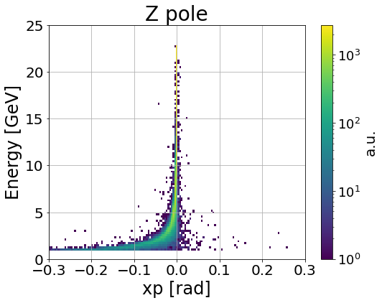
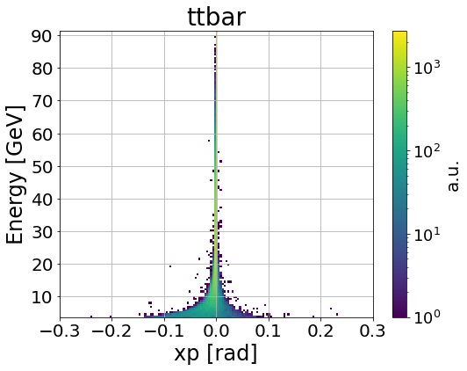
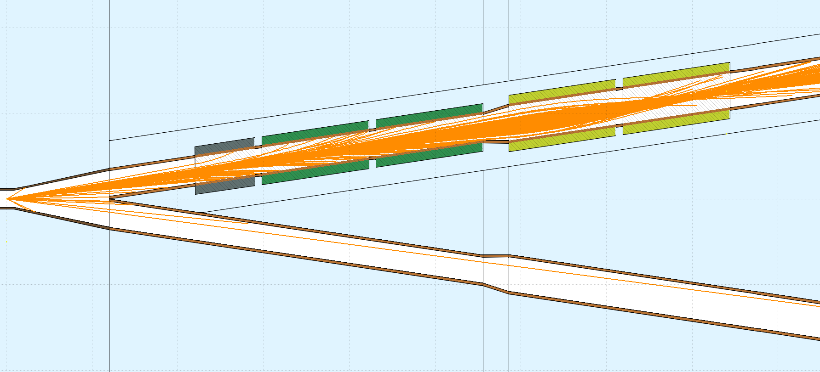
Radiative Bhabha distributions
FCC week 2024 | FLUKA studies for the FCC-ee MDI, Alessandro Frasca
BBBrem : radiative Bhabha event generator (CM of scattering particles)
cut in maximum distance between interacting particles → minimum momentum transfer
  1 σ_{y} cut: minimum distance to account for the realistic electric field screening caused by bunch particles (experience at LEP from measurements of beam lifetime, see paper by H. Burkhardt)
cut in minimum energy carried by the emitted photon → maximum energy of scattered electron
  50% energy cut (electrons up to 22.8 GeV and 91.25 GeV) to study impact on FFQs (see MDI talk for a full analysis of Bhabha loss distribution)
GUINEA-PIG++: particle in cell software for beam-beam effects to apply the boost to generated e⁻:
asymmetric beam-beam effects (see talk by D. Shatilov)
→ asymmetric losses on FFQs
⇒

Slide 10
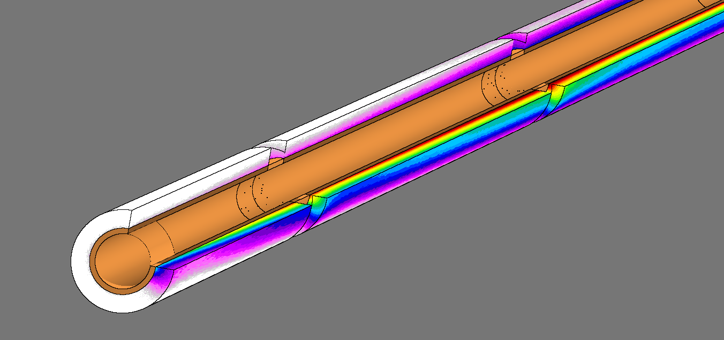
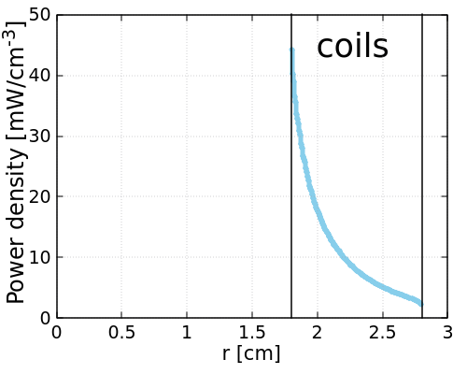
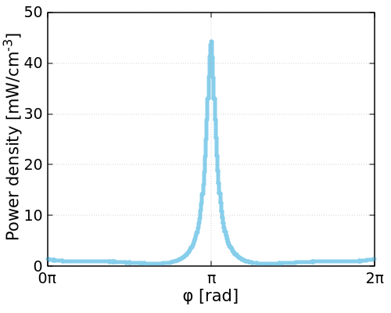
Power deposition in FFQ superconducting coils
FCC week 2024 | FLUKA studies for the FCC-ee MDI, Alessandro Frasca
simulated distributions 1 σ_{y} cut, 50% energy cut
Z pole σ*ε=18.2 mb, L=1.82E+36 s⁻¹cm⁻²
ttbar σ*ε=19.2 mb, L=1.33E+34 s⁻¹cm⁻²
TOTAL POWER DEPOSITED
φ
 | Z pole | ttbar
QC1R1 | 0.30 W | 3.4 mW
QC1R2 | 1.54 W | 20.4 mW
QC1R3 | 2.00 W | 29.7 mW
QC2R1 | 0.20 W | 1.9 mW
QC2R2 | 0.04 W | 1.8 mW
e⁻
r
Z pole, peak values in QC1R2
High gradients in energy deposition distribution
→ high local peak power density and maximum Total Ionizing Dose (TID)

Slide 11
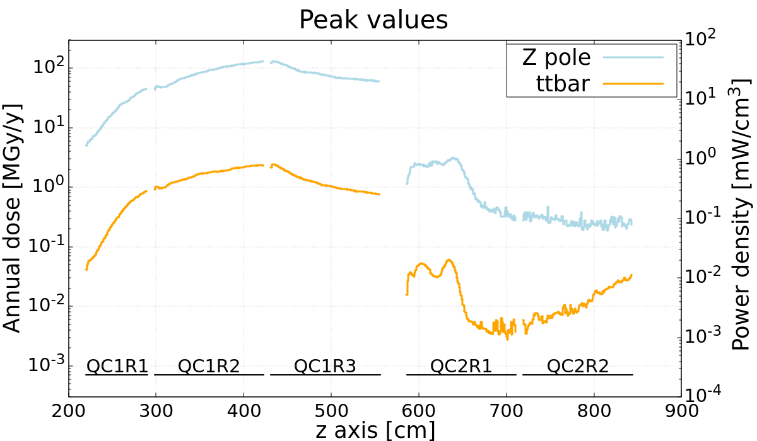
Power deposition in FFQ superconducting coils
FCC week 2024 | FLUKA studies for the FCC-ee MDI, Alessandro Frasca
simulated distributions 1 σ_{y} cut, 50% energy cut
Z pole σ*ε=18.2 mb, L=1.82E+36 s⁻¹cm⁻²
ttbar σ*ε=19.2 mb, L=1.33E+34 s⁻¹cm⁻²
Annual dose computed assuming 10⁷ s of operation per year at the reference instantaneous luminosity
TOTAL POWER DEPOSITED
 | Z pole | ttbar
QC1R1 | 0.30 W | 3.4 mW
QC1R2 | 1.54 W | 20.4 mW
QC1R3 | 2.00 W | 29.7 mW
QC2R1 | 0.20 W | 1.9 mW
QC2R2 | 0.04 W | 1.8 mW
Shielding needed in an area already with tight space constraints!

Slide 12
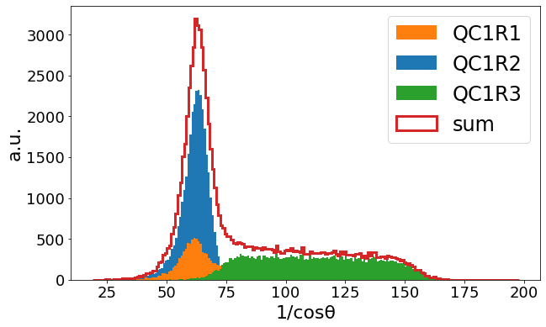


Electron impact angle analysis
FCC week 2024 | FLUKA studies for the FCC-ee MDI, Alessandro Frasca
e⁻
Radiative Bhabha electrons impacting at small angles:
higher effective shielding thickness t_{eff} = t*1/cosθ
1/cosθ >>10
radiation showers see >>10x shielding thickness
few mm of W (X₀= 0.35 cm) shielding can be effective
limiting factor: Molière radius (~size of energy deposition cone)→0.93 cm for tungsten
t
θ
t_{eff}
t_{eff} = t*1/cosθ
Distribution of 1/cosθ for electrons impacting in QC1 at Z pole
Conceptual shielding studied: 0.25 cm, 0.5 cm and 1 cm thick layer of tungsten around QC1
impact on magnet design (greater aperture needed)
1.5 cm
1.5 cm
3.05 cm
3.3 cm
0.25 cm
0.5 cm

Slide 13
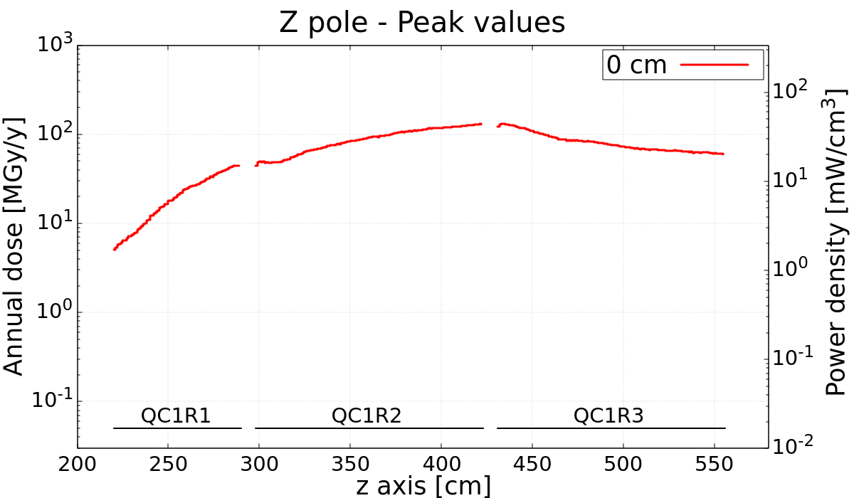
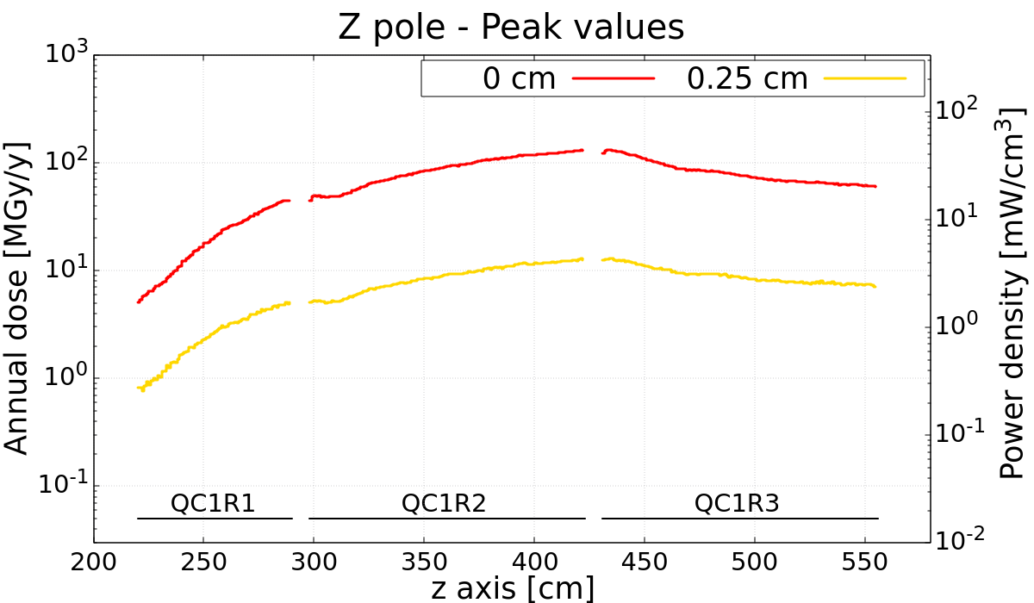
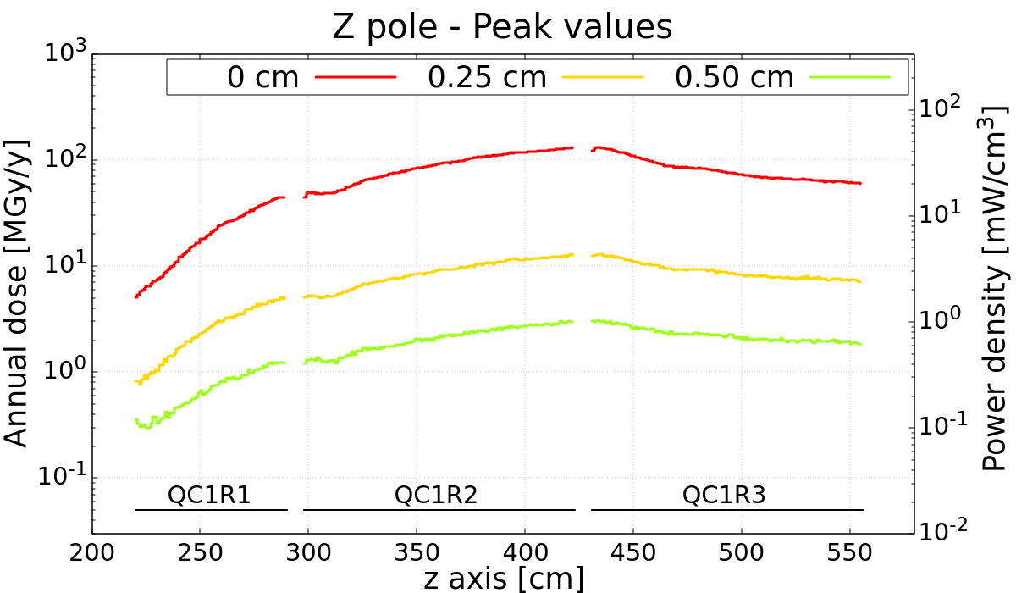
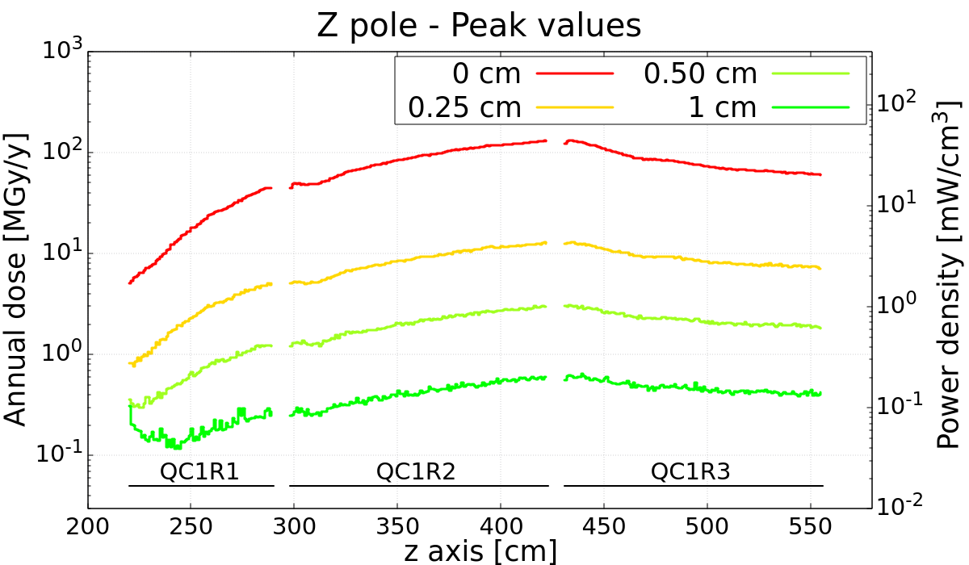
Shielding effectiveness
FCC week 2024 | FLUKA studies for the FCC-ee MDI, Alessandro Frasca
TOTAL POWER DEPOSITED
W1
QC1R1
W2
QC1R2
W3
QC1R3
0 cm
–
0.30 W
–
1.54 W
–
2.00W
0.25 cm
0.44 W
0.07 W
2.19 W
0.34 W
2.75 W
0.44 W
0.5 cm
0.57 W
0.03 W
2.85 W
0.14 W
3.59 W
0.19 W
1 cm
0.67 W
0.01 W
3.34 W
0.05 W
4.22 W
0.07 W
/10
/2
/2

Slide 14
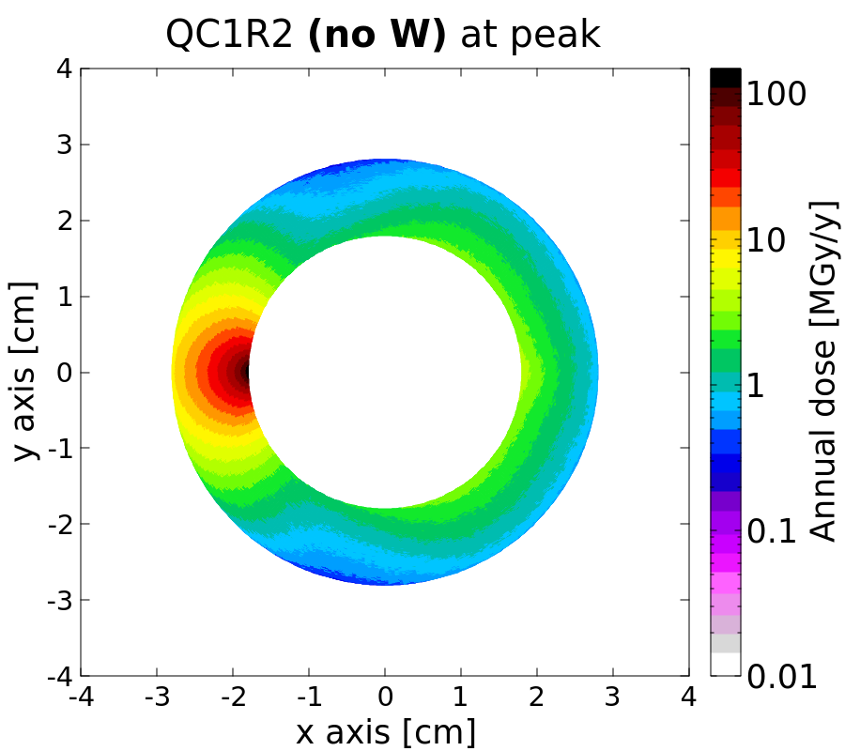
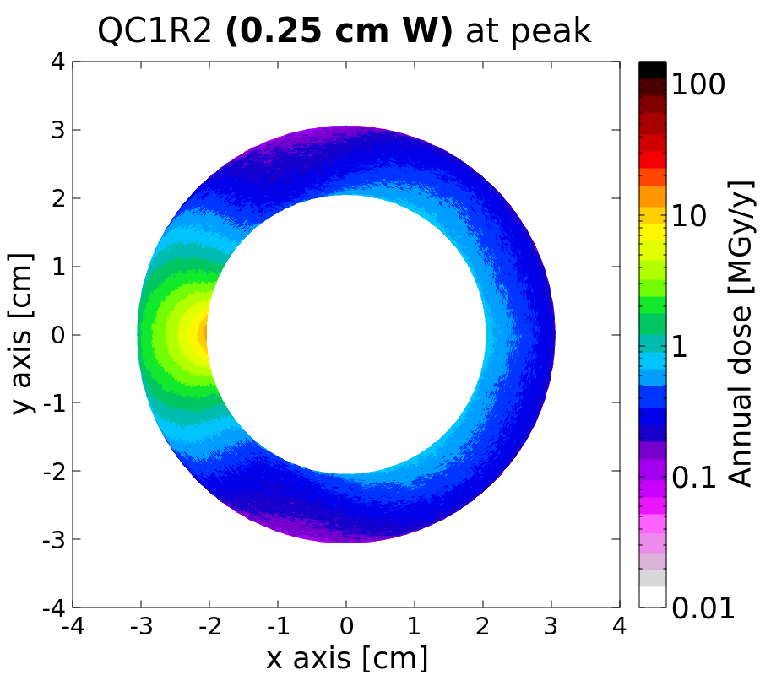
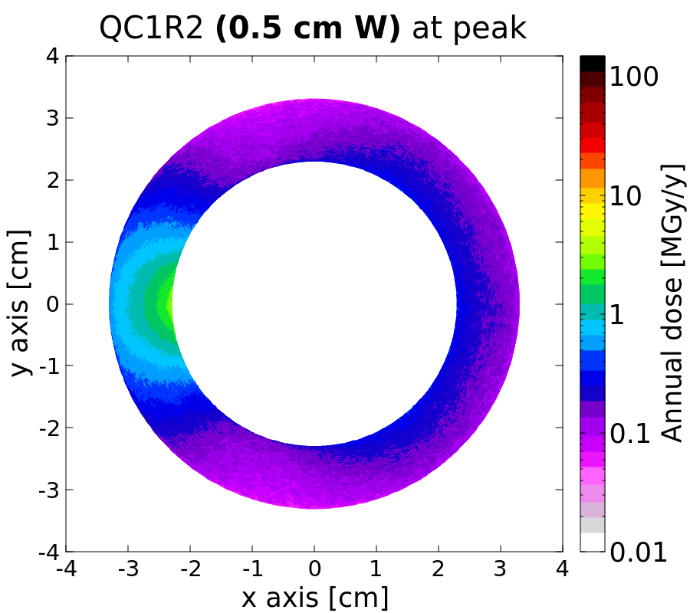
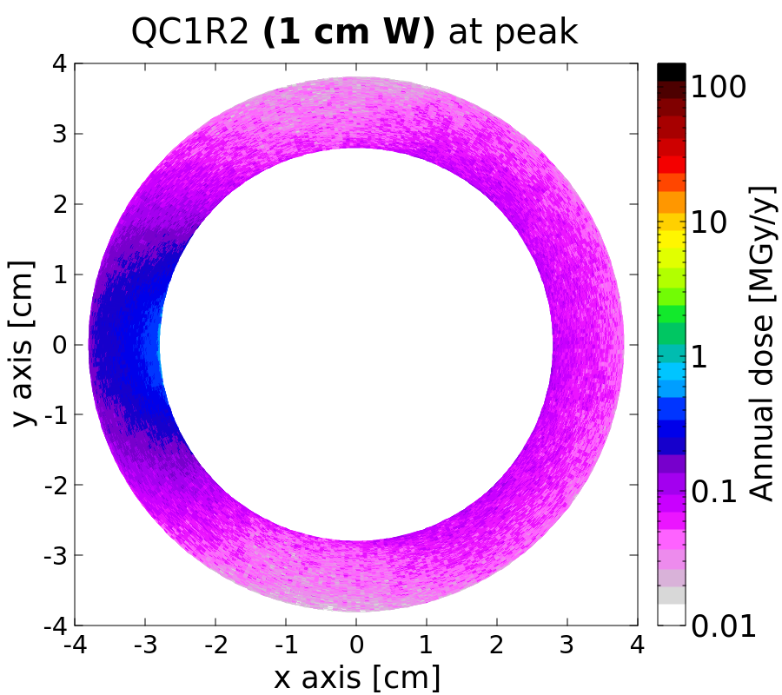
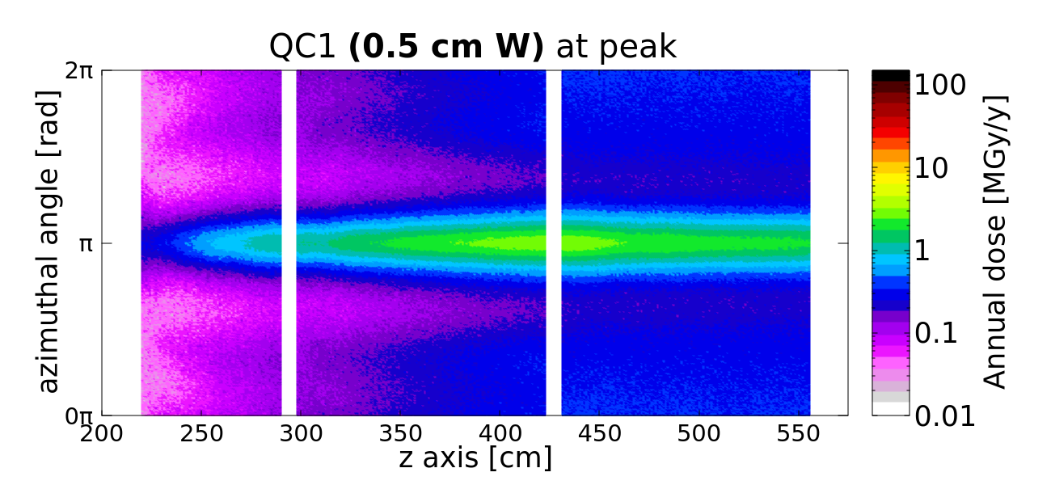
Considerations on tungsten shielding
FCC week 2024 | FLUKA studies for the FCC-ee MDI, Alessandro Frasca
What would be a reasonable dose limit?
at LHC inner triplet quadrupoles limited to 30 MGy (crossing inversion at ATLAS to overcome the design target of 300 fb⁻¹)
preliminary indication is that 5 mm shielding is necessary mainly because of TID
5 mm of tungsten ensures
  peak dose: 3 MGy/y
  peak power density deposition: 1 mW/cm3
asymmetric design can be considered
iterations with magnet design experts shall follow on this evidence (results already anticipated to John Seeman)

Slide 15
Summary and prospects
Thank you for your attention!
FCC week 2024 | FLUKA studies for the FCC-ee MDI, Alessandro Frasca
Beamstrahlung dump
input is being provided for thermomechanical and radiation protection studies (see previous talks and talk by M. Calviani)
Synchrotron radiation
studies will follow to further reduce the tunnel radiation levels with additional shielding
FFQs power and dose study
computed contribution from radiative Bhabha electrons (main contribution)
0.5cm-thick tungsten shielding would ensure safe values of peak power deposition and TID
missing additional contributions (not yet studied): incoherent pair production, Z→qq, beam gas scattering, and possibly others to be quantified
Next topic to be approached
radiation load to the detector, starting from establishing what are the key radiation sources

Slide 16
Backup
FCC week 2024 | FLUKA studies for the FCC-ee MDI, Alessandro Frasca

Slide 17
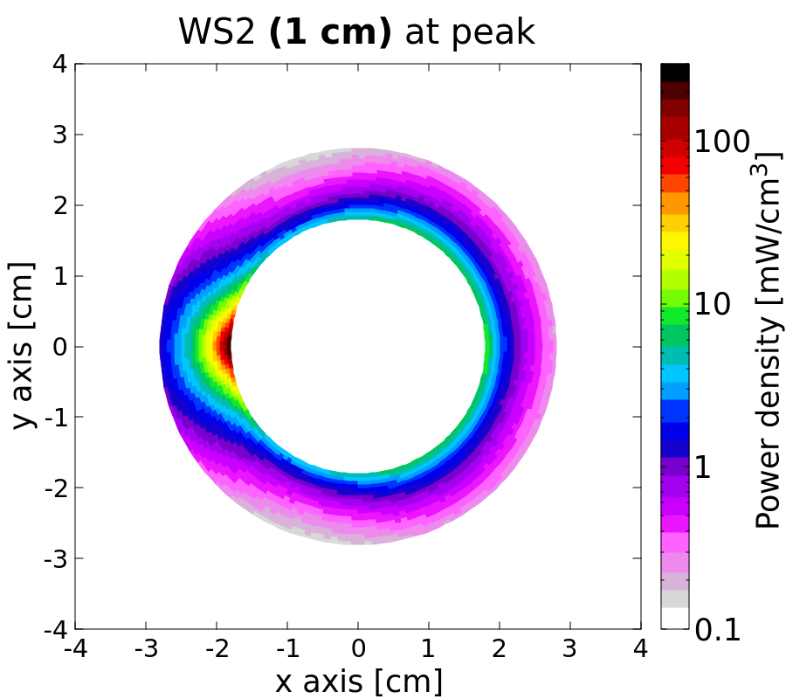
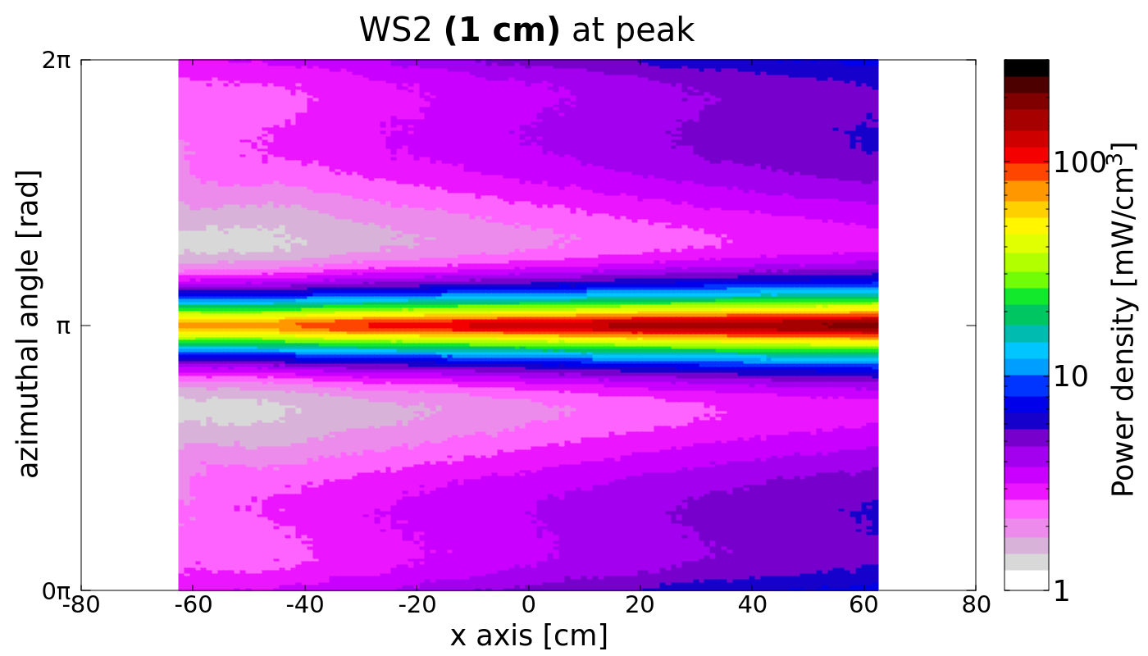
FCC week 2024 | FLUKA studies for the FCC-ee MDI, Alessandro Frasca
Power deposition in tungsten shielding

