Slide 2
Top-up injection scheme into the collider
Y. Dutheil & S. Yue, on behalf of SY-ABT
CERN, Geneva, Switzerland

Slide 3
Context and outline
The FCC lepton collider aims at maintaining record-high luminosities
  Beam lifetime and high bunch charge require continuous top-up injection
Introduction to top-up injection conventional concept
  On-axis Vs Off-axis
  Experience from LEP
Baseline scheme
  Hardware and concept selection
  Z-mode design
  Possible optimisation
  Other modes concepts
Machine protection concerns
MKI scenario
Conclusion

Slide 4
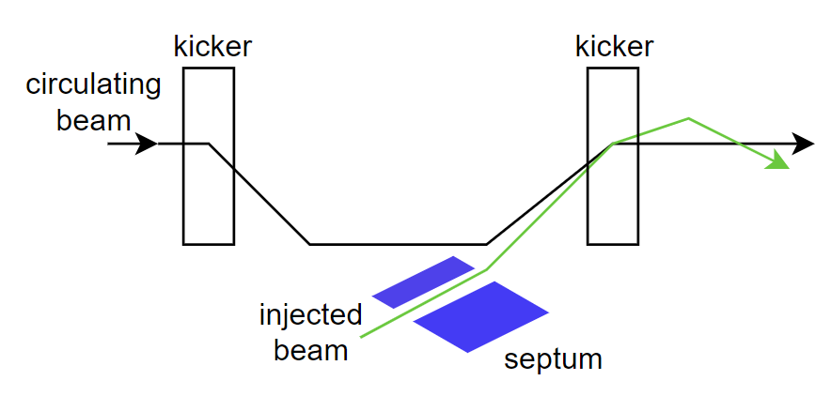
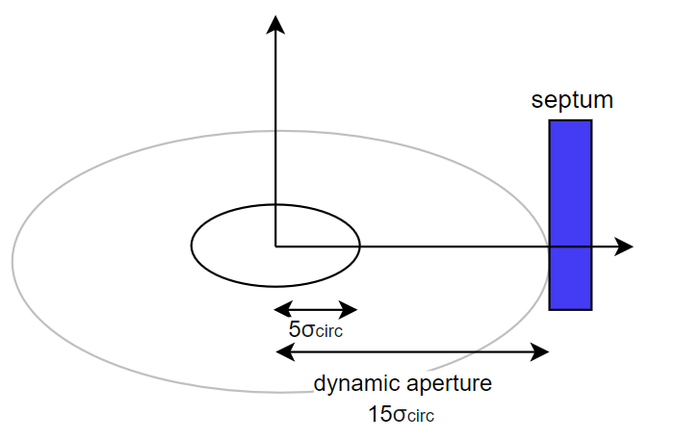
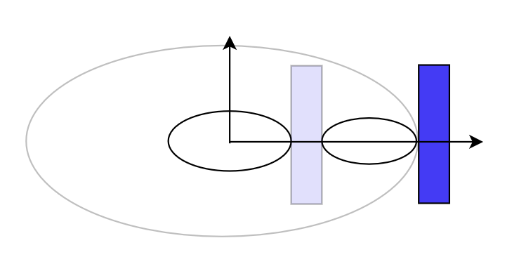
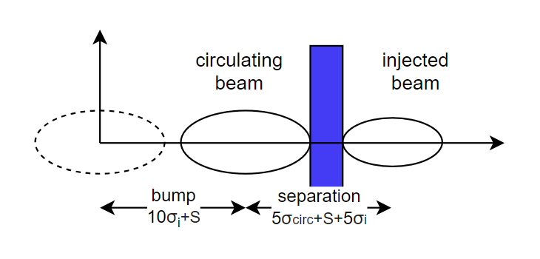
Introduction to top-up injection: conventional concept
Dipole kickers magnets create a closed bump to bring the stored beam trajectory close to the injection system (see G. Favia and J. Borburgh on Thu)
Two kickers are placed with 180° phase advance between them (π-orbit-bump)
The bump is constant for up to a single turn while off before and after
Beam separation at the injection septum
  Off-axis means the separation exists in the transverse space -> betatron oscillations and damping
  On-axis means the separation exists in momentum at a dispersive region -> longitudinal oscillations and damping
[1] P. Hunchak, 2021 FCCIS WP2 Workshop ,link

Slide 5
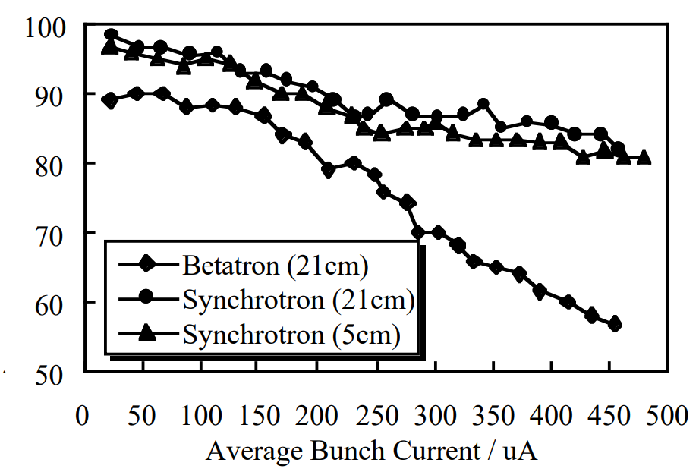
Introduction to top-up injection: history of LEP
LEP was design for both on-axis and off-axis top-up injection
  Operation started with off-axis injection until the first tests in 1994
  Following commissioning and comparison, on-axis injection became the nominal injection scheme
Advantages of the on-axis
  Faster damping since the injected beam undergoes
  longitudinal oscitations
  Flat trajectories in the achromatic experimental
  straight sections reduced radiation doses to experiments
  Overall, less affected by injection errors and provided
  better injection efficiency at higher bunch current
[1] Collier, Paul. "Synchrotron phase space injection into LEP." Proceedings Particle Accelerator Conference. Vol. 1. IEEE, 1995.

Slide 6
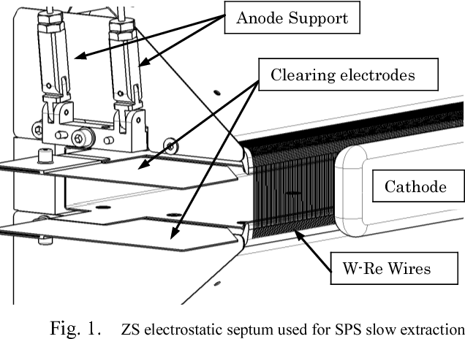
Baseline scheme: selection
Injection Septum technology
  Electrostatic septum
    Minimal blade thickness of ~100 µm
    A potential availability risk was identified due to photo-electron
    induced sparking, as observed in the SPS when accelerating positrons [2]
    An ongoing R&D program in ABT aims at characterizing the sparking probability
    in the presence of synchrotron radiation
  Magnetic septum
    Thicker blade of 1 mm to a few mm is needed
    Several technology available
  New baseline concept uses a thin magnetic septum of 2.8 mm blade thickness (see J. Borburgh on Thu)
Baseline injection scheme
  Every scheme was reviewed in 2018 [3] and conventional as well as multipole kicker injection schemes were considered suitable
  Off-axis injection scheme
    Experience from LEP is directly applicable : lower radiation to experiments with on-axis scheme
    Modelling of SR power deposition around experimental area showed that betatron injection with gap of ~10σ is not feasible [1]
  On-axis injection scheme
    Septum gap between injected and circulating beams opened by dispersion and momentum offset
    Requires sufficient dynamic aperture and flexible optics to obtain a large dispersion at the injection point
  The baseline scheme uses on-axis injection
[1] K. Andre, SR power deposition from injected beam, 161st FCC-ee Optics Design Meeting,
[2] Dubois, R ; Weisse, E ; Keizer, R L, First comments on the interaction of synchrotron light with the electrostatic septa of the SPS, SPS-ABT-Tech-Note-88-05
[3] Aiba, Masamitsu, et al. “Top-up injection schemes for future circular lepton collider.” Nuclear Instruments and Methods in Physics Research Section A: Accelerators, Spectrometers, Detectors and Associated Equipment 880 (2018): 98-106.​

Slide 7
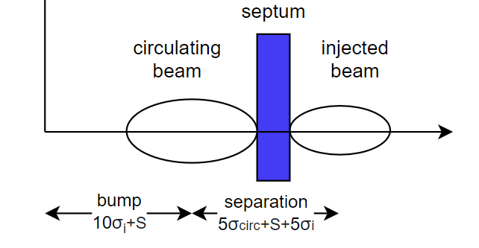
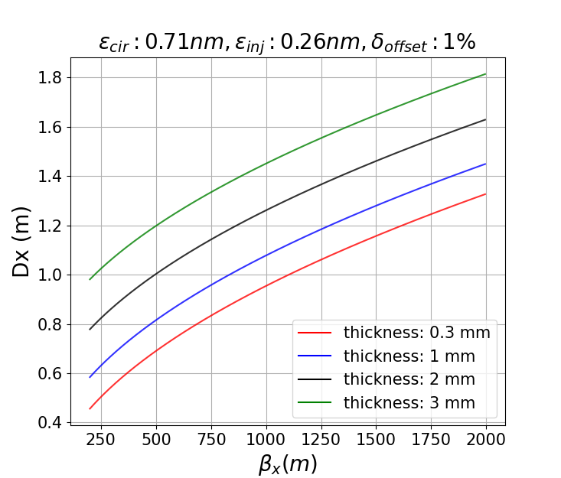
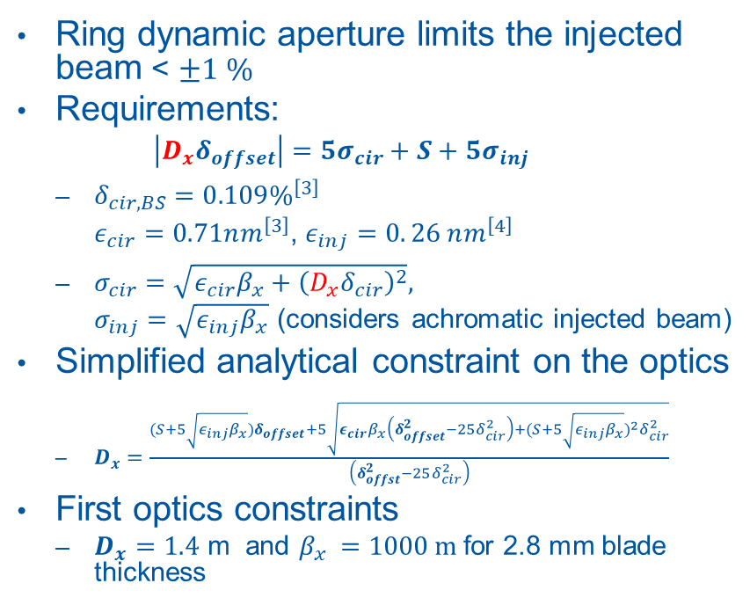
Baseline scheme: Z-mode requirements
Ring dynamic aperture limits the injected beam < $±1 \%$
Requirements:
  $\left|D_{x}δ_{offset}\right|=5σ_{cir}+S+5σ_{inj}$
  $δ_{cir, BS}=0.109\%^{\left[3\right]}$
  $ε_{cir}=0.71nm^{\left[3\right]}$, $ε_{inj}=0. 26 nm^{\left[4\right]}$
  $σ_{cir}=\sqrt{ε_{cir}β_{x}+{\left(D_{x}δ_{cir}\right)}^{2}},$
  $σ_{inj}=\sqrt{ε_{inj}β_{x}}$ (considers achromatic injected beam)
Simplified analytical constraint on the optics
  $D_{x}=\frac{(S+5\sqrt{ε_{inj}β_{x}})δ_{offset}+5\sqrt{ε_{cir}β_{x}\left(δ_{offset}^{2}−25δ_{cir}^{2}\right)+{(S+5\sqrt{ε_{inj}β_{x}})}^{2}δ_{cir}^{2}}}{\left(δ_{offst}^{2}−25δ_{cir}^{2}\right)}$
First optics constraints
  $D_{x}=1.4$ m and $β_{x }=1000 m$ for 2.8 mm blade thickness
Bumped orbit
Off energy orbit

Slide 8
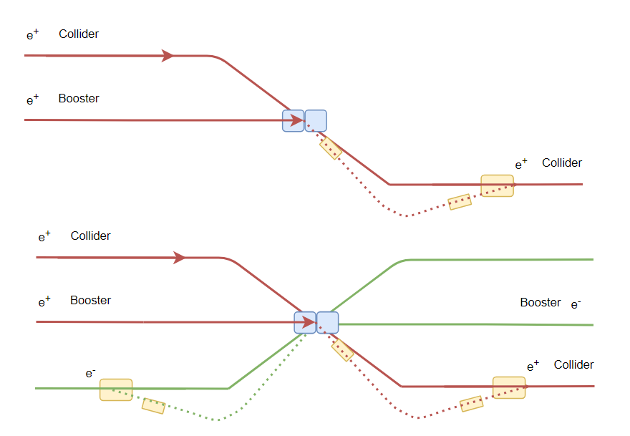
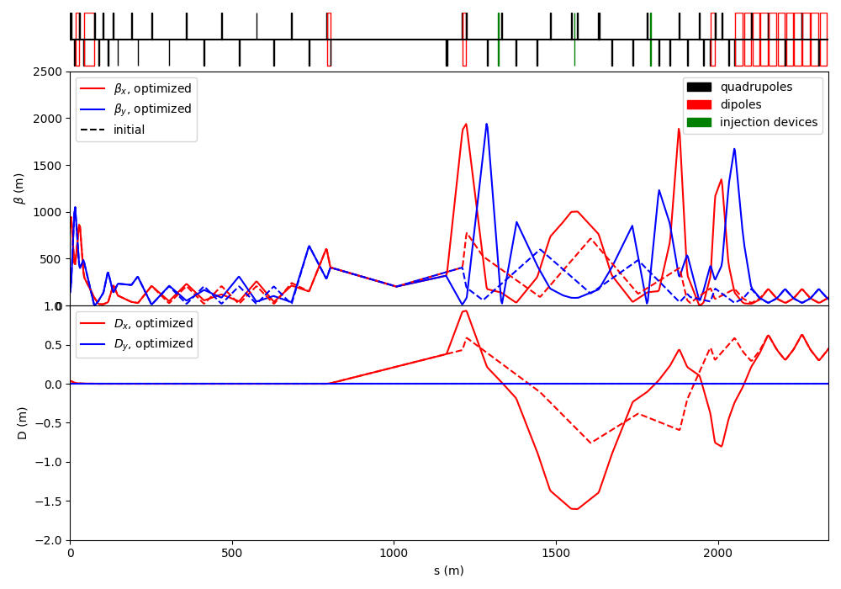
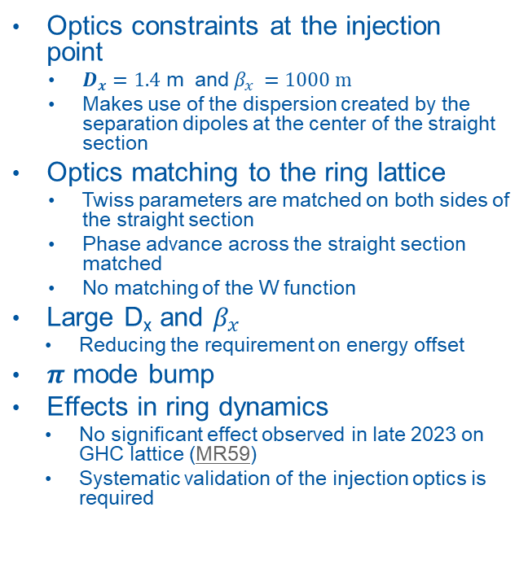
Baseline scheme: Z-mode optics design and matching
Optics constraints at the injection point
  $D_{x}=1.4$ m and $β_{x }=1000 m$
  Makes use of the dispersion created by the separation dipoles at the center of the straight section
Optics matching to the ring lattice
  Twiss parameters are matched on both sides of the straight section
  Phase advance across the straight section matched
  No matching of the W function
Large D_{x} and $β_{x}$
  Reducing the requirement on energy offset
$π$ mode bump
Effects in ring dynamics
  No significant effect observed in late 2023 on GHC lattice (MR59)
  Systematic validation of the injection optics is required

Slide 9
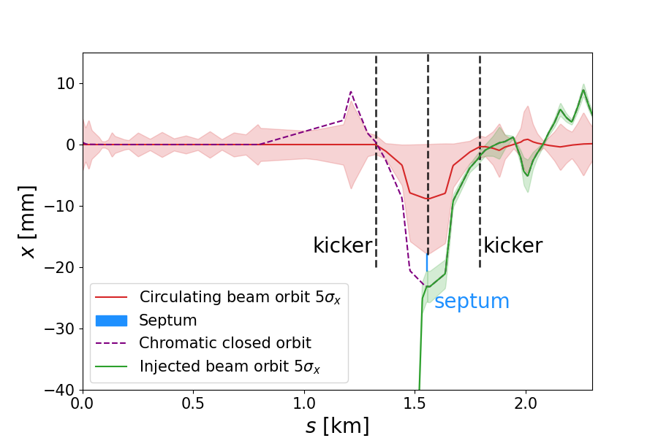
Baseline scheme: Z-mode envelopes and aperture
Circulating beam bumped close to the injection septum
  Bump amplitude of 10σ + septum thickness
  Fast bump lasting only 1 turn
Parameters
  Kicker strength: 36 µrad
  Rise and fall time depend on filling scheme
  rise & fall time 1.1 µs
  flat-top time: 304 µs for full turn filling
Strong requirements on kickers field flatness is challenging to maintain over 304 µs (see G. Favia on Thu)
Large envelopes due to dispersion
  Need to ensure the aperture is sufficient with and without the injection bump

Slide 10
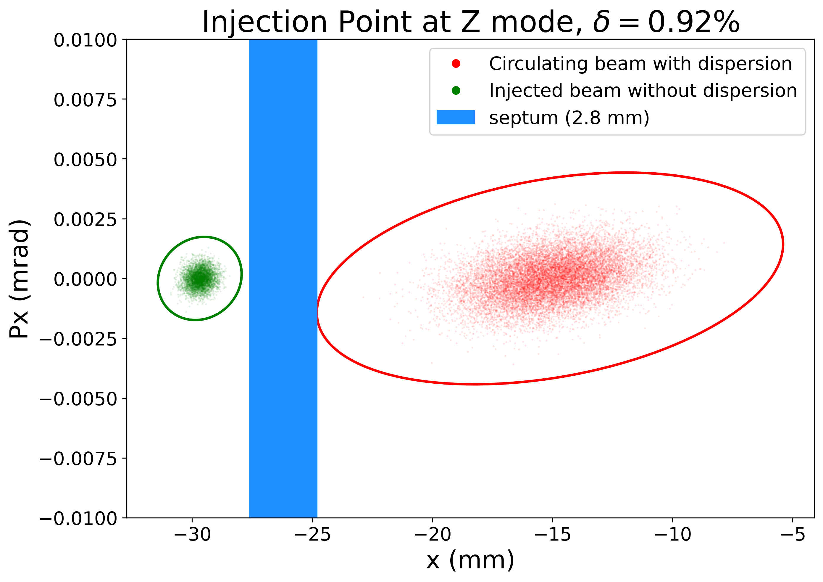
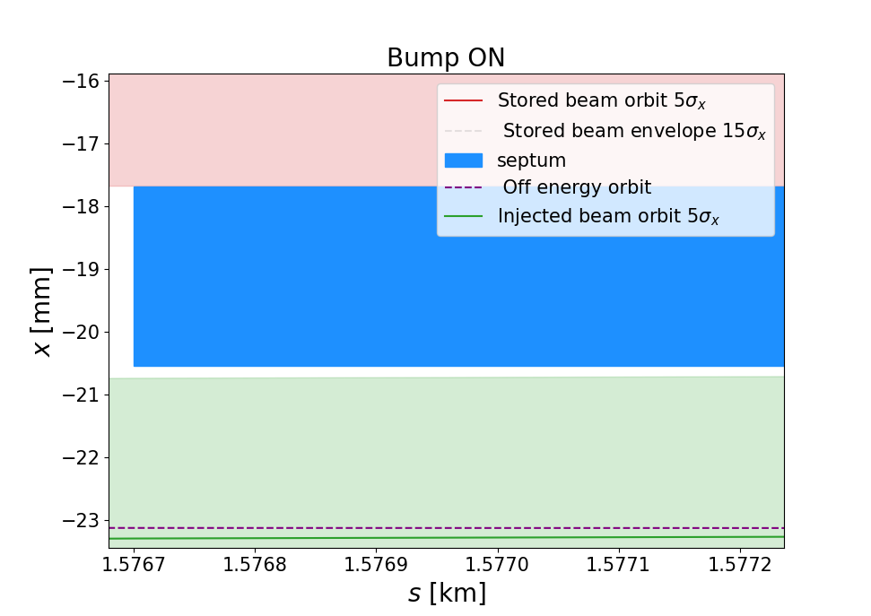
Baseline scheme: Z-mode envelopes at the injection point
Real space geometry of the envelopes at the septum
  Deflection angle of the circulating beam is 0.1 mrad
  Stray field impact for the circulating beam ~1 µrad
  Maximum gap between septum and injected beam 5σ envelope is ~0.2mm
  No need for wedged septum -> septum has fixed thickness across entire length
Halo interception by the septum
  Septum clashes with part of the circulating beam during the injection turn
  Halo absorption upstream of the septum needs to be considered and halo population precisely quantified in the presence of beam-beam

Slide 11
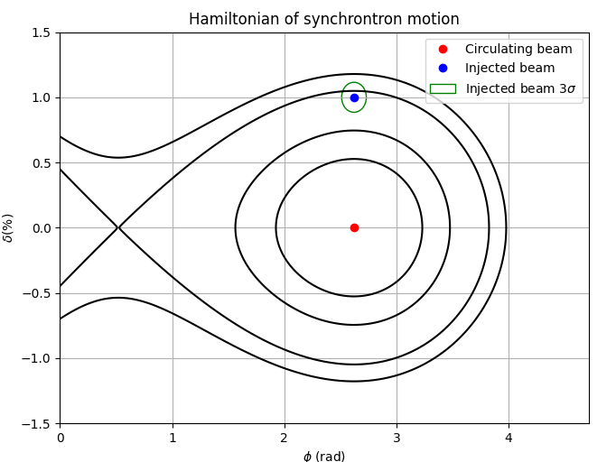
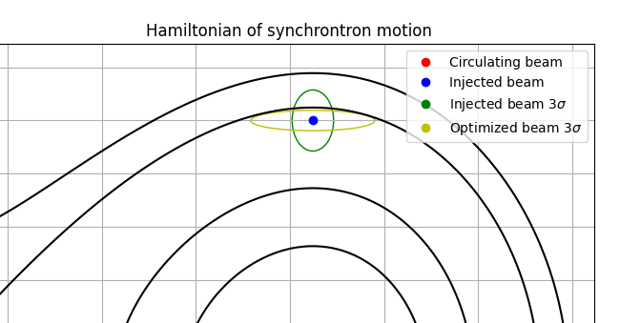
Baseline scheme: Z-mode longitudinal phase space
Longitudinal parameter
  RF acceptance in collider: 1.06% [1]
  Energy offset of beam extracted from booster : 1%
  Energy spread of beam extracted from
  booster : 0.038 %
  Bunch length of beam extracted from
  booster : 2.43 mm
Goal of ≥ 3 𝜎_{z} injected beam capture
  Increase collider ring RF acceptance
  Decrease energy offset of injected beam → ≤0.95%
  Accept lower injection efficiency
[1] K. Oide, Collider GHC lattice,

Slide 12
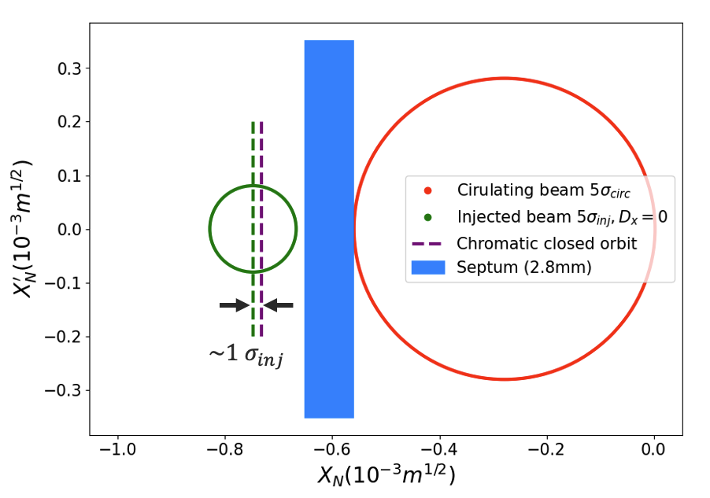
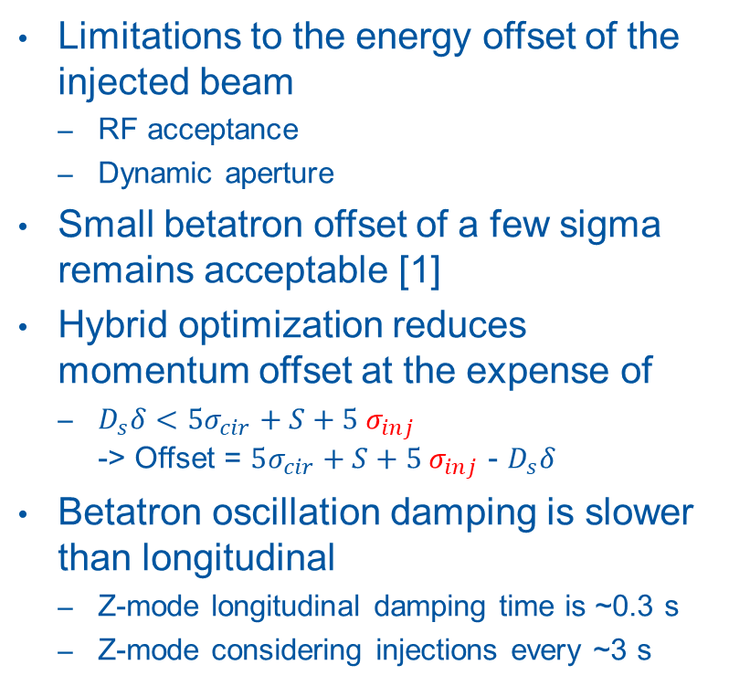
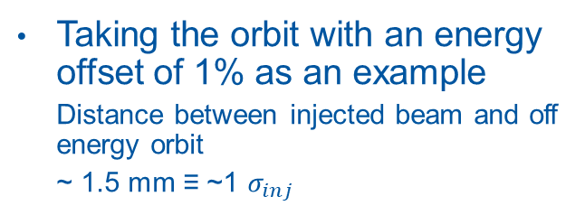
Baseline scheme: optimisation with hybrid on-off axis injection scheme
Limitations to the energy offset of the injected beam
  RF acceptance
  Dynamic aperture
Small betatron offset of a few sigma remains acceptable [1]
Hybrid optimization reduces momentum offset at the expense of
  $D_{s}δ<5σ_{cir}+S+5 σ_{inj}$
  -> Offset = $5σ_{cir}+S+5 σ_{inj}$ - $D_{s}δ$
Betatron oscillation damping is slower than longitudinal
  Z-mode longitudinal damping time is ~0.3 s
  Z-mode considering injections every ~3 s
Taking the orbit with an energy offset of 1% as an example
  Distance between injected beam and off energy orbit
  ~ 1.5 mm ≡ ~1 $σ_{inj}$
[1] K. Andre, SR power deposition from injected beam, 161st FCC-ee Optics Design Meeting,

Slide 13
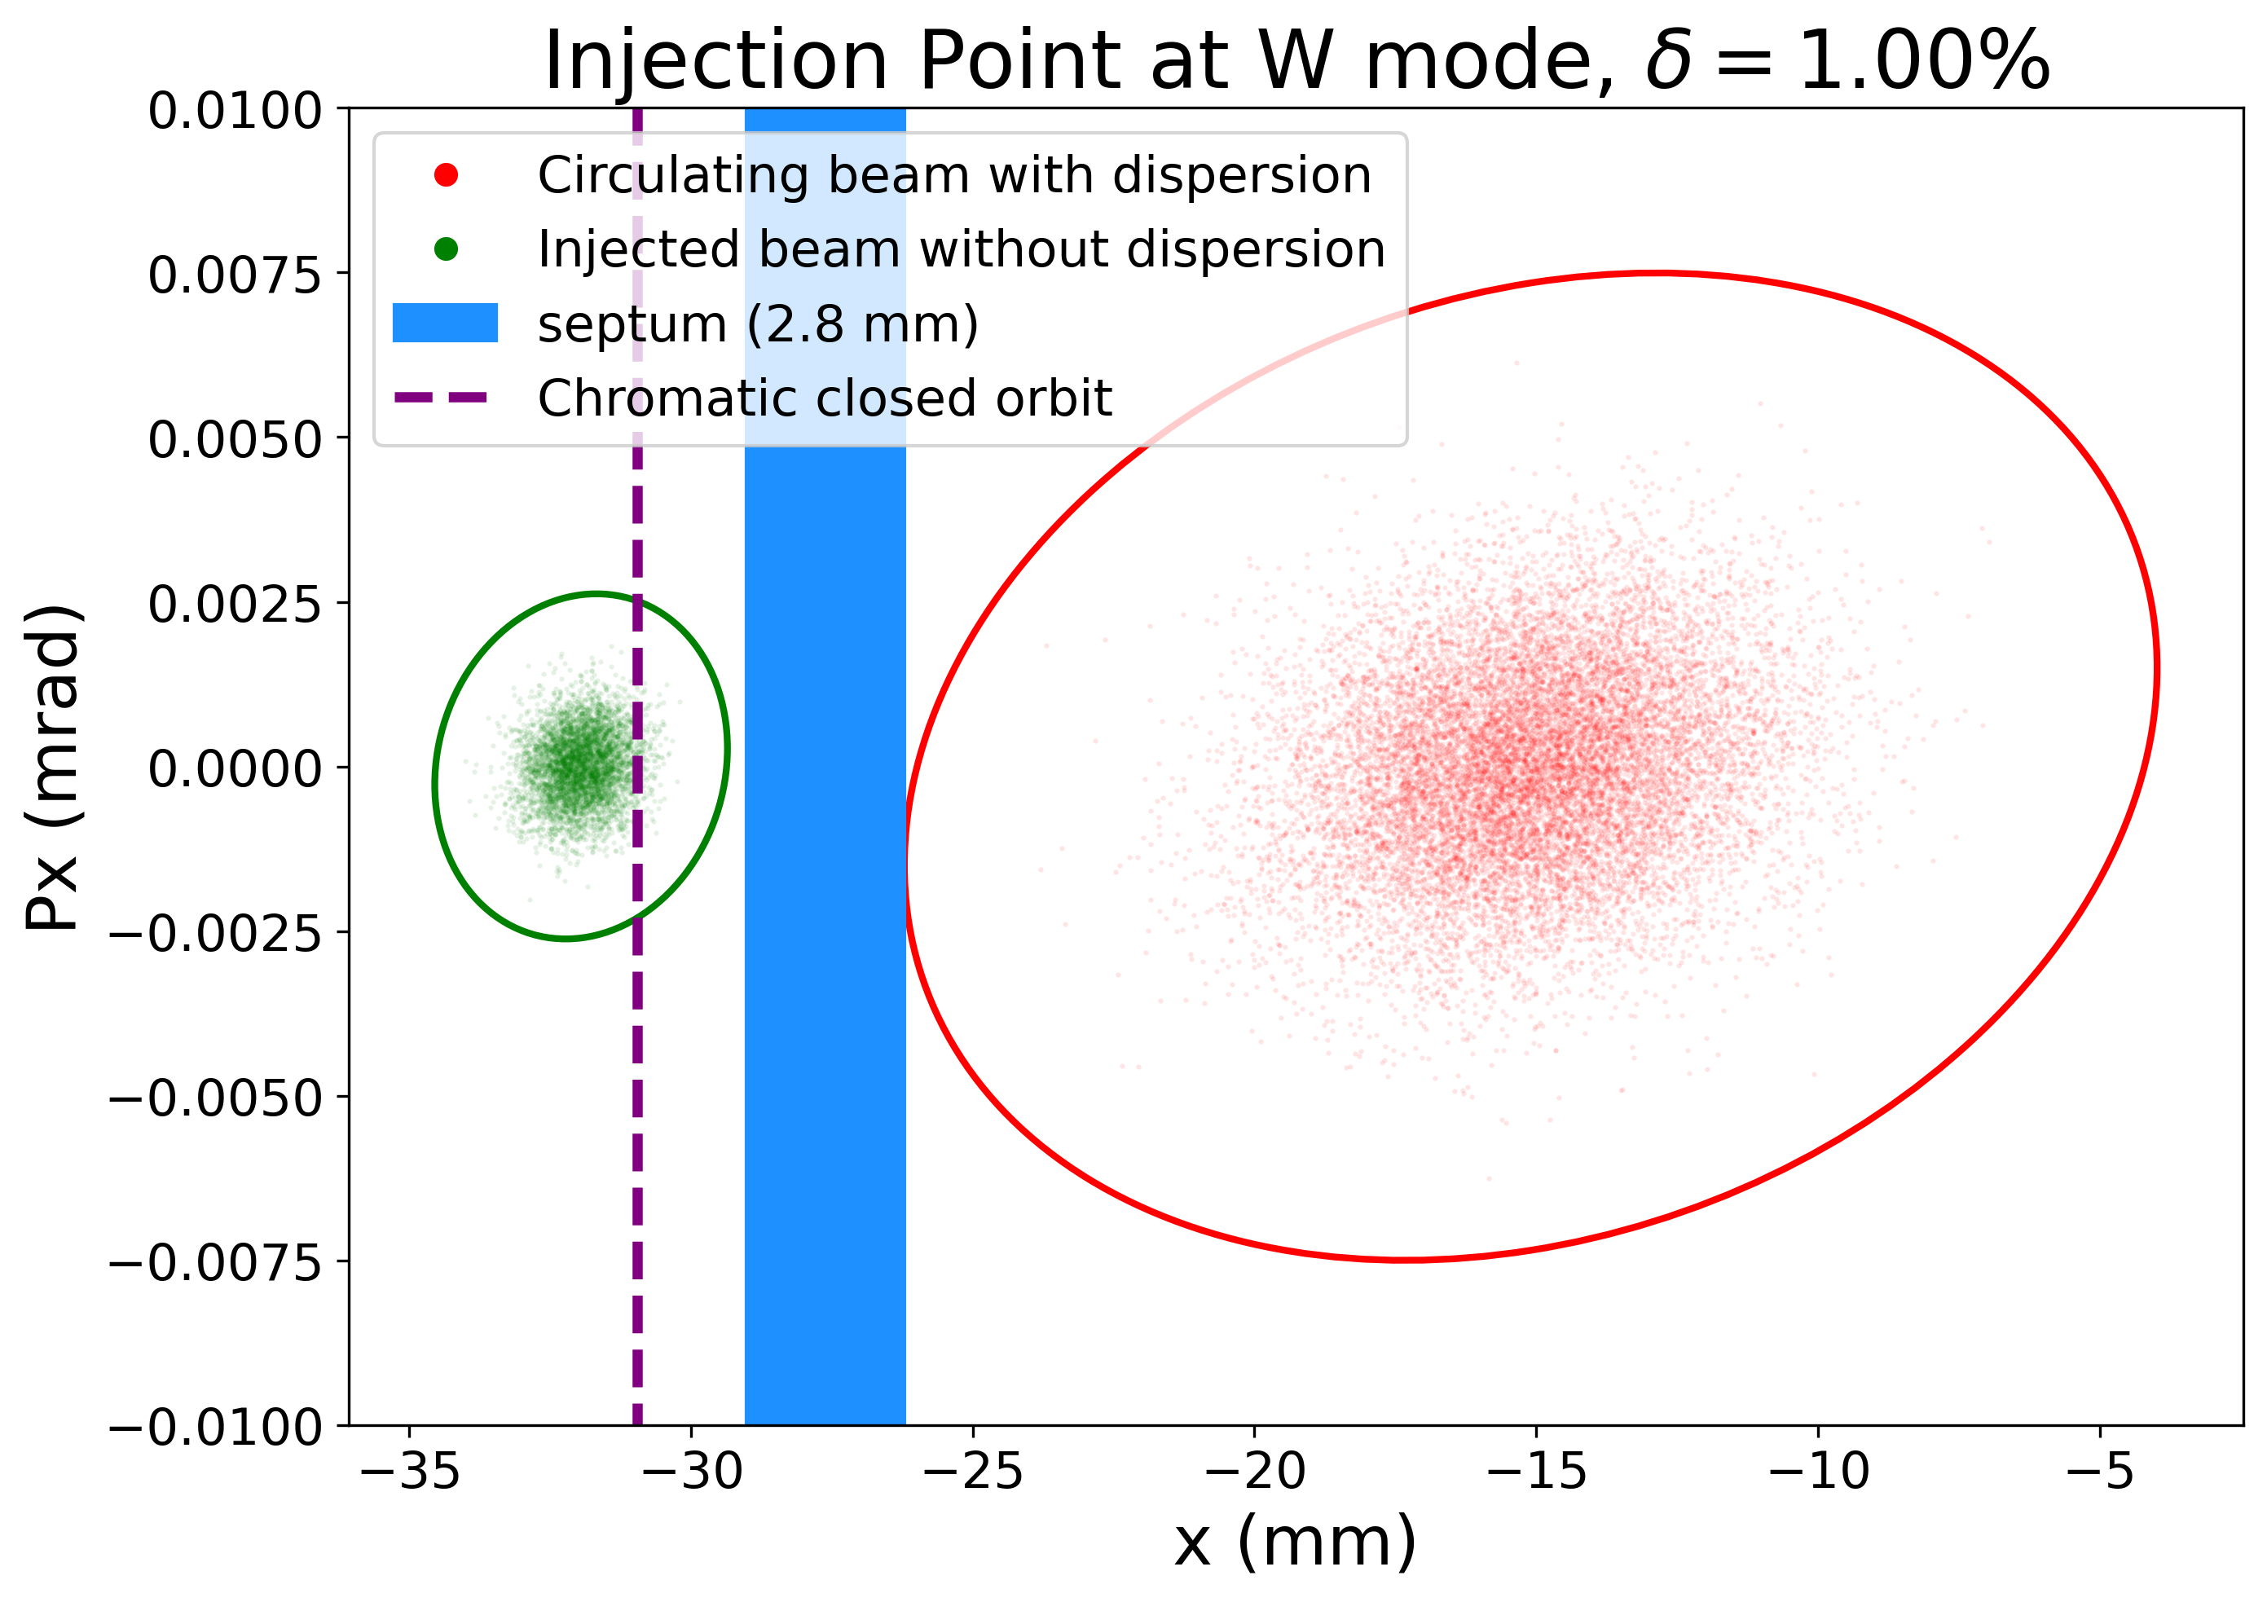
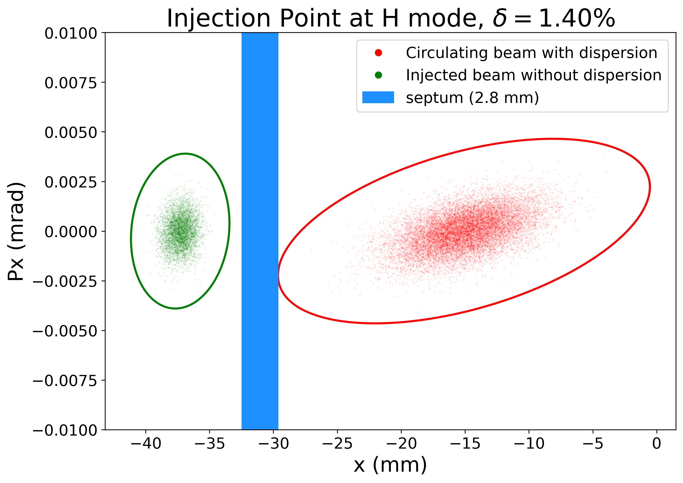
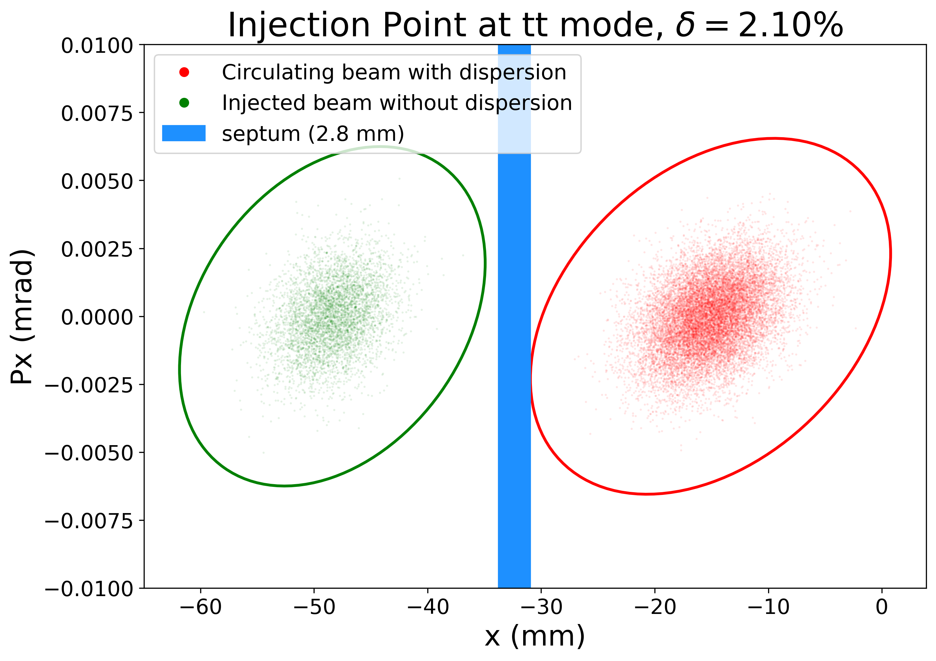
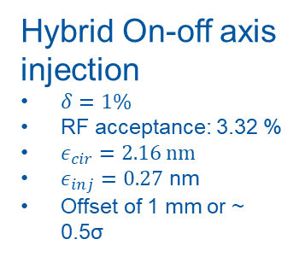
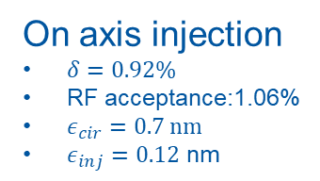
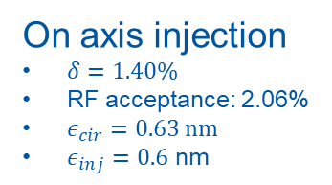
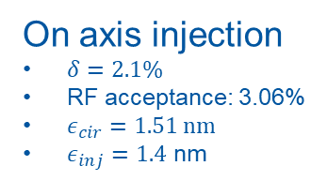
Baseline scheme: first estimates at other modes
Hybrid On-off axis injection
$δ=1\%$
RF acceptance: 3.32 %
$ε_{cir}=2.16$ nm
$ε_{inj}=0.27$ nm
Offset of 1 mm or ~ 0.5σ
On axis injection
$δ=0.92\%$
RF acceptance:1.06%
$ε_{cir}=0.7$ nm
$ε_{inj}=0.12$ nm
On axis injection
$δ=1.40\%$
RF acceptance: 2.06%
$ε_{cir}=0.63$ nm
$ε_{inj}=0.6$ nm
On axis injection
$δ=2.1\%$
RF acceptance: 3.06%
$ε_{cir}=1.51$ nm
$ε_{inj}=1.4$ nm

Slide 14
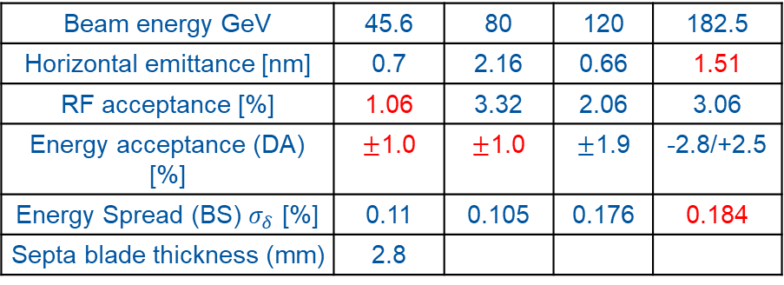
Baseline scheme: first estimates at other modes
H & T modes:
Enhance injection efficiency by increasing energy offset
W mode:
Large beam emittance
FCC-ee collider parameter [1]
Beam energy GeV | 45.6 | 80 | 120 | 182.5
Horizontal emittance [nm] | 0.7 | 2.16 | 0.66 | 1.51
RF acceptance [%] | 1.06 | 3.32 | 2.06 | 3.06
Energy acceptance (DA) [%] | $±$1.0 | $±$1.0 | $±$1.9 | -2.8/+2.5
Energy Spread (BS) $σ_{δ}$ [%] | 0.11 | 0.105 | 0.176 | 0.184
Septa blade thickness (mm) | 2.8
FCC-ee booster parameter
Beam energy GeV | 45.6 | 80 | 120 | 182.5
Horizontal emittance [nm] | 0.12 | 0.27 | 0.6 | 1.4
Energy spread [10⁻³] | 0.38 | 0.67 | 1.01 | 1.53
Extraction bunch length [mm] | 2.43 | 2.56 | 2.26 | 1.98
[1] K. Oide, Collider GHC lattice,
[2]Booster lattice, GitLab

Slide 15
Baseline scheme: first estimates at other modes
Status
  Injected beam dispersion is mismatched causing
  betatron beating of the injected beam
  Baseline scheme developed for the Z-mode requires
  adapted parameters at other modes
  Higer-energy optics rematched to the Z injection
  lattice
Challenges
  Longitudinal beam parameters matching is not possible
  at large momentum offsets close to the acceptance limit
  Top-mode large emittance presently requires very large beam sizes
  Possible hardware changes between modes
Next steps
  Tracking of injected beam to estimate injection efficiency and validation at every mode
  Considering requirements on the booster vertical emittance
  Presently using the booster horizontal equilibrium which may not be easily reachable for the Z-mode -> need to consider the effect of larger horizontal emittance

Slide 16
Machine protection consideration
Present status from discussion in 2023 between several groups of CERN [1] identified several critical failure cases and possible mitigation methods
Collider injection bump
  Circulating beam is bumped for 1 turn
  Failure of the ring kicker causes >10 sigma oscillation around the ring
  Simple model by A. Abramov (BE-ABP, CERN) shows that such oscillation is too large for the collimation system
  Reviewing the possibility to split each kicker in 2 independent systems to limit the maximum oscillation to ~5 sigma
Other systems are slow (septa, dipoles, quadrupoles)
  Failure could be mitigated by a fast dump trigger system (with reaction within 1 turn or less)
  Feasibility of a system with reaction time ≤ 1 turn remains to be studied
Circulating beam scraping on the injection septum needs to be considered
Comprehensive and systematic review on injection, extraction and beam transfer failure cases is needed
[1] A. Abramov, Y. Dutheil, M. Hofer, A. Lechner, C. Wiesner, S. Yue, FCCee beam transfer meetings special machine protection, indico

Slide 17
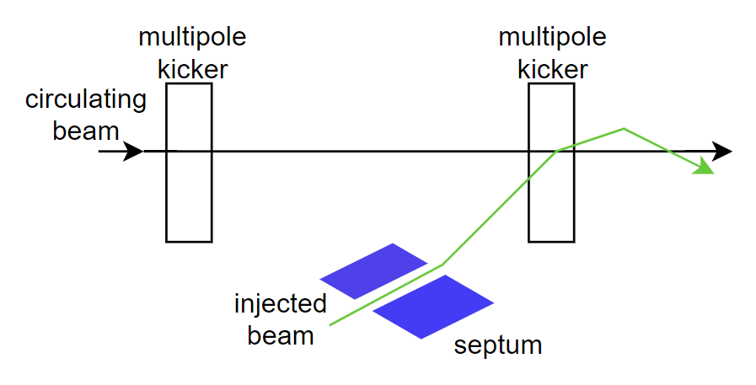
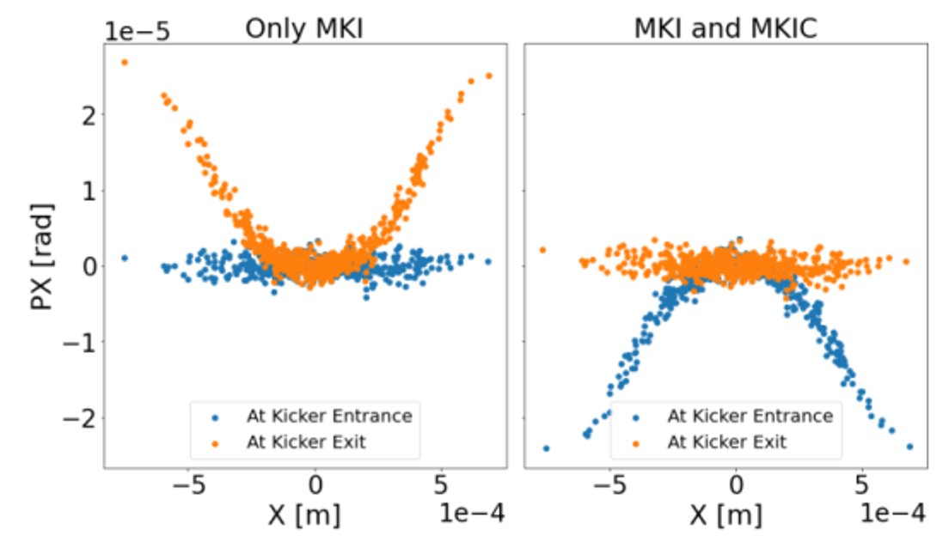
MKI injection scheme: back-up injection concept
Fast kicker magnet producing a non-linear field as close as possible from a step function
The effect of the highly non-linear field on the stored beam is countered by an identical magnet 180º phase advance upstream
Effort until 2023 by University of Saskatchewan-Canadian Light Source (P. Hunchak and
M. Boland) with support of CERN
Potential advantages
  Larger gap at the injection septum
  Lower optics constraints at the injection point
  Smaller circulating beam oscillations in case of injection failure
  Can be simulated with minimal changes to the injection straight section layout
Stored beam at MKI [1]
[1] P. Hunchak, Beam-tracking simulations and error studies, FCC-ee injection #13, 2022

Slide 18
Conclusion
Baseline top-tup injection scheme uses on-axis injection
  Limits or removes oscillations of the injected beam in experimental straight sections
  Primarily developed at the Z-mode, generalisation to other modes is ongoing
Ring requirements
  Dynamic aperture is critical for top-up injection
  Collimation and collimation scheme behaviour has not been considered yet
Challenges and assumptions to be studied
  Injected beam size is reduced by using zero dispersion -> dispersion mismatch causes betatron beating of injected beam
  Z-mode longitudinal damping time ~0.3 s is not negligible compared to the repetition time of
  ~3 s and may limit or prevent using any betatron offset or beating
  Using linear optical functions determined around the reference momentum
  Machine protection concerns may be critical to the baseline scheme
  Full ring transfer presents hardware challenging
Next steps towards the FSR
  Injection scheme tracking with synchrotron radiation and possibly beam-beam
  Agree on a realistic minimal injection efficiency for the injector chain requirement (possibly 80% after a commissioning period)
  Review of the injection scheme to be scheduled in the fall at CERN

