Slide 1
Summary slides:
FCC-hh and HFM
Soren Prestemon
Lawrence Berkeley National Laboratory

Slide 2
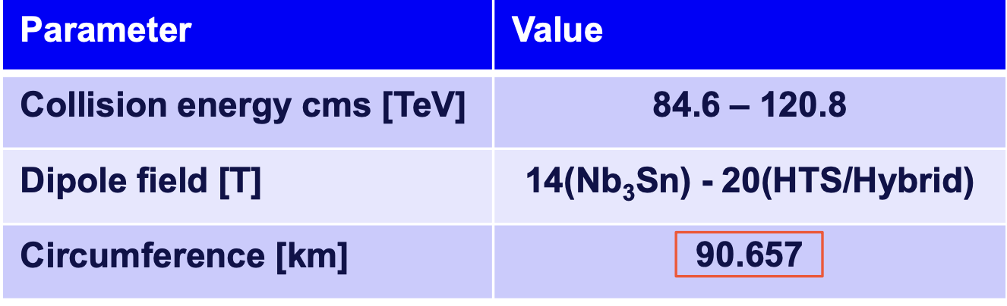
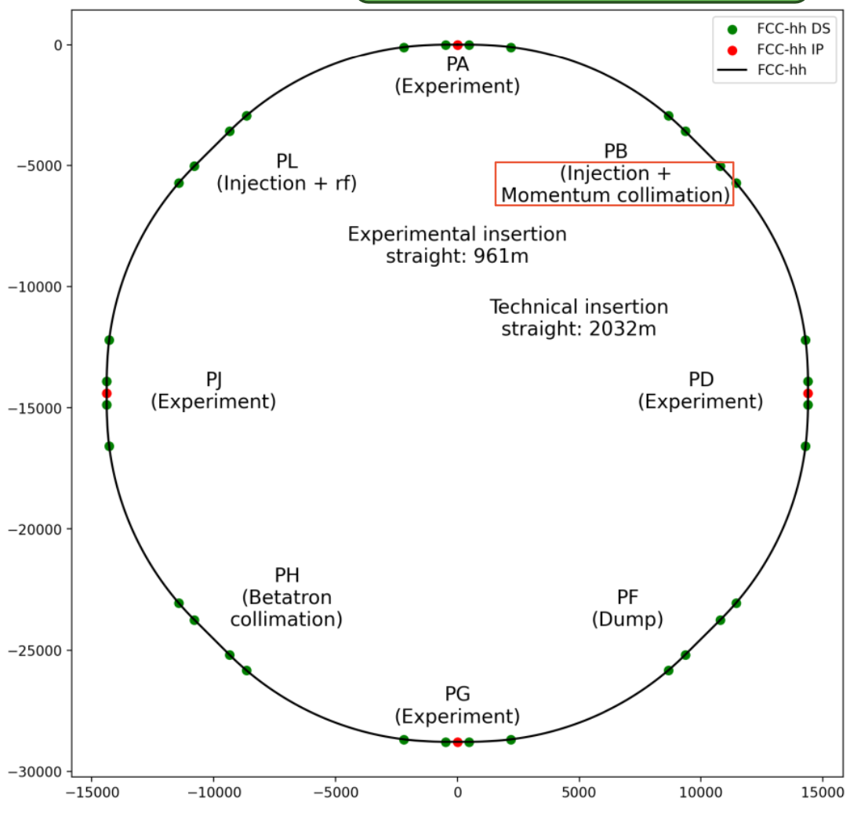
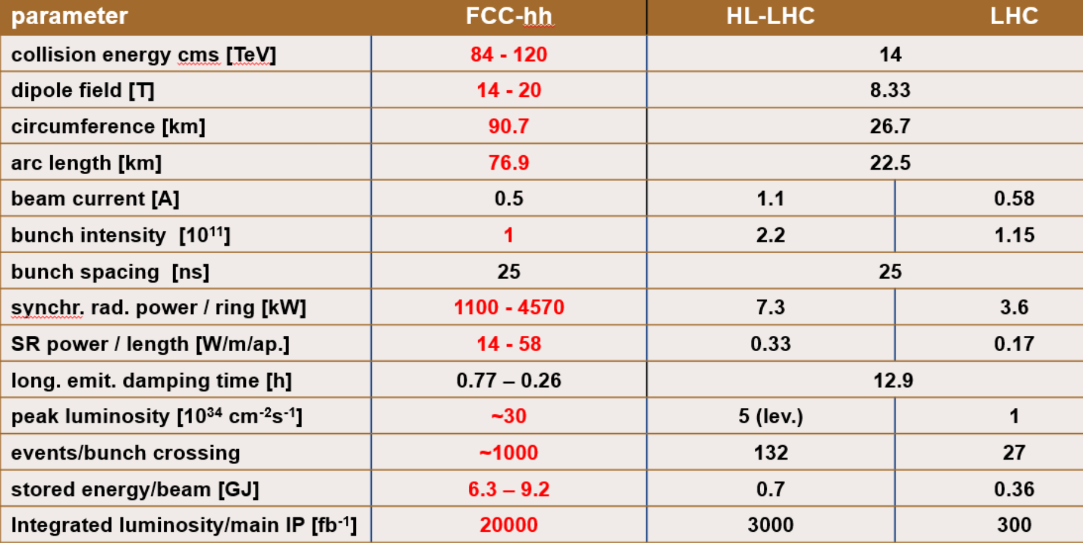
Review of FCC-hh general parameter ranges
Modifications improve:
  Injection layout
  Magnet fill factor
Gustavo Pérez Segurana

Slide 3
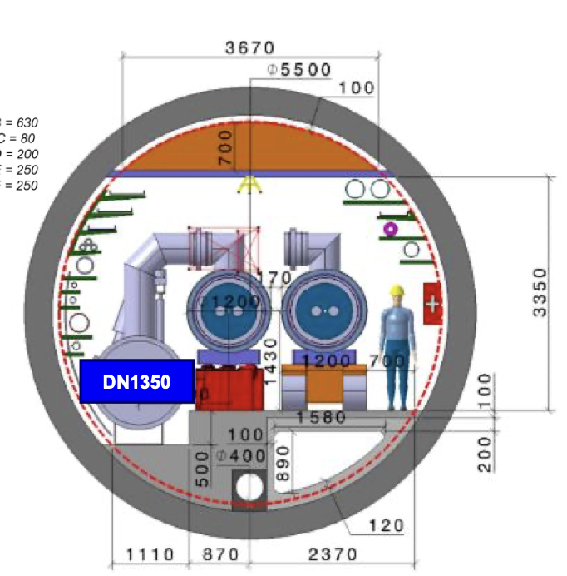
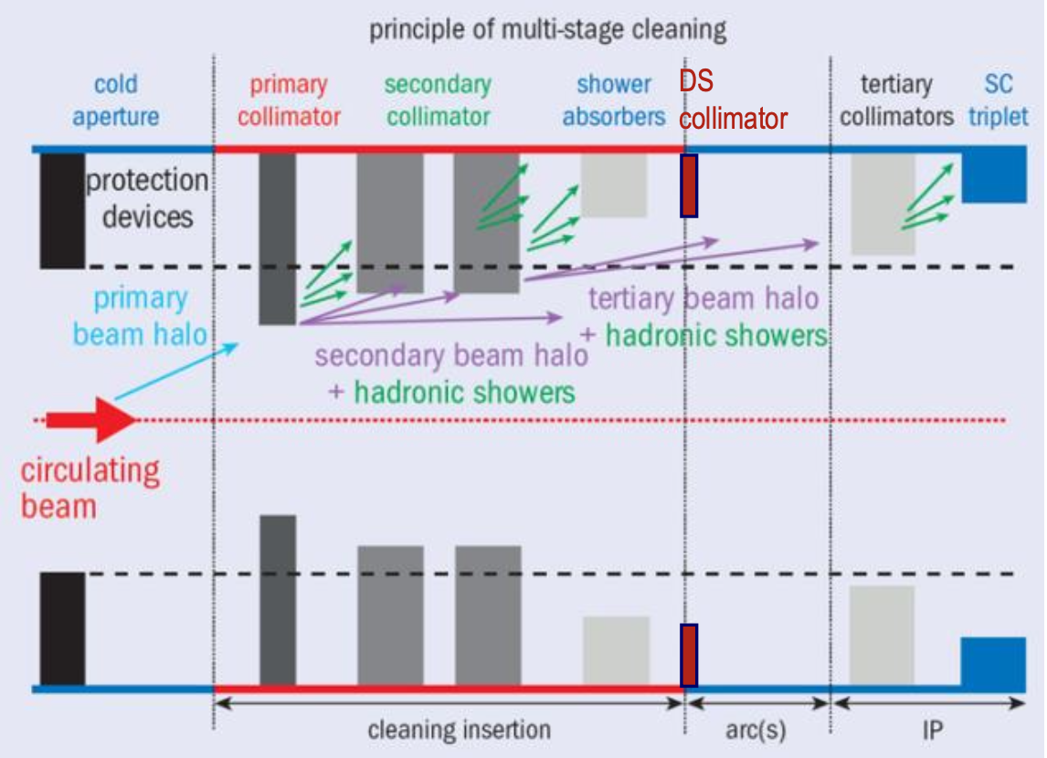
Infrastructure
High voltage source and transmission system does appear to be compatible with FCC-hh (focus has been on FCCee)
Tunnel size and layout
  Critical decision that needs to accommodate both ee and hh
  Interfacing with magnets and cryogenics critical
Collimation critical – “FCC-hh beams are highly destructive”
Mario PAROD
Laurent Delprat
Roderik Bruce

Slide 4
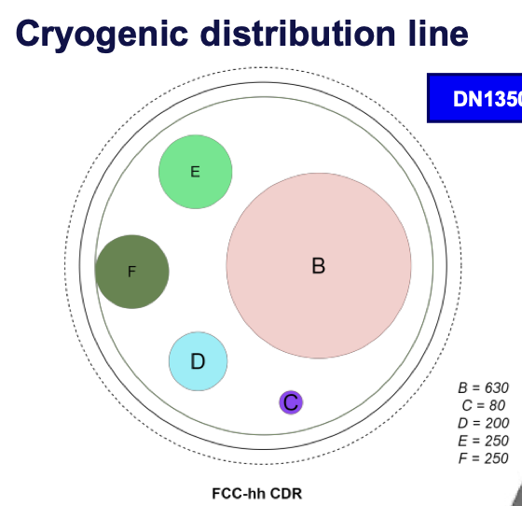
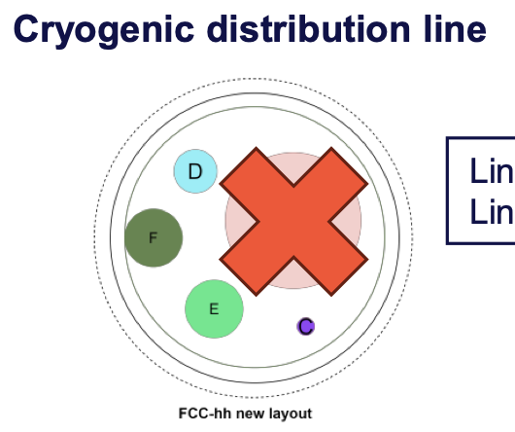
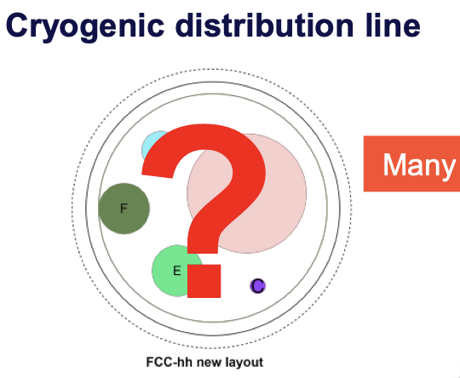
Cryogenics for FCC-hh
Conclusions:
In 1.9 K & 4.5 K configurations distribution system (vs FCC-ee tunnel) compatible
At 20K, lots of unknowns, ”seems compatible”
Fairly understood at 1.9K
Heat loads slightly less clear at 4.5K
Lots of unknowns at 20K
Laurent Delprat

Slide 5

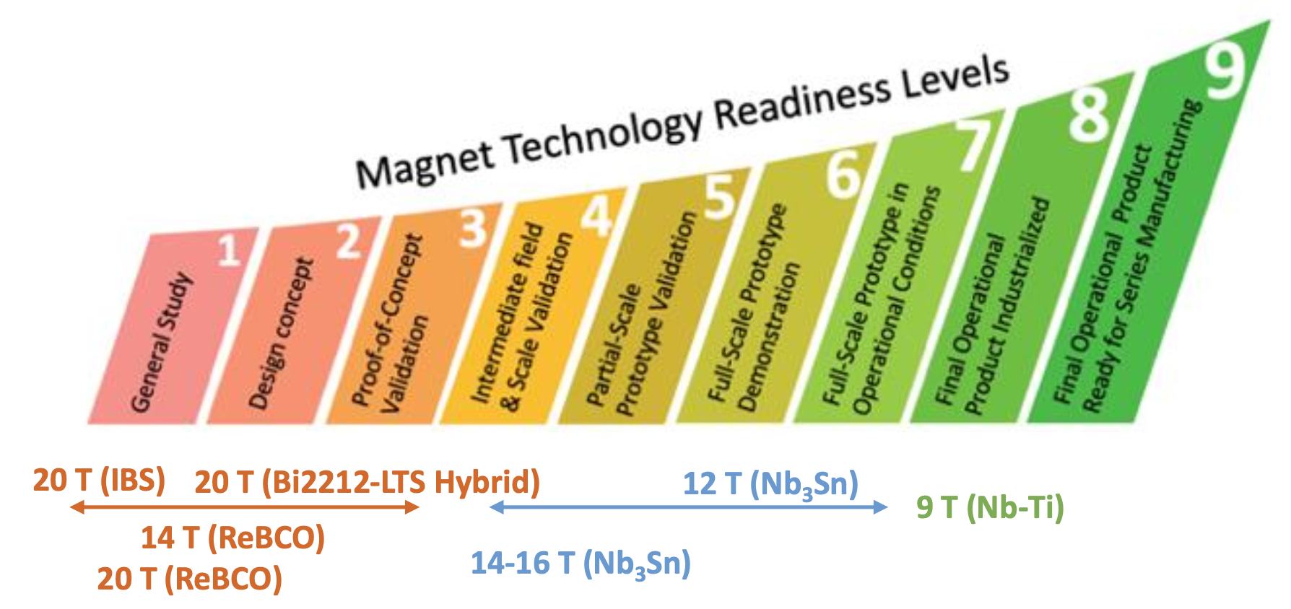
Magnet development
Message: For Nb3Sn magnets, 14+ T
Magnet prototypes therefore need to prove themselves at ~15-15.5T to demonstrate adequate margin for reliable operation
Structure of European HFM is now more clearly focused
  An effective timeline for Nb3Sn magnet development laid out
Ezio Todesco
Bernhard Auchmann

Slide 6
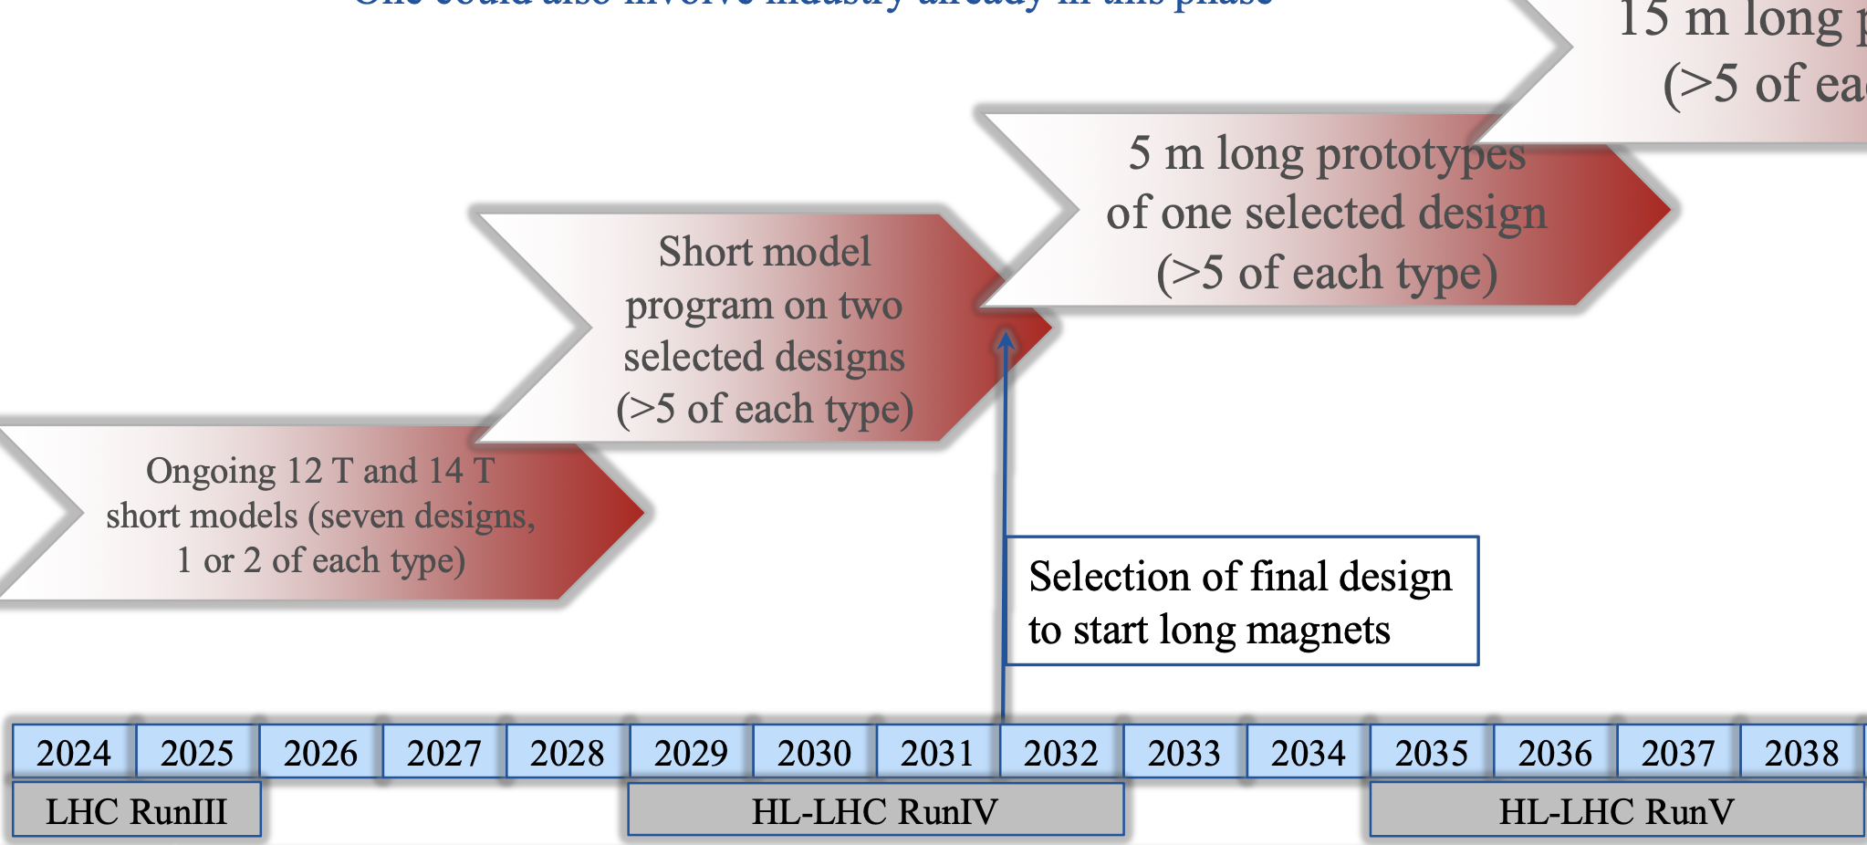
Roadmap focused on dev. / downselect / scaleup

Slide 7
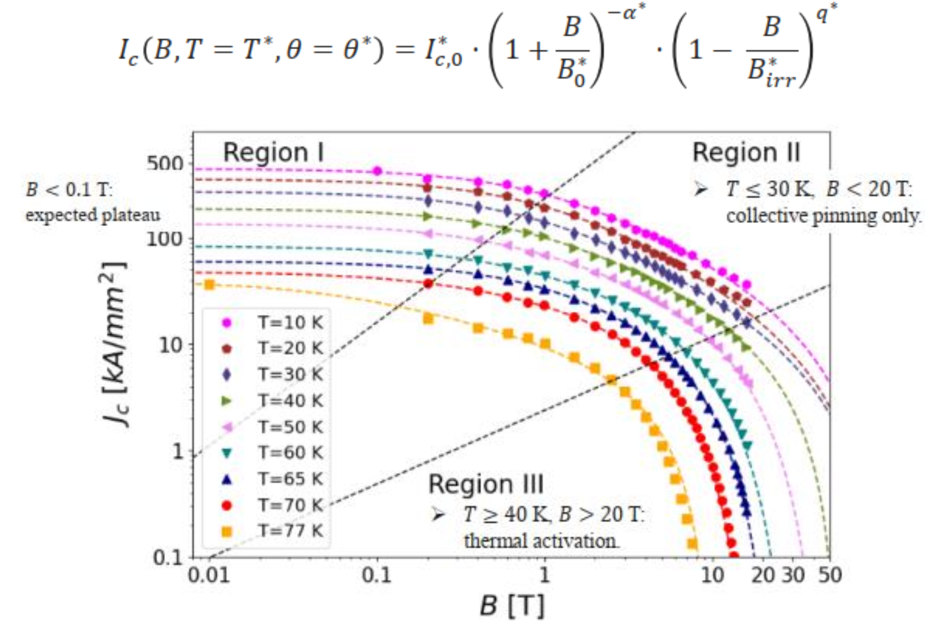
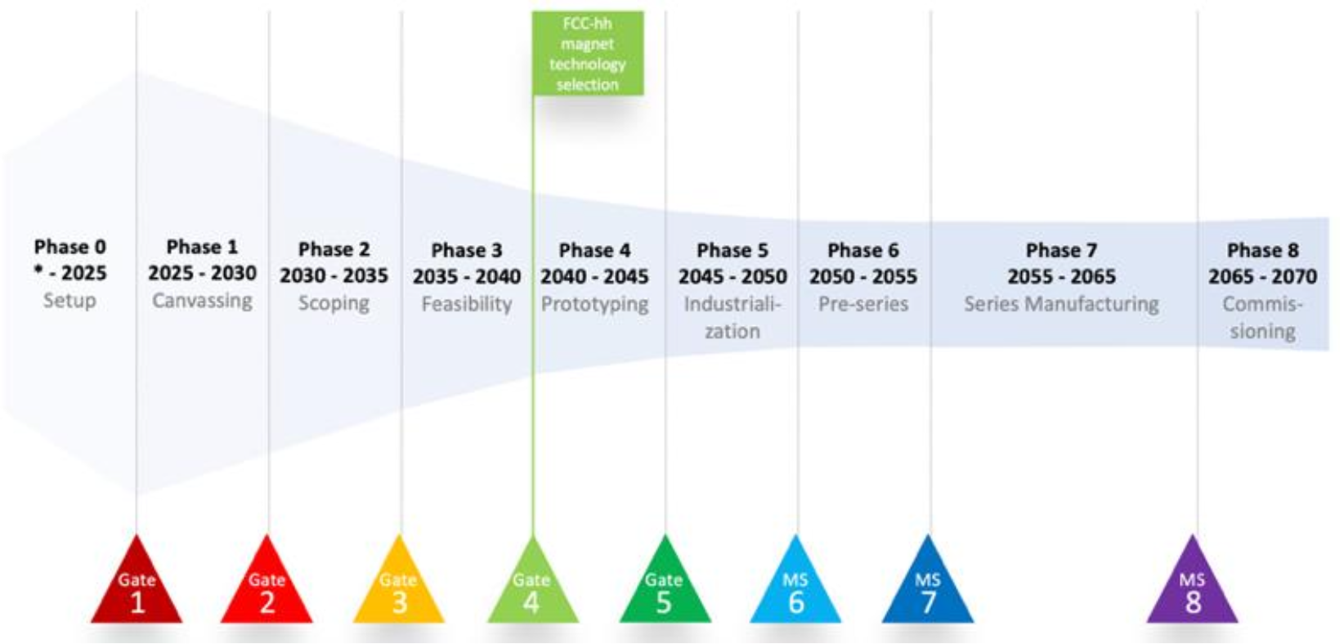
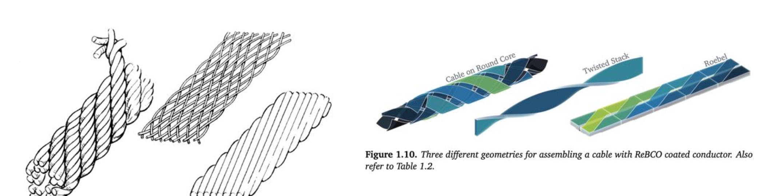
Opportunities for HTS solutions
Bernhard Auchmann
HFM focus is on REBCO
  Primarily on design concepts leveraging conductor anisotropy
Roadmap is challenging:
  Significant R&D needed to “catch up”

Slide 8
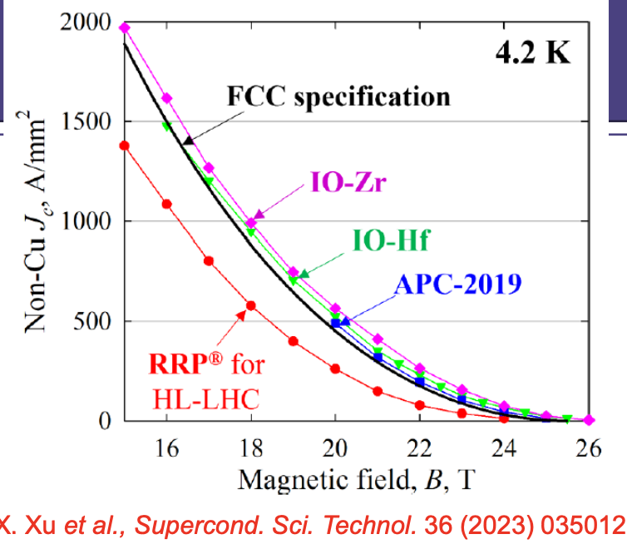
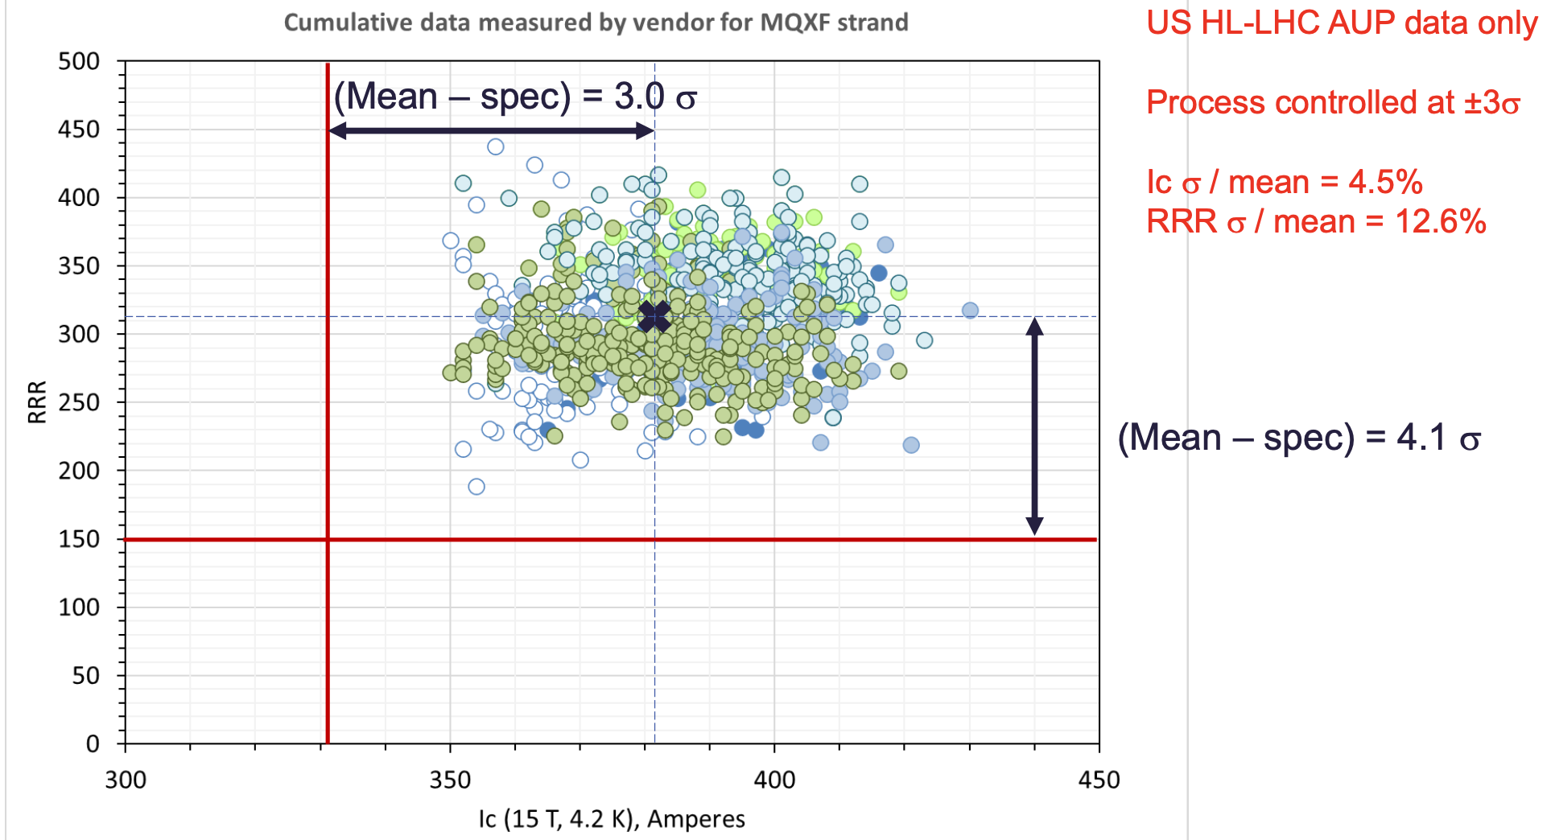
Conductor developments and considerations
Lance Cooley
Challenges:
  Superconductivity applications are a tiny fraction of the Nb market space
  Superconductivity needs pure Nb
For HTS, many challenges and opportunities
  Bi2212 led primarily by HEP
  REBCO driven primarily by Fusion now

Slide 9
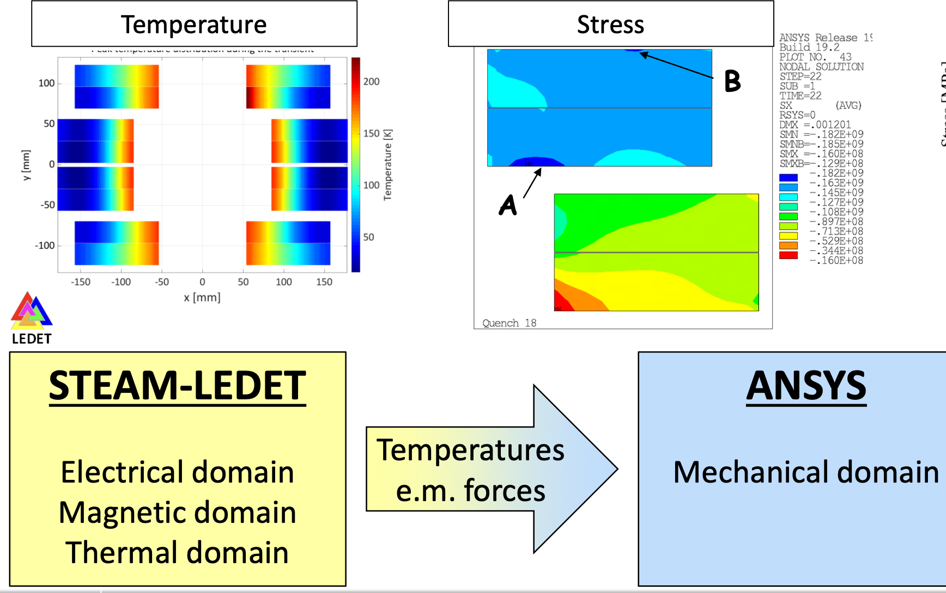
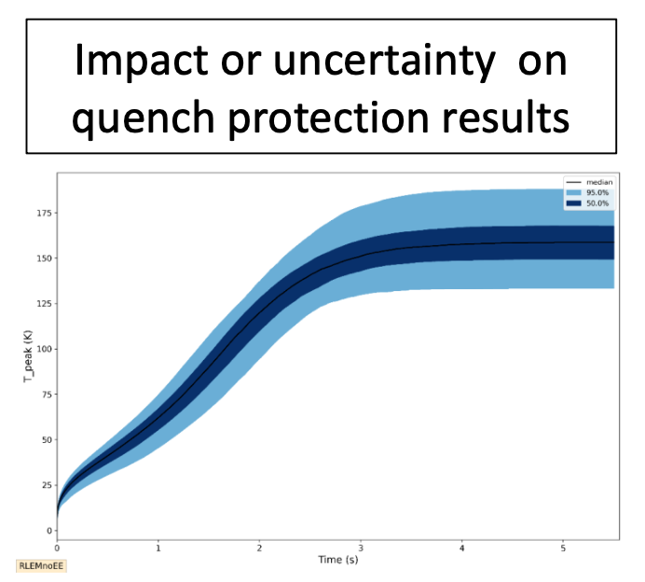
Magnet protection
Evolution of the LHC powering and protection strategy
Margins for protection get tighter at higher field
CLIC provides significant flexibility, but has some drawbacks when scaled to FCChh;
  alternative concepts are under development that may address those issues
Modeling has advanced significantly, enabling coupled physics simulations of powering circuit and thermo-mechanical response of magnets during quench
Emanuele Ravaioli

Slide 10
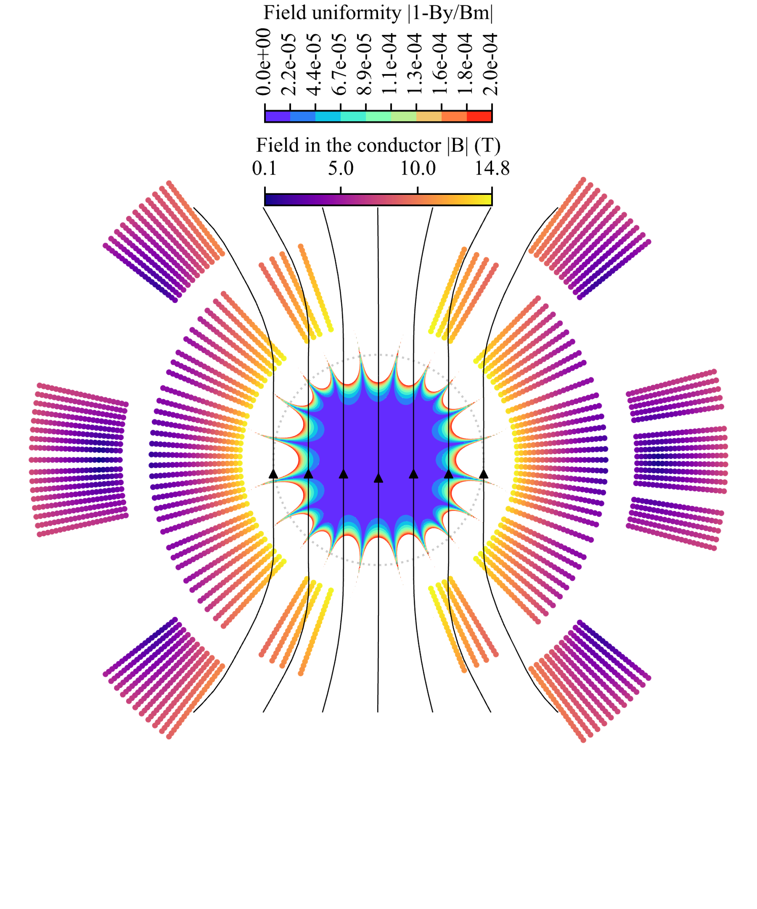
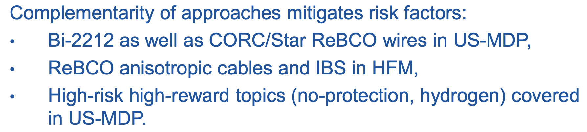
US MDP and collaboration with HFM
MDP focused on “general” high field magnet development
  “Stress-management” concepts
  “Hybrid” LTS/HTS magnets
  REBCO and Bi2212 HTS magnet technology

Slide 11

Thanks for coming to San Francisco!

