Slide 1
Linac 4 Ion Source Review
Pulsed Power Converters
D. Aguglia & D. Nisbet, TE-EPC-FPC
Tuesday 7th June 2011
Presenter: Davide Aguglia

Slide 2
Deliverables
What is to be delivered and installed by EPC-FPC?
Everything in red!
We only specify LW cables
DC Power Converters requirements fall into known technology & available in industry.
Pulsed Power Converters are much more complicated…

Slide 3
Technical description
Objective
Build new pulsed power converters to supply the L4 H⁻ source for suppression / mitigation of arc effects.
SPECS:
Acceleration: ±45kV, 0.2A,
Extraction: ±20kV, 0.2A
E-dump: +10kV, 1.5A
Ground: 0kV
Einzel lens: ±35kV, 0.2A
Flat-top: 700μs
Precision: 1%
No on the shelf industrial or CERN solutions!

Slide 4
Technical description
Integration:
The topology includes HV pulsed transformers to step-up the voltage.
Technically good
Very bad for operation!
(access time to the tunnel)
Unfeasible because of HV cable length (stray cables capacitances too big)
Final solution:
Long LV cable
Only reliable transformers in Faraday cage
Good for operation

Slide 5
Technical description
Topology: Feedback capacitor discharge voltage source – linear operation (no HF ripple on the output voltage).
Features: L4 powering compatible electronics with enhanced diagnostic features (remote & local).
Identical power conv. for uniformity & operational simplicity!
Different transformers…of course!

Slide 6
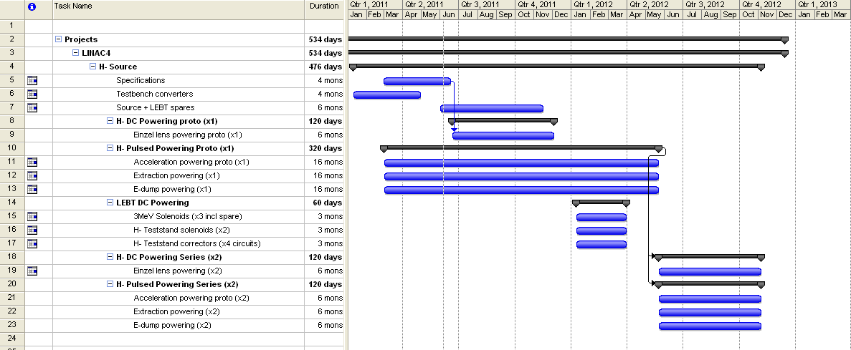
Schedule
The big deadline…working prototype set for May 2012

Slide 7
Cost & Manpower
New LINAC4 powering activities for H- Source
Workunit | Budget | Manpower (FTE) | 2011 |  |  | 2012 |  |  | 2013
 |  |  | Eng. (FTE) | Tech. (FTE) | Fell. (FTE) | Eng. (FTE) | Tech. (FTE) | Fell. (FTE) | Eng. (FTE) | Tech. (FTE) | Fell. (FTE)
3MeV Testbench powering | 20,000 | 0.1 |  | 0.1
3MeV spare power converters | 35,000 | 0.1 |  | 0.1
3MeV Solenoid Powering + Electronics | 90,000 | 0.4 |  | 0.1 | 0.1 |  | 0.1 | 0.1
357 Teststand DC Steerers and solenoids + Electronics | 110,000 | 0.3 |  | 0.1 |  |  | 0.2
H- Powering + Electronics | 710,000 | 4.5 | 0.9 | 0.8 | 0.3 | 0.7 | 0.8 | 0.3 | 0.1 | 0.3 | 0.3
Total | 965,000 | 5.4 | 0.9 | 1.2 | 0.4 | 0.7 | 1.1 | 0.4 | 0.1 | 0.3 | 0.3

Slide 8
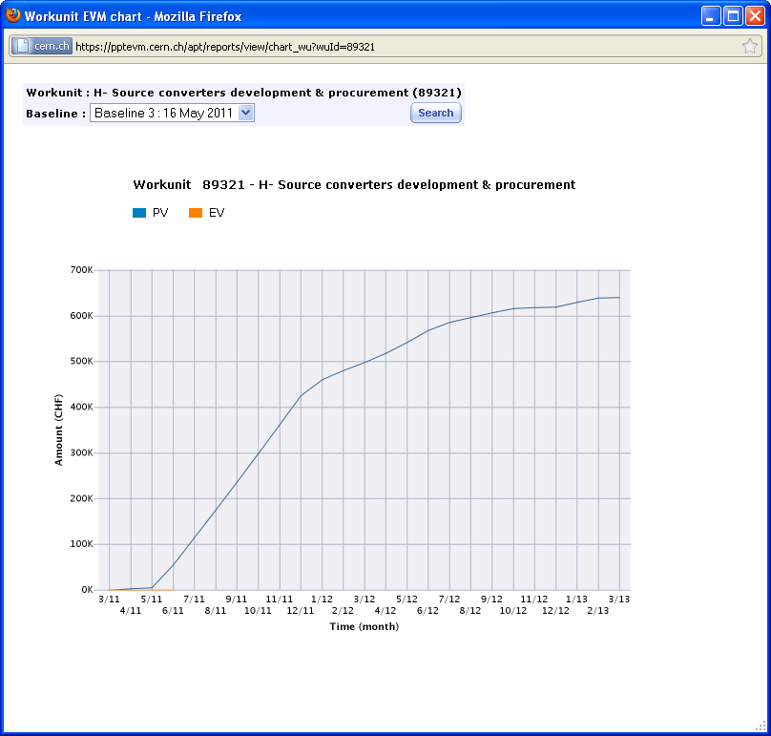
Cost vs. time
H⁻ Source Powering
(Einzel + pulsed)
  Cost shown is without electronics (70kCHF)
Active development project
  Prototypes in Summer 2012
  Series in 2012/2013

Slide 9
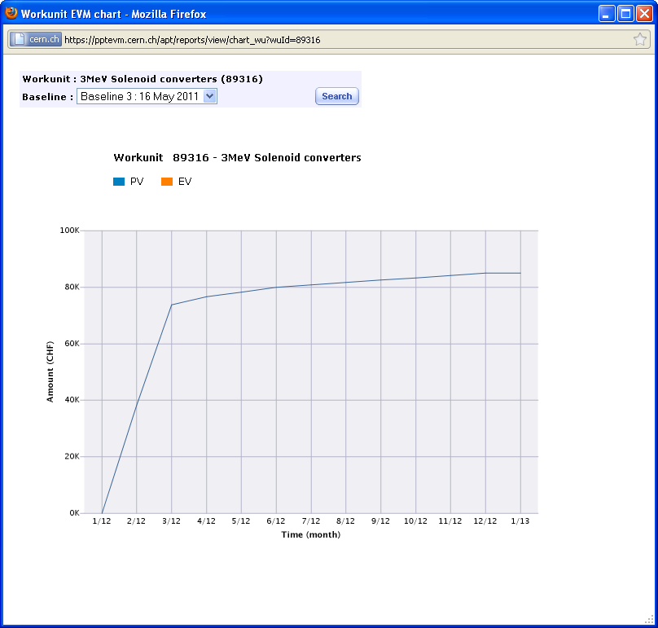
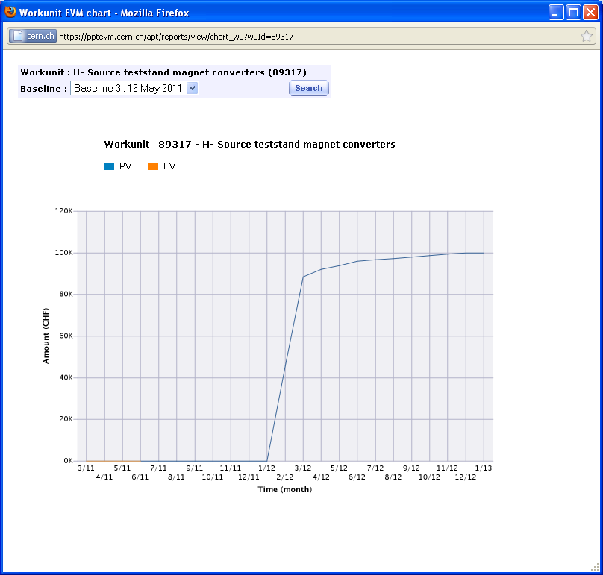
Cost vs. time
H⁻ Source (3MeV Solenoid DC powering x2 + spare)
H⁻ Source Teststand (Solenoid DC powering x2)
  Final specifications not yet available
  Anticipate order for commercial systems in 2012
H⁻ Source Teststand (LEBT Steerer DC powering x4)

Slide 10
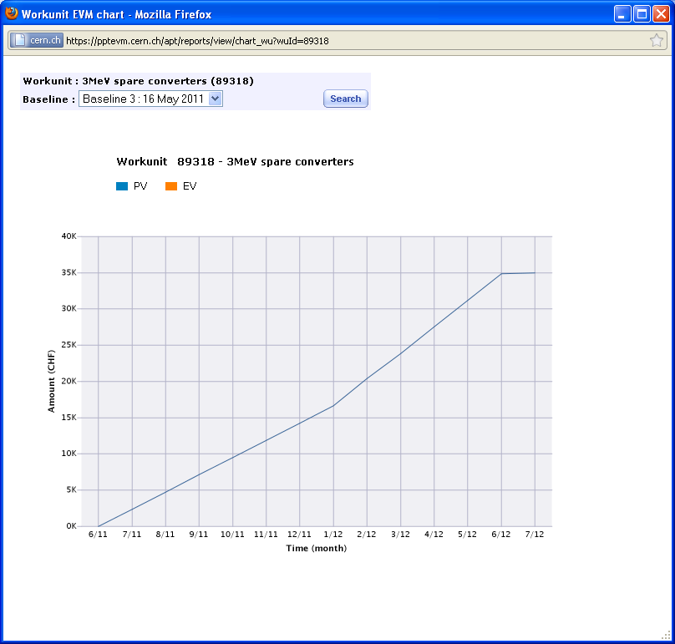
Cost vs. time
3MeV Spares
(1x 22kV, 1x Steerer)
  Ready summer 2012

Slide 11
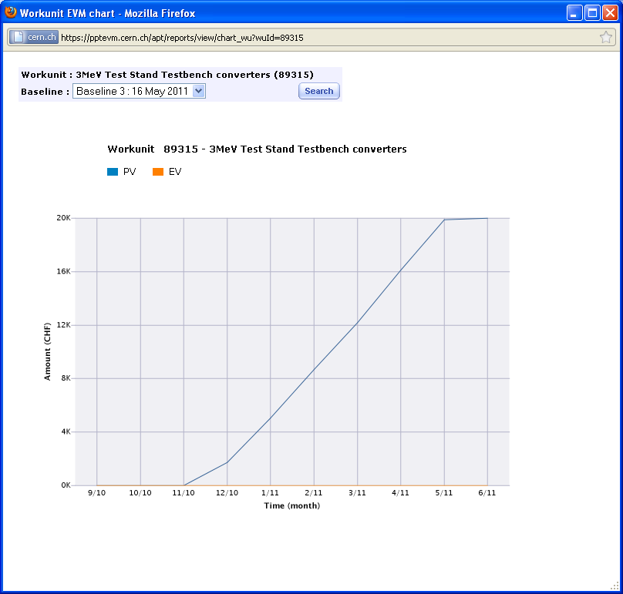
Cost vs. time
3MeV Teststand Powering (Testbench,1x Dipole, 2x Quad)
  All systems ready for commissioning in 3MeV Teststand

Slide 12
Risks & feasibility
Technical & Schedule
  Challenging time schedule – spec changes will create delays.
  Flexible system (polarities changes, wide operation range).
  Fairly new system, but we merge different technologies we master and we are using known and reliable suppliers.
  The source is a non-linear & complex system which could still give some surprises during system commissioning.
Resources
  Our first priority, risks are moved to other projects…

Slide 13
Thank you!

