Slide 1
Instrumentation for the new
H⁻ Source Test Bench
Linac-4 Ion Source Review 2011
Uli Raich CERN BE/BI

Slide 2
Parameters to be measured
Beam intensity
Transverse Profile
Transverse Emittance
Energy Spread

Slide 3
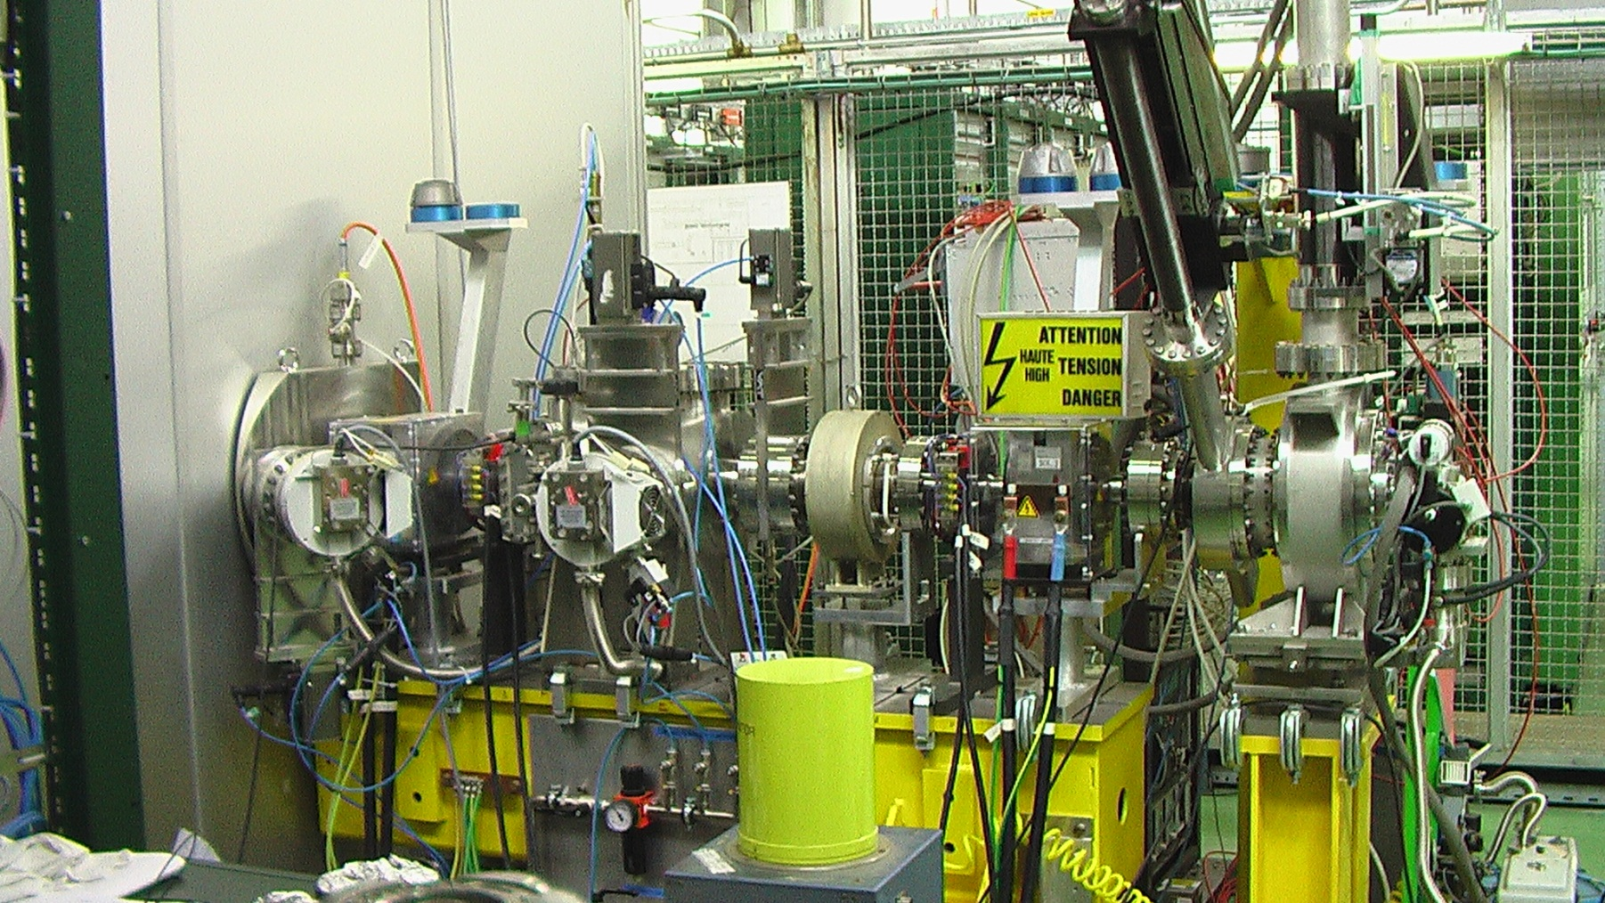
Instrumentation at current test bench
Faraday Cup
SEMGrid
Transformer
Emittance
Meter

Slide 4
Installed Instruments
Faraday Cup
  Measures intensity
  Used as beam stopper
  Readout only with oscilloscope
SEMGrid with 20 wires
  1mm wire distance in the center
Beam transformer
  Sampled at 10 MHz
Emittance meter + Faraday Cup

Slide 5
Faraday Cup
Source intensity measured by a retractable Faraday Cup
Secondary electron emission are suppressed by polarization voltage which also eliminates parasitic electrons created in the source
Pneumatic in/out mechanism on PLC like LEIR is available and controlled by a knob
Oscilloscope is used for signal observation
For final operation a 1 MHz sampling ADC is foreseen

Slide 6
Energy Spread
On the current test stand we used a spectrometer magnet + SEMGrid
The spectrometer will be used for a short time in the L4 tunnel and will be free afterwards
For the new test stand a 45 kV floating FC is under discussion
  Needs new design
  Electronics and program to do energy scan

Slide 7
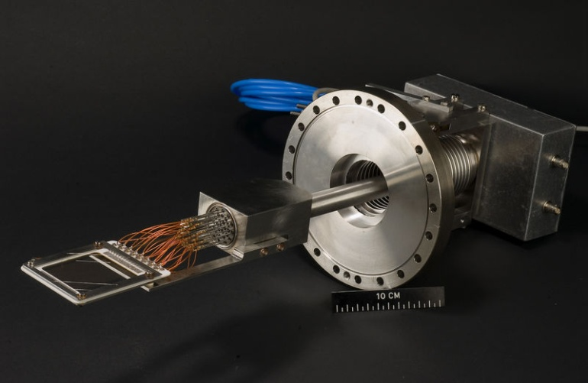
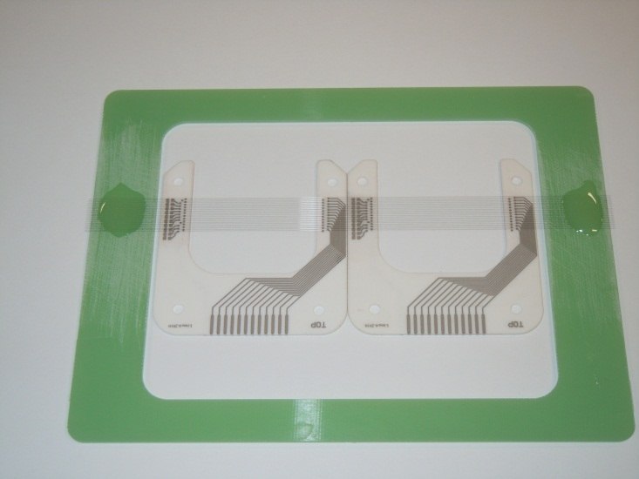
SEMGrids for Profile Meas.
SEMGrid resolution: up to 0.5mm, up to 36 wires
New analogue electronics for 36 under design
Needs time resolved measurements (200 kHz)
New VME readout card has been developed (36 channels), series of 50 cards have been produced
In/out mechanism by motor with PLC control

Slide 8
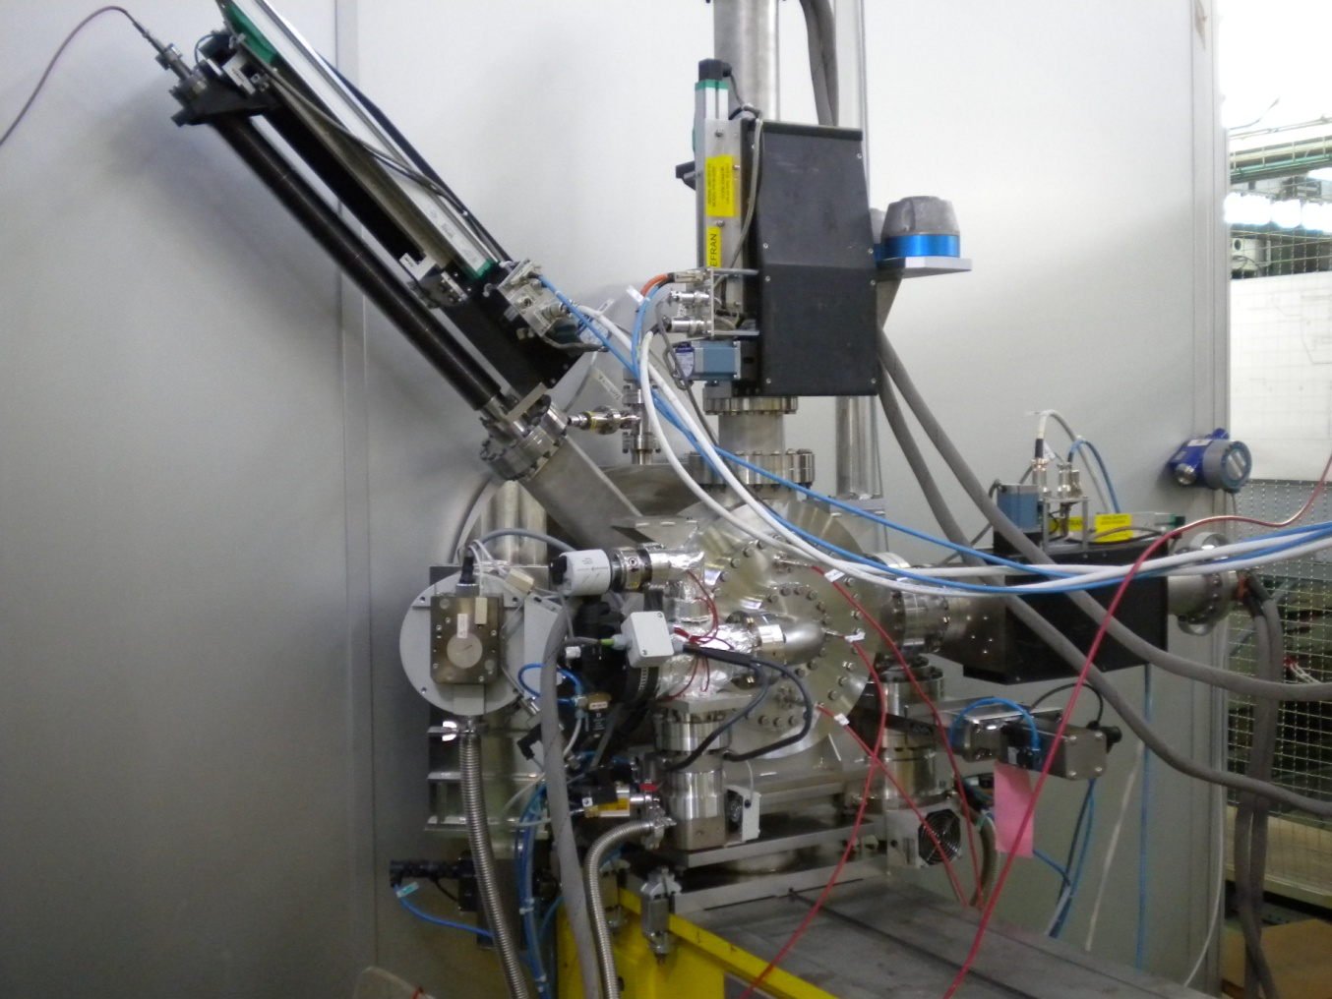
Transverse Emittance Measurement
Slit and grid phase space scanner
L-shaped 0.1mm slit moves under
45 degrees
Slit and grids move independently
Positioning precision: 50 µm
Movement PLC controlled
Slit and grids mounted in
2 independent vacuum boxes which
can be separated
Horizontal and vertical SEMGrid
wire distance .75 mm
30 signal wires
readout with home built 36 channel
250 kHz ADC
time resolved profiles

Slide 9
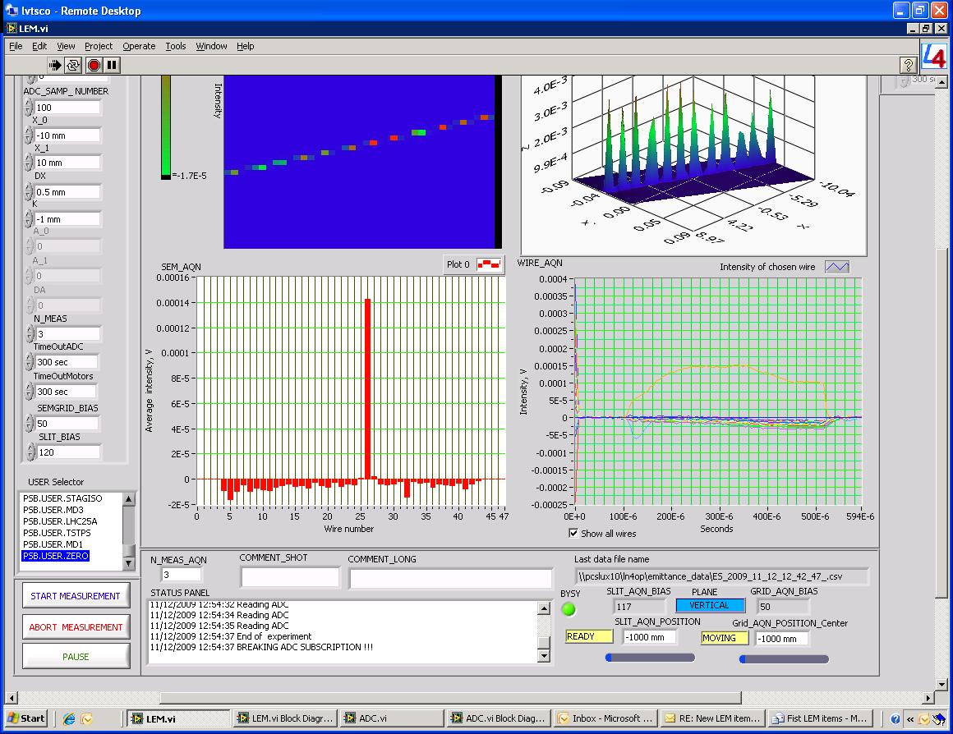
Emittance Meter Readout

Slide 10
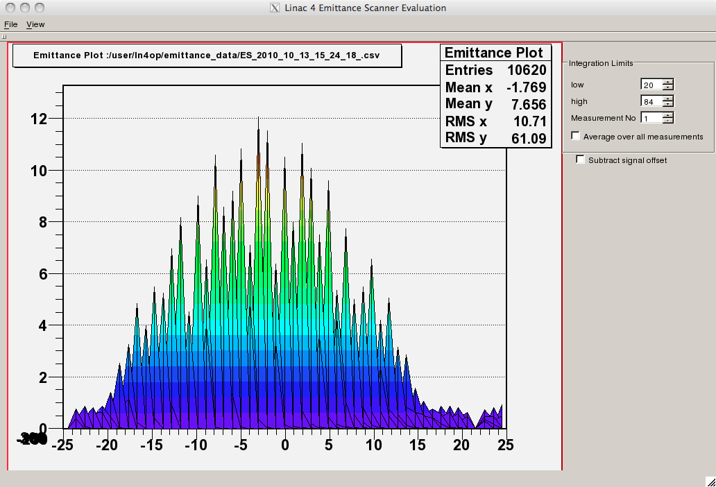
Emittance Evaluation

Slide 11
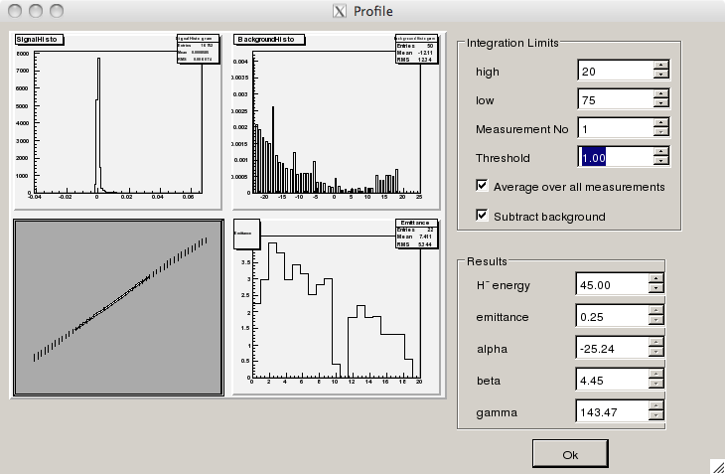
Pseudo Scubexx exvaluation
Histogram of signal levels
Background for each slit
Position
Emittance Plot
Emittance when taking less
and less channels around
peak

Slide 12
Modifications to the Emittance Meter
Long arm for the combined hor/ver slit poses mechanical problems
Use shorter separate slits or install stiff guiding
Program was designed for commissioning only
  LabView for readout, write raw data onto big files
  Evaluation program in C++ / Qt / Root
  Either these programs must be adapted and maintained or replaced by standard CO Java application
  (problem of frequent adaptations)

Slide 13
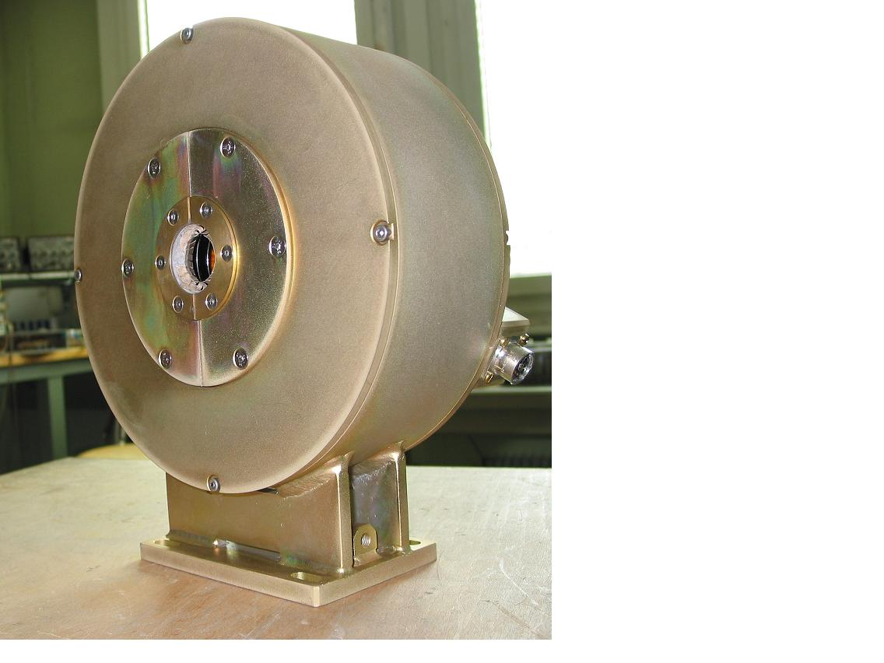
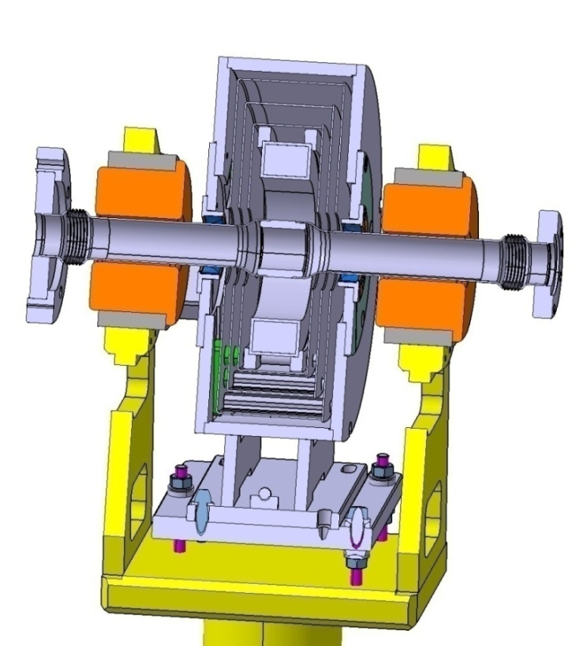
Current Transformers
Good magnetic shielding
avoids interference from
nearby pulsing quads
Shielding simulation and
test measurements have
been done
New electronics and software
has been developed for L4
Needs no additional work

Slide 14
Instruments for new test stand
SEMGrid
  Same mechanism as current device
  Wires can be polarized in addition to polarisation wires
  New analogue electronics (foreseen for Linac-4)
Faraday Cup
  Possibility to polarize up to 46 kV (variable) to measure energy spread
  Alternative: spectrometer which will not be used for Linac-4 any more
Chinese copy of LEBT transformer

Slide 15
Instruments for new test stand (2)
New emittance meter
  Mechanical changes foreseen (2 independant slits?)
  Software was designed for commissioning only
  either needs to be maintained or replaced by standard CO Java application (4-5 months of work)
Diagnostics of electrons from source to be specified and not counted
Instruments will be needed ~ 4 months before usage for assembly and test.

Slide 16
Cost table
Device | Material cost | manpower
Faraday Cup | 20 kCHF | 2 weeks
Floating 45 kV Faraday Cup | 70 kCHF (new design, 45 kV HV supply | 3 months including programming
Transformer | 25 kCHF | 2 weeks
SEMGrid | 80 kCHF | 2 weeks
Emittance Meter | 350 kCHF (includes mechanical modifications) | 3 months if software stay the same 4-5 months for new software
VME crates | 30 kCHF
Grand Total | 575 kCHF | 7.5 months 12 months if new emittance meter software

