Slide 1
IDEA Test Beam Program at T9 Beamline
Texas Tech University
(26 June to 5 July)
Nural Akchurin, Adil Hussain, Yelbir Khazykarim, Shuichi Kunori, and Odin Scheider

Slide 2
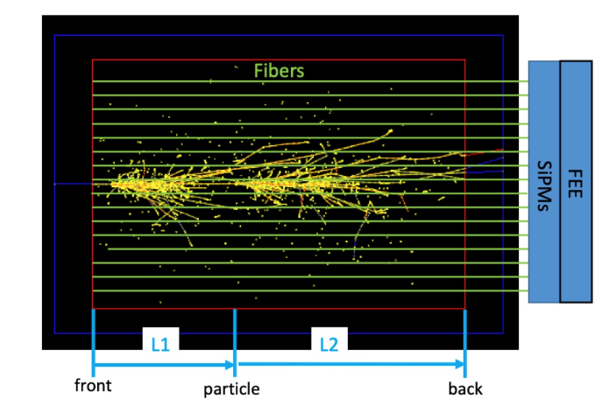
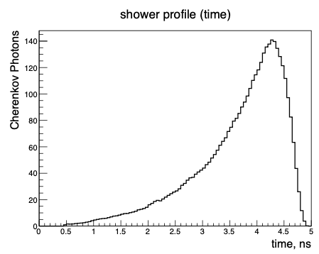
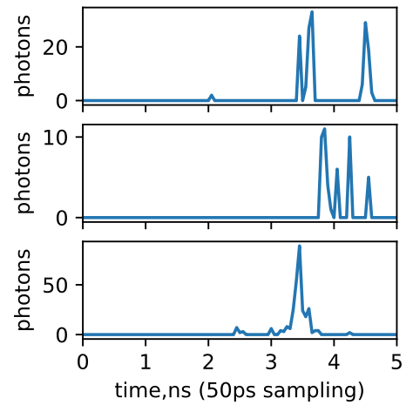
Program - I
The R&D program concerns effective longitudinal segmentation of fiber calorimeters using fast and precise signal timing
Achieving such capability opens doors towards high granularity calorimetry and other reconstruction advantages
event-1
event-2
event-3
Three simulation hadronic events are shown on the right: the sampling rate is 50 ps is used as an example

Slide 3
Program - II
Run plan includes the following:
Goals
  Measure the performance of the current SiPM’s multi-hit capability in a time window of < 5 ns
  Produce reference data for cosmic muon test stand to be studies later
Detector
  Cherenkov/scintillation fibers of various lengths to SiPM
  SiPM arrays from HPK and OnSemi with fast output
  CAEN DRS (DT5742)
  CAEN FER-5200 (A5202 digitizer, DT5215 concentrator)
  Scintillator counters for trigger
  MCP-PMT for good timing reference
Beams
  Electrons and pions with sufficient rate (to be understood) to build a high-quality data set for analyses and training

Slide 4
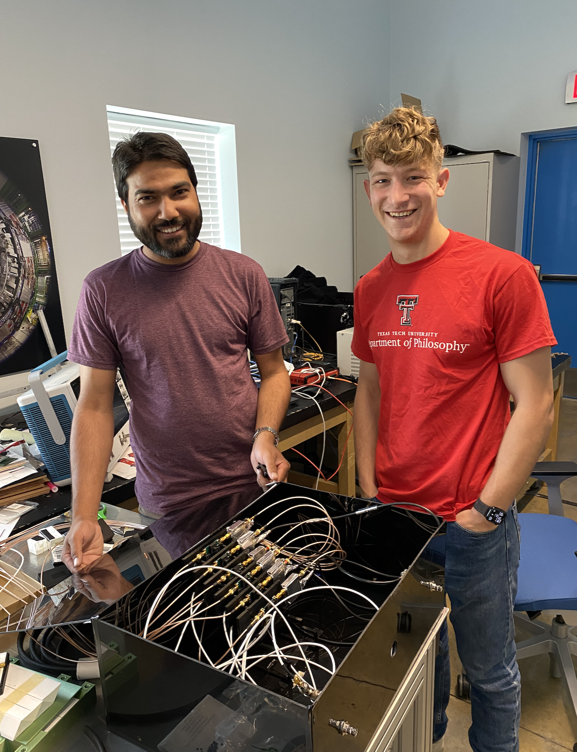
Program - III
We will bring all critical components (SiPMs, electronics, computers, and fibers) to CERN
Some equipment identified to rent from the Electronics Pool
Our team (2 senior scientists and 3 students) will arrive at CERN on Monday, June 26
Controlled Radiation Area access training is on Wednesday, June 28
Patrol training with Bastien is on Thursday, June 29 at 9 AM at T9
ISIEC form submitted (ID 911)
SiPM Box with electronics

