Slide 1
SPS status
Arthur Spierer for the SPS team
22th of June 2022, PS-SPS users meeting

Slide 2
SPS week 25
  Coordinator next week: Kevin Li
  Coordination meeting on Monday 11.30
  Technical Stop this week
    Extractions stopped towards NA on Monday 7:00
    Recovery on Thursday 18:00 (Beam already taken in the SPS Thu. Morning for checks)
    Foil irradiation cancelled due to the delay on the PSB recovery
  SFTPRO
    Requested units on T2/T4/T6 : 105/52/30
  Necessary SPS Scrubbing in view of LHC fills end of the week
    Might enter the supercycle after NA beam lines are setup
  Interruption of 2x30min on Friday for EPC transformer measurement
  HiRadMat
    Not taking place on week 26
  Next week
    Parallel MDs, replacement of HiRadMat to be defined

Slide 3
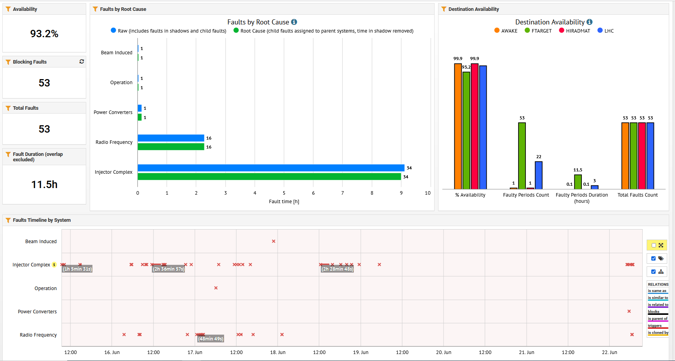
SPS availability overview

