Slide 1

Information session for candidates
2023 LD2IC

Slide 2




AGENDA
FRAMEWORK
IC POSTS
YOUR APPLICATION
CCRB
RULES-CRITERIA-TIMELINE
…
POST DESCRIPTION-COMPETENCIES
…
PROCESS-TOOL-DEADLINE
…
INTERVIEW-COMMUNICATION -RECOMMENDATION
…

Slide 3

LD2IC FRAMEWORK & ELIGIBILITY
Framework
SRR (R II 1.17 / R II 1.19)
Staff members are appointed on the basis of a limited-duration contract.
An indefinite contract may be awarded to staff members holding a limited-duration contract, under a review procedure defined by the Director-General.
AC No. 2
“The decision to open an IC position is taken by the Director-General on the proposal of the respective Head of Department”.
“The opening of posts with a view to the award of an indefinite contract shall occur within an Organization-wide exercise, which shall be held at least once per year”.
Eligibility criteria
Staff members
who are Member State nationals
holding a limited duration contract
ending on 31.12.2023 or later
having successfully completed their probation period at the end of the publication (31.08.2023)
applying for a post of an equal or higher grade and to a BMJ covering the same grade span or a higher grade span.

Slide 4
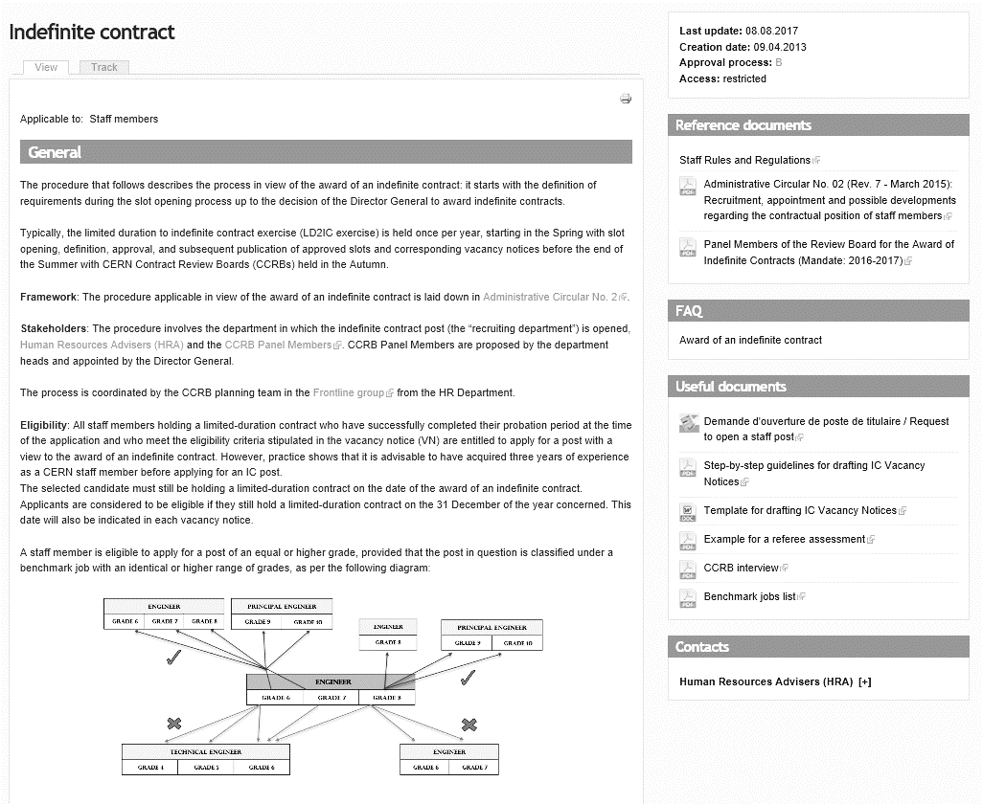
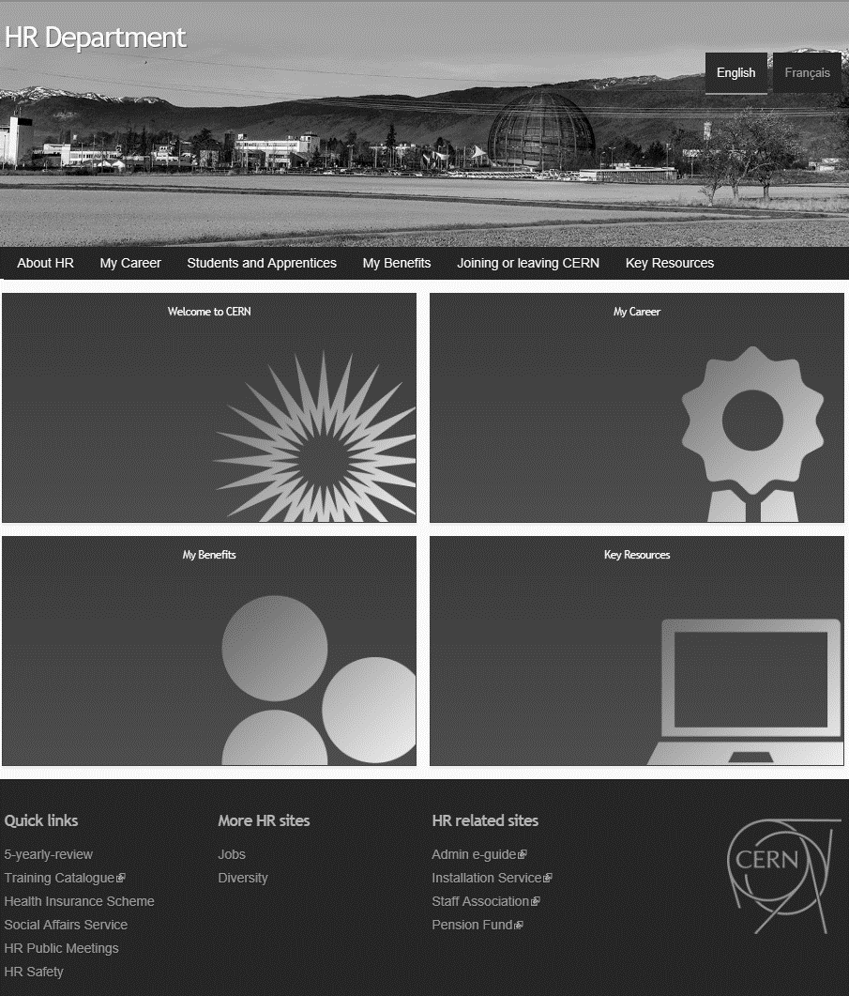
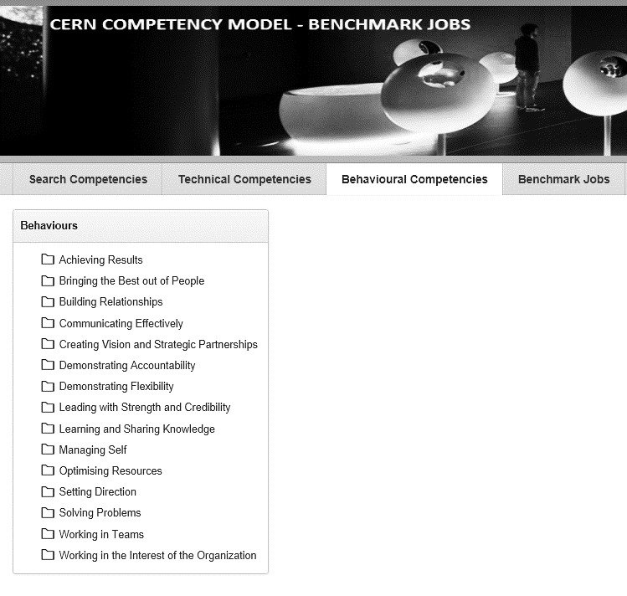
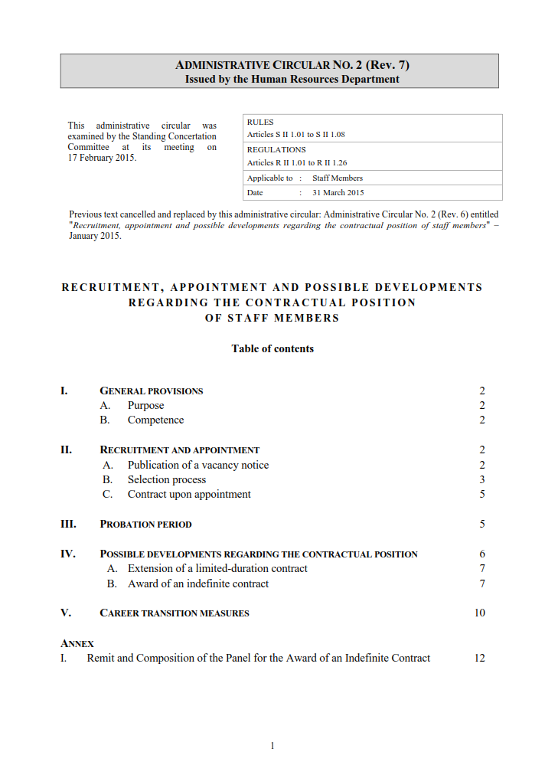


LD2IC RULES AND LITERATURE
Administrative Circular No. 2 (Rev. 7)
Administrative e-Guide > Indefinite Contract
Frequently Asked Questions (FAQs)
HR website
CCM (CERN Competency Model)
Indico event (slides and recording)

Slide 5

LD2IC TIMELINE
JULY
AUGUST
DECEMBER
JULY
AUGUST
SEPTEMBER
OCTOBER
NOVEMBER
DECEMBER
Publication of the
IC slots (benchmark jobs titles and grades)
Publication of vacancy notices on 01.08
Shortlisting candidates
Candidate information sessions on 15 August at 10:30 am (EN) /remote
Invitations to candidates
Candidate information sessions on 18 & 19 July
Application deadline 31.08 noon GVA time
From end September to December
CERN Contract Review Boards (CCRB)
Recommendations to DG

Slide 6
PERSPECTIVE, VALUE AND MINDSET
Perspective
Lot of competent and motivated people at CERN – who make CERN; are CERN
Limited number of IC posts every year – competitive
Value?
Outcome: long term contract with the Organization
Value to self: ‘taking stock’ – see what you have achieved, where you go – a moment of pride & reflection on your career so far and the years to come
Mindset!
Heads up: it can be challenging at times
  Energy and investment
  Interactions with team or colleagues
Stay positive, focused, respectful - and think of the value (independently of the outcome)
Stay authentic and true to yourself (vs advice; vs ‘trying’/ ‘practising’)

Slide 7
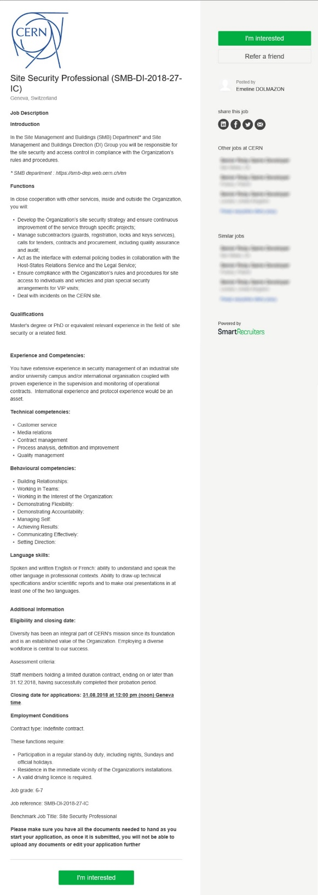

IC POSTS
Benchmark job (BMJ) Title
Introduction
Functions
Qualifications
Experience and Competencies
Employment conditions
BMJ and Grade(s)
IC POSTS
POST DESCRIPTION-COMPETENCIES
…
careers.cern/indefinite
JOB REQUIREMENTS
Apply to the post(s)
for which you are qualified

Slide 8
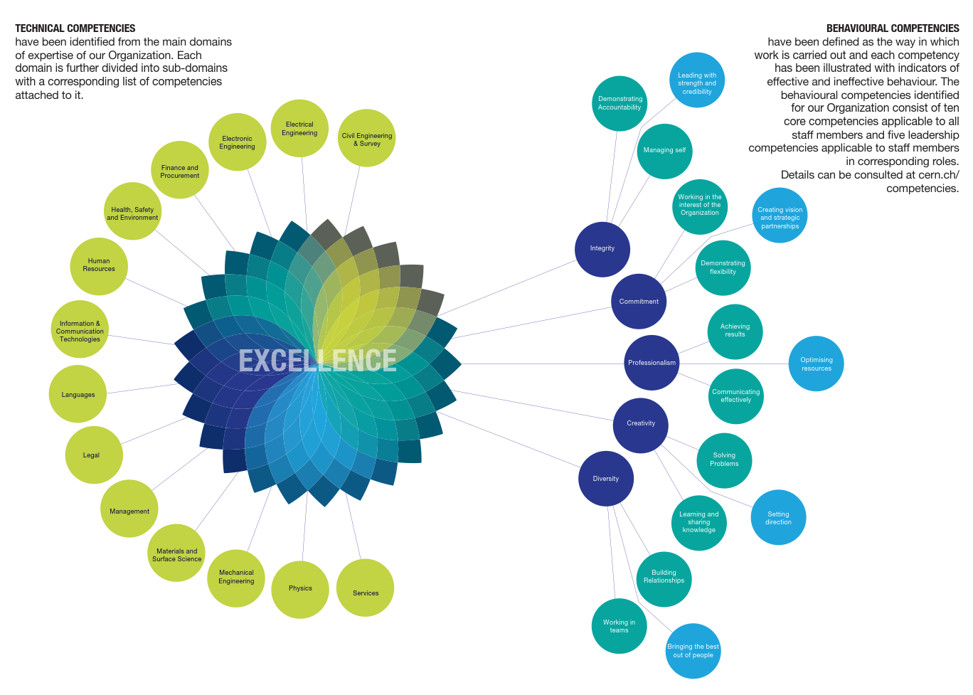
TECHNICAL AND BEHAVIOURAL COMPETENCIES (Cern Competency Model - CCM)
Download the brochure or Printer Friendly version

Slide 9
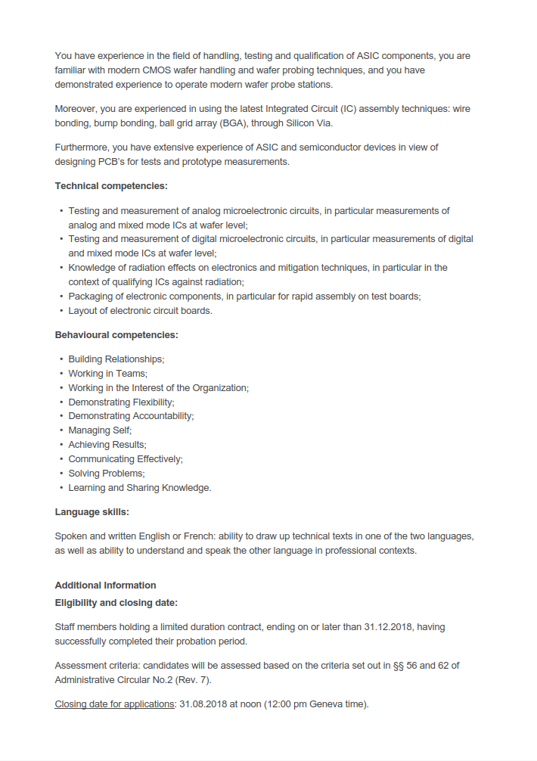
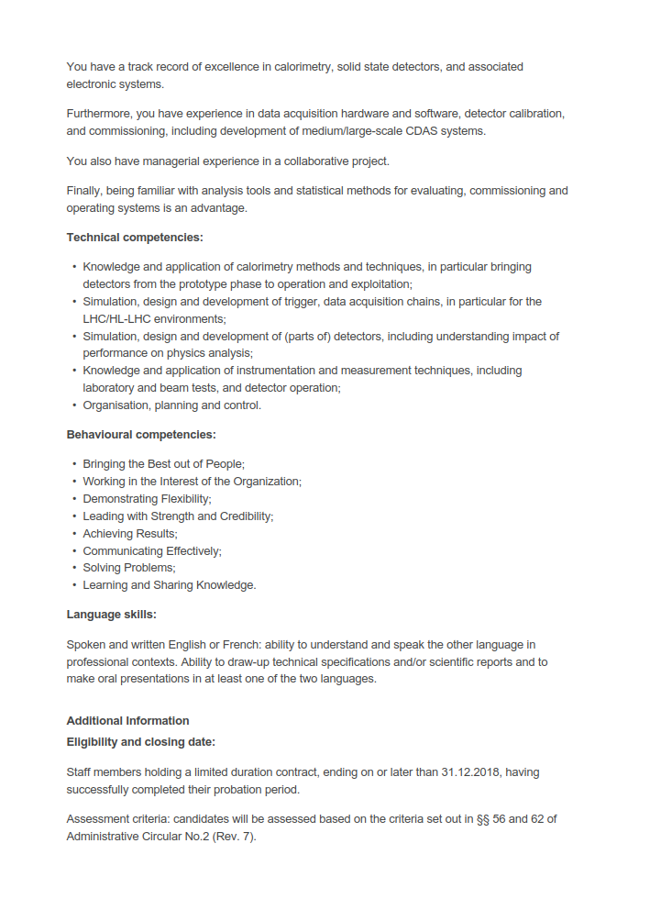
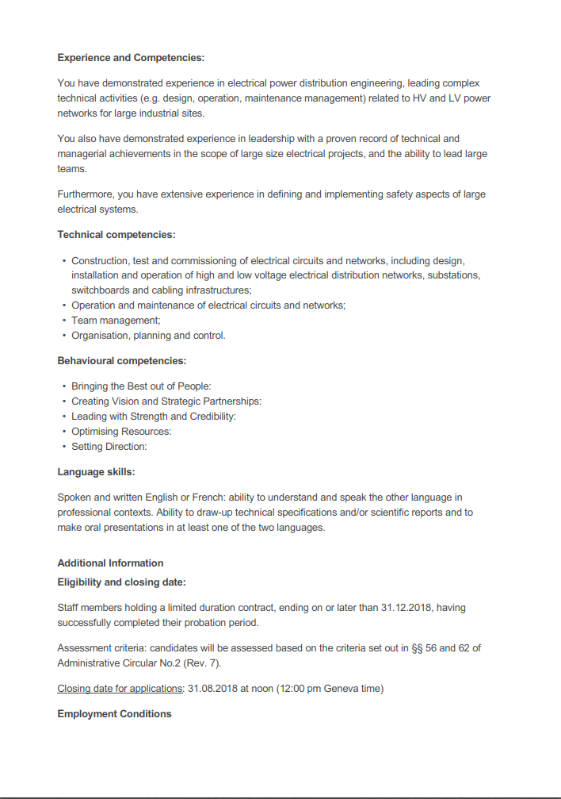

BEHAVIOURAL COMPETENCIES
in IC posts
EITHER 10 core competencies
OR mix of leadership and core competencies
OR 5 leadership competencies

Slide 10






YOUR APPLICATION
Some recommendations
YOUR APPLICATION
PROCESS-TOOL-DEADLINE
…
UPDATED CV (pdf)
MOTIVATION and YOUR CURRENT FUNCTIONS (pdf, max. 1 page)
DEADLINE
31 August noon
Start identifying 2 REFEREES
PREPARATION IS KEY
Don’t leave it until the last minute!
Prepare everything in advance
It is your responsibility to submit your application on time

Slide 11


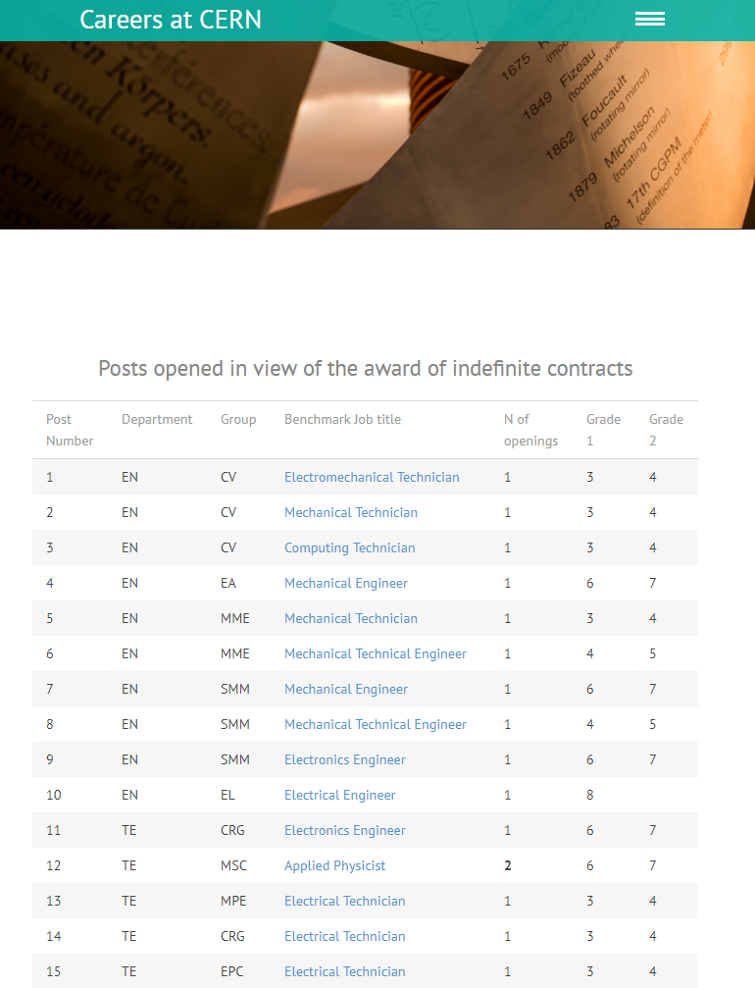

YOUR APPLICATION
careers.cern/indefinite
If no submission within 60 minutes
= session will expire
= restart
…
Be prepared
Select the job in the list to open the IC post
CV
motivation + description of current functions

Slide 12

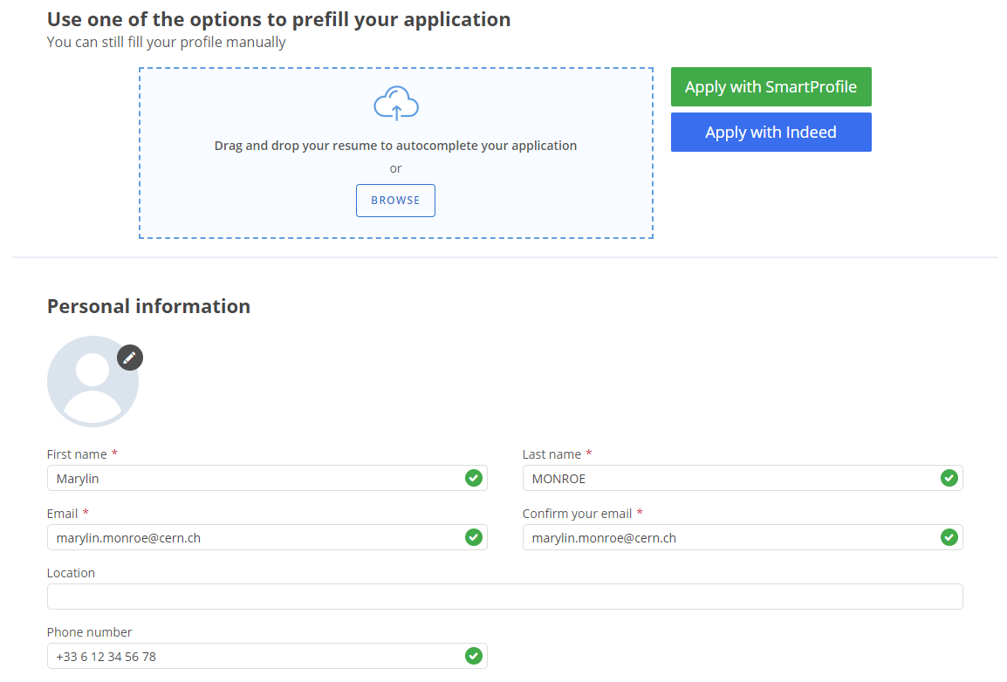
YOUR APPLICATION
Application form – page 1
Use your CERN email address

Slide 13
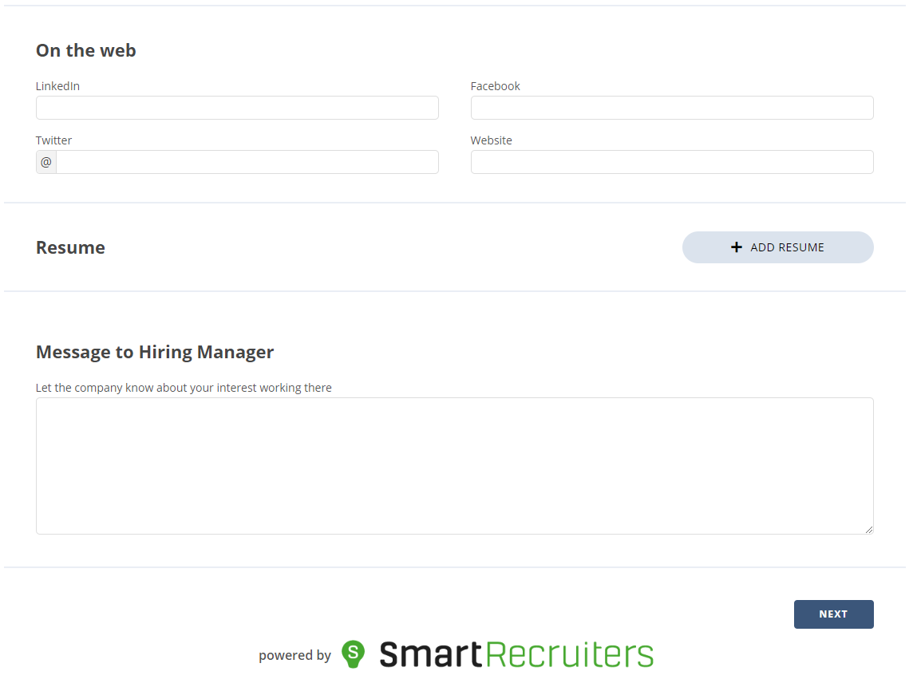


YOUR APPLICATION
Application form – page 1
Upload your CV in pdf format
Please leave this empty, it will not be taken into consideration
Next = page 2

Slide 14
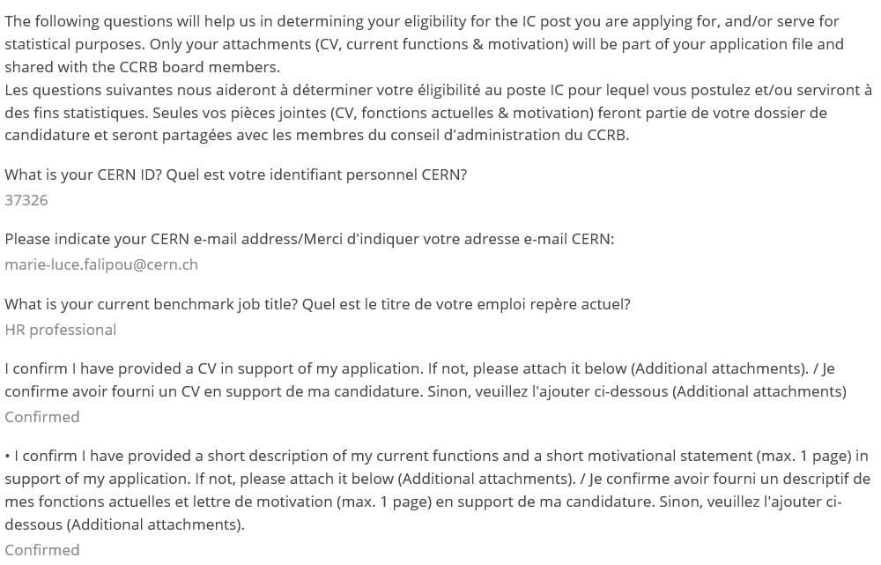

YOUR APPLICATION
Application form – page 2
MOTIVATION / CURRENT FUNCTIONS
labelled «motivation_your name»
Add your
CV labelled «CV_your name» here
if not already done on the previous page

Slide 15
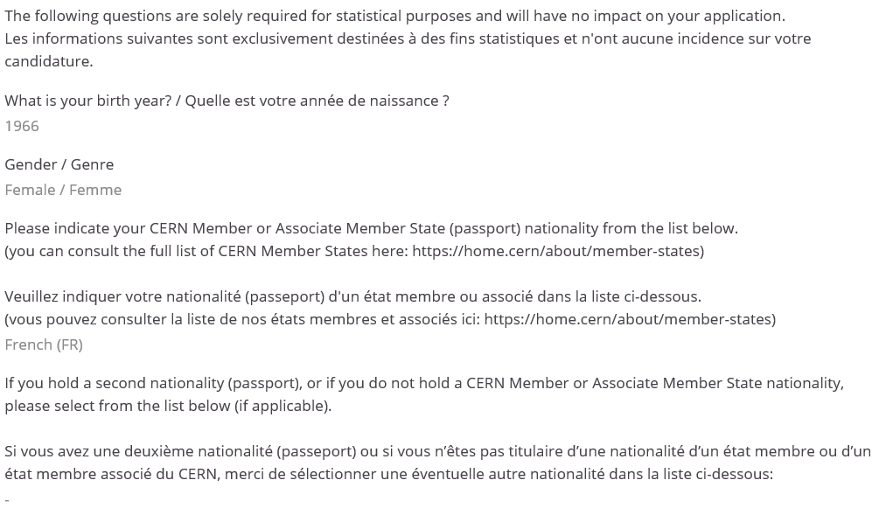

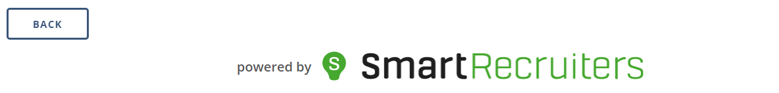
YOUR APPLICATION
Application form – page 2
Note
Candidates holding an Associate Member State Nationality are ineligible
Back = information from page 2 will be lost

Slide 16
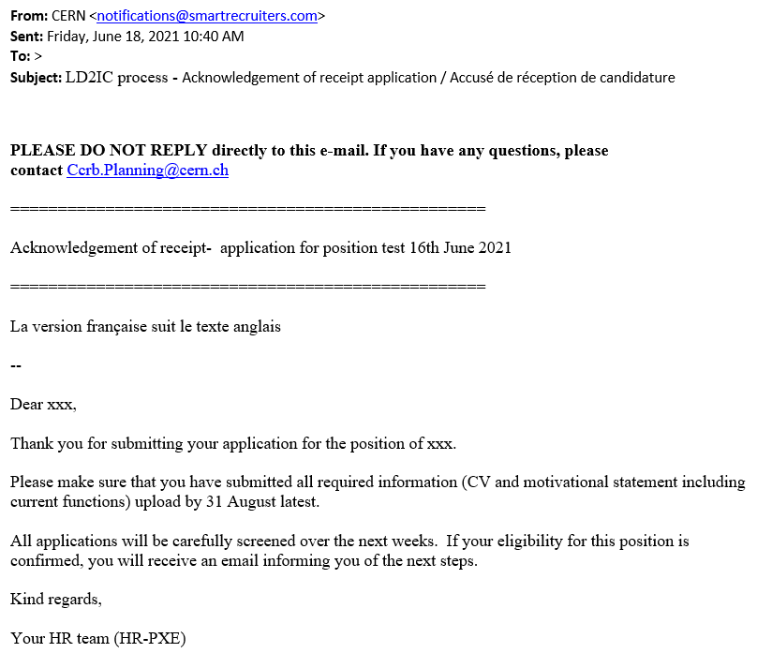

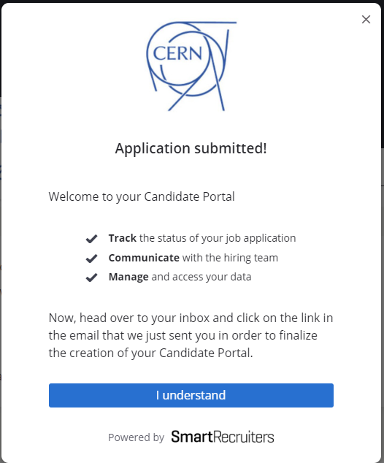
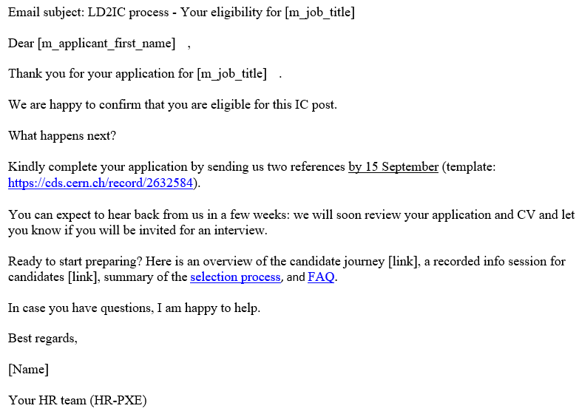
YOUR APPLICATION
Application submitted
Acknowledge-ment of receipt
Link to the reference template
Eligibility email
Reference template also available on the admin e-guide

Slide 17
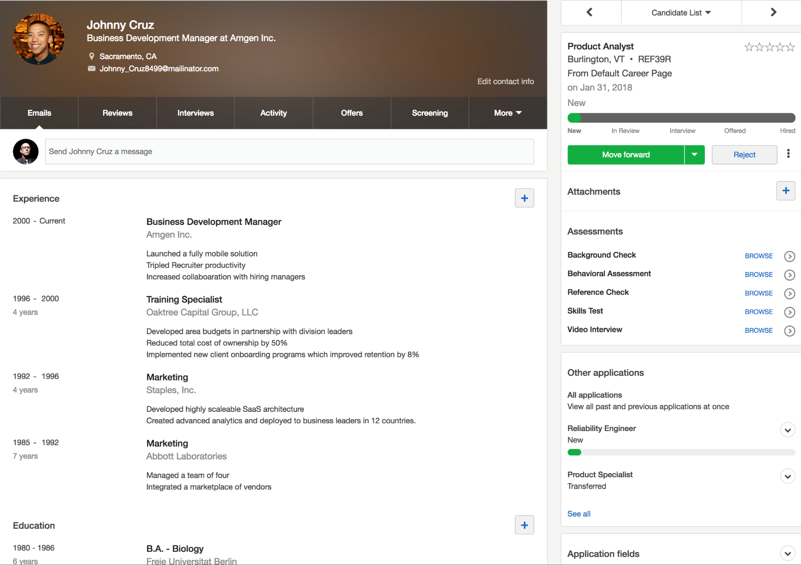

CANDIDATE PROFILE
Access your application file at any time in SmartRecruiters
*CV_Cruz
*Motivation_Cruz
x
Resume
Reference #1
x
Reference #2
x
IMG.jpg
x

Slide 18
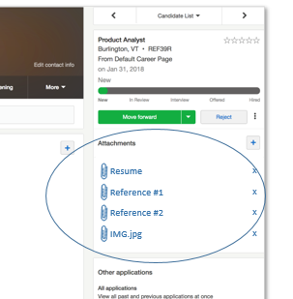
CANDIDATE SHORTLISTING AND INVITATIONS
Shortlisting criteria:
Candidates whose technical competencies, qualifications and/or professional experience correspond to the requirements stipulated in the indefinite contract vacancy notice are eligible to be shortlisted.
§ 56 of the Administrative Circular No. 2 (Rev. 7)
Next steps if shortlisted:
You will be invited to the related board for an interview. Therefore, the following documents need to be uploaded as soon as possible and no later than 15th September:
3 last performance reports (MERIT and where needed mid/end probation reports)
How?
    By replying to the eligibility or invitation email and attaching the documents to it OR
    By accessing your candidate portal and adding them under “attachments”
2 references (see next slides)

Slide 19







REFERENCES
What is the objective? Have an additional view on your work
RELEVANT PERSON
RELEVANT EXAMPLES
FORMAL DEADLINE
1 of the 2 can be external to CERN
Someone who is able to write
relevant examples of work situations
highlighting your competencies.
15th September at the latest
It is your responsibility to ensure that the reference letters are provide in due time.
Supervisor has already reported on you
Head of HR Department, Head of the
department opening the post, Board Members and Panel Chairperson: not authorized.

Slide 20

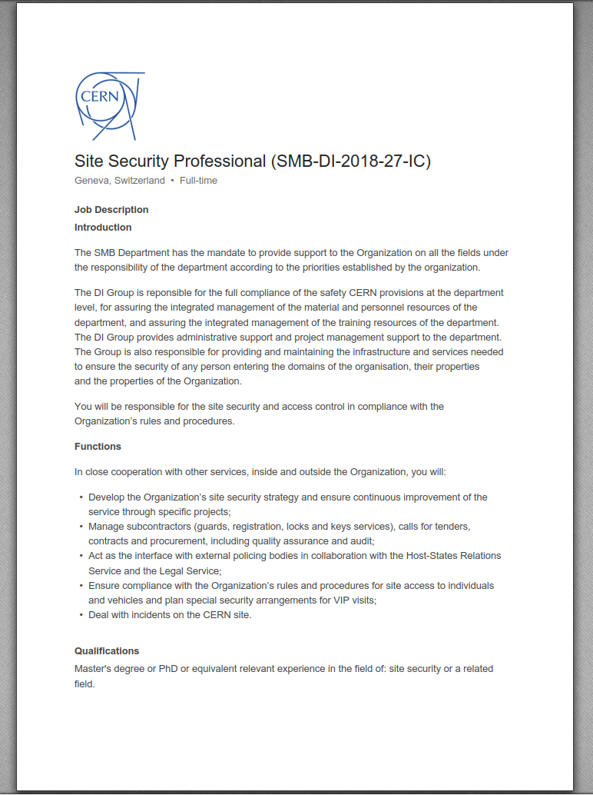
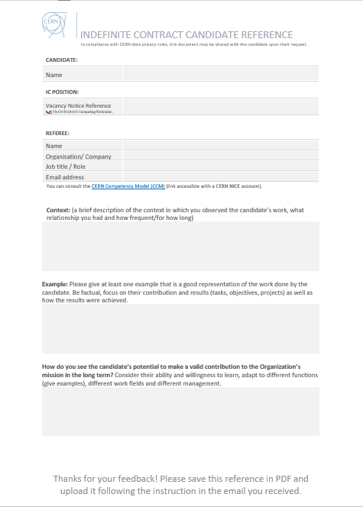


REFERENCES
x2
VN reference nr ex.:
EP-XXX-2022-XXX-IC
VACANCY NOTICE
REFERENCE TEMPLATE
UPLOAD
careers.cern/indefinite
http://cds.cern.ch/record/2632584
= referee uploads letter thanks to dedicated link

Slide 21
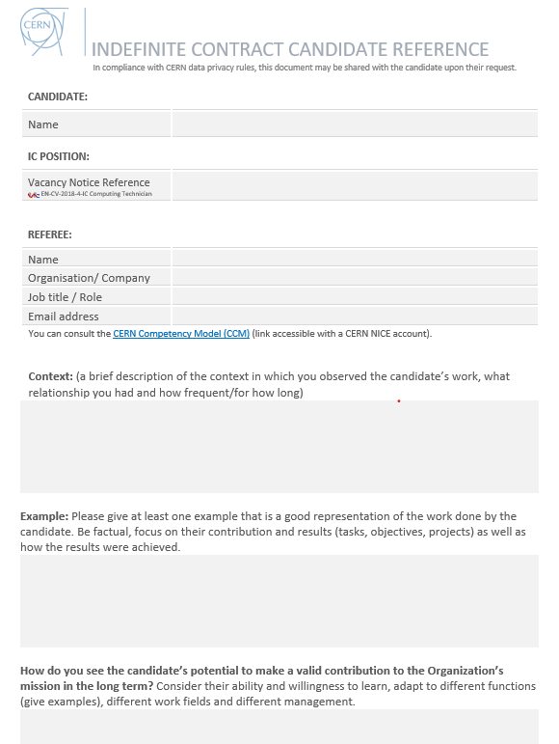
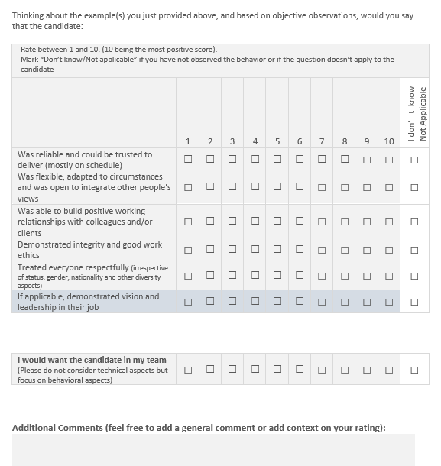

REFERENCE LETTERS: Form

Slide 22
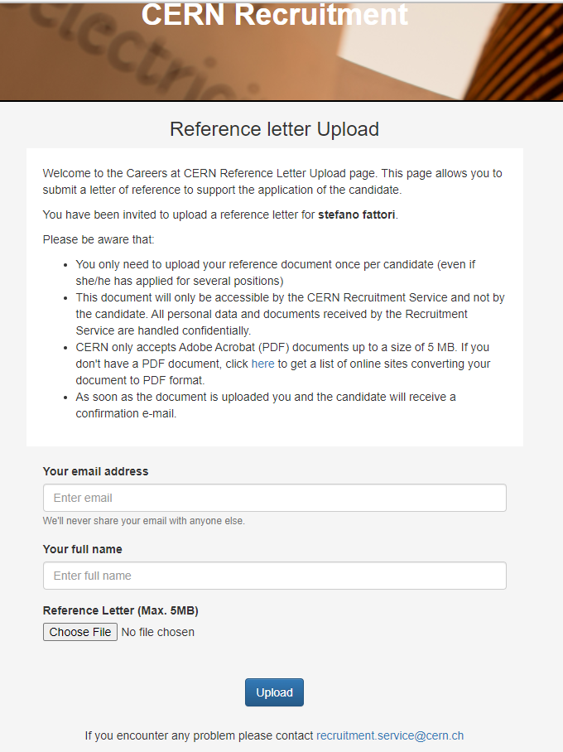
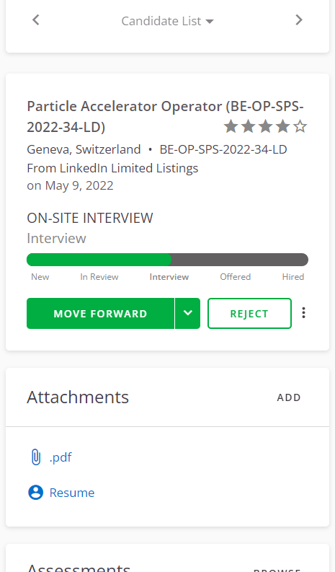
REFERENCE LETTERS: PROCESS
Eligibility email from SR includes link to reference letter template
Candidates are shortlisted
Shortlisting email from SR to forward link to referees
Referees upload the reference letter
Document is added to the application in SR

Slide 23

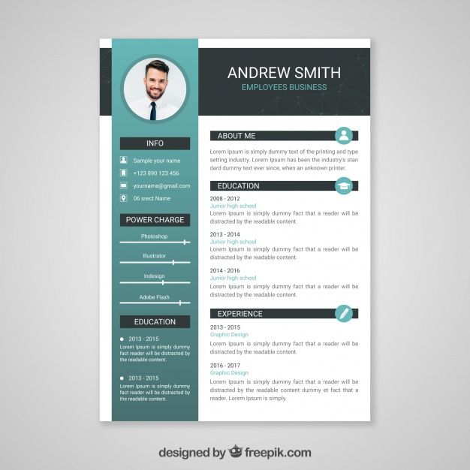
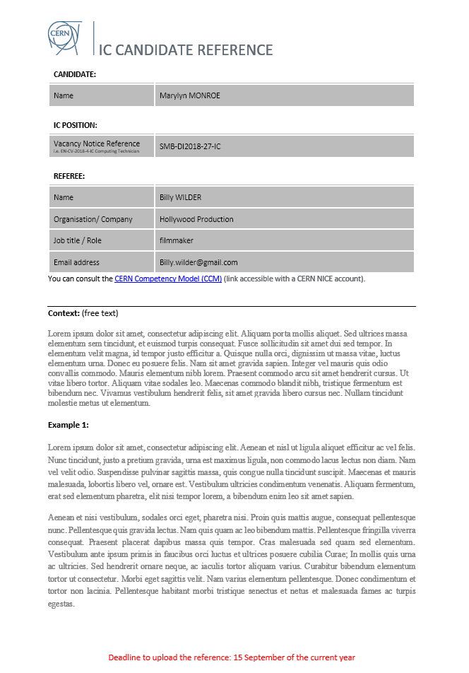
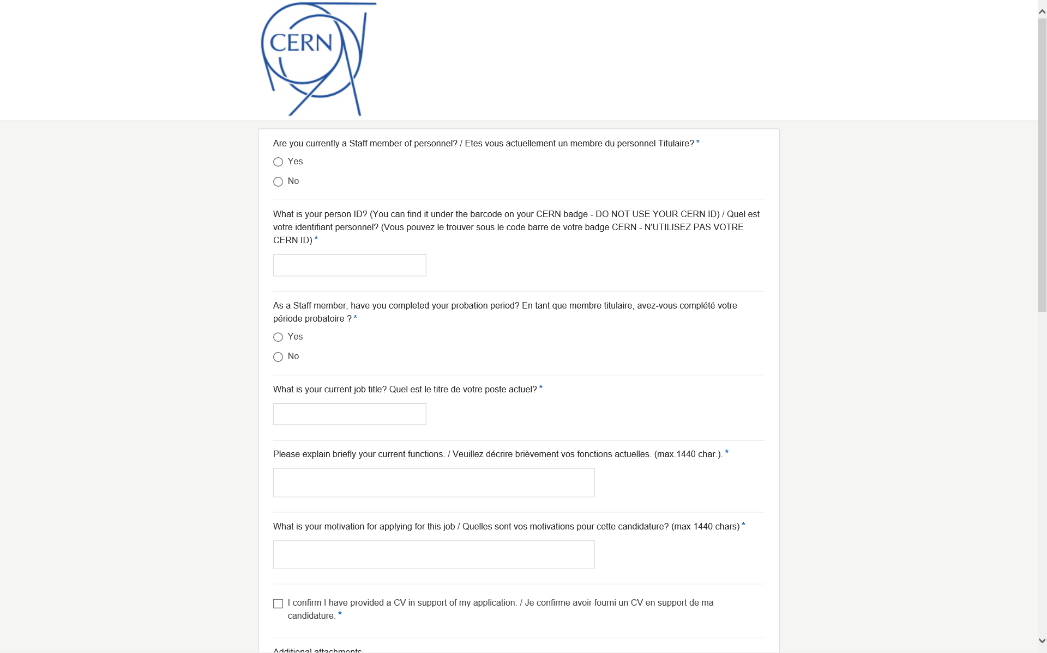
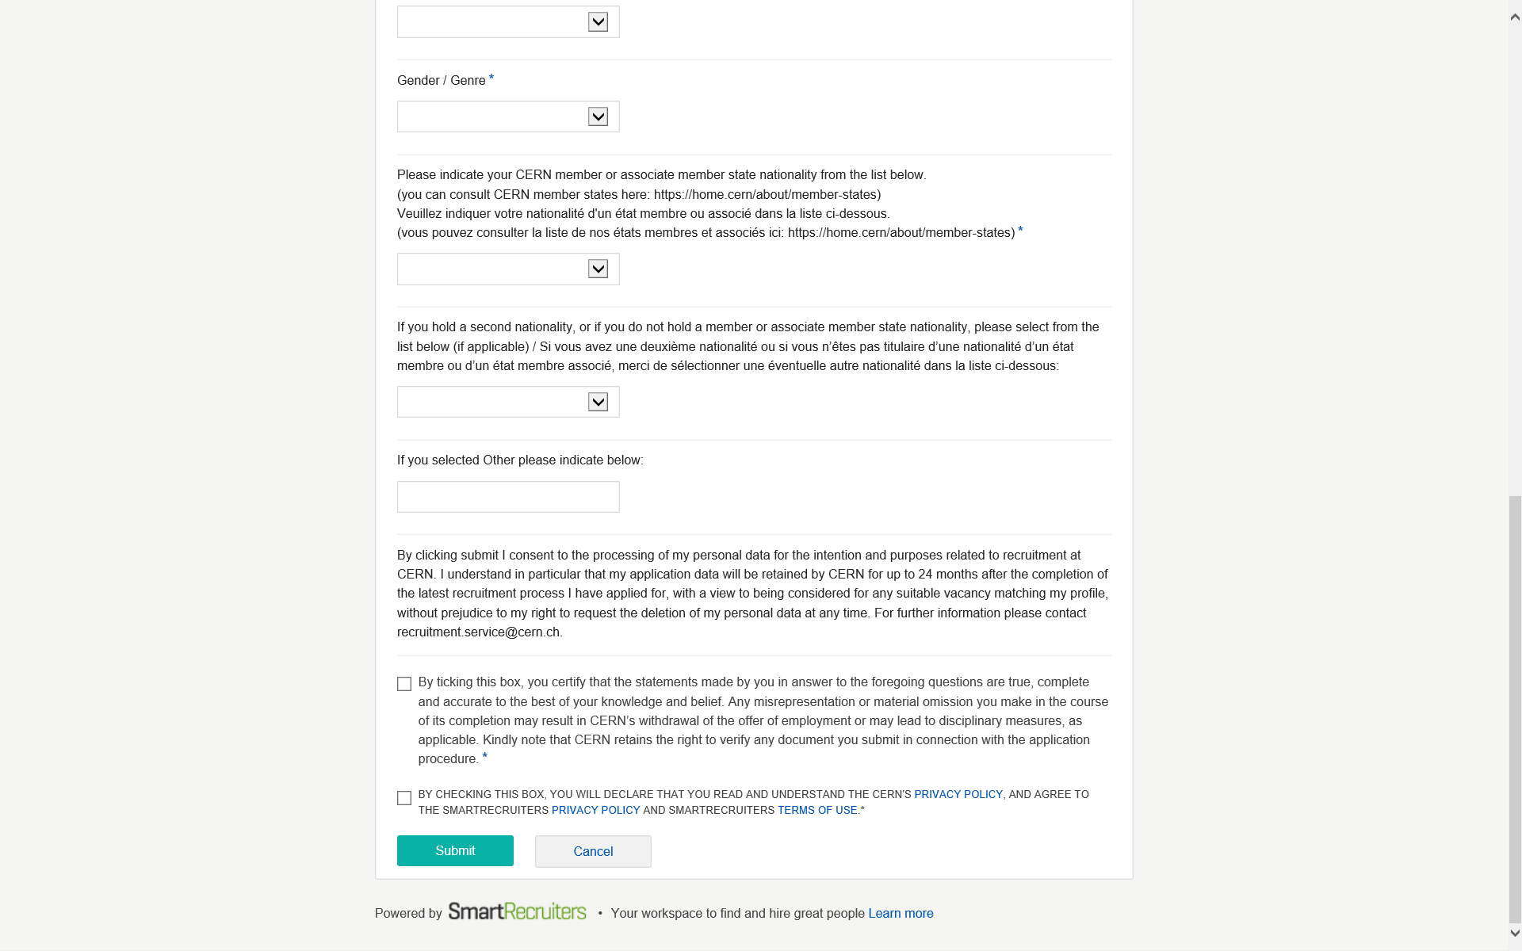
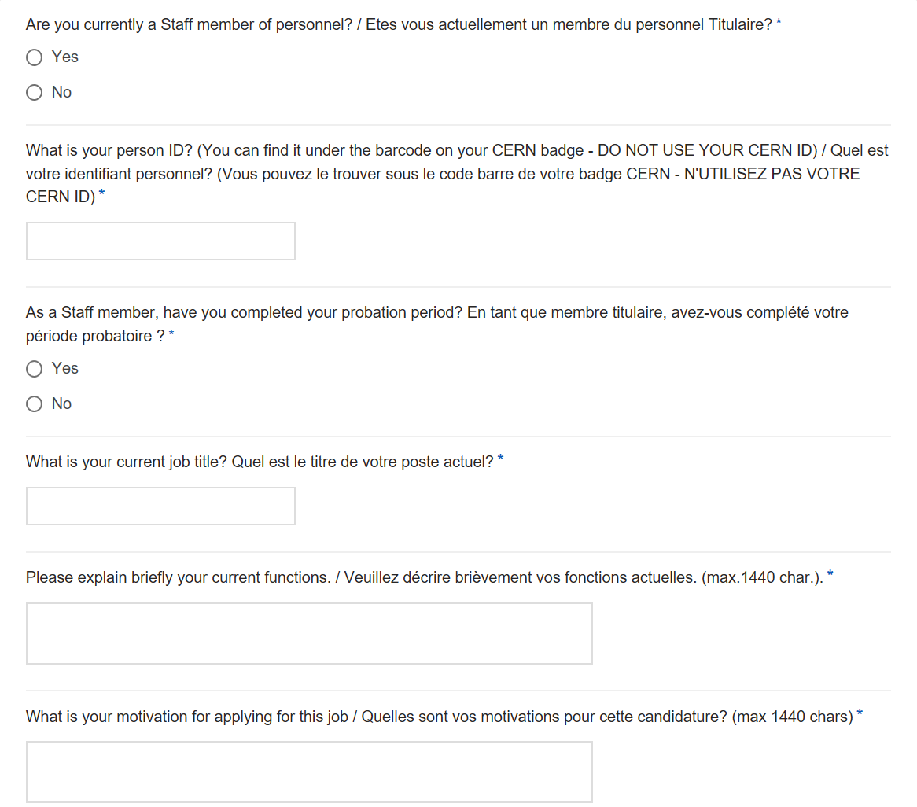

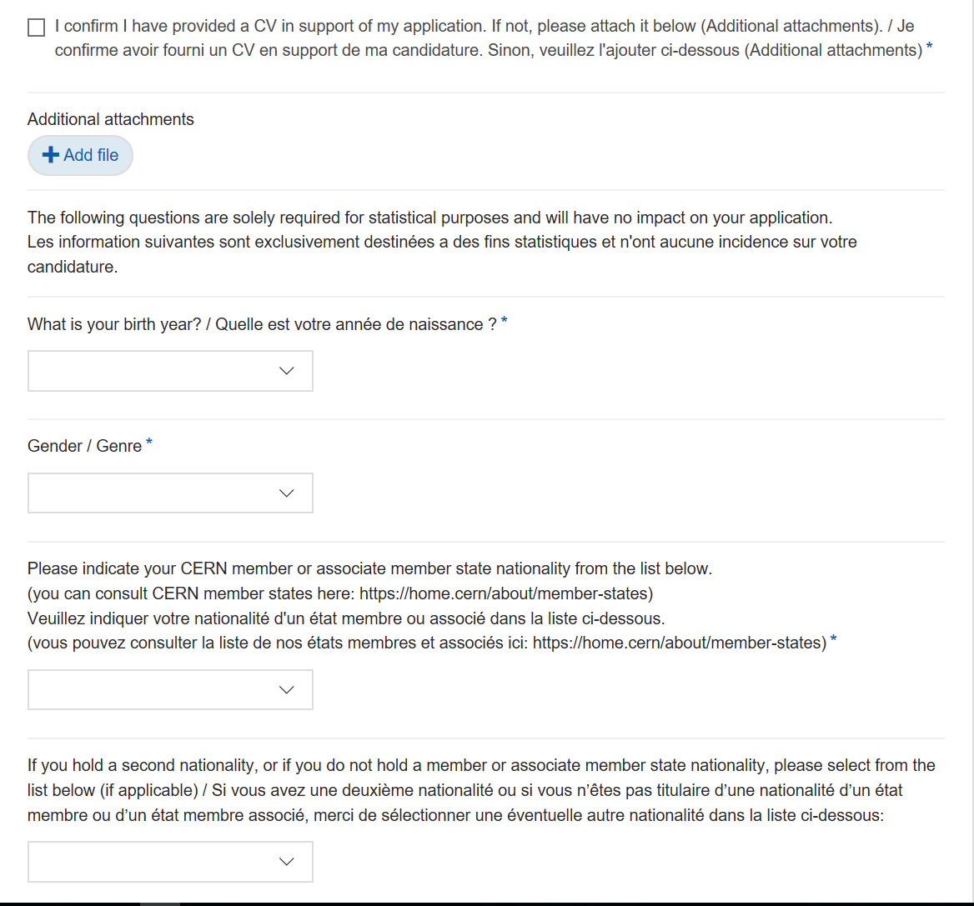
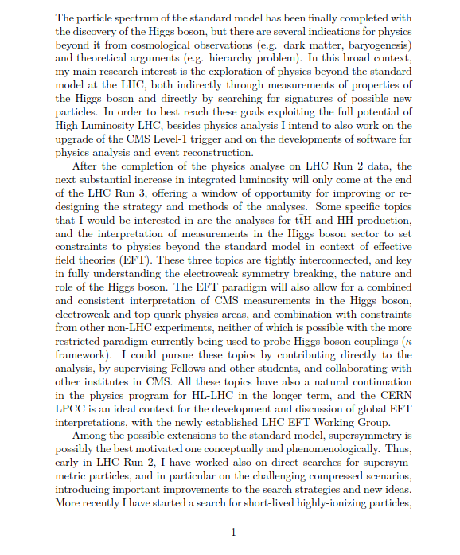

COMPLETE IC APPLICATION FOR SHORTLISTED/INVITED CANDIDATES
BY 31.08 AT NOON
BY 15.09 END OF THE DAY
x2
APPLICATION FORM
2 REFERENCES +
3 PERFORMANCE REPORTS
CV +
MOTIVATION & DESCRIPTION OF CURRENT FUNCTIONS
x3

Slide 24


CERN CONTRACT REVIEW BOARD (CCRB)
Composition
Panel Member (CCRB Chair)
HR Representative
Panel
Member
The applications of the shortlisted candidates shall be examined by a Review Board (CCRB) for the award of indefinite contracts (hereinafter “Review Board”) comprising:
- one or several members of the Panel defined in AC No.2 Annex1;
- one or several representatives of the department opening the post;
one or several representatives of the Human Resources Department; and
one or several experts from other departments (as necessary).
§ 56 of the Administrative Circular No. 2 (Rev. 7)
CCRB
Departmental Representative
Departmental Representative*
* Can be the Group Leader

Slide 25

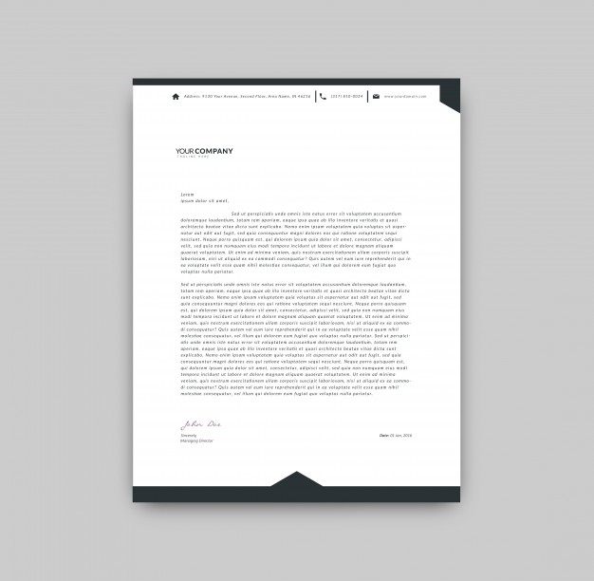

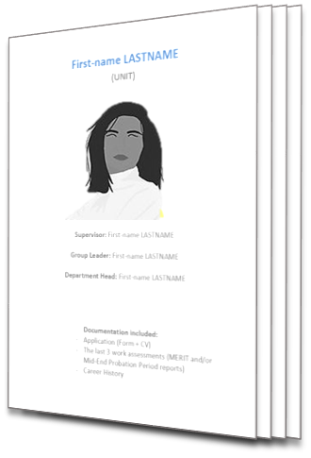
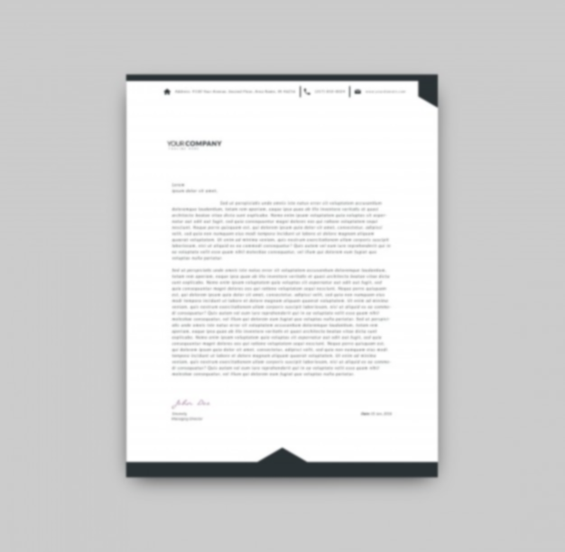












CERN CONTRACT REVIEW BOARD (CCRB)
Assessment
Assessment criteria:
“Shortlisted candidates are assessed and examined against the technical and behavioural competencies indicated in the vacancy notice; and, furthermore, as to whether they possess the requisite potential to make a valid contribution to the Organization’s mission in the long-term. “
§ 62 of the Administrative Circular No. 2 (Rev. 7)
Application form
CV
Motivation incl. current functions
Last 3 performance reports
x2
Examination
Interview
References
Additional elements
(when necessary)
Candidate
file
The examination may also comprise:
Individual interviews
Additional discussions with candidate
Oral, written or practical tests
Presentation of a thesis or project documents
15’ presentation by the candidate
30’ Q&A session

Slide 26







YOUR INTERVIEW (in person)
How
Total duration:
45 minutes
presentation
by the candidate
max. 15 minutes
TIMING
30 minutes discussion
discussion & questions:
30 minutes
LANGUAGES
CONTENT/QUESTIONS
Interview conducted in both languages
All questions to assess your experience, technical & behavioural competencies and your potential

Slide 27

YOUR PRESENTATION
How
Total duration:
45 minutes
presentation
by the candidate
max. 15 minutes
TIMING
PRESENTATION
15 minutes limit
Practice, practice, practice before!
discussion & questions:
30 minutes
LANGUAGES
CONTENT/QUESTIONS
Presentation in your preferred language (either English or French)
Think about your key messages
regarding your experience, technical & behavioural competencies and potential

Slide 28

CERN CONTRACT REVIEW BOARD (CCRB)
Recommendation
The only official information
is provided by the HR representative.
All interviewed candidates will be informed verbally by the HR representative, and in writing via email, whether or not they have been selected for a post.
The review board makes a recommendation
and the Director-General
takes the decision.

Slide 29





COMMUNICATION FLOW
“Ineligible”
Not shortlisted
email
Not eligible
shortlisting
Not shortlisted
interview
Application
submitted
References &
performance
reports
uploaded
…
Decision
Eligible
Presentation
To be sent to HR
Shortlisted
“Acknowledge-
ment Receipt”
“Eligibility
email”
Shortlisted
email
no later than
the day before
the interview
Provide us with a phone number where you can be reached.
Invitation
to the
interview

Slide 30

INFORMATION SESSIONS
All sessions are recorded.
Date | Heure | Langue
12 juillet 2023 | 14h00 – 15h30 | FRANCAIS / EN LIGNE
18 July 2023 | 10h30 – 12h00 | ENGLISH / ON-SITE 593/R-010 - Room 11
15 August 2023 | 10h30 – 12h00 | ENGLISH / REMOTE

Slide 31

LD2IC SUPPORT
Support and Advice = HRA
General advice (no rehearsals or presentation review)
Support in how to complete your file
Answer any further general questions
Technical issues = Service Desk
Process questions = CCRB team
?
Do not leave it
until the last minute!

