Slide 1


First test-beam experience with the CALICE tungsten A-HCAL prototype
ALCPG Workshop
19.-23. March 2011
Eugene, Oregon
Dominik Dannheim (CERN),
Angela Lucaci-Timoce (CERN)
on behalf of the CALICE collaboration

Slide 2
Outline
Tungsten for hadronic calorimetry
W-AHCAL test-beam setup
Calibration and particle identification
Data quality assessment

Slide 3
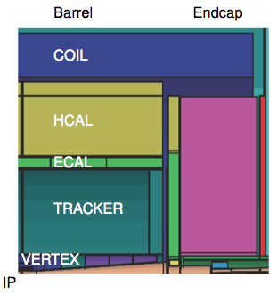
Hadronic calorimetry at 3 TeV
Resolution of hadronic calorimetry driven by:
  Intrinsic resolution
  Leakage (number of λ_{i})
To maximize number of λ_{i}:
  Increased depth
  Denser absorber
Depth severely constraint by:
  Feasible coil size for large B-field
  Size of tracker needed for
  good momentum resolution
→CALICE investigates dense absorbers for hadronic calorimetry

Slide 4
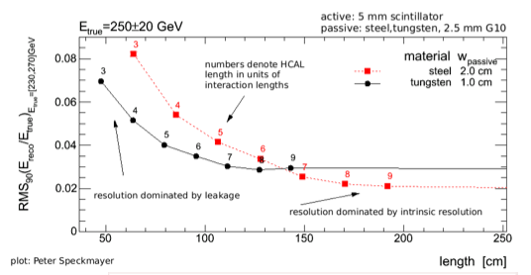
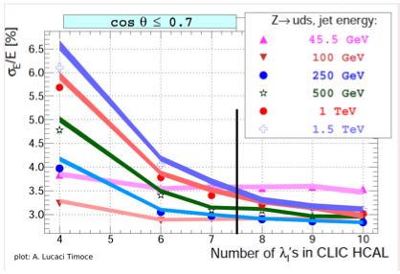
Simulation results at 3 TeV
Energy resolution for single π, reconstr. with neural network:
Shorter HCal leads to:
  more leakage
  worse resolution
Flat region reached
at smaller depth
for tungsten than
for steel absorber
For E_{jet}<50 GeV: resolution constant,
dominated by intrinsic resolution
For E_{jet}>100 GeV: leakage
dominates resolution
→Aim for HCAL depth of
7.5 λ_{i} (+1 λ_{i} from ECAL)

Slide 5
Tungsten as absorber material
Expected benefits of tungsten absorber vs. iron:
  λ_{i}(W) = 10 cm; λ_{i} (Fe) = 17 cm
  →Less leakage for same depth → more showers contained
  →Smaller shower diameter → better separation
However: little experience with tungsten for hadronic calorimetry
  So far: tungsten used for EM calorimetry (~1 λ_{i})
  No experience with tungsten in HCALs (4-9 λ_{i})
  Simulation of hadronic showers in tungsten not validated
    No data/MC comparisons
    In particular: no validation with high granularity
    Low-energy spallation neutrons increased, less ionization
      → Late component of shower more important,
      making time stamping more challenging
Goal of CALICE test-beam program with tungsten absorber:
  Validate particle-flow based calorimetry for CLIC conditions
  Help to improve/validate Geant-4 simulation models

Slide 6
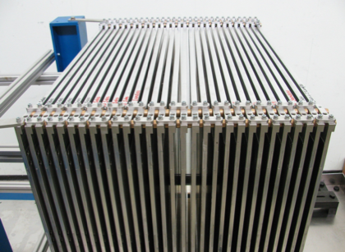
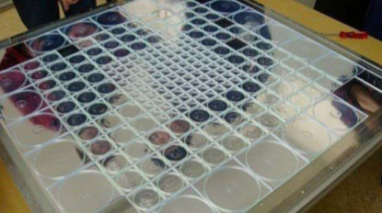
W-AHCAL prototype
Tungsten Absorber:
  30 plates of 10 mm thickness
  1 x 1 m² surface
Active material:
  Scintillator tiles of
  3 x 3 cm² (center) and
  6 x 6 cm² (edges)
Total depth incl. supports: ~3.8 λ_{i}
Readout:
  Light collection via WLS fibres,
  readout with multi-pixel SiPMs
  MICROMEGAS in last readout layer
  T3B high-precision timing meas.
  behind last readout layer
  (cf. talk by F. Simon tomorrow)
→will concentrate on SiPM readout
in the following

Slide 7
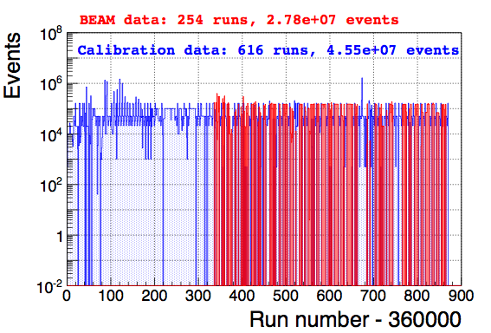
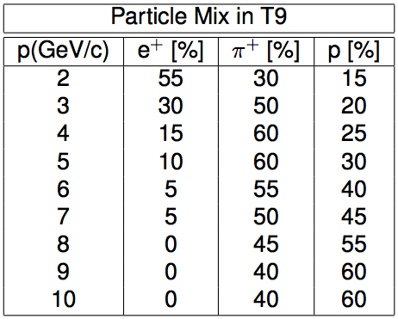
Test beam at CERN-PS
Several weeks of low-intensity μ runs in T7, to obtain MIP calibration
19 days of beam time in T9 area of CERN-PS
  Typically 2-3 spills / 45 s, 24-33 Hz DAQ rate
  28 million events in total:
  e⁺⁻, μ⁺⁻,π⁺⁻, p⁺⁻ from 1 to 10 GeV in steps of 1 GeV

Slide 8
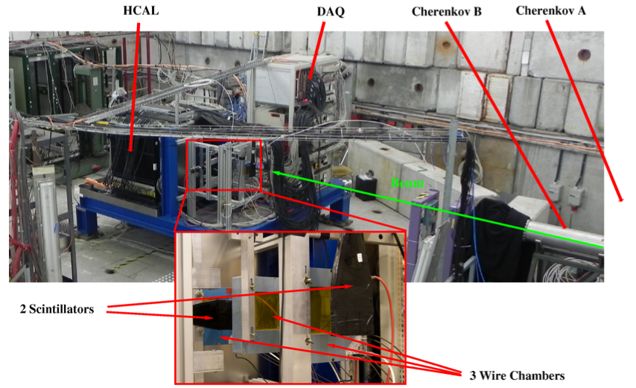
Test beam setup

Slide 9
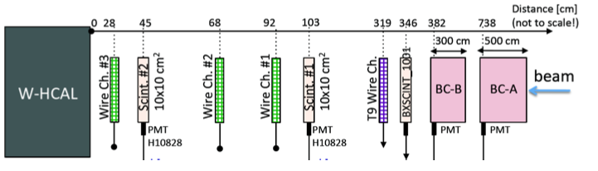
Beam instrumentation
Trigger:
  Coincidence of 2 scintillators + PMT in front of W-AHCAL
Tracking:
  3 delay-line wire chambers with x/y planes in front of W-AHCAL
  Resolution of predicted impact point on W-AHCAL surface ~0.5 mm
Particle ID:
  2 Cherenkov counters filled with CO₂ at ~0<p_{abs}<3 bar
  PMT+Scintillator+Discriminator → Cherenkov bit: on/off
  Used offline to separate electrons, muons, pions, protons

Slide 10
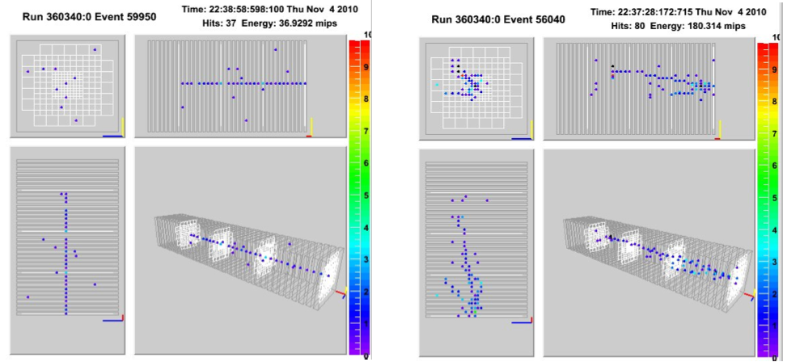
Event displays
Online reconstruction of events using calibration from 2007
(layers 31-38 missing in 2010 setup)
μ⁻ candidate
E_{beam}=8 GeV
π – candidate
E_{beam}=8 GeV

Slide 11
Calibration procedure
Dead/noisy channels
  Dead/noisy channels monitored during data taking
  Number of problematic channels ~constant
  Flagging for offline analysis handled by new software package
Temperature monitoring/correction
  → See following slides
Gain calibration
  → See following slides
Intercalibration
  Ratio of readout response between physics+calibration mode
  Probed with LED runs
  Good agreement with previous calibration (FNAL 2008)
MIP calibration
  See following slides

Slide 12
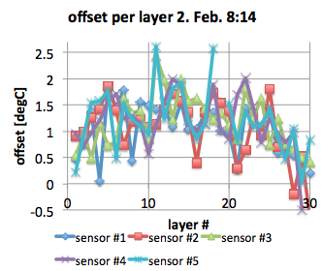
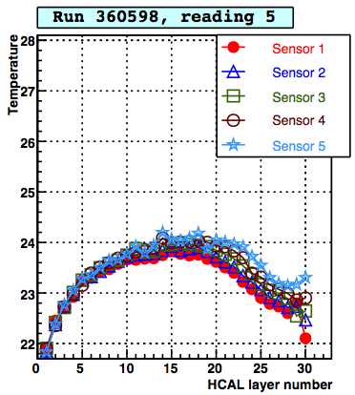
Temperature monitoring
SiPM properties depend on ambient temperature:
  Gain decreases with 1.7% / K
  Breakdown voltage increases with 65 mV / K
  Response decreases with 3.7% / K
Continuous temperature monitoring with 5 sensors per readout plane
Corrections for gain/response are applied offline during calibration procedure
Calibration offsets for temp. sensors:
Temperature profile during run:
Additional heat sources next to last layers, originating from alternative readout modules
→ larger spread

Slide 13
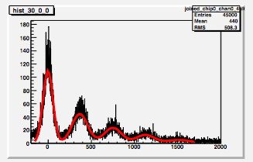
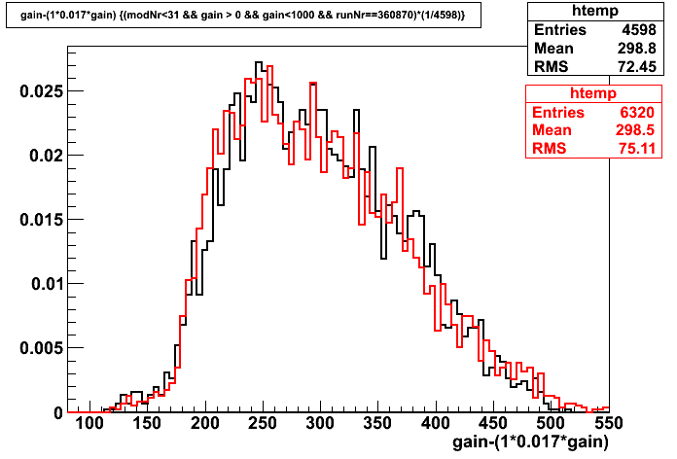
Gain calibration
Gains (ADC counts per pixel)
obtained from periodic
low-intensity LED-pulser
calibration runs during data taking
Efficiency for extracting gain
constants is used for
data-quality monitoring
0 pixels
1 pixel
2 pixels
3 pixels
#entries (normalised)
Gain = ADC counts per SiPM pixel
(modulo correction for difference between
calibration and physics readout mode)
Good agreement between gains
for FNAL 2008 data (red) and gains
for CERN 2010 data (black)
(after preliminary temperature correction)
gain value

Slide 14
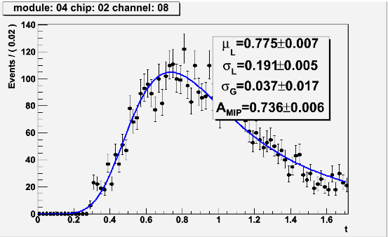
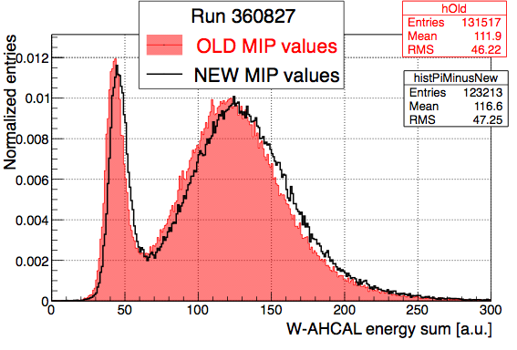
MIP calibration
ADC-to-MIP calibration performed with long low-intensity μ runs
Fit ADC distributions per channel with Gauss+Landau
MPV of Landau gives MIP value for corresponding channel
(at reference temperature given by the average temperature of
the corresponding runs)
Comparison old / new MIP calibration:
Energy response for -5 GeV run with
pion+muon selection
Example of MIP fit for one channel:
cell energy [a.u.]

Slide 15
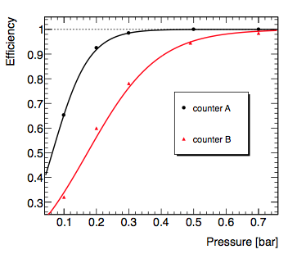
Particle-ID using Cherenkov counters
Use Cherenkov counters offline to select / veto various types of particles
Becomes difficult at low energy
(limited by p_{max}=3.0 bar)
Electron efficiency (tag and probe):
Efficiency of Cherenkov selection
limited by discrimination threshold of PMT readout
Pion purity limited by in-flight pion decays
Optimized pressure settings for each energy point,
to allow for selecting exclusive sample of
sufficient size

Slide 16
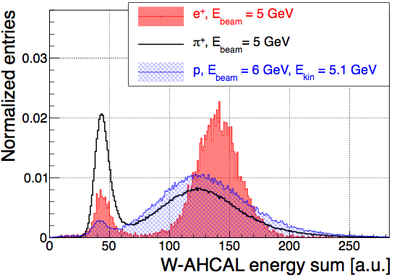
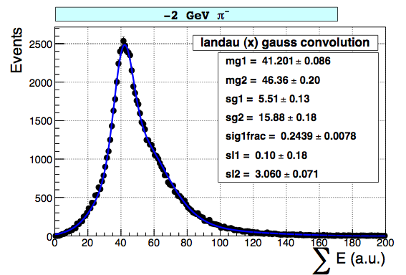
Response to e, μ, π, p
Use CERN 2007 (Fe) calibration for now, to study global quantities
(e.g. total energy sum and resolution)
Obtain particle types per event from Cherenkov counters
μ contamination at all energies, as expected from in-flight π decays
and Cherenkov cross-efficiencies
μ separation difficult for low energies, where e, π, p also look like MIPs
However: at low energies combined fits still allow to obtain individual mean and sigmas from the inclusive selections
μ+π peak at -2 GeV:
μ⁺ peak
e⁺/π⁺/p⁺ peak

Slide 17
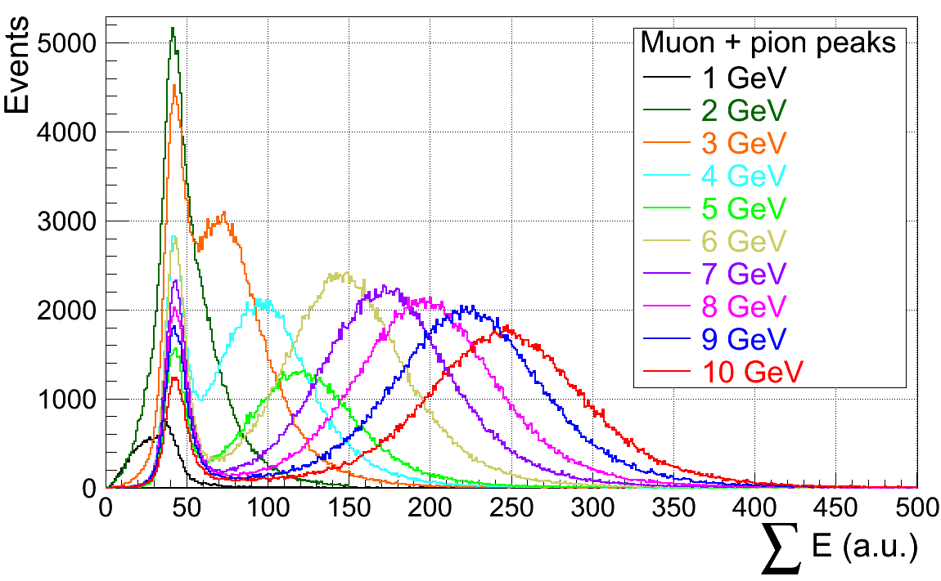
μ and π response at different energies
(negative charge)
Preliminary studies with fits indicate:
  EM resolution slightly worse than for Fe (lower sampling fraction for X0)
  Hadronic resolution similar to Fe
  e/π stable vs. energy

Slide 18
Summary/Conclusions
Successful first W-AHCAL test beam at CERN PS
28 million events collected: e, μ, π, p from 1 to 10 GeV
Calibration and data-quality studies show satisfactory results
Final calibration and simulation in progress
Outlook
2 test beam campaigns planned in 2011 at CERN SPS (H8):
  Hadrons, electrons and muons from 9 to 350 GeV
  1st period: will add 8 additional tungsten layers
  2nd period: will add also tail catcher

Slide 19
Backup slides

Slide 20
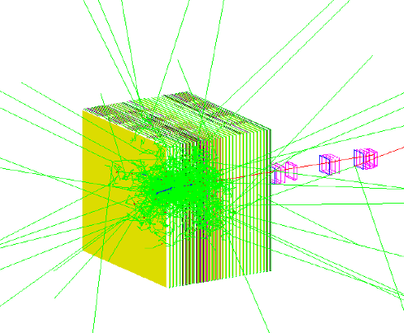
Simulation
Geant-4 simulation for AHCAL setup implemented in Mokka framework
Comparison of data with different Geant-4 physics lists ongoing
Expect differences for shower shapes and timing between:
  QGSP_BERT → high neutron content
  QGSP_BERT_HP → in addition: high precision neutron tracking

