Slide 1
For Marcel Demarteau’s
R&D talk at ALCWG11
This is a collection of slides.
It is about CLIC-specific detector R&D
and also about
some R&D that CERN is doing for the linear collider (e.g. SAltro16, Timepix2)
Lucie, March 10th 2011

Slide 2
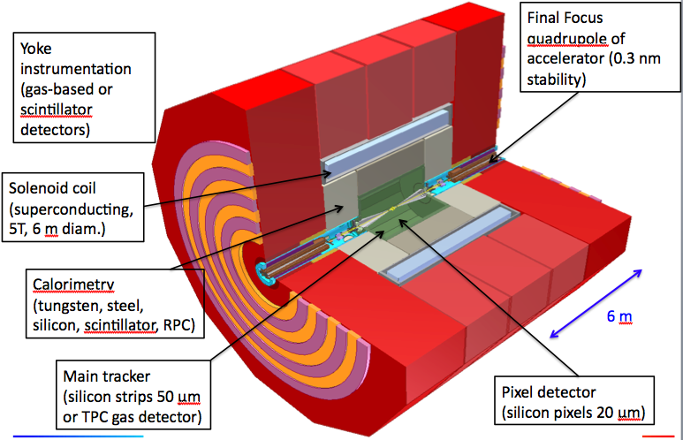
Detector concepts for CLIC

Slide 3
CLIC machine parameters
Parameter | Value
Center-of-mass energy √s | 3 TeV
Instantaneous peak luminosity | 5.9x10³⁴ cm⁻² s⁻¹
Integrated luminosity per year | 500 fb⁻¹
Beam crossing angle | 20 mrad
Train length | 156 ns
N_{bunches} / train | 312 (every 0.5 ns)
Train repetition rate | 50 Hz
IP size x/y/z | 45 nm / 1 nm / 40 μm
# γγ→hadrons / bx | 3.2
# incoherent electron pairs / bx | 3 x 10⁵

Slide 4
Vertex detector

Slide 5
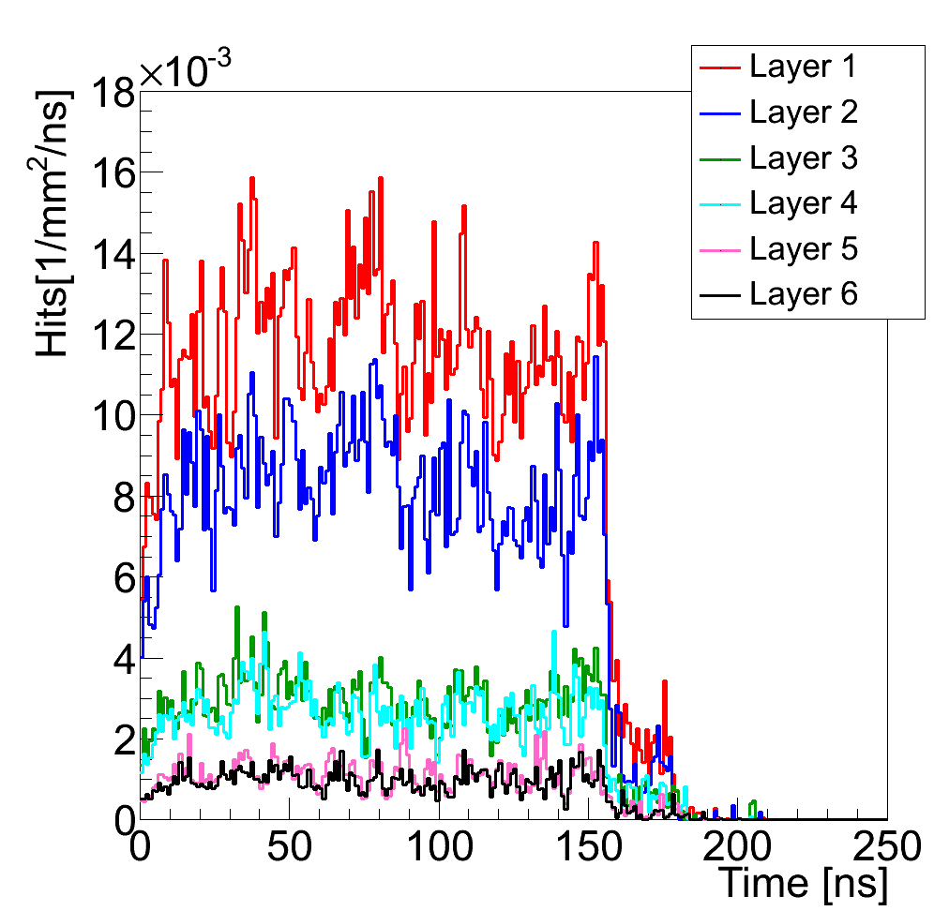
Beam-Beam backgrounds
Background occupancies in vertex region dominated by
incoherent electron pairs produced from the interaction of real or virtual photons with an electron from the incoming beam
20 mrad crossing angle leads to large amount of back-scattered particles, suppressed in latest design by optimization of absorbers and forward geometry
In CLIC_ILD innermost barrel layer
(R=30 mm):
  ~1.5 hits / mm² / 156 ns train
assuming 20 x 20 um² pixels,
cluster size of 5,
safety factor of x5:
  ~1.5% occupancy / pixel / 156 ns train
γγ→hadrons: ~5-10x smaller rates
CLIC-SiD: similar background rates
Multiple hits per bunch train can occur
Sufficient to readout only once per train
Time stamp with 5-10 ns required
CLIC-ILD
A. Sailer
A. Sailer

Slide 6
CLIC vertex detector region
CLIC_ILD
CLIC_ILD
0.6 mm Be beampipe at R=30 mm
3 double layers of pixel cylinders
3 double layers of pixel disks
20 μm pixels, analog readout, σ_{sp}=2.8 μm
X=0.18% X0 / double layer
(2 x 50 μm Si + 134 μm Carbon Support)
0.74m² surface, 1.84G Pixel
CLIC_SiD
0.5 mm Be beampipe at R_{i}=25 mm
5 single layers of barrel pixel cylinders
7 single layers of forward pixel disks
20 μm pixels, binary (analog) r/o,
σ_{sp}=5.8 μm (3 μm)
X=0.12% X0 / single layer
(50 μm Si + 130 μm Carbon Support)
1.1m² surface, 2.77G Pixel
Vertex region
(for material scan)
CLIC_SiD
Vertex region
(for material scan)
D. Dannheim, M. Vos, C. Grefe

Slide 7
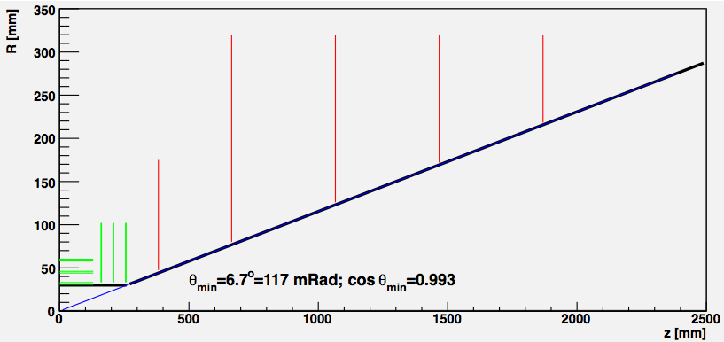
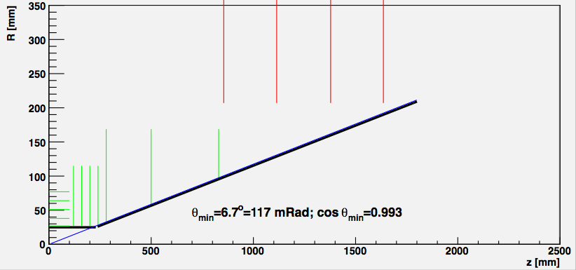
Vertex detector layout, including beam pipe
CLIC_ILD
CLIC_SiD
D. Dannheim, M. Vos, C. Grefe

Slide 8
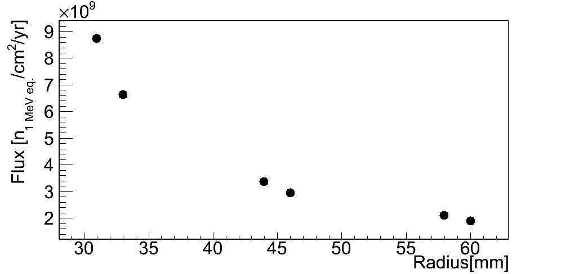
Radiation hardness requirements (CLIC-ILD)
A. Sailer, D. Dannheim
Expect negligible radiation damage from primary interactions
Background from beam-delivery system: backscattered neutrons + synchrotron radiation, not investigated in detail yet. Reducible by
careful design of collimation system
incoherent pairs:
NIEL: <~ 10¹⁰ n_{eq} / cm² / year
TID: <~ 80 Gy / year
γγ → hadrons
NIEL: <~10¹⁰ n_{eq} / cm² / year
TID: <~5 Gy / year
Incoherent pairs
NIEL
A. Sailer
γγ→ hadrons: NIEL
flux in radial direction
γγ→ hadrons: NIEL
flux in z-direction

Slide 9
Summary: vertex-detector parameters
Parameter | CLIC-ILD | CLIC-SiD
Magnetic field | 4 T | 5 T
Beam pipe (central region) | 0.6 mm Beryllium, R=30 mm | 0.5 mm Beryllium, R=25 mm
Barrel pixel layers | 3 double layers 31 mm < R < 60 mm | 5 single layers 27 mm < R < 77 mm
Forward pixel disks | 3 double layers 160 mm < z < 257 mm | 7 single layers 120 < z < 830 mm
Layer thickness | 0.18% X0 / double layer | 0.12% X0 / single layer
Pixel size | 20 μm pitch, 50 μm silicon depth
Total area | 0.74 m² | 1.11 m²
Total number of pixels | 1.84G | 2.77G
Readout | σ_{SP}~3 μm, trigger-less for 312 bx in 156 ns at 50 Hz
projected IP resolution (90º) | σ_{Rφ}=1.5 μm + 20 μm GeV / p_{T} | similar, t.b.c.
Power consumption target | < 100 mW/cm² (<0.4 μW/pixel) before power pulsing
Background occupancy (ee) | ~0.01 hits / mm² / ns (innermost layers)
Time resolution | 5-10 ns (for background rejection)
Radiation (pairs+γγ→hadr.) | NIEL: ~10¹⁰ n_{eq} cm⁻² y⁻¹ ; TID: ~100 Gy y⁻¹
9

Slide 10
R&D plans for CLIC vertex
Requirements for CLIC vertex detector:
  5-10 ns timestamp
  triggerless readout over full 156 ns train
  0.1%-0.2% X₀/layer
  ~3 μm point resolution
Possible roadmap:
  need high-resistivity thin (~50 μm) sensor layer
  need very thin readout layer (~50 μm)
  ~20μm*20μm pixels
  currently looking into hybrid solution
    With advanced interconnect (or future 3D integration)
    Possibly following Medipix3=>Timepix2=>Timepix3 (65nm)=>CLICpix road
    Sensor and ASIC thinning
    DC-DC power delivery + power pulsing

Slide 11
Do not forget to announce the power delivery and power pulsing workshop
May 9+10, Orsay, France
http://ilcagenda.linearcollider.org/conferenceDisplay.py?confId=5010

Slide 12
Timepix2
(for pixelized TPC readout, and also as a step in the roadmap to a possible CLICpix)

Slide 13
Timepix2 ASIC development
Follow-up on Timepix and Medipix3 chips
Broad client community (HEP and non-HEP):
  X-ray radiography, X-ray polarimetry, low energy electron microscopy
  Radiation and beam monitors, dosimetry
  3D gas detectors, neutrons, fission products
  Gas detector, Compton camera, gamma polarization camera, fast neutron camera, ion/MIP telescope, nuclear fission, astrophysics
  Imaging in neutron activation analysis, gamma polarization imaging based on Compton effect
  Neutrino physics
Main Linear Collider application: pixelized TPC readout
Technology IBM 130nm DM 3-2-3 or 4-1
Design groups: NIKHEF, BONN, CERN
PLL and on-pixel oscillator architecture test (MPW, spring 2011)
Expected submission of full Timepix2 chip (early 2012)
X. Llopart-Cudie, CERN

Slide 14
Timepix2 Main requirements
Matrix layout: 256x256 pixels (Pixel size 55x55 µm)
Low noise and low minimum detectable charge:
  < 75 e- ENC
  < 500 e- minimum threshold
Time stamp and TOT recorded simultaneously
  4 bits Fast time-stamp
    resolution ~1.5ns (if using on-pixel oscillator running at 640MHz)
    Dynamic range 25ns
  10-12 bits Slow time-stamp
    Resolution 25ns (@40MHz)
    Dynamic range 25.6 µs (10 bit) to 102.4 µs (12 bit)
  8-10 bit Energy Measurement (TOT)
    Standard Resolution 25ns (@40MHz)
    Energy Dynamic range from 6.4 µs to 25.6 µs (@40MHz)
Bipolar input with leakage current compensation
  e- and h+ collection, input capacitance <<50 fF
Sparse Readout
X. Llopart-Cudie, CERN

Slide 15
Timepix2 Top Level Schematic
128 double-columns @ 256● 55μm = 1.4cm
Analog Front-end
Digital Pixel Region
Readout
Control (TOKEN based)
Slow Counter 4b
DAC
ToT Counter 4b
Pixel array (256 x 256)
RefCLK Counter 6b
Fast Counter 4b
double column bus
Data 18b
&
pixel ID 9b
32 pixel regions @ 256● 55μm = 1.4cm
one double column with a 40MHz common data bus
Fast oscillator (600MHz)
MUX
Fast Counter 4b
Slow Counter 4b
ToT Counter 4b
FAST OR
RefCLK Counter 6b
DAC
8-Pixel Region
End of Column Logic
FiFO 4-depth
periphery bus
GLB time stamp
Readout control
(Token based)
periphery
periphery data bus 40MHz
Data output block
DAC
Bandgap
Bias gen.
EFUSE
chip ID
Serializer/
64-to-8
Slow control
Tx
RX
RX
RX
Tx
640MHz
Oscillator PLL
Tx
V. Gromov, Nikhef
Data_out Data_in
Fast OR
Reset_GLB
Clock 40 MHz
8 x 320MHz LVDS

Slide 16
SAltro16
(for TPC pad readout)
We have just received Saltro16 back from the foundry. So it is not yet tested.
I presume that you are also receiving slides from the from the LC-TPC collaboration. These may contain material of the GEM test in the TPC, where the amplifier stage of S-Altro is already in use.

Slide 17
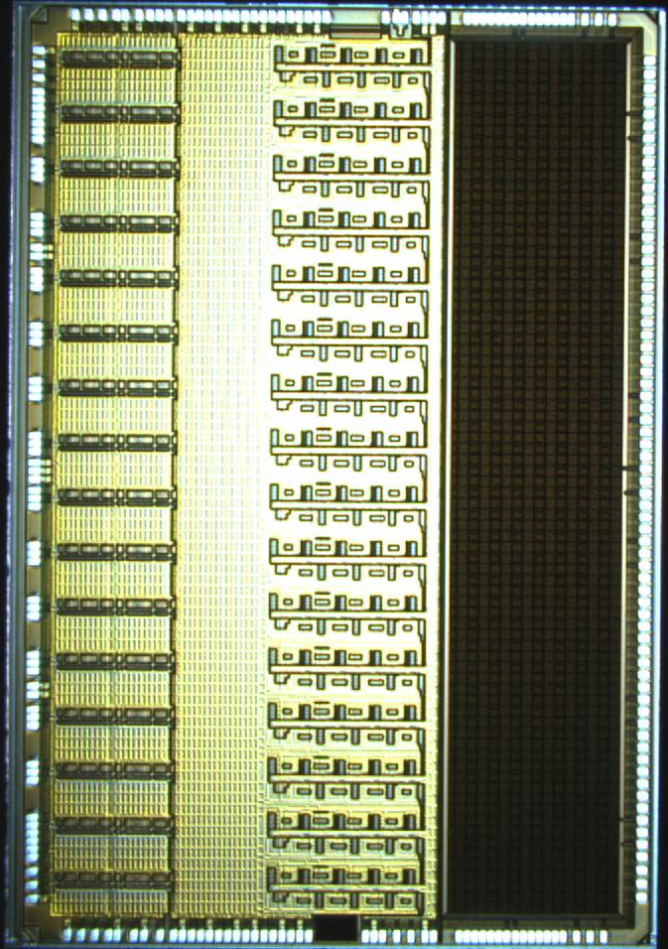
The Saltro 16
P. Aspell, M. de Gaspari, H. Franca,
E. Garcia, L. Musa, CERN
A 16 channel front-end chip including DSP functions for the readout of gaseous detectors such as MWPC, GEM, Micromegas.
Submitted in IBM 130nm CMOS technology, Q3 2010.
Received back from the foundry Q1, 2011, currently under test.
Size: 5750um x 8560um, 49.22mm²

Slide 18
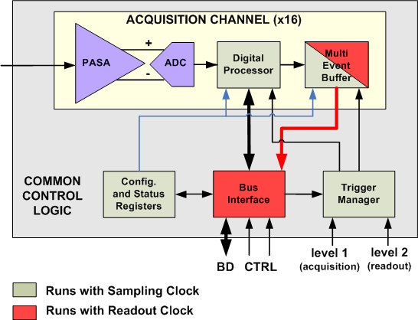
The Saltro 16
architecture.
16 channels,
Each channel comprising :
Low-noise programmable pre-amplifier and shaper,
ADC,
Digital Signal Processor.
Max sampling frequency: 40MHz
Max readout frequency: 80MHz
Interface compatible with the ALICE TPC
PASA | ADC | Digital Signal Processor
Single-ended to differential | 10bit | Baseline correction 1: removes systematic offsets
Pos/neg polarity | 40MHz max freq | Digital shaper: removes the long ion tail
Shaping time 30-120ns | Power adjustable to the freq | Baseline correction 2: removes low-freq baseline shifts
Gain 12-27mV/fC |  | Zero Suppression
Power pulsing feature included. | Possibility of power pulsing via external bias control. | External clock control for power pulsing

Slide 19
Superconducting solenoid

Slide 20
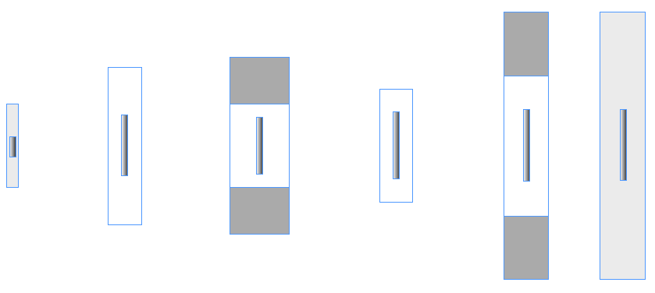

R&D on reinforced superconducting cable for main solenoid
Material studies and magnet calculations are ongoing in several labs.
Using experience from ATLAS and CMS magnet systems, an R&D effort has started on the superconducting cable for the main solenoid.
Conductor overview
5T, 5 layer
18kA, 40 strand cable
Atlas CS
Atlas BT
CMS
Atlas ECT
Rutherford SC cable
Pure Al stabilizer
Reinforced Al stabilizer
B. Cure, CERN
AA reinforcement

Slide 21
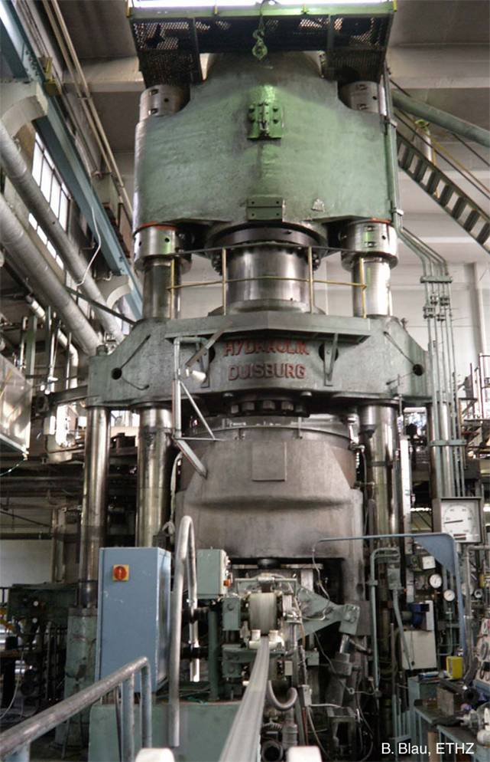
Update:
SC conductor R&D
– main detector magnet
Coextrusion “Rutherford cable”
With structural Al stabiliser (Al-0.1wt%Ni)
Preparations under way
(in collaboration CERN+KEK)
Collaboration with industry
-> first tests foreseen
second half of 2011
Co-extrusion press at Nexans
B. Cure, A. Gaddi, Y. Makida, A. Yamamoto

