Slide 1

Daniel Kosc
Kristupa Seskauskaite
Marta Adamina Krawczyk
Peter Blum
Shrishti Kulkarni
Viona Cufo
The CERN Webfest 2023

Slide 2
Structure of presentation
Problem and Motivation
Our Solution
Our design and functionality
Website prototype presentation
Future features
Conclusion
Q&A

Slide 3
Motivation
Personal experience and conversation with different students we have noticed one major issue:
Where do I START?
Overwhelming amount of information available
Verbosity of research papers

Slide 4
Current approach
  Refining soft skills and seeking guidance from experienced individuals, such as professors
  Effective for some, but not be suitable for everyone, especially those who lack the confidence or developed soft skills to ask for help.

Slide 5
Our Goal
Remove friction from the research process
Help users explore science and find topics that
interest them
Give direction to students looking for research topics
Inspire future scientists

Slide 6
Our Solution:
Sci-Feed

Slide 7
Sci-Feed
User-friendly webpage
Designed to facilitate the research process
  At the moment particularly for topics related to CERN
Interactive interfaces to promote exploration
Relevant resources filtered based on search prompts

Slide 8
Target group
  Students and aspiring scientists who may not have extensive scientific backgrounds or research experience.
  Serves as a search hub, redirecting users to relevant science papers, articles, and videos from the CERN database based on their search topics.
Anyone interested in learning more about STEM topics at CERN
High school and
undergraduate students

Slide 9
Making the research process user-friendly and interactive
Streamlines the search process, presenting only the most relevant information using an interactive quiz-like interface.
Integration of pretrained Large Language Models that allow features like:
  Summaries of the selected resources, ensuring they match the user's level of understanding
  Chat-bot interface that allows the users to ask questions about specific papers or topics, enhancing their learning experience.

Slide 10

User flow
Your keywords
Landing page
Trending topics
The feed
Moodboard quiz
Notes:
https://www.figma.com/file/C8LXOdPibWgXpXqBoFQu9S/Scifeed-low-fidelity-prototype-(Community)?type=design&node-id=0-1&mode=design&t=2Zgioq8oAvBuHzln-0

Slide 11
How the mood board works
Pictures
Resizing
Further research
A predetermined array to choose from
Resize the image based on importance
Leads back to the querying page
Selection
Recommendations
Pictures for the mood board
Our code suggests image categories & subcategories of interest

Slide 12

Notes:
https://drive.google.com/file/d/1rYFG1ihUBEsFFJsmlCuDkyyG6ADkGuzq/view?usp=sharing

Slide 13
Future features
Listening to the Summary of the Paper (podcast style)
Top researchers
More databases included
  Scale research so it is not just CERN-centric
Use filters to get more appropriate content (date, type, author, …)
Decrease latency

Slide 14
SciFeed envisions a future where scientific knowledge is readily accessible to all, igniting a passion for discovery and fostering a global community of inquisitive minds, driving transformative advancements and training the new generation of scientist.

Slide 15
Find our project
Front-end: https://www.figma.com/community/file/1264603999168198188
Back-end: https://github.com/danyk20/SciFeed/tree/main

Slide 16
Sources used
https://looka.com/editor/138331027
https://www.figma.com/file/dUVby0DgZbhAtj9MIJWaen/Spotify-UI-Design-(Search%2FArtist-Profile)-(Community)?type=design&node-id=42-28&mode=design&t=pfNqZtcwrBhnuRm1-0
http://cds.cern.ch/
https://knowledgetransfer.web.cern.ch/applications-cern-technologies-society
https://openai.com/blog/chatgpt
https://huggingface.co/com3dian/Bart-large-paper2slides-expander
https://pypi.org/project/transformers/2.1.0/
https://pypi.org/project/PyPDF2/
https://pypi.org/project/requests/

Slide 17
Q&A

Slide 18
Backup

Slide 19
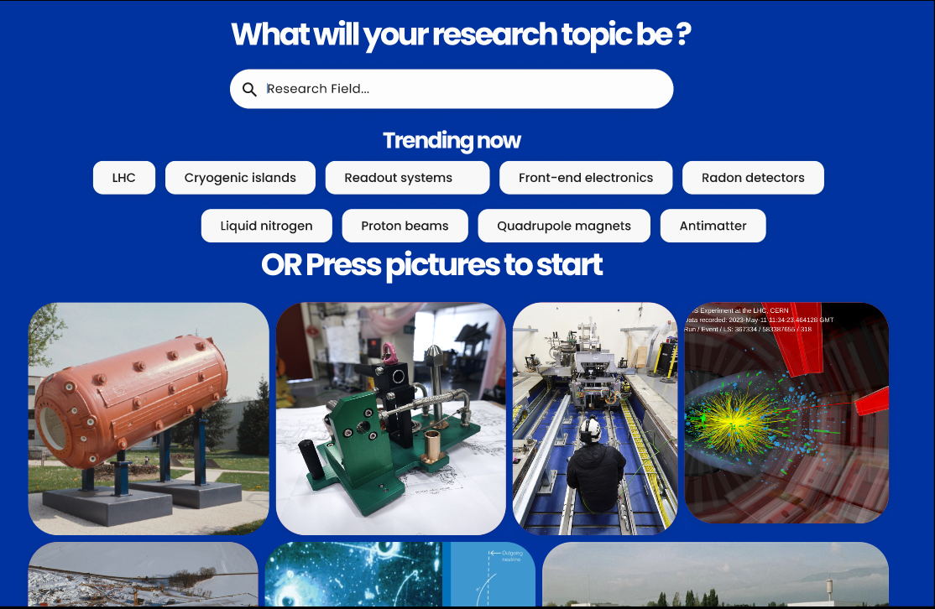
Notes:
Design and functionality - minimal and intuitive design which should only show necessary features

Slide 20
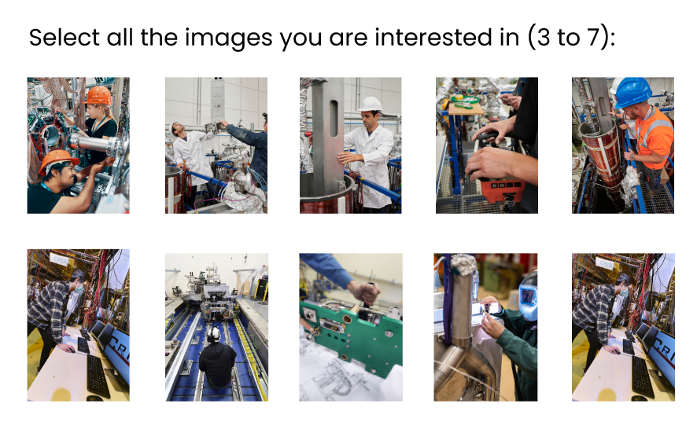

Slide 21
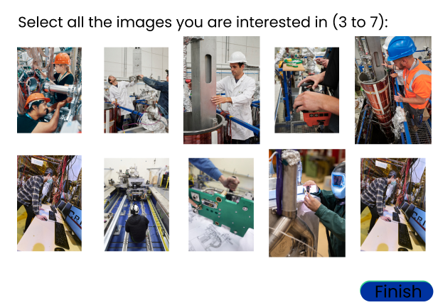

Slide 22
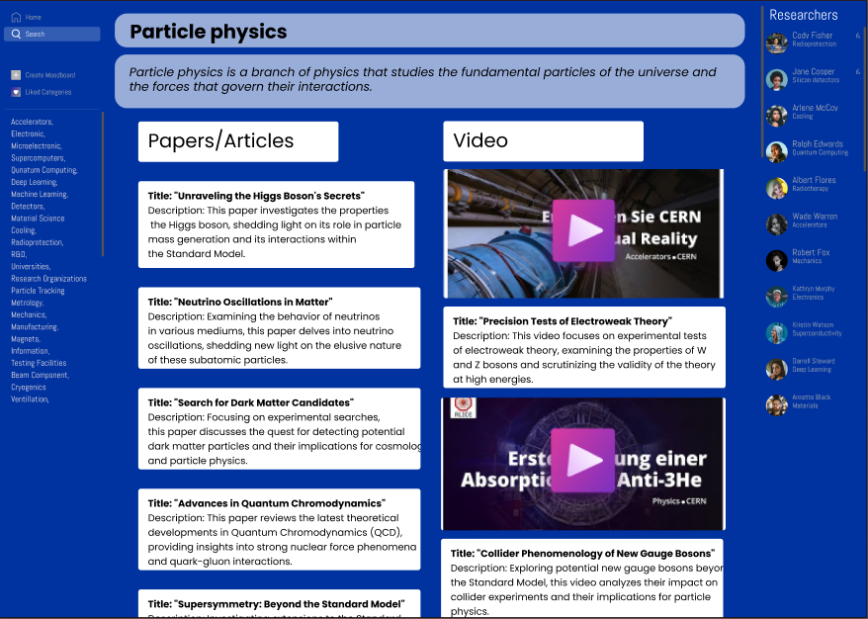

Slide 23
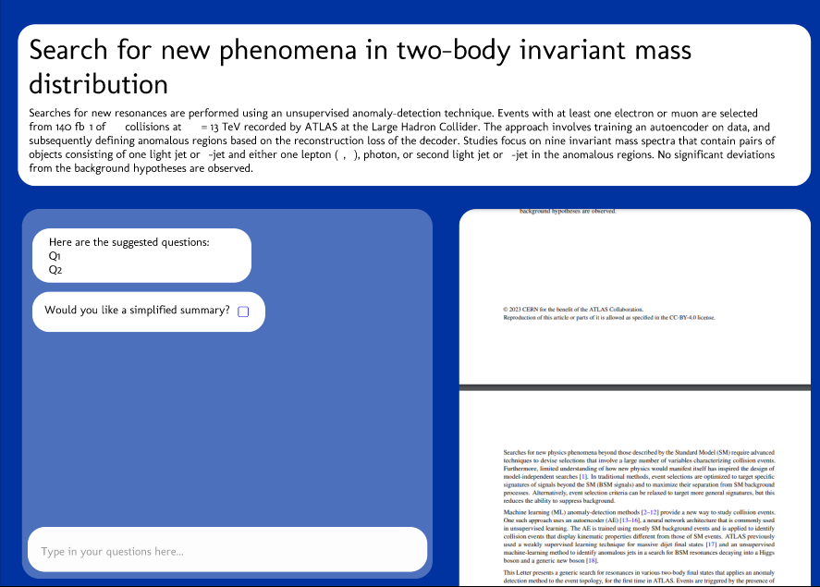

Slide 24
Back up slides design
Landing page - three ways to interact -
  search up keywords you are interested in
  select a trending topic or
  click on pictures to take a moodboard quiz.
Picture quiz - simplified picture quiz to find your research topic - click and drag the pictures to adjust their importance to you Shrishti will explain more
The feed -
  includes short AI description of the topic
  Papers and videos with AI generated tagline
  Most active researchers in the field (obtained from the documents)
Interactive chatbot - ask questions about the paper and experience research in a less intimidating manner

Slide 25
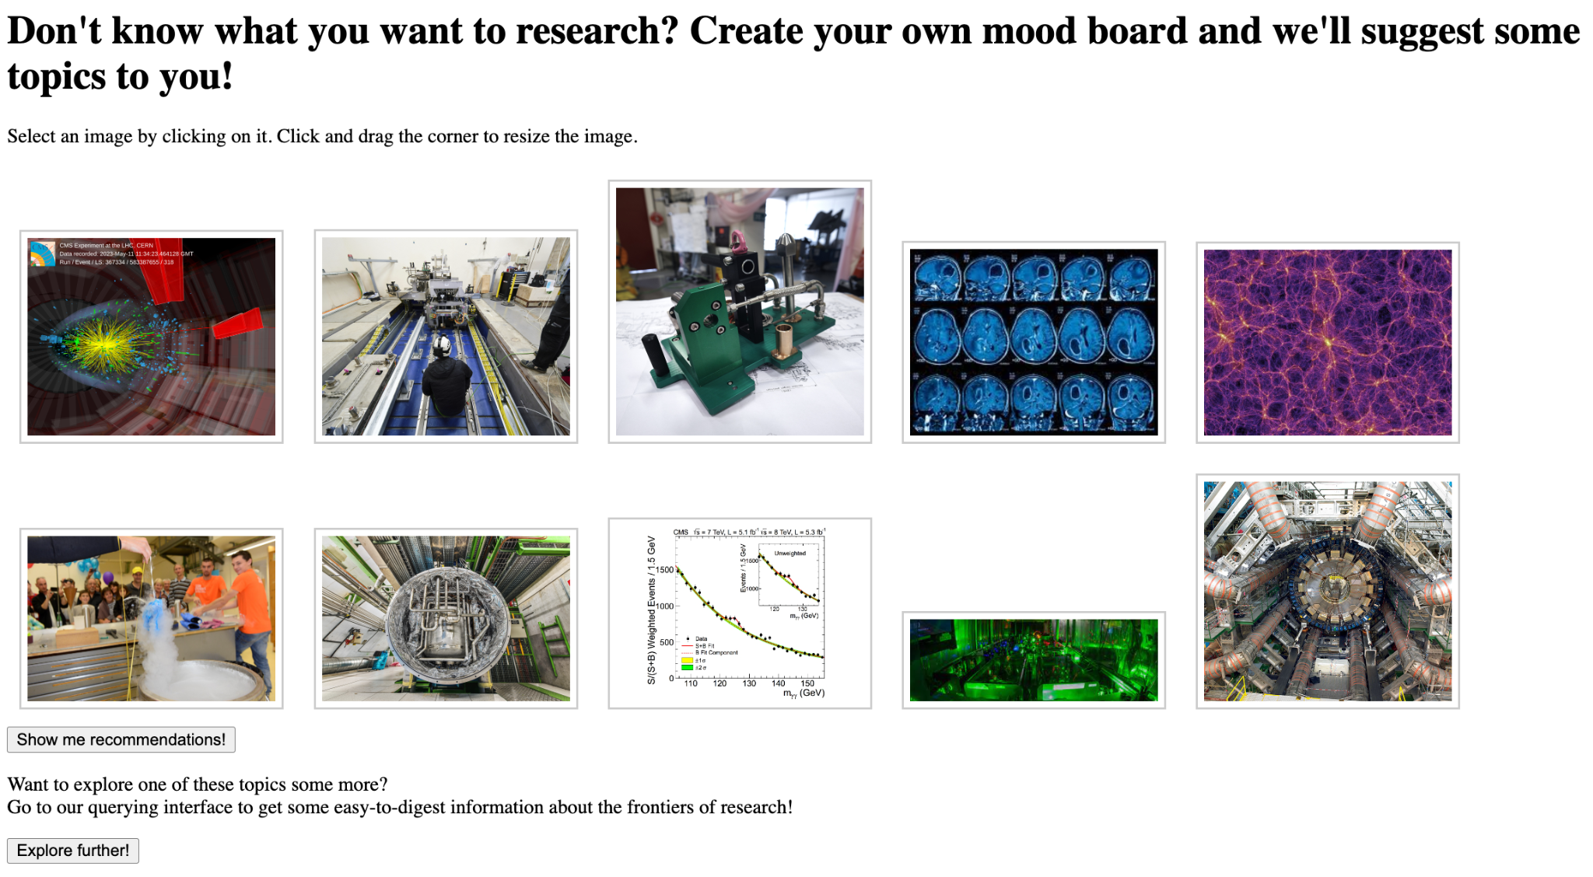

Slide 26
