Slide 1
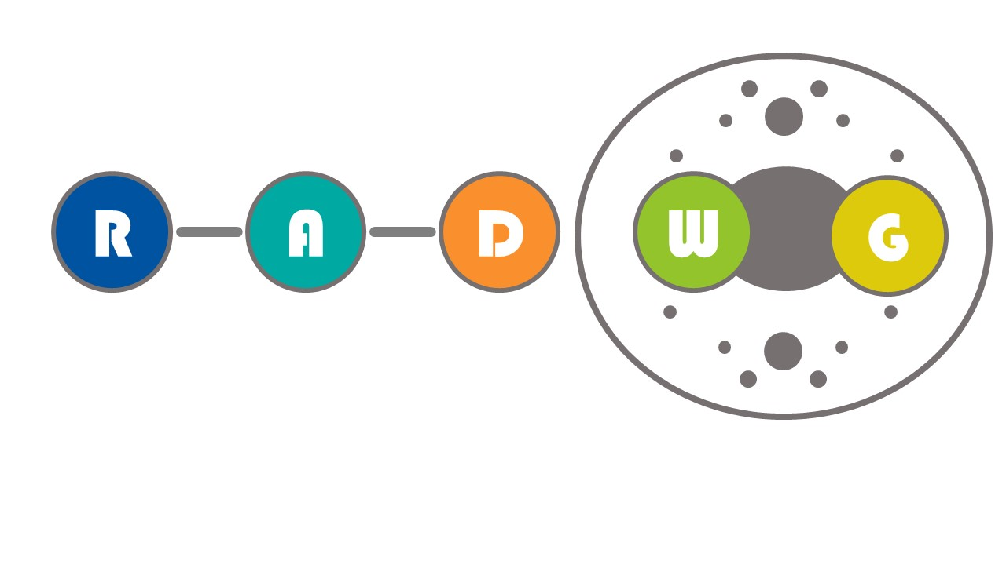
RADWG Meeting
Project DQHDS
Edward Nowak, David Carrillo, Ryder Sharpe, Enrique de Nicolás
Thanks to the TE-MPE-EP section and the Radiation Team

Slide 2
Outline
Project description and production plans
Location and expected radiation levels
Component level testing
System level tests
Strategy

Slide 3
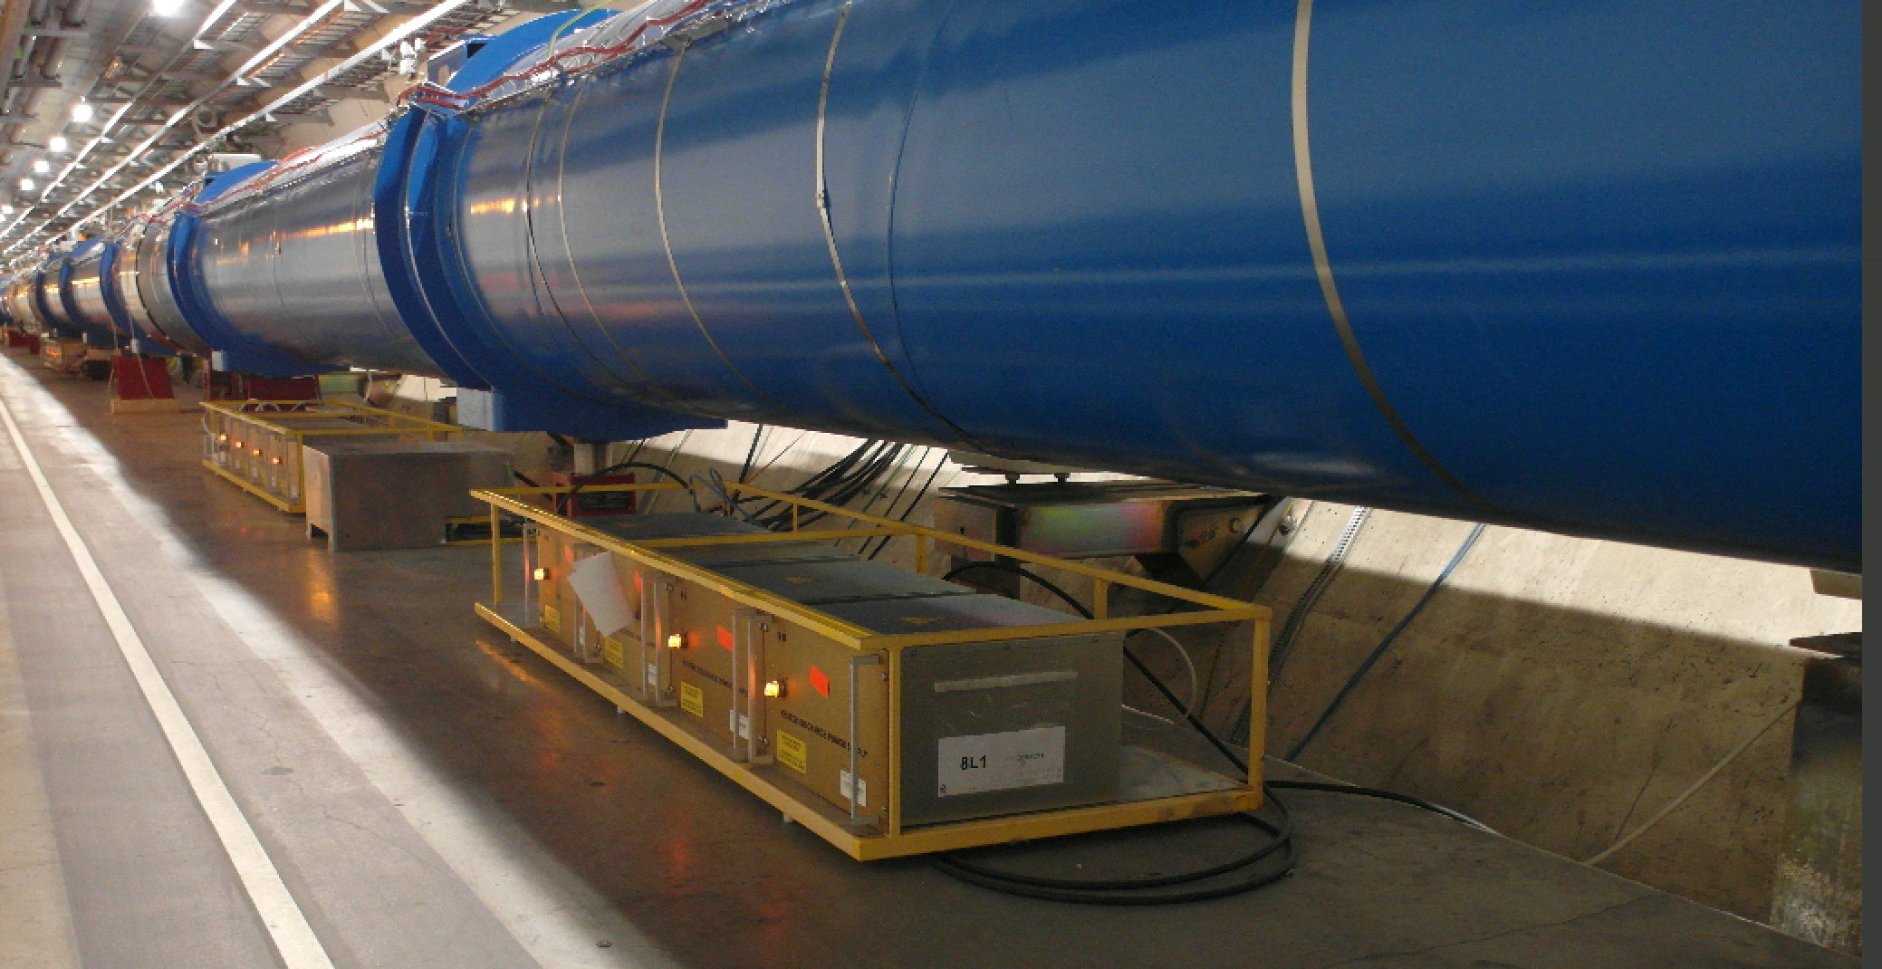
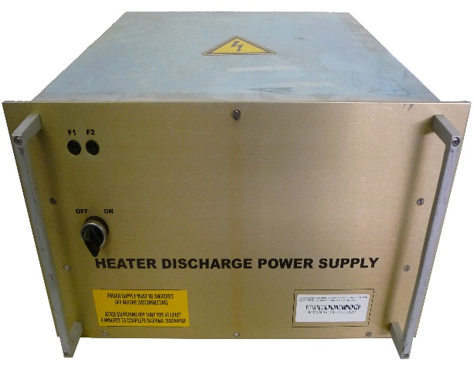
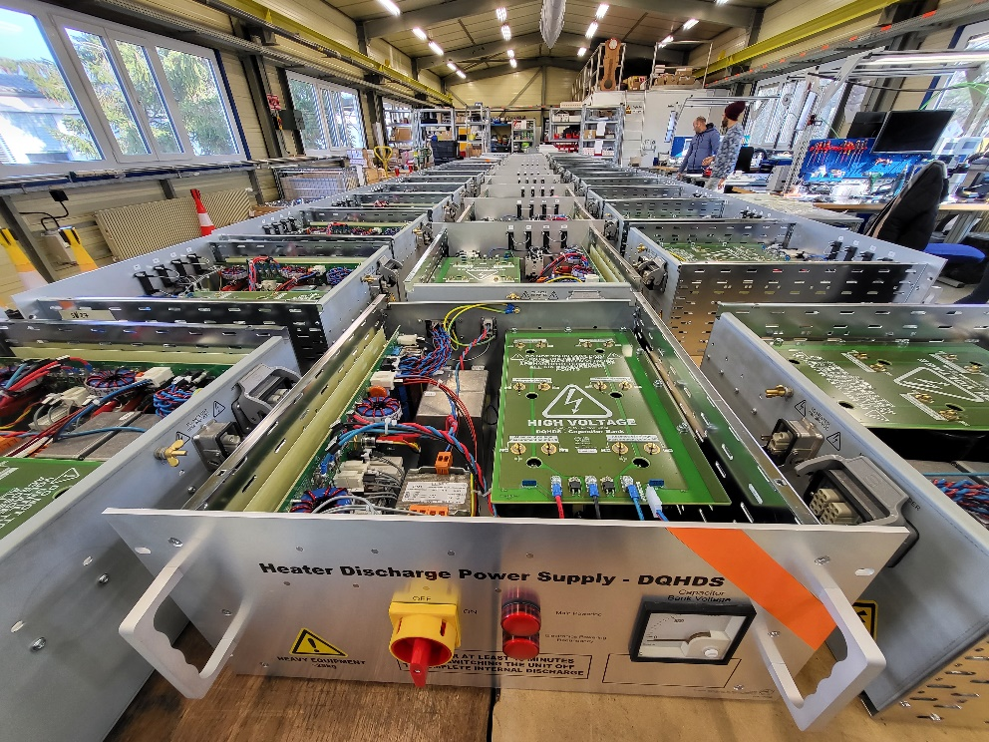
Project(s) description
Proven technology
  More than 6000 LHC DQHDS in operation in the LHC since 2008
Present LHC DQHDS
Quench event → The Quench Heater Discharge power Supplies (DQHDS) energize the heater strips inside the magnet
New DQHDS
The HL-LHC Heater Discharge Power Supplies are in the baseline of the HL-LHC project for the protection of the new Inner Triplet magnets, D1 and D2 that will be installed during LS3
The IPQ/IPD Protection Rack Upgrade project intends to exchange DQHDS v1 from selected locations of the LHC
Same design of DQHDS for both projects
Other elements besides the DQHDS not relevant for the RADWG (e.g. cabling, passive interface modules, racks..)

Slide 4
Components procurement and production plans
60 units already produced for the IT String Test Facility (spares for the machine)
In-kind production by Japan – KEK: 630 DQHDS units to be manufactured and accepted at CERN by March 2025
Design and manufacturing files. EDA https://edms.cern.ch/project/EDA-04198

Slide 5
Location and expected radiation levels
HL-LHC: USC55, UJ56, UJ14/UJ16 ( worst case < 10 Gy/year)
IPQ/IPD upgrade and present LHC units: worst case cell 9 and 12 for IP1/5 (<100 Gy/year)
Radiation levels expected based on: HL-LHC Radiation level specification document (EDMS: 2302154 )

Slide 6
Component Level Testing
2018: several meetings with the radiation team to discuss the components susceptible to fail. Tests performed at the PSI Proton Irradiation Facility. Total fluence ~10¹² p/cm² E.g.:
  15 V regulator: https://edms.cern.ch/document/2011367/1 tested up to 500 Gy. Two SET and small voltage drift, not affecting in either case the functionality of the DQHDS unit
  Timer NE556 - https://edms.cern.ch/document/2011196/1 No single events nor cumulative effects below 1000 Gy
  Transistor: https://edms.cern.ch/document/2029282/1 Current gain decrease, not affecting DQHDS functionality. Tested up to 500 Gy
Further tests planned to be done in CHARM for thyristors and timers

Slide 7
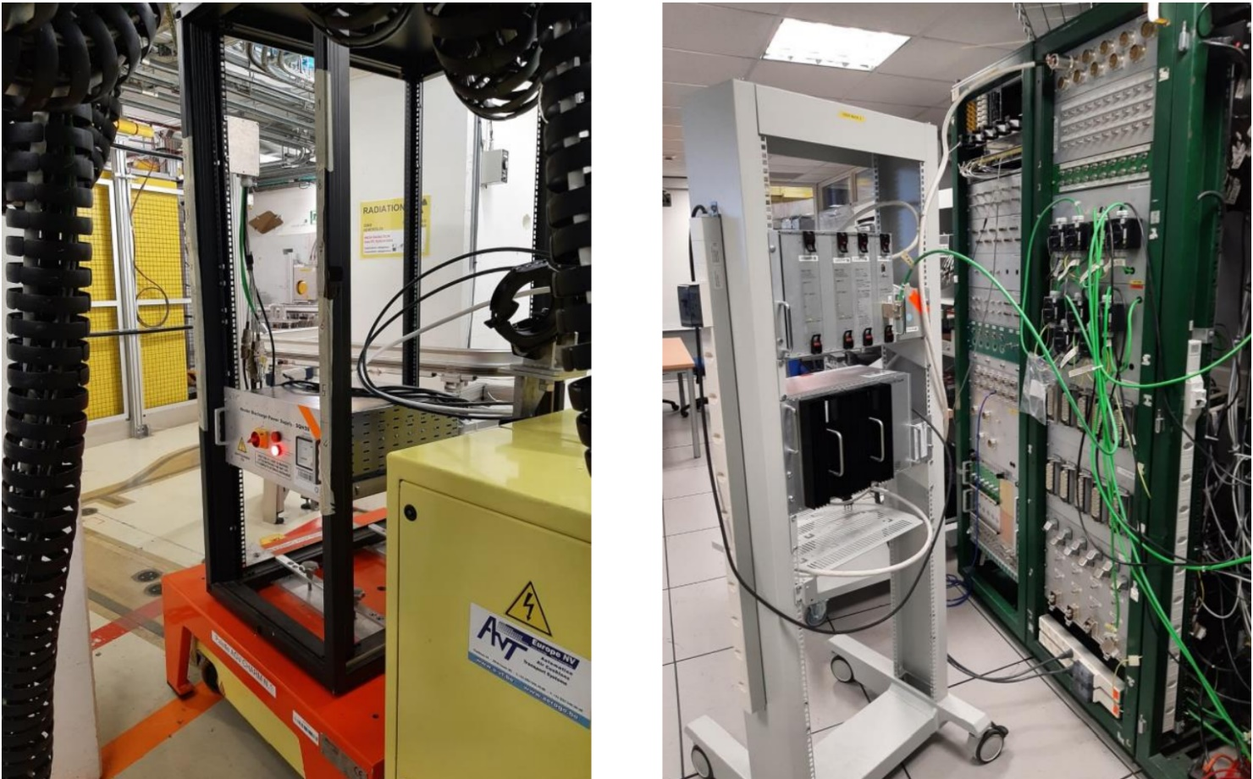
System Level Testing results
2018. Present LHC DQHDS units tested up to 410 Gy and 460 Gy
Now. Tests with new DQHDS:
  Tests in CHARM - May 2023
  HL-LHC DQHDS units survived up to 345 Gy and 326 Gy –It is believed the 555 timer or a thyristor failure could explain this behaviour

Slide 8
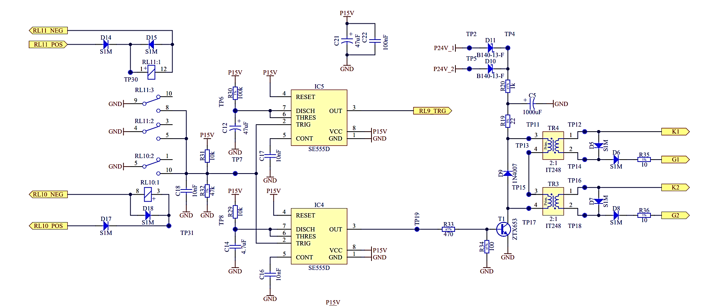
System Level Testing results
Responsible for charging (i.e. availability). Up to 200 mA drawn.
Responsible for triggering (i.e. reliability). No current drawn. This configuration is the one tested at PSI

Slide 9
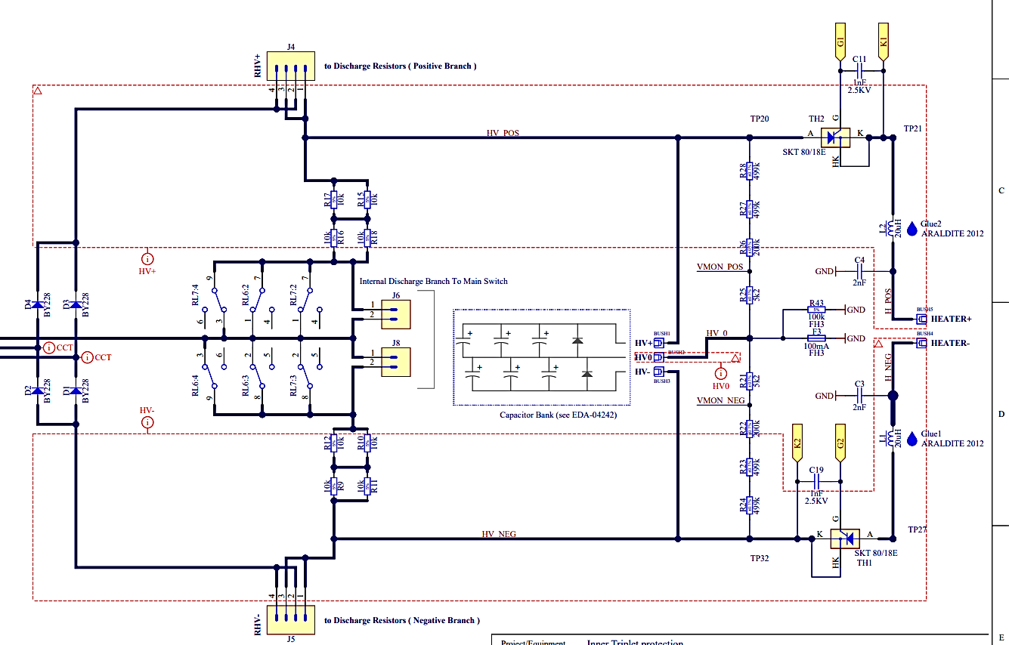
System Level Testing results
Short in the thyristors could also explain the failure (see next slide)
After RP release, the units will studied to narrow down the failure

Slide 10
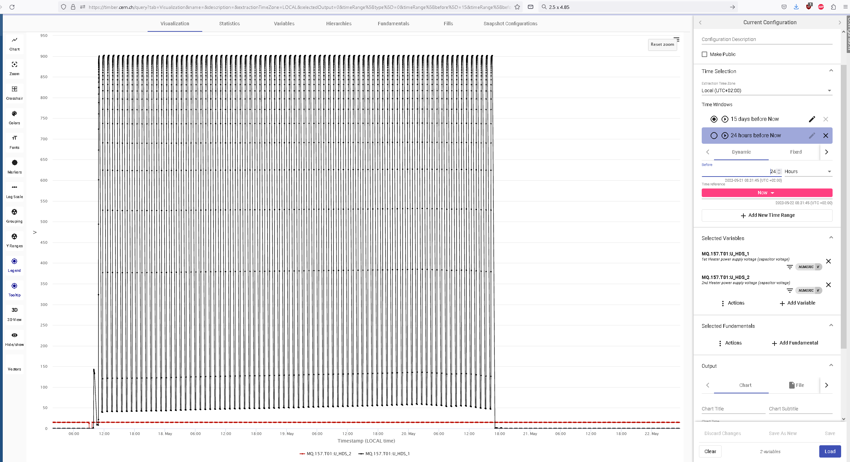
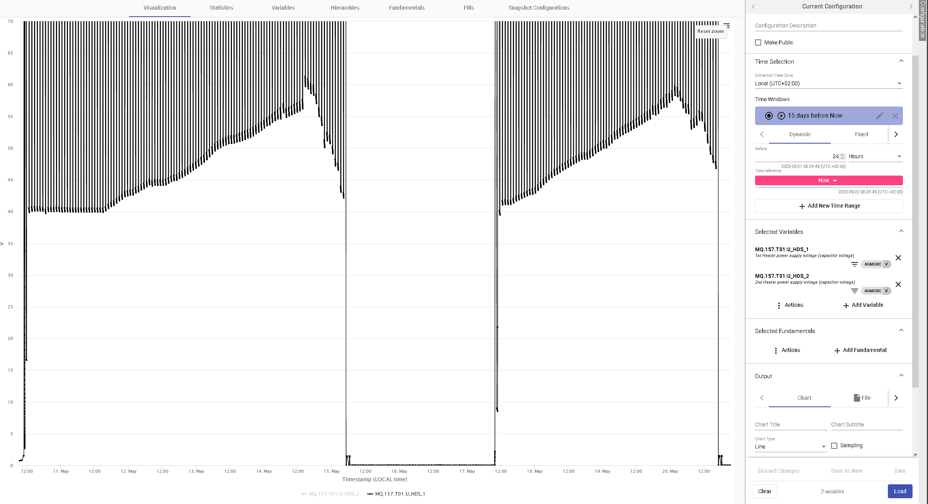
System Level Testing results
Voltage in the DQHDS capacitor bank after each discharge
900 V
Possible causes for a lower radiation withstand:
  Radiation withstand of latest thyristors/timers is lower
  In case the failure is due to the timers: new test setup draws max current from the timer during a significant part of the time (not the case in 2018).
Still, values are enough for objective, i.e. ~200 Gy (rotation policy after ~100 – 150 Gy– see next slides)
50 V
Remaining voltage in the capacitor bank after each discharge
Start of irradiation
~ 3 days

Slide 11
Mitigations strategies
Fault is safe (availability affected, not reliability)
It is foreseen to perform a rotation of the units every ~1-2 years
  4 HL-LHC model / 14 classic per IP side (1 & 5)
  RADMON useful to be installed in the critical places (e.g. 1 per rack ~5 per IP side)
Additionally, timers and thyristors will be tested in CHARM to characterize in detail their failure modes

Slide 12
THANK YOU

