Slide 1
RADWG Activities Overview
Rudy Ferraro (BE-CEM-EPR)
RadWG Workshop – 06th July, 2023

Slide 2
Radiation Test Service
BE-CEM-EPR provides, the service of radiation testing of electronic components supporting the Radiation Working Group (RadWG)
The RadWG supports the accelerator sector equipment groups for the assessment of radiation tolerance of electronic equipment to be installed in radiation exposed areas.
It is as a forum for electronic engineers to discuss
  design practices
  radiation tests
  radiation induced failures in the accelerators.
The RadWG is one of the pillars of the CERN Radiation Hardness Assurance process
RADWG Activities Overview by R. Ferraro (BE-CEM-EPR )

Slide 3
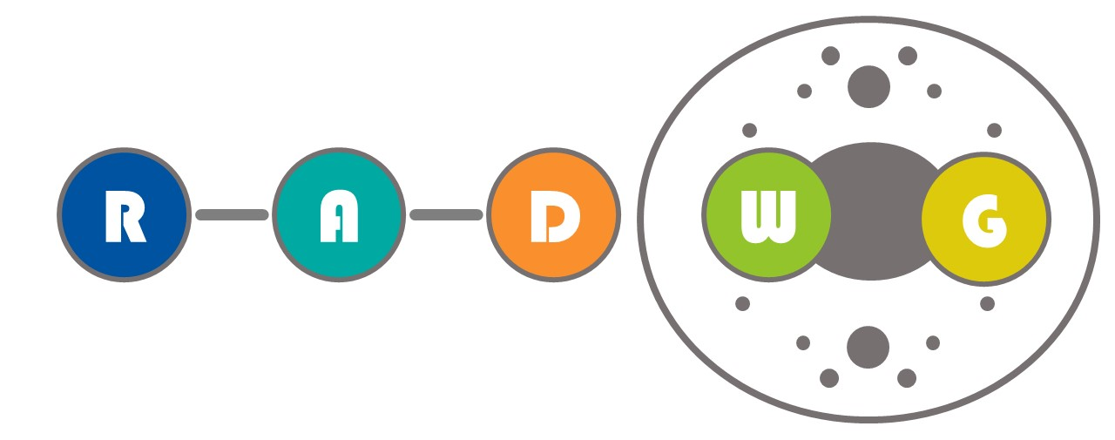

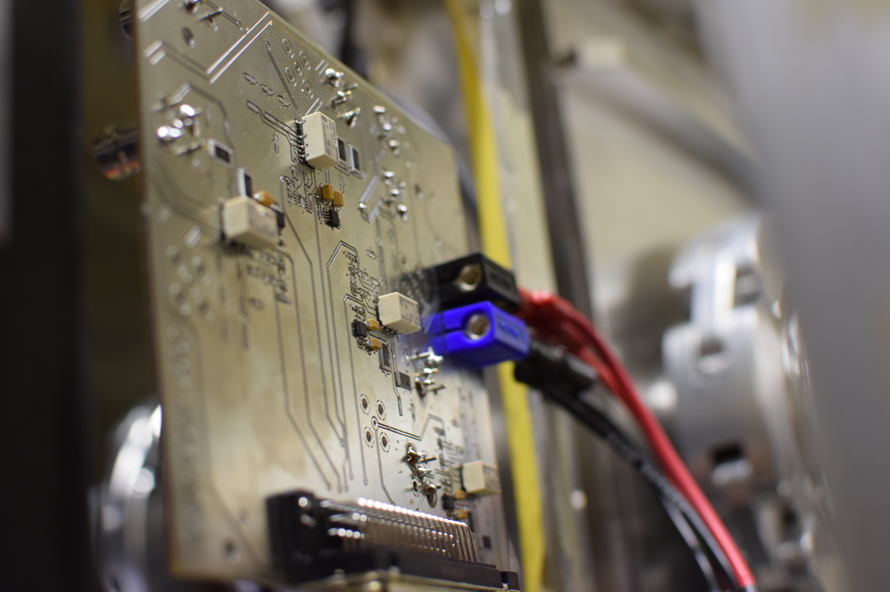
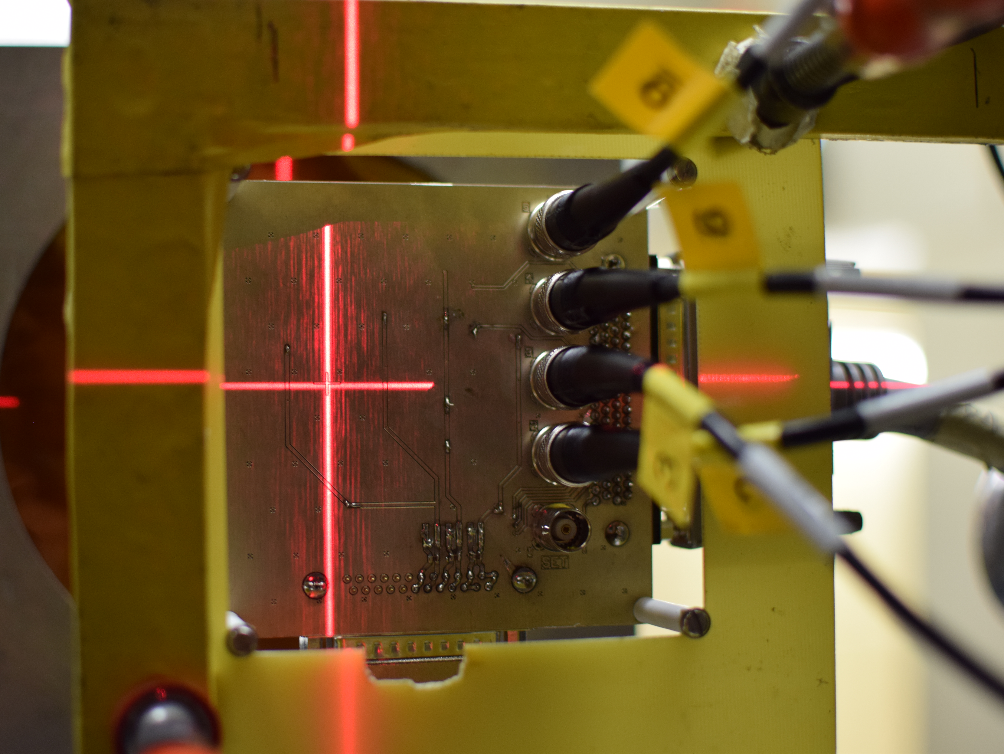
Radiation test service – BE-CEM-EPR
Request collection
The requests for radiation testing are collected and processed selecting the most suitable methodology and facilities
Database and Publication
The results are collected, stored and in EDMS and published in the RADWG database to allow an easy research of the best candidates for the new radiation tolerant designs
01
Test planning and structure
06
02
Each component/system is analyzed, and all the possible radiation effects are taken into account for planning the test and structure it
Result analysis
The results are analyzed during and after the tests for each component considering the end application and the possible operational issues
Board and instrumentation preparation
05
03
For each component a dedicated set of test board is prepared and the associated instrumentation is chosen to face the complexity of the radiation test
04
Testing
The test are carried out at CERN facilities such as CHARM or Co60 and in external facilities. The transport, personnel and instrumentation are selected considering the peculiar aspect of each facility
RADWG Activities Overview by R. Ferraro (BE-CEM-EPR )

Slide 4
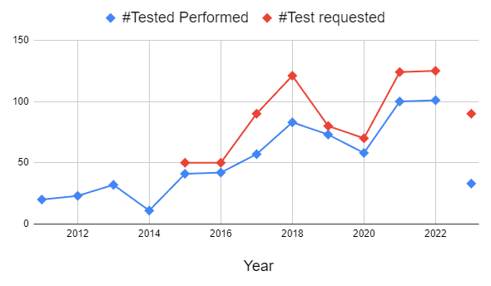
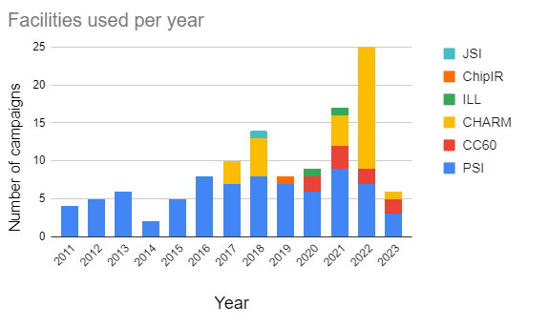
2023 In Number
93 component test request for 2023 (so far)
33 components tested (so far)
5 Radiation campaigns done (3*PSI, 2*CC60, 2*CHARM)
Compare to previous year we are in the high range of components tested per month
5 more PSI campaigns are planned, together with regular CHARM tests
We will probably test more components this year than the previous years
RADWG Activities Overview by R. Ferraro (BE-CEM-EPR )

Slide 5
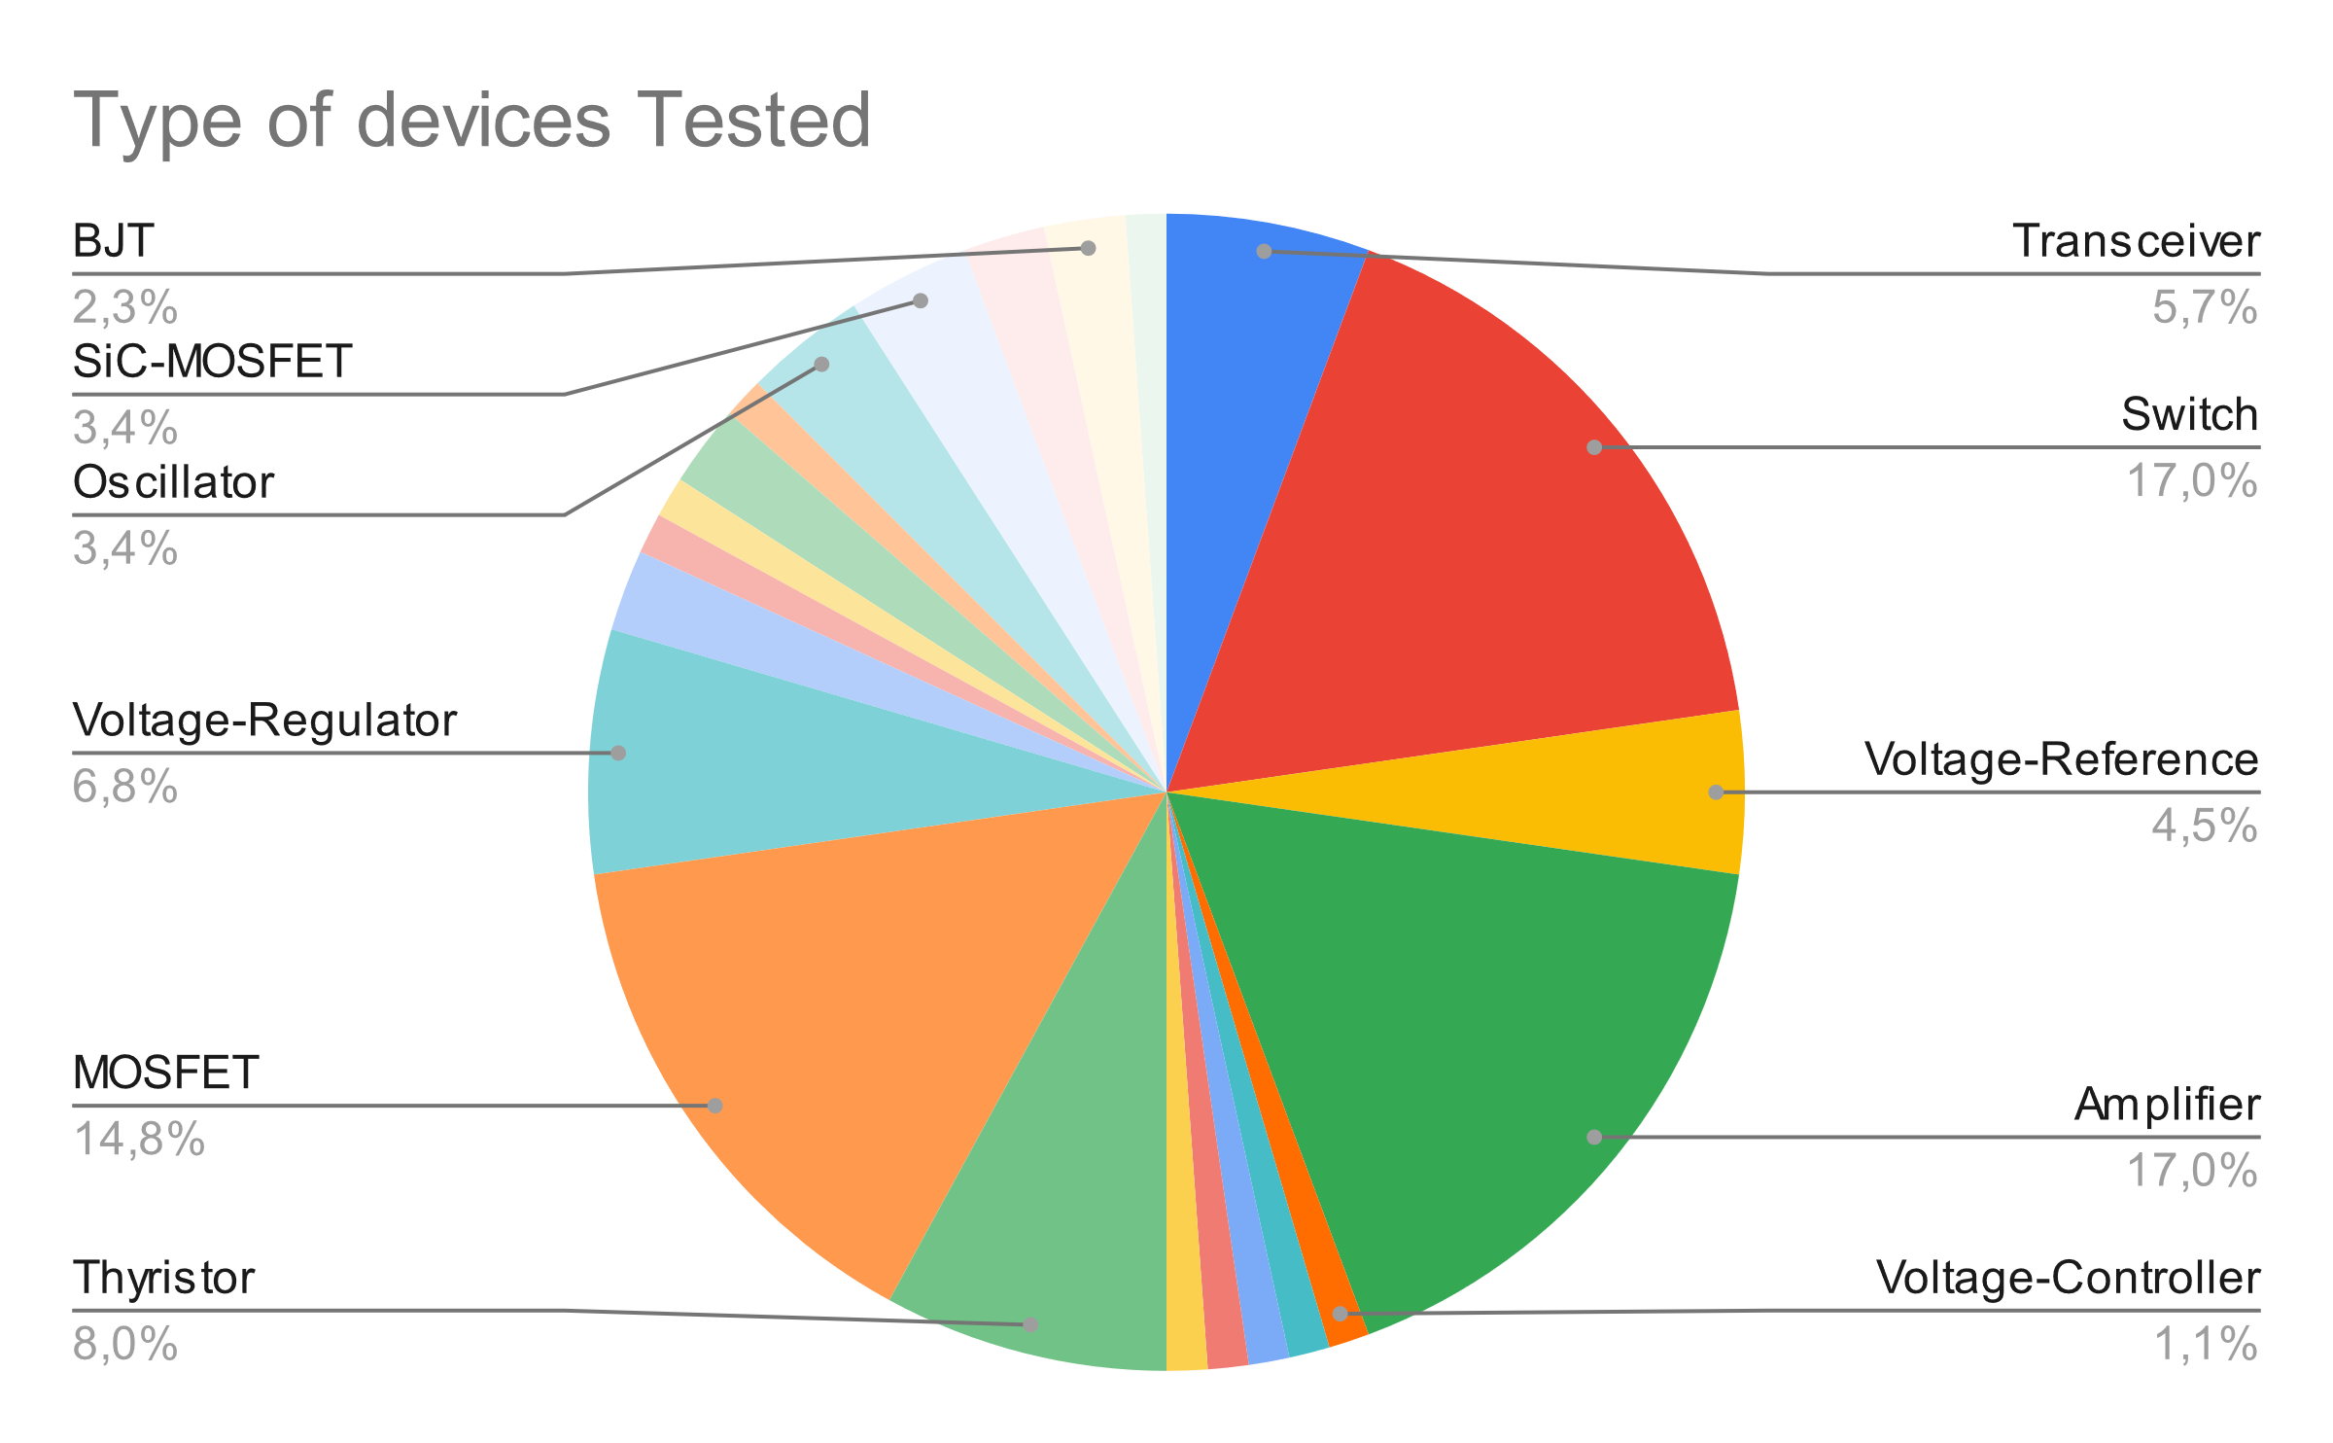
Test Service Status: Requests per type
Total requests: 93 [not only references but also #lots]
RADWG Activities Overview by R. Ferraro (BE-CEM-EPR )

Slide 6
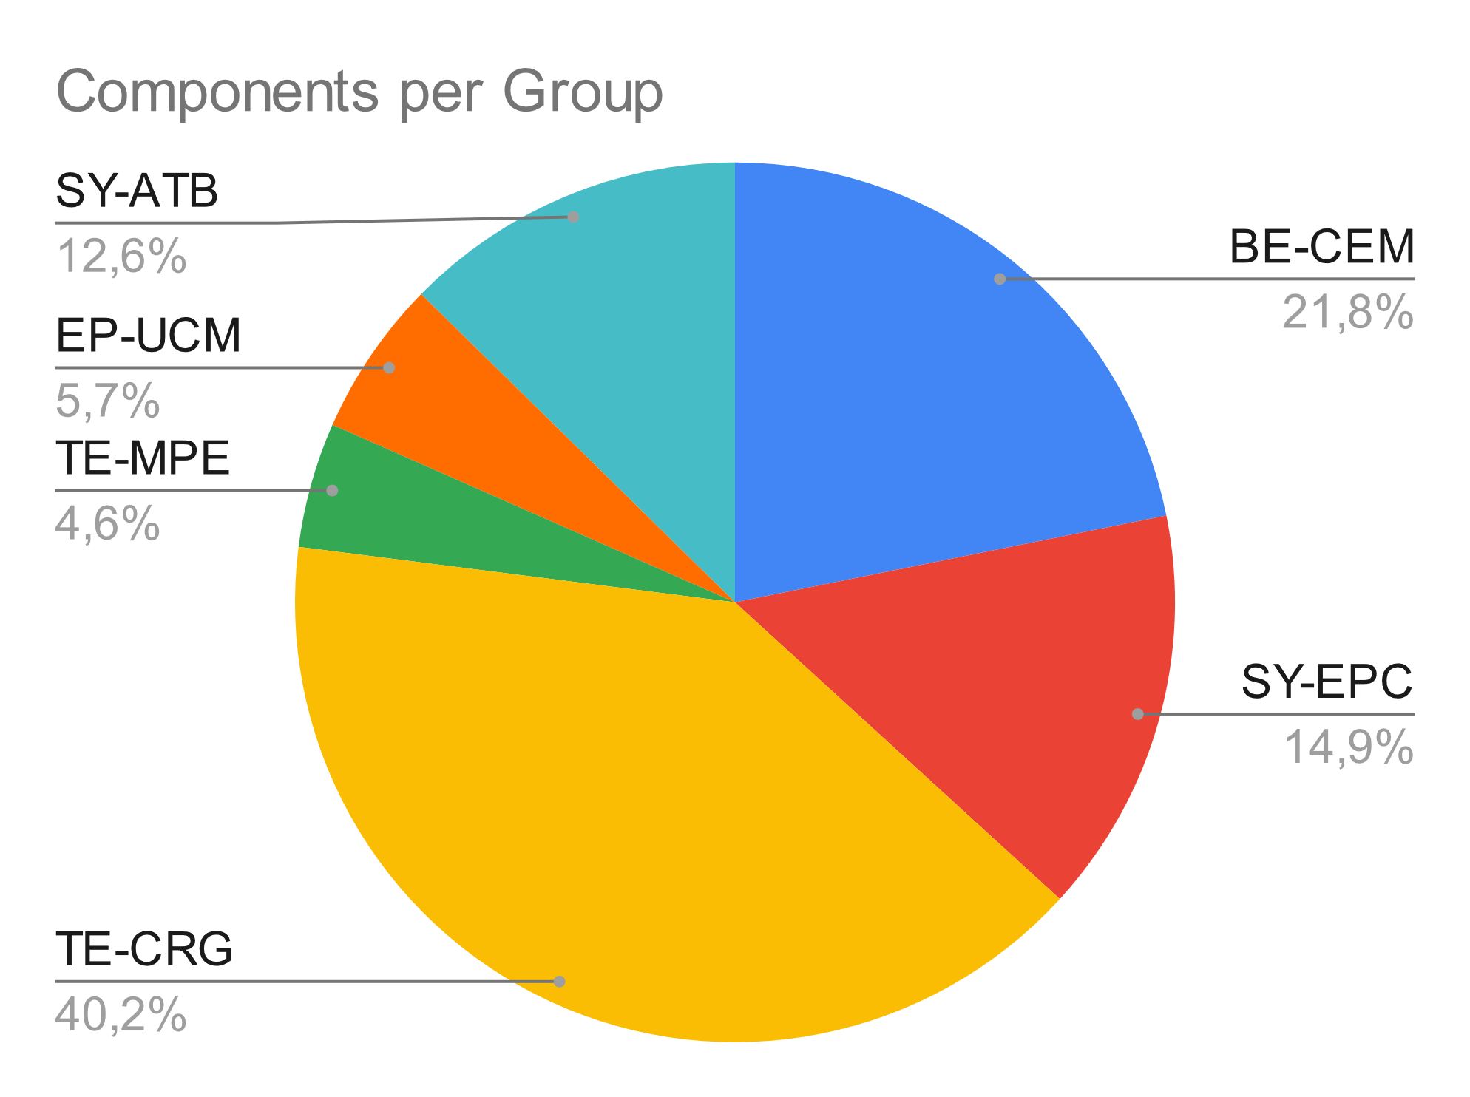
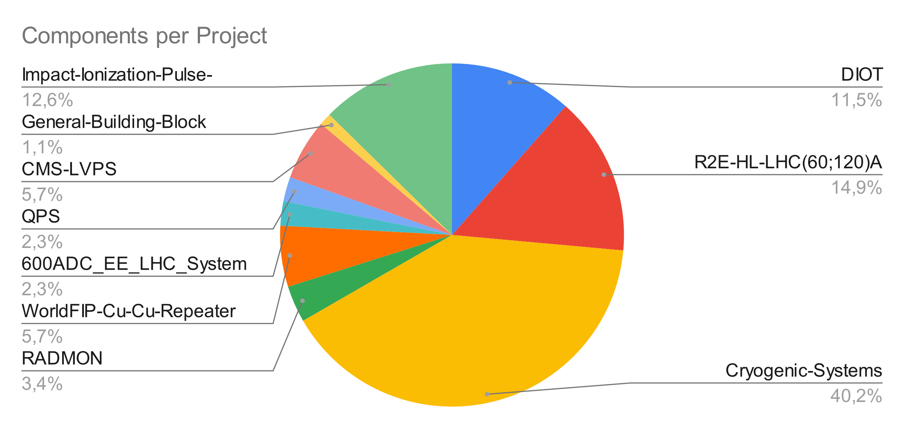
Test Service Status: Requests per group/project
*Cryogenic Systems components are few part references but a lot of different lots
RADWG Activities Overview by R. Ferraro (BE-CEM-EPR )

Slide 7
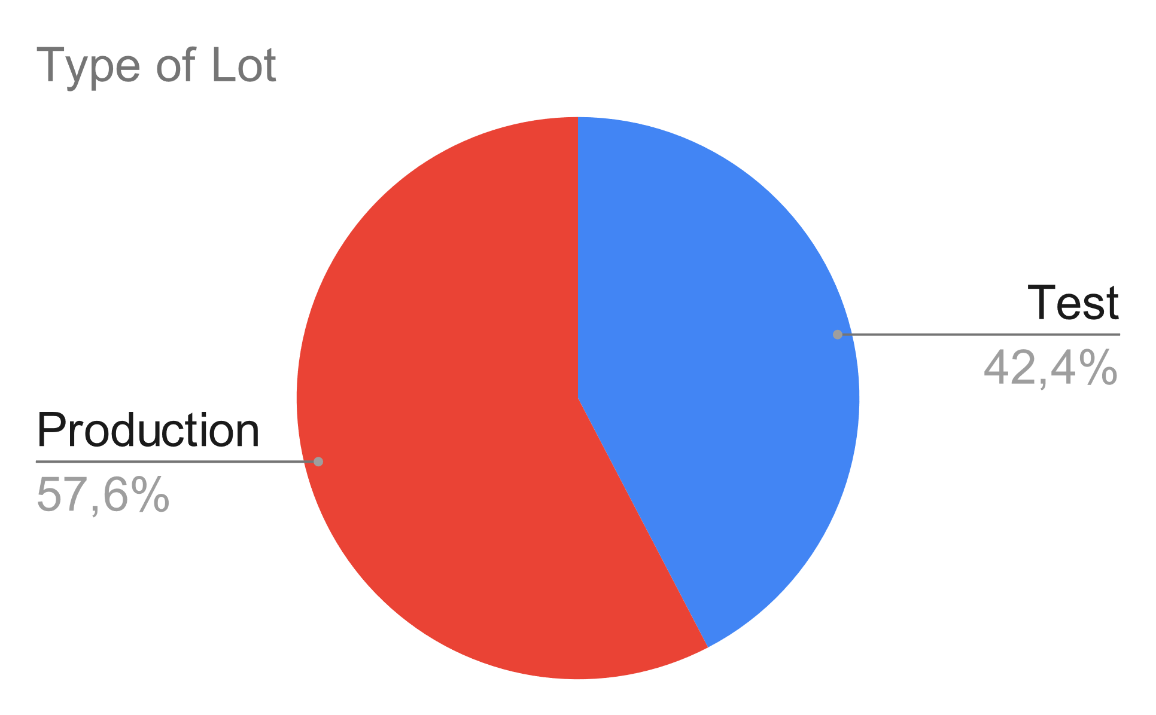
Test Service Status: Requests per lot type
Distribution of the type of lots:
Quite balanced between new test and production lot qualification
RADWG Activities Overview by R. Ferraro (BE-CEM-EPR )

Slide 8
PSI 2023 Test Status: 24 devices tested so far
March 3-6 (7DUTs)
May 13-14
August 26-27
October 21-22
FCA36N60NF x2 lots (SiC MOS – TE-CRG)
ISO7763FQDWRQ1 (Isolator – TE-CRG)
ISO124U x3 lots (Isolator – TE-CRG)
TCA9406 (I2C Transceiver – TE-CRG)
DS2401+ (1-Wire – SY-EPC)
CY62157EV30 (SRAM – BE-CEM)
INA146UA (Opamp – BE-CEM)
SN74LVC16T245DGG (Transceiver – BE-CEM)
PCA9615 (I2C Transceiver – BE-CEM)
( RD3P130SP (MOSFET – SY-EPC ))
We still have available slots for this year so don’t hesitate to make requests
CD4066 (Analog Switch BE-CEM)
SM30T12CAY (Thyristor TE-CRG)
SMP75-8 (Thyristor TE-CRG)
SP00800SDT (Thyristor TE-CRG)
SP0080SC (Thyristor TE-CRG)
SM15T12CAY (Thyristor TE-CRG)
LFSPXO018038 (Oscillator BE-CEM)
LFSPXO018041 (Oscillator BE-CEM)
LFSPXO0180xx (Oscillator BE-CEM)
IKW15N120BH6 (IGBT – SY-EPC)
ISO124U x1 lot (Isolator – TE-CRG)
= Production Lot
= Test Lot
April 1-2 (9 DUTs)
July 15-16
September 8-10
November 25-26
RADWG Activities Overview by R. Ferraro (BE-CEM-EPR )

Slide 9
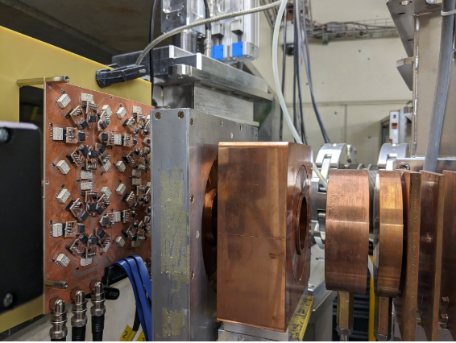
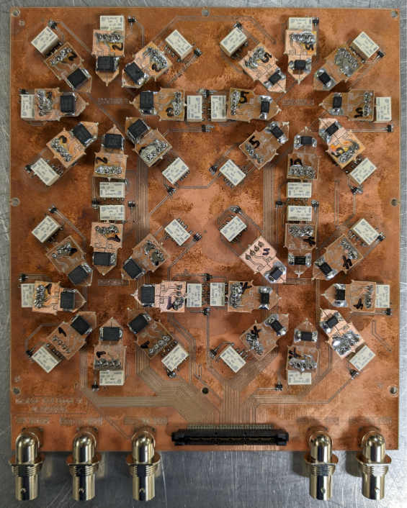
Recent Results: TSS/TSV Thyristors (TE-CRG)
6 References were tested
8 DUTs per reference tested
Main objective: Measure current leakage around -1 V to 1 V
Test setup made to:
Bias devices during irradiation
Read complete thyristor characteristics
RADWG Activities Overview by R. Ferraro (BE-CEM-EPR )

Slide 10
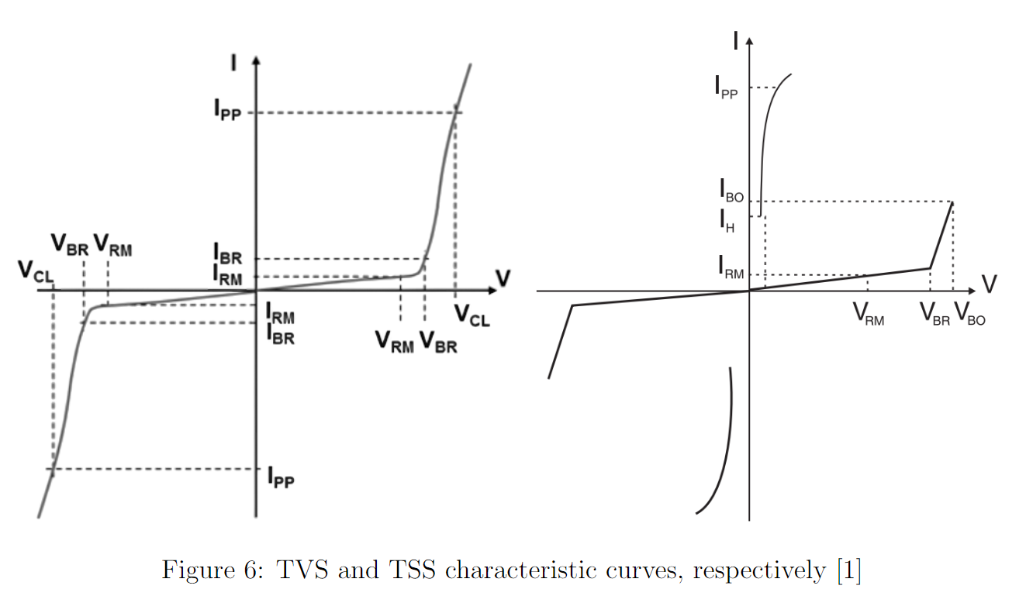
Recent Results: TSS/TSV Thyristors (TE-CRG)
TVS versus TSS standard characteristics:
RADWG Activities Overview by R. Ferraro (BE-CEM-EPR )

Slide 11
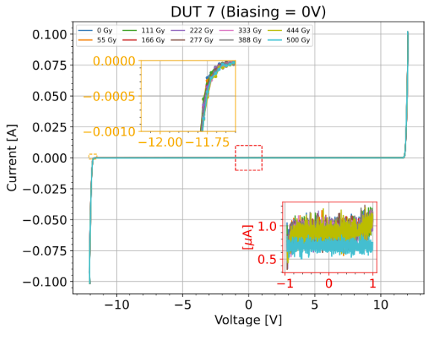
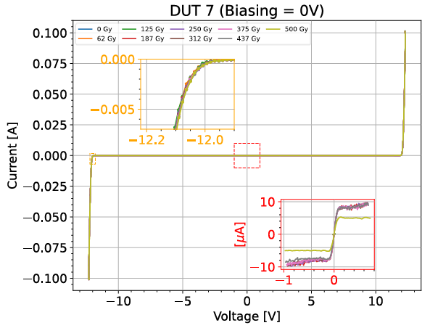
Recent Results: TSS/TSV Thyristors (TE-CRG)
TVS Results
SM15T12CAY
SM30T12CAY
No change of VBR visible
High current leakage increase in SM30T12CAY (up to 10 uA)
Report: EDMS 2913493
RADWG Activities Overview by R. Ferraro (BE-CEM-EPR )

Slide 12
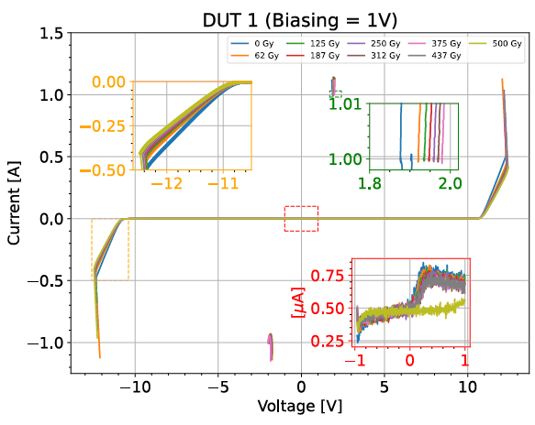
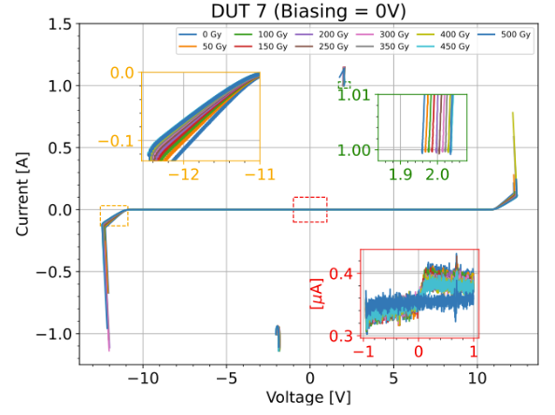
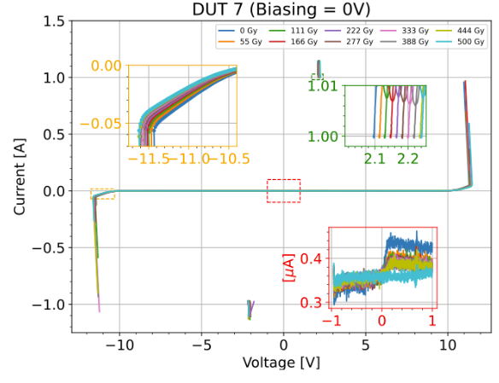
Recent Results: TSS/TSV Thyristors (TE-CRG)
TSS Results
SP00800SDT
SP0080SC
SMP75-8
Slight increase of VBO, VBR and IH (but negligible overall)
Slight increase current leakage but all lower than 1 uA
Report: EDMS 2913493
RADWG Activities Overview by R. Ferraro (BE-CEM-EPR )

Slide 13
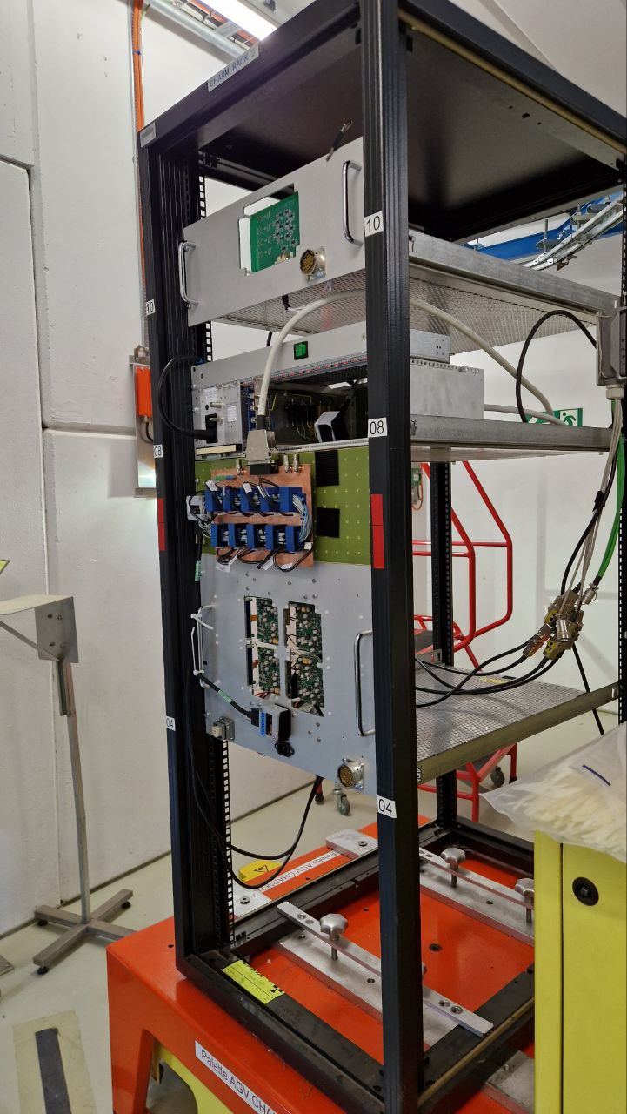
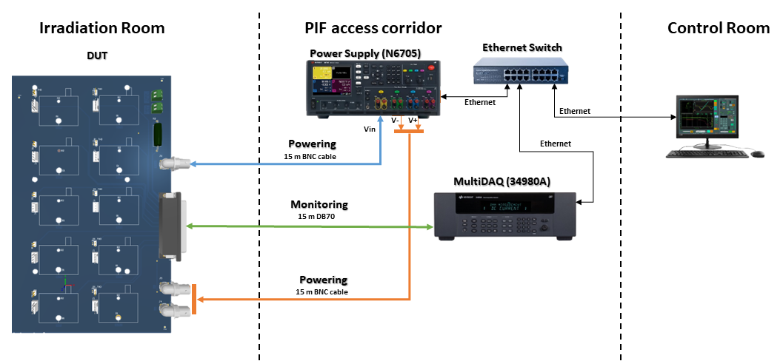
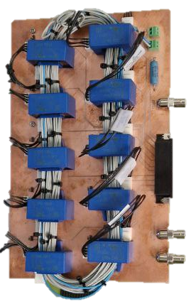
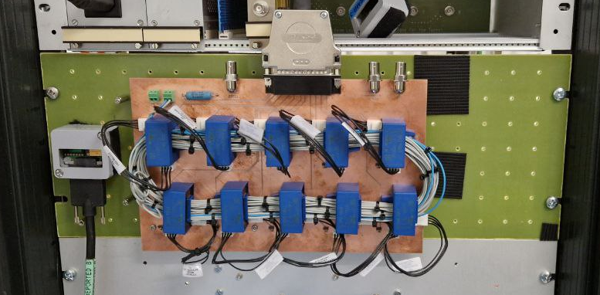
Recent Results: HAS-100S Hall Effect sensor (TE-EPC)
Tested at CHARM in position 13 for 3 weeks
Cumulated Radiation Levels:
  TID: 917 Gy DD: 6.91x10¹²neq.cm², DDEF/TID: 7.5 x10⁹ neq/cm²/Gy
Test Method:
  Fixed current to be measured set at 20 A
  Acquisition of the A_{measured} = f(A_{injected}) from 0 to 50 A
RADWG Activities Overview by R. Ferraro (BE-CEM-EPR )

Slide 14
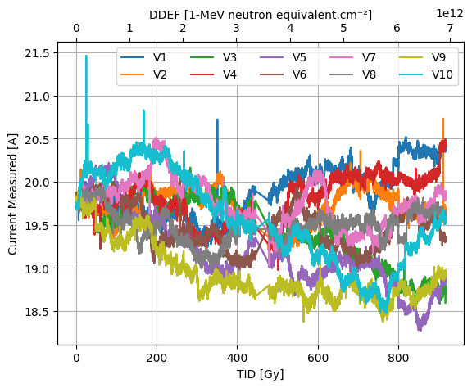
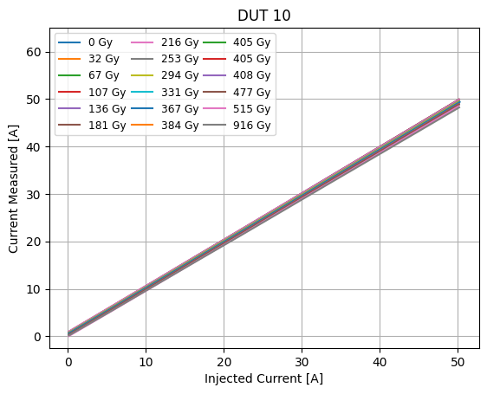
Recent Results: HAS-100S Hall Effect sensor (TE-EPC)
Preliminary Analysis:
Small drift of the measured current
  ^{Maximum change: -1.5 A (-7.6%)}
Change of calibration curve
RADWG Activities Overview by R. Ferraro (BE-CEM-EPR )

Slide 15
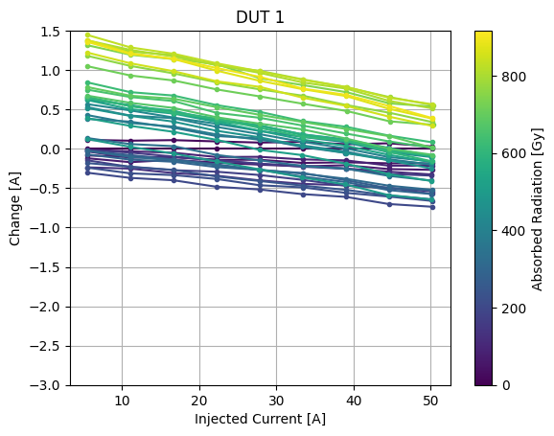
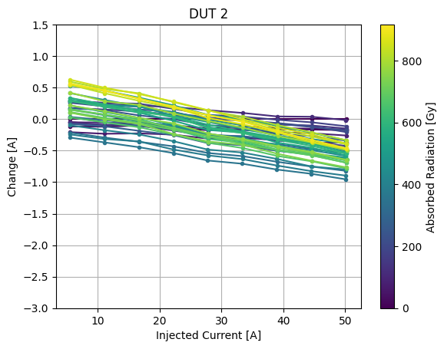
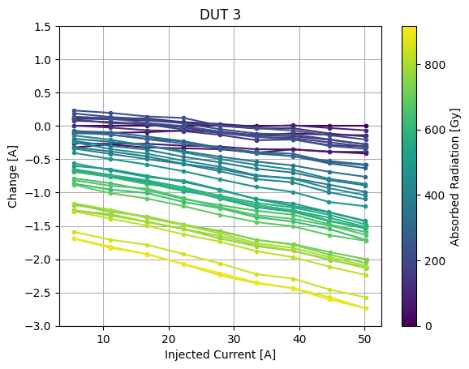
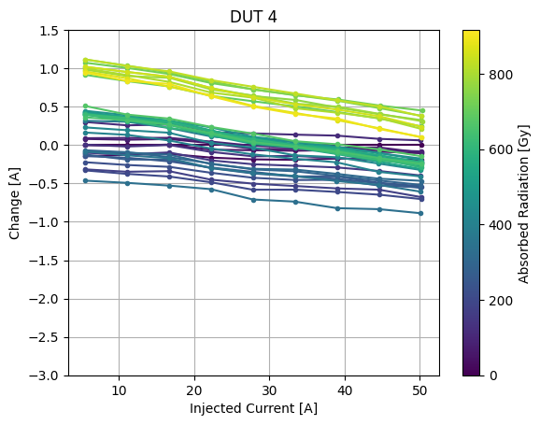
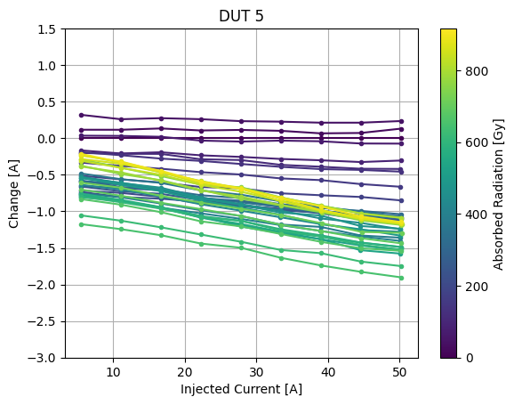
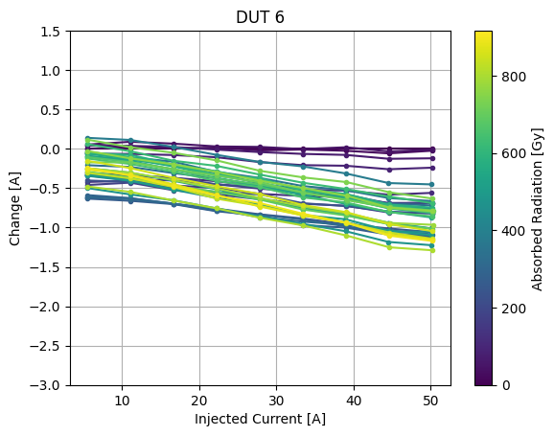
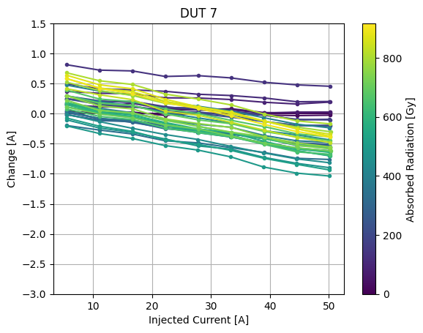
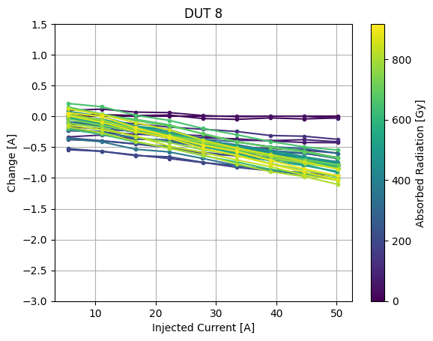
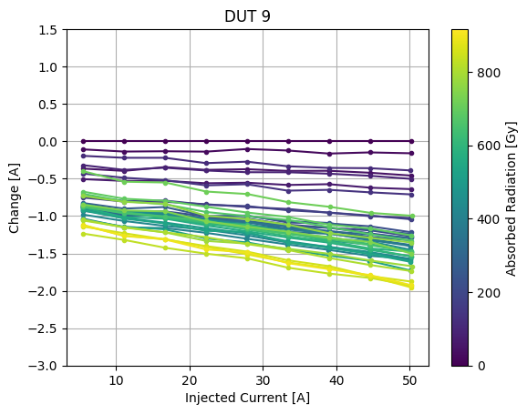
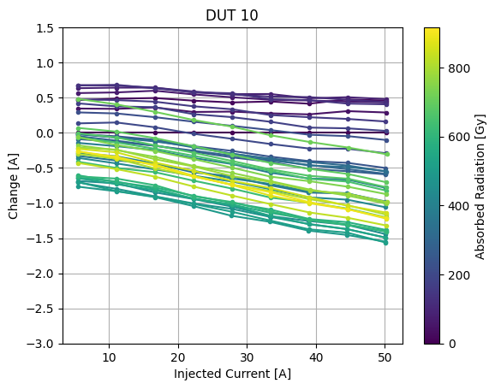
Recent Results: HAS-100S Hall Effect sensor (TE-EPC)
Characteristic Relative change in current / Difference of measured current:
Nonlinear degradation behaviour, one of several rebounds visible
Quite big variability within devices
RADWG Activities Overview by R. Ferraro (BE-CEM-EPR )

Slide 16
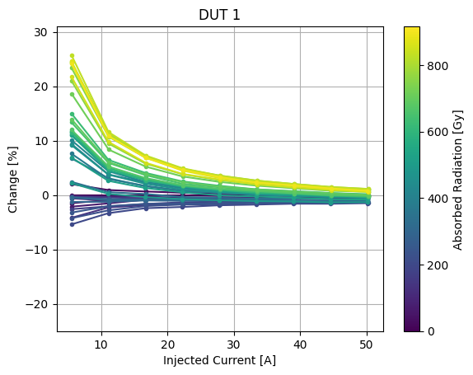
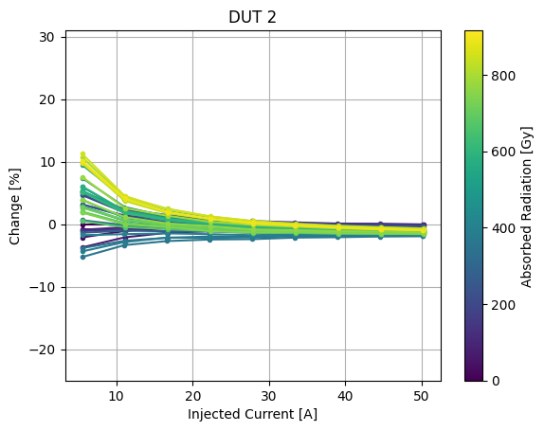
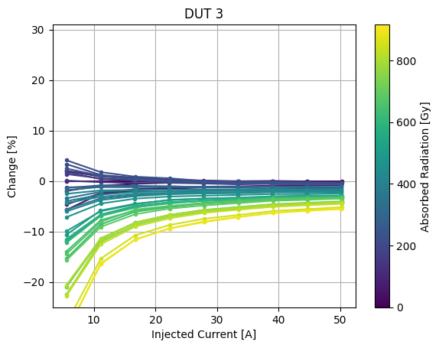
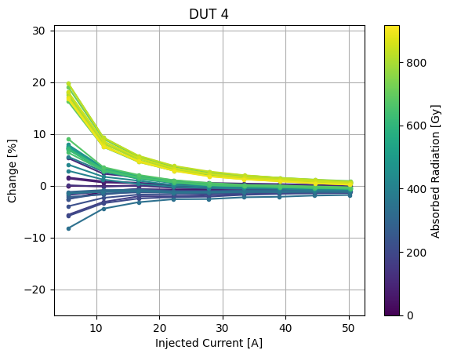
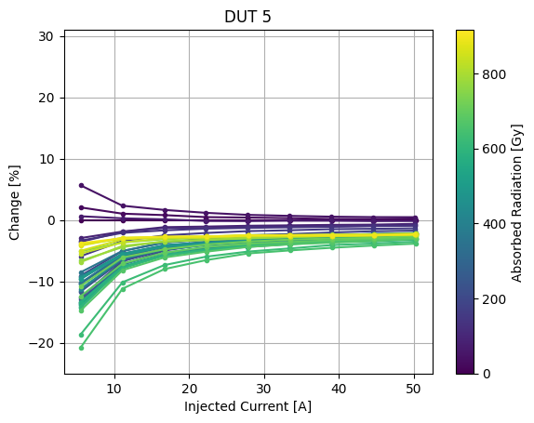
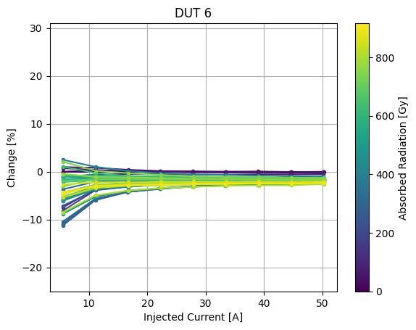
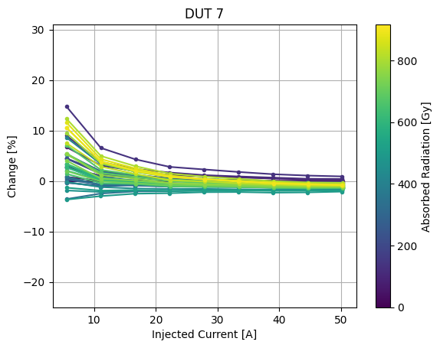
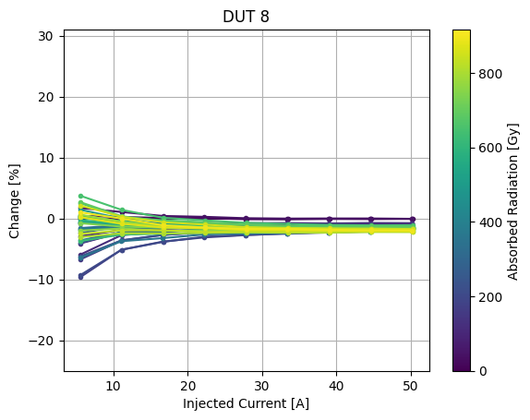
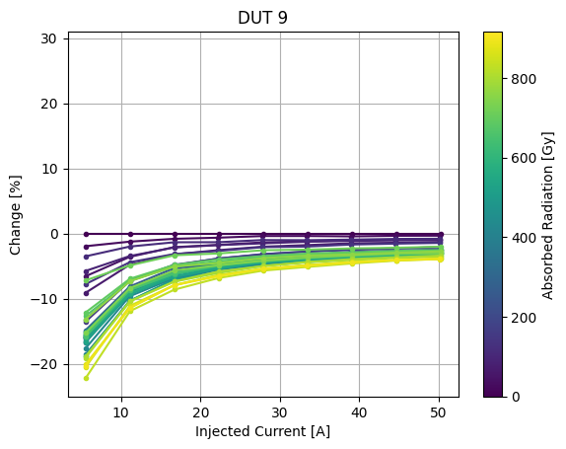
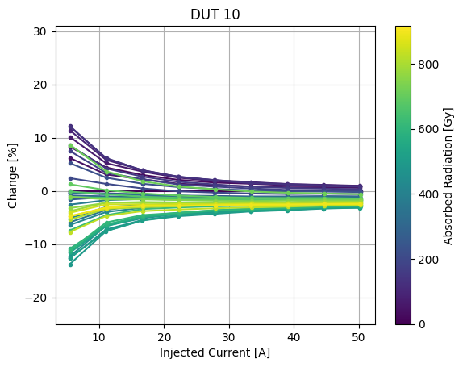
Recent Results: HAS-100S Hall Effect sensor (TE-EPC)
Characteristic Relative change in percentage
Bigger error on lower current measurement

Slide 17
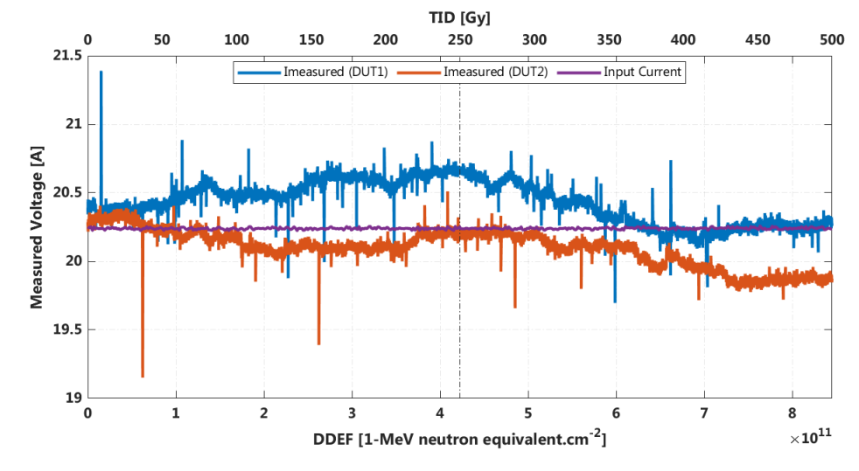
Recent Results: HAS-100S Hall Effect sensor (TE-EPC)
CHARM
PSI
Two devices were tested in the same conditions at PSI
Only two devices were tested due to their size (can be put only one by one in the beam)
As visible the variation was bigger for most of the devices
Can be a lot-to-lot variation but the internal design is made of bipolar devices, so it is most likely due to combined TID-DD effects
RADWG Activities Overview by R. Ferraro (BE-CEM-EPR )

Slide 18
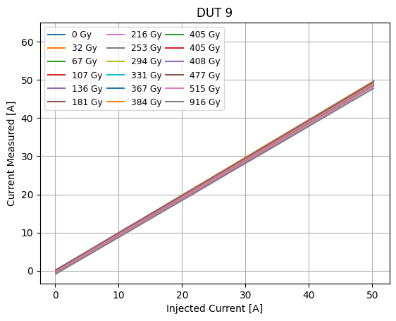
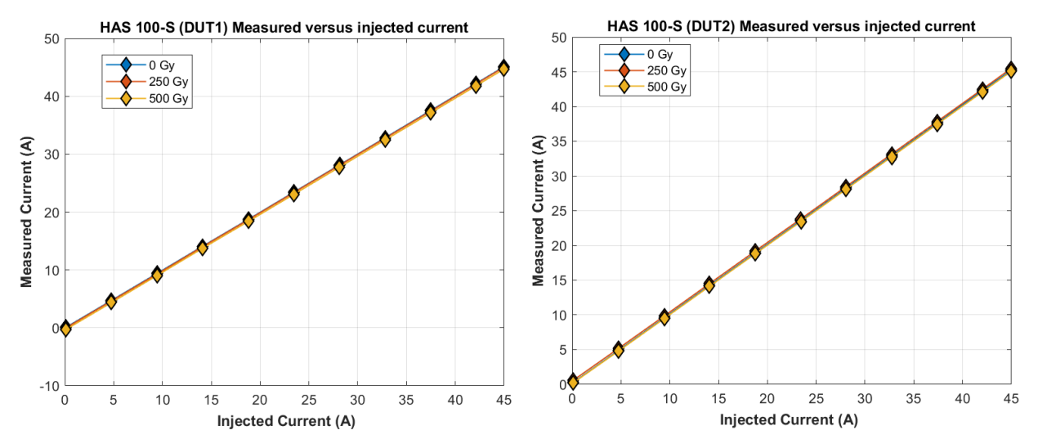
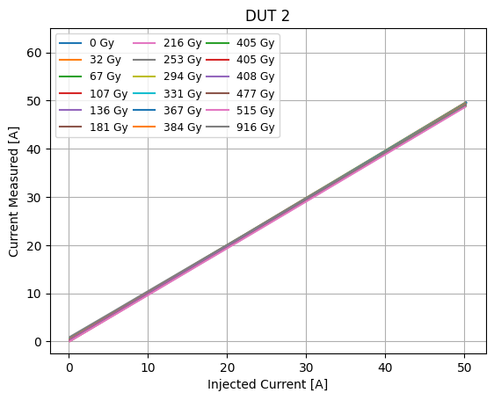
Recent Results: HAS-100S Hall Effect sensor (TE-EPC)
CHARM
PSI
Biggest degradation
On the calibration the difference is more noticeable
Lowest degradation
RADWG Activities Overview by R. Ferraro (BE-CEM-EPR )

Slide 19
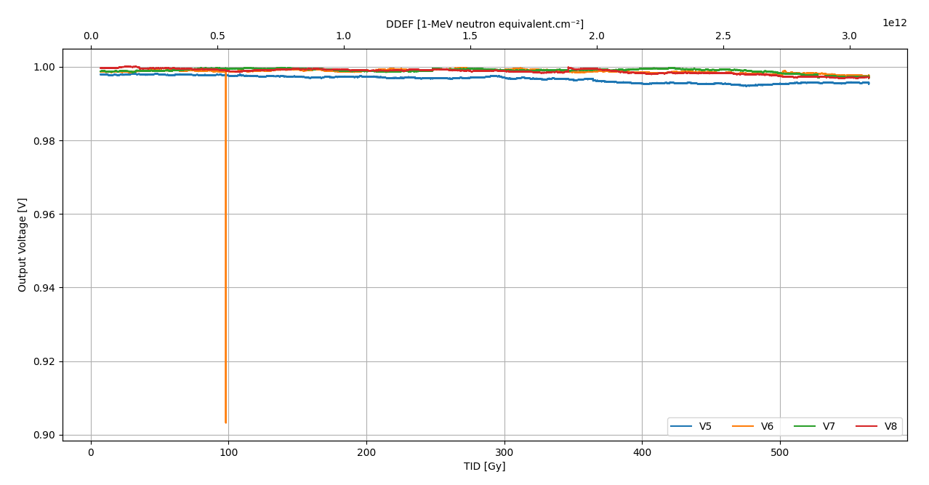
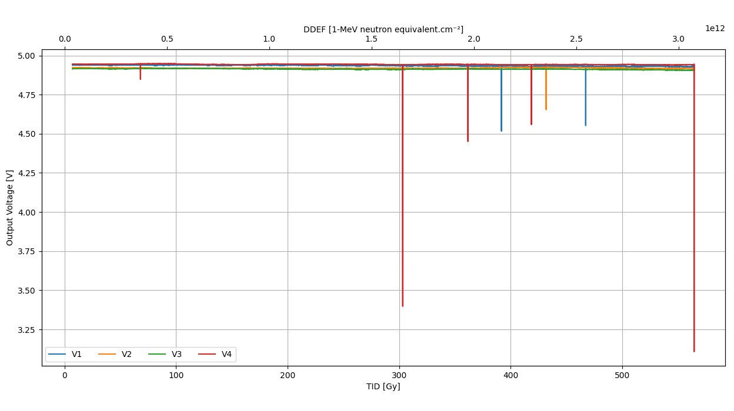
Recent Results: LT8610 DCDC
Output Load set to 100 mA
5 DUTs set to 1V output and 5 DUTs set to 5V outputs
1 Power cycle every 12h
1 V Output
SETs
SETs
No significant degradation observed but some quite big SETs were observed with probably a high occurrence since those were captured by the MultiDAQ sampling every 10s

Slide 20
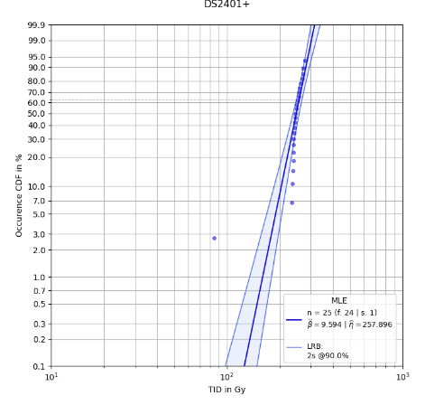

Recent Results: 1-Wire serial ID (TE-EPC)
Tested at PSI
Test protocol: Continuous reading of the ID and comparison with the one before irradiation
Devices died before target of 500 Gy ( died = returned corrupted ID, CRC etc.. Random data)
Use of reliability Weibull tool to extract Weibull failure distribution parameters
Failure distribution of the device
Target
Weibull(a,b) parameters fit
Outsider
PSI Failures
RADWG Activities Overview by R. Ferraro (BE-CEM-EPR )

Slide 21

Test Request Template:
Test Request document: EDMS 2779784
Contains:
  Information about equipment:
    Locations, Deployment plan, lifetime, number of units in operation
  Information about radiation levels in operation: TID, DDEF, HeH, ThN
  Information about DUTs:
    Use in the system (schematic)
    Parameters of interest
    Radiation Design requirements
    Maximum tolerated failure rate (SEEs)
Will help us to track better the request and also to prepare better the tests
To be sent to: EPR-Radiation-Test-Team@cern.ch
All request are then put in the following EDMS folder: [link]
RADWG Activities Overview by R. Ferraro (BE-CEM-EPR )

Slide 22

Test results analysis and reporting
The website https://radwg.web.cern.ch/ embeds an User-Friendly database
  More than 558 reports from the 2011 up to 2023
225 users subscribed to the mailing list lhc-proj-radwg-members
The service produces reports in a common template for all the components tested
  Test reports template ensure a coherent reporting
databases accessible by all the equipment groups
https://radwg.web.cern.ch
RADWG Activities Overview by R. Ferraro (BE-CEM-EPR )

Slide 23
Conclusions
BE-CEM-EPR provides the service of radiation testing of electronic components supporting the Radiation Working Group (RadWG)
High testing activity in 2023
CHARM Tests has restarted
3 PSI campaigns were performed and they are still some spots in the 5 next campaigns for this year
RADWG Activities Overview by R. Ferraro (BE-CEM-EPR )

Slide 24
Thank you for your attention!

