Slide 1
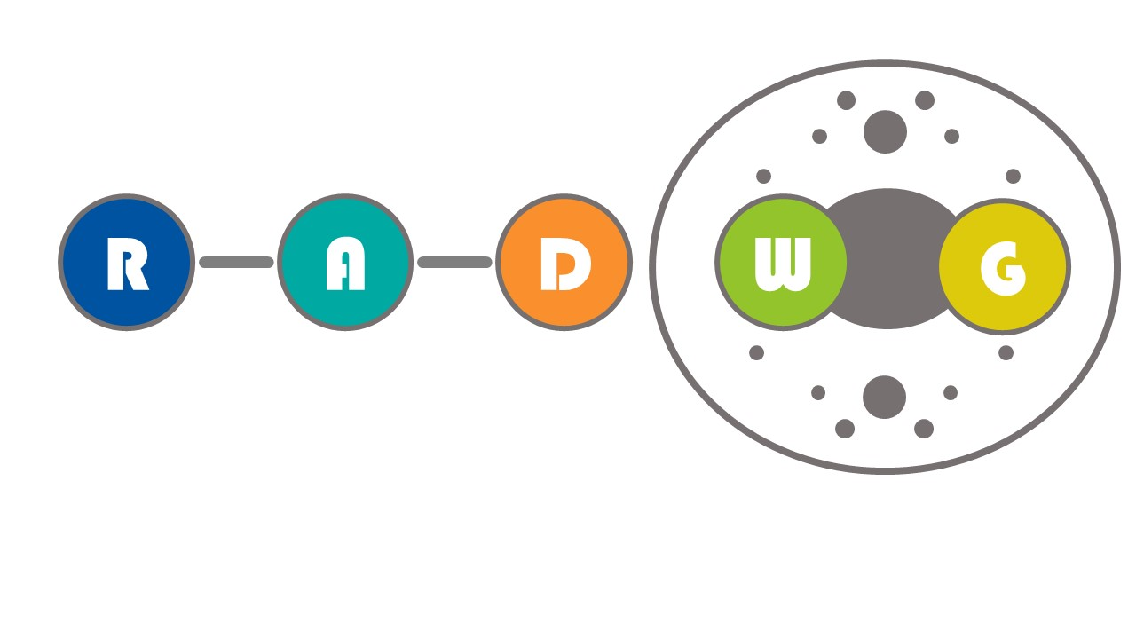
RADWG Workshop (15/06/23)
Salvatore Danzeca BE-CEM-EPR
Manoel Barros Marin SY-BI-BP
on behalf of the RADWG

Slide 2
AGENDA
Introduction
Activities Overview by Rudy Ferraro
Invited Talk: Electronics Nuclear Radiation Compatibility in ITER (Martin Felix Dentan , SY-STI)
Status and News of the RADNEXT Program (Andrea Coronetti, SY-STI)
Status of DQHDS Systems (David Carrillo, Edward Nowak, Gert-Jan Coelingh, TE-MPE)
Open Questions

Slide 3
Common order for radiation tolerant DC/DC converters
  bPOL12 and bPOL48
  RADWG organising a common order
  Input from equipment groups required
      Number of pieces required
      Modules vs Chip on board
      Etc.
  A mail to collect the request has been sent to potential users
  Please provide the availability of budget for this purchase
  Modules vs Chip on board
    PCB constraints following the EP suggested layout and guidelines
      The PCB require a particular stackup with 80 um prepreg
        This poses some limitations in the production and several companies declined to quote for that particular stackup
        At the moment only one company replied positively and is capable of producing this stackup
        Take away : the stackup should be done following the EP recommendation and at the moment only one company is capable of producing this stackup

Slide 4
THANK YOU

