Slide 1
Σ(1385) analysis Status
Enrico Fragiacomo, Massimo Venaruzzo
INFN and University Trieste
Resonances meeting – CERN – 04/03/2011

Slide 2
Outlook
How is the signal extracted
Comparison of the extracted signal with the MC-truth (for simulated data)
Results for real data
Pt spectrum

Slide 3
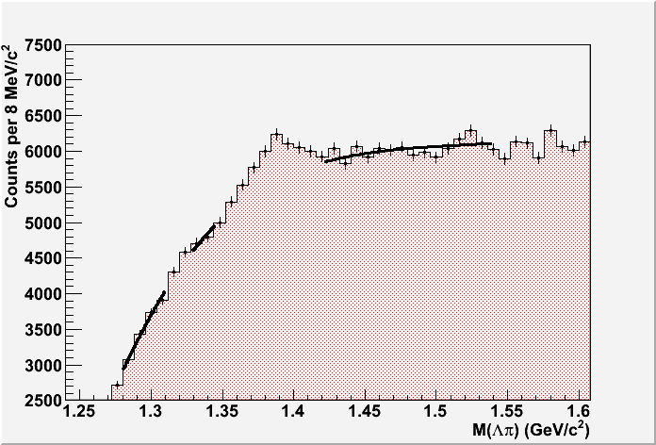
Side-band fit of the invariant mass
Simulated data from period LHC10d1/d4
1.6 < p_{t} < 1.8 GeV/c
STEP 1/4
The invariant mass is fitted side-band with a Laurent expansion
Note the exclusion regions around the Ξ(1320) and Σ(1385) peaks

Slide 4
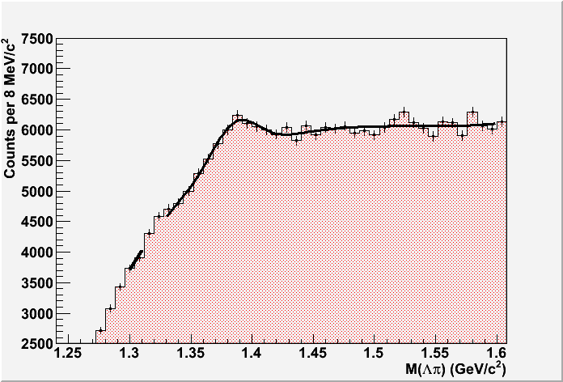
Combined BKG+SIGNAL fit
Simulated data from period LHC10d1/d4
1.6 < p_{t} < 1.8 GeV/c
STEP 2/4
The side-band parameters are used as starting points for a combined BKG+SIGNAL fit
Best results with a gaussian function!

Slide 5
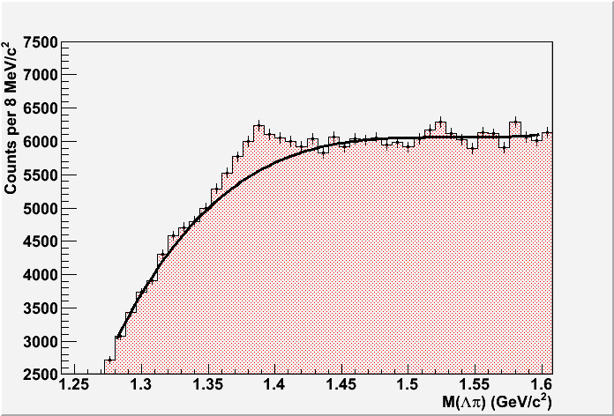
Defining the background
Simulated data from period LHC10d1/d4
1.6 < p_{t} < 1.8 GeV/c
STEP 3/4
The BKG part of the combined fit is interpolate to describe the combinatorial background
The BKG function is subtracted to extract the signal

Slide 6
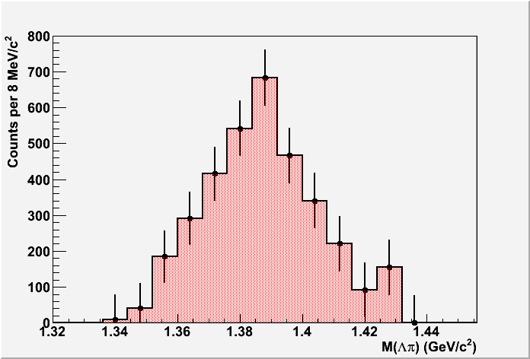
Getting the signal
Simulated data from period LHC10d1/d4
1.6 < p_{t} < 1.8 GeV/c
STEP 4/4
Statistical errors are propagated through the extraction procedure
The signal histogram is used to obtain mean, rms and integral

Slide 7
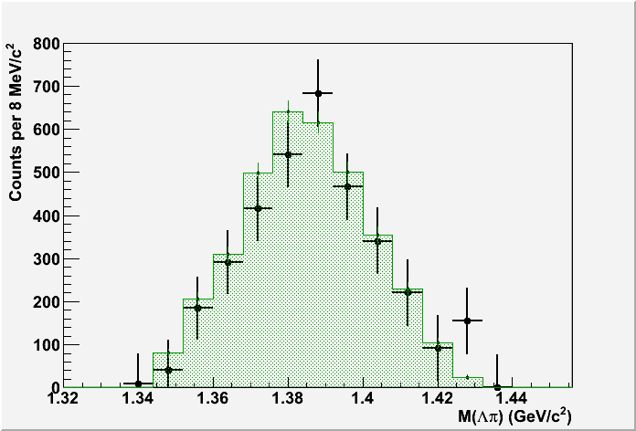
Comparing with the MC-true (1/2)
Simulated data from period LHC10d1/d4
1.6 < p_{t} < 1.8 GeV/c
The extracted signal is compared with the MC-true peak (in green)

Slide 8
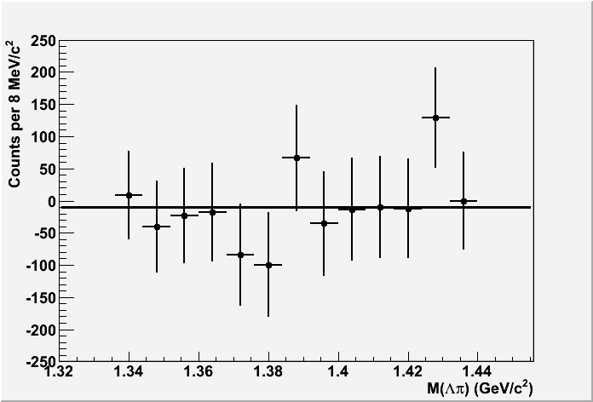
Comparing with the MC-true (2/2)
Simulated data from period LHC10d1/d4
1.6 < p_{t} < 1.8 GeV/c
Difference between the extracted signal and the MC-true peak
Pol0 fit:
p0 = 10.±21.
Χ²/NDF=6.5/7

Slide 9
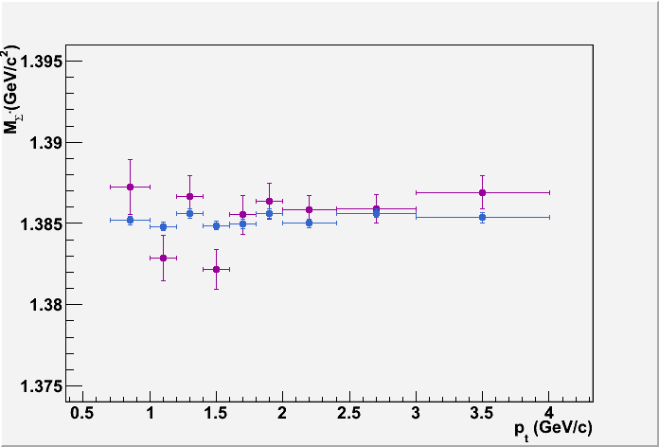
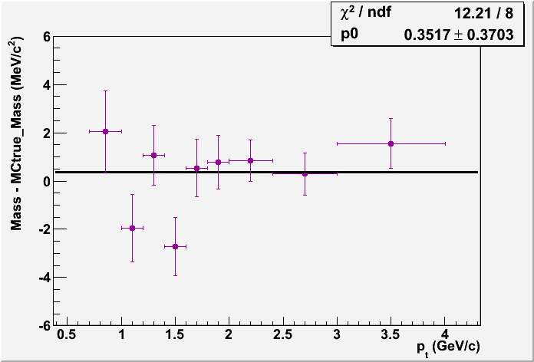
Mass
Simulated data from period LHC10d1/d4
Mass of the Σ* vs pt
Mean value from extracted histo
Mean value from MC-true histo
PDG band

Slide 10
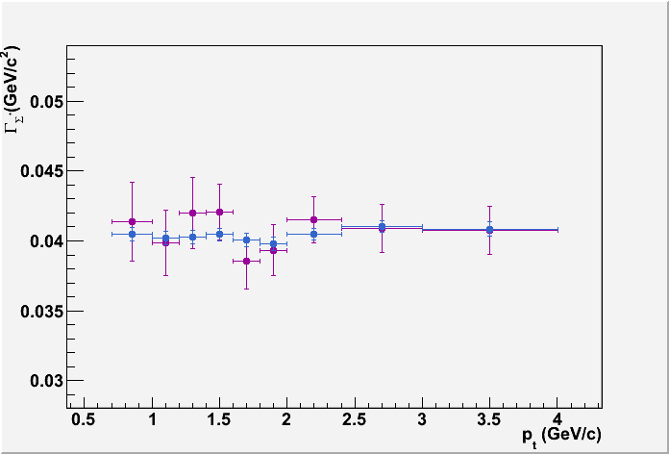
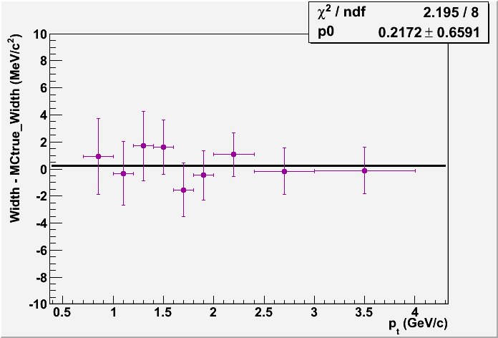
Width
Simulated data from period LHC10d1/d4
Width of the Σ* vs pt
2.35 * RMS from extracted histo
2.35 * RMS from MC-true histo
PDG band

Slide 11
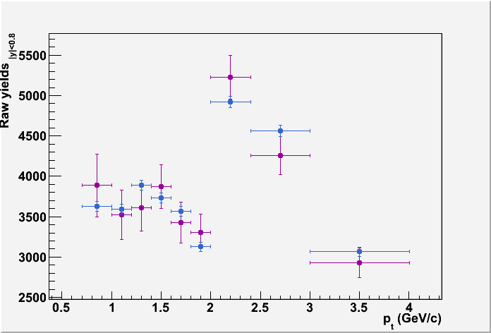
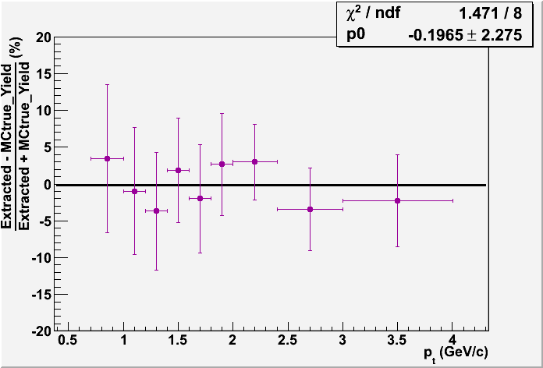
Yields
Simulated data from period LHC10d1/d4
Integral of the extracted histo
Integral of the MC-true histo

Slide 12
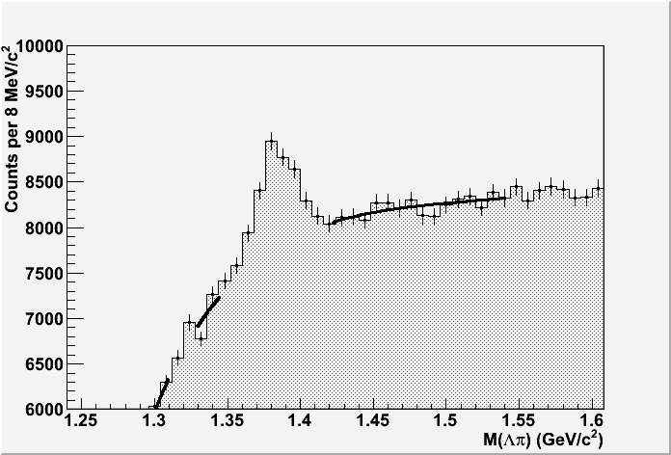
Side-band fit of the invariant mass
Real data from period LHC10b/c
2.4 < p_{t} < 3.0 GeV/c
The invariant mass is fitted side-band with a Laurent expansion
Note the exclusion regions around the Ξ(1320) and Σ(1385) peaks

Slide 13
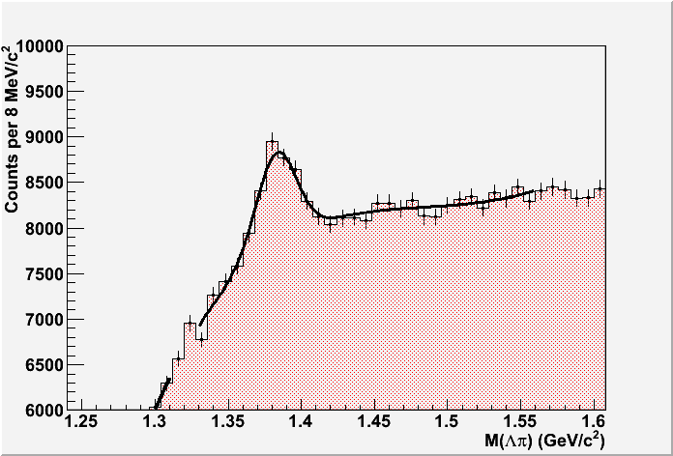
Combined BKG+SIGNAL fit
Real data from period LHC10b/c
2.4 < p_{t} < 3.0 GeV/c
The side-band parameters are used as starting points for a combined BKG+SIGNAL fit
Best results with a gaussian function!

Slide 14
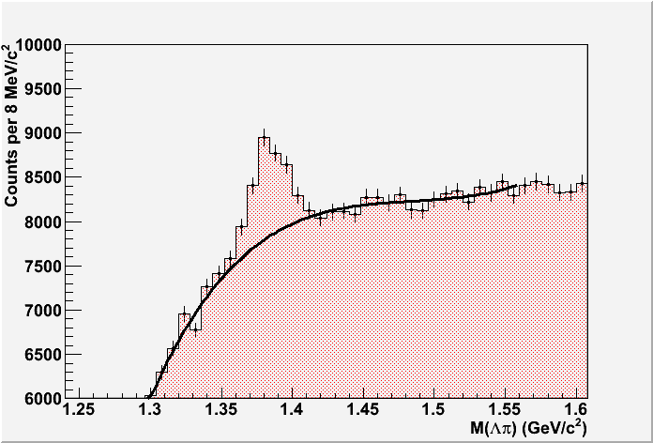
Defining the background
Real data from period LHC10b/c
2.4 < p_{t} < 3.0 GeV/c
The BKG part of the combined fit is interpolate to describe the combinatorial background
The BKG function is subtracted to extract the signal

Slide 15
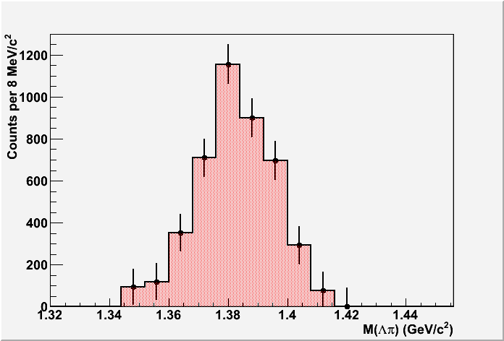
Getting the signal
Real data from period LHC10b/c
2.4 < p_{t} < 3.0 GeV/c
Statistical errors are propagated through the extraction procedure
The signal histogram is used to obtain mean, rms and integral

Slide 16
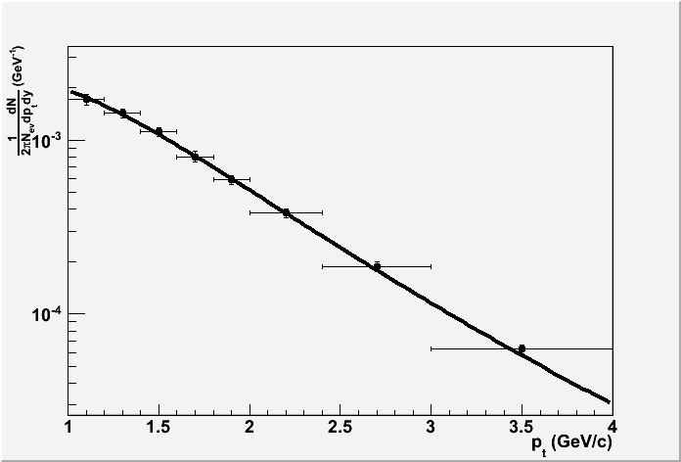
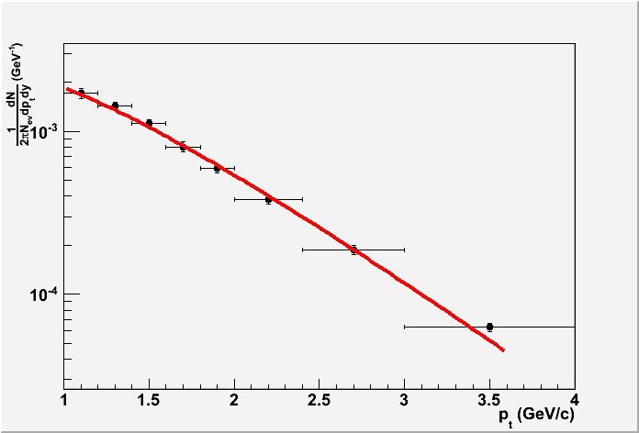
Pt spectrum with fits
Levy-Tsallis
n = (8.1 ± 1.5)
T = (276 ± 28) MeV
Chi2/NDF = 0.7/5
Exp
T = (517 ± 8) MeV
Chi2/NDF = 5.5/6

Slide 17
Conclusions
Extraction procedure well defined
Statistical errors dominates!
For simulated data, the MC-true signal is within the statistical errors of the extracted signal
Plan to analyze LHC10d period to increase statistics for real data

Slide 18
Backup slides

Slide 19
Event and track selection
Cut | Value
AliPhysicsSelection
Reject kink daughters
ClusterRequirementITS | SPD + Any SDD/SSD
MaxChi2PerTPCcluster | 4
Z vertex | -10 < z < 10
Λ daughters TPC clusters | > 70
Bachelor TPC clusters | > 70
Chi2/nTPCclusters | < 4
Λ mass | 1.110 GeV/c² < m < 1.122 GeV/c²
Λ cos of point. Angle | > 0.99
Λ daughters DCA | < 0.5 cm
Primary Vertex - Λ DCA | < 0.3 cm
Primary Vertex - Bachelor DCA | < 0.05 cm

Slide 20
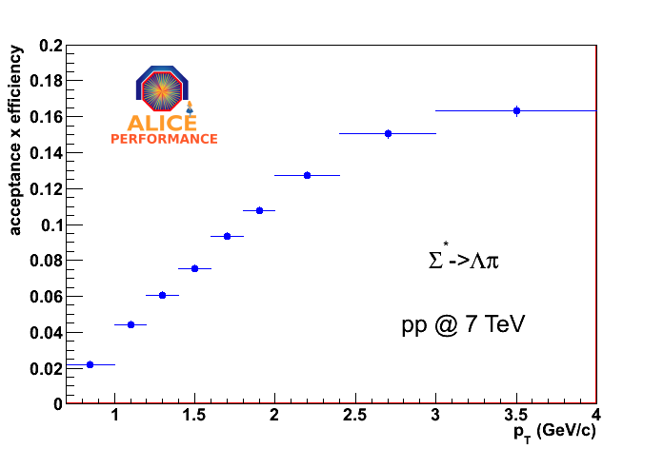
Efficiency

Slide 21
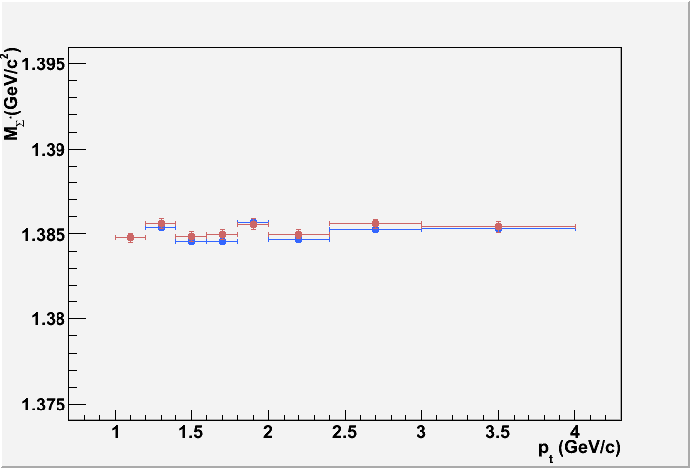
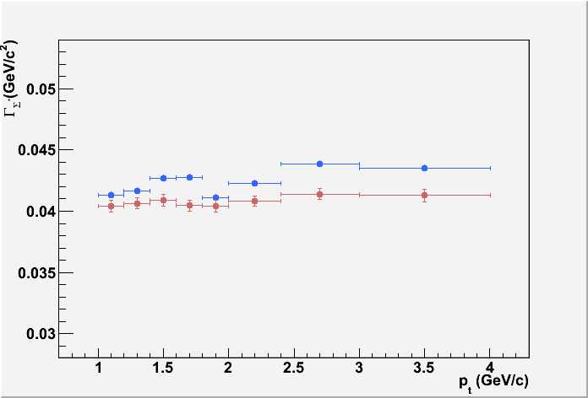
MC-true signal mass and width
LHC10d1/d4 sim data
All points from MC-true signal. No signal extraction was performed!
Statistical errors only
Mass of the Σ* vs pt
Width of the Σ* vs pt
2.35 * RMS from the histogram
Mean value from the histogram
2.35 * σgaus from gaussian fit
Mean value from gaussian fit
PDG band
PDG band
All points are within the statistical errors of the PDG value
On average, three (five) MeV/c higher than the PDG value -> Resolution effect

Slide 22
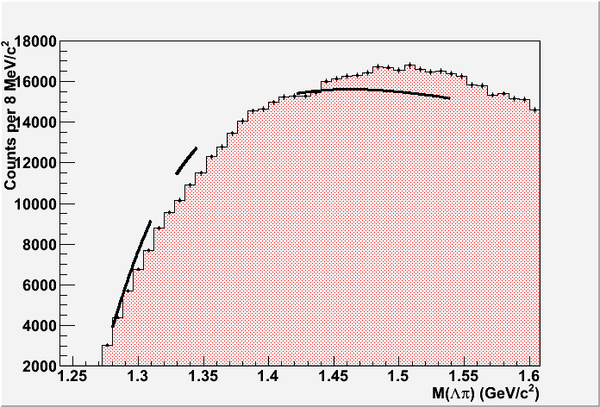
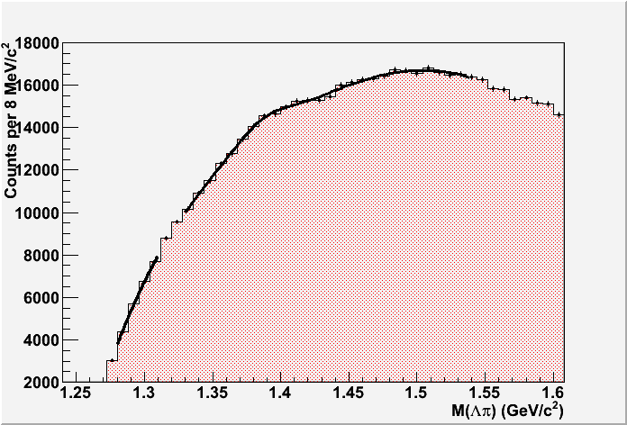

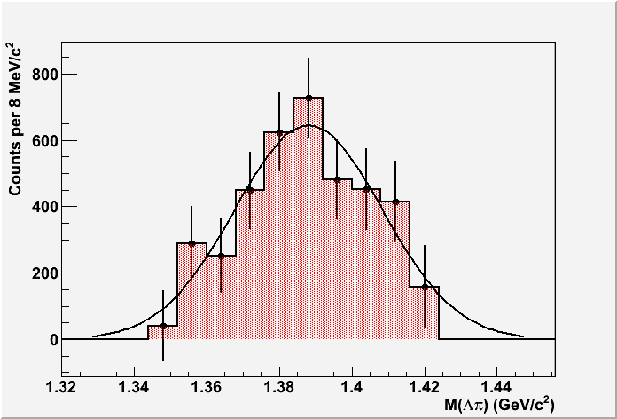
Sim data LHC10d1/d4
0.7 < p_{t} < 1.0 GeV/c

Slide 23
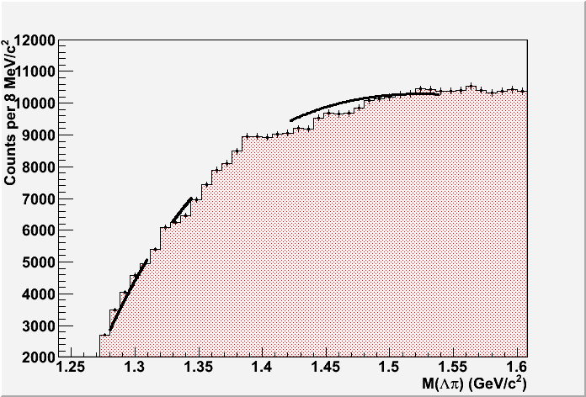
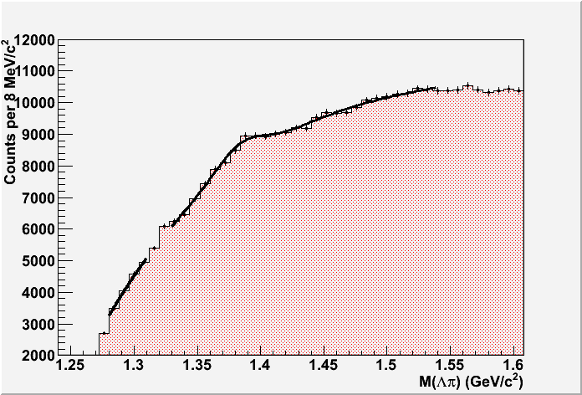
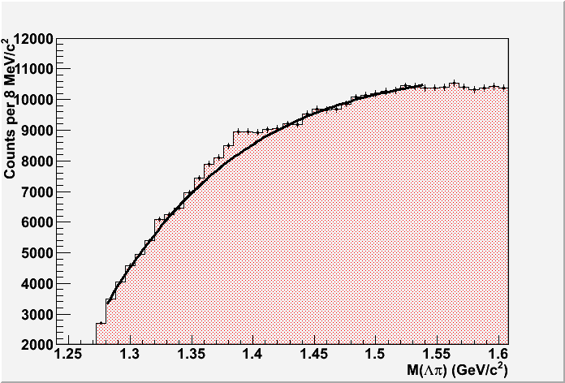
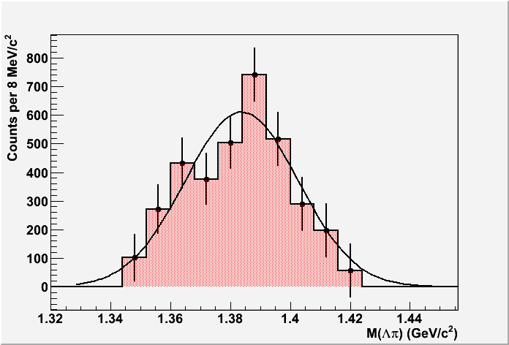
Sim data LHC10d1/d4
1.0 < p_{t} < 1.2 GeV/c

Slide 24
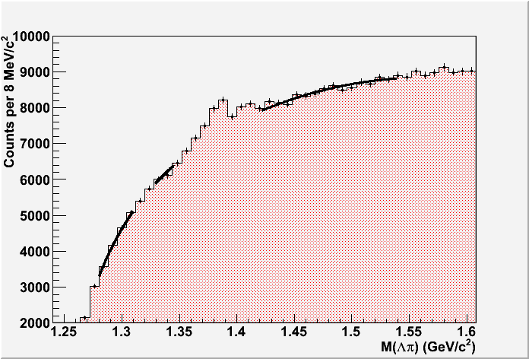
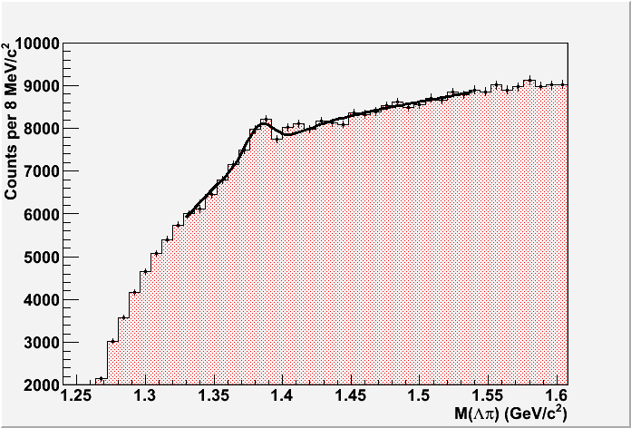
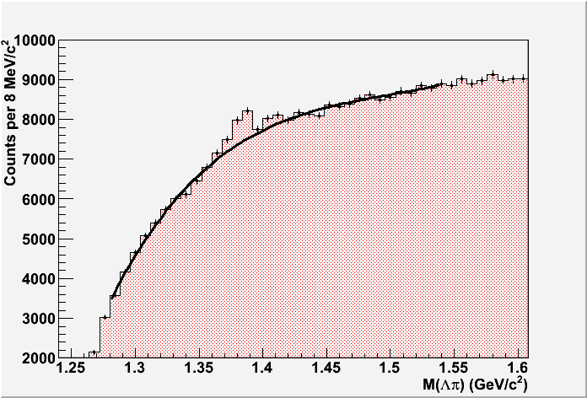
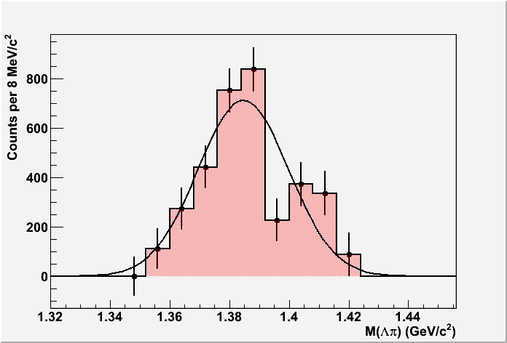
Sim data LHC10d1/d4
1.2 < p_{t} < 1.4 GeV/c

Slide 25
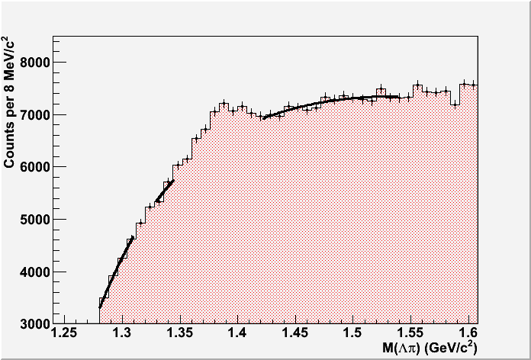
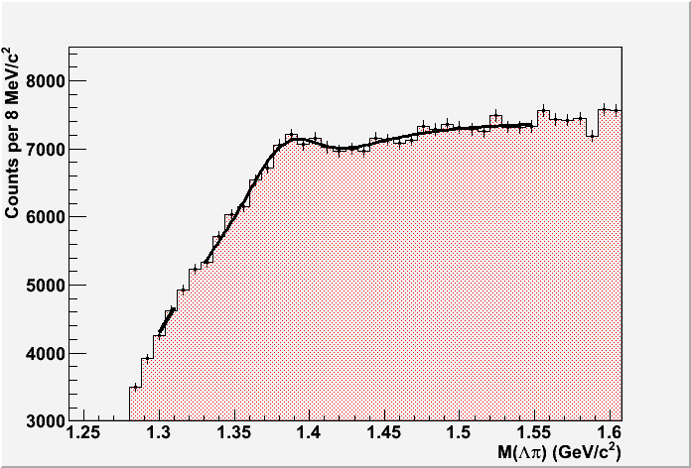
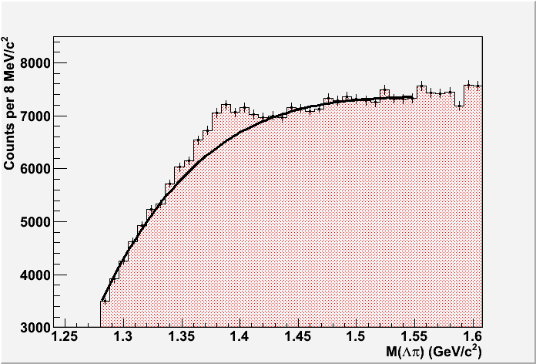
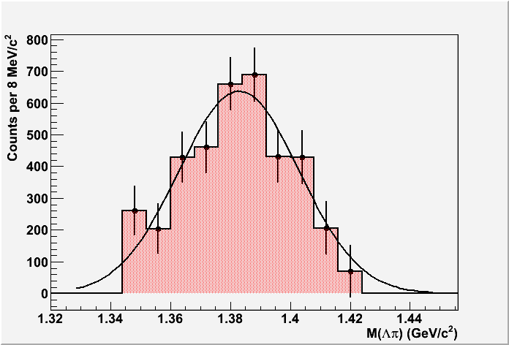
Sim data LHC10d1/d4
1.4 < p_{t} < 1.6 GeV/c

Slide 26
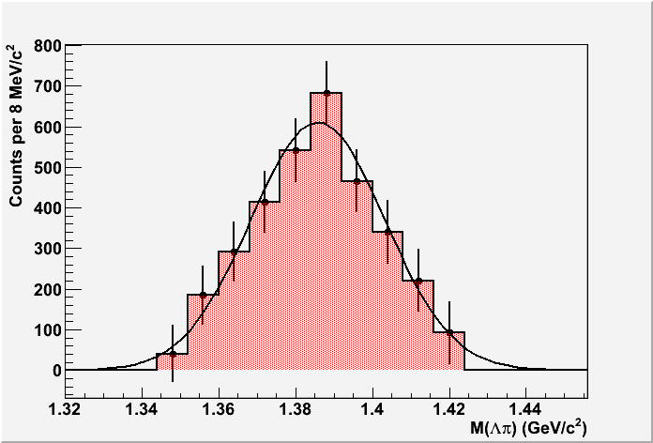
Sim data LHC10d1/d4
1.6 < p_{t} < 1.8 GeV/c

Slide 27
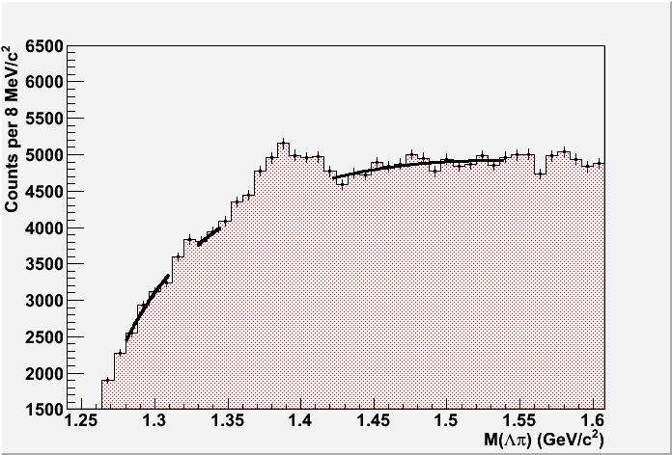
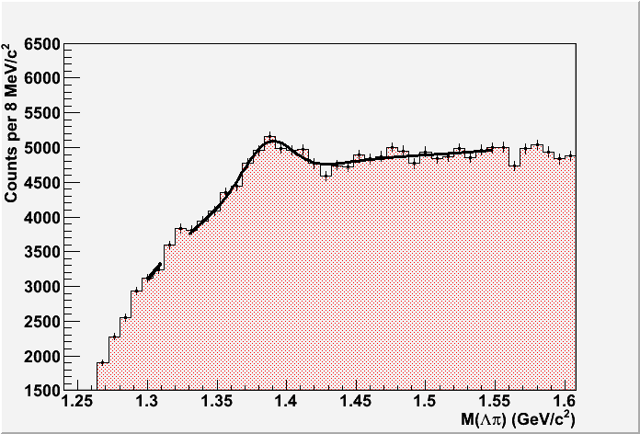
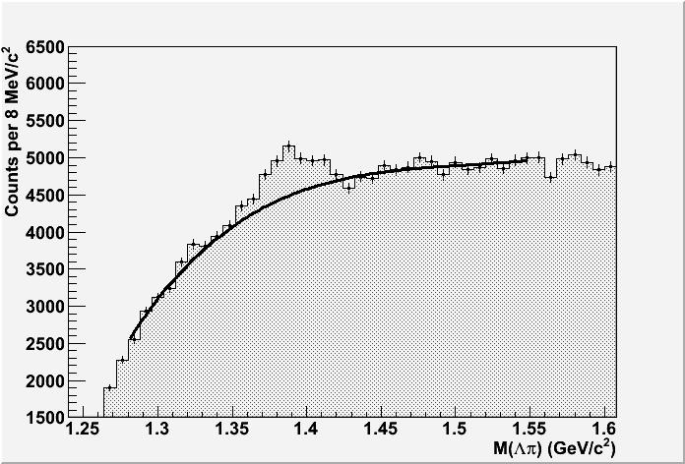
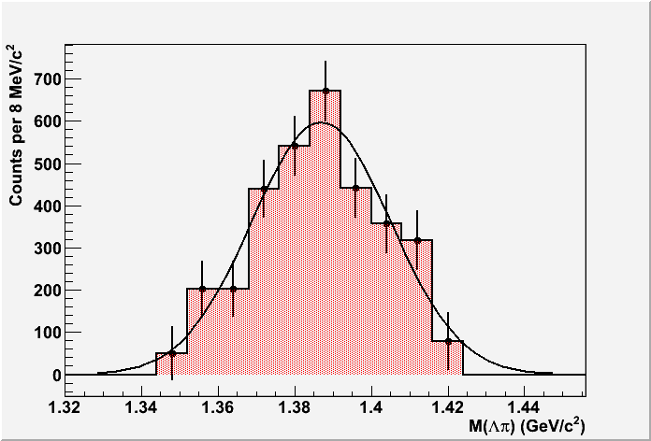
Sim data LHC10d1/d4
1.8 < p_{t} < 2.0 GeV/c

Slide 28
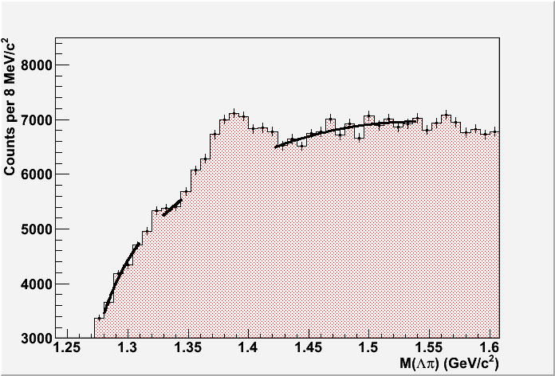
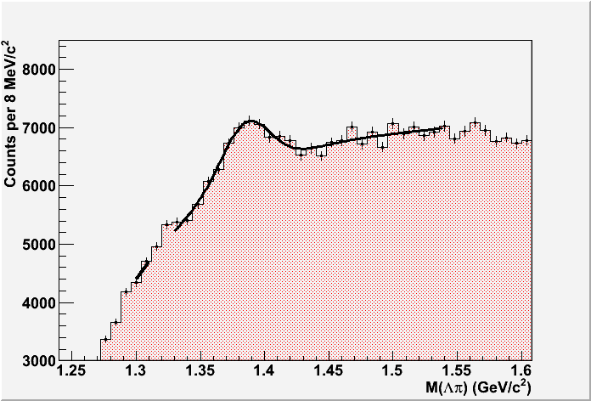
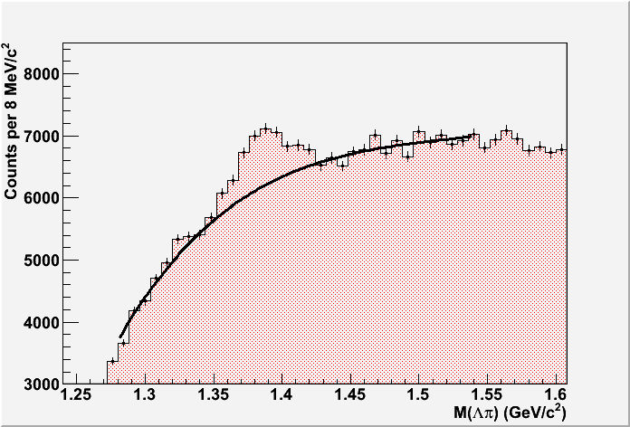
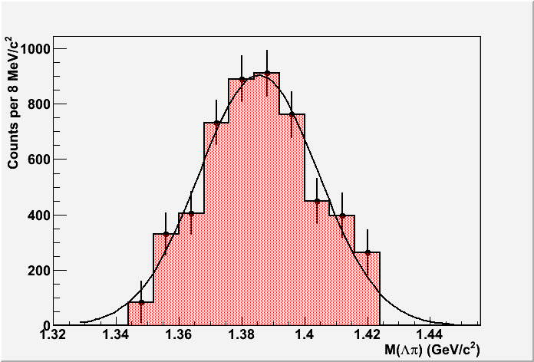
Sim data LHC10d1/d4
2.0 < p_{t} < 2.4 GeV/c

Slide 29
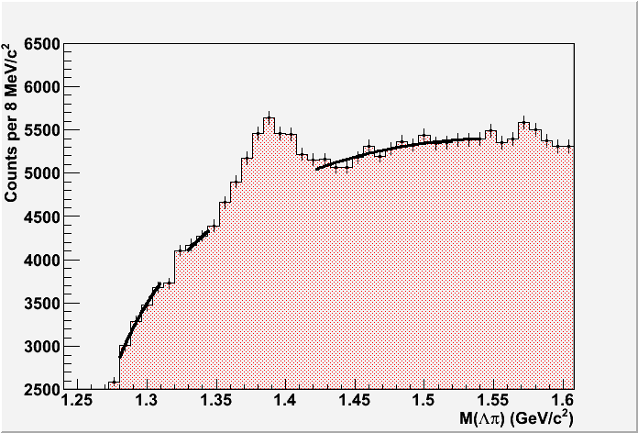
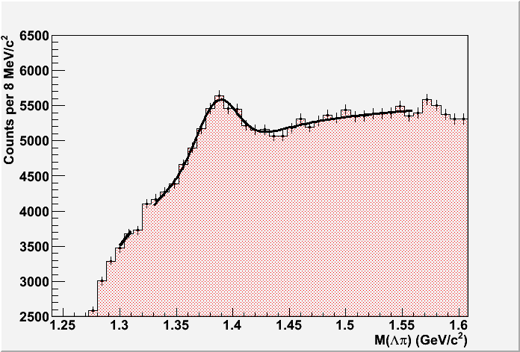
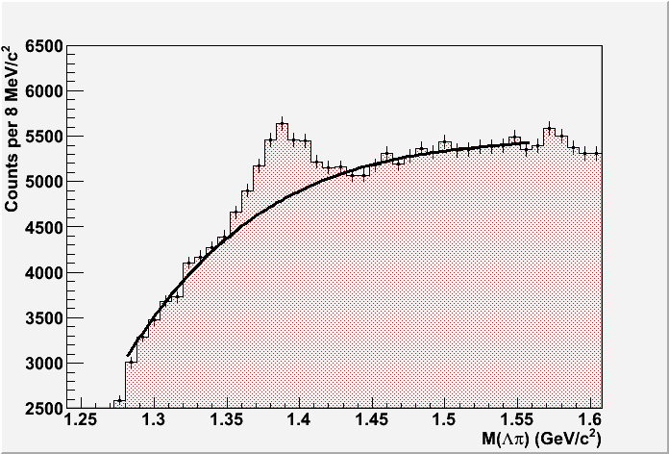
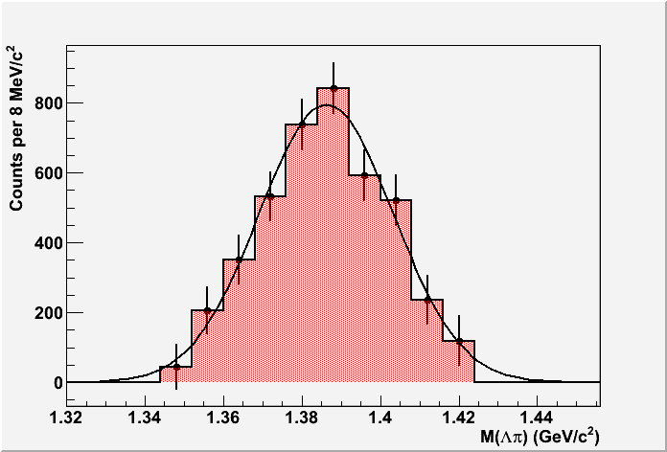
Sim data LHC10d1/d4
2.4 < p_{t} < 3.0 GeV/c

Slide 30
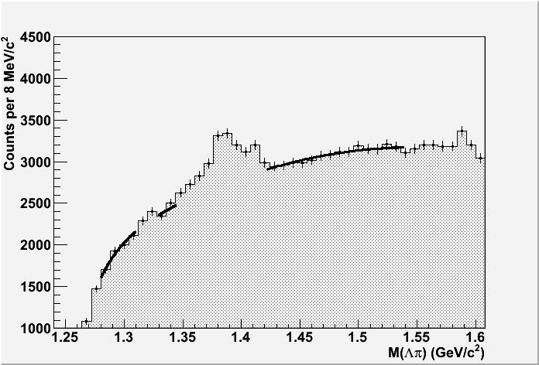



Sim data LHC10d1/d4
3.0 < p_{t} < 4.0 GeV/c

Slide 31


Old extraction procedure
Sim data LHC10d1/d4
1.0 < p_{t} < 1.2 GeV/c
Side-band only
Signal as gaussian fit after SB background subtraction
Side-band (SB) fit extrapolated to the signal region
MC-true

Slide 32


Old extraction procedure
Sim data LHC10d1/d4
2.0 < p_{t} < 2.4 GeV/c
Side-band only
Signal as gaussian fit after SB background subtraction
Side-band (SB) fit extrapolated to the signal region
MC-true

Slide 33

Old extraction procedure
LHC10b+c period
2.4 < p_{t} < 3.0 GeV/c
Side-band only

