Slide 1
Electromagnetic design optimization
June 2023
Susana Izquierdo Bermudez, Juan Carlos Perez , Lucio Fiscarelli, Ezio Todesco, Emma Lucie Gautheron

Slide 2
Introduction
∿ 55 mm coil; ∿ 360 A/mm² J_{overall}; ∿ 17.5 T B_{ss}
Goal:
  Electromagnetic optimization, understanding better the role of the iron on b₃ and B_{p}/B₀
Some constrains:
  Inner support thickness L1 = 4 mm
  Yoke vertical ‘aperture’, 150 mm, to flare the ends
  Yoke OR = 300 mm

Slide 3
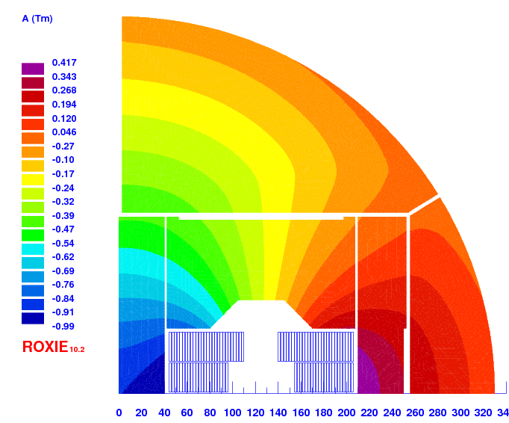
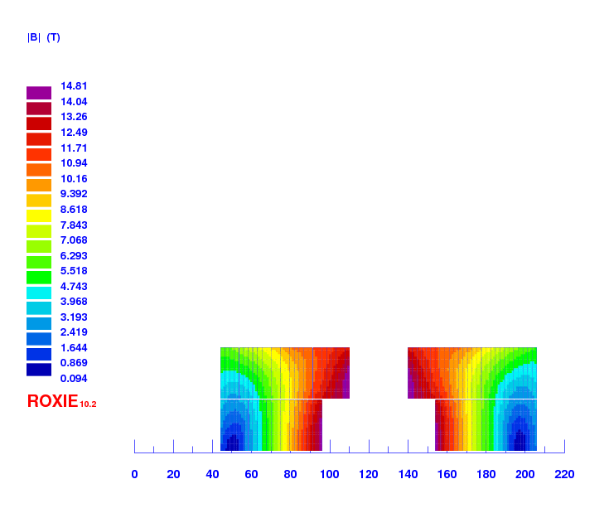
Starting point – v207
 |  | v207
strand diameter | mm | 1.1
Cu/SC | -- | 0.9
# of strands/cable | -- | 44
# turns/quadrant | -- | 50
Eq. coil width | mm | 56
I_{nom} | A | 20120
J_{overall} | A/mm² | 325
J_{cu} | A/mm² | 1016
J_{sc} | A/mm² | 914
Ratio Bp/Bo | -- | 1.05
B₀ at I_{nom} | T | 14.00
B_{p} at I_{nom} | T | 14.76
B_{ss} | T | 18.03

Slide 4
Iron v4

Slide 5
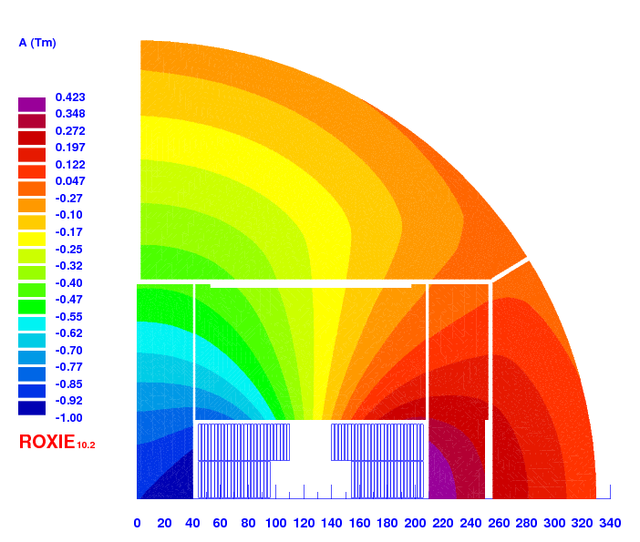
Iron v5

Slide 6
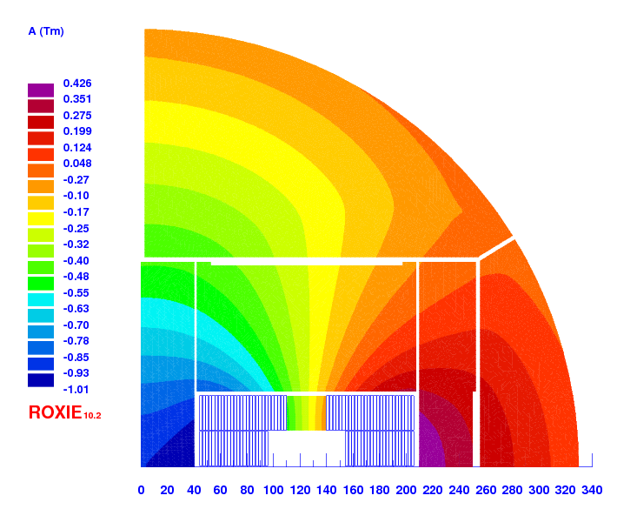
Iron v6

Slide 7
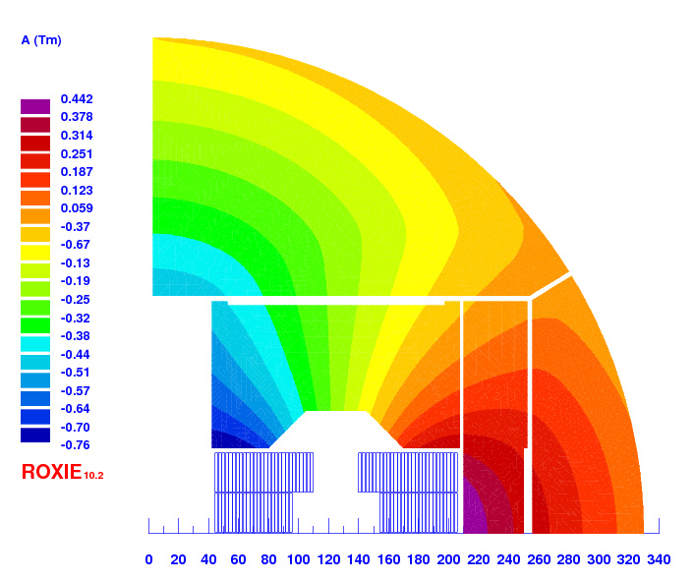
Iron v7

Slide 8
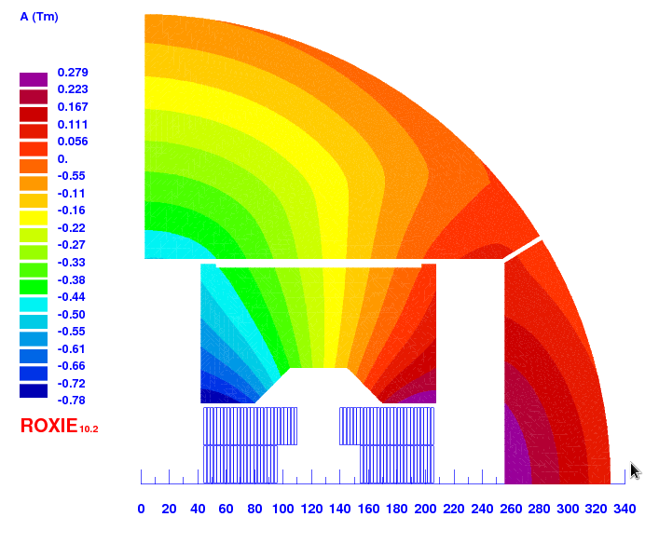
Iron v8

Slide 9
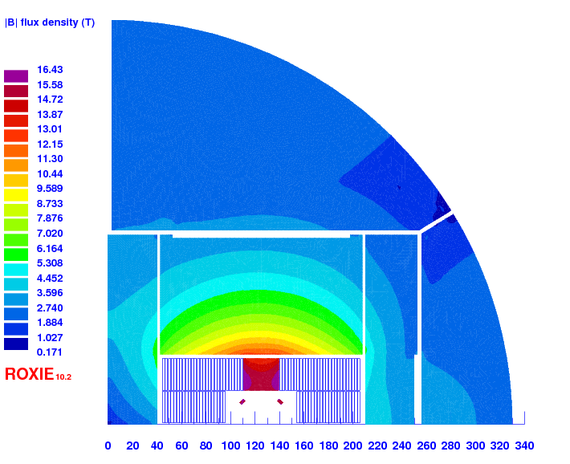
Iron v9
2 mm shims in the aperture

Slide 10
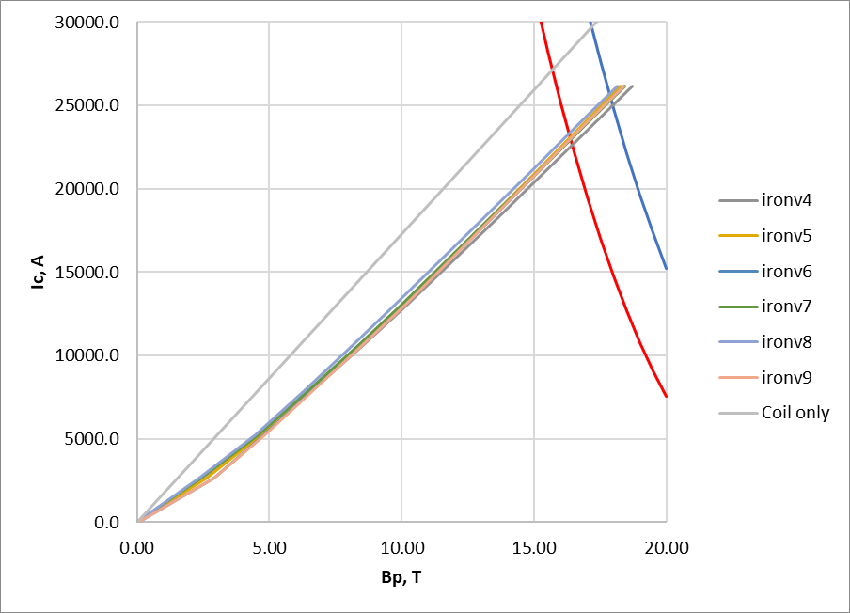
Load lines

Slide 11
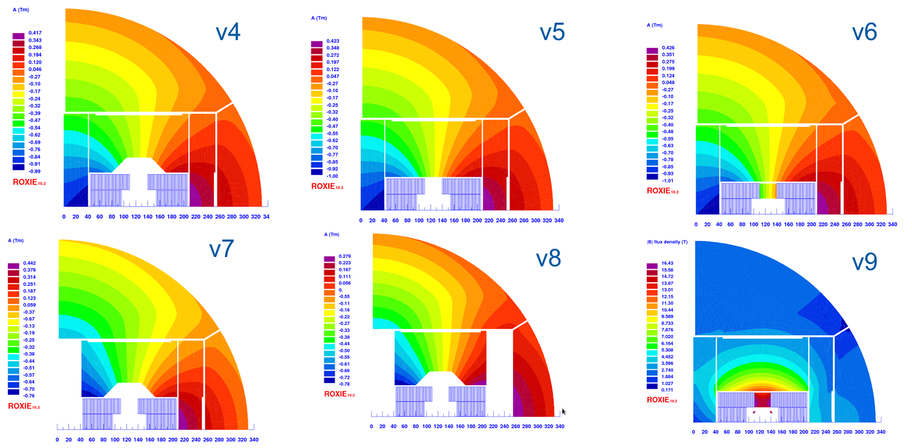
Let’s better put numbers in a table
I assume a nominal field of 14 T
I assume an increase of energy from injection to collision of 15 (similar to the baseline FCC, 3.3 TeV for 50 TeV collision)
 | I (A) | B0 | Bp | Bss | Bp/B0 | Bp/Bss [%] | Δb2 | Δb3 | Δb5 | Δb7
Coil only | 24664 | 14.00 | 14.93 | 15.68 | 1.067 | 95.3 | 0.0 | 0.0 | 0.0 | 0.0
iron v4 | 20027 | 14.00 | 14.76 | 17.97 | 1.054 | 82.1 | -24.8 | -3.7 | 5.8 | 0.3
iron v5 | 19633 | 14.00 | 14.81 | 17.87 | 1.058 | 82.9 | -24.4 | 124.4 | 0.6 | 0.5
iron v6 | 19116 | 14.00 | 13.94 | 17.90 | 0.996 | 77.9 | -22.8 | 741.4 | -27.8 | -24.3
iron v7 | 20526 | 14.00 | 14.81 | 17.90 | 1.058 | 82.7 |  | -9.8 | 5.9 | 0.3
iron v8 | 20920 | 14.00 | 14.85 | 17.85 | 1.061 | 83.2 | -26.2 | -10.5 | 5.8 | 0.3
iron v9 | 19112 | 14.00 | 13.97 | 17.90 | 0.998 | 78.1 | -23.0 | 477.4 | -25.3 | 117.2

Slide 12
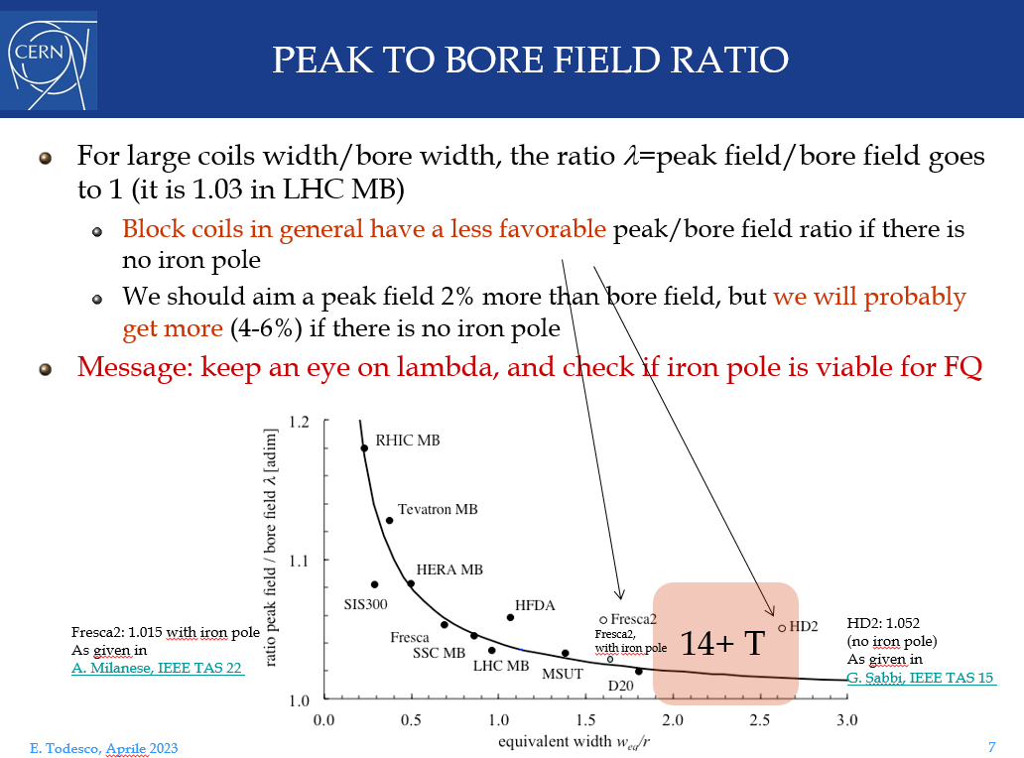
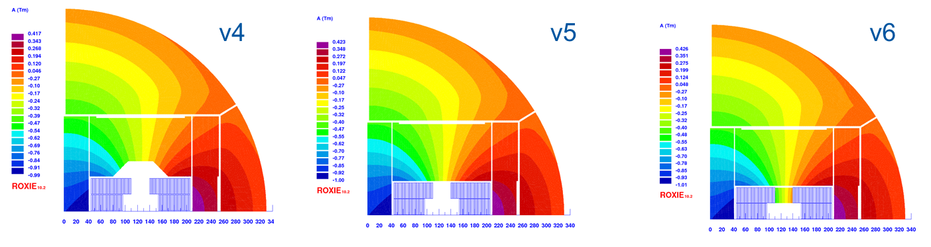
Peak to bore field ratio
5.4 % enhancement with the ‘good field quality solution’
The insert in the pad is not helping to improve the ratio peak field bore field (v5 has 5.8 % enhancement), and adds 100 units of b₃ in saturation
What helps enormously is the iron pole, but is > 700 units of b₃ from injection to nominal
 | I (A) | B0 | Bp | Bss | Bp/B0 | Bp/Bss [%] | Δb2 | Δb3 | Δb5 | Δb7
Coil only | 24664 | 14.00 | 14.93 | 15.68 | 1.067 | 95.3 | 0.0 | 0.0 | 0.0 | 0.0
iron v4 | 20027 | 14.00 | 14.76 | 17.97 | 1.054 | 82.1 | -24.8 | -3.7 | 5.8 | 0.3
iron v5 | 19633 | 14.00 | 14.81 | 17.87 | 1.058 | 82.9 | -24.4 | 124.4 | 0.6 | 0.5
iron v6 | 19116 | 14.00 | 13.94 | 17.90 | 0.996 | 77.9 | -22.8 | 741.4 | -27.8 | -24.3
iron v7 | 20526 | 14.00 | 14.81 | 17.90 | 1.058 | 82.7 |  | -9.8 | 5.9 | 0.3
iron v8 | 20920 | 14.00 | 14.85 | 17.85 | 1.061 | 83.2 |  | -10.5 | 5.8 | 0.3
iron v9 | 19112 | 14.00 | 13.97 | 17.90 | 0.998 | 78.1 | -23.0 | 477.4 | -25.3 | 117.2

Slide 13
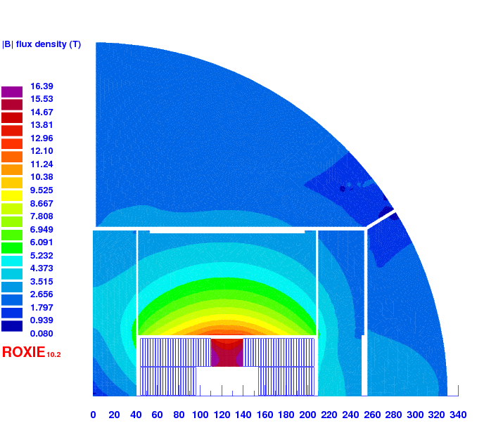
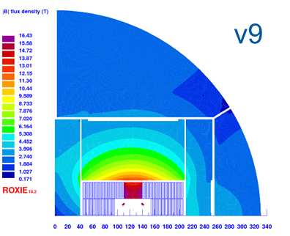
Peak to bore field ratio
2 mm thick iron shims in the aperture can fix 260 units out of 740 units, with negligible impact in Bp/B0
  At least two shims per quadrant needed if we don’t want other harmonics to get very high
One could try to further reduce optimizing the shape of the pole
  My feeling is that it would be very hard to get < 200 units of Δb₃ saturation. Is it something to explore?
v6
 | I (A) | B0 | Bp | Bss | Bp/B0 | Bp/Bss [%] | Δb2 | Δb3 | Δb5 | Δb7
Coil only | 24664 | 14.00 | 14.93 | 15.68 | 1.067 | 95.3 | 0.0 | 0.0 | 0.0 | 0.0
iron v4 | 20027 | 14.00 | 14.76 | 17.97 | 1.054 | 82.1 | -24.8 | -3.7 | 5.8 | 0.3
iron v5 | 19633 | 14.00 | 14.81 | 17.87 | 1.058 | 82.9 | -24.4 | 124.4 | 0.6 | 0.5
iron v6 | 19116 | 14.00 | 13.94 | 17.90 | 0.996 | 77.9 | -22.8 | 741.4 | -27.8 | -24.3
iron v7 | 20526 | 14.00 | 14.81 | 17.90 | 1.058 | 82.7 |  | -9.8 | 5.9 | 0.3
iron v8 | 20920 | 14.00 | 14.85 | 17.85 | 1.061 | 83.2 |  | -10.5 | 5.8 | 0.3
iron v9 | 19112 | 14.00 | 13.97 | 17.90 | 0.998 | 78.1 | -23.0 | 477.4 | -25.3 | 117.2

Slide 14
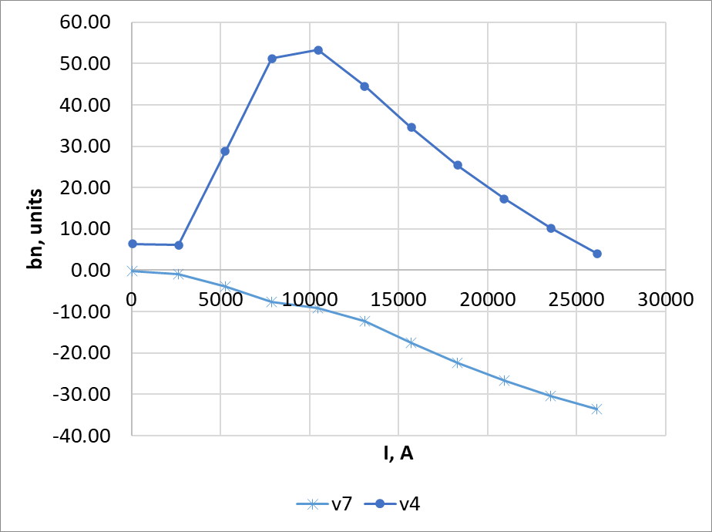
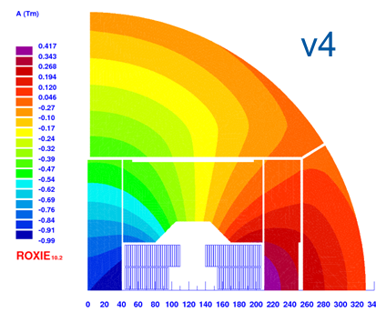
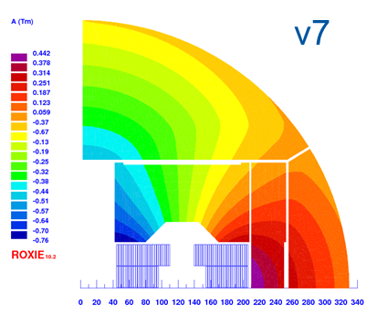
Peak to bore field ratio
If for mechanical reasons, it is a problem to have iron in between apertures, the price to remove is not very expensive:
  We increase the Bp/Bo ratio from 1.054 to 1.058, and we lose 0.6 % of margin in the load line
  +20 units of b2 (cross talk)
 | I (A) | B0 | Bp | Bss | Bp/B0 | Bp/Bss [%] | Δb2 | Δb3 | Δb5 | Δb7
Coil only | 24664 | 14.00 | 14.93 | 15.68 | 1.067 | 95.3 | 0.0 | 0.0 | 0.0 | 0.0
iron v4 | 20027 | 14.00 | 14.76 | 17.97 | 1.054 | 82.1 | -24.8 | -3.7 | 5.8 | 0.3
iron v5 | 19633 | 14.00 | 14.81 | 17.87 | 1.058 | 82.9 | -24.4 | 124.4 | 0.6 | 0.5
iron v6 | 19116 | 14.00 | 13.94 | 17.90 | 0.996 | 77.9 | -22.8 | 741.4 | -27.8 | -24.3
iron v7 | 20526 | 14.00 | 14.81 | 17.90 | 1.058 | 82.7 | -50 | -9.8 | 5.9 | 0.3
iron v8 | 20920 | 14.00 | 14.85 | 17.85 | 1.061 | 83.2 |  | -10.5 | 5.8 | 0.3
iron v9 | 19112 | 14.00 | 13.97 | 17.90 | 0.998 | 78.1 | -23.0 | 477.4 | -25.3 | 117.2

Slide 15
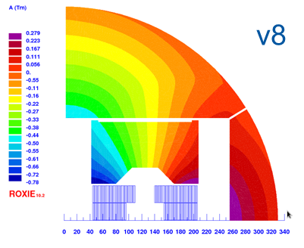
Peak to bore field ratio
If we also remove the iron form the horizontal pad, we increase a bit more the Bp/B0 ratio, and loose another 0.5 % margin
Also the fringe field will be large (didn’t check)
 | I (A) | B0 | Bp | Bss | Bp/B0 | Bp/Bss [%] | Δb2 | Δb3 | Δb5 | Δb7
Coil only | 24664 | 14.00 | 14.93 | 15.68 | 1.067 | 95.3 | 0.0 | 0.0 | 0.0 | 0.0
iron v4 | 20027 | 14.00 | 14.76 | 17.97 | 1.054 | 82.1 | -24.8 | -3.7 | 5.8 | 0.3
iron v5 | 19633 | 14.00 | 14.81 | 17.87 | 1.058 | 82.9 | -24.4 | 124.4 | 0.6 | 0.5
iron v6 | 19116 | 14.00 | 13.94 | 17.90 | 0.996 | 77.9 | -22.8 | 741.4 | -27.8 | -24.3
iron v7 | 20526 | 14.00 | 14.81 | 17.90 | 1.058 | 82.7 | -50 | -9.8 | 5.9 | 0.3
iron v8 | 20920 | 14.00 | 14.85 | 17.85 | 1.061 | 83.2 |  | -10.5 | 5.8 | 0.3
iron v9 | 19112 | 14.00 | 13.97 | 17.90 | 0.998 | 78.1 | -23.0 | 477.4 | -25.3 | 117.2

Slide 16
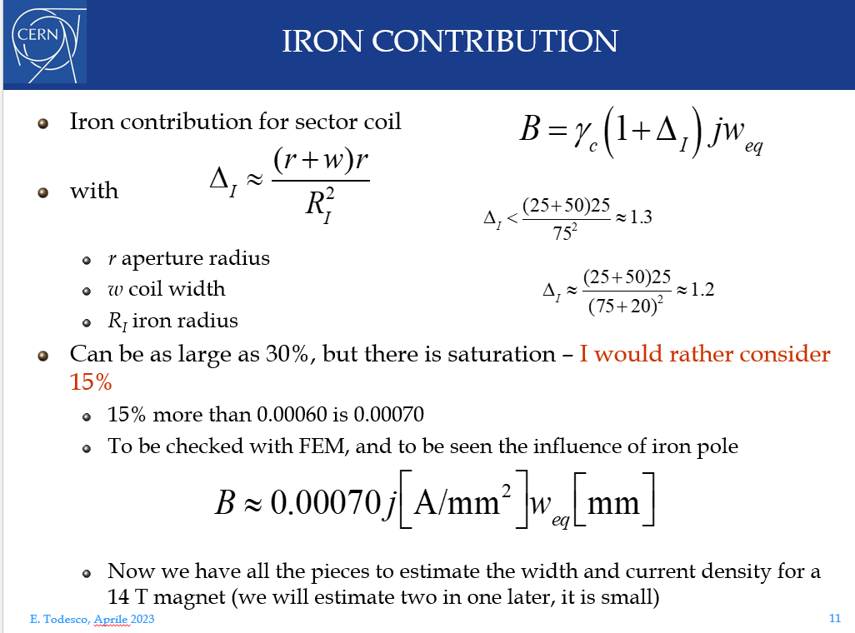
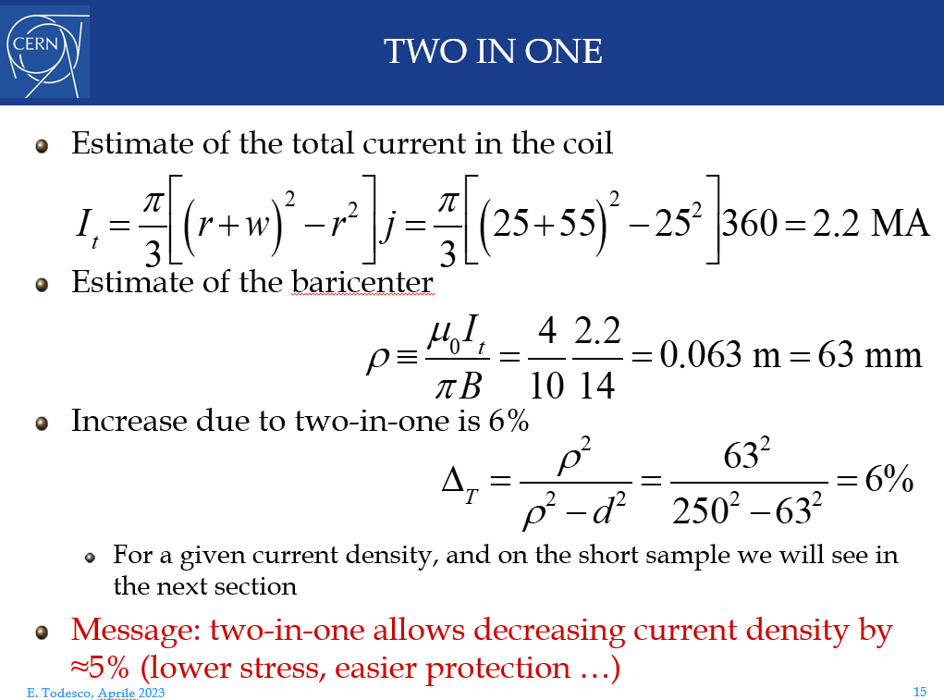
Iron and 2 in 1 contribution
Fr Ezioom:
  +15 % due to iron saturation
  + 5 % from 1in1 to 2in1
What I get:
  With the same current, the single coil produces 19 % field less than the 2in1 magnet with iron, so Ezio is right and accurate ☺
  To produce the same field, the magnet needs 23 % more current and operates with 13 % less margin in the load line
  If we place ourselves at the same margin of the load line, the current is 6 % higher and the field 14 % lower
 | I (A) | B0 | Bp | Bss | Bp/B0 | Bp/Bss [%]
Coil only | 24664 | 14.00 | 14.93 | 15.68 | 1.067 | 95.3
iron v4 | 20027 | 14.00 | 14.76 | 17.97 | 1.054 | 82.1
Coil only | 20070 | 11.39 | 12.15 | 15.68 | 1.067 | 77.5
Coil only | 21268 | 12.07 | 12.88 | 15.68 | 1.067 | 82.1

Slide 17
Conclusion
The best is to put as much iron as possible ☺
It would be interesting to take a look to the magnetic measurements of FRESCA2 and RMM, to see the role of the pole

Slide 18
v4
v5
v6
v7
v8
v9
 | I (A) | B0 | Bp | Bss | Bp/B0 | Bp/Bss [%] | Δb2 | Δb3 | Δb5 | Δb7
Coil only | 24664 | 14.00 | 14.93 | 15.68 | 1.067 | 95.3 | 0.0 | 0.0 | 0.0 | 0.0
iron v4 | 20027 | 14.00 | 14.76 | 17.97 | 1.054 | 82.1 | -24.8 | -3.7 | 5.8 | 0.3
iron v5 | 19633 | 14.00 | 14.81 | 17.87 | 1.058 | 82.9 | -24.4 | 124.4 | 0.6 | 0.5
iron v6 | 19116 | 14.00 | 13.94 | 17.90 | 0.996 | 77.9 | -22.8 | 741.4 | -27.8 | -24.3
iron v7 | 20526 | 14.00 | 14.81 | 17.90 | 1.058 | 82.7 |  | -9.8 | 5.9 | 0.3
iron v8 | 20920 | 14.00 | 14.85 | 17.85 | 1.061 | 83.2 | -26.2 | -10.5 | 5.8 | 0.3
iron v9 | 19112 | 14.00 | 13.97 | 17.90 | 0.998 | 78.1 | -23.0 | 477.4 | -25.3 | 117.2

