Slide 1
Parametric analysis for 14+ T magnet based on block coils
Ezio Todesco
Technology Department
European Organization for Nuclear Research (CERN)
Acknowledgements to J. C. Perez and S. Izquierdo Bermudez
D. Perini for feedback and discussions

Slide 2
CONTENTS
Previous dipoles based on block coils (see Appendix)
Two features of block coils and main parameters
Sensitivity analysis
Quench protection
Stress induced by electromagnetic forces

Slide 3
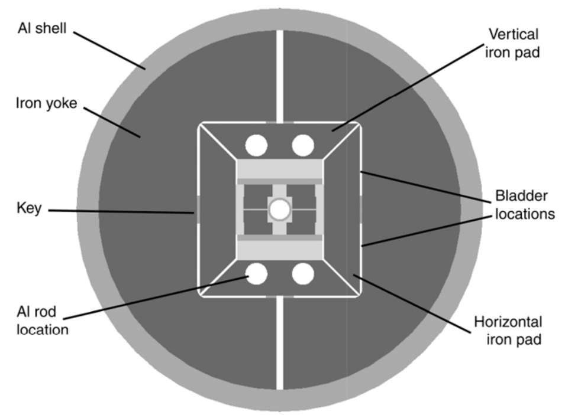
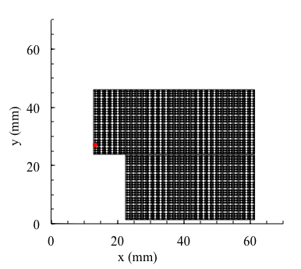
PREVIOUS DIPOLES ON BLOCK COILS
HD2
      13.74 T reached at 4.5 K, never tested at 1.9 K
      35 mm aperture (diameter)
      45 mm equivalent coil width
      480 A/mm² overall current density at 15 T

Slide 4
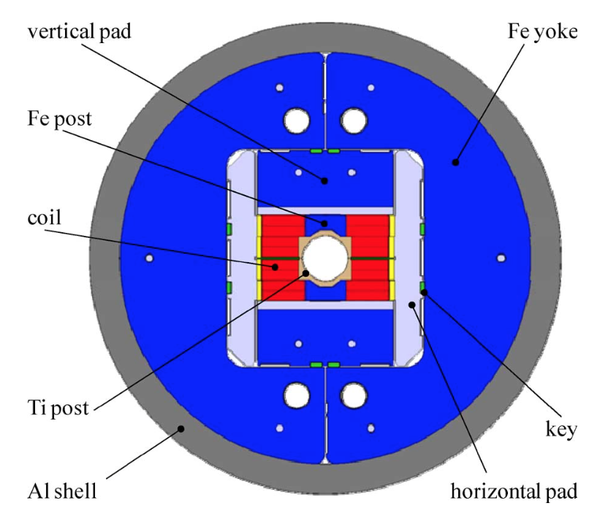
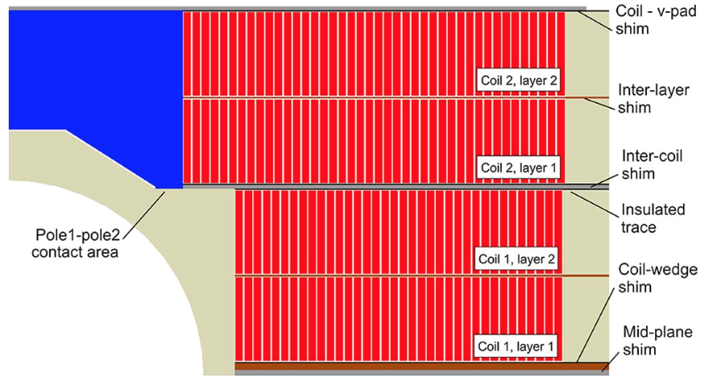
PREVIOUS DIPOLES ON BLOCK COILS
FRESCA2
      14.6 T reached at 1.9 K
      100 mm aperture
      80 mm equivalent coil width
      220 A/mm² overall current density at 13 T

Slide 5
CONTENTS
Previous dipoles based on block coils
Two features of block coils and main parameters
Sensitivity analysis
Quench protection
Stress induced by electromagnetic forces

Slide 6
TWO FEATURES OF BLOCK COILS
AND MAIN PARAMETERS
Plan of this section:
Two specific features of block coils, that make them different from cos theta coils
  The ratio between peak field and bore field
  Coil efficiency
Parameters of magnetic design
  The iron contribution
  A proposal on how much to share the 14 T between coil width and current density
  The two in one effect

Slide 7
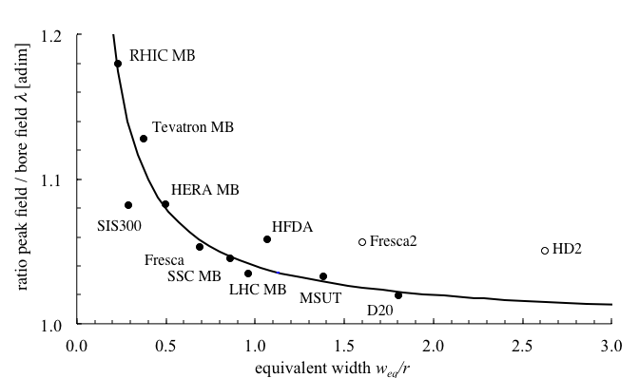
PEAK TO BORE FIELD RATIO
For large coils width/bore width, the ratio λ=peak field/bore field goes to 1 (it is 1.03 in LHC MB)
  Block coils in general have a less favorable peak/bore field ratio if there is no iron pole
  We should aim a peak field 2% more than bore field, but we will probably get more (4-6%) if there is no iron pole
Message: keep an eye on lambda, and check if iron pole is viable for FQ
Fresca2: 1.015 with iron pole
As given in
A. Milanese, IEEE TAS 22
Fresca2,
with iron pole
14+ T
HD2: 1.052
(no iron pole)
As given in
G. Sabbi, IEEE TAS 15

Slide 8
ESTIMATE OF COIL EFFICIENCY
For a solenoid of thickesss w
  μ₀ is the coil efficiency: ratio between overall current density and coil width
  In practical units (w in mm, j in A/mm²), efficiency is
  4π10⁻⁴ T/(A/mm) = 0.00126 T/(A/mm)
For a cosθ dipole
  B=μ₀jw/2
  Efficiency is 0.000628 T/(A/mm)
  For a 60 degrees coil 0.000693 T/(A/mm)
  For a sector coil with wedges and field quality efficiency is 0.00066 T/(A/mm)
Question: what can we expect for blocks?

Slide 9
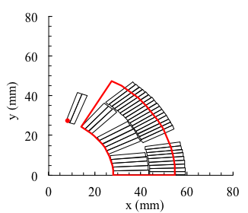
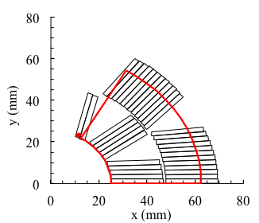
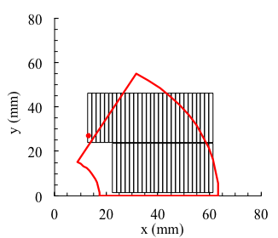
EQUIVALENT COIL WIDTH DEFINITION
Equivalent coil width is defined as the width of the sector coil that has the same quantity of conductor of the actual coil – needed to account for wedges and non sector coils
  LHC dipole: 27 mm
  FalconD and 12 T: 37-40 mm
  D20 and HD2: 45-46 mm
  FrescaII: 80 mm
LHC MB
FalconD
HD2

Slide 10
COIL EFFICIENCY
Coil efficiency γ_{c} is defined as the the field divided by overall current density (over insulated coil) and equivalent coil width
  For naked sector coils: γ_{c}=0.00066 T/(A/mm)
  Tevatron: 0.00069 (removing iron)
  LHC MB and MBPCT1: 0.00066 (removing iron and grading)
For block coils the efficiency is about 10% lower, we can expect 0.00060 from previous designs
  γ_{c}=0.00059 T/(A/mm) for HD2 (removing iron)
  γ_{c}=0.00061 T/(A/mm) for FrescaII (removing iron)
Message: keep an eye on the efficiency, it will be probably lower than in a sector coil …
  (see my Covid-19 Lecture notes chapter 4, for the whole discussion on coil efficiency, in particular section 4.4 and 4.5) https://indico.cern.ch/event/1274005/

Slide 11
IRON CONTRIBUTION
Iron contribution for sector coil
with
  r aperture radius
  w coil width
  R_{I} iron radius
Can be as large as 30%, but there is saturation – I would rather consider 15%
  15% more than 0.00060 is 0.00070
  To be checked with FEM, and to be seen the influence of iron pole
  Now we have all the pieces to estimate the width and current density for a 14 T magnet (we will estimate two in one later, it is small)

Slide 12
COIL WIDTH SELECTION
Since one has
To get 14 T:
With 50 mm coil width, you need ∼400 A/mm²
With 55 mm coil width, you need ∼360 A/mm²
With 60 mm coil width, you need ∼320 A/mm²
  Note: MQXF has 460 A/mm², 11 T has 530 A/mm²
Message: current density is 10-20% than in MQXF

Slide 13
SOMETHING MORE ABOUT COIL EFFICIENCY
25 mm aperture and 55 mm coil width: cross-sectional surface of
  If the cable width is 25 mm, one get two layers of about 60 mm
  Having a longer block in the midplane gives more field
  Message: do we really have to align the two decks as in HD2, Fresca2, RMM ?
(cosθ)/ρ=0.89/84=0.0106
(cosθ)/ρ=0.99/82.5=0.0120
50
25
27°
8.6°
25
80

Slide 14
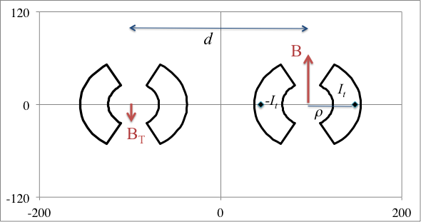
IMPACT OF TWO IN ONE ON ELECTROMAGNETIC DESIGN
Two in one brings an additional, positive contribution to coil efficiency (as iron)
A very rough estimate is
  Where d is the inter-beam distance and ρ is the baricenter of the coils
  (see next slide and chapter 9.7 of notes in https://indico.cern.ch/event/1274005/
  the estimate is rather optimistic (i.e. it overestimate the real contribution since the sector is collapsed in the plane)

Slide 15
IMPACT OF TWO IN ONE ON ELECTROMAGNETIC DESIGN
Estimate of the total current in the coil
Estimate of the baricenter
Increase due to two-in-one is 6%
  For a given current density, and on the short sample we will see in the next section
Message: two-in-one allows decreasing current density by ≈5% (lower stress, easier protection …)

Slide 16
LOADLINE FRACTION AND SHORT SAMPLE
LHC dipole: 86% at 8.3 T and 7 TeV
  But they work today at 83.5%, 6.8 TeV
MQXF: 77% (7 TeV)
  These fractions computed on specified cable critical current, the production is better
I would place the magnet at 80% of short sample
  14/0.8=17.5 T short sample
  Note for FCC the target was 16 at 86%, i.e. 18.6 T (1 more tesla, D. Tommasini, et al., IEEE TAS 28)
  RMM reached 16.7 T peak field (E. Gautheron, et. al IEEE TAS 23)

Slide 17
LOADLINE FRACTION AND SHORT SAMPLE
To operate at 14 T, short models should reach systematically more … how much ?
  For LHC and HL LHC magnets, an ultimate was defined (7% more; corresponding to 7.5 TeV operation)
  For MQXF, with 11.3 T peak field, this means 12.1 T – it went systematically up to 13 T and above (6 out of 7 models)
  For 14 T, we should have the possibility of testing at least up to 15 T – this has implications on current (is it possible to go above 20 kA?) and on protection and mechanics
  Message: define an ultimate as in the LHC and as in HL LHC at 7.5 TeV operation (7% more than nominal), corresponding to 15 T
  The structure and the protection of the short models should be designed to go up to short sample

Slide 18
CONTENTS
Previous dipoles based on block coils
Main parameters
Sensitivity analysis
Quench protection
Stress induced by electromagnetic forces

Slide 19
CONTENTS
The Factor X: ratio between critical surface slope and loadline slope
  This quantity is important since it rules the parametric dependence
  In the plot, factor X is 1 – this is the case of magnet with thin coils as MCBXF
Critical surface
X=1
Loadline

Slide 20
CONTENTS
The Factor X: ratio between critical surface slope and loadline slope
  This quantity is important since it rules the parametric dependence
  Typically high field magnets have X>1
  Property of the design but also of the superconductor
Critical surface
Loadline
X=2

Slide 21
CONTENTS
The Factor X: ratio between critical surface slope and loadline slope
  If you add cable width, so to lower the loadline, you gain much less in short sample …
  You can compute how much exactly for a linear case
  See seminar in July my Covid-19 Lecture notes chapter 8 and 9, for the whole discussion on coil efficiency) https://indico.cern.ch/event/1274005/
Critical surface
X=2
Loadline

Slide 22
FACTOR X
The factor X is an analytical tool to estimate the sensitivity of short sample on magnet parameters
  Geometrically, is defined as the slope of the critical surface divided by the slope of the loadline
  It is an adimensional parameter
  κ: fraction of sc in the insulated coil
  s: slope of the sc critical surface
  w_{eq}: equivalent coil width
  γ_{c}: coil efficiency, see previous slides
  Δ_{I}: iron contribution
Factor X is 1-1.5 for magnets with 10-mm-coil widths like RHIC or MCBXF
Factor X is around 3.7 for LHC dipoles (28 mm coil width)

Slide 23
FACTOR X
The larger is X, the less you gain in short sample field improving the design by
  Adding conductor (more coil width w_{eq})
  Adding superconductor (increasing the sc fraction in the strand κ)
  Improving the critical surface (increasing the slope s)
  (see notes chapters 8 and 9)
  For LHC dipole, increasing the cable width or the critical current, or the sc content, by 20%, you gain in short sample only 20%/(1+3.7), i.e. 4%
  How much is the factor X for 14+ T dipole?

Slide 24
FACTOR X
Slope at 17.5 T: 250 (A/mm²)/T
  Every additional tesla you lose 250 A/mm²
  This is half of the slope of Nb-Ti
Filling factor: fraction of sc in the insulated cable
  With 0.9 Cu fraction, 1.1 mm diameter and 0.15 mm insulation: 0.36
  With 0.9 Cu fraction, 1.0 mm diameter and 0.15 mm insulation: 0.34
  With 1.2 Cu fraction, 0.85 mm diameter and 0.15 mm insulation: 0.29
Coil width: let us take 55 mm
Iron contribution: 15%
Factor X is around 3.2

Slide 25
SENSITIVITY ANALYSIS
Dependence on strand critical current
  A gain of 10% in critical current gives 10%/4.2=2.4% more short sample field (0.4 T)
Dependence on coil width
  Increasing 9% coil width from 55 to 60 mm you gain 2.2% in short sample (0.4 T) – that is you have 2% more margin on the loadline
  Decreasing 10% coil width from 55 to 50 mm you lose 2.4% in short sample (0.4 T) – that is you have 2% less margin on the loadline
Dependence on copper ratio of the strand
  Going from the 1.0 mm strand with 0.9 copper ratio to MQXF strand (0.85 mm with 1.2 copper):
  Filling factor lowers from 0.34 to 0.29 (-15%)
  You lose in short sample 15%/4.2=3.5%, i.e. 0.6 T, i.e. 3% on margin on the loadline

Slide 26
SENSITIVITY ANALYSIS
Dependence on λ: quite different
  Nearly whatever you gain in λ you get in short sample
  In our case, if we manage to reduce the ratio peak field/bore field of 2%, we gain 1.6% of margin on the loadline!
Message: try to reduce the ratio peak field/bore field as much as possible
Message: we are in a domain where any increase of the slope of the loadline, or any gain in critical surface, is weighted by one fourth

Slide 27
CONTENTS
Previous dipoles based on block coils
Main parameters
Sensitivity analysis
Quench protection
Stress induced by electromagnetic forces

Slide 28
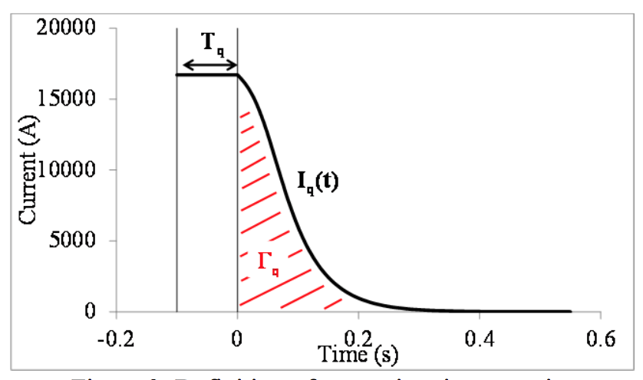
QUENCH PROTECTION
Time margin definition: time needed to quench all superconductor from the beginning of quench not to exceed T_{max}
  I₀: nominal current
  Γ_{q}= quench integral of the magnet fully quenched
  Γ(T_{max})= MIITs of the cable (depending on specific heats, resistivity, and copper quantity)

Slide 29
QUENCH PROTECTION
Limits on time margin
  LHC dipoles have a time margin of 100-200 ms (outer/inner layer)
  HL-LHC Nb₃Sn magnets (MQXF and 11 T) have 40 ms
  40 ms for T_{max}=350 K was set as target for protection for FCC T. Salmi, et al., IEEE TAS 2019
Estimate of time margin
  ν: copper to SC ratio
  j₀: overall current density
  U_{d}: energy density in the insulated coil
  H_{ave}: average enthalpy of insulated coil (over material)
  ρ: average resistivity of copper (over temperature)

Slide 30
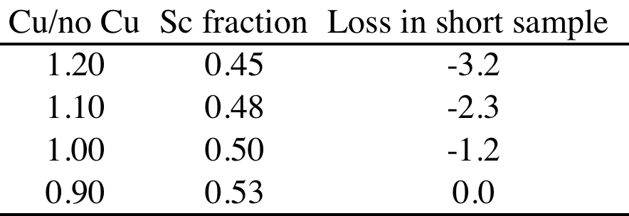
QUENCH PROTECTION
14+T versus MQXF
  ν from 1.2 to 0.9 (-25%)
  j₀ from 480 to 360 (55 mm case) :
Message: with 0.9 copper ratio and 55 mm coil width, the protection will be easier than in MQXF
  This is due to the lower current density w.r.t. MQXF
Sensitivity of short sample on Cu fraction, assuming 0.9 as baseline

Slide 31
CONTENTS
Previous dipoles based on block coils
Main parameters
Sensitivity analysis
Quench protection
Stress induced by electromagnetic forces

Slide 32
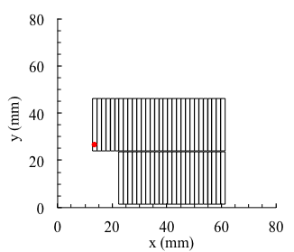
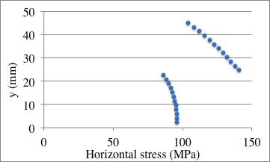
STRESS
With block coils, the accumulation of azimuthal stress is removed – we are left with radial (horizontal) stress
Case of HD2 at 14 T – ironless
  Peak of 140 MPa on upper deck, if iron gives 10% this allowed reducing the current and the peak goes to 125 MPa
    Not so far from HL LHC values
140 MPa
100 MPa

Slide 33
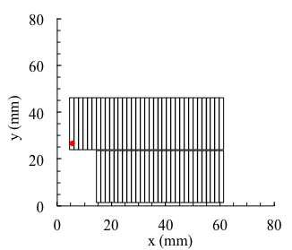
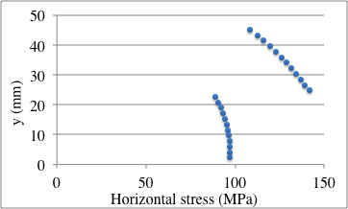
STRESS
Contrary to the azimuthal stress, the radial stress does not decrease when having lower current densities
Cross-check adding 10 turns to HD2 and keeping the 14 T target in an ironless configuration (this part to be updated)
  Current reduces from 18.5 kA to 15.0 kA, so 20% less current density, but same values of accumulation of horizontal stress
140 MPa
100 MPa

Slide 34
STRESS
Message: at 14 T, with 10% from iron, we should have 125 MPa accumulation of horizontal stress in the lower part of the upper deck
This stress is not dependent on current density – so more turns will not help to reduce this value
14 T, with 10% from iron
~125 MPa
~90 MPa

Slide 35
APPENDIX
Previous dipoles based on block coils and flared ends (see Appendix)

Slide 36

LNBL HD2
Scope: R&D Nb₃Sn magnet based on block coils
  Name: HD2
  Reference field: 15 T*
  Design: LBNL
  Production: LBNL
  Period: 2005-2010
  Units: one short model HD2
    a-b-c tests, plus d-e without cold bore,
    i.e. with 43 mm aperture
  Length: 1 m
  Material: Nb₃Sn
  Op. temperature: tested only at 4.5 K
  Aperture diameter: 35 mm
    Including the inner structure
  Outer diameter: 600 mm
    Note: reference field not defined, papers establish a target of 15.0 T bore field
    13.74 T reached at 4.5 K
    A second iteration on the design was done, named HD3 (2010-2014)

Slide 37
LNBL HD2
Main features
  A dipole with accelerator features based on blocks
  No wedges needed in the coil
  Two layer coil, limiting the free aperture at 35 mm
  Saddle ends to give space to the aperture
    A similar paradigm adopted for FrescaII, but with four layers (no wedges, saddle ends

Slide 38
LNBL HD2
Strand diameter | (mm) | 0.800
Filament size | (μm)
N strands |  | 51
Cu/No_cu |  | 0.95
Critical current density | (A/mm²) | 1250 (16 T, 4.22 K)
Cable width | (mm) | 22
Eq. coil width | (mm) | 45.9
Cable mid thickness | (mm) | 1.400
Keystone angle | (°) | 0.000
N. turns |  | 54
N. blocks |  | 2
Insul. thickness (az/radial) | (mm) | 0.11/0.11

Slide 39

LNBL HD2
Main parameters
  Current: 17400 A
  Loadline fraction: 0.96 (4.5 K)
  0.88 (1.9 K)*
  Temperature margin: --
  Equivalent coil width: 44.1 mm
  Inductance: 5.6 mH
  Stored energy: 0.75 MJ
  Grading: no
  Distance coil to iron: few mm
  Iron contribution to field: 15%
  Saturation: 10%
  Overall current density: 483 A/mm²
  *never tested at 1.9 K

Slide 40
LNBL HD2
Mechanical structure
  Bladder and keys and Al shell
  Iron is very close to the coil (few mm)
  Radial (horizontal) stress: 107/154 MPa (lower/upper deck)
    This estimated via the Fx value given in the literature divided by the cable width
Protection
  Energy extraction and quench heaters

Slide 41
FRESCA2
Scope: dipole for cable test station at CERN
  Name: FRESCA2
  Reference field: 13 T, with 15 T as ultimate
  Design: CERN
  Production: CERN and CEA
  Period: 2012-2019
  Units: one
    Coil replacement
  Length: 1.2 m
  Material: Nb₃Sn
  Op. temperature: 1.9 K
  Aperture diameter: 100 mm
  Outer diameter: 1030 mm
    14.6 T reached

Slide 42
FRESCA2
Main features
  Unprecedented coil width (80 mm equivalent)
  Very low overall current density to achieve the 13 T target (220 A/mm²)
  A large aperture dipole with accelerator features based on blocks
  No wedges needed in the coil
  Four layers coil, required by the large aperture of 50 mm
  Saddle ends to give space to the aperture
    Same paradigm adopted for HD2

Slide 43
FRESCA2
Strand diameter | (mm) | 1.000
Filament size | (μm) | 48
N strands |  | 40
Cu/No_cu |  | 1.3
Critical current density | (A/mm²) | 1400 (15 T, 4.22 K)
Cable width | (mm) | 21.32
Eq. coil width | (mm) | 81.6
Cable mid thickness | (mm) | 1.890
Keystone angle | (°) | 0.000
N. turns |  | 156
N. blocks |  | 4
Insulation thickness (az/radial) | (mm) | 0.200/0.200

Slide 44
FRESCA2
Main parameters
  Current: 10900 A
  Loadline fraction: 0.72
  Temperature margin: 5.8
  Inductance: 50 mH
  Stored energy: 4.6 MJ
  Distance coil to iron: 20 mm
  Iron contribution to field: 15%
  Overall current density: 220 A/mm²

Slide 45
FRESCA2
Mechanical structure
  Bladder and keys and Al shell
  Radial (horizontal) stress: 80/100 MPa (lower/upper deck)
    This estimated via the Fx value given in the literature divided by the cable width
Protection
  Energy density on the insulated coil: 0.122 J/mm³
  Energy extraction and heaters

