Slide 1



Power Update - Winter 2023
Dr. Emanuele Simili HEPiX Benchmarking Working Group meeting 06 December 2023
Notes:
PoW @ HEPiX

Slide 2
Outline
Update on my benchmarks results:
- HEPscore/Watt comparison extended to more machines
- Thread-Scan , Frequency Scan , Open issues
- What Watt: investigating the best estimate of average power
Me vs. the Energy Plug-in
- Testing experience and run strategy
- Plug-in validation (comparison with my exporter tools)
Outlook and next steps
- Collect / consolidate / streamline
- Joining the developers …
…
Notes:
outline

Slide 3
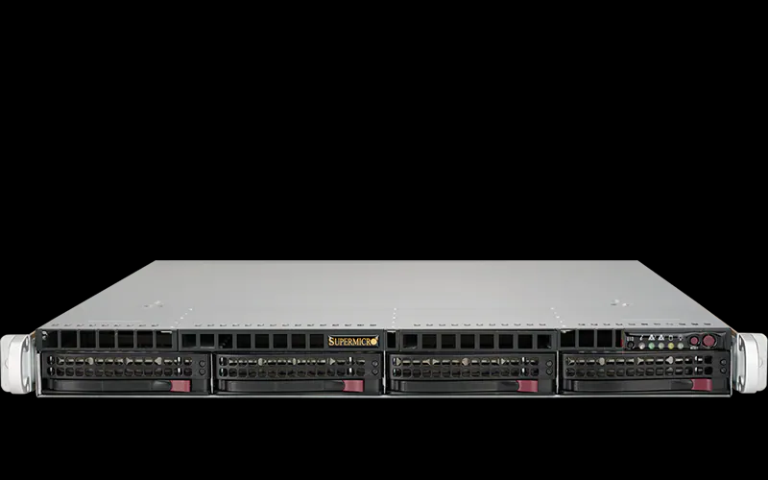
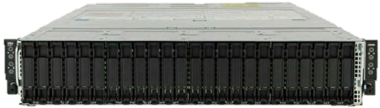
Hardware in-House
AMD48c / AMD96ht: Single AMD EPYC 7003 48-Core Processor (GIGABYTE)
CPU: x86 AMD EPYC 7643 48C/96HT @ 2.3GHz (TDP 225W)
RAM: 256GB (16 x 16GB) DDR4 3200MT/s → 2.7 GB/core
HDD: 3.84TB Samsung PM9A3 M.2 (2280)
OS: CentOS 7.9
1
ARM80c: Single socket Ampere Altra Q80-30 80-Core Processor (GIGABYTE)
CPU: ARM Q80-30 80C @ 3GHz (TDP 210W)
RAM: 256GB (16 x 16GB) DDR4 3200MT/s → 3.2 GB/core
HDD: 3.84TB Samsung PM9A3 M.2 (2280)
OS: CentOS 7.9
1
2xAMD32c / 2xAMD64ht: Dual Socket AMD EPYC 7513 32-Core Processor (DELL)
CPU: 2 * x86 AMD EPYC 7513, 32C/64HT @ 2.6GHz (TDP 200W)
RAM: 512GB (16 x 32GB) DDR4 3200MT/s → 4 GB/core
HDD: 3.84TB SSD SATA Read Intensive
OS: CentOS 7.9
~ 100
2*ARM80c: Dual Socket Ampere Altra Q80-30 80-Core Processor (MegaRAC)
CPU: 2 * ARM Q80-30 80C @ 3GHz (TDP 210W)
RAM: 512GB (32 x 16GB or 16 x 32GB) DDR4 3200MT/s → 3.2 GB/core
HDD: 2 * 1Tb NVMe (INTEL + SAMSUNG)
OS: Rocky 9.2
~ 10
Notes:
MT/s = Mega-Transfers per second (~ twice the MHz frequency)

Slide 4
Tested Remotely
2*AMD256ht: Dual Socket AMD EPYC 9754 128-Core Processor (SuperMicro)
CPU: 2 * x86 AMD EPYC 9754, 128C/256HT @ 3.1GHz (TDP 360W)
RAM: 1.536TB (24 x 64GB) DDR4 3200MT/s → 3 GB/core
HDD: 512GB NVMe + 3.84TB SSD
OS: Rocky 9.2
SuperMicro
ARM128c: Single Socket Ampere Altra Max Q80-28 128-Core Processor (XMA)
CPU: ARM Q128-28 @ 2.8GHz (TDP 250W)
RAM: 512GB (64 x 8GB) DDR4 3200MT/s → 4 GB/core
HDD: 1Tb NVMe Storage
OS: Rocky 8.8 Green Obsidian
XMA
New hardware we are currently testing: AMD Siena (at SuperMicro)
AMD128c: Single Socket AMD EPYC 8534P 64-Core Processor (SuperMicro)
CPU: AMD EPYC 8534P @ 3.1GHz (TDP 200W)
RAM: 576GB (6 x 96GB) DDR5 3200MT/s → 4.5 GB/core
HDD: 1Tb NVMe Storage
OS: Rocky 8.8 Green Obsidian
SuperMicro
Also: we ordered a NVidia Grace (ARM) machine, and we are looking for AmpereOne (not yet available from our vendors).

Slide 5

Latest Results
Notes:
results

Slide 6
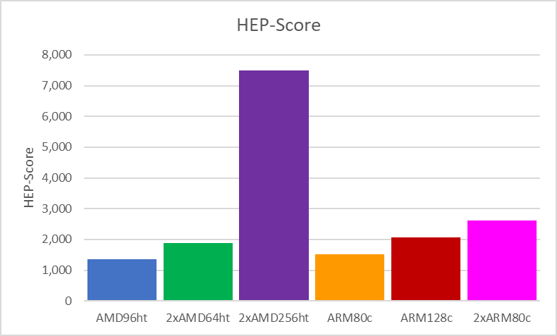
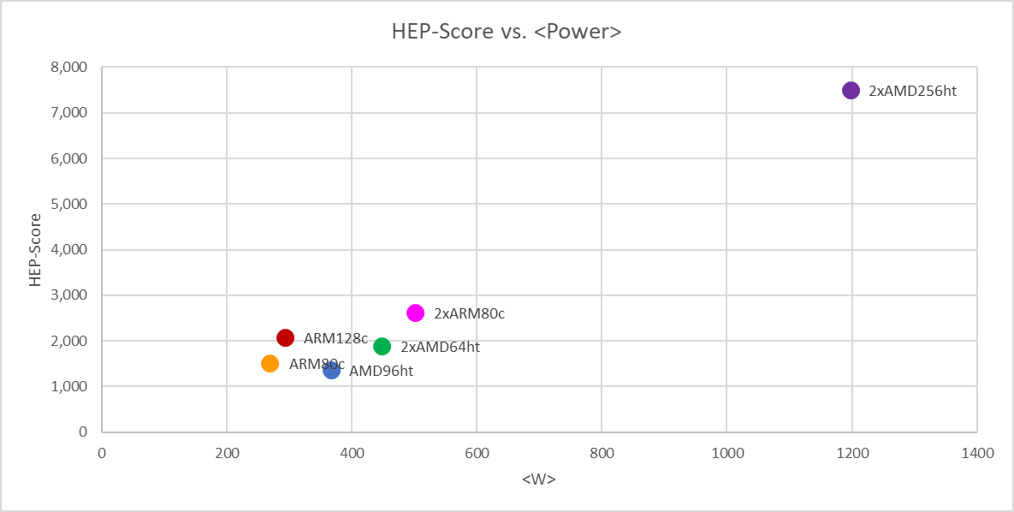
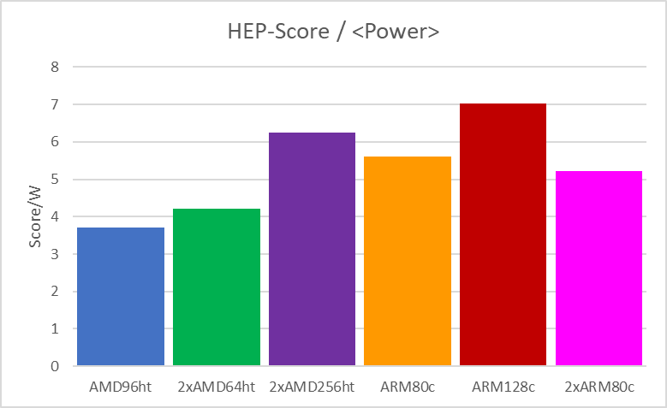
Latest HEPscore/Watt
I had the chance to test a few more machines, and I added them to my comparative charts.
The last one (AMD EPYC Bergamo) slightly increased the scale …

Slide 7
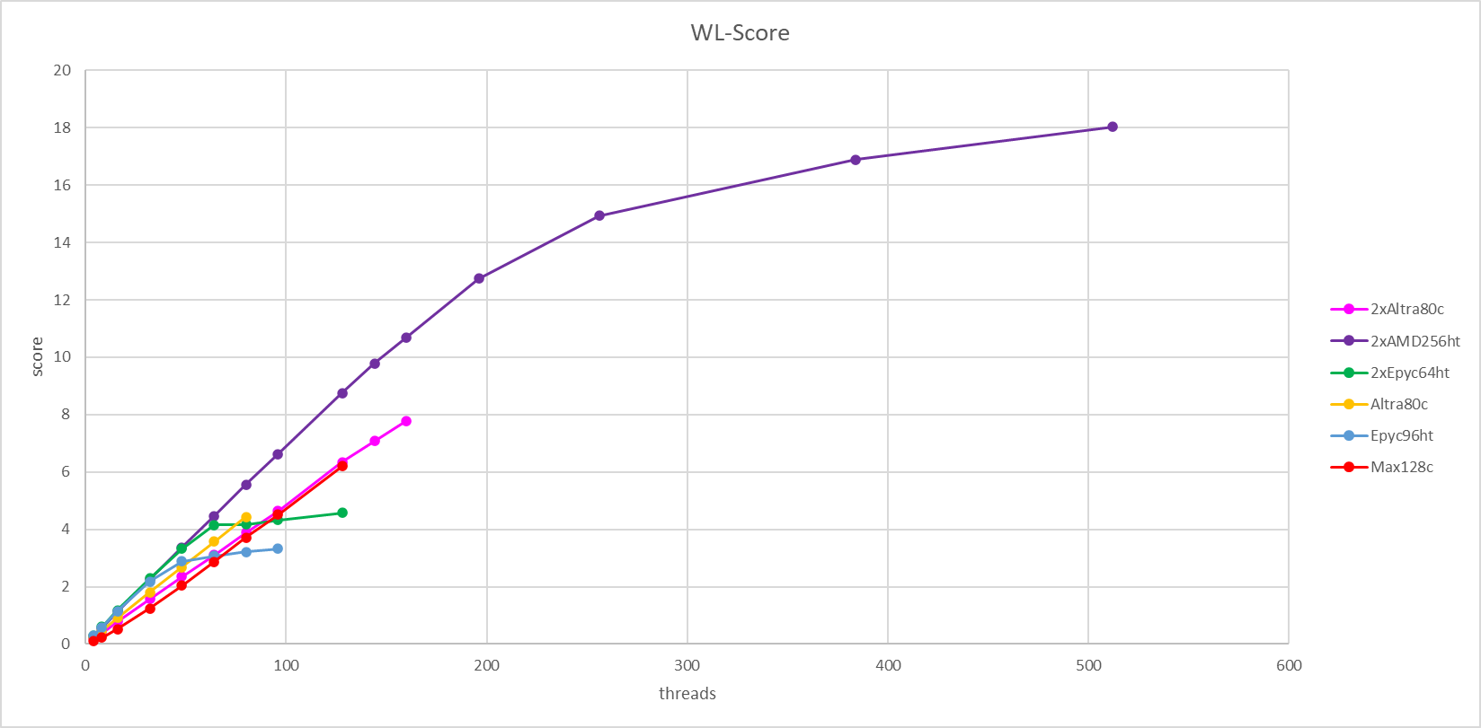
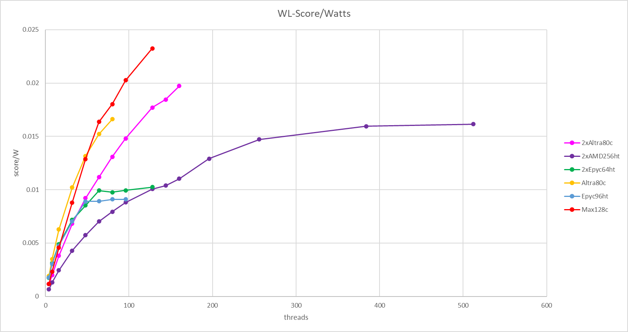
Latest Thread-Scan
I also tried to run my “thread-scan” (where I limit the number of copies of each workload). Not all the workload had a clean run on all machine, but I could save a few …
Here showing one of the few fully successful runs:
cms-gen-sim-run3-ma-bmk
I run each workload separately, with the command:
singularity run -B $(pwd):/results oras://${CONTAINER} -c ${nCP} -t ${nTR} -e ${nEvt}

Slide 8
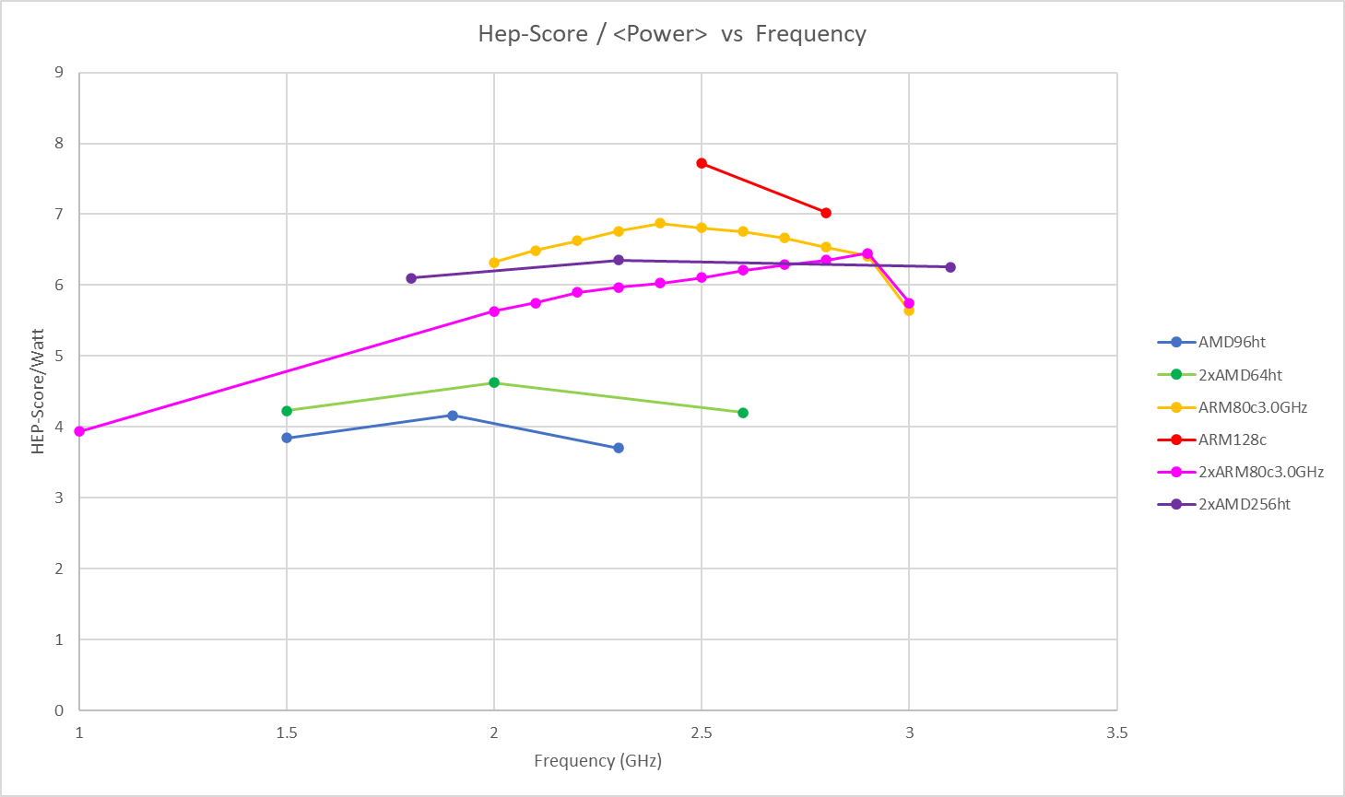
Latest Frequency Throttling
I re-ran the HEPscore benchmark at different frequencies, with a finer step (where possible). This confirmed our previous observation that mid-frequencies gives the best performance per watt …
… but also raised a few more questions:
Why 1*Q80 ≠ 2*Q80 ?
*
Notes:
- only two frequency bins were tested on AltraMax,
- the Bergamo middle point is fleaky* : frequency was not constant during job execution.

Slide 9
Other Results …
Taking a closer look at the HEPscore results, it looks like 1+1<2
not 2x
From the in-house results:
Ampere Altra Q80: DualSocket (2618) = 1.73 * SingleSocket (1513)
From Tommaso (INFN) + in-house results:
Ampere Altra Q128: DualSocket AltraMax (3768) = 1.82 * SingleSocket AltraMax (2064)
We found some study about inter-socket bandwidth as a possible explanation (for ARMs). We don’t know if x86s behave similarly …
- https://www.anandtech.com/show/16979/the-ampere-altra-max-review-pushing-it-to-128-cores-per-socket/3
- https://www.anandtech.com/show/16315/the-ampere-altra-review/3

Slide 10
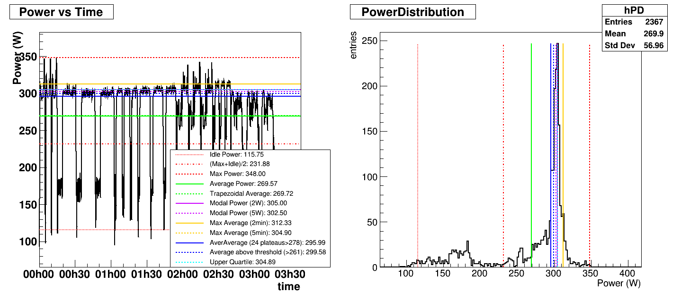
What Watt
We had some discussions about what is the most representative figure for the average Power (watts)
ARM80c
Visually, it is pretty clear what number we want (average plateau or gaussian peak), but I am not sure what statistical tricks I must use to extract it from data …
(Next: looking into K-mean clustering?)
// Idle Power = idleAverage = (idlePower/idleBins) ;
// Max Power = maxPower ;
// (Max+Idle)/2 = halfMaxMin = (maxPower + (idlePower/idleBins))/2. ;
// Average Power = averagePower ;
// Trapezoidal Average = trapzAverage = sumJobPow/sumJobSec ;
// Modal Power (2W) = powMode2 ;
// Modal Power (5W) = powMode5 ;
// Max Average (2min) = maxPow2min ;
// Max Average (5min) = maxPow5min ;
// AverAverage = the average of plateau's averages = averAverage ;
// Power above 75% threshold = powAboveThreshold ;
// Upper Quartile = powQuartile ;

Slide 11
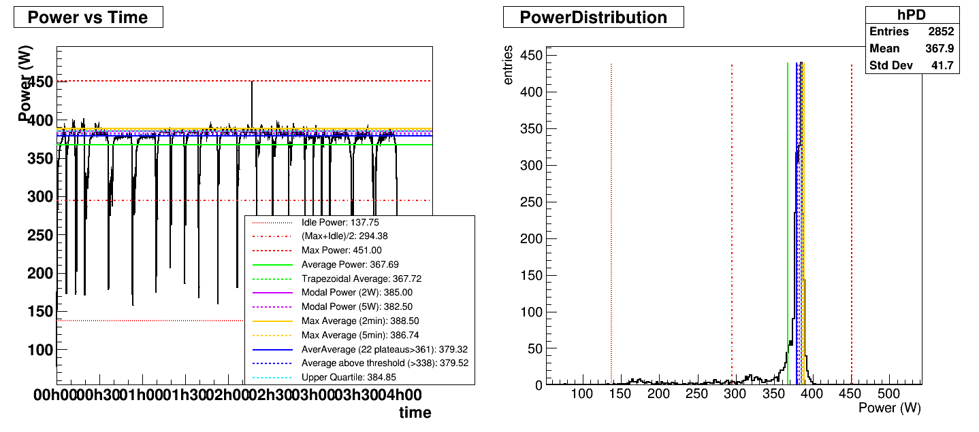
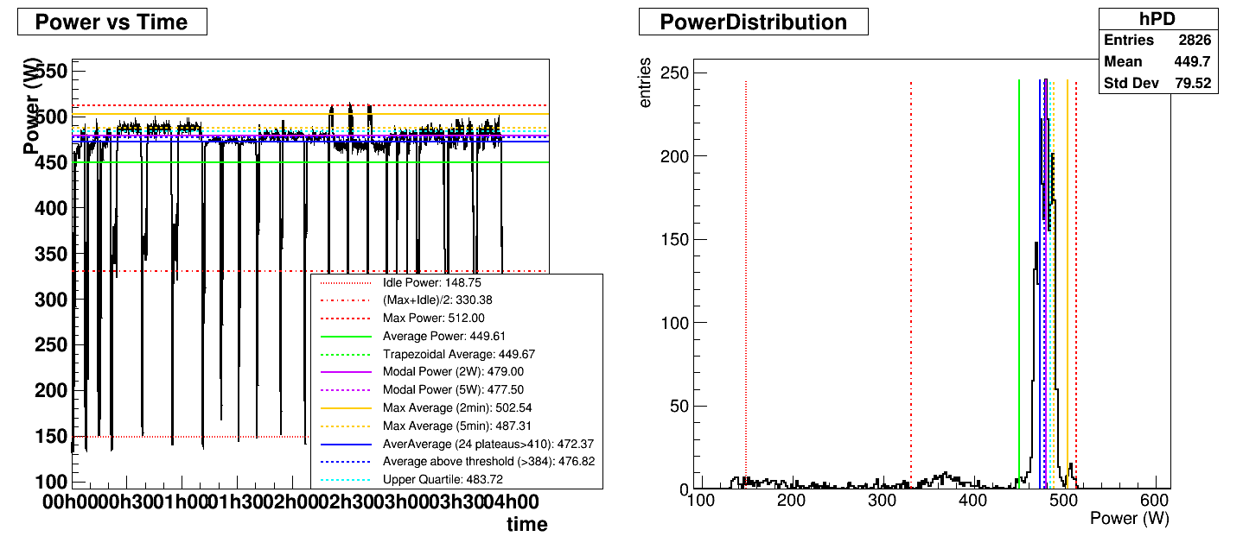
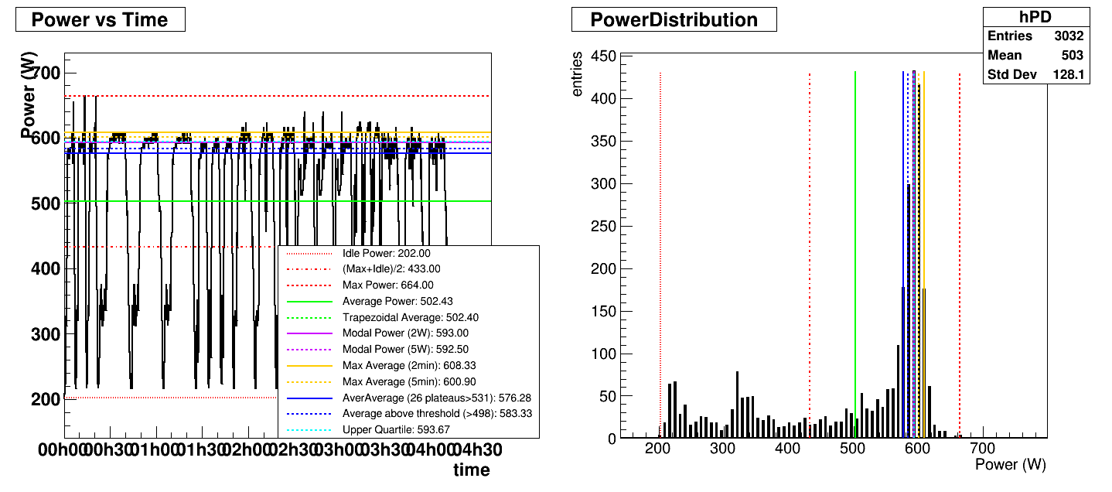
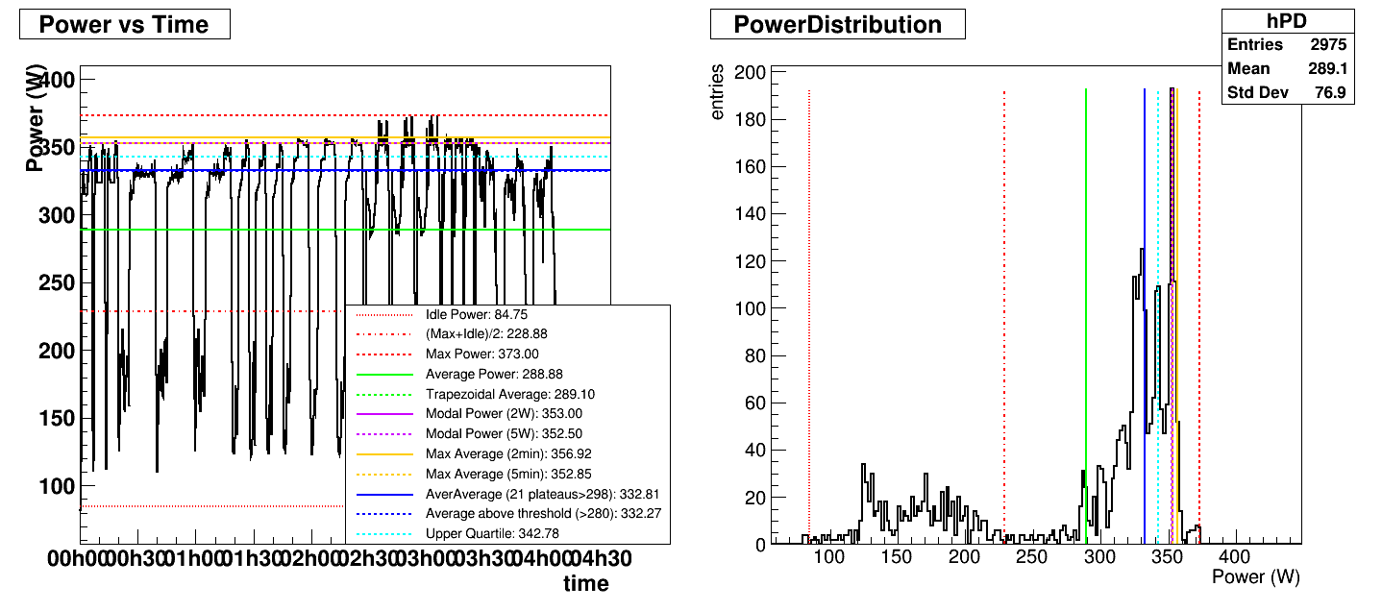
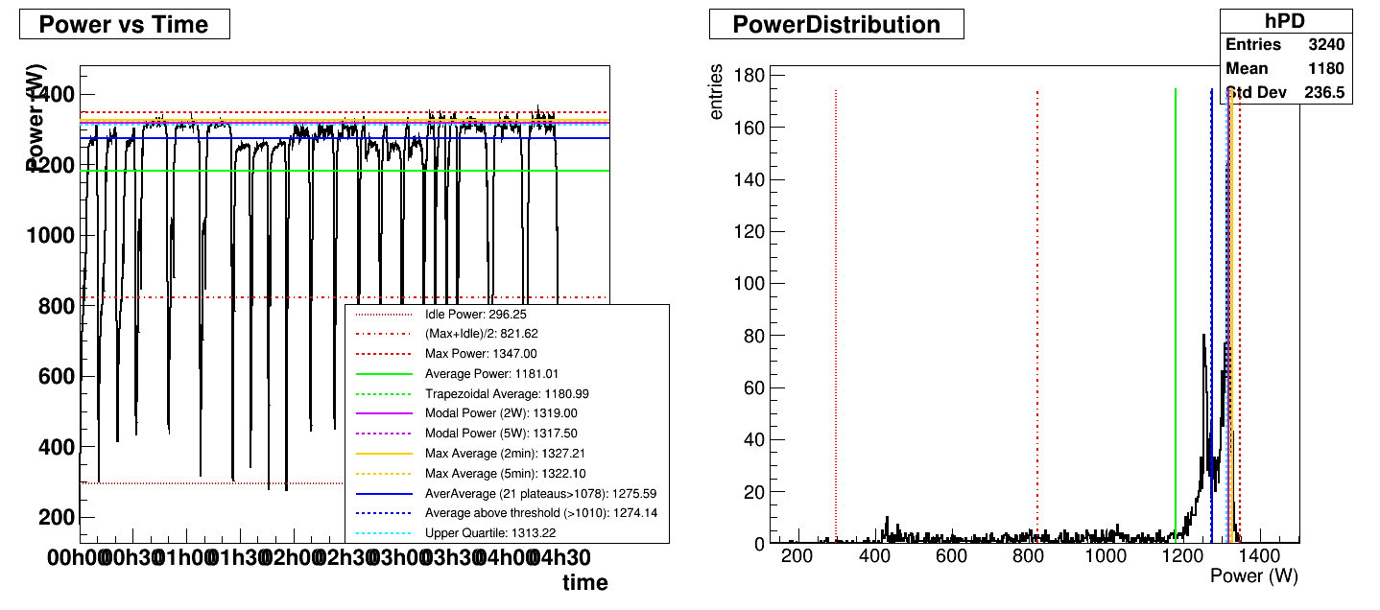
AMD96ht
ARM80c
2*AMD64ht
2*ARM80c
ARM128c
2*AMD256ht

Slide 12

Me vs the Energy Plug-In
Notes:
plugin

Slide 13

Testing Experience
My 1st experience was terrible: Ladislav’s energy plug-in only produced 0s … because the IPMI command did not work on my machine.
When I changed it, I started getting weird error messages:
[ERROR] Plugin "CommandExecutor" failed: IndexError("no such group")
which made me think about user privileges (only root can run IPMI).
So, I tried sudo ipmi and cat ipmi.json (local) … but still got 0s at best!
I tested different versions of HEPscore + Suite, but a few of them did not work with plugins (1.6rc3 & 1.6rc4) and just crashed.
After opening an issue, exchanging a few email, and bothered
my colleagues, I gained a better understanding regex, and
finally fixed the troublesome line in the plug-in configuration …

Slide 14
Run Script
run_hepscore_plugins.sh
activemq:
...
global:
benchmarks:
- hepscore
...
hepscore:
version: $HEPSCORE_VERSION
config: default
options:
userns: True
# clean: True
plugins:
CommandExecutor:
metrics:
cpu-frequency:
...
power-consumption:
command: sudo ipmitool dcmi power reading | grep "Instantaneous power reading:"
regex: '\s+Instantaneous power reading:\s*(?P<value>\d+).*'
# command: cat /tmp/ipminfo.json | grep ipmi_power_watt | tr -d -c 0-9
# regex: '(?P<value>\d+)'
unit: W
interval_mins: $PLUGIN_INTERVAL_MIN
load:
...
used-memory:
...
used-swap-memory:
...
#!/bin/bash
## set environment
OUTFILE="run_HEPplugin.csv"
SAMPLING_INTERVAL_SEC="30"
WAIT="10"
EXEDIR=$(pwd)
...
## output the versions & stuff
echo "** User: $(whoami)"
echo "** Architecture: $(uname -i)"
echo "** Singularity Version: $(singularity --version)"
echo "** Python Version: $(python3 --version)"
echo "** Number of Threads: $(nproc)"
echo "** System: $(uname -a)"
echo "** Frequency: $(cpupower frequency-info | grep 'GHz (ass')"
echo "** Date-Time: $(date)"
## start collector & wait N sec.
./jget.sh ${OUTFILE} ${SAMPLING_INTERVAL_SEC} &
sleep ${WAIT}
## ---
while getopts ':c:k:iprs:e:wd:' OPTION; do
...
...
echo "Running script: $0 - version: $SCRIPT_VERSION"
...
## ---
pkill jget.sh
cp ${EXEDIR}/workdir/suite_results/run_*/bmkrun_report.json .
echo "Final HEP-Score:"
jq . ${EXEDIR}/bmkrun_report.json | grep '"score": [0-9]'
exit 0
hepscore_config.yml
Note: this ?<value> thing is crucial !
starts my own IPMI collector
standard
run.sh
script

Slide 15
Latest Test Results
First look (just counting the lines):
- AMD: "start_time": "2023-11-08T12:43:45.844219Z" , "end_time": "2023-11-08T16:42:15.880657Z" ~ 4h
start-line=674 , end-line=1151 , interval=30sec. ; 1151-674 = 477 lines * 1/2min. ~ 240min. = 4h
- ARM: "start_time": "2023-11-08T12:41:16.625898Z", "end_time": "2023-11-08T16:00:46.475620Z", ~ 3h20min.
start-line=596 , end-line=996 , interval=30sec. ; 996-596 = 400 lines * 1/2min. ~ 200min. = 3h20min
All my experience is reported in a Jira issue: https://its.cern.ch/jira/browse/BMK-1374
Line by Line comparison (see excel):
The above comparison was done by setting the same sampling interval (30 seconds) on all plug-ins and in my exporter script. Results match ☺

Slide 16
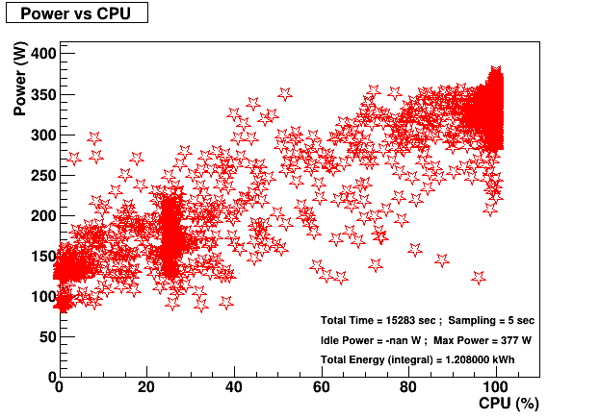
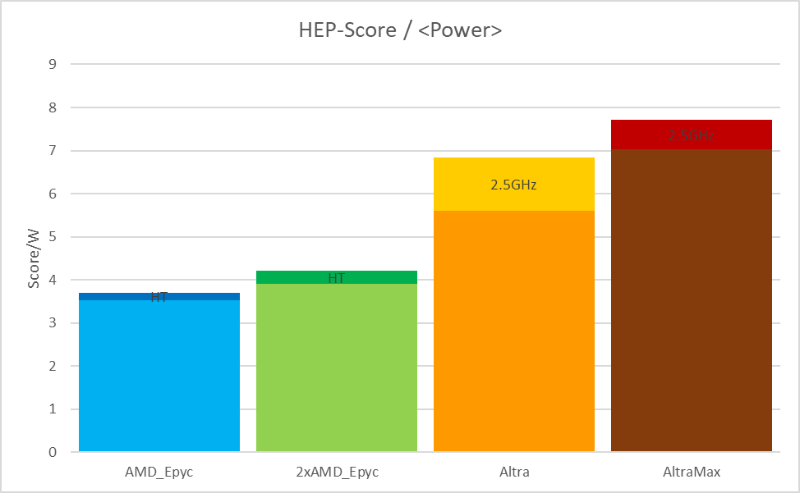
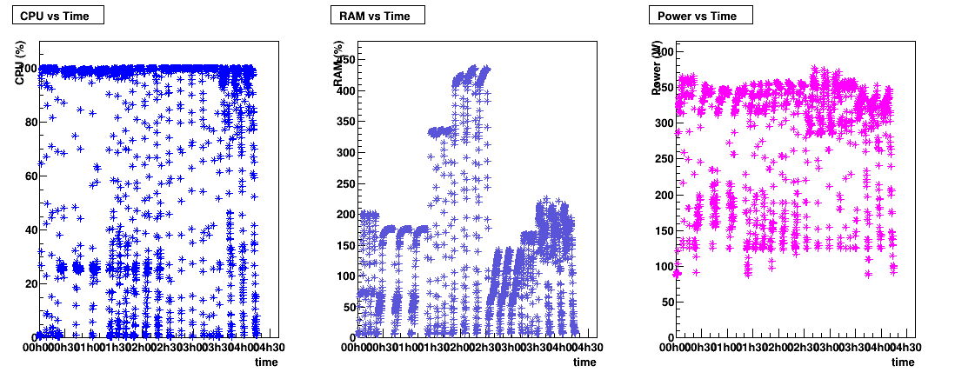
My IPMI collector & analyser
jdump.sh
jget.sh + Job
IPMI
/tmp/ipmidump.json
ipmi_runtime.csv
(root’s crontab)
(user’s script)
{
"date_yyyymmdd": "$DATE" ,
"time_hhmmss": "$TIME" ,
"cpu_usage_percent": "$CPUSE" ,
"memory_usage_gb": "$MEMUSE" ,
"cpu_frequency_ghz": "$FREQ" ,
"ipmi_power_watt": "$POWER"
}
Excel
ipmi2root.C
(ROOT script)

Slide 17
HEPscore Energy Plug-in
run.sh
IPMI
energy_plugin
bmkrun_report.json
HEPscore
{
"host": {
"hostname": "arm-e22",
...
"plugins": {
...
"hepscore": {
"cpu-frequency": {
...
"power-consumption": {
"start_time": "2023-11-03T15:55:11.310751Z",
"end_time": "2023-11-03T19:11:11.293188Z",
"values": [
115.0,
303.0,
...
169.0
],
"statistics": {
"min": 108.0,
"mean": 269.0862944162437,
"max": 344.0
},
"config": {
...
},
...
"score": 1509.9384,
"status": "success"
}
}
}
?
about 500 lines
I am not sure how / I have not developed the tools to deal with this output …

Slide 18

OutLook
Notes:
outlook

Slide 19
Things on my List
Improve on the calculation and reach a consensus about What Watt to use in benchmarking and agree on a common HEPscore/Watt metric.
Consolidate my results and streamline the process from benchmarking to a reference table / excel (a.t.m. a lot of copy/paste by hands).
Study the effect of frequency throttling at cluster level: we have an Ansible script to tune the frequency remotely! How to use in production?
Benchmark newly available x86 & ARM chips: AMD Siena (ongoing!), Nvidia Grace (we bought one), AmpereOne (looking for), …
Provide my input and feature request in the plug-in development … and maybe make my hands dirty – we should talk about this.

Slide 20
Feature Request
To make this plug-in into a fully usable product, there are a few things that we need to fixed / streamline / optimise. My proposal is to open a fresh Jira issue to discuss possible new features. With some guidance, I can then I can take part in the development process …
I believe the following issues / features should be addressed:
- Export plug-in metric as a timeseries in a CSV file with (e.g., time-stamp, CPU, RAM, Frequency, Power, …), either during or at the end of the run.
- What happens if a plugin skips a beat? How often does it happen (never)? We should define an error message and set the metric to NaN (not 0) !
- Tag the time-series with workload name and number (start-end)! Or … we can think about a Utility that does so by reading the json file …
- Add more statistic calculations, including the mean* power, once we agree on it.
- Understand limitations about sampling interval (30 sec. ok, but 15 sec. crashes).
- Any other thoughts?

Slide 21



End
Notes:
when the machinery works on its own, we can think about something else …

Slide 22
My IPMI script(s)
#!/bin/bash
## NEW ipmidump script, renamed "jdump.sh" because it dumps JSON ## v1.0 by Emanuele ##
##
## It dumps a bunch of system metrics to a json-like file (with the proper metric names).
## The sampling frequency can be set as command line argument when starting the script.
## Default frequency is 5 sec (good enough for most purposes), it cannot be less than 1 sec.
## Output:
##
## {
## "date_yyyymmdd": $DATE ,
## "time_hhmmss": $TIME ,
## "cpu_usage_percent": ${CPUSE} ,
## "memory_usage_gb": ${MEMUSE} ,
## "cpu_frequency_ghz": ${FREQ} ,
## "ipmi_power_watt": ${POWER} ,
## }
##
## This script should run as a background process (by root):
## $ sudo ./jdump.sh 5 &
##
## Or started on boot (add an entry to root's crontab):
## $ sudo crontab -e <-- @reboot /opt/jdump.sh 5
##
EXPORT_DIR="/tmp"
EXPORT_JSON="ipminfo.json"
EXPORT_CSV="ipminfo.csv"
SAMPLING="5"
# Regular expression to test for floats
re='^[0-9]+([.][0-9]+)?$'
# Set sampling frequency (minimum is 1 sec)
if [ $# -ge 1 ]; then
if [[ ${SAMPLING} =~ $re ]] ; then
SAMPLING=$1
fi
fi
#echo "Sampling = ${SAMPLING}"
#!/bin/bash
## jget.sh v1.0 by Peppo
##
## Grabs the IPMI info (and other metrics) from a JSON dump file and appends them to a CSV file, indefinitely.
## It works with the new JSON output from 'jdump.sh' (hardcoded as JFILE), the output file can be given as command line argument.
## Normally, this is run as a sub-process by the script running the actual benchmark.
##
## Usage (to just dump runtime metric to CSV):
## $ ./jget.sh &
##
OUTFILE="ipminfo.csv"
JFILE="/tmp/ipminfo.json"
json_to_csv()
{
local json_file="$1"
local csv_file="$2"
if [ ! -s "$csv_file" ]; then
# Extract keys using grep and format them as CSV line & Remove ":" and the trailing comma & Write the values to CSV file
keys=$(grep -oP '"[^"]+":' "$json_file" | tr -d '":' | tr '\n' ',')
keys=${keys%,}
echo "$keys" > "$csv_file"
fi
# Extract values using grep and format them as CSV line & Remove the trailing comma & Write the values to CSV file
values=$(grep -oP '"[^"]+":\s*"\K[^"]+' "$json_file" | tr '\n' ',')
values=${values%,}
echo "$values" >> "$csv_file"
}
# Check if dump file exists
if [ ! -f "$JFILE" ]; then
echo "No IPMI dump file was found: $JFILE. I quit!"
exit 1
fi
# Check if one command line agrument is given, if so set the output file accordingly
if [ $# -eq 0 ]; then
echo "No output filename supplied. Using default: $OUTFILE ..."
elif [ $# -eq 1 ]; then
OUTFILE=$1
echo "Output filename: $OUTFILE ..."
else
echo "Too many arguments. I quit!"
fi
# Check if old output file exists (just print a warning and overwrite it)
if [ -f "$OUTFILE" ]; then
echo "Previous IPMI file found: $OUTFILE. It will be overwritten!"
rm $OUTFILE
fi
# Read the dump file when it changes (requires 'ifnotify-tools')
while inotifywait -q -e close_write ${JFILE} 1>/dev/null
do
json_to_csv $JFILE $OUTFILE
done
# Main loop: exports metrics every ${SAMPLING} seconds
while true
do
# Trick to keep the exporter synchronised: sleep & ... wait
sleep ${SAMPLING} &
# Set the time-stamp
DATE=$(date +"%F")
TIME=$(date +"%T")
# CPU usage (total %) & Check for floating point number (or NaN)
CPUSE=$(top -bn1 | grep "Cpu(s)" | sed "s/.*, *\([0-9.]*\)%* id.*/\1/" | awk '{print 100 - $1}')
if ! [[ ${CPUSE} =~ $re ]] ; then
CPUSE="NaN"
else
CPUSE="${CPUSE}"
fi
# Memory usage (total GB) & Check for floating point number (or NaN)
MEMUSE=$(free -tm | awk 'FNR == 2 {printf("%.2f"), $3/1024}')
if ! [[ ${MEMUSE} =~ $re ]] ; then
MEMUSE="NaN"
else
MEMUSE="${MEMUSE}"
fi
# CPU Frequency (GHz) & Check for floating point number (or NaN), requires 'kernel-tools'
FREQ=$(cpupower frequency-info -f | grep "current CPU frequency:" | awk '{print $4 / 1000000}')
if ! [[ ${FREQ} =~ $re ]] ; then
FREQ="NaN"
else
FREQ="${FREQ}"
fi
# IPMI Power Consumption output & Check for floating point number (or NaN), requires 'ipmitool'
IPMIQUERY=$(ipmitool dcmi power reading | grep "Instantaneous power reading:")
arr=($IPMIQUERY)
POWER=$(echo ${arr[3]})
POWEX=${POWER}
if ! [[ ${POWER} =~ $re ]] ; then
POWER="NaN"
POWEX="${POWER}"
else
POWER="${POWER}"
fi
## Print to json file (overwrite):
cat > $EXPORT_DIR/$EXPORT_JSON <<EOF
{
"date_yyyymmdd": "$DATE" ,
"time_hhmmss": "$TIME" ,
"cpu_usage_percent": "$CPUSE" ,
"memory_usage_gb": "$MEMUSE" ,
"cpu_frequency_ghz": "$FREQ" ,
"ipmi_power_watt": "$POWER"
}
EOF
#echo "${WHEN} , ${CPUSE} , ${POWER} , ${MEMUSE} , ${FREQ} , ${GPUSMI}"
## For backward compatibility, let's dump values in the old CSV standard as well
if [ ! -z "$EXPORT_CSV" ]; then
echo "${DATE} , ${TIME} , ${CPUSE} , ${POWER} , ${MEMUSE} , ${FREQ} , ${GPUSMI}" > "$EXPORT_DIR/$EXPORT_CSV"
fi
wait
done
jdump.sh
jget.sh
user
... and the HEPscore benchmark runs in parallel
root

Slide 23








Bugs

Slide 24

x86 vs ARM

