Slide 1

ARMing GridKa?
Comparing and Evaluating ARM Servers in their performance and power consumption to current x86 Servers with the HEPScore23

Slide 2

Data collection and analysis
For both x86 and ARM the used benchmark was HEPScore23
For x86 available benchmarks from GridKa were used
For ARM new benchmarks were run
For ARM for each configuration 10 benchmarks were run
Power measurement done with ipmitool => 5% deviations
For power consumption the average value per benchmark was used
  ["power-consumption"]["statistics"]["mean"]
final value => the average of the individual values of the benchmarks with the same configuration
Deviation => uncertainty of the individual values of the benchmarks with the same configuration

Slide 3
ARM vs x86 power and performance
Amper Altra 80-Core:
ARMv8 Family
Bought in 2023
1.0 GHz min
3.3 GHz max
At around 3.0 GHz default speed
Doesn't support boosting or hyperthreading (latter on is an ARM limitation)
80 Threads (= 80 Cores)
Red Hat Enterprise Linux 8.9
10 benchmarks per configuration
ARM Server System (A1)
AMD EPYC 7742 64-Core:
Bought at end of 2021
1.5 GHz min
2.25 GHz max
1 server has 2 sockets and 64 cores per socket
128 or 256 Threads with SMT on (SMT=Simultaneous Multithreading)
Red Hat Enterprise Linux 7.9
12 benchmarks with SMT off
36 benchmarks with SMT on
x86 Server System (X1)
AMD EPYC 7702 64-Core:
Bought at begin of 2021
1.5 GHz min
2.0 GHz max
1 server has 2 sockets and 64 cores per socket
SMT always on (256 Threads)
Red Hat Enterprise Linux 7.9
15 benchmarks with SMT on
x86 Server System (X2)

Slide 4
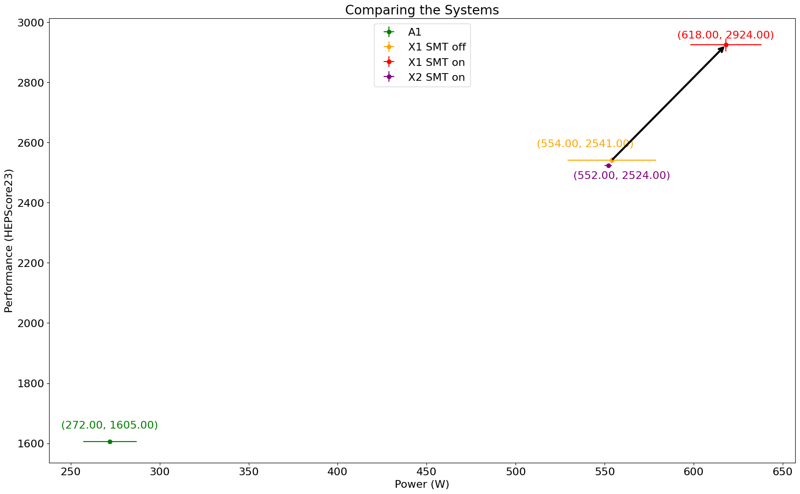
ARM vs x86 power and performance
ARM (A1) with 80 threads
x86 (X1) with 128 threads
x86 (X1) with 256 threads
x86 (X2) with 256 threads
Core/Thread count matters!

Slide 5
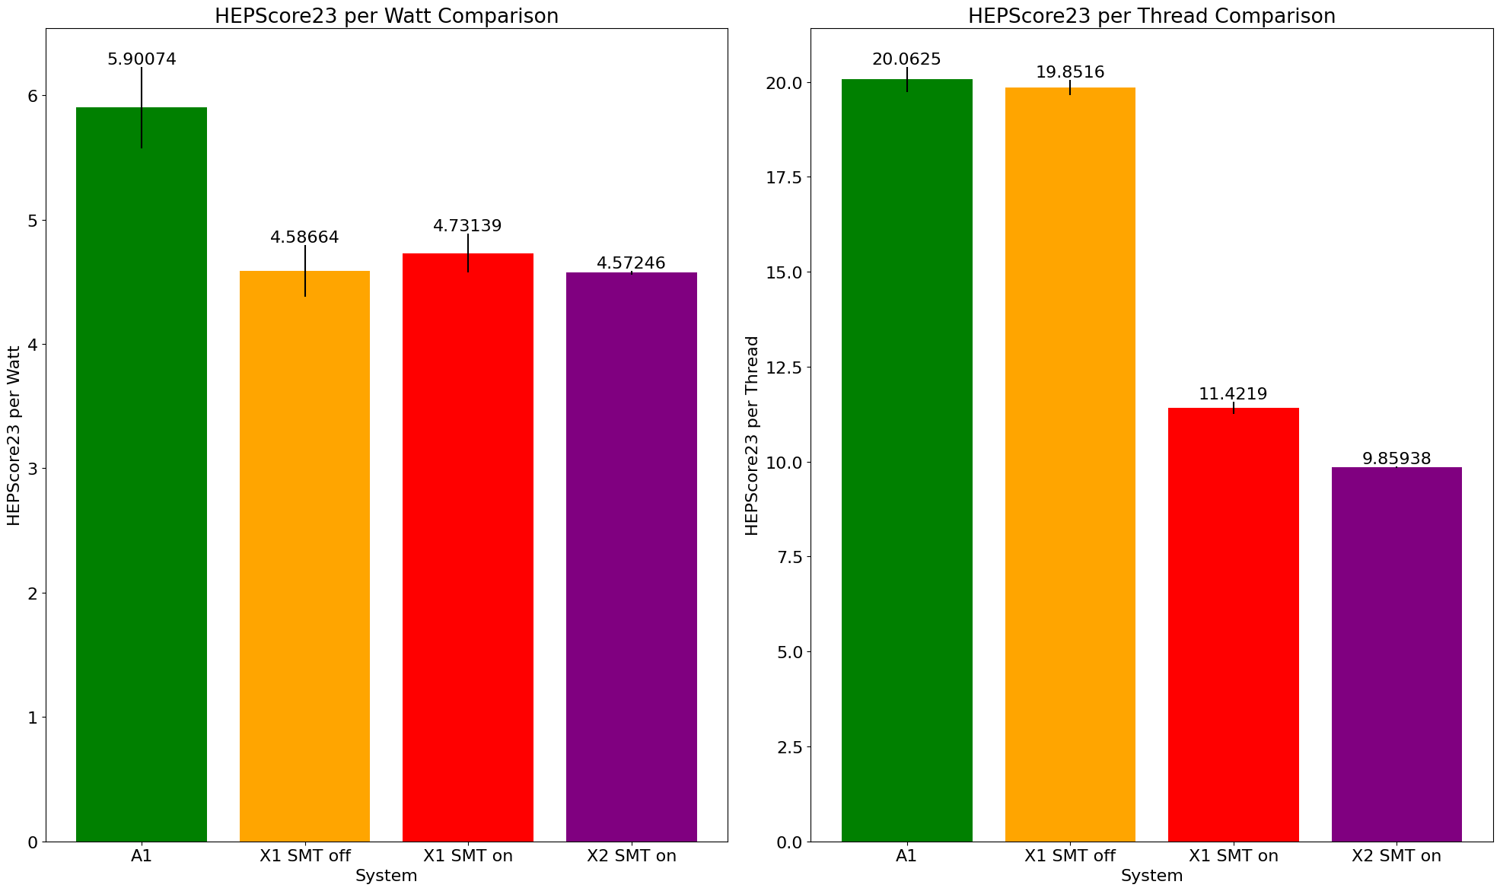
ARM vs x86 power and performance
HEPScore per Watt:
A1: 5.90+/-0.33
X1 SMT on: 4.59+/-0.21
X1 SMT off: 4.73+/-0.16
X2 SMT on: 4.572+/-0.017
HEPScore per Thread:
A1: 20.062+/-0.025
X1 SMT on: 19.85+/-0.07
X1 SMT off: 11.42+/-0.09
X2 SMT on: 9.859+/-0.012
ARM has higher power efficiency than current x86 WNs
24,7%

Slide 6
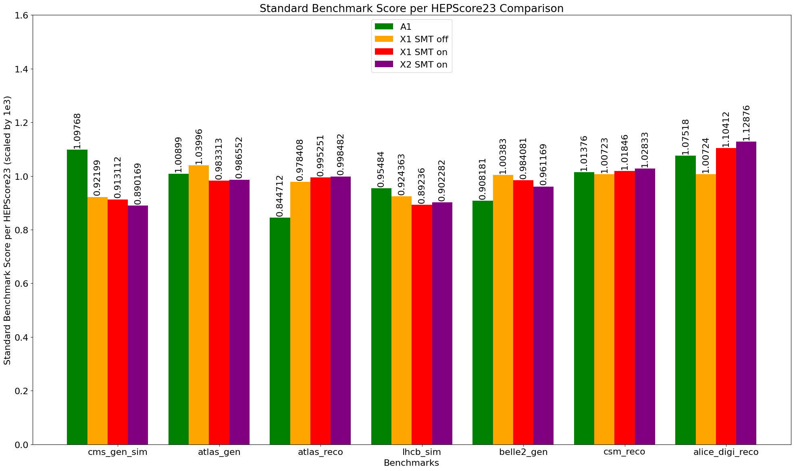
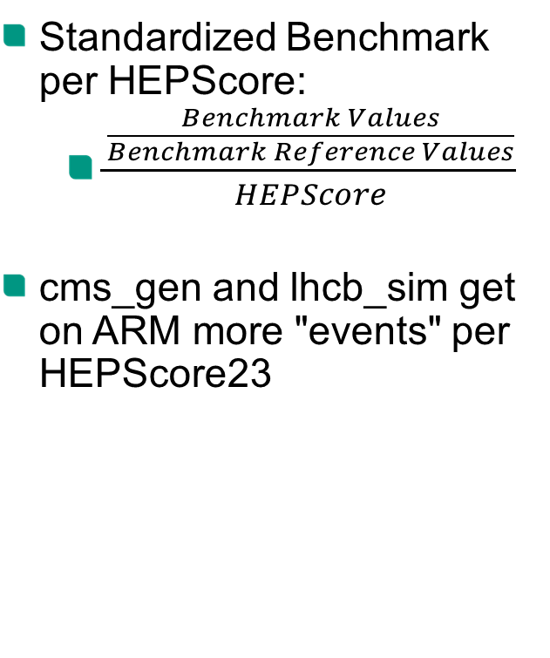
ARM vs x86 power and performance
Standardized Benchmark per HEPScore:
  $\frac{\frac{Benchmark Values}{Benchmark Reference Values}}{HEPScore}$
cms_gen and lhcb_sim get on ARM more "events" per HEPScore23

Slide 7
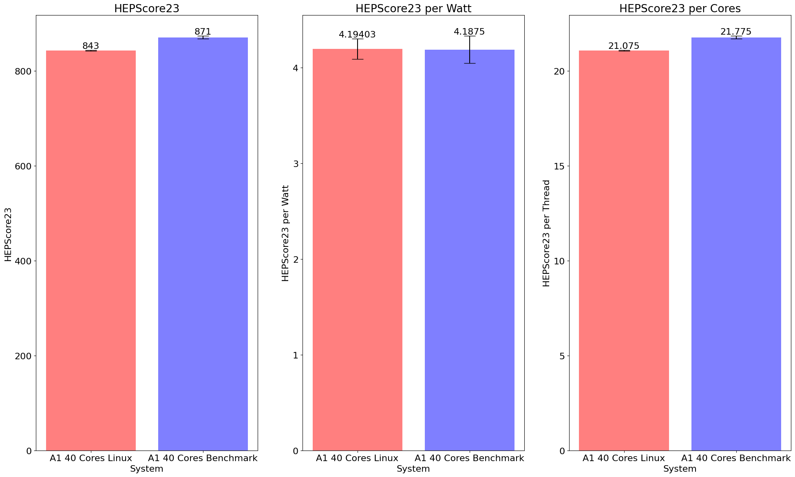
ARM Core Scaling – Linux vs Benchmark
Limiting cores with Linux through: /sys/devices/system/cpu/cpuX/online
Limiting with the Benchmark through –n cores argument
Benchmark core limitation result in higher score

Slide 8
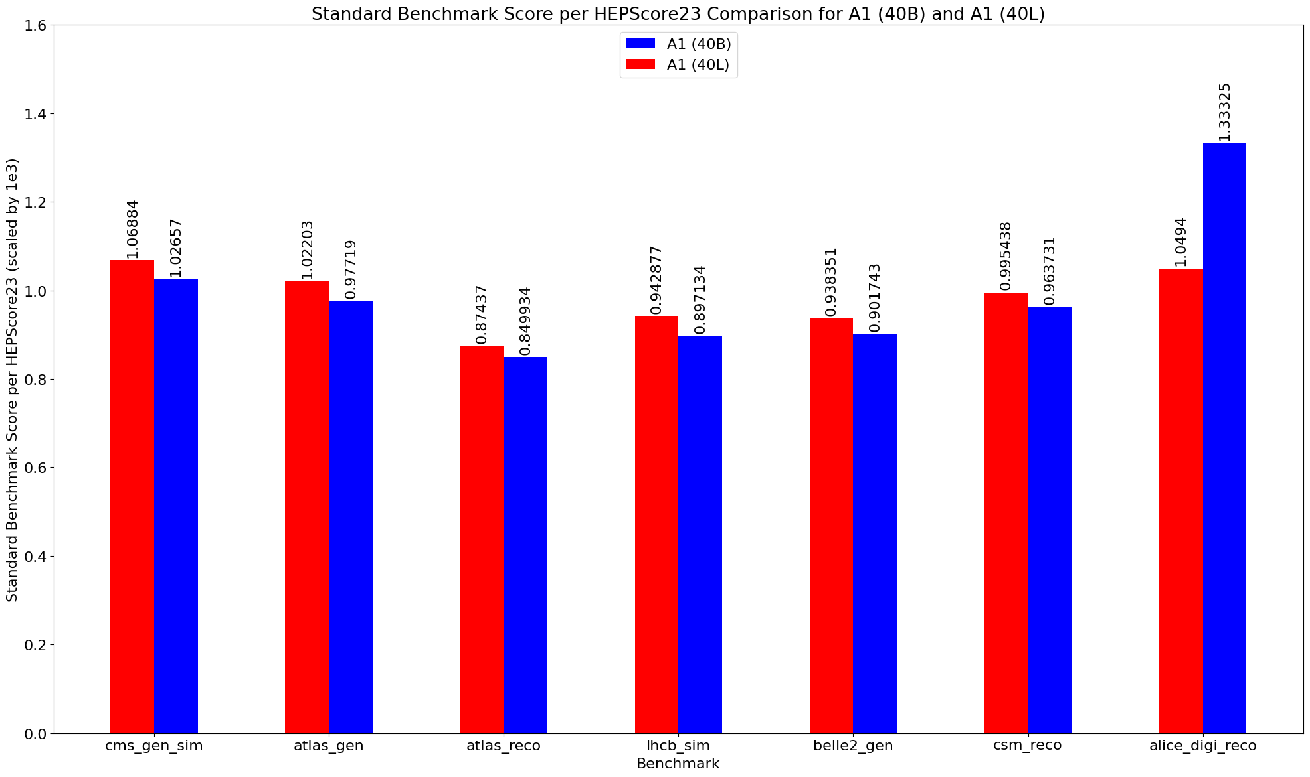
ARM Core Scaling – Linux vs Benchmark
L => Linux limits Cores
B => Benchmark limits Cores
Alice does also not seem to respect the set core boundaries on ARM

Slide 9
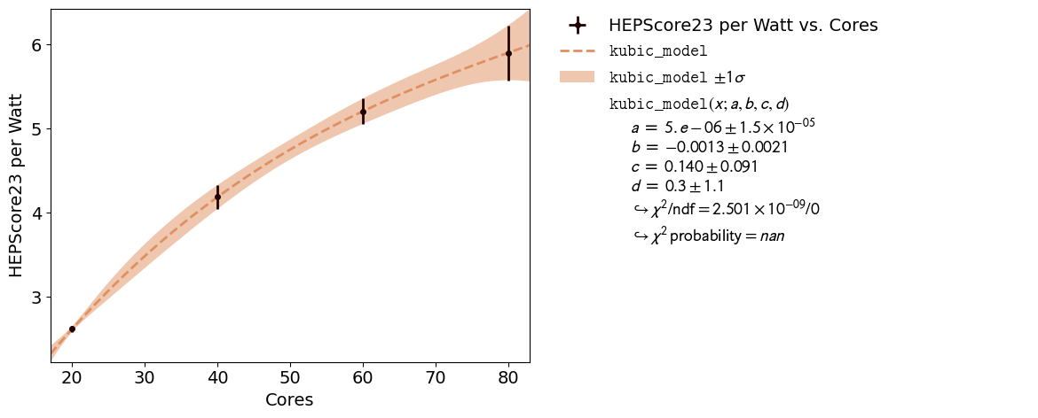
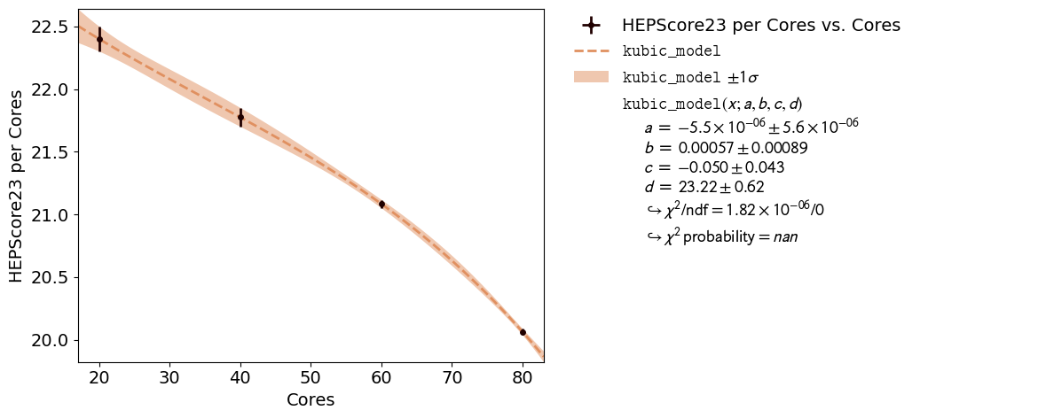
ARM Core Scaling Impact
For all further Graphs the cores have been limited through the Benchmark
Using all available cores seems most effective

Slide 10
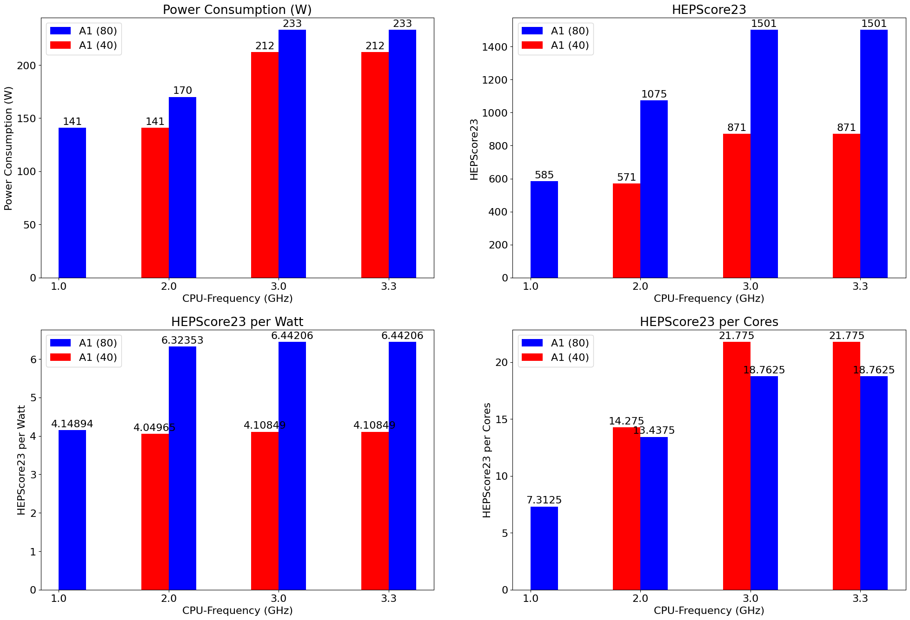
ARM CPU Frequency Scaling Impact
Frequency limited through cpupower
Difference between 3.0 Ghz and 3.3 Ghz not measurable
Base Power consumption is high
Tripling in frequency does not result in tripling in power consumption
Cores limited through Benchmark

Slide 11
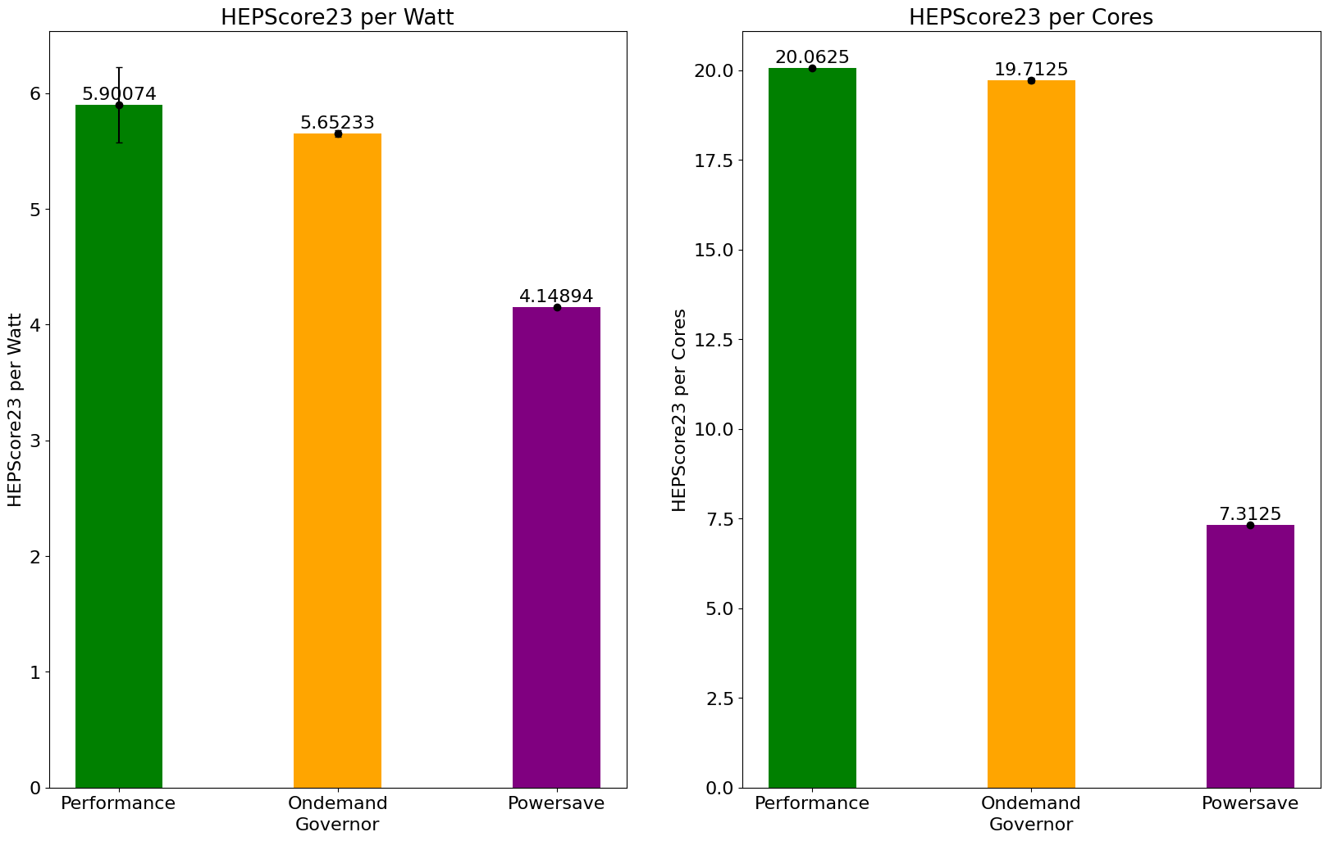
ARM CPU Governor Impact
Performance (Default):
Runs at maximum frequency
OnDemand:
Scales the frequency dynamically according to current load
sampling rate: 20.000
Powersave:
Runs at minimum Frequency
Using all 80 cores

Slide 12
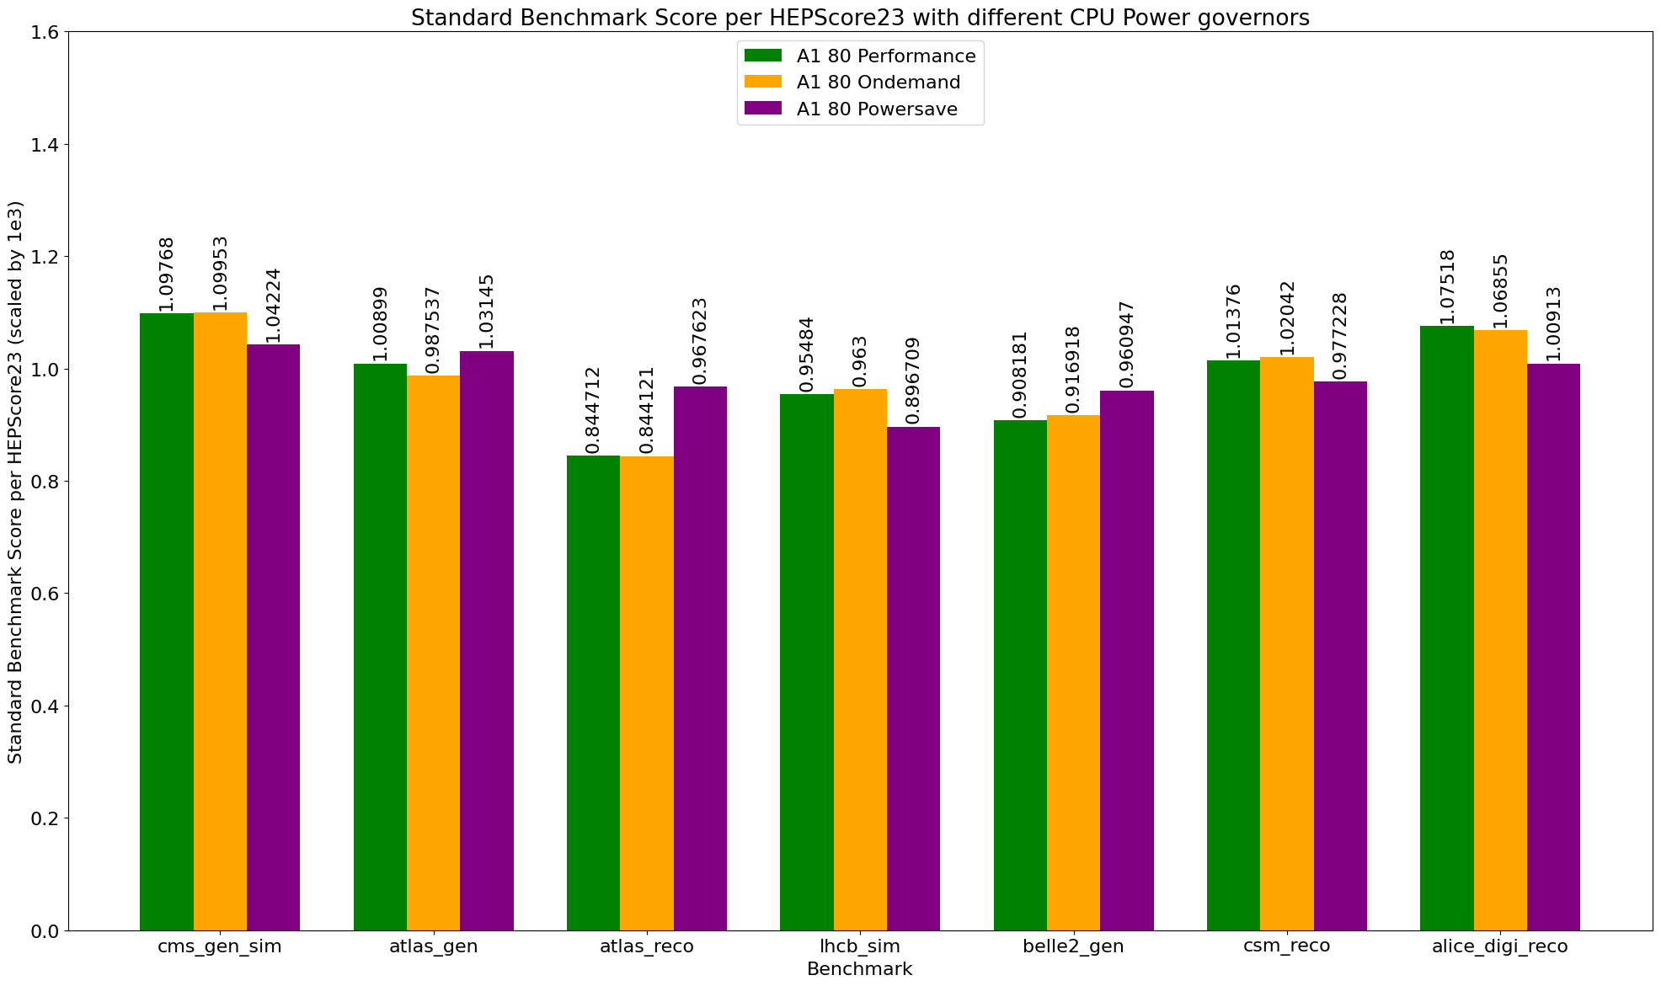
ARM CPU Governor Impact

Slide 13
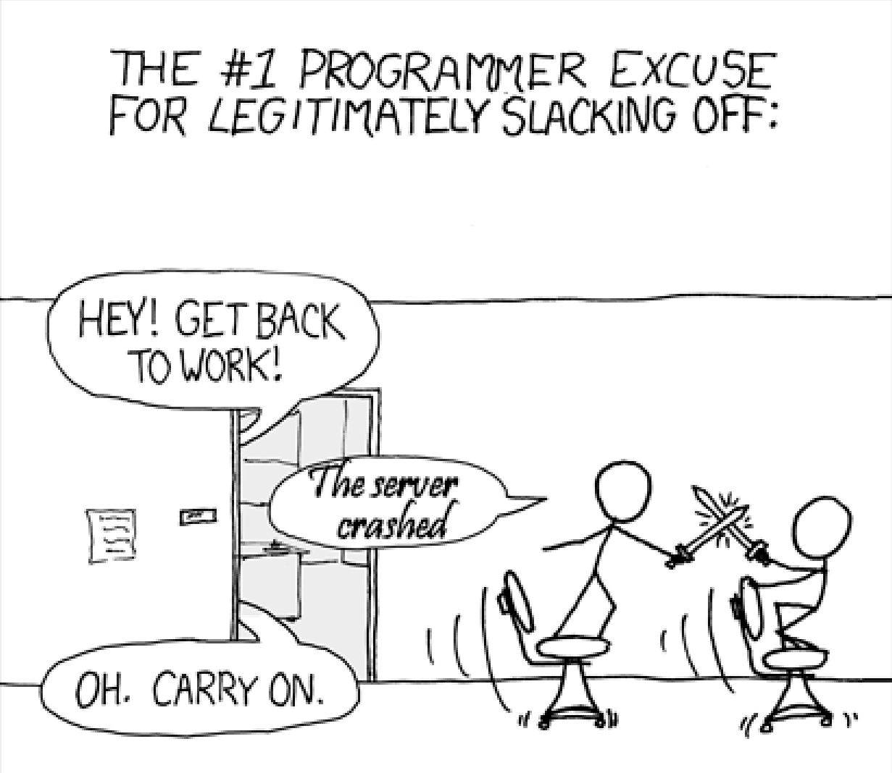
Outlook
Evaluating the Benchmark with 72 cores in “work mode”
Power measurement with smart power supply
Taking the load dips between benchmarks into account
Comparing the ARM Server to newer x86 Server
Including the 128 Core ARM Servers
Investigating RAM usage of ARM Servers
HEPScore per EURO comparison
Thermal impact

