Slide 1





Slide 2

Gauguin –ova pitanja
Koja je budućnost svemira?
Koje su bile najranije
faze Velikog praska?
Od čega se sastoji svemir?
Kamo idemo ?
Tko smo mi ?
Odakle dolazimo?
Notes:
Čovjeka su odvajkada mučila teška pitanja, a ovdje ih je jezikom umjetnosti predocio francuski postimpresionisticki slikar Eugene Henri Paul Gauguin
Od kuda dolazimo (s desna)? Tko smo mi? Kuda idemo?
7 June 1848 – 8 May 1903 francuski postimpresionizam
U kozmoloskom jeziku ta pitanja su: Od kuda dolazimo…= Koje su bile rane faze Big Banga (Velikog praska) "On the right (Where do we come from?), we see the baby, and three young women - those who are closest to that eternal mystery. In the center, Gauguin meditates on what we are. Here are two women, talking about destiny (or so he described them), a man looking puzzled and half-aggressive, and in the middle, a youth plucking the fruit of experience. This has nothing to do, I feel sure, with the Garden of Eden; it is humanity's innocent and natural desire to live and to search for more life. A child eats the fruit, overlooked by the remote presence of an idol - emblem of our need for the spiritual. There are women (one mysteriously curled up into a shell), and there are animals with whom we share the world: a goat, a cat, and kittens. In the final section (Where are we going?), a beautiful young woman broods (to be in deep thought;meditate), and an old woman prepares to die. Her pallor and gray hair tell us so, but the message is underscored by the presence of a strange white bird. I once described it as "a mutated puffin," and I do not think I can do better. It is Gauguin's symbol of the afterlife, of the unknown (just as the dog, on the far right, is his symbol of himself).

Slide 3
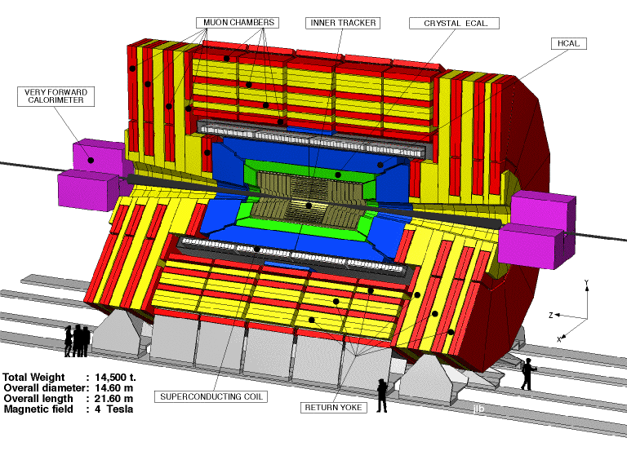
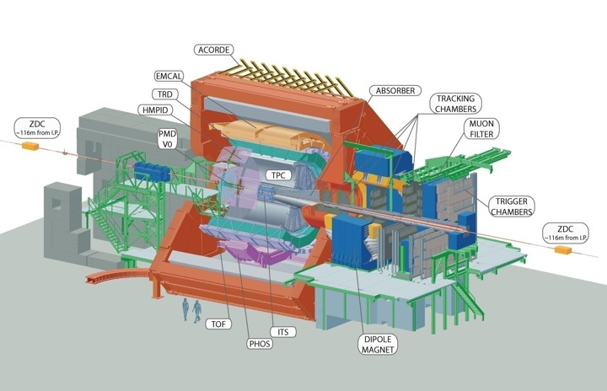
Detektori u fizici elementarnih čestica
Notes:
Ispricati Feynmanovu pricu o SUTONCIMA

Slide 4
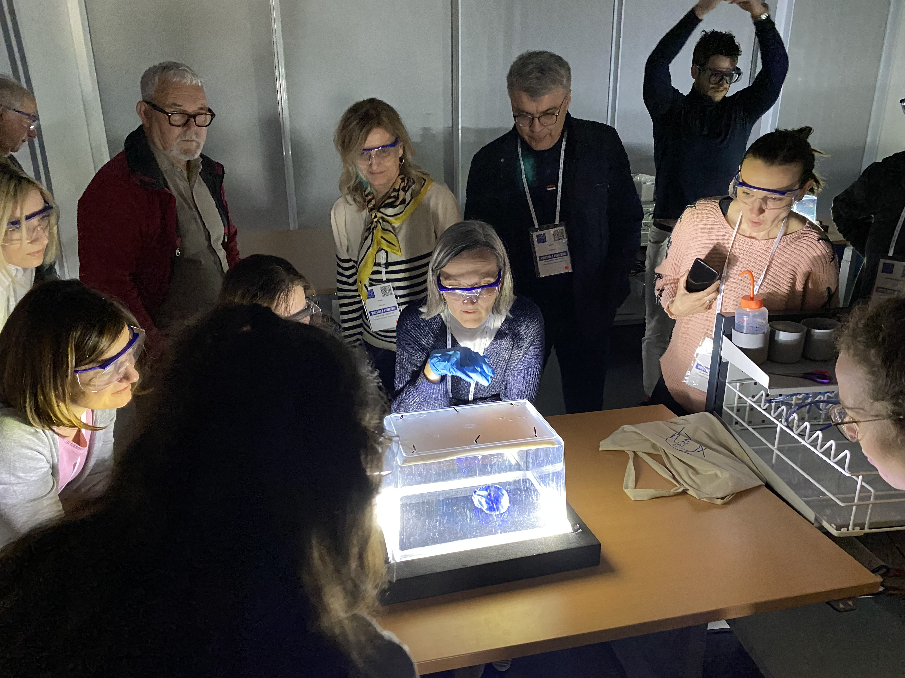
Ekipa za kućne detektore
Idemo na
posao …

Slide 5
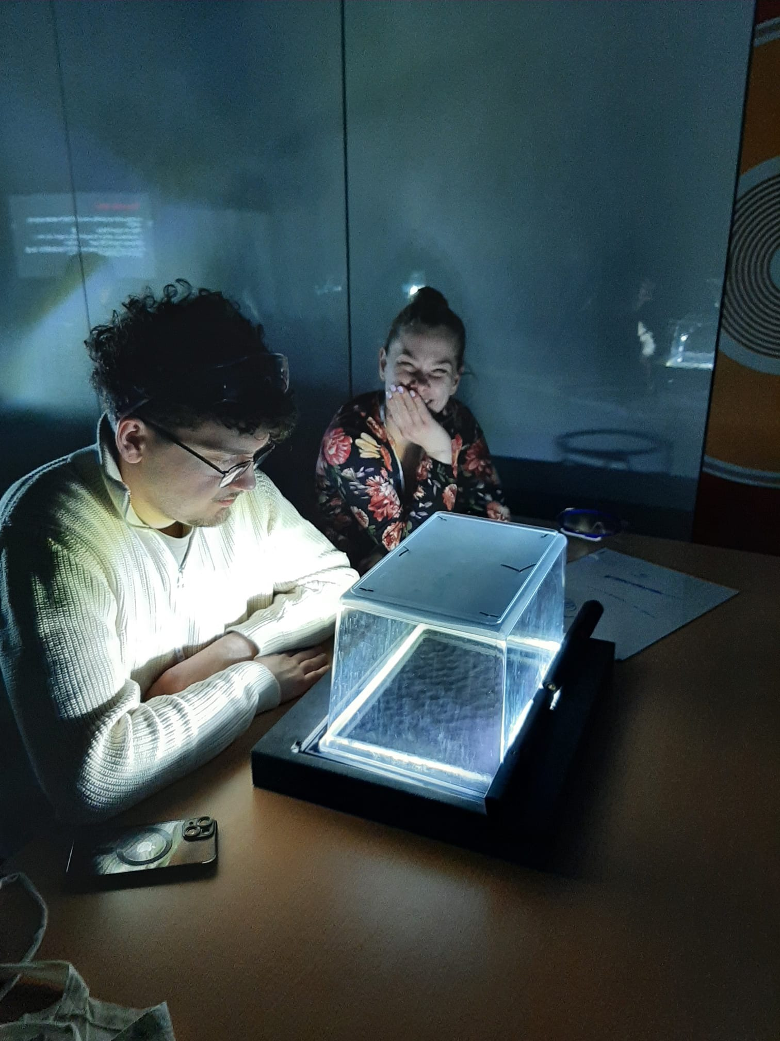
Ili možda ovo …

Slide 6
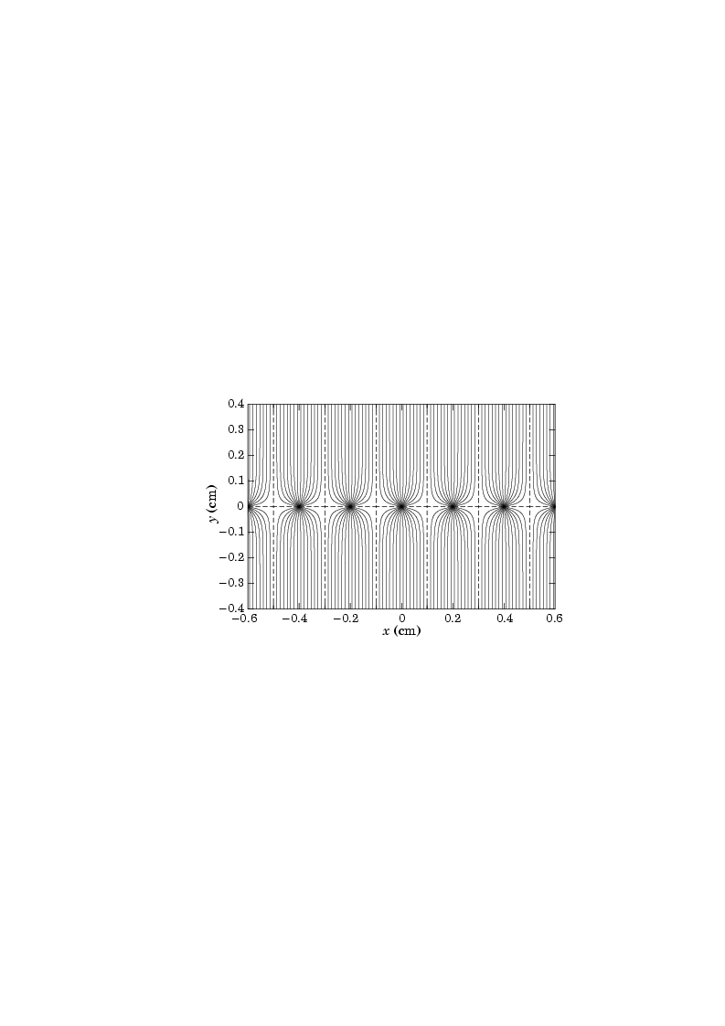
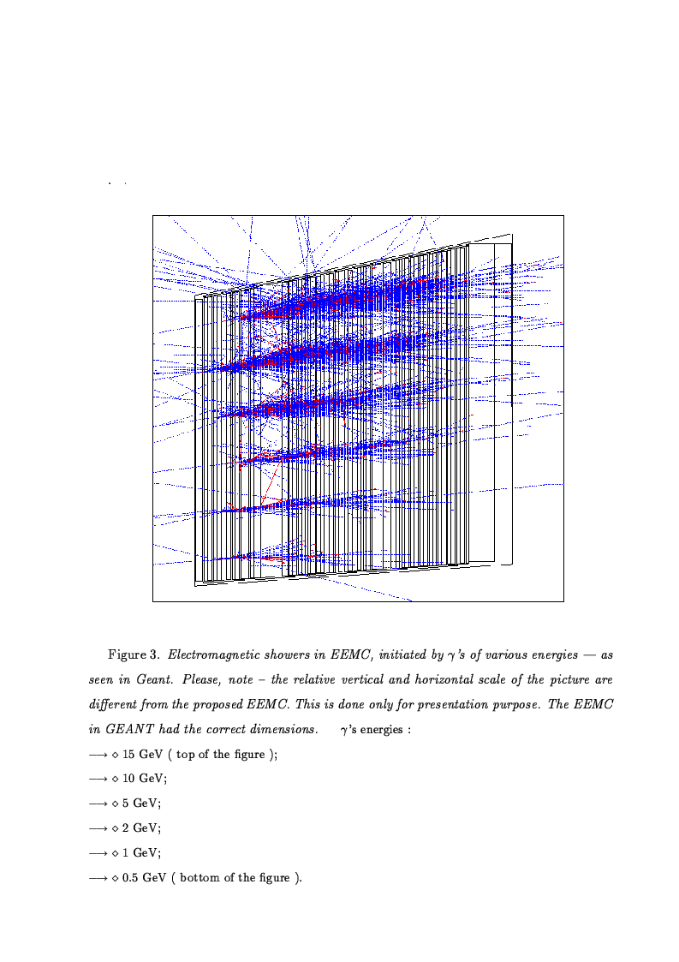
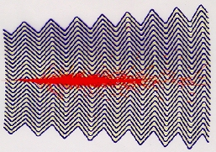
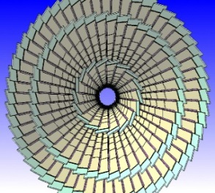
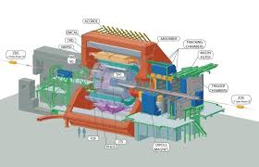
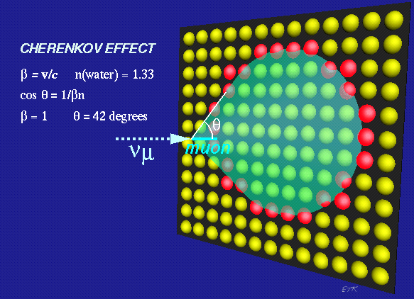
Ajmo nešto reći o detektorima ...
Mnogožičane komore
Hadronski kalorimetar
Elektromagnetski kalorimetar
Poluvodički detektori
Čerenkovljevi detektori
Hibridni detektori (ALICE, CMS)
Spin-off
Interakcija čestica s materijom
Kvarkovsko – Gluonska Plazma
Sažetak

Slide 7

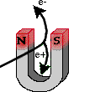
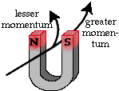
Što je cilj detekcije čestica?
Detekcija čestica
Cilj detekcije je izmjeriti čestica u konačnom stanju u sudarima visokih energija.
Manji impuls
Veći
impuls
Možemo li magnetskim poljem detektirati česticu?

Slide 8



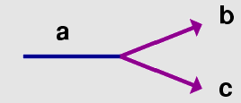

Uvod u detekciju čestica
Mjerenja čestica u konačnom stanju
  Stabilne čestice:
    Fotoni:
    Leptoni:
    Hadroni:
  Nestabilne čestice :
    Direktna rekonstrukcija: Primjer:
    Identifikacija i djelomična rekonstrucija: Primjer:

Slide 9
Najvažniji zadaci detektora
Najvažniji zadaci detektora
  Mjerenje položaja: Odrediti točke prolaza nabijenih čestica (“hits”)
  Tragovi: rekonstrukcija putanje čestica uz upotrebu nekoliko mjerenih položaja točaka uzduž putanje
  Mjerenje impulsa: Mjerenje impulsa nabijenih čestica unutar magnetskog polja iz rekonstrukcije zakrivljenosti putanje
  Mjerenje energije: Deponiranje energije čestice u dijelu detektora
  Identifikacija čestica: Masa i vrijeme proleta
  Određivanje naboja čestice: Zakrivljenost nabijenih čestica u magnetskom polju
  Okidanje (trigger): Okidanje detektora na “zanimljivim” događajima
  Data acquisition: Isčitavanje “događaja” i spremanje nakon okidanja

Slide 10
Konceptualno pitanje
Koji od sljedećih procesa ne uzrokuju nabijene
čestice:
Ionizacija
Zakočno zračenje
Čerenkovljevo zračenje
Comptonovo raspršenje
Notes:
Fotoni prodiru dublje u materiju nego nabijene čestice
Snop fotona ne gubi energiju prolaskom kroz materiju nego intenzitet

Slide 11
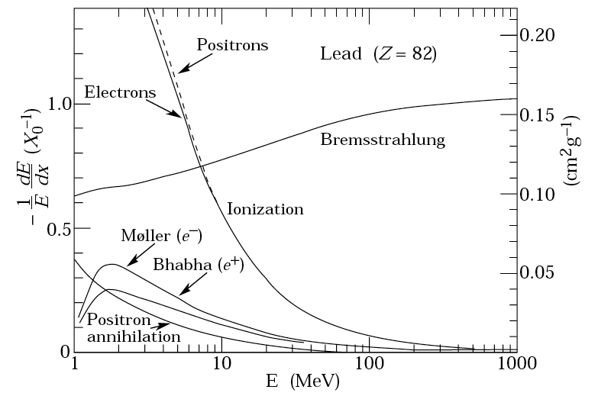
Interakcija čestica pri prolasku kroz materiju
Pregled interakcija
Čestice stvorene u visokoenergijskim sudarima međudjeluju elektromagnetski i /ili nuklearno pri prolasku kroz materijal detektora
Glavni procesi za nabijene čestice su:
Ionizacija
Čerenkovljevo zračenje
Zakočno zračenje
C. Fabjan, 1987
Notes:
Low energy phenomena :photoelectric effect
mid-energy phenomena:compton scattering
Compton scattering usually refers to the interaction involving only the electrons of an atom
Inverse Compton scattering
Inverse Compton scattering is important in astrophysics. In X-ray astronomy, the accretion disc surrounding a black hole is believed to produce a thermal spectrum. The lower energy photons produced from this spectrum are scattered to higher energies by relativistic electrons in the surrounding corona. This is believed to cause the power law component in the X-ray spectra (0.2-10 keV) of accreting black holes.
high-energy phenomena:pair production
Cerenkov Radiation
Electromagnetic radiation is emitted when a charged particle passes through a medium under the condition
v ≡βc >v^{phase} ≡c / n (14.15)
group
where n is the index of refraction of the medium. When βn >1, there is an angle (a direction) where constructive interference occurs. This radiation is a particular form of energy loss, due to soft collisions, and is not an additional amount of energy loss. Soft collisions involve small energy transfers from charged particles to distant atoms which become excited and subsequently emit coherent radiation (see Evans, p. 589).
In quantum electrodynamics, Bhabha scattering is the electron-positron scattering process:
Møller scattering is the name given to electron-electron scattering in Quantum Field Theory
Zakocno zracenje:
Notice the (Z/M)² dependence; this shows that bremsstrahlung is more important in a high-Z medium and is more important for electrons and positrons than for protons and α-particles.

Slide 12
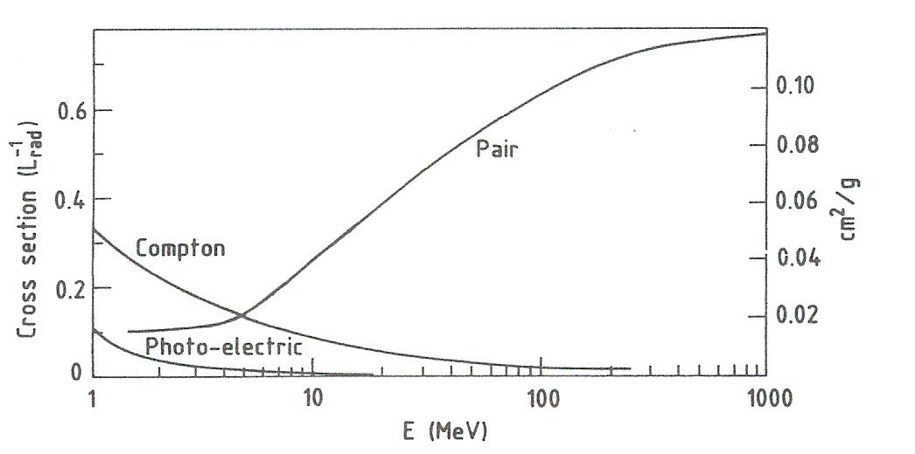
Interakcija čestica pri prolasku kroz materiju
Glavni procesi za fotone:γ
Lead (Z=82)
Fotoelektrični efekt
Comptonovo raspršenje
Produkcija parova
C. Fabjan, 1987
Notes:
Low energy phenomena :photoelectric effect
mid-energy phenomena:compton scattering
Compton scattering usually refers to the interaction involving only the electrons of an atom
Inverse Compton scattering
Inverse Compton scattering is important in astrophysics. In X-ray astronomy, the accretion disc surrounding a black hole is believed to produce a thermal spectrum. The lower energy photons produced from this spectrum are scattered to higher energies by relativistic electrons in the surrounding corona. This is believed to cause the power law component in the X-ray spectra (0.2-10 keV) of accreting black holes.
high-energy phenomena:pair production
Cerenkov Radiation
Electromagnetic radiation is emitted when a charged particle passes through a medium under the condition
v ≡βc >v^{phase} ≡c / n (14.15)
group
where n is the index of refraction of the medium. When βn >1, there is an angle (a direction) where constructive interference occurs. This radiation is a particular form of energy loss, due to soft collisions, and is not an additional amount of energy loss. Soft collisions involve small energy transfers from charged particles to distant atoms which become excited and subsequently emit coherent radiation (see Evans, p. 589).
In quantum electrodynamics, Bhabha scattering is the electron-positron scattering process:
Møller scattering is the name given to electron-electron scattering in Quantum Field Theory
Zakocno zracenje:
Notice the (Z/M)² dependence; this shows that bremsstrahlung is more important in a high-Z medium and is more important for electrons and positrons than for protons and α-particles.

Slide 13
Konceptualno pitanje
Dublje u materiju prodiru:
fotoni
nabijene čestice
ovisi o vrsti nabijenih čestica
Notes:
Fotoni prodiru dublje u materiju nego nabijene čestice
Snop fotona ne gubi energiju prolaskom kroz materiju nego intenzitet

Slide 14
Zakočno zračenje
Gubitak energije elektrona zračenjem:
Radijacijska duljina X₀ je debljina medija koja reducira
srednju energiju snopa elektrona za faktor e.
Kritična energija E_{c} je energija kod koje je gubitak energije
na zračenje jednak gubitku energije na ionizaciju.

Slide 15
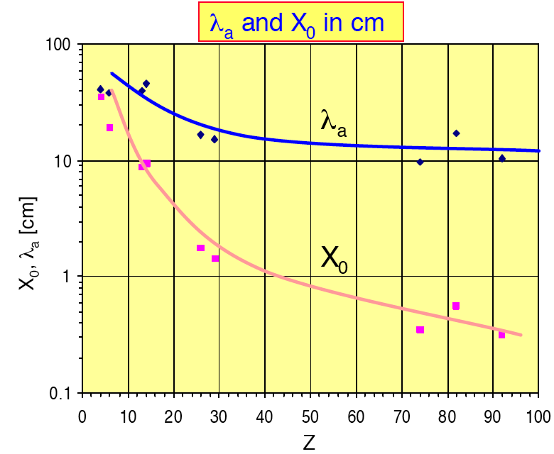
Interakcija s materijom
Usporedba nuklearne interakcijske duljine (u cm) s radijacijskom duljinom (u cm)
Materijal | Z | A | Z/A | X₀ (cm) | λ_{I} (cm) | Gustoća (g/cm³)
H₂ (tek.) | 1 | 1.008 | 0.992 | 866 | 718 | 0.0708
He | 2 | 4.002 | 0.500 | 756 | 520 | 0.125
C | 6 | 12.01 | 0.500 | 18.8 | 38.1 | 2.27
Al | 13 | 26.98 | 0.482 | 8.9 | 39.4 | 2.70
Cu | 29 | 63.55 | 0.456 | 1.43 | 15.1 | 8.96
Pb | 82 | 207.2 | 0.396 | 0.56 | 17.1 | 11.4
W | 74 | 183.8 | 0.403 | 0.35 | 9.58 | 19.3
U | 92 | 238.0 | 0.387 | 0.32 | 10.5 | 19.0
Scint. |  |  | 0.538 | 42.4 | 81.5 | 1.03
BGO |  |  | 0.421 | 1.12 | 22.1 | 7.10
CsI |  |  | 0.416 | 1.85 | 36.9 | 4.53
NaI |  |  | 0.427 | 2.59 | 41.1 | 3.67
λ_{I}
X₀, λ₀ [cm]
X₀
Z

Slide 16
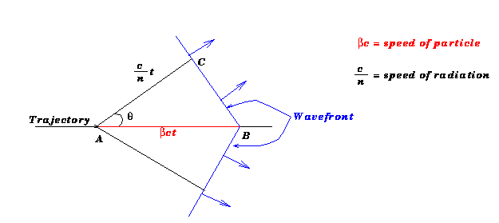
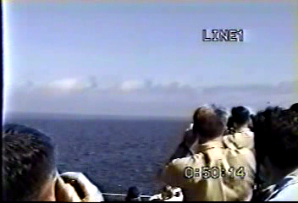
Čerenkovljevo zračenje
Čerenkovljev efekt nastaje kad se nabijena čestica kreće brzinom većom od c/n (brzinom svjetlosti u tom mediju) gdje je
c brzina svjetlosti u vakuumu
n index loma u tom sredstvu
➔ Emitira se “udarni val” fotona
Simul.
Notes:
Velike promjene tlaka blizu brzine zvuka (aviona) cine da se vlaga kondenzira. Mora biti vlazan dan i to se radje desava pri niskim preletima (ne na velikim visinama).

Slide 17
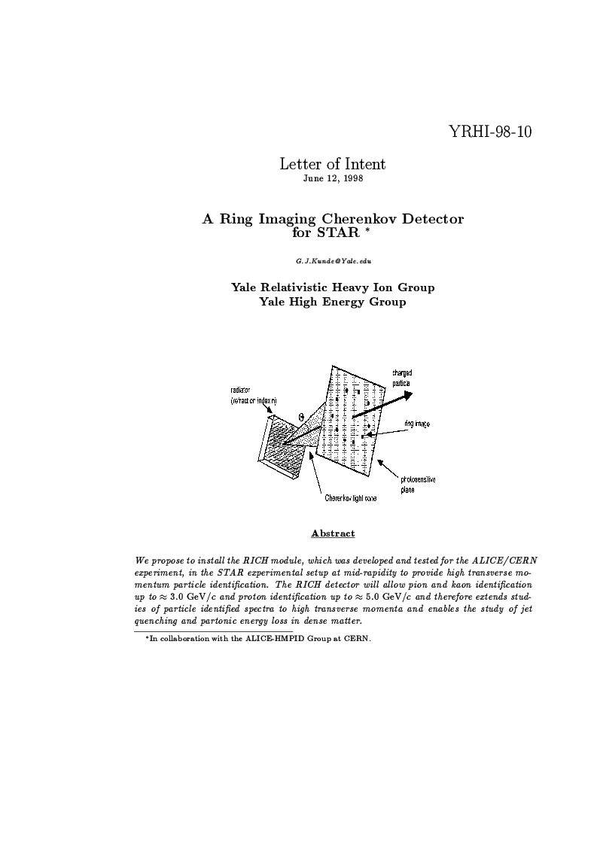
Čerenkovljevi detektori
Svojstva čerenkovljevih detektora
Mjerenjem kuta mjerimo brzinu
Dominira plava svjetlost
Broj fotona ~
λ-valna duljina
Primjena čerenkovljevih detektora
Detektori praga (razdvajanje čestica istog impulsa a različitih masa)
Identifikacija čestica (RICH➔STAR)

Slide 18
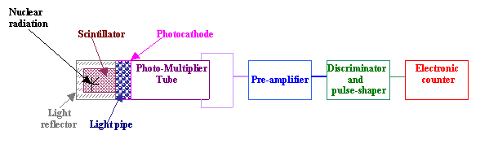
Uvod u detekciju čestica
Detekcija čestica
Scintilatorima

Slide 19
Kalorimetri
Energija i pozicija čestica se može mjeriti metodama
totalne apsorpcije :
Ulazna čestica interagira u detektoru velike mase,
stvarajući sekundarne čestice ...➔pljusak.
Gotovo sva početna energija čestice se pojavljuje ili
kao ionizacija ili kao pobuđenje medija ➔”kalorimetar”
Nužni su za određivanje energije neutralnih hadrona.
Energijska rezolucija ~ ➔dobra na vis. Energ.
Kalorimetri daju brzu (100 ns) inf. o ukupnoj energiji
Zašto je bolja rezolucija na visokim energijama?

Slide 20
Elektromagnestki pljusak

Slide 21
Elektromagnetski pljusak

e

Slide 22
Elektromagnetski pljusak
e⁺

e⁻
e

e⁺

Slide 23
Elektromagnetski pljusak
e⁺
e⁺
this process repeats itself in a “cascading” fashion until there is not enough energy in the particles to continue


e⁺
e⁺
e⁻
e⁻
e⁺


e⁻
e⁻



e⁻
e⁺
e⁻
e⁺
e

e⁻
e⁺
e⁺
e⁻
e⁻


e⁻
e⁻

e⁺
e⁻

e⁺

e⁺
e⁻
e⁻
e⁺
e⁺

Slide 24
Elektromagnetski pljusak
e⁺
e⁺


e⁺
e⁺
e⁻
e⁻
e⁺


e⁻
e⁻



e⁻
e⁺
e⁻
e⁺


e⁻
e⁺
e⁺
e⁻
e⁻


e⁻
e⁻

e⁺
e⁻

e⁺

e⁺
e⁻
e⁻
e⁺
e⁺
*Uočite: Stvaraju se samo fotoni, elektroni i pozitroni

Slide 25
Hadronski kalorimetar
Hadronski pljusak : ulazni hadron ➔ neelastični sudar
➔proizvodnja sekundarnog hadrona …
λ je velik u odnosu na X₀ ➔Hacal su veliki u odnosu na Ecal
U hadronskoj kaskadi 30 % energije se gubi
(razbijanje jezgre,nuklearna pobudjenja, evaporacija neutrona)

Slide 26
Hadronska kaskada
μ
e

Π⁺
Π⁻
e
μ
Π⁻
Π⁻

K⁺
Π⁻
K⁺
Π⁺
e
μ
p
μ
n
K⁻
ν
Π⁺
e
e
μ
Π⁻
e
Π⁻
Π⁺
Π⁻
e
Π⁻

μ

μ
*Uočite: proizvode se različite čestice p, n, Π, ν, Λ, Κ, Ξ
Notes:
The particles that have been produced may also contain high enough energy to either fracture another nucleus or further degrade itself

Slide 27
Mnogožičane komore
Ulazna čestica
_Katodna ravnina__________________________
MWC➔ anodne žice
_Katodna ravnina___________________________
2mm
Svaka žica djeluje kao nezavisni proporcionalni brojač
Katode su na neg. pot. (2kV) dok su anode uzemljene
Signal na žici koja okida je negativan i velik
Signal na susjednim žicama je mali i pozitivan
Prostorna rezolucija ~ 1 mm
Razlučivanje više hitaca

Slide 28
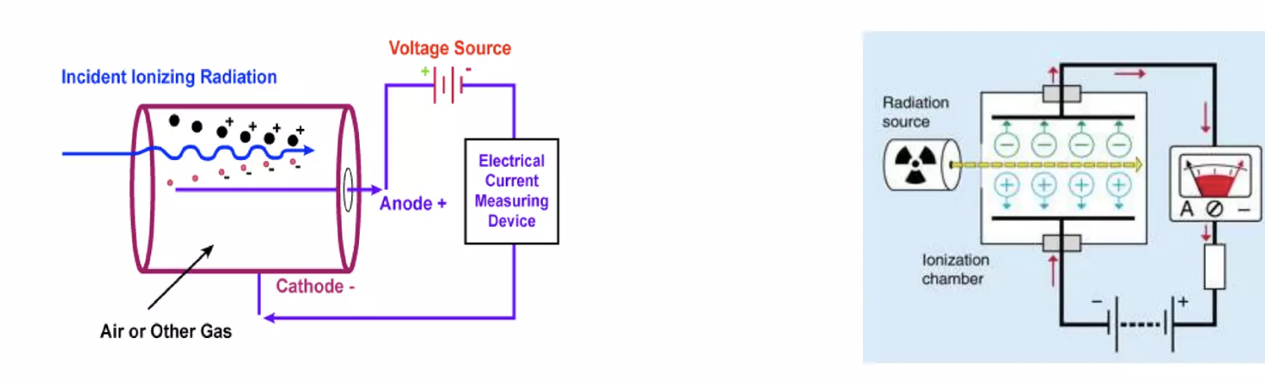
Ionizacijski detektori
Parovi elektron ion se stvaraju kad nabijena čestica ide kroz plin.
Elektroni idu na anodu, a pozitivni ioni na katodu. Razlika
potencijala između katode i anode tjera naboje na gibanje kroz
strujni krug, a ta struja se onda očitava na ampermetru.

Slide 29
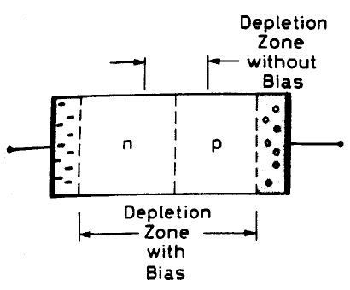
Poluvodički detektori
Analogni plinskim ionizacijskim detektorima:
Čestica u prolazu stvara parove elektron-šupljina (elektron-ion)
Umjesto plina medij je poluvodički (čvrsti) materijal
Negativan napon na p-stranu,
pozitivan napon na n-stranu
Veći napon = više aktivnog medija
+ bolje skupljanje naboja
Previsok napon ➔
poluvodič postaje vodič

Slide 30


Poluvodički detektori (usporedba s ionizacijskim detektorima)
E _{elektron – šupljina}<E _{elektron-ion} ➔Bolja energijska rezolucija
Bolja moć zaustavljanja od plinskih detektora (veća gustoća)
Male dimenzije (<50 μm)➔dobra poz. Rezolucija
Veća osjetljivost na zračenje (kraći vijek trajanja)
Detektori male površine (cm²) (svaka traka➔pojačalo)
Više materijala➔interakcija čestica koje detektiramo
Detektori trebaju ponekad hlađenje radi smanjivanja šuma

Slide 31
Ostale ionizacijske komore
Driftne (vlačne) komore
Prostorna informacija ➔iz mjerenja vremena pomaka (drifta)
elektrona u ionizacijskom dogadjaju
Nabijena
čestica
+HV2
Drift područje
-HV1
Anodna
žica
Scintilacijski brojač
Notes:
A multiwire chamber in which spatial resolution is achieved by measuring the time electrons need to reach the anode wire, measured from the moment that the ionizing particle traversed the detector.

Slide 32
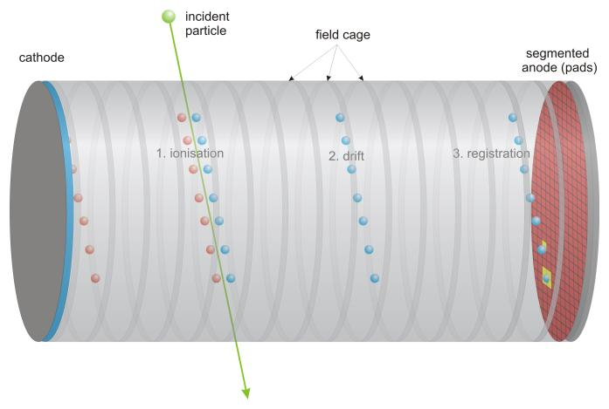
Ostale ionizacijske komore
Komore vremenske projekcije (time projection chamber)
3D tračni detektor
Kombinacija vlačne i mnogožičane komore
Mag. polje
El. polje
elektroni
MWC

Slide 33
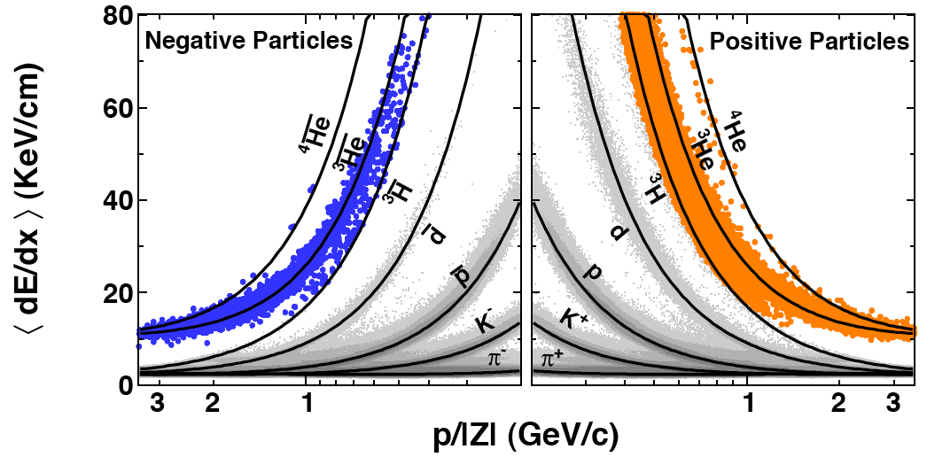


dE/dx vs Rigidity
Kako još identificirati čestice ...
Preliminary
Notes:
In accelerator physics, rigidity is a concept used to determine the effect of particular magnetic fields on the motion of the charged particles.
It is a measure of the momentum of the particle, and it refers to the fact that a higher momentum particle will have a higher resistance to deflection by a magnetic field. It is defined as R = Bρ = p/q, where B is the magnetic field, ρ is the gyroradius of the particle due to this field, p is the particle momentum, and q is its charge. It is frequently referred to as simply "Bρ".^{[1]}
It is important to note that the rigidity is defined by the action of a static, dipole, field, whose field lines are perpendicular to the velocity vector of the particle. This will cause a force perpendicular both to the velocity vector, and to the field lines, defining a plane through which the particle moves. The definition of the Lorenz force implies that the particle's motion will be circular, thus giving a constant radius of curvature.

Slide 34
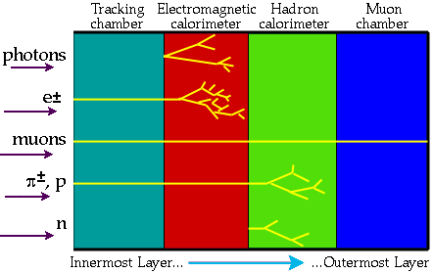
Hibridni detektori
Eksperimenti u FEČ ➔Istovremena detekcija više čestica
Redoslijed detekcije čestica ilustriran je na slici:

Slide 35
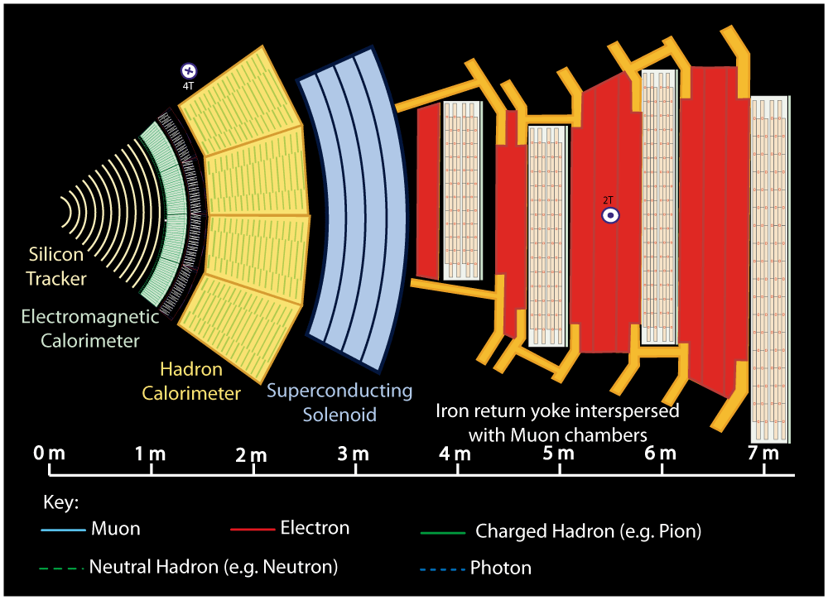
Notes:
Buttons. Click on any particle type to display the relevant slide with animations. Clicking again will return to this slide.
Recommend putting this slide in the middle of your presentation and putting the other 5 slides at the end.
If you have any difficulties, contact David.Barney@cern.ch

Slide 36
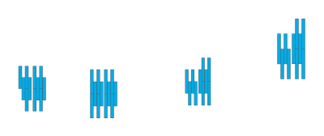


Notes:
Muon: passing through CMS, bending in the field (both ways, depending on when it is inside or outside of the solenoid) leaving hits in the Tracker layers and the muon chambers before escaping completely

Slide 37
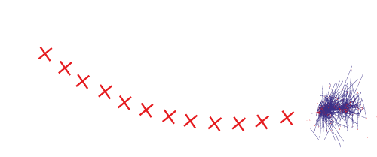
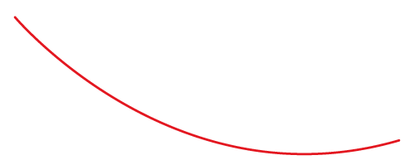

Notes:
Electron: Bending in the magnetic field, leaving hits in the tracker layers and being “stopped” by the electromagnetic calorimeter

Slide 38
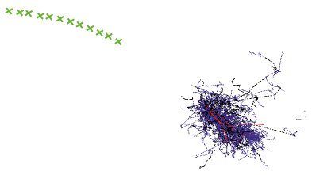


Notes:
Charged hadron: Bends in the magnetic field and leaves signals in the tracker layers; passes through the electromagnetic calorimeter leaving essentially no signal, and is “stopped” by the hadron calorimeter

Slide 39
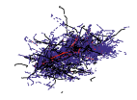

Notes:
Neutral hadron: Does not bend in the magnetic field and does not leave any signal in the tracker layers; passes through the electromagnetic calorimeter leaving essentially no signal, and is “stopped” by the hadron calorimeter

Slide 40



Notes:
Photon: passes through the tracker without bending in the magnetic field or leaving hits, is “stopped” by the electromagnetic calorimeter

Slide 41
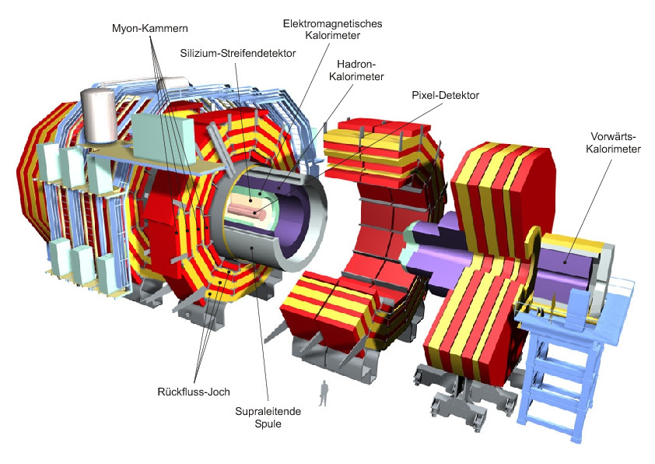
CMS detektor

Slide 42
ALICE eksperiment

Slide 43

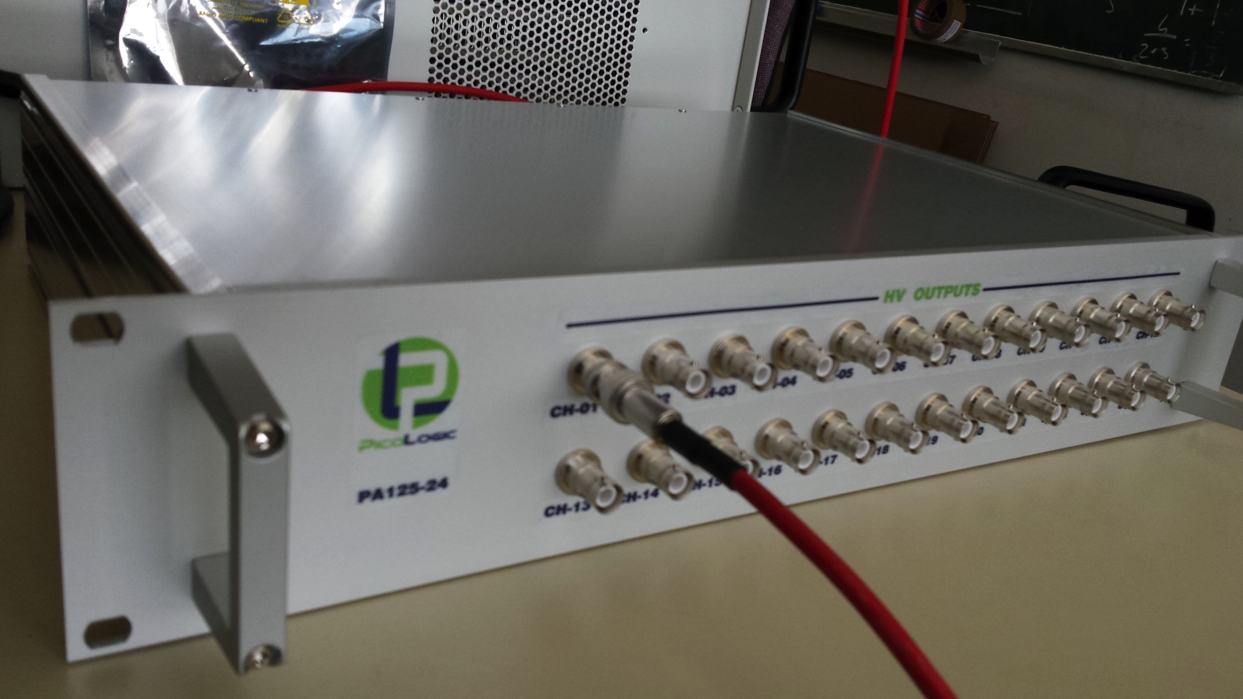
Spin off company - PicoLogic
www.picologic.hr
Izvoz u: Njemačku, SAD, Finsku, Indiju,
Mađarsku, Rumunjsku, Izrael, Španjolsku,
CERN

Slide 44

Kratki izlet u metafiziku

Slide 45
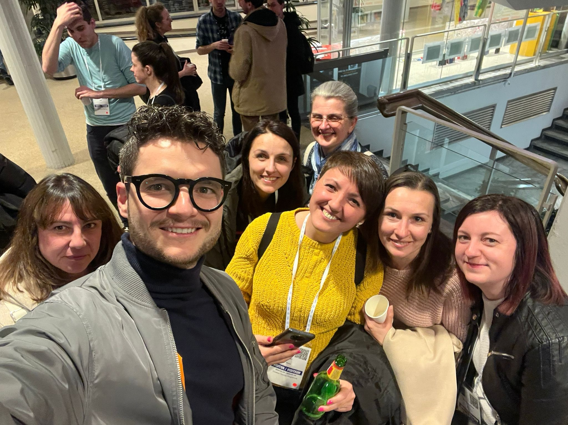
Hvala na pažnji!

