Slide 1
follow up items from FCC week and tuning workshop
Frank Zimmermann, FCC-ee Optics Design meeting, 6 July 2023
thanks for Michael Benedikt, Alain Blondel, John Byrd, and Mike Koratzinos

Slide 2
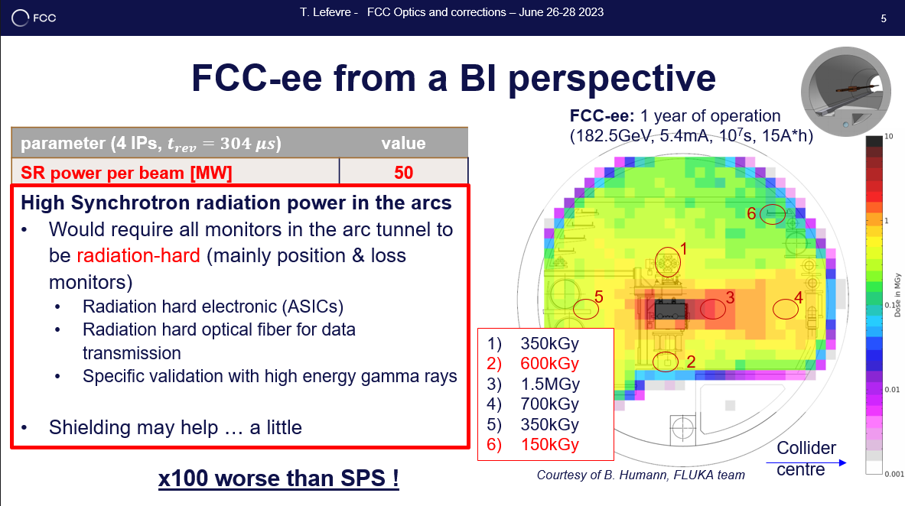
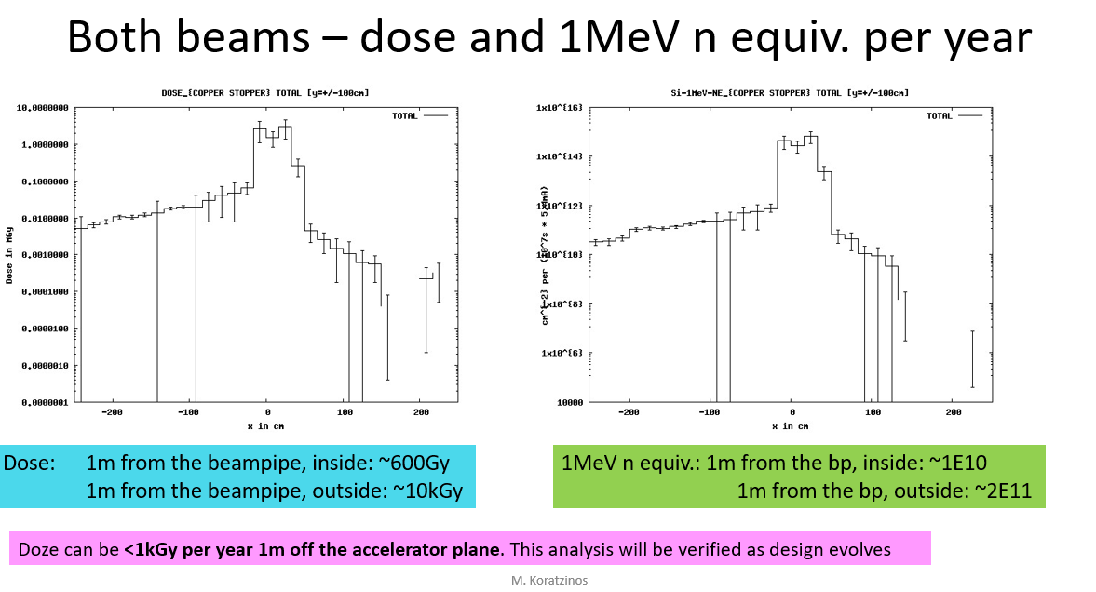
tunnel radiation caused by synchrotron radiation
presented at FCC week
presented at tuning workshop
Mike Koratzinos
Thibaut Lefèvre

Slide 3
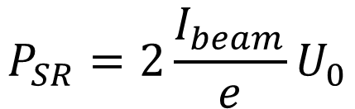
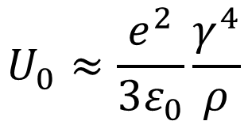

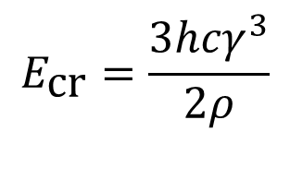
synchrotron radiation & tunnel radiation
energy loss per
particle per turn
$$U_{0}≈\frac{e^{2}}{3ε_{0}}\frac{γ^{4}}{ρ}$$
$$P_{SR}=2\frac{I_{beam}}{e}U_{0}$$
$$E_{\text{cr}}=\frac{3{hcγ}^{3}}{2ρ}$$
SR power
critical energy
$$\frac{d^{2}N_{γ}}{ds dt}=\frac{5}{2\sqrt{3}}αγ\frac{I_{beam}}{eρ}$$
SR photon rate
per meter
with ρ the arc bending radius
 | FCC-ee ZH | FCC-ee ttbar | LEP-2
Beam energy [GeV] | 120 | 182.5 | 104
Beam current [mA] | 26.7 (x2) | 4.9 (x2) | 3.4 (x2)
Bending radius [km] | 9.94 | 9.94 | 3.1
Energy loss / turn [GeV] | 1.89 | 10.42 | 3.34
SR power [MW] | 100 | 100 | 23
Photon flux per arc unit length [10¹⁶ γ/m/sec] | 4.2 (x2) | 1.2 (x2) | 1.5 (x2)
Total SR heat per arc unit length [kW/m] | 1.3 | 1.3 | 1.0
Critical photon energy [MeV] | 2.2 | 7.7 | 4.6

Slide 4
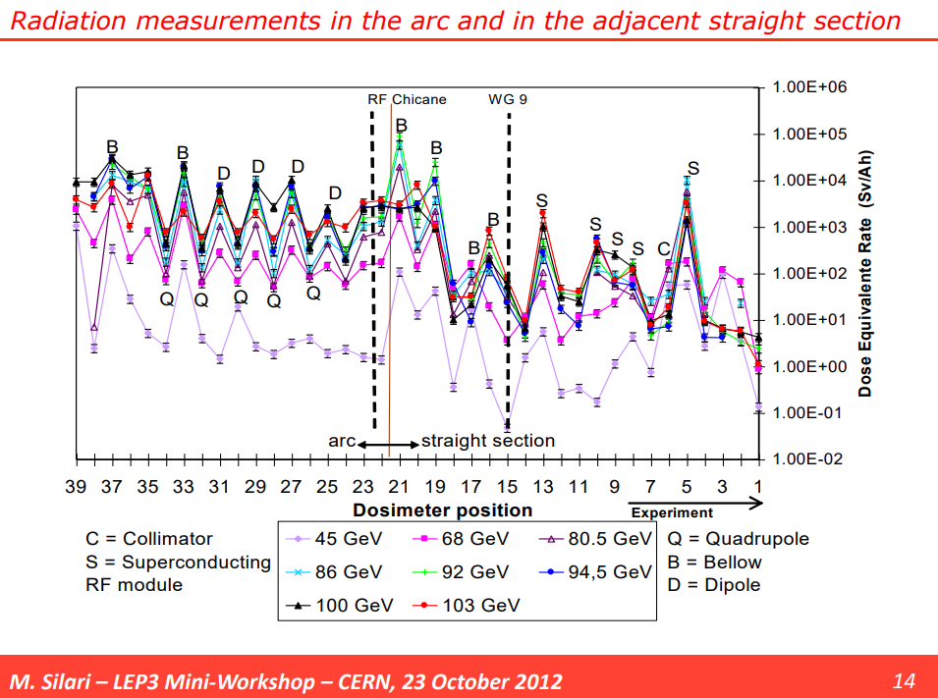
tunnel radiation doses at LEP

Slide 5
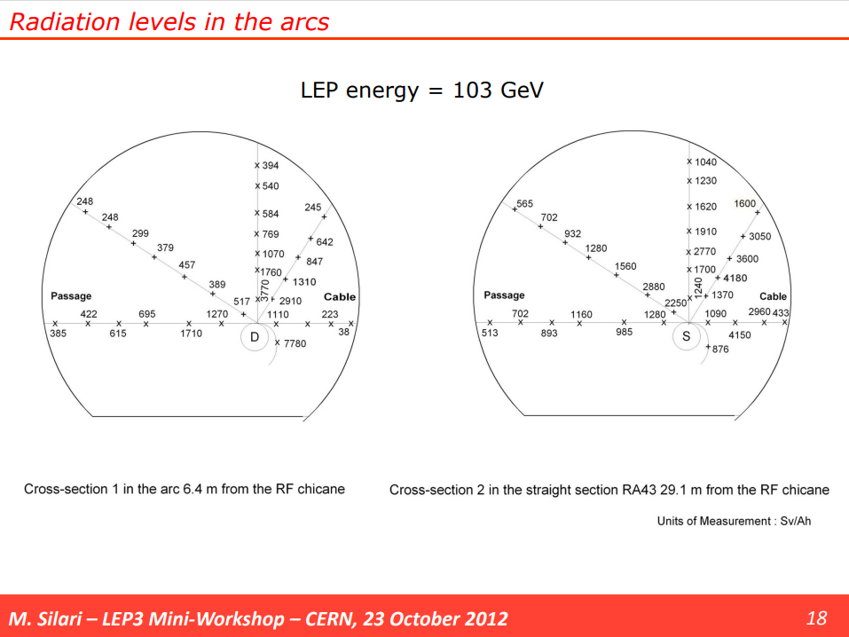
tunnel radiation doses at LEP

Slide 6
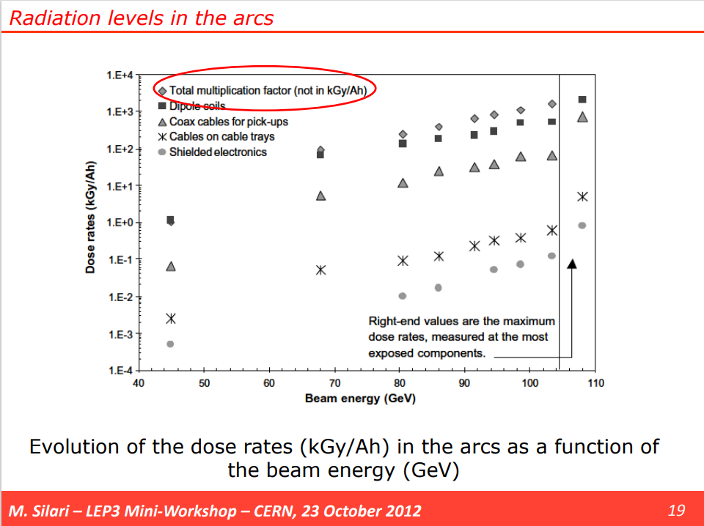
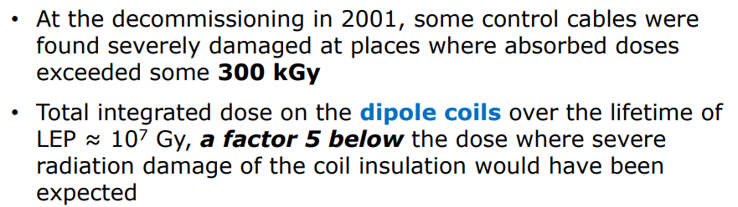

tunnel radiation doses at LEP
x15 Ah → $\sim$15 kGy

Slide 7
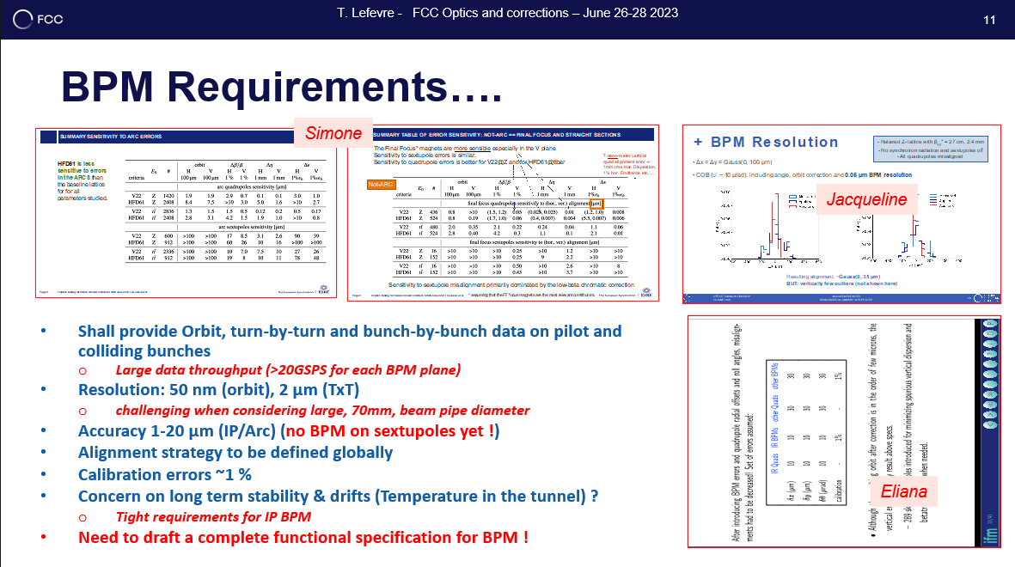
BPM specifications
Thibaut Lefèvre

Slide 8
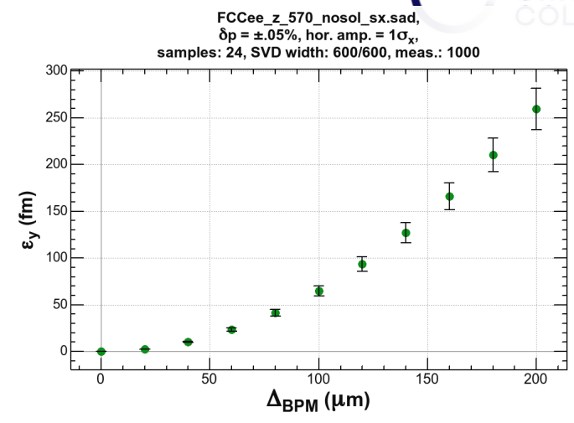
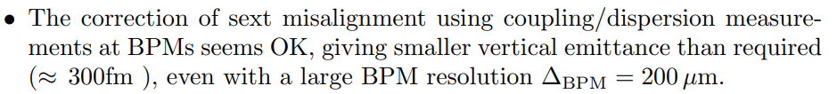
BPM specifications
Katsunobu Oide

Slide 9
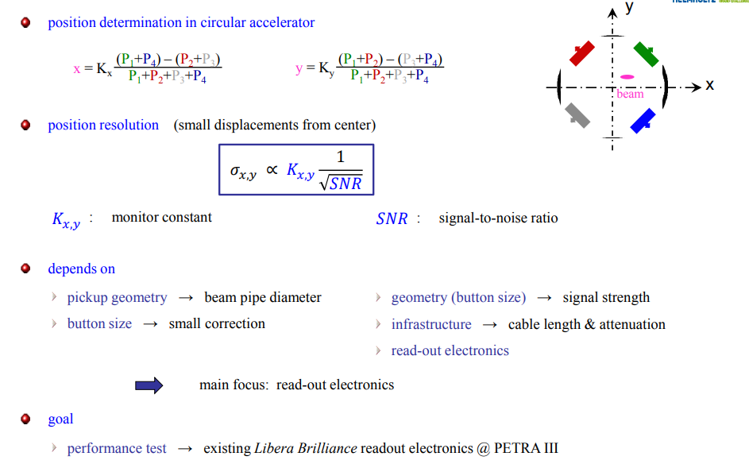

BPM resolution
$$K_{x,y}≈\frac{R}{\sqrt{2}}$$
G. Kube, DEELS2019 etc.

Slide 10
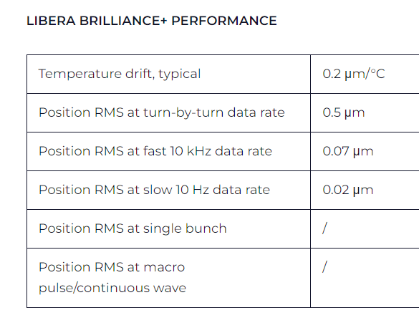
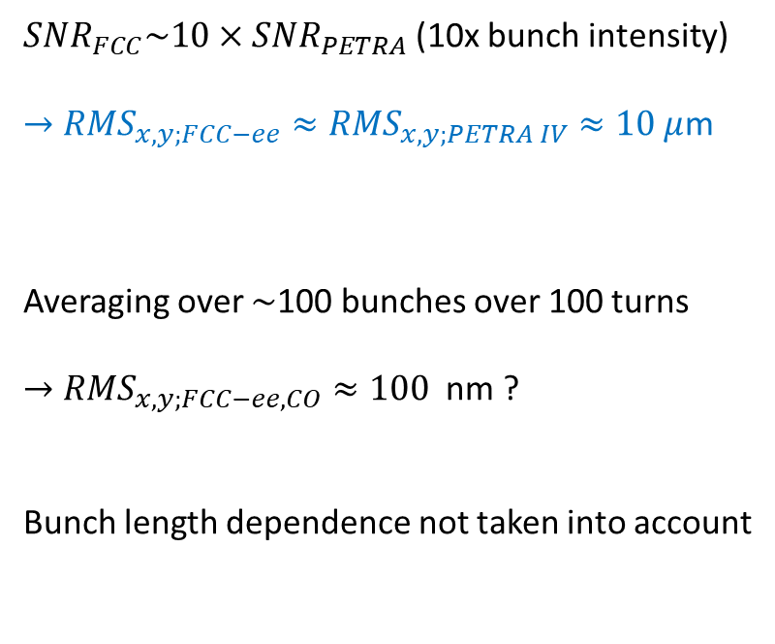
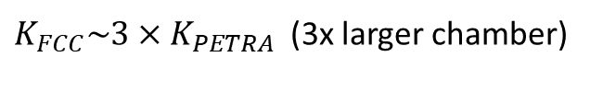
BPM resolution from PETRA IV to FCC-ee
Libera Brilliance resolution not sufficient for PETRA IV;
CDR relied on Libera Brilliance+
PETRA IV resolution target, single bunch (2.5$×{10}^{10})$turn by turn: 10 μm
$K_{FCC}\sim 3×K_{PETRA}$ (3x larger chamber)
${SNR}_{FCC}\sim 10×{SNR}_{PETRA}$(10x bunch intensity)
$→$ ${RMS}_{x,y;FCC−ee}≈{RMS}_{x,y;PETRA IV}≈10 μ$m
Averaging over $\sim$100 bunches over 100 turns
$→$ ${RMS}_{x,y;FCC−ee, CO}≈100$ nm ?
Bunch length dependence not taken into account

Slide 11
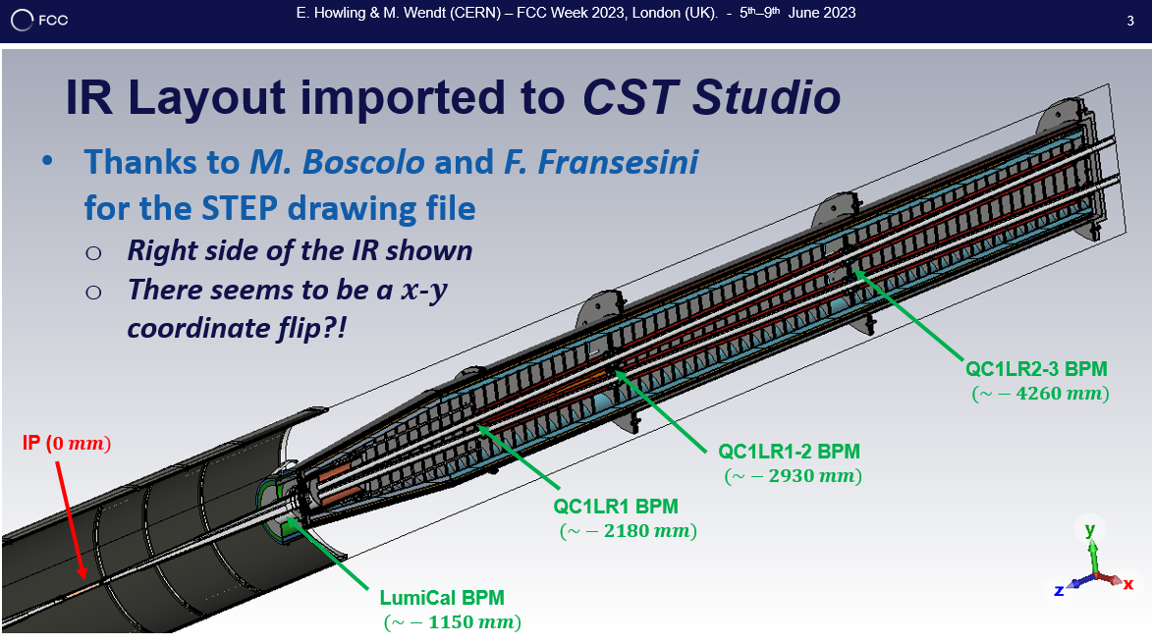
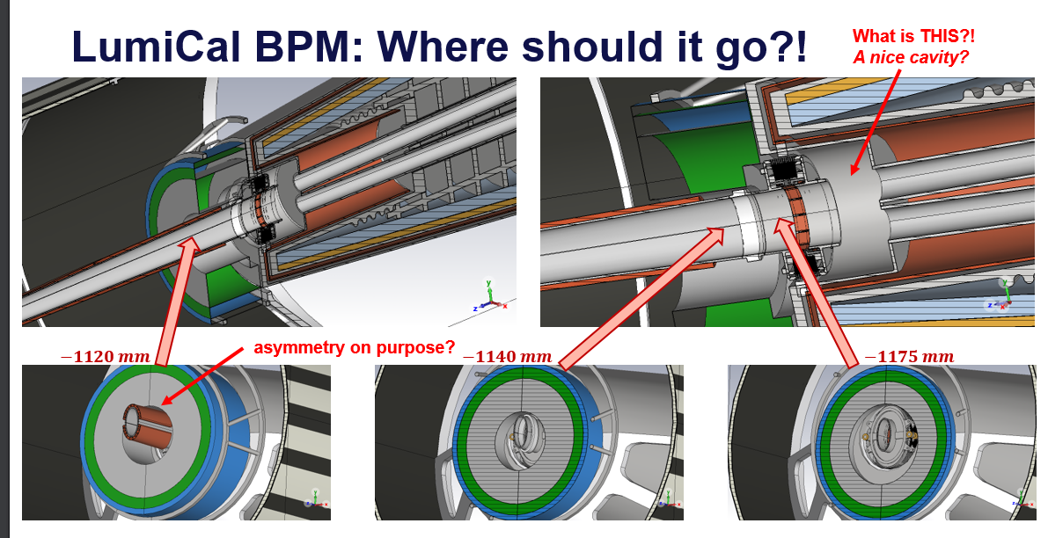
IR BPM
M. Wendt

Slide 12
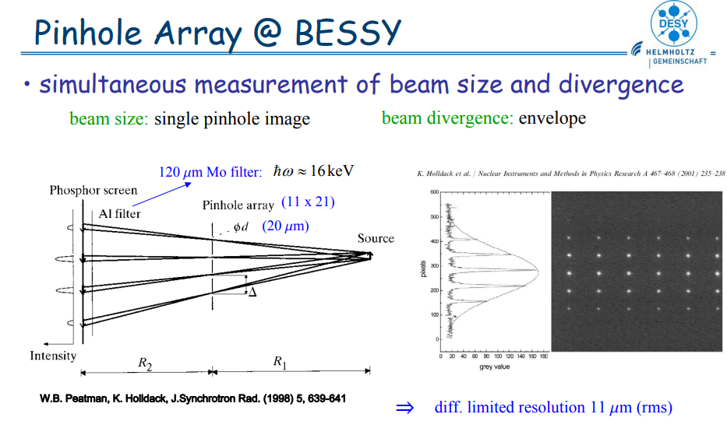
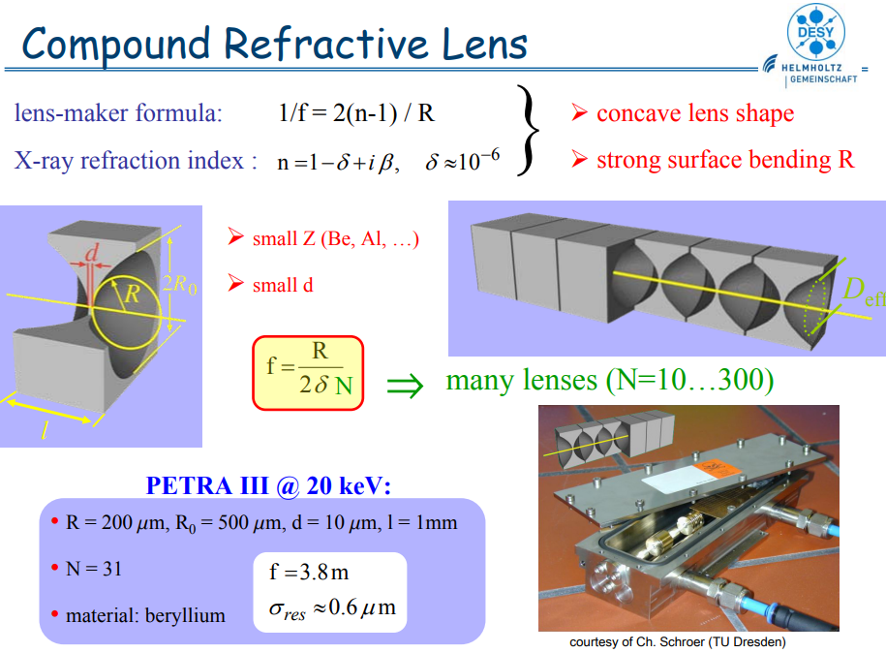


SR light diagnostics
diffraction limit
$$σ_{x}σ_{x^{′}}≥\frac{λ}{4π}$$
$${→σ}_{x}≥\frac{λγ}{4π}$$
resolution improvements
shorter wavelength, e.g. 10 keV photons (λ=0.12 nm), e.g. X-ray pin hole camera ?
interferometric approach, probing spatial coherence, double slit
G. Kube

Slide 13
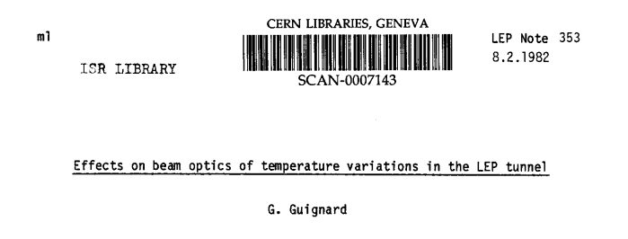
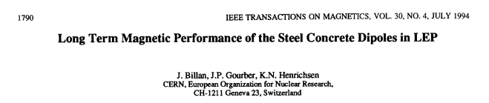
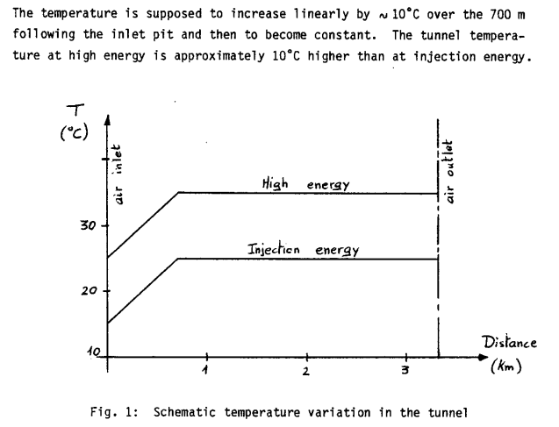
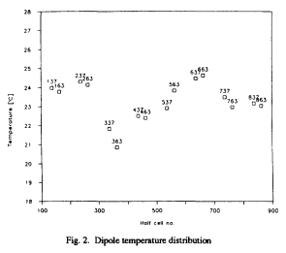
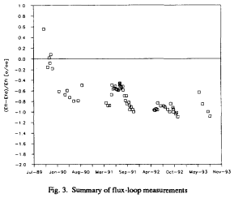
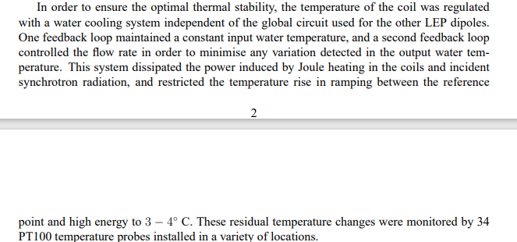



tunnel temperature stability
spatial variation $\sim$4 deg
time variation of flux
(needs to converted to T)
assumed variation between injection and top energy $\sim$10 deg
actual “residual” variation at spectrometer $\sim$3-4 deg

Slide 14
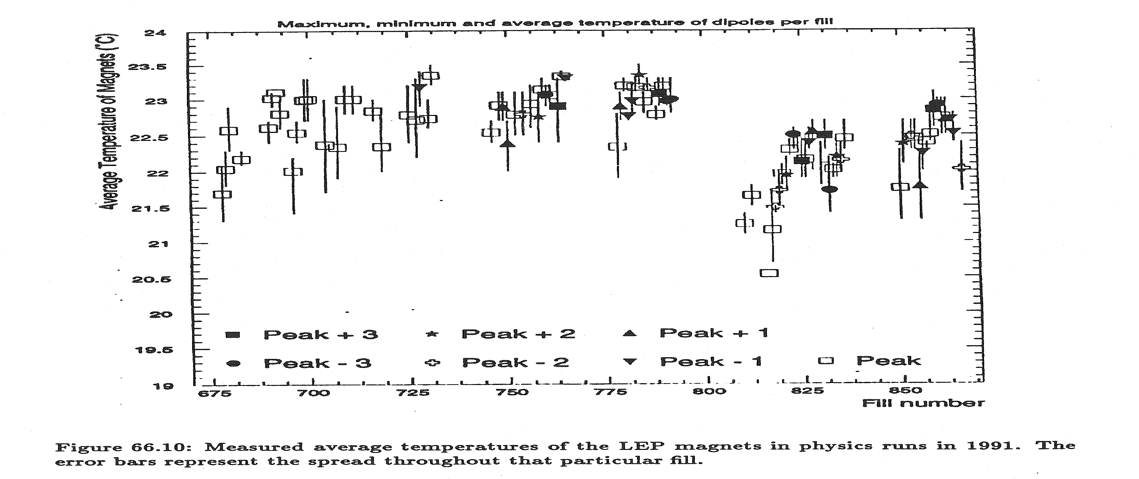
tunnel temperature stability – LEP1

Slide 15
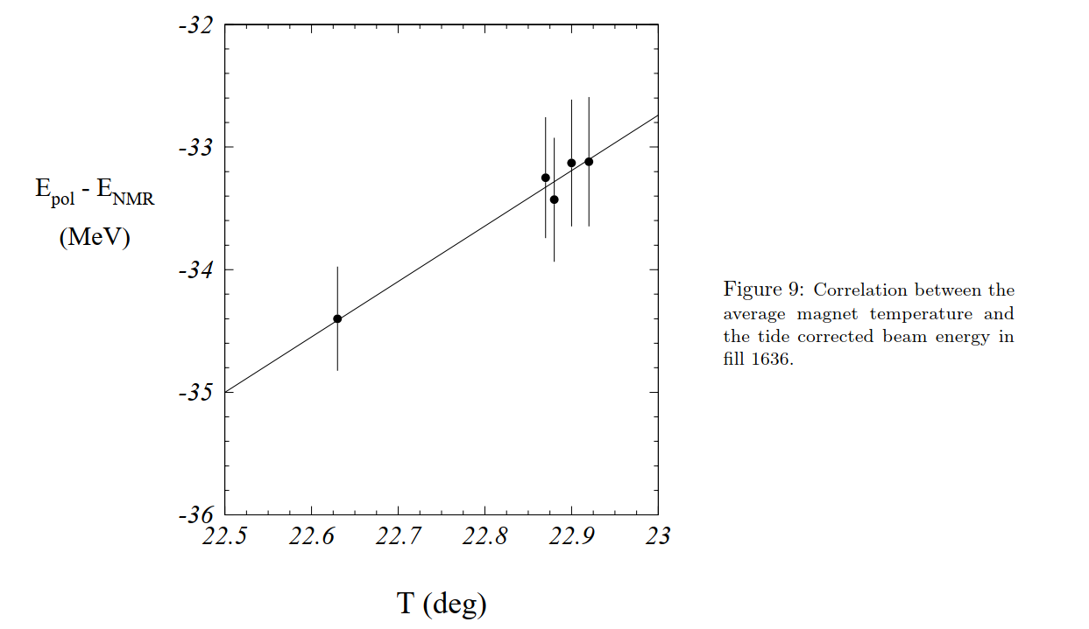
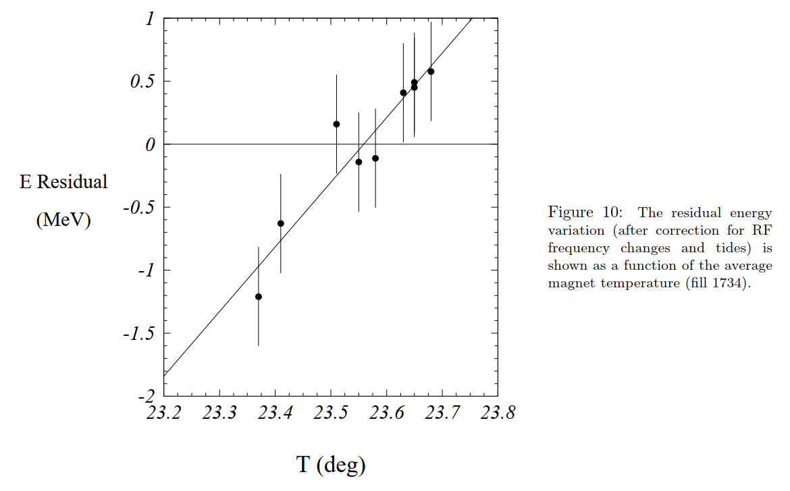

tunnel temperature stability – LEP1
L. Arnaudon et al., “Accurate Determination of the LEP Beam Energy by Resonant Depolarization”, CERN SL/94-71 (BI)
Magnet temperature change
during a LEP-1 fill $\sim 0.$4 deg

Slide 16
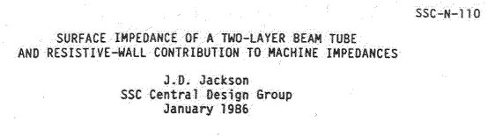
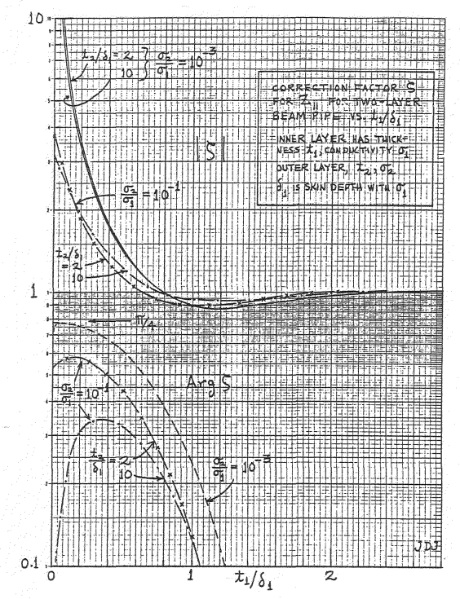
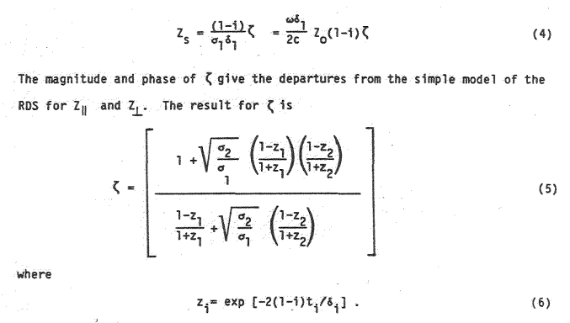
resistive-wall instability
can we conceive a possible multiplayer chamber which lowers the impedance at
lowest RW mode ?

