Slide 1
Applications of optical technology in accelerator instrumentation and diagnostics
John Byrd
Lawrence Berkeley National Laboratory

Slide 2
Introduction
Accelerator development has a long history of adopting and adapting new technologies to make bigger, better, and cheaper machines.
Revolutions in two fields are being applied towards accelerators:
  Ultrastable mode-locked lasers
  Optical fiber networking technology
Optical technology is approaching a similar level as RF and microwave technology to controlling accelerators.

Slide 3
Selected topics in optical accelerator instrumentation
Time
  Femtosecond timing distribution for accelerators using stabilized optical fiber links (LC, LPA, XFELs)
  Optical techniques for measuring ultrafast electron bunches (LC, LPA, XFELs)
Intensity
  Laser stripping of high intensity H- beams (PX, ADS)
  Laser diagnostics of H- beams (PX, ADS)

Slide 4

High precision timing and synchronization
Next generation linacs require unprecedented level of synchronization to achieve high beam quality: Linear colliders, FELs, and LPAs (staging)
  LC needs <50 fsec relative stability in linac systems
  CLIC needs <15 fsec
Master
1 psec=0.5 deg @1.3 GHz
Stabilized link
Stabilized link
Stabilized link
Stabilized link

Slide 5
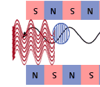
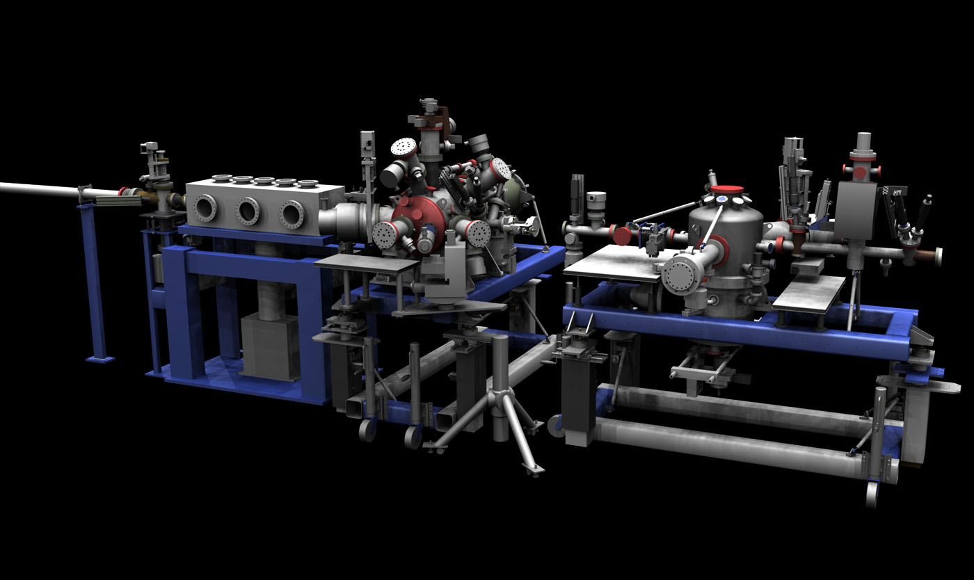
X-ray/optical Pump-probe
Pump laser
Laser pump pulse
∆t
Electron linac/undulator
Master
Ultrafast laser pulse “pumps” a process in the sample
Ultrafast x-ray pulse “probes” the sample after time ∆t
By varying the time ∆t, one can make a “movie” of the dynamics in a sample.
Synchronism is achieved by locking the x-rays and laser to a common clock.

Slide 6
Time and Frequency Domain
Stabilized Links
Fiber links can be stabilized based on the revolution in metrology time and wavelength standards over the past decade.
50% reflective mirror
CW Signal
Source
Optical fiber
Measure relative forward/reverse phase
Compensate fiber length
Maintain constant number of optical wavelengths
50% reflective mirror
Pulsed Signal
Source
Optical fiber
Measure repetition rate compared to source
Compensate fiber length
Maintain constant repetition rate of forward/reflected pulses
Correction BW limited to R/T travel time on fiber (e.g. 1 km fiber gives 100 kHz)

Slide 7
Three Challenges
Provide long-term stable clock over entire accelerator complex: injector, linac, diagnostics, and lasers
  Use stabilized links to maintain stable relative phase
  Laser-laser stability should be <10 fsec (maybe better).
  RF cavity stability should be <50-100 fsec.
Lock remote clients to stable clock
  Advanced digital controllers (RF and mode-locked laser oscillators)
  Direct seeding of remote lasers
Measure resulting electron and photon timing stability
  Femtosecond electron arrival time and bunch length and energy spread monitors
  Femtosecond x-ray arrival time, pulse length, spectrometer

Slide 8
Single Channel Link
Transmitter
Receiver
Signal fiber
RF phase
detect
and
correct
CW
laser
AM
d₂
FRM
FS
FRM
Rb
lock
Beat fiber
0.01C
0.01C
optical
delay
sensing
f_{FS}
f_{RF}
d₁
FRM is Faraday rotator mirror (ends of the Michelson interferometer)
FS is optical frequency shifter
CW laser is absolutely stabilized
Transmitted RF frequency is 2856 MHz
Detection of fringes is at receiver
Signal paths not actively stabilized are temperature controlled

Slide 9
RF Transmission tests
2km
0.01C
0.01C
RF phase
detection
and
correction
1560nm
RF in
phase
data
RF in
ref.
arm
CW
fiber
laser
AM
+50MHz
RF in
ref.
arm
+50MHz
delay
data
Rb
freq.
locker
optical
delay
sensing
Compare relative phase of 2856 MHz transmitted long and short stabilized links.
Shift RF phase to compensate for link variation
Compensate for GVD correction
Actively calibrate RF phase detection front end (mixers, splitters, etc.)

Slide 10
RF Transmission results
Relative delay of 2km and 2 meter fibers
61 hours

Slide 11
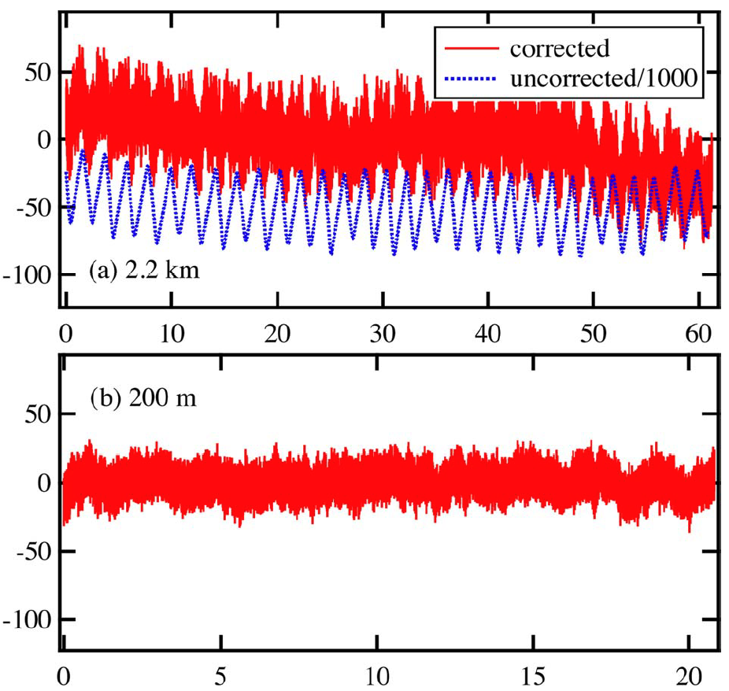
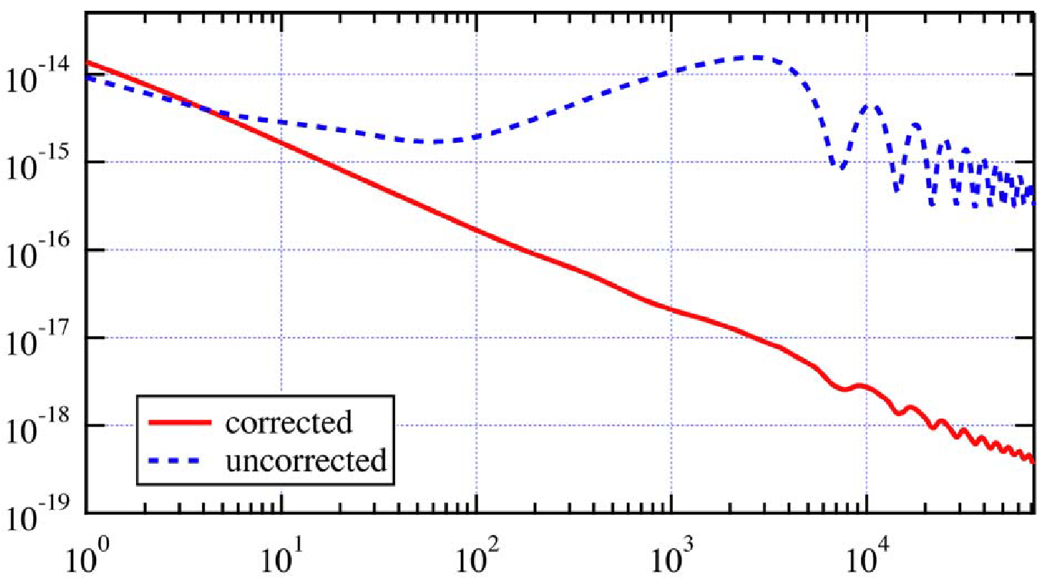
Detailed results
2.2km
1kHz bandwidth
For 2.2km, 19fs RMS over 60 hours
For 200m, 8.4fs RMS over 20 hours
2-hour variation is room temperature
delay error, femtoseconds
200m
Allan deviation
2km data
time, hours
time, seconds

Slide 12
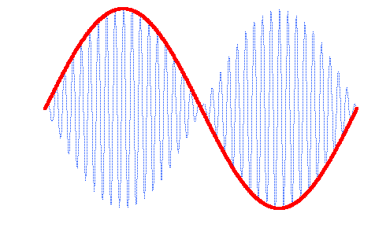
All-optical lock schemes
Synchronization of lasers with RF signals limited by resolution in phase(0.01 deg@3GHz=10 fsec)
Go to optical frequencies…
Create a beat wave generated from two mode-locked comb lines (up to a few THz)
Lock the beat wave of one laser with a remote laser

Slide 13
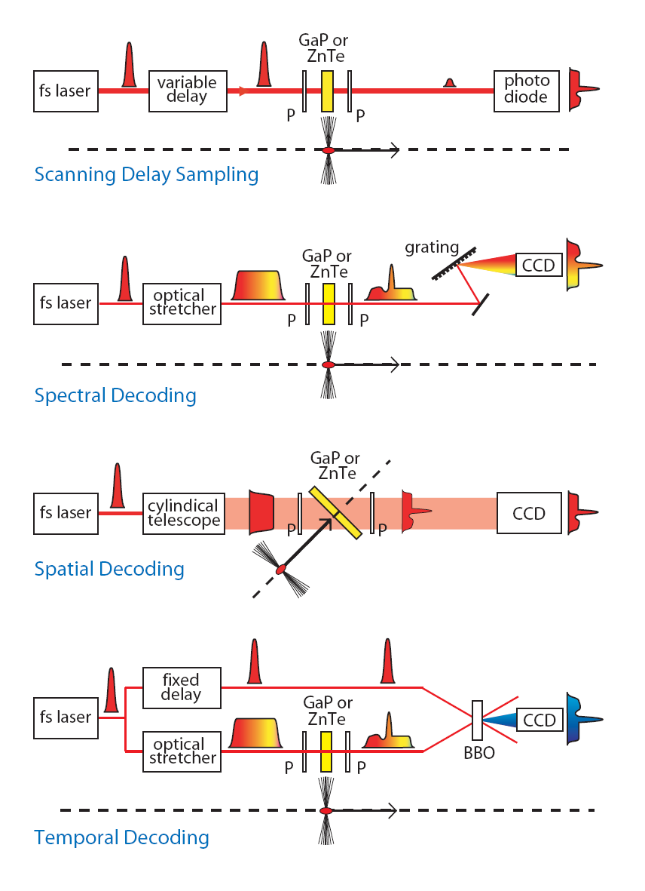
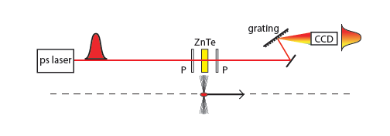
Electro-Optic Detection of Direct Beam Fields
Spectral Decoding
complexity
FELIX
DESY
LBNL
...
demonstrated
time resolution
Spatial Encoding
SLAC
DESY
LBNL, ...
Temporal Decoding
FELIX
DESY
RAL(CLF)
MPQ
Jena, ...
spectral upconversion

Slide 14
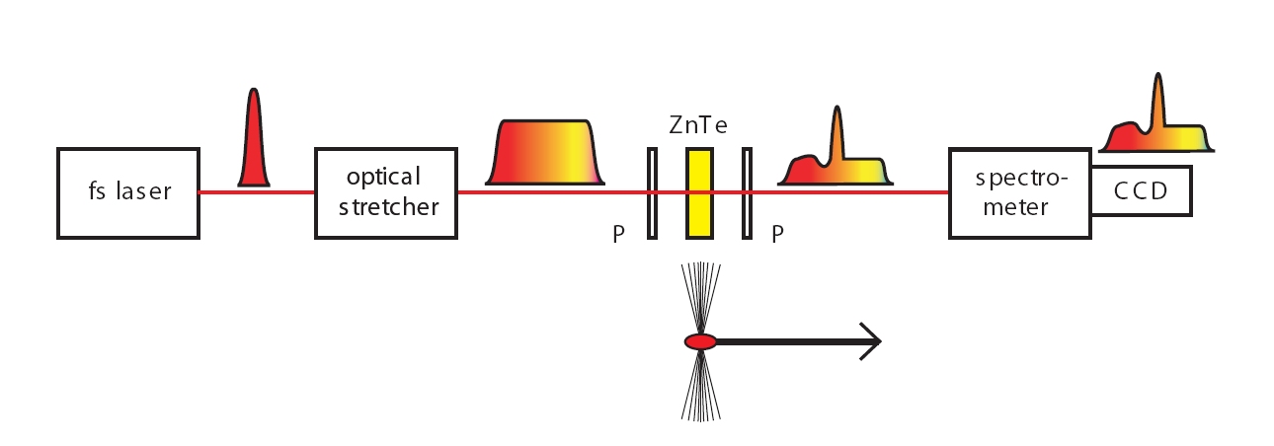
EO Sampling: spectral encoding
Probe laser is optically stretched with time-wavelength correlation
EO effect is imprinted on pulse
Correlation is imaged from an optical spectrometer.

Slide 15
Spectral upconversion diagnostic
Aim to measure the bunch Fourier spectrum...
use long pulse, narrow band, probe laser
same physics
as “standard” EO
... accepting loss of phase information
& explicit temporal information
... gaining potential for determining
information on even shorter structure
... gaining measurement simplicity
laser complexity reduced, reliability increased
laser transport becomes trivial (fibre)
problematic artefacts of spectral decoding become solution
NOTE: the long probe is converted to optical replica
Courtesy, S. Jamison

Slide 16
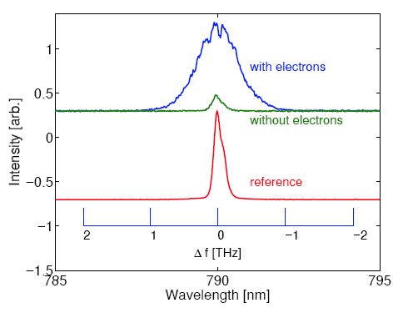
Spectral upconversion diagnostic
Results from experiments at FELIX (Feb 2009)
Theory / Expt. comparison
in FEL’09; (Appl. Phys. Lett.)
FELIX
temporal
profile
sum
frequency mixing
difference
frequency mixing
inferred
FELIX
spectrum
S.P. Jamison, G. Berden, P. J. Phillips, W.A. Gillespie, A.M. MacLeod
APL 2010: 96(23): 231114- 231114-3

Slide 17
Group-velocity mismatch
Inside the crystal the two different wavelengths have different group velocities.
Define the Group-Velocity
Mismatch (GVM):
As the pulse
enters the crystal:
Second harmonic created
just as pulse enters crystal
(overlaps the input pulse)
Crystal
Second harmonic pulse lags
behind input pulse due to GVM
As the pulse
leaves the crystal:

Slide 18
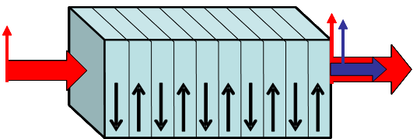
Alternative method for phase-matching: periodic poling
Recall that the second-harmonic phase alternates every coherence length when phase-matching is not achieved, which is always the case for the same polarizations—whose nonlinearity is much higher.
Periodic poling solves this problem. But such complex crystals are hard to grow and have only recently become available.
Notes:
Drawing courtesy of George Stegeman of CREOL.

Slide 19
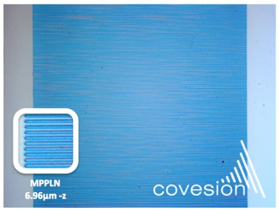
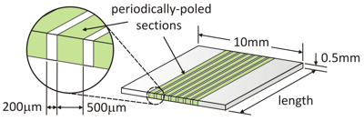
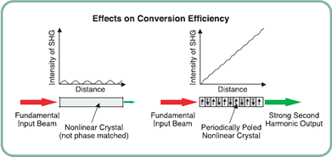
Example product
Covesion MgO:PPLN for Second Harmonic Generation

Slide 20
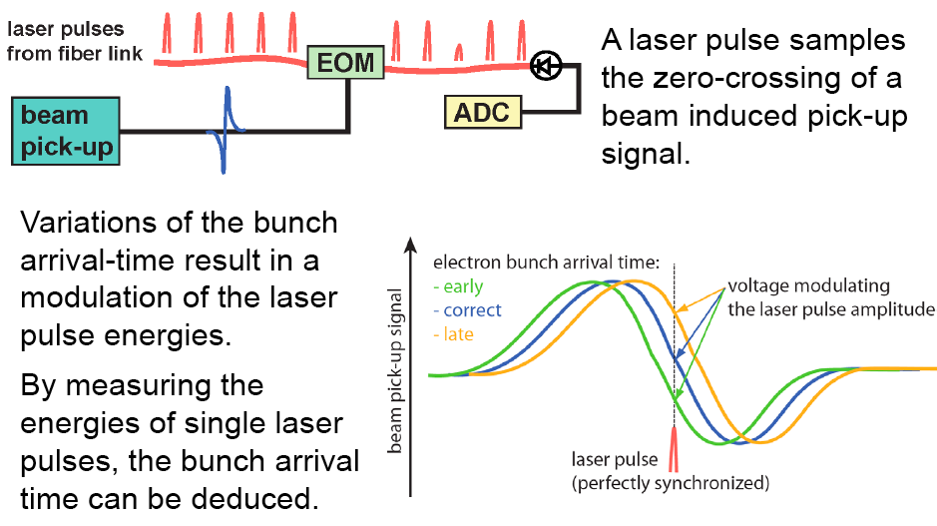
Example: Beam Arrival Time Monitor using MLL pulses
Florian Loehl, et al., PRL 104, 144801 (2010)

Slide 21
Sub-fsec arrival monitor
Sensitivity of e-beam arrival monitors proportional to reference frequency.
Use THz beat wave as a reference frequency.
Electro-optically modulate beat wave with e-beam electric field.
fsec e-bunch

Slide 22
Frequency-Resolved Optical Gating (FROG)
FROG involves gating the pulse with a variably delayed replica of itself in an instantaneous nonlinear-optical medium and then spectrally resolving the gated pulse vs. delay.
Pulse to be measured
SHG FROG is simply a spectrally resolved autocorrelation.
Beam
splitter
E(t–τ)
Camera
SHG
crystal
Spec-
trometer
E(t)
E_{sig}(t,τ)= E(t)E(t-τ)
Variable delay, τ
Use any ultrafast nonlinearity: Second-harmonic generation, etc.
Notes:
Invented by Rick Trebino and Dan Kane

Slide 23
SHG FROG Measurements of a Free-Electron Laser
Richman, et al., Opt. Lett., 22, 721 (1997).
5
5
4
4
3
3
Intensity
Spectral Intensity
Spectral Phase (rad)
Phase (rad)
2
2
1
1
-4 -2 0 2 4
0
5076 5112 5148
0
Time (ps)
Wavelength (nm)
SHG FROG works very well, even in the mid-IR and for difficult sources.

Slide 24
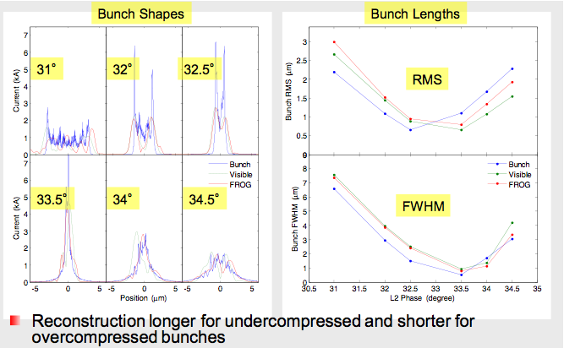
Simulated FROG results for LCLS

Slide 25
Laser-(assisted) Stripping of high intensity H- beams
Charge exchange injection is used for high intensity accumulation in proton synchrotrons
  Accelerate H- beams
  Remove first electron via Lorentz stripping (magnetic field)
  Remove second electron with carbon foil
Issues
  Foil generates losses in the ring
  Losses activate accelerator components
  Carbon foils cannot survive multi-MW beams
  Machine impedance
Possible Solution: Laser stripping of hydrogen
  Use optical field to promote electron to higher energy level and Lorentz strip
Challenges:
  Laser systems with sufficient average power and quality to achieve 100% stripping.
e
e
H⁰
H-
p
p

Slide 26
Laser Stripping: transport and cavity system
transport
optics
from
laser
active
align
H- beam
~20cm
waist, 40um
evacuated
tube
active
align
transmitted
power
coarse
tune
info
reflected
power and
alignment
sensor
motor/piezo
controller
fine tune info
Four-mirror cavity:
Round-trip time relatively independent of focal spot size
Cavity length is actively tuned to stay on optical resonance
Pulse length is long enough to not require stabilization of laser offset frequency

Slide 27
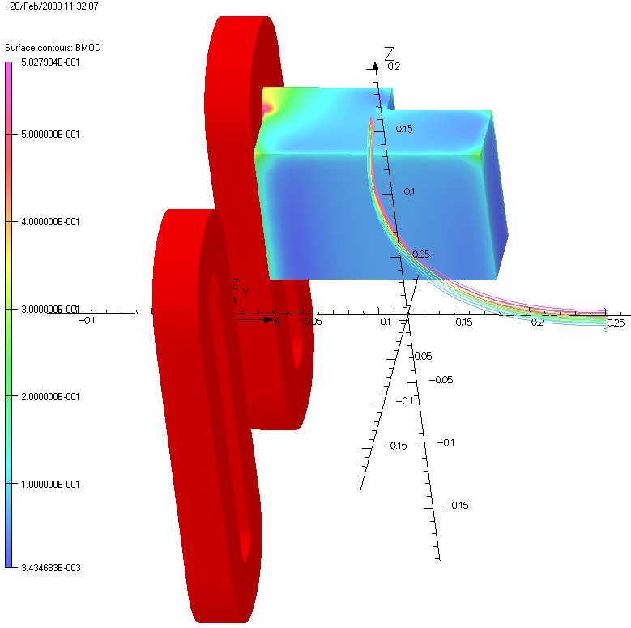
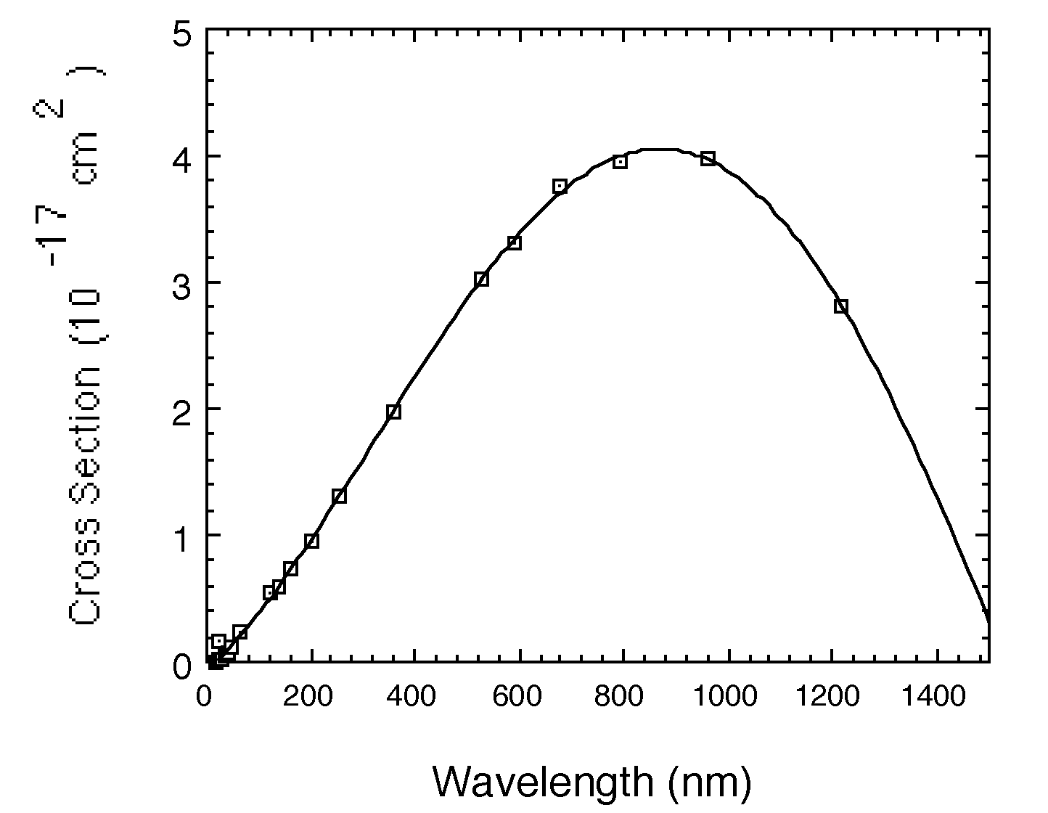
Laser Neutralization of H⁻
detector
Radius ~ 4”
Photodissociation for H⁻ ions is 0.75eV
Photons with λ<1500 nm can separate H⁻ ion into free electron and neutral H
Deflect and detect low energy electrons
H-
laser
Used at Los Alamos for transverse and longitudinal emittance measurements
Routinely used in SNS for measurement of transverse beam profiles
Challenge: reproduce this setup at multiple stations along the linac.
Solution: fiber distribution of laser signal.
Photodissociation x-section

Slide 28
Overall layout
integrating
sphere
power monitor
H-
e-
Narrow band lockin amp detects 1MHz modulated signal
Laser reprate is locked to 325MHz from machine
Galvo scan is triggered by macropulse event signal
Upper components are in tunnel, lower are in a laser hutch
Faraday cup
transimpedance
preamp
galvo
fiber
coax
amplitude
modulator
lockin
amp
mod
1MHz
MLL
laser
lock
box
timing
control
control, analysis

Slide 29
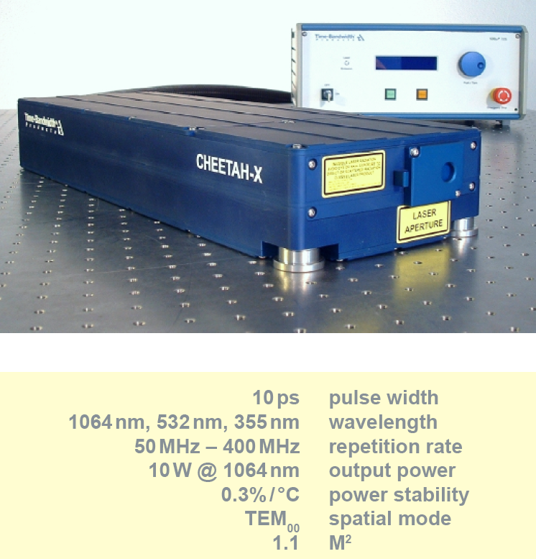
Commercial 10ps, 10W, 325MHz laser
Modelocked laser with internal amplifier
Sealed laser head, turn key
Pulse widths can be longer than 10ps, fixed at factory
Sync to RF option
Our laser is basically the same, without amplifier

Slide 30
Distribution to multiple stations
400m (approximate size of facility)
100m
laser
100m
100m
laser
100m
Loss will be 10dB or less through 100m fibers
Alternative is more lasers of lower power, but it’s $99k for 10W, $84k for 0.8W
No problem with solid fiber, <1dB
laser
precision rotation stage directs beam to any of 8 outputs by “go to position” command
hollow fiber
solid fiber
pre-aligned collimators on X-Y and tilt stages

Slide 31
Summary
Time
  Present:Femtosecond timing distribution has demonstrated <10 fsec over few km. Future: Demonstrate <1 fsec and 20 km.
  Present: EO sampling techniques can measure electron signals with 10 THz bandwidths. Arrival times w.r.t clock at <10 fsec. Internet communication technology quite relevant.
  Future: Demonstrate <1 fsec.
Intensity
  Present: Laser stripping principle demonstrated. IR laser systems capable of ~100% stripping to be demonstrated in the next year.
  Future: UV laser systems under development
  Present: Concepts for fiber delivery of laser wires are developed.
  Future: Demonstrate concept on prototype H- beam.

