Slide 1


Search for the Higgs boson in WH −>lνbb and WW^{(*)} −> lνlν decay modes on ATLAS
German D Carrillo Montoya, Lashkar Kashif
University of Wisconsin-Madison
On behalf of the ATLAS Collaboration
DPF 2011, Brown University, Rhode Island
August 10, 2011

Slide 2
Outline
Data samples
WH, H −> bb:
- event selection
- backgrounds
- systematics
- exclusion limit on Higgs cross-section
H −> WW ^{(*)} −> lνlν :
- event selection in 0- and 1-jet channels
- backgrounds
- exclusion limit
Conclusion and outlook

Slide 3
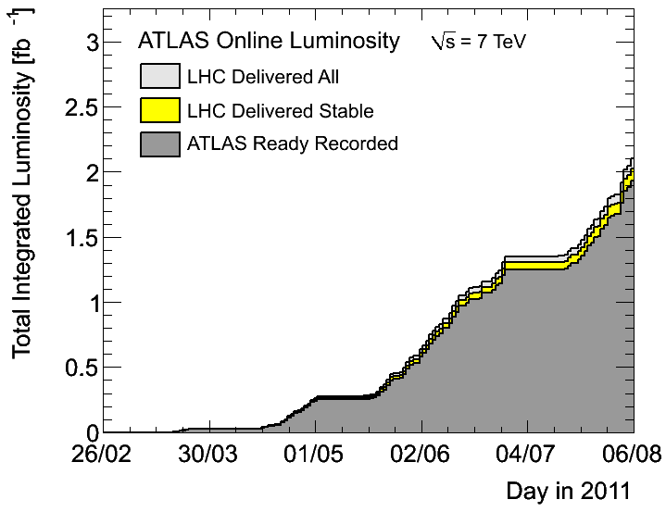
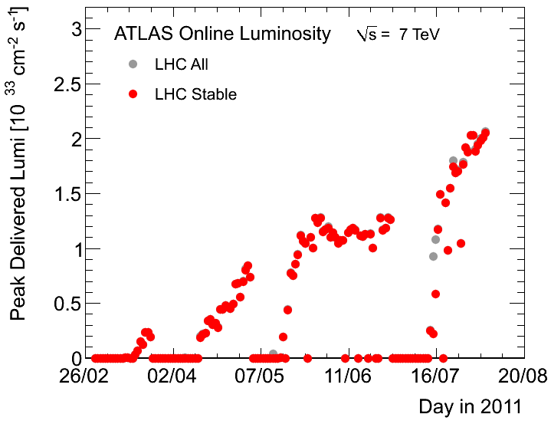
Data sample
Dataset used in these analyses
These analyses based on 1.04 fb⁻¹ data from March-June 2011
Maximum instantaneous luminosity ~1.26 * 10³³ cm⁻² s⁻¹
Error on luminosity: 3.7%
Average #interactions per bunch crossing ~6

Slide 4
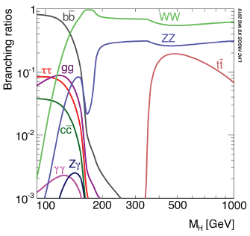
The WH −>lνbb channel
H−>bb branching fraction is large at low masses
~2/3 at M_{H} = 120 GeV
Inclusive H−>bb search difficult owing to large prompt bb background
Assoc. production with leptonically decaying W makes a search feasible
- cross-section*BR ~ 85 fb for M_{H} = 120 GeV
Simple cut-based analysis: require two b-tagged jets in addition to W search criteria
Higgs signal would show up as excess in bb invariant mass spectrum

Slide 5
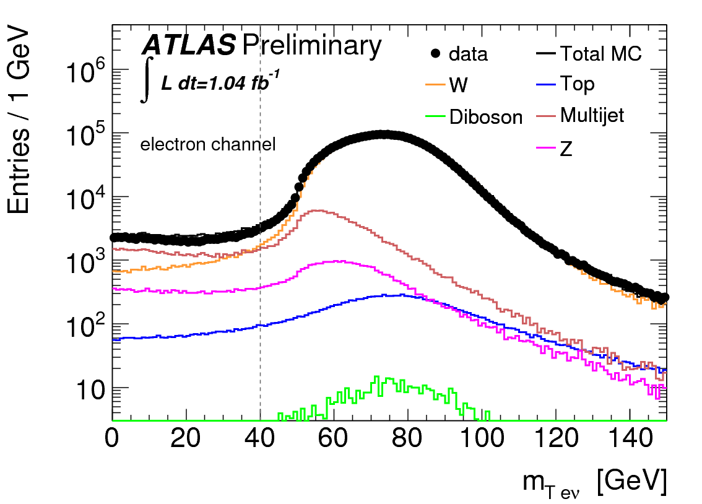
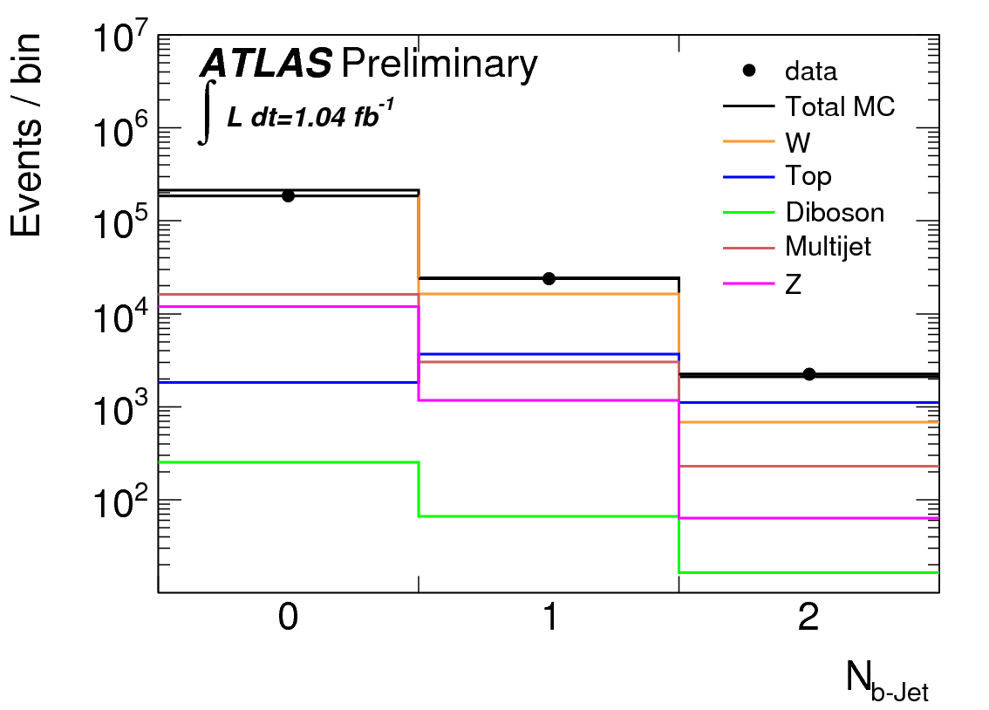
WH: event selection
Trigger: lowest-threshold unprescaled triggers
electron: 20 GeV
muon: 18 GeV
Exactly 1 lepton in event:
P_{T} > 25 GeV, |η^{μ}| < 2.4, |η^{e}| < 2.47
Exactly 2 jets in event:
E_{T} > 25 GeV, |η| < 2.5
- reconstructed using anti-k_{T} algorithm
- both jets must be b-tagged
E_{T}^{miss} > 25 GeV
Transverse mass M_{T} > 40 GeV

Slide 6
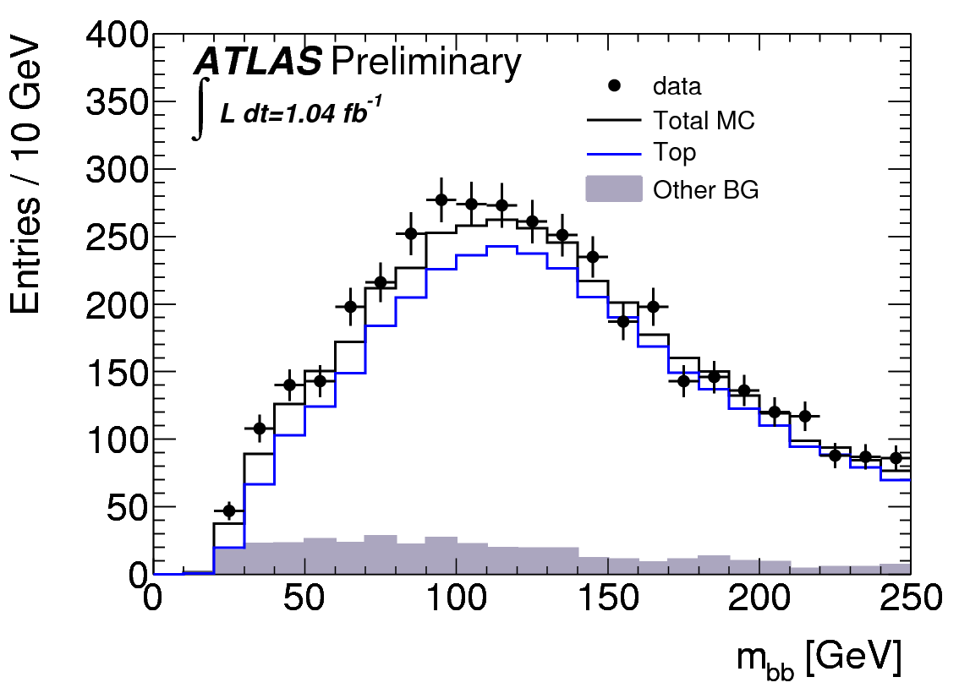
WH: backgrounds
Top: dominant at high m_{bb}
Take shape from MC, but extract normalization using m_{bb} sidebands in data
- m_{bb} < 80 GeV, 140 < m_{bb} < 250 GeV
Cross-check in top control region in data requiring 3 jets
Top control region
W+bb: main contribution at low m_{bb}
Take shape from m_{jj} distribution of un-b-tagged jets in MC
Get normalization from sidebands as for top background
QCD: extracted from template fit, using E_{T}^{miss} template from data
WZ (irreducible), WW: small, estimated from MC

Slide 7
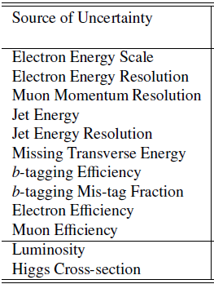
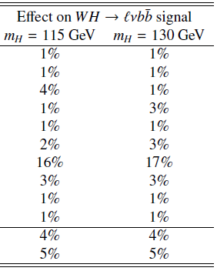
WH: systematic uncertainties on event yield
By far, dominant systematic uncertainty is from b-tagging
Uncertainties on background estimates:
top: 6%, W + bb: 9%, QCD: 50%, diboson: 11%

Slide 8
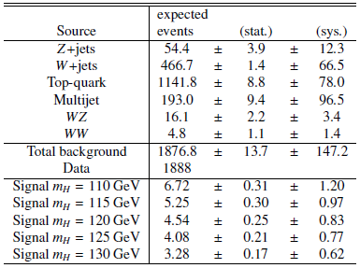
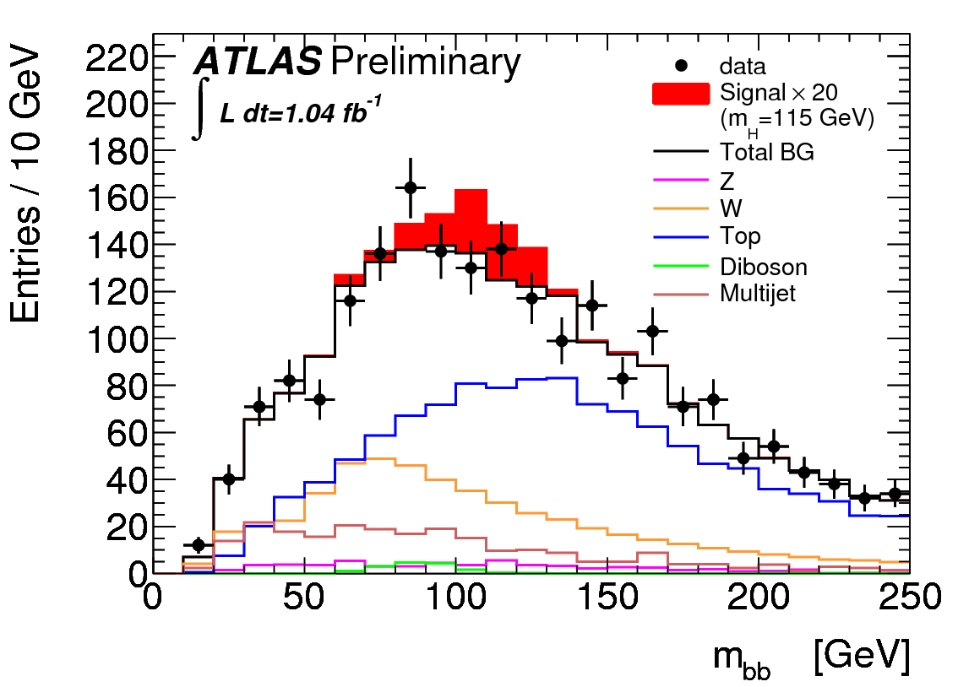
WH: results
We compare observed event count with expectation, including signal in range 110 GeV < M_{H} < 130 GeV
No significant excess over background is observed −> set limits

Slide 9
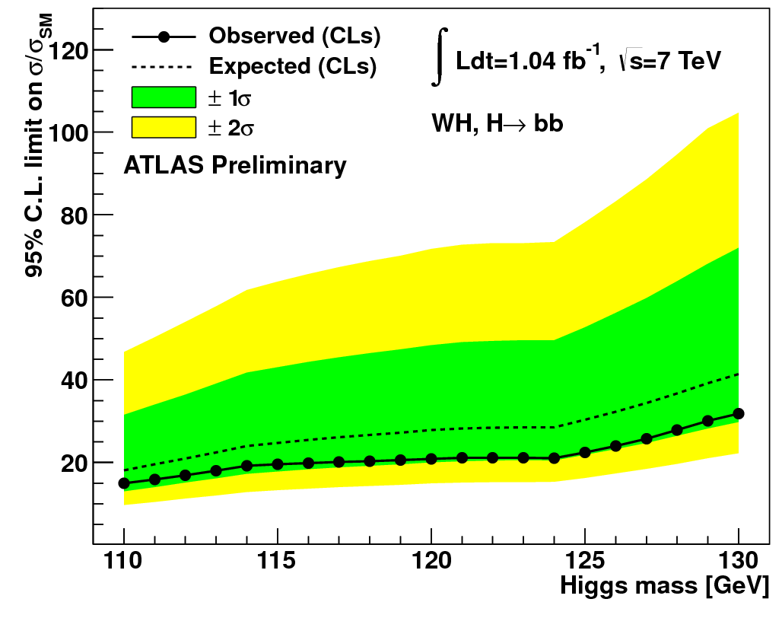
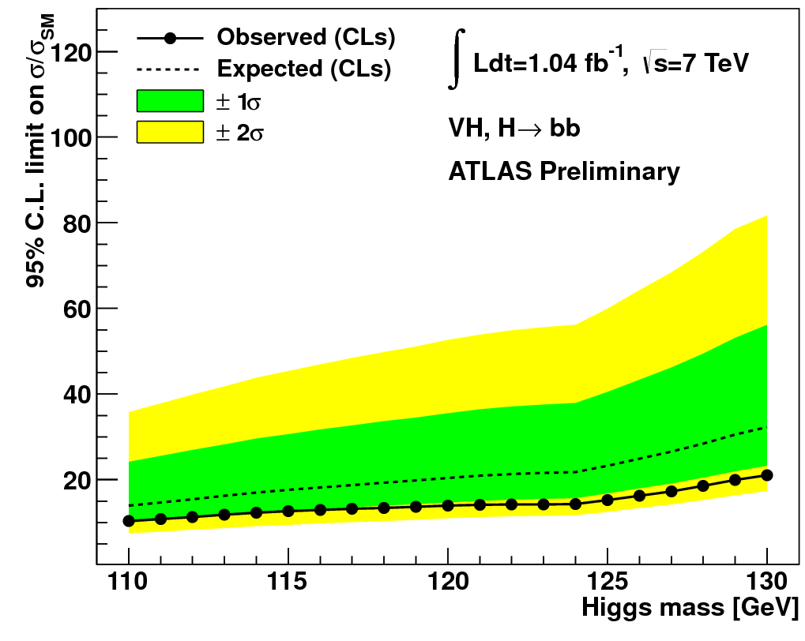
WH: limits
Combination of WH and ZH
Cross-section limits at 95% CL are 15-30 times the Standard Model cross-section for 110 GeV < M_{H} < 130 GeV
Combination with ZH channel yields limits between 10 and 15 times SM cross-section

Slide 10
The H −>WW ^{(*)} −> lνlν channel
H −> WW −> lνlν is a very sensitive channel for M_{H} ~ 2 M_{W}
- one of two channels that currently exclude the SM Higgs at LHC for some masses
- very promising discovery channel
Cross-section*BR ~ 0.45 pb for M_{H} = 150 GeV
6 final states: ee, eμ, μμ channels, each accompanied by 0 or 1 jet
- event selection is basically selecting two leptons and large missing E_{T}
Currently, the analysis covers mass range of 110 GeV < M_{H} < 240 GeV

Slide 11
H−>WW: event selection
Trigger depends on lepton channel:
ee: 20 GeV single electron trigger
μμ: OR of two single muon triggers
eμ: OR of above three triggers
Exactly 2 leptons in event, leading lepton P_{T} > 25 GeV
- subleading lepton: P_{T} (e) > 20 GeV, P_{T} (μ) > 15 GeV
ee, μμ channels:
m_{ll} > 15 GeV, |m_{ll} - m_{Z}| > 15 GeV, MET_{rel} > 40 GeV
eμ channel:
m_{ll} > 10 GeV, MET_{rel} > 25 GeV
MET_{rel} = E_{T}^{miss} if Δφ_{min} > π/2
E_{T}^{miss} * sin(Δφ_{min}) if Δφ_{min} < π/2
where Δφ_{min} = min[Δφ(E_{T}^{miss} , l), Δφ(E_{T}^{miss} , j)]

Slide 12
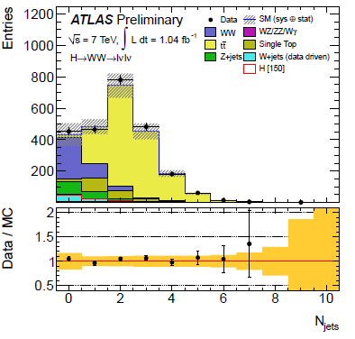
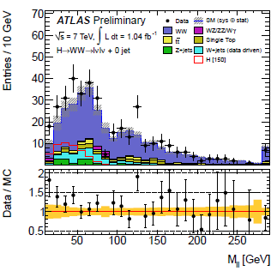
H−>WW: topological selections
Events are divided into 0- and 1-jet final states
- if 1-jet event, apply b-jet veto to reduce top background
Apply Higgs mass-dependent cuts
M_{H} < 170 GeV:
m_{ll} < 50 GeV
Δφ_{ll} < 1.3
M_{H} >= 170 GeV:
m_{ll} < 65 GeV
Δφ_{ll} < 1.8
0.75*M_{H} < m_{T} < M_{H}

Slide 13
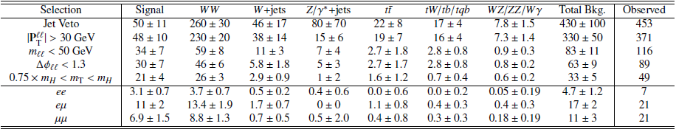
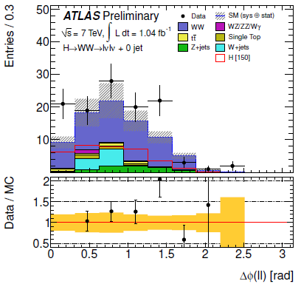
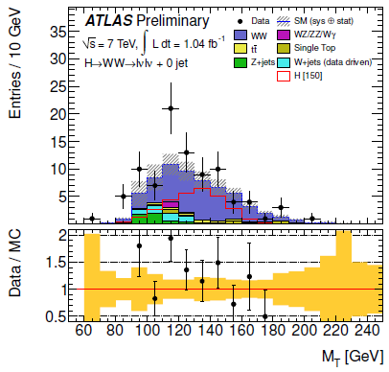
H−>WW: 0-jet channel

Slide 14
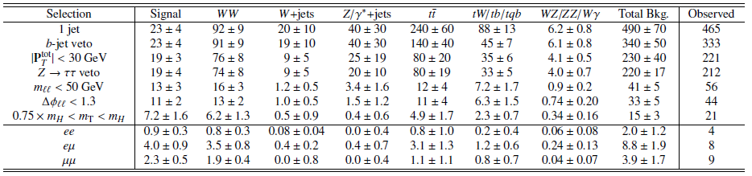
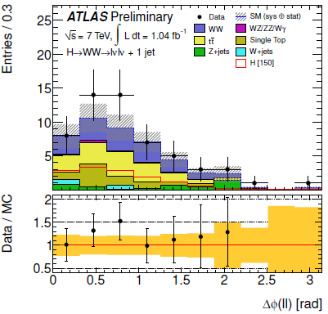
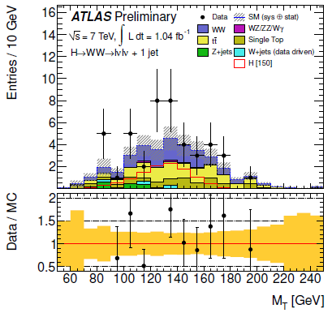
H−>WW: 1-jet channel

Slide 15
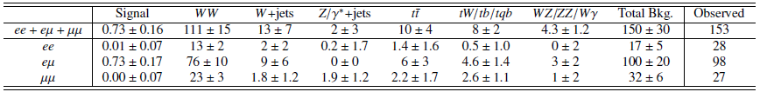
H−>WW: backgrounds
WW: dominant background in 0-jet channel
Dedicated control region in data used to derive normalization in signal region
Require m_{ll} > 80 GeV, remove topological cuts
Top: dominant background in 1-jet channel
Normalization from control region: reverse b-jet veto and remove topological cuts
W+jets: fully data-driven, control sample in data obtained requiring one loose lepton, while other lepton must pass tight selection
Estimate a fake factor in dijet data using an orthogonal trigger
Z + jets: ‘ABCD’ method: derive MET mismodelling factor

Slide 16
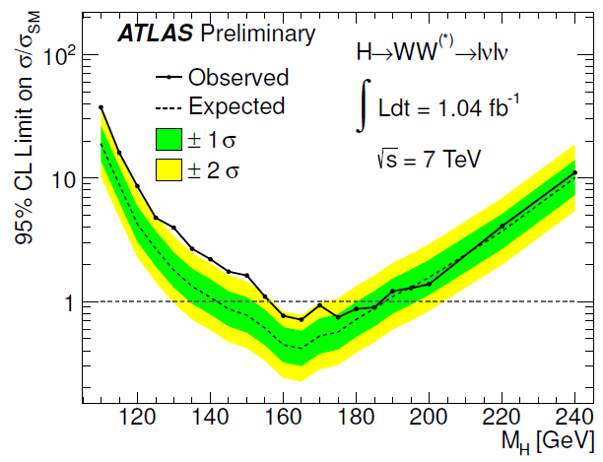
H−>WW: limits
We exclude a SM Higgs with 158 GeV < M_{H} < 186 GeV at 95% CL
Observed limit is >=2σ higher than expected in range 126 GeV < M_{H} < 154 GeV

Slide 17
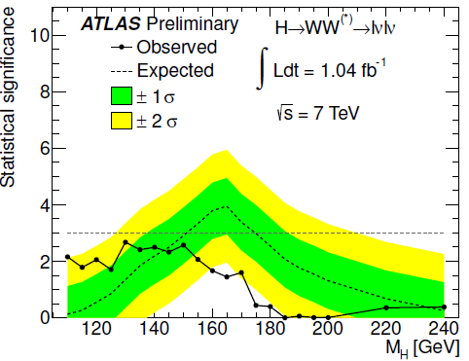
Conclusion and outlook
We have presented ATLAS Higgs search results in the WH −>lνbb and H−>WW^{(*)} di-leptonic decay channels
WH −>lνbb sets limits on Higgs production cross-section 15-30 times the Standard Model cross-section for 110 GeV < M_{H} < 130 GeV
H−>WW^{(*)} −> lνlν excludes Standard Model Higgs in mass range 158 GeV < M_{H} < 186 GeV at 95% confidence level
- intriguing excess seen at lower masses
The LHC is increasing our dataset fast −> new results expected soon
Analysis improvements meanwhile
multivariate analyses
reduced systematics
Signal significance in H−>WW−> lνlν

