Slide 1
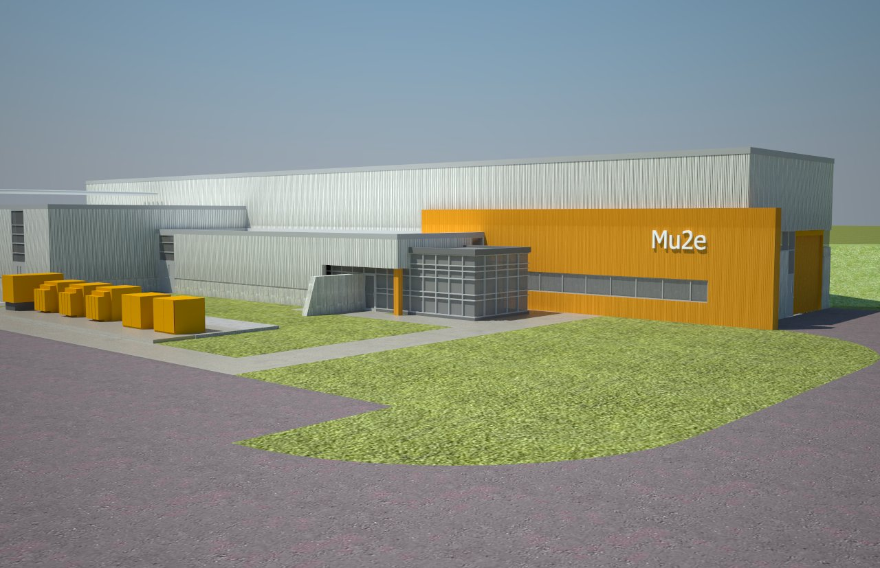
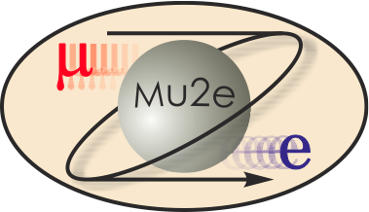
Summary and Status of the Mu2e Experiment at Fermilab
2011 DPF Meeting
Craig Group
(University of Virginia and Fermilab)
…on behalf of the Mu2e collaboration.

Slide 2
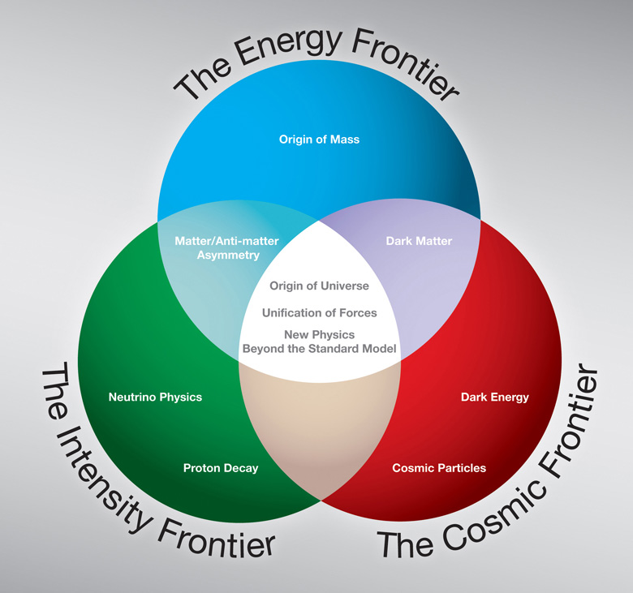
The Frontiers of Particle Physics
Mu2e

Slide 3
The Intensity Frontier!
One can probe the properties of the universe by looking for extremely rare processes
Complementary alternative to using higher energies
The medium-term future of accelerator-based particle physics on US soil is the intensity frontier:
  Neutrino experiments (NOvA, LBNE, MINOS, MINERvA, and others… )
  Precision measurements (g-2)
  Rare decays (Mu2e, MEG, COMET, and others)

Slide 4
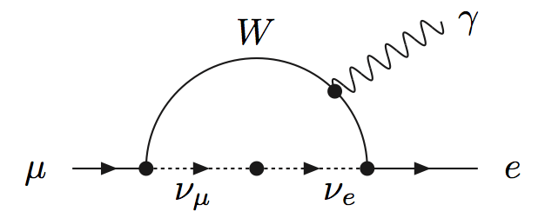
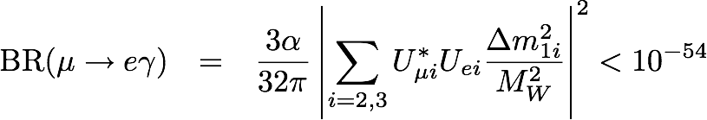
Charged Lepton Flavor Violation (CLFV)
Neutrinos have mass!
    → individual lepton numbers are not conserved!
Therefore, Lepton Flavor Violation occurs in Charged Leptons!
NO PHYSICS BACKGROUND!
Observation is unambiguous sign of new physics!

Slide 5
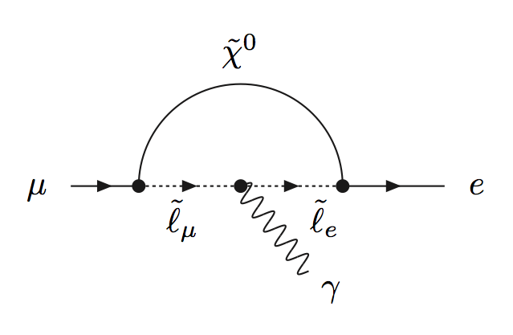
Searching for CLFV
Can look for muon decaying into an electron plus a photon:
μ→eγ
Experiments: MEGA, MEG, and others…

Slide 6
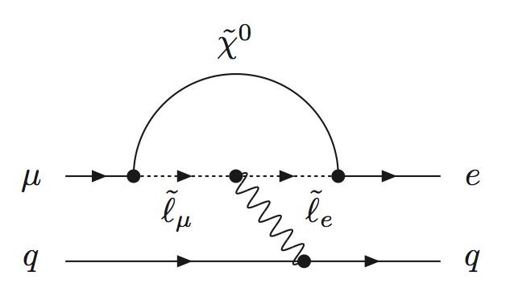
Searching for CLFV
In the presence of a nucleus (N):
μ+N→e+N
The electron is mono-energetic in CM frame!
Experiments:Mu2e, SINDRUM II, TRIUMF, COMET, and others…

Slide 7


Mu2e
Experiment with preliminary approval that is proposed to begin data taking in 2018 at Fermilab.
Goal: Search for
  Measure ratio:
  With sensitivity to R at 90% C.L. of 6*10⁻¹⁷
    → 4 orders of magnitude better than current limits
    Need more than 10¹⁷ stopped muons!
      -- 3.6*10²⁰ protons on target (2 year run – 2x10⁷ s)
    Need to keep background small and well understood

Slide 8
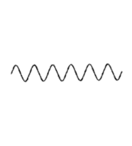
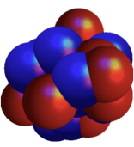
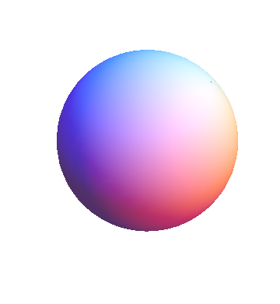

Experimental Signature
A single monoenergetic electron
If N = Al, Ee = 105. MeV
  (Electron E depends on Z)
Nucleus coherently recoils off outgoing electron, no breakup
e⁻
μ⁻

Slide 9
Background Processes
Signal is a single 105 MeV e-.
Many possible sources of background events:
  Muon decay in Coulomb orbit (DIO)
  Radiative muon/pion capture
    →Photon produced that can convert asymmetrically
  Beam electrons can scatter in target
  Muon/pion decay in flight
  Antiprotons and other late arriving particles
  Cosmic-ray induced electrons
These can all be controlled
and none produce a sharp peak at 105 MeV!

Slide 10
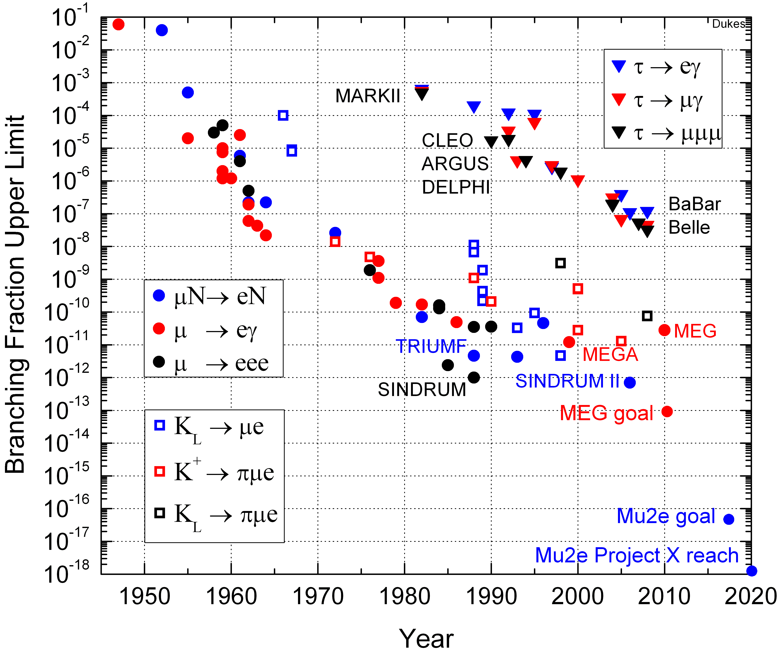
History of CLFV Searches

Slide 11
History of CLFV Searches
New MEG result: 2.4x10⁻¹²
arXiv:1107.5547
July 2011

Slide 12
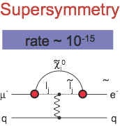
CLFV from SUSY
Access to SUSY through loops.
In Mu2e, a signal of Terascale physics at LHC implies:
40 signal events
~
0.2 background events
~

Slide 13
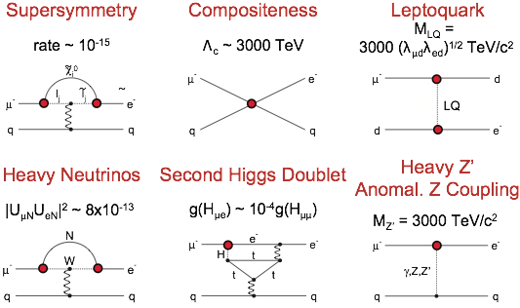
Other “new physics” also provide
Mu2e signal
Marciano, Mori, and Roney , Ann. Rev. Nucl. Sci. 58

Slide 14
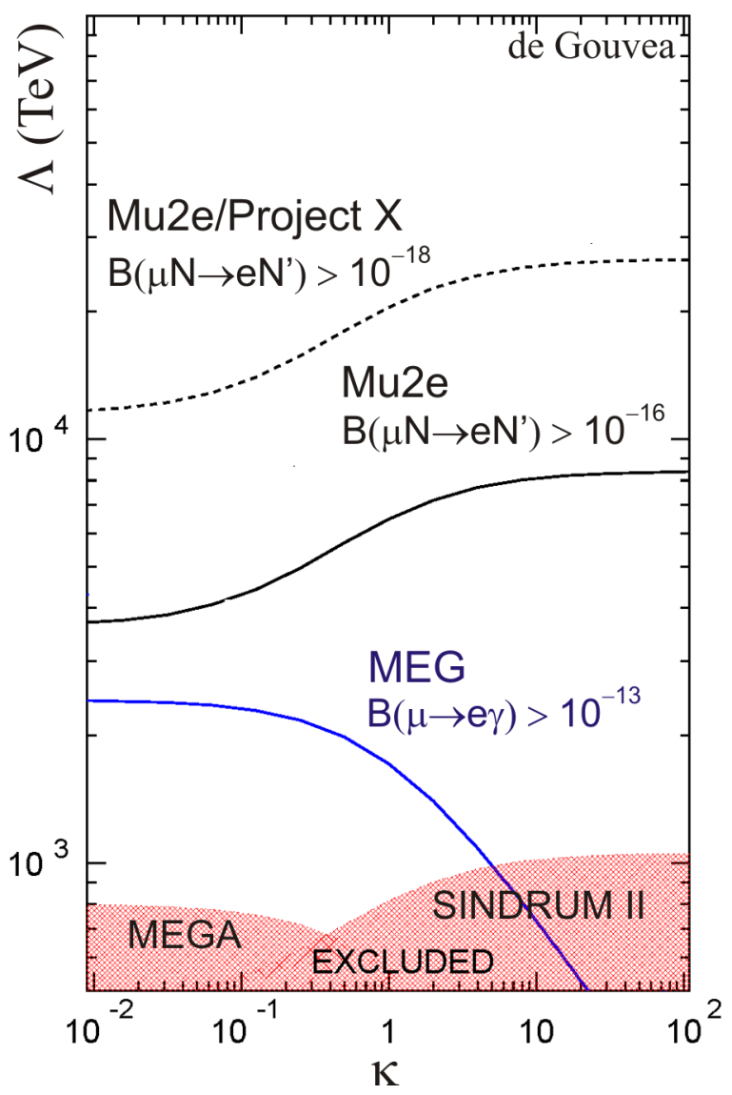
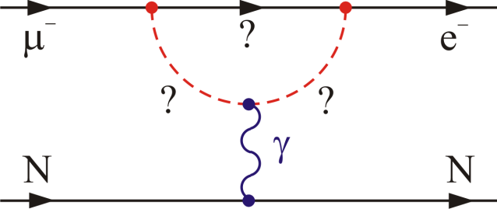
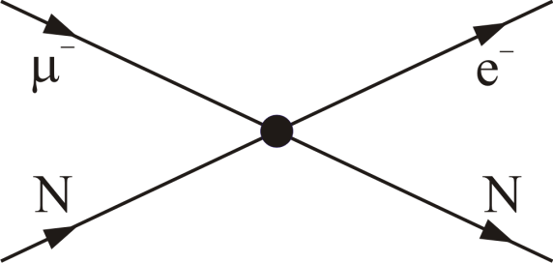
CLFV in μ⁺→e⁺γ and μ⁻N→e⁻N
Model independent effective CLFV Lagrangian
Mass
scales probed
~10,000 times that
probed directly
by LHC
Loops
Contact Interactions
κ << 1
magnetic moment type operator
μ → eγ rate ~300X
μN → eN rate
κ >> 1
four-fermion interaction
μN → eN >> μ → eγ rate
Loops
Contact

Slide 15
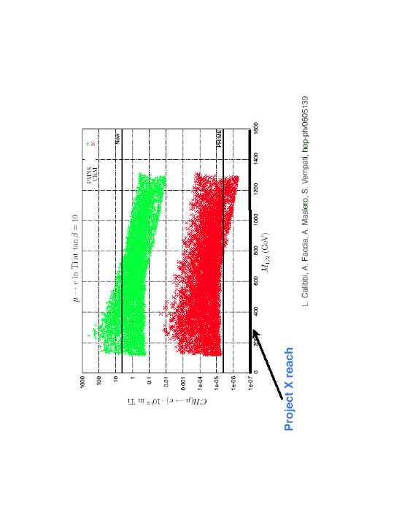

Constraints on new physics
L. Calibbi, A. Faccia, A. Masiero, S. Vempati hep-ph/0605139
Neutrino-Matrix Like (PMNS)
Minimal Flavor Violation(CKM)
Current limits
Can distinguish
between PMNS and MFV
Mu2e
Complementarity between Lepton Flavor Violation
(LFV) and LHC experiments
Notes:
squarks and gluinos ~ 1 TeV should be visible at LHC and Mu-e gamma, 2-2.5 TeV perhaps beyond LHC but effects detectable in mu-e conversion

Slide 16
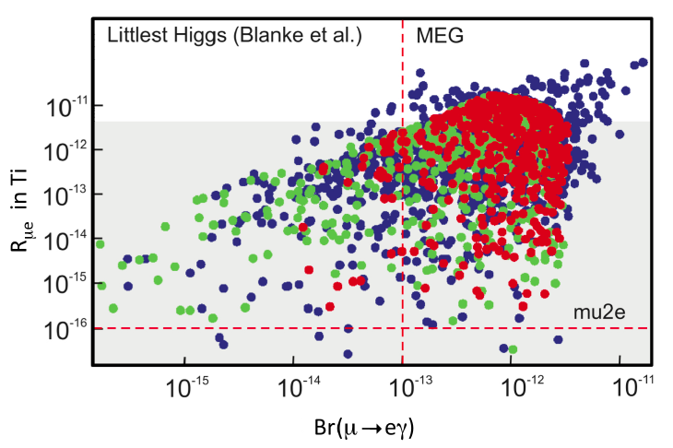
Constraints on new physics
Goal
Goal

Slide 17
Mu2e Beyond the LHC
  Provides information about flavor structure of new physics even if it is not easily accessible at the LHC.
A null result at the proposed sensitivity will severely constrain new physics models.
  CLFV is predicted at observable rates for Mu2e in many models of new physics.
  Mu2e can probe mass scales up to 10⁴ TeV, far beyond the direct reach of the LHC.

Slide 18
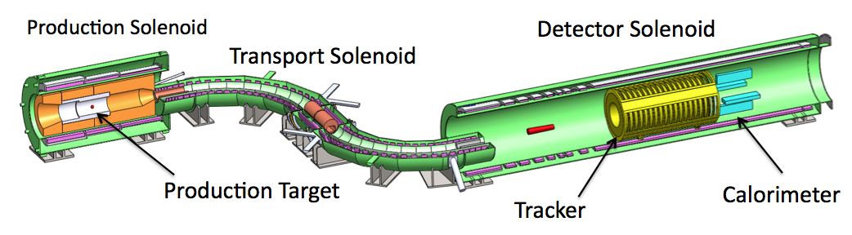

The Mu2e Experiment
Proton Beam
(for sense of scale)
Proton beam hits production target in Production Solenoid.
Pions captured and accelerated towards Transport Solenoid by graded field.
Pions decay to muons.
1)

Slide 19
The Mu2e Experiment
Proton Beam
(for sense of scale)
Proton beam hits production target in Production Solenoid.
Pions captured and accelerated towards Transport Solenoid by graded field.
Pions decay to muons.
1)
Courtesy of Symmetry Magezine

Slide 20
The Mu2e Experiment
Proton Beam
2)
Transport solenoid performs sign and momentum selection.
Eliminates high energy negative particles, positive particles and line-of-sight neutrals.

Slide 21
The Mu2e Experiment
Proton Beam
3)
Muons stop in target and decay.
Conversion electron trajectory measured in tracker, validated in calorimeter.
Cosmic Ray Veto surrounds Detector Solenoid.

Slide 22

Sensitivity Goal
X10000 improvement over current best limit!
How:
Improved efficiency for producing and stopping muons
  Production target in gradient field*
  Mu2e will stop 50 billion muons per second!
  Expect to stop 21 muons per 10,000 proton on target.
Reduced backgrounds and detector occupancy due to pulsed beam
  Single event sensitivity! <0.2 bkg events expected in 2-year run
* Djilkibaev, Lobashev et. al.

Slide 23
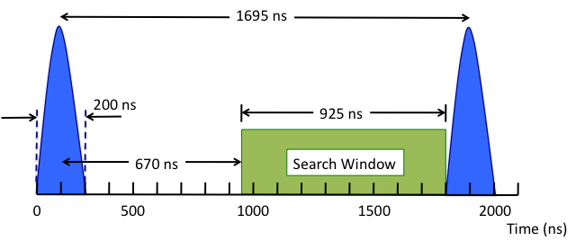
4 Orders-of-Magnitude?
We have the best accelerator setup in the world for this measurement! Ideal pulse spacing…
(μ lifetime in 1s orbit of AL ~864 ns)
Bunch structure
Extinction level of 10⁻¹⁰ between bunches is crucial!
(Removes ‘prompt’ backgrounds!)

Slide 24
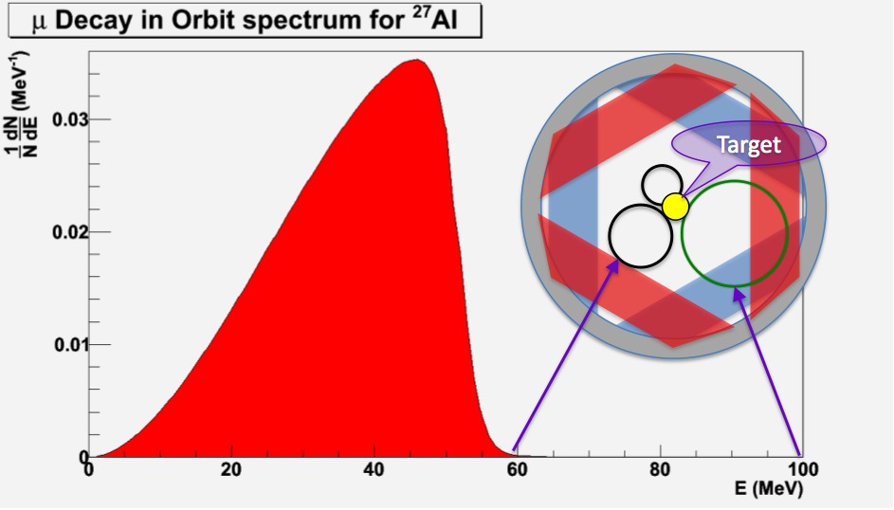
4 Orders-of-Magnitude?
  → Straw tracker designed such that no acceptance for lower-energy electrons from muon decay in orbit.

Slide 25
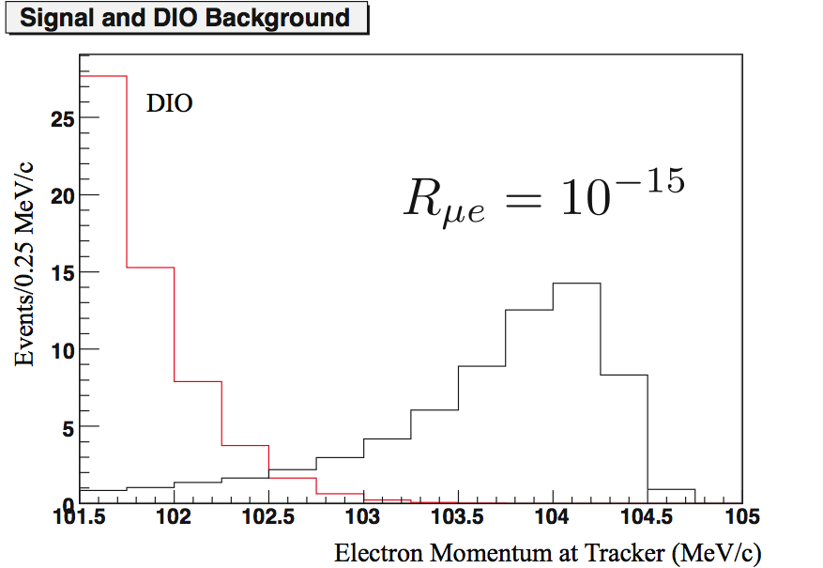
4 Orders-of-Magnitude?
Long tail due to
nuclear recoil
Conversion momentum shifted due to material interactions

Slide 26
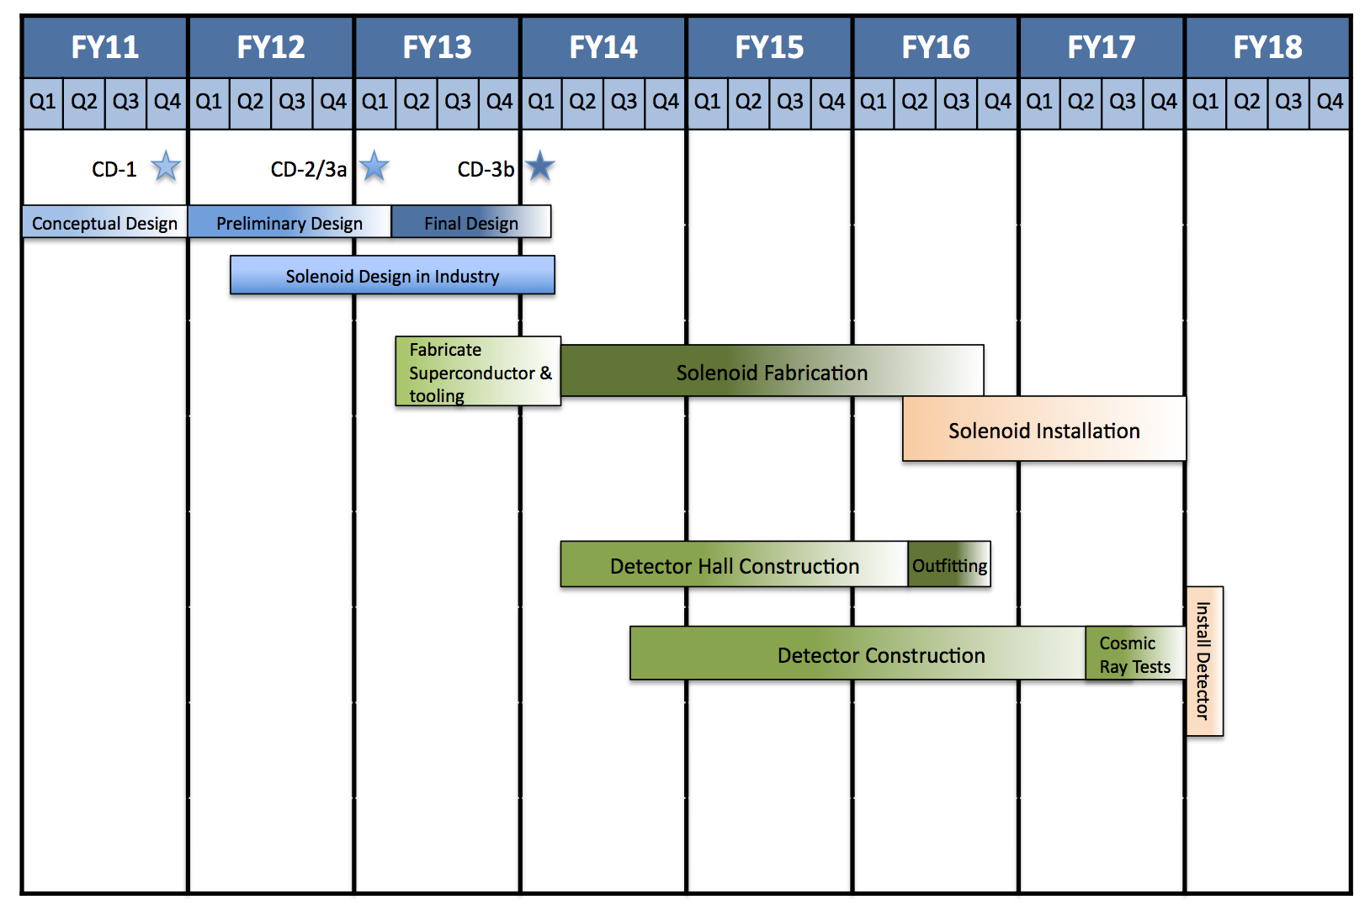
Mu2e Schedule
Design Phase
Solenoid Design
Solenoid Fabrication
Detector Hall Construction
Hardware R&D effort
to finalize design
Detector Construction
Accelerator R&D

Slide 27
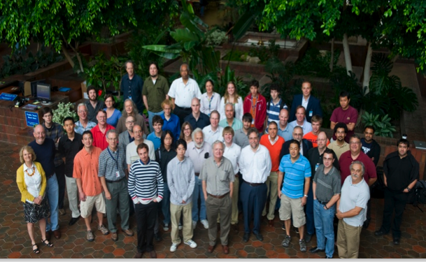
The Mu2e Collaboration
Boston University
Brookhaven National Laboratory
Cal Tech
University of California, Berkeley
University of California, Irvine
City University of New York
Duke University
Fermilab
University of Houston
University of Illinois, Urbana-Champaign
Institute for Nuclear Research, Moscow
JINR, Dubna, Russia
Lawrence Berkeley National Laboratory
Los Alamos National Laboratory
Northwestern University
INFN Frascati
INFN Pisa, Università di Pisa, Pisa, Italy
University of Massachusetts
INFN Lecce, Università del Salento, Italy
Rice University
Syracuse University
University of Virginia
College of William and Mary
University of Washington, Seattle
~120 collaborators

Slide 28
Summary
The intensity frontier and flavor physics may well reveal a sign of exotic physics!
Mu2e will improve sensitivity by 4 orders-of-magnitude relative to past CLFV searches.
Mu2e will provide complementary information relative to the LHC and is sensitive to mass scales many orders of magnitude higher than can be directly probed at colliders.

Slide 29
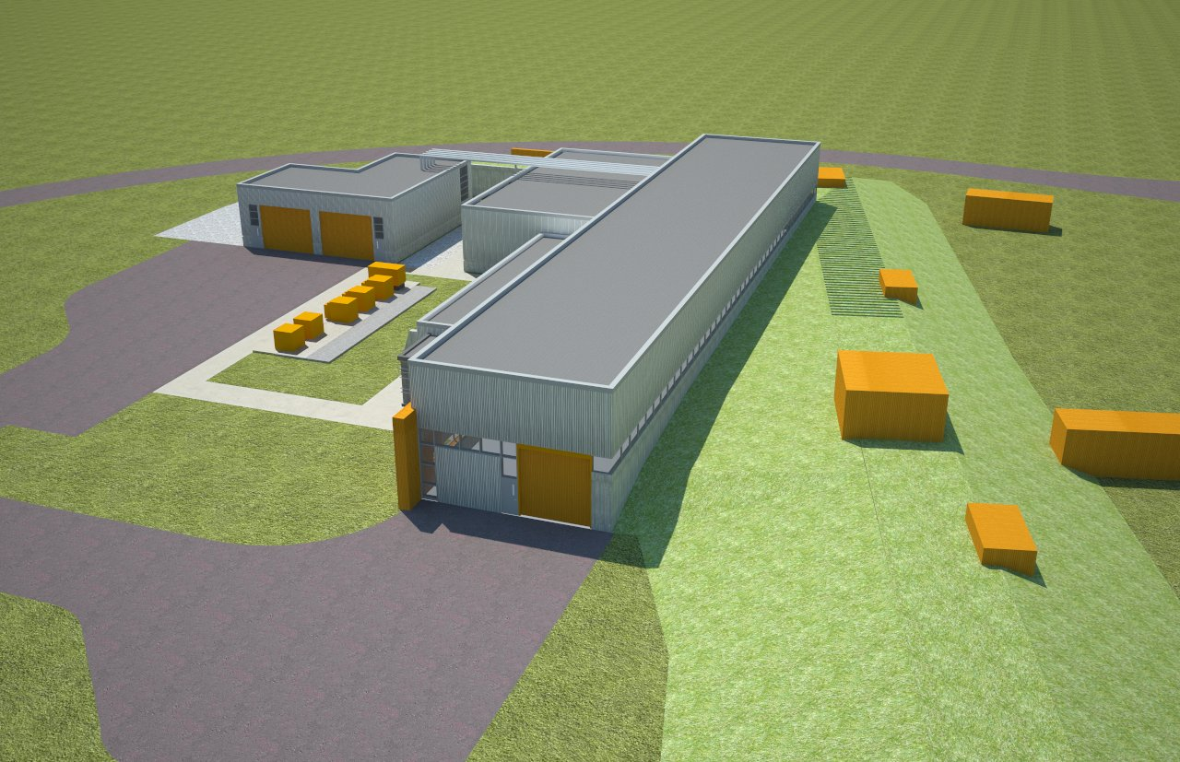
Backup

Slide 30

CDR

Slide 31
Mu2e Review Status
Mu2e received mission-need approval from DOE in November 2009.
From our Mission Need Statement:
  “A muon-to-electron conversion experiment at Fermilab could provide an advance in experimental sensitivity of four orders of magnitude.”
We have a complete set of requirements designed to meet this goal:
  →Describes what each major system component must achieve
We have a conceptual design that we believe satisfies these requirements.
Mu2e had a successful Independent Design Review on May 3rd and 4th
Two more reviews later this Summer…
Goal: Approved conceptual design by end of 2011

Slide 32
Possible Scenarios
We see something the first year!
  Change target to better constrain the new physics rule out some backgrounds.
See something with two years of data:
  Plan for intensity upgrade
  New targets…
Don’t see anything:
  Intensity upgrade to Project X for sensitivity improvement of two additional orders-of-magnitude.

Slide 33

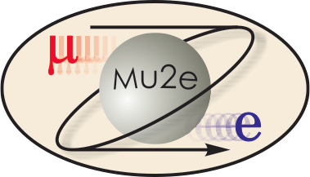
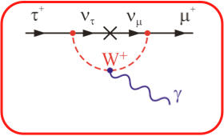
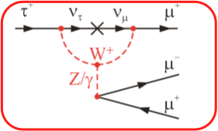
CLFV and Tau Decays
τ processes also suppressed in Standard Model
but less:
Smaler
GIM
Cancellations
because of
large τ mass
Lee, Shrock Phys.Rev.D16:1444,1977
Pham, hep-ph/9810484
SM ~ 10⁻⁴⁰
SM ~ 10⁻¹⁴
Good News:
Beyond SM rates are several orders of magnitude larger than in associated muon decays
Bad News:
τ’s hard to produce:
~10¹⁰ τ/yr vs ~10¹¹ μ/sec in fixed-target experiments (Mu2e/COMET)
also e→τ at electron-ion collider?
M. Gonderinger, M. Ramsey-Musolf, arXiv:1006.5063v1
33

Slide 34
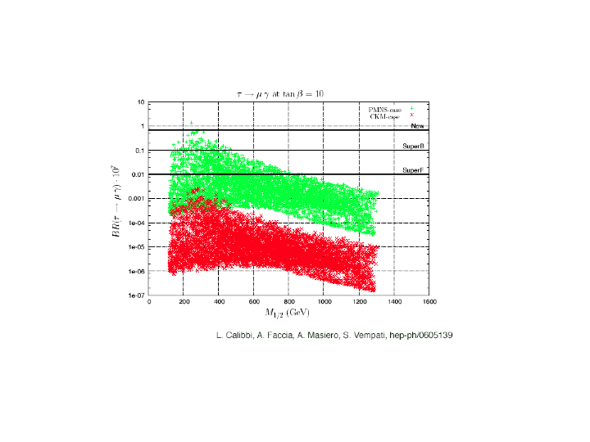
Supersymmetry in Tau LFV
L. Calibbi, A. Faccia, A. Masiero, S. Vempati hep-ph/0605139
Neutrino-Matrix Like (PMNS)
Minimal Flavor Violation(CKM)
Neutrino mass via the see--saw mechanism, analysis is performed in an SO(10) framework
R. Bernstein, FNAL Mu2e Pittsburgh Feb 2011

