Slide 1
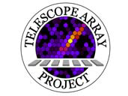

Cosmic Ray in the Northern Hemisphere: Results from the Telescope Array Experiment
Charlie Jui
University of Utah
DPF, Brown University
Aug. 11, 2011

Slide 2
Telescope Array Collaboration
T Abu-Zayyad¹, R Aida², M Allen¹, R Azuma³, E Barcikowski¹, JW Belz¹, T Benno⁴, DR Bergman¹,
SA Blake¹, O Brusova¹, R Cady¹, BG Cheon⁶, J Chiba⁷, M Chikawa⁴, EJ Cho⁶, LS Cho⁸, WR Cho⁸,
F Cohen⁹, K Doura⁴, C Ebeling¹, H Fujii¹⁰, T Fujii¹¹, T Fukuda³, M Fukushima^{9,22}, D Gorbunov¹²,
W Hanlon¹, K Hayashi³, Y Hayashi¹¹, N Hayashida⁹, K Hibino¹³, K Hiyama⁹, K Honda², G Hughes⁵,
T Iguchi³, D Ikeda⁹, K Ikuta², SJJ Innemee⁵, N Inoue¹⁴, T Ishii², R Ishimori³, D Ivanov⁵, S Iwamoto²,
CCH Jui¹, K Kadota¹⁵, F Kakimoto³, O Kalashev¹², T Kanbe², H Kang¹⁶, K Kasahara¹⁷, H Kawai¹⁸,
S Kawakami¹¹, S Kawana¹⁴, E Kido⁹, BG Kim¹⁹, HB Kim⁶, JH Kim⁶, JH Kim²⁰, A Kitsugi⁹, K Kobayashi⁷,
H Koers²¹, Y Kondo⁹, V Kuzmin¹², YJ Kwon⁸, JH Lim¹⁶, SI Lim¹⁹, S Machida³, K Martens²², J Martineau¹,
T Matsuda¹⁰, T Matsuyama¹¹, JN Matthews¹, M Minamino¹¹, K Miyata⁷, H Miyauchi¹¹, Y Murano³,
T Nakamura²³, SW Nam¹⁹, T Nonaka⁹, S Ogio¹¹, M Ohnishi⁹, H Ohoka⁹, T Okuda¹¹, A Oshima¹¹, S Ozawa¹⁷, IH Park¹⁹, D Rodriguez¹, SY Roh²⁰, G Rubtsov¹², D Ryu²⁰, H Sagawa⁹, N Sakurai⁹, LM Scott⁵,
PD Shah¹, T Shibata⁹, H Shimodaira⁹, BK Shin⁶, JD Smith¹, P Sokolsky¹, TJ Sonley¹, RW Springer¹,
BT Stokes¹, TA Stroman¹, SR Stratton⁵, S Suzuki¹⁰, Y Takahashi⁹, M Takeda⁹, A Taketa⁹, M Takita⁹,
Y Tameda³, H Tanaka¹¹, K Tanaka²⁴, M Tanaka¹⁰, JR Thomas¹, SB Thomas¹, GB Thomson¹, P Tinyakov^{12,21}, I Tkachev¹², H Tokuno⁹, T Tomida², R Torii⁹, S Troitsky¹², Y Tsunesada³, Y Tsuyuguchi², Y Uchihori²⁵,
S Udo¹³, H Ukai², B Van Klaveren¹, Y Wada¹⁴, M Wood¹, T Yamakawa⁹, Y Yamakawa⁹, H Yamaoka¹⁰,
J Yang¹⁹, S Yoshida¹⁸, H Yoshii²⁶, Z Zundel¹
¹University of Utah, ²University of Yamanashi, ³Tokyo Institute of Technology, ⁴Kinki University,
⁵Rutgers University, ⁶Hanyang University, ⁷Tokyo University of Science, ⁸Yonsei University,
⁹Institute for Cosmic Ray Research, University of Tokyo, ¹⁰Institute of Particle and Nuclear Studies, KEK,
¹¹Osaka City University, ¹²Institute for Nuclear Research of the Russian Academy of Sciences,
¹³Kanagawa University, ¹⁴Saitama University, ¹⁵Tokyo City University, ¹⁶Pusan National University,
¹⁷Waseda University, ¹⁸Chiba University ¹⁹Ewha Womans University, ²⁰Chungnam National University,
²¹University Libre de Bruxelles, ²²University of Tokyo, ²³Kochi University, ²⁴Hiroshima City University,
²⁵National Institute of Radiological Science, Japan, ²⁶Ehime University

Slide 3
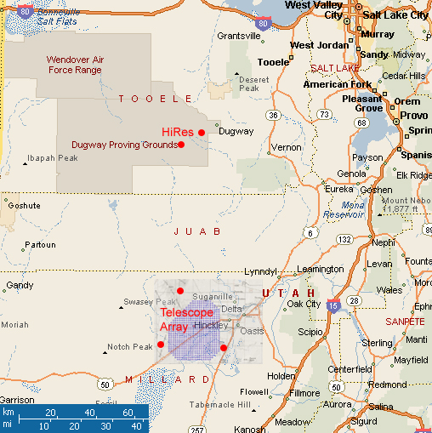
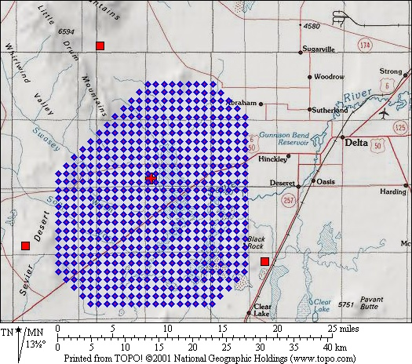
Telescope Array Experiment
TA is a ultrahigh energy (>10¹⁷ eV) cosmic ray observatory located in the West Desert of Utah: largest in the northern hemisphere

Slide 4
Outline
Introduction to Telescope Array
TA Data Analysis
Energy Spectrum Results
Composition Results
Anisotropy Results

Slide 5
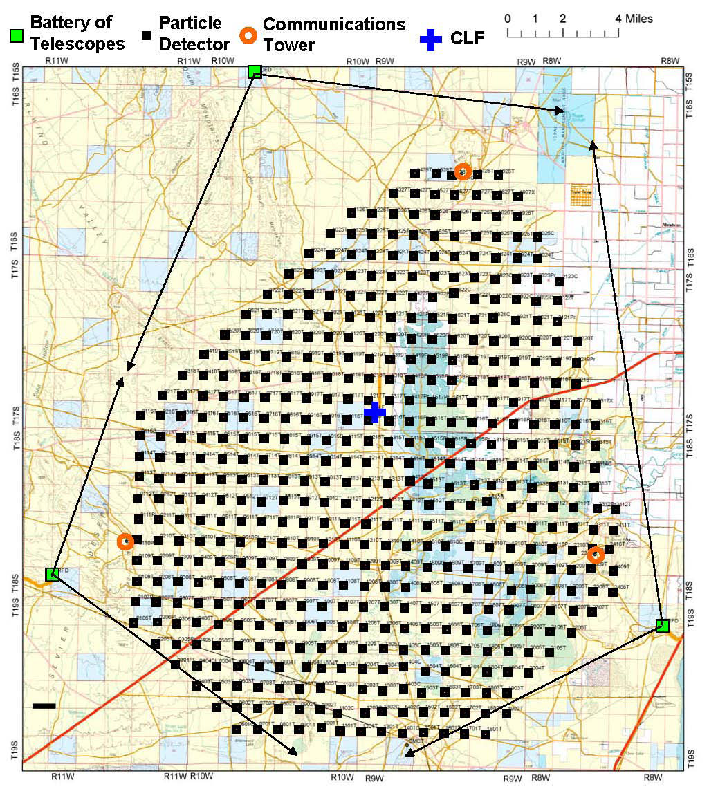
TA Detectors
Part 1
TA is a hybrid experiment
507 scintillation counters surface detector (SD)
  Covers 730 km².
3 fluorescence detector (FD) stations
  Located at the corners of the SD array
Middle Drum FD
Black
Rock
FD
Long Ridge FD

Slide 6
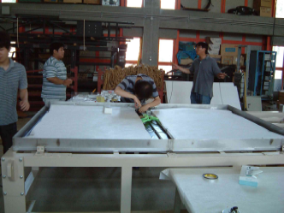
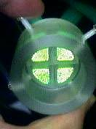
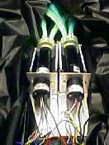
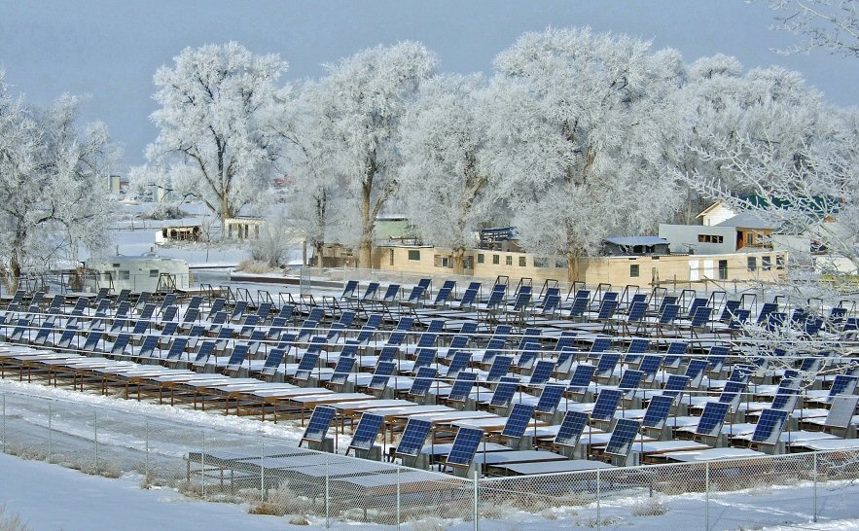
Scintillation Counters
Pre-assembled in Japan, Final Assby/testing in Delta: 2 layers, 1.25 cm scintillator, 3m² area

Slide 7
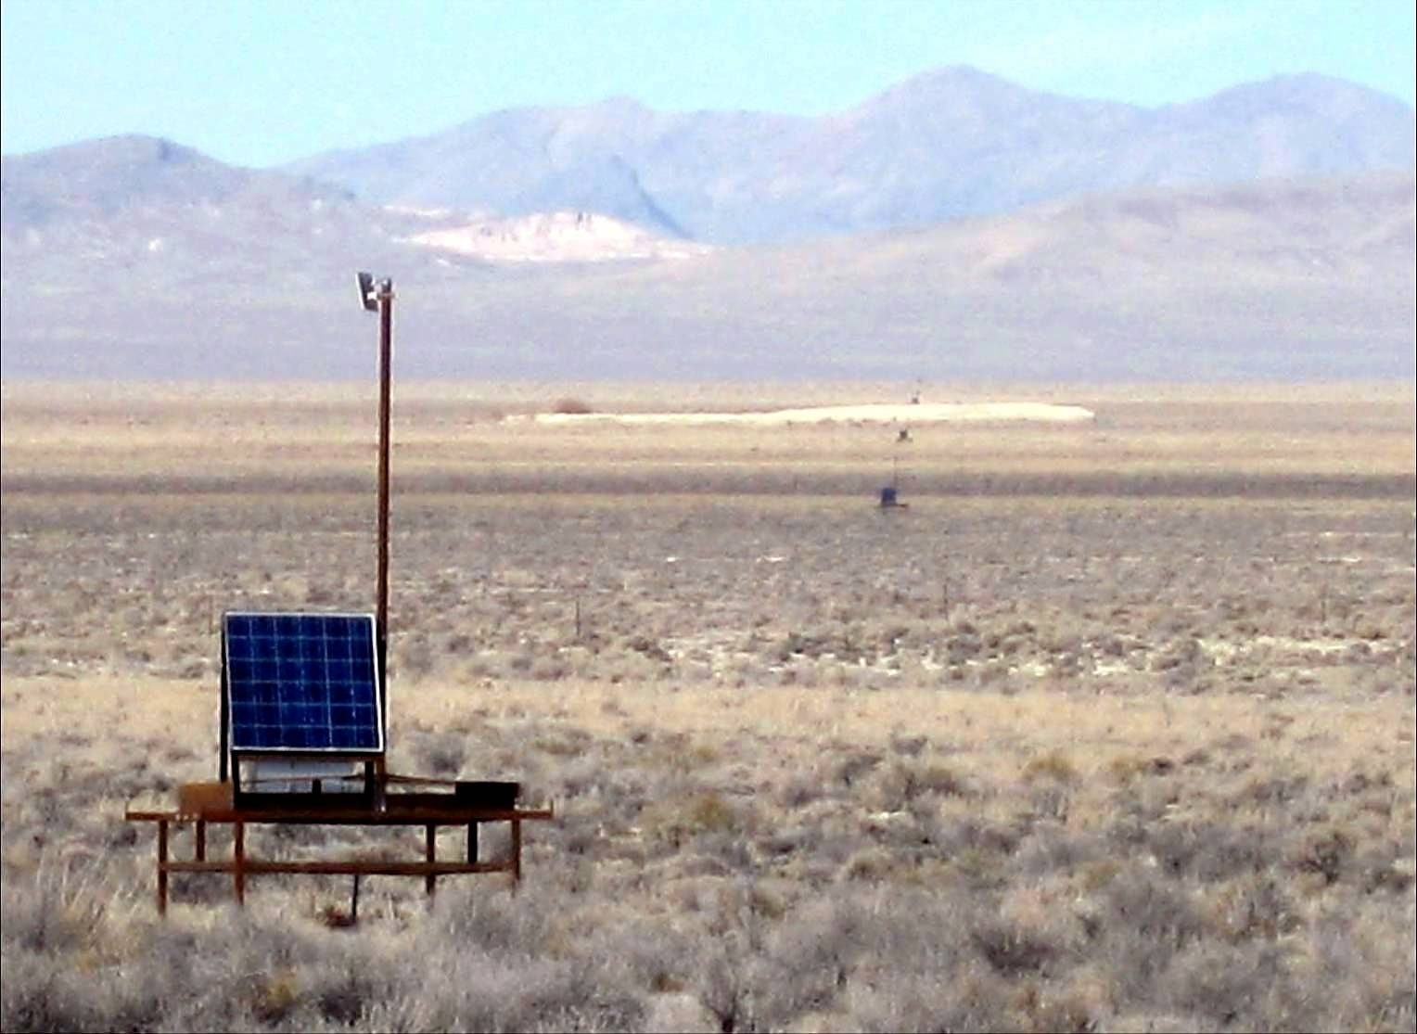
Scintillator Detectors on a 1.2 km square grid
Power: Solar/Battery
Readout: Radio
Self-calibrated: μ background
Operational: 3/2008

Slide 8
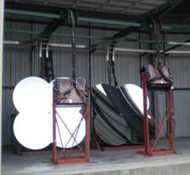
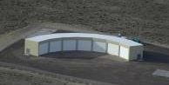
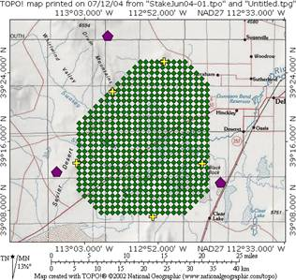
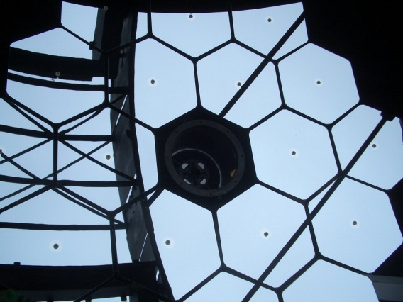
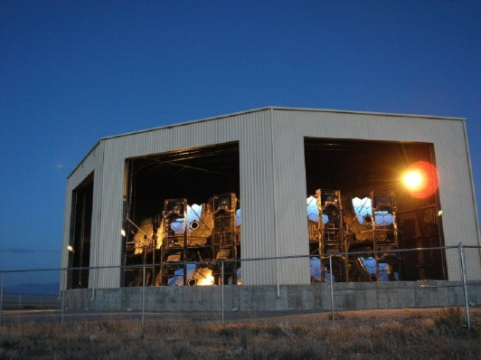
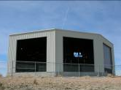
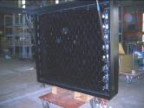
TA Fluorescence Detectors
Refurbished
from HiRes-I
Middle Drum
14 telescopes@station
256 PMTs/camera
Observations since ~10/2007
5.2 m²
~30km
New FDs
12 telescopes/station
256 PMTs/camera
Hamamatsu R9508
FOV~15x18deg
Observation since ~11/2007
Black Rock Mesa
Long Ridge
Observation since ~6/2007
~1 m²
6.8 m²
Notes:
8

Slide 9
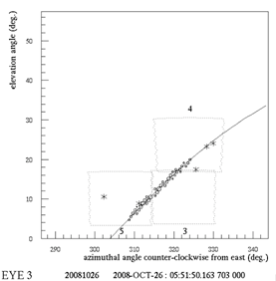
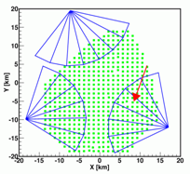
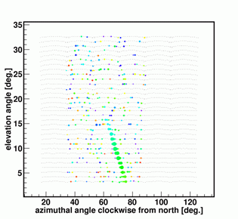
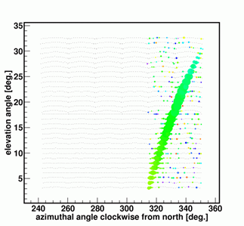
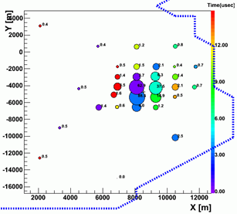
Example Event from 2008-10-26
 | θ [º] | φ [º] | x[km] | y[km]
MD mono | 51.43 | 73.76 | 7.83 | -3.10
BR mono | 51.50 | 77.09 | 7.67 | -4.14
Stereo BR&LR | 50.21 | 71.30 | 8.55 | -4.88
MD
LR
BR
SD

Slide 10
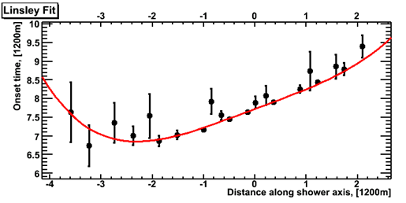
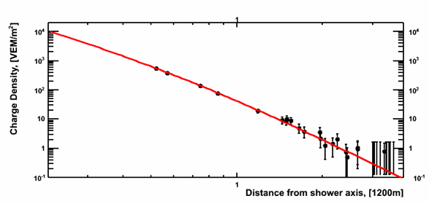

Analyzing SD Event
Part 2
2008/Jun/25 - 19:45:52.588670 UTC
Geometry Fit (modified Linsley)
Fit with AGASA LDF
  S(800): Primary Energy
  Zenith attenuation by MC
Lateral Density Distribution Fit
r = 800m

Slide 11
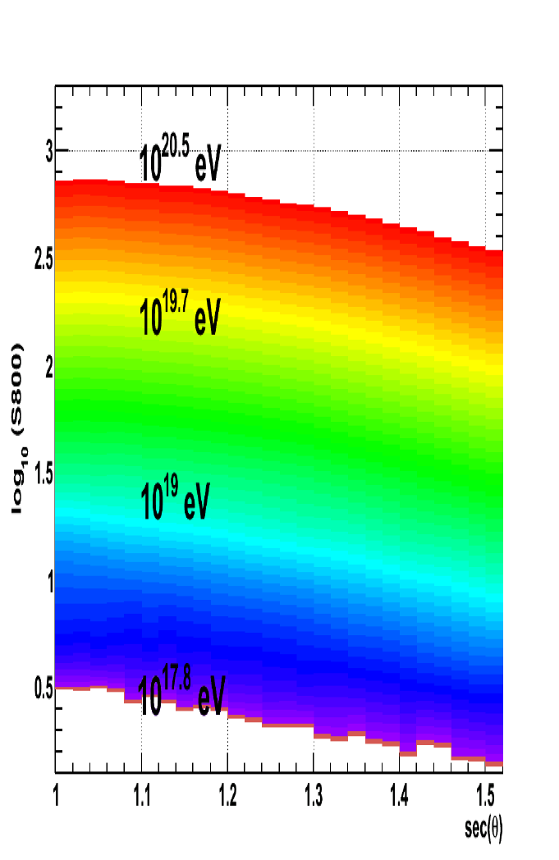
Surface Array Energy Measurement
Energy table is constructed using the MC (CORSIKA)
Determination of event energy by interpolating between S800 vs. sec(θ) lines
Uses novel “de-thinning” of CORSIKA (paper draft in internal review)

Slide 12
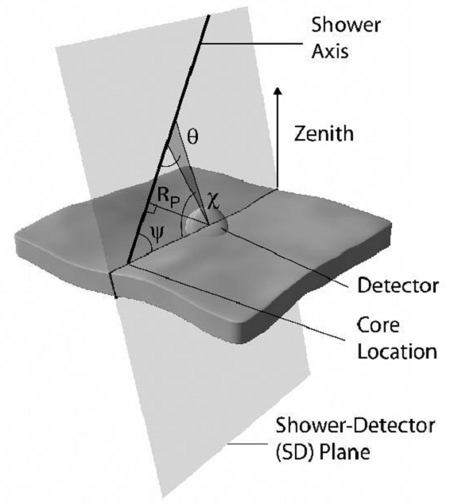
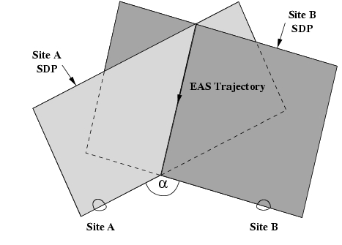
FD Geometrical Reconstruction
1.
The trajectory of the EAS can be determined in one of two ways:
  Monocular reconstruction using the arrival time of light signal at the detector.
  By intersecting the shower-detector planes (SDP) seen from the two detector sites.
2.

Slide 13
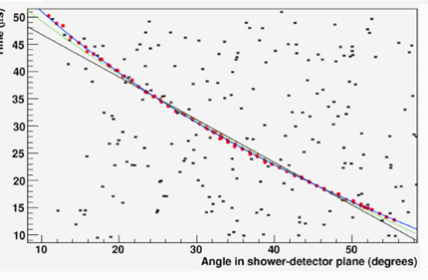
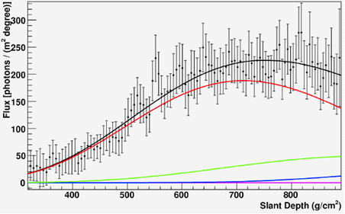
Measurement of a fluorescence Event
Event Display Black Rock Mesa
Fluorescence
Direct (Cerenkov)
Rayleigh scatt.
Aerosol scatt.
Monocular timing fit
Reconstructed Shower Profile

Slide 14
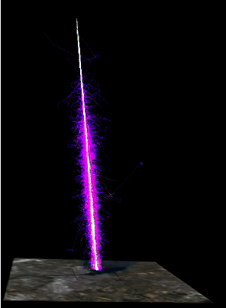
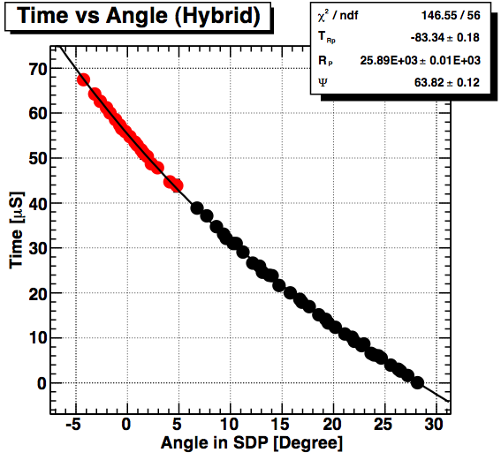
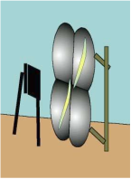
Hybrid Reconstruction
Primary Cosmic Ray
FD mono has ~5° ang. resolution
Adding SD → ~0.5° resolution.
( Stereo FD resolution ~0.5° )
UV Fluorescence Photons
Isotropic Emission
Charged Particles
Electromagnetic Shower
RED: Surface Detector
“Virtual” PMT
3. Hybrid reconstruction:
Incorporating timing information of SD into FD geometry fit
BLACK: Fluorescence
Telescope PMT

Slide 15
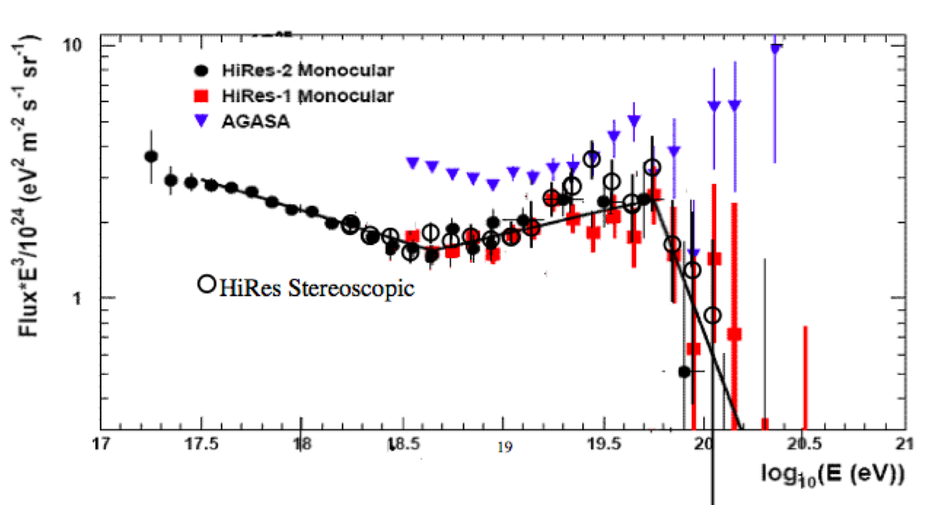
Energy Spectrum of UHE CR
Part 3
The TA Collaboration was in part a merger of the High Resolution Fly’s Eye (HiRes) and the Akeno Giant Air Shower Array (AGASA)
AGASA and HiRes disagreed over the observation of the GZK Suppression @ ~10^{19.8} eV: proton+ CMBR γ → Δ → ...
AGASA: continuing spectrum seen
Differential flux multiplied by E³
To highlight the subtle features in a steeply falling spectrum
HiRes: GZK suppression
At 5σ significance

Slide 16
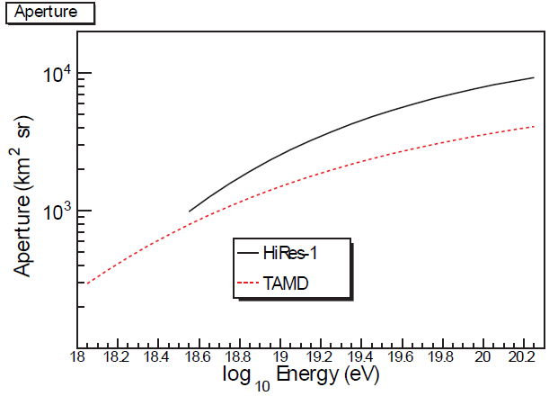
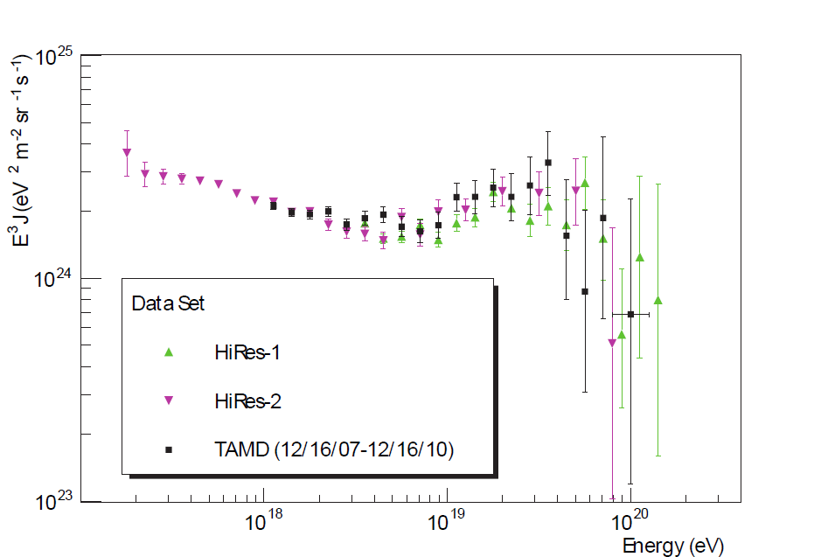
TA Middle Drum FD
TA Middle Drum (northern) FD site is instrumented with 14 refurbished telescopes from HiRes
HiRes : 1 layer of telescopes: < 17 ° in elevation, all azimuths
MD: two layers : <31°, 110° azimuth
Same MC and reconstruction code for aperture calculation and spectrum as HiRes.
3 yrs = 1/3 exposure of HiRes
Same spectrum! (paper draft in internal review)
TA MD 3 yrs

Slide 17
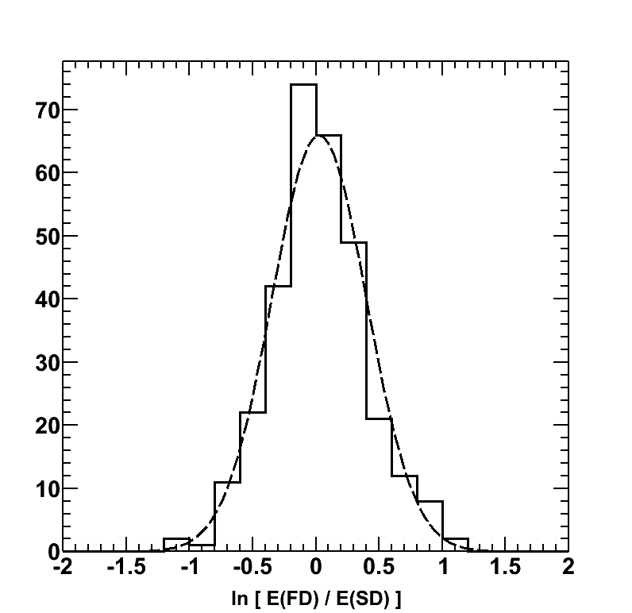
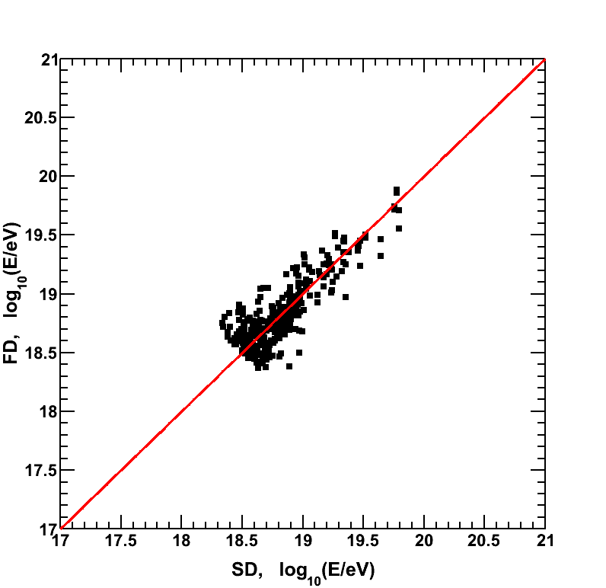
Transfer of HiRes energy scale
SD energy divided by 1.27
SD energy divided by 1.27
Agreement between the TA MD and HiRes spectra (taken with the same telescopes) → Common fluorescence energy scale for TA
Hybrid events > 10^{18.5} eV: SD energy scale (CORSIKA) 27% higher than the FD: adopt single (linear) scaling factor of 1.27

Slide 18
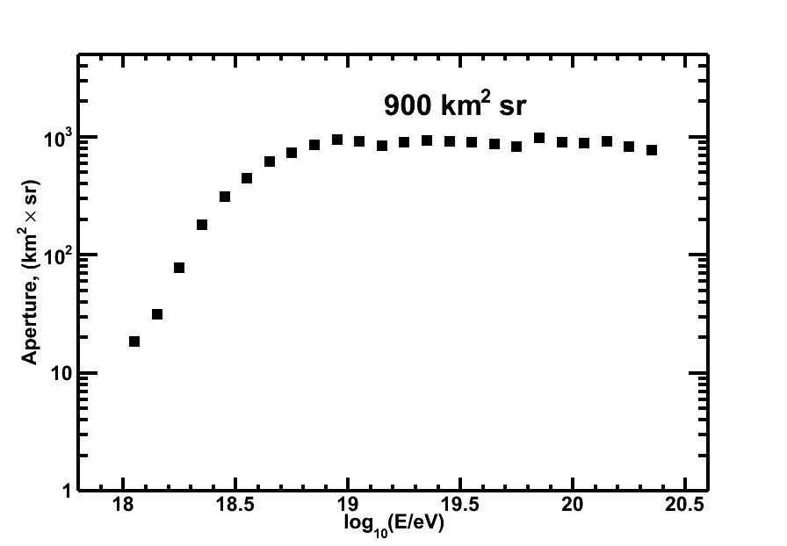
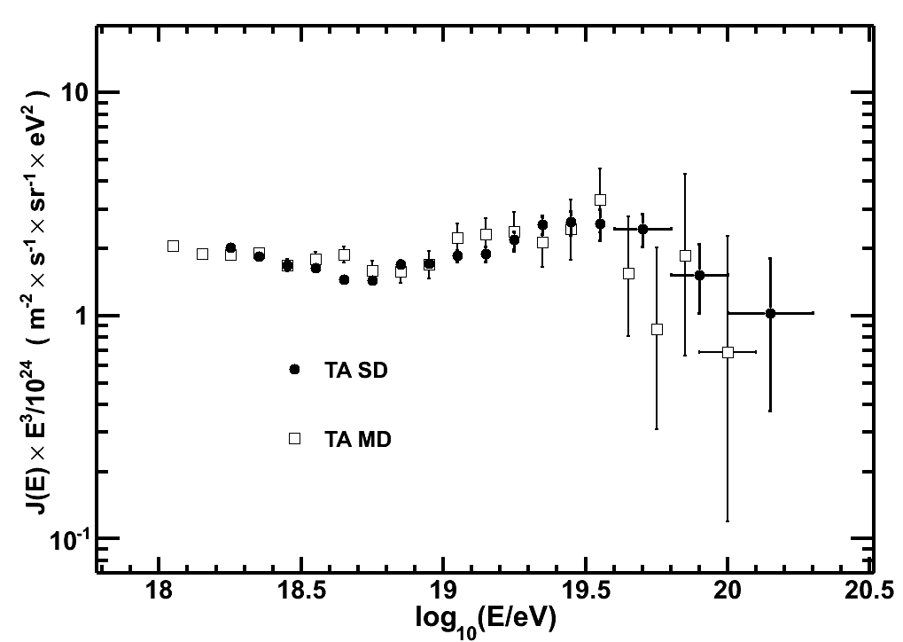
SD spectrum
Using SD data from 2008/05/11-2011/04/25
Only the energy is rescaled down by a factor of 1.27 (determined from hybrid events)
TA SD aperture
3 yrs of data represents about 2× AGASA exposure
Resulting SD spectrum is in excellent agreement with the MD FD result
SD consistent with GZK Cut-off

Slide 19
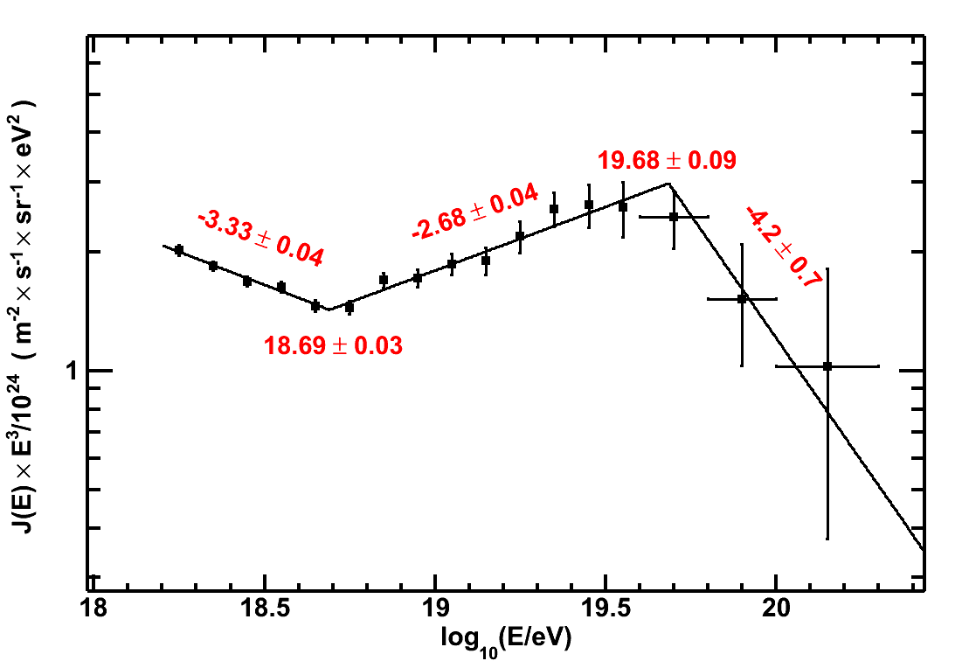
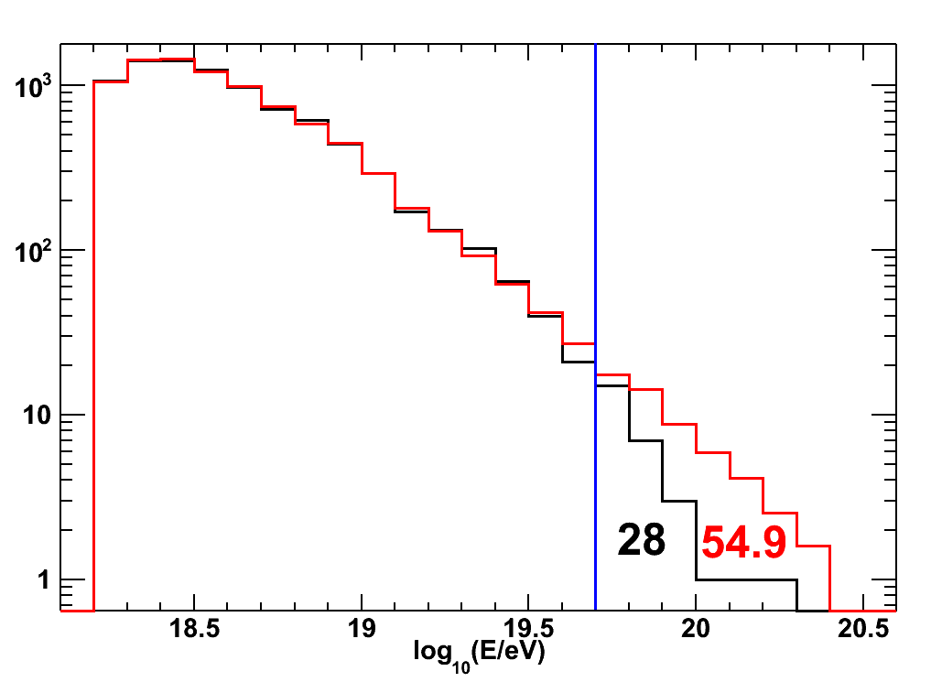


GZK significance
Broken power law fits show breaks consistent with ankle and GZK cut-off as observed by HiRes (GZK at 19.7±0.1)
Assuming continuing power law beyond cut-off: Expect events; observe 28 events
(Paper draft in internal review)

Slide 20
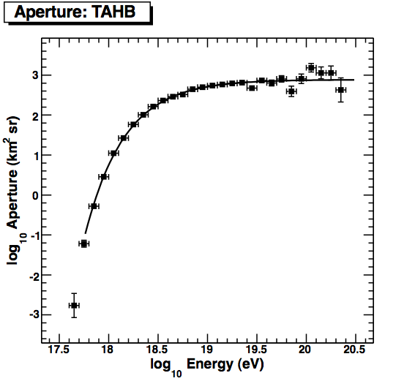
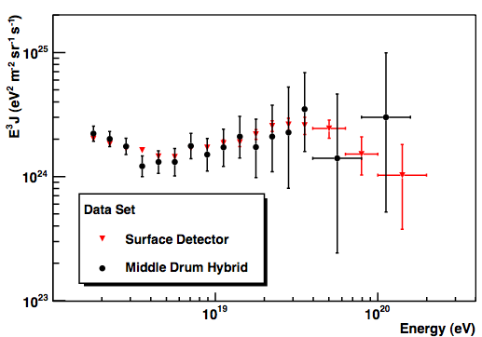
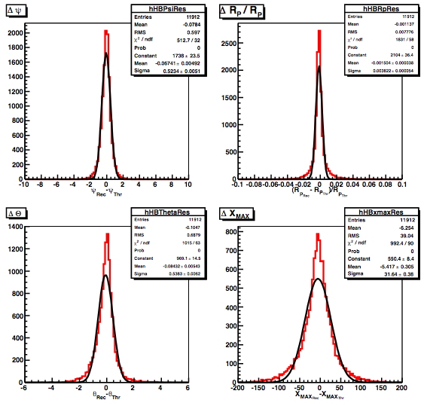
Hybrid Results: MD
Using hybrid events from MD site : energy spectrum in good agreement with SD spectrum
Same FD MC and reconstruction code as HiRes but with hybrid geometry
PRELIMINARY
AUG 2011
Ψ angle
Rp
σ=0.52°
σ=0.38%
σ=0.54°
σ=32g/cm²
Zenith
Xmax

Slide 21
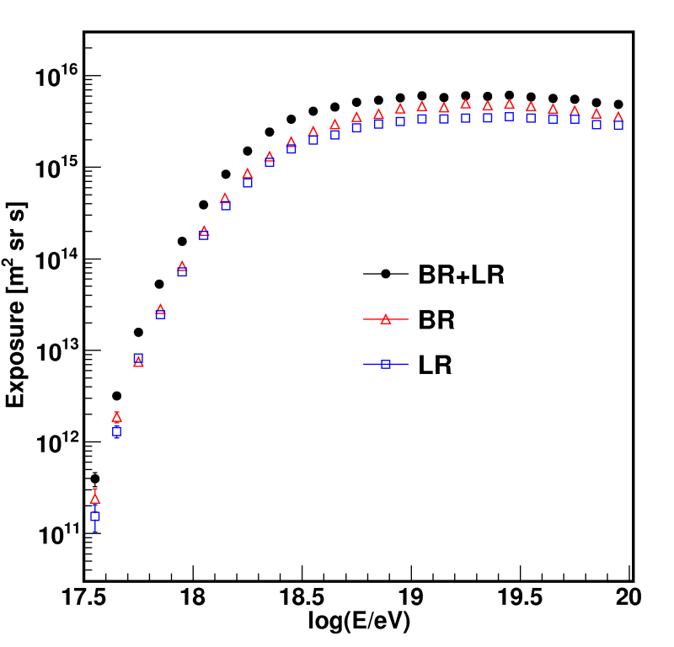
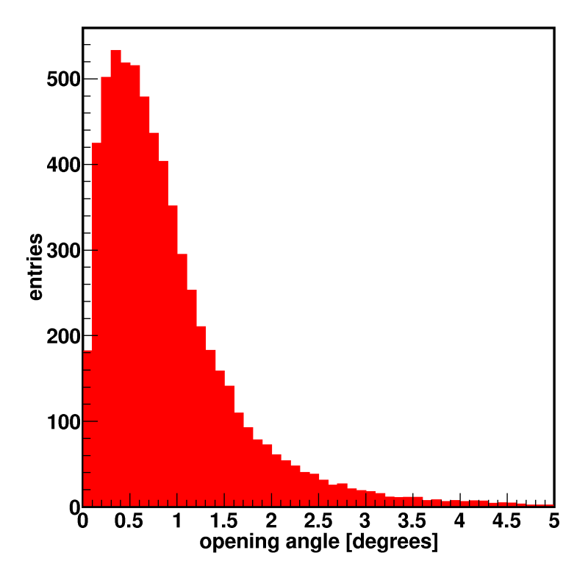
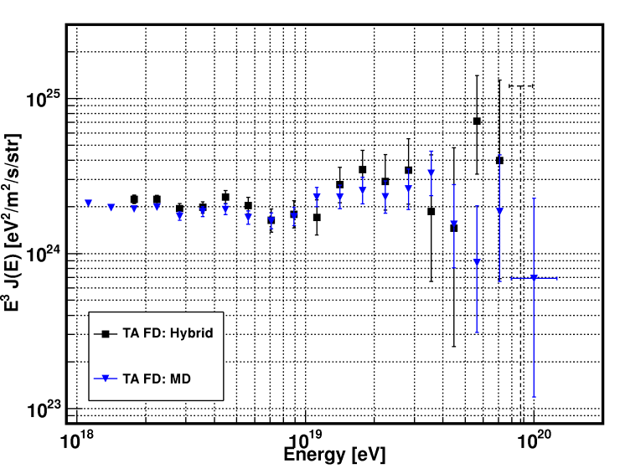
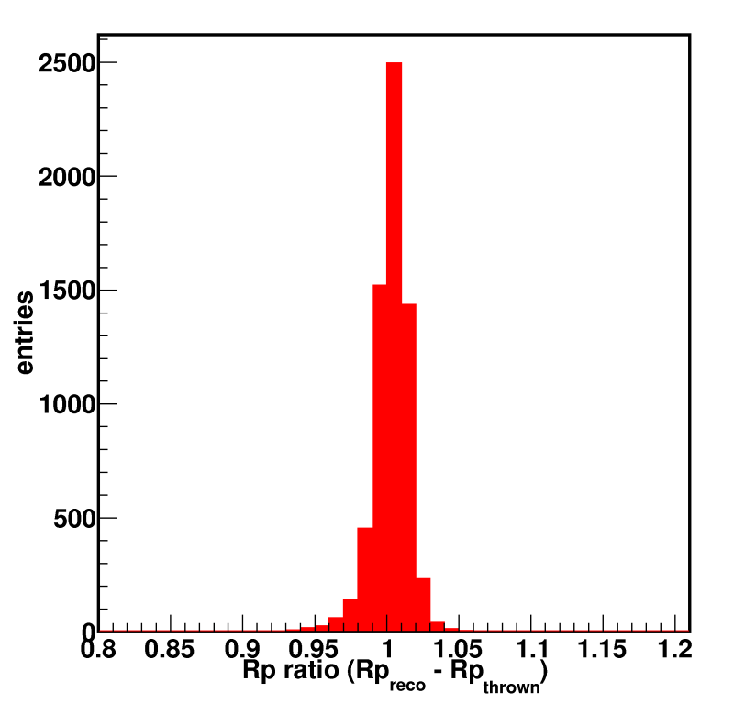
Hybrid Results: BR+LR
10^{18.2}eV
BR+LR have large overlap:
Combined hybrid spectrum consistent with the others
  Overlaid with MD FD here
Hybrid Exposure
PRELIMINARY
AUG 2011
Arrival direction
resolution
(68%): 0.9deg
Rp resolution
(68%): 1.5%

Slide 22
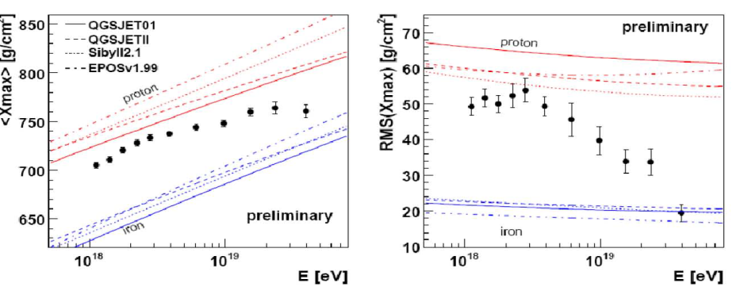
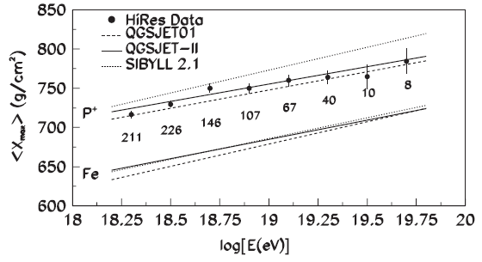
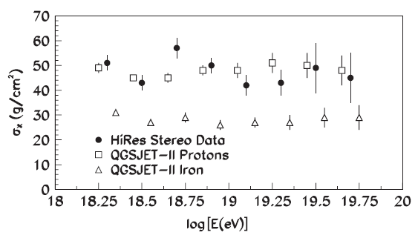
Composition Study: Xmax
Part 4
Controversy?
Collider Blog
Mar 3, 2010
http://muon.wordpress.com/2010/03/03/highest-energy-cosmics-rays-are-iron-nuclei/
The composition of the highest energy cosmic rays, those with energies on the order of tens of EeV (= 10⁶ TeV), appears to include a significant number of iron nuclei – a result that I find truly astonishing. I learned about this from a nice post at Diax’s Rake…
AUGER: Phys.Rev.Lett.104:091101,2010
Suggests shift to heavier composition at higher energies:
But the <Xmax> and RMS(Xmax) are inconsistent w.r.t a simple two-component model
HiRes: Phys.Rev.Lett.104:161101,2010 (with Xmax data suppl.)
Completely consistent with predominately light (protons) composition

Slide 23



TA preliminary result from BR+LR stereo events
First <Xmax> results consistent with predominately proton composition
Over all distribution and shape also matches proton better than iron.
PRELIMINARY
AUG 2011
QGSJET-II
protons
Iron nuclei

Slide 24



QGS-JET II iron
Log (E/eV)=
18.8-19.0
PRELIMINARY
AUG 2011
K-S p values
QGS-JET II protons
QGS-JET II iron
Log (E/eV)=
19.2-19.4
QGS-JET II protons
In 0.2 logE bins data distribution also agrees better with protons
K-S test favors protons (line at p=0.05) up to 10^{19.3} eV
  Low statistics at 10^{19.4} eV and above (~2.5 years of data)
Coming soon
  Xmax width analysis
  Hybrid Xmax analysis
Future
  Pushing analysis up to the GZK cut-off with more events

Slide 25

Anisotropy?
Part 5
3 yrs of SD Events :
  856 events > 10¹⁹ eV;
  49 events > 4.0×10¹⁹ eV
Angular resolution ~1.5° at > 10¹⁹ eV
Dec and RA distribution consistent with isotropy
PRELIMINARY
AUG 2011
20 events
> 5.7 ×10¹⁹ eV
AGN
TA SD event with 3.1 circle

Slide 26

AGN correlation?
AUGER 2007
Using AUGER hypothesis (2007): 3.1°, E>5.7 ×10¹⁹ eV correlated with AGN z<0.018 (8/13 correlated)
Expect: ~15/20, observe 8/20,
vs. isotropic background: 5/20 ➔ p_{ISO}=0.25
AUGER 2010
Updated AUGER (2010): 21/55 consistent with current TA result
TA excess is however only 3 of 5 expected
More TA data to come!
PRELIMINARY
AUG 2011
TA surface array

Slide 27
Conclusions
Telescope Array has been observing UHE cosmic rays in the Northern Hemisphere for ~3 years
Energy spectrum consistent with HiRes results (GZK cut-off + ankle structure)
  ***TA surface scintillator array consistent with GZK cut-off
Preliminary <Xmax> composition result from stereo data consistent with light (proton) composition
  Xmax width and hybrid results to follow soon
TA SD data consistent with isotropy
  But AUGER 2010 AGN correlation consistent with TA
More data and results to come in the next few years
Low Energy Extension (TALE) to begin construction in 2011
RADAR detection of UHE cosmic rays at TA (a la MARIACHI) funded and underway (generating lots of RF interference!)

