Slide 1
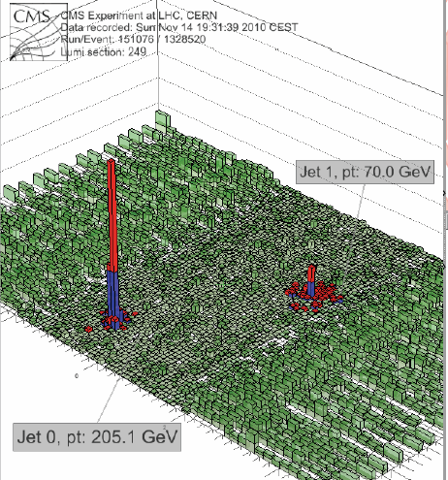
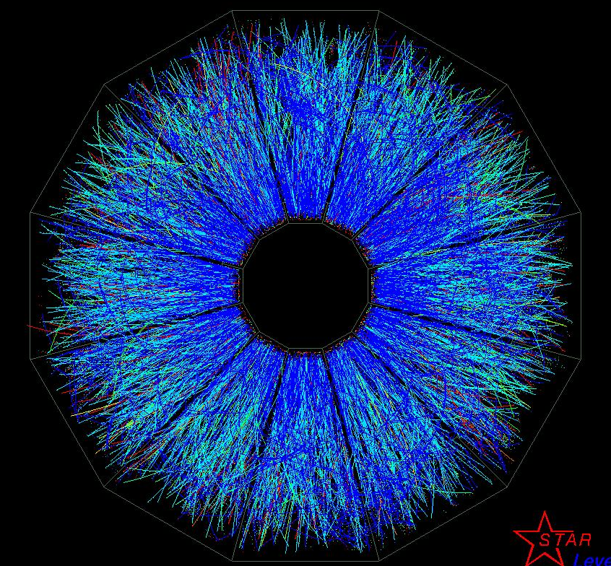
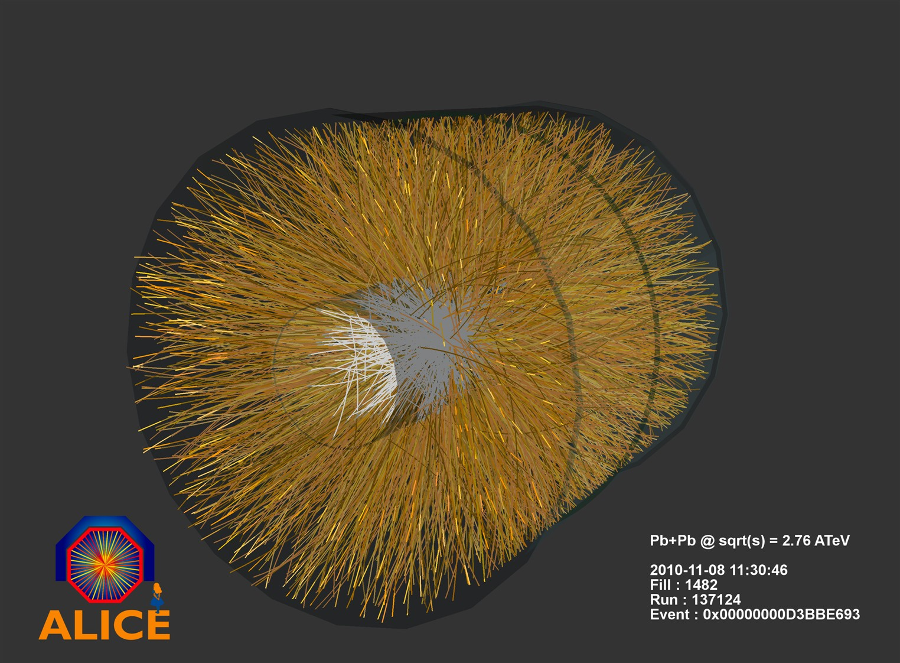

Heavy Ion Physics
Report From the
High Temperature Frontier
Report on Experimental Insights at the Temperature Frontier
Barbara Jacak
Stony Brook University
August 10, 2011

Slide 2
What are the properties of hot QCD matter?
thermodynamic (equilibrium)
  T, P, ρ
  Equation Of State (relation btwn T, P, V, energy density)
  v_{sound}, static screening length
transport properties (non-equilibrium)*
  particle number, energy, momentum, charge
  diffusion sound viscosity conductivity
In plasma: interactions among charges of multiple particles
charge is spread, screened in characteristic (Debye) length, λ_{D}
also the case for strong, rather than EM force
  *measuring these is new for nuclear/particle physics!
  Nature is nasty to us: does a time integral…

Slide 3
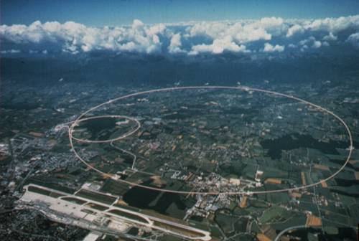
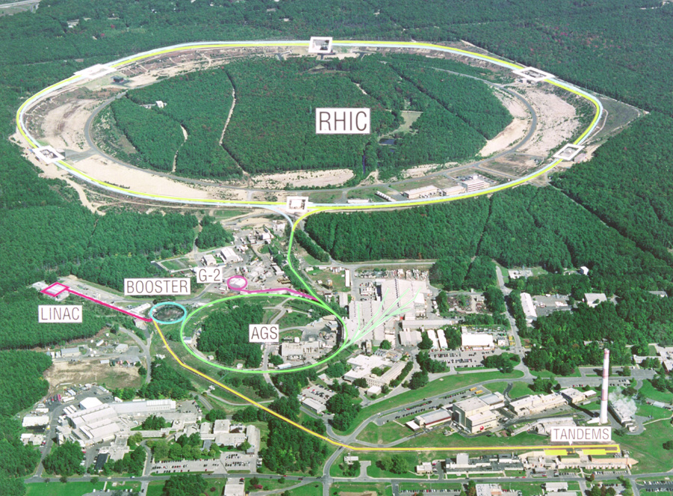
Heat nuclei at both RHIC and LHC
Compare to:
p+p – no medium
p/d+A – cold nuclear matter effects
Pb+Pb at 2.76 TeV per NN
Au+Au at 200 GeV per NN
5 active experiments:
STAR, PHENIX
ALICE, ATLAS, CMS

Slide 4
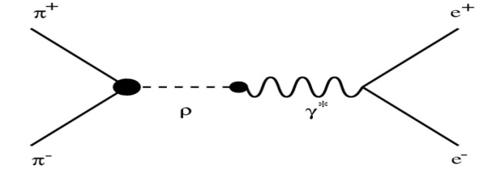
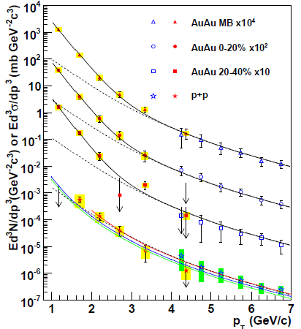
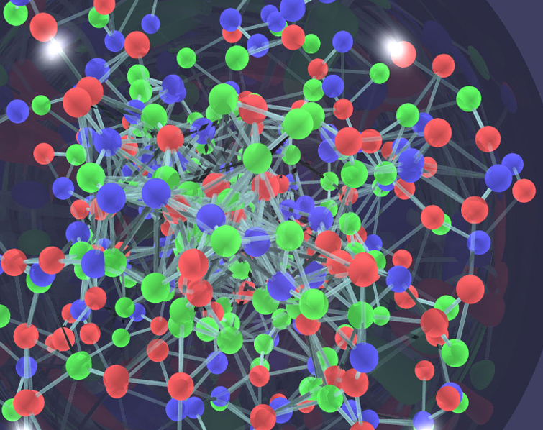

Temperature reached? thermal radiation
e⁺
γ
e⁻
γ∗
Low mass, high p_{T} e⁺e⁻ →
nearly real photons
Large enhancement above
p+p in the thermal region
PRL104, 132301 2010
pQCD γ spectrum
(QCD Compton scattering)
agrees with p+p data

Slide 5
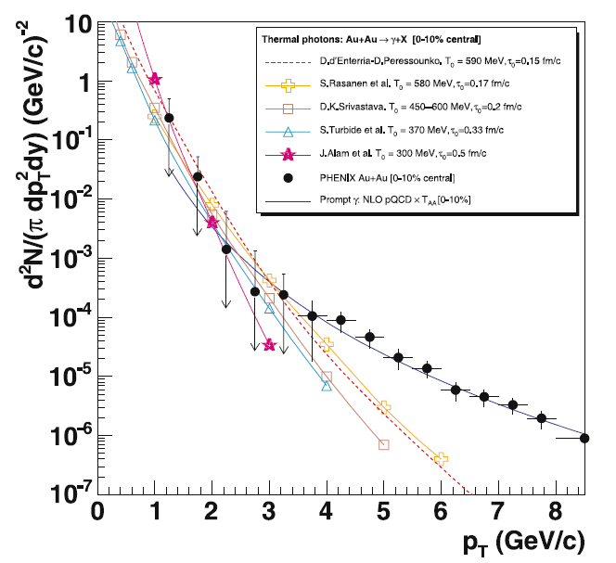
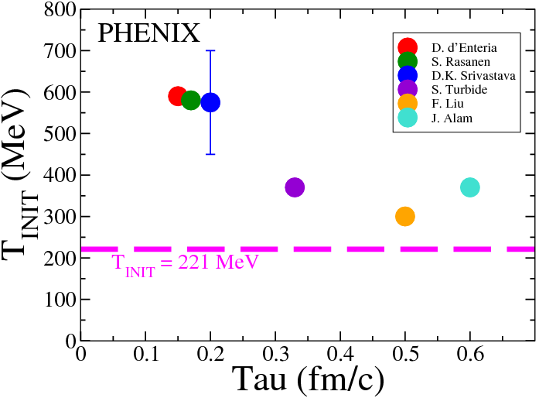
direct photons: T_{init} > T_{c} !
5
Exponential fit in p_{T}:
T_{avg} = 221 ±23 ±18 MeV
Hydrodynamics models reproduce data (different τ₀)
T_{init} ≥ 300 MeV
> 4 trillion degrees!
NB: T_{c} ~ 170 MeV
T_{init} at LHC ~ 30% higher
(by more indirect measures)

Slide 6
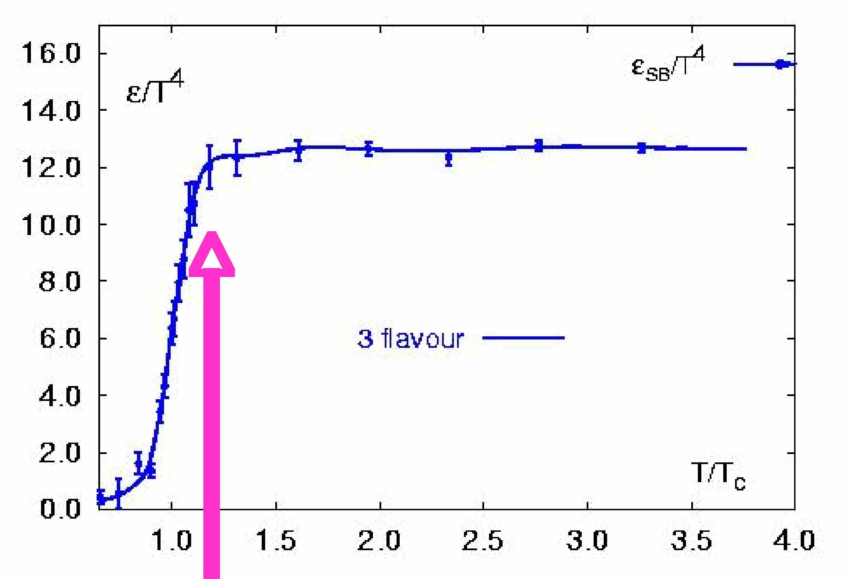
Now we are on the map
Ideal Gas
Plasma
Energy density / T⁴
Hadrons
Temperature
RHIC puts us here
… what have we
learned about QGP?
T_{c} ~ 170 ± 10 MeV
ε ~ 3 GeV/fm³

Slide 7
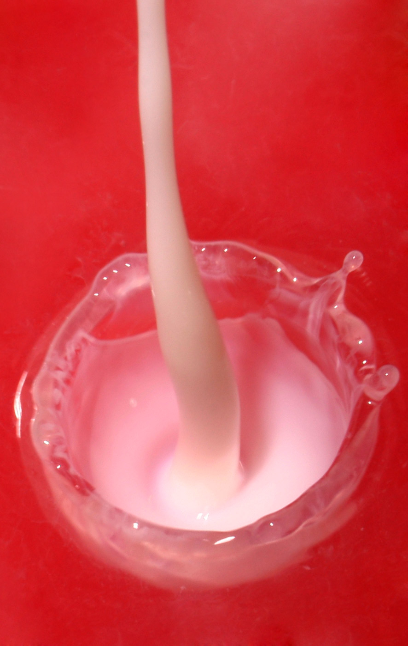
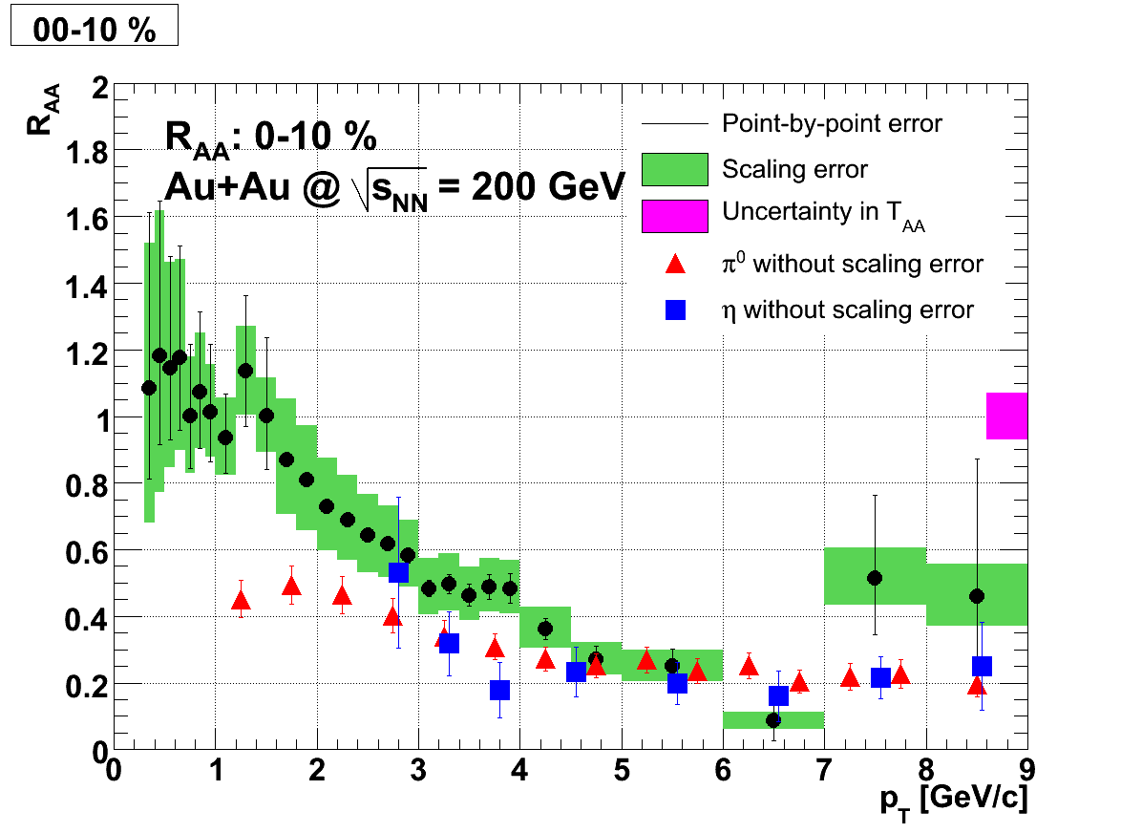
QCD matter at T =300-600 MeV (at RHIC)
Collective flow with low viscosity/
  entropy ratio: “perfect liquid”
  How low? Strong coupling…
Opacity very high
  Plasma ~ stops quarks & gluons
  How and why? Strong coupling…
Even heavy quarks lose energy & flow
  Not expected from pQCD; mechanism?
  -> strong coupling
  High mass scatterers?
J/ψ suppression indicates
  color screening
  How much?
Example of the viscosity of milk. Liquids with higher viscosities will not make such a splash when poured at the same velocity.
Non photonic electrons
π⁰, η

Slide 8
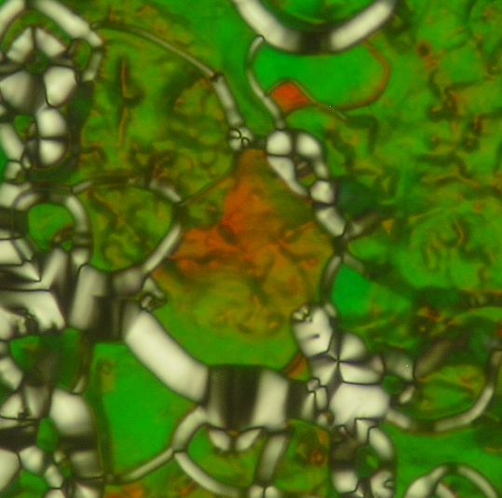

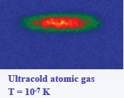
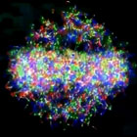
Strong coupling: forefront issue in other fields!
Quark gluon plasma is like other systems with strong coupling – all exhibit liquid properties & phase transitions
Cold atoms: coldest & hottest matter on earth are alike!
Dusty plasmas & warm, dense plasmas
have liquid and even crystalline phases
Strongly correlated condensed matter:
liquid crystal phases and superconductors
In all these cases have a competition:
Attractive forces ⇔ repulsive force or kinetic energy
Result: many-body interactions; quasiparticles exist?
❖

Slide 9
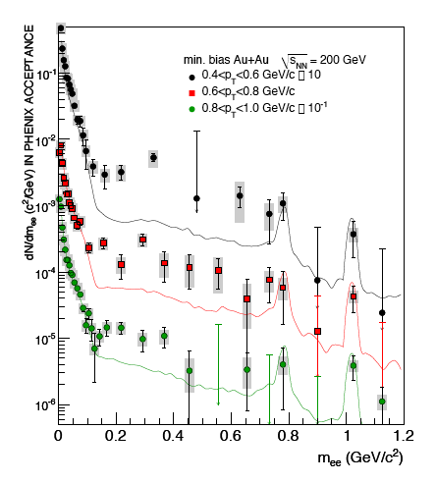
e⁺e⁻ excess at low mass, low p_{T}
Excess at
M_{ee} < 2-3 T_{c}
Non-perturbative radiation (lQCD)?
Rate boosted by correlations in medium?
Pre-equilibrium emission?
PRC81, 034911 (2010)

Slide 10
New results from heavy ion collisions at RHIC and the LHC

Slide 11
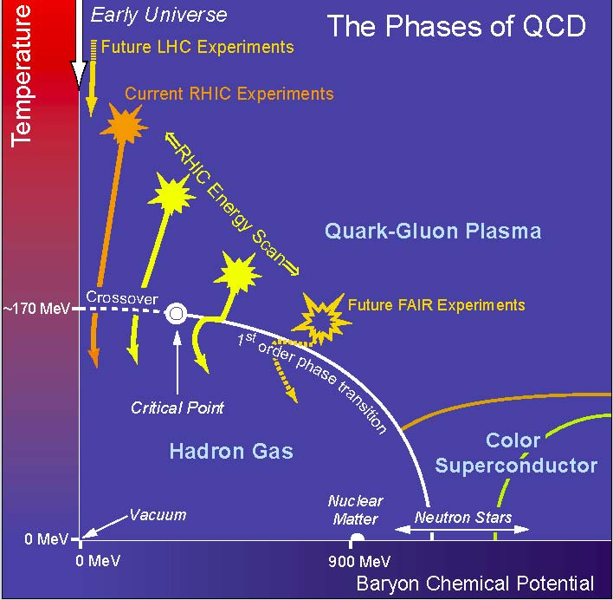
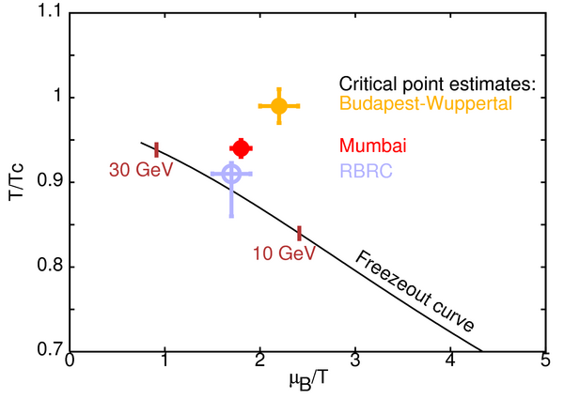
Critical point search: low energy Au+Au @ RHIC
S. Gupta, QM2011
Tools:
Fluctuations, partonic collective flows

Slide 12
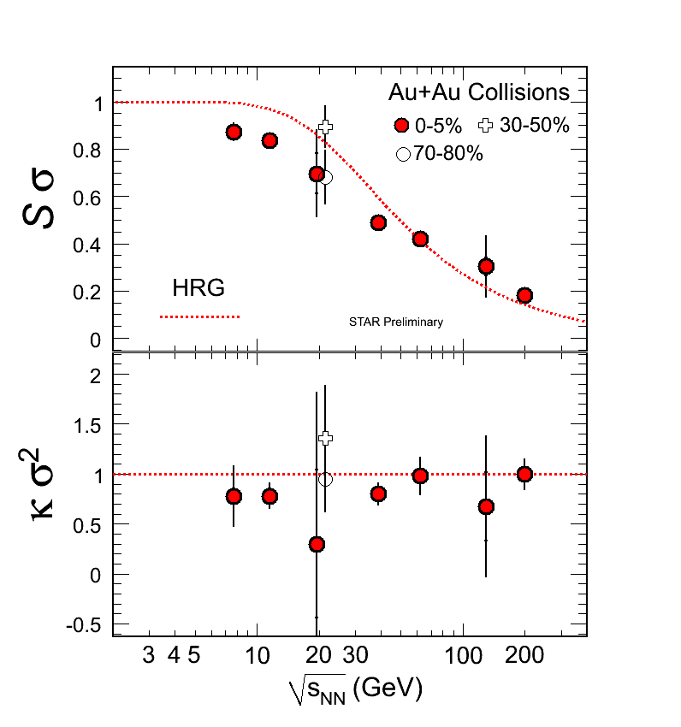
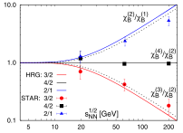
Fluctuations as Critical Point Signature
Karsch, et al. PLB
2010.10046
  Event-by-event net-baryon fluctuation ratios from STAR are so far consistent with the Hadron Resonance Gas
  Hadron freezeout not (yet) near critical point
  Calculations of higher moments from LQCD deviate from HRG calculations and may provide conclusive evidence for critical point if observed in data

Slide 13
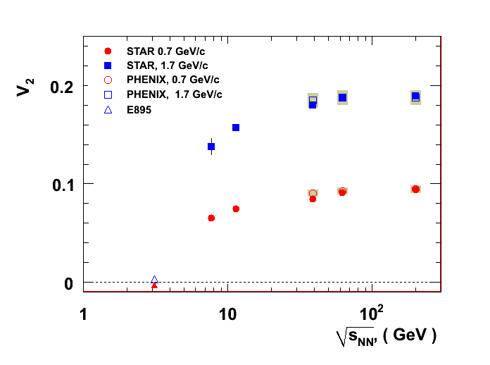

Pb+Pb at LHC ➔ similar flow as at RHIC
ALICE
Preliminary, STAR, PHENIX and E895 data
STAR at RHIC
ALICE
p_{T} = 1.7 GeV
p_{T} = 0.7 GeV
v₂ saturates @ 39 GeV
10³
10⁴
@ LHC T_{init} ~30% higher
η/s(t) sampled differently

Slide 14
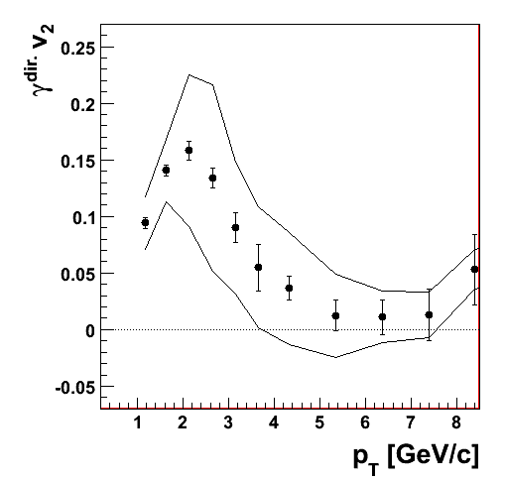
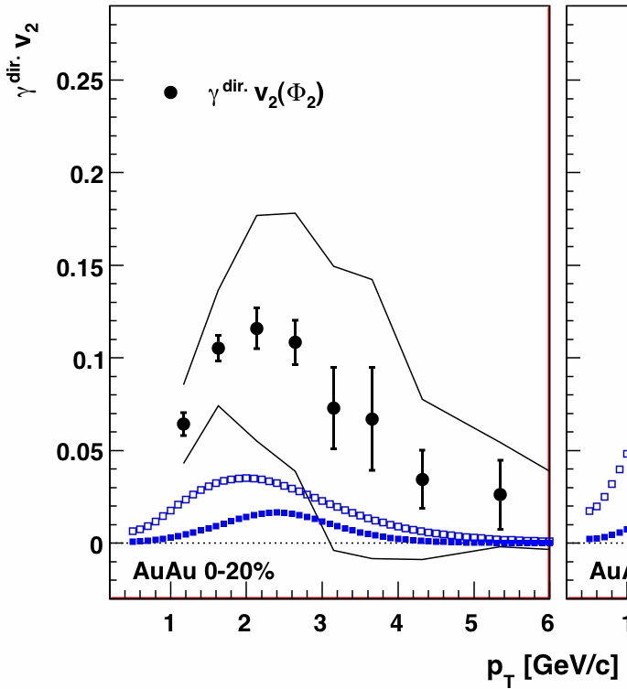
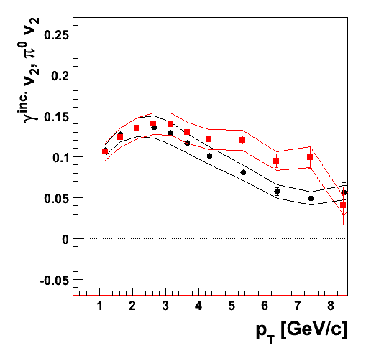
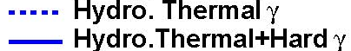
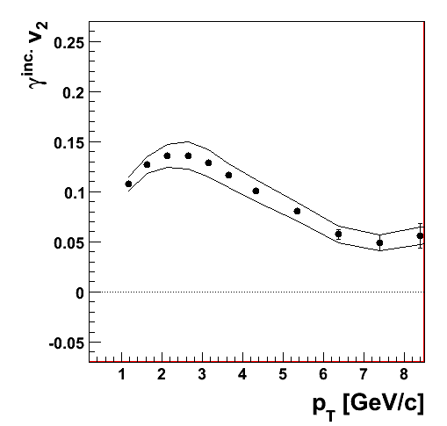
Thermal photons also flow!
arXiv:1105.4126
Au+Au@200 GeV
minimum bias
Au+Au@200 GeV
minimum bias
Au+Au@200 GeV
minimum bias
Statistical subtraction
inclusive photon v₂
- decay photon v₂
= direct photon v₂
π⁰ v₂
Direct photon v₂
inclusive photon v₂
inclusive photon v₂
π⁰ v₂ similar to inclusive photon v₂
Flow magnitude is surprising. Can “extras” explain it?

Slide 15
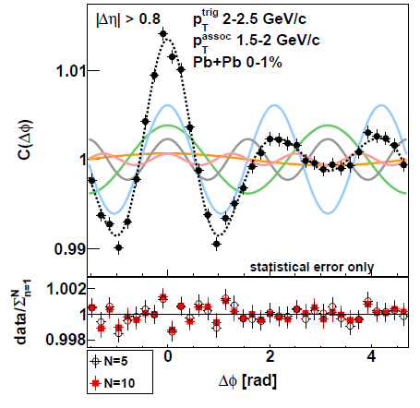
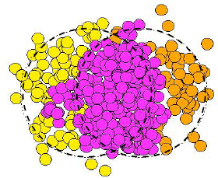
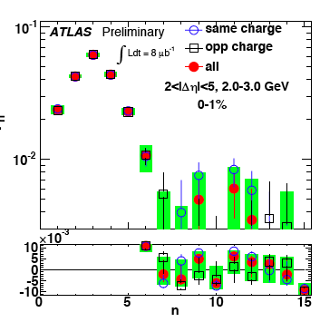
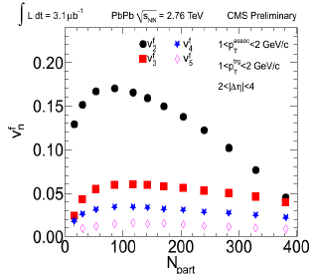
Initial nucleon positions fluctuate (& flow)
ALICE
v₃
v₂

Slide 16
Perfect liquid? What’s the viscosity of QGP?
Use hydro with lattice EOS
Set initial energy density to reproduce observed particle multiplicity
Use various values of η/s
  Quantum mechanical lower bound is 1/4π
  determined with help from AdS/CFT
Constrain with data
  (Account for hadronic state viscous effects with a hadron cascade afterburner)

Slide 17
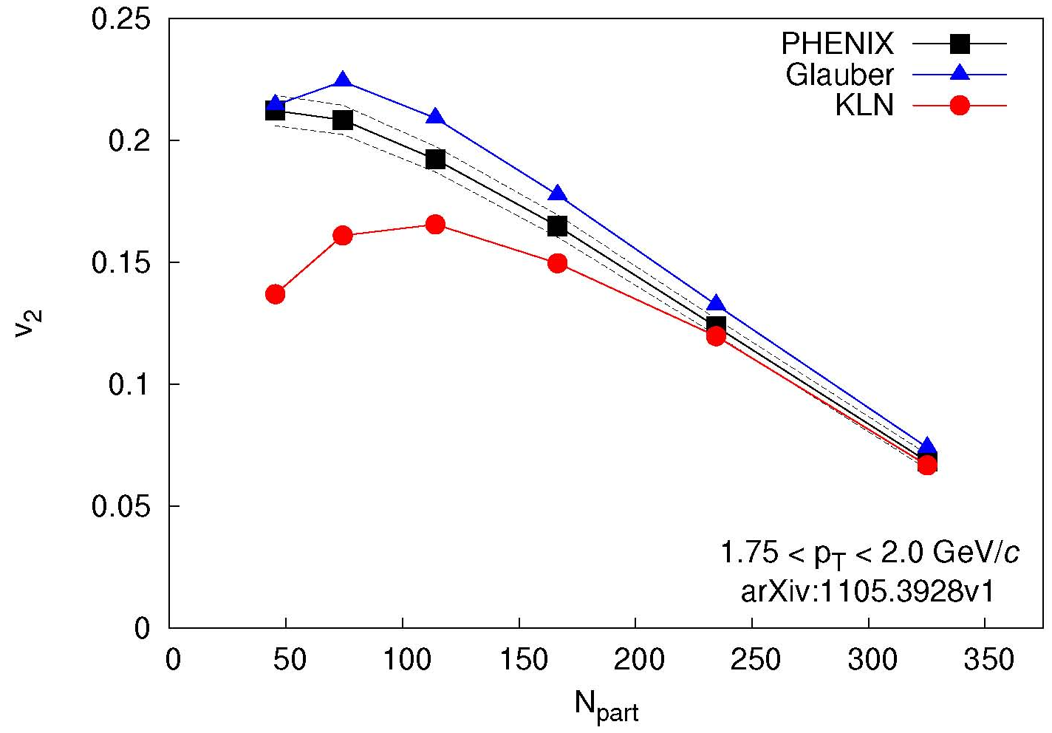
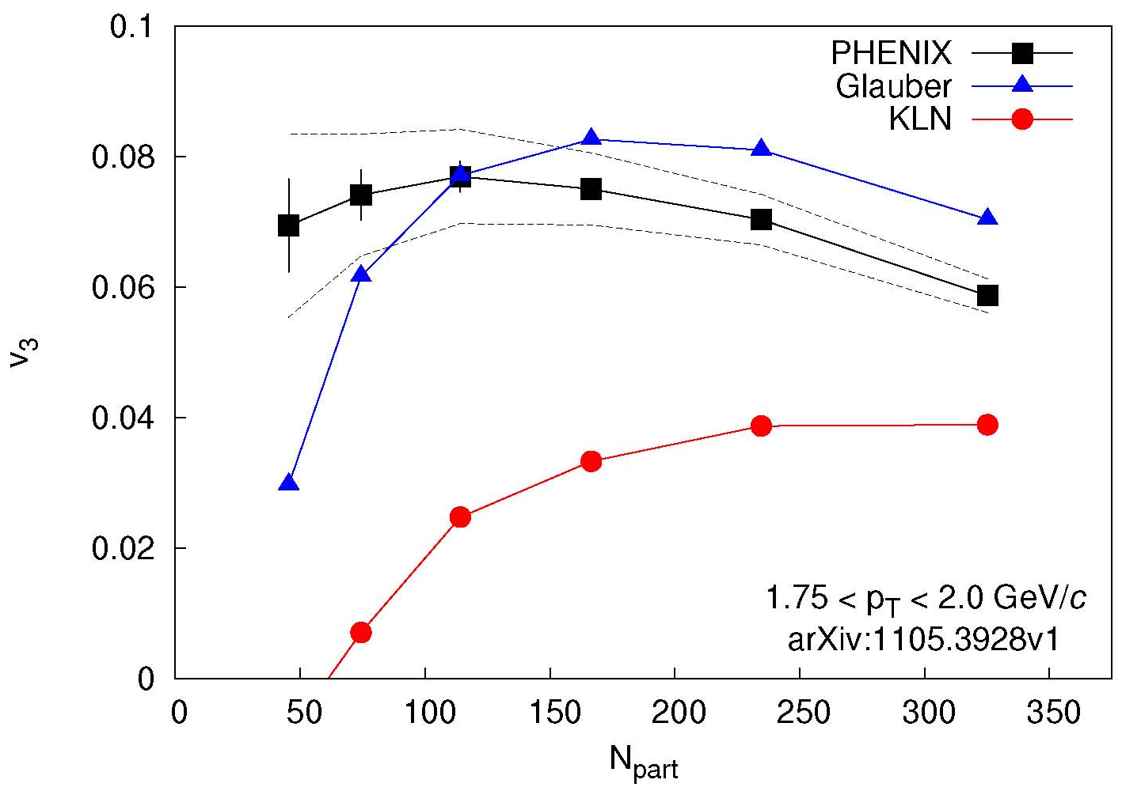
Fluctuations, flow and the quest for η/s
arXiv:1105.3928
v₂ described by both Glauber and CGC
but different values of η/s
v₃ described only by Glauber
breaks degeneracy
Theory calculation:
Alver et al.
PRC82,034913
arXiv:1105.3928
Theory calculation:
Alver et al.
PRC82,034913
200 GeV Au+Au
Lappi, Venugopalan, PRC74, 054905
Drescher, Nara, PRC76, 041903
2 models with
Different fluctuations,
Eccentricity, ρ distribution
Glauber
  Glauber initial state
  η/s = 1/4π
MC-KLN
  CGC initial state
  η/s = 2/4π
Stefan Bathe for PHENIX, QM2011

Slide 18
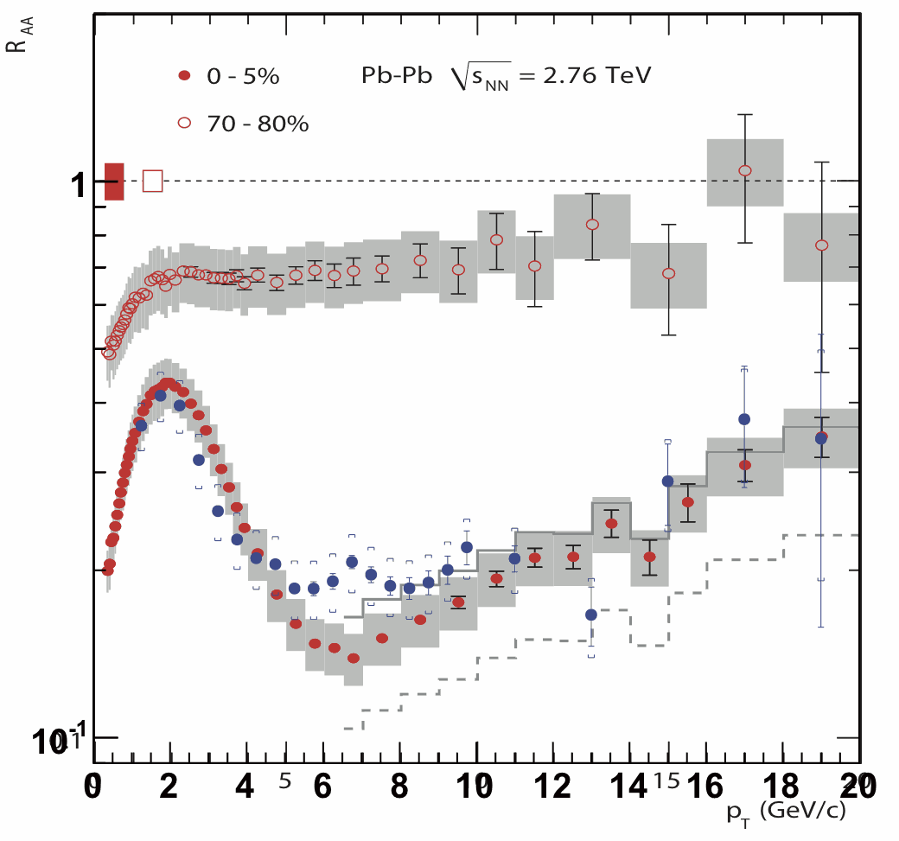
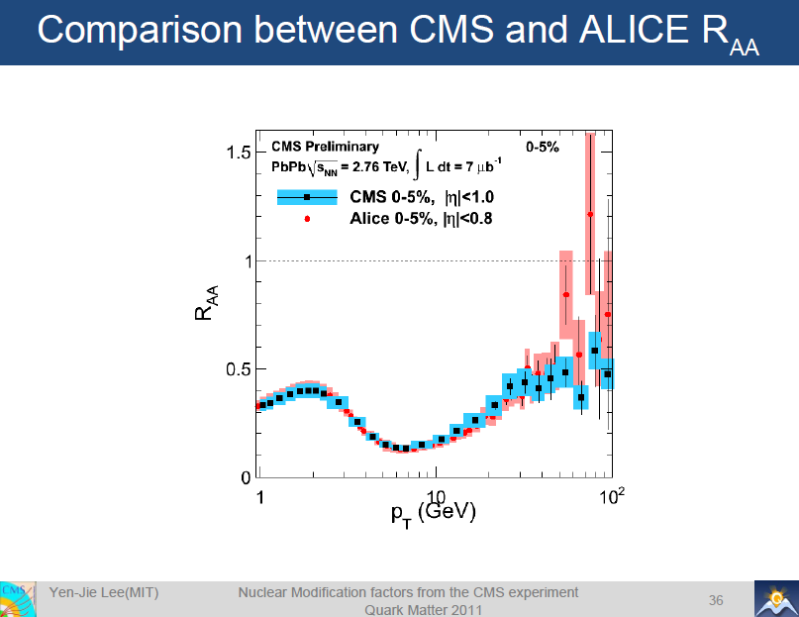
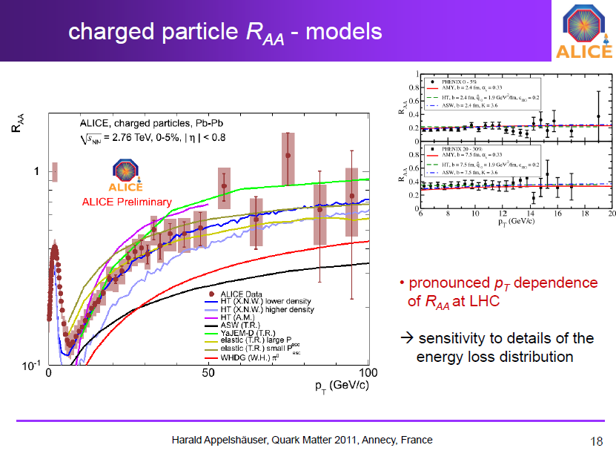
Energy loss in QGP
ALICE
R_{AA}= AuAu/pp x N_{coll}
PHENIX

Slide 19
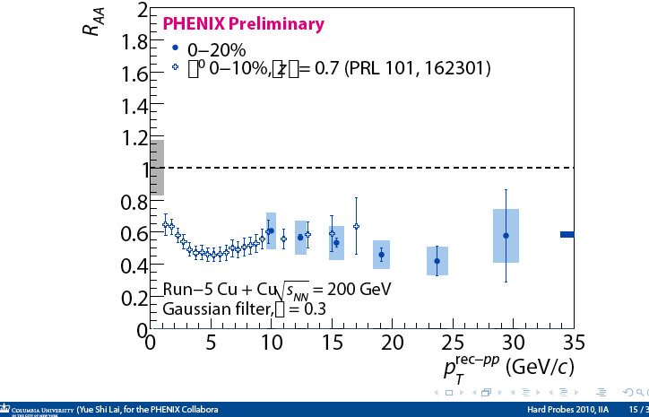
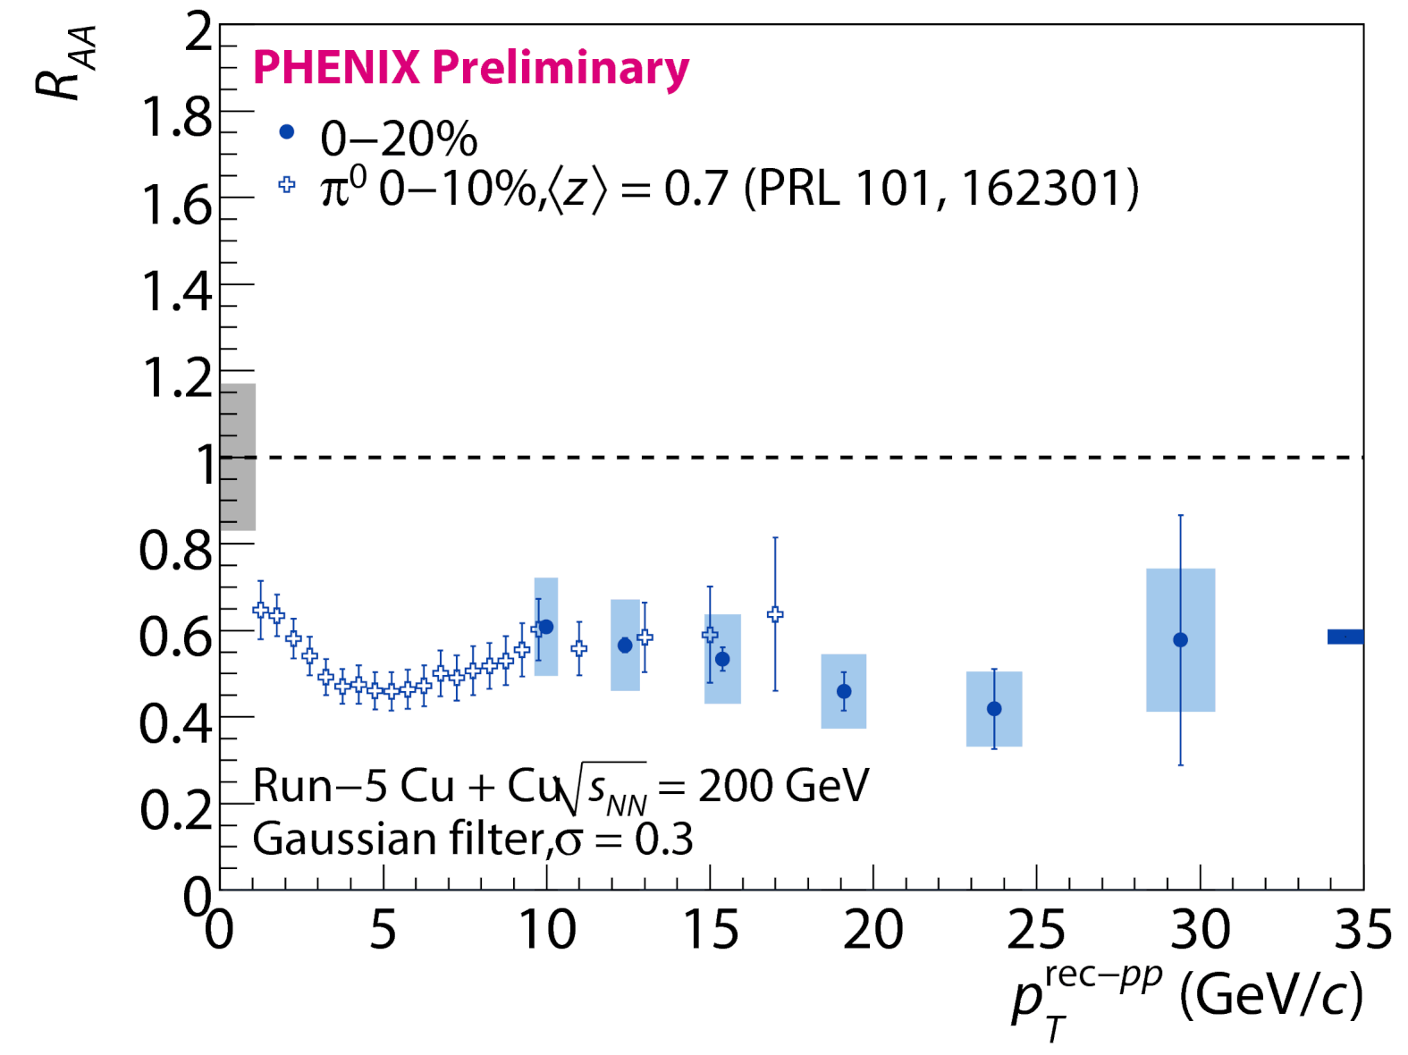
Reconstruct jets in heavy ion collisions
Requiring a narrow jet ➔
same suppression as leading hadron
Hard to reconcile if eloss = splitting inside jet cone

Slide 20
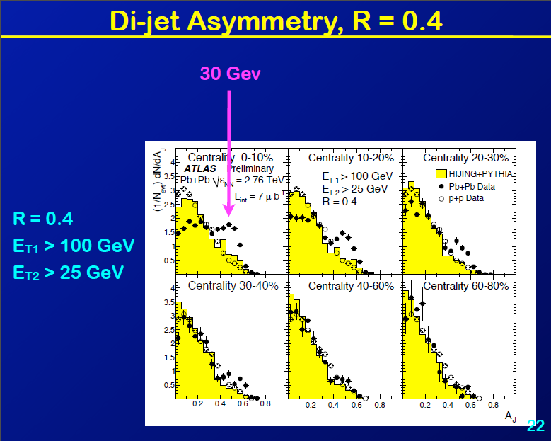
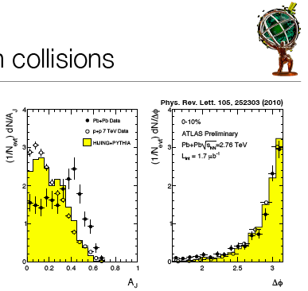
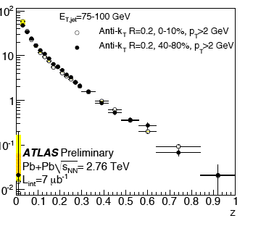
Much zippier jets in Pb+Pb at LHC!
Similar R_{AA} as RHIC for 100 GeV ➔ 250 GeV jets; R independent
Energy loss ➔jet asymmetry; no decorrelation, Fragm.Fn. same!
CMS finds excess soft particles in interjet region…

Slide 21
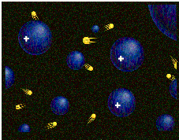
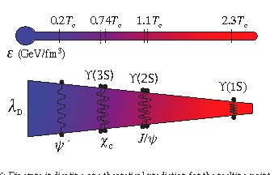
Is there a relevant screening length?
Plasma: interactions among charges of multiple particles
  spreads charge into characteristic (Debye) length, λ_{D}
  particles inside Debye sphere screen each other
Strongly coupled plasmas: few (~1-2) particles in Debye sphere
  Partial screening -> liquid-like properties
  sometimes even crystals!
Test with heavy quark bound states
  Do they survive?
  All? None? Some? Which size?
Are residual correlations important?

Slide 22
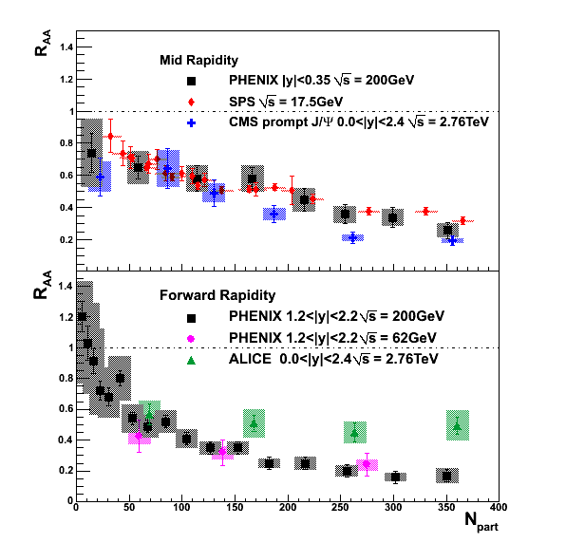
J/ψ vs. system size, √s
Low p_{T}
No clear suppression pattern with ε, T!
Why more suppression at y=2?
Breakup in hadron gas?
Final state coalescence of qq?
To quantify color screening in quark gluon plasma:
study as function of √s, p_{T}, r_{onium}
Also MUST measure J/ψ in d+A/p+A for cold matter effects: gluon shadowing, energy loss
J/ψ R_{AA} ~same from 17.5-200 GeV!
2.76 TeV direct J/ψ lower at mid-y, inclusive above at forward y

Slide 23
New questions from RHIC & LHC data!
At what scales is the coupling strong?
How is equilibration achieved so rapidly?
Nature of QCD matter at low T but high ρ?
What is the mechanism for quark/gluon-plasma interactions? For the plasma response?
  Is collisional energy loss significant?
Is there a relevant (color) screening length?
Are there quasiparticles in the quark gluon plasma? If so, when and what are they?

Slide 24
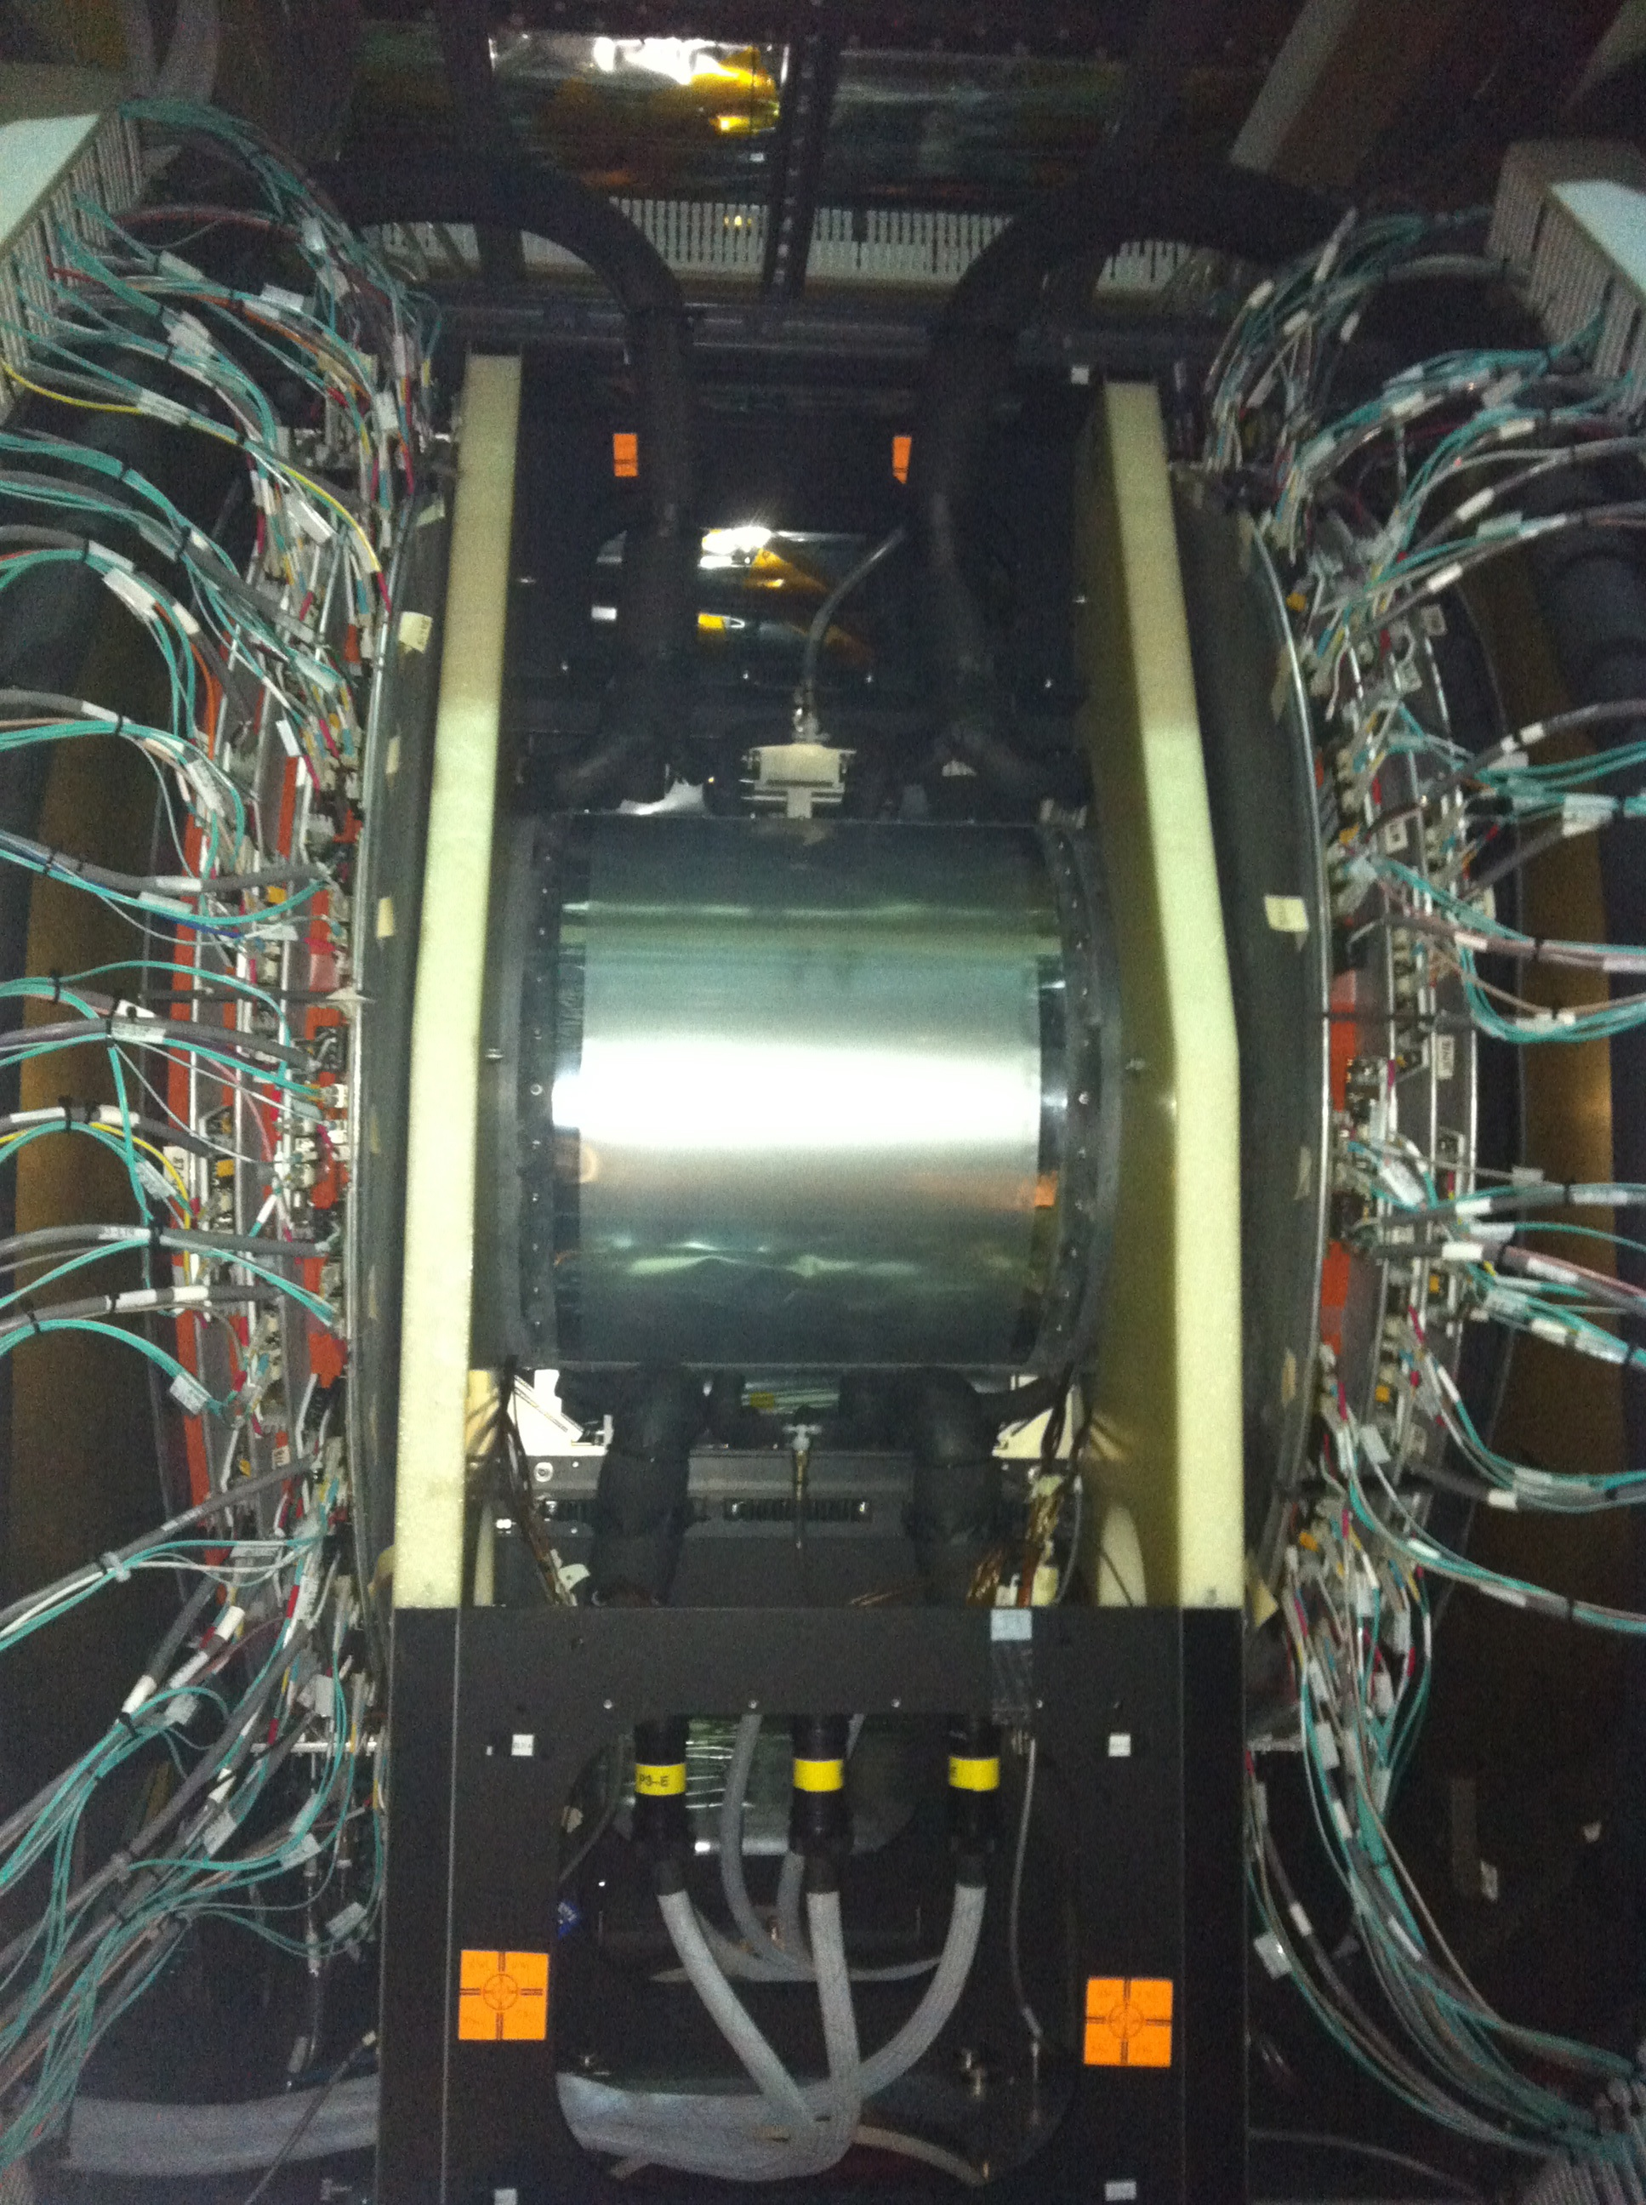
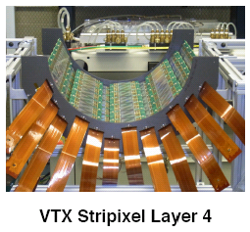
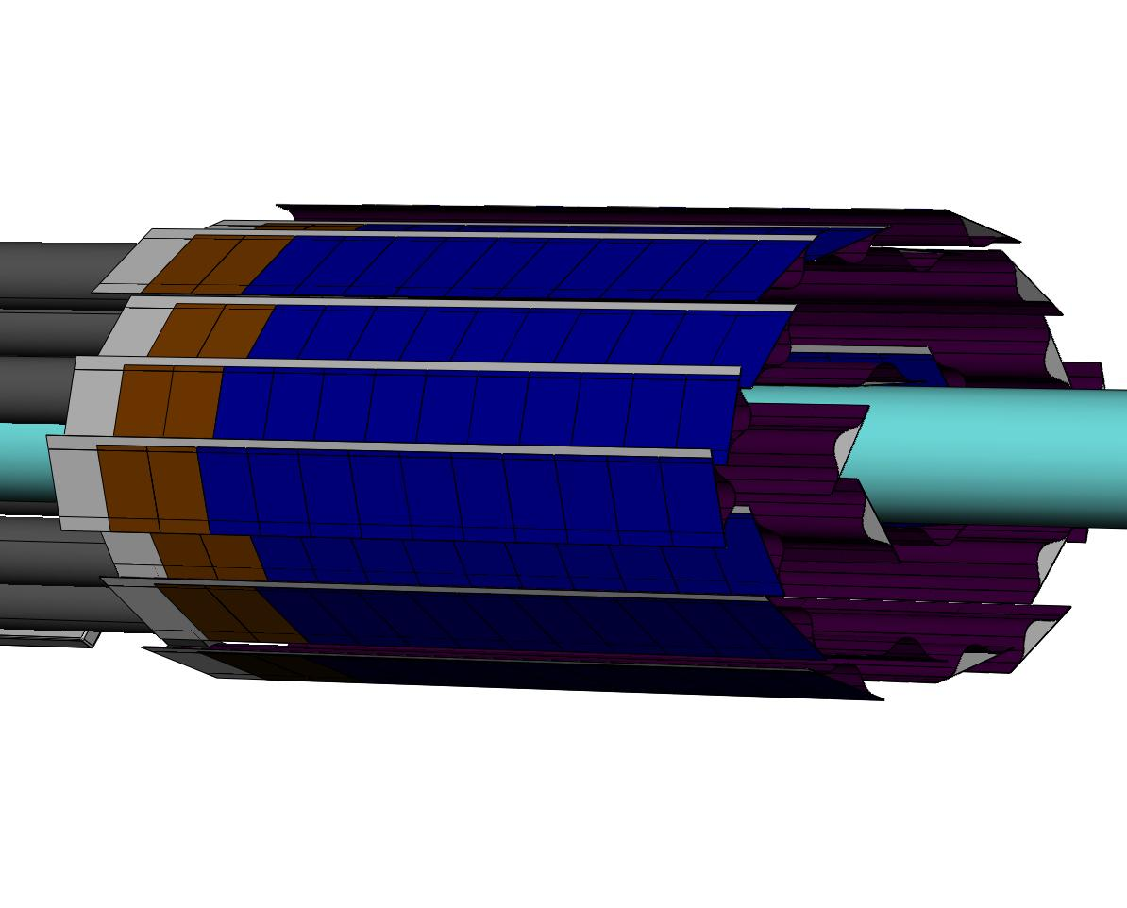
Next step for experiments:
Do even b quarks come to a screeching halt?
  M_{b} ~ 4.2 GeV/c²
  What does b fate tell us about interactions inside?
Higher luminosity to access rarer (i.e. heavier) probes
Add silicon microvertex detectors to both PHENIX and STAR
  Displaced vertex to separate
  c,b; reconstruct D & B mesons
Vertex detectors in place @ LHC
Address Q 1,4,6

Slide 25
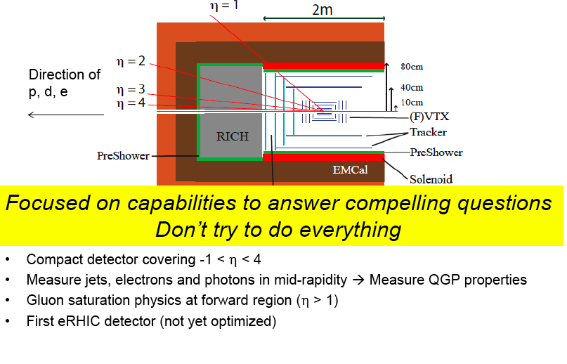
After 2015: Upgrade PHENIX
HCAL
x50 acceptance for quarkonia, jets
❖

Slide 26
Conclusions
T > Tc ; now study quark gluon plasma properties
  QGP behaves as a strongly coupled liquid
Flow (pressure gradients) build up & saturate below 39 GeV
  Soft photons flow too!
η/s near quantum limit; similar @ LHC and RHIC
  Uncertainties being reduced by higher harmonics of flow
Parton energy loss large at low p_{T} @ LHC and RHIC
  At high p_{T}, hadron suppression less, but still substantial
  Jets suppressed from 10-250 GeV, but dijet correlation & fragmentation unchanged. WHERE is the lost energy??!!
Need to understand onium suppression patterns in terms of medium effects on the correlation -> screening length
The data raise entirely new questions!
  Answer by running time and p+A at LHC
  Upgrades at RHIC for heavy quark & jet probes of plasma

Slide 27
backup slides

Slide 28
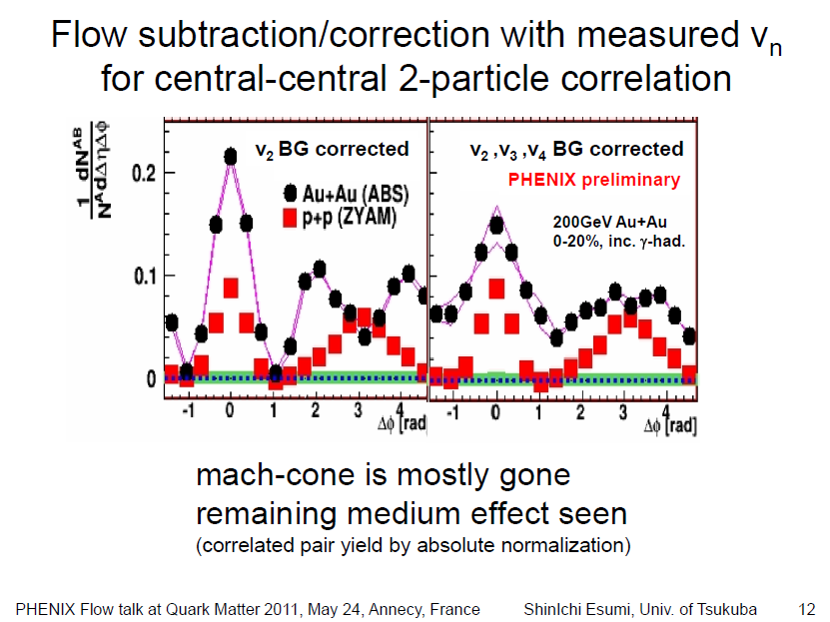

Slide 29
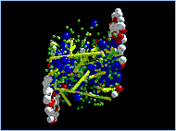

Calculating transport in QGP
weak coupling limit ∞ strong coupling limit
perturbative QCD not easy! Try a pure field…
kinetic theory, cascades gravity ↔ supersym 4-d
interaction of particles (AdS/CFT)
2→3,3→2,n→2…

Slide 30





Lepton pair emission ↔ EM correlator
e.g. Rapp, Wambach Adv.Nucl.Phys 25 (2000)
Emission rate of dileptons per volume
γ∗→ee
decay
EM correlator
Medium property
Boltzmann factor
temperature
Medium modification of meson
Chiral restoration
Hadronic contribution
Vector Meson Dominance
q
q
qq annihilation
Thermal radiation from
partonic phase (QGP)
From emission rate of dileptons, the medium effect on the EM correlator as well as
temperature of the medium can be decoded.
Yasuyuki Akiba - PHENIX QM09
Notes:
30

Slide 31

Suppression pattern ingredients
Color screening
Initial state effects
  Shadowing or saturation of
  incoming gluon distribution
  Initial state energy loss
  (calibrate with p+A or d+A)
Final state effects
  Breakup of quarkonia due
  to co-moving hadrons
  Coalescence of q and qbar
  at hadronization
  (calibrate with A, centrality dependence)
arXiv:1010.1246

Slide 32


Expect if c-cbar pairs numerous or correlated
Open charm flows
but J/ψ does not
PRL.98: 172301,2007
So, cc coalescence in final state @ RHIC is not large
Higher at LHC?

Slide 33


b-bar bound states
Coalescence could be important at LHC
  More c-cbar pairs produced. Use b-bar to probe…
Does partial screening preserve correlations, enhancing likelihood of final state coalescence?
arXiV:1010.2735 (Aarts, et al): Υ unchanged to 2.09T_{c}
  χ_{b} modified from 1-1.5T_{c}, then free
ϒ (2S,3S)
suppressed

Slide 34

Prompt (CMS) vs. inclusive (ATLAS) J/ψ
at high p_{T}, prompt J/ψ < inclusive?
  (b states less suppressed)
recall:
√s dependence is weak
LHC less suppressed!
  Final state coalescence?

Slide 35


susceptibilities & net-baryon fluctuations
Relation between the baryon susceptibilities, χ_{Β}, and cumulants of the net-baryon fluctuations

Slide 36


Elliptic flow scales with quark number
200 GeV
Au+Au
implication: valence quarks, not hadrons, are relevant DOF
coalesce into hadrons when T falls below T_{c}
consistent with success of hydro with lattice EOS, but…
what gives? dressed quarks are born of flowing field?
Nb: strongly interacting liquids lack well-defined,
long-lived quasi-particles

Slide 37


minimum η at phase boundary?
strongly coupled dusty plasma
B. Liu and J. Goree,
cond-mat/0502009
quark gluon plasma
Csernai, Kapusta & McLerran
PRL97, 152303 (2006)
minimum observed in other strongly coupled systems –
kinetic part of η decreases with Γ while potential part increases

Slide 38
Insights, given first LHC results
Quarkonia energy dependence not understood!
  Need charmonium and bottonium states at >1 √s at RHIC
  + guidance from lattice QCD!
Jet results from LHC very surprising!
  Steep path length dependence of energy loss
  also suggested by PHENIX high p_{T} v₂; AdS/CFT is right?
  Little modification of “jet” fragmentation function
  looks different at RHIC (different jet definition, energy)
  Lost energy goes to low p_{T} particles at large angle
  is dissipation slower at RHIC? Due to medium or probe?
  Little modification of di-jet angular correlation
  appears to be similar at RHIC
Need full, calorimetric reconstruction of jets in wide y range at RHIC to disentangle probe effects/medium effects/initial state

Slide 39


Slide 40


Slide 41


Slide 42


Direct photon flow ingredients
200GeV Au+Au 20-40%
PHENIX Preliminary
Key cross checks:
  γinc are really γ’s:
  check using γ-> e+e-
  Rγ for virtual vs. real γ
γ^{inc.} v₂
(Φ₂^{BBC})
γ^{inc.} v₂ with external conversion method

Slide 43


heavy quark suppression & flow?
PRL.98: 172301,2007
arXiV: 1005.1627
Collisional energy loss?
v₂ decrease with p_{T}?
role of b quarks?

Slide 44
Mysteries in heavy ion physics
Energy loss mechanism
  @ LHC 40 GeV jets opposing 100 GeV jets look “normal”
  no broadening or decorrelation
  no evidence for collinear radiation from the parton
  @ RHIC low energy jets appear to show medium effects
  but, “jet” is defined differently
  c & b to probe role of collisional energy loss VTX, FVTX
  quantify path length dependence U+U, Cu+Au
J/ψ suppression and color screening
  amazingly similar from √s=17-200 GeV; but initial states differ
not SO different at LHC
  Other states y & √s dependence (e.g. ψ’) FVTX, statistics
  d+Au for initial state; 130 GeV Au+Au eventually?
NSAC milestone DM11, 12
NSAC milestone DM5

Slide 45

To answer these questions
❖

Slide 46



How does this happen?

Slide 47

Cost estimate
❖

Slide 48


Slide 49

Our big picture plan

Slide 50

Thermal photons (virtual)
Observe excess photons beyond pQCD in AA collisions. In thermal p_{T} region

Slide 51

Dielectron production in 0.5 < m_{ee} < 1 GeV
Significant excess in central collisions.
Dominantly at low p_{T}
We are investigating using Run-10 data with the HBD
NSAC milestone DM6

Slide 52


Beam Energy Scan in PHENIX
Is there a critical point separating 1st order phase transition & smooth cross-over?
Quark-number scaling of V₂
  saturation of flow vs collision energy
  find η/s minimum at critical point from flow
Critical point searches via:
  fluctuations in <p_{T}> & multiplicity
  K/π, π/p, pbar/p chemical equilibrium
  R_{AA} vs √s, ….

Slide 53


Dense gluonic matter (d+Au, forward y): large effects observed
arXiv:1010.1246
arXiv:1105.5112
Di-hadron suppression at low x
pocket formula (for 2➔2):
Shadowing/absorption stronger than linear w/nuclear thickness
trend as, e.g. in CGC …

Slide 54


Slide 55

Calculate the correlator on the lattice
non-perturbative contributions to thermal dilepton rates
at low mass
For small energy, ω/T<(1-2) spectral function > free form
For ω/T ≃ 1 thermal dilepton rate ~ order of magnitude > leading order Born rate
for ω/T>∼(2 − 4) the spectral function is close to the free form
From fit to lattice spectral fn. in Phys.Rev.D.83.034504 (2011)

Slide 56


Heavy quark diffusion
Ding, et al.
arXiV:
1107.0311
J/Ψ: Not yes/no!
Is the correlation gone @ T >1.5 T_{c}?
What happens at 1.0-1.2T_{c}?
Is there observable evidence of partial screening?

Slide 57


Matter flows like a ~ideal liquid
huge pressure buildup
large anisotropy →
rapid equilibration
Kolb, et al
Hydrodynamics reproduces
elliptic flow of q-q and 3q states
Mass dependence requires
soft EOS, NOT gas of hadrons
only works if viscosity/entropy is near the minimum for a quantum system (1/4π)
“perfect” liquid (D. Teaney, PRC68, 2003)

Slide 58
Beam Energy Scan at RHIC
√s_{NN} (GeV) | Status | Experiment
5.0 | TBD | STAR
7.7 | analyzed | STAR PHENIX (limited statistics)
11.5 | analyzed | STAR
19.6 | Collected in 2011 | STAR, PHENIX
27 | Collected in 2011 | STAR, PHENIX
39 | analyzed | STAR, PHENIX
62 | analyzed | STAR, PHENIX
130 | collected in Run-1, analyzed limited statistics | STAR, PHENIX

Slide 59

don’t give up! ask lattice QCD
Karsch, et al.
running coupling
coupling drops off for r > 0.3 fm

Slide 60

High m_{eff} → large collisional energy loss
R. Kolevatov &
U.A. Wiedemann
arXiV:0812.0270
Composite quasiparticles?
b/c separation provides the test!

Slide 61


Collective motion & elliptic flow (v₂)
Almond shape overlap region in coordinate space
z
y
x
momentum space
dN/dφ ~ 1 + 2 v₂(p_{T}) cos (2φ) + …
hydrodynamics works!

