Slide 1
Fast beam current transformer
considerations for TT20
Marek Gasior
for the SY-BI-IQ section

Slide 2
Numbers, current situation and open questions
Numbers from issue BIIQ-639 = “BCT meas in SPS TT20”: 1e12 protons in 10 – 20 ms
1e12 protons in 10 ms → beam current 16 μA
1e12 protons in 20 ms → beam current 8 μA
Currently, the lowest current we measure is a couple of tens of microamperes in a ≈ 200 μs pulse at the end of LINAC 3 (ITH.BCT.41)
Recent developments should allow attempting measuring microamperes in TT20 if the length of the measurement is not excessive:
10 ms is excessive, 1 ms starts to be reasonable, but in general, the shorter the measurements, the better measurement quality (some examples in next two slides)
A FBCT in TT20 for measuring microamperes would be a dedicated device for such low intensities and would not be able to measure larger currents
It would be a serious new development, requiring proper budget and manpower allocation
Fundamental questions for the feasibility of an FBCT in TT20 optimised for microampere beam currents:
What would be the shortest acceptable measurement time ?
What would be the timeline of the project ?

Slide 3
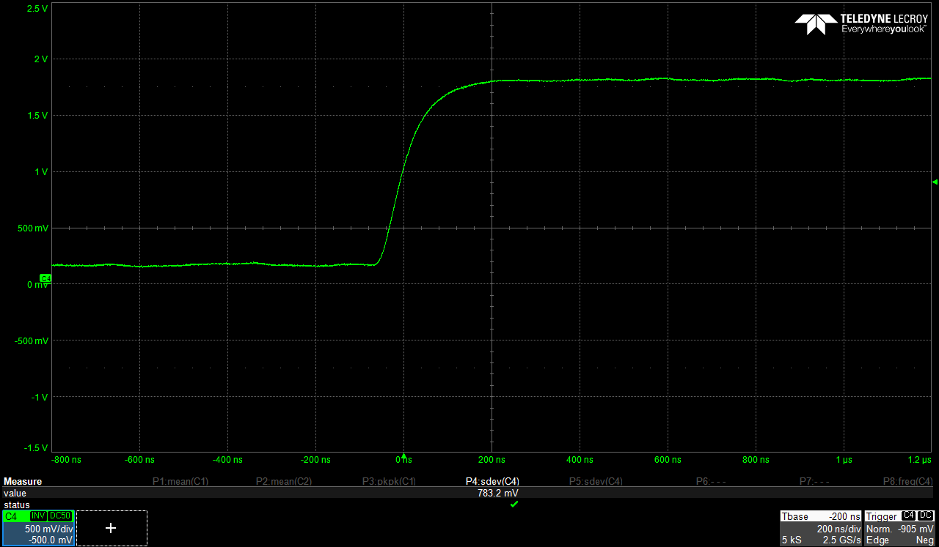
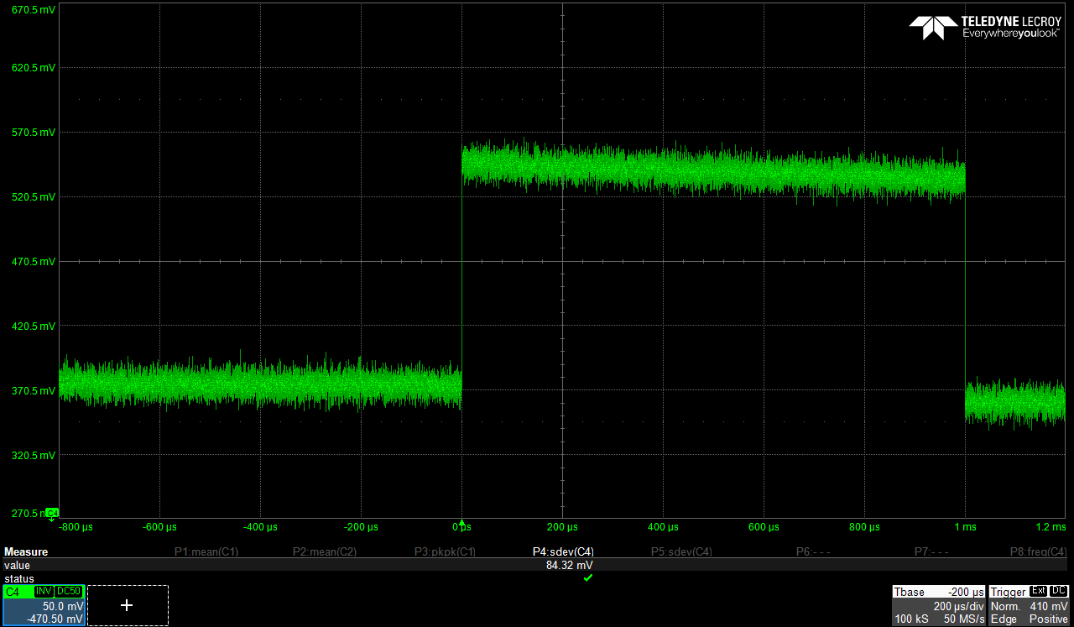
Lab measurements – LINAC 3 recent R&D
200 ns / div
20 μA, 1 ms

Slide 4
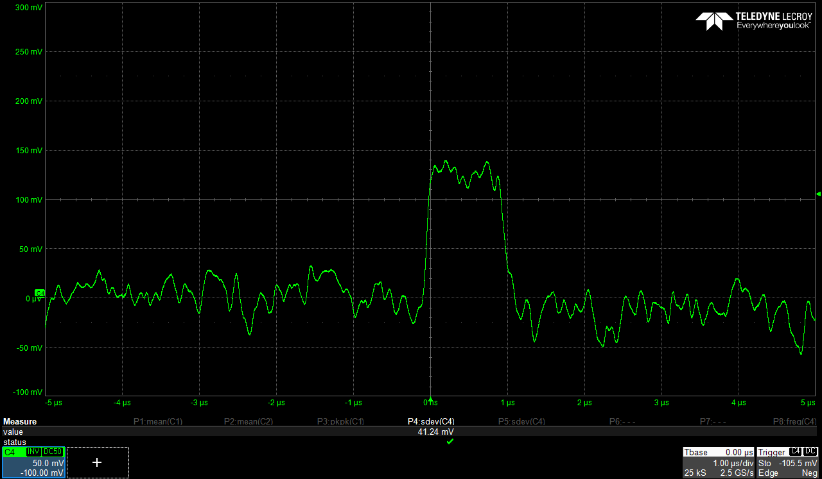
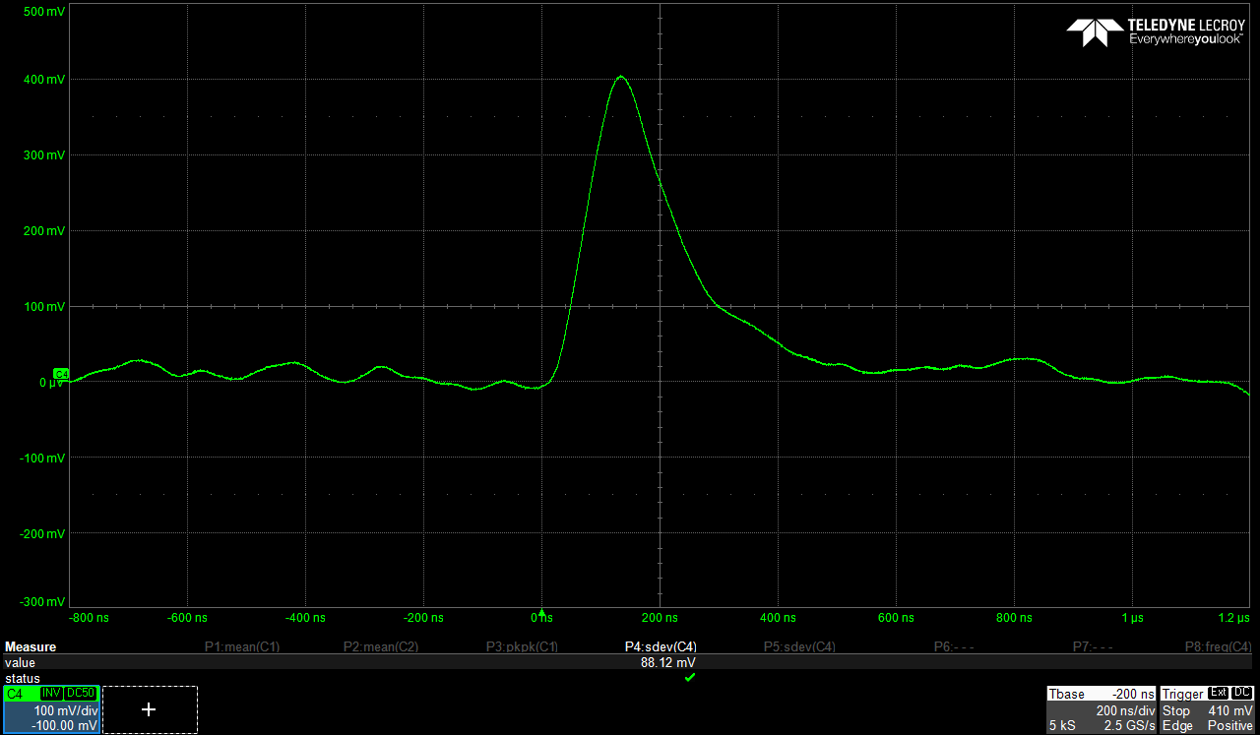
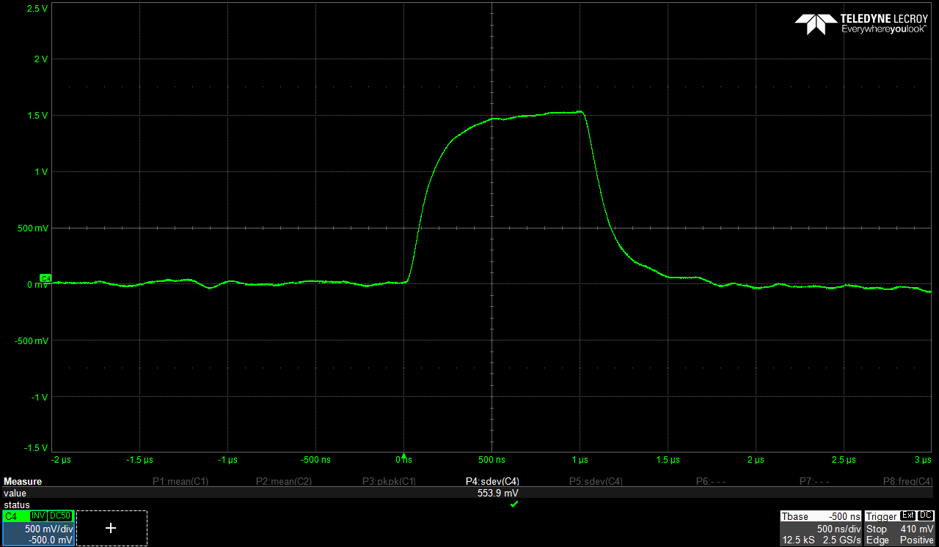
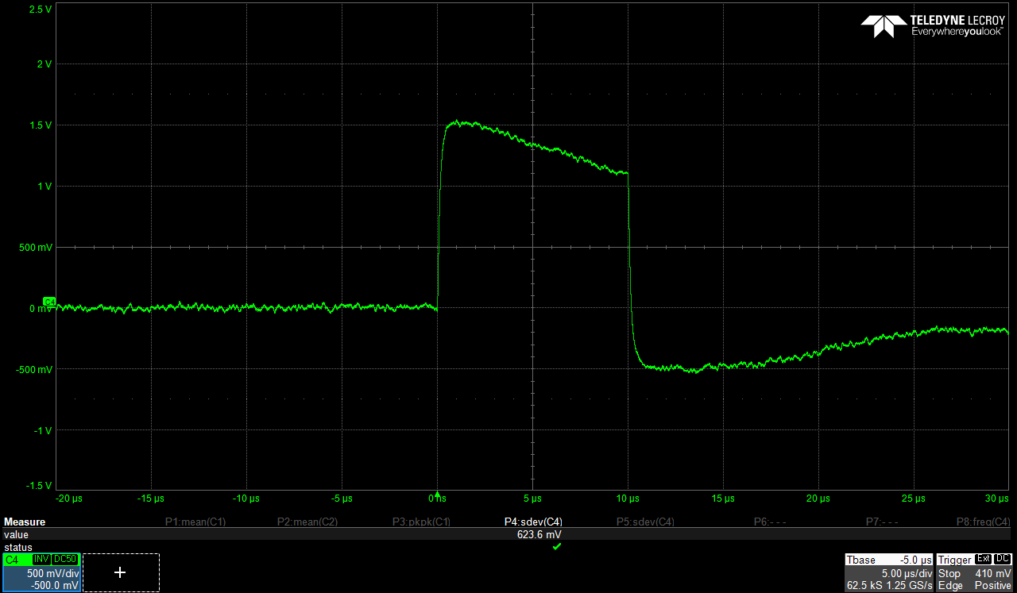
Recent R&D for low currents: one-turn FBCT + dedicated head amplifier
2 μA, 1 μs
10 μA, 100 ns
20 μA, 1 μs
20 μA, 10 μs

Slide 5
Spare slides

Slide 6
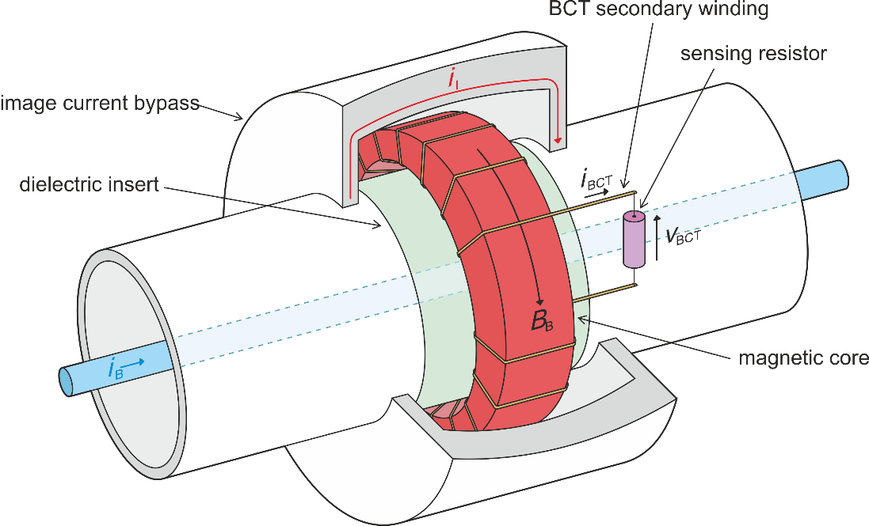
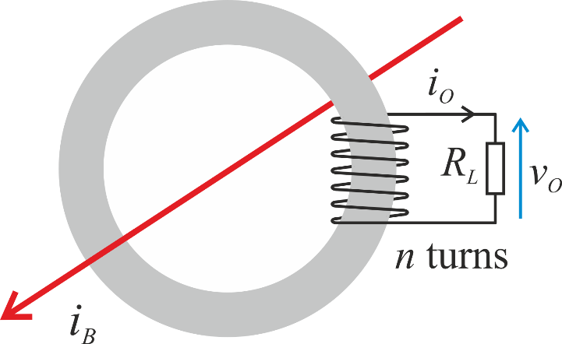
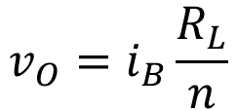
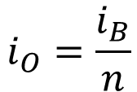

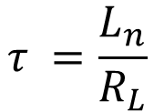
FBCT principles
$$i_{O}=\frac{i_{B}}{n}$$
$$v_{O}=i_{B}\frac{R_{L}}{n}$$
$$τ =\frac{L_{n}}{R_{L}}$$
$$L_{n}=n^{2}A_{L}$$

Slide 7
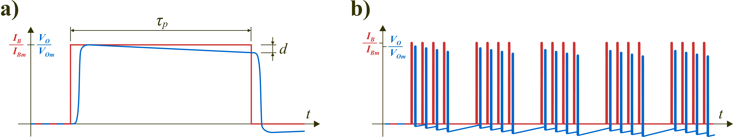
FBCT principles

Slide 8
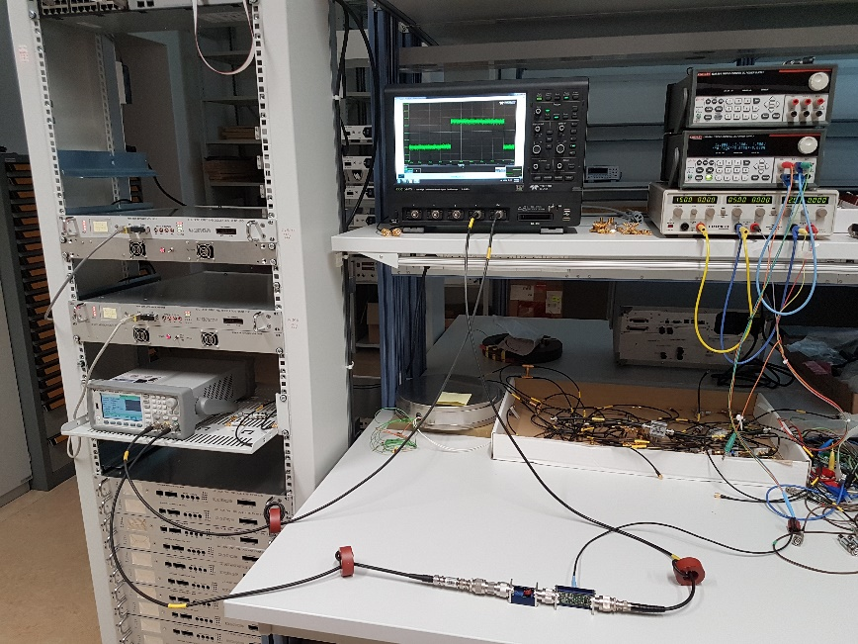
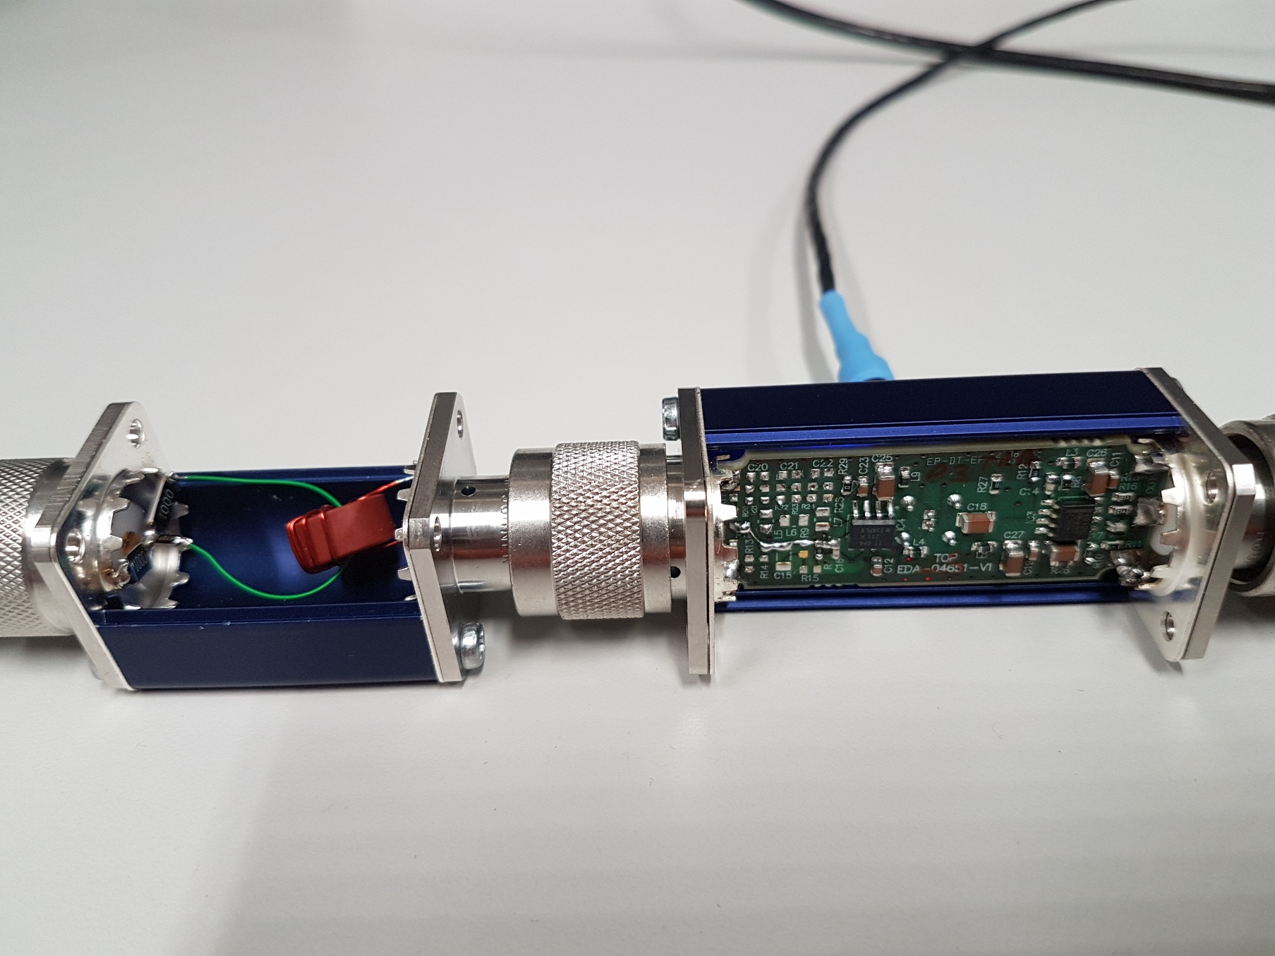
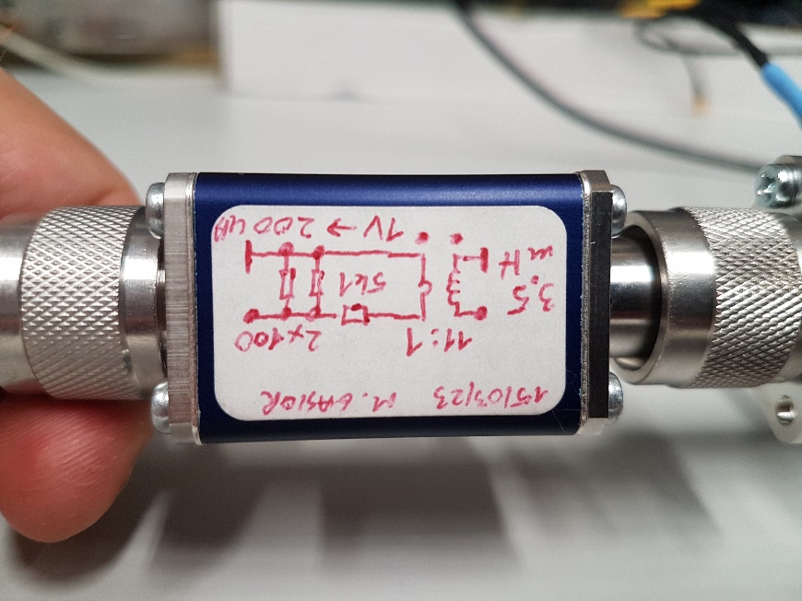
Lab measurement setup

