Slide 1
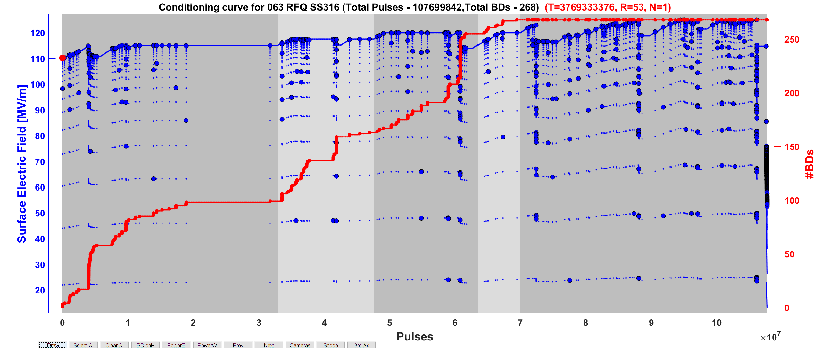
Stainless Still electrodes non-irradiated.
Maximum field 120 MV/m.

Slide 2
Stainless Still electrodes non-irradiated.
Maximum field 120 MV/m.

Slide 3
