Slide 1












Bringing European Science Closer to Market - ATTRACT
John Wood
Chair, ATTRACT Project Advisory Committee(PAC)
Foundation Future Leaders, CERN
November 27, 2023

Slide 2
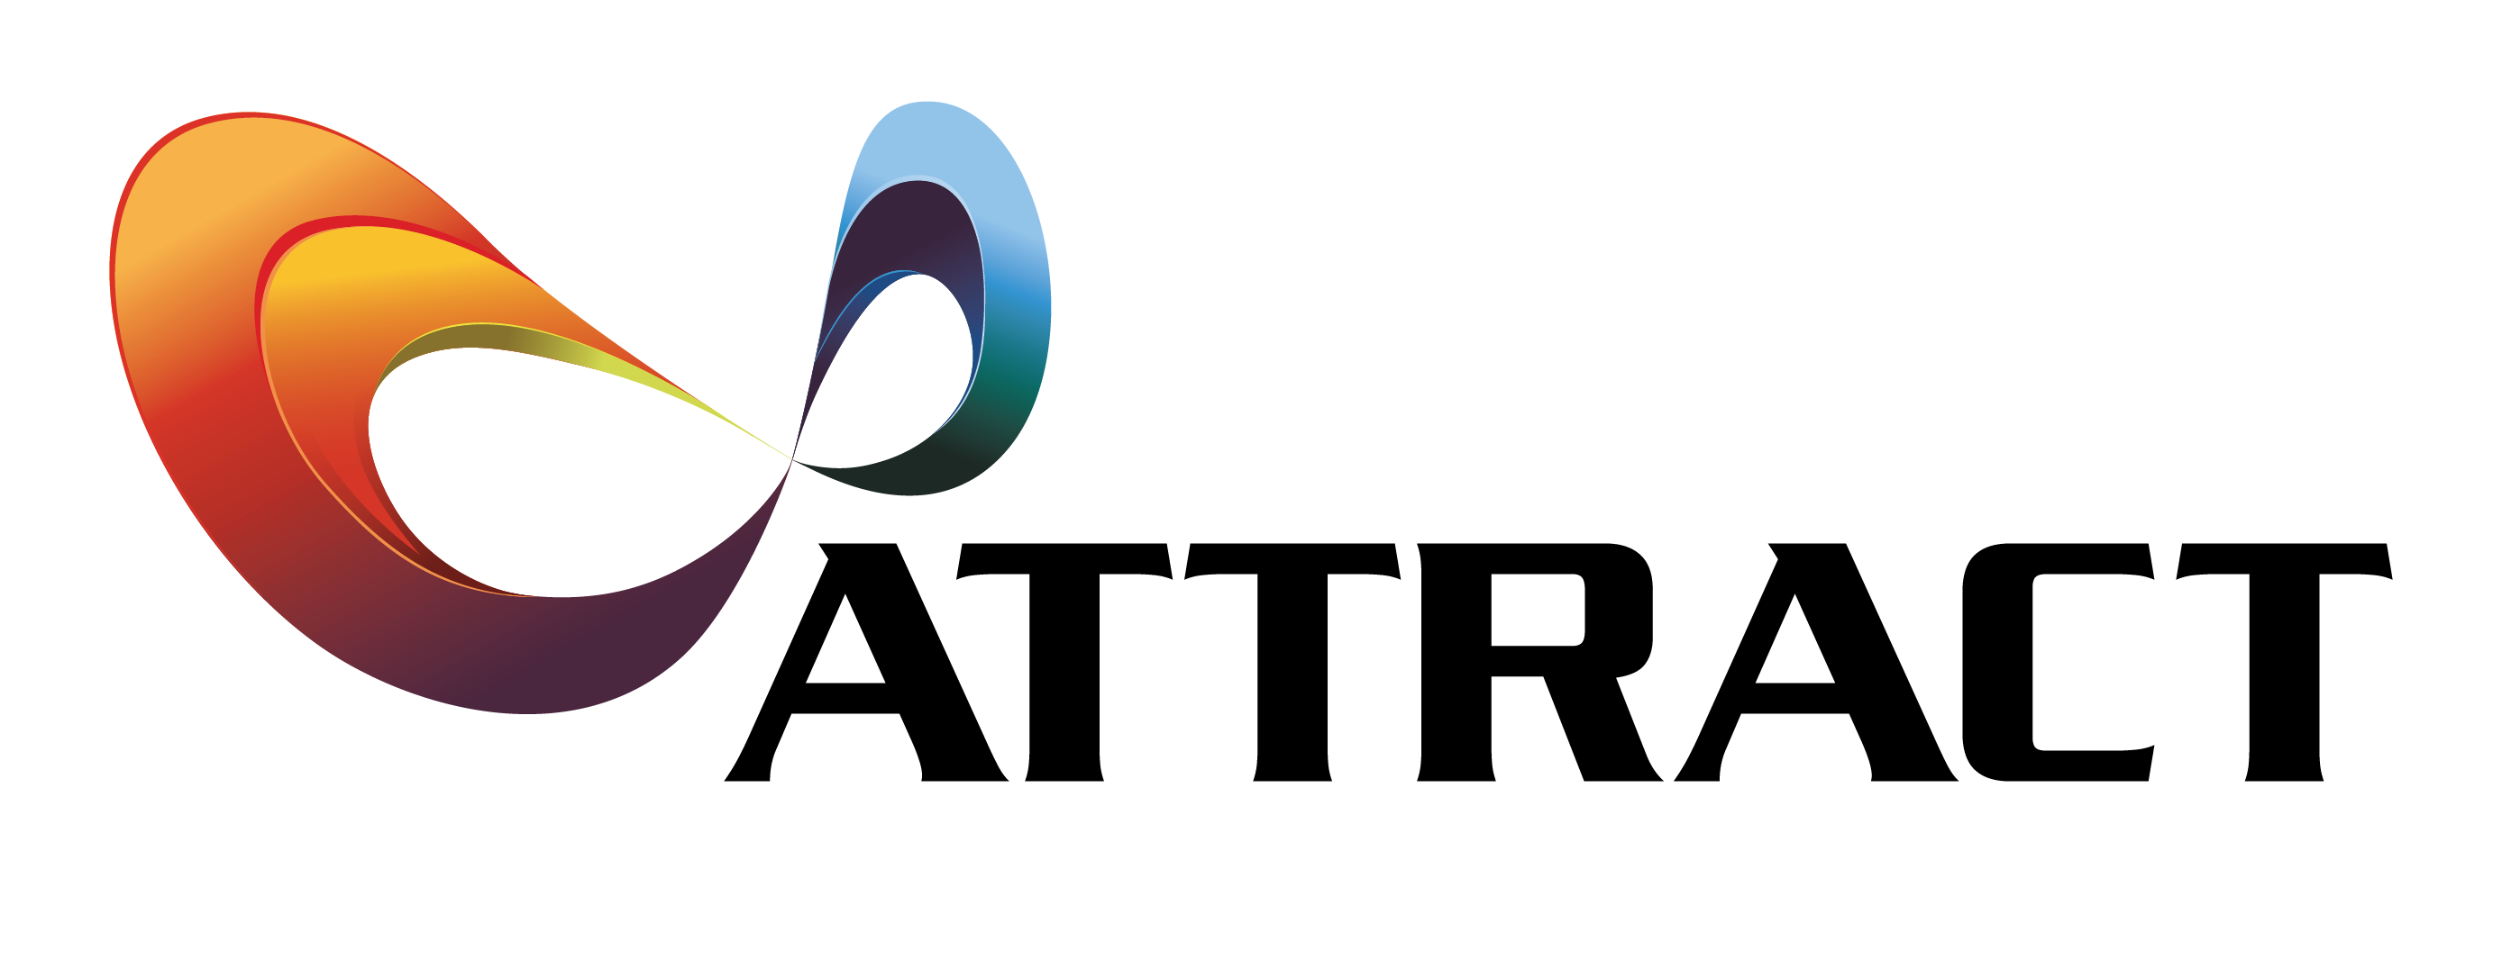
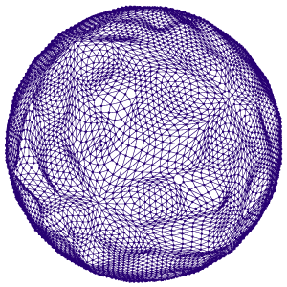
Why ATTRACT?
We believe that the potential of European Research Infrastructures as Innovation Engines is not yet fully exploited.
  The European Commission defines Research Infrastructures (RI) as facilities providing resources and services for research communities to conduct research and foster innovation*.
But is this really the case? Could pushing the limits of Fundamental Science, which is the mission of RIs, in some new way translate research faster and in a more streamlined fashion into industrial applications, new business and social wealth?
The ATTRACT initiative was created in 2018 to address the above question, in a dialogue with the EC.
It become apparent that this new approach would need to deviate from the traditional role of considering RI as access facilities for industry.
Moreover, the communities behind RIs would also need to tap into industrial know-how in a better way (e.g. advanced and high scale manufacturing capacity) for pushing their own research-driven mission.
* https://ec.europa.eu/info/research-and-innovation/strategy/european-research-infrastructures_en

Slide 3
Basic Philosophy of ATTRACT:
To create a novel Ecosystem focusing on breakthrough detection and imaging (D&I) technologies in Europe.
The dialogue between the ATTRACT Consortium and the EC, as well with several influential thinkers, led to the following key insights*:
A new action framework beyond the existing RI-industry frameworks and practices was needed for enabling the opportunities identified in the paradigm of “Open Science, Open Innovation, Open to the World”, to harness both value creation and value capturing, and share it
  see Henry W. Chesbrough and Melissa M. Appleyard, Open Innovation and Strategy, California Management Review Vol. 50, No. 1, 2007.
Focus on bottom-up, low TRL initiatives in D&I with industry (SME)-RI co-innovation potential innovation (but do not assume all scientists wish to turn into entrepreneurs themselves). But the (young) entrepreneurs should be on board!
Aim at a sustainable cycle, in phases (cascade funding approach). Try to engage private investors …
Create a framework that can be dynamically tested by generating, gathering and analyzing related data. This is needed to validate the concept and see whether it can be significantly scaled-up, also outside D&I.
Many of them have been reflected in the EC policy paper, Sustainable Research Infrastructures,
https://ec.europa.eu/info/sites/default/files/research_and_innovation/research_by_area/documents/swd-infrastructures_323-2017.pdf

Slide 4
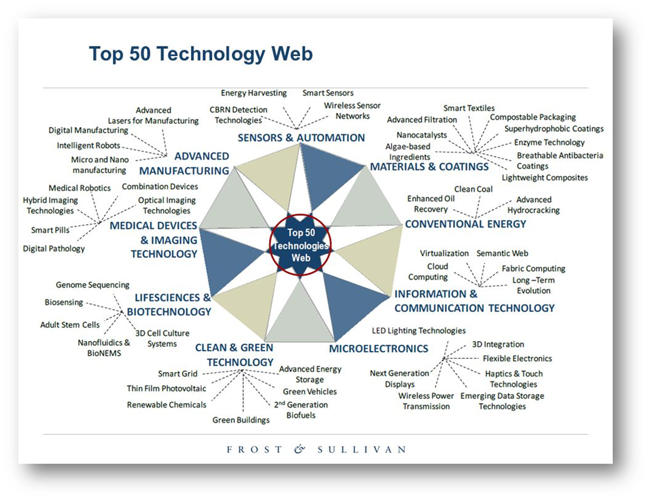
ATTRACT: Why Detection and Imaging (D&I)?
What in the picture has nothing to do with D&I?
The scientific mission of European RIs as well as their R&D associated communities is strongly coupled with detection and imaging technology instrumentation (including computing).
Detection and Imaging technologies are and will be at the core of future industrial developments applications and business (e.g. IoT, Smart Cities, Autonomous Transport, Sustainable Agriculture, etc).

Slide 5
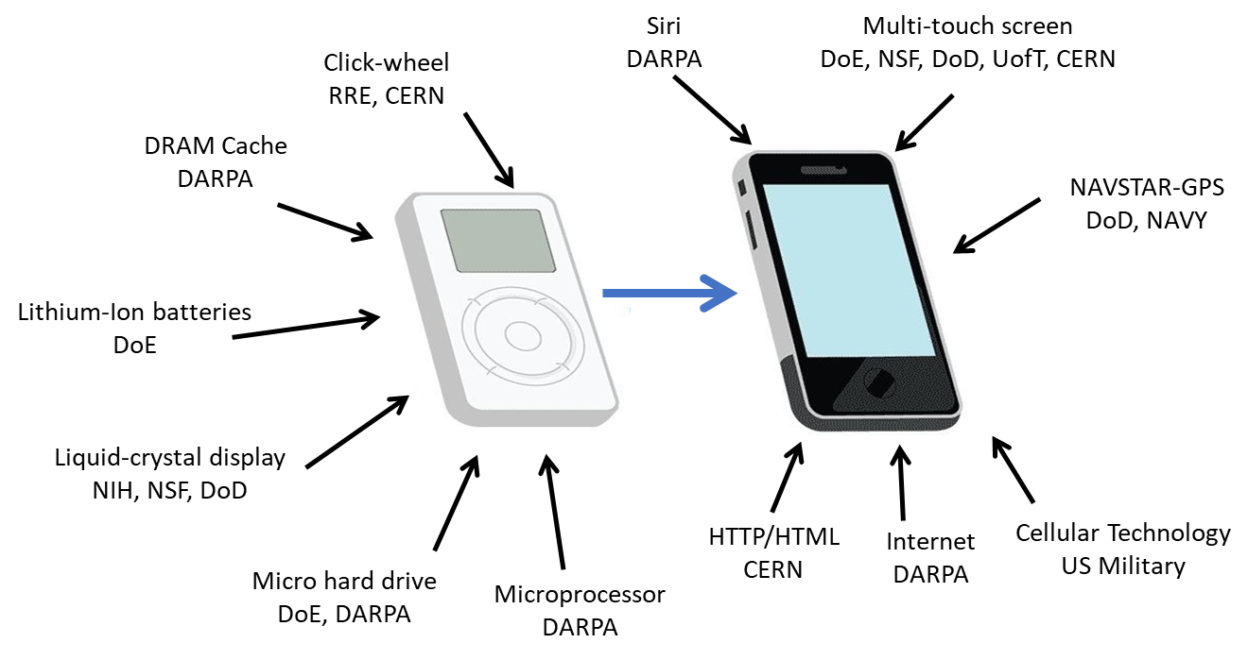
ATTRACT: Key pillars (1)
“So where does breakthrough Innovation come from?”
Public Funding: Key for helping nascent breakthrough technologies, many of them even at the conceptual level, mature for raising the interest of private capital .
DARPA: Defense Advance Research Project Agency
RRE: Royal Radar Establishment
CERN: European Organization for Nuclear Research
DoE: Department of Energy
NIH: National Institute of Health
NSF: National Science Foundation
DoD: Department of Defence
UofT: University of Toronto

Slide 6
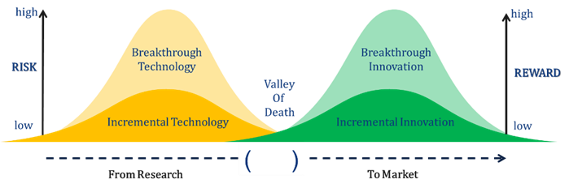
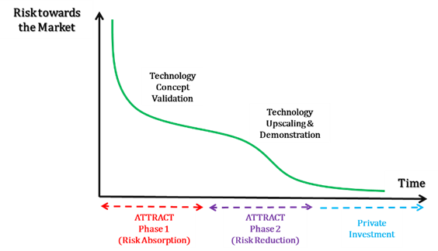
ATTRACT: Key pillars (2)
“Not two Valleys of Death look the same”
Phased approach to funding: Breakthrough Technologies (coming from Fundamental Research) are very risky for private capital.
De-risking them needs public funding:
  First, a risk-absorption stage, where ideas and concepts could reach a prototype level and technology concept validation (Phase-1).
  Second, a risk-mitigation stage, where the most promising concepts are further helped raising towards a pre-market product (Phase-2).

Slide 7

ATTRACT: Key pillars (3)
“Trust and shared know-how is not built in one day”
Co-Innovation:
Bridge between two communities (research and industry) that in principle have different motivations and goals for undertaking R&D&I (capital and/or resource intensive) efforts .
Entails the identification and collaboratively pursuing of win-win outcomes, starting already at the conceptual stages of a technology development and enduring them until the later stages of the innovation value chain (e.g. commercialization).
This model differs from established research-industry customer-supplier relationships.
If I would have known…
I solved it years ago!
I have a solution!
But I don’t have a problem.
Finally I solved the problem!
Research
Industry
Research
Industry
Your problem is my problem!
Let’s find a solution!!
Industry
Research
Co-Innovation

Slide 8

ATTRACT: Key pillars (4)
“Young people want to change the world”
Young Innovators Projects:
ATTRACT is facilitating the integration of interdisciplinary MSc level students working side by side with professional researchers from academia and industry developing the R&D&I funded projects.
These Young Innovators’ goal is prototyping technology solutions specifically addressing the United Nations Sustainable Development Goals,
They use a Design Thinking approach inspired by the technology developed by the projects.

Slide 9
Example of what we wish to see …
Enabling potential projects where, for example…
….a biologist realizes that her ideas for a new sensor,
….are solving the issues faced by an astrophysicist friend,
….and when both get in contact with a company developing solutions for plastic recycling,
….the three of them think it is worthwhile working together, and even more,
… relying on some young folks for prototyping their ideas and get inspired by new ones.

Slide 10
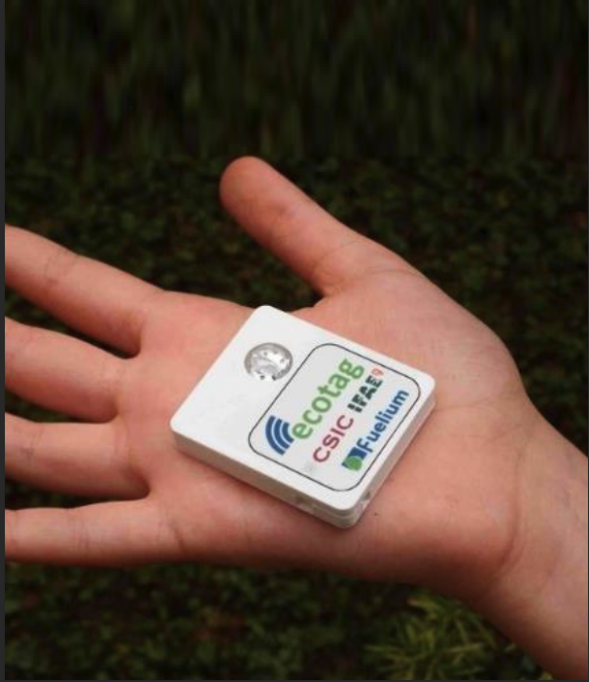
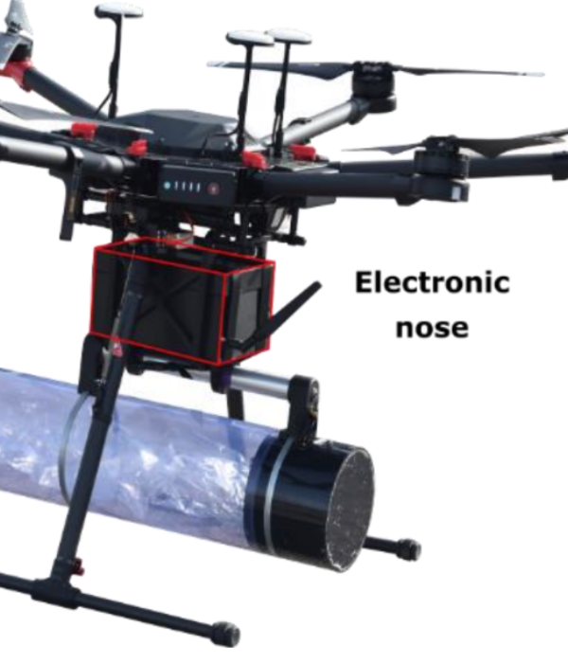

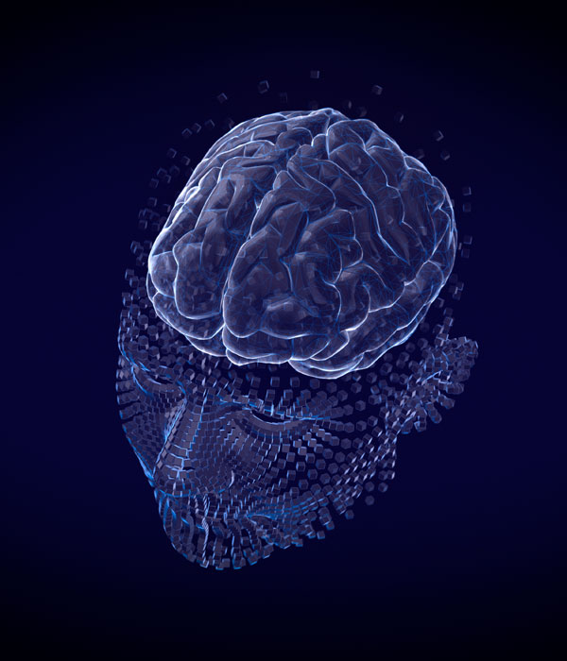
ATTRACT Phase-1: Technology Examples
Portable Eco-Batteries
Pollution Detecting Drones
Advanced IoT Technologies
Virtual Reality for Healthcare
ATTRACT SHOWROOM: 170 examples of breakthrough technologies
https://phase1.attract-eu.com/showroom/

Slide 11
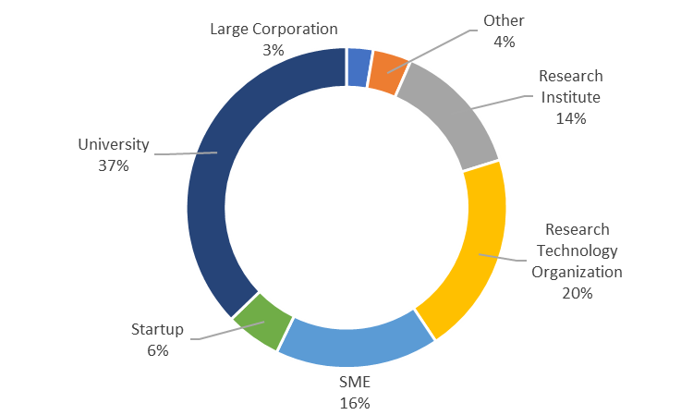
ATTRACT Phase-1: Type of Organizations Involved
Notes:
1) The Project – Overall scope of ATTRACT, importance of detection and imaging technologies to enable innovation, access to Project Work Plan and deliveries.
2) ATTRACT Call – All information for the call, examples of challenges to tackle, documentation, and link to submission platform
– Also Speed Networking service. 32 MATCHES already!
3) Consortium – PARTNERS visibility (link to website)
4) Committees – All ATTRACT committees and short bios.
5) News and events – Latest news, events and also MEDIA ROOM for journalists

Slide 12
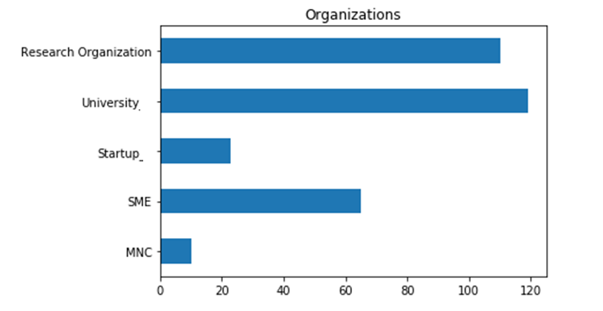
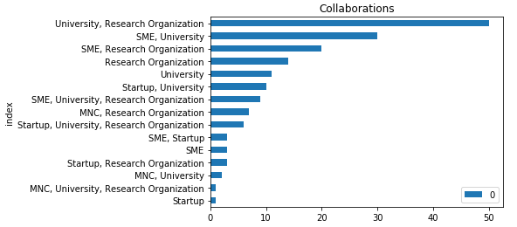
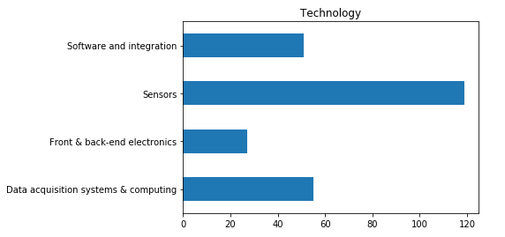
ATTRACT Phase-1: Summary Statistics
https://attract-eu.com/wp-content/uploads/2021/04/ATTRACT-5.pdf

Slide 13
Identified Challenges (so far…)
Awareness among researchers of the different technologies being developed in the other funded projects
Disruptive effects of COVID-19 (lack of access to labs, testing of new ideas …)
Projects to find and engage with the right (industrial) partners to scale up the TRL
Provide the right type of (IP) help for the researchers interested in commercializing their ideas
Engaging the right type of ( C ) VCs at the right moment (PAC is working on this!!)

Slide 14
ATTRACT Phase 2 is now in full swing
Three open calls were handled for a total funding of €28 M for funding in accordance with the EC call text:
    The most promising opportunities arising from ATTRACT Phase 1, for their transition from the lab to the market;
    Young innovators from universities developing ideas and prototypes for social innovation in collaboration with professional researchers within the ATTRACT ecosystem based on Design Thinking methodologies.
    Professional scholars undertaking a socio-economic study of the ATTRACT initiative.
The evaluation process of the calls, by three different and call-related Independent Committees, has concluded and all the projects have started.
The different Independent Committees have selected for being funded:
    18 R&D&I projects.
    8 projects contributing to the overall Socioeconomic study of the ATTRACT initiative.
    10 projects financing ideas and prototypes of Young Innovators.

Slide 15
ATTRACT Phase 2: Some preliminary statistics (18 R&D&I funded projects)
Strong Industrial participation (32%).

Slide 16
ATTRACT Phase 2: Some preliminary statistics (18 R&D&I funded projects)
Widespread participation among EU MS and AC

Slide 17
A new round of Phase 1(B): ATTRACT EIC Innovation Ecosystems
The ATTRACT Consortium responded to the 5M€ call launched by the EIC Innovation Ecosystems: HORIZON-EIE-2021-SCALEUP-01-02: Scaling up deep tech ecosystems.
It was approved by the EC and the Grant Agreement has been signed.
This new development of the ATTRACT initiative will specially focus on:
  Breakthrough technologies from fundamental science applied to Sustainability Challenges, thus in connection with EC’s key strategic initiatives such as the Green Deal.
Due to a legal problem in Brussels, the launch of the call is delayed and may require some changes.

Slide 18
Some reflections
The ATTRACT initiative is consolidated as a framework for deploying an Innovation Ecosystem in Europe in the field of breakthrough detection and imaging technologies.
The first quantitative and qualitative evidence indicates that ATTRACT is contributing to accelerate the translation of science-driven technologies to the market.
The continuous support of the EC, both through the Framework Programmes, but as well with expertise, is key.
As the EC very well knows, it takes a great effort to build an innovation ecosystem, but very little one to let it die if the nurturing and willingness disappears.

Slide 19
ATTRACT: How we are deploying it? What’s next?
“From R&D&I communities to brimming Ecosystems”
ATTRACT Phase 2
35 M EC total Funding
ATTRACT Transition:
From the RI Unit to the EIC
“MAXI” ATTRACT
EIC
ATTRACT Phase 1
20 M EC total Funding
Ambition
Full integration and deployment of ATTRACT into the European Innovation Council (EIC) .
Phases 1 and 2 deployed cyclically.
Development of an EU scale Programme for Young Innovators.
Extrapolation of the ATTRACT model at National level.
Expanding beyond the Detection and Imaging field.
Started in 2021.
Open Call leveraging on the most promising opportunities from Phase 1 (25 M Euros). Launching targeted by the end of May 2021.
TRL 7-8.
400 Young Innovators benefitting (2M Euros).
A multifold socio-economic study of ATTRACT will be completed (1 M Euros).
Foreseen.
Transition towards the European Innovation Council.
R&D&I: Small Open Call Phase 1 type
Strategic objectives:
Integration model into the EIC (Pathfinder?/Accelerator?/Other?)
2. How private and public financing could be integrated?
3. How to scale-up the opportunities for Young Innovators?
Finished.
The first 170 R&D&I breakthrough are completed
TRL 3-4.
100 Young Innovators benefitted.
2019-2020 Horizon 2020
2019-2024 Horizon 2020
2022-2024 Horizon Europe
2025 (?) Horizon Europe/ Beyond?

Slide 20
ATTRACT Phases 1 & 2: More Information
https://attract-eu.com/
ATTACT Phase 1 Facts and Figures: https://attract-eu.com/facts-and-figures/
Phase 1 Funded Projects: https://phase1.attract-eu.com/showroom/projects/
Phase 1 Young Innovators’ Projects: https://phase1.attract-eu.com/showroom/student-projects/
Phase 2 Funded R&D&I Projects: https://attract-eu.com/attract-calls/rdi-projects-thematic-call/

Slide 21


Thanks!
This project has received funding from the European Union’s Horizon 2020 research and innovation programme under grant agreement No. 101004462 and No. 777222.

