Slide 2
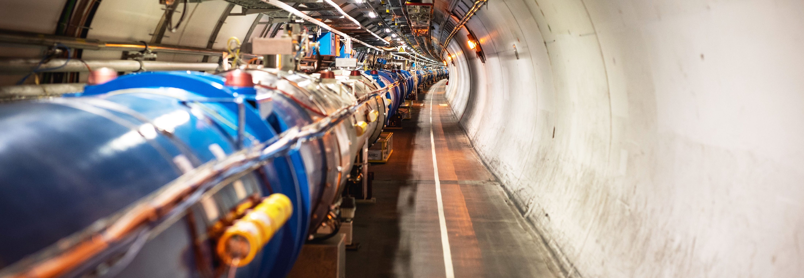
Scientific Challenges and Future Programs at CERN
Pippa Wells, Deputy Director for Research and Computing

Slide 3

CERN is the world’s biggest laboratory for particle physics.
Our goal is to understand the most fundamental particles and laws of the universe.

Slide 4
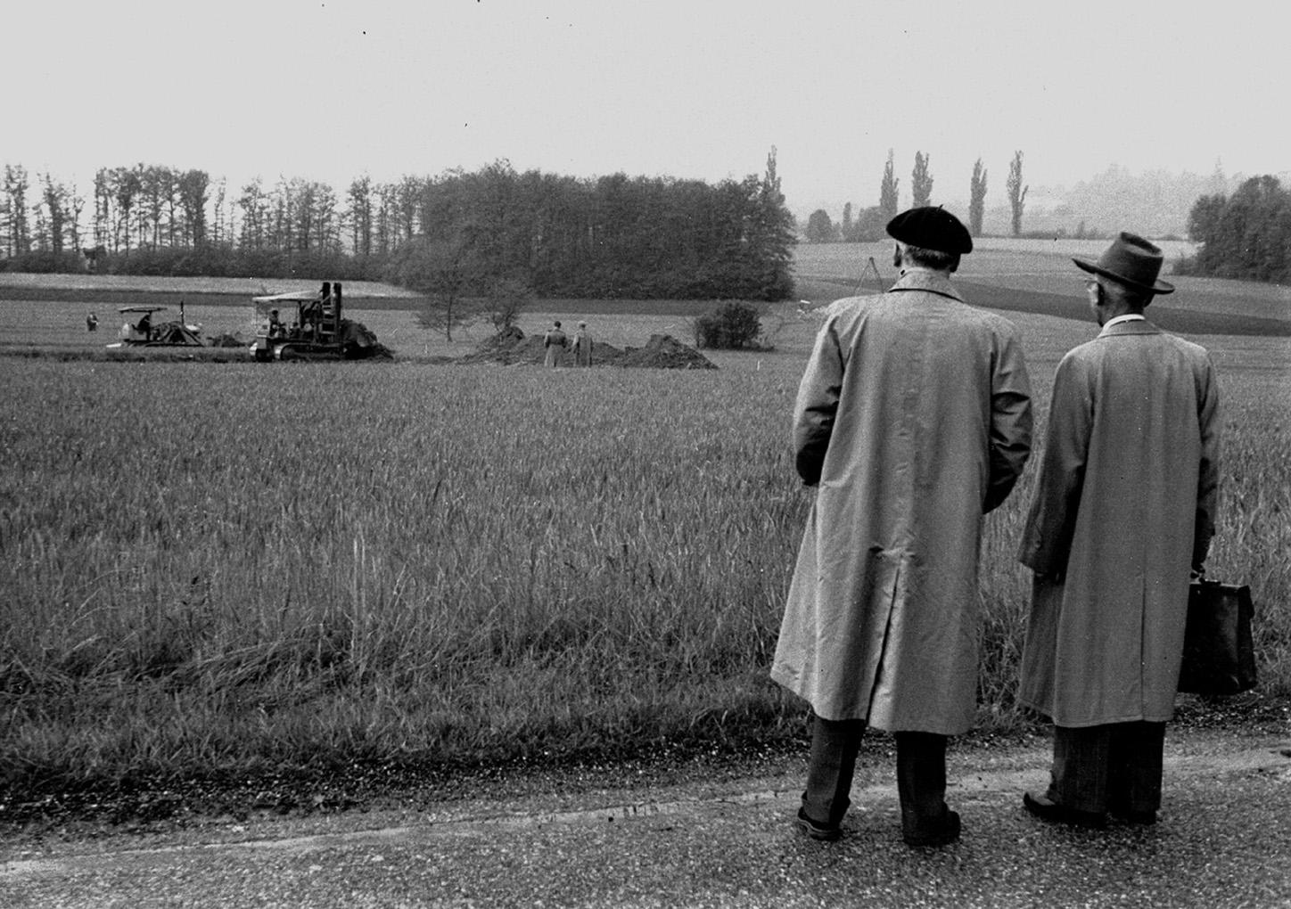
CERN – Science for Peace
1954

Slide 5
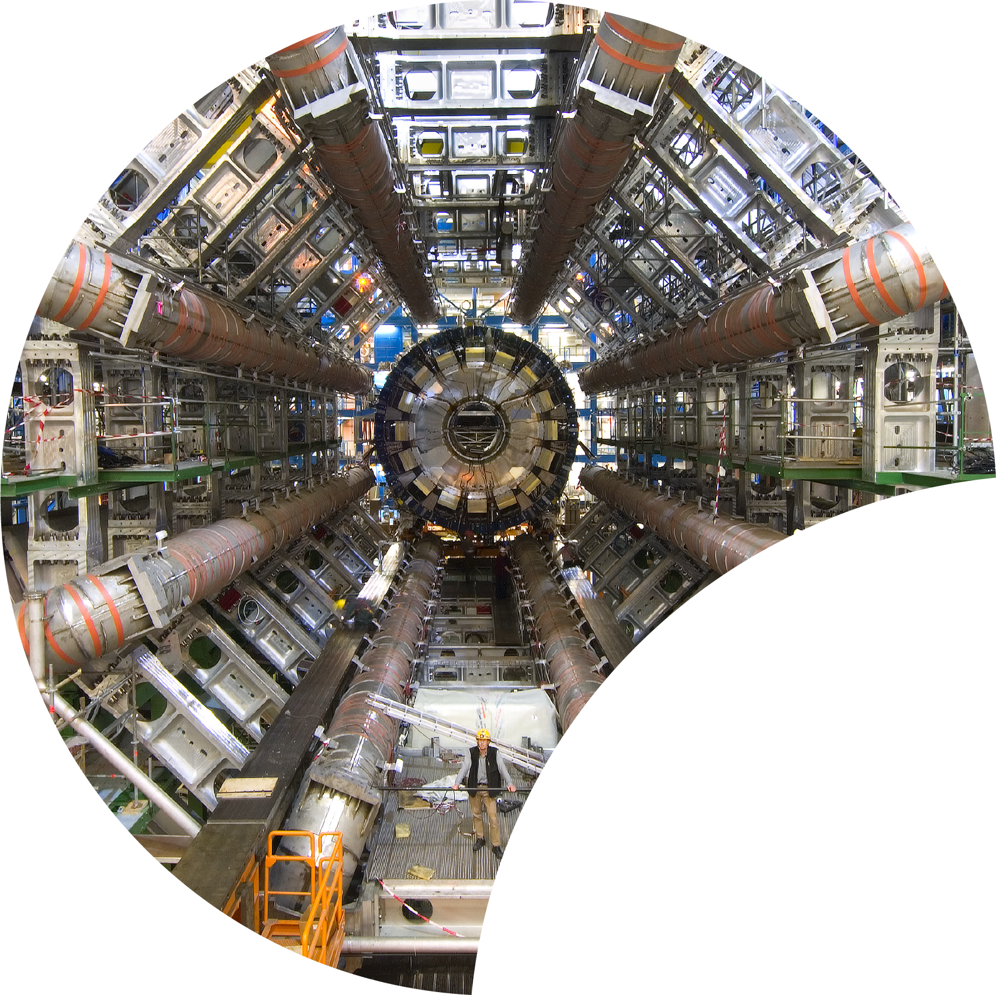
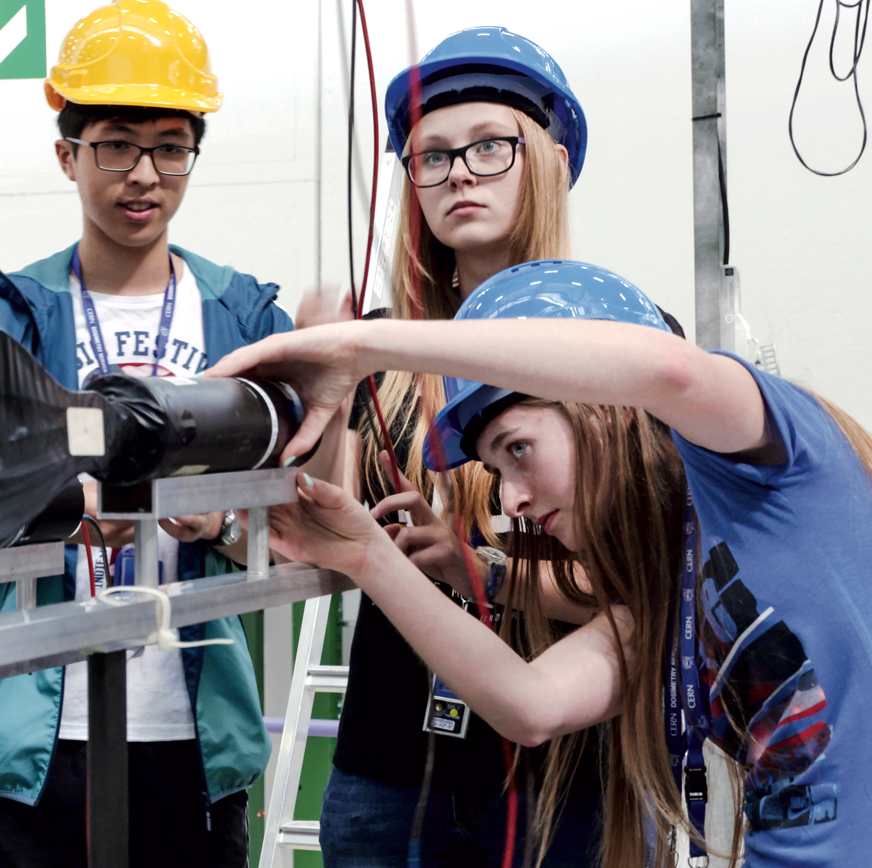

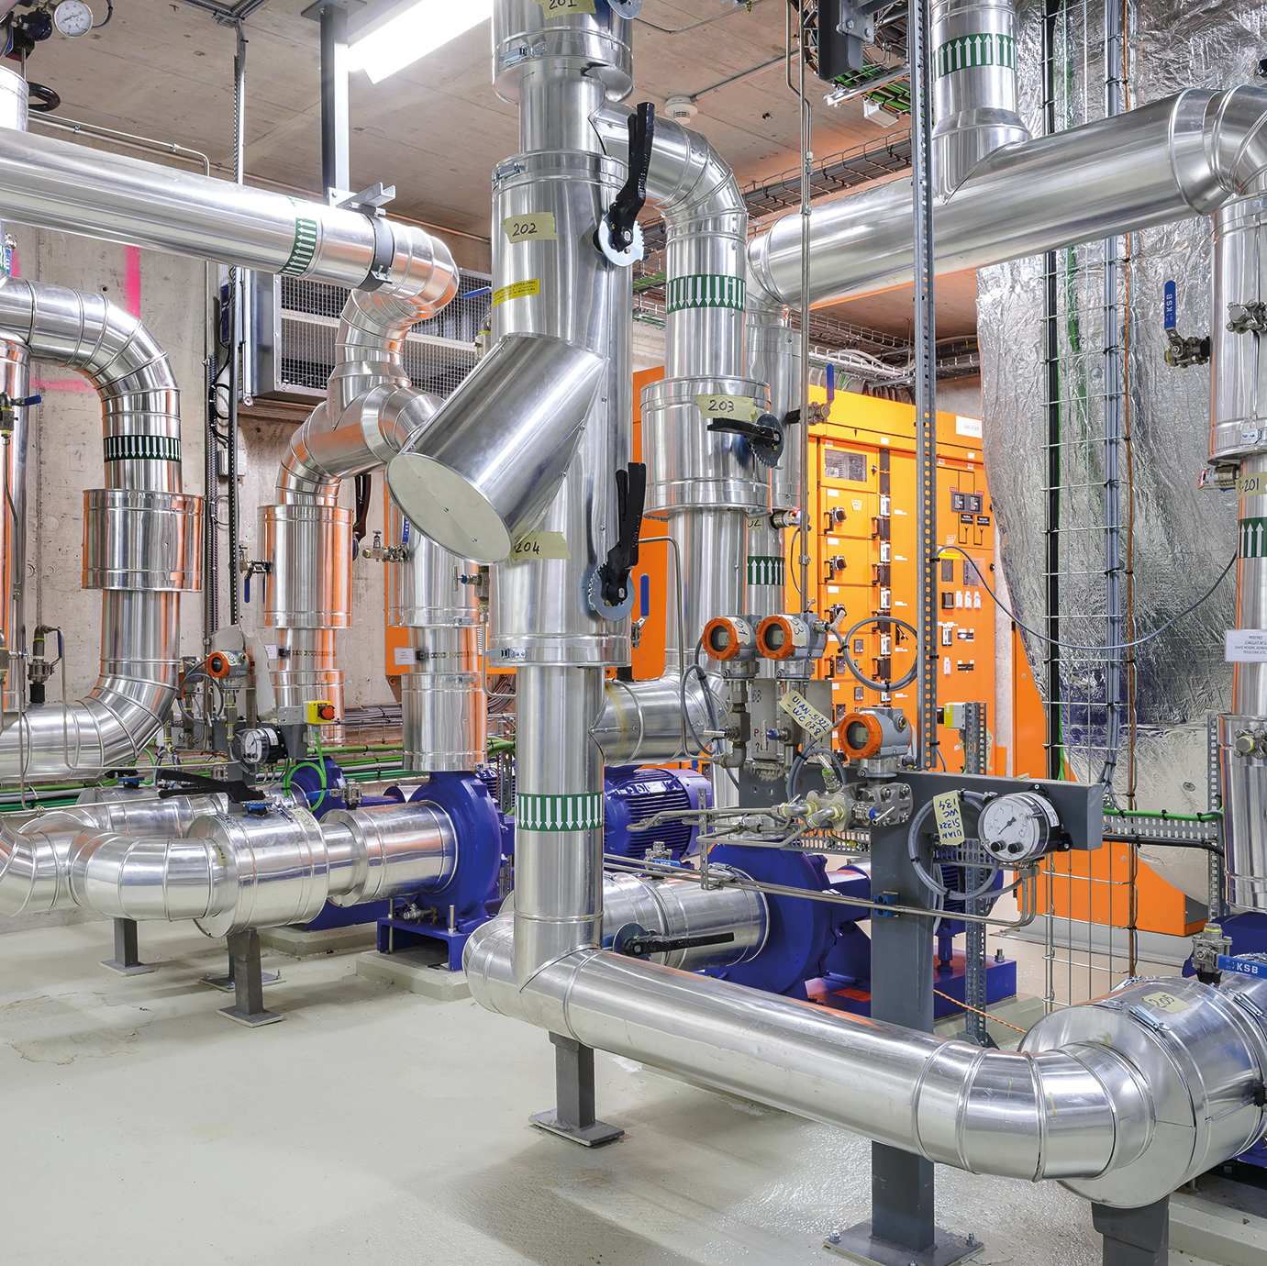

Four pillars underpin CERN’s mission
RESEARCH
EDUCATION
& TRAINING
COLLABORATION
TECHNOLOGY
& INNOVATION

Slide 6
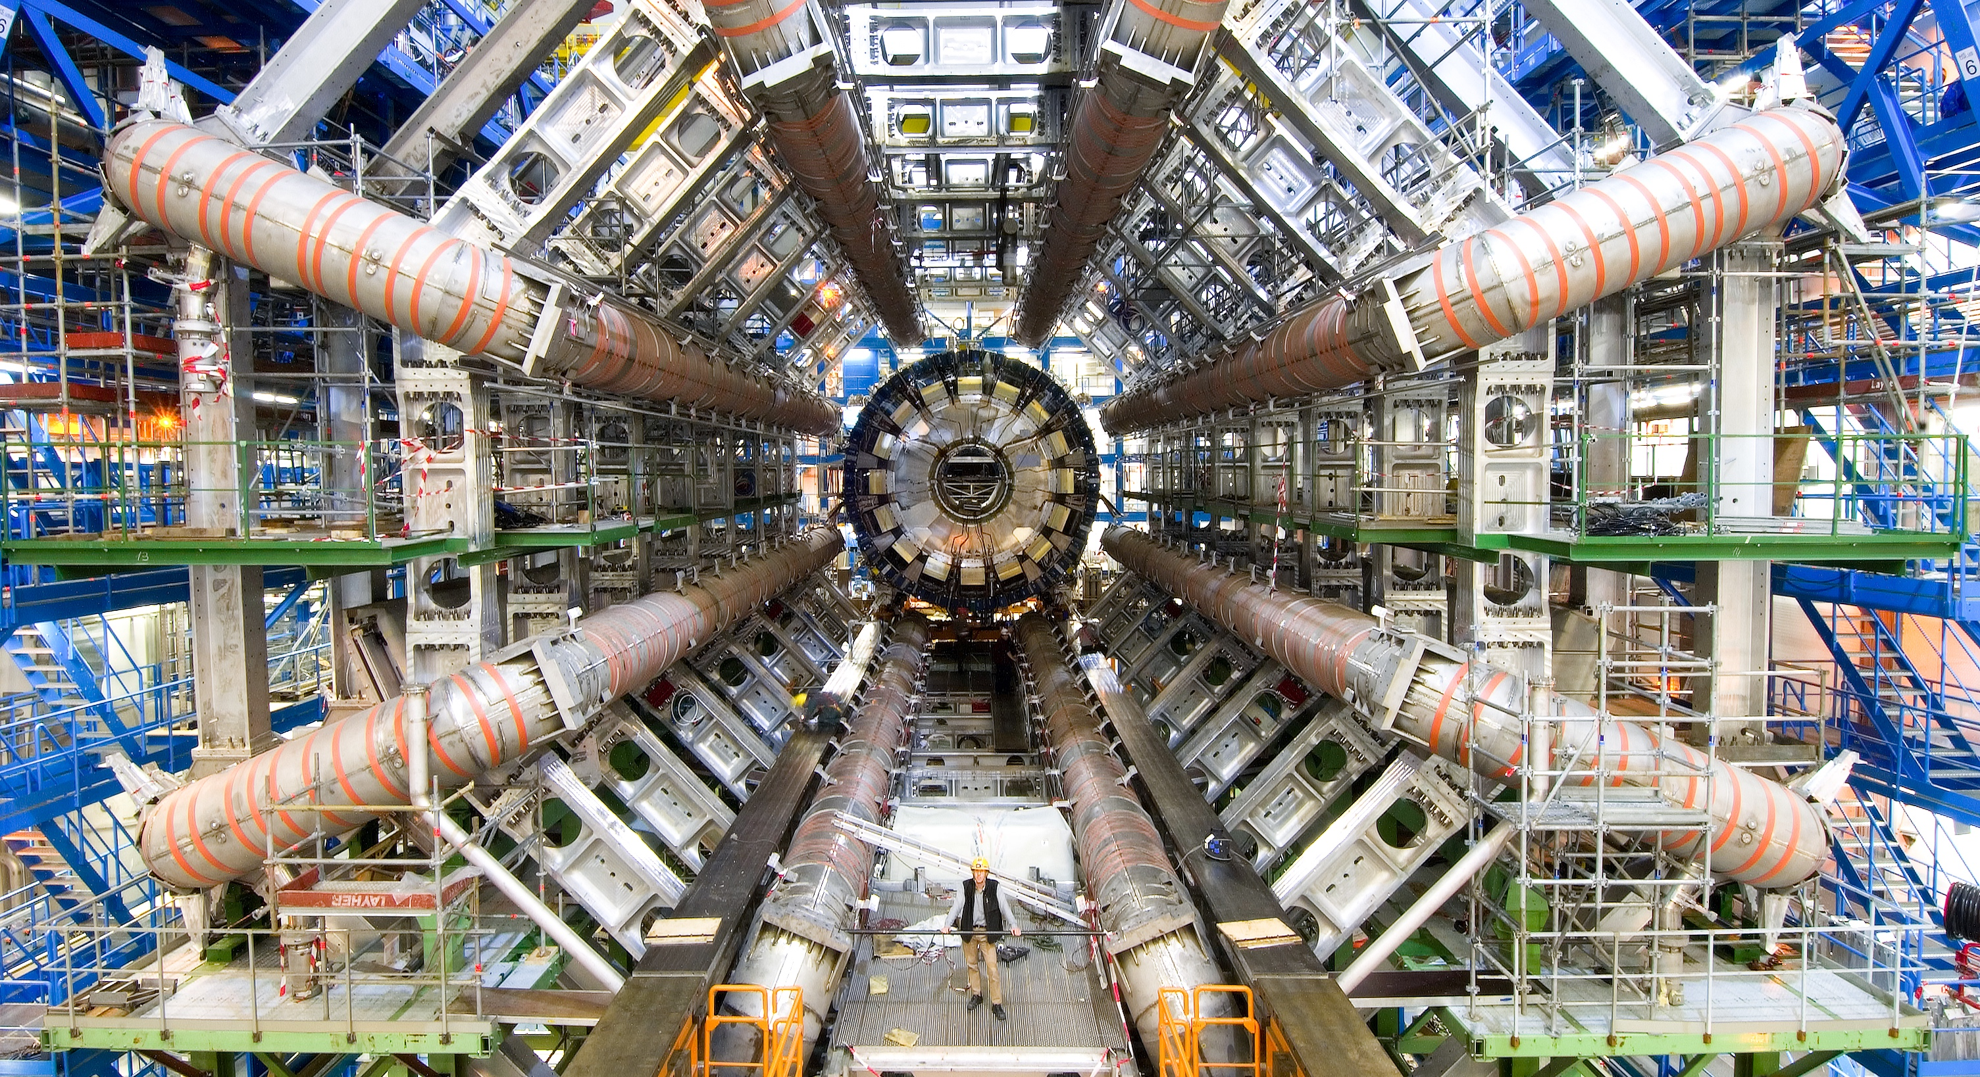
RESEARCH
Notes:
ATLAS detector in 2005

Slide 7
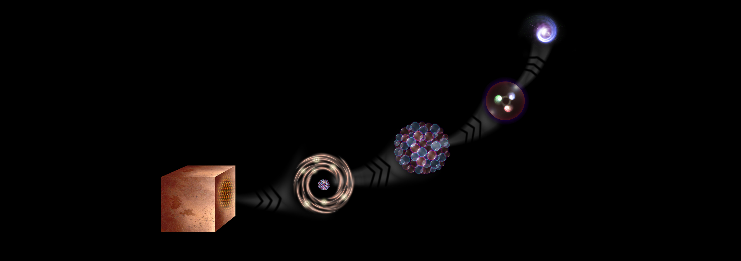
What is the universe made of?
We study the elementary building blocks of matter and the forces that control their behaviour
Quark
<10⁻¹⁸ m
Proton
~10⁻¹⁵ m
Nucleus
~10⁻¹⁴ m
Electron
Matter
0,1 m
Atom
~10⁻¹⁰ m
Notes:
This slide and the next address the questions that underpin research in particle physics.
One of the questions is “What are we made of?”
To answer this question, we study the fundamental particles that make up matter.
The speaker takes the visitors on a brief journey from visible matter to the electron and the quark: electrons and quarks are the fundamental particles of matter

Slide 8
Ordinary matter
uud → proton
udd → neutron
electron
Need to add a neutrino to explain radioactive atoms

Slide 9
Three families of matter particles
Heavy, unstable particles and
anti-particles seen in cosmic
rays and particle accelerator
experiments

Slide 10
Standard Model of Particle Physics
Electromagnetism, weak and
strong forces also explained
by particles. W and Z
discovered at CERN in 1983.
Higgs boson is a consequence
of the mechanism allowing
any fundamental particles to
have mass.

Slide 11
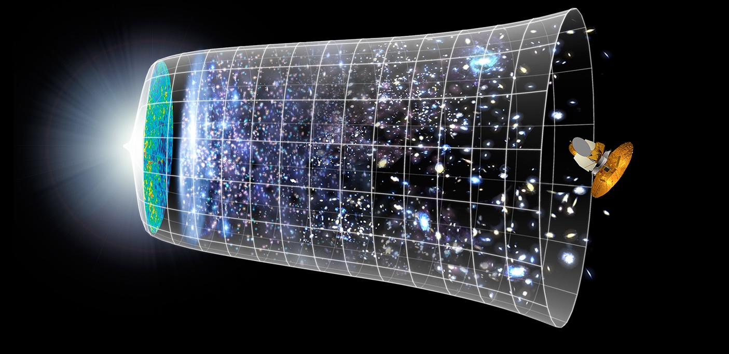

How did the universe begin?
Big Bang
We reproduce the conditions a fraction of
a second after the Big Bang, to gain insight into the structure and evolution
of the universe.
Telescopes
Accelerators
380 000 years
13.8 Billion Years
Today
10²⁸ cm
Notes:
The other question that underpins research in particle physics is “How did the Universe begin?”
We gain insight into the structure and evolution of the Universe, from the first billionth of a second (10⁻¹²s) after the Big Bang.
From the very small (particle physics at modern accelerators allows us to study the fundamental laws of nature on scales down to smaller than 10⁻¹⁸ m) to the very big (telescope-based astrophysics), we gain knowledge about the laws and evolution of the universe.

Slide 12
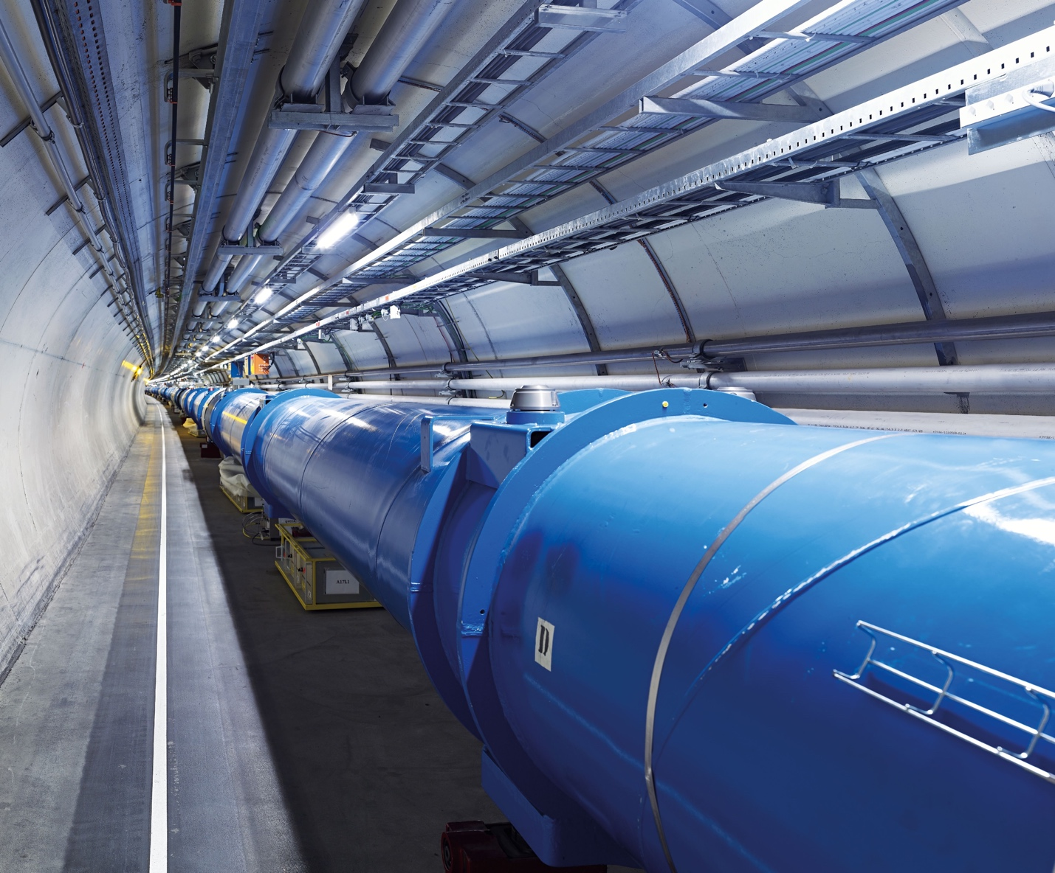
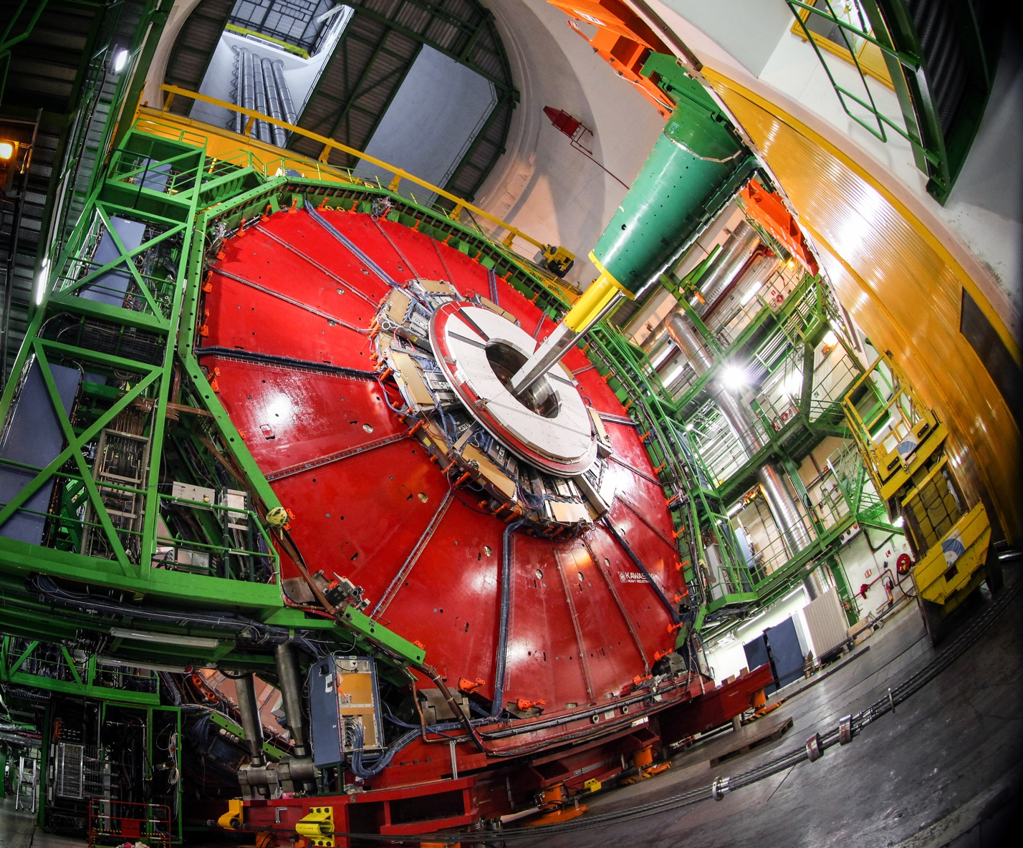
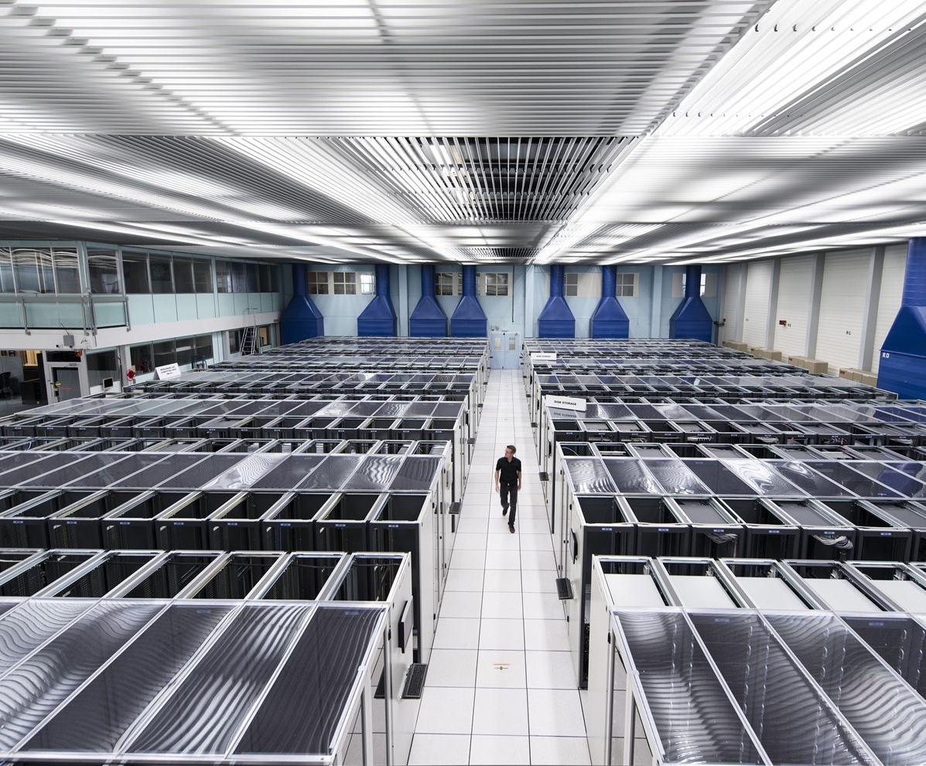
CERN develops technologies in three key areas
ACCELERATORS
DETECTORS
COMPUTING

Slide 13
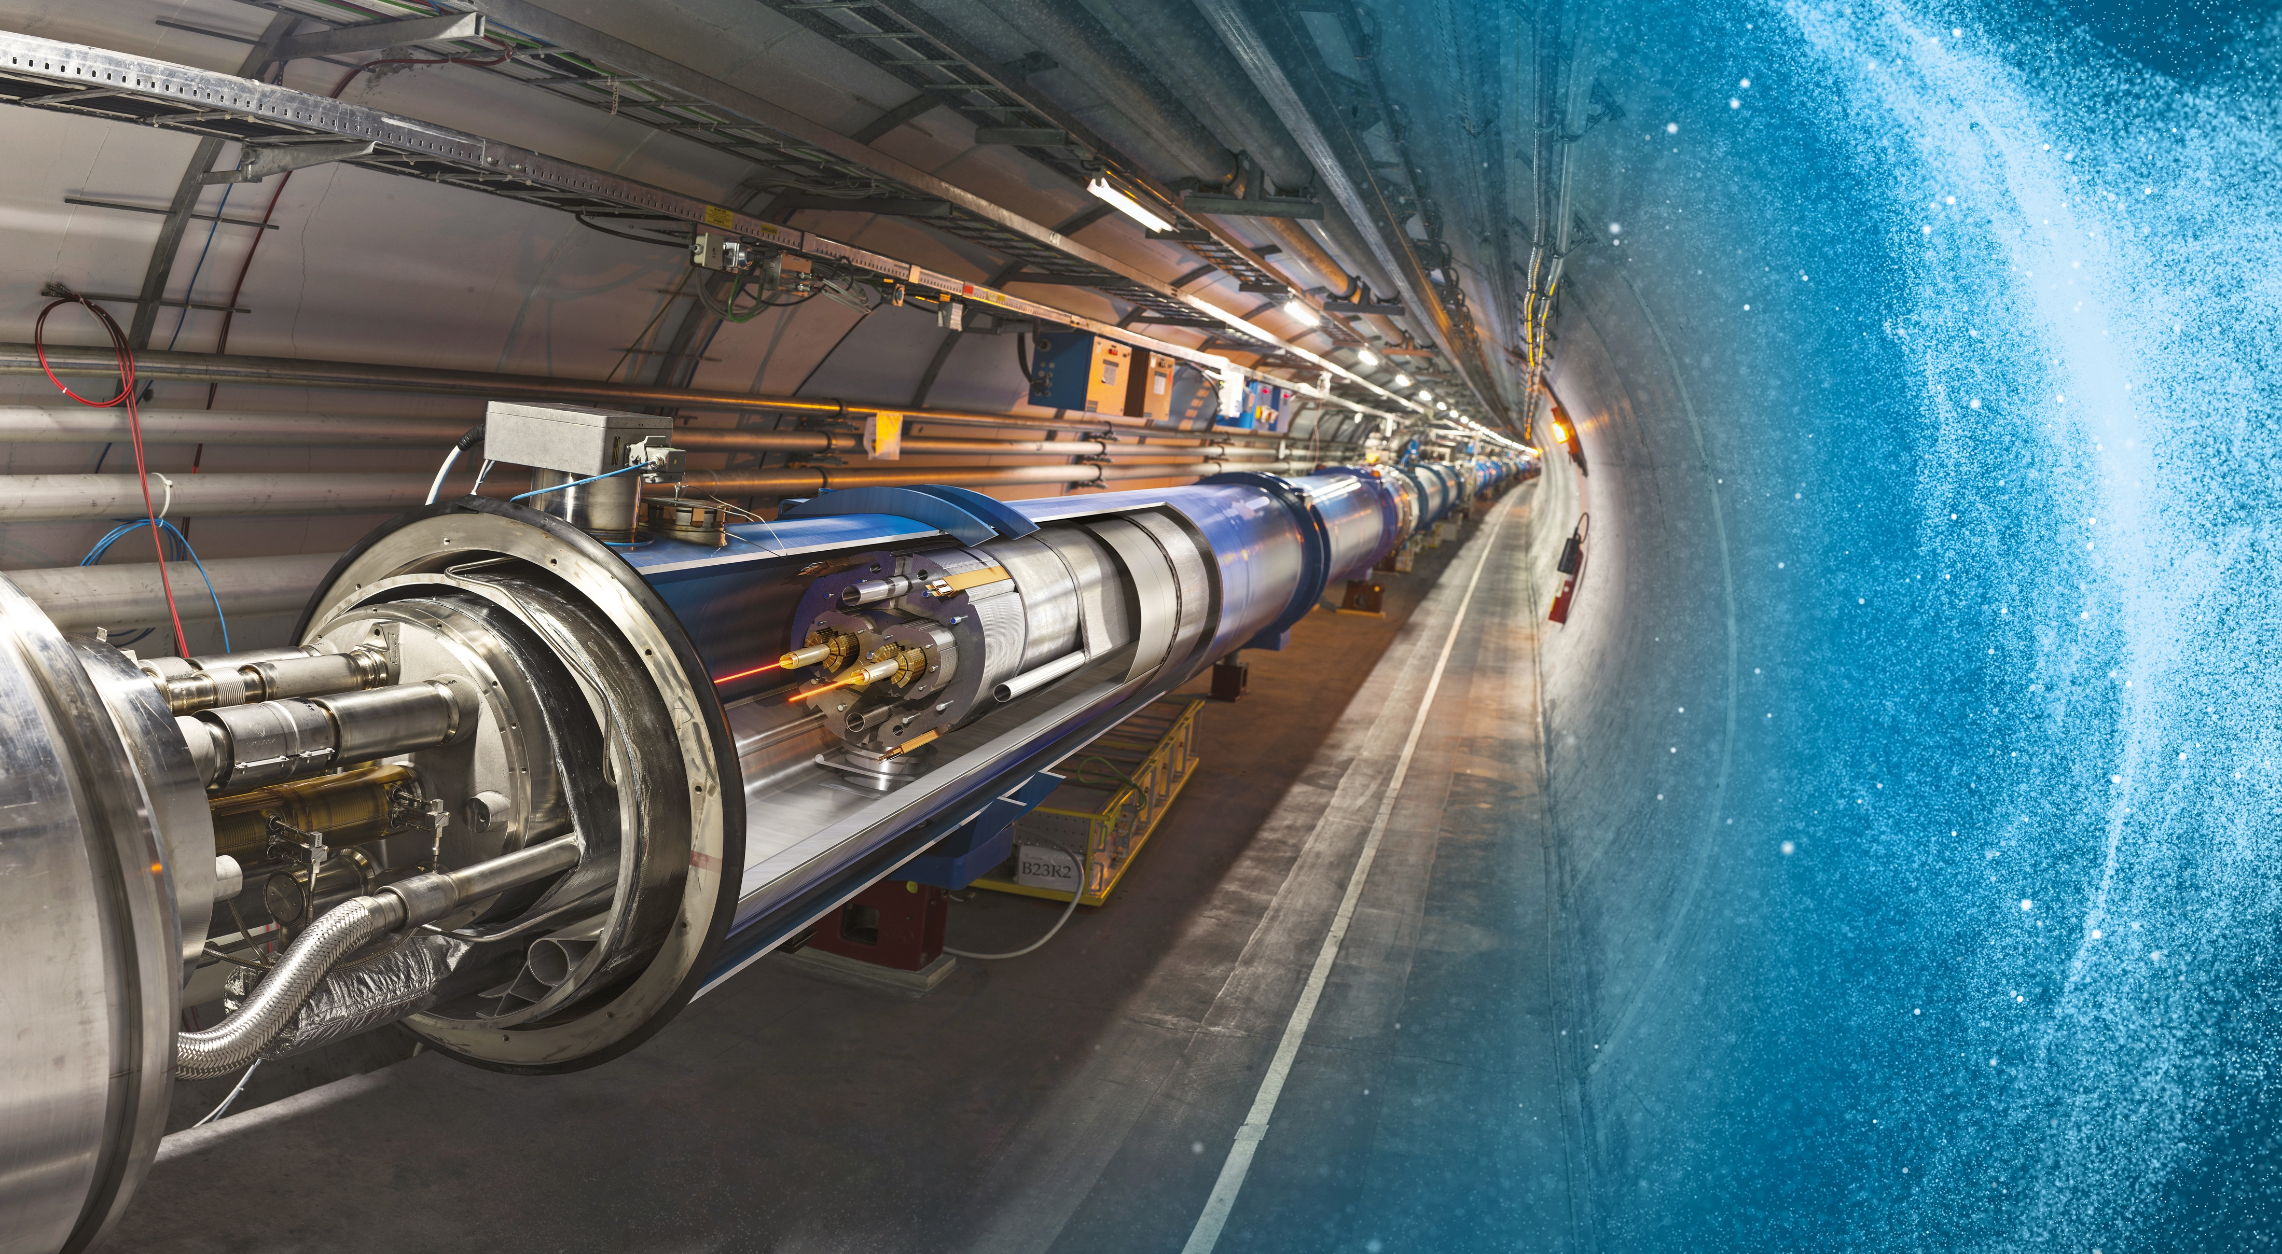
Large Hadron Collider (LHC)
27 km in circumference
About 100 m underground
Superconducting magnets steer the particles around the ring
Particles are accelerated
to close to the speed
of light

Slide 14
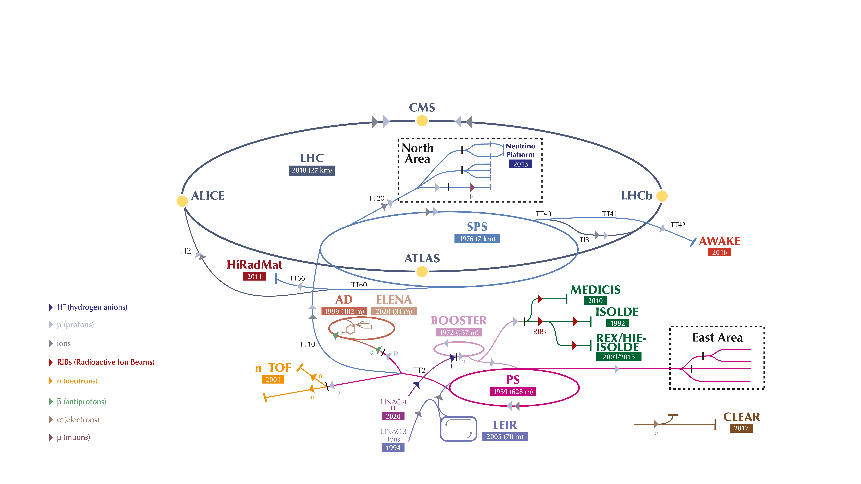
The CERN accelerator complex

Slide 15
The CERN accelerator complex

Slide 16
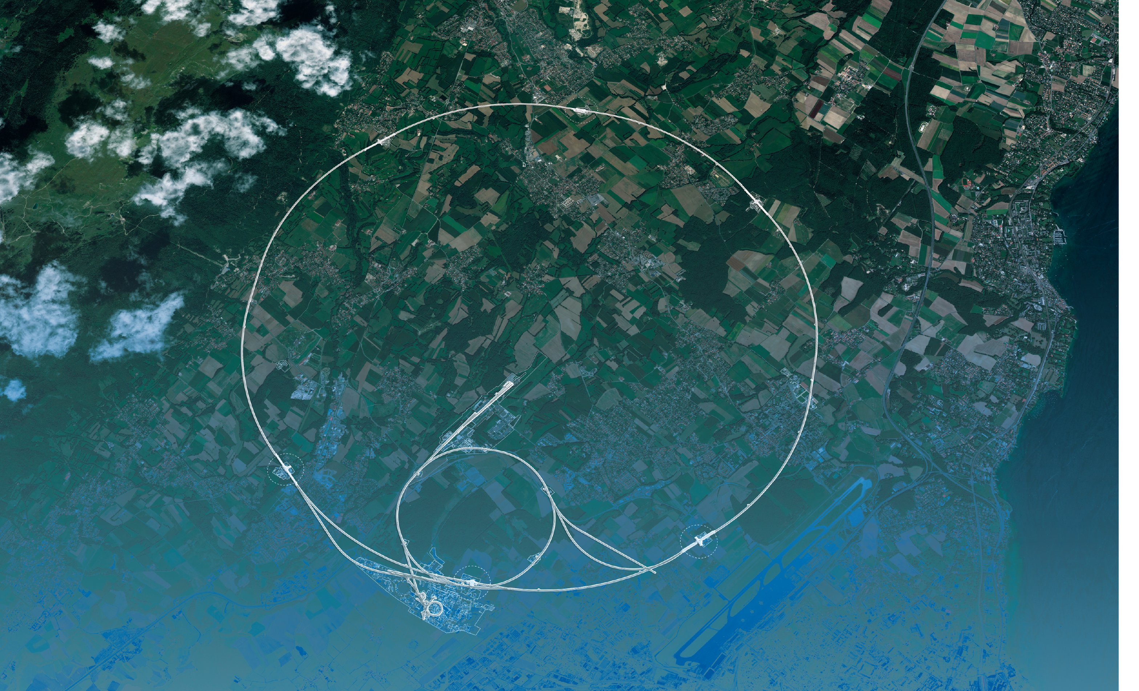
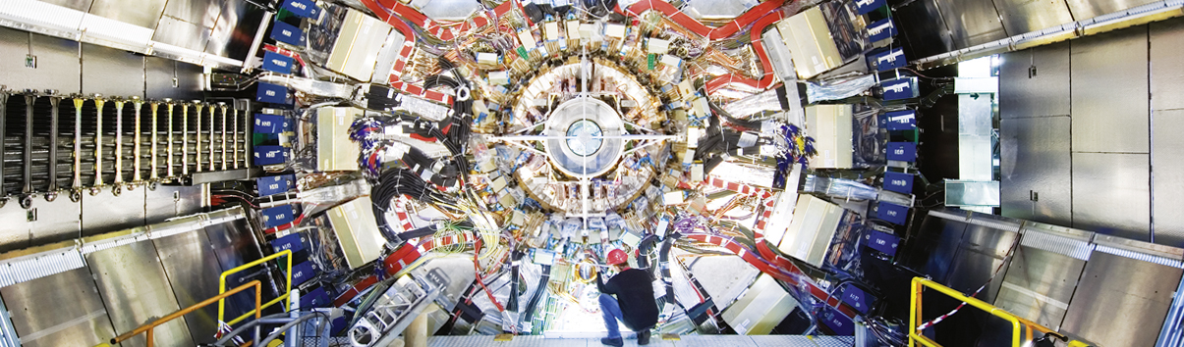
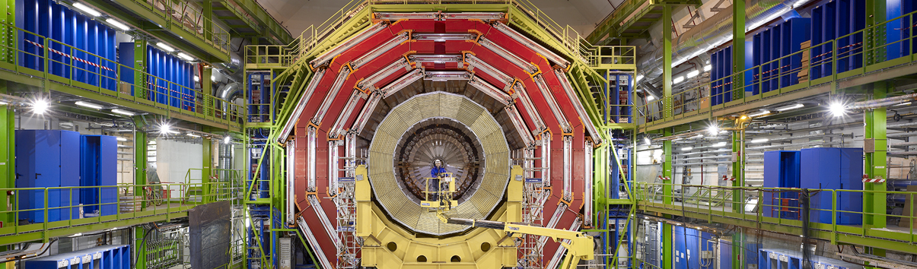
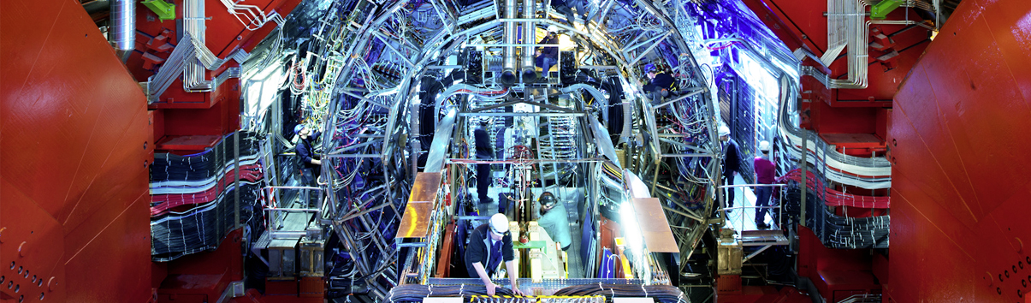
Giant detectors record the particles formed at the four collision points
ATLAS
CMS
CMS
ALICE
ALICE
ATLAS
LHCb
LHCb
Notes:
This slide allows the speaker to describe the accelerator complex and the four main LHC detectors.
About the accelerator complex (OPTIONAL)
The LHC is the last in a chain of particle accelerators, which gradually accelerate particles at increasing energy until they enter the LHC
Particles collide at four points on the LHC, where detectors register the collisions.
(ON CLICK)
About the four detectors, the speaker may give a 1-2 sentence description of the goal of each detector (TIME PERMITTING):
ATLAS – is a general-purpose detector, designed to carry out research ranging from precise measurements of the Higgs boson to searches for new physics beyond the Standard Model, similar to CMS. It is the largest collider-detector ever built (44m in length and 25m in diameter).
CMS - is a general-purpose detector, similar to ATLAS. It is one of the detectors, with ATLAS, where evidence for the Higgs boson was discovered and announced in 2012. It is the heaviest collider-detector (12.5 tonnes).
ALICE – studies the properties of the so-called quark-gluon plasma, a state of matter that probably existed just after the Big Bang, before protons and neutrons were formed.
LHCb – studies the asymmetry between matter and antimatter in interactions of particles containing the so-called b quark. This may help understand why our Universe is made up of only matter.

Slide 17
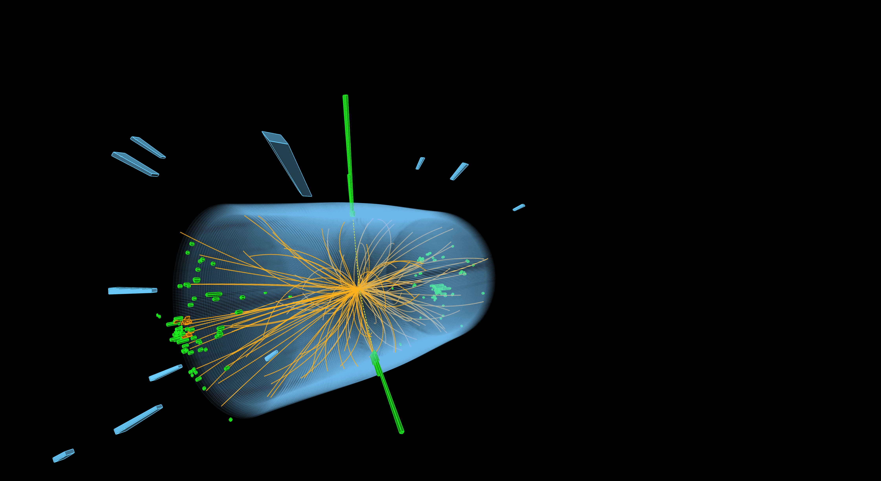
The LHC produces more than 1 billion particle collisions per second
The energy of the particles in collision is converted into new particles.

Slide 18
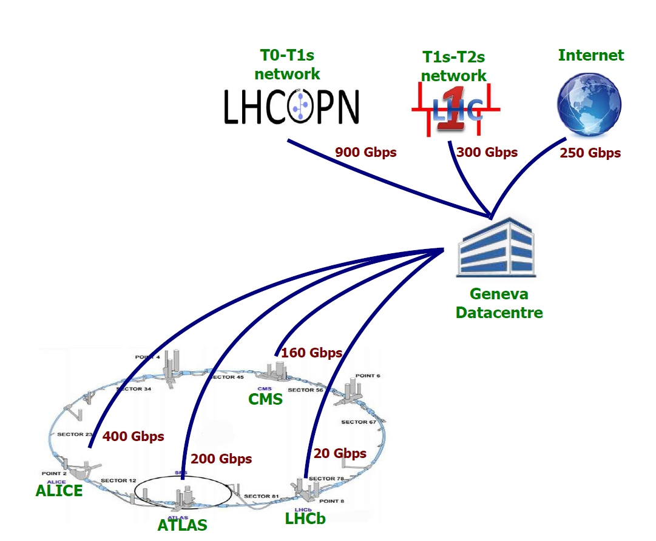
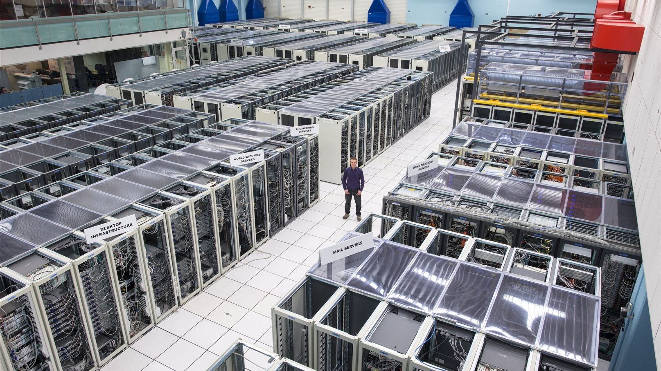
Big Science – Big Data
40 million pictures per second per experiment, of which only ~1000 recorded.
Worldwide LHC Computing Grid used to store, distribute, process and analyse data.
1.4 million processing cores
170 data centres in >40 countries
1500 PB of storage

Slide 19

November 2005

Slide 20

ATLAS Experiment
25m high, 44m long
Total weight 7000 tonnes
100 million “pixels” per picture.
3000 scientists including 1000 students

Slide 21
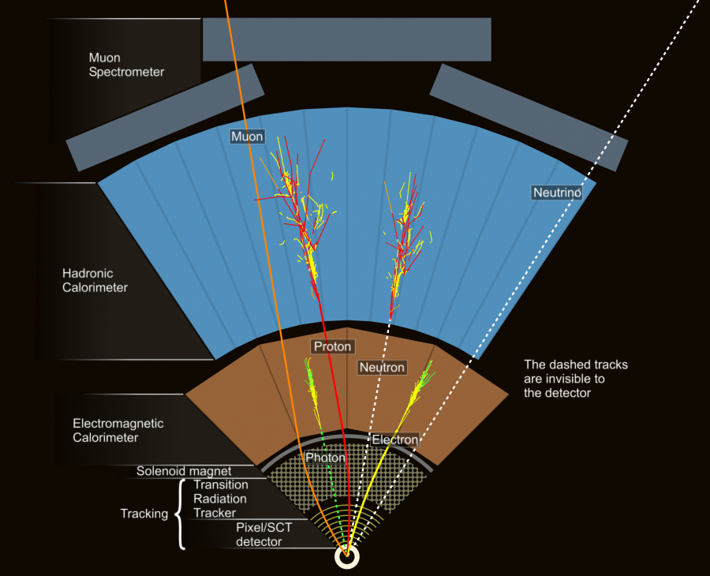
Measure the particles’ energy, direction
and charge.
Distinguish different particle types.

Slide 22
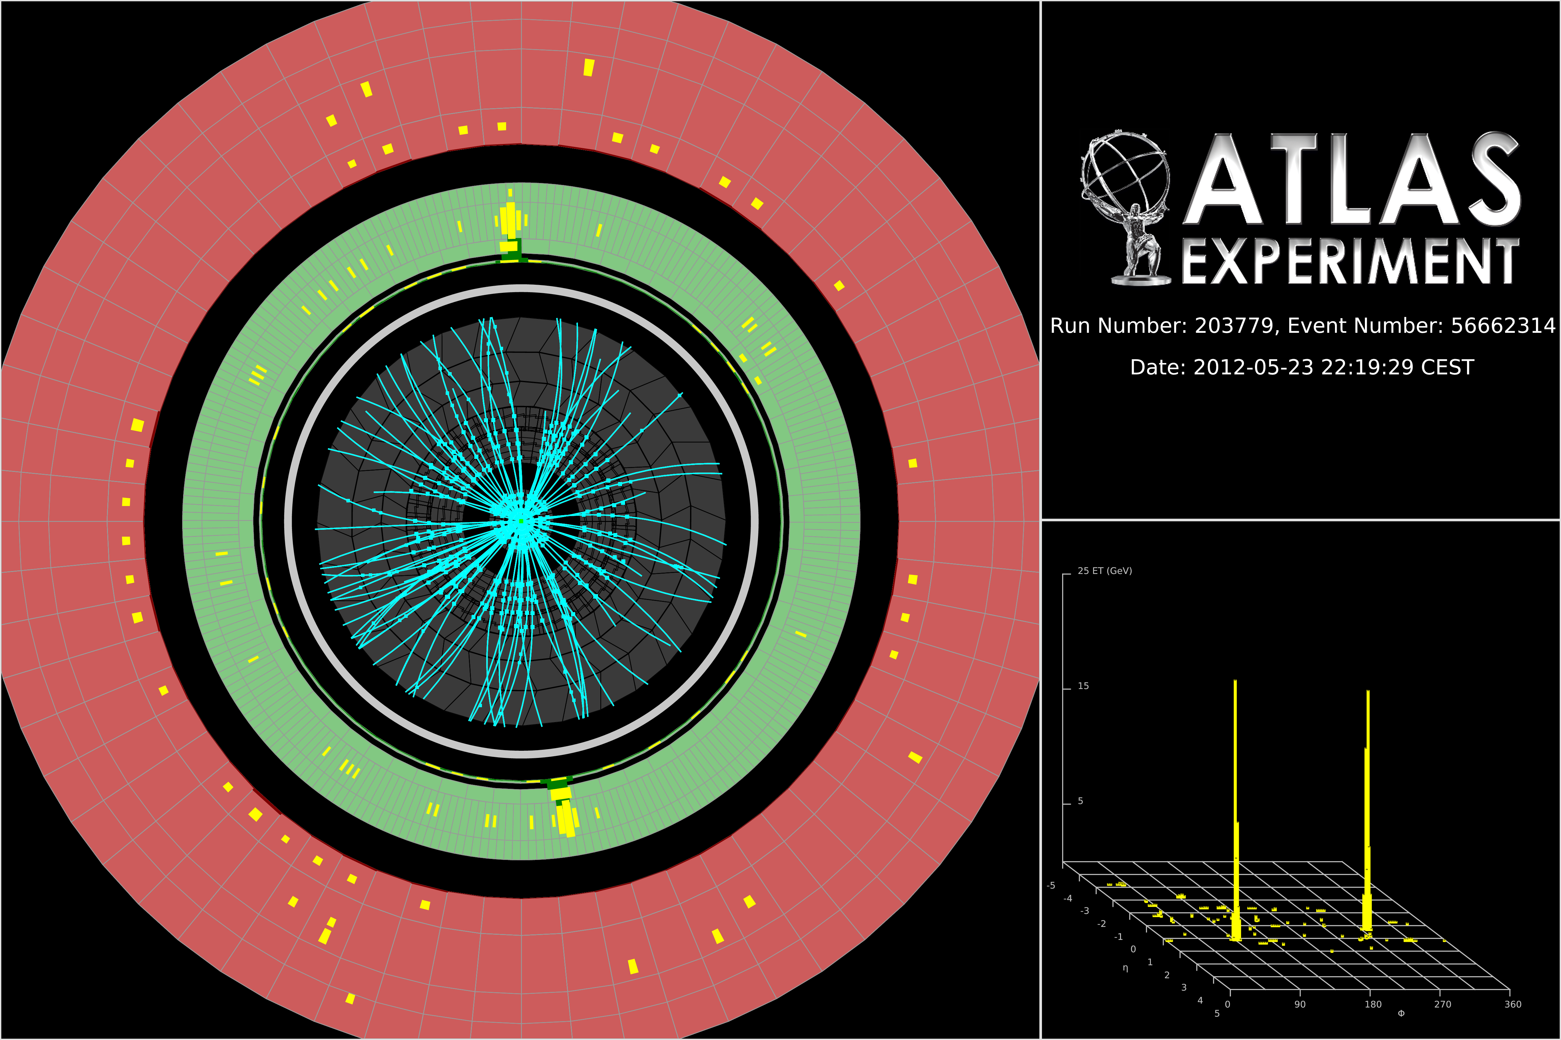
Higgs boson candidate with two photons

Slide 23
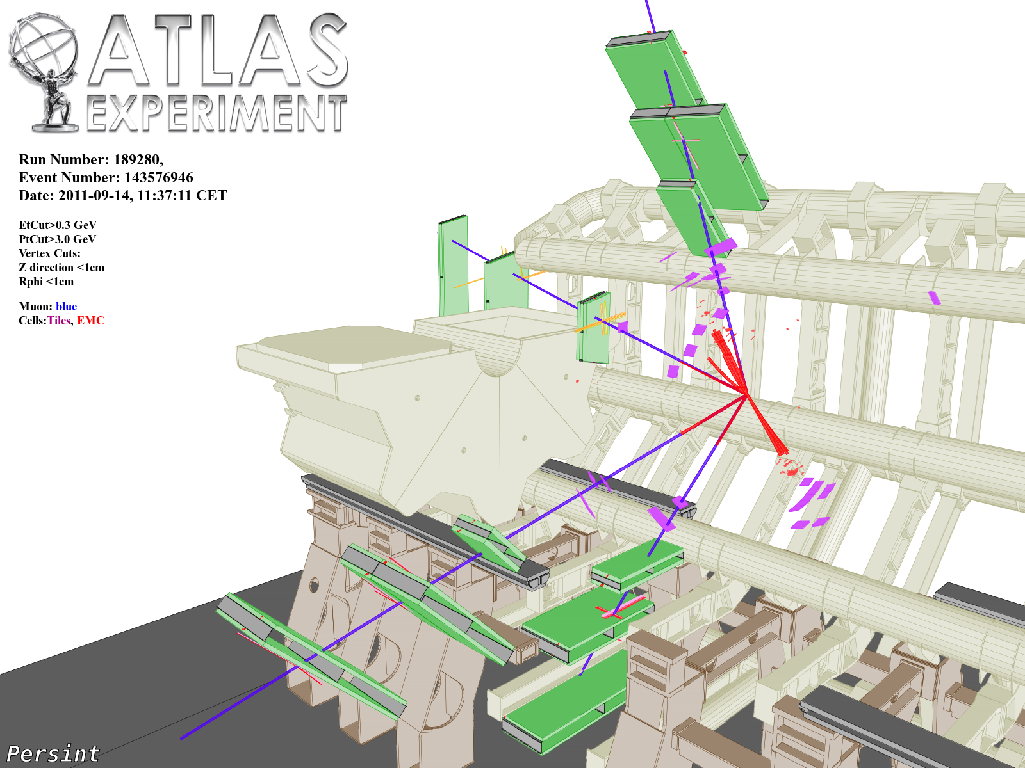
ZZ → μμμμ

Slide 24
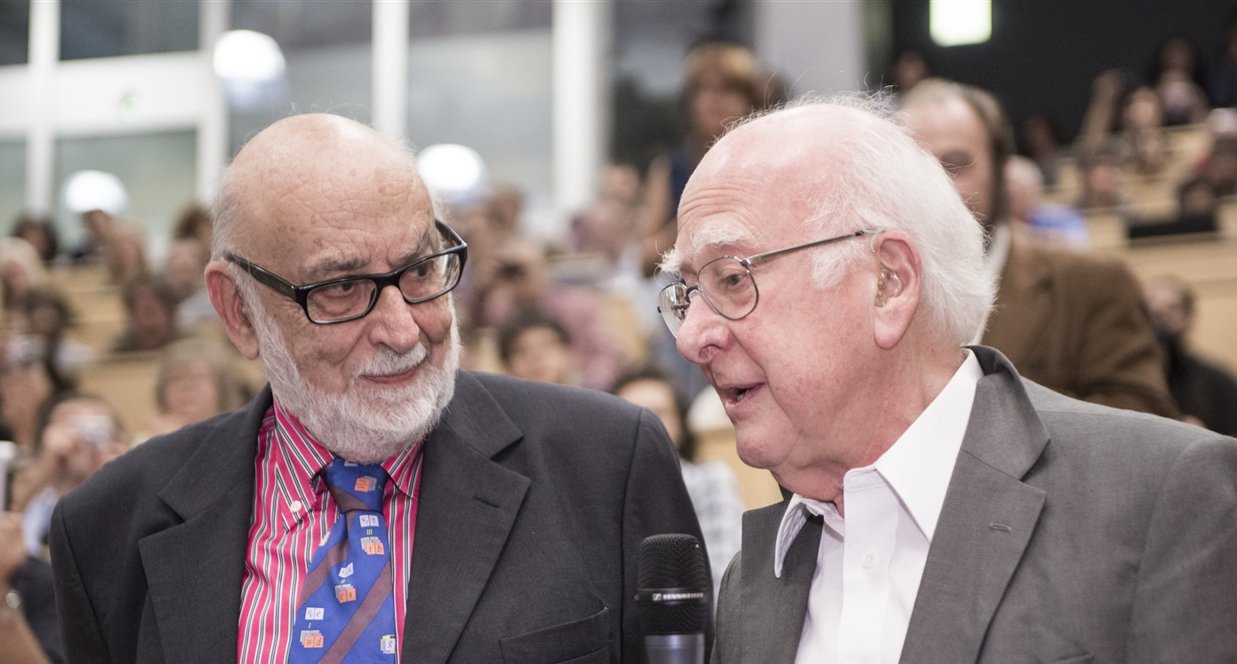

Higgs boson Discovery 2012, Nobel Prize 2013
François Englert and Peter Higgs on 4 July 2012. In 1964, with Robert Brout, they proposed the mechanism by which fundamental particles can have a mass.
Notes:
Dorothy Hodgkin awarded Nobel prize in 1964

Slide 25
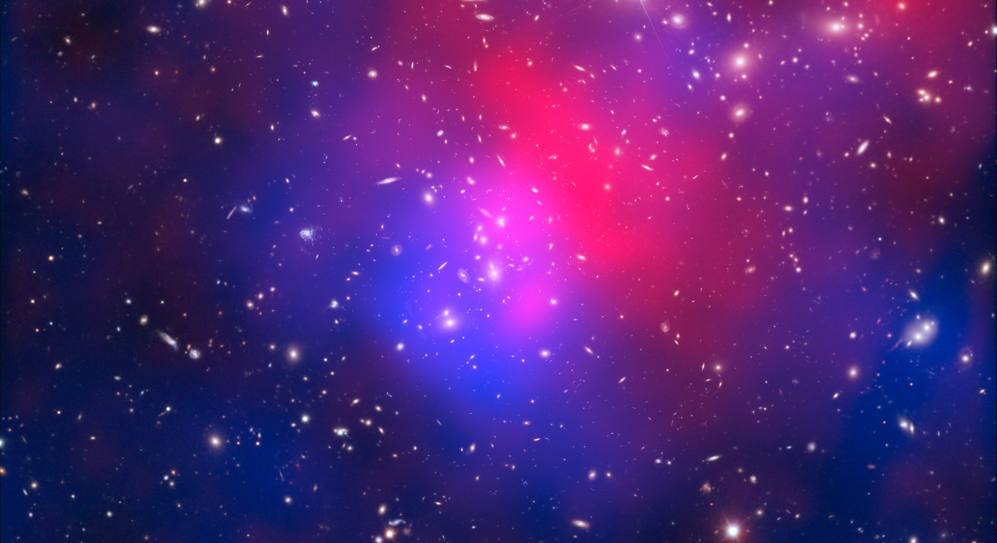
There are many unanswered questions in fundamental physics
Including
What is the unknown 95% of the mass
and energy
of the universe?
Is there only one Higgs boson, and does it behave exactly as expected?
Why is the universe made only of matter, with hardly any antimatter?
Why is gravity so weak compared to the other forces?
Notes:
This slide is a preamble to the following two slides, which focus on CERN’s future projects, aimed at moving closer to answering the questions shown on the slide (and others).

Slide 26
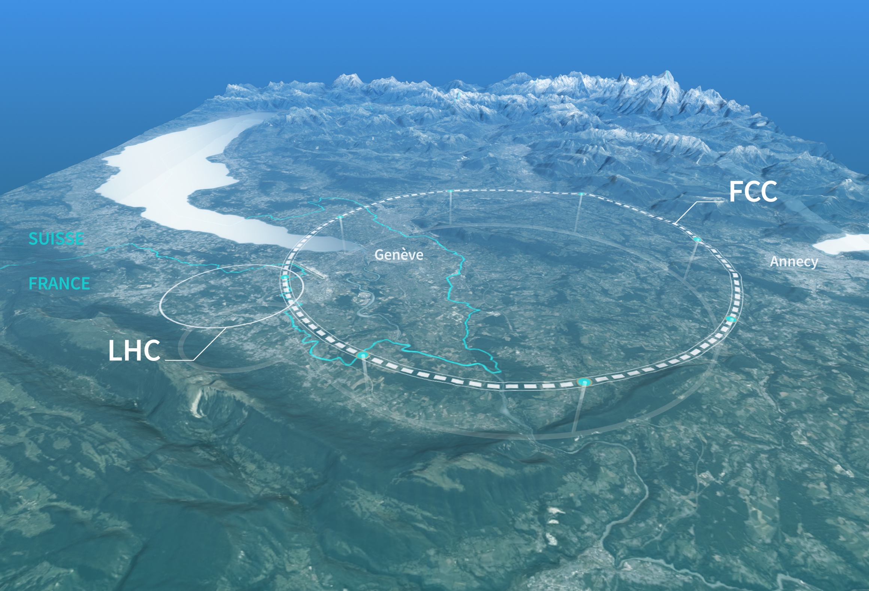
Preparing CERN’s future
Driven by the 2020 Update of the European Strategy for Particle Physics
Full exploitation of LHC – High Luminosity upgrade
Technical and financial feasibility study of a Future Circular Collider (report for end 2025)
Accelerator R&D to develop technologies for FCC and for alternative options
Detector and computing R&D
Maintain and expand a compelling scientific diversity programme
Continue to support other projects around
the world

Slide 27
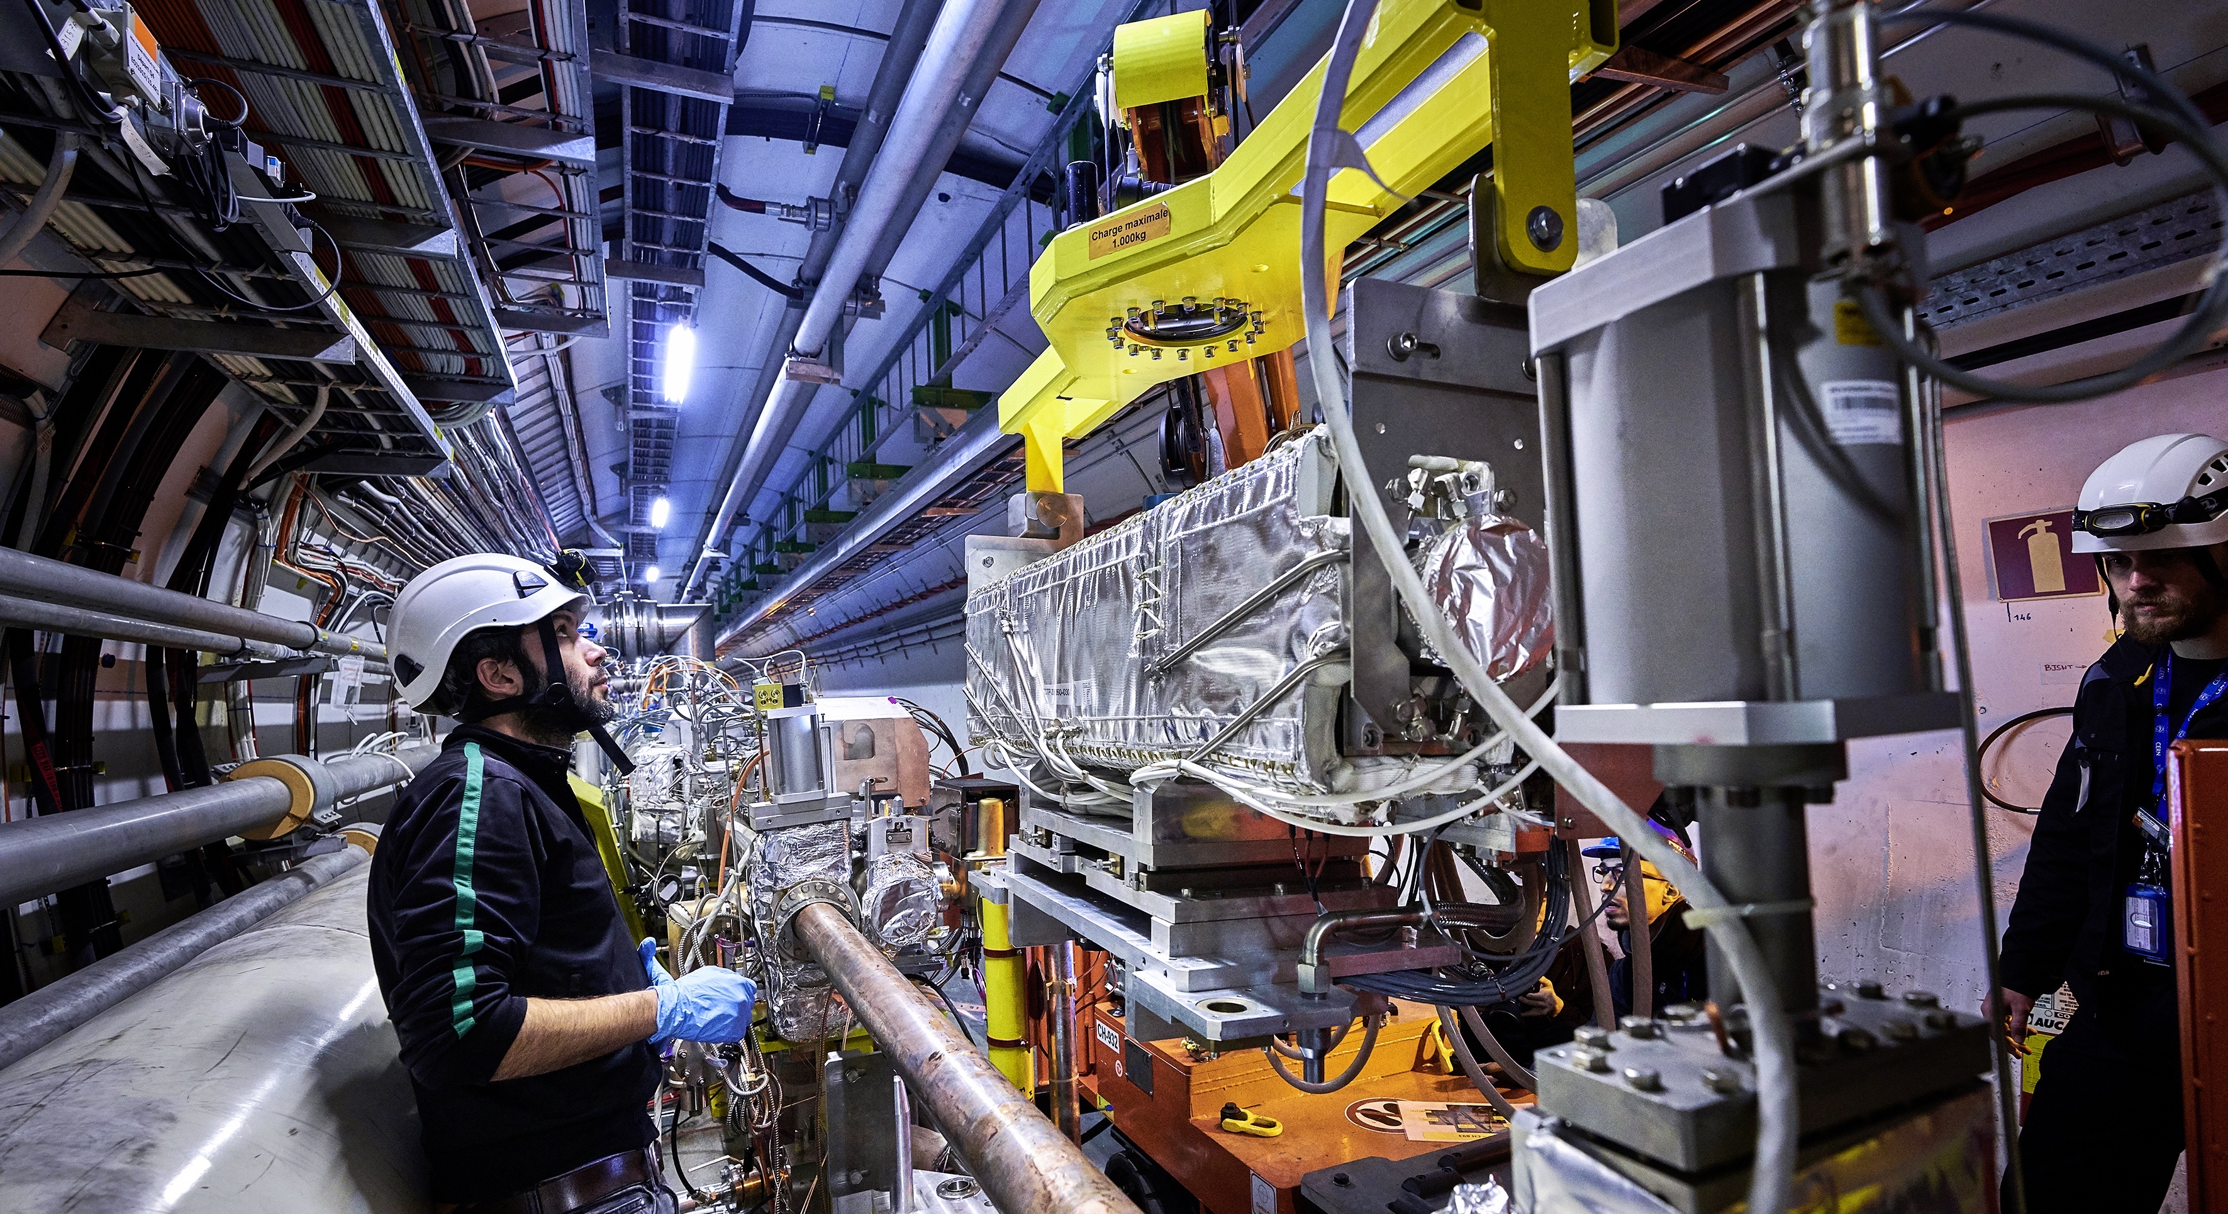
Upgrade to the
High-Luminosity LHC is under way
Run 3 in progress. Aim to double the data sample.
Then HL-LHC will use new technologies to provide
10 times more collisions
than the LHC. Experiments also need major upgrades.
It will give access to rare phenomena, greater precision and discovery potential.
It will start operating in 2029, and run until 2041.

Slide 28
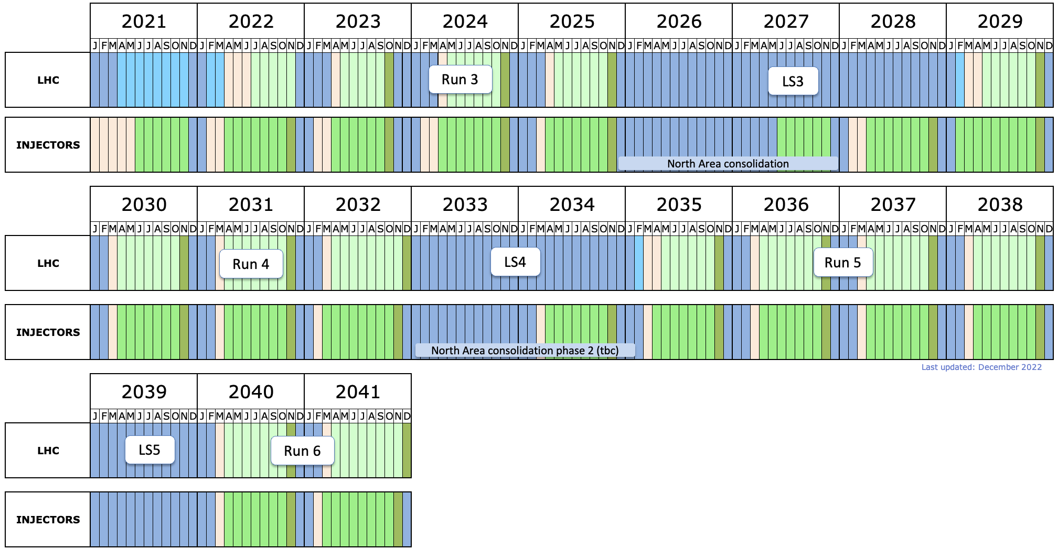
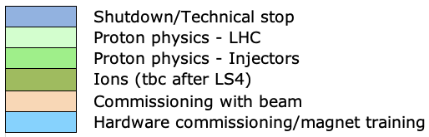
LHC Timeline
today
start HL-LHC
LS2: Upgrade of accelerator and detectors (Phase I)
LS3: Upgrade HL-LHC and Phase II ATLAS&CMS
North Area upgrade?
LS4: Upgrade
Phase IIb ALICE&LHCb

Slide 29
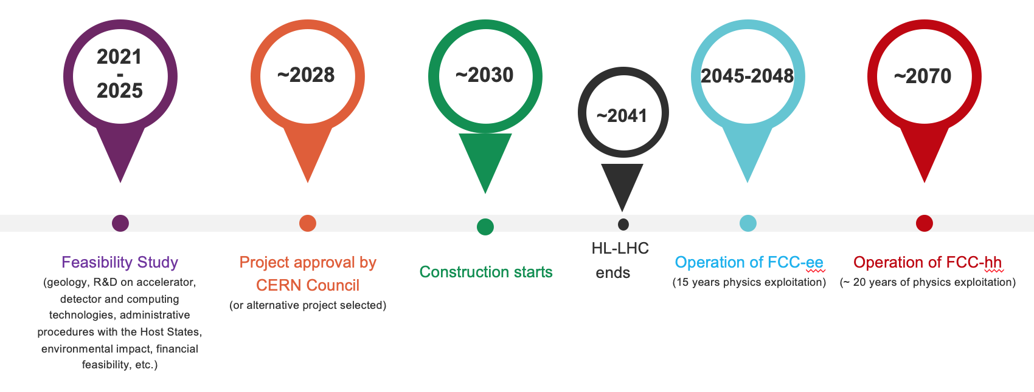
Future Circular Collider Timeline

Slide 30
The CERN accelerator complex

Slide 31
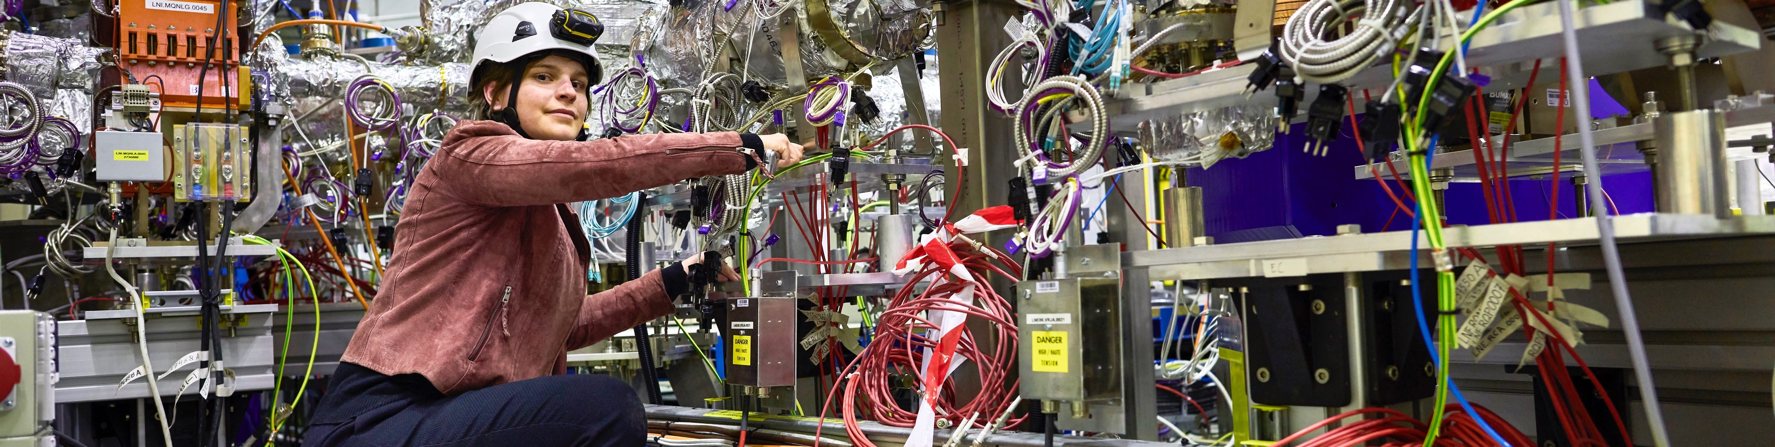
CERN has a diverse scientific programme
Nuclear Physics
(ISOLDE)
Antimatter Research
(Antiproton Decelerator)
Cosmic rays and cloud formation
(CLOUD)
Fixed-target experiments,
which include searches for rare phenomena
Contribution to the Long Baseline
Neutrino Facility in the USA (LBNF)
Notes:
Key messages:
While the Large Hadron Collider (LHC) is the flagship of CERN’s accelerator complex and the results of the LHC experiments are often in the limelight, CERN has a very diverse research programme
This programme covers a wide range of physics topics, from the Standard Model to supersymmetry, from dark matter to cosmic rays.
Experiments at other accelerators and facilities both on-site and off are an equally important part of the Laboratory’s activities.
THE SPEAKER SHOULD AVOID DESCRIBING EACH OF THE EXPERIMENTS SHOWN ON THE SLIDE BUT RATHER FOCUS ON THE MESSAGES ABOVE.

Slide 32
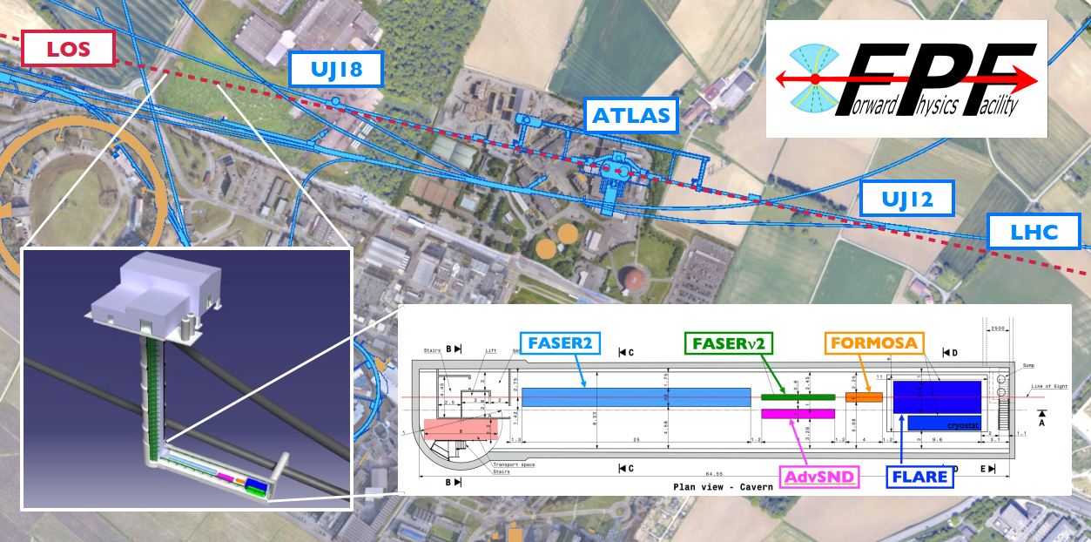
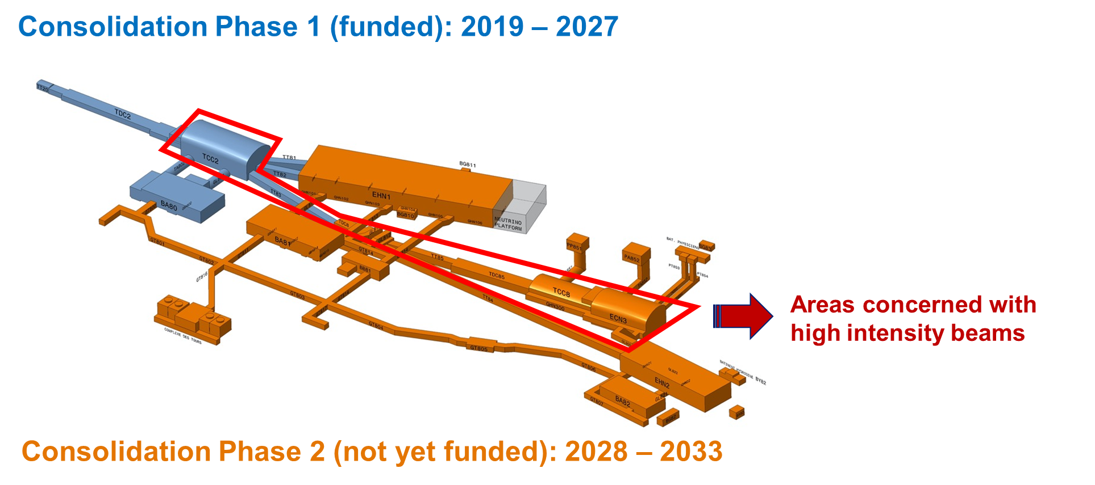
Physics Beyond Colliders
North Area High Intensity Beams ECN3
Several experiments under study: HIKE, SHADOWS, Beam Dump Facility with SHiP, TauFV
Report on post LS3 options to SPSC in 2023
Long lived particles (LLP) @ LHC:
Forward Physics Facility (in line of sight of ATLAS interaction point) – preparing EoI
LLP experiments at large angle to the beam line
LHC fixed target: gas targets; crystal extraction
Notes:
ECFA plenary
https://indico.cern.ch/event/1172215/
See talk on Physics Beyond Colliders

Slide 33


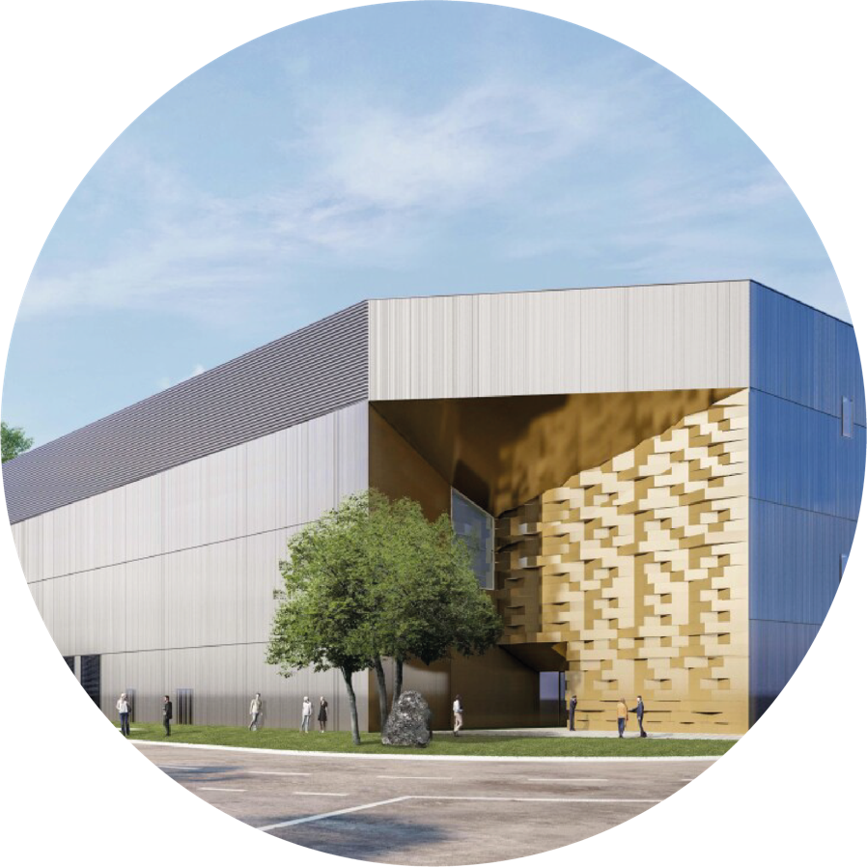
Committed to environmentally responsible and sustainable research
Minimize the impact of the laboratory’s activities on the environment with defined
priority actions
Identify and develop
CERN technologies that
would help mitigate society’s
impact on the environment
Energy:
Consume less, improve
efficiency, and recover more

Slide 34
CERN will continue to play a crucial role in answering fundamental scientific questions
Particle physics will continue to have a positive impact on wider society

