Slide 1
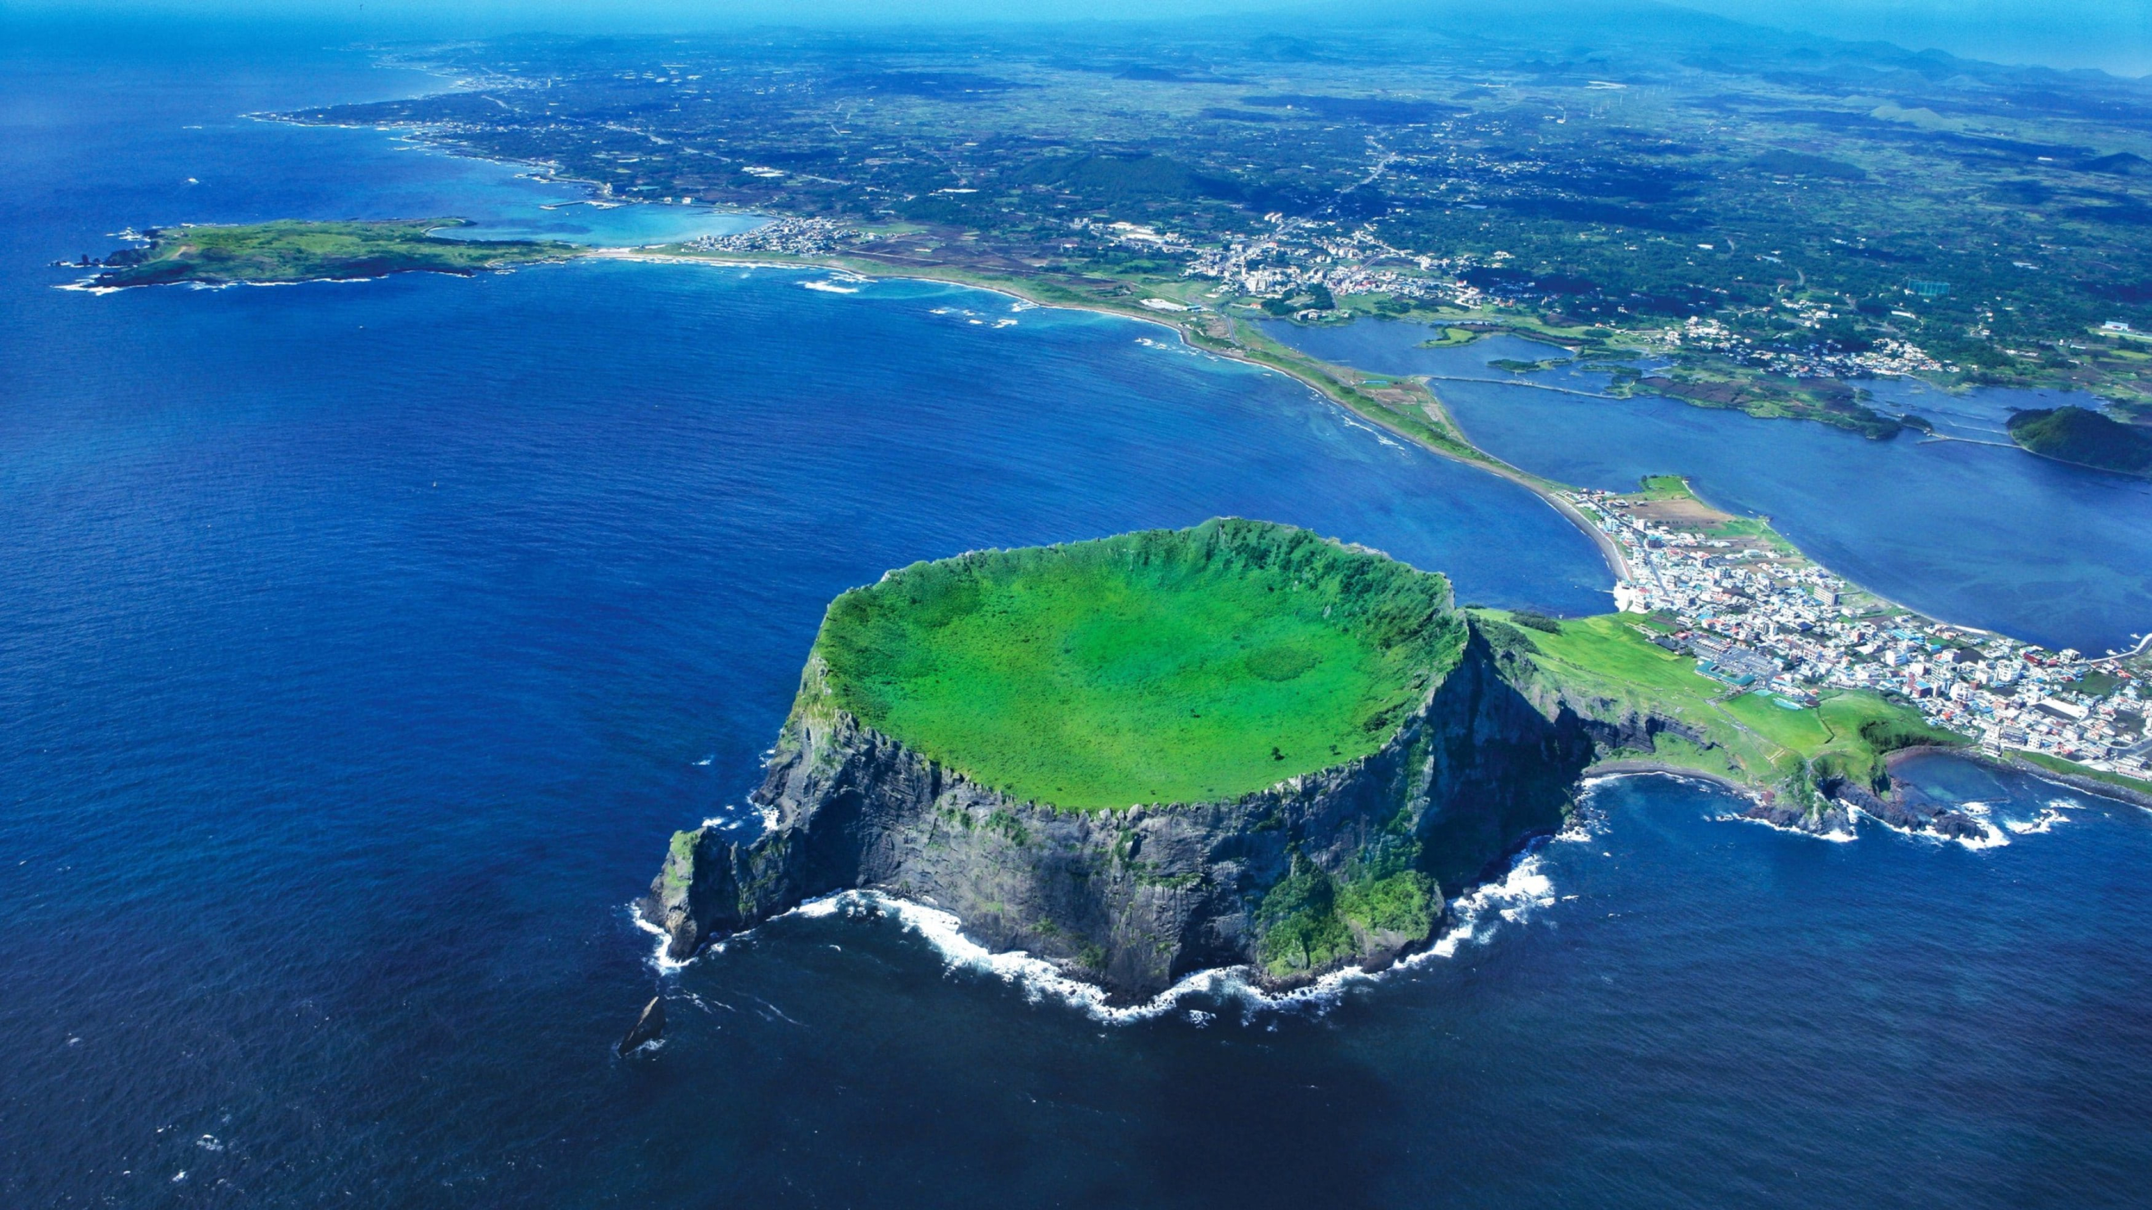



SUT – Thailand site report
Wachaloem Poonsawat
Natthawut Laojamnongwong
7th Asia Tier Center Forum
1 - 3 November 2023
Jeju Island, South Korea

Slide 2
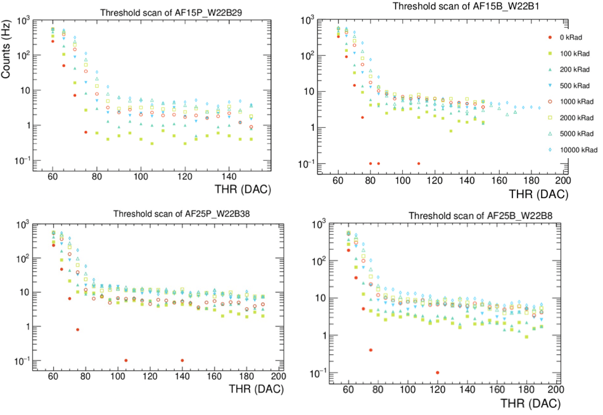
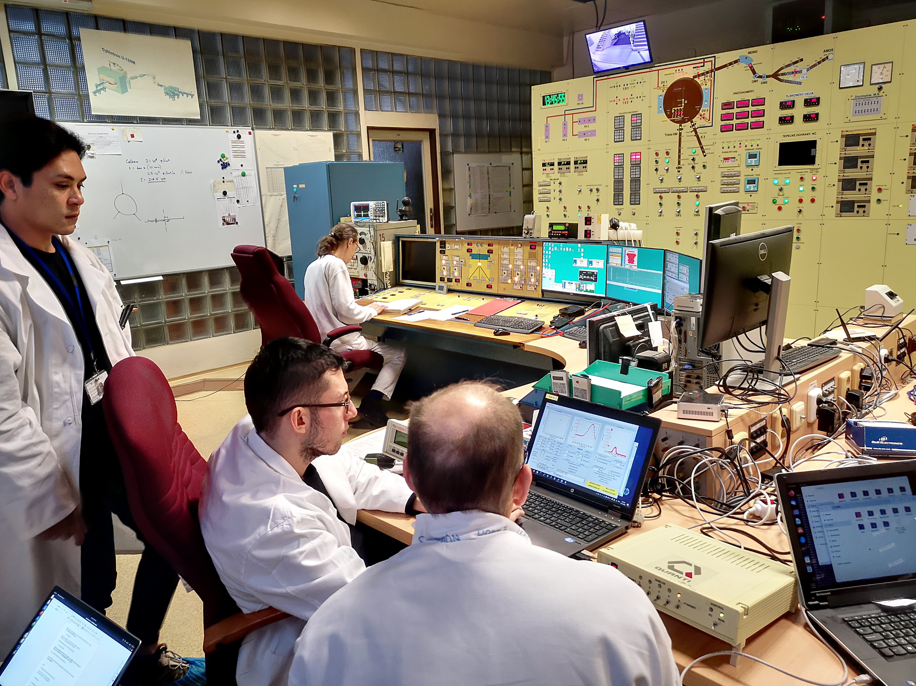
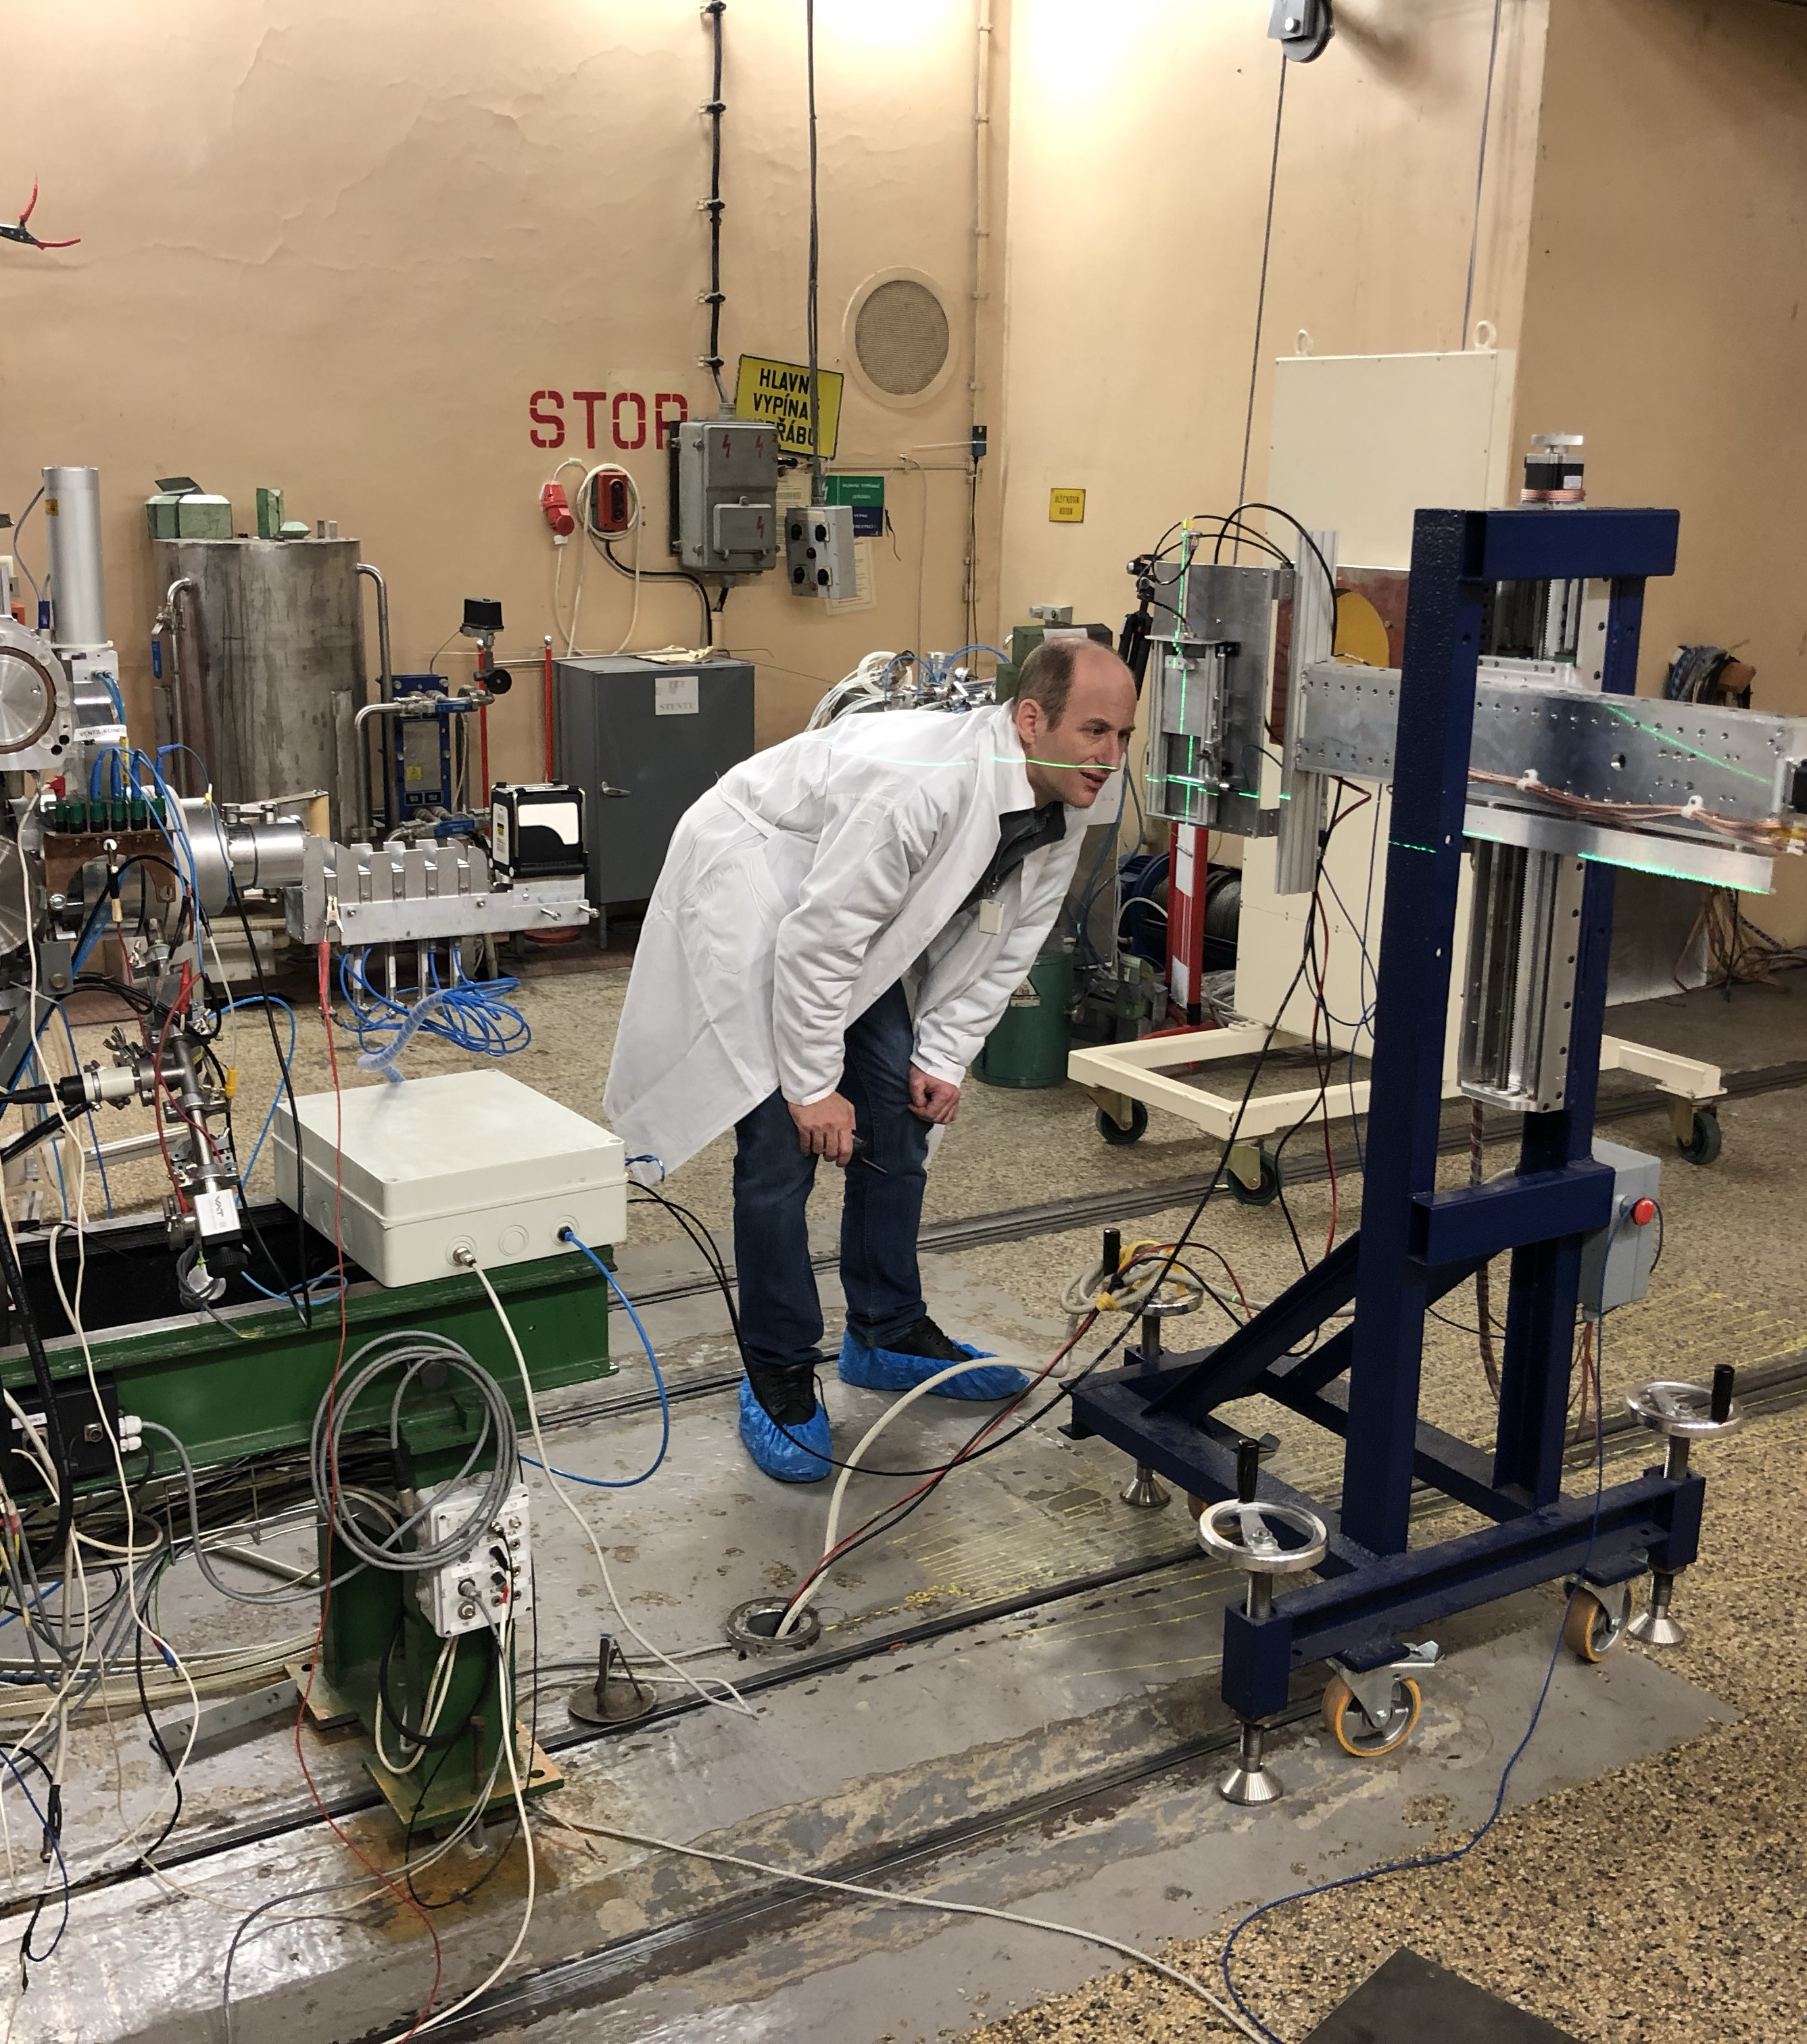
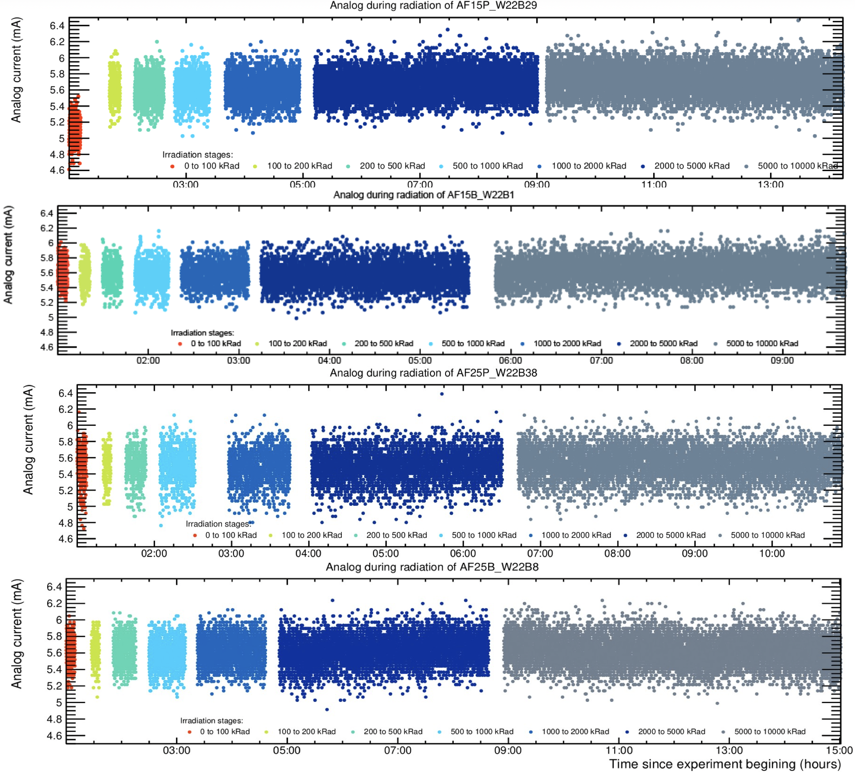
Thailand duty to ALICE
Join the sensor irradiation at NPI REZ, Czech Republic
Relation of event rate and threshold of APTS
APTS chip was mount and irradiate with proton beam, 30 MeV and 7 x 10⁸ - 1.5 x 10⁹ proton/(cm²s)
The total absorbed TID for each chip is 10 Mrad
The distributions of current when chip was irradiated

Slide 3
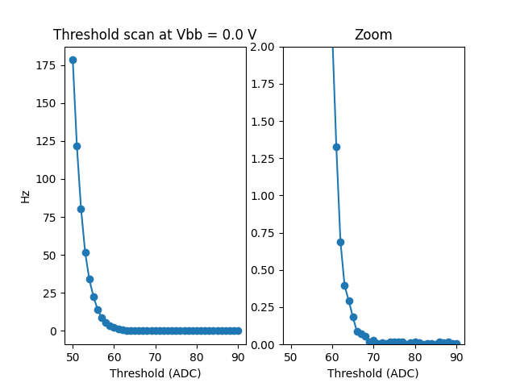
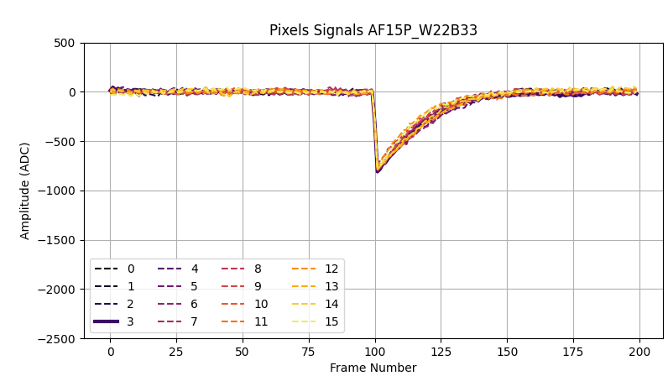
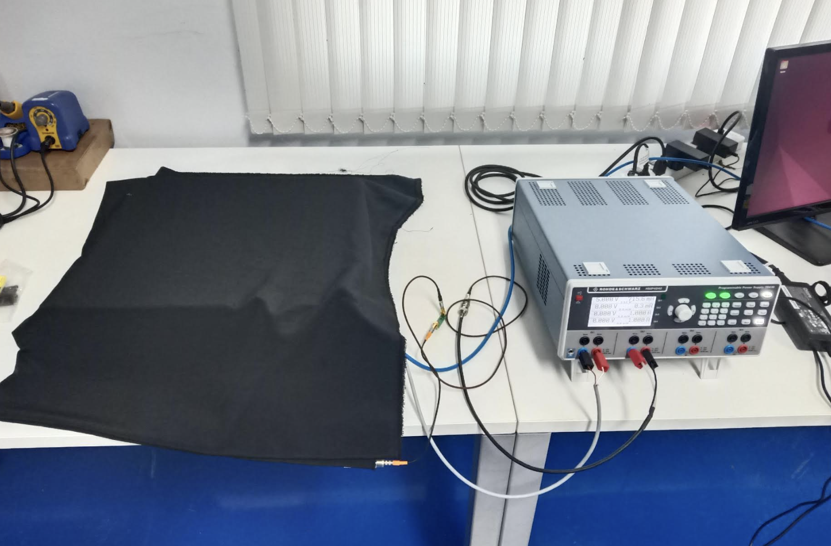
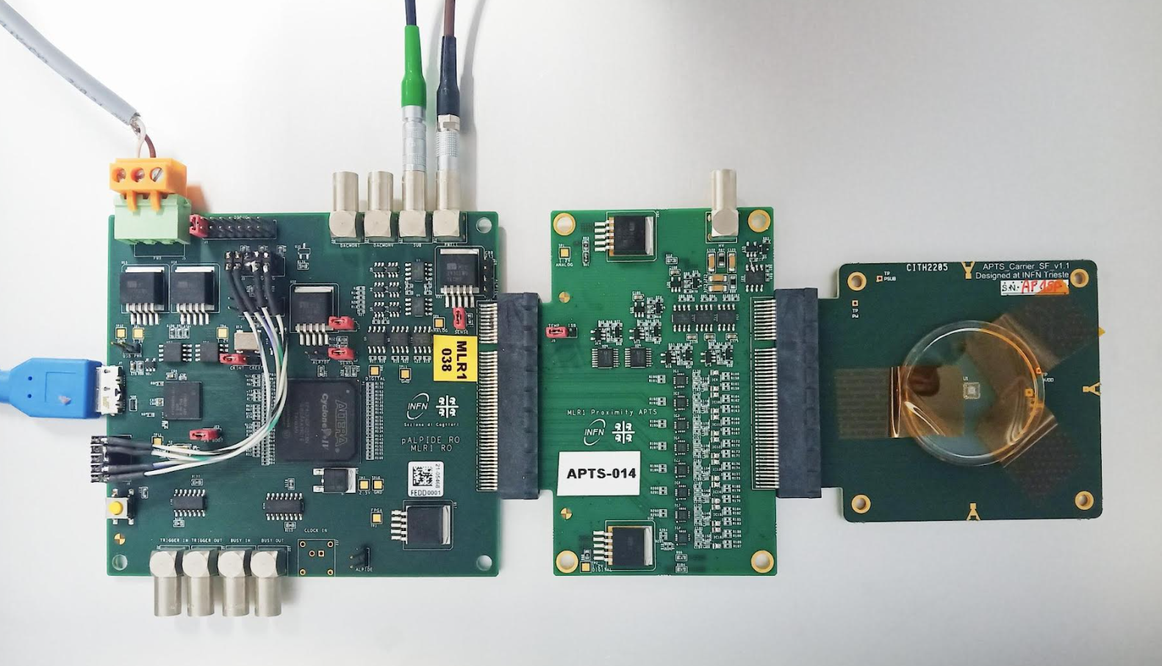
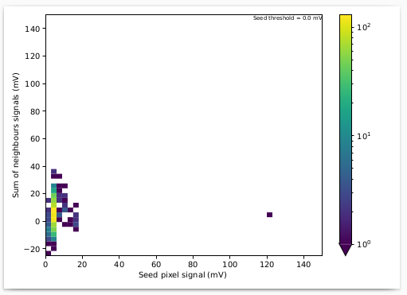
Thailand duty to ALICE
APTS chip was delivered to Synchrotron Light Research Institute
Experiment setup similar to CERN setup
Laboratory chip test
Radiation source chip test with Sr-90 (Low number of particle)
Threshold scand
Experimental setup
Test pulsing
DAQ board
APTS chip
Source scan (without source)
background
Proximity

Slide 4
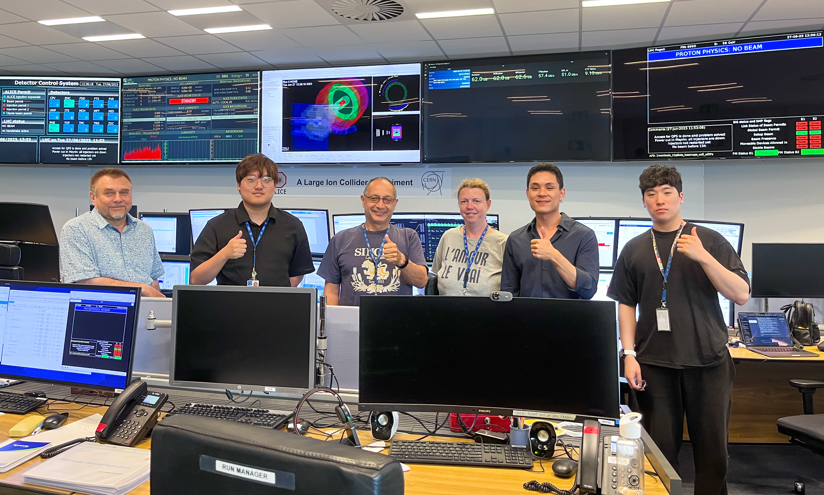
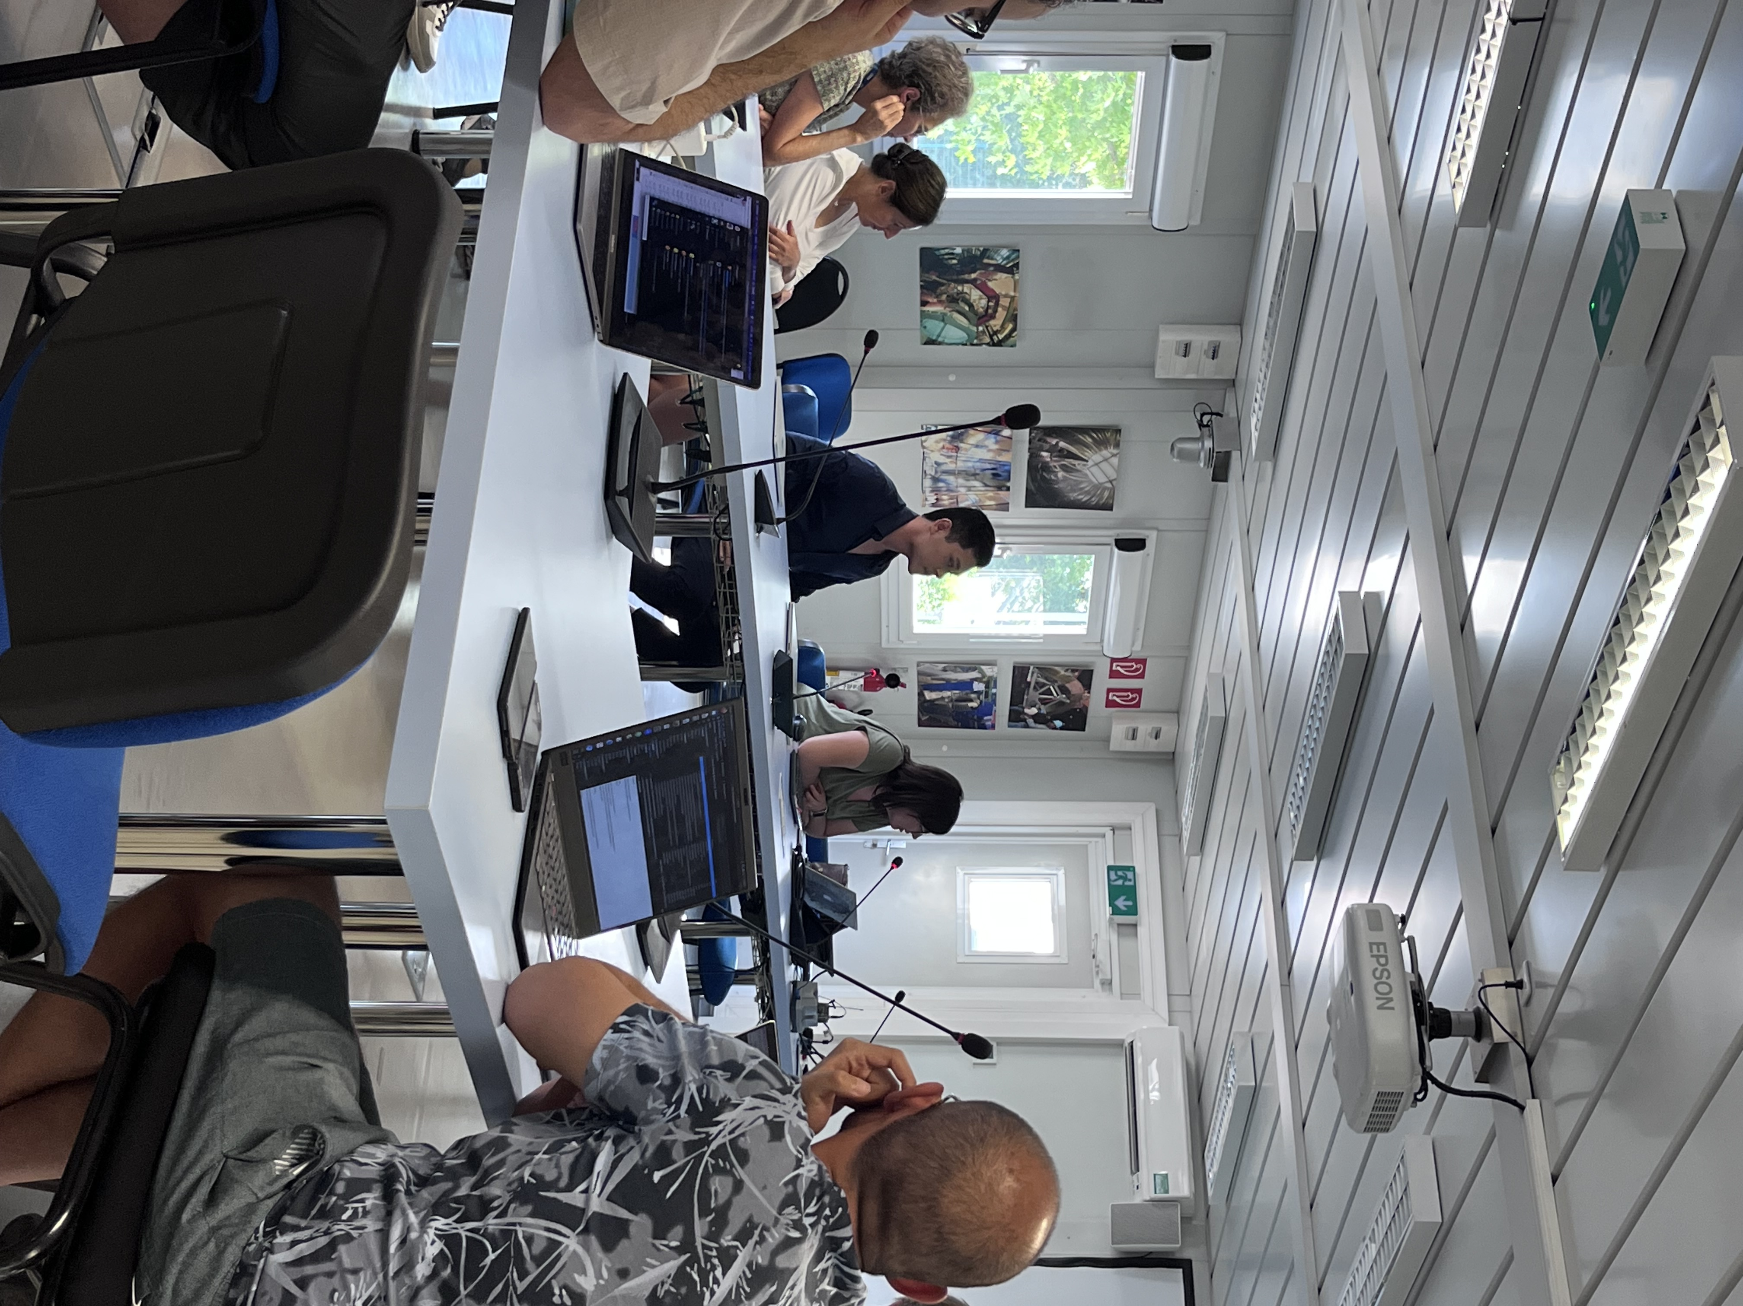
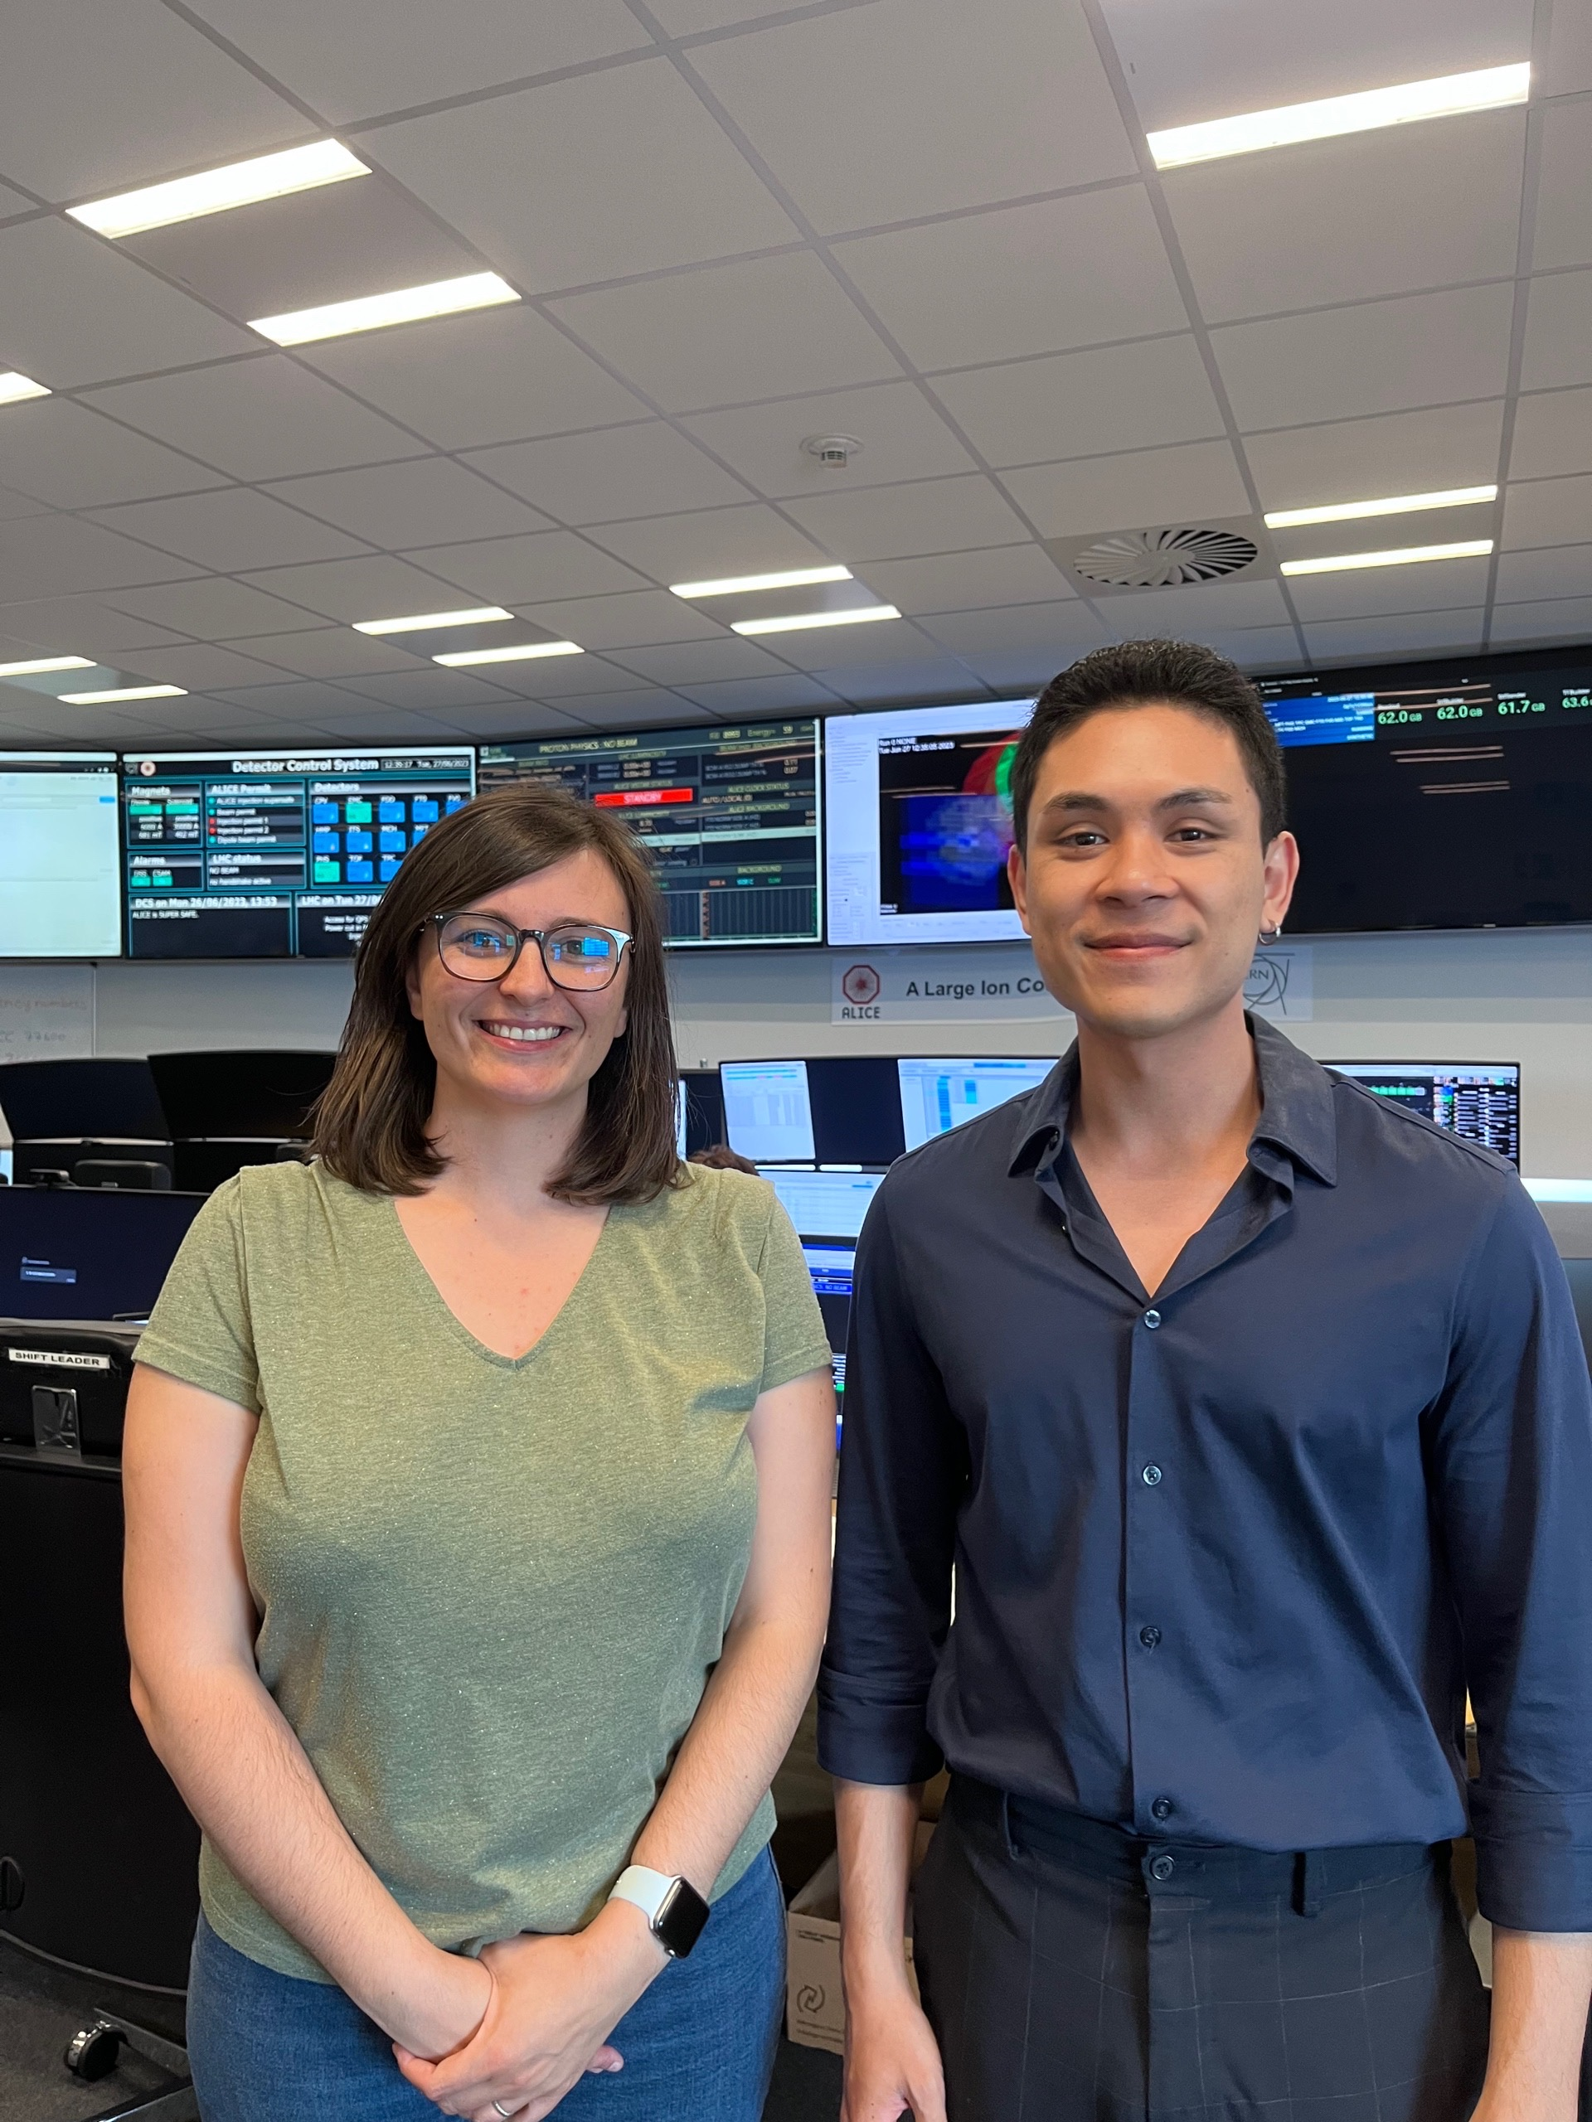
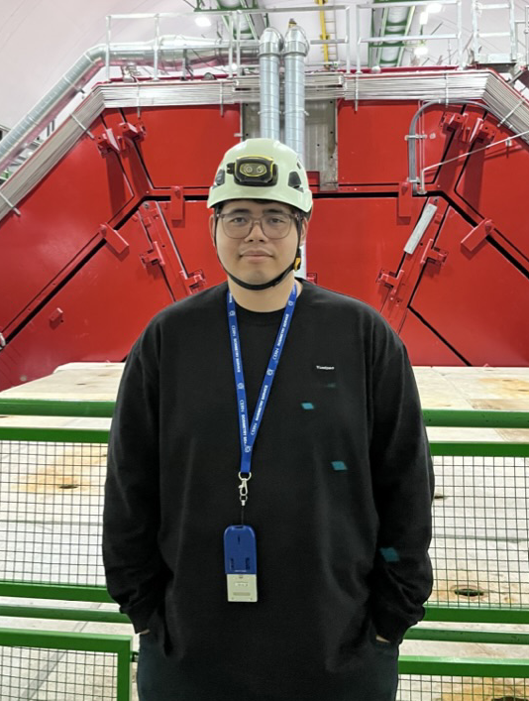
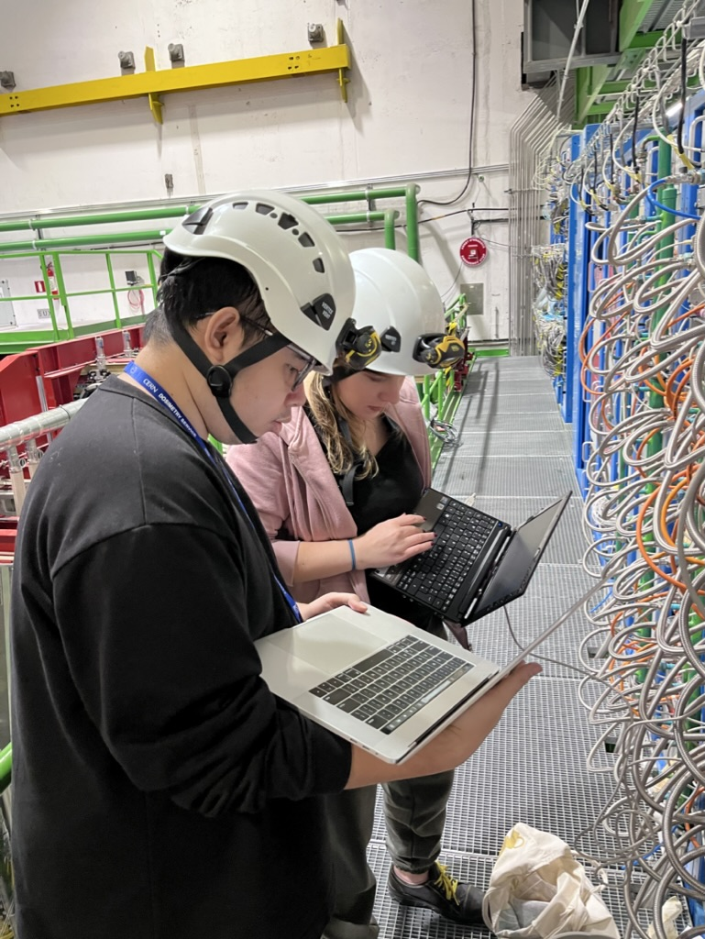
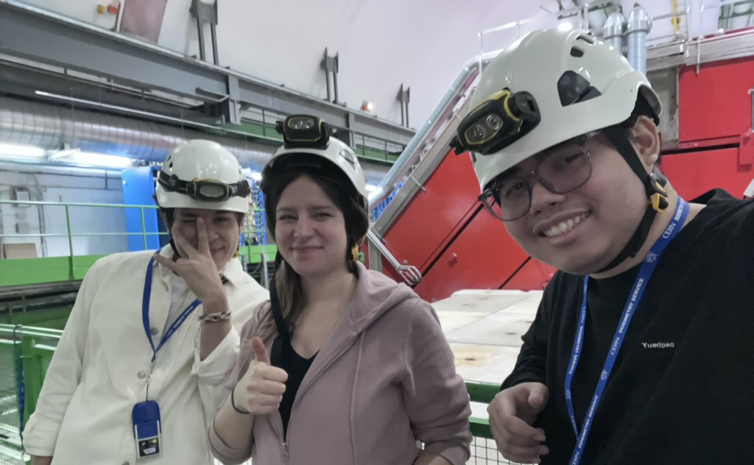
Thailand duty to ALICE
Role run manager at ALICE
Run manager under RUN3, coordinated central system tests for consolidation and performances during machine development 1
Service Task For Ph.D. Student at ALICE
The physicist have to full fill ALICE service task in order to be allow for publishing publication.
Dr. Anastasia Berdnikova, the ALICE TRD coordinator, assigned me duty to replace damaged PSU during stopped beam.

Slide 5



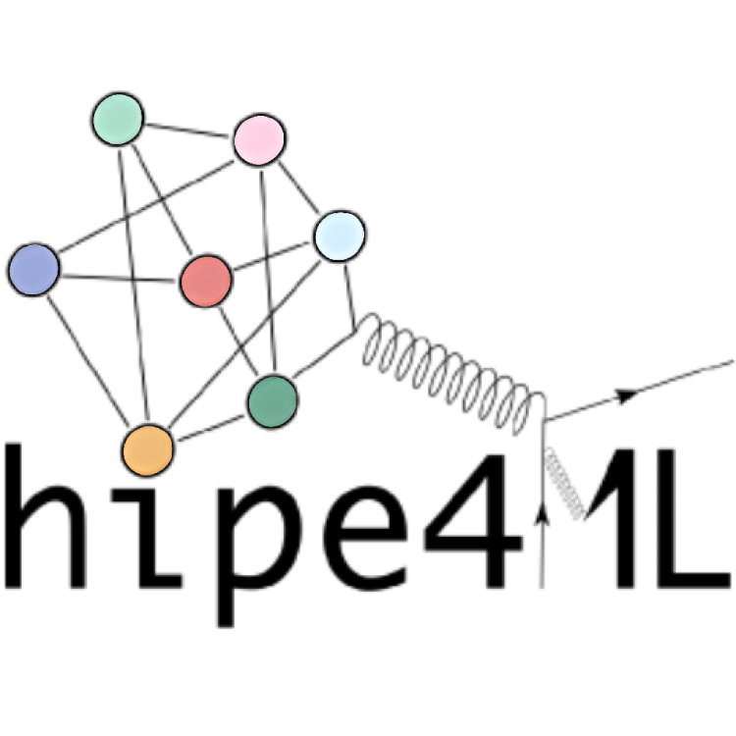

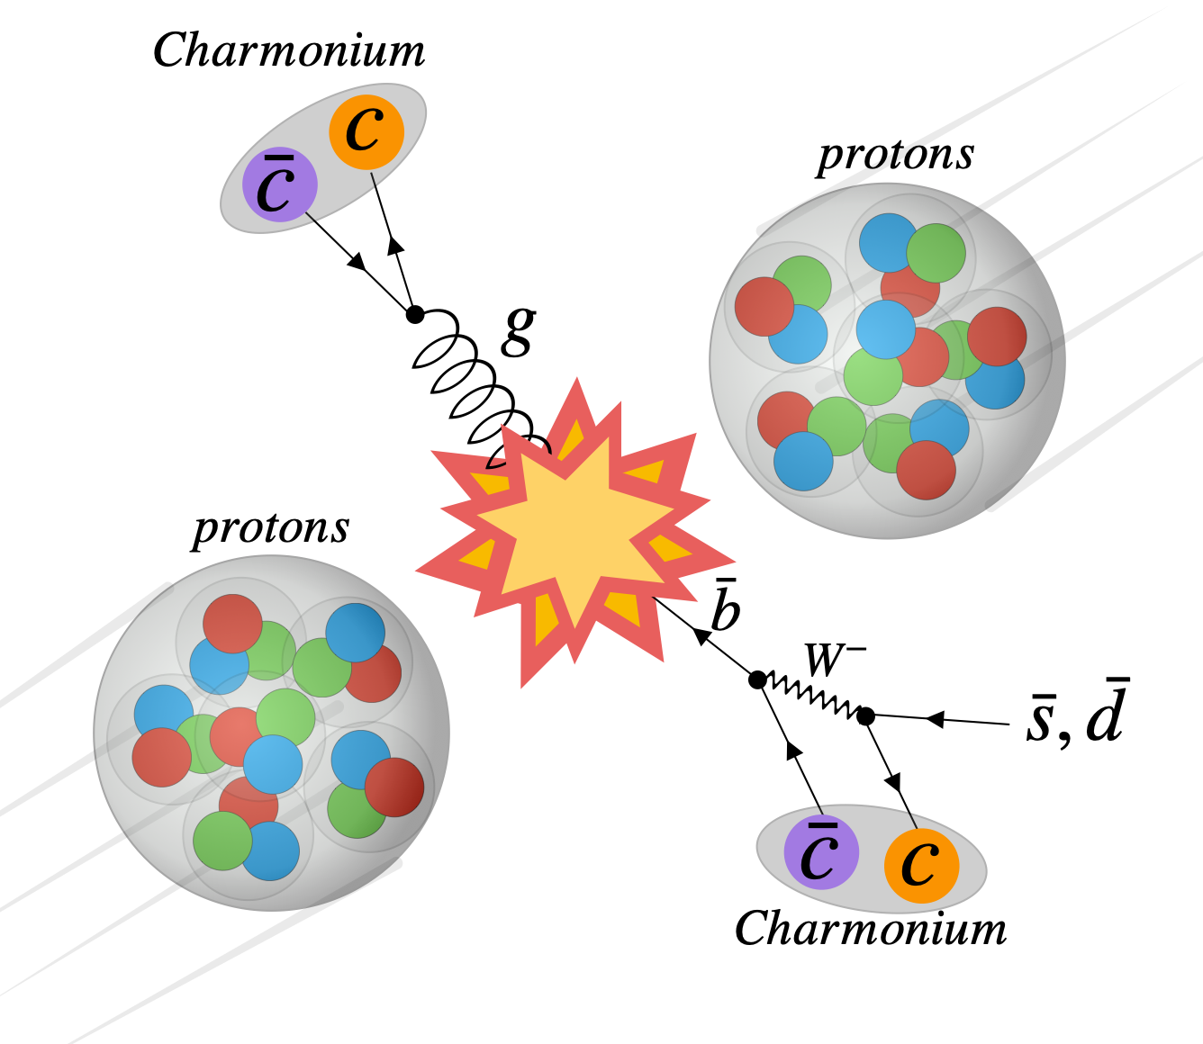








The invariant mass spectroscopy is used for investigating charmonium decaying to proton-antiproton pairs which is the channel decaying by most of charmonia species.
To utilize machine learning and Monte Carlo simulation techniques to reduce the background and increase the efficiency of measurement.
Tawanchat Simantathammakul ¹
Asst. Prof. Dr. CHINORAT KOBDAJ ¹
Dr. BENJAMIN DÖNIGUS ²
Omsap Jaroonrak ¹
¹ Suranaree University of Technology, School of Physics, Institute of Science, Thailand
² Goethe University, Physics Department, Frankfurt, Germany

Slide 6
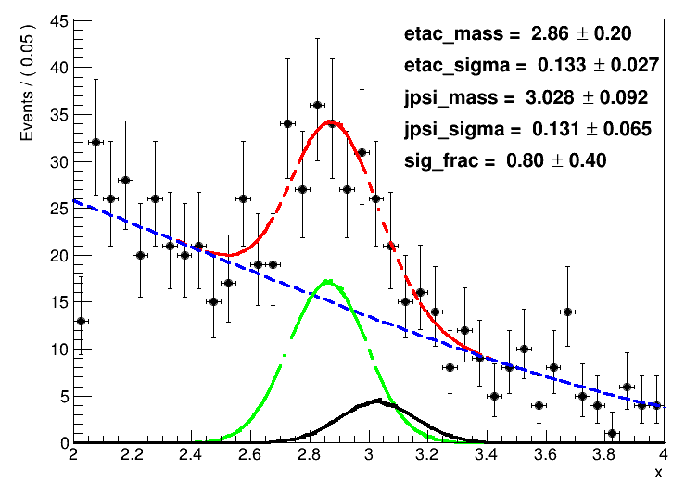

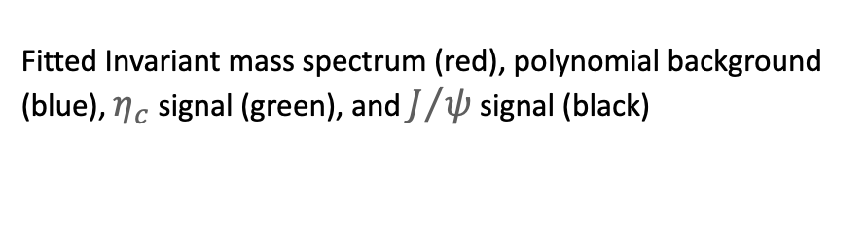
Multivariate selection using machine learning
Real data*
MC data
Real Background
(Only side-band)
MC Prompt Signal
Training and testing sets
Tuning hyper parameters
using Optuna optimization
Training and Testing the model
Full spectrum
Apply the model to the data

Slide 7
Research Plan
Activities | Months |  |  |  |  |  |  |  |  |  |  |  | Expected output | Annotation
 | 1 | 2 | 3 | 4 | 5 | 6 | 7 | 8 | 9 | 10 | 11 | 12
1) Study the ALIROOT/ALIPHYSICS framework for the Charmed particle | ✔︎ | ✔︎ | ✔︎ | ✔︎ | ✔︎ | ✔︎ | ✔︎ | ✔︎ |  |  |  |  | Understand and complete the installation of ALICE software framework at SUT | Fully utilize AliRoot, AliPhysics, AliDPG on SUT server.
2) Perform the Monte Carlo Simulation for ηc and J/ψ |  | ✔︎ | ✔︎ |  |  |  | ✔︎ | ✔︎ | ✔︎ | ✔︎ |  |  | Monte Carlo simulation Data ηc and J/ψ in the AliESDs.root format | Data collecting and MC simulation has been done.
3) Write the analysis code for the ALICE data to find ηc and J/ψ |  |  |  | ✔︎ | ✔︎ | ✔︎ | ✔︎ | ✔︎ | ✔︎ | ✔︎ | ✔︎ | ✔︎ | Analysis code for ηc and J/ψ | Working on optimizing model and significance scanning.
2566
4) Confirm the results to PWG and measure systematic uncertainty | ✔︎ | ✔︎ | ✔︎ | ✔︎ | ✔︎ | ✔︎ |  |  |  |  |  |  | Invariant mass spectrum of ηc and J/ψ
5) Prepare publication and submit to ALICE committee |  |  |  |  | ✔︎ | ✔︎ | ✔︎ | ✔︎ | ✔︎ | ✔︎ | ✔︎ | ✔︎ | 1 publication

Slide 8
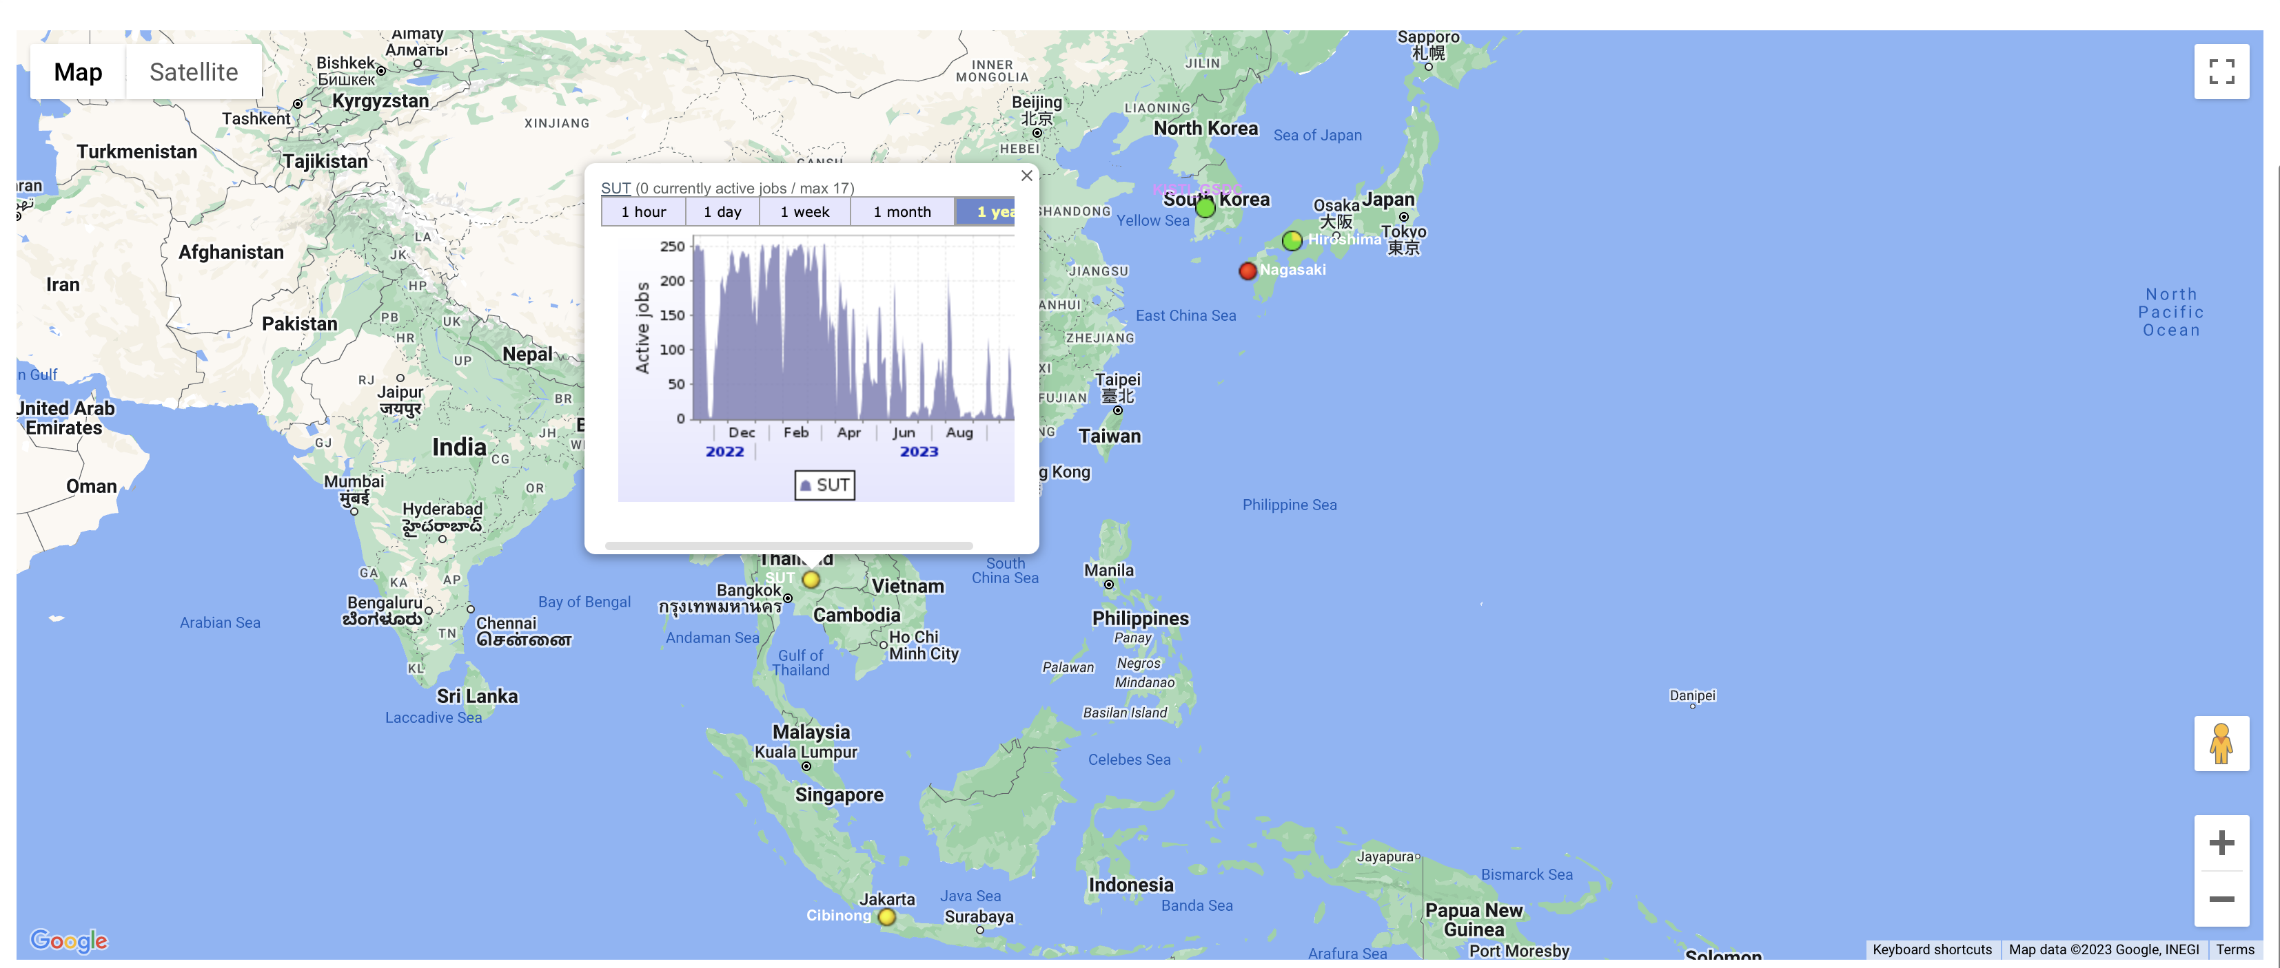
SUT ALICE site report
http://alimonitor.cern.ch/map.jsp

Slide 9
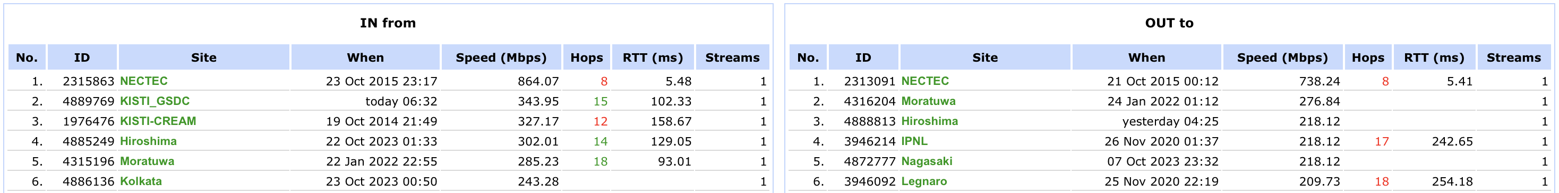
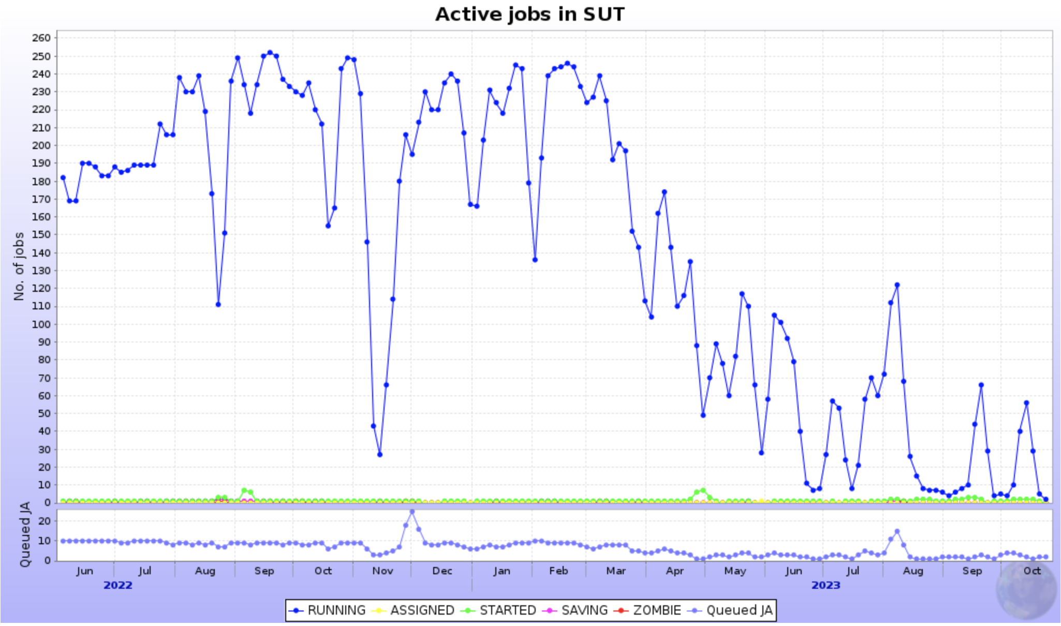
SUT ALICE site report
Top Bandwidth IN at SUT
NECTEC
KISTI_GSDC
KISTI-CREAM
Hiroshima
Moratuwa
Kolkata
Top Bandwidth OUT at SUT
NECTEC
Moratuwa
Hiroshima
IPNL
Nagasaki
Legnaro
Active jobs at SUT since June 2022
http://alimonitor.cern.ch/display

Slide 10
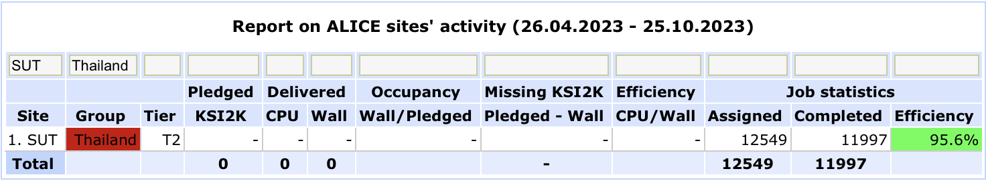
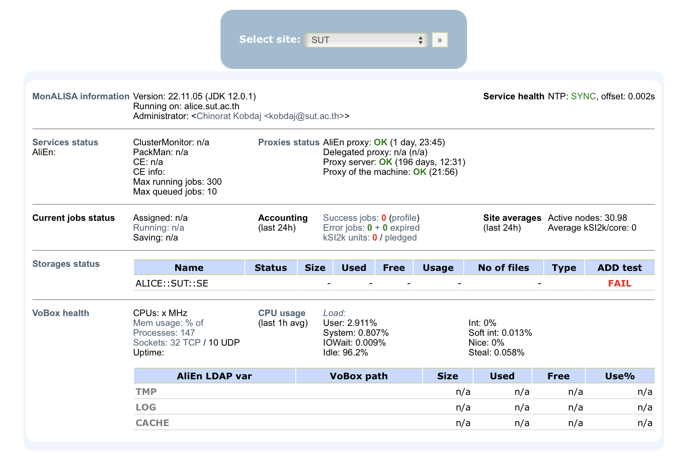
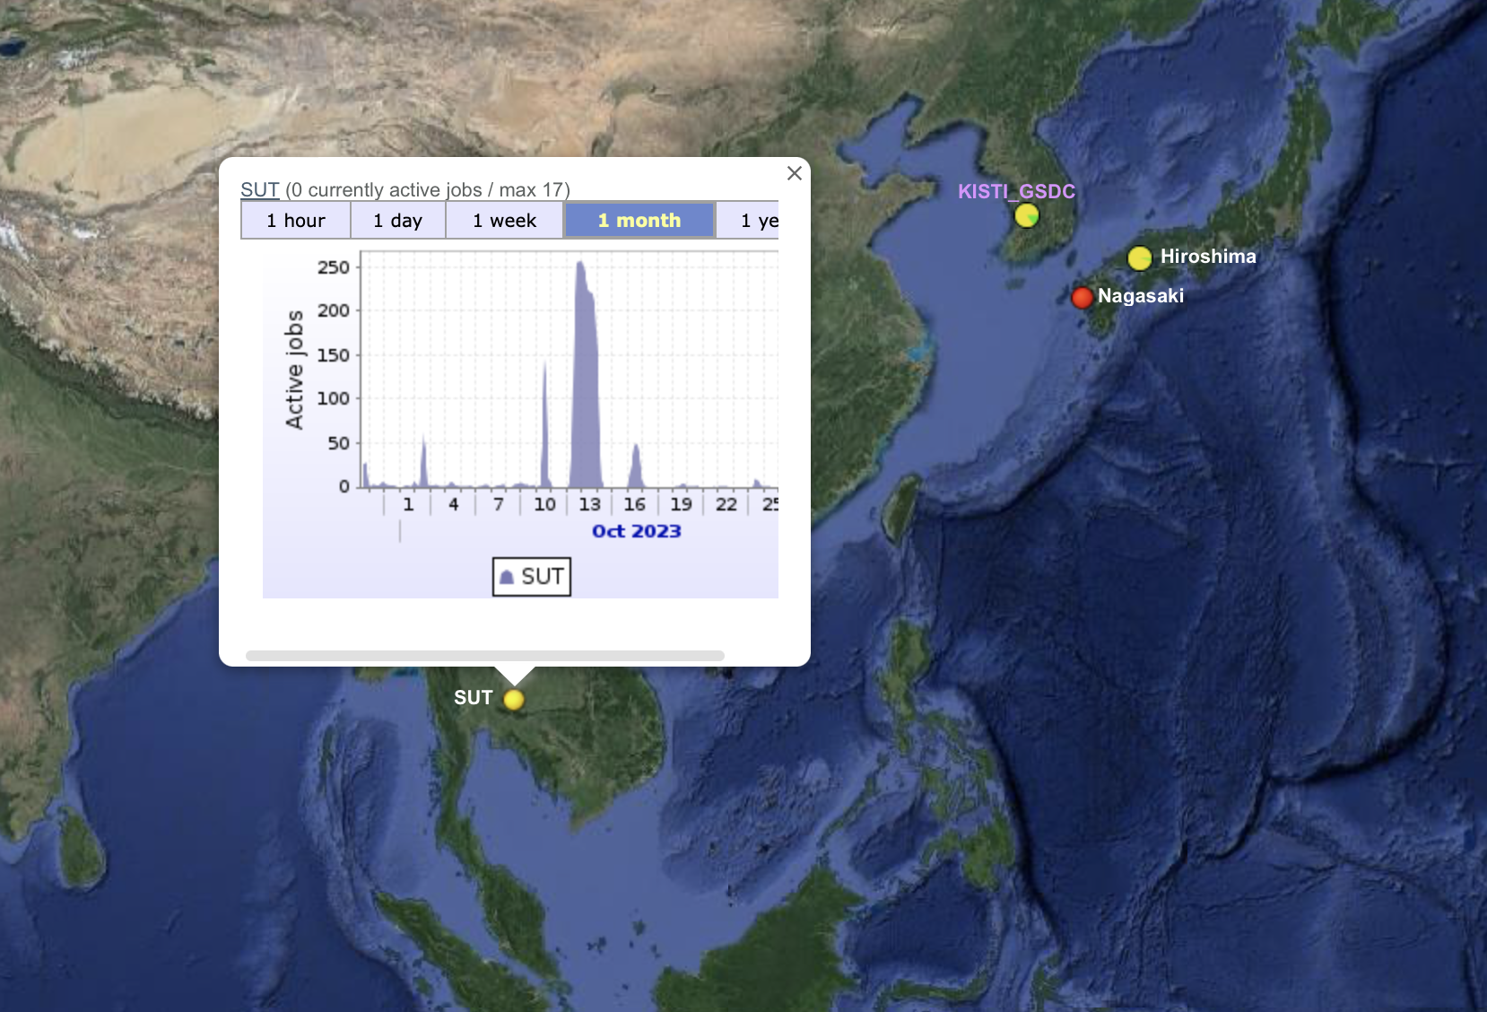
SUT ALICE site report

Slide 11
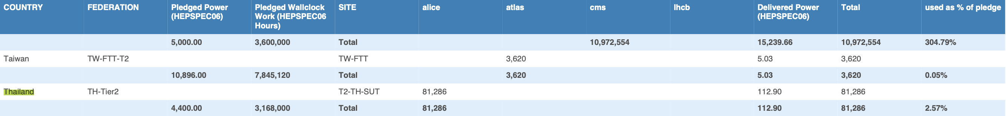
SUT ALICE site report

Slide 12
SUT ALICE site report
SUT particle server
  T2-TH-SUT @computing center
  256 CPU cores
  896 GB of RAM
  100 TB storage
  CentOS7
  Htcondor-CE version 5.1.1
Code Development
  Supermicro 32 cores 512 GB RAM 80 TB storage CentOS7, HT-Condor
  IBM 64 cores 128 GB RAM 8 TB storage CentOS7, HT-Condor
  IBM 32 cores 128 GB RAM 8 TB storage Ubuntu
12

Slide 13
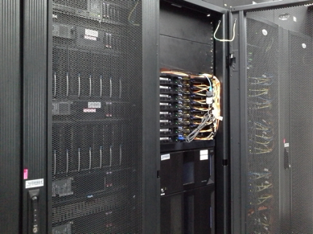
Chula site report (CUNSTDA)
Locate at CU e-Science cluster, MHMK Building, Faculty of Science, Chulalongkorn University
Storage
  1. IBM Storwize 3700: 160 TB
  2. Lenovo ThinkSystem DE2000H: 160 TB
Total CPU: 676 cores
https://esciencecu-twiki.sc.chula.ac.th/introduction-to-our-cluster/our-resources
12

Slide 14
Chula site report (CUNSTDA)
Machine | CPUs/node | Memory (GB)/node | No. of nodes | Note
Frontend
Lenovo System X 3550 M5 | 20 (Intel Xeon CPU E5-2640 v4 2.40GHz) with HT on (40 threads) | 32 | 1 | escience1.sc.chula.ac.th
Lenovo System X 3550 M5 | 16 (Intel Xeon CPU E5-2620 v4 2.10GHz) | 64 | 1 | escience2.sc.chula.ac.th
Lenovo SR630 | 32 (Intel Xeon Gold 5218 2.3GHz) | 8 x 32GB TruDDR4 2933MHz | 1 | 1x Tesla T4 GPU escience3.sc.chula.ac.th
Worker: Slurm
Lenovo SR630 | 32 (Intel Xeon Gold 5218 2.3GHz) | 8 x 32GB TruDDR4 2933MHz | 7 | 1x Tesla T4 GPU/node HPC, HTC
Lenovo x3850 X6 | 80 (Intel Xeon E7-8870v4 2.1 MHz) | 512 | 1 | HPC, HTC
Lenovo SR850 | 88 (Intel Xeon Gold 6152 2.10GHz) | 324 | 1 | escience4.sc.chula.ac.th
IBM BladeCenter HS22 | 16 (Intel Xeon CPU E5-2650 2.00GHz) | 32 | 5 | HTC
IBM iDataPlex DX360M4 | 16 | 128 | 2 | gridMathematica
Lenovo SR635 | 16 (AMD EPYC 7313P 3.0 GHz) | 256 | 2 | 1 machine with Nvidia T4, 1 machine with Nvidia A2
DGXStation |  |  | 1
Worker: Kubernetes
Dell PowerEdge R740 | 24 (Intel Xeon Pentium 8268 2.9 GHz) | 6 x 64GB DDR4 2933MHz | 3
Lenovo SR630 | 32 (Intel Xeon Gold 5218 2.3GHz) | 8 x 32GB TruDDR4 2933MHz | 2 | 1x Tesla T4 GPU/node
TOTAL | 676 CPUs
12
https://esciencecu-twiki.sc.chula.ac.th/introduction-to-our-cluster/our-resources

Slide 15
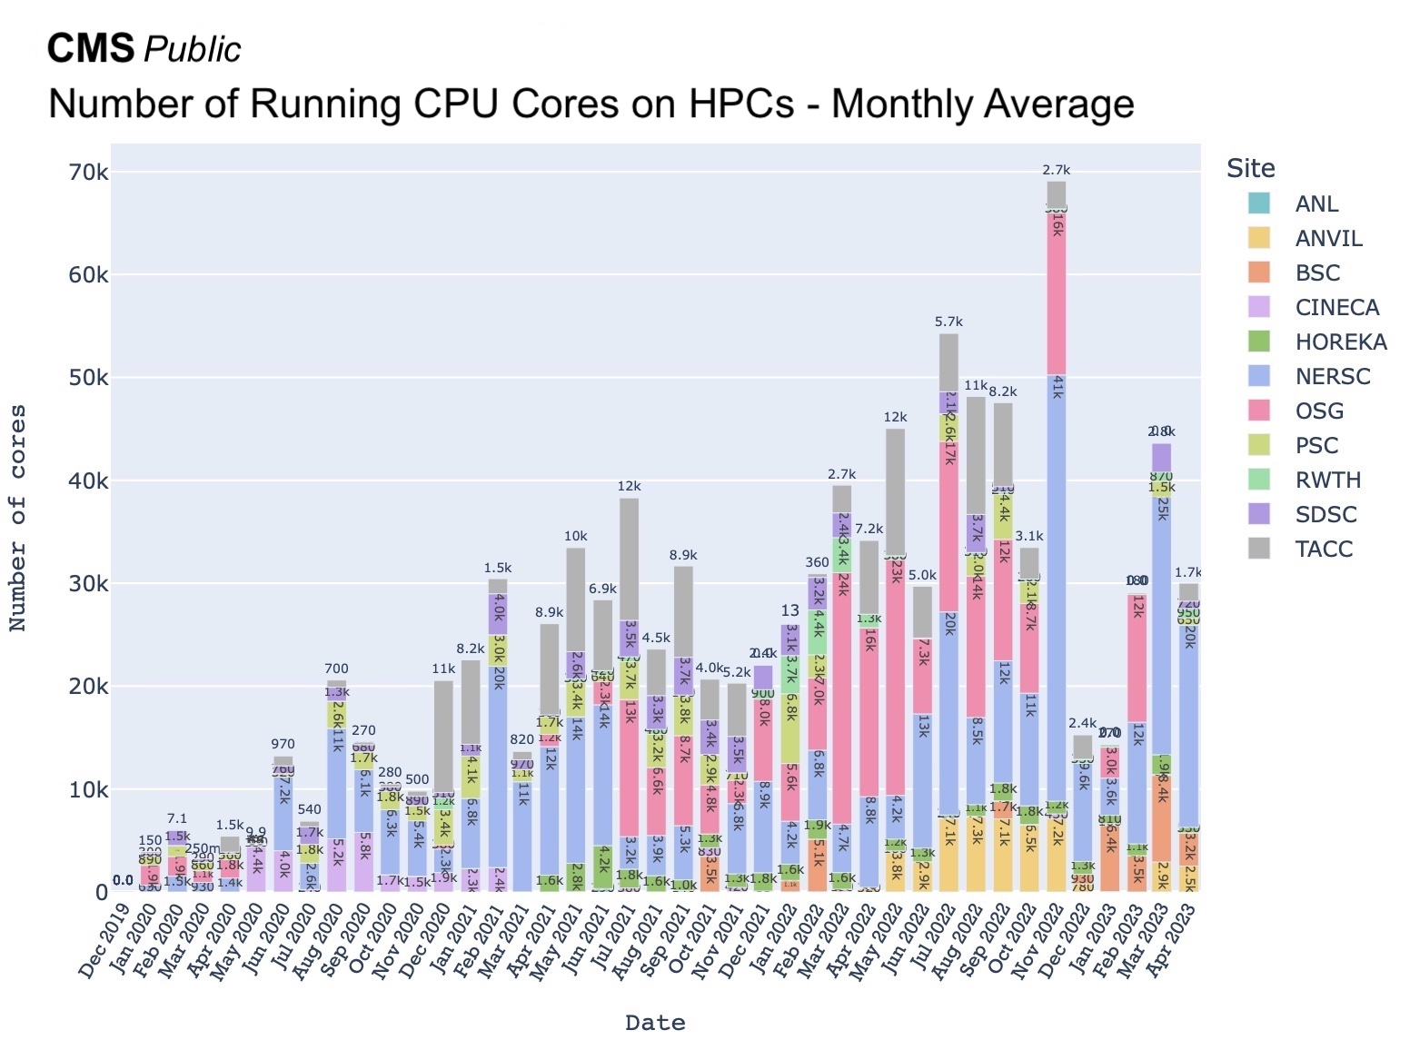
Chula site report (CUNSTDA)
12
https://twiki.cern.ch/twiki/pub/CMSPublic/CMSOfflineComputingResults/230503-CMS-on-HPC.png

Slide 16
CERN server donation
Discussed the CERN server donation program with Simone Campa (simone.campana@cern.ch).
Discussed the transportation and document of approval with Catharine Noble (catharine.noble@cern.ch).
Discussed SUT hardware requirement with Eric Sallaz (eric.sallaz@cern.ch)
List of hardware requested through the CERN server donation program
  1,000 CPU cores
  4,000 GB RAM
  500 TB storage
  high-speed cable connection to server (LAN, Internet, etc.).
In progress
16

Slide 17
Network status

Slide 18
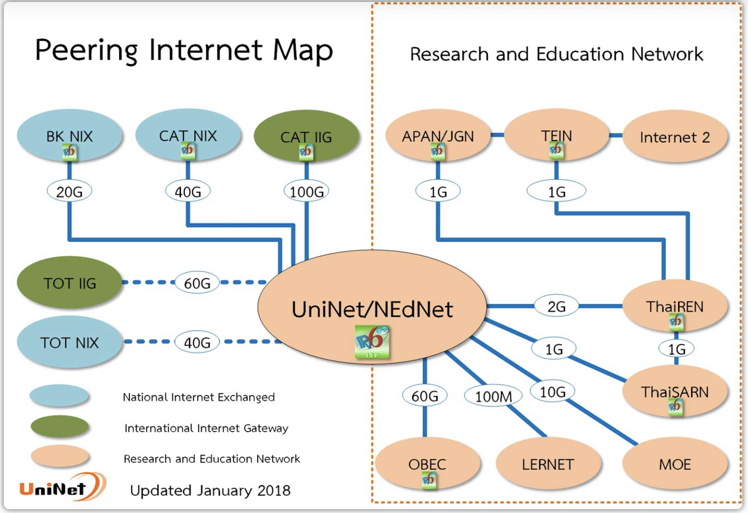
UniNet
https://www.uni.net.th/?page_id=403

Slide 19
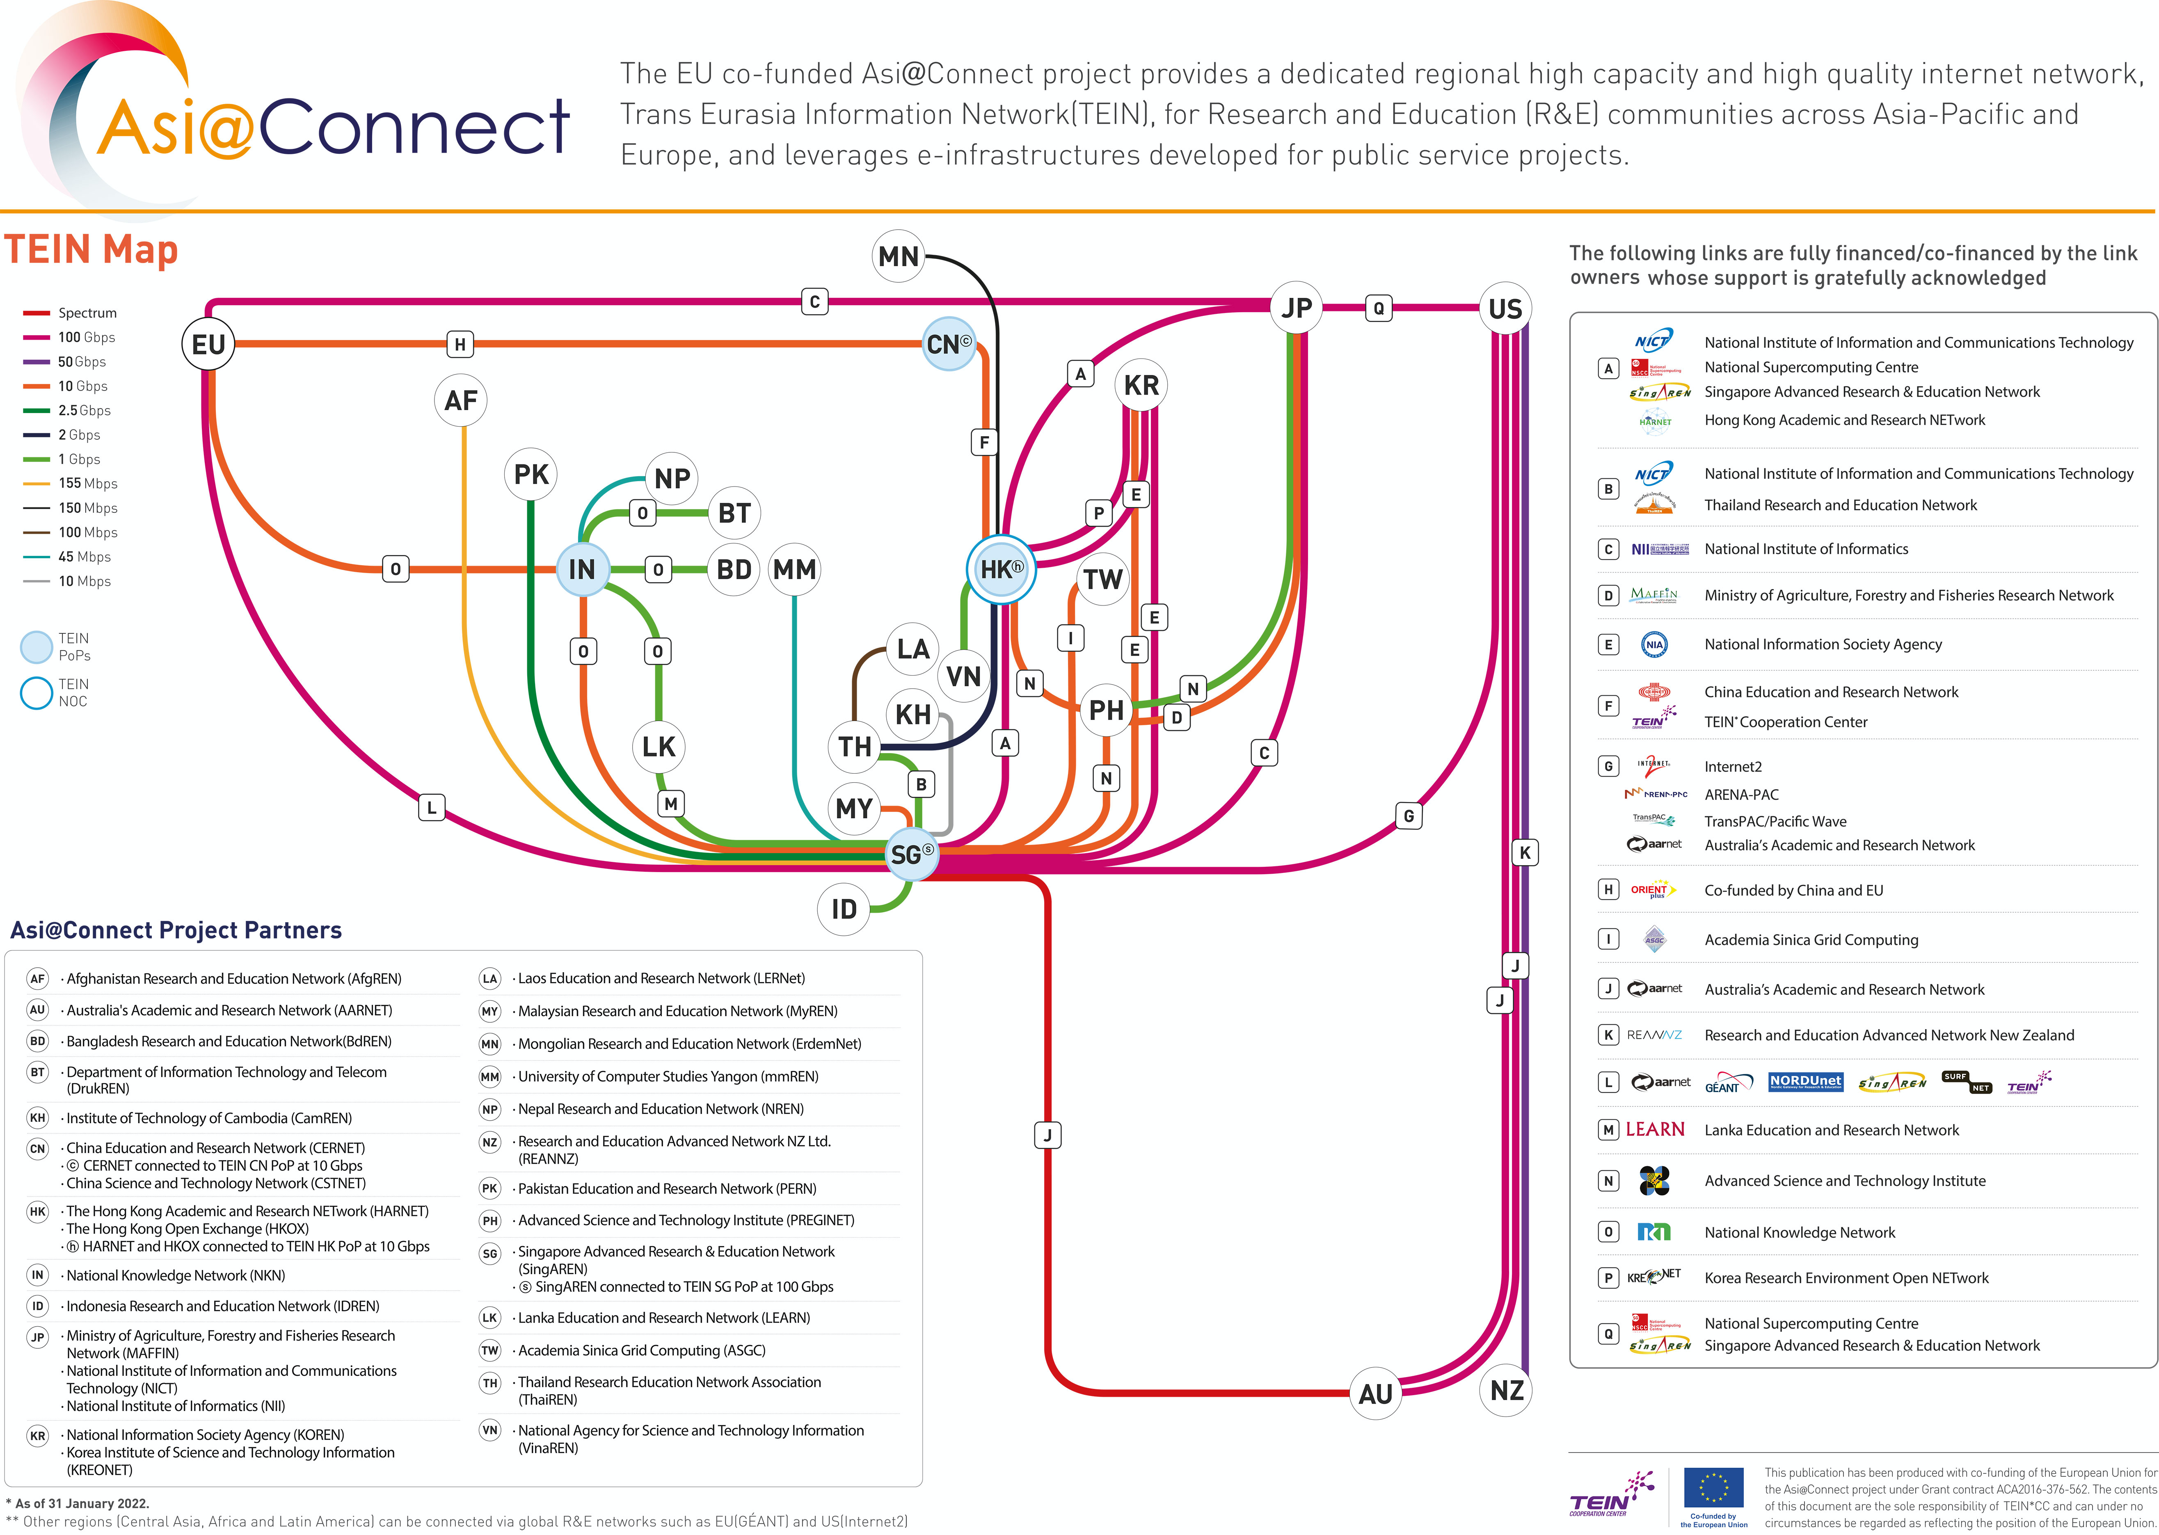

Slide 20
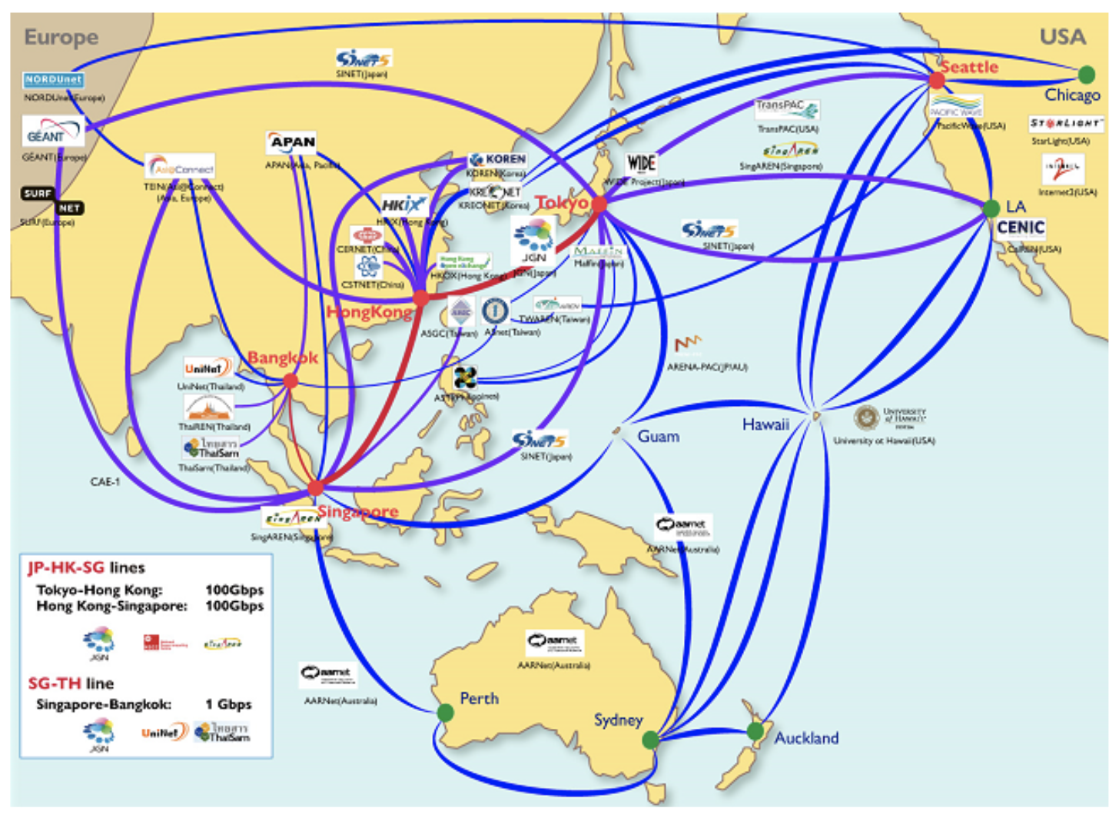
https://testbed.nict.go.jp/jgn/english/networks/index.html
JGN

Slide 21
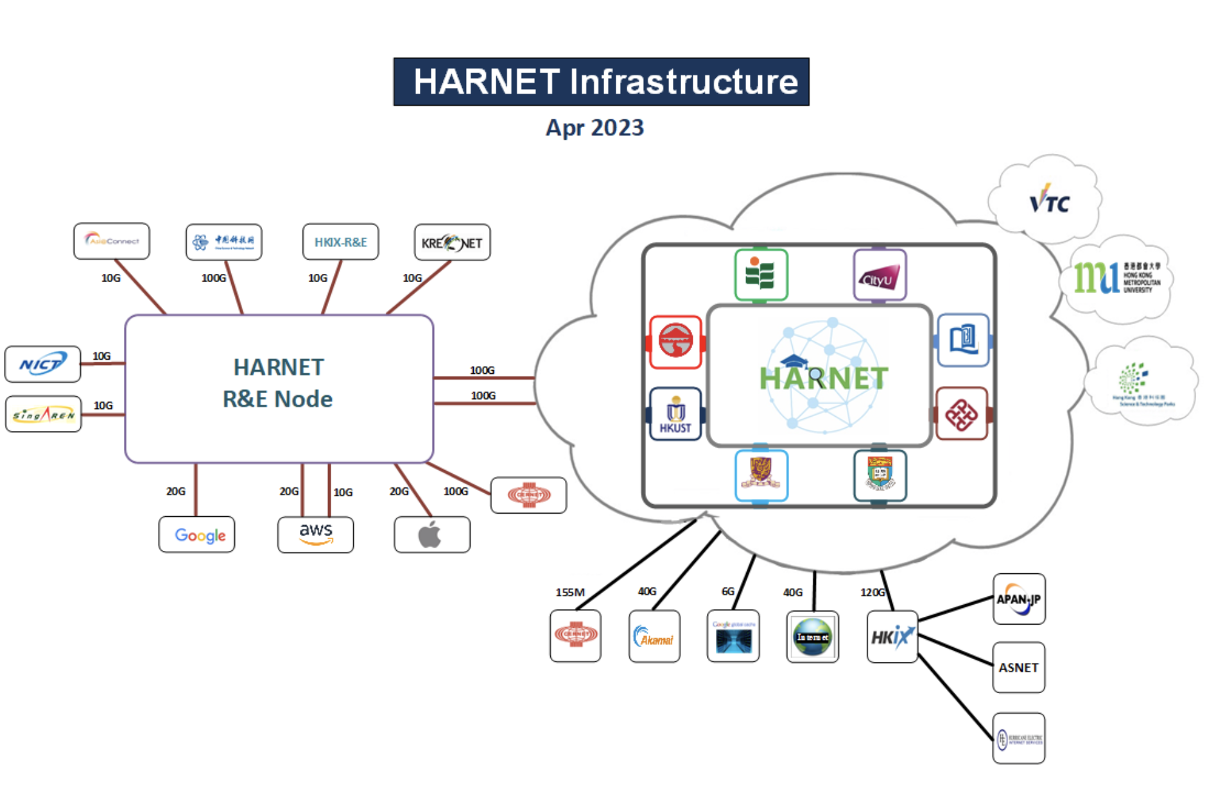
https://www.harnet.hk/about/jucc-harnet
HARNET

Slide 22

ThaiSC
Developing HPC technical Specialist to support the future expansion of the Thai digital industry.
High Performance Computing (HPC) Administrator Trainee 2 months in Thailand
Trainee abroad

Slide 23
Future plan
SUT ALICE site upgrade
  At SUT, new server support from PMB-U will be launched in 2024.
  A server contributed by the CERN donation program will be installed on the SUT site.

Slide 24
Q&A
24

Slide 25

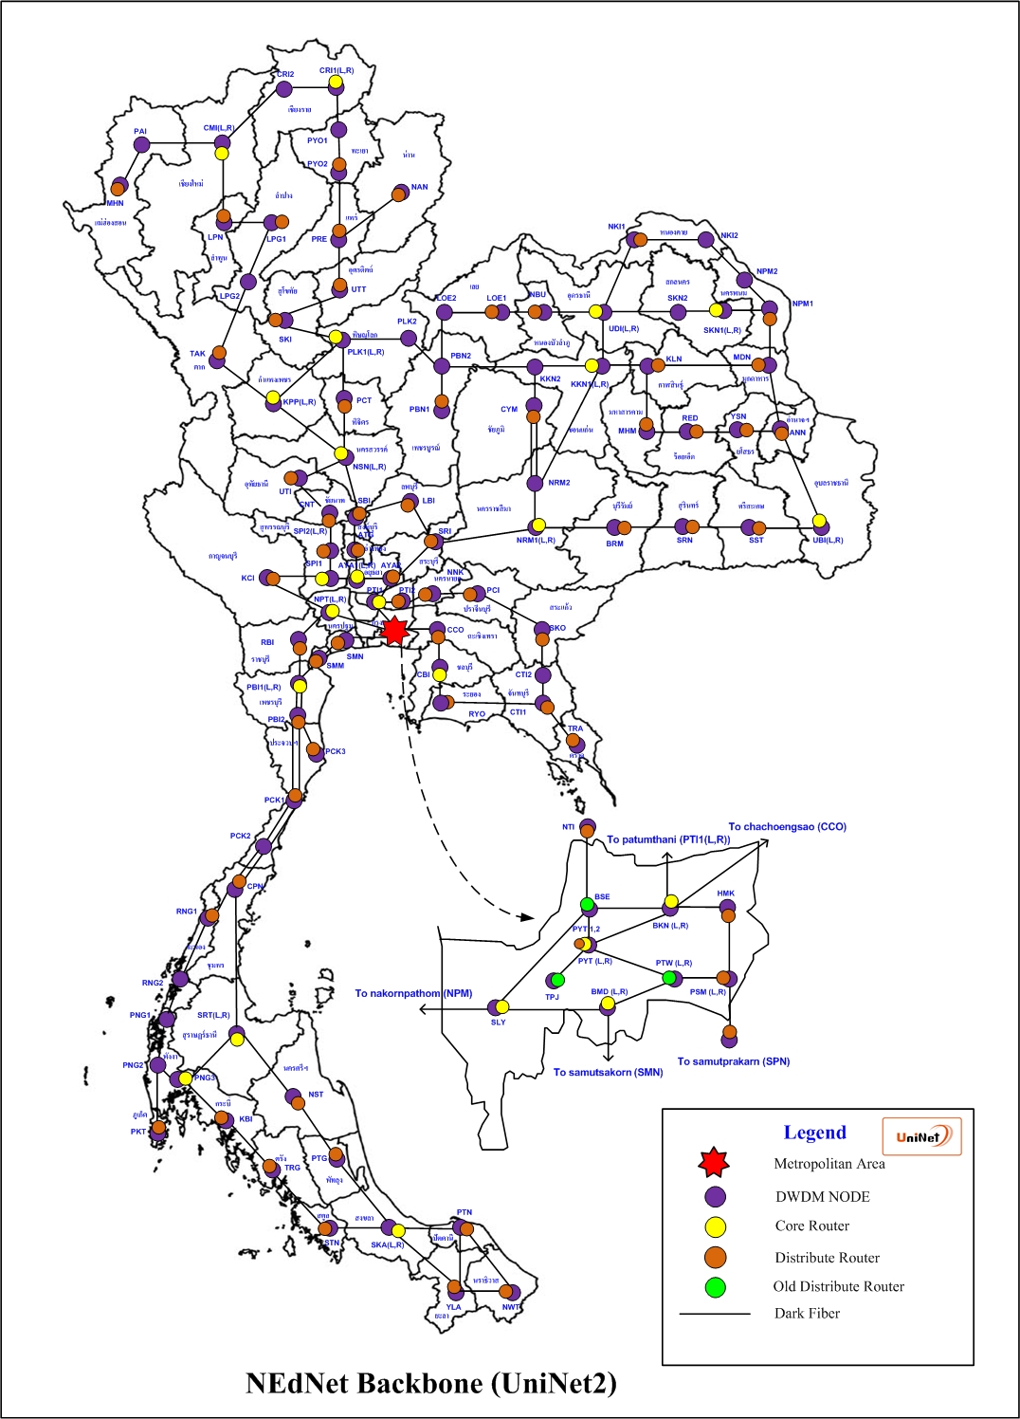
Main Backbone
  bandwidth 50 Gbps
Distribute Backbone
  bandwidth 10-20 Gbps
Support IPv4/IPv6 Dual Stack and Native
Support MPLS (L3 VRF)
Support Traffic Engineering
Support QoS

Slide 26

CAT-IIG
AS4651
CAT-NIX
AS4652
JGN/APAN
AS7660
TEIN-SG
AS24490
LERNet
AS4652
TEIN-HK
AS24489
80 Gbps
40 Gbps
1 Gbps
600 Mbps
100 Mbps
UniNet
AS4621
ThaiREN
AS24475
3 Gbps
1 Gbps
10 Gbps
20 Gbps
1 Gbps
Sym-IIG
AS132876
BKNIX
AS63529
ThaiSARN
AS3836
UniNet/ThaiREN International Peering

Slide 27


Traffic flow with MPLS-TE
1λ
5λ
KPT
PNL
KKN
5λ
5λ
MPLS-TE
5λ
1λ
5λ
NKN
1λ
NRM
5λ
10
Gb
6λ
MPLS-TE
5λ
5λ
5λ
SPI_1
AYA_1
PTI
1λ
5λ
1λ
4λ
5λ
3λ
NKM
SLA
BKN
3λ
REN NETWORK
Notes:
그림 빼고 말만(정의만)

Slide 28
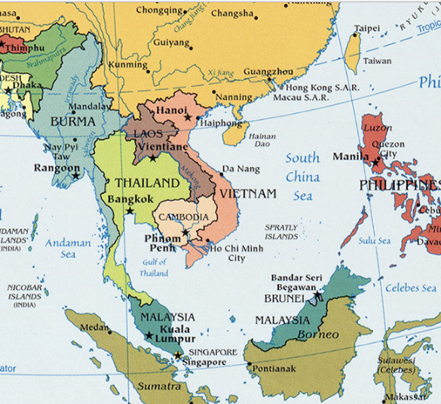
Link ThaiREN to
Singapore POP
Bandwidth : 622 Mbps
Link ThaiREN
Hong Kong POP
Bandwidth : 1000 Mbps
==================
Connectivity LHCONE
L3-VPN @ Singapore POP
L3-VPN @ Hong Kong POP

Slide 29
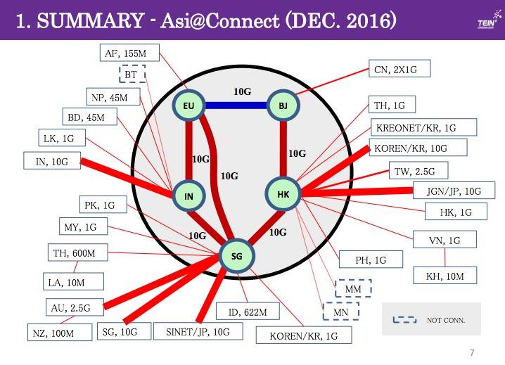
Old Peering
NEW Peering

Slide 30
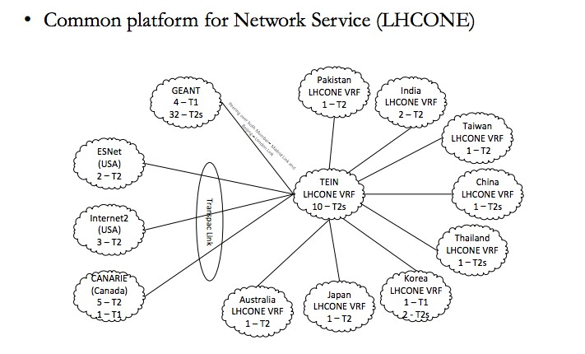
Connecting to LHCONE with
  L3-VPN @ Singapore POP
  L3-VPN @ Hong Kong POP

Slide 31
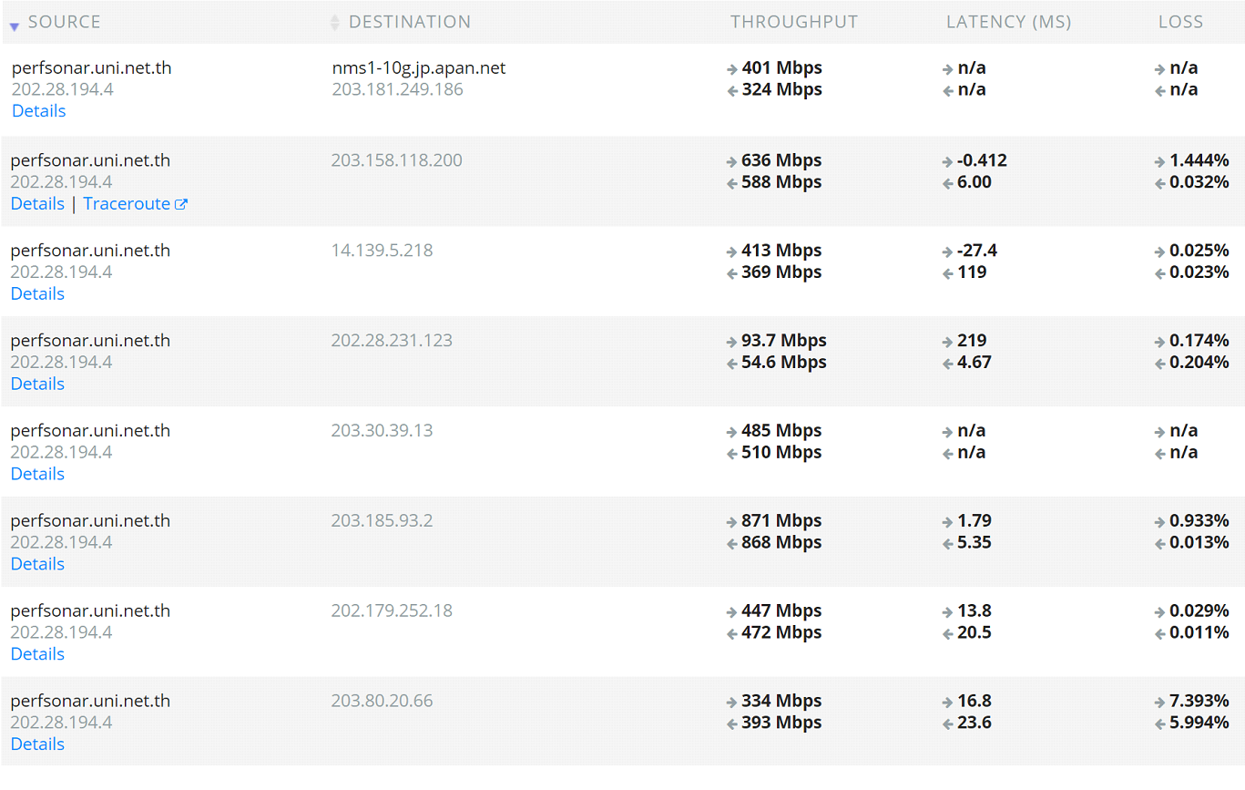
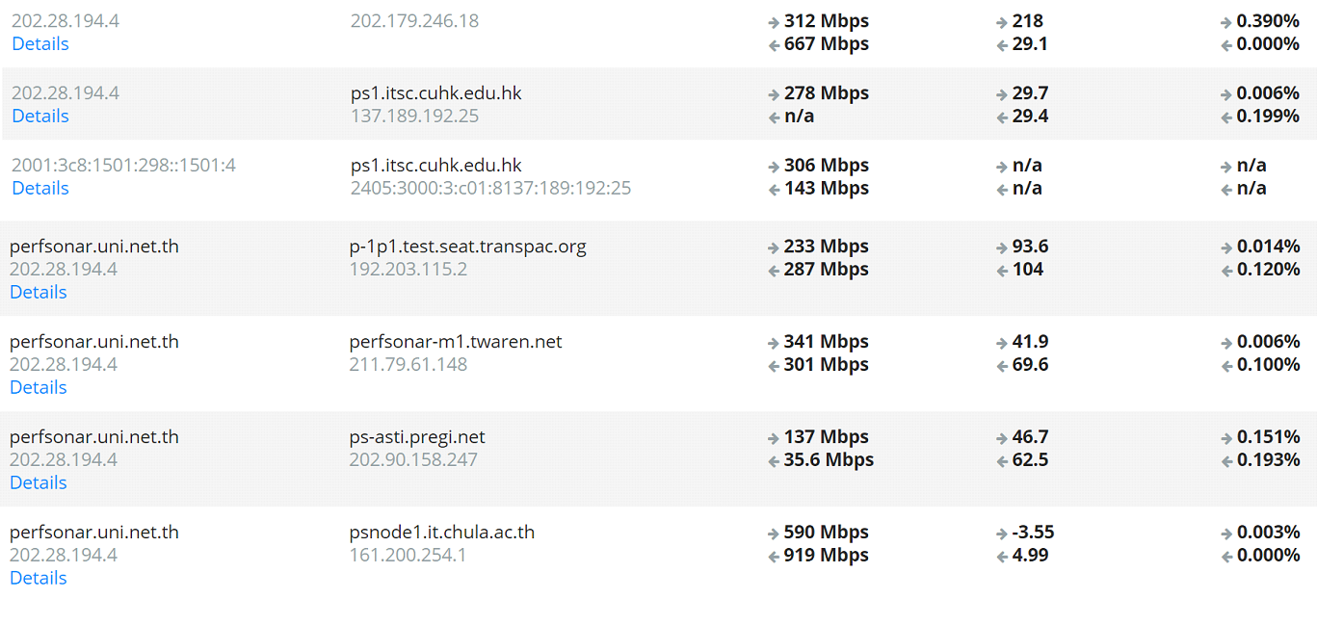
PerfsoNAR Performance Measurement

Slide 32
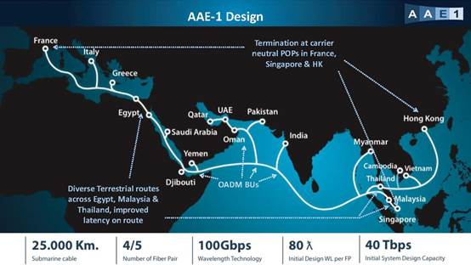
Future Network Infrastructure of Thailand
1) Asia-Africa-Europe 1 (AAE-1) is a 25,000km submarine cable from South East Asia to Europe across Egypt, connecting Hong Kong, Vietnam, Cambodia, Malaysia, Singapore, Thailand, India, Pakistan, Oman, UAE, Qatar, Yemen, Djibouti, Saudi Arabia, Egypt, Greece, Italy and France.
https://www.submarinenetworks.com/en/systems/asia-europe-africa/aae-1/aae-1-consortium-selects-xtera-for-equipping-terrestrial-segments

Slide 33

AAE-1 cable system has been finally launched for service as of June 23rd, 2017
Crossing of the Thailand peninsula to minimize the latency for the landing sites situated east of Thailand.
Main party in Thailand is

Slide 34
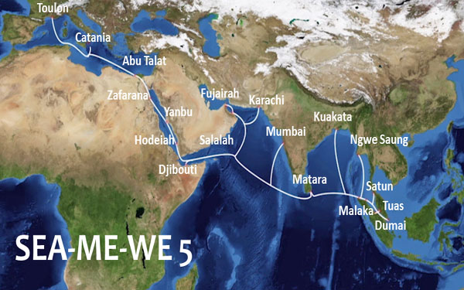
2) The Southeast Asia-Middle East-Western Europe (SEA-ME-WE 5) submarine cable system has been successfully connected to its landing station at Catania in Sicily total 20,000 km
http://www.thefinancialexpress-bd.com/2016/02/02/13555

Slide 35
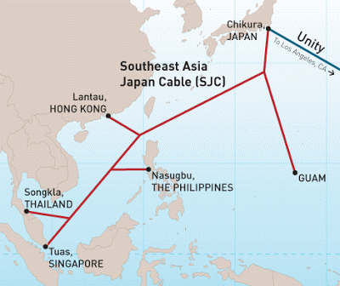
3) Southeast Asia - Japan Cable System (SJC)
Cable length: 8,900km Chikura, Japan ; Chung Hom Kok, Hong Kong ; Nasugbu,
Philippines ; Shantou, China ; Songkhla, Thailand ; Telisai, Brunei ; Tuas, Singapore
Southeast-asia Japan Cable (SJC) Plan (Source/Courtesy Telegeography)
http://soft-brain.blogspot.com/2008/09/

