Slide 1
Status of implementation of the 2023 ISAB-G recommendations; Starting the Strategy Planning process; Ad-interim organization
November 29, 2023
ISAB-G Meeting
Markus.Nordberg@cern.ch

Slide 2
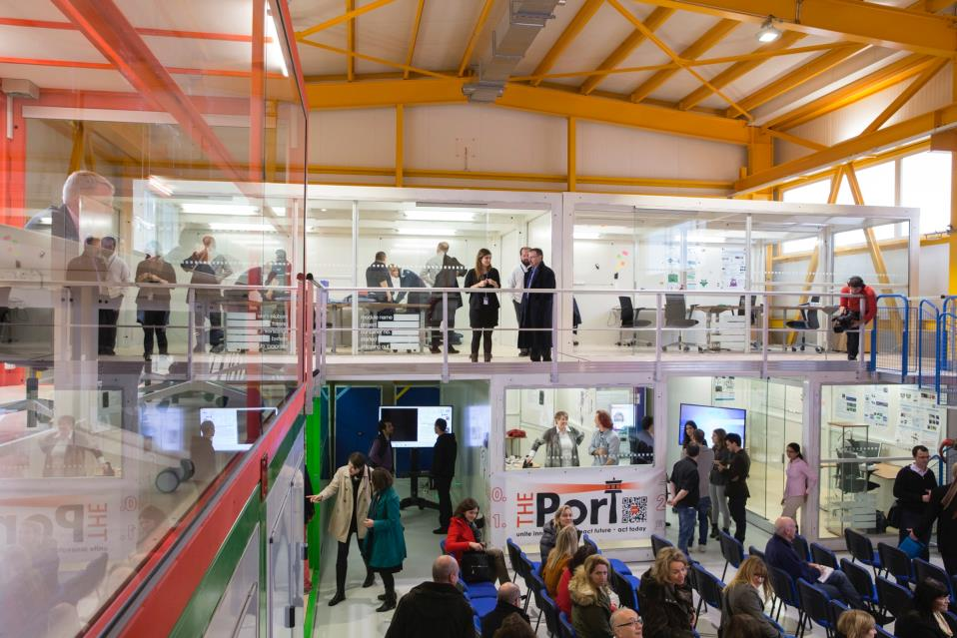

STATUS OF KEY ISAB-G 2023 RECOMMENDATIONS
Update current Strategy Plan (2021-2025) to extend up to 2030: has started (see memo)
Continue the current sharing of administrative tasks between the basic IdeaSquare operations and the EU-funded project activities: Ad-Interim organization in place (see below)
CERN management sets up modest stable long-term baseline funding that covers basic operations that cannot be funded from grants such as by the EU, and some free-running creative activities in addition to the grant-sponsored activities (e.g. ATTRACT): not yet in place
IdeaSquare works together with the CERN management to explore ways to expand the building and suggests that IdeaSquare finds a significant part of the required funding for this expansion from external parties: formal request submitted, external funding (partially) obtained
ISAB-G notes the success of the “Terra Forming” theme for CBIs. It recommends continuing with this theme and to further developing it: Well in progress (WS’s in June and November)
CIJ to increase published articles ($>$ 20/year)… and to organise training, especially for young researchers: efforts underway (e.g. L. Valtonen)

Slide 3
STATUS OF KEY ISAB-G 2023 RECOMMENDATIONS (2)
Continuing the effort to work with the EU on ATTRACT-like activities, such as Green Village, CARAT and Women in Tech, and even to intensify the collaboration with the EU on this if possible: Well in progress (4 submission planned by early 2024)
IdeaSquare continues to offer fast prototyping to CERN personnel, continues to host an internal open day (“Open Doors”) and continues to host high-level events to bring together experts from several different domains (e.g. NEB): Implemented (NEB, FPGA, Arduino, 3D printers…)
IdeaSquare explores the possibility to better involve the CERN Member States, especially those from the East and South parts of Europe, e.g., by better promoting IdeaSquare in these countries: In progress
Exploring the possibilities for a residence programme for deep tech innovation. The CERN programmes for fellowships and associateships could provide such a framework. A link could be established with the ECFA detector R&D and training programmes: In progress

Slide 4
STRATEGY PLAN 2023 – 2025 UPDATE
Key activity drivers: ATTRACT (incl. CBI), ramping up Green Village, continuing CERN-offerings (hosting R&D&I initiatives; tech courses/WSs and support to CERN people; Science Gateway offerings; SPARKS)
Key goals: Further increase/improve relevance for CERN; new Student Program in place by 2025 (“i2P”); building extension by 2025-2026
Key resources: ATTRACT, budget from CERN assured for 2023, additional income needed by 2024 (see below)
Key challenges in 2024: Completion of ATTRACT Phase-2 Projects; ramping up ATTRACT P-1B; ramping up i2p-Pilot modules, ramping up Green Village projects (expecting EU-funding)

Slide 5
EVOLUTION OF i2 ACTIVITIES
Since 2015, 2100+ students have been trained by i2 (plus another 800 in the UK)

Slide 6
i2 UPDATED BUDGET PLAN UP to ‘25, kCHF
Note: This draft Plan assumes: ATTRACT ends in early 2025; no new EU-income. To be updated for January!

Slide 7
Ad-Interim IdeaSquare Internal Organization (in IPT). Effective until June, 2024
C. Hartley (IPT DL)
P. Tello (IPT-EU-PI)
R. Pennings
P. Tello
EU-Funded Activities (ATTRACT, Green Village etc.)
Student Program (CBI)
Comms (i2)
Project Mgmt
CIJ Journal
Admin, Project Mgmt
Admin
CERN-Funded Activities
Events, Workshops
Student Programs
Comms (i2)
Green Village
Science Gateway
Admin (i2; incl. GRADE & GV)
Other Activities (Ext. Funding)
Exec Mgmt
Admin
Exec Mgmt
Note: This Diagram shows the supervision of Teams.

Slide 8
AD-INTERIM SHARING OF PRIMARY TASKS AT i2

Slide 9
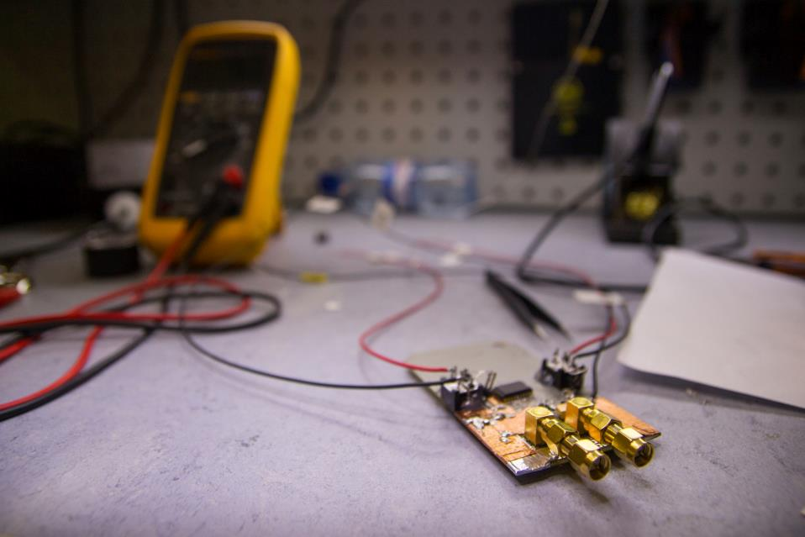
CONCLUSIONS
i2 activities in 2023 have progressed well along the Strategy Plan
Over 2100 students have been trained so far by i2 personnel
Primary focus is in 2024 in ATTRACT Phase 2, 1B and Green Village initiatives. 2024+ CERN budgets need still to be secured
Increasing activities at i2 necessitate to extend the current building by ca 400m² by 2025-26. Formal request has been submitted

