Slide 1
Update: Science Gateway Education
TSF 21 March 2023 | sciencegateway.education@cern.ch

Slide 2
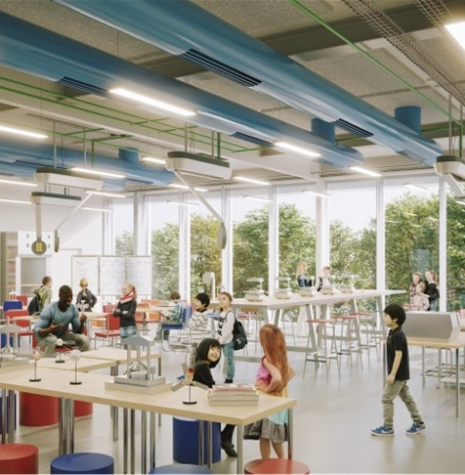
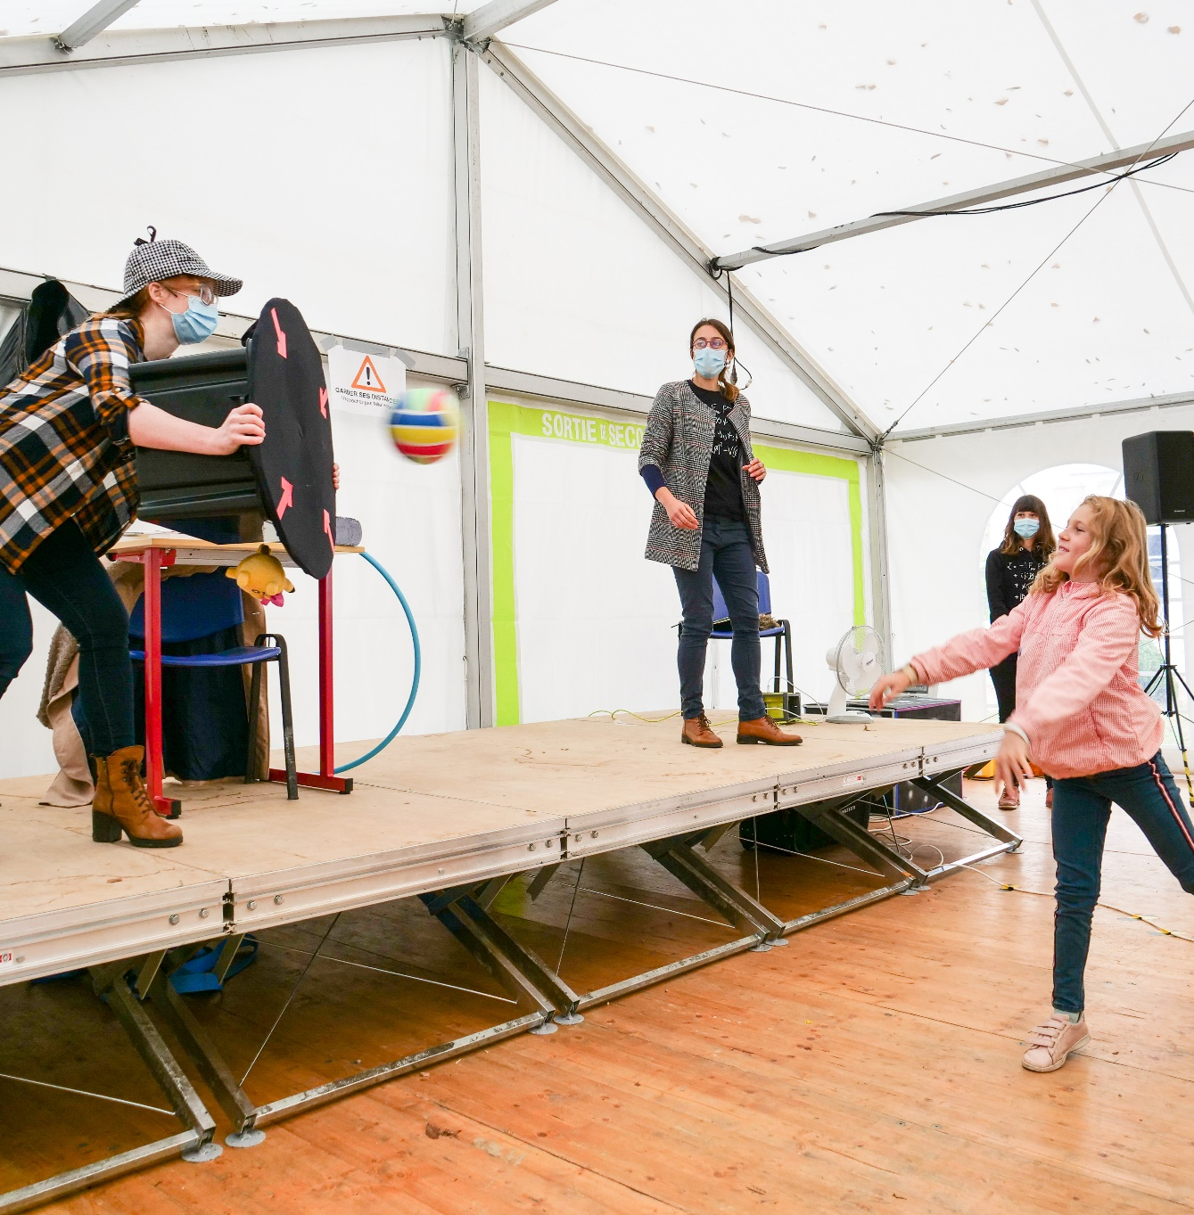
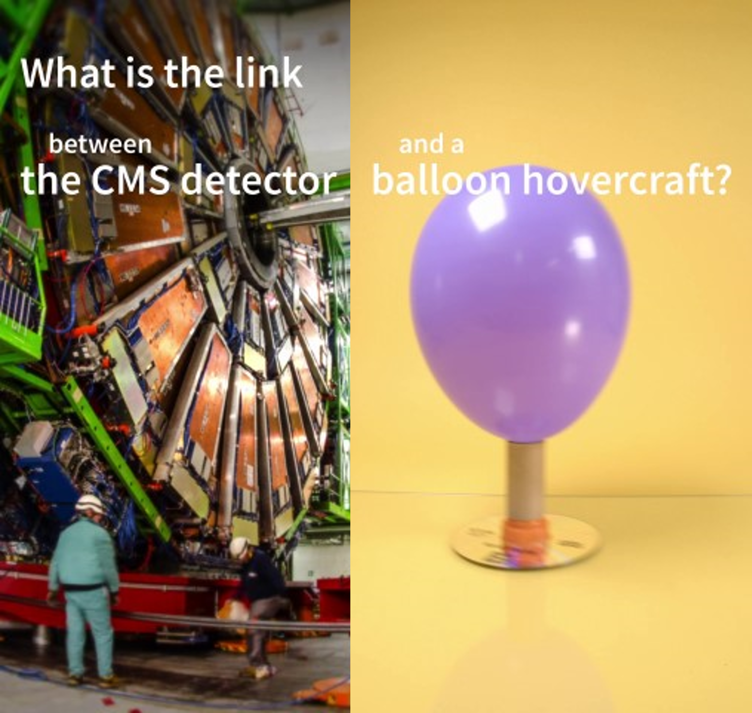

Science Gateway Education
Labs
Discover your inner scientist
Science Shows
Explore the stories of discoveries
Online Learning
Engage online to find out more
Notes:
Science Gateway will offer different education activities – each with a unique education potential:

Slide 3
Science Gateway Education
Labs
Discover your inner scientist
Science Shows
Explore the stories of discoveries
Online Learning
Engage online to find out more

Slide 4
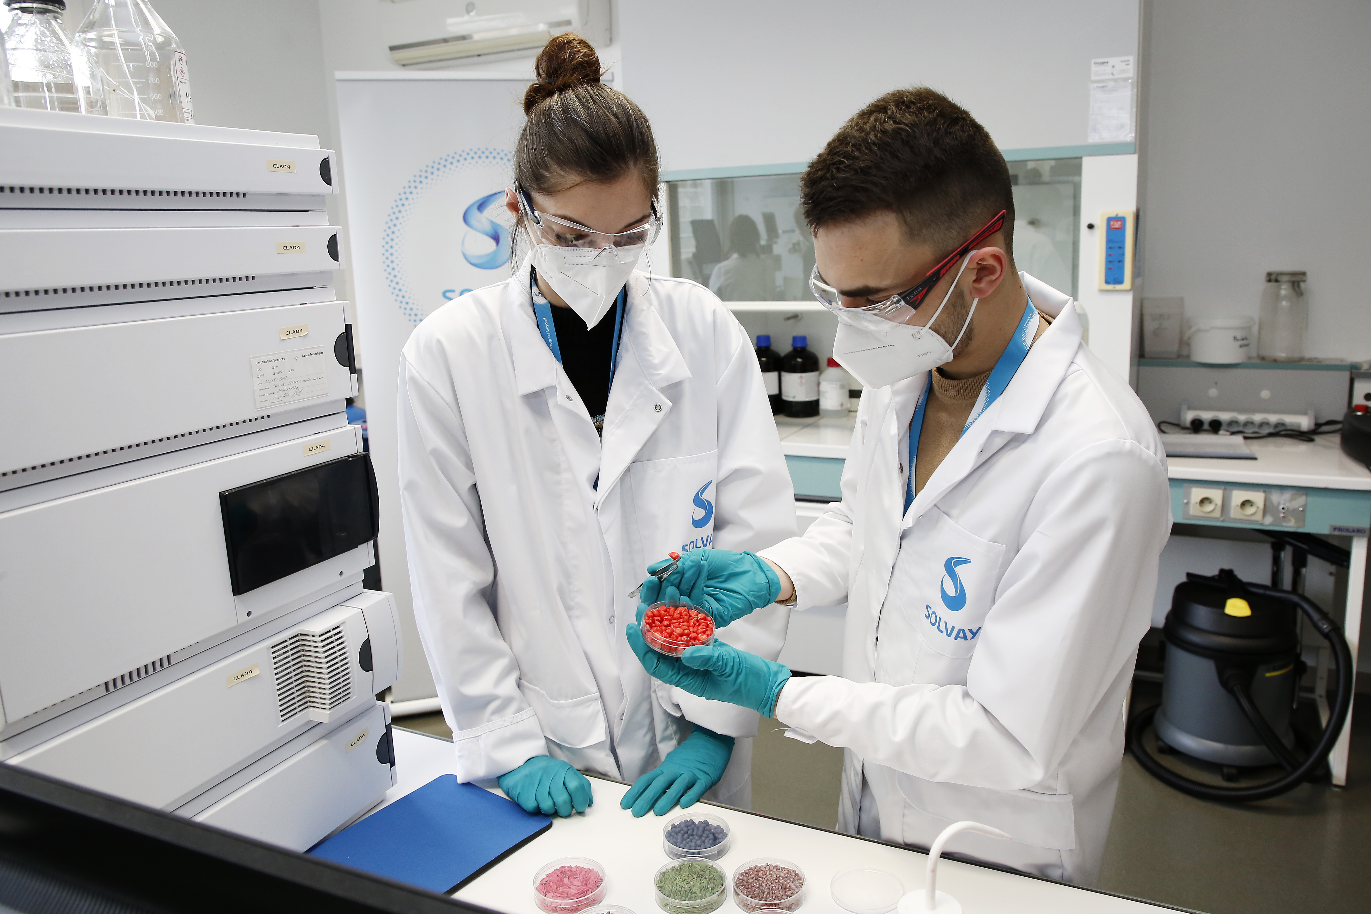

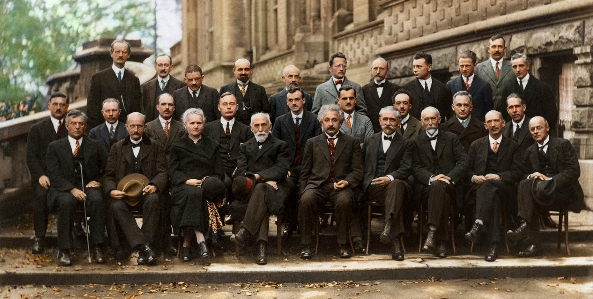
CERN-Solvay Education Programme
level 1
DIY experiments videos for social media
Reach: 10⁶ views per year via CERN channels
level 2
Online physics course for high-school students
level 3
CERN-Solvay student camps for high-school students
Reach: 10² participants in total from around the world
Goal: to develop interest in STEM
Goal: to build confidence & transform STEM interest
Goal: to trigger STEM interest
Reach: 10⁴ participants per year from around the world

Slide 5
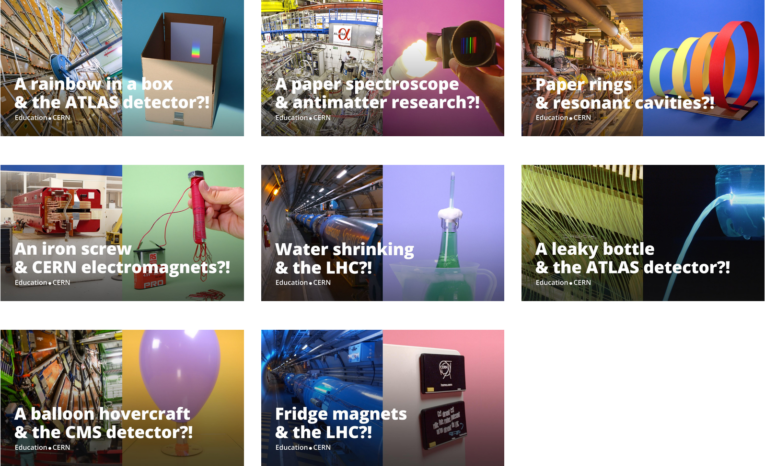
Level 1: DIY experiments videos
cern.ch/solvay-education-programme/diy-experiments-videos
Notes:
Connecting concept
DIY experiment
CERN experiment
Thermal dilation
DIY thermometer: thermal expansion of water in bottle + straw
Thermal contraction of LHC by 81m upon first cooldown
Magnetic permeability
Iron guides magnetic field lines: paperclips attracted to magnet fall when iron knife is inserted in between
Magnetic yokes of CMS, ALICE, dipoles, SC, but not ATLAS
Resonance
Multiple connected pendula, but you can make only one of them move by rocking all of them at its resonant frequency: buildup of mechanical energy
RF cavities: buildup of electromagnetic energy at the frequency set by the shape
Spectroscopy
DIY spectrograph
ALPHA: antihydrogen spectroscopy

Slide 6
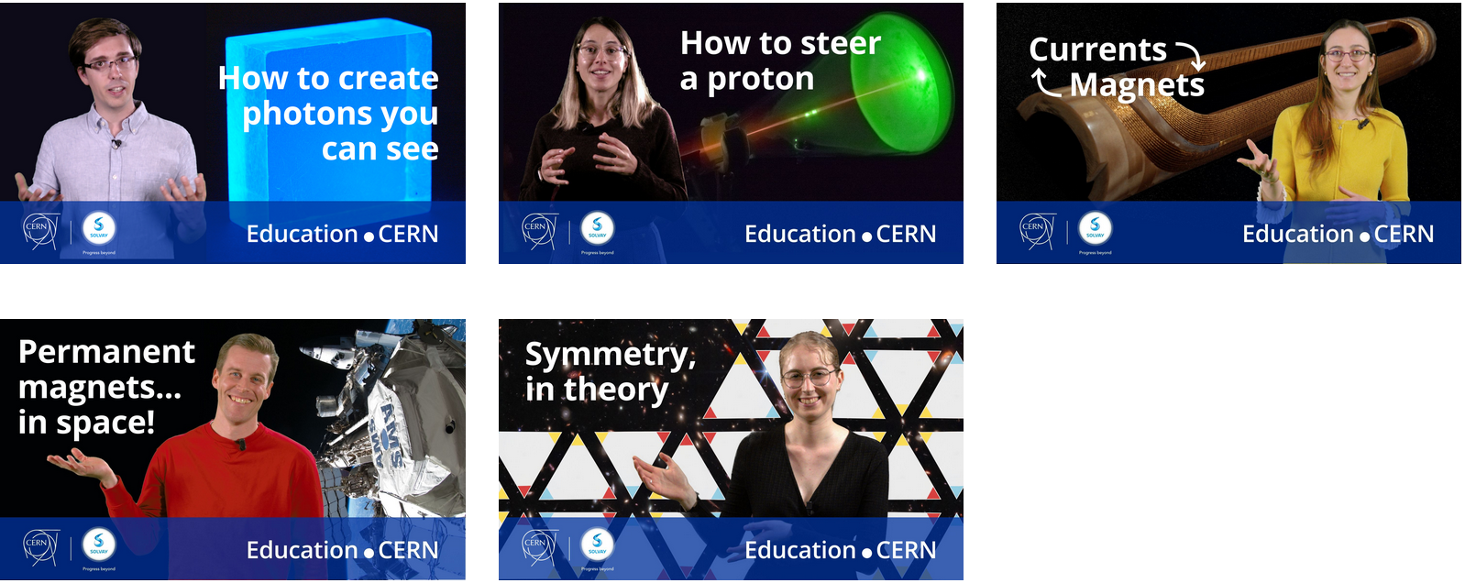
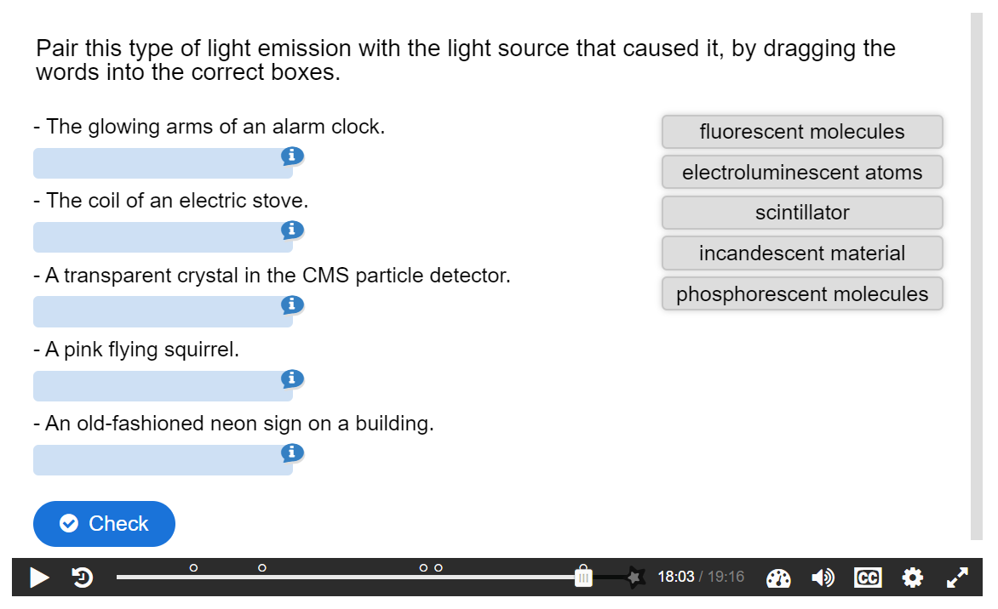
Level 2: Online physics course
cern.ch/solvay-education-programme/online-course
Next:
Phase transitions
Superconductivity & superfluidity
Notes:
Phase transitions
Early particle physicists used cloud chambers to reveal particles coming from the sky. In this video, we don't really care about identifying particles from their tracks. We use a cloud chamber as a playground to study phase transitions. Sublimation of dry ice into CO₂ gas. Condensation of isopropanol from vapor to liquid droplets. Deposition of water into frost. Plasma in fluorescent tube lighting up the chamber… Latent heat: why does T remain constant during a phase transition? Metastable states: supersaturated vapour. First vs. second-order phase transitions: critical point.
Superconductivity, superfluidity
Previously, phase transitions linked to the position of the atoms or molecules in space. In the LHC magnets, macroscopic quantum phase transitions linked to changes in the electronic configurations. Superconductivity of the Nb₃Ti / NbSn cables, superfluidity of liquid He in the cryogenic system. SC = zero resistance / perfect conductor below critical temperature AND super-diamagnetic material / material exhibiting the Meissner effect. Type I vs. type II. SF = zero viscosity below critical temperature. Infinite vortices, flows through bottom of containers and creeps up walls.

Slide 7
Video views
#CERNSolvayEducation
level 1
level 2
level 3

Slide 8
Video views
#CERNSolvayEducation
level 1
level 2
level 3

Slide 9
YouTube retention score for course videos
Average percentage viewed
30.6
28.1
22.2
24.9
ⓘ Compared to other videos shows your video's audience retention compared to all YouTube videos of similar length.

Slide 10
Online course: user data
(31 March 2023)
1402 non-CERN users
868 certificates delivered
61.9 % course completion rate

Slide 11
Online course: video data
(31 March 2023)
 | Students who submitted answers | Students who passed | Success ratio (%)
Luminescence | 936 | 907 | 96.9
Electromagnetism | 962 | 901 | 93.7
Currents & magnets | 880 | 857 | 97.4
Permanent magnets | 320 | 306 | 95.6
*
*
The video was published on 01/11/22 and the statistics began on 30/11/22,
so there is approximately one month without stats for this value.

Slide 12
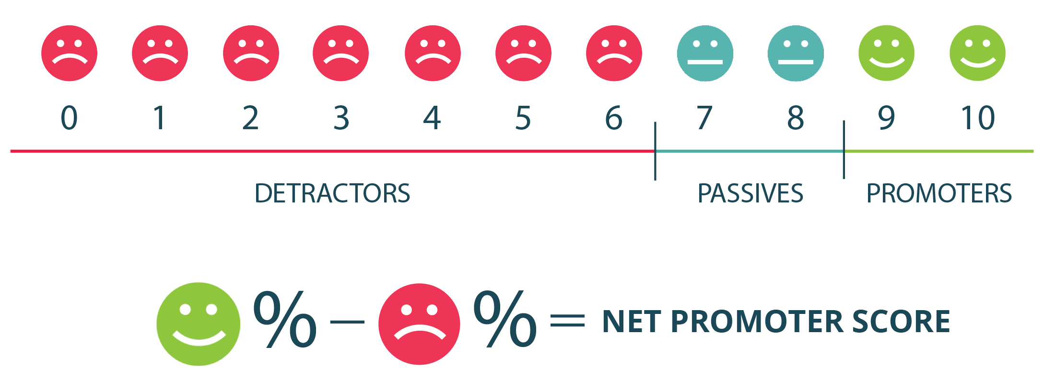
Online course: feedback
(31 March 2023)

Slide 13
Online course: feedback
(31 March 2023)
Completely agree
Agree
Agree a little
Disagree a little
Disagree
Completely disagree

Slide 14
Level 3: CERN-Solvay student camp

Slide 15
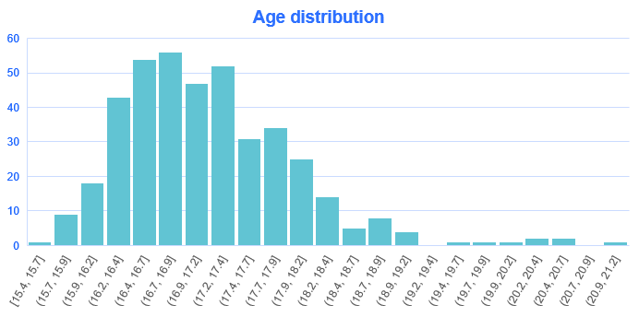
Student camp: application data
797 applications in the system
607 completed, 190 drafts

Slide 16
Student camp: application data
Students | Countries
77 | Türkiye
73 | Italy
48 | Spain
32 | France
31 | India
28 | Bulgaria
27 | Poland
23 | Portugal
21 | Germany
20 | Brazil
19 | Cyprus, Romania, Greece
17 | United States
13 | United Kingdom
12 | Slovakia
11 | Australia
8 | Slovenia, Serbia
6 | Pakistan, Croatia
5 | Ireland, Switzerland
4 | Czechia, Canada, China, Egypt, Hungary, Argentina, Belgium
3 | Lebanon, Costa Rica, Finland, Georgia, Mexico
2 | Russia, Japan, Austria, North Macedonia, Latvia, Bangladesh, Sri Lanka, Sweden
1 | Cuba, Vietnam, Colombia, Hong Kong SAR China, Morocco, South Africa, Bosnia & Herzegovina, Liechtenstein, Montenegro, Estonia, Azerbaijan, Belarus, Netherlands, Norway, Denmark, Syria, Bolivia, Thailand, Albania, Moldova
607 | Grand total

Slide 17
Student camp: application data

Slide 18
Selection process
Female | Australia
Male | Brazil
Female | Bulgaria
Female | Canada + Taiwan
Female | China
Female | Cyprus
Female | Finland
Female | France
Female | France + UK
Female | Georgia
Male | Germany + Turkey
Male | Greece
Male | India
Male | Ireland
Male | Italy
Male | Latvia
Female | Morocco
Male | Netherlands
Female | Norway + Mexico
Male | Pakistan
Male | Poland
Male | Portugal
Female | Romania
Male | Serbia + Croatia
Female | Slovakia
Male | Slovenia
Male | Spain
Female | Türkiye
Female | United Kingdom
Female | United States
Review of all applications by CERN volunteers based on pre-defined rating criteria
  motivation statements + video
Evaluation of top 5-10 per country (about 100 in total) by core team
  Reviewing all information including reference letter(s), grade reports, …
  1 student per country, max. 2
Final selection: 16 female, 14 male,
32 nationalities, 13 travel grants – all extremely happy to be at CERN ☺

Slide 19
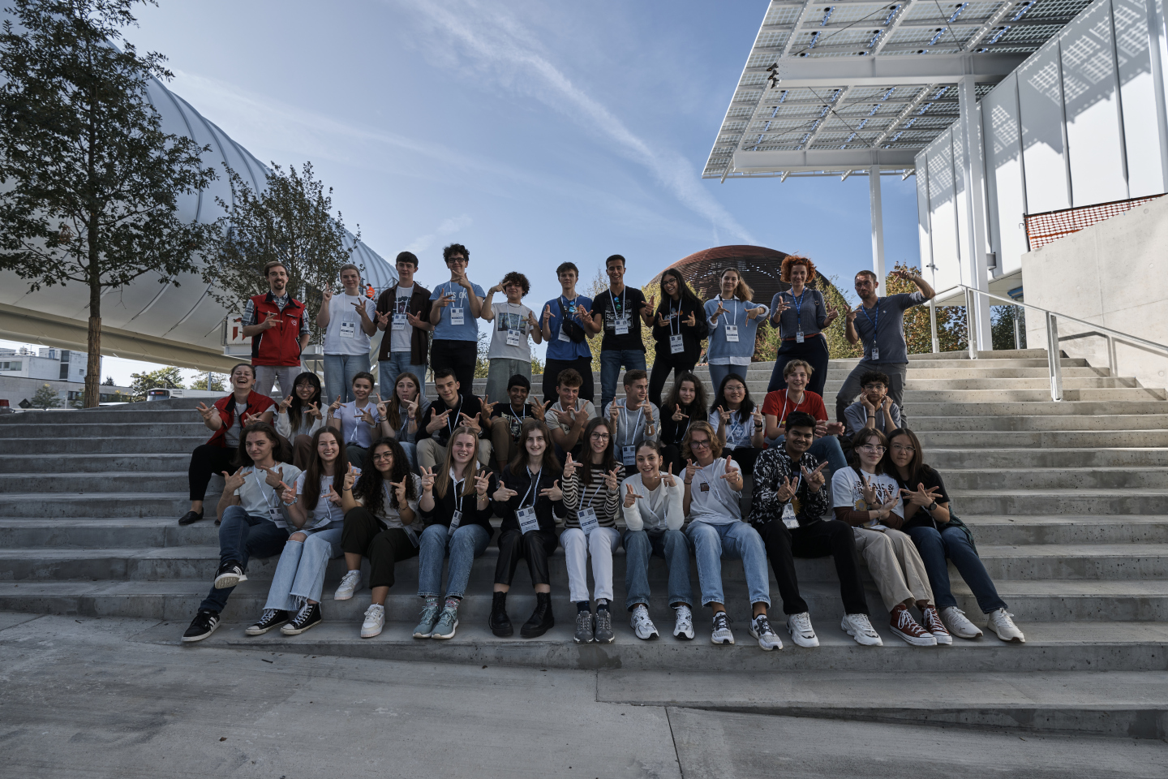

Slide 20
Camp 2 & 3
The second camp will take place in June 2024, with an application period from December 2023 to January 2024.
The third camp will take place in October 2024.
Please help us promote this opportunity!

Slide 21
Science Gateway Education
Labs
Discover your inner scientist
Science Shows
Explore the stories of discoveries
Online Learning
Engage online to find out more

Slide 22

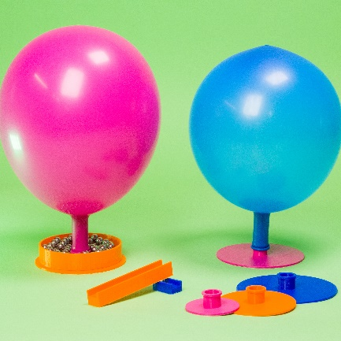
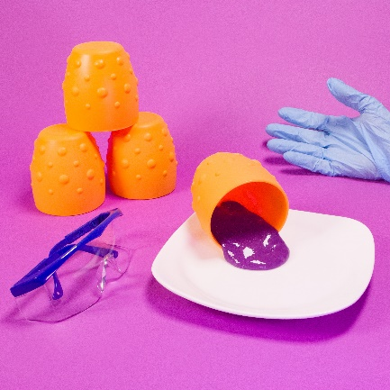
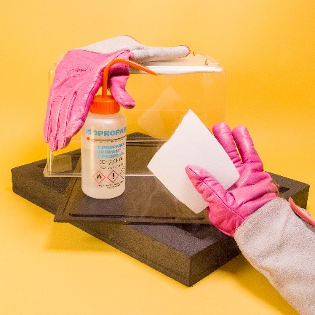
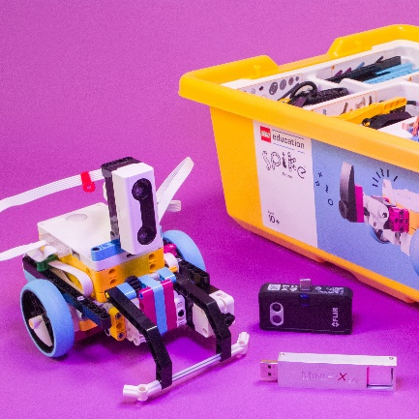
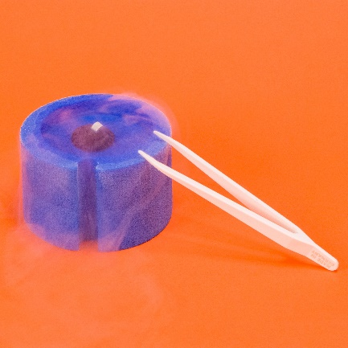
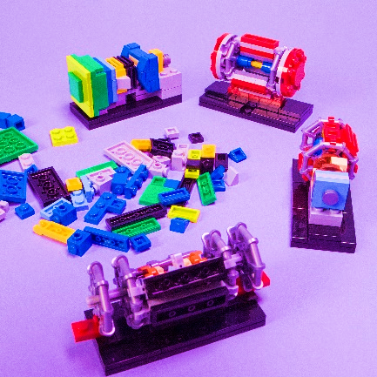
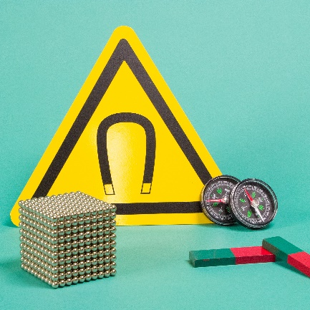
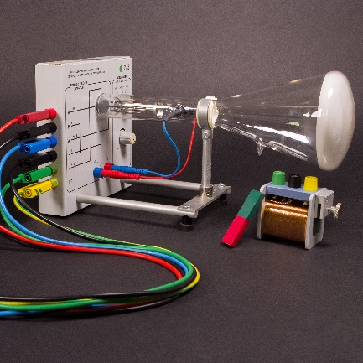
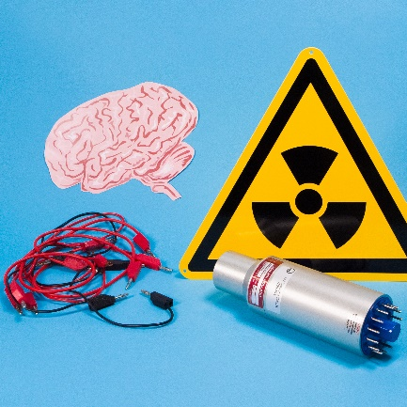
Status
Almost ready for inauguration?!
https://visit.cern/group-bookings as central entry point for booking guided tours, lab workshops and exhibitions for groups
99% of slots for school groups booked, booking possible 9 months in advance
Individual visitors can register for „open lab workshops“ once they arrive on site

Slide 23
Science Gateway Education
Labs
Discover your inner scientist
Science Shows
Explore the stories of discoveries
Online Learning
Engage online to find out more

Slide 24

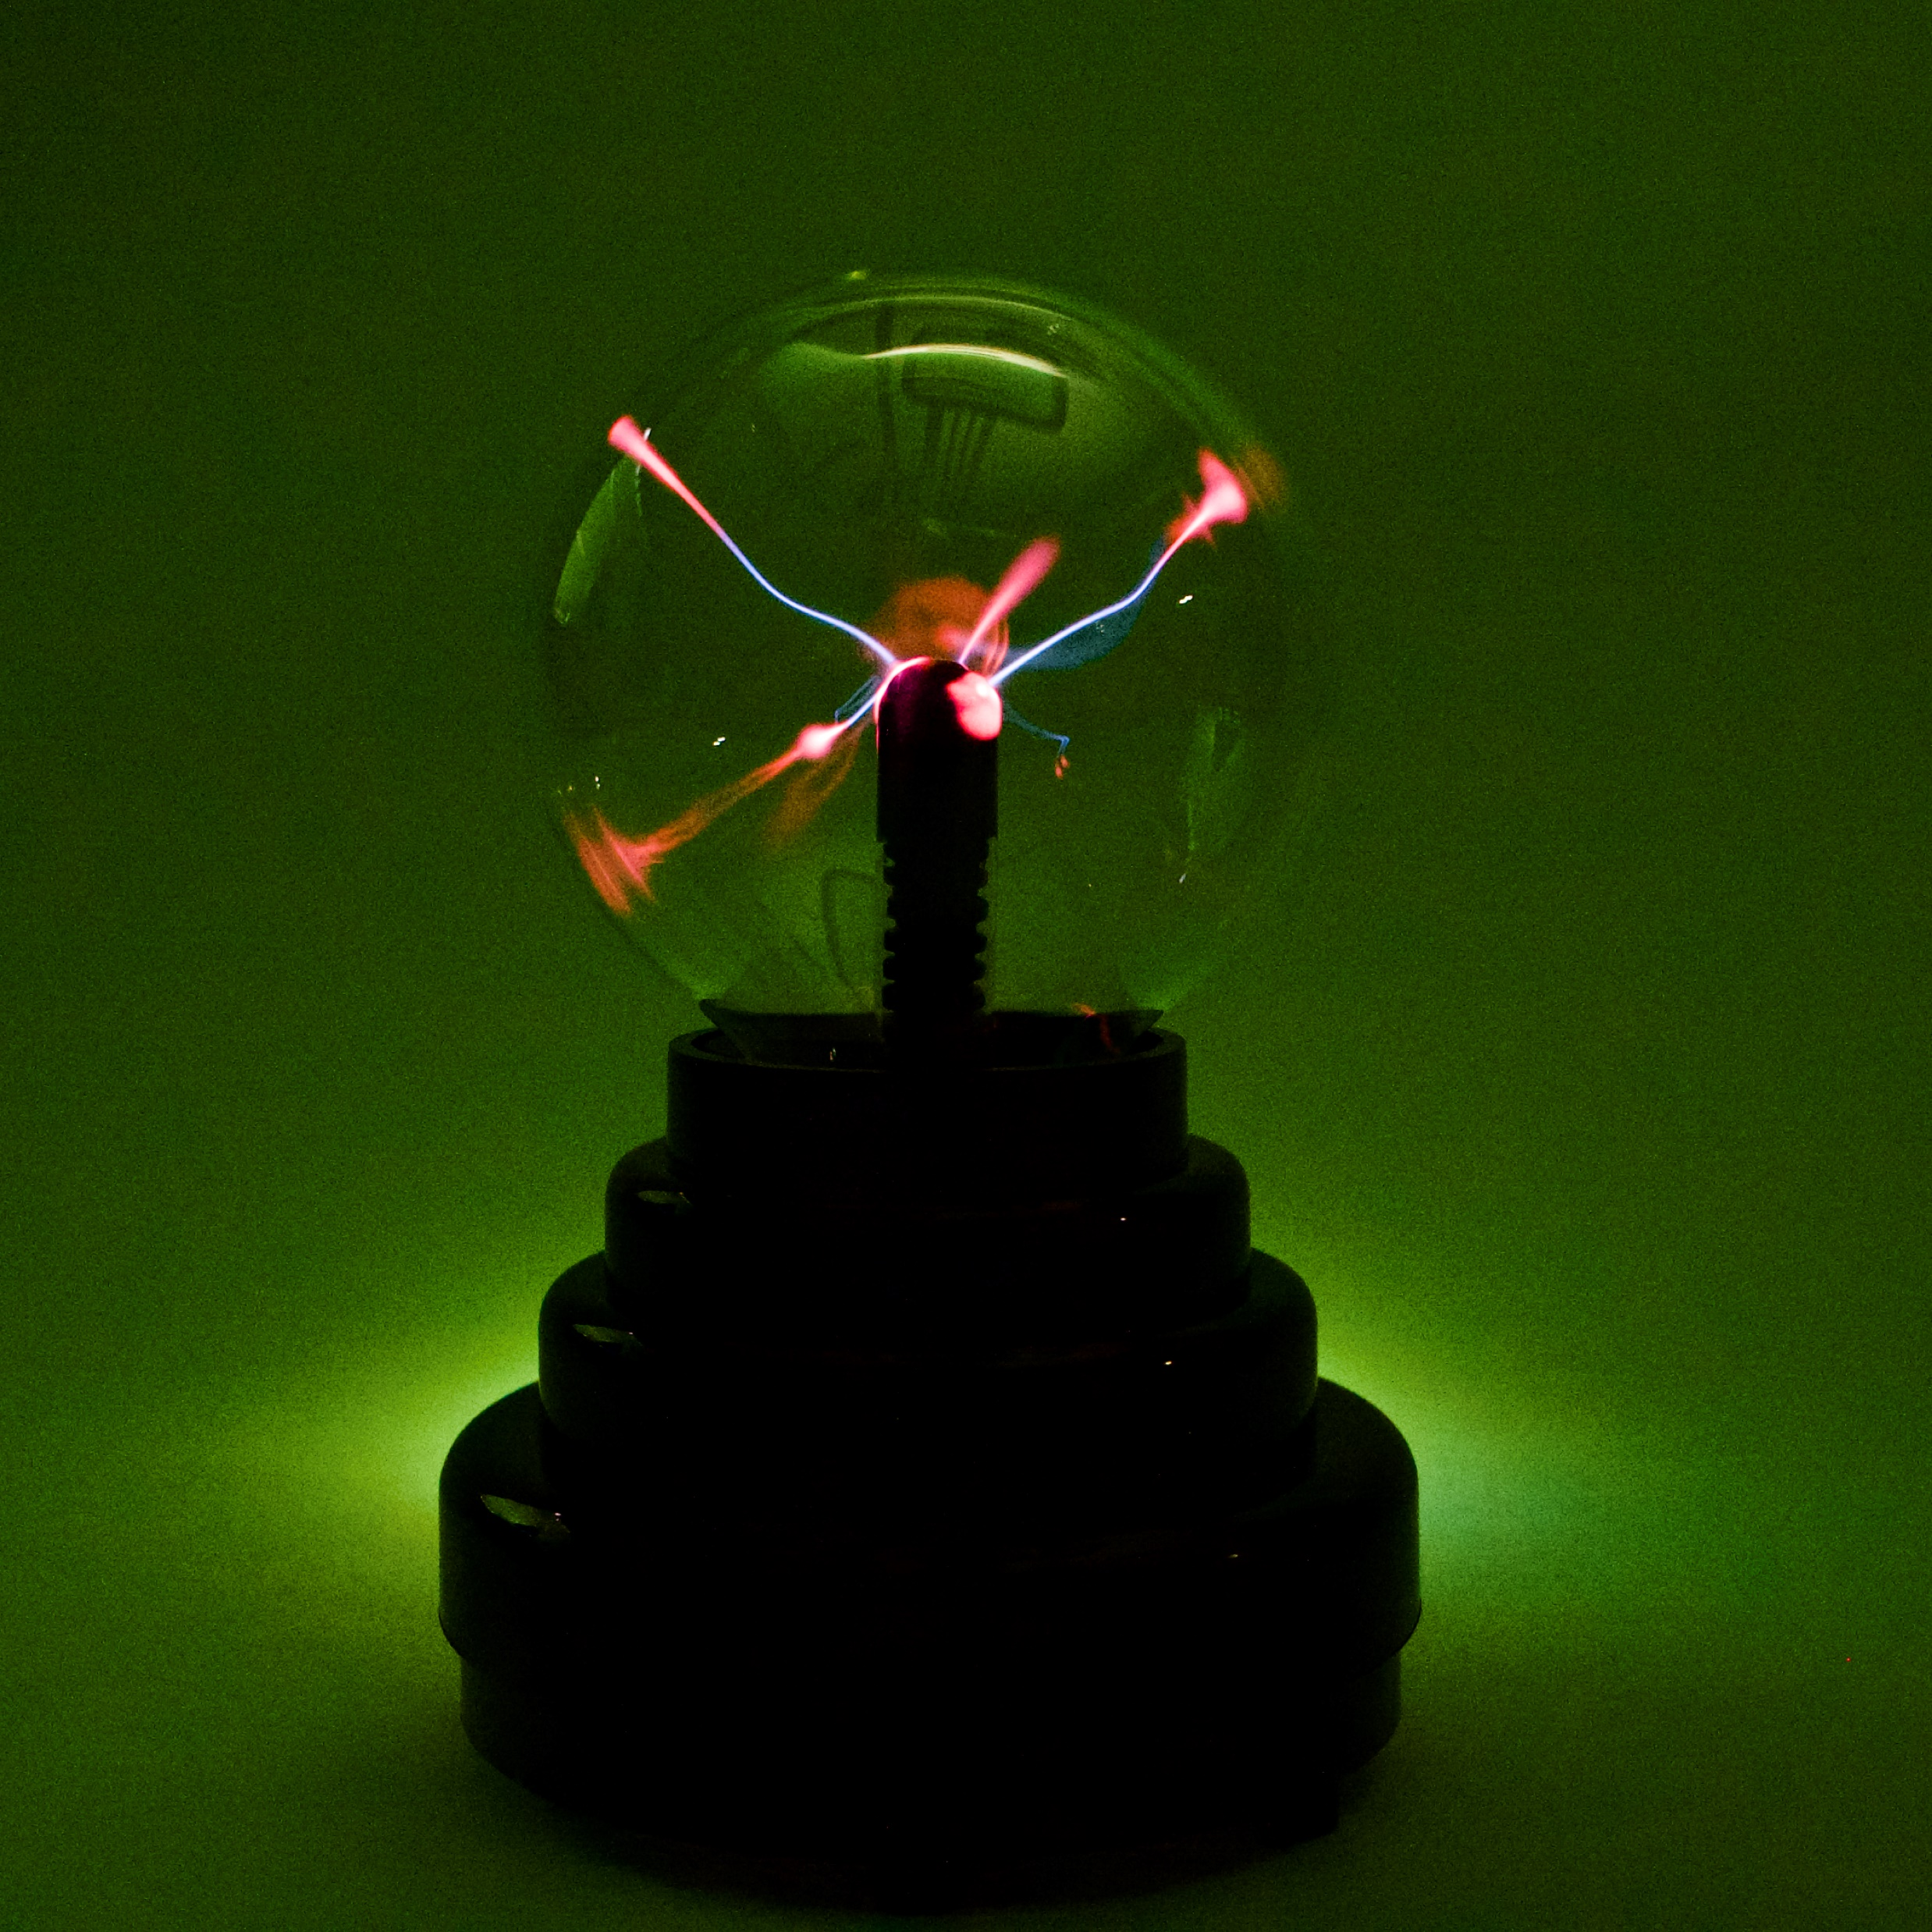
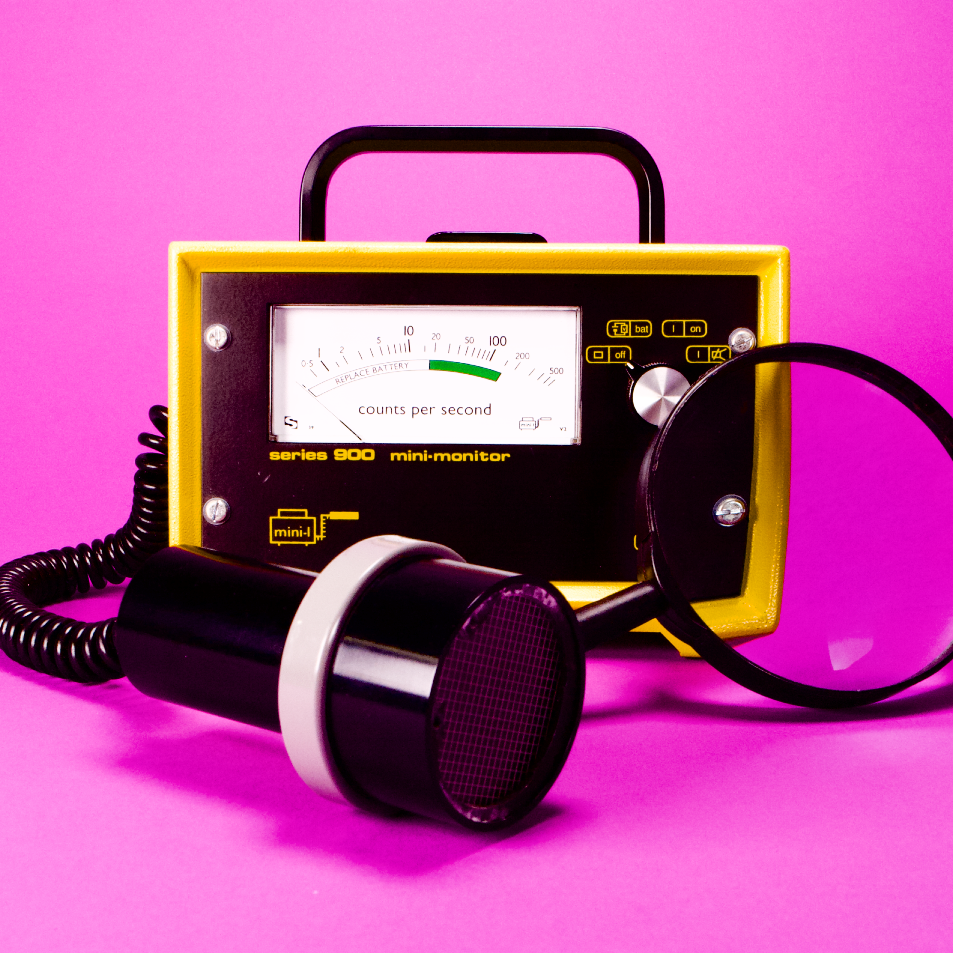
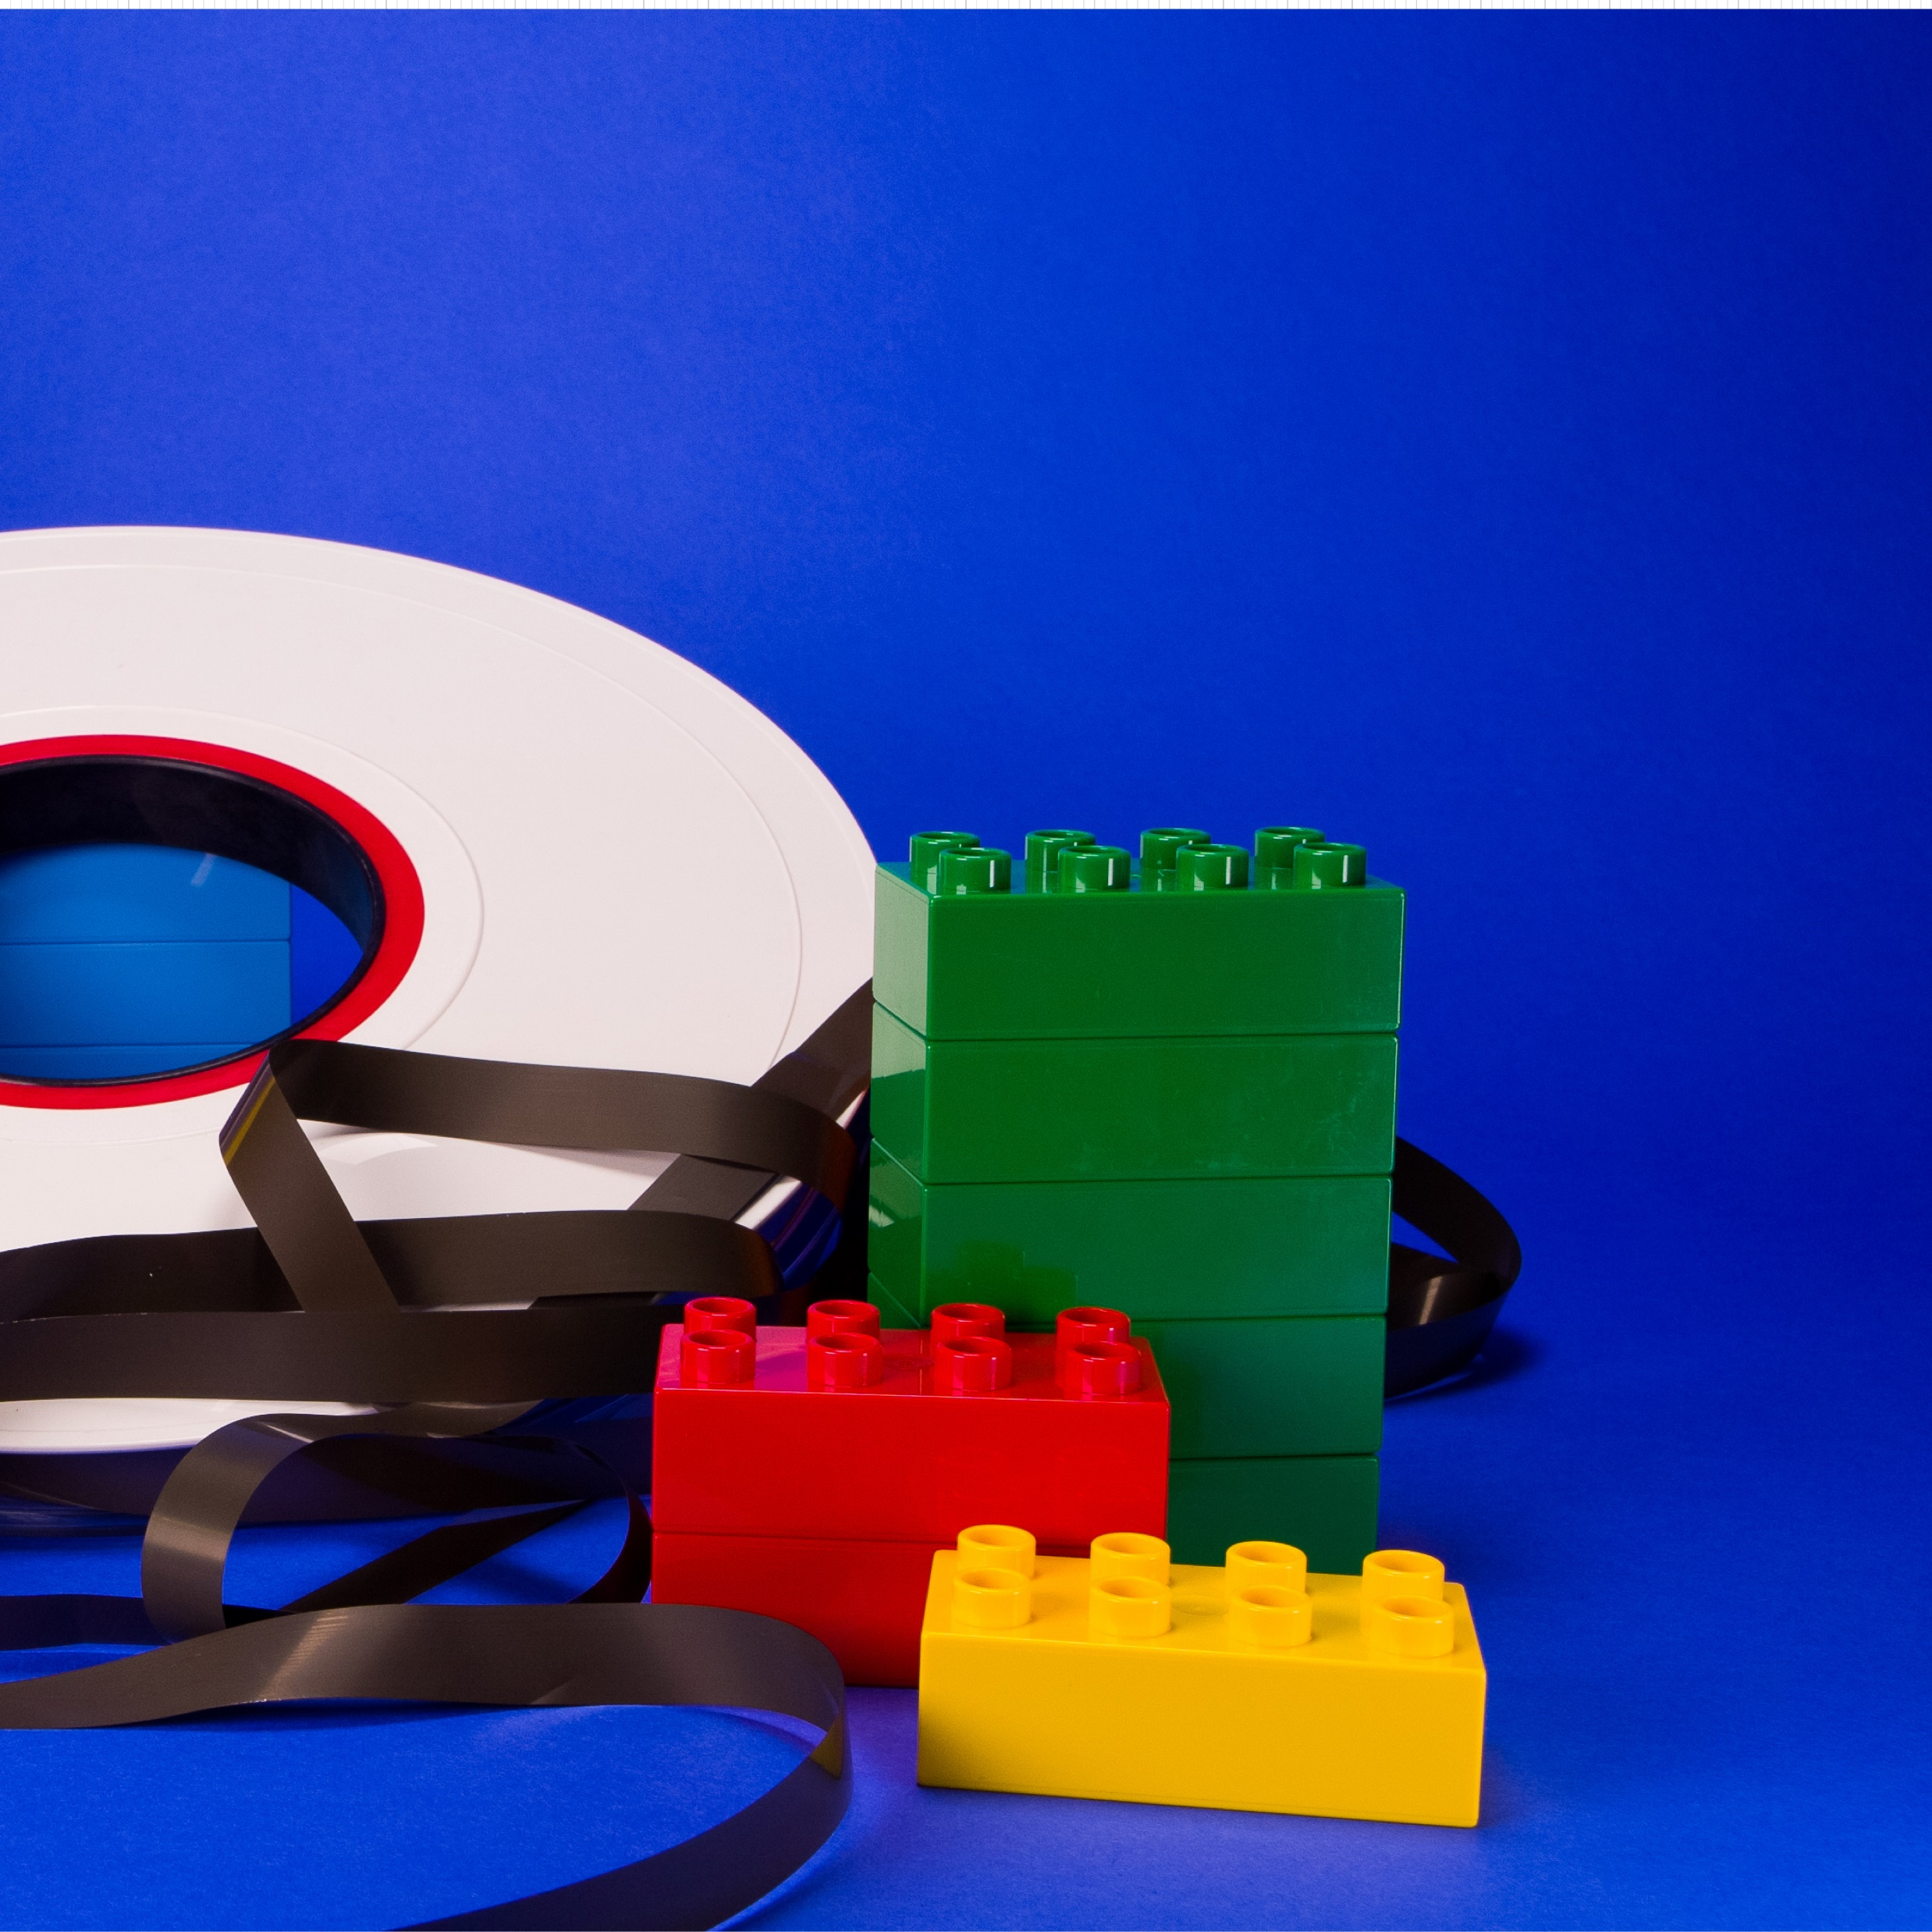
Catalogue of science shows at Science Gateway
(to be expanded with time)
Title | Timing (approx.) | Target group*
Mysteries of matter | 45 min | 6 years +
Journey through a detector | 45 min | 12 years +
Seize the data | 45 min | 10 years +
Science of magical parties | 25 min | 4 - 7 years
Proton express | 45 min | 12 years +
*Target group is approximate and will not be enforced. It should be considered a recommendation for the best understanding rather than a strict limitation.

Slide 25
Thanks for your attention!
Let’s discuss

