Slide 1
Feynman diagrams in physics education:
Opportunities, Challenges, Practices
Merten Dahlkemper^{1,2}, Pascal Klein², Andreas Müller³,
Sascha Schmeling¹, Jeff Wiener¹
1: CERN, Geneva; 2: University of Göttingen; 3: University of Geneva
Notes:
Hello! I took the freedom and adapted the title a bit with respect to the agenda. I will first talk about Opportunities, then my research about challenges and in the end we will have some time for a discussion about practices

Slide 2
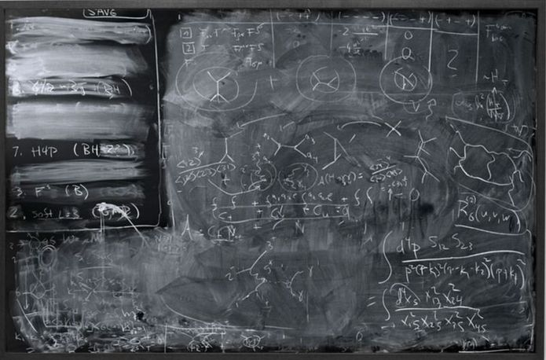
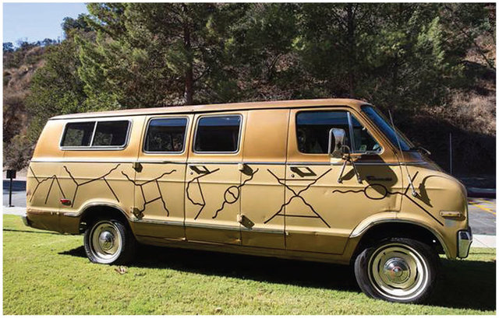
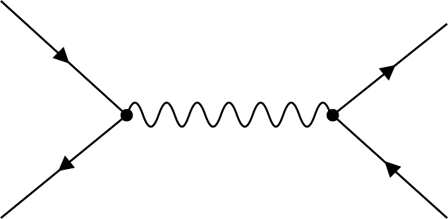
What is it all about?
Feynman diagrams:
A successful tool in particle physics
A popular depiction in science communication
But also an educational tool?
https://www.michael-whittle.com/diagrammatology/the-meta-engines-of-creativity-diagrams-in-physics
https://www.researchgate.net/publication/319224539_Pathways_for_Theoretical_Advances_in_Visualization/figures
Notes:
There is a limited number of visualisations in pp that might be accessible for students, and FD are one of them. They are a successful tool in the discipline, for 75 years, but also a popular depiction in all kinds of outreach material – popularized also by Feynman itself who drew the diagrams on his van and rode it through the US.
But my question is: Can they also used in between, as an educational tool, to teach concepts of particle physics?

Slide 3
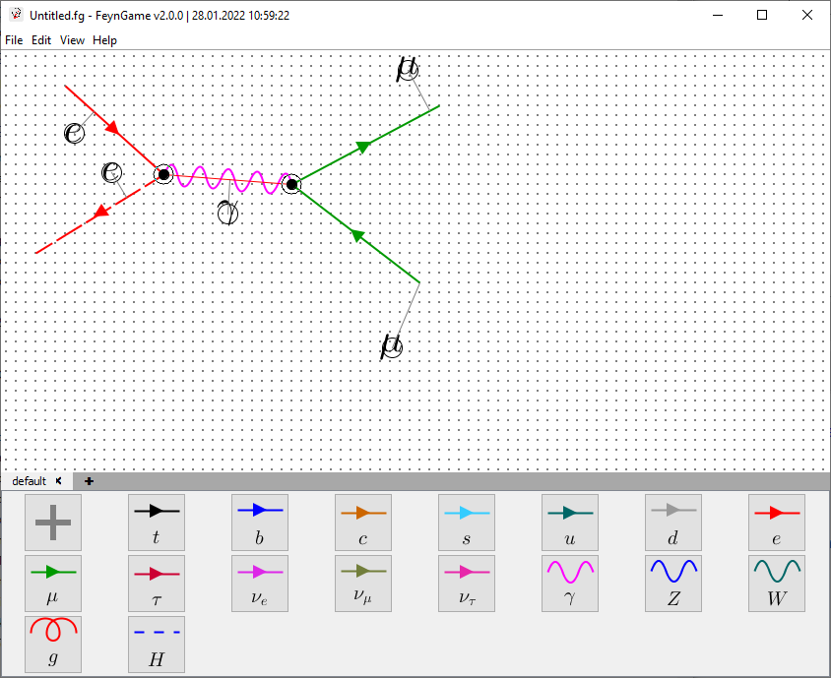
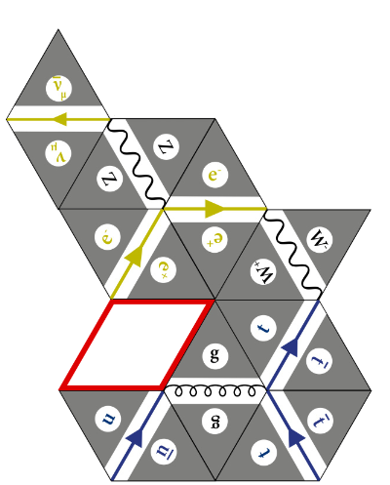
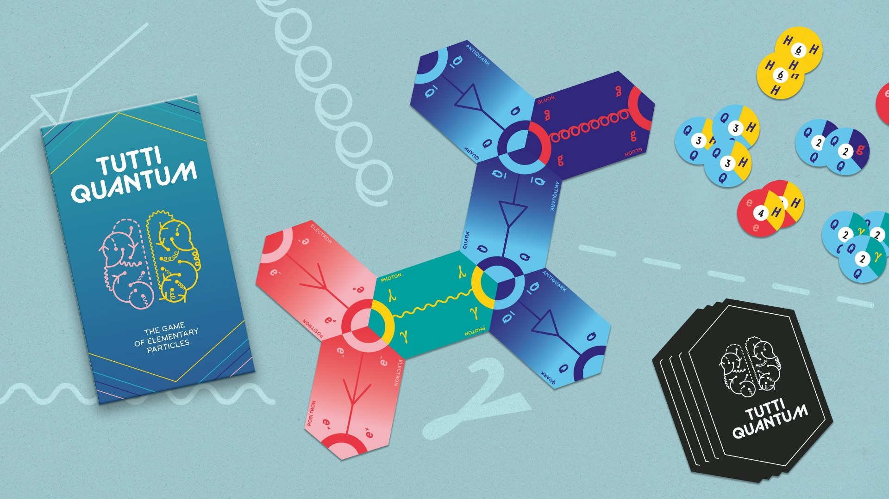
Particle Physics in school
Particle physics is being discussed as a subject for physics curricula since the 1980s
(Aubrecht (1986), Kranjc Horvat et al. (2022))
Suggestions for teaching and learning material have been made
(e.g., Allday (1997), Wiener et al. (2017))
Feynman diagrams could be a source of multiple conceptional difficulties
(Passon et al. (2018, 2020))
Learning materials with Feynman diagrams in the form of computer programs and educational games:
https://helvetiq.com/media/catalog/product/t/u/tuttiquantum_lifestyle.jpg
Lindenau & Winkler (2020)
Harlander et al. (2020)
Notes:
When we talk about particle physics in school, there have been many discussions since the 1980s and the topic also made it into many school curricula all over the world.
During this time, many different suggestions for teaching and learning material about concepts from particle physics have been made, and this meeting is the best example for that.
However, few of them include feynman diagrams which are an important form of representation in particle physics, but could also be a source of conceptual difficulties, since they are a not a depiction of something that happens but abbreviations for a mathematical term. Misconceptions regarding the nature of particles and of particle processes could occur from them.
There have been few studies explicitly including Feynman diagrams to teach concepts from particle physics. However, there have been some learning materials quite recently which aim to teach the concept of Feynman diagrams itself. One of them you even find downstairs in the shop.

Slide 4
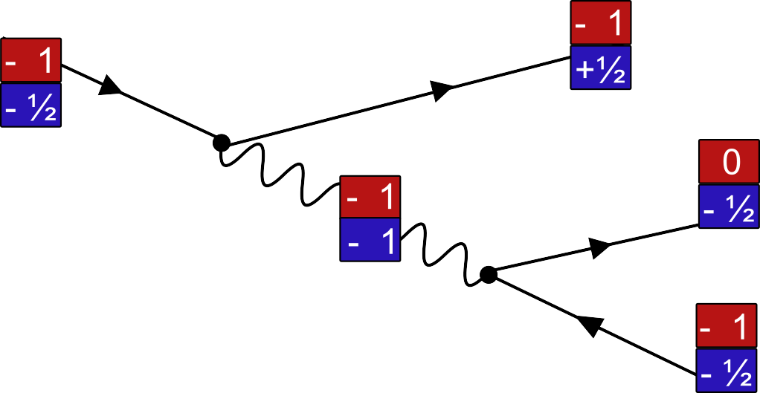
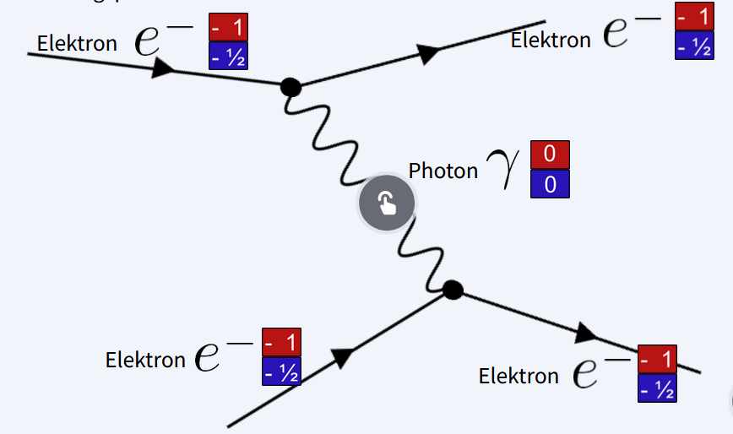
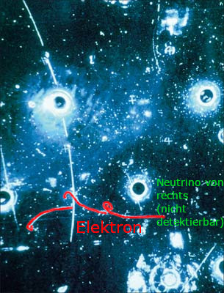
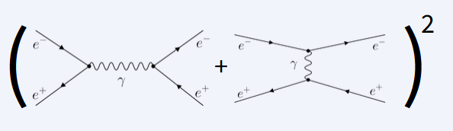
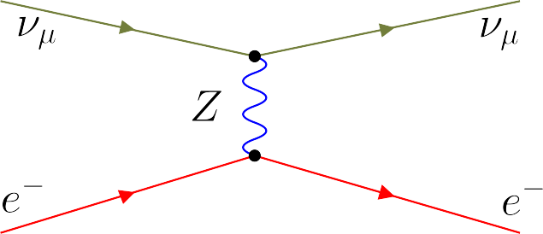
What can we teach with Feynman diagrams?
Charge conservation
The role of interaction particles
Superposition and mathematical nature of physics
How particle discoveries work
Notes:
However, the question remains: If we use these diagrams, which concepts can we teach with them.
And here we get to the opportunities part: We have conducted expert interviews with particle physicists and as a result we suggest for topics which might be suited for being taught using Feynman diagrams:
…

Slide 5
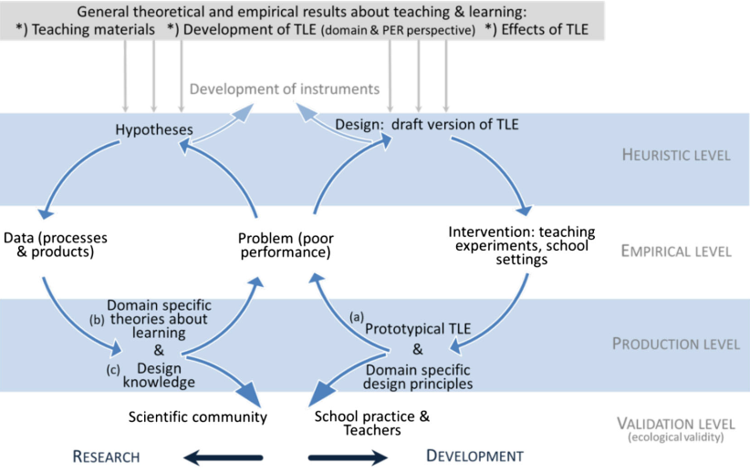
Framework: Design-Based Research
General Design Principles
Draft version of learning material
Data Gathering
Interviews
Questionnaires
Eye Tracking
Can we use Feynman diagrams to teach concepts of particle physics?
Investigation with high school students
Haagen-Schützenhöfer & Hopf, 2020
Notes:
So far about the opportunities, but how did I test them and, more importantly, how did I test for challenges?
This leads me to my research framework, the design-based research approach. I won’t go into detail of this framework, just so much that it is . Can we use Feynman diagrams to teach concepts of particle physics? And if yes which and how?
The next step would be to formulate general design principles and build a draft version of the learning material.

Slide 6
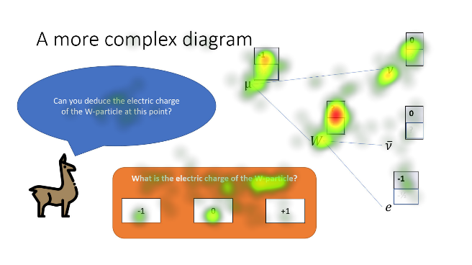
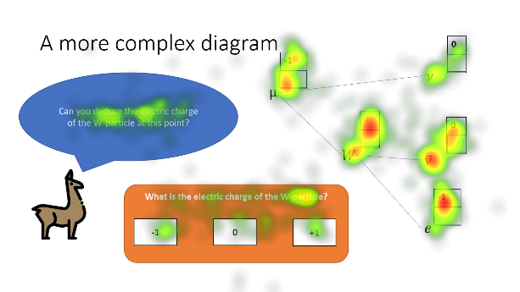
Eye tracking data: Strategies
“Upper particles” reasoning strategy
“Lower particles” reasoning strategy

Slide 7
Eye Tracking data: Outcomes
Students have different strategies when investigating FD and they’re visible in their gaze patterns
  → These strategies could be promoted by visual cues implemented into the diagrams
“Training examples” alter students’ gaze patterns, but maybe not in a desired way?
  → We need to pay attention how to explain the mechanisms of FD

Slide 8
Conceptual Challenges
Inadequate conceptions (with examples)
Particle-related
  Confusion of virtual and interaction particles
Related to diagram elements
  Arrow direction associated to incoming/outgoing particles (instead of anti-/particle)
Interaction-related
  A weak interaction depicts transformation from particles to anti-particles
Charges-related
  Confusion of charge and energy

Slide 9
Conceptual Challenges: Outcomes
Learners’ answers reveal multiple conceptual challenges
  → Conceptions can be categorized, but no single conception is widespread among learners
Adequate conceptions are more widespread than inadequate conceptions
  → Adequate conceptions are mostly in line with learning goals of the material

Slide 10
Framework: Design-Based Research
General Design Principles
Draft version of learning material
Gathering data
Questionnaires
Eye Tracking
Can we use Feynman diagrams to teach concepts of particle physics?
Evaluation with high school students
Visual strategies of students
Conceptual difficulties for particle interactions
Refined version of learning material
Haagen-Schützenhöfer & Hopf, 2020
Notes:
And with that I want to conclude, coming back to the DBR-cycles, in which the data will give us insights into visual strategies of students and conceptual difficulties for particle interactions as well as a refined version of the learning material.

Slide 11

Opportunities
FD offer explanation hooks for
  Conservation of charges
  Mediation of interactions by interaction particles
  Mathematical nature of physics
  Connection between theoretical and experimental physics
Challenges
Diagrams can be complex for students to read
Misconceptions are connected to FD
Practices
We need to pay attention towards
  Language - how to describe certain concepts
  Depictions – what to draw and what not to draw
  Visual cues – where to support students in reading FD
  Discussion
  How far can we go with FD on the high school level?
  Which other learning objective would you think about for FD on high school level?
  What are your experiences with teaching Feynman diagrams?

Slide 12
References
Airey, J., & Eriksson, U. (2019). Unpacking the Hertzsprung-Russell Diagram: A Social Semiotic Analysis of the Disciplinary and Pedagogical Affordances of a Central Resource in Astronomy. Designs for Learning, 11(1), 99–107.
Allday, J. (1997). The nature of force in particle physics. Physics Education, 32(5), 327. https://doi.org/10.1088/0031-9120/32/5/016
Aubrecht, G. J. (1986). Report on the conference on the teaching of modern physics. The Physics Teacher, 24(9), 540–547. https://doi.org/10.1119/1.2342122
Dahlkemper, M. N., Klein, P., Müller, A., Schmeling, S. M., & Wiener, J. (2022). Opportunities and Challenges of Using Feynman Diagrams with Upper Secondary Students. Physics, 4(4), Article 4. https://doi.org/10.3390/physics4040085
Haagen-Schützenhöfer, C., & Hopf, M. (2020). Design-based research as a model for systematic curriculum development: The example of a curriculum for introductory optics. Physical Review Physics Education Research, 16(2), 020152. https://doi.org/10.1103/PhysRevPhysEducRes.16.020152
Hahn, L., & Klein, P. (2022). Eye tracking in physics education research: A systematic literature review. Physical Review Physics Education Research, 18(1), 013102. https://doi.org/10.1103/PhysRevPhysEducRes.18.013102
Harlander, R. V., Klein, S. Y., & Lipp, M. (2020). FeynGame. Computer Physics Communications, 256, 107465. https://doi.org/10.1016/j.cpc.2020.107465
Klein, P., Küchemann, S., Brückner, S., Zlatkin-Troitschanskaia, O., & Kuhn, J. (2019). Student understanding of graph slope and area under a curve: A replication study comparing first-year physics and economics students. Physical Review Physics Education Research, 15(2), 020116. https://doi.org/10.1103/PhysRevPhysEducRes.15.020116
Klein, P., Lichtenberger, A., Küchemann, S., Becker, S., Kekule, M., Viiri, J., Baadte, C., Vaterlaus, A., & Kuhn, J. (2020). Visual attention while solving the test of understanding graphs in kinematics: An eye-tracking analysis. European Journal of Physics, 41(2), 025701. https://doi.org/10.1088/1361-6404/ab5f51
Klein, P., Viiri, J., & Kuhn, J. (2019). Visual cues improve students’ understanding of divergence and curl: Evidence from eye movements during reading and problem solving. Physical Review Physics Education Research, 15(1), 010126. https://doi.org/10.1103/PhysRevPhysEducRes.15.010126
Klein, P., Viiri, J., Mozaffari, S., Dengel, A., & Kuhn, J. (2018). Instruction-based clinical eye-tracking study on the visual interpretation of divergence: How do students look at vector field plots? Physical Review Physics Education Research, 14(1), 010116. https://doi.org/10.1103/PhysRevPhysEducRes.14.010116
Kranjc Horvat, A., Wiener, J., Schmeling, S. M., & Borowski, A. (2022). What Does the Curriculum Say? Review of the Particle Physics Content in 27 High-School Physics Curricula. Physics, 4(4), Article 4. https://doi.org/10.3390/physics4040082
Krejtz, K., Szmidt, T., Duchowski, A. T., & Krejtz, I. (2014). Entropy-based statistical analysis of eye movement transitions. Proceedings of the Symposium on Eye Tracking Research and Applications, 159–166. https://doi.org/10.1145/2578153.2578176
Krejtz, K., Duchowski, A. T., Krejtz, I., Kopacz, A., & Chrząstowski-Wachtel, P. (2016). Gaze transitions when learning with multimedia. Journal of Eye Movement Research, 9(1), Article 1. https://doi.org/10.16910/jemr.9.1.5
Langendorf, R., Schneider, S., & Klein, P. (2022). Extracting information from the Hertzsprung-Russell diagram: An eye-tracking study. Physical Review Physics Education Research, 18(2), 020121. https://doi.org/10.1103/PhysRevPhysEducRes.18.020121
Leppink, J., Paas, F., Van der Vleuten, C. P. M., Van Gog, T., & Van Merriënboer, J. J. G. (2013). Development of an instrument for measuring different types of cognitive load. Behavior Research Methods, 45(4), 1058–1072. https://doi.org/10.3758/s13428-013-0334-1
Lindenau, P., & Winkler, O. (2020). Feynman-Rhombino. Unterricht Physik, 180, 40–43.
Mozaffari Chanijani, S. S., Klein, P., Bukhari, S. S., Kuhn, J., & Dengel, A. (2016). Entropy based transition analysis of eye movement on physics representational competence. Proceedings of the 2016 ACM International Joint Conference on Pervasive and Ubiquitous Computing: Adjunct, 1027–1034. https://doi.org/10.1145/2968219.2968564
Novak, E., Daday, J., & McDaniel, K. (2018). Assessing Intrinsic and Extraneous Cognitive Complexity of E-textbook Learning. Interacting with Computers, 30(2), 150–161. https://doi.org/10.1093/iwc/iwy001
Passon, O., Lindenau, P., & Kobel, M. (2020). Von Feynman-Diagrammen und Stromkreisen. Unterricht Physik, 180. https://www.friedrich-verlag.de/physik/quantenphysik/von-feynman-diagrammen-und-stromkreisen-7480
Passon, O., Zügge, T., & Grebe-Ellis, J. (2018). Pitfalls in the teaching of elementary particle physics. Physics Education, 54(1), 015014. https://doi.org/10.1088/1361-6552/aadbc7
Rodemer, M., Eckhard, J., Graulich, N., & Bernholt, S. (2020). Decoding Case Comparisons in Organic Chemistry: Eye-Tracking Students’ Visual Behavior. Journal of Chemical Education, 97(10), 3530–3539. https://doi.org/10.1021/acs.jchemed.0c00418
Susac, A., Bubic, A., Kazotti, E., Planinic, M., & Palmovic, M. (2018). Student understanding of graph slope and area under a graph: A comparison of physics and nonphysics students. Physical Review Physics Education Research, 14(2), 020109. https://doi.org/10.1103/PhysRevPhysEducRes.14.020109
Wiener, G. J., Schmeling, S. M., & Hopf, M. (2017). Introducing 12 year-olds to elementary particles. Physics Education, 52(4), 044001. https://doi.org/10.1088/1361-6552/aa6cfe

Slide 13
Backup

Slide 14
Eye Tracking and diagrams
Plethora of examples from physics and chemistry education to investigate students’ problem-solving strategies
E.g., Hertzsprung-Russel diagrams (Langendorf et al., 2022), kinematics diagrams (Susac et al., 2018, Klein et al., 2019, 2020), vector field diagrams (Klein et al., 2018, 2019)
Different kinds of analysis
  Global and local scale (Hahn & Klein, 2022)
  Different metrics on the local scale: angular distribution of saccades (Klein et al., 2018), fixation/transition ratio (Rodemer et al., 2020), Time on unknown elements (Klein et al., 2019, Langendorf et al., 2022)
  Entropy based measures (Krejtz et al., 2014, 2016, Mozzafari et al., 2016)
Notes:
Maybe you have noticed while I showed you the two diagrams before: You use visual strategies to examine the diagram and to solve the task.
And indeed, as the title of the talk already gave away, one method I am using to examine students’ strategies is Eye Tracking. Over the last 15 years, there have been many examples of how eye tracking could unpack students’ problem solving strategies. It has been used for example with the HRD from astronomy, with kinematics or with vector field diagrams.
Warum nun gerade Eye Tracking? Es gibt einige Beispiele aus den letzten zehn bis 15 Jahren Physik- und Chemiedidaktik, in denen mit Hilfe von ET das Verständnis von Diagrammen und anderen mutliplen Repräsentationen untersucht wurde.
Zu nennen sind da HRDs, eine bestimmte Form eines disziplinspezifischen Diagramms in der Astronomie, aber auch grundlegendere Typen wie Kinematik- oder Vektorfeld-Diagramme.
Wie genau wurde das gemacht? Da gibt es sehr unterschiedliche Arten der Analyse, die zunächst in globale und locale Analyse unterschieden warden können. Uns interessiert hier aber vor allem die locale Analyse, also wie wird das konkrete Diagramm untersucht? Auch hier gib es wieder ganz unterschiedliche Arten wie eine Analyse der Richtungen, in die geschaut wird, oder eine genaue Analyse der Zeiten auf unterschiedlichen Elementen. Was in unserem Fall interessant ist, sind hingegen die Transitionen zwischen verschiedenen Elementen. Und hier kommen Entropie-basierte Maße ins Spiel…

Slide 15
Design principles for instructional design
General Design Principle | Theoretical Rationale
Extraneous processing in a mulitmedial learning environment should be reduced. | The capacity of the working memory is limited (Sweller, 1999; Moreno & Mayer, 2007)
Interactive learning environments should engage learners. | Metacognition, motivational and affective factors mediate learning (Moreno & Mayer, 2007)
Disciplinary representations should be unpacked in order to increase the educational value. | Disciplinary and pedagogical affordance are usually in conflict with each other (Airey & Lindner, 2017)
Notes:
To have hypotheses based on which we could create a prototype we have formulated 3 general design principles based on cognitive load theory, cognitive-affective theory of multimedia learning and theory of social semiotic resources.
These general design principles are then connected to specific design principles: 1: Use signaling and summaries; 2: Use appropriate contexts, conversational language, interactive questions; 3: Use step-by step approaches and adapted explanations

Slide 16
Design Principles
Interactive learning environments should engage learners.
Appropriate Contexts
Conversational language
Interactive questions
Students reflect in their answers
Explanatory feedback
Summaries
Signalling
Extraneous processing in a mulitmedial learning environment should be reduced.

Slide 17
Design Principles
Unpacking of disciplinary ressources
Step-by-step approach
Explanations adapted to previous knowledge

Slide 18
Evaluation study
2 Research Questions
  In which way does the learning with Feynman diagrams foster the understanding of charge conservation?
  Which conceptual challenges do students exhibit after an instruction about Feynman diagrams about the interactions of particles?
27 students at a German high school in Göttingen + 6 students at German high school in Geneva
  Age 15 – 19y
  22 male, 11 female
Pre-Questionnaire: Prior knowledge in particle physics
Learning material was shown while eye movements were recorded
(2 groups: pre-post and post-only)
Post-Questionnaire:
  Comprehension questions
  Cognitive load questionnaire (Leppink et al., 2013, adapted by Novak et al., 2018)
  Instructional Material Motivation survey (Keller, 1993, 2010)
Notes:
This evaluation study aimed on answering two concrete research questions, namely in which way Feynman diagrams foster the understanding of charge conservation, and which conceptual challenges students exhibit after an instruction about Feynman diagrams about the interactions of particles.
I have just finished the data taking of this study, so the in-depth analysis is still to come. The students in my study were 15-19 years old, from one high school in Göttingen and one German school in Geneva, unfortunately not quite gender balanced.
I’ve assessed the prior knowledge in the topic as well as how much they occupied themselves before with physics.
Then the learning material was shown while they solved small comprehension tasks. This was actually done in two groups. During this process their eye movements were recorded.
Afterwards they answered comprehension questions about the second topic as free texts, in order to answer the second research question. Besides, they answered a cognitive load questionnaire and an instructional material motivation survey in order to gather data about the fullfillment of the design principles.

Slide 19
Study Design
“pre-post” (N = 17)
7 small tasks about cc with Feynman diagrams
Intro to Feynman diagrams
Intro to charge conservation
(text)
Examples about cc with Feynman diagrams
7 small tasks about cc with Feynman diagrams
Second part about interaction particles
No pre-test
“post-only”
(N = 16)
Notes:
The two groups differed in a small detail. While the so-called pre-post group got a textual explanation of charge conservation followed directly followed by tasks they should answer about charge conservation without having seen examples before. Only after doing these tasks they saw actual examples with diagrams about charge conservation and then did the tasks again. To control for memory effects, another group did not get the “pre-test” before the examples. After this session about charge conservation, they got a second chapter of the learning material with interaction particles.

Slide 20
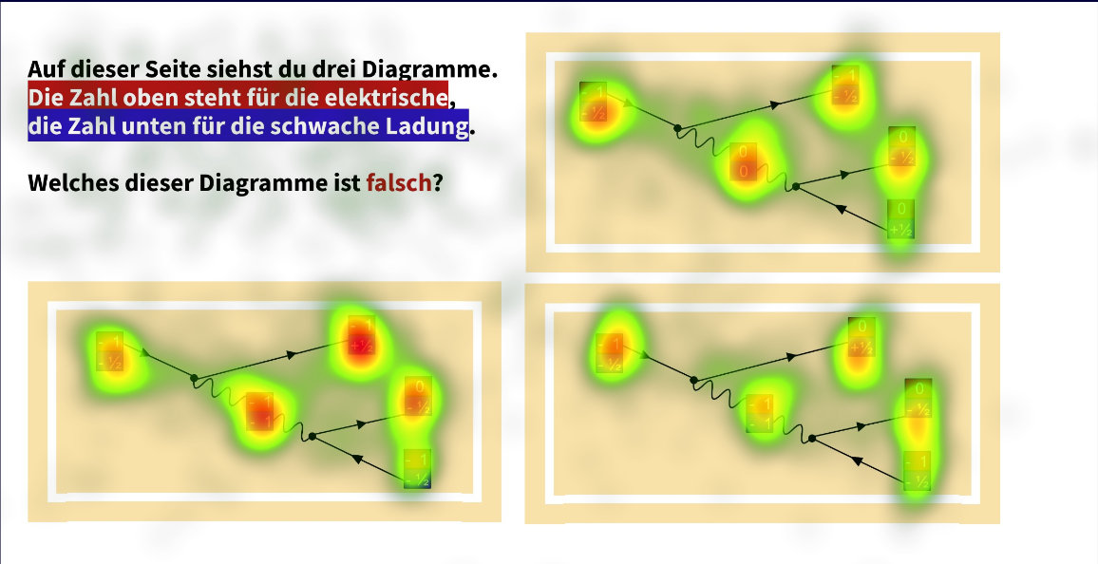
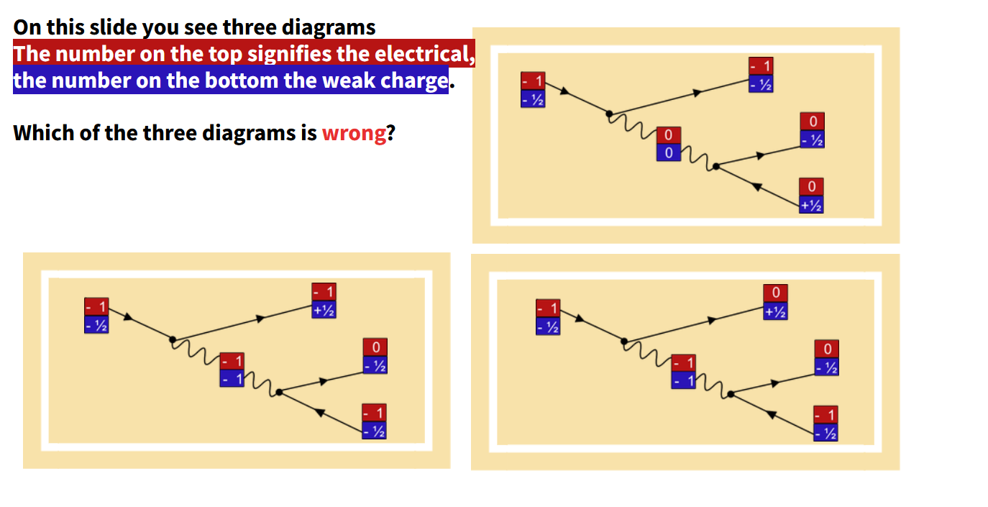
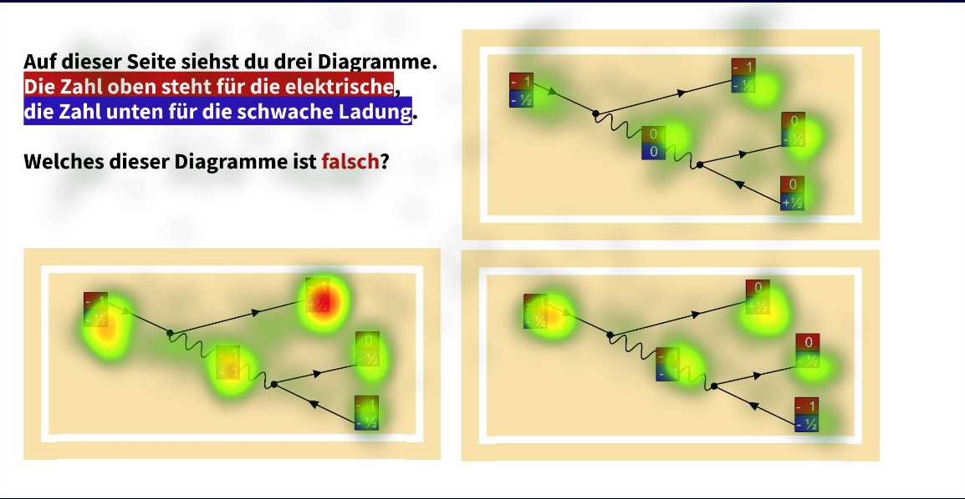
Eye Tracking data – Students’
Wrong Answers (N=14)
Correct Answers (N=18)

Slide 21
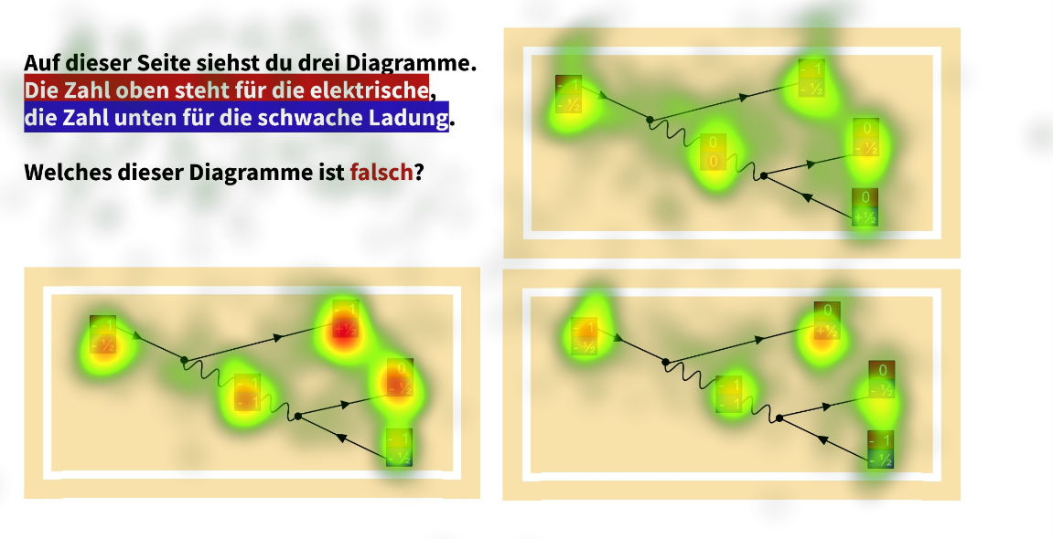
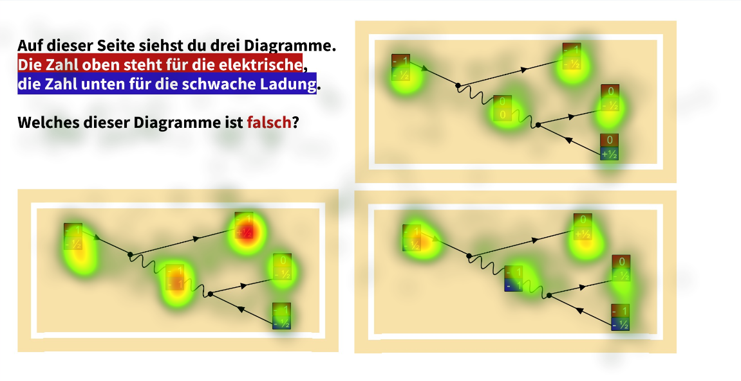
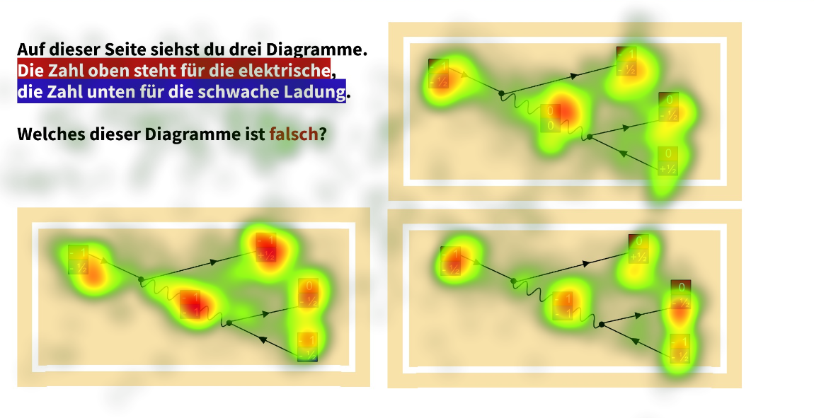
Eye Tracking data: Influence of training examples
Before training examples
After training examples
Pre-Post
(N=15)
Post
(N=14)

Slide 22
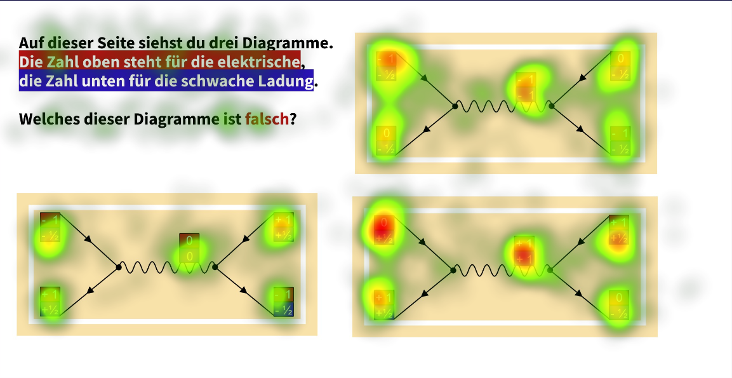
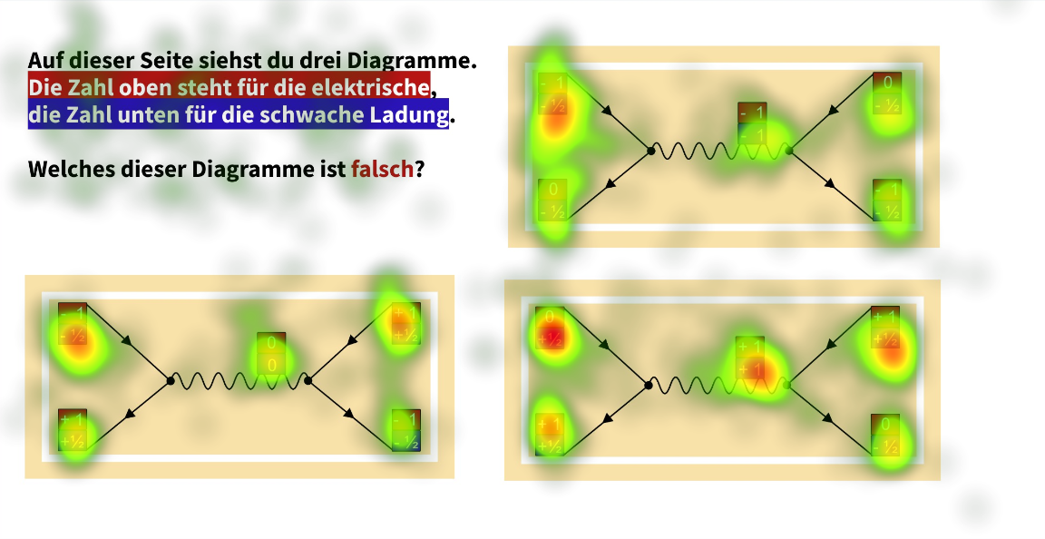
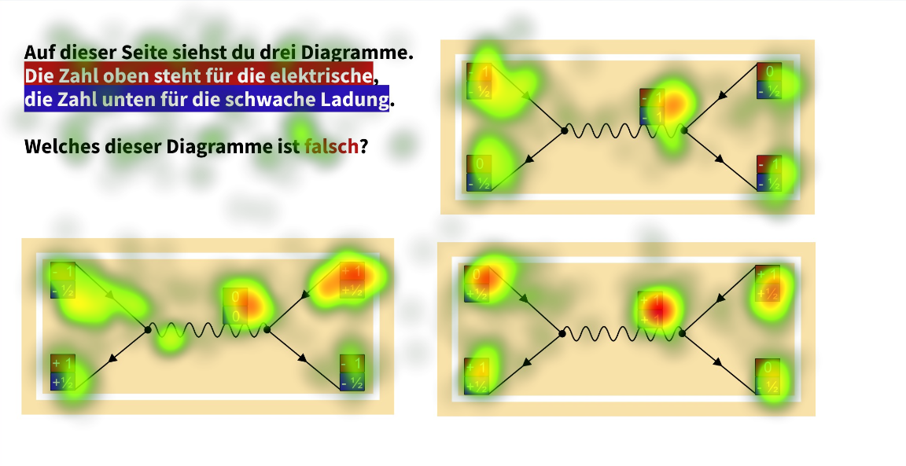
Eye Tracking data
Pretest
Posttest
Pre-Post
(N=15)
Post
(N=14)

Slide 23
Eye Tracking data: Outcomes
Students have different strategies when investigating FD and they’re visible in their gaze patterns
Students’ visual processing of the diagrams differs among those who answer questions correctly and incorrectly
  Correctly answering students’ gaze behaviour is more focused on areas which determine the correctness
Students’ visual processing of the diagrams slightly differs among those who have or haven’t seen diagrams before
  Students who have seen examples spread out their visual attention more than those who see diagrams for the first time
  The difference is more prevalent for diagrams which are more difficult for students

