Slide 1
CERN’s 70th anniversary celebrations
Luciano Musa - Mélissa Gaillard
CERN Teacher and Student Forum | 3 October 2023

Slide 2
What do we aim to achieve?
Celebrate the past, invigorate the present, promote the future
Recognising achievements
Generating momentum for the future
Promoting CERN’s values
Consolidating CERN’s reputation and visibility
Fostering a sense of pride and unity
Engaging the public
a CERN’s 70th anniversary as forward looking event

Slide 3
Whom do we aim to reach?
The anniversary year’s programme will encompass a range of activities tailored to one or more of these target audiences
The CERN community
The wider particle physics community
The general scientific community
The general public
The local, national and international authorities and policymakers
The media
a Engage various audiences across Member, Associate and non-Member States

Slide 4


Main themes and topics
Four main themes
capture the essence of CERN at this 70-year milestone
“Pushing back the Frontiers of Knowledge”
  Discoveries, Big Questions, Charting the Way Forward
    topics: main discoveries and advancements over the past seven decades; main open questions in fundamental physics and how to address them; the way forward.
“Advancing Science and Technology”
  Together for a Sustainable Future
    topics: the synergy of science and technology; applications to society and societal challenges; sustainability.
“Science Without
Borders”
  International Cooperation and Dialogue through Science
  topics: universality of science; international collaboration; dialogue;
  a model for other fields.
  Training, Education, Accessibility in Science
    topics: science training and education; inspiration; open science; accessibility and inclusiveness in science;
“Science for All”

Slide 5
CERN 70 Project Organization

Slide 6
High-level Timeline
Develop concept
& framework
Designation of CT
& ET members
Presentation to Council
Project implementation begins
Presentation to Council of
finalised programme
March 2023
May 2023
November 2023
2024
April 2023
June 2023
December 2023
Council informed about the planned CERN70 celebrations
Approval of project framework
Celebration programme and implementation plans finalised
Events throughout the year starting in January 2024
Designation of MS’ and AMS’ National Contact Persons is nearly finalised – 1st meeting: 20th October

Slide 7
Celebrations Programme 2024
  17 September
  at CERN
  1 October
  at CERN
  January
  Official opening
  announcement
  CERN Community Event
  Official Ceremony
digital communication campaign,
coordinated media news release with MS and AMS
grand celebration inviting entire CERN community,
symposium followed by festive gathering
host highest-level authorities from
MS, AMS, OBS, NMS and other key stakeholders
Throughout the Year
Science Events to engage with the broader community
science fairs, public lectures, workshops, interactive exhibits, …
a The emphasis will be on engaging MS and AMS as partners, nurturing a sense of community

Slide 8
List of Country Contacts
Austria | Brigitte | De Monte
Belgium | Véronique | Halloin
Bulgaria | Venelin | Kozhuharov
Bulgaria | Leandar | Litov
Croatia
Cyprus | Panos | Razis
Czech Republic | Alexander | Kupčo
Denmark | Jens-Jorgen | Gårdhøj
Estonia | Kairi | Otto
Finland | Juska | Pekkanen
France | Perrine | Royole-Degieux
Germany | Sascha | Schmeling
Greece | Christine | Kourkoumelis
Hungary | Csilla | Pentek
India
Israel | Nathan | Chicheportiche
Italy | Francesca | Scianitti
Latvia | Toms | Torims
Lithuania
Netherlands | Martijn | van Calmthout
Norway | Eli | Baeverfjord Rye
Norway | Hilde | Lynnebakken
Pakistan | Zafar | Yasin
Poland | Pawel | Brückman de Renstrom
Poland | Marek | Pawłowski
Portugal | Pedro | Abreu
Portugal | Catarina | Espirito Santo
Romania | Anca | Ghinescu
Romania | Florin | Buzatu
Serbia | Predrag | Milenovic
Slovak Republic | Ivan | Melo
Slovenia | Andrej | Gorisek
Spain | Pablo | Camacho
Sweden | Ernesto | Gutiérrez
Sweden | Fredrik | Engelmark
Switzerland | Hans-Peter | Beck
Türkiye | Berna | Yuksel
Ukraine | Maksym | Titov
United Kingdom | Stephanie | Hills
United Kingdom | Jess | Atkinson

Slide 9
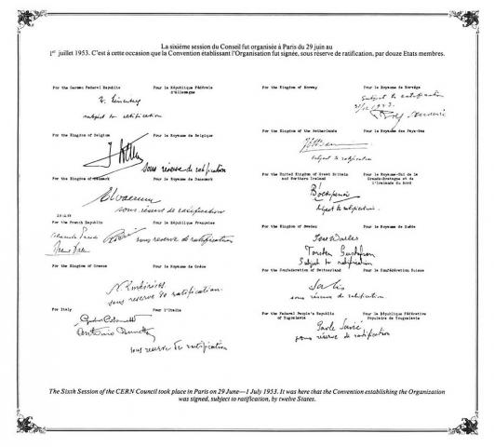
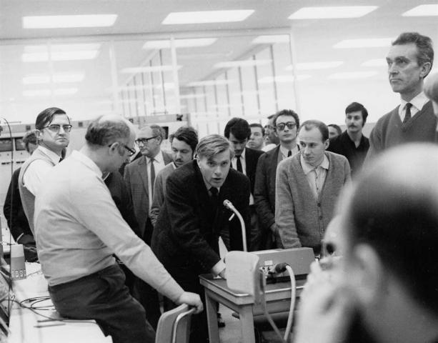
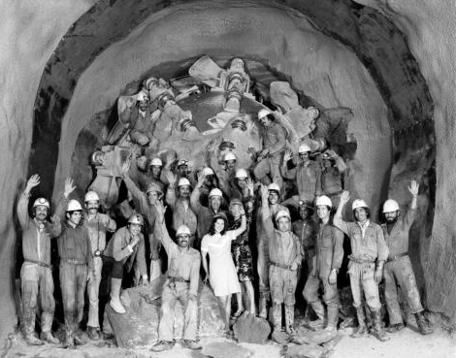
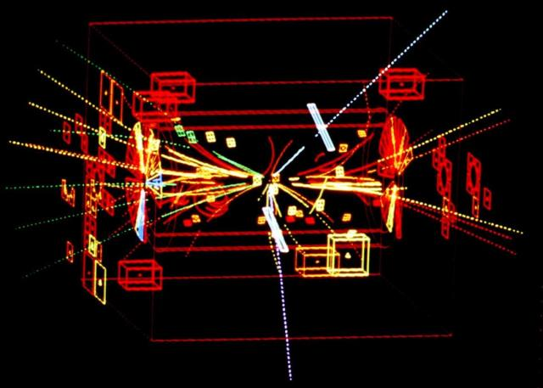
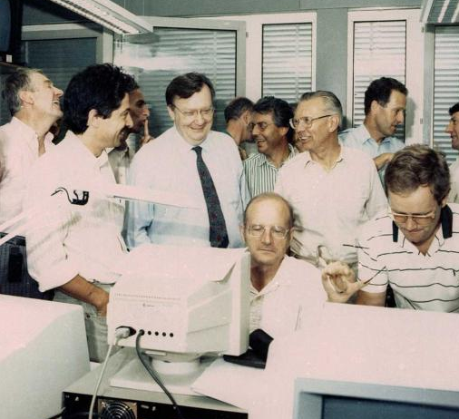
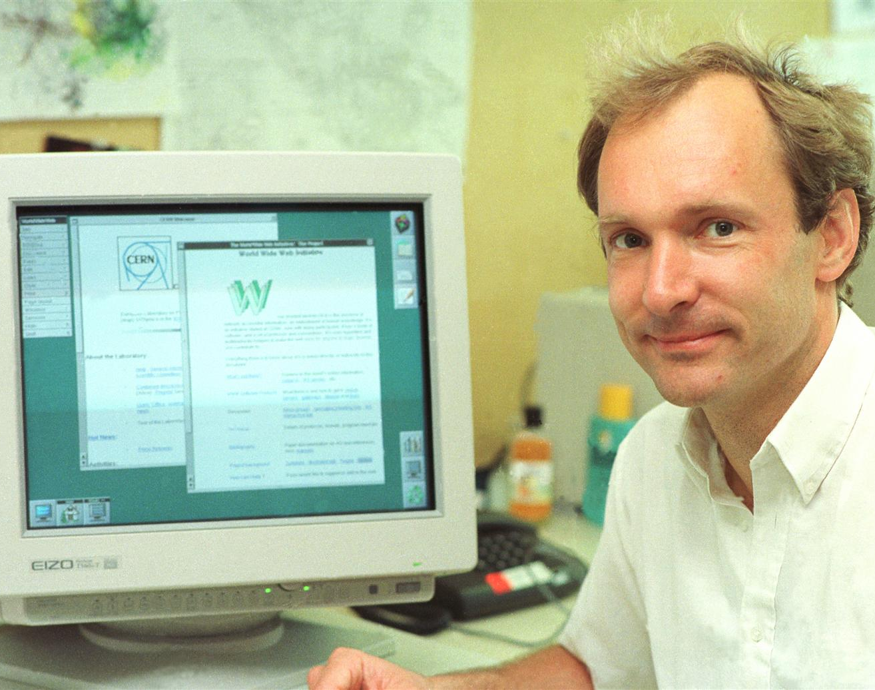
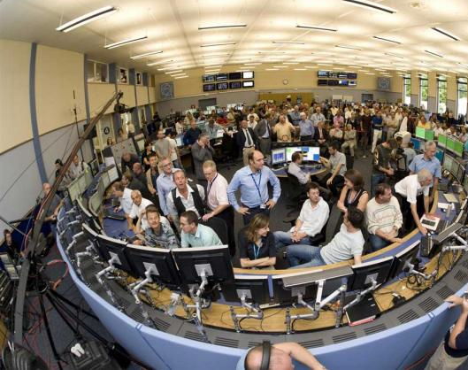
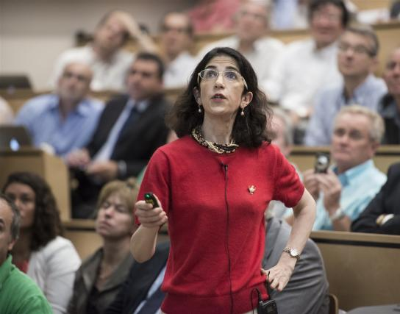
1954-2024
Sep ‘54
Jul ’74
Jan ’71
Jan ’83
Jan ’90
Jul ’12
Jul ’89
Sep ’08

Slide 10
CERN 70 Contacts
CERN 70 Project Office:
cern.70@cern.ch

