Slide 1
MBHDP301
11T hybrid magnet
Magnet overview after cooldown n°1
Mechanical Measurement Lab of EN-MME
EDMS #2711698
June 26th 2023 – Rev.1

Slide 2
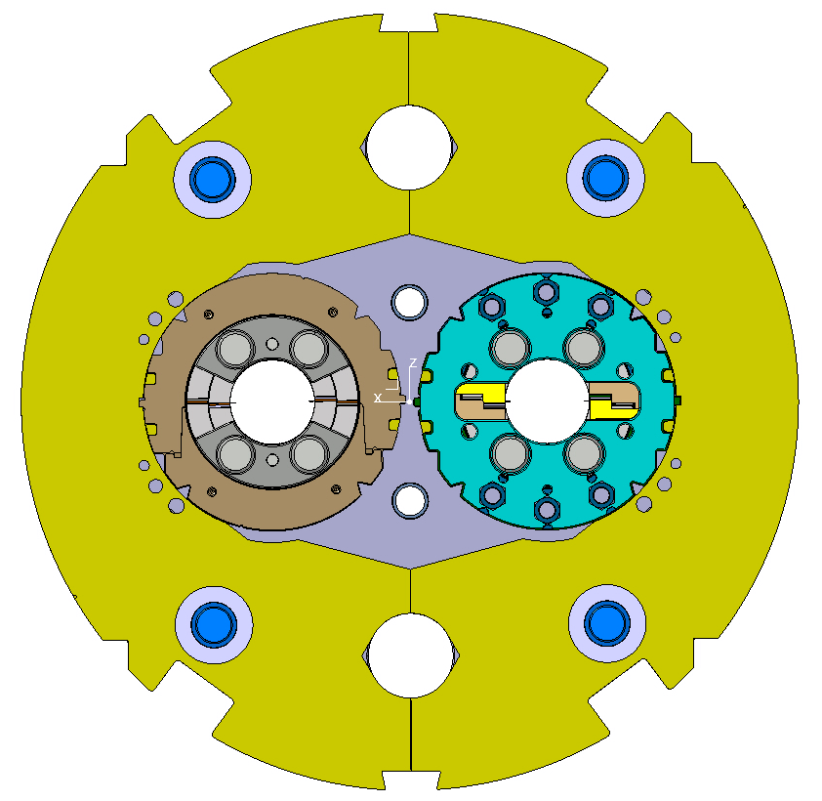
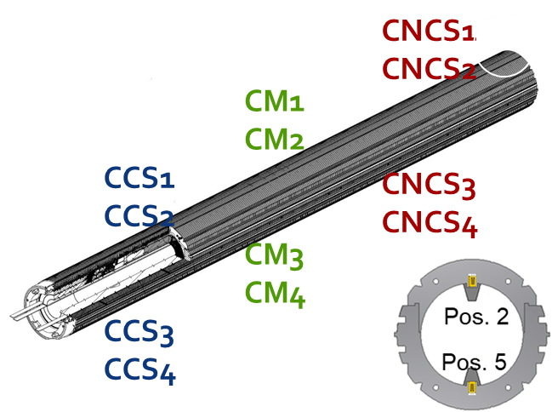
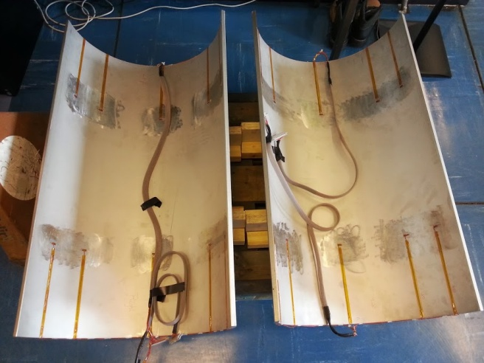
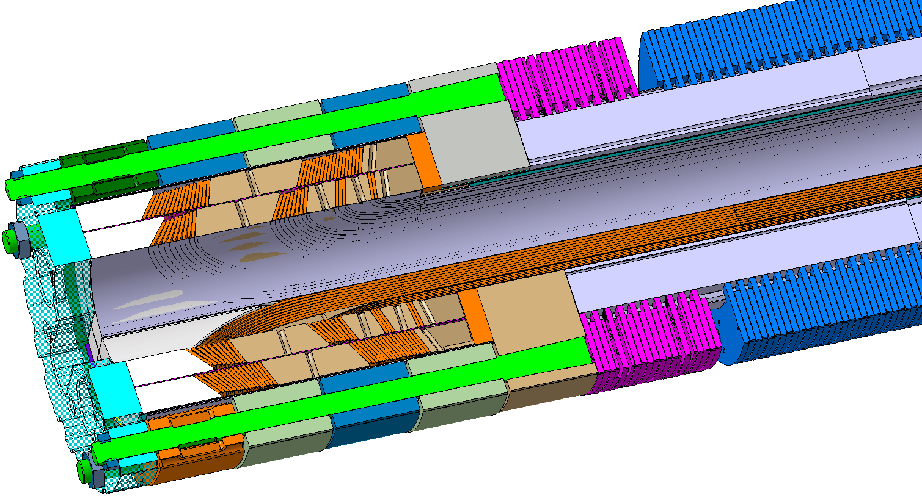
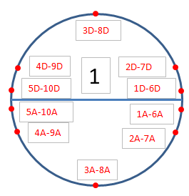
Instrumentation overview
SP301
12 instrumented collars;
8 Bullet gauges
Distributed fibers
SP302
12 instrumented collars;
8 Bullet gauges
12 Tie rods (End cage)
Distributed fibers
Instrumented SS Shell

Slide 3
FEA estimations
EDMS 2909313 v.0.1
3D mechanical behavior of the 11T cold mass at cryogenic temperature: EDMS 2643402

Slide 4
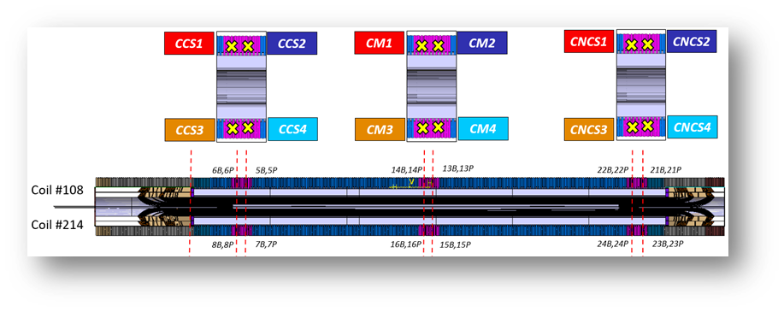
SP301 collars compression stress

Slide 5
SP302 collars compression stress

Slide 6
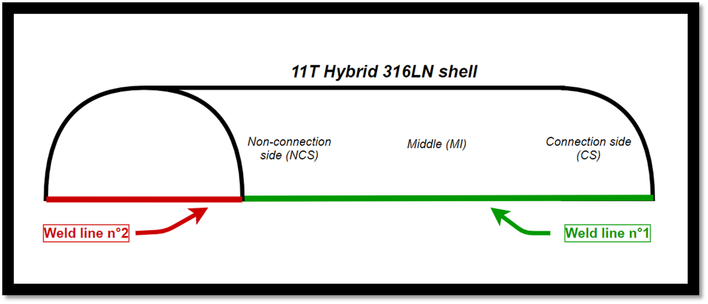
316 LN external shell stress

Slide 7
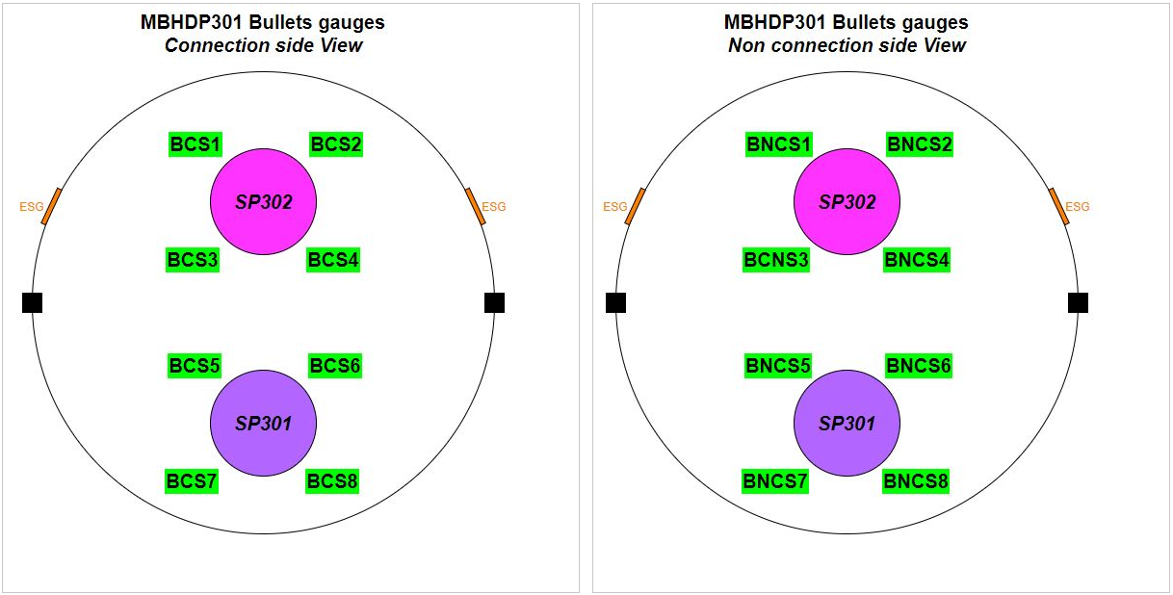
End plates longitudinal stress

Slide 8
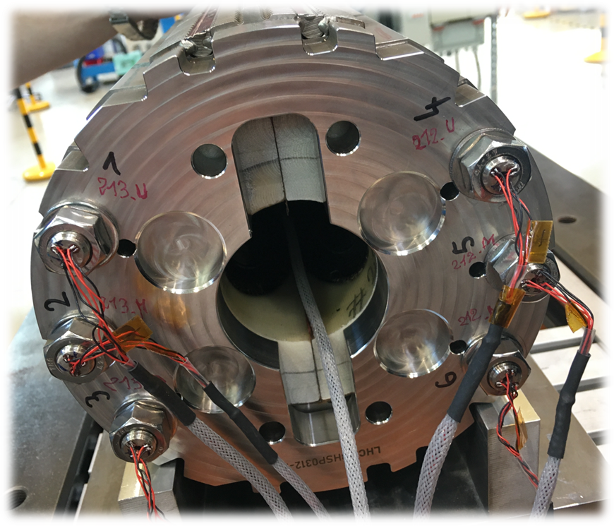
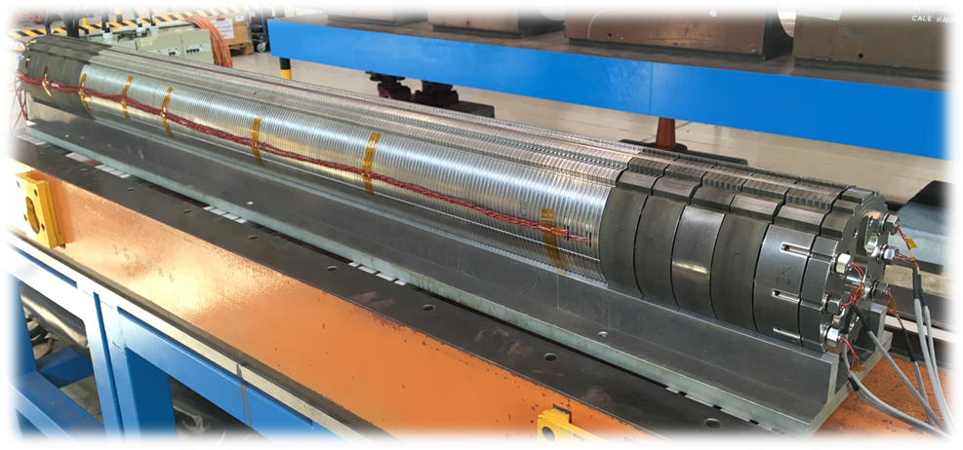
SP302 End cage tie rods stress

Slide 9
SP302 End cage tie rods stress

