Slide 1

The ATLAS experiment at the CERN-LHC
A global project, BIG science!
CERN
May 20th, 2011
Marzio Nessi CERN & University of Geneva
Markus Nordberg CERN

Slide 2
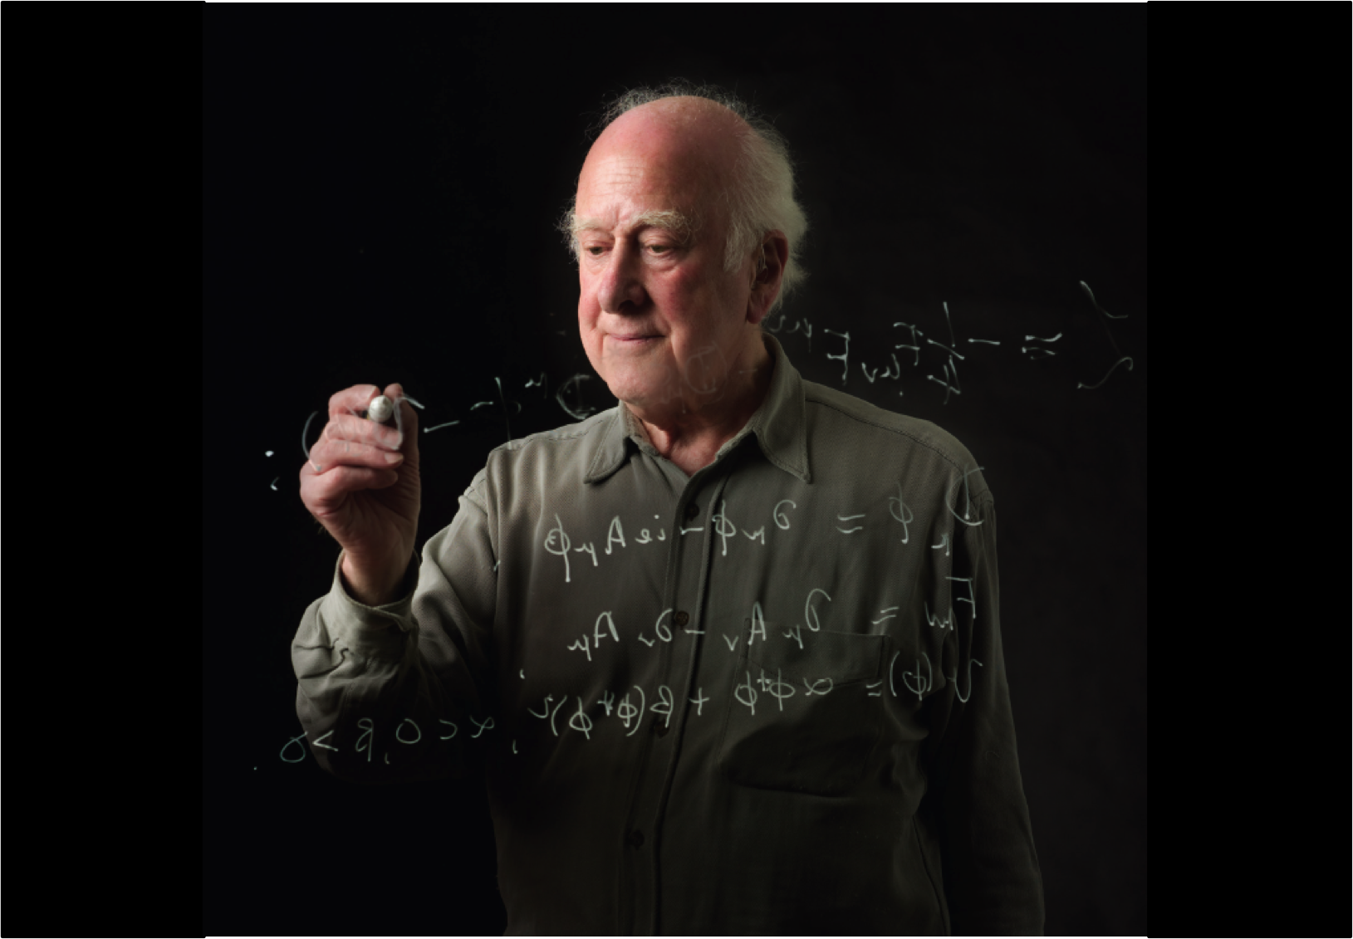
Our Mission
Partons hard scattering at an unprecedented c.m. Energy
…. mimics the energy density of the early universe (~ psec) …. probes physics at very small distances
….. look for physics beyond today’s knowledge (standard model) !!!
    →Higgs mechanism, Supersymmetry (dark matter), extra dimensions, new forces, compositeness, …… New phenomena are expected at these energies
√(sx₁x₂) = √(sx)
[ “Hard scattering partons” ]
proton
x₁p
x₂p
proton
proton beams

Slide 3

We know that something is wrong with this picture!

Slide 4
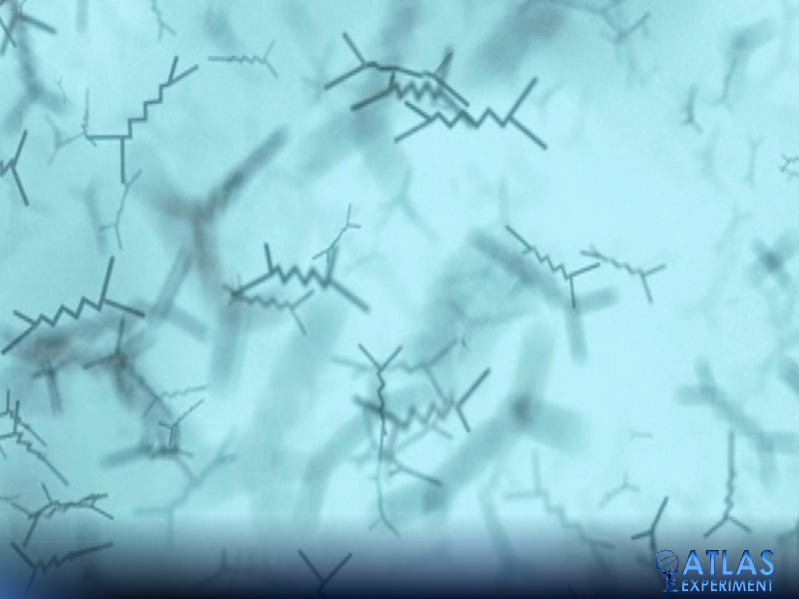
Our understanding will go through this

Slide 5

General picture
CERN : as the host laboratory
ATLAS : as the scientific project
LHC : as the beams facility

Slide 6

Our playground (27 km of circumference)
The LHC

Slide 7
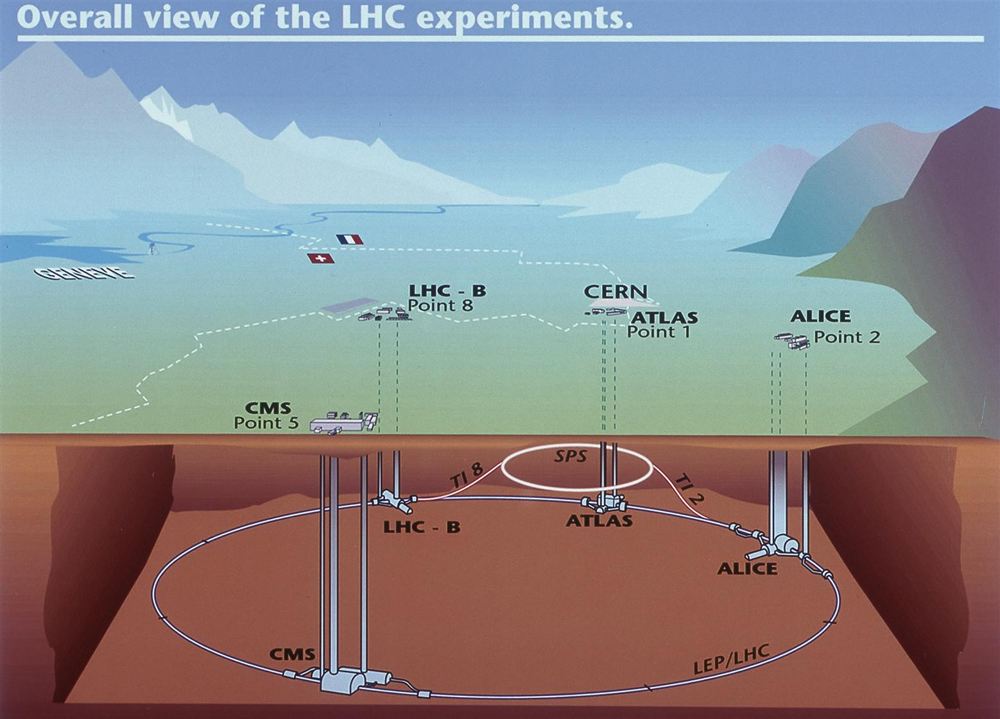
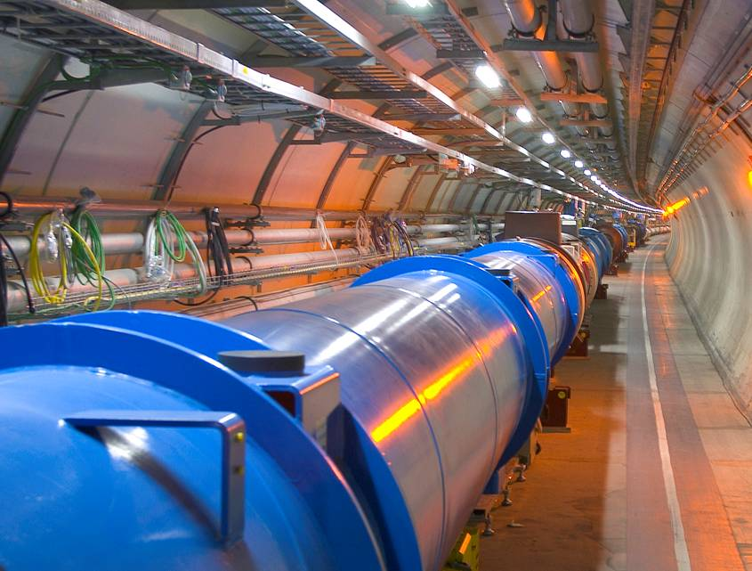

Slide 8
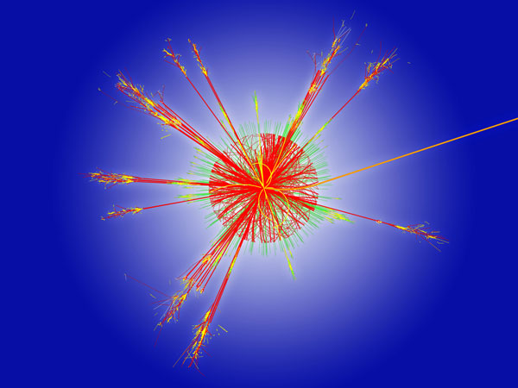
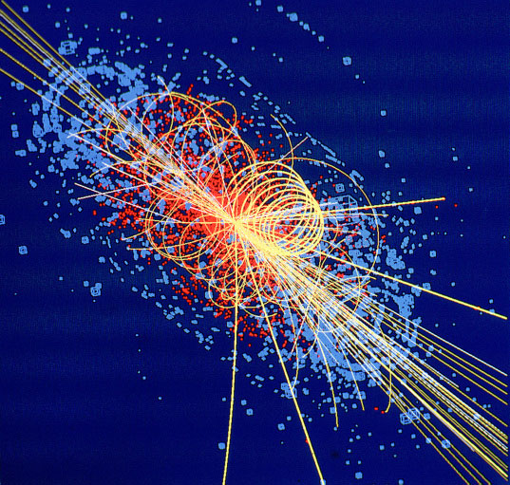
The hottest spots in the galaxy… and around it we place a fancy “microscope”
When two beams of protons collide, they will generate temperatures 1000 million times hotter than the
heart of the sun, but in a minuscule space.

Slide 9
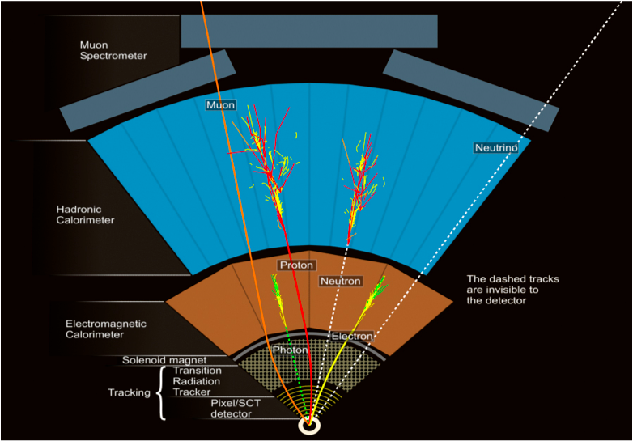
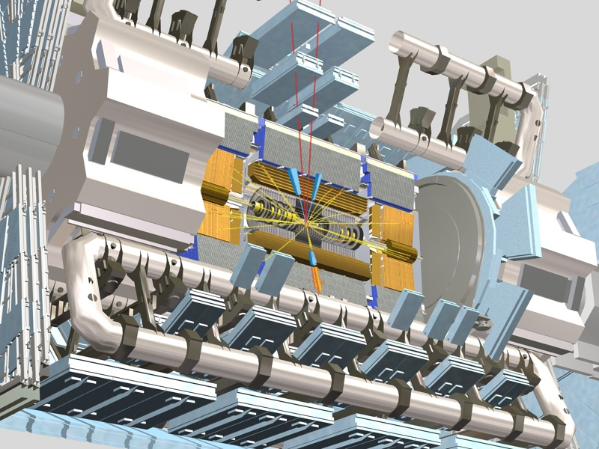
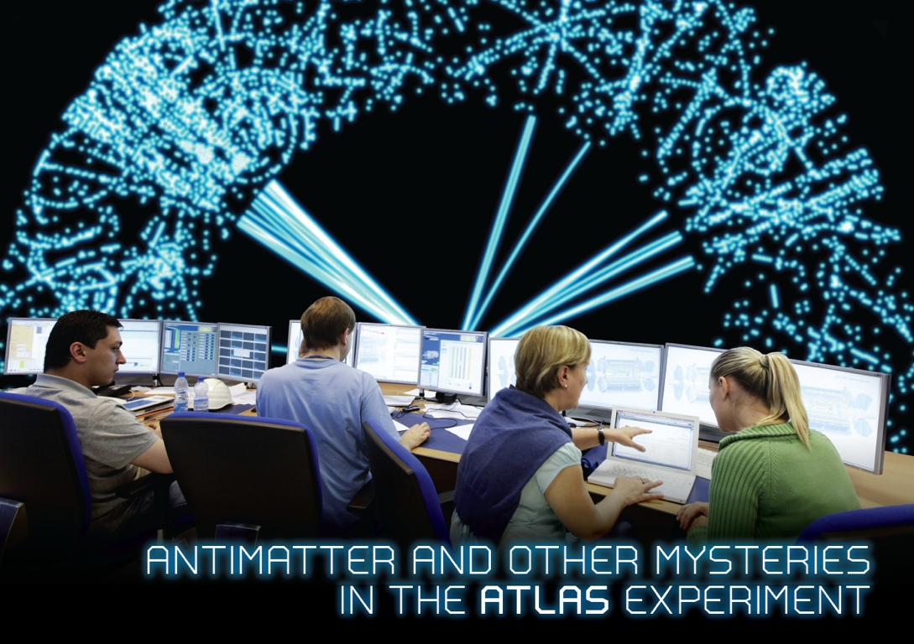
ATLAS
11/15/2007
M.Nessi

Slide 10
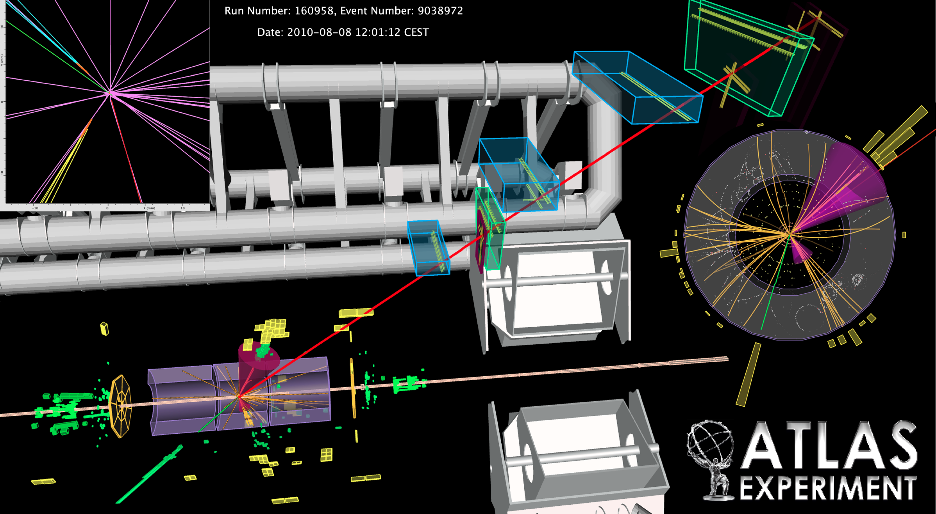
A collision event (a Top quark candidate)
_
Displaced secondary vertices
tt -> e ν b , μ ν b
Muon tracking and identification
Hadronic jets reconstruction
Charge particles tracking
Electrons and Photons identification
Missing transverse energy reconstruction

Slide 11
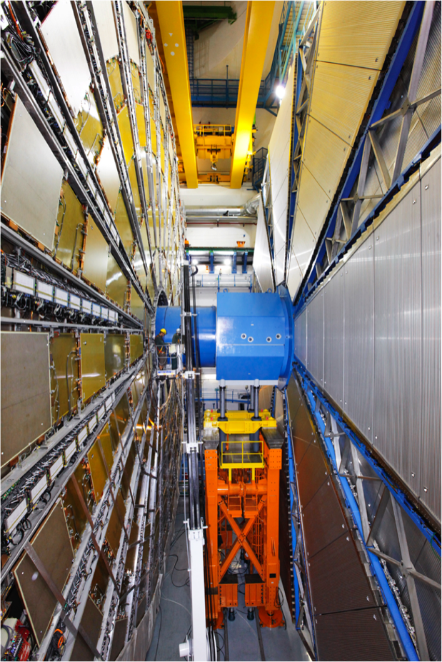

The ATLAS detector

Slide 12
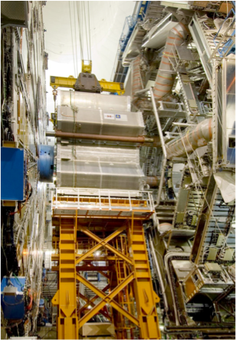
The ATLAS detector

Slide 13
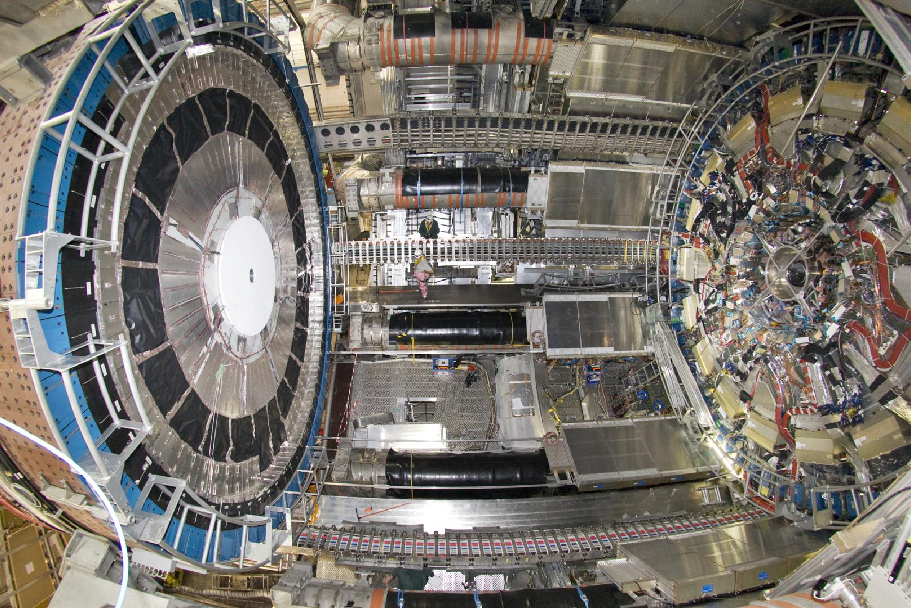
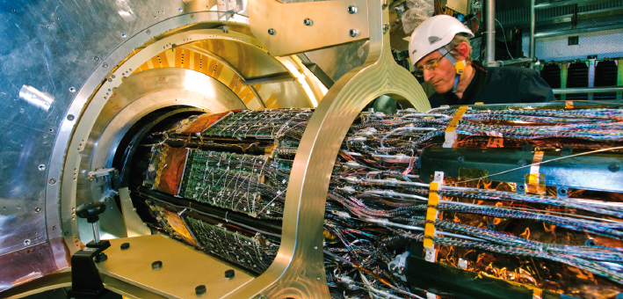
The ATLAS detector

Slide 14
Project ingredients
A very strong motivation in the entire community towards new physics (this is the real motor !!!)
A well established collaborative method
An incredible amount of knowledge within the community in many aspects of modern technology (hardware, micro-electronics, computing and detector techniques) matured over 50 years of HEP history
A well established Host Laboratory (CERN) capable to assist and support such an effort with the necessary infrastructure

Slide 15
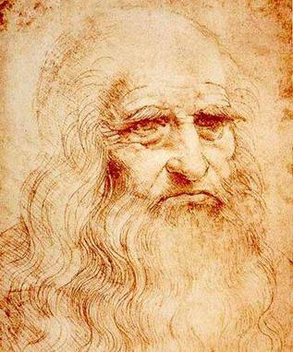
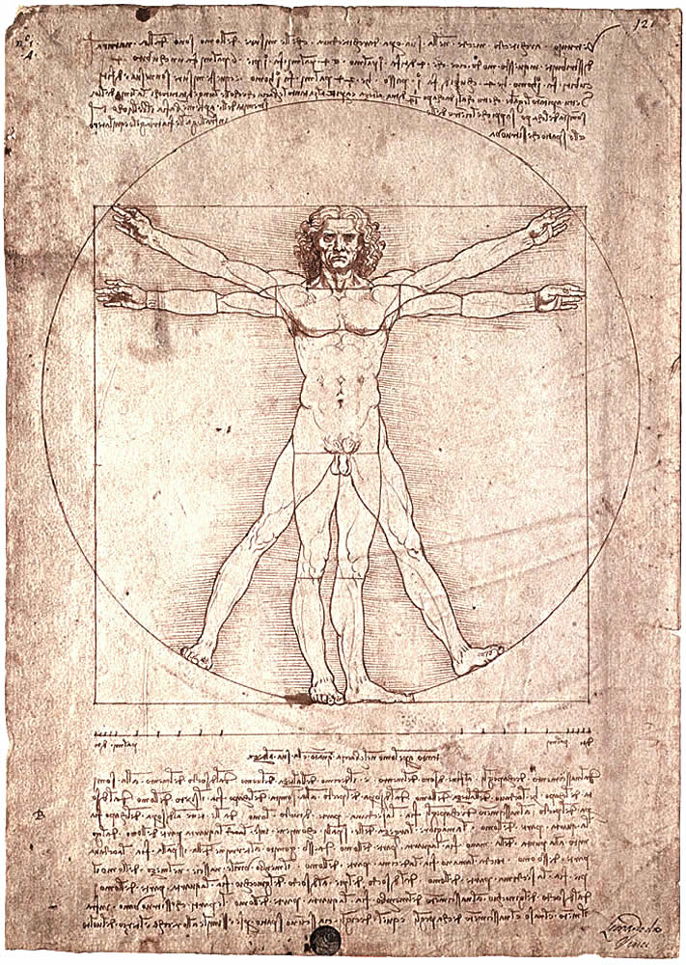
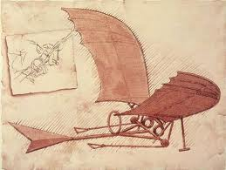
~1510
one man show

Slide 16
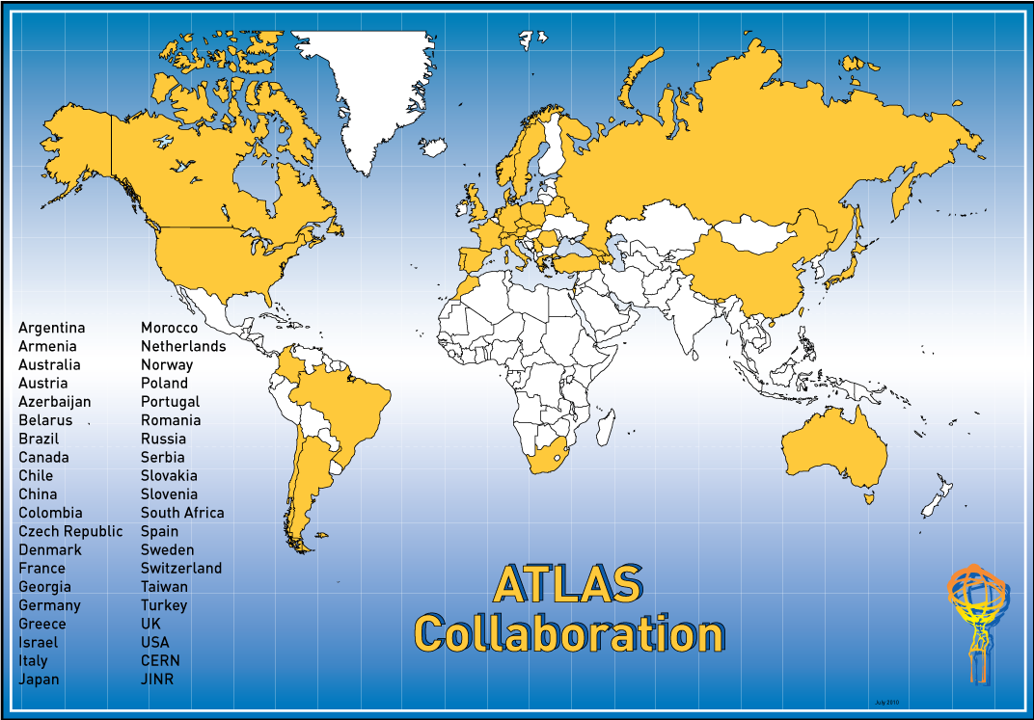
3030 active scientists:
-- ~ 1830 with a PhD → contribute to M&O share
-- ~ 1200 students
~4500 scientists over the last 15-20 years
174 Institutions, 38 Countries
Albany, Alberta, NIKHEF Amsterdam, Ankara, LAPP Annecy, Argonne NL, Arizona, UT Arlington, Athens, NTU Athens, Baku,
IFAE Barcelona, Belgrade, Bergen, Berkeley LBL and UC, HU Berlin, Bern, Birmingham, UAN Bogota, Bologna, Bonn, Boston, Brandeis, Brasil Cluster, Bratislava/SAS Kosice, Brookhaven NL, Buenos Aires, Bucharest, Cambridge, Carleton, CERN, Chinese Cluster, Chicago, Chile, Clermont-Ferrand, Columbia, NBI Copenhagen, Cosenza, AGH UST Cracow, IFJ PAN Cracow, SMU Dallas, UT Dallas, DESY, Dortmund, TU Dresden, JINR Dubna, Duke, Edinburgh, Frascati, Freiburg, Geneva, Genoa, Giessen, Glasgow, Göttingen, LPSC Grenoble, Technion Haifa, Hampton, Harvard, Heidelberg, Hiroshima IT, Indiana, Innsbruck, Iowa SU, Iowa, UC Irvine, Istanbul Bogazici, Johannesburg/Witwatersrand, KEK, Kobe, Kyoto, Kyoto UE, Lancaster, UN La Plata, Lecce, Lisbon LIP, Liverpool, Ljubljana, QMW London, RHBNC London, UC London, Lund, UA Madrid, Mainz, Manchester, CPPM Marseille, Massachusetts, MIT, Melbourne, Michigan, Michigan SU, Milano, Minsk NAS, Minsk NCPHEP, Montreal, McGill Montreal, RUPHE Morocco, FIAN Moscow, ITEP Moscow, MEPhI Moscow, MSU Moscow, Munich LMU, MPI Munich, Nagasaki IAS, Nagoya, Naples, New Mexico, New York, Nijmegen, Northern Illinois University, BINP Novosibirsk, NPI Petersburg,Ohio SU, Okayama, Oklahoma, Oklahoma SU, Olomouc, Oregon, LAL Orsay, Osaka, Oslo, Oxford, Paris VI and VII, Pavia, Pennsylvania, Pisa, Pittsburgh, CAS Prague, CU Prague, TU Prague, IHEP Protvino, Regina, Rome I, Rome II, Rome III, Rutherford Appleton Laboratory, DAPNIA Saclay, Santa Cruz UC, Sheffield, Shinshu, Siegen, Simon Fraser Burnaby, SLAC, Stockholm, KTH Stockholm, Stony Brook, Sydney, Sussex, AS Taipei, Tbilisi, Tel Aviv, Thessaloniki, Tokyo ICEPP, Tokyo MU, Tokyo Tech, Toronto, TRIUMF, Tsukuba, Tufts, Udine/ICTP, Uppsala, UI Urbana, Valencia, UBC Vancouver, Victoria, Waseda, Washington, Weizmann Rehovot, FH Wiener Neustadt, Wisconsin, Wuppertal, Würzburg, Yale, Yerevan

Slide 17
WE ….culture

Slide 18
WE ….culture
opposite to …. I culture

Slide 19


Slide 20
Who are we really ?
Designers
Proponents
Clients
Owners
Constructors
Users
We are used to work like this since ever !
… from LOI (letter of intent) to Scientific publications

Slide 21
A well established collaborative method
Highly democratic (individuals, transparency, 1 vote/institution)
Minimal centralized structures (management, sub-projects)
Rotation of responsibilities (all positions by election, 2 years)
Decision making process based on consensus
Resources flow : bottom up
Structures and rules evolving in time with the project
Intense pier reviewing (inside/outside)
All publications signed by the entire collaboration

Slide 22
1 person per institution
Meet 3-4 times per year
Policy making body
Overview/organize all elections
Forum for discussions and information sharing
Work distributed in working groups and projects
Daily work steered by Executive Board
1 person per funding agency
Meet 2 times per year
Control and release budgets
Approve major strategical choices
ATLAS Plenary Meeting
Resources Review Board
Collaboration Board
Executive Board
3 central management functions (spokesperson, technical coordinator, resources coordinator)
Project Leaders, Activity Leaders
Substructure organized in projects or activities
Repeat overall structure at project level

Slide 23
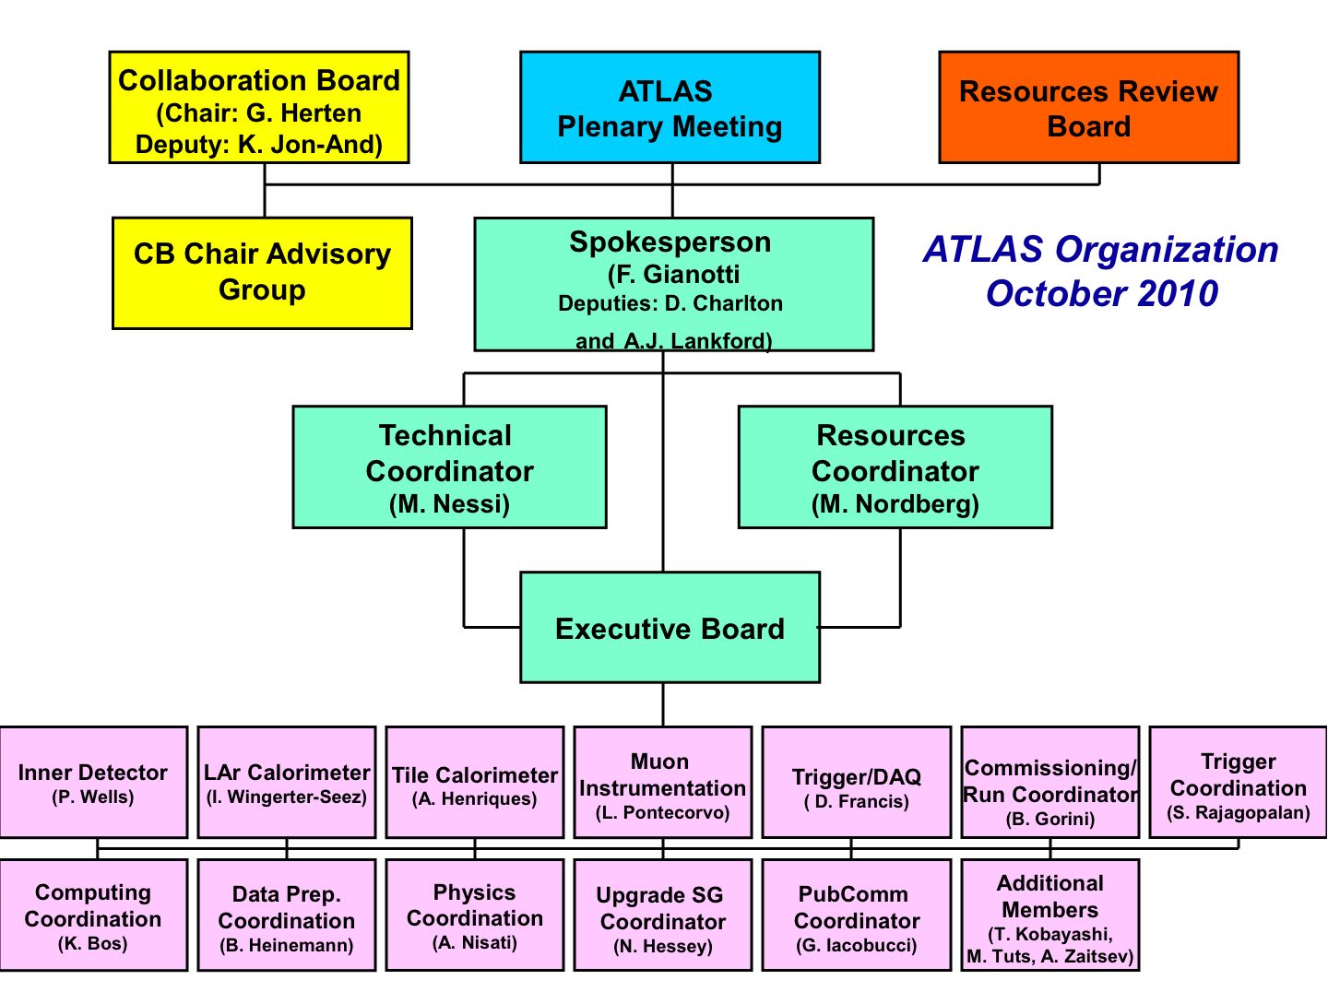

Slide 24
Decision making process (on technical matters)
Policy matters
Collaboration board (might vote, 1 institute = 1 vote)
Baseline matters
Resource matters
Executive board (based on consensus)
Political matters
Physics matters
Technical management board
Sub-systems steering groups
Floor
……..
Controversial matters
……..
Technical matters

Slide 25
Decision making process (on physics)
Policy matters
Collaboration board (might vote, 1 institute = 1 vote)
Baseline matters
Resource matters
Executive board (based on consensus)
Political matters
Physics matters
Physics coordination, analysis editorial boards, publ. committee
Physics working groups
Floor, individuals, university groups
……..
Controversial matters
……..
Physics

Slide 26
13 pages of Authors / publication

Slide 27
Project Culture
  There are several underlying sub-cultures in ATLAS
    Physics culture versus Engineering culture
    Hardware oriented culture versus software/computing etc.
    Sub-system cultures (e.g. ”Calorimeter culture versus Muons culture”)
    Geographical cultures (“North versus South; West versus East”; languages)
  Such cultural diversity originates itself from
    Global nature of modern high energy physics (38 countries, 70 nationalities)
    Decentralized nature of resources, diverse funding sources
    Different ways to account and organize resources
  Project cycles and dominating cultures
    Sub-system/engineering culture more dominant during construction
    Physics culture very strong during project definition (design); then resurfaces when physics analysis started

Slide 28
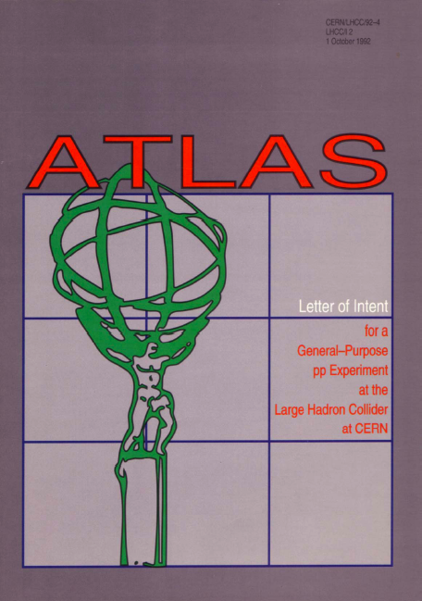

M&O MOU operation MOU
2003
LOI letter of intent 1992
MOU memorandum of understanding
RDxx
RD20
RD27
RD34
EAGLE
ASCOT
RDyy
TP technical proposal 1994
RD13
RD3
RD6
1989
TDRs technical design reports from 1996
Beam 2008
Phase -1
Design Phase
Construction Phase
Exploitation Phase

Slide 29
M&O MOU operation MOU
2003
LOI letter of intent 1992
MOU memorandum of understanding
RDxx
RD20
RD27
RD34
EAGLE
ASCOT
RDyy
TP technical proposal 1994
RD13
RD3
RD6
1989
TDRs technical design reports from 1996
Beam 2008
Phase -1
Design Phase
Construction Phase
Exploitation Phase

Slide 30

Each TDR is submitted to a independent review process (international pier review, LHCC committee which report to the CERN research director and not to the ATLAS project)
Memorandum of Understanding. Gentlemen agreement between collaborating institutes/laboratories, defining the relative responsibility in term of deliverables. In some cases few institutions cluster around the same deliverable, because of its complexity. Who sign up for a deliverable takes a moral, financial and technical responsibility. MOU are then signed by the funding agencies (governments)
MOU

Slide 31
90% of the technology was fixed in 1992/1993 how is it possible for it to still be at the leading edge in 2011?
We are not just customers of technology
We are partners in developing it
We are often proponents and often drivers
Our incredible network of universities and national laboratories allows us to have a privileged overview
Therefore we are favorably seen as potential promoters of spin-offs
……

Slide 32
90% of the technology was fixed in 1992/1993 how is it possible to keep flexibility in order to adapt to new needs or findings
Different stages of the project co-exist during the entire life of the project (R&D, prototyping, engineering design, mass production, tests in particle beams, statistical methods optimization, simulation ….)
We acquire technology when it is really necessary (see computer power …. which hasn’t reached full capacity yet)
Part of the community is busy keeping the detector and software evolving (upgrade scenarios established for the next 20 years)

Slide 33
CORE Costing
(industrial contracts, material, …)
Political figure
(~xxx M$)
imposed up-front by the CERN directorate
Common Projects 44%
Adopted by all partners as 1996 investments baseline
Offline computing not part of it

Slide 34
Institutions deliverables
Organized in detector systems (sensors!)
Each system is like a Colloboration of various institutes within the ATLAS Collaboration
Each system has its own organization, with management and institutes boards
Each system is responsible to deliver a part of ATLAS to central ATLAS + its maintenance and operation. Each system defines its deliverables (type B costs) and is fully responsible of it
ATLAS monitors the process (quality, schedule), but no central accounting !!
Overcosts and institutions manpower are on the institutions responsibility

Slide 35
Institutions deliverables
Systems and sub-systems as clusters of various institutions of different funding agencies
Avoiding one funding agency to control the entire process, gives more flexibility and internal contingency
Central ATLAS organize frequent internal reviews of the process in a very detailed way. Where necessary and in case of major problems help is injected using common funds
CERN purchasing infrastructure is used to solve and facilitate industrial contracts where required by institutions clusters

Slide 36
Common Projects
All what can not be handled by individual institutes or clusters.
Parts of common utility:
infrastructures, services, installation at CERN, magnets, cryogenics, labs, mechanical structures, radiation shieldings, control rooms, safety projects, overall commissioning and M&O …
Common Projects 44%
Full costing, including manpower and engineering
Full accounting reports to RRB (twice/year)

Slide 37
Resources Allocation
  On sub-system level, resources are made directly available by national FAs and consumed by participating institutes at home. The related cost categories and available resources are:
    R&D, Prototyping, Infrastructure, Personnell
    Direct material costs e.g. components, production (used for RRB CORE reporting)
  On the Common Fund level, allocation of centralized resources are based on approved project planning and corresponding income collected from FAs as part of their MoU commitments
  CORE resources are monitored and reported in the RRB
  Relationship between time/resources/schedule
    “Time is our contingency”. The budget has no contingency so very hard to recuperate lost time when encountering technological problems
    Note: lack of income or resources from a FA at some given moment never actually resulted in a serious delay. In some cases, work got re-organized and responsibilities re-arranged
    CERN (as Host Lab) permitted temporary budget over drafts, against firm financial pledges

Slide 38
Scheduling
  The schedule has the following structure
    Top-down (Start-up date of the LHC accelerator)
    Bottom-up (Sub-system construction and global integration and commissioning)
  Schedule uncertainties and unforeseen change consequences are addressed by
    Scenario planning; critical path analysis
    Work package analysis and reformulation
    Installation simulations
  The schedule format suggests high initial degree of parallelism across the subsystems; later more sequential as components arrive at CERN
  Contingency management
    No explicit contingency in the schedule planning, a part a 3 months ready for installation early delivery
    Delays in a given sub-system construction pushes full detector commissioning date accordingly
    However: Through re-organization of work packages in other sub-systems and changes in priorities, some contingency can be generated, but at the cost of taking some level of risk
    Main driver of the ATLAS schedule the LHC machine schedule changes

Slide 39
Which technologies did we cover during construction this way?
Silicon pixel detector (80M channels)
Silicon strip detector (~100 m2 of silicon micro strips )
Diamond pixel/strip detectors
Gas straw detector using transition radiation effect (300000 straws)
Liquid Argon electromagnetic sampling calorimeter (300 tons)
Scintillating Tiles calorimeters (42 tons of scintillator, 1100 km of readout fibers)
Scintillating fibers techniques
Cerencov counters
Large area gas drift chambers for muon detection (precision and trigger)
Radiation hard nsec electronics, mostly digital
Analog and Digital pipeline
Optical fibers readouts and transmission
Superconductivity and cryogenics
Complex mechanical structures analysis, seismic analysis, composite materials
Ultra vacuum techniques
Detectors, cables and electronics cooling
Large scale connectivity, DC-DC power converters technologies, HV technologies
PVSS slow control architecture
Scalar data acquisition and multilevel trigger systems, large computing farms
GRID environment
Fancy (spectacular !) transports and logistics

Slide 40
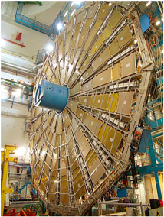
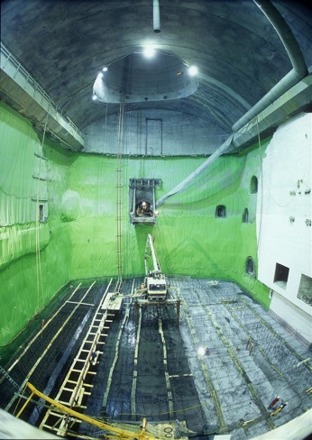
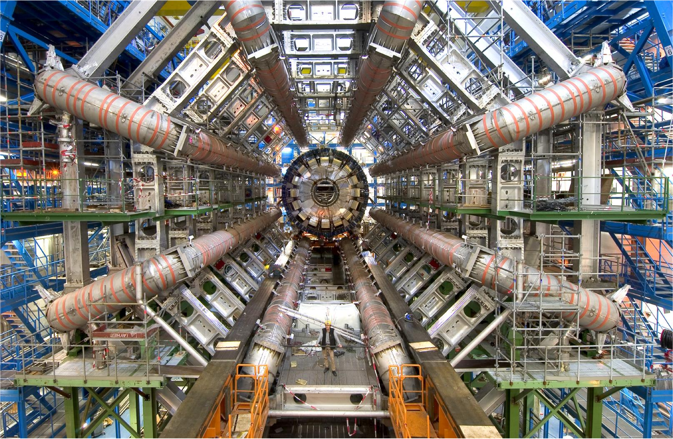
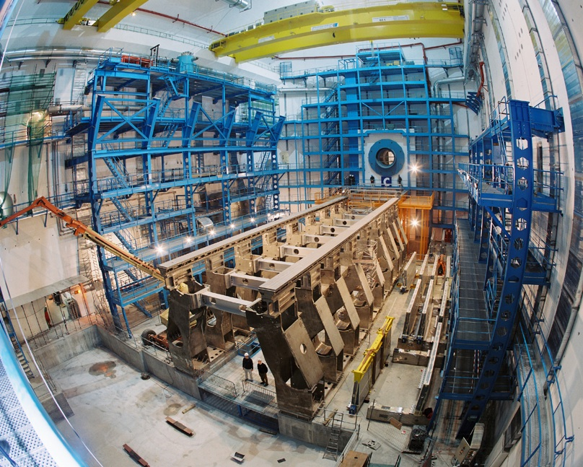
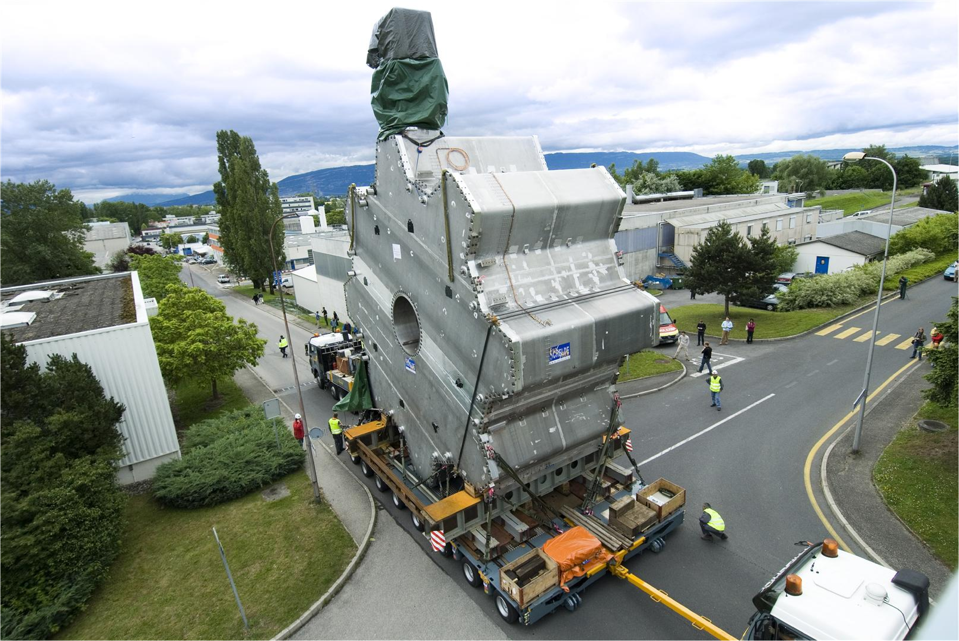
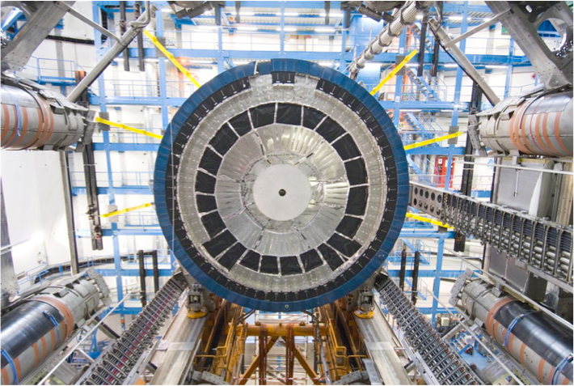
HARDWARE examples
civil engineering
Super-conducting toroidal magnets
Muon big wheels
Metal structures
End-cap toroid magnets
End-cap cryo calorimeters

Slide 41
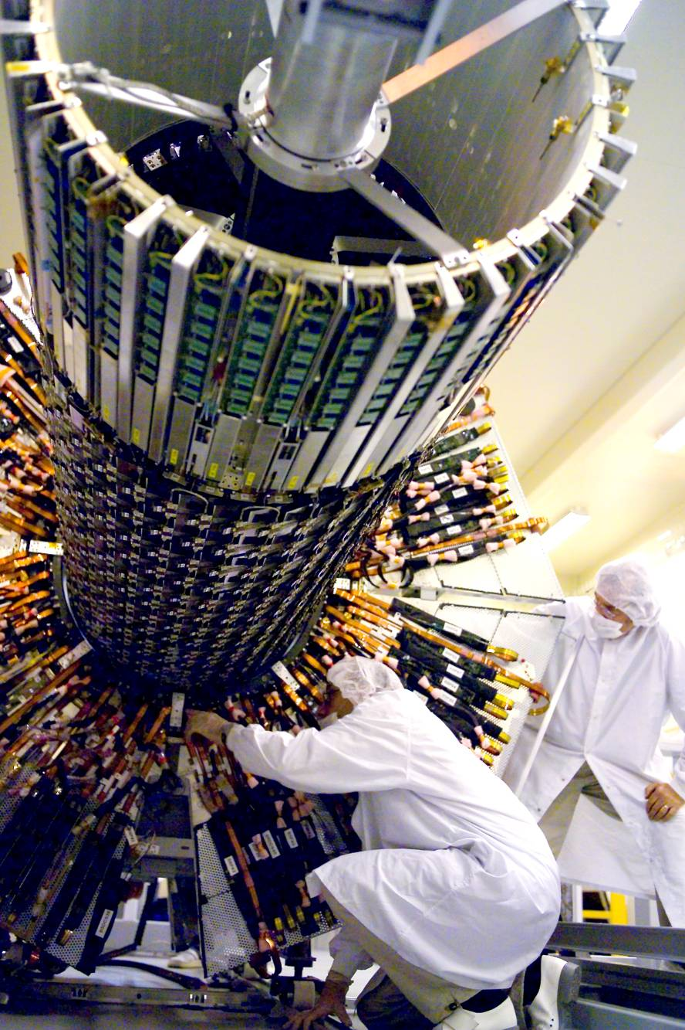
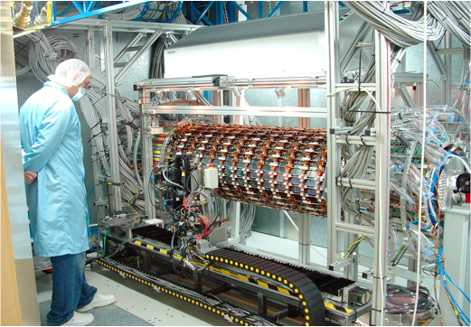
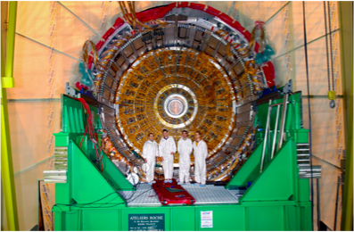
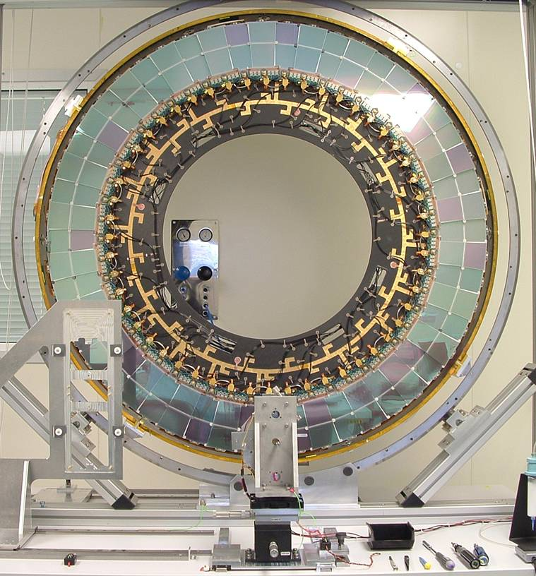
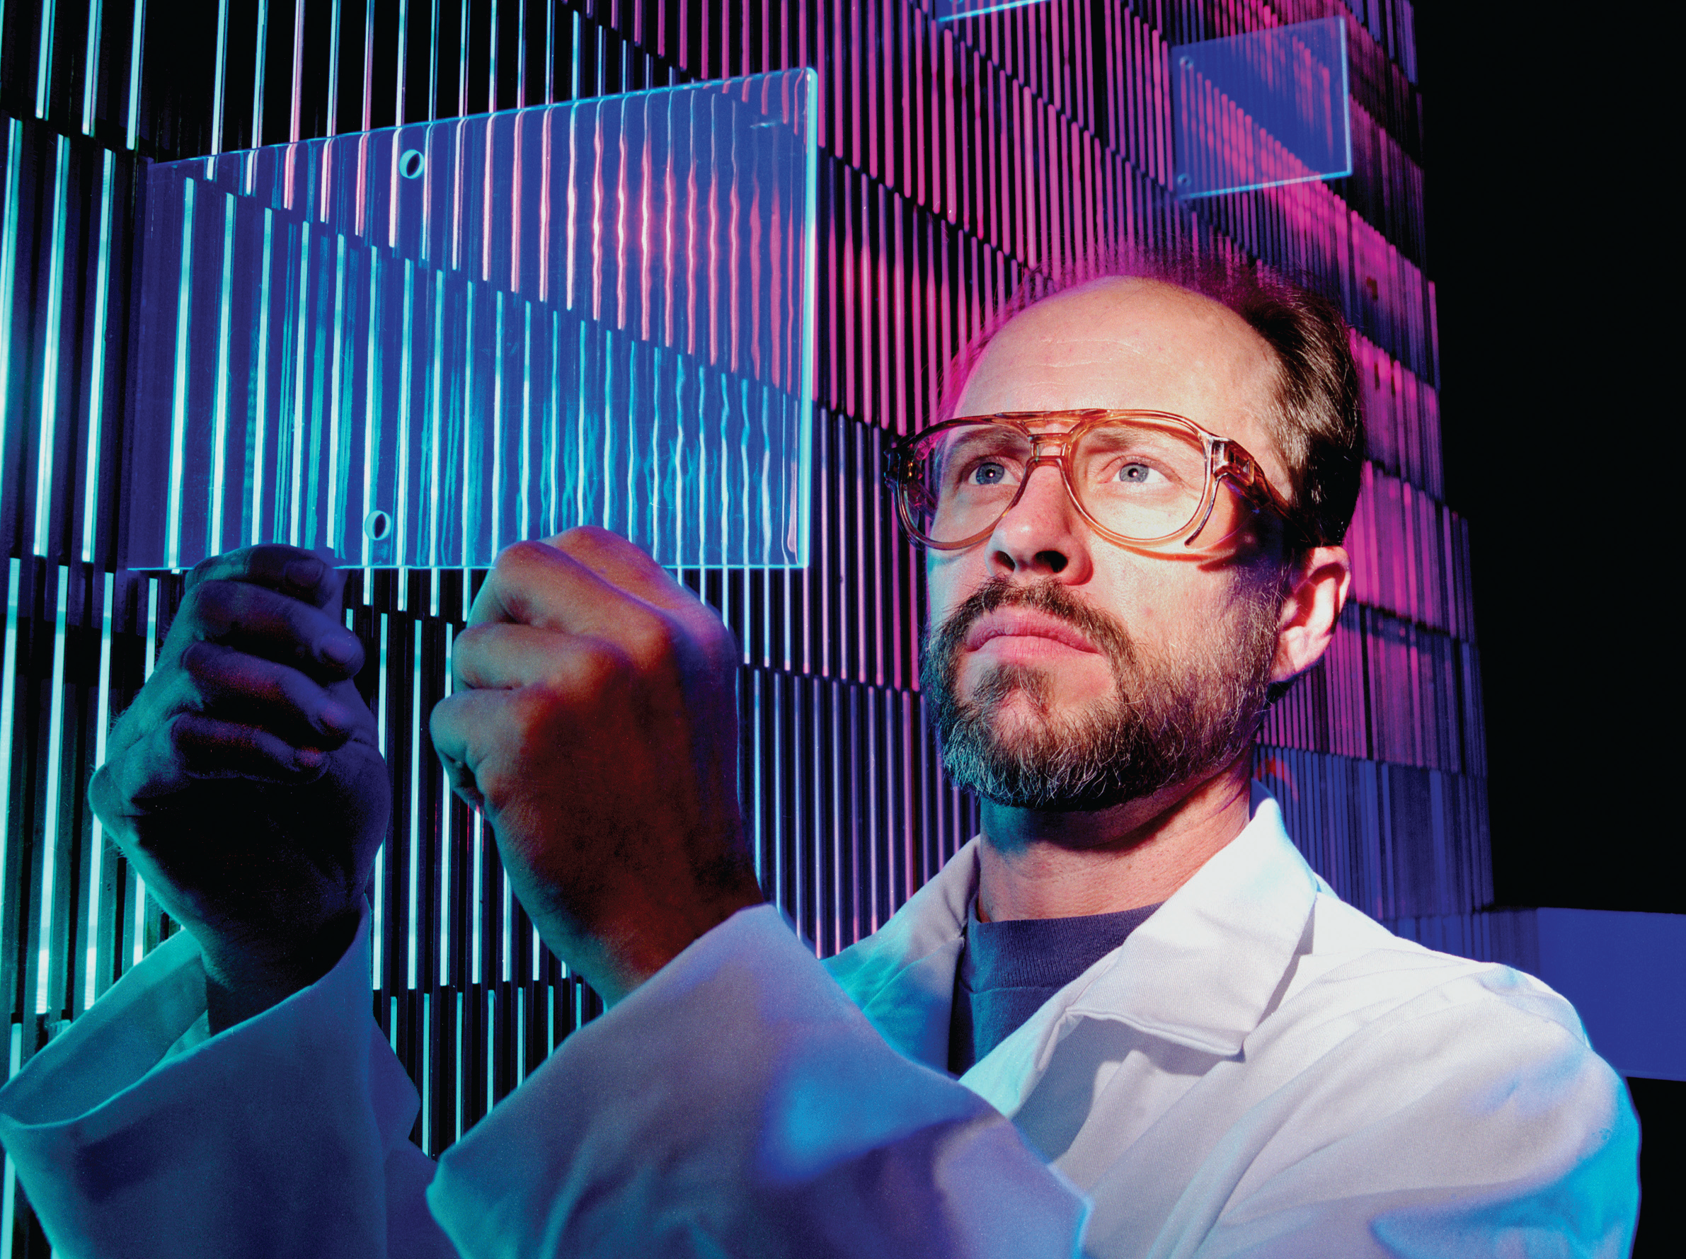
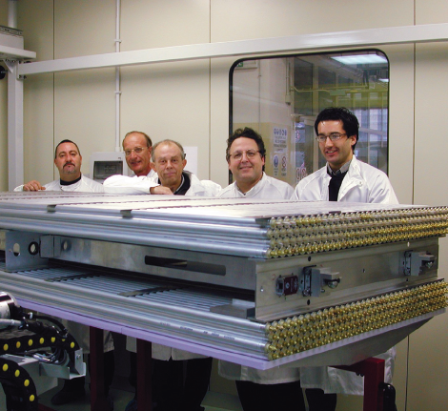
HARDWARE examples
Silicon strip detector
LAr accordion calorimeter
Silicon tracker
Silicon strip disk
Scintillating tiles calorimeter
Monitored drift tubes

Slide 42
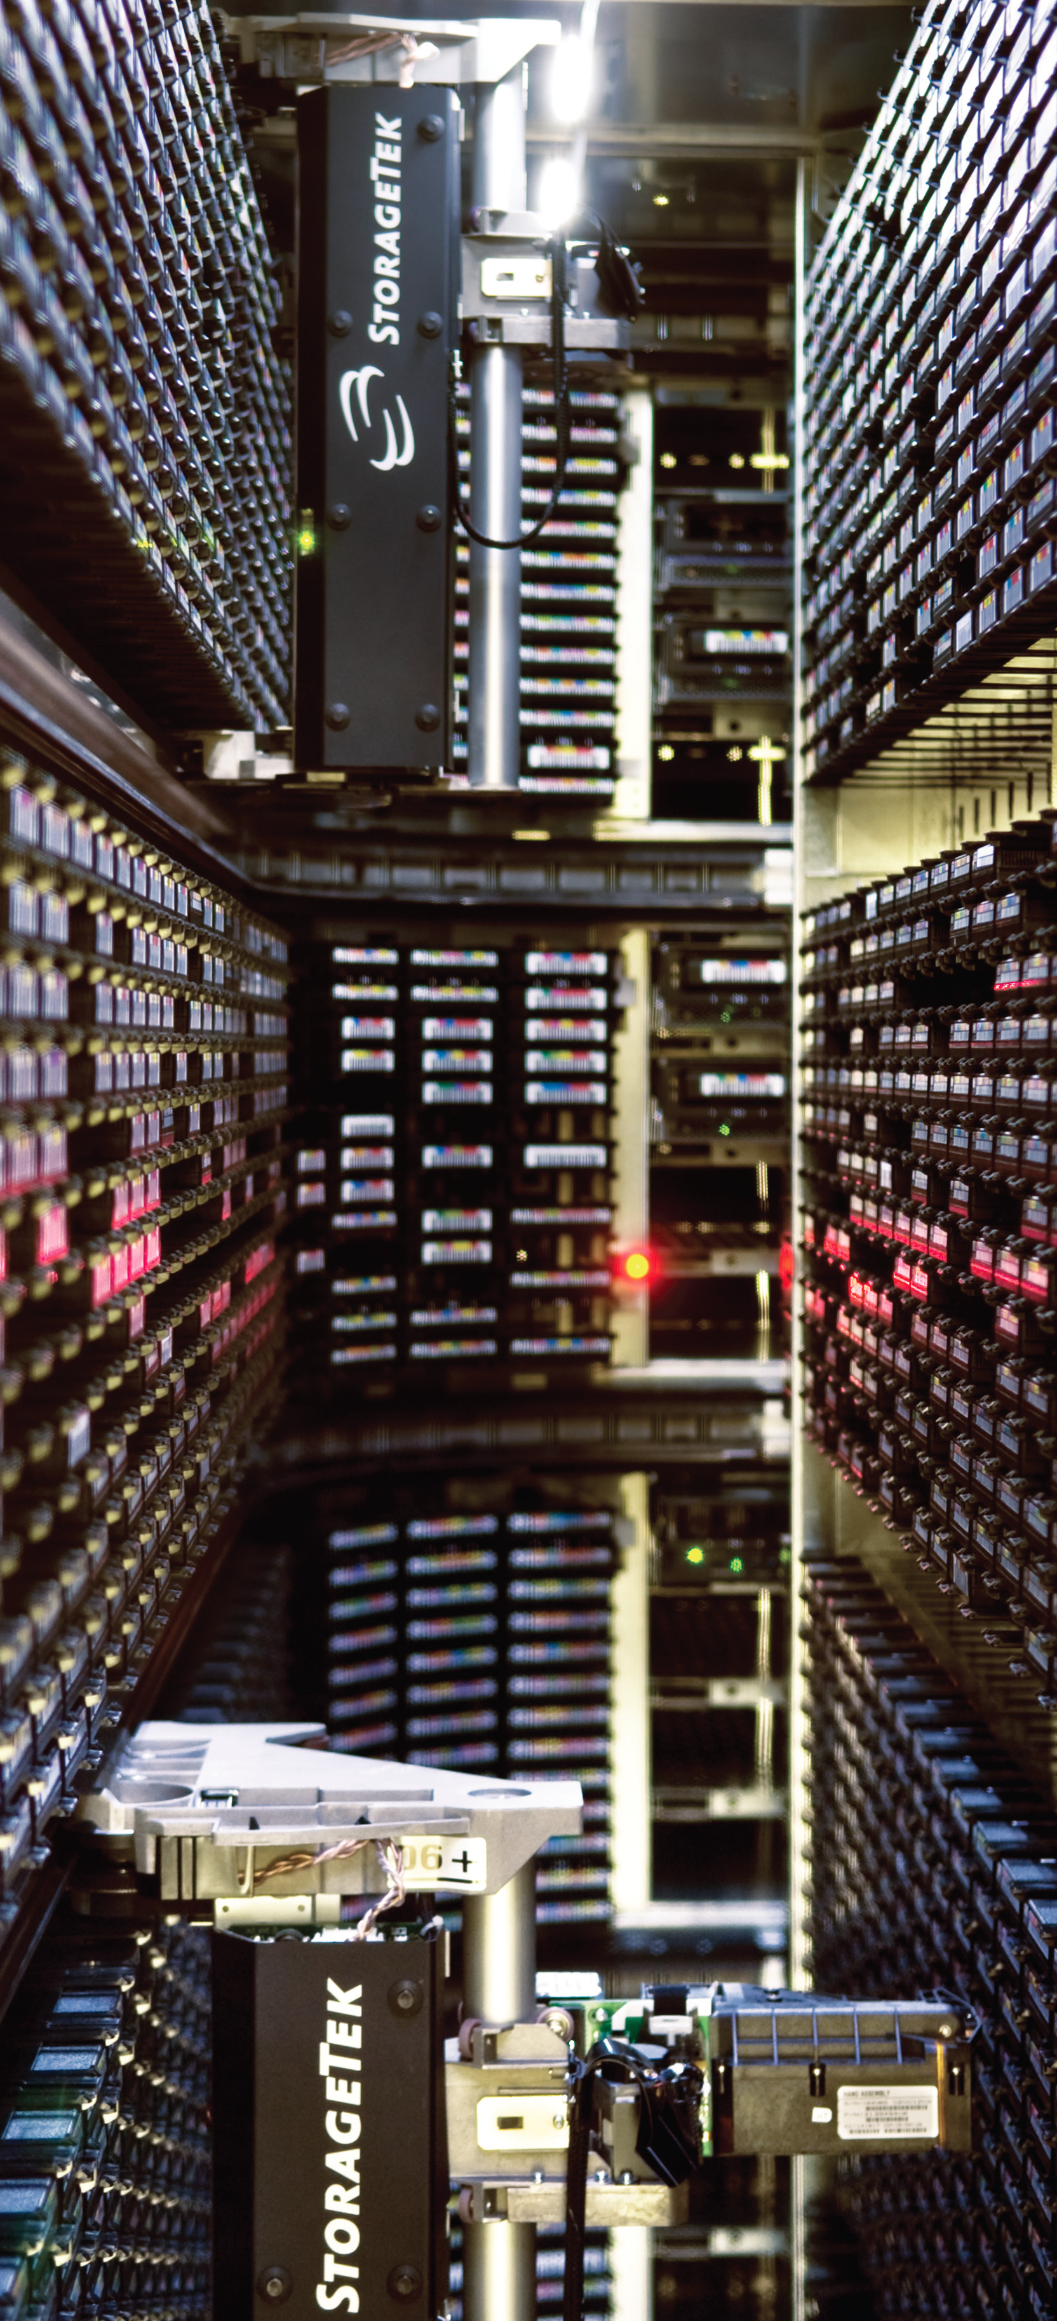
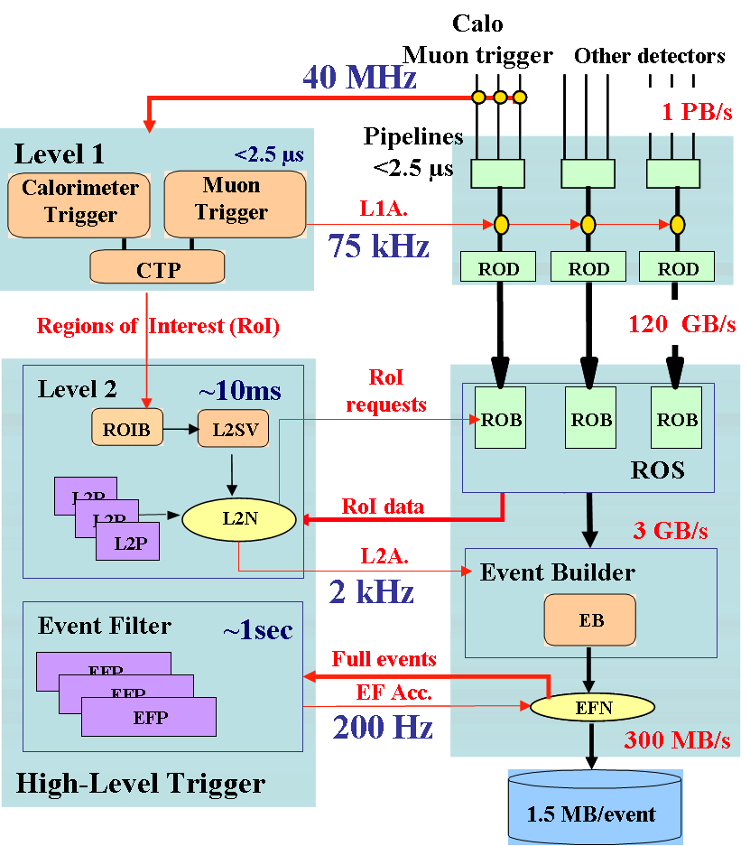
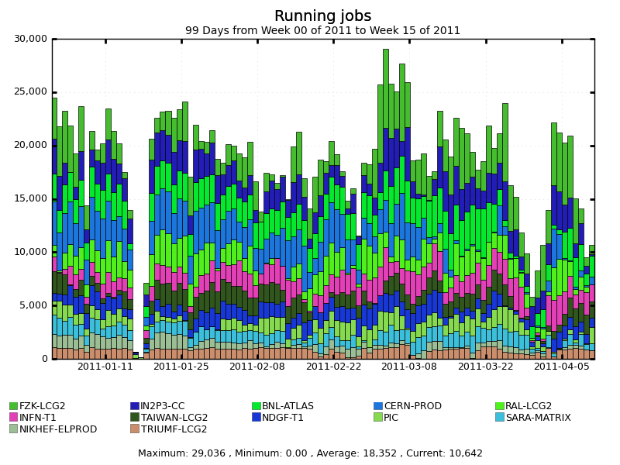
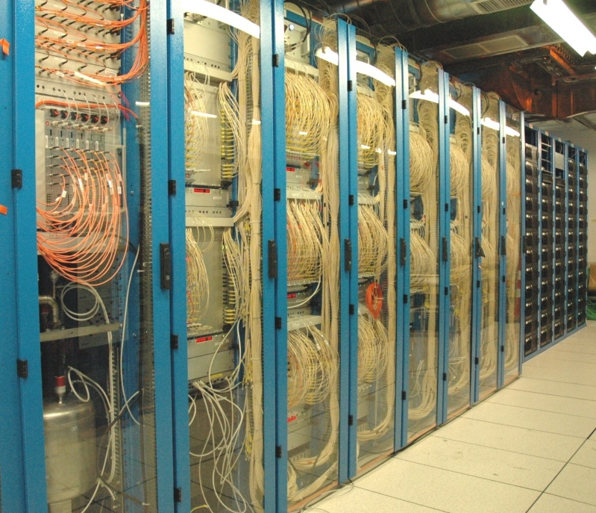
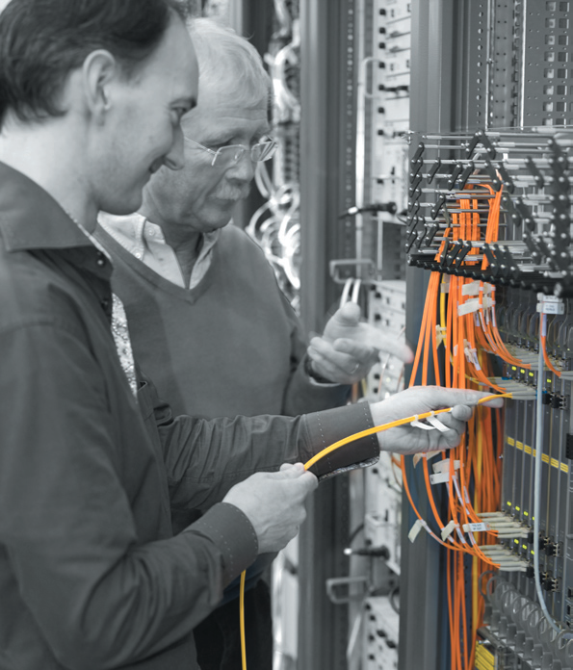
Computing examples
Hardware
Total throughput of ATLAS data through the Grid: from 1st January to mid September
Database
migration
> 6 GB/s
-- 6 GB/s
Grid-based analysis in 2011 : > 1100 different users, > 22M analysis jobs
> 1000 different users, > 15 million analysis jobs processed

Slide 43
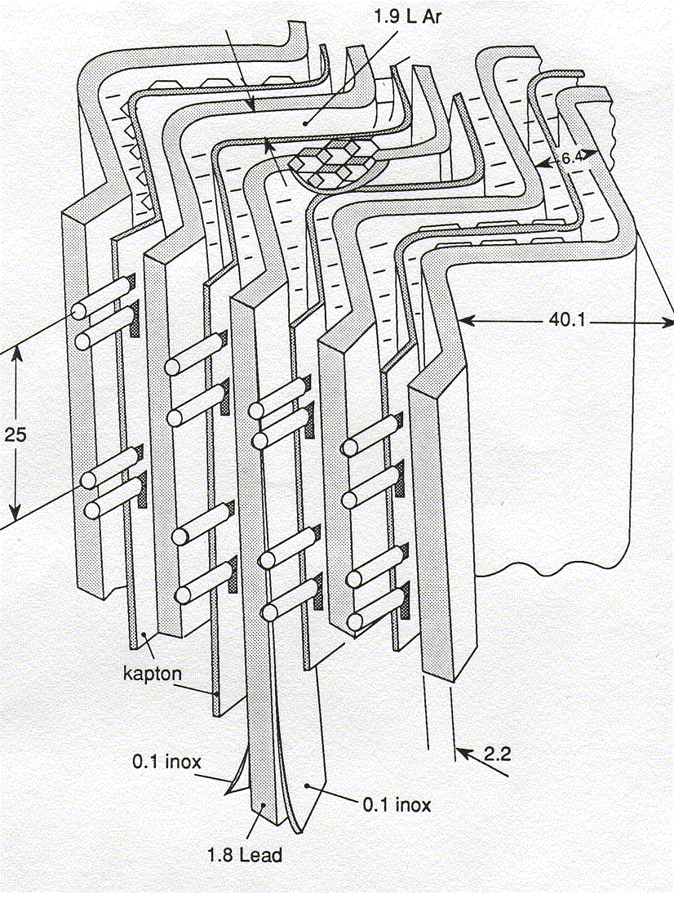
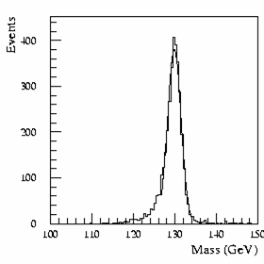
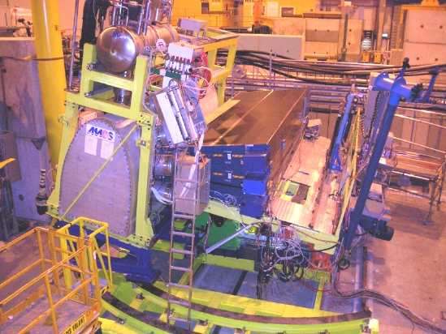
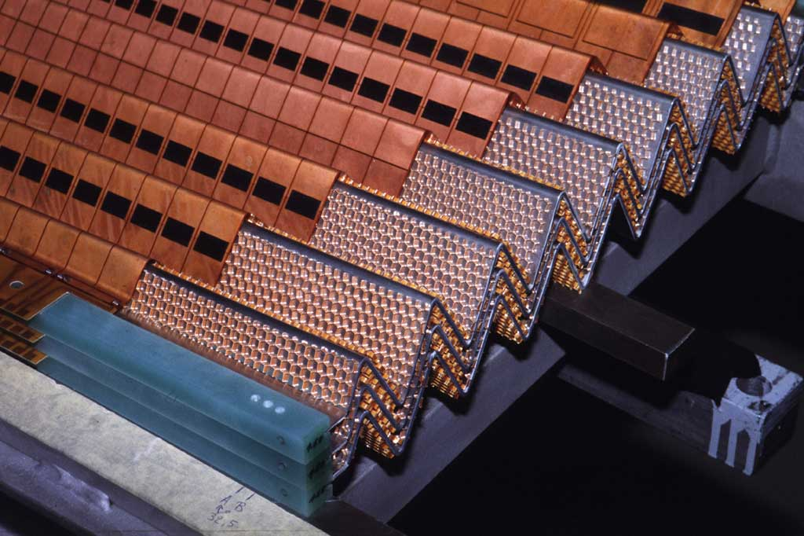
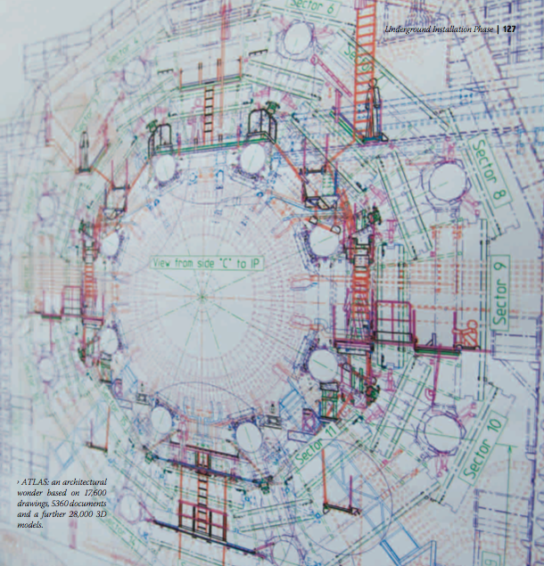
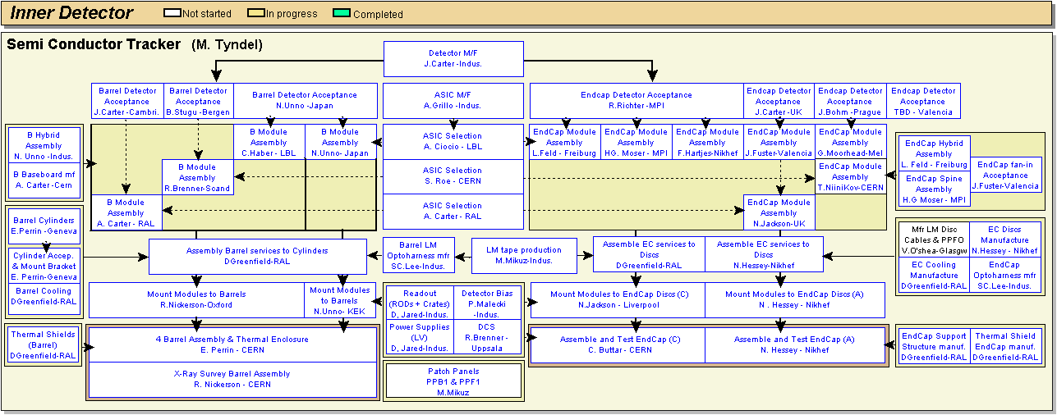
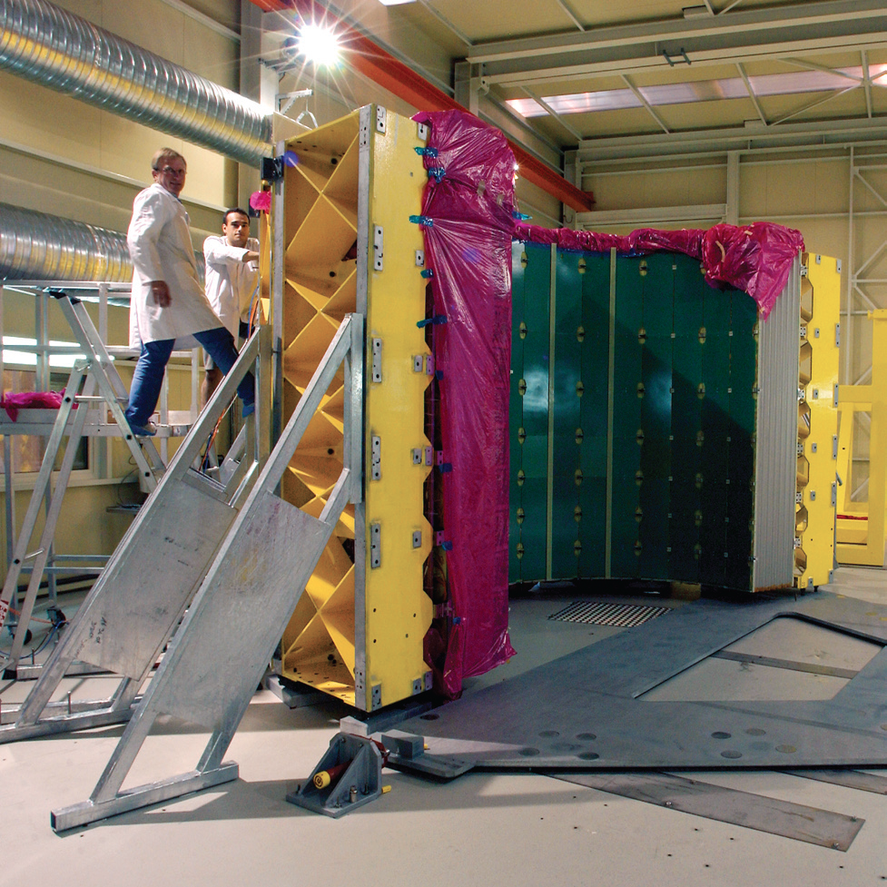
20 years of history
H → 4 e
Initial idea
Full GEANT simulation
prototyping
Tests with beams
Full scale design
Engineering reviews
Mass production organization
Surface preassebly and tests

Slide 44
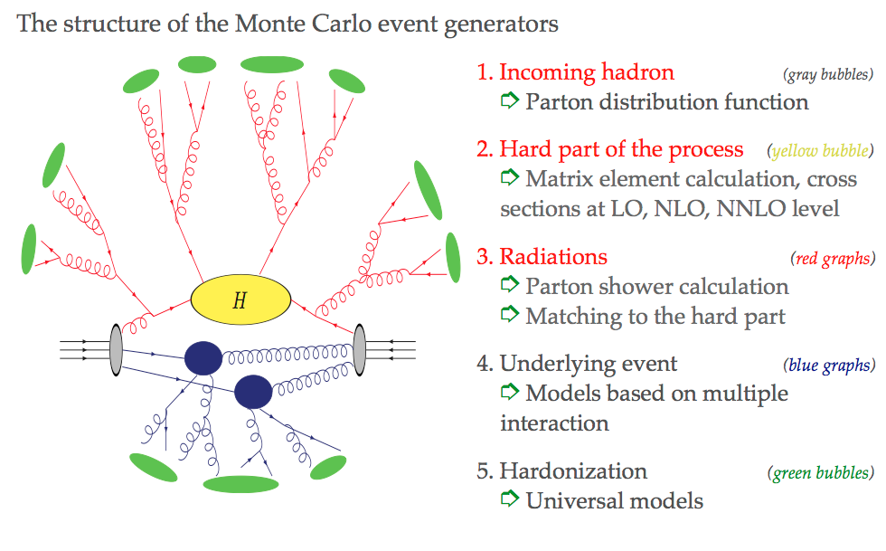
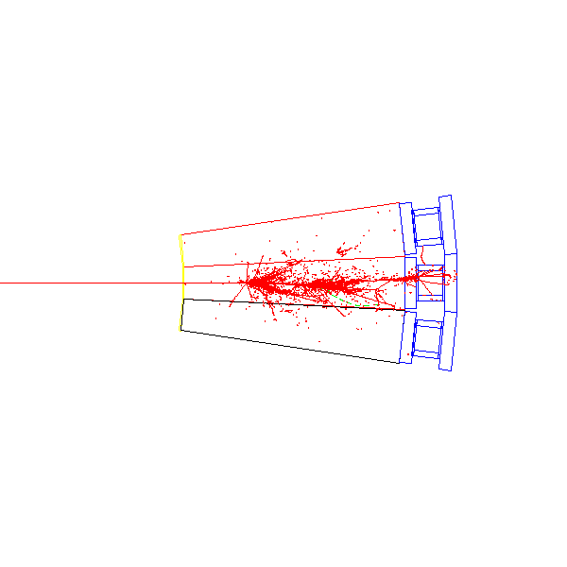
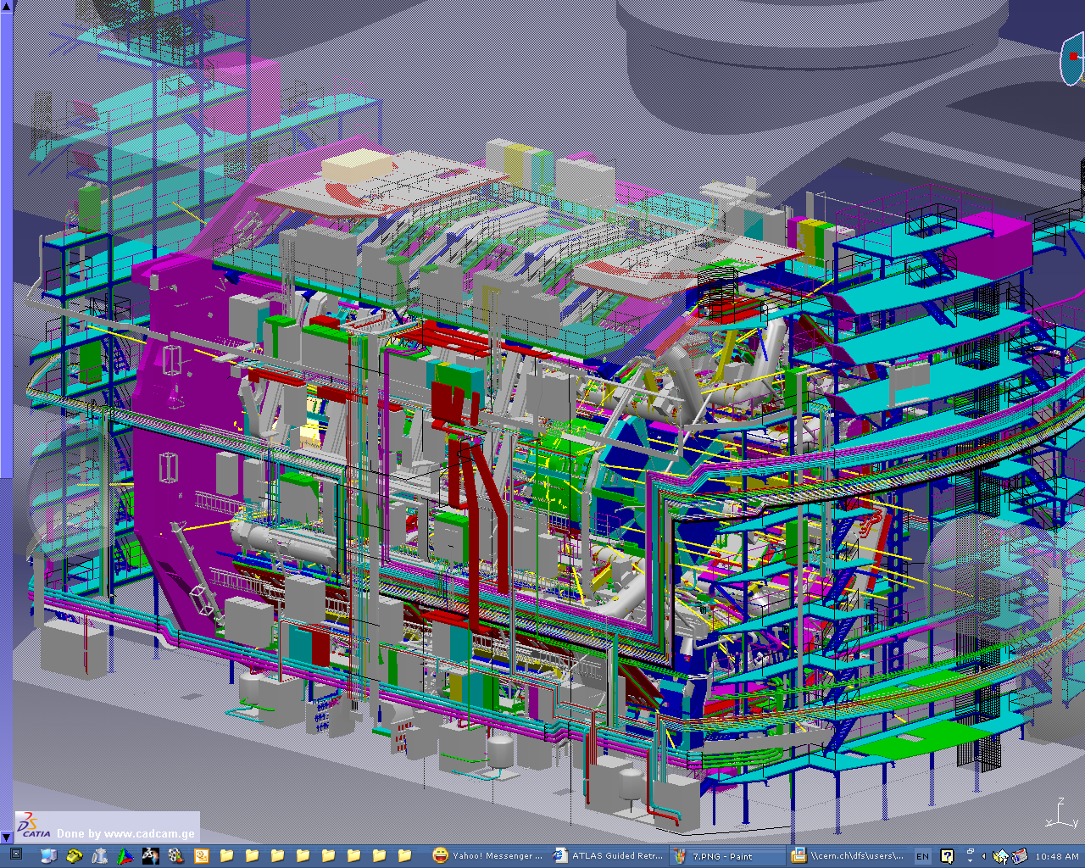
Strong emphasis on simulation ! (from detector design and problem definition, to the final analysis of the data!)
Basics physics processes simulation at the parton level
Detector response simulation to visible particles, technology optimization (GEANT)
Engineering simulation of all details via CAD systems
Detailed simulation of the detector response through the physics reconstruction process vs. data
(all simulation packages)

Slide 45
The lessons !
Push R&D as far as possible
Bring services in the game in a early stage (power, cabling, piping, cooling, optical transmission, …)
Do not trusts competitive tendering
Avoid functional procurements specifications
Avoid behaviour : “ 20 years ago we did …”
Allow very critical but constructive opinions
Avoid single Funding Agencies monopoly on a technology
Bring out problems at a very early stage, no protection!
Bring software in as early as possible
Risk on new technologies (sub-micron vrs establ. nuclear tec.)
….

Slide 46
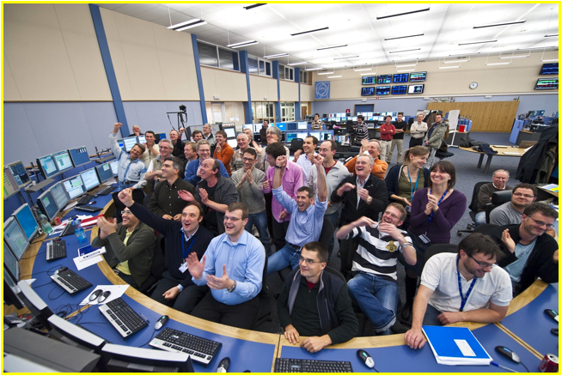
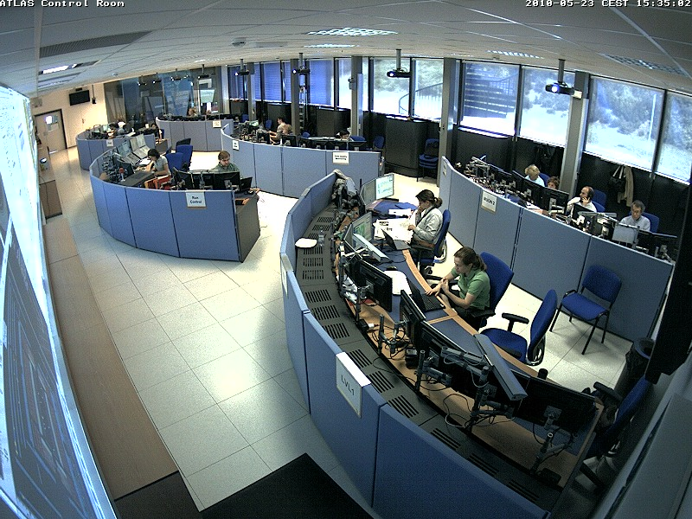
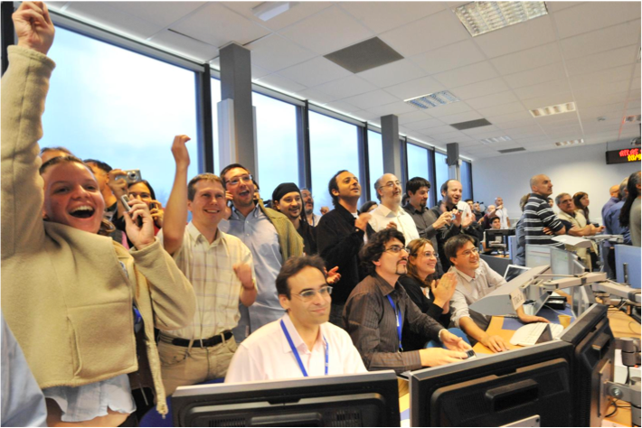

Status
Machine and experiments have restarted in November 2009, after a false start in 2008.
Still tuning the machine before going very far reaching the ultimate performance
L_{p} = 10³³ p/cm²/sec reached !
New discovery region entered !
Next run (2011-2012) goal : 7 TeV, 5-6 fb⁻¹?

Slide 47


OTP (Operation service tasks support)
Work organized in 3 classes (1-control room shifts, 2-expert shifts, 3-technical jobs)
2009 + 2010
1804/2596 active authors are doing service work (OTP) at the 25% level/year
1333/2596 active authors are taking shifts or are acting as experts on call
Physics duties for free!
2010

Slide 48

A rich program in front of us
- Every year 4 weeks of Heavy Ions (8 runs)
Every year a Xmas shutdown for 8-9 weeks
19 m shutdown in 2013/2014 -> LHC to nominal energy
12 m shutdown in 2018 -> Phase 1 upgrade
24 m shutdown in 2022 -> HL-LHC upgrade
→ Up to 2035

Slide 49







ATLAS Preliminary
1960s
1970s
1980s
Top quark physics (1990s)
High P_{T} QCD (1990s)
eμ + 2 b-tags

Slide 50





























Slide 51
Thanks!

Slide 52


Production tracking
For entire ATLAS :
1509 intermediate milestones to monitor
817 different main work packages (3 levels)
Centralized monitoring !!

Slide 53
Assembled components travel to CERN , a really global project !

Slide 54

Underground installation
Gigantic 20’000 m³ 3-D puzzle … 5 years of work

Slide 55

Underground assembly
~ 90M active sensors
~ 7000 tons of detectors
~ 3000 km of cables
~ 2000 tons of temporary supports
Infrastructure
Feet & supports
Barrel Toroid
Barrel Calorimeters
Cables & services
End Cap Calorimeters
Barrel Muon Chambers
Mid 2003
Inner Detector
Forward Muon Spectrometer
July 2008
End Cap Toroids
Shieldings
Pixel detector
End Cap Inner Detector
Commissioning with cosmics
Beam Pipe

Slide 56
The real detector : main job -> configuration control

Slide 57



Slide 58



Slide 60


5/19/11

Slide 61


Slide 62


Slide 63


Slide 64


Slide 65


Slide 66


Slide 67
The engineering process (part 1)
Define physics requirements (L.O.I, Letter of intent)
Design detector with simulation tool (GEANT)
Verify physics performance through full simulation
Construct a prototype and expose it to particle beams, to demonstrate performance
~ 5-6 years (R&D project)
Involve the engineers for a full detector design
Once the design exists, bring it back to physics simulation
Construct a module 0, defining the mass production chain
Validate module 0 in the test beams
Based on this experience, write a technical design report (TDR)
Commit the community via a MOU (a Memorandum Of Understanding)

Slide 68
The engineering process (part 2)
Make plans for mass production, prepare technical specs for procurements
Once ready pass an ATLAS internal readiness review
Funding agencies release funds according to the readiness rev.
Start material procurements, if contract large involve CERN in the administrative process (market survey, tender, adjudication,..)
~ 8-10 years of mass production
If production is done in several institutions, clone tooling
Produce components according to the agreement, ship it to the next step in the production chain
Progress monitored via a dedicated progress tracking tool (PPT)
Deliver production to ATLAS at CERN according to an agreed set of ready for installation milestones (normally 3-4 months before needed)

Slide 69
Status
Machine and experiments have restarted in November 2009, after a false start in 2008.
Still tuning the machine before going very far reaching the ultimate performance
L_{p} = 10³³ p/cm²/sec reached !
New discovery region entered !
Next run (2011-2012) goal : 7 TeV, 5-6 fb⁻¹?

Slide 70
OTP (Operation service tasks support)
Work organized in 3 classes (1-control room shifts, 2-expert shifts, 3-technical jobs)
2009 + 2010
1804/2596 active authors are doing service work (OTP) at the 25% level/year
1333/2596 active authors are taking shifts or are acting as experts on call
Physics duties for free!
2010

Slide 71
A rich program in front of us
- Every year 4 weeks of Heavy Ions (8 runs)
Every year a Xmas shutdown for 8-9 weeks
15 m shutdown in 2012/2013 -> LHC to nominal energy
15 m shutdown in 2018 -> Phase 1 upgrade
19 m shutdown in 2022 -> HL-LHC upgrade
→ Up to 2035

Slide 72
ATLAS Preliminary
1960s
1970s
1980s
Top quark physics (1990s)
High P_{T} QCD (1990s)
eμ + 2 b-tags

