Slide 1
BWS SPS Preliminary c-wire and tank heating plots post TS1 2023
J. Emery, F. Roncarolo, N. El-Kassem
30.06.2023

Slide 2
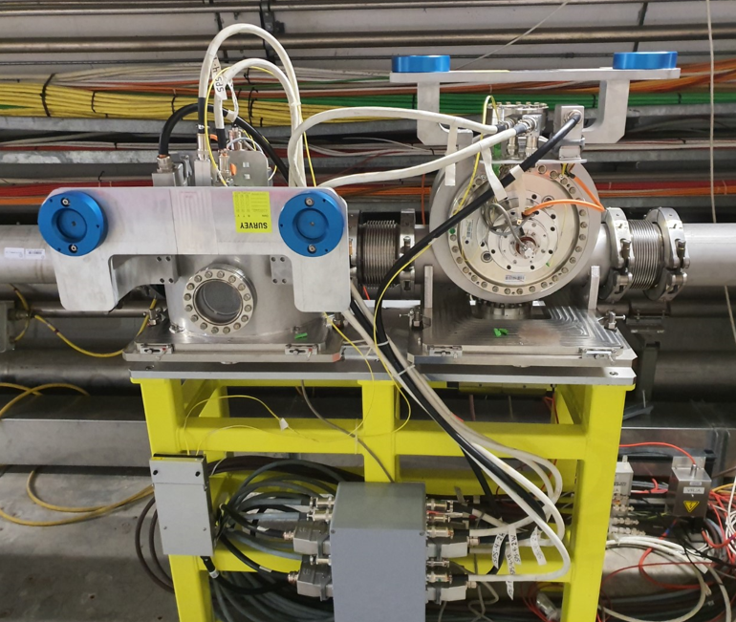
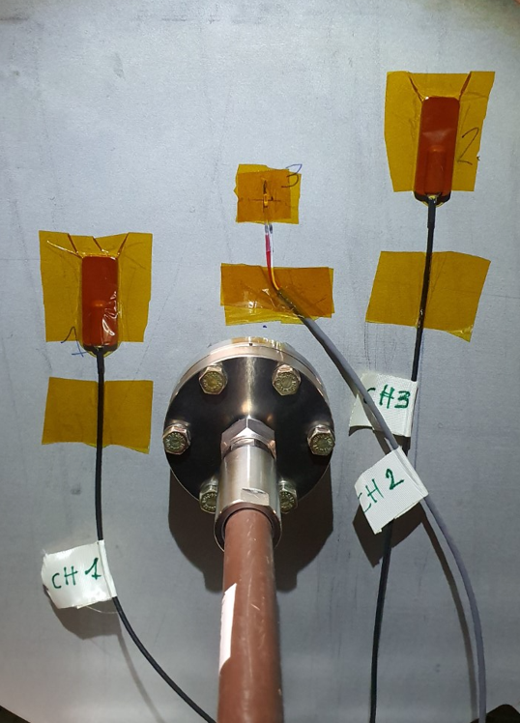
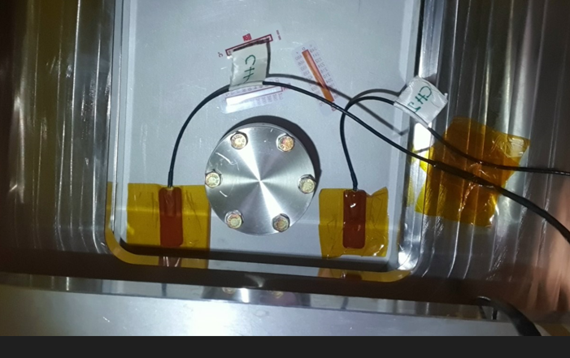
BWS SPS Preliminary wire heating plots post TS1
41678V PT100 prob
TS1 2023 (20.06.2023): - BWS 41677 exchanged mechanism rotated from V to H +6 ferrites at the bottom of the tank +temp sensors (passives + 2 PT100)
- BWS 41678V exchanged mechanism +5 ferrites at the bottom of the tank +temp sensors (passives + 3 PT100)
41677H PT100 prob

Slide 3
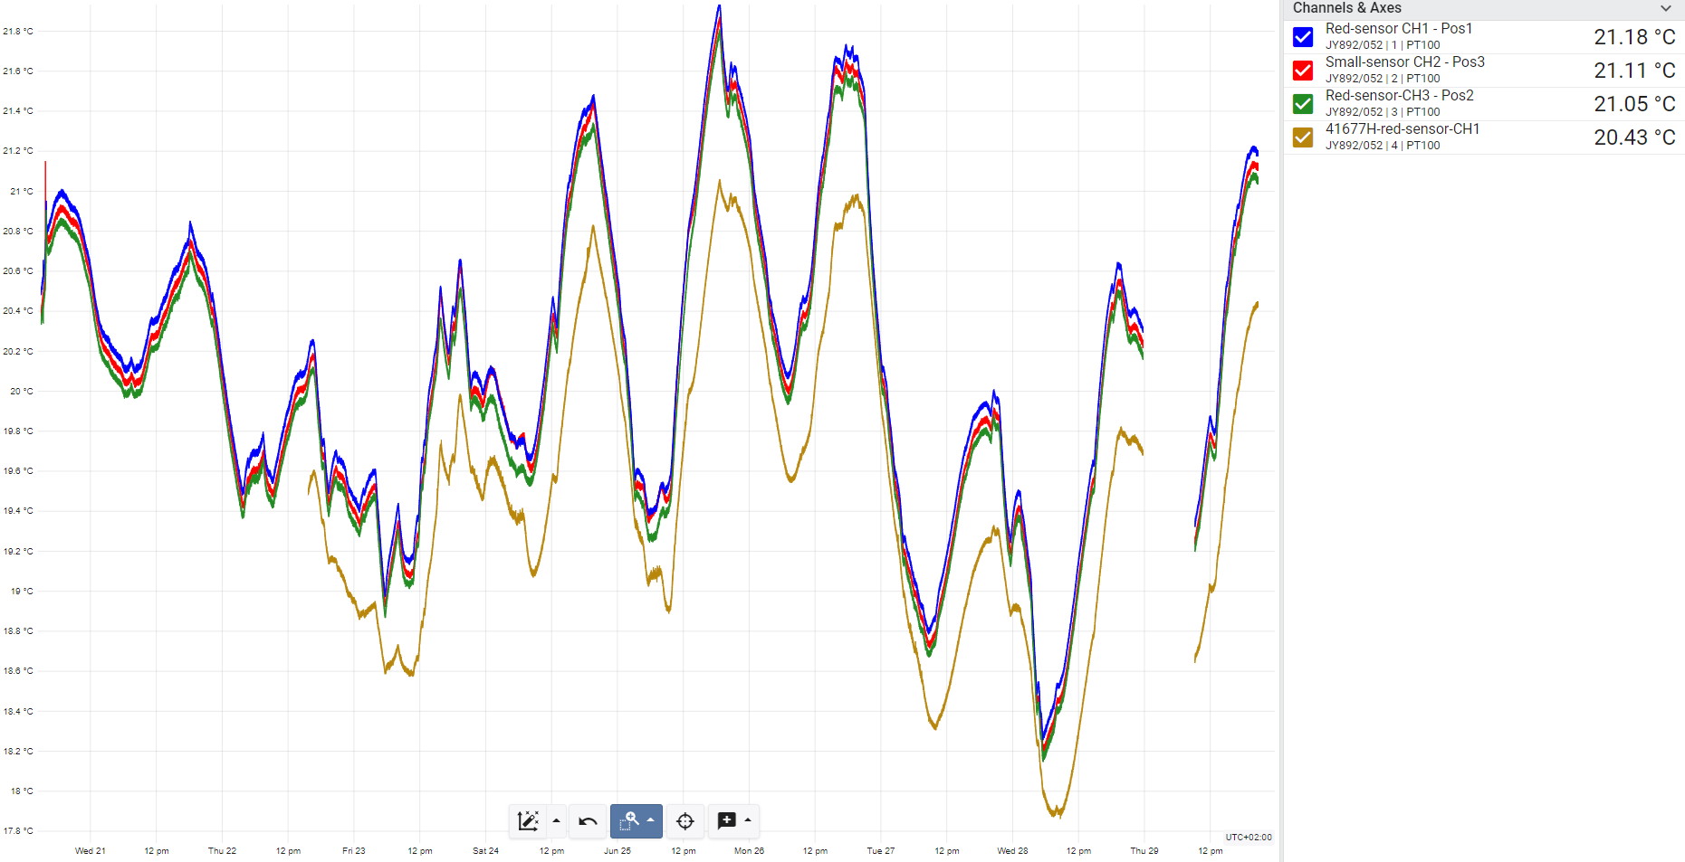
BWS tanks temperatures (PT100 in-air side of the wall)
21.8
3 sensors 41678V
Temperature degC
20.0
1 sensor 41677V
25
26
17.8
21
22
23
24
27
28
29
30.60.2023

Slide 4
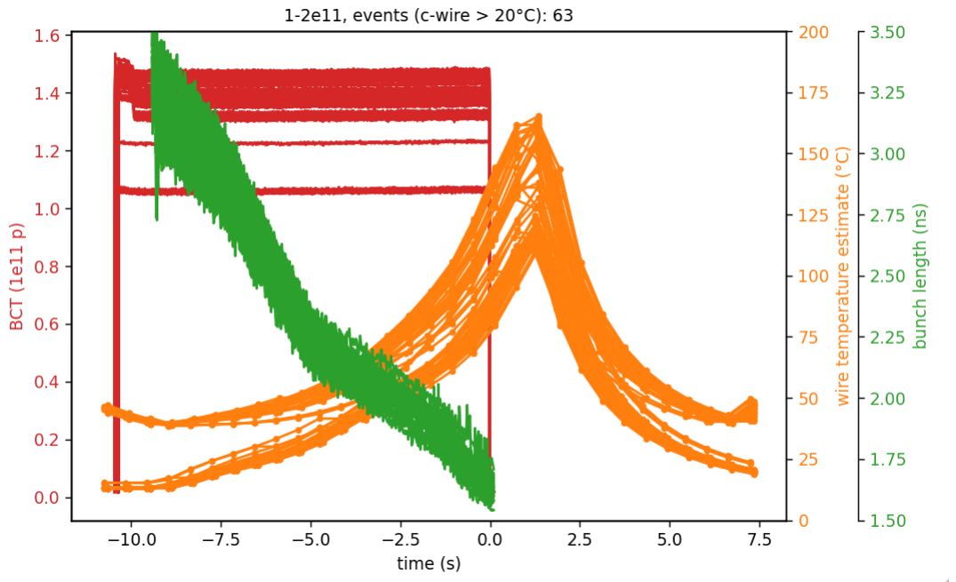
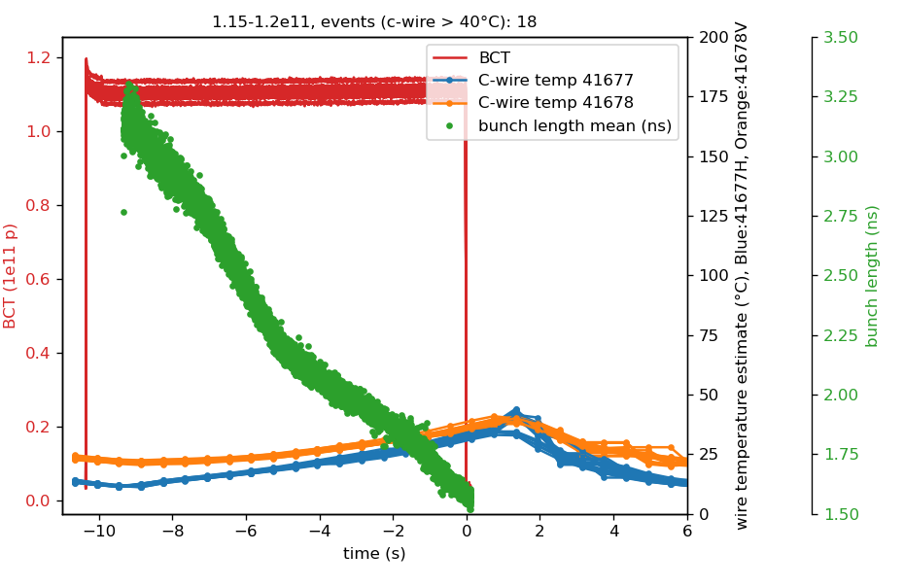
One bunch
41678V 21-22.04.2023
41677H & 41678V 22–29.06.2023
TS1

Slide 5
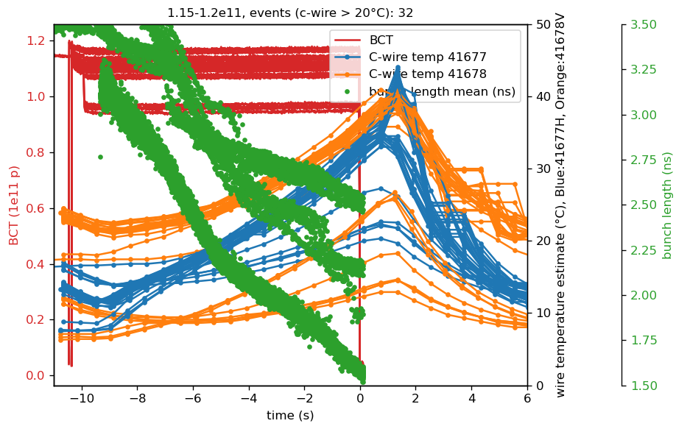
One bunch
41677H & 41678V 22–29.06.2023

Slide 6
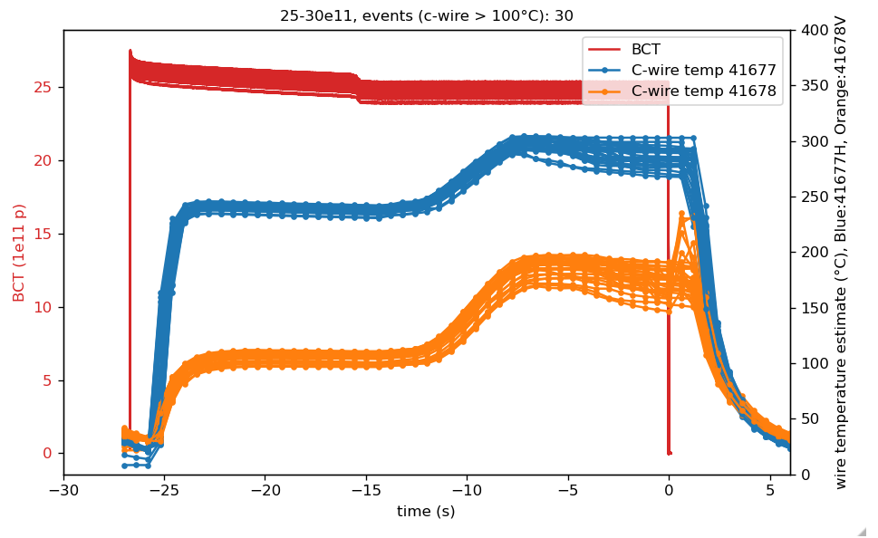
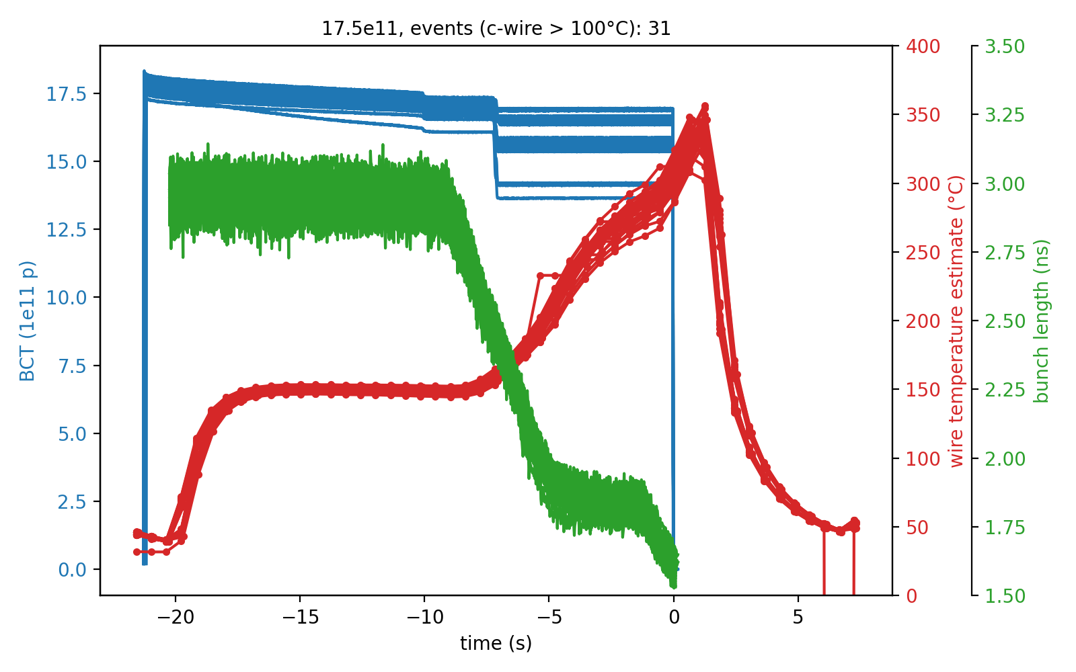
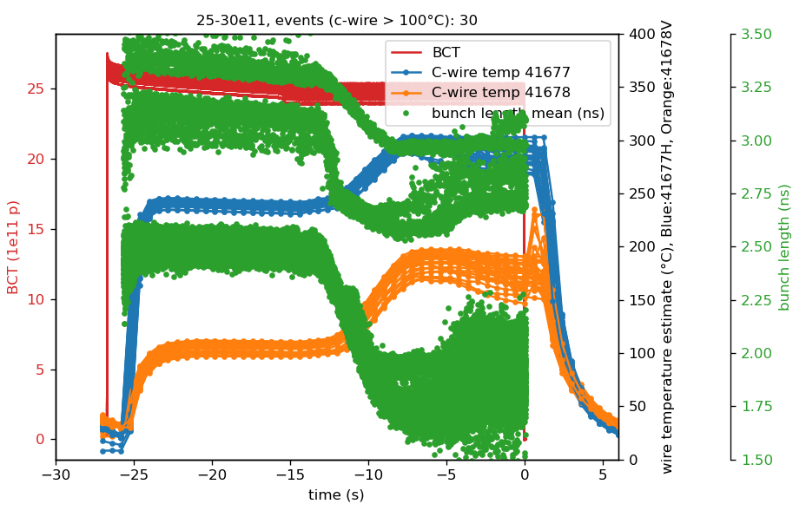
17.5e11p
41677H & 41678V 22–29.06.2023
41678V 21-22.04.2023
TS1

Slide 7
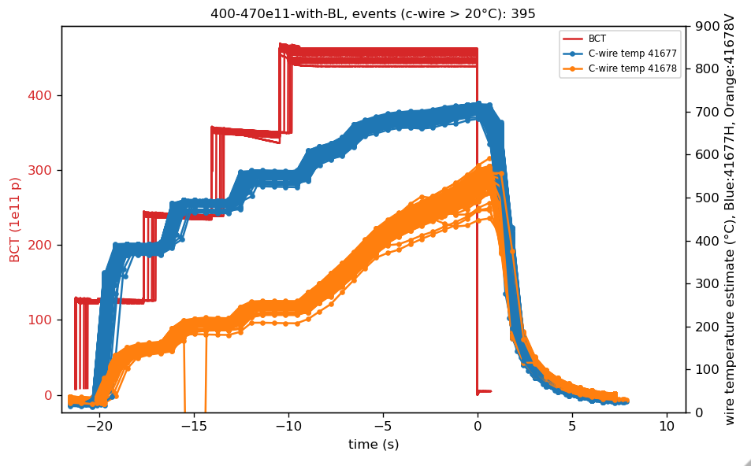
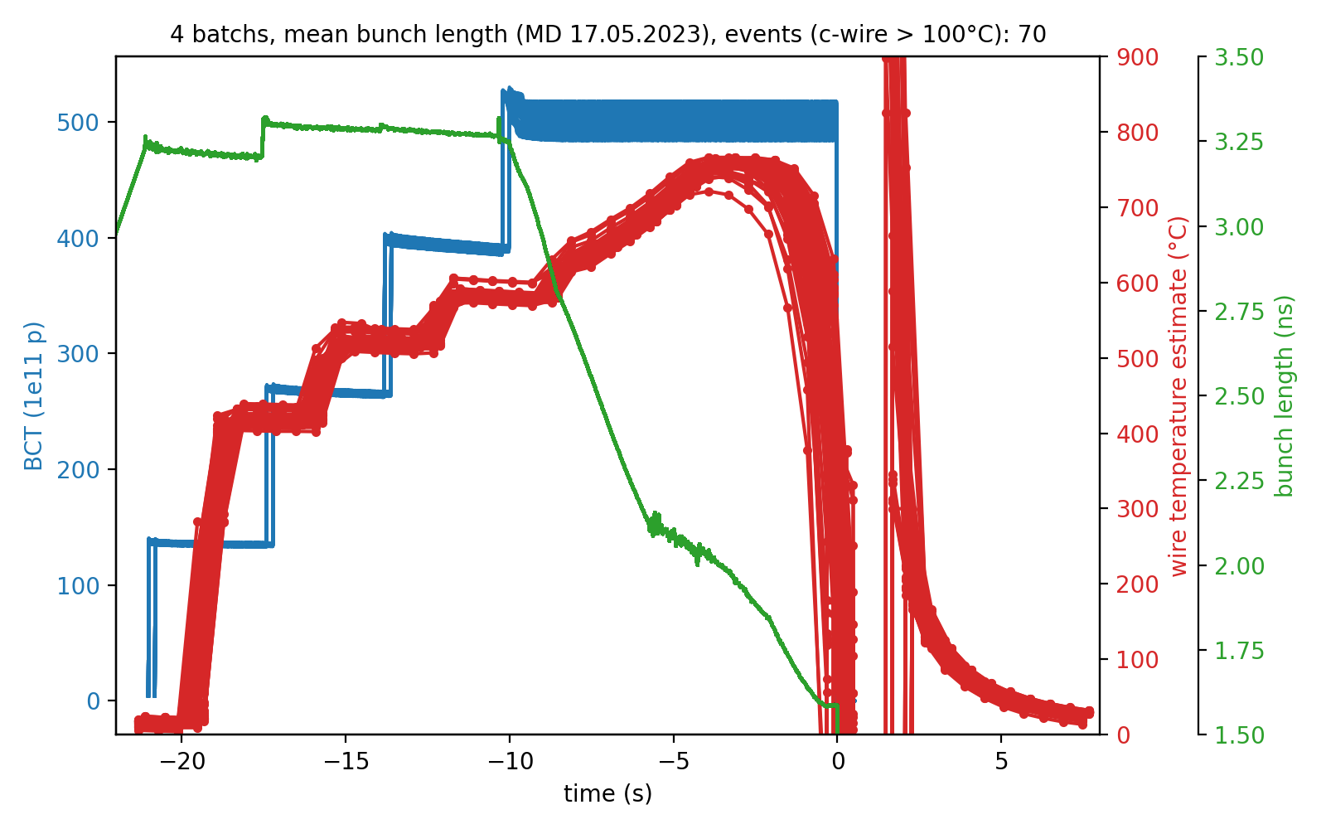
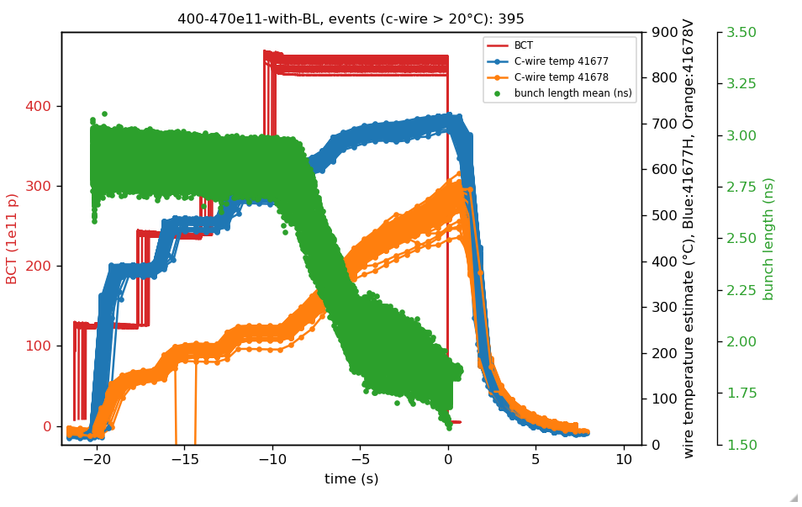
4.5-5.0e13p
41677H & 41678V 22–29.06.2023
41678V 21-22.04.2023
TS1

Slide 8
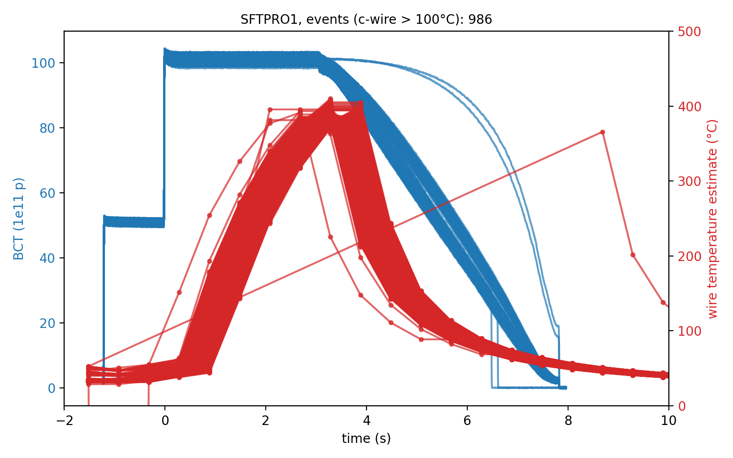
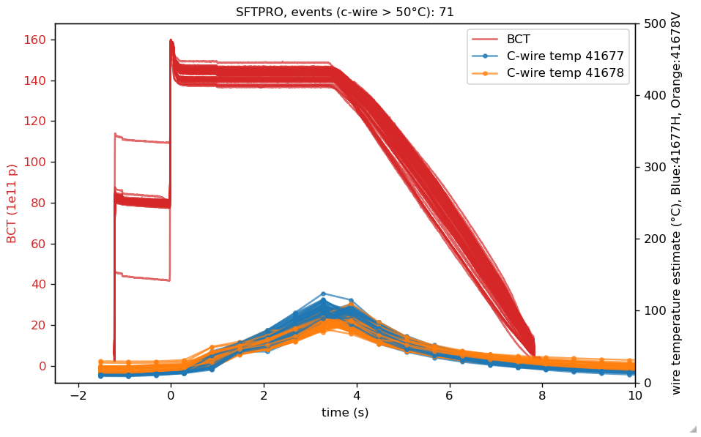
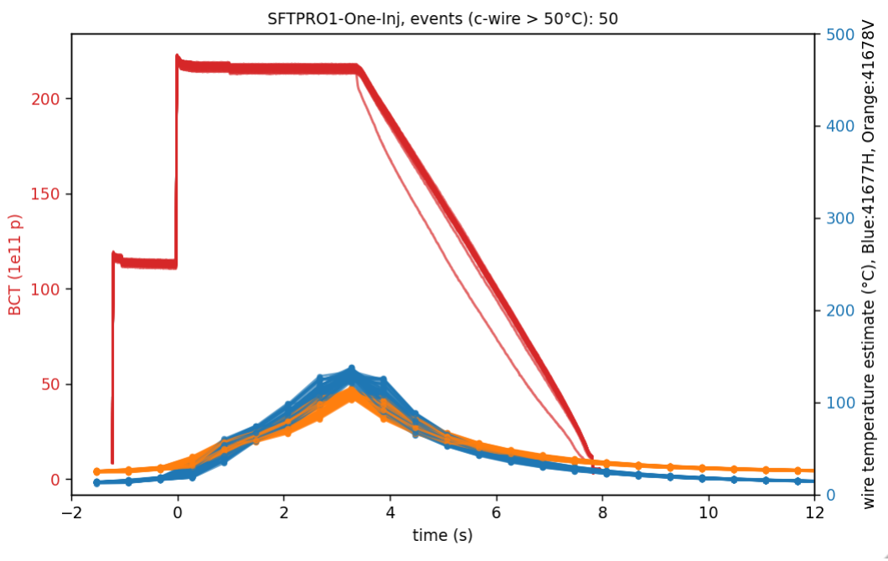
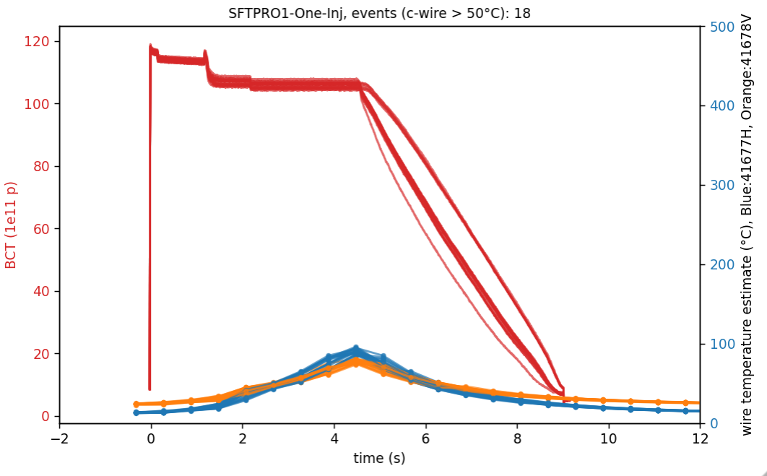
SFTPRO
41678V 21-22.04.2023
41677H & 41678V 22–29.06.2023
TS1

Slide 10
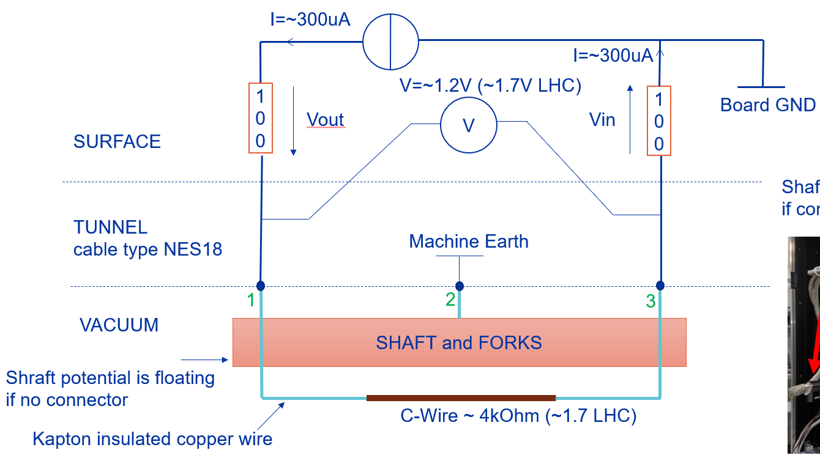
LIU-BWS c-wire measurement circuit
Fundamental principle kept from previous generation of scanners
A constant current is injected from the surface. The return current and the voltage across the c-wire is measured.
The resistivity is evaluated using the injected current ~constant and the changing voltage.
Temperature estimated with - standard thermal coefficient (carbon graphite) - assuming a uniform heating along the wire
=> EMI not excluded to contribute to the signal
ADC @ 200kHz down sampled with median filters and averages down to 1.5Hz for the logging (as presented today)

Slide 11
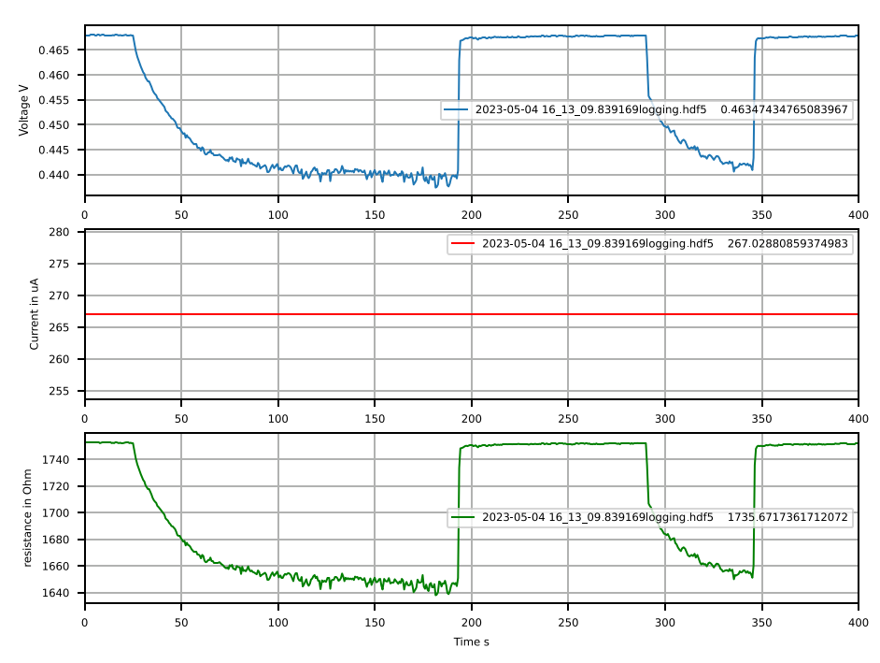
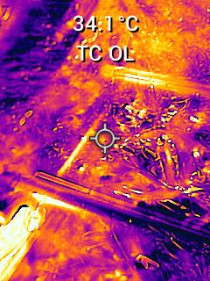
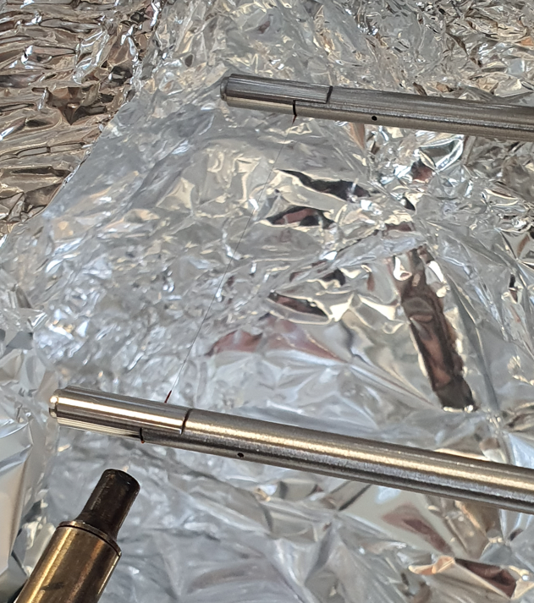
Experimental setup wire heating (04.05.2023)
Quick experiment test with heat gun at ambient pressure to see how electronics reacts (04.05.2023)
c-wire measured with LIU electronics in presence of varying temperature
The current source is stable at this slow time constant
only the voltage is falling due to lower resistivity
C-wire
LHC Forks
C-wire resistivity falls by ~100 Ohm with this setup -Estimation thermal coefficient: ~ -100Ohm/1700Ohm/200°C => -0.00029
-Literature: => -0.0005
Heat gun set at 400C

Slide 12
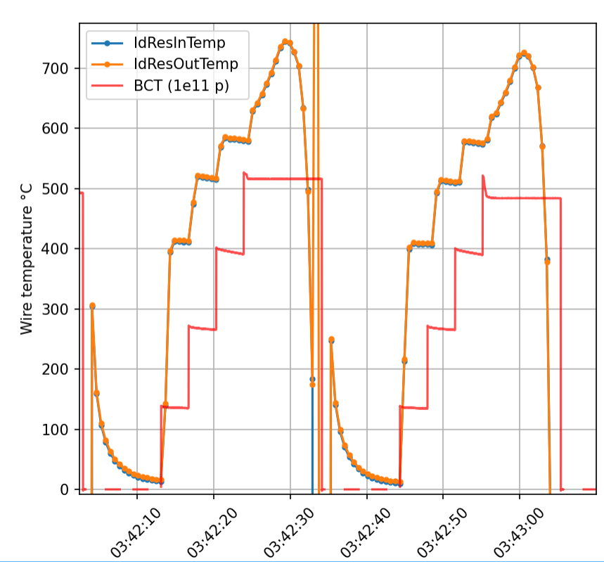
Preliminary wire heating plots 41678V
C-wire most probably broke at this moment
D)
Observations just before the c-wire broke: 1) 4 steps of temperatures, step size are getting smaller while injection intensities steps are constant. 2) slow rise that reaches a maxima => bunch length change (see later) 3) faster rate of temperature falling => different thermal effect (thermionic) or EMI? 4) sometimes a peak at high temperature 5) temperature falls with a long time constant
- Is the heating process going from uniformly distributed along the wire to heating only on the sides?
- Is there some kind of EMI perturbating the wire measurements? => help from Mike Barnes on this
4)
2)
3)
1)
5)
UTC - 22 April 2023

Slide 13
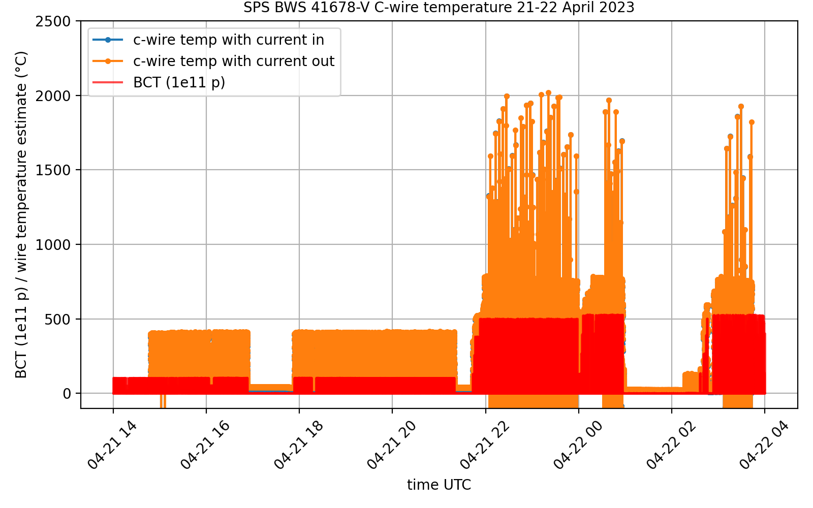
Preliminary wire heating plots 41678V available data set overview
Logging in NXCALS was setup here
C-wire broke
here

Slide 14
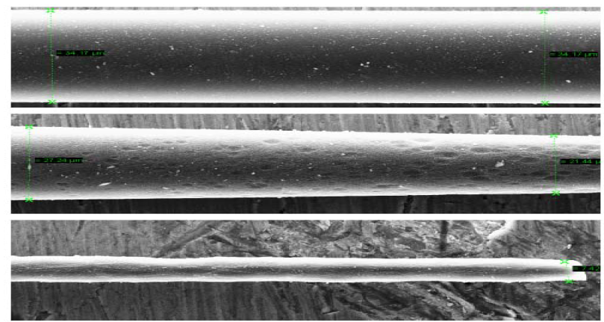
Possible thermal effect on the wire
Sublimation of material: Fiber fracture at three distances from the beam impact location:
1 mm (upper plot), 0.5 mm (middle plot) and at beam center location (bottom plot). Carbon Fiber Damage in Particle Beam M. Sapinski, et al, HB2010

